Slide 1
CEPC Muon Detector Simulation in CEPCSW
Bai Zibing
2024.05.13

Slide 2
Detector
=DetectorConstruction in Geant4
Stripes(surface+scintillator+cut+fiber+SiPM)
↓
Super Layers × 6
↓
Trds × 12
↓
Barrel

Slide 3
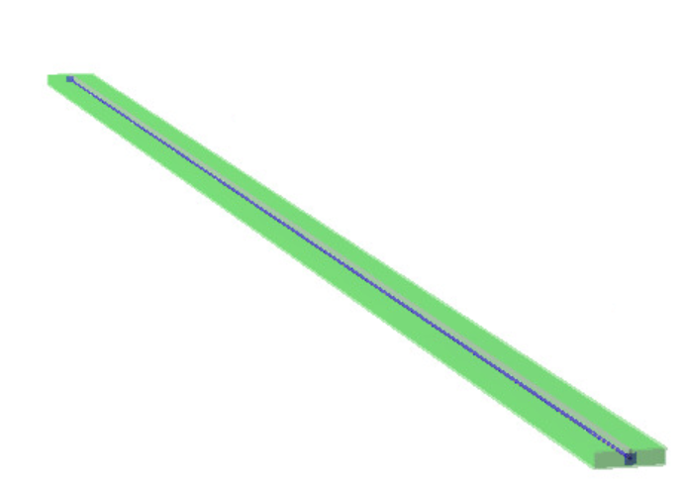
Stripe

Slide 4
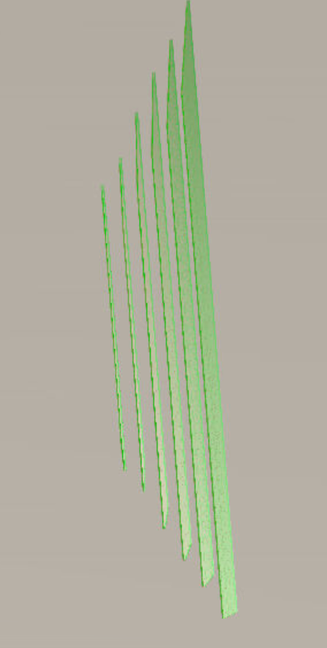
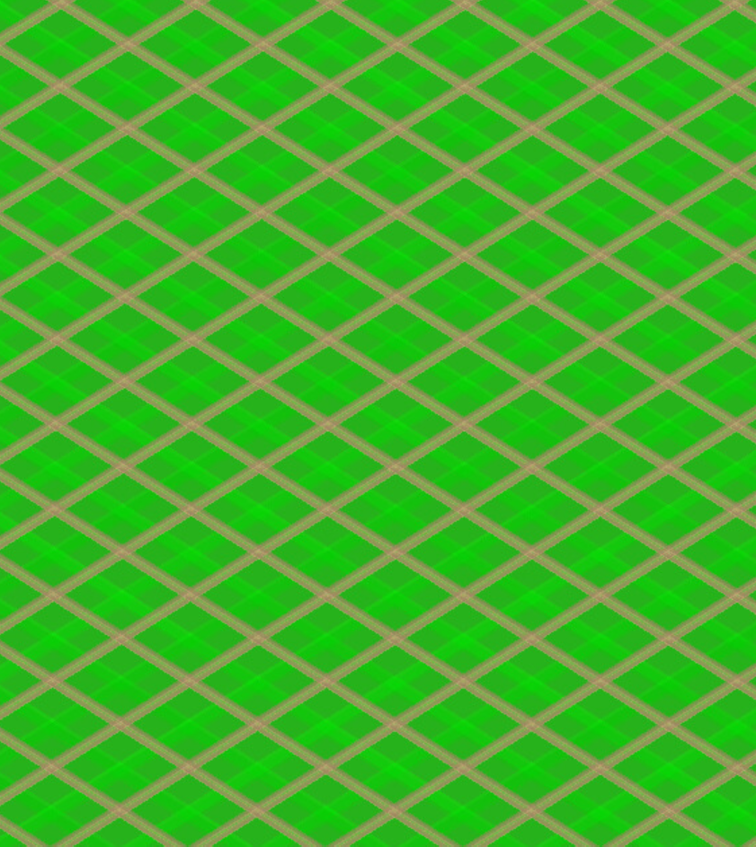
Super Layer

Slide 5
Barrel
A little bit bug still in it
Tolerant world smaller than it
（Maybe it can be solved by customized）

Slide 6
To do
Confirm the design of End-cap
Debug
Move SD & main in it

