Slide 1
Status on SJTU RPC Lab
Lining Mao
2024.5.13

Slide 2
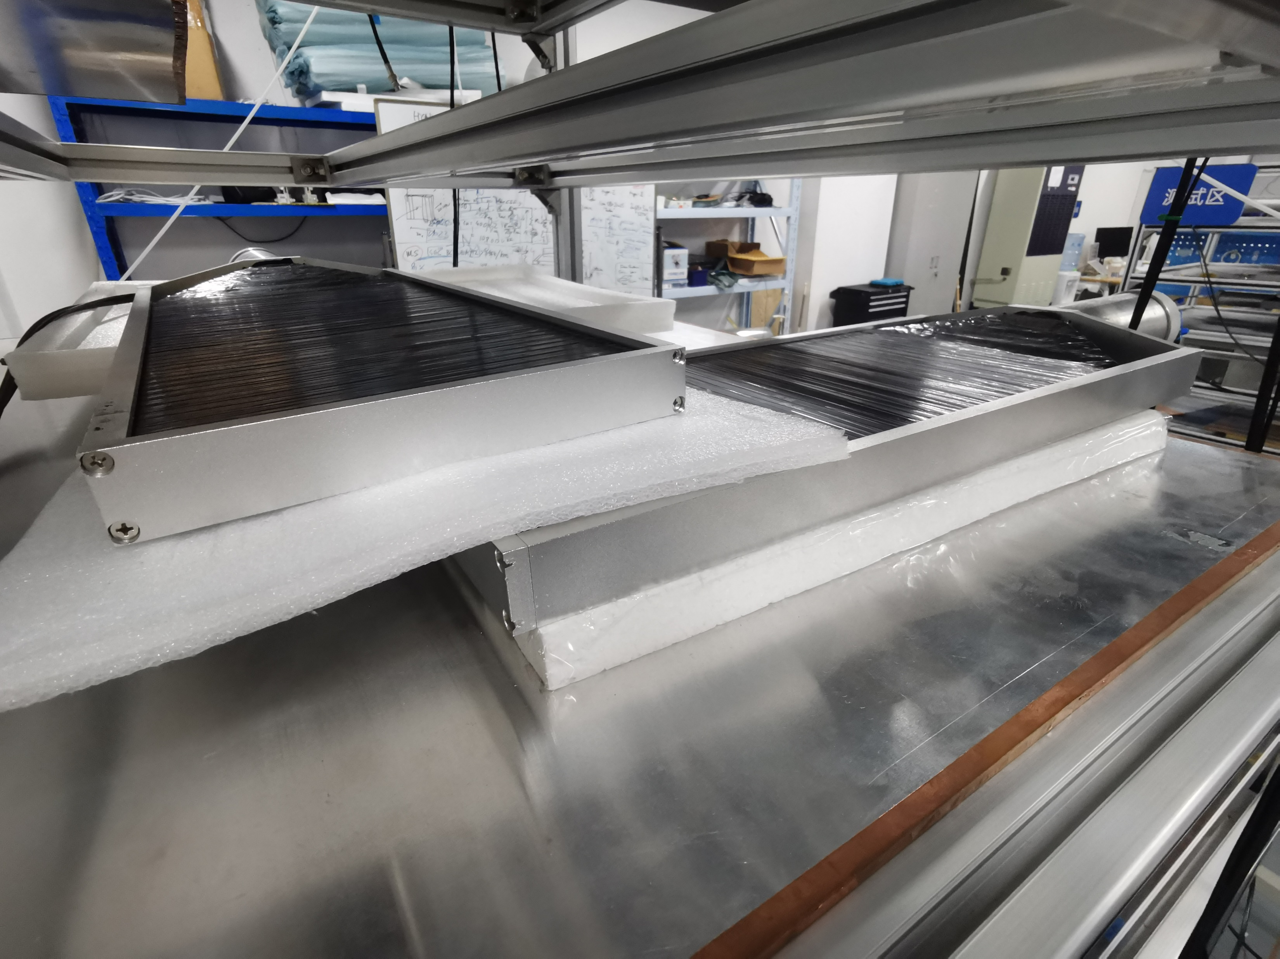
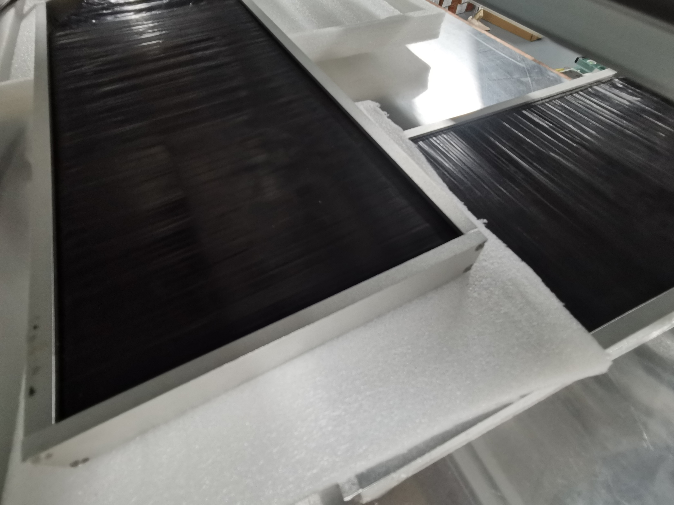
New setup of efficiency
Smaller coincidence area
The R134a gas was used up during the test
The gas arrived yesterday, can restart the system soon

