Slide 1
Z-pole event pileup estimation
Suen Hou
suen@sinica.edu.tw
2024/04/30
1 Bhabha events on LYSO cells (3x3mm²)
pile-up rate ~1x10⁻⁴ at low-θ edge
2 Z lineshape Z → qq
pile-up rate (4π coverage) ~1x10⁻³
Resolve BCID, inner ECAL layers,
SiPM do High-gain + 3-bit (8 levels) comparator

Slide 2
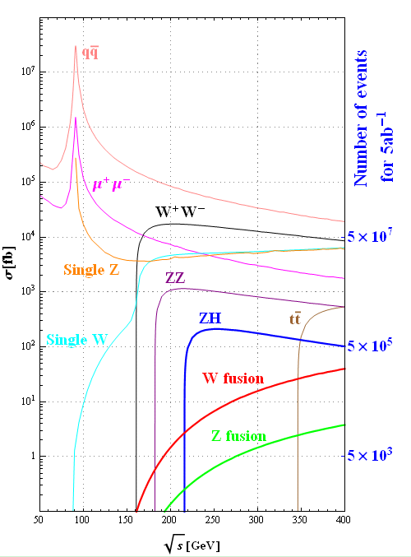
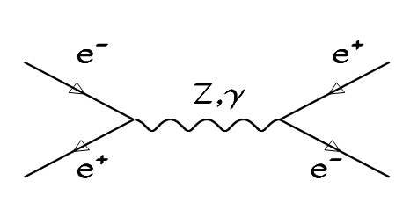
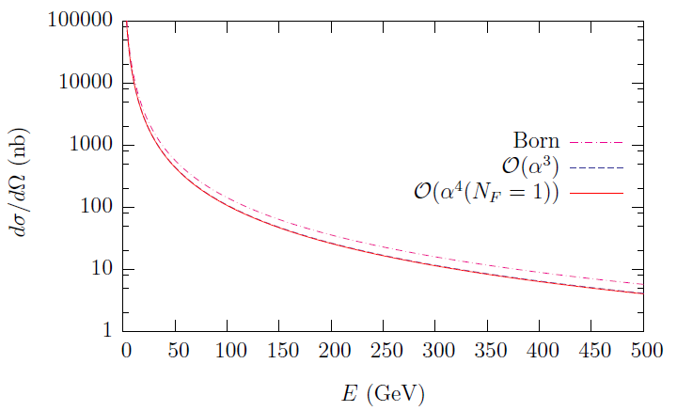
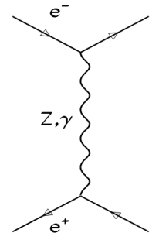
Cross-section
Z-lineshape
e⁺e⁻ → Z → qq‾
Luminosity by Bhabha
e⁺e⁻ → e⁺e⁻
σ = 41 nb
Bhabha
at θ= 5º
hep-ph/0411321 NPB 716 (2005) 280

Slide 3
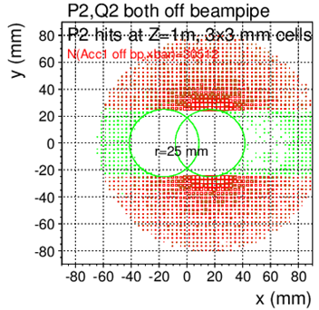
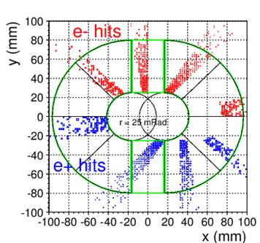
BHLUMI X-section, racetrack @CEPC
Acceptance @z=1m r>25 mm, |y|>25 mm
e⁺, e⁻ back-to-back
Symmetric to
out-going pipe center
LAB frame
e⁺, e⁻ detected
@ Z=1000 mm
at Z = 1000 mm
LAB ONE e⁺ or e⁻ detected |  | LAB both e⁺, e⁻ detected
θ>15 mRad | θ>15mR & |y|>15mm | θ>15 mRad | θ>15mR & |y|>15mm
395.3 | 255.9 | 257.8 | 245.9
θ>25 mRad | θ>25mR & |y|>25mm | θ>25 mRad | θ>15mR & |y|>25mm
133.5 nb | 81.8 nb | 85.4 nb | 78.0 nb
θ>30 mRad | θ>30mR & |y|>30mm | θ>30 mRad | θ>30mR & |y|>30mm
87.2 | 51.8 | 54.9 | 49.1
racetrack
CDR

Slide 4
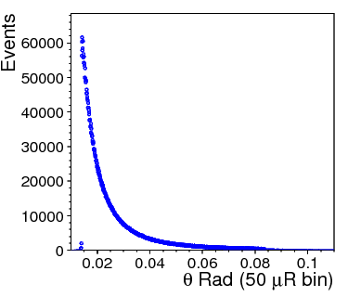
Systematics against δL/L ~10⁻⁴
δN/N ~10⁻⁴
in fiducial θ window
1. Det. Position offset
Multi. Scattering, det. Resolution
B-field helix
3. Rad. Bhabha, preshower offset
δL/L ~ 2 δθ/θ_{min}
δL/L < 10⁻⁴ for θ_{min}= 20 mRad
→ δθ = 1μRad dr=1μm @ z=1m
Bhabha smeared by
Multiple scattering
Detector resolution
OFFSET on the mean
Causing δN/N error
Si-strip detector
fiducial edge = central line between two strips
Multi.Scattering → events flow in/out Fiducial
+ geo error → event counting error
δN/N ~10⁻⁴
M.S. non-liner !!
dominant systematic

Slide 5
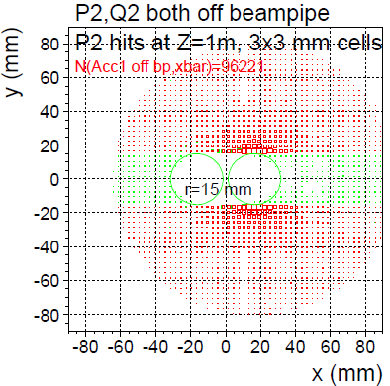
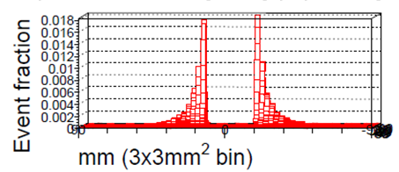
Bhabha pile-up rate @High-Lumi Z
High-Lumi Z (2021 design) L_{max}/IP = 115 x 10³⁴/cm²s
Bhabha both e⁺, e⁻ detected, X-sec = 246 nb
Event rate = (246x10⁻³³) x (115 x 10³⁴) /sec = 115 kHz
Event rate / 25 ns bunch crossing = 0.003 events /b.c.
Pile-up: next b.c., @adjacent cell in peak region
Pile-up Fraction = 0.018*6cells/2sides = 0.054
Pile-up event rate = 0.003*0.054 = 1.6 x 10⁻⁴ in 3x3 mm² cells
c.f. LEP
L= 1x10³²
X-sec= 100nb
Rate= 10 Hz
50 GeV e- shower in 3x3 mm² cells
event fraction /(cell of 3x3mm²)
maximum at beampipe edge = 0.018
LYSO signal overlap
25 ns

Slide 6
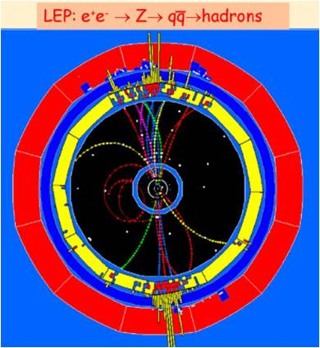
Z → qq‾ pile-up rate @High-Lumi Z
High-Lumi Z (2021 design) L_{max}/IP = 115 x 10³⁴/cm²s
Z → qq‾ , X-sec = 41 nb
Event rate = (41x10⁻³³) x (115 x 10³⁴) /sec = 47 kHz
bunch cross = 40 MHz
Event rate / 25 ns bunch crossing = 0.001 events /b.c.
next b.c. having a Z → qq‾
Pile-up rate 4π coverage ~ 1x 10⁻³
if BCID not identified
pileup of two 2-jets ➔ 4-jet
rare decay precision ~1x 10⁻³
25 ns

Slide 7
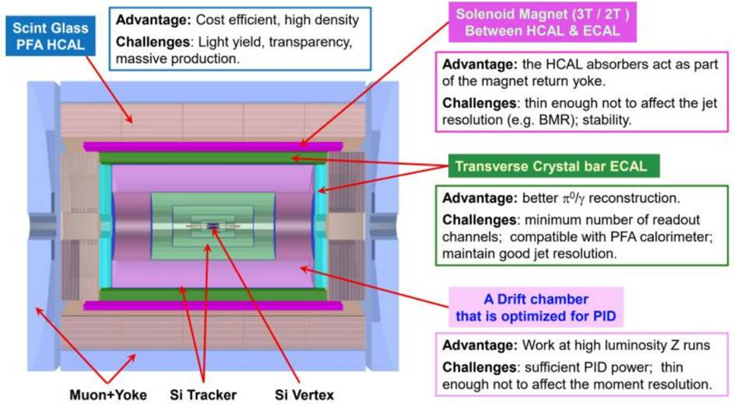
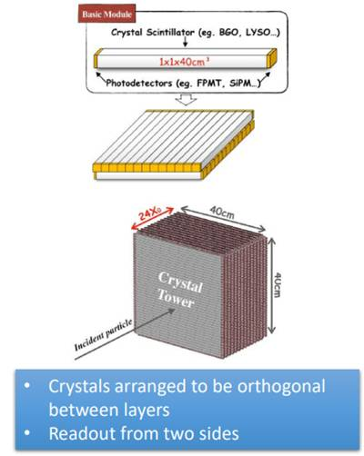
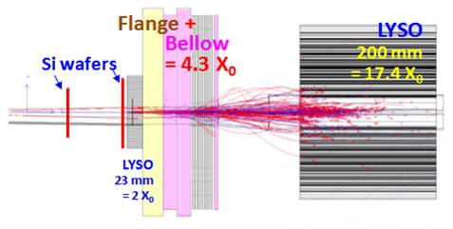
SiPM w. Comparator in MIP layers
SiPM output
ECAL front 2X_{o} layers, LumiCal 2X_{o} decks
High-gain signal (ADC of multi BC)
3-bit (8 levels) comparator per BC
25 ns

