Slide 1
CEPC vertex detector towards TDR
Zhijun Liang,
On behalf of CEPC vertex working group

Slide 2
Towards TDR
Aim to have a draft of TDR by the end of 2024.
First review meeting in July 2024.
System level design, choose baseline technology
Electronics, service and mechanics needs to be included
Major change from CDR to TDR
Beam pipe diameter: 28mm (CDR) → 20mm (TDR) (reduce 30%)
Instant Luminosity per IP:
Z pole: 32×10³⁴ cm⁻²s⁻¹ (CDR) → 192 ×10³⁴ cm⁻²s⁻¹ (TDR, 50MW) (6 times increase)
ZH: 5.6×1034 cm-2s-1 (CDR) → 8.3 ×10³⁴ cm-2s-1 (TDR) (~1.5 times increase)

Slide 3
Discussion with TowerJazz China
Met with TowerJazz management team at IHEP
Jianchun, Wei wei, Yiming, Yunpeng, Zhou Yang, Zhang Ying, Zhijun
Possible to submit Engineering run and MPW in China
Potential faster turn around for Engineering run
Support 65nm and 180nm CIS and modified process
In one of Tuesday TDR meeting, together with Yifang, we decide to use 65nm CIS as our baseline for reference TDR

Slide 4
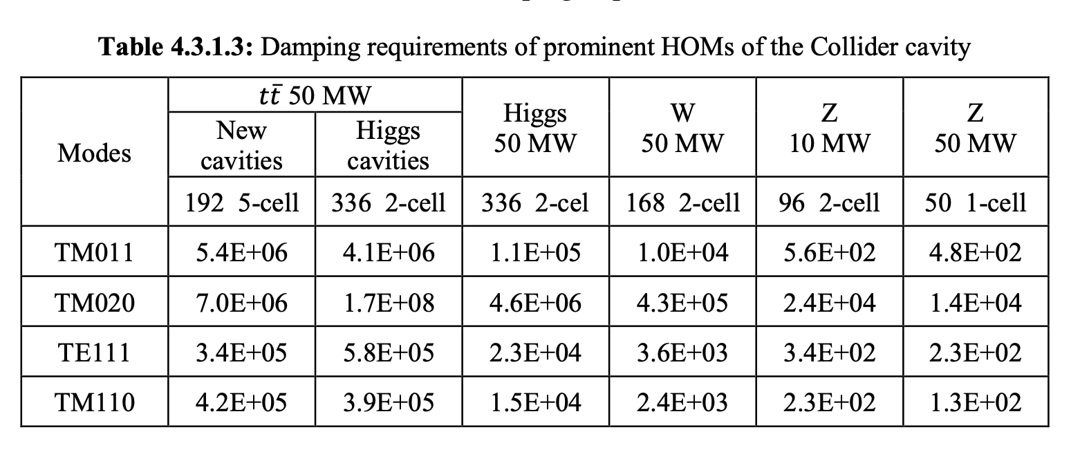
Vertex
Last meeting, From CEPC workshop at Marseille plenary section
Discussion of Giga-Z during first 10 year (ZH runs)
Need more specification of low-lumi Z runs during first 10 year operation
In TDR, it mentioned that low-lumi Z run can run up to 10MW
Z pole Beam background from MDI group was assumed 50MW (high-lumi Z)
Vertex detector need to support at least the low-lumi-Z operation
From CEPC TDR

Slide 5
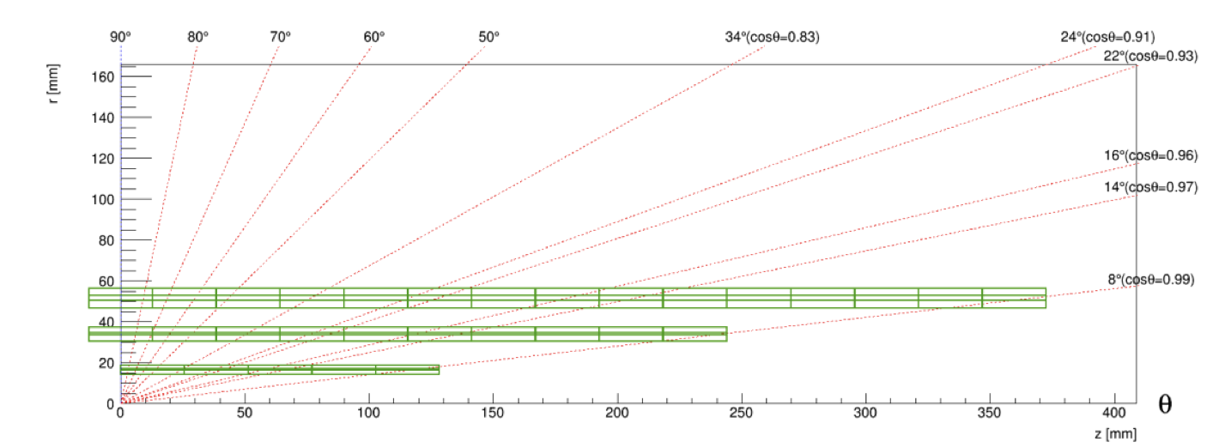
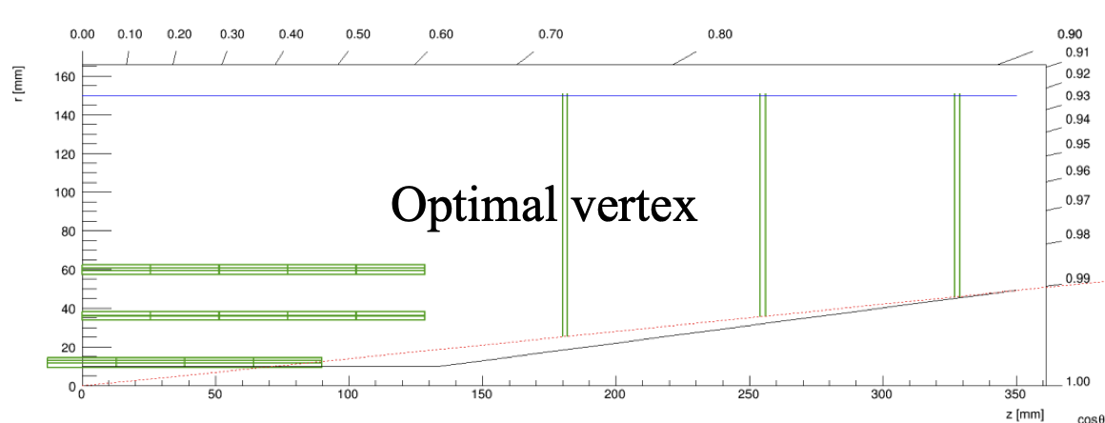
Summary
Vertex detector MOST2 prototype layout has been implement in CEPCSW
Try to perform further optimization with full simulation
long barrel layout Mechanics design is in progress
“Short barrel + endcap” layout will come later
Next step is refining air cooling simulation, beam background
Short barrel + endcap
Long barrel

Slide 6
Backup

