Slide 1
RPC status in SJTU
Lining Mao
On behalf of the RPClab
2024.5.17

Slide 2
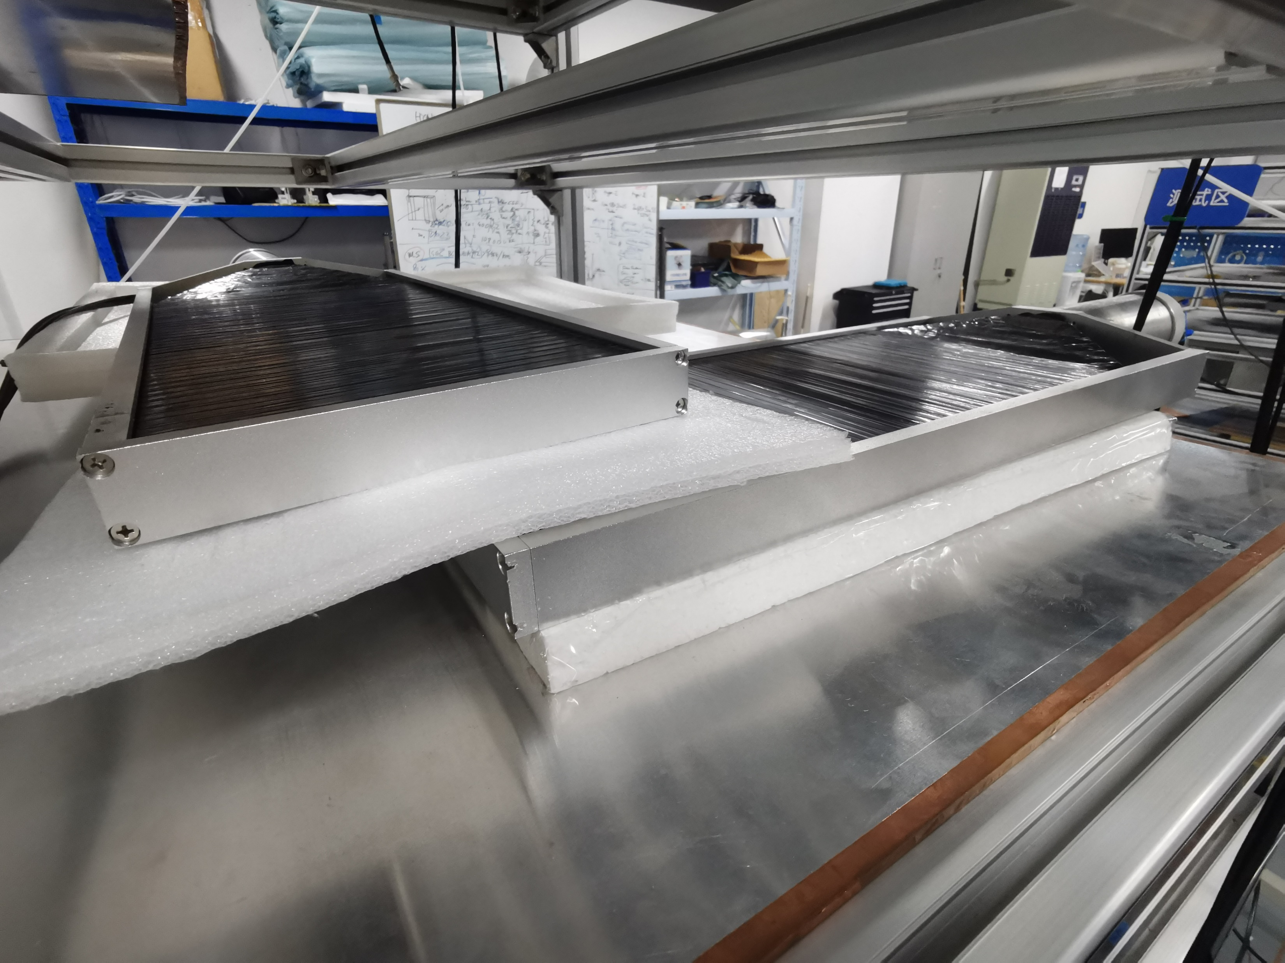
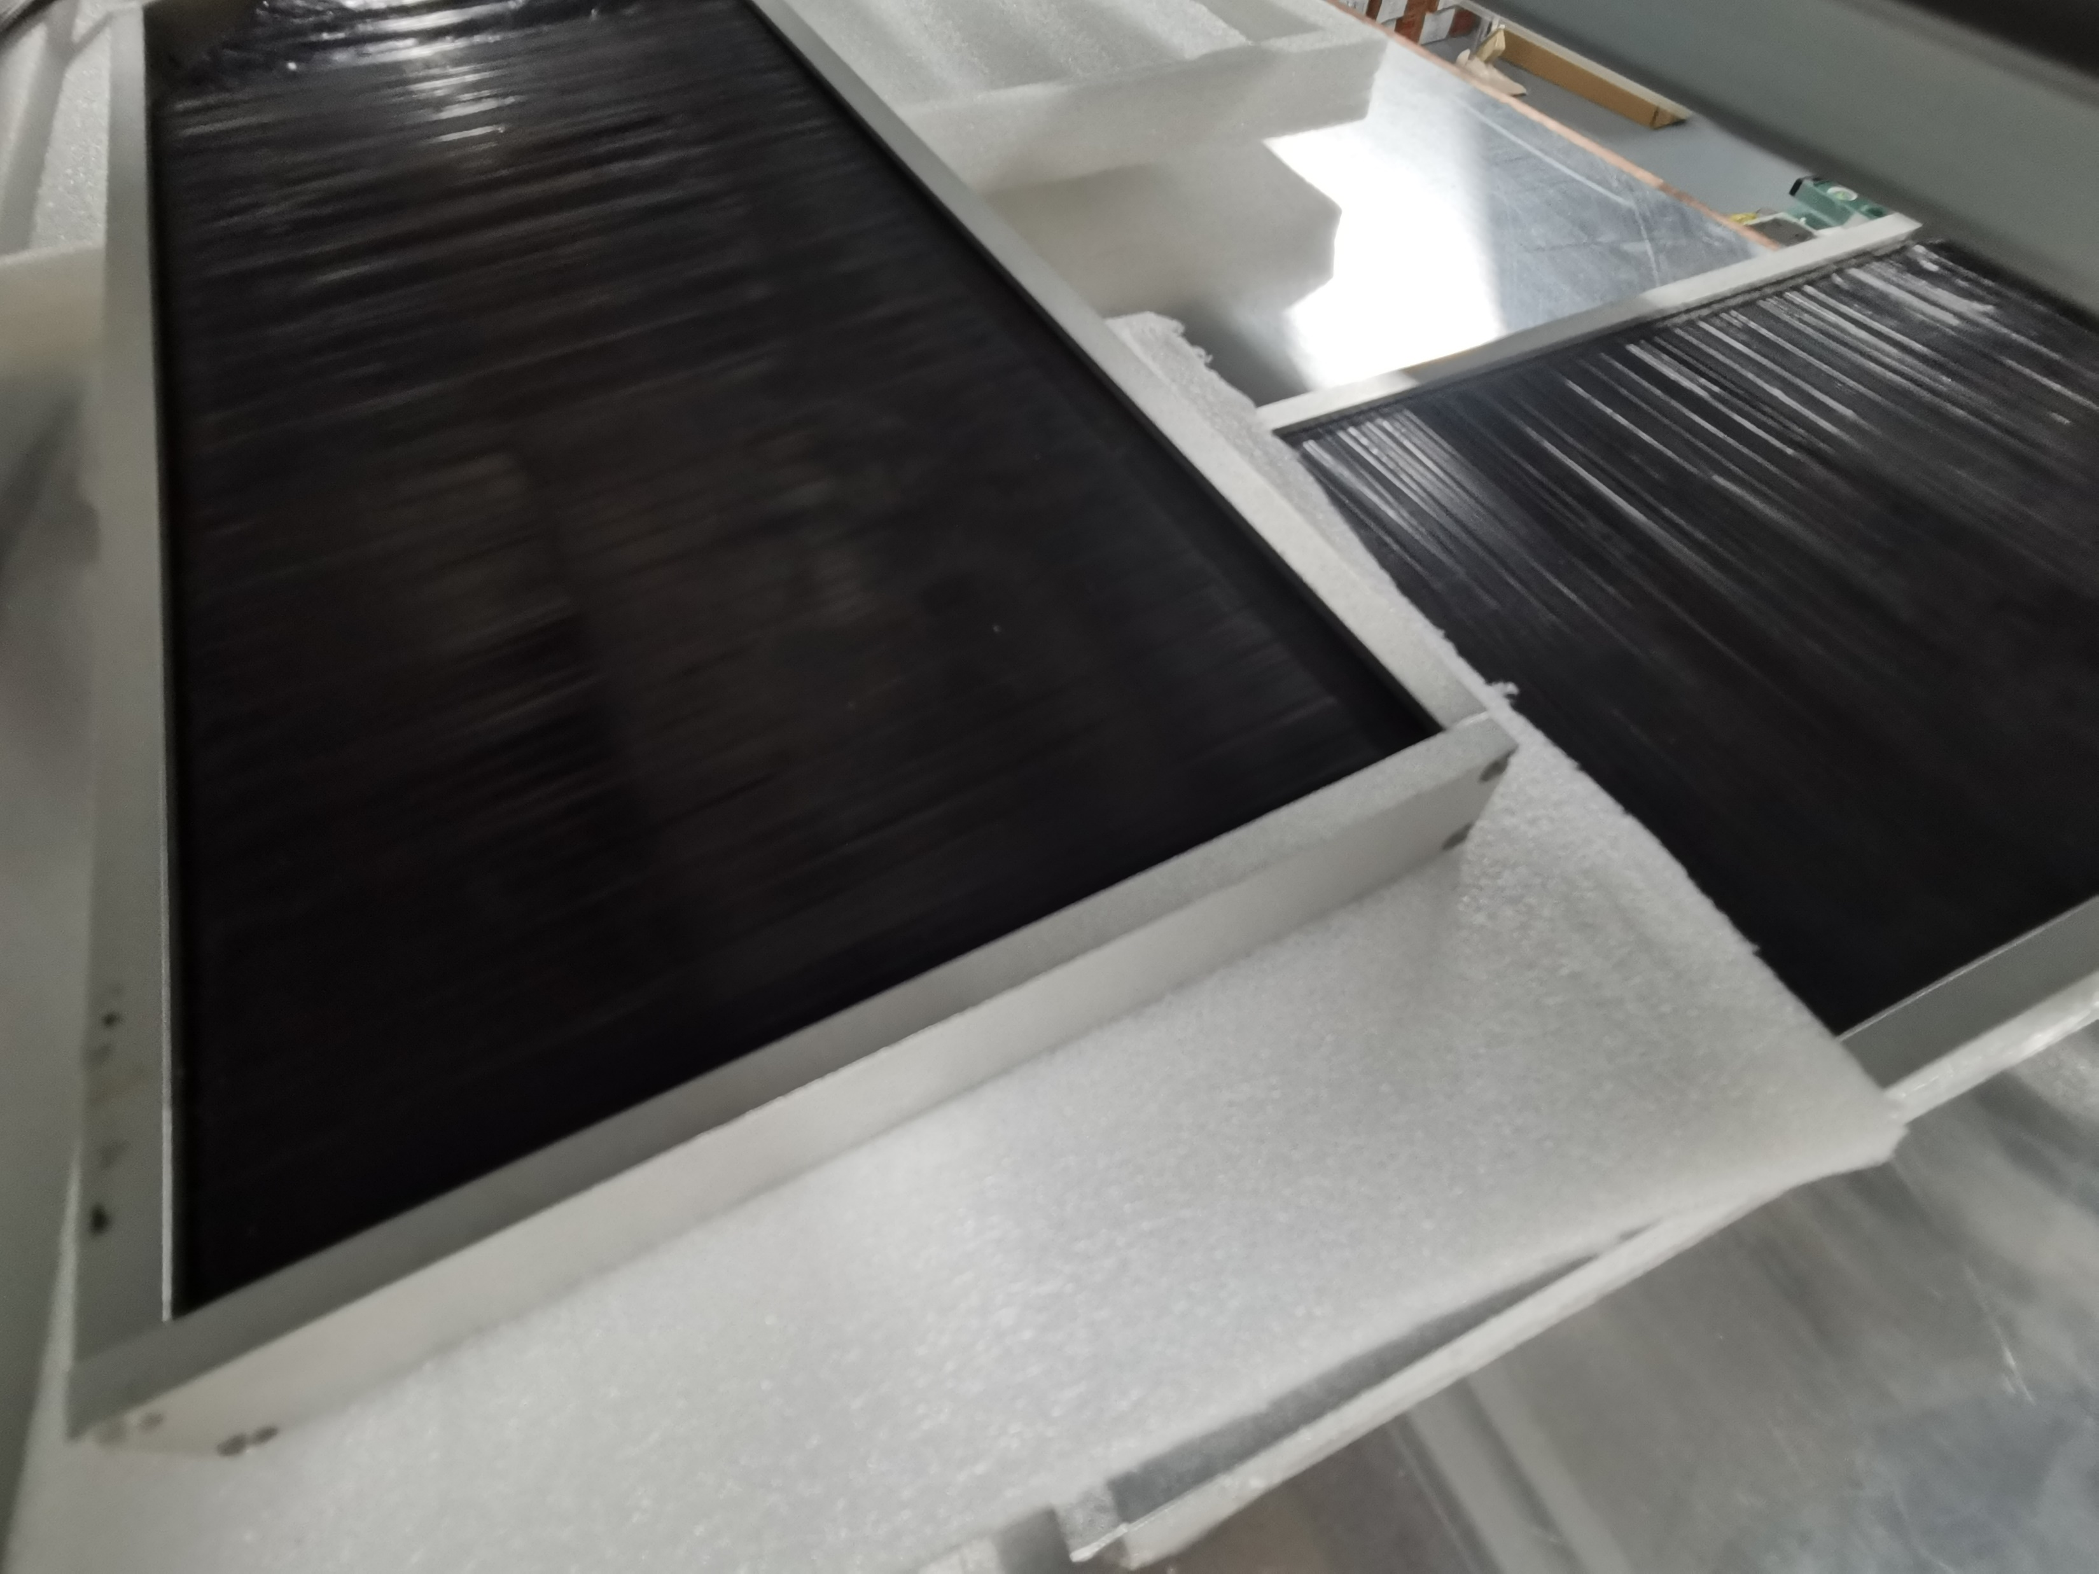
New setup of efficiency
Smaller coincidence area
The R134a gas was used up during the test
The gas arrived yesterday, can restart the system soon

Slide 3
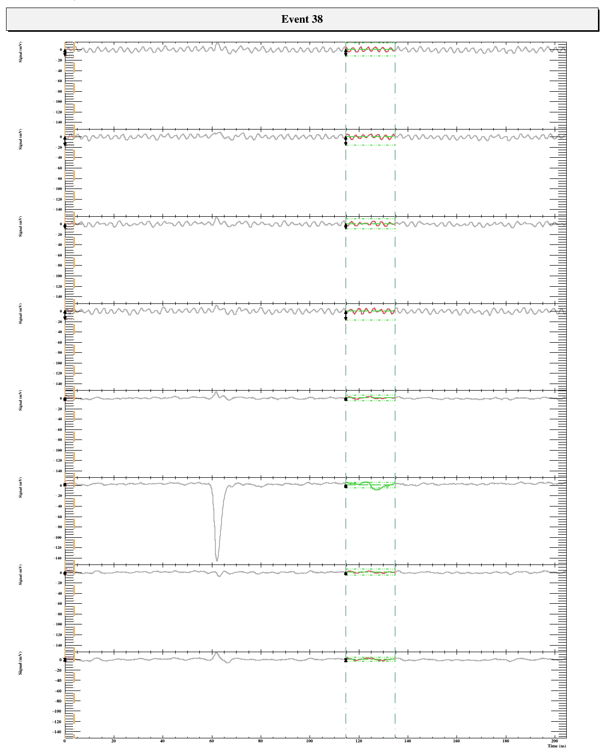
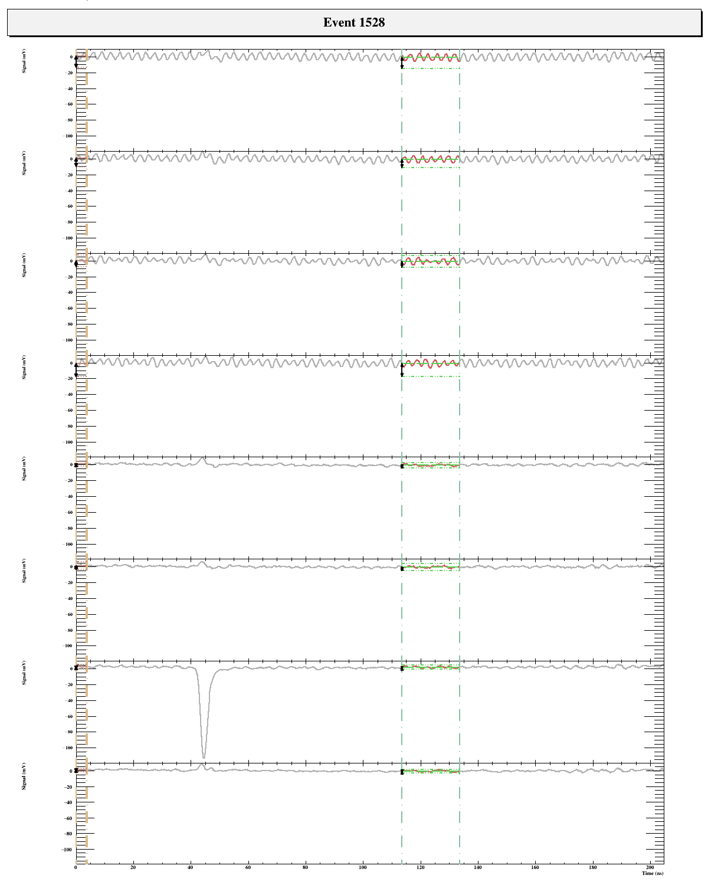
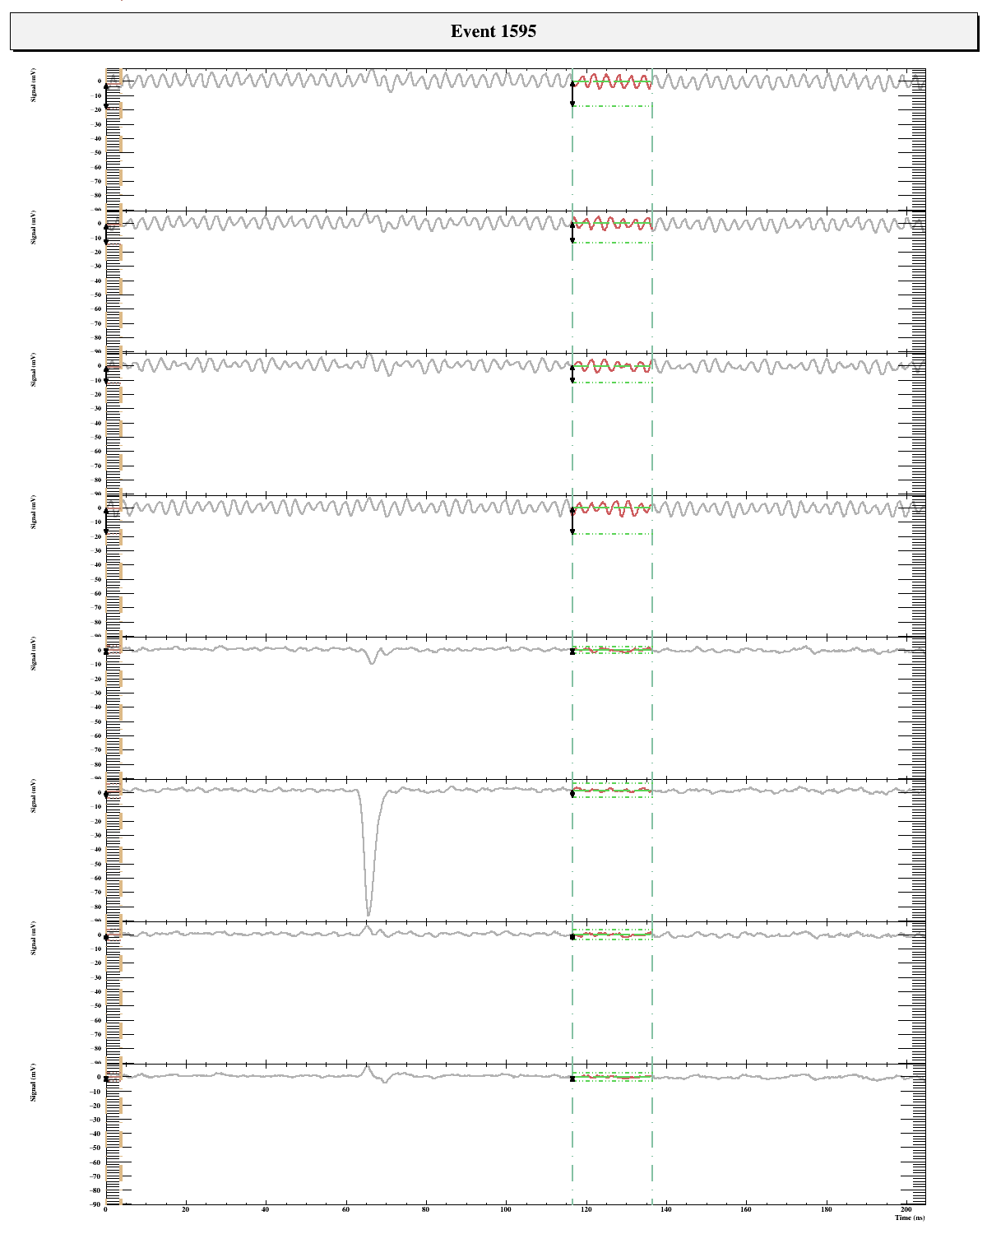
Signals example read from DAQ system
Roughly counted by eyes efficiency ~90%
Still have some bugs on the analysis software which can help to analyse large amount of events

