Slide 1
The Chiral and Axial Symmetry Restoration At Finite Temperature In Holographic QCD
Hiwa A. Ahmed (何瓦)
School of Nuclear Science And Technology, UCAS
Weekly Group Meeting
May 17th, 2024

Slide 2
Introduction
Quantum Chromodynamics (QCD) is the theory of the strong nuclear interactions. The Lagrangian of the theory is
The theory has a large symmetry group which is only manifest when we decompose the fermionic kinetic terms into into left-handed and right-handed parts.
$G_{F}={U(1)}_{V} ×$ ${U(1)}_{A} ×{SU(N_{f})}_{L} ×{SU(N_{f})}_{R}$
The left-handed and right-handed fermions transform in the same way under ${U(1)}_{V}$symmetry.
The left-handed and right-handed fermions transform with an opposite phase under ${U(1)}_{A}$symmetry. ${U(1)}_{A}$symmetry suffers an anomaly.

Slide 3
Introduction
The quark condensate – also known as a chiral condensate – is a vacuum expectation value of the composite operators ${\overline{ψ}}_{−i}\left(x\right)ψ_{+j}\left(x\right)$.
Although the condensate preserves the Lorentz invariance of the vacuum, it does not preserve all the global symmetries of the theory.
The condensate remains untouched only when L = R. This tells us that the symmetry breaking pattern is

Slide 4
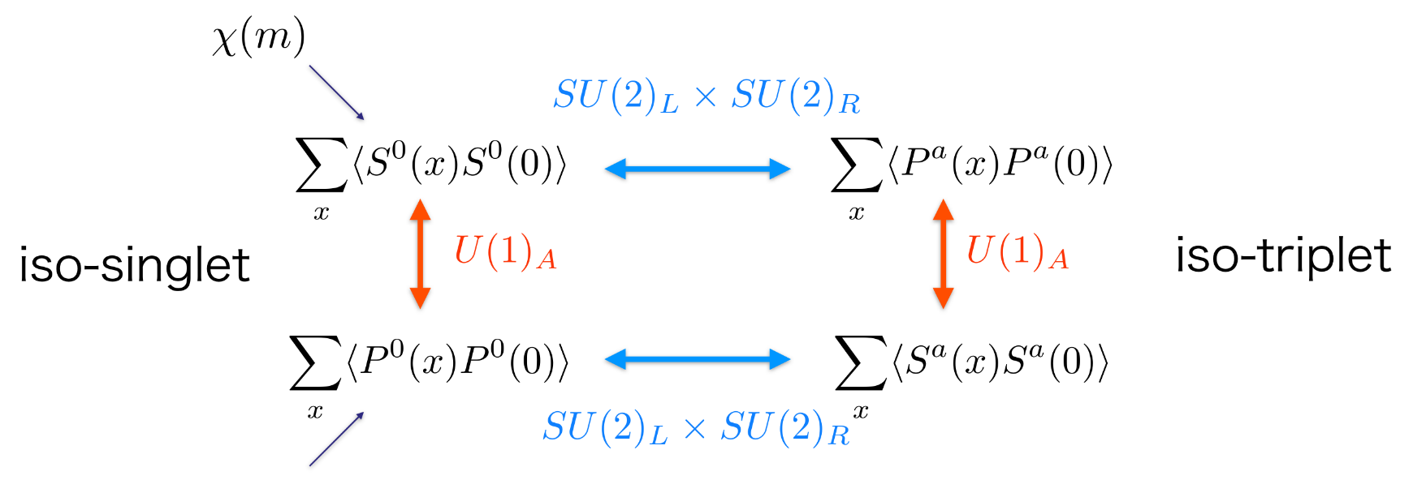
Motivation
The order parameter of the chiral symmetry is given by the quark condensate. The lattice QCD simulation showed that the chiral symmetry is restored at high temperature.
Similarly, the lattice QCD simulation provided the restoration of the ${U(1)}_{A}$ symmetry at high temperature. The topological susceptibility can be assigned as an indicator for the strength of the $U{\left(1\right)}_{A}$ axial breaking.
2111.02048 [hep-lat]
$$χ_{σ}$$
$$χ_{π}$$
$$χ_{η_{l}}$$
$$χ_{a_{0}}$$

Slide 5
AdS/CFT Correspondence

Slide 6
AdS/CFT dictionary

Slide 7
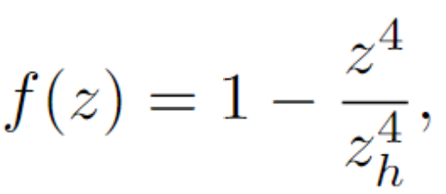
Formalism
Following the bottom-up holographic QCD model, we employ a five-dimensional gauge model respecting the $U{(N_{f} )}_{L}×U{(N_{f} )}_{R}$ symmetry with $N_{f}$ being the number of the quark flavors. The five-dimensional model is described by the bulk left- ($L_{M}$) and right- ($R_{M}$) gauge fields. To incorporate the quark condensation operator in the bottom-up approach, we introduce a bulk scalar field $X$ which is a $N_{f}×N_{f}$ matrix and transforms as bifundamental representation under the $U{(N_{f} )}_{L}×U{(N_{f} )}_{R}$ symmetry.
$$X=\left(X_{0}+S^{a} t^{a}\right) e^{2 i π^{a} t^{a}} ,$$
7

Slide 8
Formalism
There are two different configuration for the dilaton field that successfully describe the spontaneous symmetry breaking in the holographic QCD:
A)
[1511.02721 [hep-ph]]
$M_{5}^{2}= (Δ − p)(Δ + p − 4)$=-3 with $Δ=3 and p=0$
B)
$Φ\left(z\right)=μ_{g}^{2} z^{2}$ and
$$M_{5}^{2}(z)=−3 −μ_{c}^{2} z^{2}$$
[1604.02571 [hep-ph]]

Slide 9
Mixing in Holographic QCD
We take the mixing between the $σ$ and $f_{0}\left(980\right)$ as an example:

Slide 10
Meson Susceptibility
The meson susceptibility are defined as [JHEP08(2023)189]
The susceptibilities correspond to meson-correlation functions at zero momentum transfer.

Slide 11
Model parameters
The parameters for the case A:
The parameters for the case B:

Slide 12
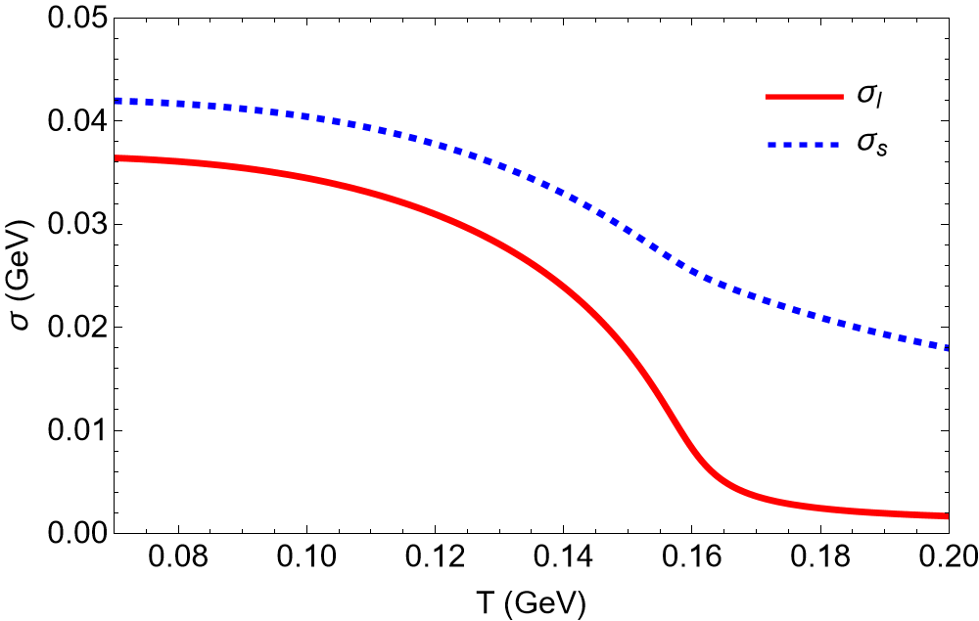
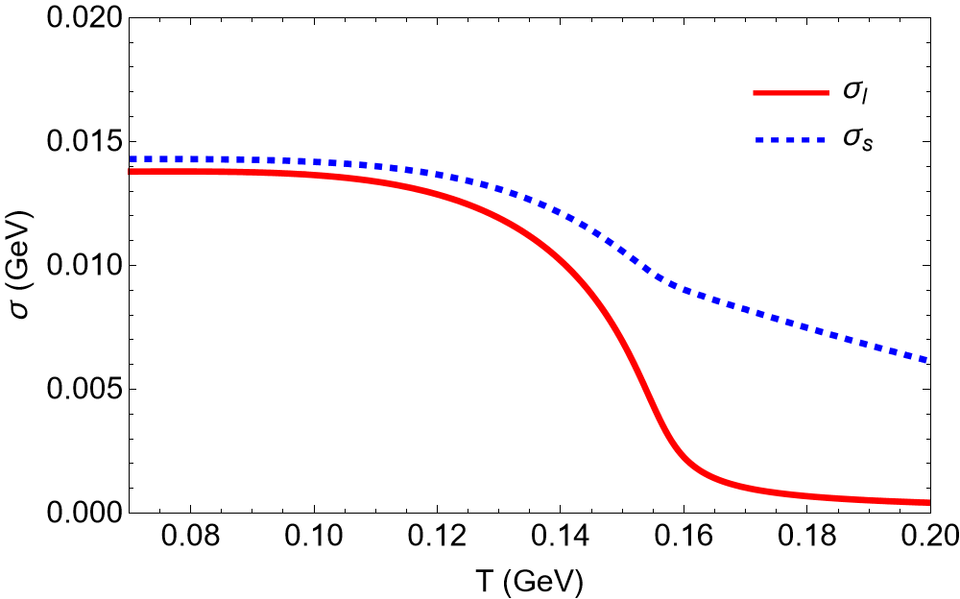
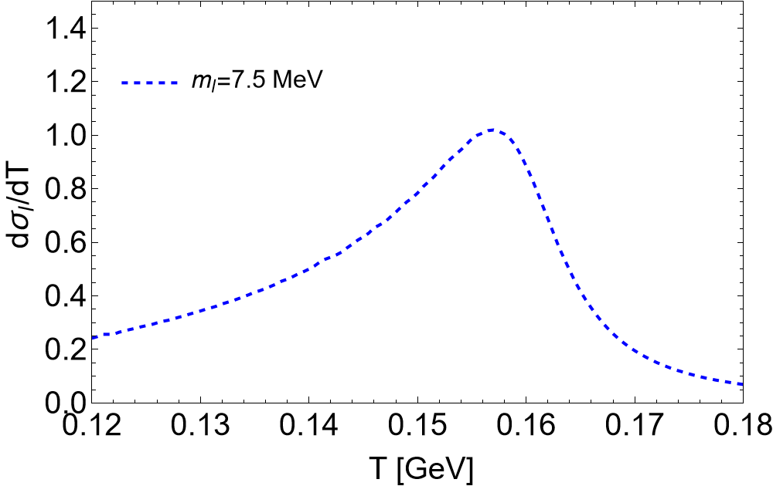
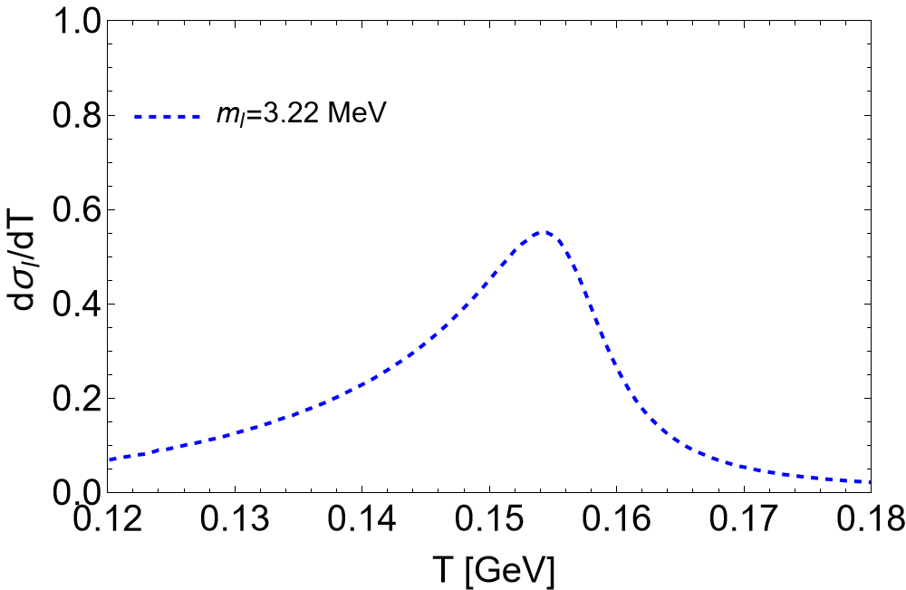
Chiral Condensate
Case A
Case B
$T_{pc}=0.157$ GeV
$T_{pc}=0.154$ GeV

Slide 13
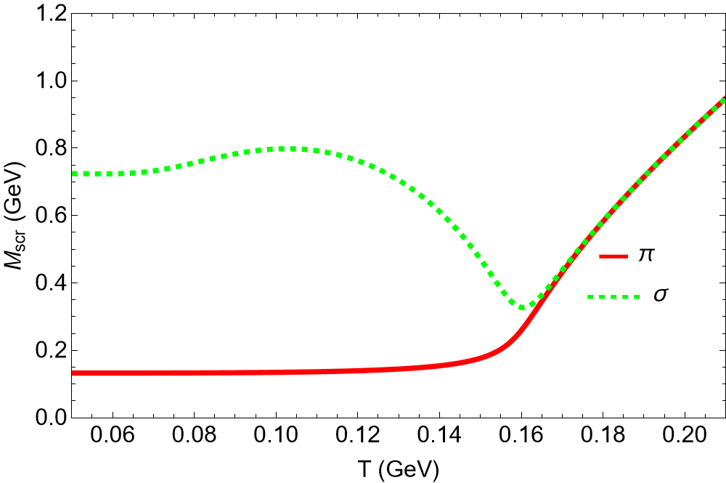
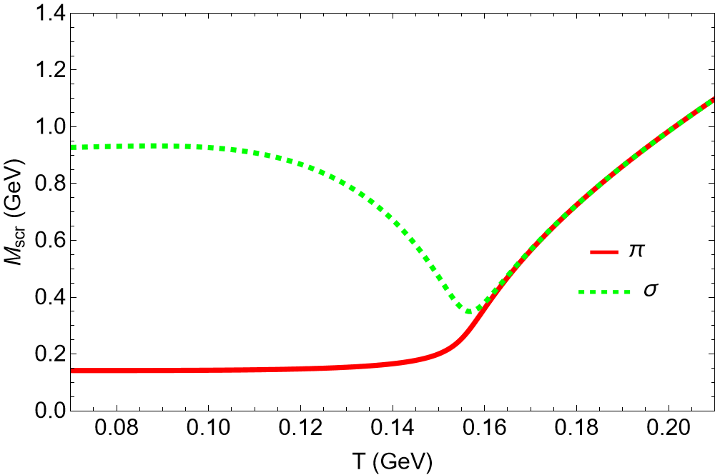
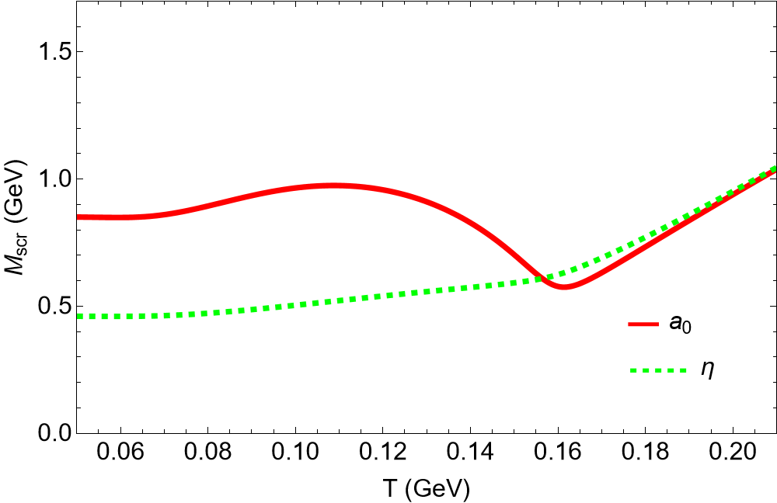
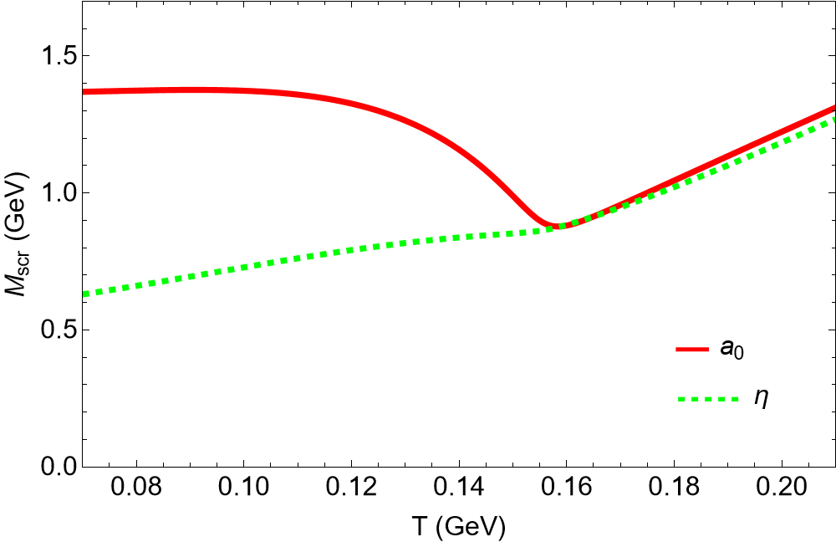
Screening Mass
Case A
Case B

Slide 14
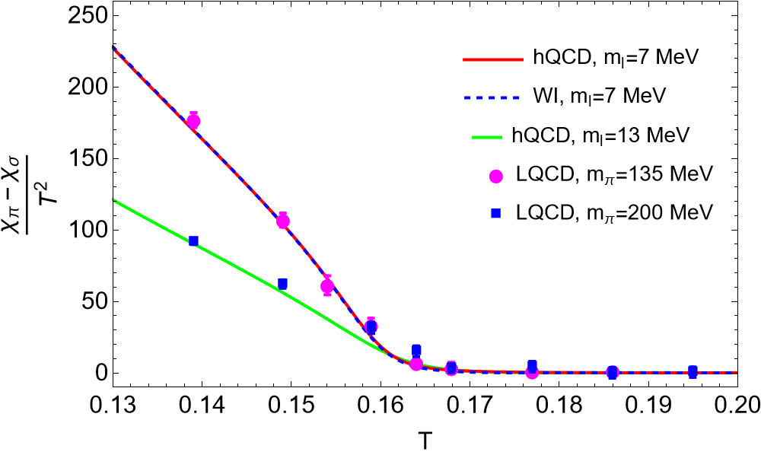
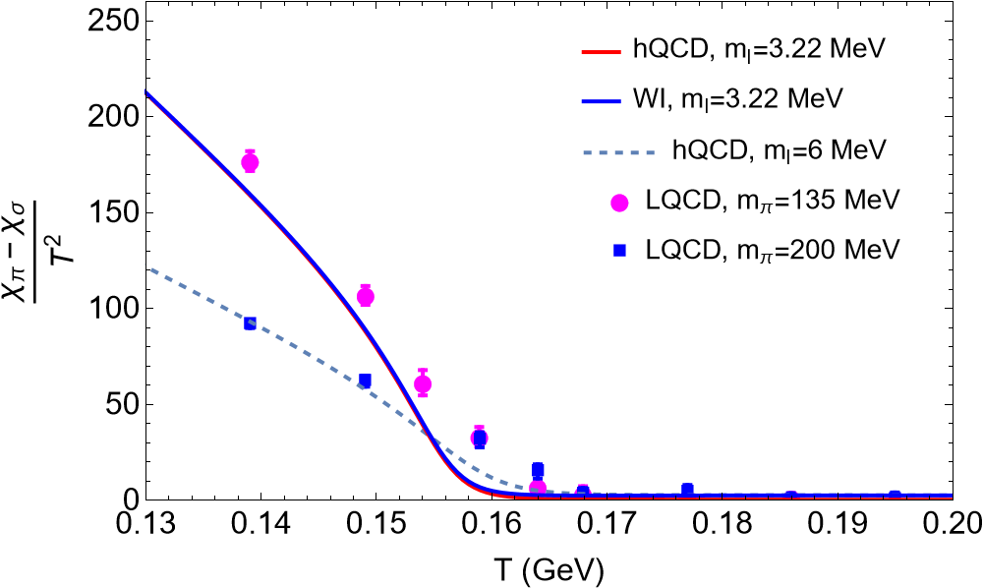
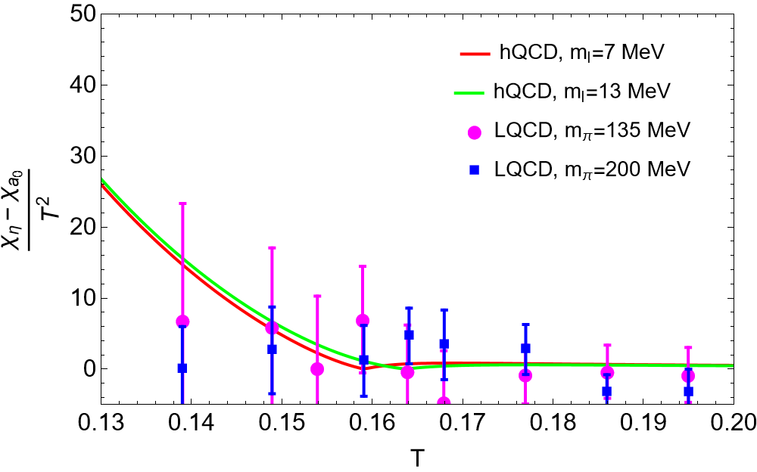
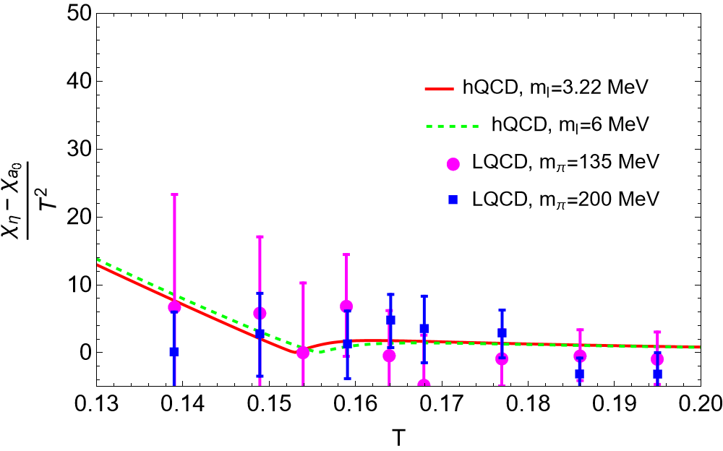
Chiral SU(2) symmetry restoration
Case A
Case B
LQCD: [Phys.Rev.Lett. 113 (2014) 8, 082001]

Slide 15
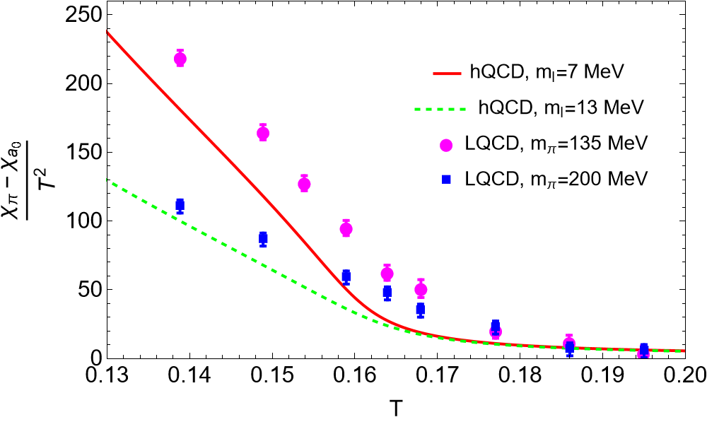
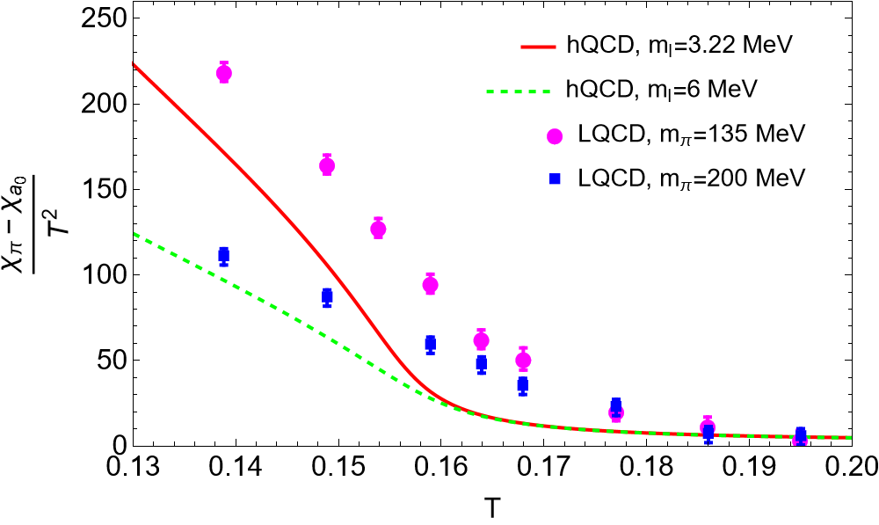
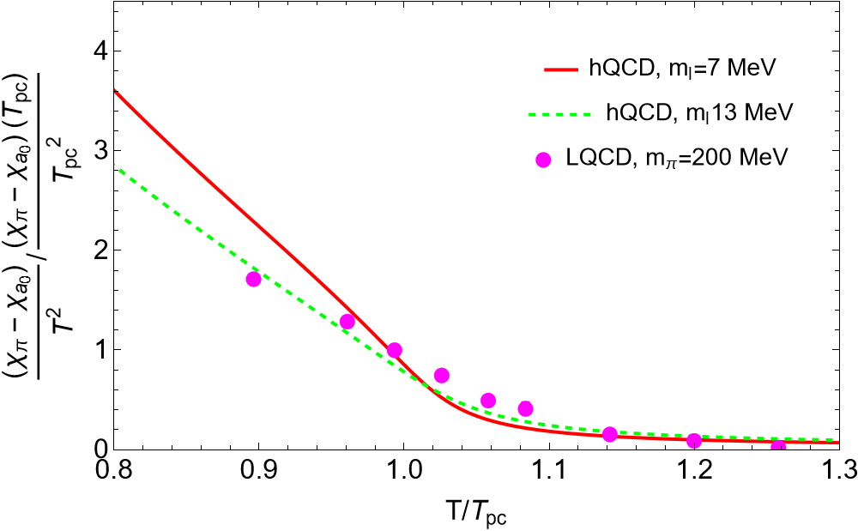
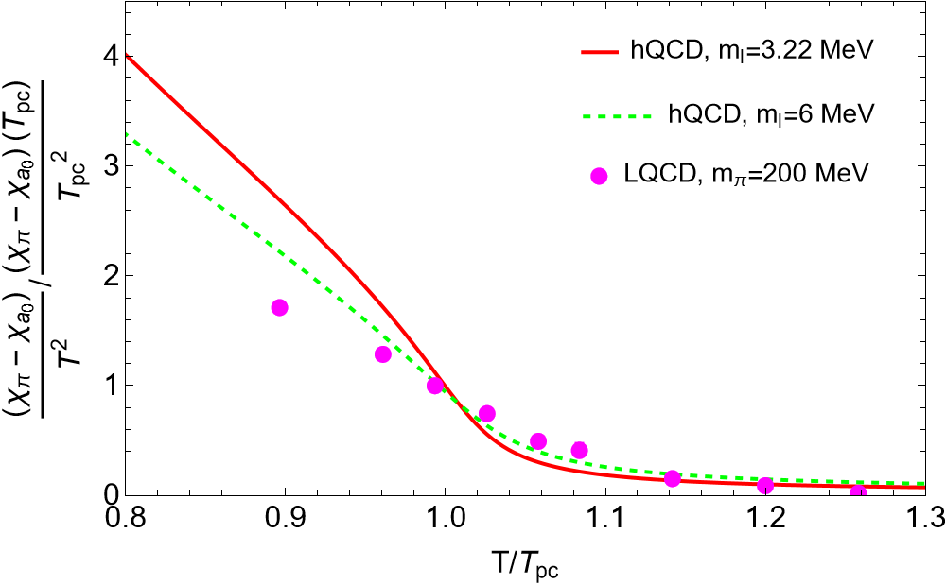
$U{\left(1\right)}_{A}$ symmetry restoration
Case A
Case B
LQCD: [Phys.Rev.Lett. 113 (2014) 8, 082001]

Slide 16
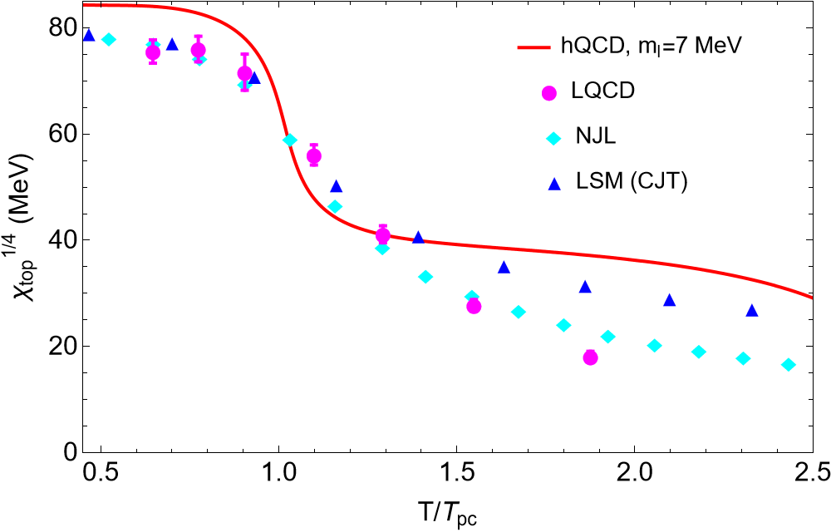
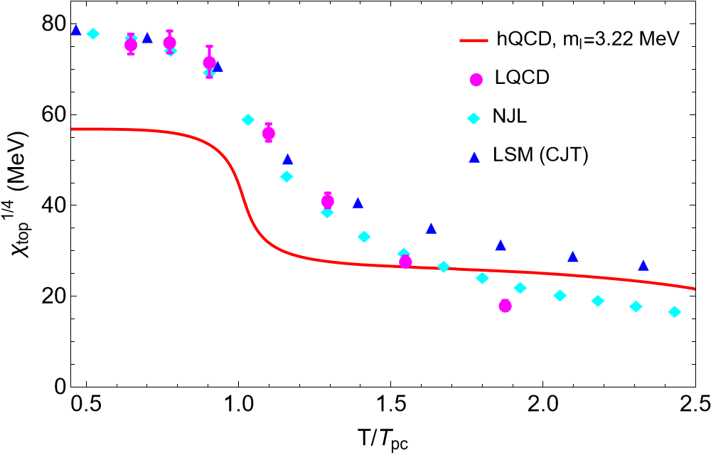
Topological Susceptibility
In hot QCD, the $χ_{top}$ is a crucial quantity to measure the topological charge fluctuation of the QCD θ-vacuum:
Case A
Case B
LQCD: [1606.07494 [hep-lat]]; NJL: [2106.05674 [hep-ph]]; LSM: [2005.07003 [hep-ph]]

