Slide 1

中国科学院高能物理研究所
Institute of High Energy Physics, CAS
CEPC Detector Magnet V0
Feipeng NING
2024.05

Slide 2

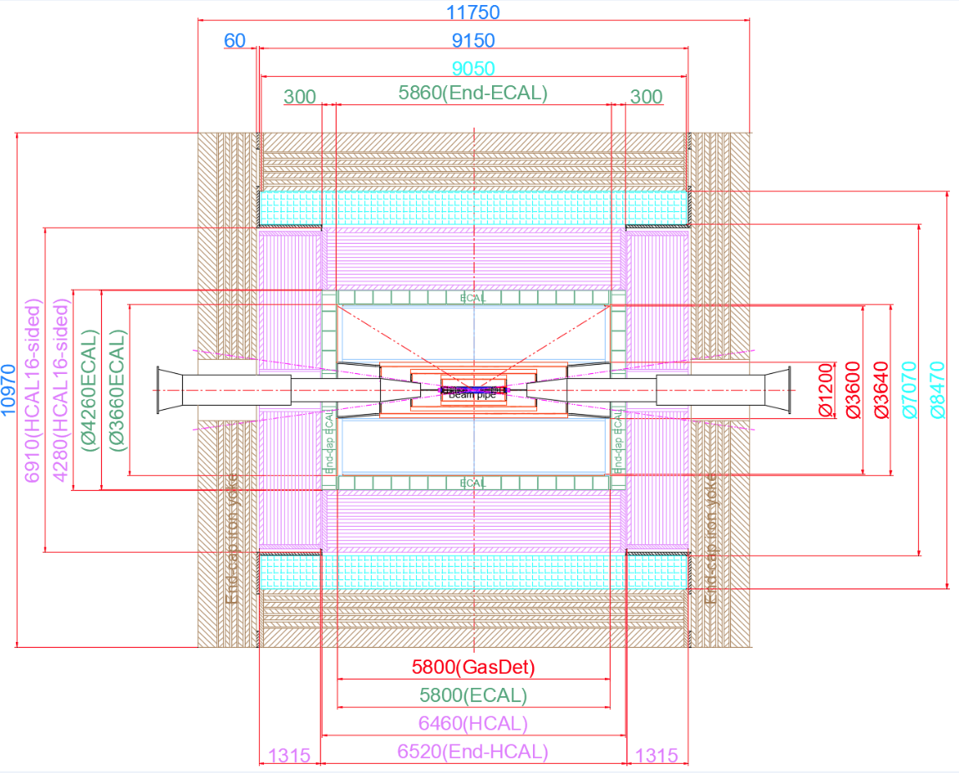
1. The size of magnet
Inner diameter | 7070 mm
Thickness | 700 mm
Outer diameter | 8470 mm
Length | 9050 mm

Slide 3
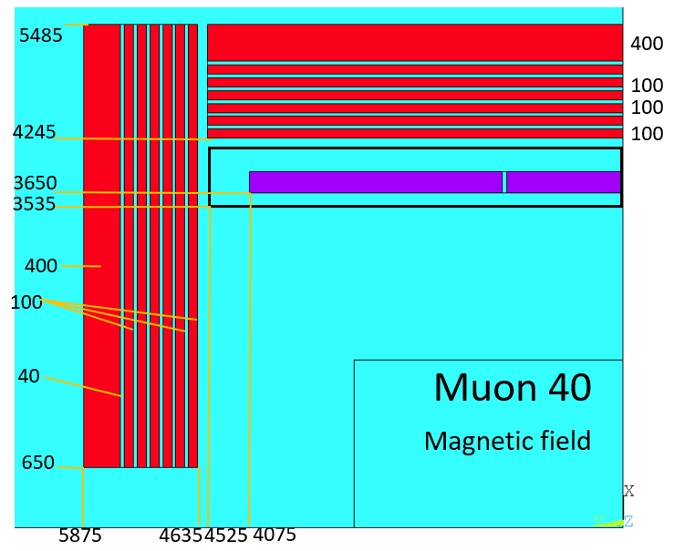
Detect Magnet
Yoke parameters：
Barrel yoke (ton) | 2300
Each End yoke (ton) | 754
Total Yoke (ton) | 3808
Diameter(m) & length (m) | 10.97&11.75
Coil parameters:
Inner diameter | 7300 mm
Operating current | 16702 A
Cable length | 33 km
Inductance | 11 H
Stored Energy | 1.54 GJ
Total mass | 220 tons
The gap between each layer of yoke is 40 mm.
Notes:
Two changes: first, add yoke to reduce the range of stray field; second, the size of HCal increase, so size of the solenoid and the yoke increase accordingly.

Slide 4
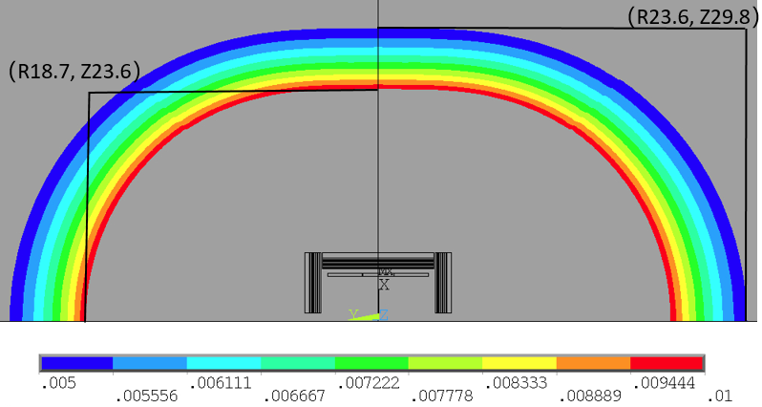
50 Gauss and 100 Gauss distribution:
stray field
Stray field
50 Gs | R direction | 23.6m
 | Z direction | 29.8m
100 Gs | R direction | 18.7m
 | Z direction | 23.6m
100 Gauss
50 Gauss
50 Gauss and 100 Gauss distribution

Slide 5
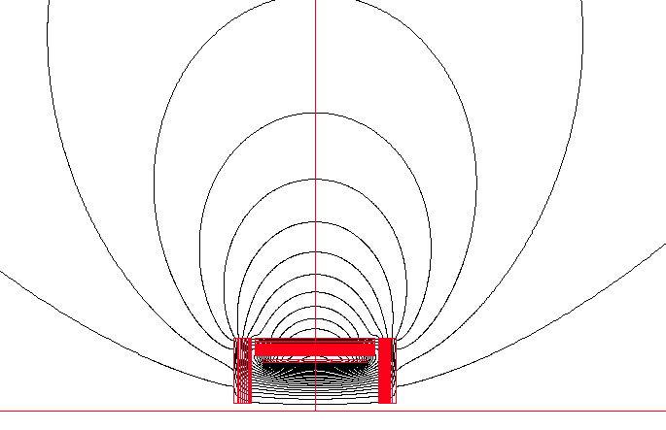
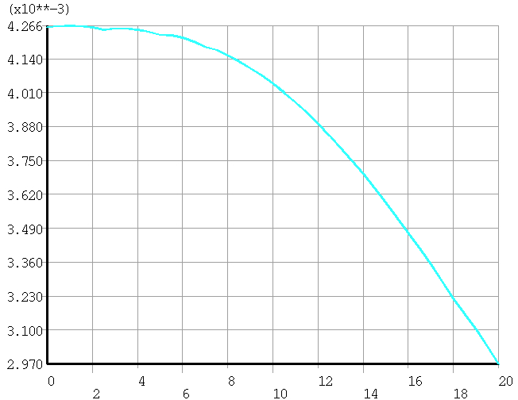
Stray field at the booster ring
25m
V0
From 42.7 Gs to 29.7 Gs
 | V0
Stray field (Gauss) | 42.7
Total Yoke (ton) | 3808

Slide 6
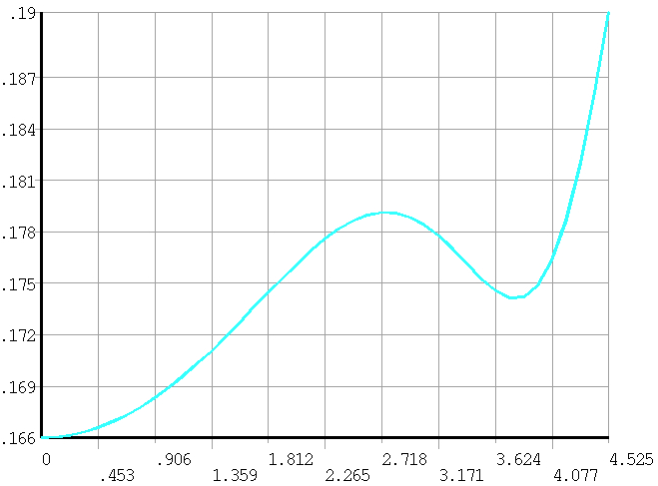
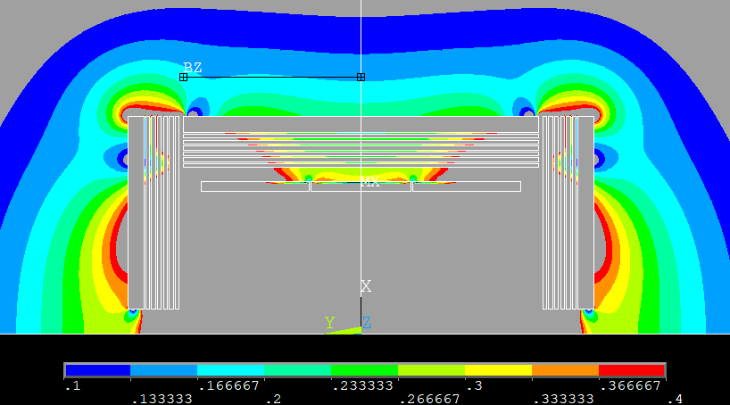
Yoke and stray field
1 m
 | B (T)
V0 | 0.166~0.184

