Slide 1

R&D Status of muon detector
Xiaolong Wang
For muon Det R&D group
Fudan University
REF TDR meeting, 05/21/2024

Slide 2
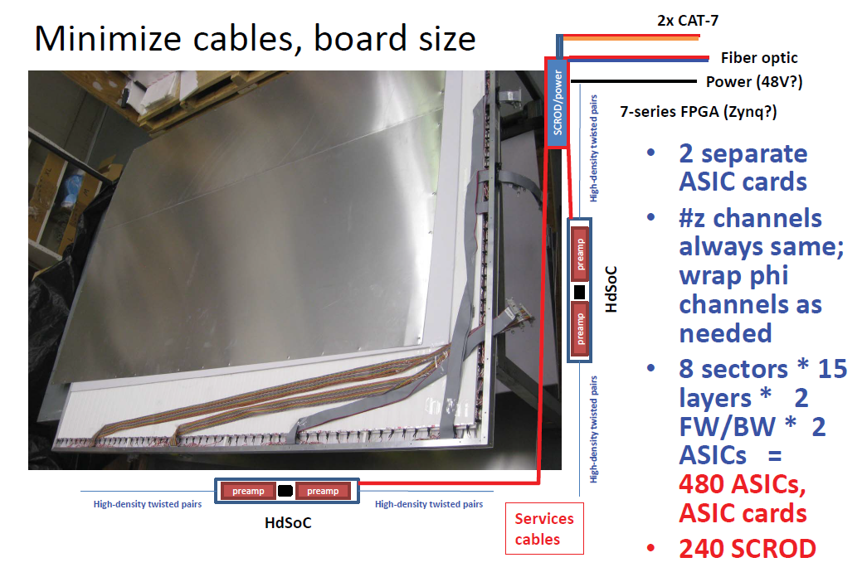
Assignment of R&D (scintillator)
1. Production of scintillator strip: expected to be within one month
2. Design of aluminum frame for detector module: FDU
3. G4 simulation and CEPCSW implementation: Nankai and SCNU
4. FEE design for detector module: FDU
5. R&D for BEE: USST and FDU (has uncertainty)
6. Purchase CAEN equipment for DAQ for prototype testing
7. Design of a time calibration (optional): Nankai and FDU
H.Y. Zhang, X.Y. Wang et al., Design and test for the CEPC muon subdetector based on extruded scintillator and SiPM, arXiv: 2312.02553, accepted by JINST.

Slide 3
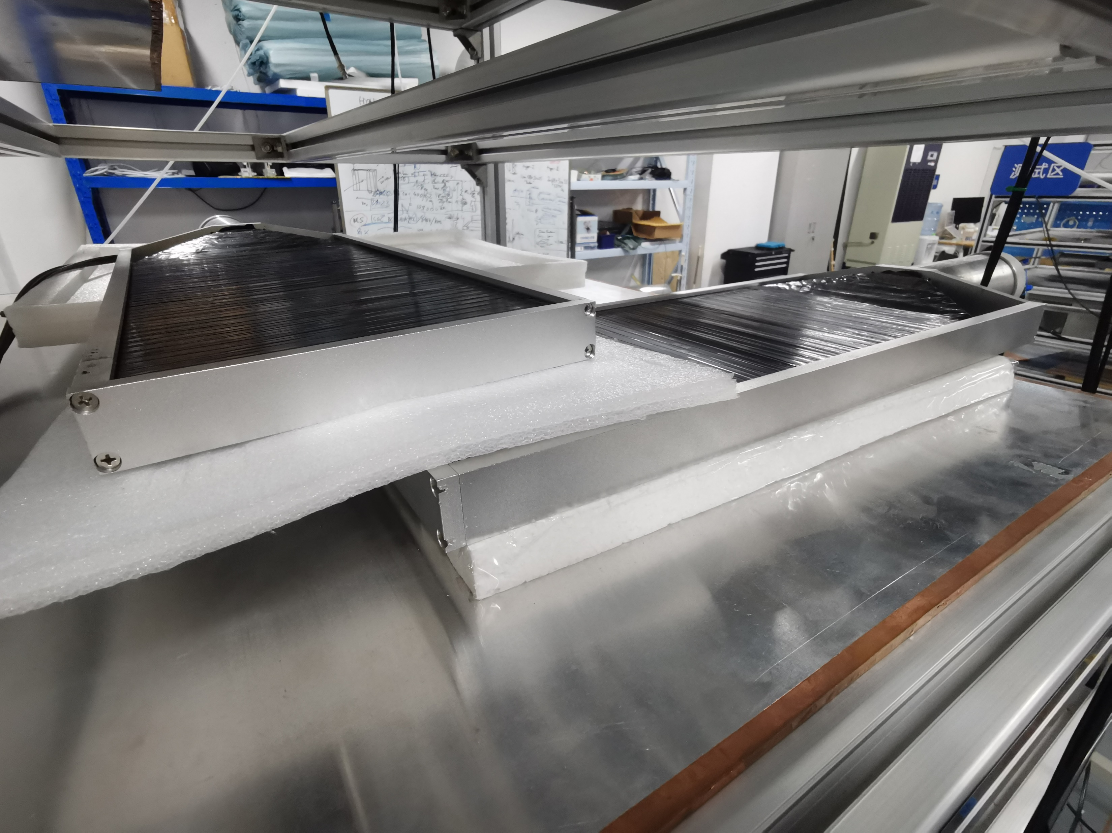
Assignment of R&D (RPC)
1. Design of FEE
2. G4 simulation
3. Optimization of RPC
4. Tuning the CR trigger
Mainly by SJTU
Prepare a document to compare scintillator and RPC --- Xiaolong, Jun, and Yuguang
  Performance, cost, design and construction, maintenance, etc.
We need to purchase!

Slide 4

From scintillator-based muon detector
XiaoLong Wang, Fudan University
A slide for TDAQ years ago.
The detecting area is about $8600 m^{2}$, with about 80k readout channels.
The Belle II KLM subdetector is a good reference. Belle II has much lower energy, but BX rate is 4 times higher. So we scale the number from KLM directly.
EKLM: $66×19.5+42=1329 MB/s$, so that the data size for CEPC would be about $5.4 GB/s$.
Bandwidth: $1 GHz$ for 64 independent channels in one ASIC.

