Slide 1



CEPC MDI EDR progress - cryomodule design
Xiangzhen Zhang, Xiaochen Yang, Penghui Li,…
2024.06.27
Cryogenics Group, Accelerator Research Center
Institute of High Energy Physics(IHEP)

Slide 2
Content
Introduction
Cryogenic scheme of the cryostat
Structural design of the cryostat
Calculation and simulation
EDR superconducting anti-solenoid
MDI alignment
Summary and plan

Slide 3
  Introduction
In CEPC, there are two combined-function Superconducting magnets in MDI
Each combined-function magnet includes double aperture high gradient quadrupole (Q1a, Q1b, Q2) and anti-solenoid, around each side of the IP point.
The cryostat is used to provide the cryogenic environment for SC magnets, which is below 5.0 K.
ITEM | Q1a | Q1b | Q2 | Anti-solenoid
Central field gradient (T/m) | 142.3 | 85.4 | 96.7
Cooling type | LHe | LHe | LHe | LHe
Operating current (A) | 780 | 650 | 770 | 1300
Magnetic storage energy (KJ) | 11.5 | 11 | 33.2 | 630
Cross section parameter (mm) | Φ40~61 | Φ52~78 | Φ62~88 | 100 sections
Magnet length (m) | 1.22 | 1.23 | 1.53 | 5.1
Net weight (Kg) | 25 | 32 | 43 | 302
Total weight of magnets (Kg) |  |  |  | 402
From Yingshun Zhu

Slide 4
  Introduction
Insufficient or unfinished works for the cryostat
Design and optimization of the structure.
Heat and mass transfer of the cryostat.
PI＆D of the cryogenic system.
Scheme of the current leads.
Some other problems.
From Yingshun Zhu

Slide 5
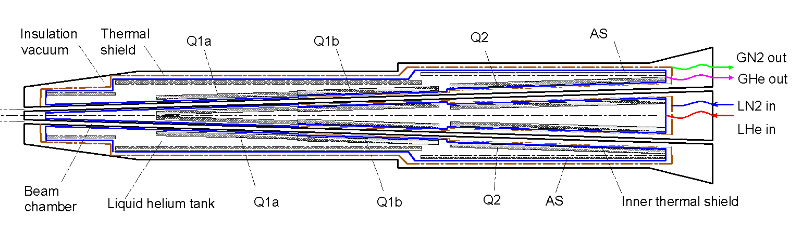
Cryogenic scheme of the cryostat
Cryostat scheme
Superconducting magnets are immersed in the helium tank for the low temperature.
One thermal shield is set for the heat interruption from the ambient temperature.
The shield is extended between the helium tank and the beam chamber.
The 4K cold mass is cooled by supercritical or subcooled helium, and the shield is by liquid nitrogen.

Slide 6
Cryogenic scheme of the cryostat
Cooling system
Conventional helium cooling scheme: Liquid helium is directly provided by helium refrigerator. The flow rate is limited by the refrigerator. Liquid helium can be subcooled or supercritical type.
Helium circulation cooling scheme: A closed helium circulation is established depending on a pump. The flow rate can be increased largely. The system will be complex.
Superfluid helium(HeⅡ): Perfect cooling uniformity; Stable pressure; Higher magnet current; Higher cost.

Slide 7
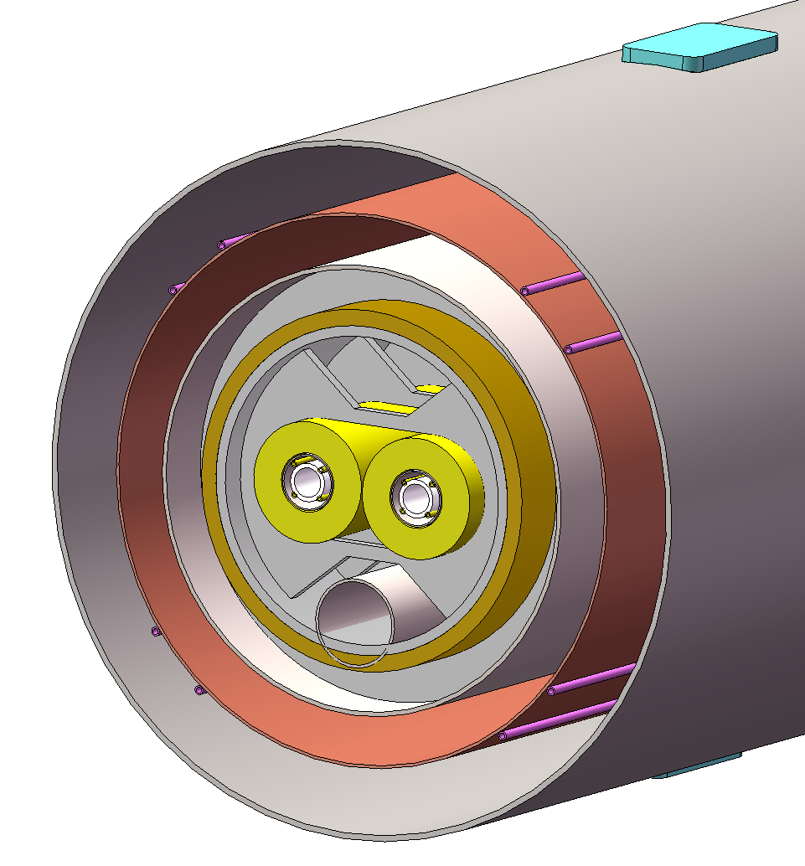
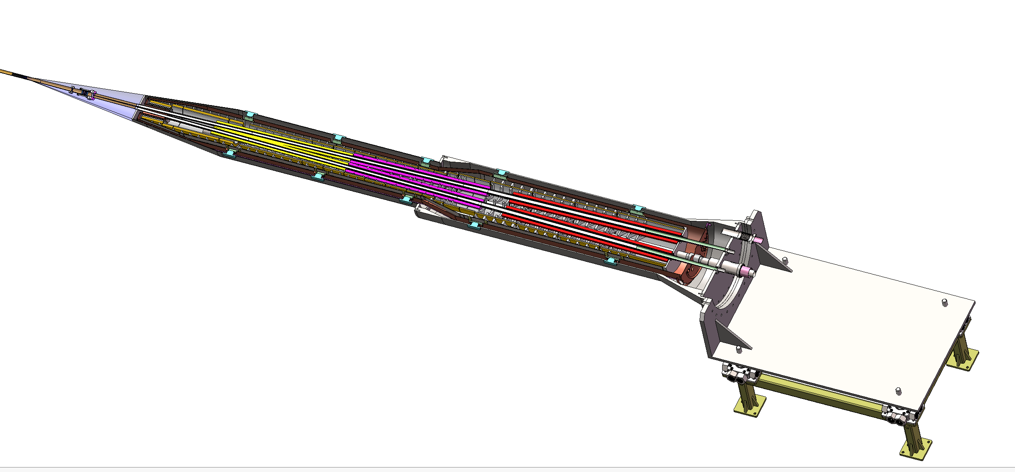
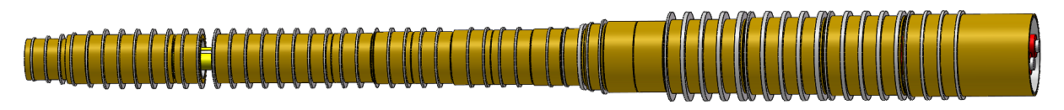
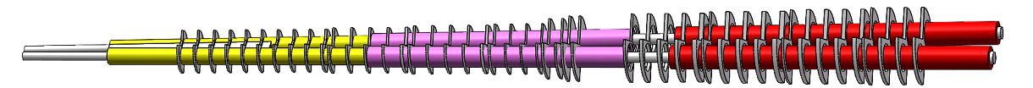
Structural design of the cryostat
Support of SC magnet
The superconducting magnets Q1a,Q1b and Q2 are supported on the inner wall of the solenoid.
The anti-solenoid is supported by a ring on the inner wall of the helium tank.
Vacuum
Thermal shield
1985mm
LHe tank
1915mm
Support
Anti-solenoid
2885mm
Anti-solenoid
Q1a
Beam chamber
Q1a
Q1b
Q2
Notes:
标注尺寸

Slide 8
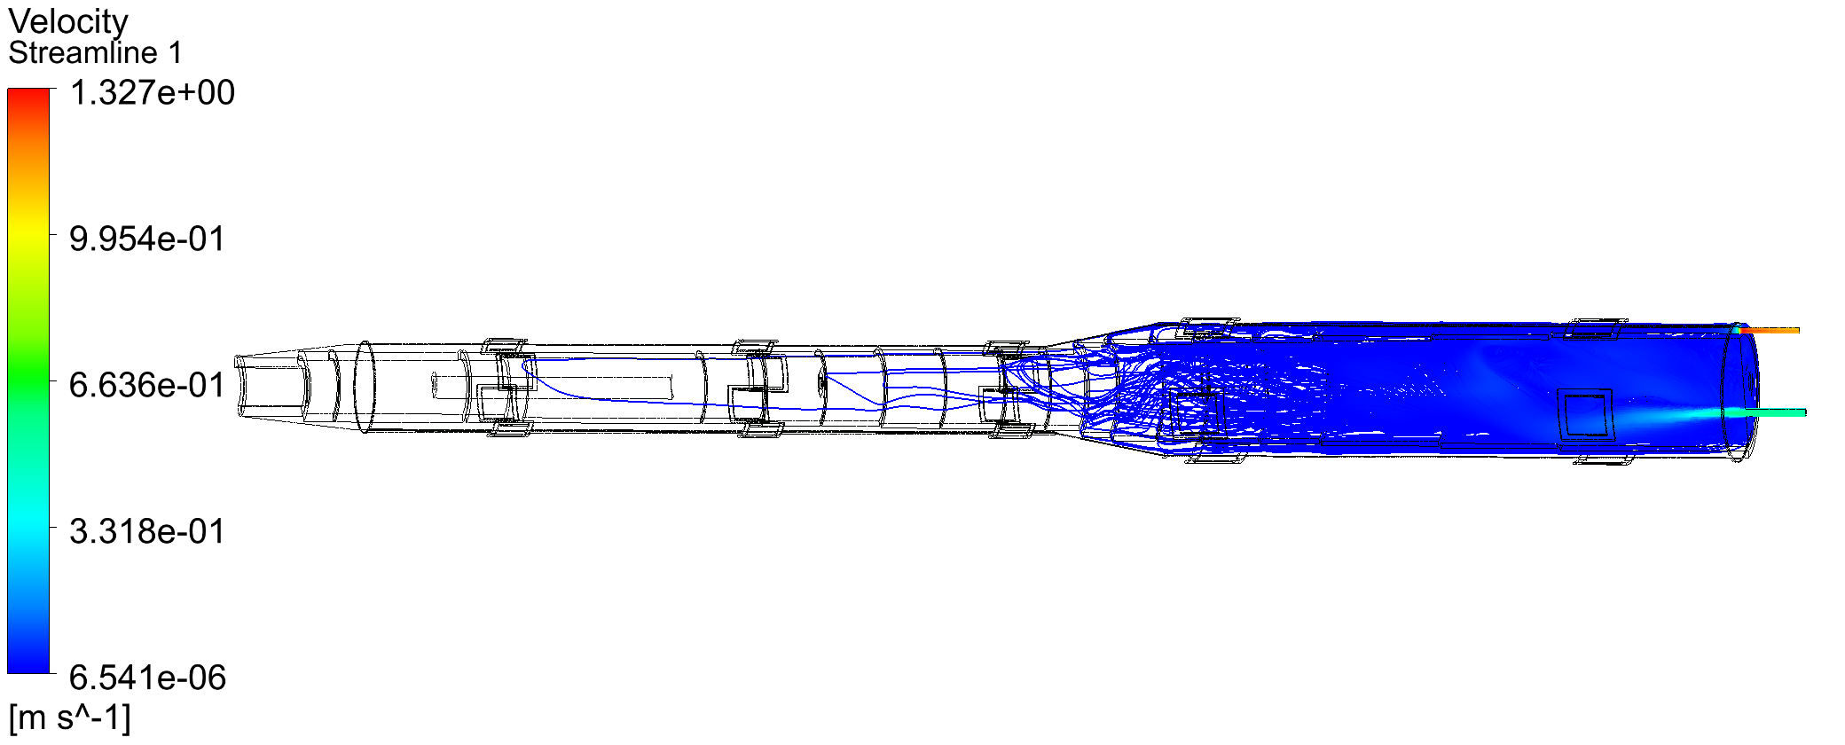
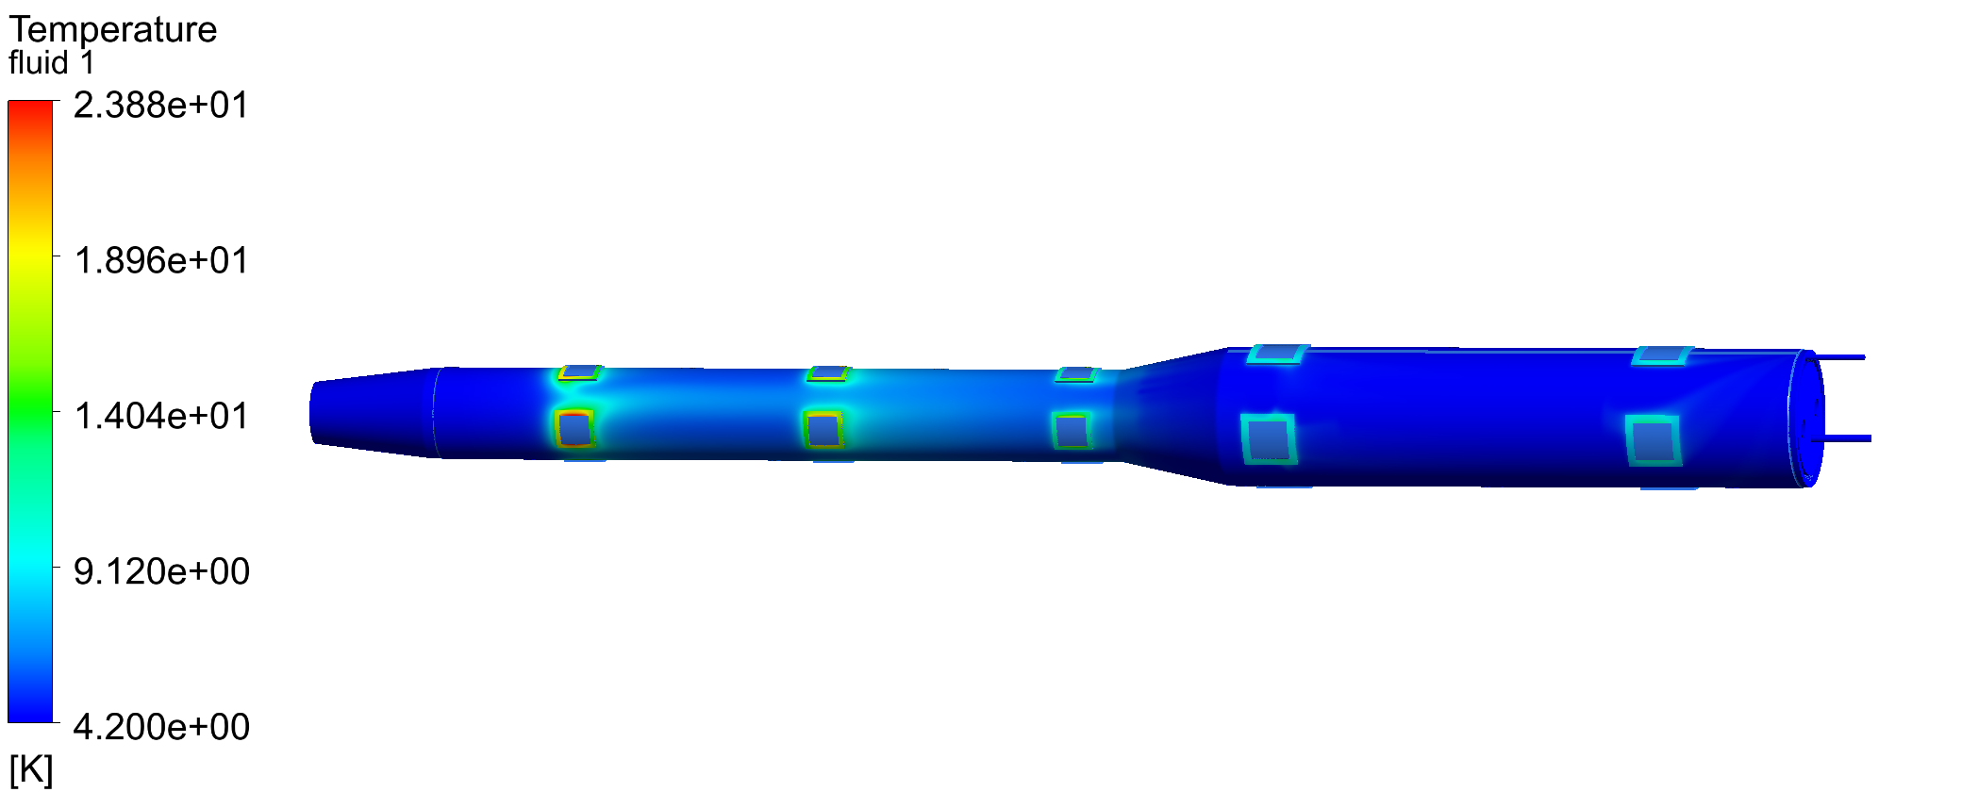
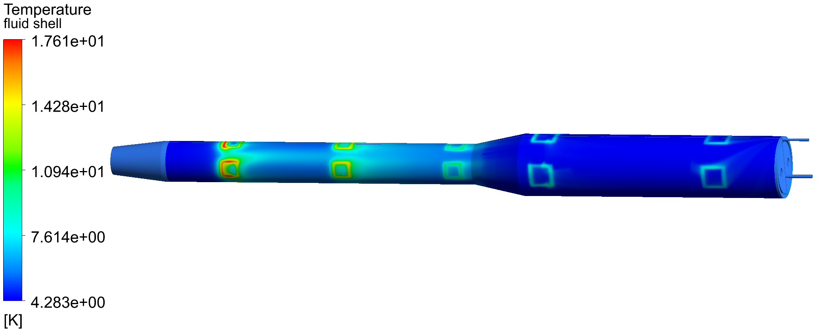
Calculation and simulation
Cooling of anti solenoid
Cooling flow: One-way in and out
Without considering the magnetic support structure:
Heat conduction of support is 13.68 W; Heat flux of thermal radiation is 0.1 W/m²;
Helium inlet flow is 3.0 bar@4.2 K.
outlet
inlet
Outer cylinder of helium tank
Not feasible！
Fluid domain

Slide 9
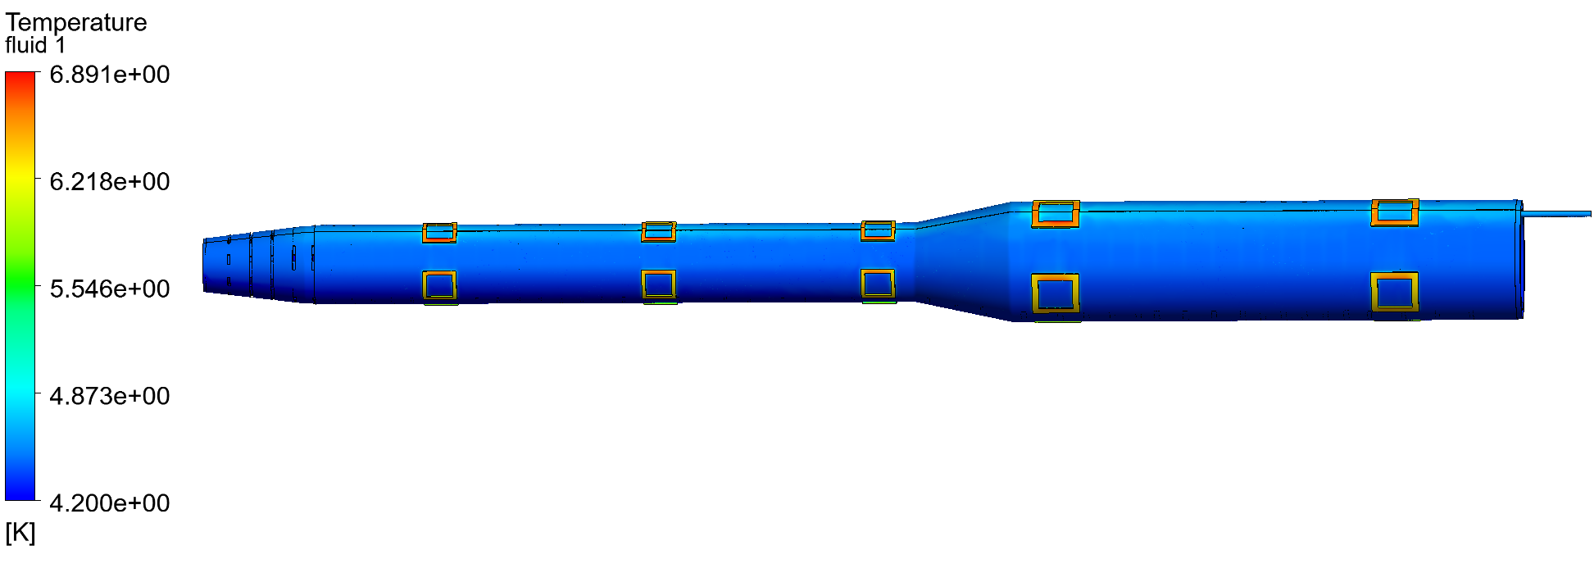
Calculation and simulation
Cooling of anti solenoid
Cooling flow: Outer single-layer flow channel ：
inlet
outlet
Temperature distribution of the outer cylinder of the helium tank: 3bar@4.2K 10g/s

Slide 10
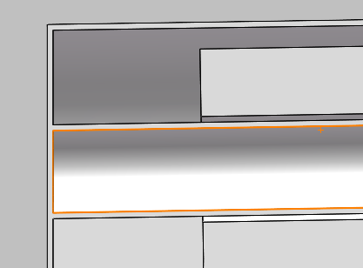
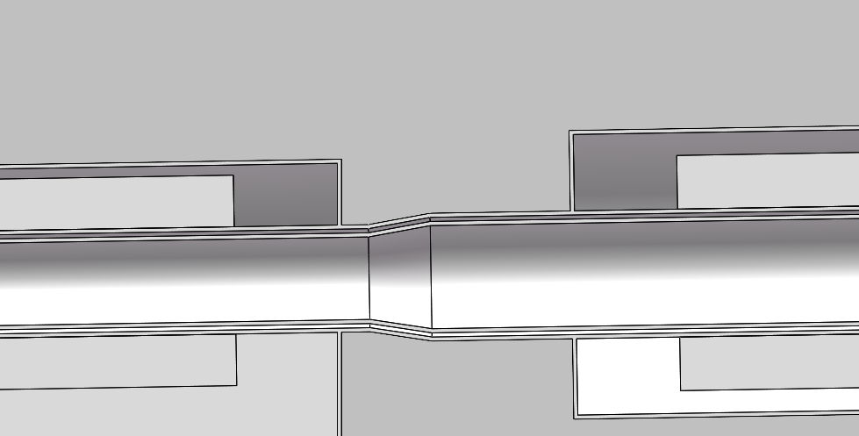
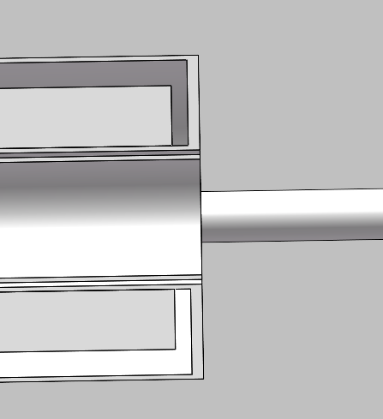
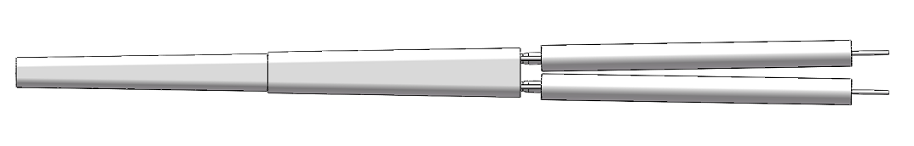
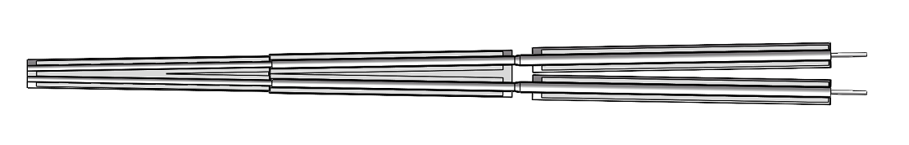

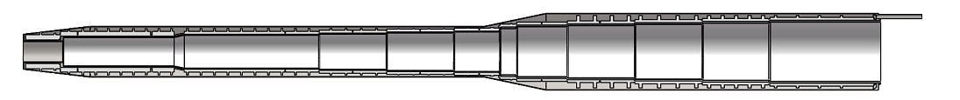
Calculation and simulation
Optimized helium channel
Inner and outer double flow channel design：
Quadrupole flow channel:
Minimum gap is 2mm
outlet
inlet
Anti-solenoid flow channel :
outlet
inlet
Minimum gap is 4mm

Slide 11
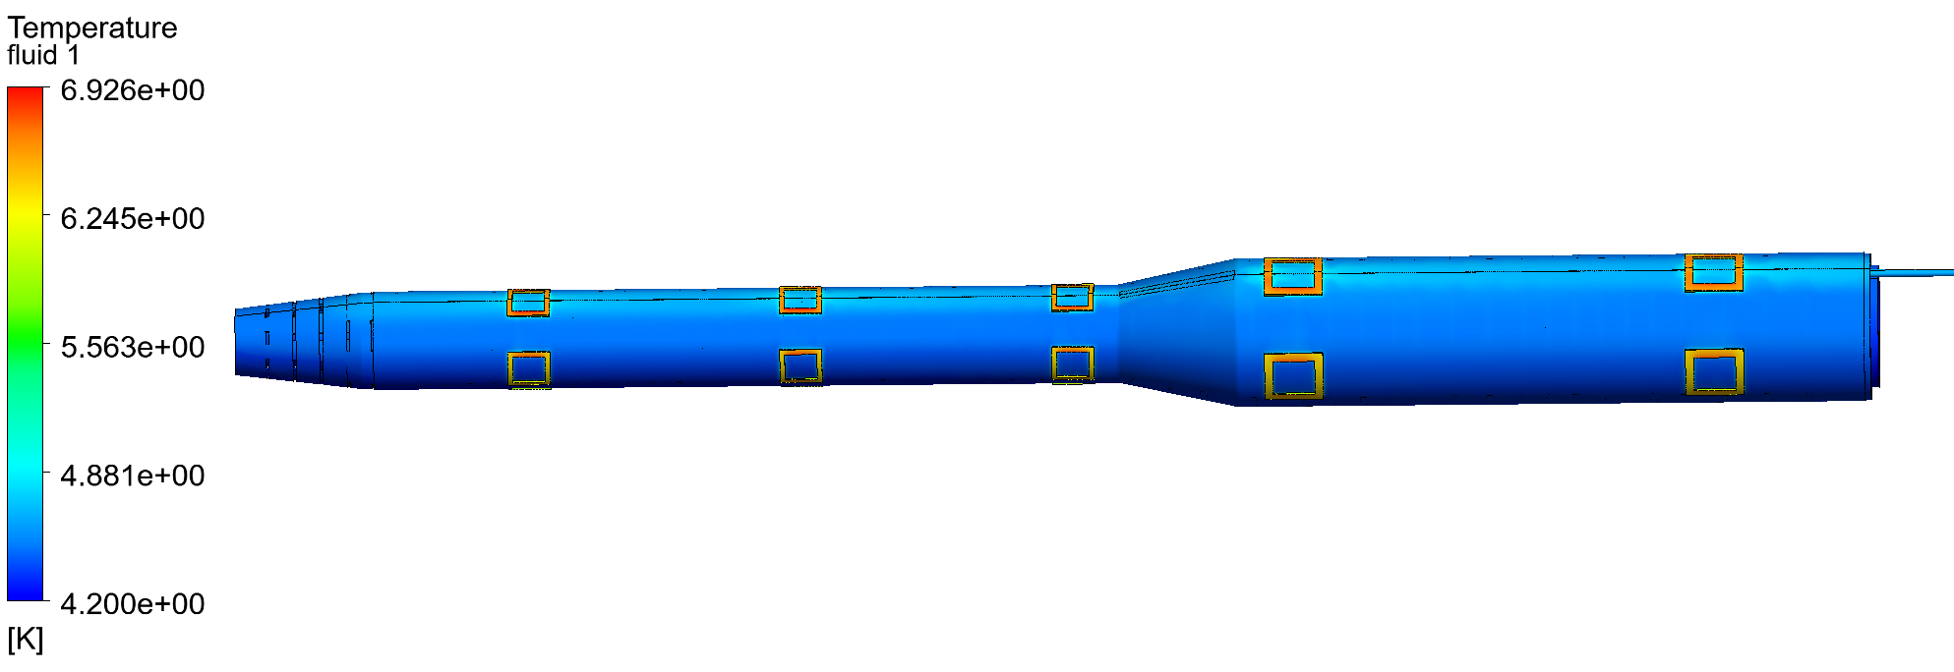
Calculation and simulation
Cooling of anti solenoid
Comparison of single-layer and double-layers cooling channels ：
outlet
inlet
A double-layers flow channel is more effective for cooling superconducting magnets compared to a single-layer flow channel, especially when the helium flow rate is low ；
Some other advantages, including the heat management, quench recovery or magnet cooling time.

Slide 12
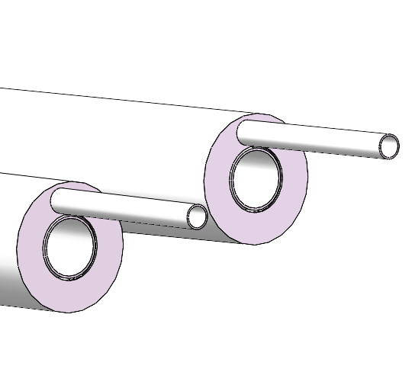
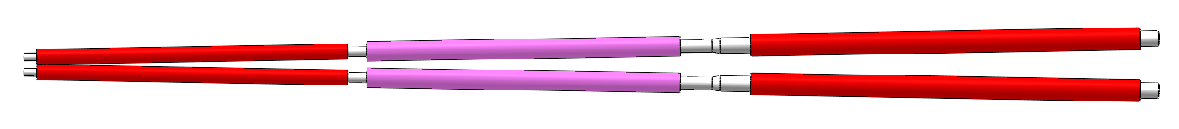
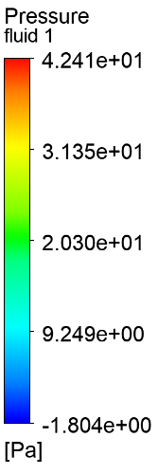
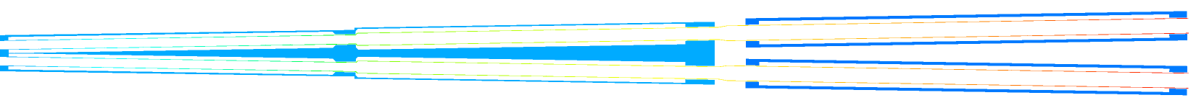
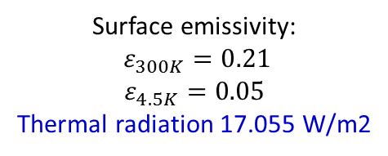
Calculation and simulation
Cooling of quadrupole coils
Q1-A
Q1-B
Q2
Surface emissivity:
$ε_{300K}=0.21$
$$ε_{4.5K}=0.05$$
Thermal radiation 17.055 W/m2
Thermal radiation 0.2 W/m2
Thermal radiation 0.2 W/m2
Helium flows into the inner channel and out from the outer channel.
Inlet helium state:
3.0bar@4.5K
(Supercritical helium)
Fluid pressure difference diagram (Inlet flow rate 10g/s)

Slide 13
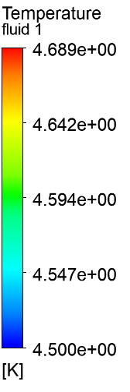

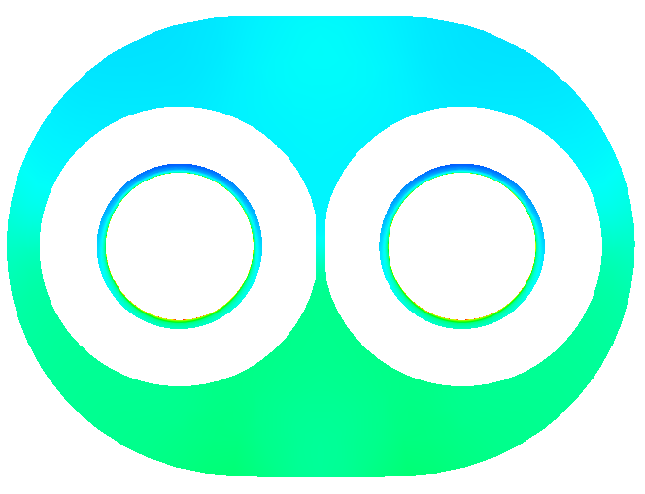



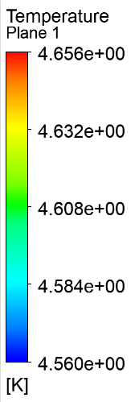

Calculation and simulation
Cooling of quadrupole coils
Inlet flow rate 10g/s, 3.0bar@4.5K
Helium fluid is heated in the inner channel.
The temperature of the fluid in the inner channel varies greatly near Q1-A
X
x=2.500 m
x=0.060 m
x=1.250 m
x=1.400 m
Temperature distribution of helium fluid
x=3.500 m

Slide 14
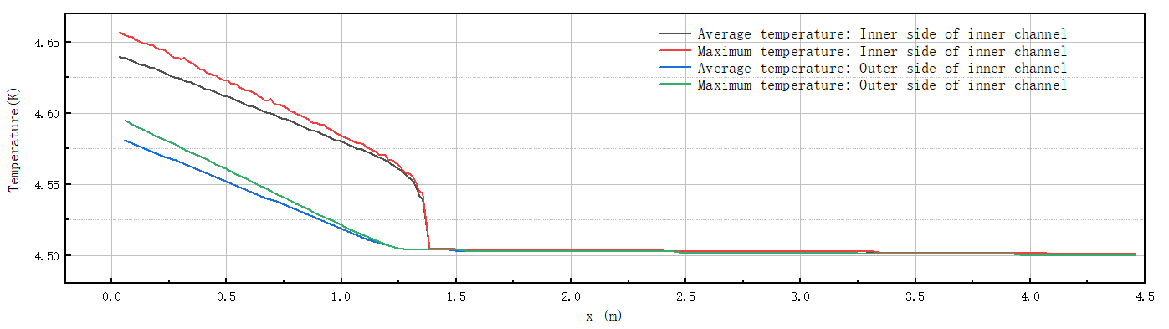
Calculation and simulation
Cooling of quadrupole coils
Inlet flow rate 10g/s, 3.0bar@4.5K
Temperature distribution inside the inner channel
Temperature distribution on the outer side of the inner channel
X
The temperature of 10g/s subcooled helium increases by about 0.04K, after passing through Q2 and Q1-B.
When subcooled helium flows through Q1-A, its temperature risesrapidly, with a gradually increasing temperature difference at the same X position.

Slide 15
Calculation and simulation
Cooling of quadrupole coils
The static thermal radiation of a quadrupole focusing magnet is constant.
The higher the flow rate, the lower the temperature of the Q1-A magnet.
The flow rate of subcooled helium is determined based on the temperature of the magnet.

Slide 16
Calculation and simulation
Possible Improvement
Application cases of large flow forced flow cooling ---- supercritical helium cycle pump:
The electron-proton collider HERA at the electron synchrotron laboratory (DESY) in Hamburg, Germany, uses a 45g/s helium circulating pump. （DESY）
The Atlas-LHC at CERN in Geneva, Switzerland, uses two 600g/s helium circulation pumps and two 1.2Kg/s helium circulation pumps.
The Superconducting magnet Test Facility at the Atomic Energy Research Institute of Japan.
TOSKA at the Institute of Technical Physics at the Karlsruhe Research Center in Germany.
Refrigerator
Refrigerator
helium circulating pump
LHe
LHe
SC Magnet
SC Magnet
Conventional helium cooling mode
Helium circulation cooling mode

Slide 17
Calculation and simulation
Supercooled LHe Circulation
A tank is used to control the pressure.
The flow rate can be improved largely.
Temperature distribution can be more uniform.
The system is complicated.

Slide 18
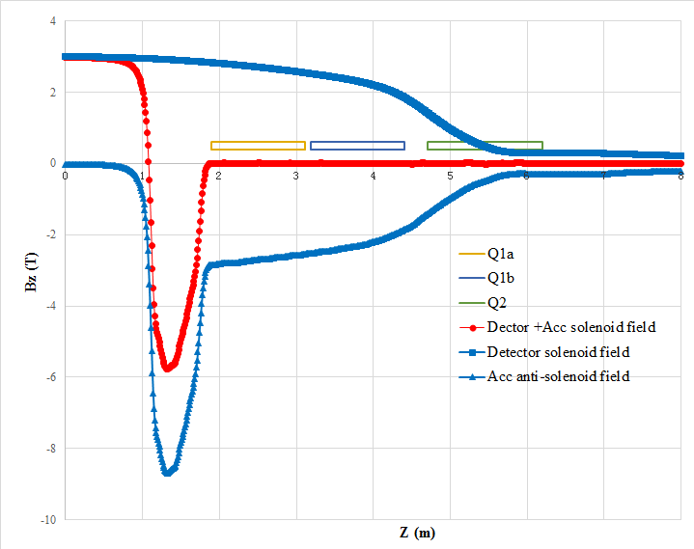
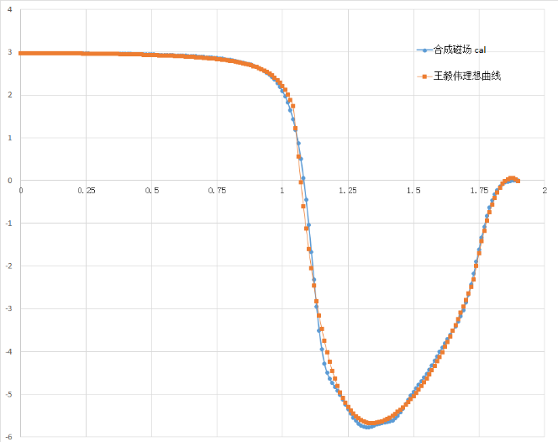
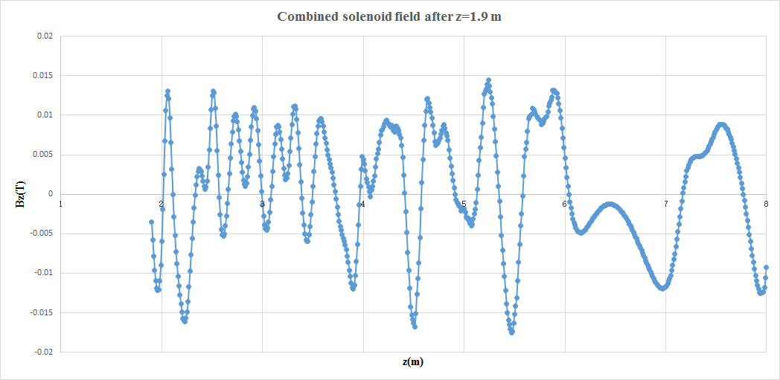
EDR superconducting anti-solenoid
In order to reduce the magnet size, energy and cost, the anti-solenoid is divided into more than 100 sections with different inner coil diameters.
The coil radius of anti-solenoid in quadrupole region is smaller than that in TDR. ( radius reduction about 10 to 15mm)
Magnetic field calculation and optimization is performed using axi-symmetric model in OPERA-2D.
The central field of the first section of the anti-solenoid is the strongest, with a peak field of 8.7T @ r=0, and 10.7T in coil.
Combined field
Combined field @z <1.9m
Combined field @z >1.9m
Combined field of Anti-solenoid and Detector solenoid is fine tuned.
The total integral solenoid field is almost zero.
The net solenoid field inside quadrupole magnet at each longitudinal position is smaller than 170 Gs.

Slide 19
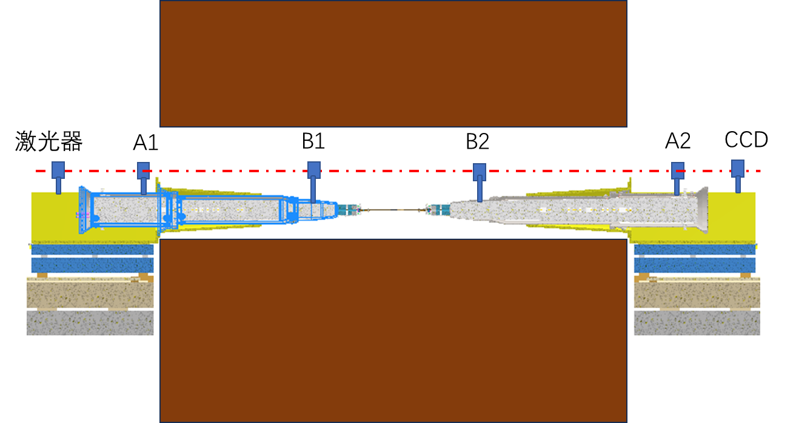
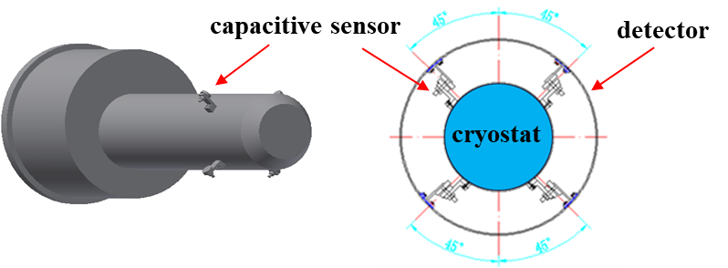
MDI alignment
MDI alignment
cryostat module pre-alignment
Installation and alignment
Position inspection of superconducting magnet
cryostat module position monitoring
Existing issues:
  How to measure the front position after the cryostat module is inserted into the detector?
  Optional methods:
    Permanently place several tracker targets at the front of the cryostat module, with large openings at both ends of the detector to allow the tracker to measure the targets inside from the outside.
    To use laser collimation, it is necessary to open a through hole.
    Installing sensors

Slide 20
Summary
Design status of cryomodule:
The cryostat has been updated as the optimization of the SC magnets.
Supercritical/ Suncooled liquid helium is used as the cold source.
Double cooling channels of SC magnets can be used, if the mechanical space is allowed.
A supercooled LHe circulation is designed, which can increase the flow rate largely.
Works to be done:
Optimization of the cryostat;
Thermal and mechanical analysis; (quench protection, energy storage , supports )
Current lead and cryogenic system;
Measurement requirements; (temperature/pressure/BPM)
Initial consideration of processing and manufacturing technology;

Slide 21
EDR plan
EDR plan for MDI SC cryostat:
2024:
Update the design of the cryomodule
Thermal and mechanical analysis of the structure
Optimization of heat and mass transfer of the helium
Design of current leads
2025:
PI＆D scheme determination
Assembly process design and alignment considerations
2026:
Machine-finishing technological design
Cryogenic performance test of critical component

Slide 22
Thanks for your attention!

