Slide 1
Locations of the SppC detector halls
Yiwei Wang, Haocheng Xu
CEPC day, Jun 27, 2024, IHEP

Slide 2
Outline
Locations of the SppC detectors halls in TDR
Preliminary scheme of the SPPC detector hall independent to CEPC
Move the SPPC detector further out from the CEPC tunnel

Slide 3
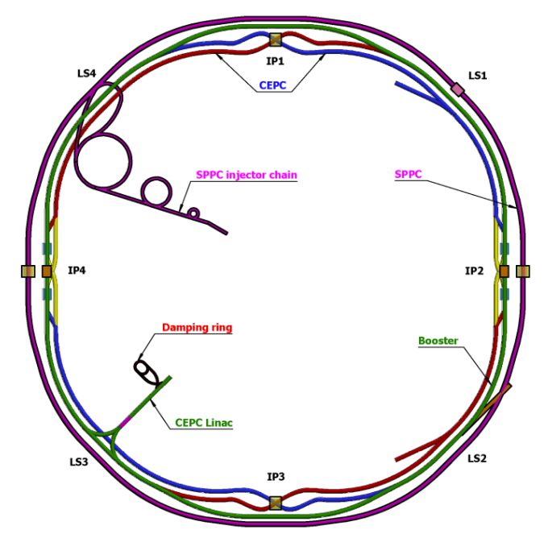
Remind of the CEPC and SPPC compatibility
The SPPC will share the tunnel of CEPC as much as possible.
The SPPC locates outside of CEPC.
IP2 and IP4 for CEPC RF and SPPC interaction
IP1 and IP3 for CEPC interaction and SPPC collimation
In the 8 arc regions and 4 short straight sections, two machines share the tunnel (distance of machine centers=3.5m)
In the 4 long straight sections, the SPPC will bypass the CEPC

Slide 4
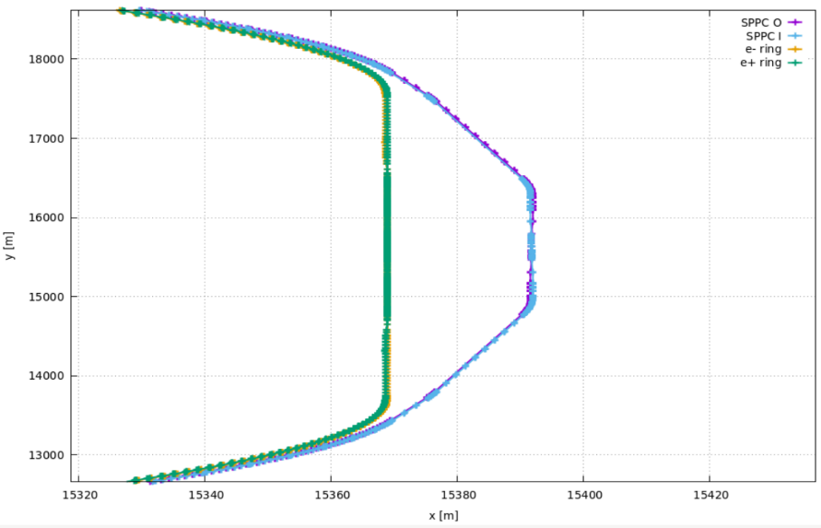
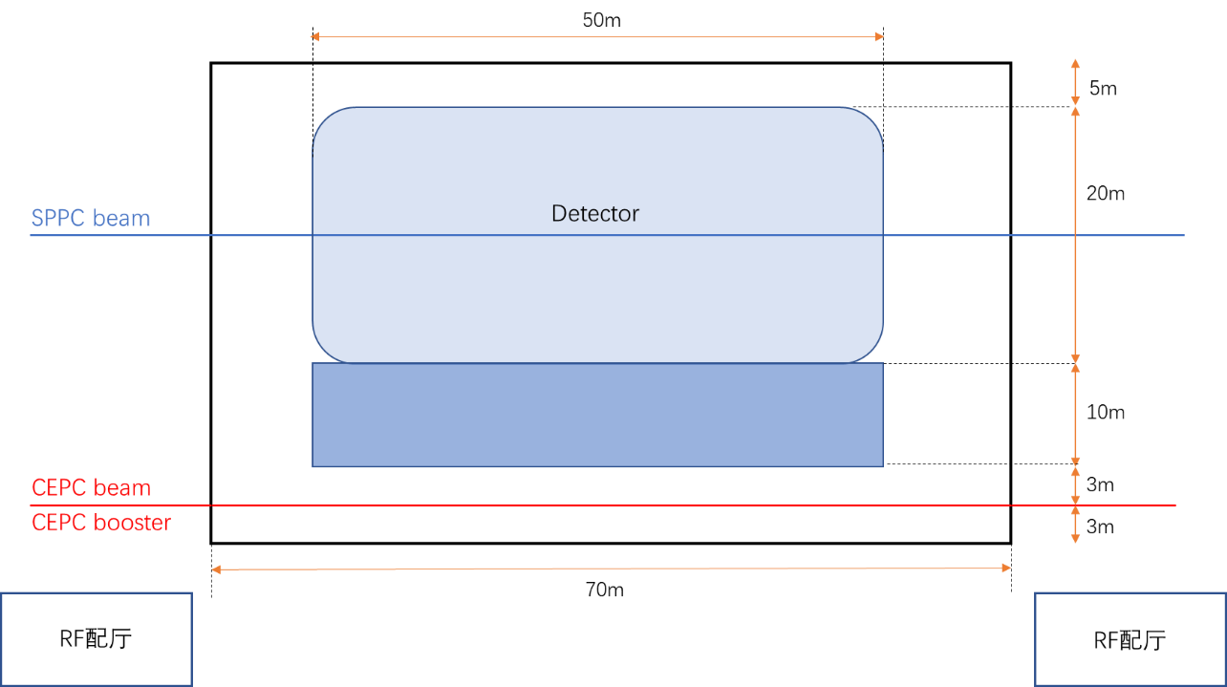
Location of the SppC detector hall (1)
TDR scheme
SPPC will bypass with Bmax=20T bends
Distance=23m, total length of bypass at IP2 around 4400 m
CEPC beam line near IP2 will go through the SPPC detector hall which have to be constructed during the CEPC civil construction.
23 m
IP2
23 m
*Dimensions of the hall and detector need to be defined

Slide 5
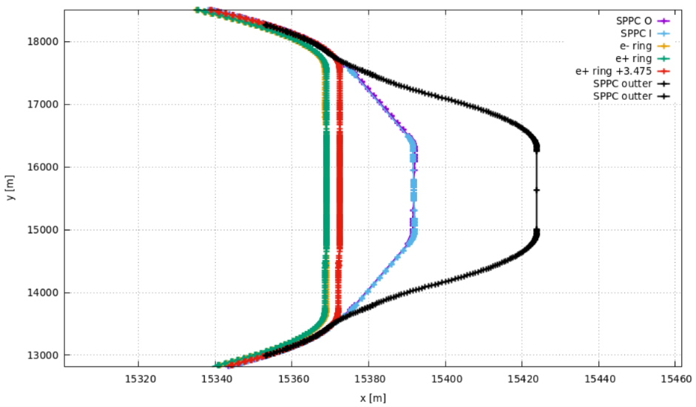
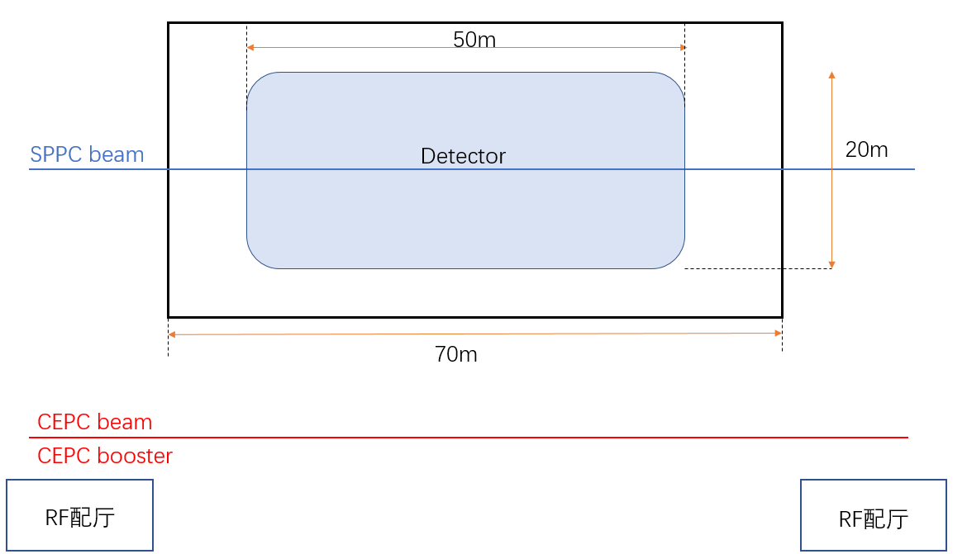
Location of the SppC detector hall (2)
Move the SPPC detector further out from the CEPC tunnel
SPPC will bypass with Bmax=20T bends
Distance ≤55 m, if constraint the total length of bypass near IP2 ≤ 4400 m
CEPC tunnel is independent to SPPC detector hall which no need to be constructed during the CEPC civil construction.
≤55 m
IP2
≤55 m
*Dimensions of the hall and detector need to be defined

Slide 6
Summary
A preliminary scheme of the SPPC detector hall independent to CEPC
Move the SPPC detector further out from the CEPC tunnel
Distance ≤55 m, if constraint the total length of bypass near IP2≤4400 m and B≤20 T for bends

