Slide 1
About aerogel Cherenkov counters for π/K–separation at range of several tens GeV/c
Alexander Barnyakov on behalf of BINP Aerogel team
CEPC day, 27/06/2024, Shanghai
OUTLINE:
Aerogel is unique material
Aerogel RICH with focusing effects:
– ARC-FCC
– FARICH technique
– mRICH technique (RICH with Fresnel lens)
– aerogel fibers
– precise position sensetive photon detectors
Summary

Slide 2
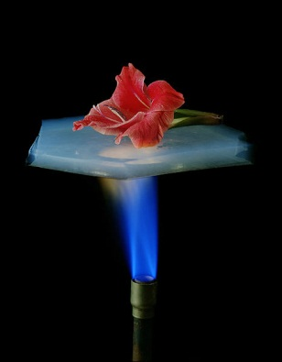
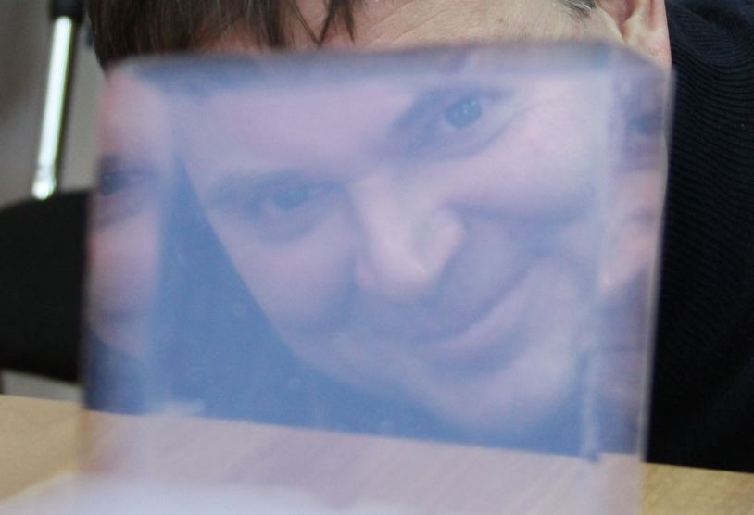
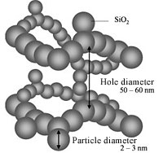
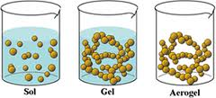
Silica aerogel
Silica aerogel was first produced in 1931 by Samuel S. Kistler
Lightest solids. Close the nature’s gap in refractive index between gases @ STP ( n-1 ≲ 10⁻³ ) and liquids/solids (n≳1.3).
3D network of SiO₂ nanometer sized pellets and 50-100 nm pores
Now produced by sol-gel method out of silicon alkoxide Si(OR)₄
Gelation
Supercritical drying

Slide 3


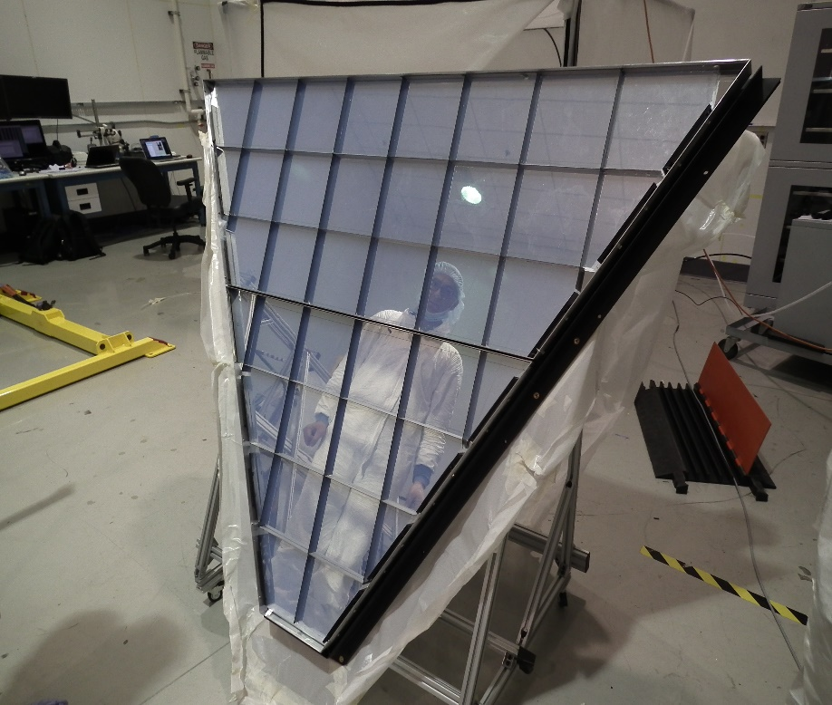
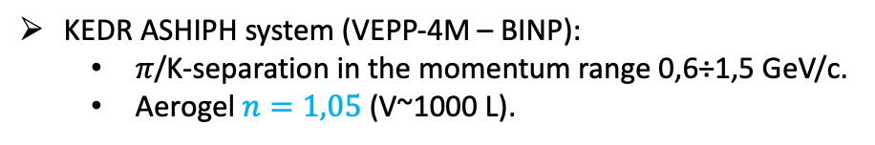
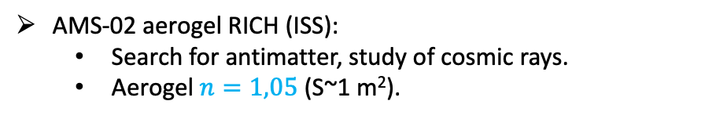
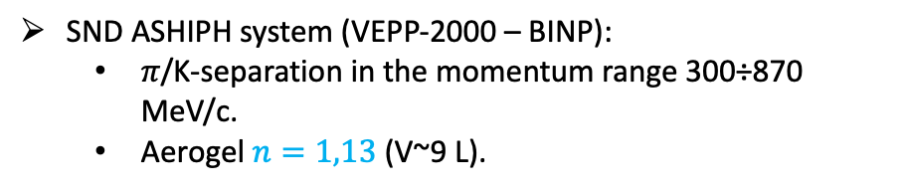
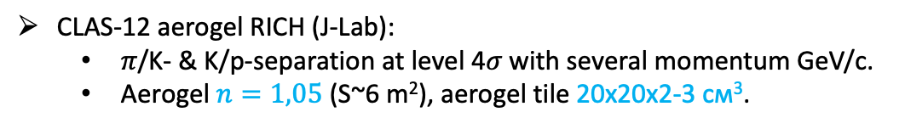
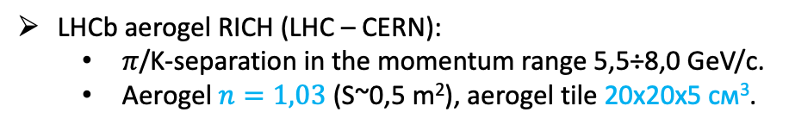
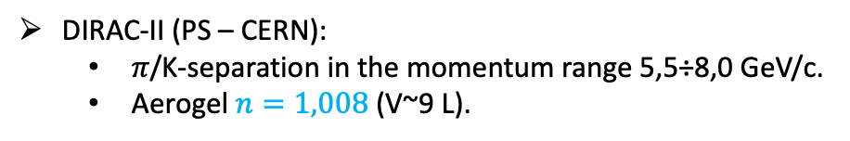
History of aerogel radiators in Novosibirsk
The history of the Novosibirsk aerogels began in 1986.
KEDR ASHIPH system (VEPP-4М – BINP):
  𝜋/K-separation in the momentum range 0,6÷1,5 GeV/с.
  Aerogel $n=1,05$ (V~1000 L).
SND ASHIPH system (VEPP-2000 – BINP):
  𝜋/K-separation in the momentum range 300÷870 MeV/с.
  Aerogel $n=1,13$ (V~9 L).
DIRAC-II (PS – CERN):
  𝜋/K-separation in the momentum range 5,5÷8,0 GeV/с.
  Aerogel $n=1,008$ (V~9 L).
AMS-02 aerogel RICH (ISS):
  Search for antimatter, study of cosmic rays.
  Aerogel $n=1,05$ (S~1 m²).
LHCb aerogel RICH (LHC – CERN):
  𝜋/K-separation in the momentum range 5,5÷8,0 GeV/с.
  Aerogel $n=1,03$ (S~0,5 m²), aerogel tile 20х20х5 см³.
Aerogel RICH for CLAS12
CLAS-12 aerogel RICH (J-Lab):
  𝜋/K- & K/p-separation at level 4𝜎 with several momentum GeV/с.
  Aerogel $n=1,05$ (S~6 m²), aerogel tile 20х20х2-3 см³.

Slide 4
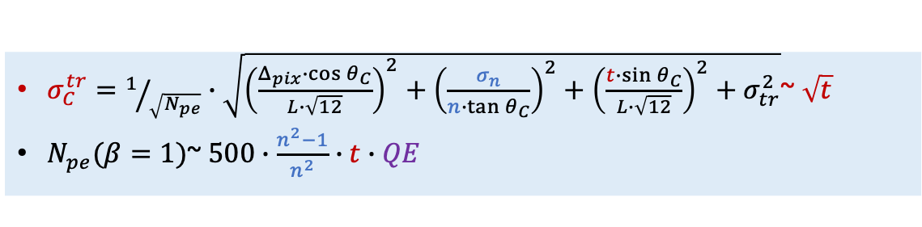
RICH detectors capability for π/K–separation
• At least 5 hits have to be detected to reconstruct Cherenkov ring.
• Thickness of Cherenkov radiator should be:
– ≥1 cm for n=1.05 (aerogel)
– ≥4 cm for n=1.008 (aerogel)
– ≥15 cm for n=1.002 (C₅F₁₂)
• Some focusing system is needed to provide impact from thickness at the level of few mrads for base 200÷300 mm!!!
$σ_{C}^{tr}=1/{\sqrt{N_{pe}}}∙\sqrt{{\left(\frac{Δ_{pix}∙\cos{θ_{C}}}{L∙\sqrt{12}}\right)}^{2}+{\left(\frac{σ_{n}}{n∙\tan{θ_{C}}}\right)}^{2}+{\left(\frac{t∙\sin{θ_{C}}}{L∙\sqrt{12}}\right)}^{2}+σ_{tr}^{2}}$~ $\sqrt{t}$
$N_{pe}(β=1)$~ $500∙\frac{n^{2}−1}{n^{2}}∙t∙QE$

Slide 5
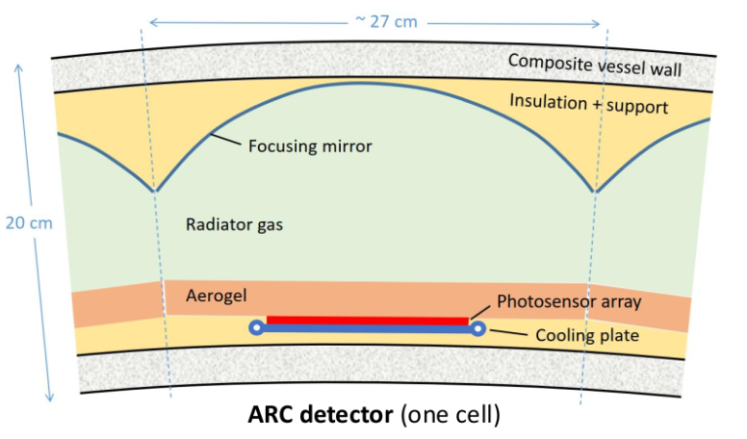
ARC-FCC: few remarks
Light collection through aerogel
  Cherenkv light produced in aerogel will pass through aerogel twice
  Cherenkov light from gas will pass the aerogel too
  Therefore aerogel transperancy has to be better than for proximity focusing RICH approach preliminary by factor of two
Connection of Aerogel with perfluoride gases (C₄F₁₀, C₅F₁₂,…). This issue has to be investigated very carefully
  Refractive index of aerogel will be changed due to replacement of air (n=1.0003) to gas (n=1.004) inside the aerogel pores, as well as light scattering parameters
  Mechanical destroy of aerogel is possible due to condensation of pressurised C4F10 inside pores [NIM A421 (1999) 249-255]
To combine aerogel and gas Cherenkov radiators the system design has to become more complex
Design inspired by succes of DELPHI and LHCb experiments

Slide 6
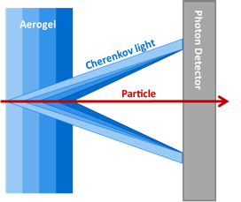
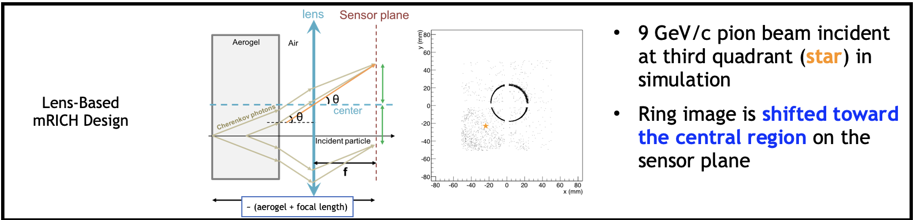
Several approaches for focusing Cherenkov light from aerogel
Thicknesses and refractive indexes in each layer are adjusted in such way that Cherenkov rings from each layer overlap in the same region of the position-sensitive photon detector.
The number of detected Cherenkov photons increases due to increase of the thickness without degradation of Cherenkov angle resolution due to uncertainties of photon emission point.
T.Iijima et al., NIM A548 (2005) 383 and A.Yu.Barnyakov et al., NIM A553 (2005) 70
Focusing Aerogel RICH (FARICH)
A. Del Dotto et al., NIM A876 (2017) 237-240
Aerogel RICH with Fresnel lens

Slide 7
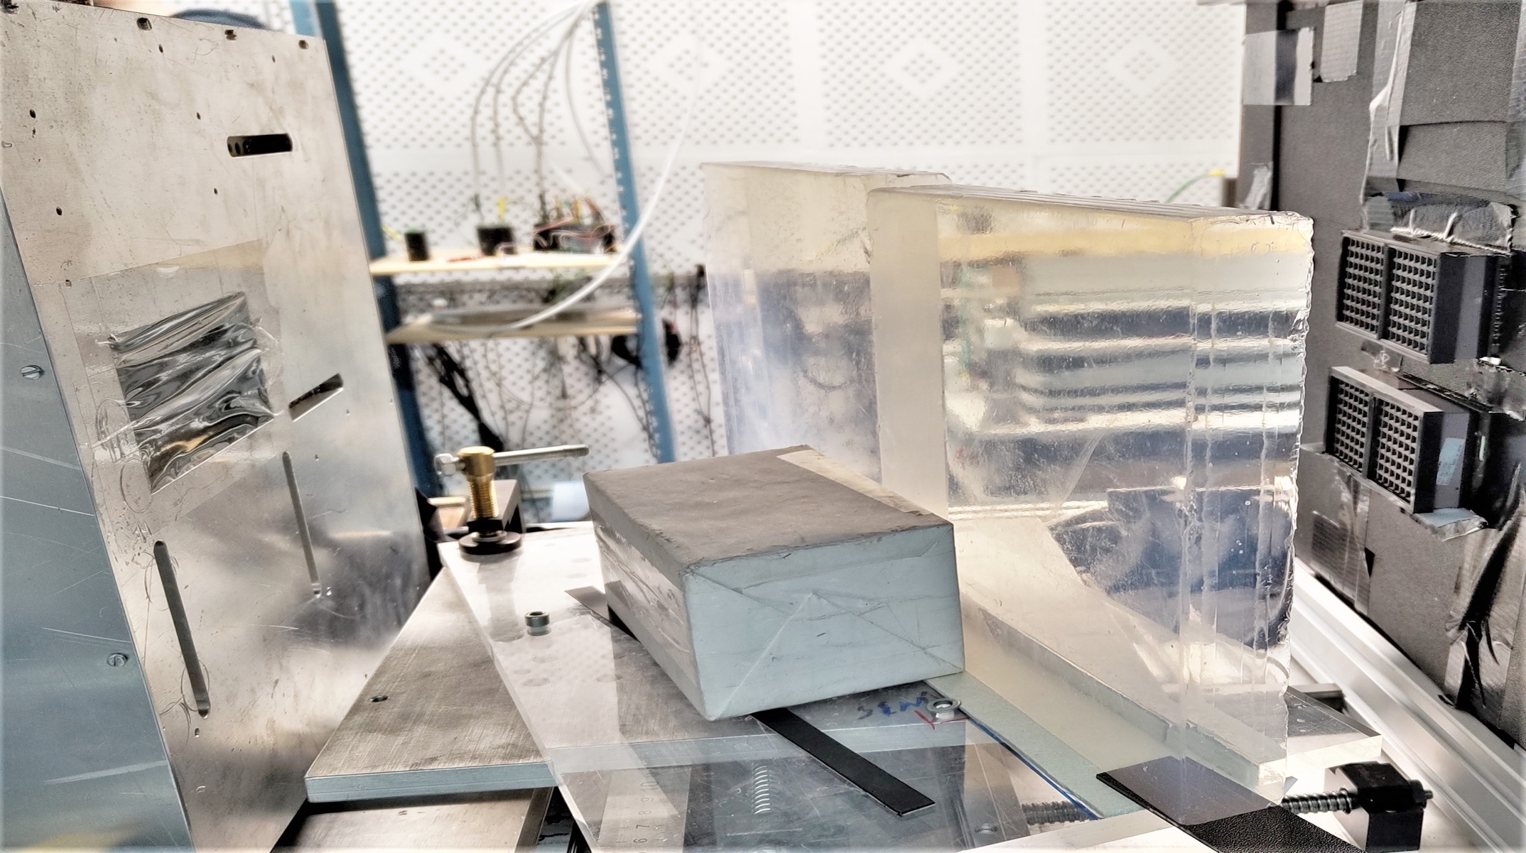
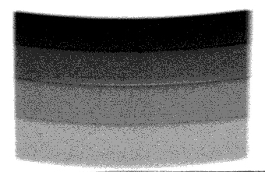
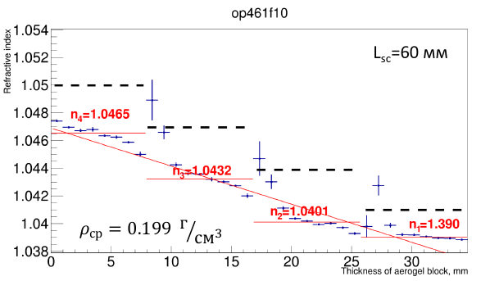

The largest 4-layer focusing aerogel samples were produced in Novosibirsk and tested at BINP in 2022-2023
MaPMT H12700 (Hamamatsu)
with mask 3х3 mm²
2 aerogel pcs
230x230x35 mm
GEM
$$e^{−}$$
Refractive index profile is measured with help of digital X-ray setup at the BINP.
Single photon Cherenkov angle resolution is investigated with relativistic electrons at BINP beam test facilities
”Extracted beams of VEPP-4M complex”.

Slide 8
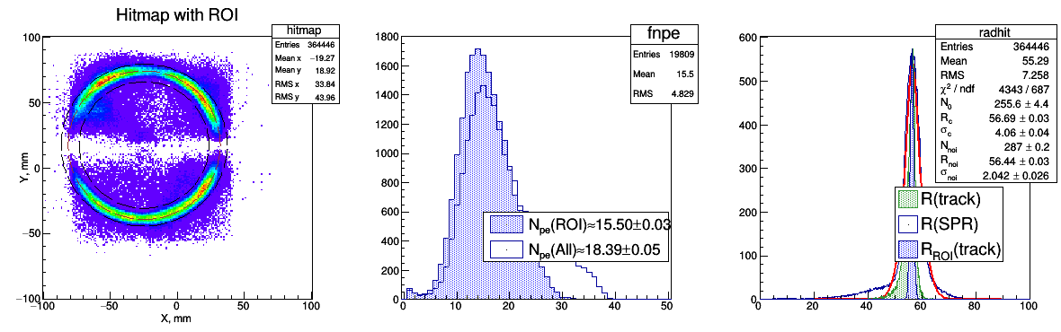
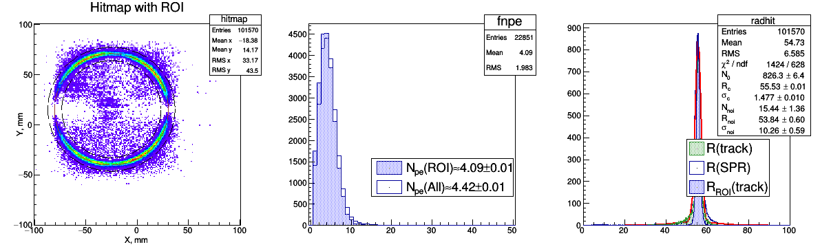
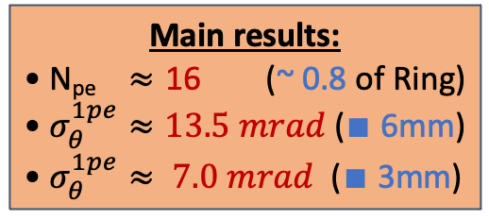
Recent beam test results
Pixel 6x6 mm
Geom.Eff. ~ 80%
Pixel 3x3 mm
Geom.Eff. ~ 20%
Main results:
• N_{pe} $≈$ 16 (~ 0.8 of Ring)
• $σ_{θ}^{1pe}≈13.5 mrad$($∎$ 6mm)
• $σ_{θ}^{1pe}≈ 7.0 mrad$ ($∎$ 3mm)

Slide 9
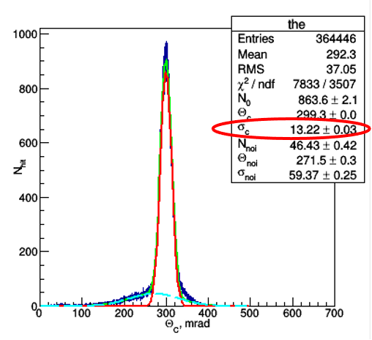
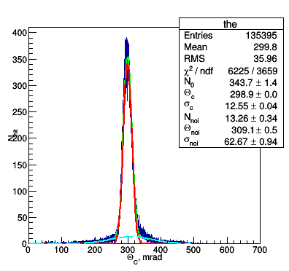
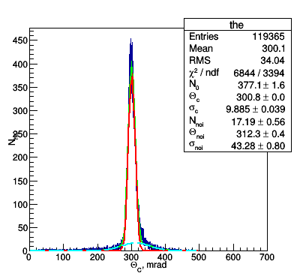
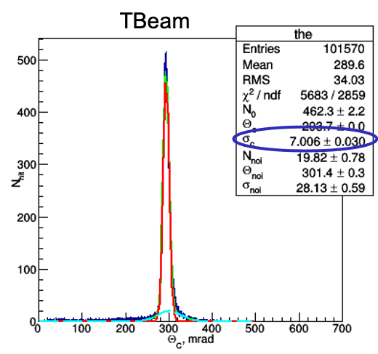
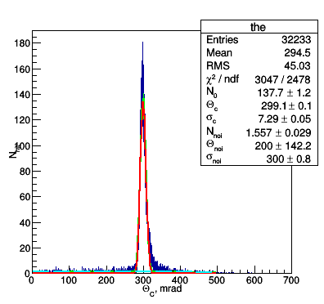
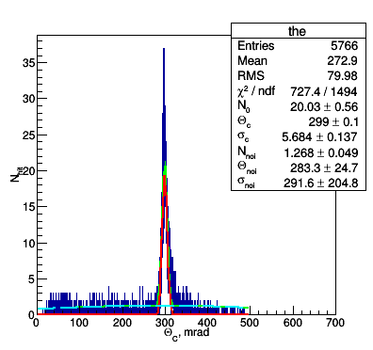
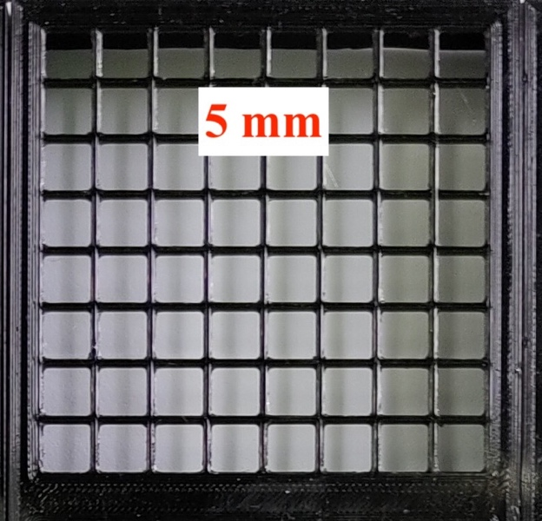
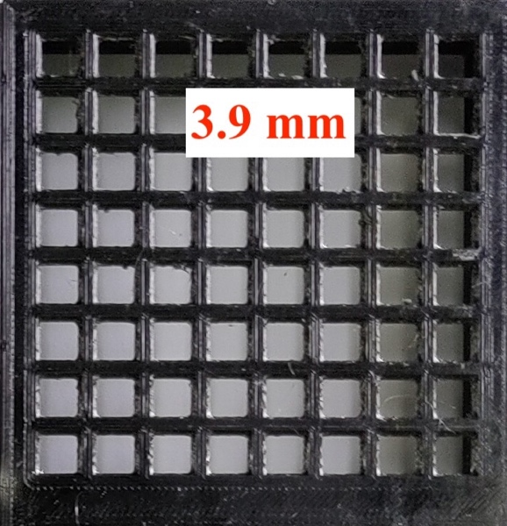
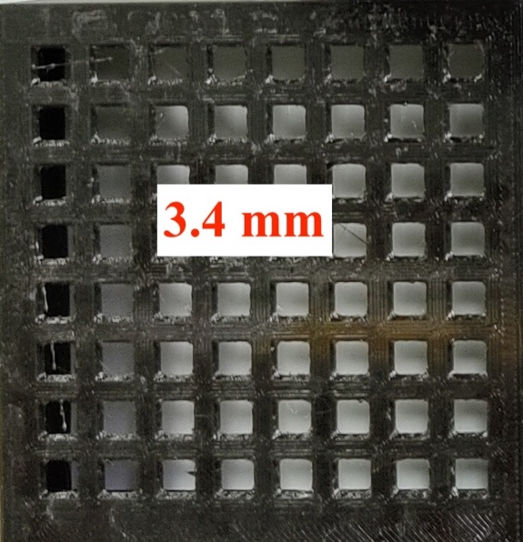
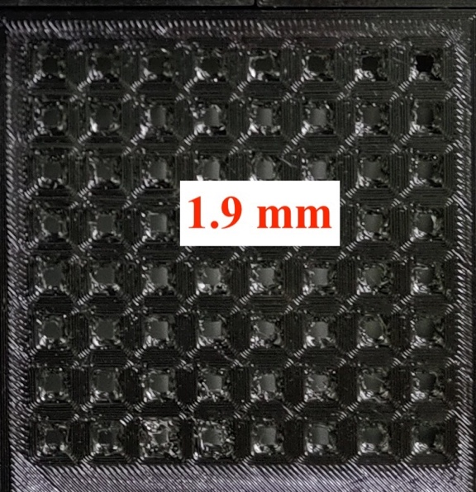
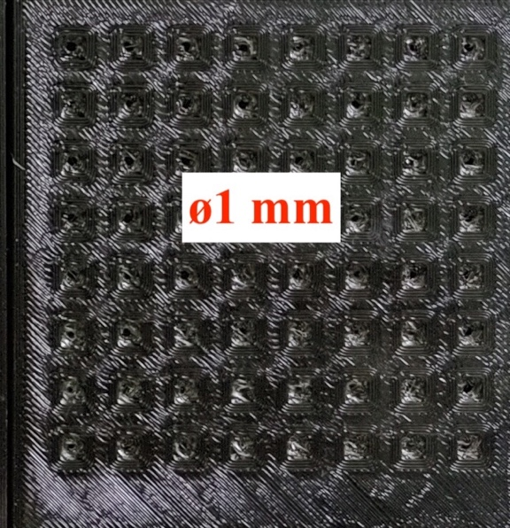
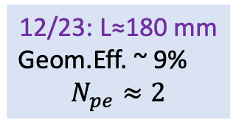
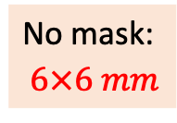
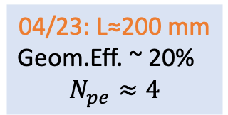
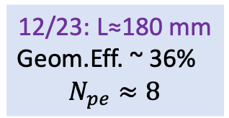

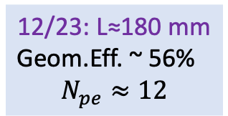
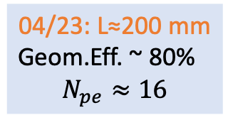
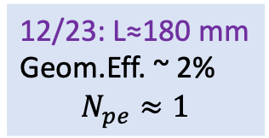

TBeam 2023 res.: $σ_{θ_{C}}^{1pe}=\sqrt{\frac{∆_{pix}^{2}}{{\left(\sqrt{12}∙L∙n\right)}^{2}}+σ_{aer}^{2}+σ_{trk}^{2}}$
$σ_{aer}≈5.6$ mrad
No mask:
$6×6 mm$
3 mm
04/23: L≈200 mm
Geom.Eff. ~ 80%
$$N_{pe}≈16$$
12/23: L≈180 mm
Geom.Eff. ~ 56%
$$N_{pe}≈12$$
12/23: L≈180 mm
Geom.Eff. ~ 36%
$$N_{pe}≈8$$
04/23: L≈200 mm
Geom.Eff. ~ 20%
$$N_{pe}≈4$$
12/23: L≈180 mm
Geom.Eff. ~ 9%
$$N_{pe}≈2$$
12/23: L≈180 mm
Geom.Eff. ~ 2%
$$N_{pe}≈1$$
$π/K$: – 5.5 GeV/c 6 GeV/c 6.5 GeV/c 8.0 GeV/c 8.5 GeV/c
µ$/π$: – 1.2 GeV/c 1.4 GeV/c 1.5 GeV/c 1.6 GeV/c 1.7 GeV/c

Slide 10
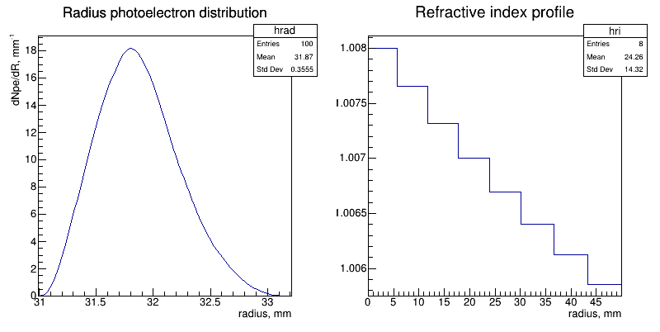
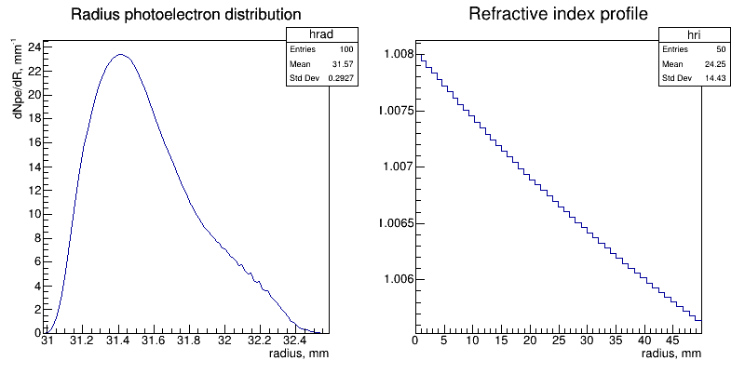
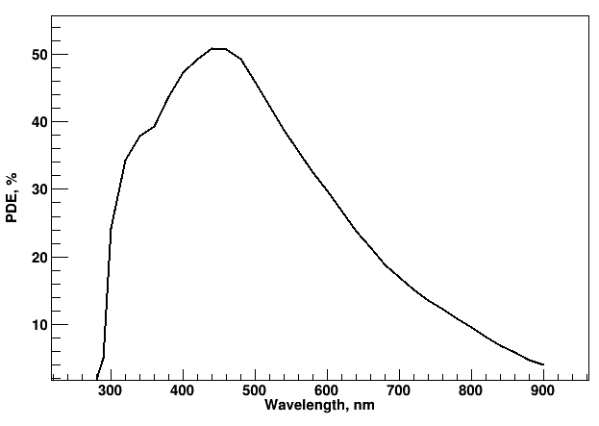
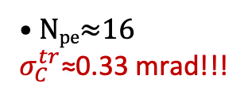
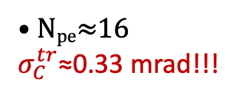
FARICH option for π/K–separation at 30 GeV/c
8-layer aerogel n_{max}=1.008; pixel≈0.2mm
Gradient aerogel n_{max}=1.008; pixel≈0.7mm
Focal distance is 300 mm
The possibility to produce of gradient aerogel was demonstrated in
NIM A766 (2014) 88-91 and NIM A766 (2014) 235-236
PDE for MPPC-S14160 (Hamamatsu)
• N_{pe}≈16
$σ_{C}^{tr}$≈0.33 mrad!!!
• N_{pe}≈16
$σ_{C}^{tr}$≈0.33 mrad!!!
It looks good enough for reliable π/K–separation @ 30 GeV/c

Slide 11
Aerogel with n=1.008 (Novosibirsk)

Slide 12
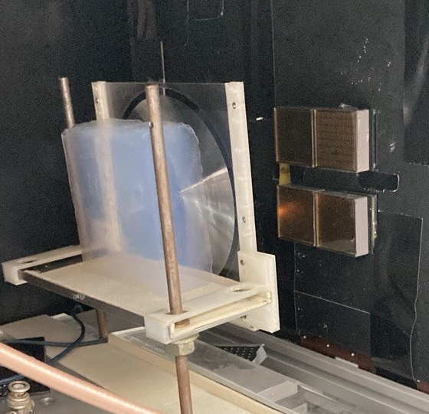
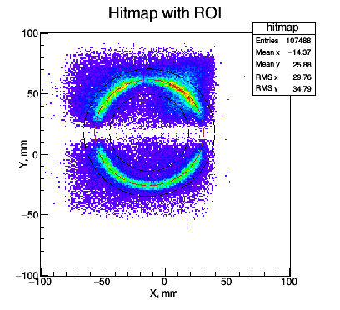
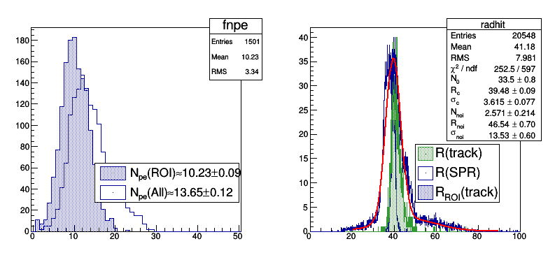
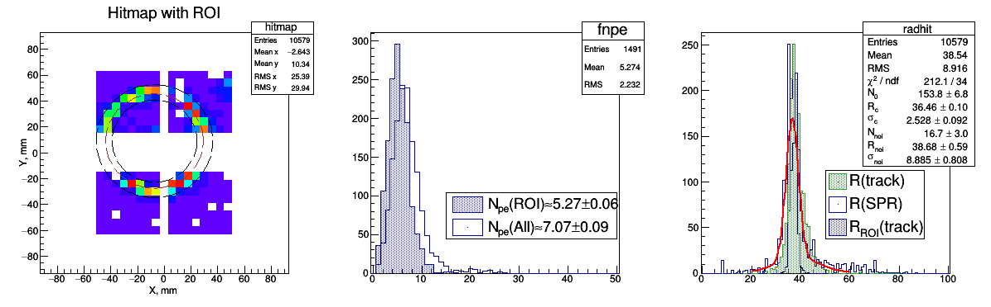
Some results of beam tests at the BINP with mRICH design
Without lens
With Fresnel lens
Aerogel:
• n=1.028
• L_{sc}(400nm)=48.2±0.7 mm
• Thickness=40mm
Fresnel lens:
• Acrilic (PMMA)
• L_{f}=6’’
• Manufacturer: Edmund
PMT:
• 4 Hamamatsu H12700
• pixel 6x6 mm

Slide 13
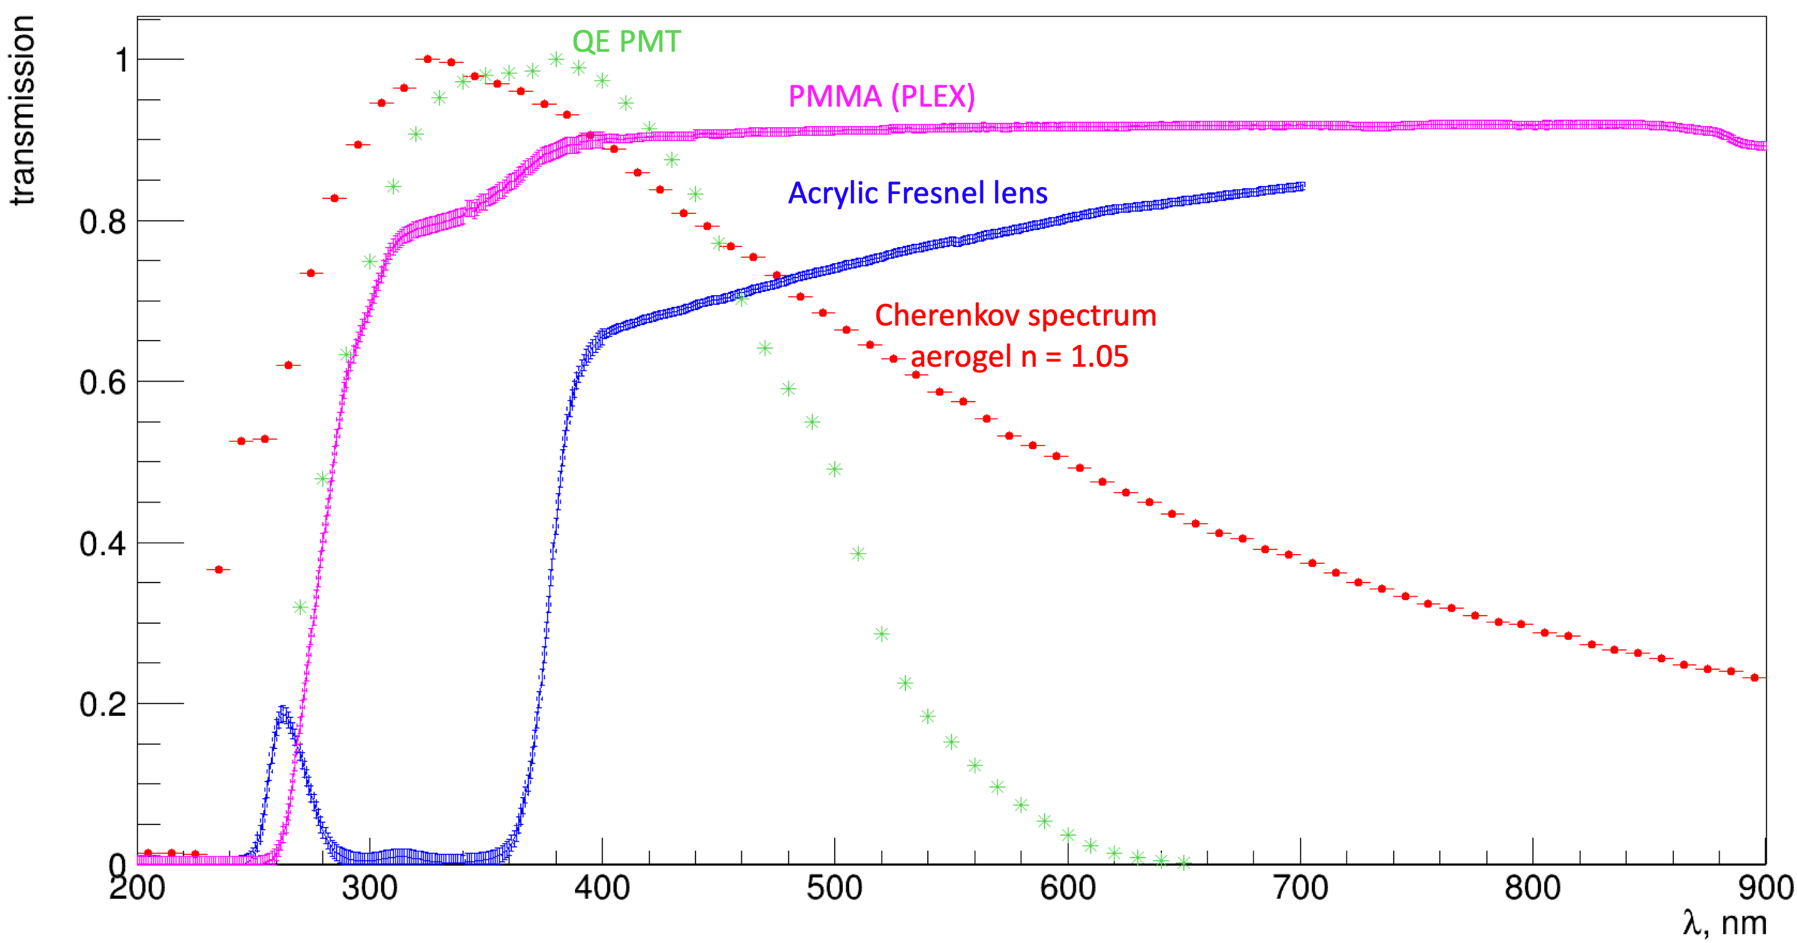
Fresnel lens transparency
• About half of Cherenkov photons from aerogel is absorbed by lens material
• It is necessary to check possiblity to produce Fresnel lenses based on PMMA without UV absorbers and so on.

Slide 14
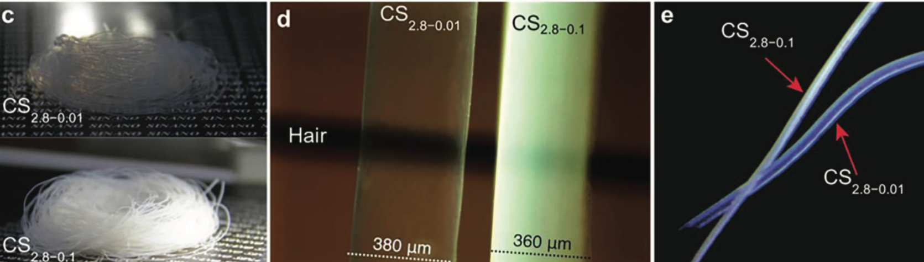



Fiber Aerogel RICH: idea & motivation
For π/K-separation above 10 GeV/c we need decrease n and N_{pe} decreases too.
We consider approach how to compensate number of Cherenkov photons with help of aerogel fibers without segnificant angle resolution degradation.
• It was inspired by discussion at SINANO (Sughou) with prof. Xeutong Zhang and Co. in August 2023.
• The possibility of aerogel fiber production is decribed in article:
Adv. Sci. 2023, 10, 2205762
Single fiber params:
• n=1.03÷1.008
• Length = 35÷60 mm
• ø 0.4÷2 mm

Slide 15



Particle separation power evaluated in GEANT-4
Aerogel fiber (n=1.05, L=35 mm,
L_{sc}(400nm)=43
Phton Detector $σ_{x}≈$200µm; PDE(400nm)≈45% (Hamamtsu S14160)

Slide 16










Several PMTs with submillimeter position sensetivity
MCP PMT
PSS-SiPM or LG-SiPM
Digital PC
Planacone XP8122
32x32 pixels with 1mm size and pithch ~2mm
To decreas readout electronics channels it is possible to develop ‘spread delay lines’ or ‘chrge sharing’ approaches
Expected spatial resolution as small as
$$σ_{x}≈\frac{1}{\sqrt{12}}≈0.3µm$$
XP8122
Planacon
59 mm
53 mm
DPC3200-22-44 – 3200 cells/pixel (from Philips)
Each microcell is connected through controled lattch and could be switched On or Off for readout
Output data are ‘timestamp‘ of the first fired microcells and total ‘number‘ of fired microcells
Output data could be changed to ‘timestamp‘ and ‘serial number‘ of fired microcell and then spatial resolution will be determined microcell sizes:
$$σ_{x}≤50,25,12µm$$
PSS 11-3030-S (from NDL, China)
3x3 or 6x6mm SiPM is read out by 4 digitizers
Position is reconstructed by charge sharing among 4 pads connected to resistive plane of the SiPM
Declared resolution for single photon hit is about
$$σ_{x}≈200µm$$

Slide 17




Photon detector option for Fibra RICH
Position Sensetive SiPM or PSS 11-3030-S (from NDL, China) or LG-SiPM (from FBK, Italy) are able to provide spatial resolution $σ_{x}≈$200µm per single photon detected.

Slide 18


DPC: Front-end Digitization by Integration of SPAD & CMOS Electronics
Digital Photon Counter (DPC)
T. Frach, G. Prescher, C. Degenhardt, B. Zwaans, IEEE NSS/MIC (2010) pp.1722-1727
C. Degenhardt, T. Frach, B. Zwaans, R. de Gruyter, IEEE NSS/MIC (2010) pp.1954-1956

Slide 19


DPC is an Integrated “Intelligent” Sensor by Philips Digital Photon Counting
DPC3200-22-44 – 3200 cells/pixel
DPC6400-22-44 – 6396 cells/pixel
FPGA
Clock distribution
Data collection/concentration
TDC linearization
Saturation correction
Skew correction
Flash
FPGA firmware
Configuration
Inhibit memory maps
32.6 mm

Slide 20
Summary
Now it is not clear ‘How to do’ RICH detector for π/K–separation at 30 GeV/c in colliding beam experiments, but it seems this issue could be solved soon!!!
  There are three approaches with aerogel radiator:
    FARICH approach: 4-layer focusing aerogel with n_{max}=1.008
    mRICH approach: thick (about 6cm) aerogel radiator with n=1.008 and Fresnel Lens
    fibre RICH: aerogel fibres with n=1.008, length 6÷8 cm and ø200÷400µm (Crazy option!!!)
  There are several approaches how to do photon detectors with postion sensitivity better about several hundreds microns:
    MCP PMTs which could be readout with help of delay lines or charge distribution lines
    Position Sensitive SiPMs, where hit positions are reconstructed by calculation of charge shared among 4 readout pads
    Digital Photon Counters (like Philips Digital SiPMs), where it is possible to readout time and serial number of fired microcell
The most expensive task is R&D of photon sensors and compatible R/O electronics. Any commercial investments as well as government supports here would be very useful!!!

Slide 21

On possibility threshold Cherenkov counters provide π/K–separation at 30 GeV/c
The relation of refractive index and threshold momentum for kaons:
$${\left(\frac{m_{K}}{P_{thr}}\right)}^{2}=\left(n^{2}−1\right)∝ N_{Ch.}^{ph.} if n\sim 1.$$
  If $n=1.05 →{ P}_{thr}^{K}=1.5 GeV/c$ and $N_{Ch.}^{ph.}≈3ph.e/cm$ (ASHIPH with SiPM)
  If $n=1.03 → P_{thr}^{K}=2.0 GeV/c$ and $N_{Ch.}^{ph.}≈2ph.e/cm$
  If $n=1.008 → { P}_{thr}^{K}=3.9 GeV/c$ and $N_{Ch.}^{ph.}≈0.5ph.e/cm$ (aerogel for DiRAC)
  If $n=1.002 → P_{thr}^{K}=7.8 GeV/c$ and $N_{Ch.}^{ph.}≈0.1ph.e/cm$ (gas C₅F₁₂)
  If $n=1.00014→ P_{thr}^{K}=30 GeV/c$ and $N_{Ch.}^{ph.}≈0.008ph.e/cm$ ${(P}_{thr}^{π}=9 GeV/c)$
Threshold Cherenkov counters for π/K–separation at 30 GeV/c with 8÷10pe from relativistic particle has to be $\sim 10m$ thick!!!
It is not a deal for colliding beam experiments!!!

