Slide 1
CEPC vertex detector towards TDR
Zhijun Liang,
On behalf of CEPC vertex working group

Slide 2
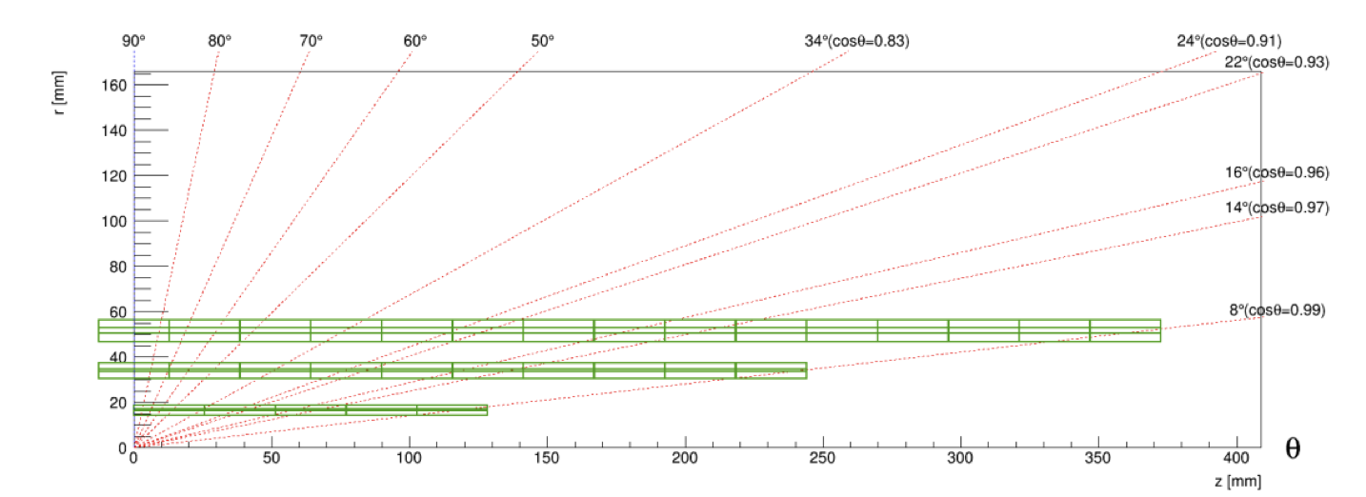
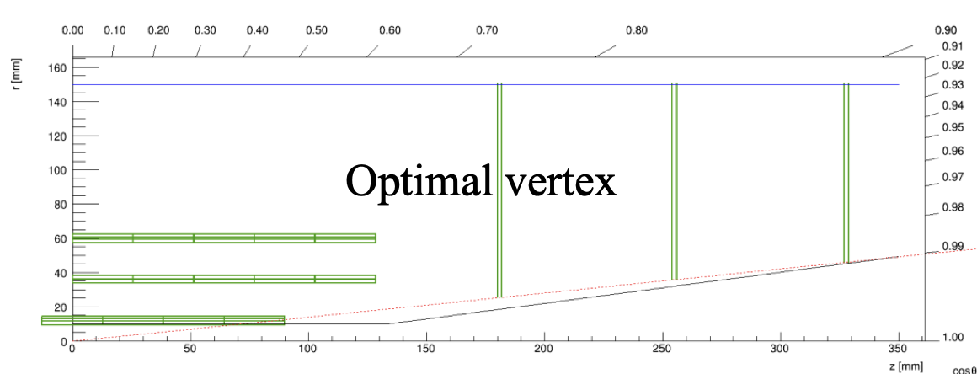
Vertex detector design status
Reminder of last CEPC day
  Show the design “long barrel” vertex and support structure
  Evaluate the Material budget
Update today
  Focus on Air cooling and power consumption of “long barrel” vertex detector
  “Short barrel + endcap” layout will come later
Example of Long barrel layout
Short barrel + endcap

Slide 3
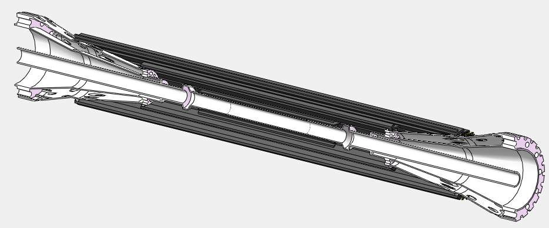
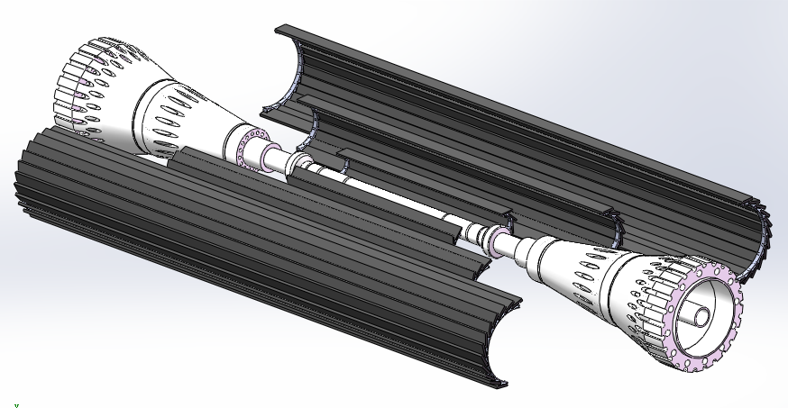
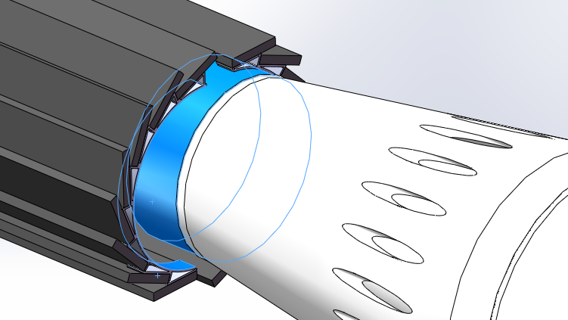
Reminder of long barrel design
The support ring can be either glued/bolted to or pre machined on the beam pipe related parts. (for the inner most layer bolting and machining are too difficult)
The VTX on the tentatively modified beam pipe components
The drawings show the option that pre-assembled halves barrels mounted onto the beam pipe(dedicated tooling required)
From Jinyu Fu
More consideration - different constraint on two ends?

Slide 4
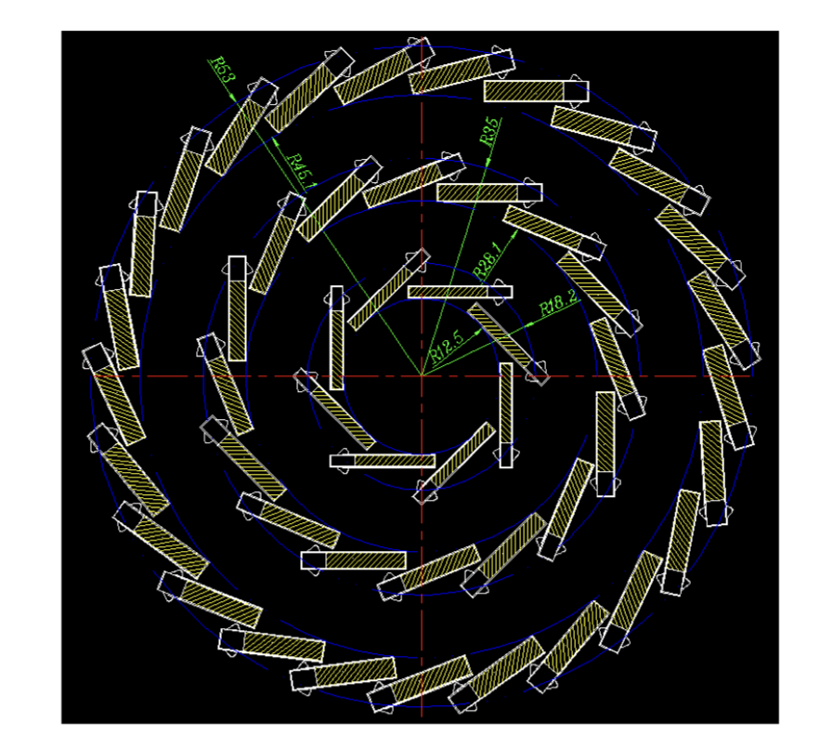
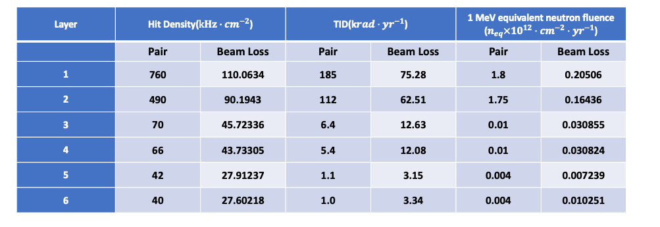
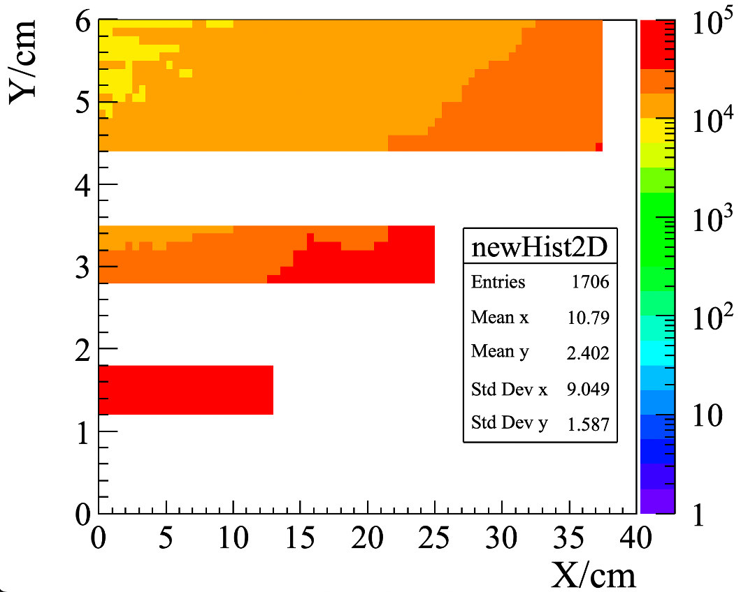
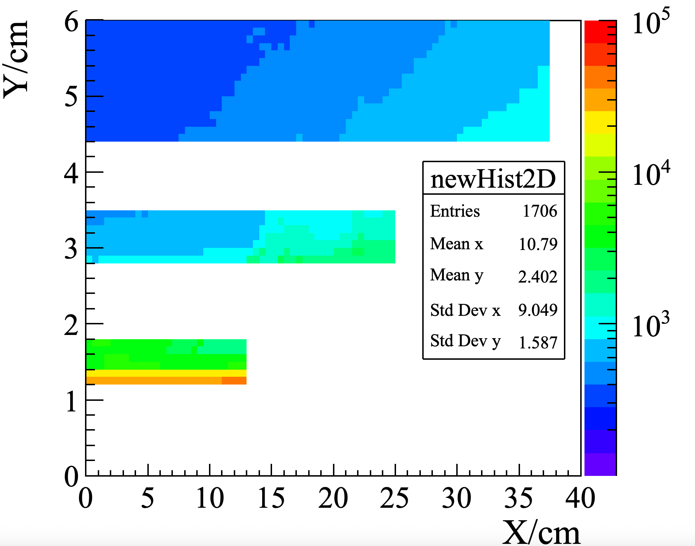
Beam background estimation for long barrel
Can use 2D background hits information for ”long barrel” layout from old software
But can not do that “short barrel+ endcap” layout
Need to move to new software CEPCSW
From Haoyu and Weiyi
Background hit rate @ ZH
Background hit rate @ high lumi Z
Higgs
Z

Slide 5
Air Cooling of vertex detector
Beam pipe temperature is very important for vertex inner layer cooling
  With thermal conduct from beam pipe, it brings down temperature
  We now assume 26 Celsius as beam pipe temperature
  if we can bring beam pipe down to 10-15 Celsius would be helpful
Final goal: ~20°C, 温度梯度10-20 °C, 震动 1微米
  Middle and outer layer are likely to reach the goal by further optimization
  Inner layer still need significant improvement
From Jinyu Fu
Barrel layer | # of ladder | Max temperature (Celsius)
 |  | 50 mW /cm2 | 40mW/cm2 | 30mW/cm2
Inner layer w/wo beam pipe Temperature | 8 | 82°C (wo) / 61°C (w) | 67°C(wo beam pipe) / 49 (w beam pipe) | 51°C (wo) / 42°C (w)
Middle | 16 | 35°C | 28°C | 22°C
Outer | 25 | 37°C | 30°C | 24°C
Total heat generation of the VTX is 337W, assuming 40mW/cm²

Slide 6
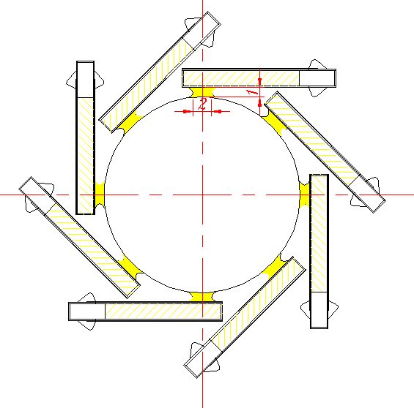
Plan to improve cooling
The thermal conduct to beam pipe is important
To bring down temperature, a potential solution to add thermal conductive glue
  Thermal glue to Increase thermal conductivity to beam pipe
  Beam pipe has active cooling
  Need to evaluate the material effect and re-do thermal simulation
Other options :
  Reduce temperature of beam pipe
  Increase the distance of first layer to beam pipe
  Higher air flow
  low material Active cooling

Slide 7
VTX像素芯片功耗分布估算
(from Weiwi,Ying)
估算说明：
太初3芯片：180 nm工艺，电源1.8 V;
65 nm芯片：电源1.2 V;
Data rate@Triggless-CDR: 4.48 Gbps /chip
bunch spacing (min.): 25 ns需要快前沿前端
Data rate@Triggless-TDR (Low Lumi):
1 Gbps/chip
Low Lumi@TDR: bunch spacing ~几百ns，像素前端不需要快前沿，Matrix功耗可降低到60 mW
 | Matrix | Periphery | DataTrans. | DACs | Total Power
太初3芯片 @ triggerless (CDR) | 304 mW | 135 mW | 206 mW | 10 mW | 655 mW
65nm 芯片 @ 1 Gbps/chip (TDR LowLumi) | 60 mW | 80 mW | 36 mW | 10 mW | 186 mW

Slide 8
Electronics
0.75W
0.193W
0.15W
1.2W
1.2W
DCDC:
50mmX20mm
lpGBT :
9mmX9mm
VTRX+:
10mmX20mm
DCDC:
50mmX20mm
DCDC：电源管理芯片
  TAICHU功耗0.8W（1.8V*0.42A）
  单个DCDC最多为10个TAICHU提供电源，效率按85%计算
  DCDC功耗为0.8*10*15% = 1.2W
  如果最外层需要20个芯片则需要2个DCDC
  lpGBT和VTRX+需要其他种类电源（1.2V，2.5V），总体功耗不高，~1W，则DCDC功耗为0.15W
lpGBT：数据汇总芯片
  0.75W@10.24Gb/s
VTRX+：光电转化芯片
  1发1收：0.193W（RX：2.5V*0.05A，TX：2.5V*0.02A，core：1.2V*0.015A）
说明：1：图中仅展示ladder一端一面，底面及ladder另一端有同样的配置
2：lpGBT及VTRX+的参数为CERN对应芯片手册得到，CEPC最终参数可能有所不同。

Slide 9
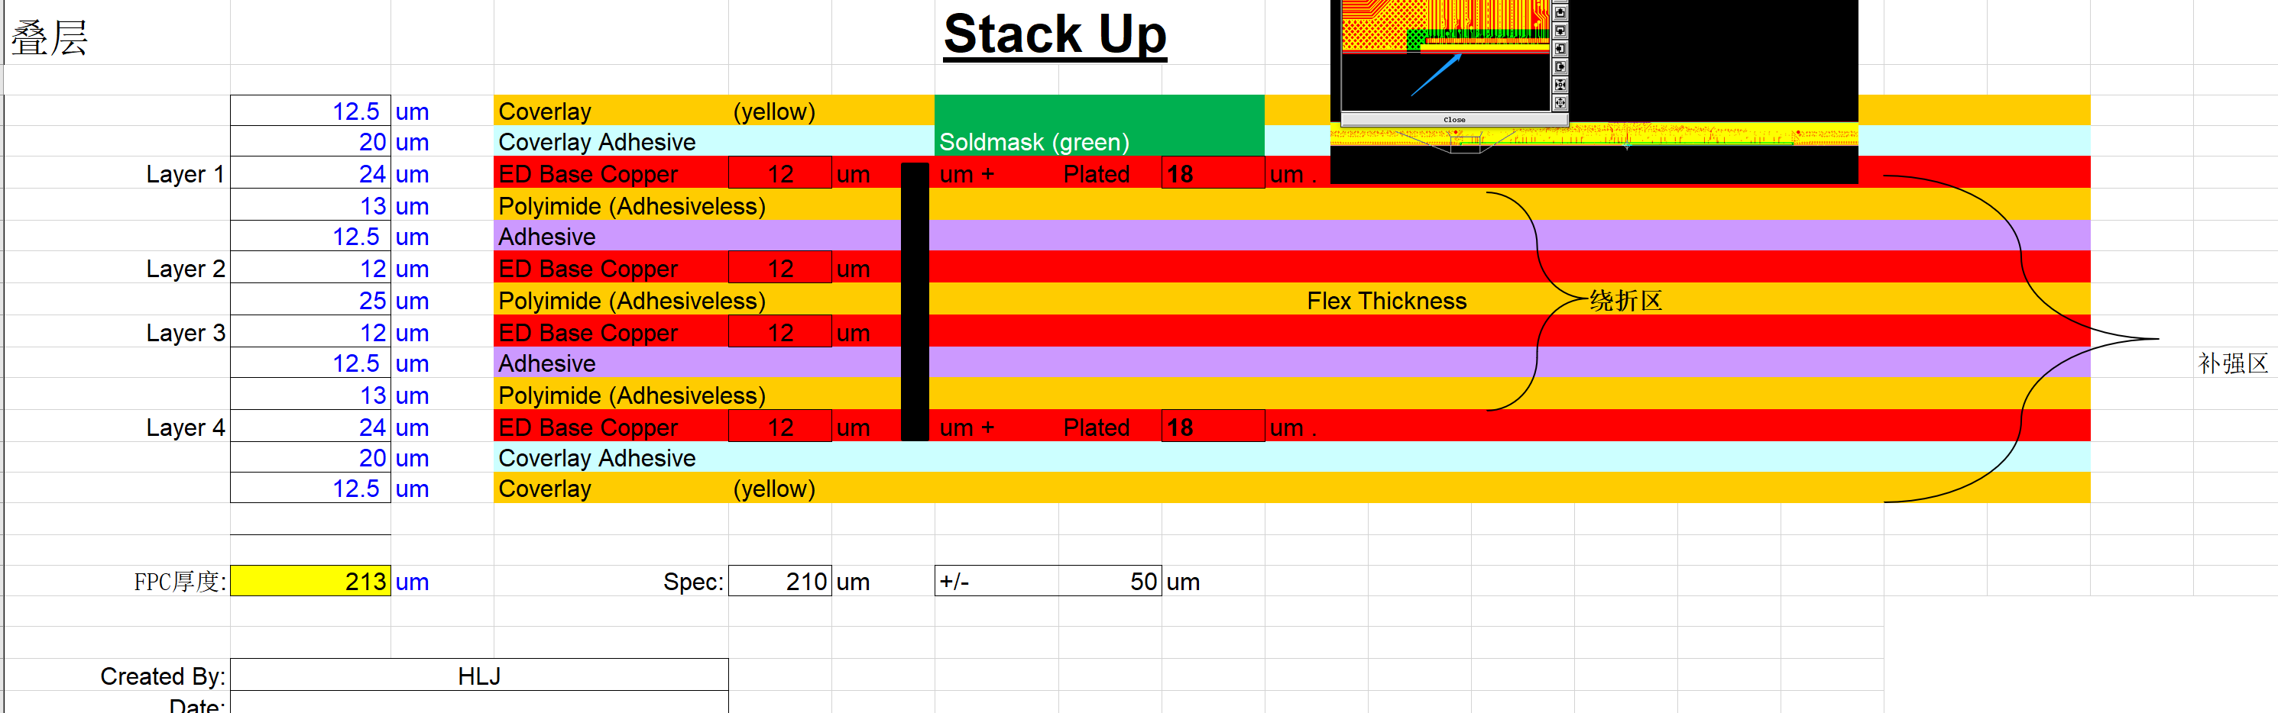
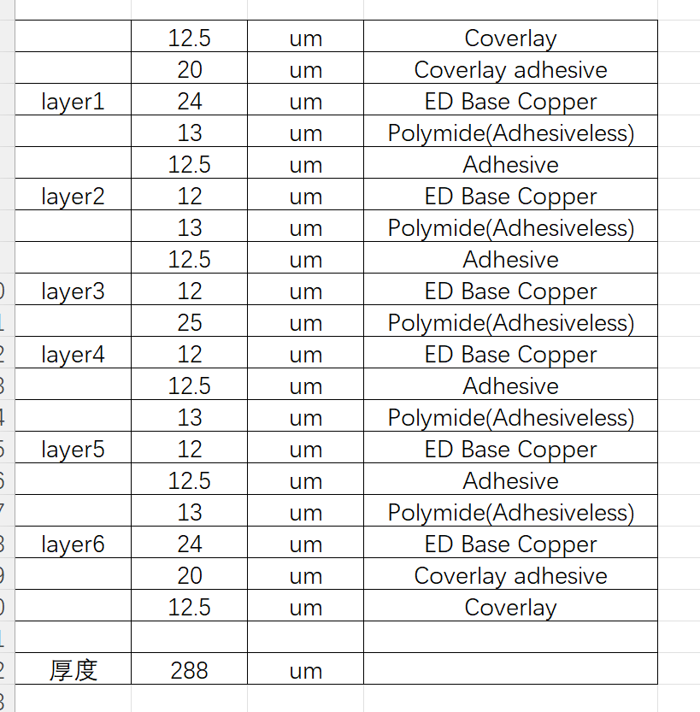
Flex厚度和物质分布
(from Weiwi,Ying)
4层柔性板基于国内Cu工艺（当前阶段）
国内工艺当前只能实现基于铜的PCB，如需采用铝材料，需要委托CERN进行加工（accessibility？）
6层柔性板基于国内Cu工艺（当前阶段）

Slide 10
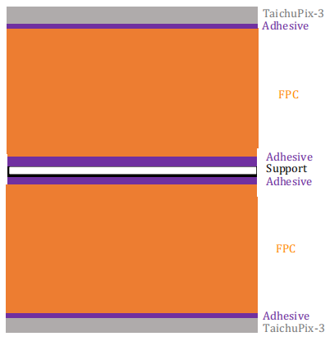
backup: CEPCSW full simulation
50um Si
12.5um Acrylicglue
12.5um Kapton
12.5um Acrylicglue
8um G4_Al
13um Kapton
12.5um Acrylicglue
8um G4_Al
13um Kapton
12.5um Acrylicglue
12um G4_Al
25um Kapton
12um G4_Al
12.5um Acrylicglue
13um Kapton
8um G4_Al
12.5um Acrylicglue
13um Kapton
8um G4_Al
12.5um Acrylicglue
12.5um Kapton
12.5um Acrylicglue
250um CFPR
12.5um Acrylicglue
12.5um Kapton
12.5um Acrylicglue
8um G4_Al
13um Kapton
12.5um Acrylicglue
8um G4_Al
13um Kapton
12.5um Acrylicglue
12um G4_Al
25um Kapton
12um G4_Al
12.5um Acrylicglue
13um Kapton
8um G4_Al
12.5um Acrylicglue
13um Kapton
8um G4_Al
12.5um Acrylicglue
12.5um Kapton
12.5um Acrylicglue
50um Si
50um Si
12.5um Acrylicglue
12.5um Kapton
12.5um Acrylicglue
8um G4_Al
13um Kapton
12.5um Acrylicglue
12um G4_Al
25um Kapton
12um G4_Al
12.5um Acrylicglue
13um Kapton
8um G4_Al
12.5um Acrylicglue
12.5um Kapton
12.5um Acrylicglue
250um CFPR
12.5um Acrylicglue
12.5um Kapton
12.5um Acrylicglue
8um G4_Al
13um Kapton
12.5um Acrylicglue
12um G4_Al
25um Kapton
12um G4_Al
12.5um Acrylicglue
13um Kapton
8um G4_Al
12.5um Acrylicglue
12.5um Kapton
12.5um Acrylicglue
50um Si
layer1
layer2、3 (for each ladder with more than 10 sensors)

Slide 11
Summary
long barrel layout Mechanics design is in progress
“Short barrel + endcap” layout will come later
Next step is improving cooling simulation,
Look into material effect and its physics performance

Slide 12
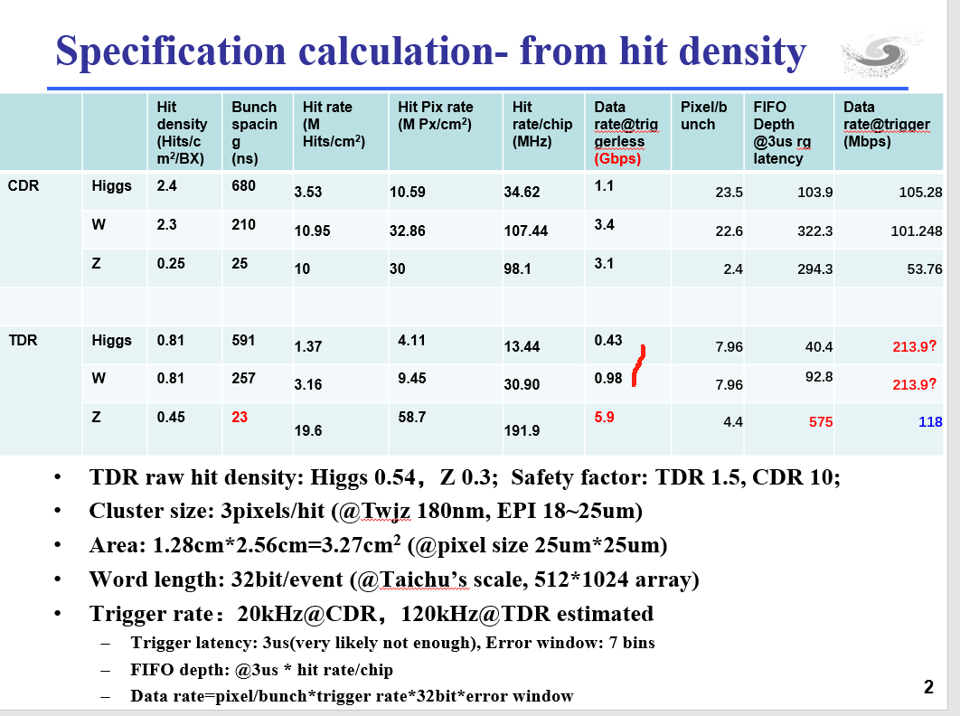
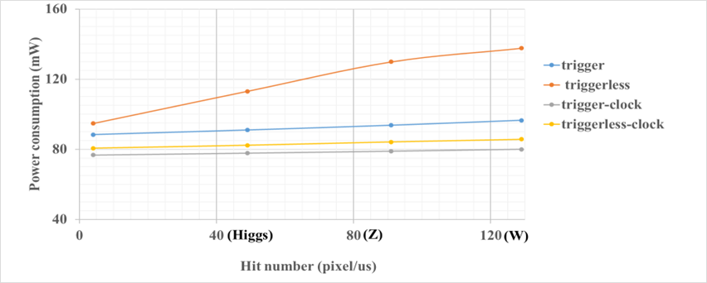
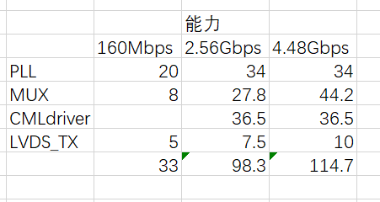
Backup

Slide 13
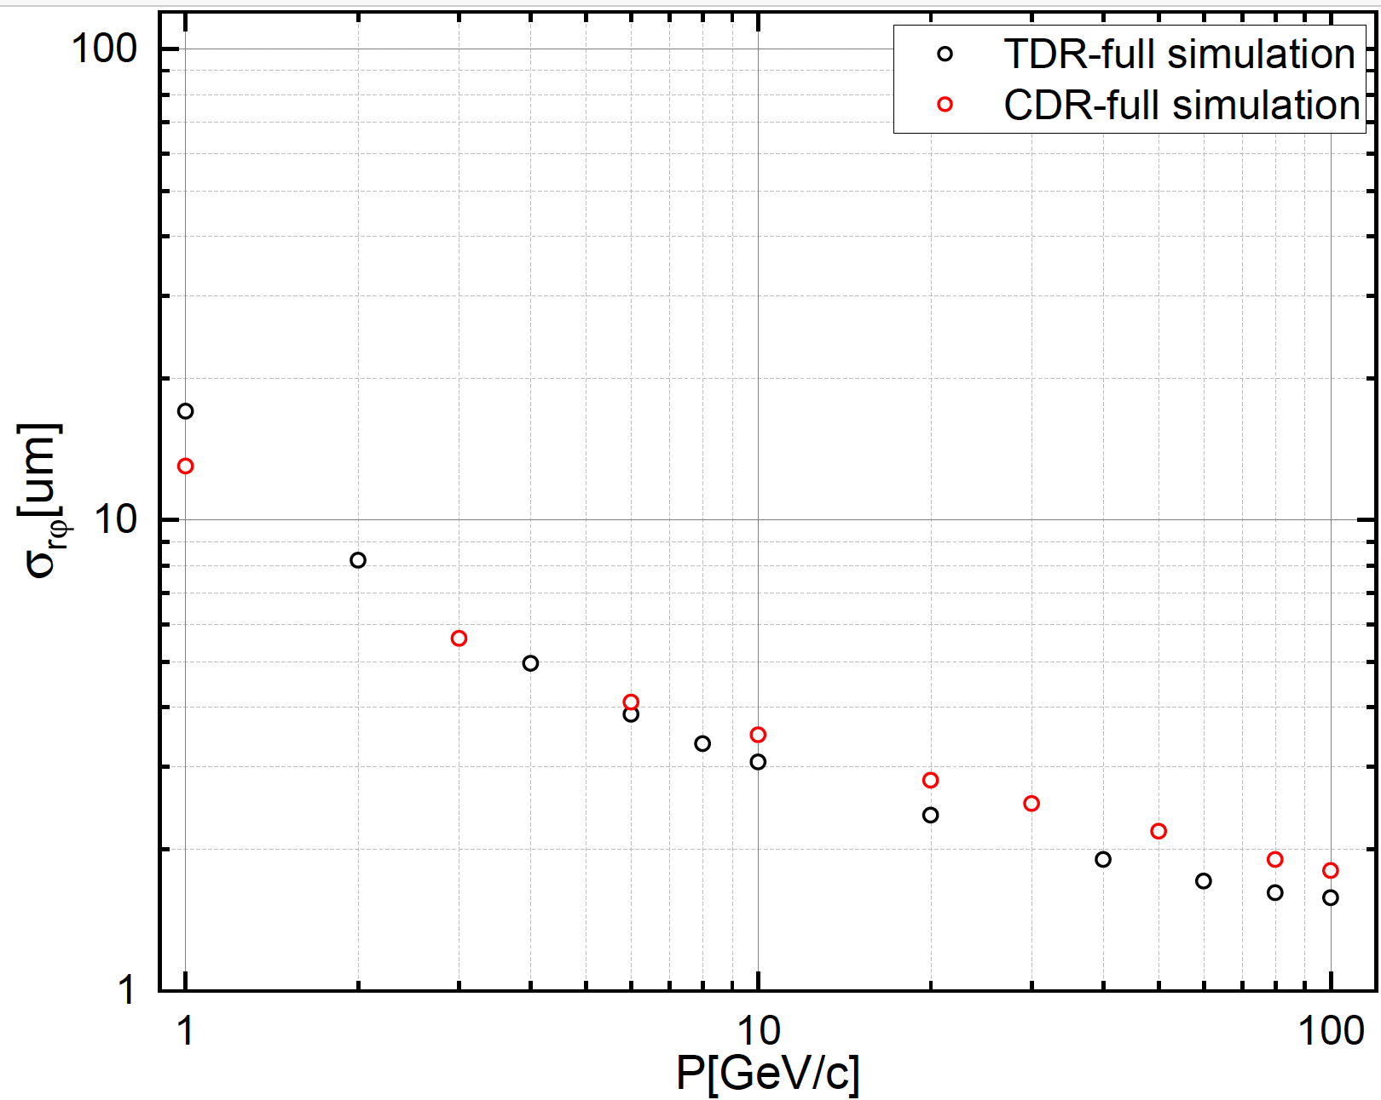
Backup: first look into performance in long barrel layout
Long barrel layout has similar performance as CDR results
  Theta ~85 degree

Slide 14
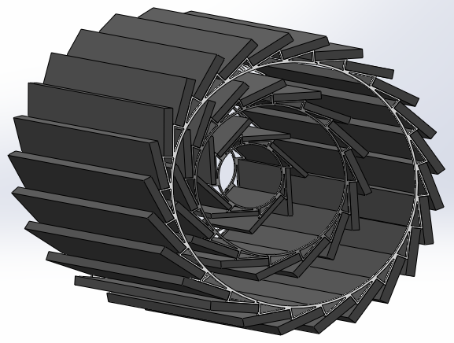
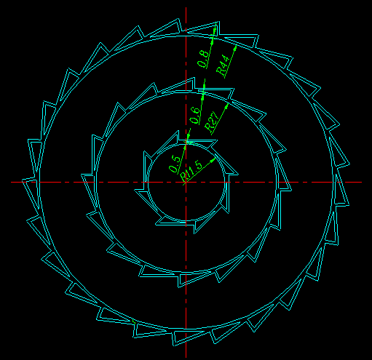
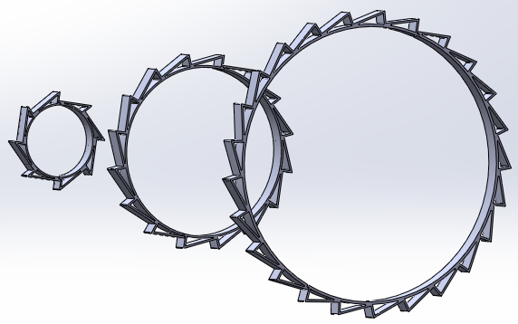
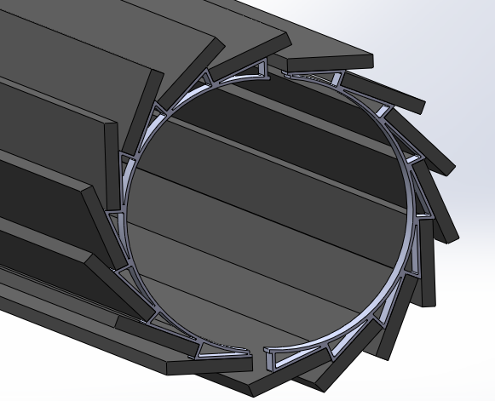
VTX assembly
Support rings / Al alloy
Ladder can be glued / bolted to the support ring. Gluing will save space to make the ratchet teeth hollow, which helps ventilation, currently we prefer this method.
Two methods to assemble the VTX:
Assemble the barrel in advance (consisting of two halves), and then install the barrel on the beam tube.
Install (or machined) the support rings on beam pipe in advance, then directly install the ladders (preferred).
Notes:
Ratchet shaped support ring The ratchet teeth is hollow, this is not only for reducing the materials due to the support ring is outside the acceptance. It is mainly used for air ventilation, the end of ladder is kind of blocked .

Slide 15
VTX installation on the beam pipe
The support ring can be either glued/bolted to or pre machined on the beam pipe related parts. (for the inner most layer bolting and machining are too difficult)
The VTX on the tentatively modified beam pipe components
The drawings show the option that pre-assembled halves barrels mounted onto the beam pipe(dedicated tooling required)
More consideration - different constraint on two ends?

Slide 16
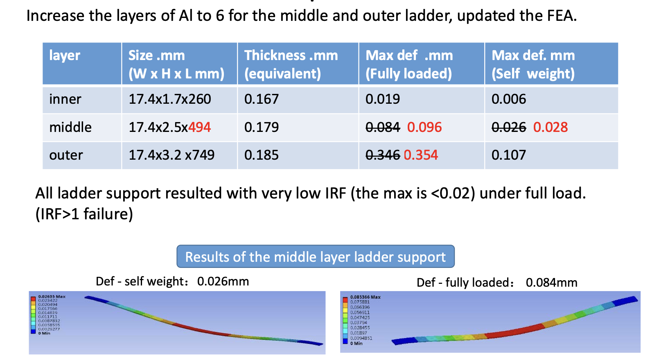
Update on mechanics

Slide 17
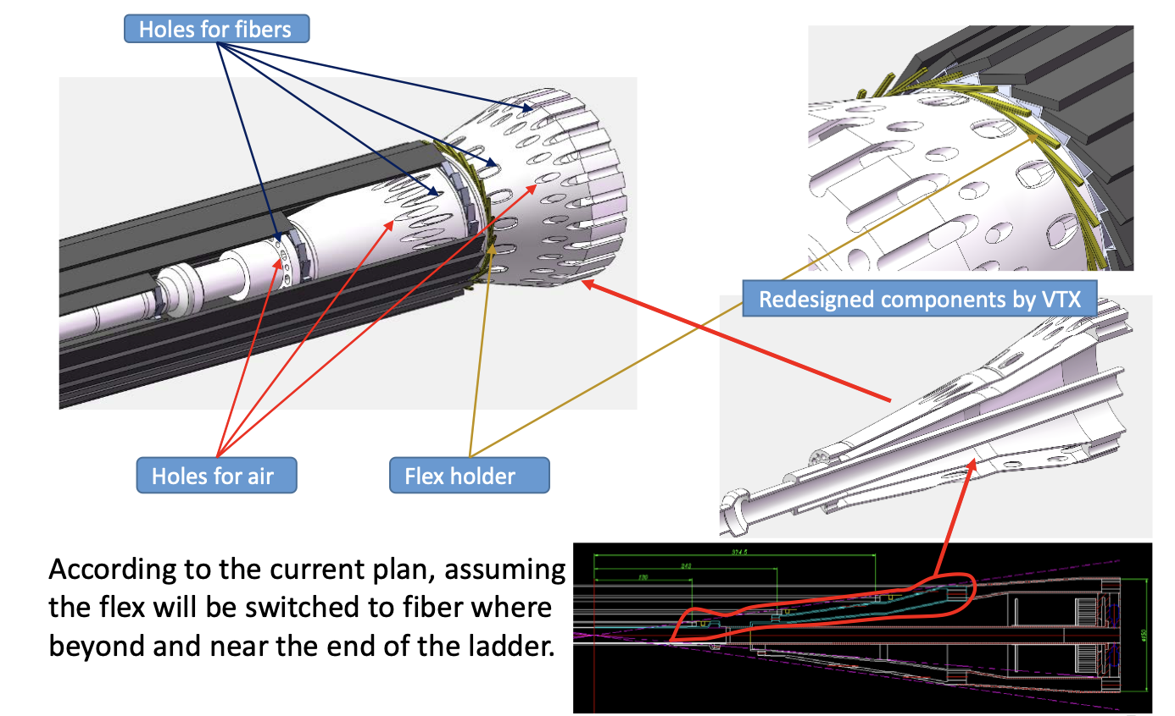
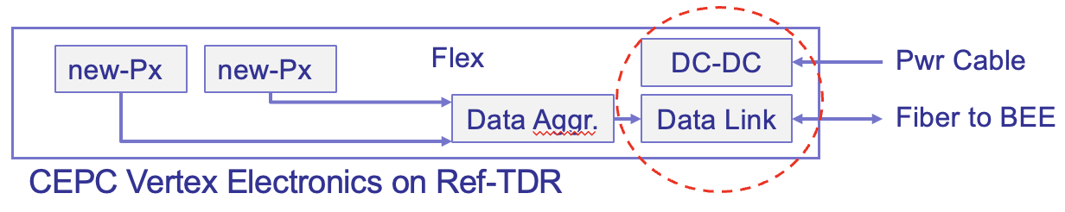
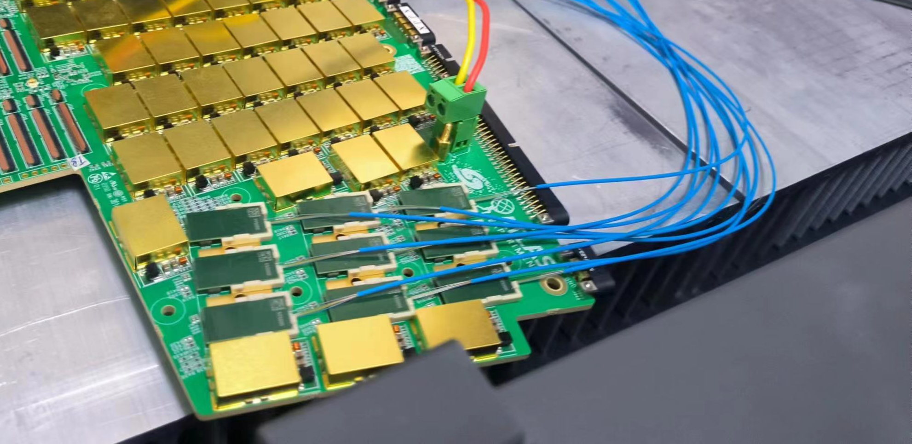
Cable and service
Optical fiber connector can not go through holes for fibers
Plan to re-do fibers connector after routing the cables

Slide 18
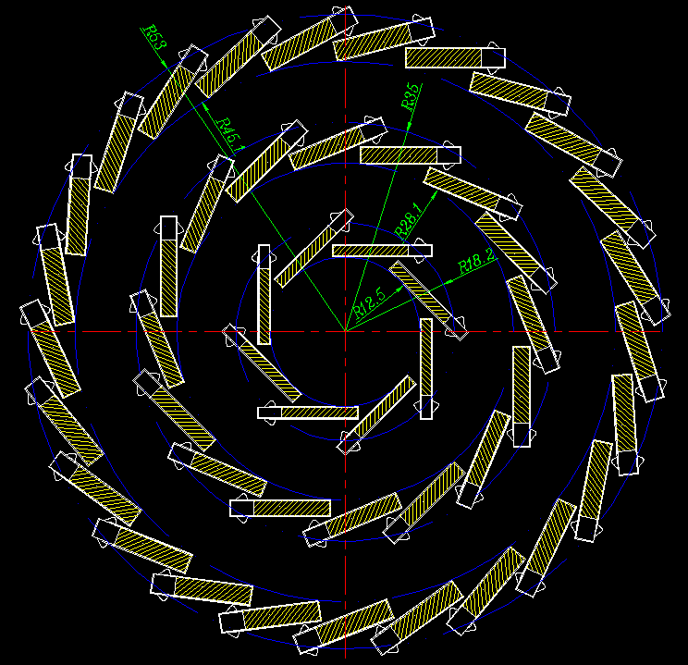
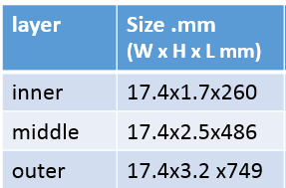
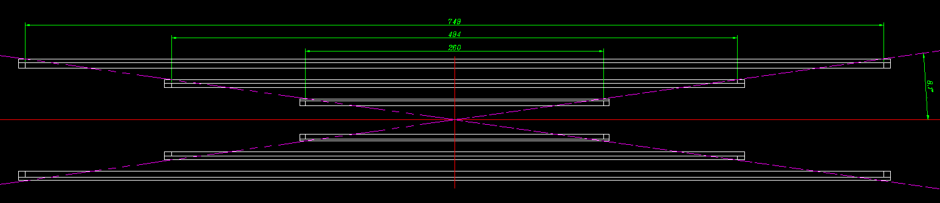
Layout - long barrel
The VTX - section view
3 different sizes of ladders( section size and length ) for barrels.
Ladder support size
The VTX - side view

Slide 19
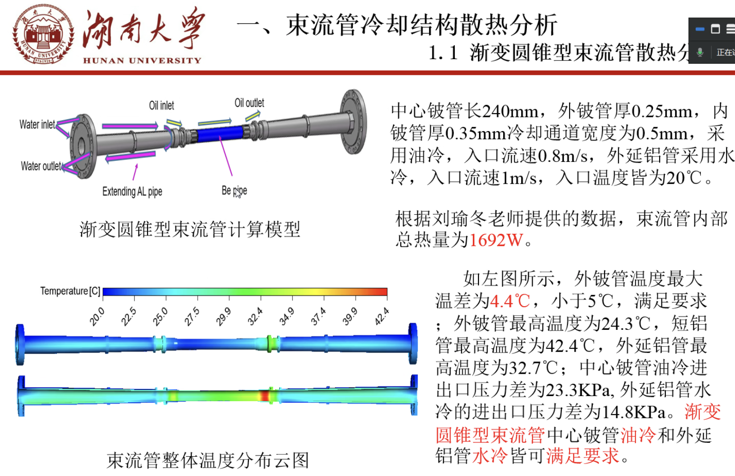
Beam pipe Cooling discussion
Discussion with Quan and experts from Hunan University about beam pipe cooling
  Water cooling vs paraffin cooling
  Converging on water cooling solution
    Advantage Better cooling power , Less material budget (a factor of 2 lower)
    Disadvantage: Beam pipe corrosion by water during Radiation hardness (need more study)
      Beam pipe coating as one of possible solution to be studied

