Slide 1
CEPCSW ------ VXT _Barrel section
Tianyuan Zhang
5/23/2024

Slide 2
Update on mechanics

Slide 3
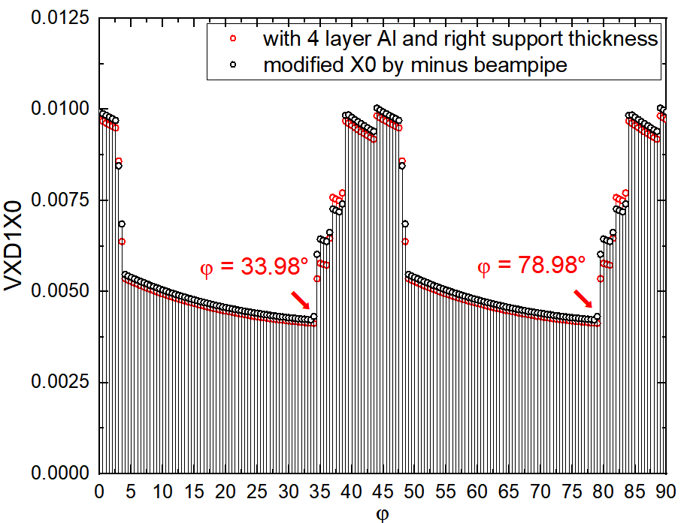
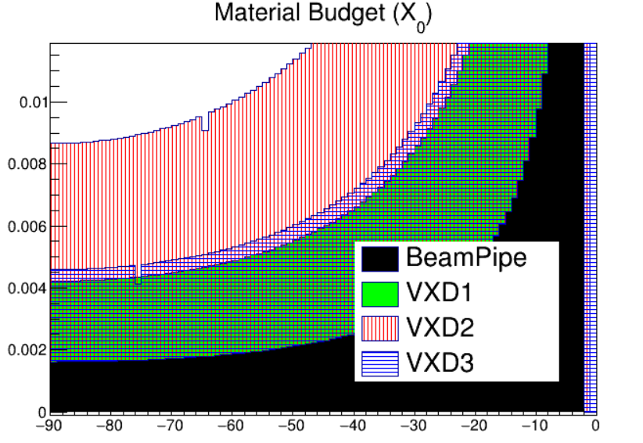
VTX-Material Budget
Under different structures, X0 w.r.t. phi
the variation of X0 with theta in the previous structure
Compared to the previous structure, the corrected structure has doubled its support thickness and a decrease in the number of first layer Al to four layers.

Slide 4
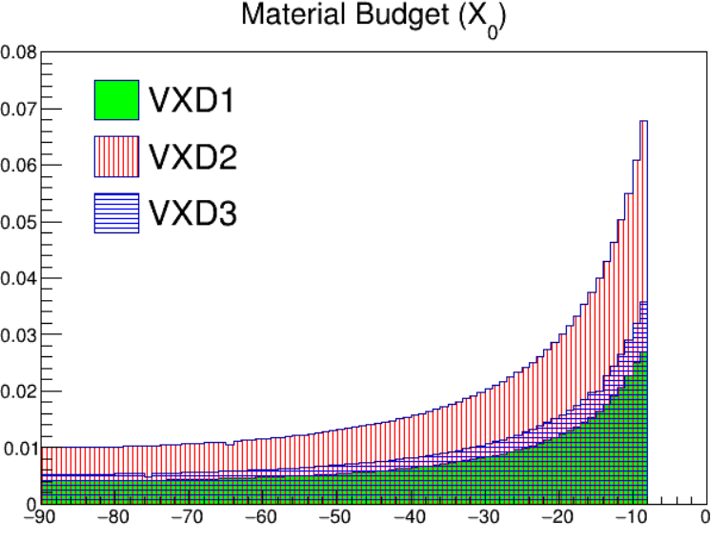
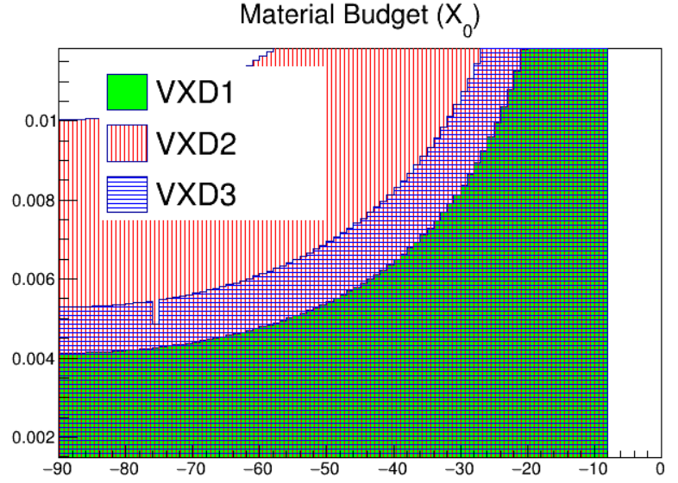
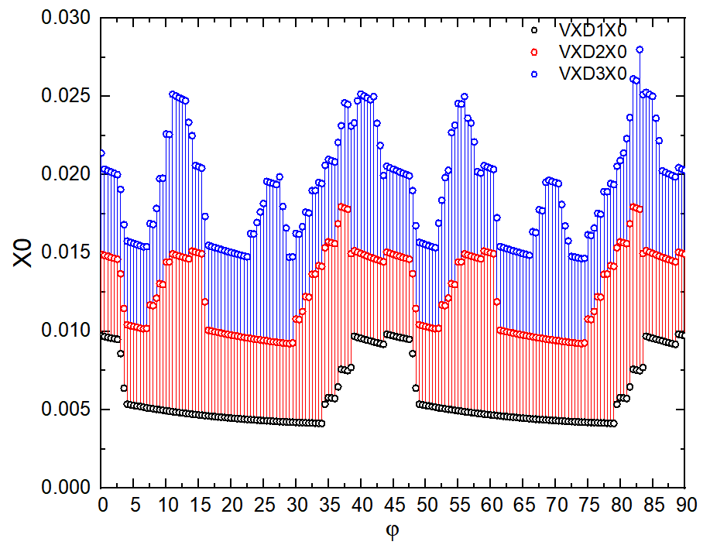
VTX-Material Budget
in detail
the variation of X0 with theta in the corrected structure
Pick out the minimum value of phi in the first layer, which is 33.98

Slide 5
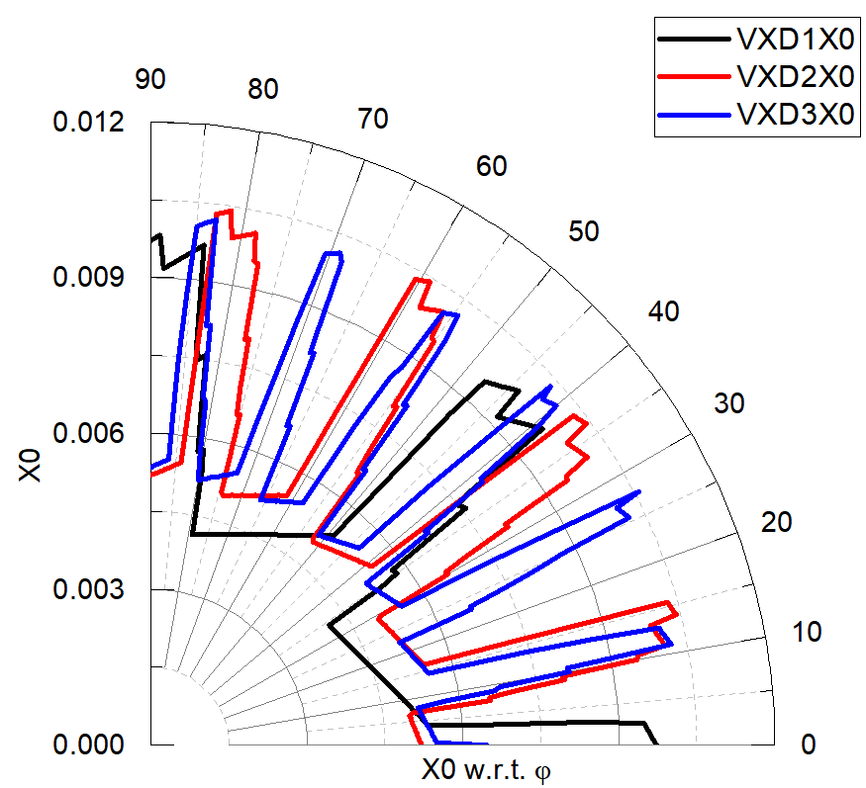
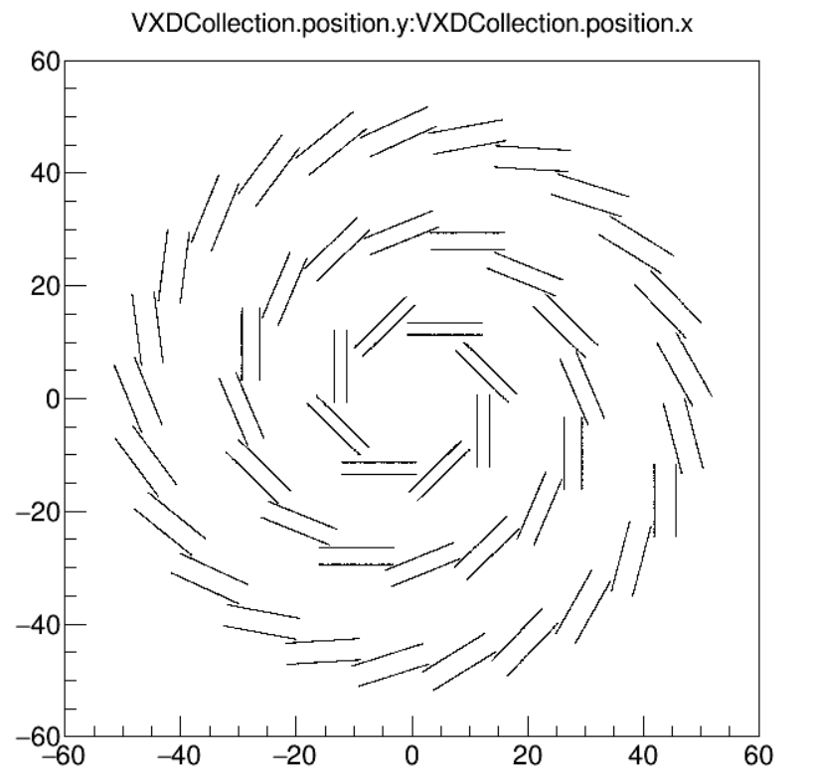
VTX-Material Budget
Based on the requirements discussed last week, the variation of X0 with phi from 0 to 90 has been drawn.
After inspection, at a certain phi value, the larger material mass is due to passing through 7 layers of silicon

Slide 6
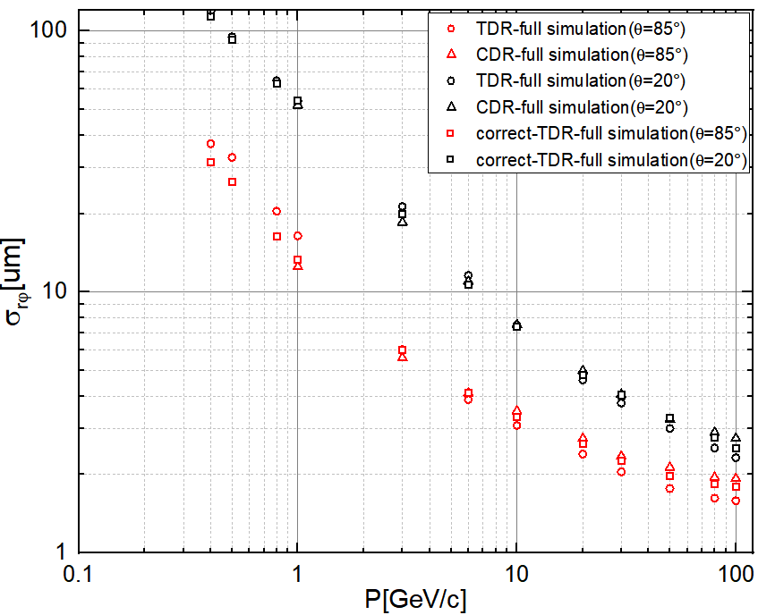
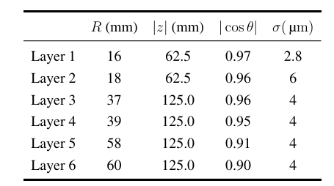
Simulation of different structures
$δd_{0}$随出射粒子动量的变化
The correct-TDR-full simulation and CDR, following from the single-point resolutions provided in Table, the impact parameter $d_{0}$ exhibits similar performance as the momentum changes.

