Slide 1
chATLAS
An AI Assistant for the ATLAS Collaboration
Jeremy Couthures¹, Daniele Del Santo², Gabriel Facini³, Joe George⁴, Runze Li⁵, Daniel Murnane⁶, Cary Randazzo⁷
Quantum Computing and Machine Learning Workshop Quantum Computing and Machine Learning Workshop,
Aug 3-9 2024, Changchun China
(1)
(2)
(3)
(4)
(5)
(6)
(7)

Slide 2
Main Topics in this Talk
Introduction, Necessary Background
chATLAS, Technical Details and Status
Results of work at present
Plans for future updates
Conclusions

Slide 3
Introduction, Necessary Background
ATLAS Experiment - Size and its logistical effects on communication
A brief talk about the RAG type of LLM
chATLAS Background

Slide 4
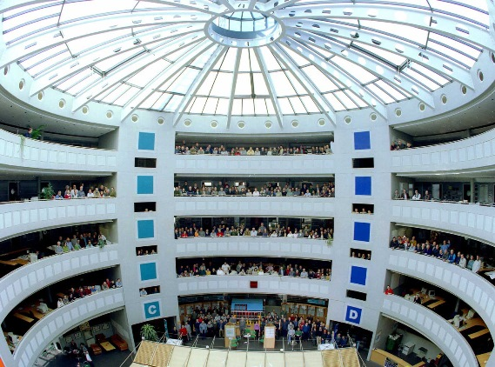
Introduction - ATLAS Experiment
ATLAS is big.
This makes it hard to communicate efficiently.
(storing and accessing data, more on this in a minute)
The detector is 46m long, 25m high, and 25m wide. It is one of the largest collaborative efforts ever attempted in science, with approximately 6000 members and 3000 scientific authors.

Slide 5
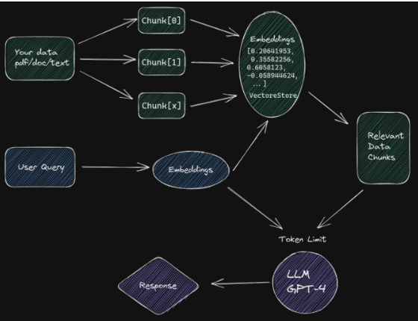
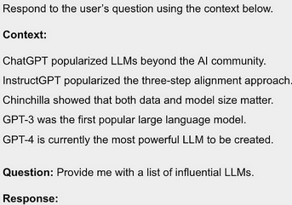
Introduction - A brief talk about the RAG type of LLM
Different types of RAG realization
Retriever Type: Sparse(Passages) vs.
Dense(continuous embeddings)
Retriever Granularity: Chunks vs
Tokens retrieved (fast and difficult)
Pre/Post Retrieval Enhancement
Generator Modifications:
*Input-Layer Integration,
Output-Layer Integration, (Dual output distributions, see kNN-LM)
Intermediate-Layer Integration (Chunked Cross Attention)

Slide 6
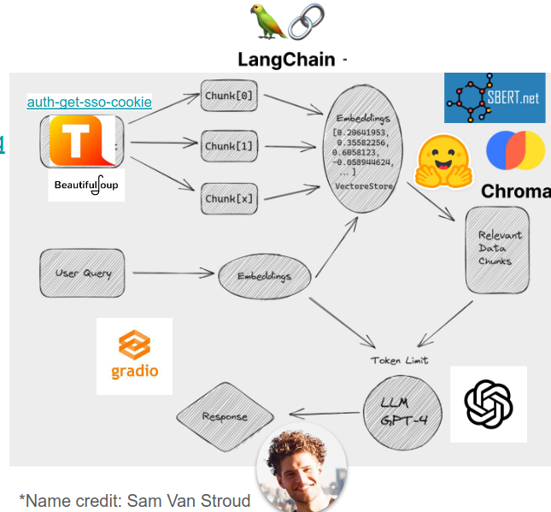
Introduction - chATLAS Background
Developers in ATLAS were independently working on a similar idea.
Skills and projects were synthesized into chATLAS
Simple start
UI added and moved to flask (Joe George)

Slide 7
chATLAS, Technical Details and Status
Scraping and Document Collection (ATLAS has a Lot of Data)
Embedding and Vector Database
Evaluation
UI & Serving in Production

Slide 8
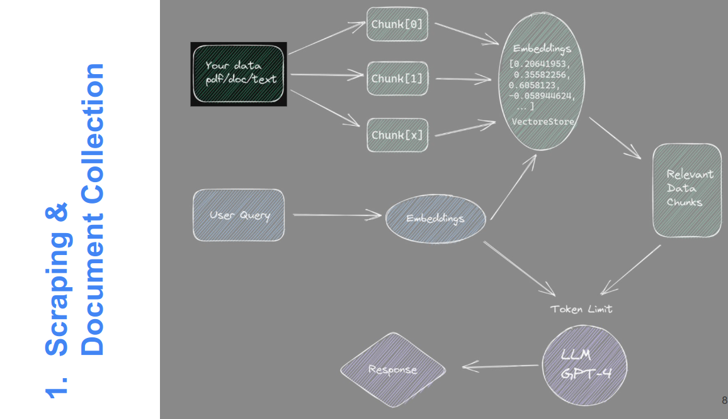
chATLAS, 1. Scraping and Document Collection

Slide 9
chATLAS, 1. Scraping and Document Collection
Egroup
Archive
Jira
Twiki
Group level Docs
Indico Meetings
PDF Plots
ATLAS Software Docs
CDS Papers & Notes
ATLAS Codebases
Mattermost

Slide 10
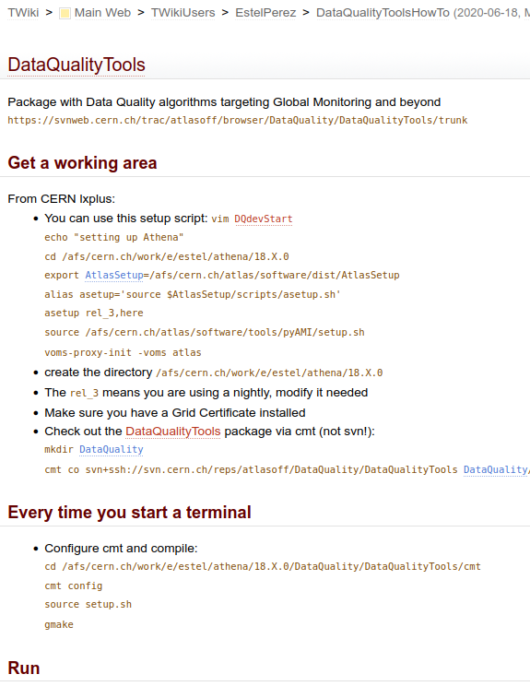
chATLAS, 1. Scraping and Document Collection
Twiki and CDS
Initial scrape using BeautifulSoup and auth-get-sso-cookie followed by,

Slide 11
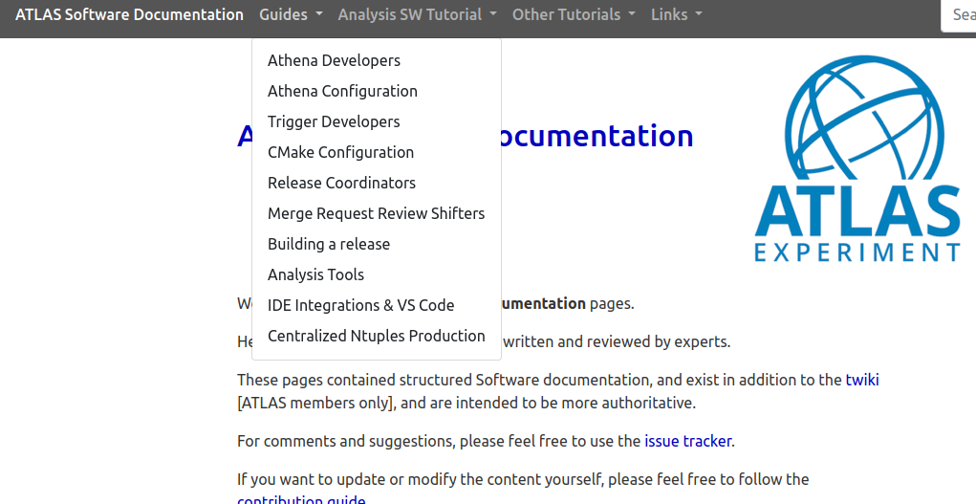
chATLAS, 1. Scraping and Document Collection
ATLAS Software Docs
Hundreds of ATLAS Software Docs
Using:
BeautifulSoup
and auth-get-sso-cookie

Slide 12
chATLAS, 1. Scraping and Document Collection
E-group
Archive

Slide 13
chATLAS, 1. Scraping and Document Collection
E-group Archive Anonymization
Tool was developed to Anonymize data as it is being gathered OR after
Uses a combination of 3 Named Entity Recognition(NER) models: Transformer based, Spacy based, NLTK based (NLTK seems most performant for this style/structure)
The Tool was designed and optimized around ATLAS egroups message data so it may have varying performance when applied elsewhere (experiments pending)
Records unique identity of individuals (“Anonymous_1”, _2, _etc) so the model can keep track who is saying what and how it relates to the meaning of the text.

Slide 14
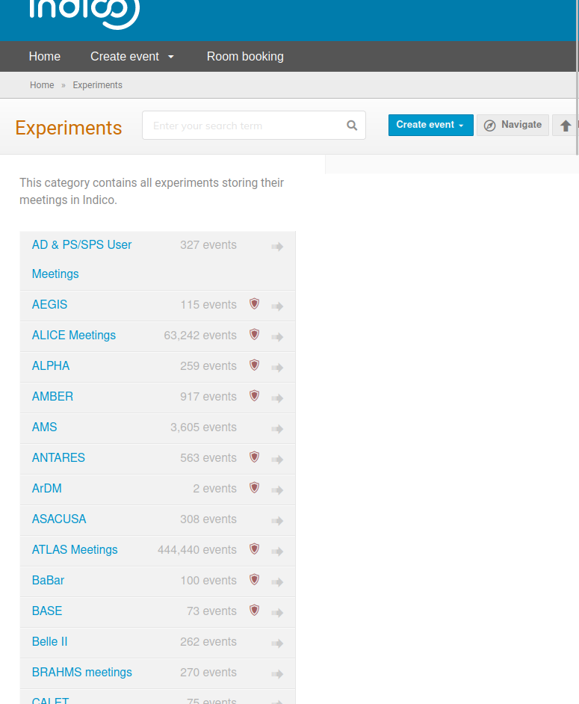
chATLAS, 1. Scraping and Document Collection
Indico Meetings
Using:
Nougat
and
Marker
440,440 ATLAS Indico Meeting Events

Slide 15
chATLAS, 1. Scraping and Document Collection
PDF Plots,
ATLAS Codebases,
Group level Docs
Mattermost,
Jira,
Tools Used:
(Pending further experiments)
Measurements for these will depend on further investigation - expected to large also

Slide 16
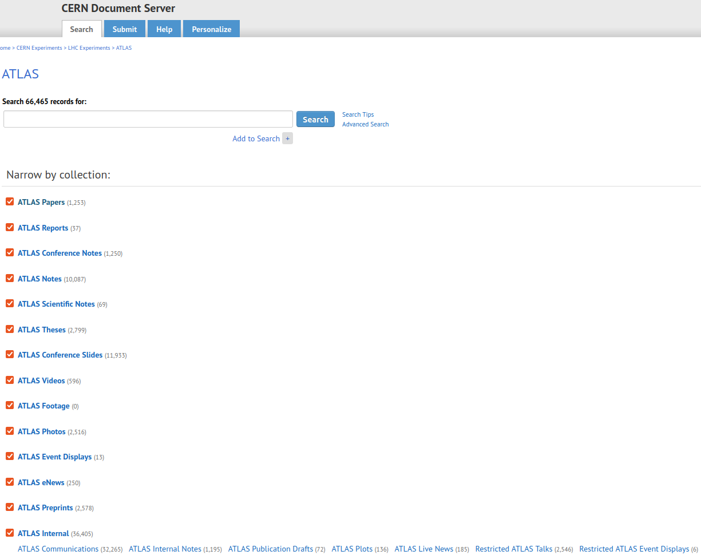
chATLAS, 1. Scraping and Document Collection
CDS Papers & Notes
Using:
Nougat and Marker
Total: “66,465 records found”
36,405 are Internal including communications, notes, etc.

Slide 17
chATLAS, 1. Scraping and Document Collection

Slide 18
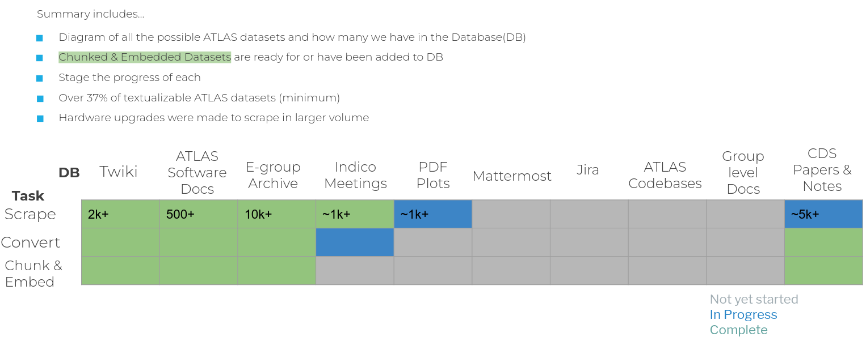
chATLAS, 1. Scraping and Document Collection
Summary

Slide 19
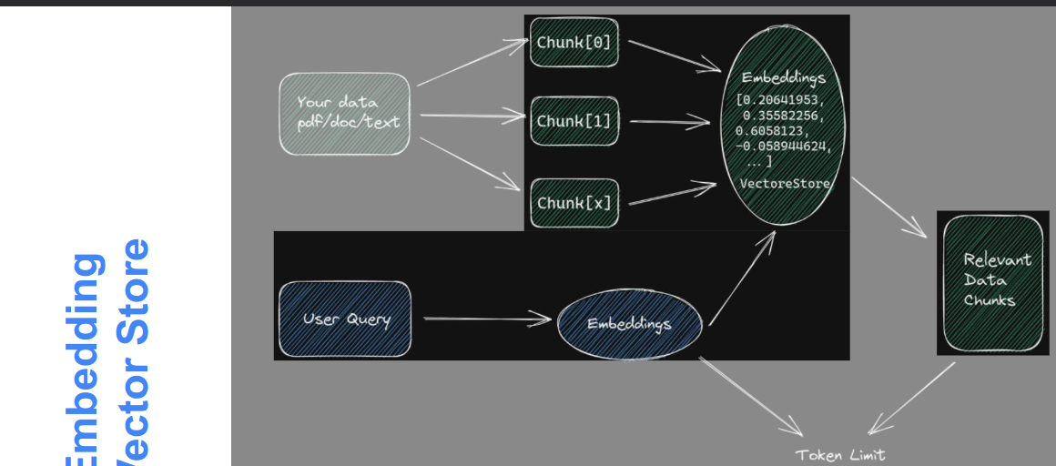
chATLAS, 2. Embedding and Vector Database

Slide 20
chATLAS, 2. Embedding and Vector Database

Slide 21
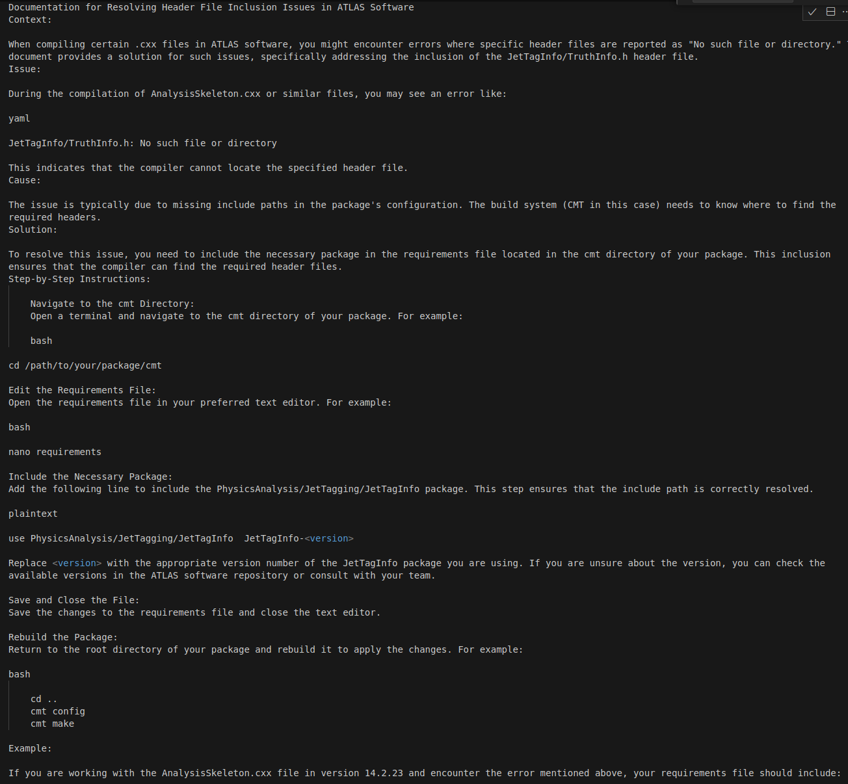
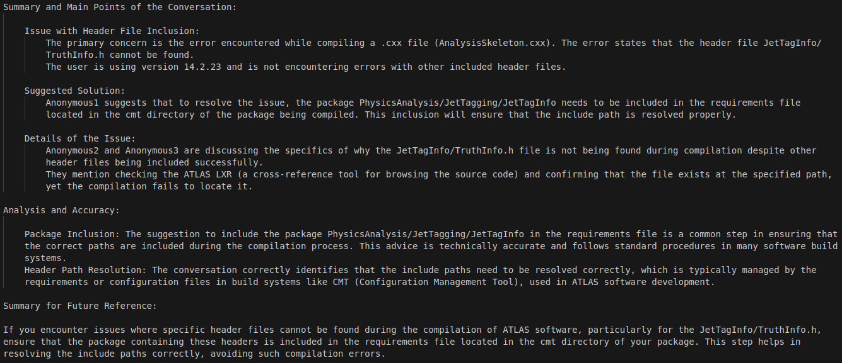
chATLAS, 2. Embedding and Vector Database
(Egroup Archive) User Experience and Data Quality Improvement
↓
→
And then, Embedded & Chunked ←

Slide 22
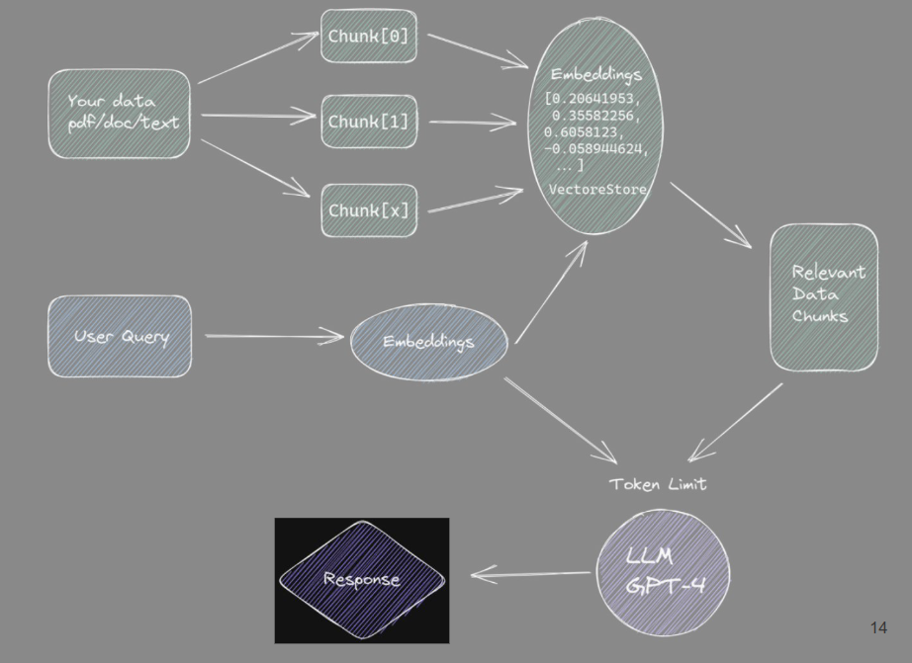
chATLAS, 3. Evaluation

Slide 23
chATLAS, 3. Evaluation
What kind of questions can our RAG answer?

Slide 24
chATLAS, 3. Evaluation
Exploring other extensive and complete evaluation methods (results in future update)

Slide 25
chATLAS, 4. UI & Deployment
Deployment

Slide 26
chATLAS, 4. UI & Deployment
Deployment

Slide 27
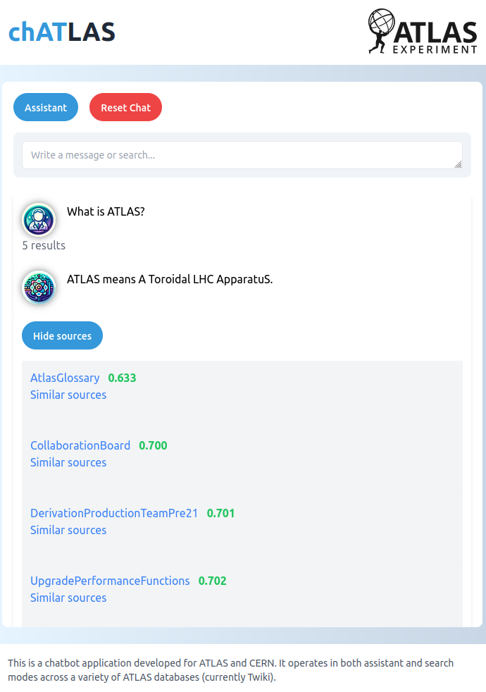
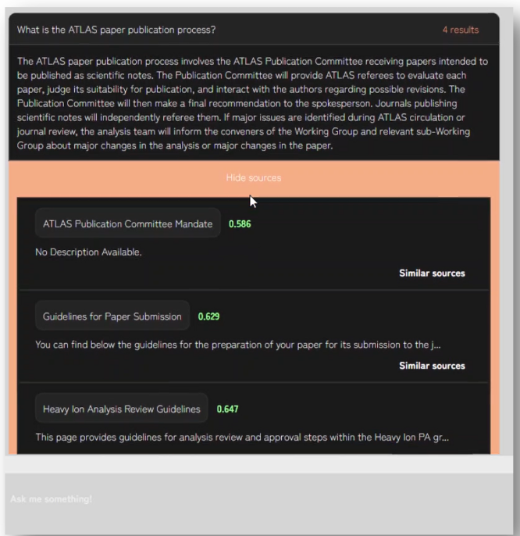
Results of work at present

Slide 28
Plans for future updates
Gather and Install more Data to RAG
CDS papers (in alpha), conferences, pub notes, etc.
E-groups (scraped, anonymized, embedded)
Indio (some sources in hand)
Daily updates such as from new/changes to Twikis
Find my plot - find plots more easily by storing information in DB Running - need to serve via API
Fine tune of open source LLM a la AstroLLaMa - low stats show promise
Serving open source LLM via API running at university
Improve quality through advanced RAG techniques
Or a mixture of experts like ChatGPT
UI Improvements: thumbs up/down etc (RLHF?)
Knowledge Graphs
Detailed and extensive Evaluation system for incremental progress
Multimodality ideas, check back for updates

Slide 29
Conclusions
chATLAS project established in the spare time of few developers
Still in early development
Deployment platform stability is a major issue
Open invite to contribute
If there was a collaborative effort to store and format information that prepares them for installing to AI, it could reduce the efforts required by development teams and new physics could be discovered sooner
ATLAS has a lot of data, takes time to gather, organize, format, and process
chATLAS started as a standard RAG, but it has evolved to meet needs of ATLAS, aid discovery, and explore other useful applications

Slide 30
End
__________________
Questions?

Slide 31
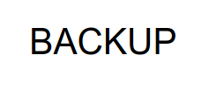

Slide 33
