Slide 1



LLM model for HEP - Xiwu (溪悟)
Siyang Chen（陈思炀）
Institute of High Energy Physics, CAS, Beijing
Quantum Computing and Machine Learning Workshop 2024
Changchun, 2024.8

Slide 2
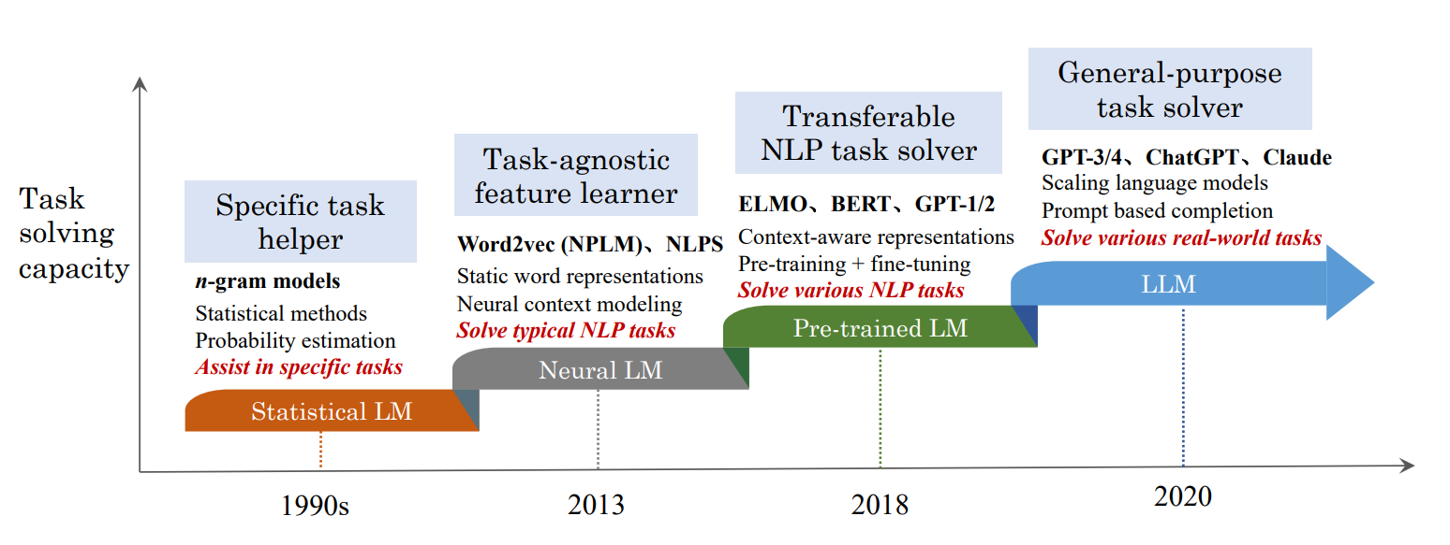
What is Large Language Model (LLM) ?
The research of Language Model has received widespread attention, which can be divided into four major development stages:
Notes:
统计语言模型（SLM）：是1990年代基于统计学习的语言模型：基本思想是基于马尔可夫假设构建单词预测模型，例如，根据最近的上下文预测下一个单词。具有固定上下文长度n的SLM也称为n-gram语言模型，例如二元和三元语言模型
神经语言模型（NLM）：以word2vec为代表的词向量的语言模型开启了使用语言模型进行表示学习（超越词序列建模）的先河，对 NLP 领域产生了重要影响。
预训练语言模型 (PLM）：在大规模未标注语料库上进行特别设计的预训练任务来预训练语言模型，大大提高了 NLP 任务的性能，确立了“预训练和微调”的学习范式。
大语言模型 (LLM)：研究人员发现，扩展 PLM（例如扩展模型大小或数据大小）通常会提高下游任务的模型能力

Slide 3
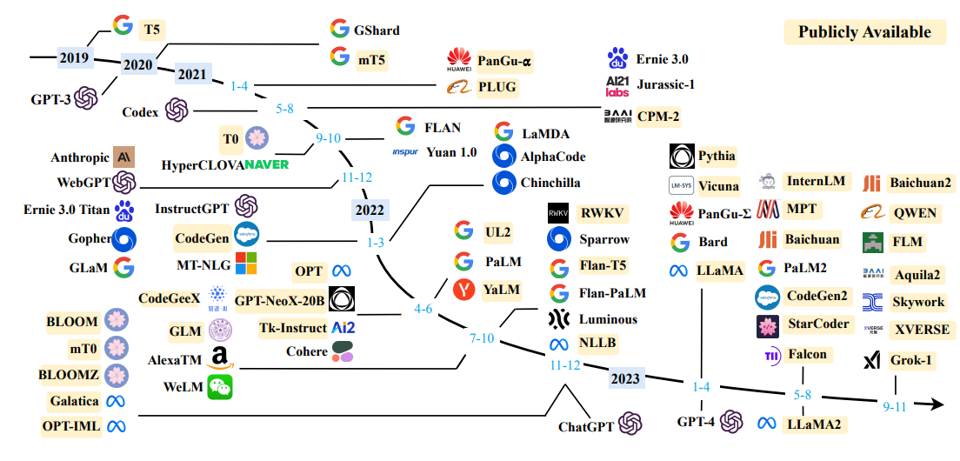
What is Large Language Model (LLM) ?
Large Language Models, typically have hundreds of billions to trillions of parameters, have showcased remarkable performance across numerous domains.
  GPT4o, Gemini, LLaMA, QWEN, Baichuan ...
  Question Answering, Code Generation, Machine Translation ...
Notes:
众所周知，拥有千亿甚至万亿参数的大模型在多种任务上均取得了非常出色的表现。
其中有代表性的有GPT4o、GEmini还有开源的llama qwen和百川等等
他们在问答、代码生成、机器翻译等领域展现出了强大的能力和应用价值

Slide 4
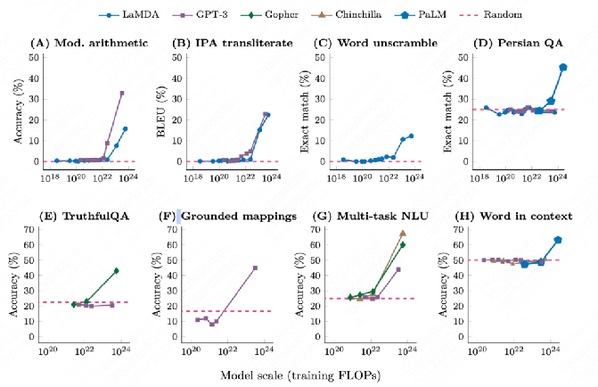
What is Large Language Model (LLM) ?
  As the number of model parameters and datas grow, LLMs exhibit what is known as "Emergent Abilities."（涌现）
  These abilities enable LLMs to effectively handle a variety of tasks without the need for specific parameter adjustments.
Notes:
为什么大模型拥有如此出色的能力
我们看这张图片，它包含8张子图。分别在是八个不同的子任务下测试大模型的few-shot的能力。
横轴是模型的规模（注意这里是用training FLOPs来衡量，而不是用参数量来衡量），纵轴的模型的表现，用一些评估指标来衡量，比如accuracy。
可以很明显地看到，training FLOPs在10的22次方处，是一个发生涌现的临界点。在这个数之前，模型的表现平平无奇，和随机猜测差不多。而在这个数之后，模型的效果得到了突飞猛进般的提升
这是因为随着大模型参数和训练量的增长，发生了涌现的现象
这个能力让大模型可以不需要过多参数调整的情况下处理多样的任务。

Slide 5
Why we need a LLM for HEP ?
  The LLMs can suffer from hallucinations (幻觉).
  The capability of general LLMs for focused areas may be constrained.
Q: Please provide an example of simulating particle decay on BOSS?
Q: What is HEPS?
A: HEPS stands for Headline Earnings Per Share. It is a financial metric ... (from GPT-3.5)
A: To simulate particle decay on the BigBOSS (BOSS) website, you can use the following steps:
1. Go to the BigBOSS website (https://bigboss.lbl.gov/).
2. Click on the "Simulation" tab on the top menu.
3. Select the option for "Particle Decay Simulation" from the drop-down menu.
4. Choose the type of particle you want to simulate
... (from GPT-3.5)
A: HEPS can refer to several different things, depending on the context. Here are a few possibilities: High Energy Physics, High Energy Photon Source, Higher Education Price Index (HEPI) ... (from GPT-4o)
Notes:
为什么训练高能物理大模型？
这是因为大型语言模型（LLMs）可能会出现幻觉（即生成不真实或不准确的信息）。
我们在使用通用大型语言模型到特定领域的时候，能力可能会受到限制。
什么是heps
请给出一个在boos上模拟粒子衰变的例子

Slide 6
A LLM for HEP: Xiwu (溪悟)
  Xiwu: A basis flexible and learnable LLM for HEP
    Xi(溪): Streamlet → Drops of water
    Wu(悟): Understanding and inferring
  Why consider flexible?
    Training LLM from scratch is unaffordable
    Hardly keep up with the pace of development of open-source models
    Using the strengths of others to improve oneself
  How to achieve learnable?
    Construct just-in-time learning system based on RAG
    Collect and clean usage information, then construct Data Flywheel
Notes:
Xiwu: 一个灵活且可学习的高能物理大型语言模型（LLM）
溪（Xi）: 小溪 → 水滴 形容源源不断汇入的数据和知识
悟（Wu）: 理解和推理

Slide 7
A LLM for HEP: Xiwu (溪悟)
  Xiwu: A basis flexible and learnable LLM for HEP
    Xi(溪): Streamlet → Drops of water
    Wu(悟): Understanding and inferring
  Why consider flexible?
    Training LLM from scratch is unaffordable
    Hardly keep up with the pace of development of open-source models
    Using the strengths of others to improve oneself
  How to achieve learnable?
    Construct just-in-time learning system based on RAG
    Collect and clean usage information, then construct Data Flywheel
Notes:
为什么要考虑灵活性？
从零开始训练大型语言模型成本高昂
很难跟上开源模型发展的步伐
利用他人的优势来提升自己

Slide 8
A LLM for HEP: Xiwu (溪悟)
  Xiwu: A basis flexible and learnable LLM for HEP
    Xi(溪): Streamlet → Drops of water
    Wu(悟): Understanding and inferring
  Why consider flexible?
    Training LLM from scratch is unaffordable
    Hardly keep up with the pace of development of open-source models
    Using the strengths of others to improve oneself
  How to achieve learnable?
    Construct just-in-time learning system based on RAG
    Collect and clean usage information, then construct Data Flywheel
Notes:
如何实现可学习性？
基于RAG构建即时报学习系统
收集和清洗使用信息，然后构建数据飞轮（Data Flywheel）

Slide 9
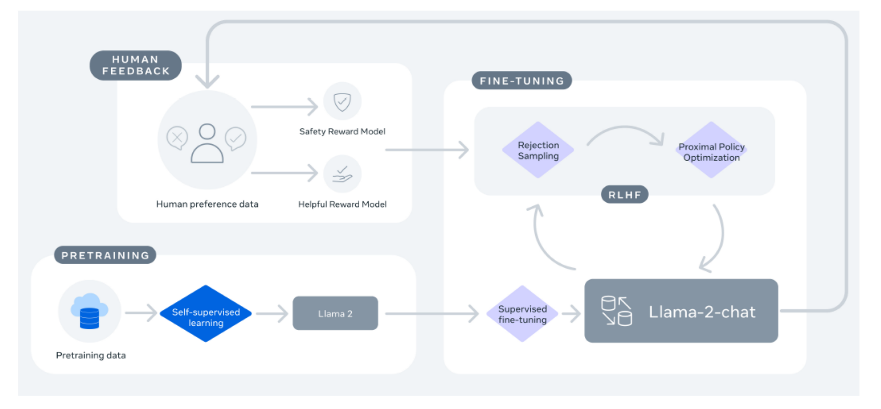
How to Train a LLM?

Slide 10
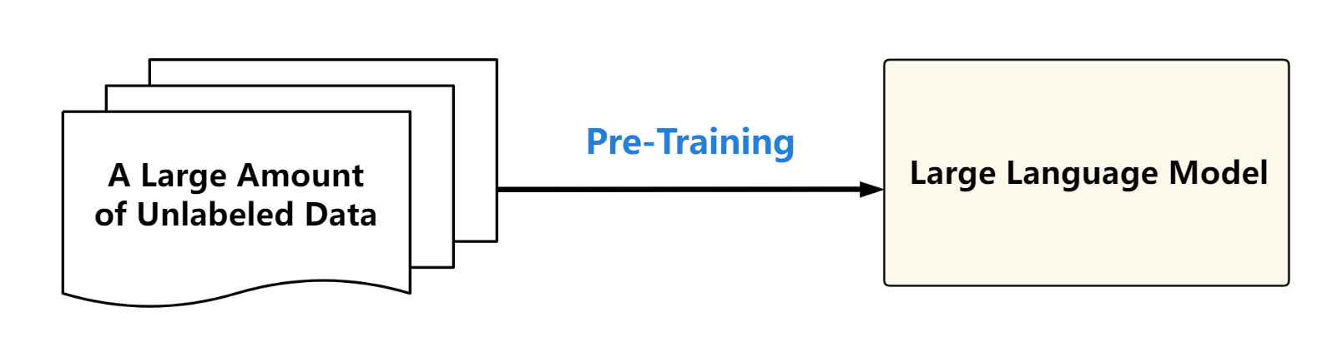
How to Train a LLM?
  Pre-training is the initial phase in the training of large models.
    Model is trained on a vast corpus of unlabeled text
    Enabling it to thoroughly understand fundamental aspects of language such as grammar, semantics, and contextual relationships.
    Allowing the model to acquire a substantial amount of foundational knowledge.
Notes:
预训练是大模型训练的第一阶段，模型在大量无标签语料库上进行训练，使其能够充分理解语言的基本语法、语义和上下文关系，学习海量基础知识。

Slide 11
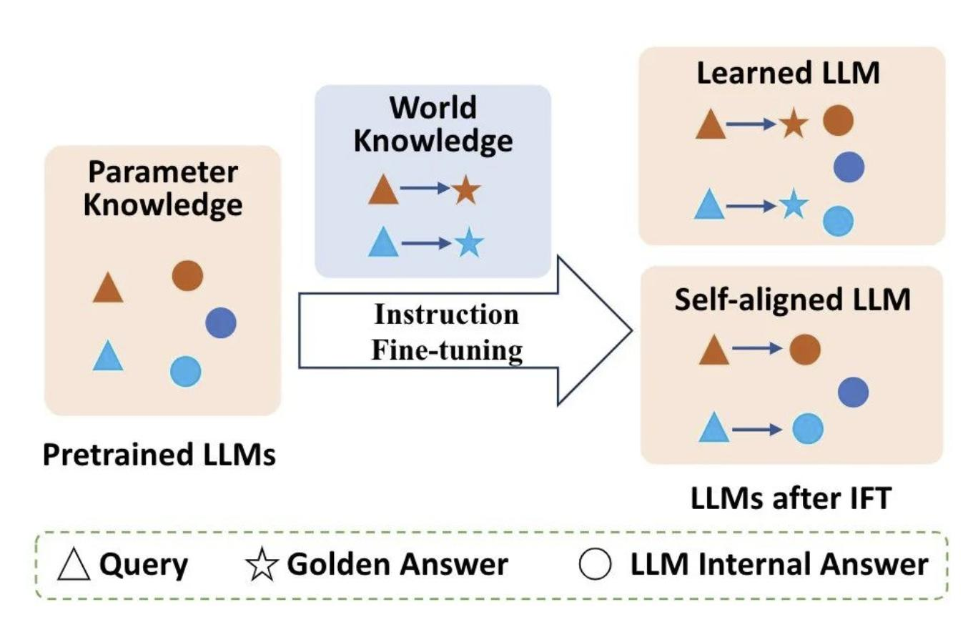
How to Train a LLM?
  In instruction fine-tuning, acquiring world knowledge that conflicts with the model's existing knowledge can be harmful rather than beneficial.
  Effective instruction fine-tuning requires achieving behavioral adaptation while preserving the consistency of the model's parameterized knowledge.
Fine-tuning is not to make the model "learn" additional knowledge,
but to align the existing knowledge within the model.
Notes:
微调是大模型训练的第二阶段，预训练阶段大模型学习到海量知识，但是大模型还没有学会解决各类具体的任务。通过指令微调，让模型学会使用预训练阶段习得的知识，使之具备正确响应各种输入的能力。
1.对于指令微调而言，学习与模型参数知识不一致的内容无法带来增益，甚至会造成额外的损害。
2.有效指令微调的本质在于完成行为模式转换的同时，保持指令微调前后模型参数中知识的一致性。

Slide 12
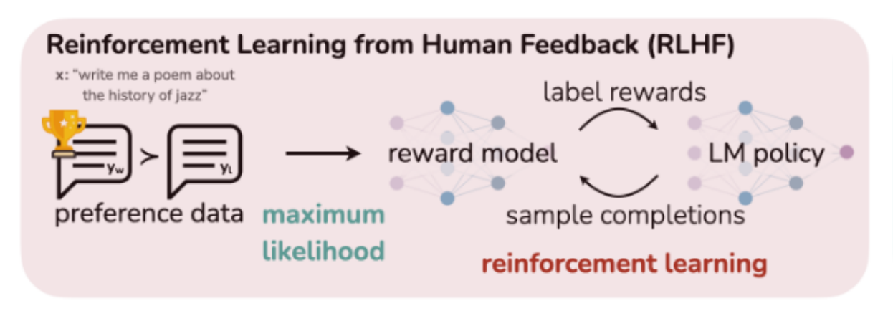
How to Train a LLM?
  RLHF uses a reward model to learnalignment from human feedback.
  This reward model, after being tuned, is able to rate different outputs and score them according to their alignment preferences given by humans.
Notes:
由于大模型预训练的数据良莠不齐，它们可能会为人类生成有毒、偏见甚至有害的内容。因此，有必要使 LLM 与人类价值观保持一致
RLHF根据人类反馈设置奖励模型，在经过调优后，能够对不同的输出进行评分，并根据人类给出的对齐偏好对其进行打分。奖励模型向原始的大语言模型（LLM）提供反馈，这些反馈用于进一步调优LLM

Slide 13
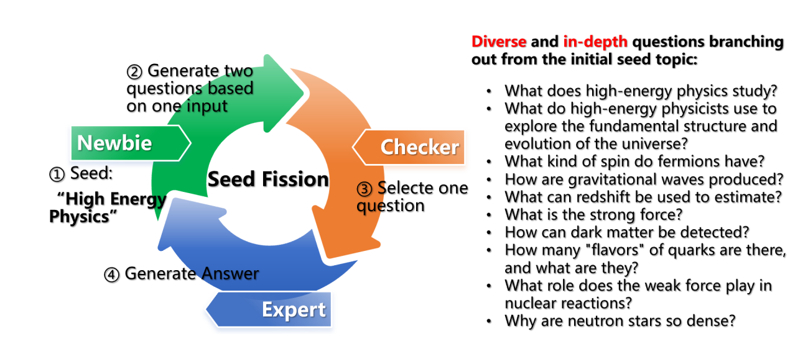
Dataset for Xiwu-1.0
  Seed Fission
  For example, use “Particle physics” as the “seed”, 50 Q&A pairs and 2822 candidate questions can be generated.
Notes:
1.最初设计一个种子题目交给新手。
2.新手根据输入生成2到10个随机问题
3.检查员筛选掉重复和过滤，选择最有趣的问题，或决定退出当前主题以选择另一个候选主题。所选问题将被发送给专家，而其余问题将进入候选问题列表。
4.专家根据其配备的知识库和搜索引擎回答问题，并提供答案来源。
5.答案作为新手的输入信息，然后新手会提出更多问题。

Slide 14
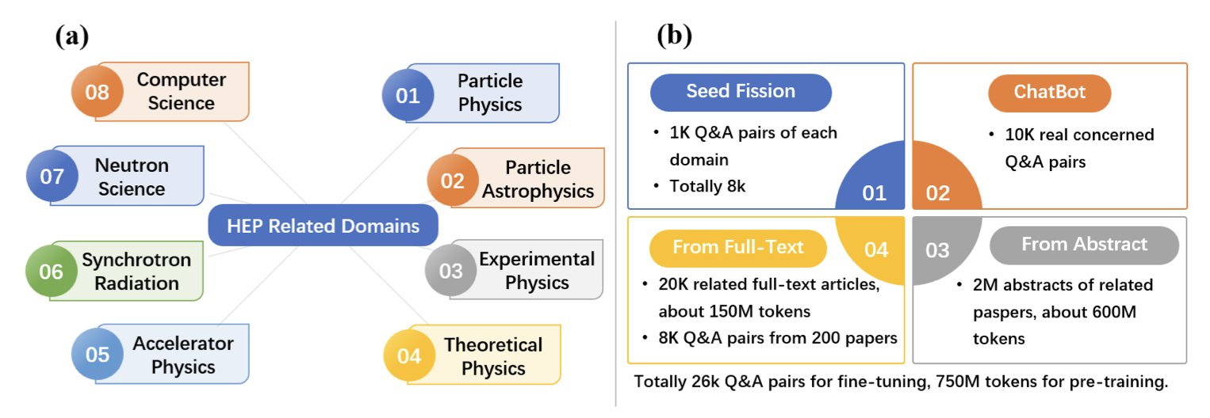
Dataset for Xiwu-1.0
Notes:
我们最终通过以下四个方法构建了来自八个不同领域的高能物理数据集
首先我们使用了种子裂变技术针对每个领域生成了一千个问答对
其次我们在haichat平台上收集了一万条高能物理领域真实场景下用户与ChatGPT交互的

Slide 15
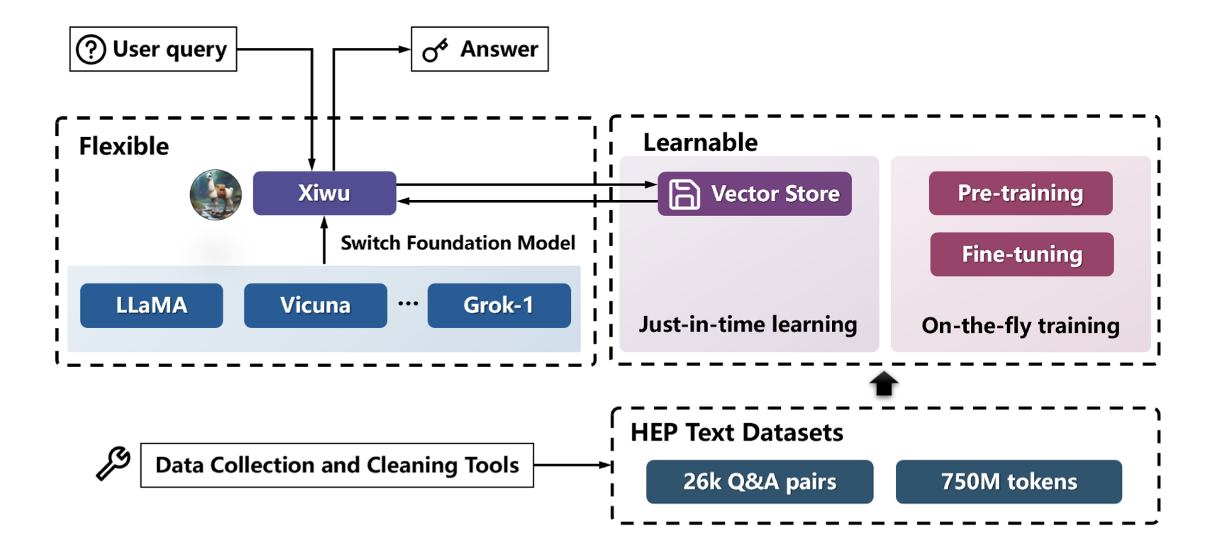
Architecture of Xiwu-1.0
  Xiwu-1.0, based on Vicuna-1.5-7B and Vicuna-1.5-13B, was released in April 2024.
Notes:
这是Xiwu的架构图：
我们可以看到Xiwu整个系统主要由两个部分组成，其中大模型部分可以根据需要灵活的更换基座大模型
及时学习系统得到的知识通过向量数据库及时的提供给xiwu增强其性能

Slide 16
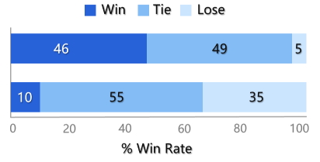
Xiwu-1.0 Evaluation
Xiwu-1.0 perform much better than foundation model in HEP quiz dataset, but slightly lower than ChatGPT-175B.
  Sometimes show catastrophic forgetting
  Worse in general ability assessment
Fine-tuning setting for Xiwu-1.0:
  Learning rates: 2e-5
  Learning rate scheduler: cosine
  epochs: 3.0
  Warmup ratio: 0.03
  Pre-device training batch size: 2
  Gradient accumulation steps: 16
Xiwu-13B
vs. Vicuna-13B
Xiwu-13B vs. ChatGPT-175B
Notes:
提出了100条精心设计的问题
使用让Xiwu、Vicuna和ChatGPT175分别进行作答并请专家比较他们的回答质量
同时我们在测试中发现：Xiwu发生了灾难性遗忘
在这导致了它通用能力的退化

Slide 17
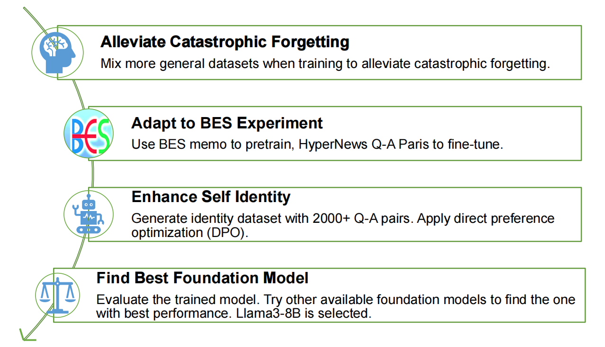
Xiwu-2.0
  Datasets used in training Xiwu-1.0 (covers 8 fields of HEP, 26k Q-A pairs for fine-tuning and 750M tokens for pretraining).
  BESIII internal data
  General Instruction Fine-tuning Datasets (e.g., Alpaca, MOSS), not related to HEP.
Notes:
相较于Xiwu1，Xiwu2的提升主要体现在以下几个方面
通过引入更多的通用数据集来缓解灾难性遗忘
适配BESIII实验
优化增强了自我认知的训练和能力
更换了基座模型

Slide 18
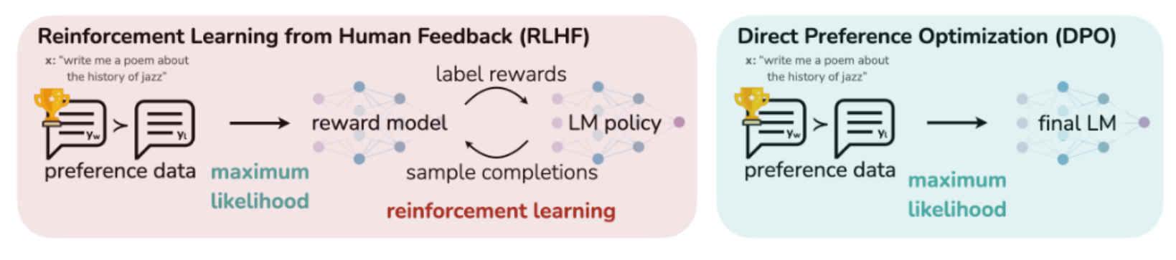
Xiwu-2.0 Self-cognition DPO datasets
  Direct Preference Optimization(DPO) for human preferences without using reinforcement learning.
    Traditional methods fine-tune language models by first fitting a reward model to human feedback and then using RL to maximize this reward.
    In contrast, DPO directly optimizes the policy to best satisfy preferences using a simple classification objective, eliminating the need for an explicit reward function or RL.
Notes:
传统方法首先通过人类反馈来拟合一个奖励模型（Reward Model）。然后使用强化学习（RL）来最大化这个奖励模型。这种方法虽然有效，但存在一些复杂性和计算成本高的问题。
与传统方法不同，DPO直接优化策略，以最佳满足人类偏好。DPO使用一个简单的分类目标来实现这一点，而不需要显式的奖励函数或强化学习。这种方法不仅简化了过程，还减少了计算成本。

Slide 19
Architecture of Xiwu-2.0
RAG based on LlaMA-Index
LLaMA-3
>100k Q&As
>2B tokens
  The second version Xiwu-2.0, built on LLaMa-3-8B, is already in use in Dr. Sai.
  and version based on LLaMA-3-70B is coming soon.
Notes:
对比Xiwu1，我们可以看到高能物理数据集的规模变得更加大
同时Xiwu2更换了Llama3作为基座模型
并且也使用Llama index作为向量数据库

Slide 20
Xiwu 2.0: Training Setting
Pre-training
SFT
DPO
per_device_train_batch_size: 3
gradient_accumulation_steps: 8
learning_rate: 0.0001
num_train_epochs: 2.0
lr_scheduler_type: cosine
warmup_steps: 0.1
fp16: true
per_device_train_batch_size: 4
gradient_accumulation_steps: 1
learning_rate: 0.0001
num_train_epochs: 1.0
lr_scheduler_type: cosine
warmup_ratio: 0.1
bf16: true
per_device_train_batch_size: 1
gradient_accumulation_steps: 8
learning_rate: 0.000005
num_train_epochs: 1.0
lr_scheduler_type: cosine
warmup_steps: 0.1
fp16: true
  Xiwu-8B’s Computational Consumption：
  DPO/LoRA: single GPU, A800-80G;
  SFT: 4 GPUs, each is a A800-80G, 320G in total;
  Pre-training: 8 GPUs, each is A800-80G, 640G in total
Notes:
介绍计算资源
Xiwu1.0受限于软硬件条件限制，预训练部分较少，更多的将语料用在了RAG上
因为高能物理语料不算太多，为了增强高能物理能力预训练了两个轮次
SFT一个轮次是因为强大的学习能力一轮就足够，第二个轮次没有观测到在验证集和测试集的loss下降并且导致灾难性遗忘

Slide 21
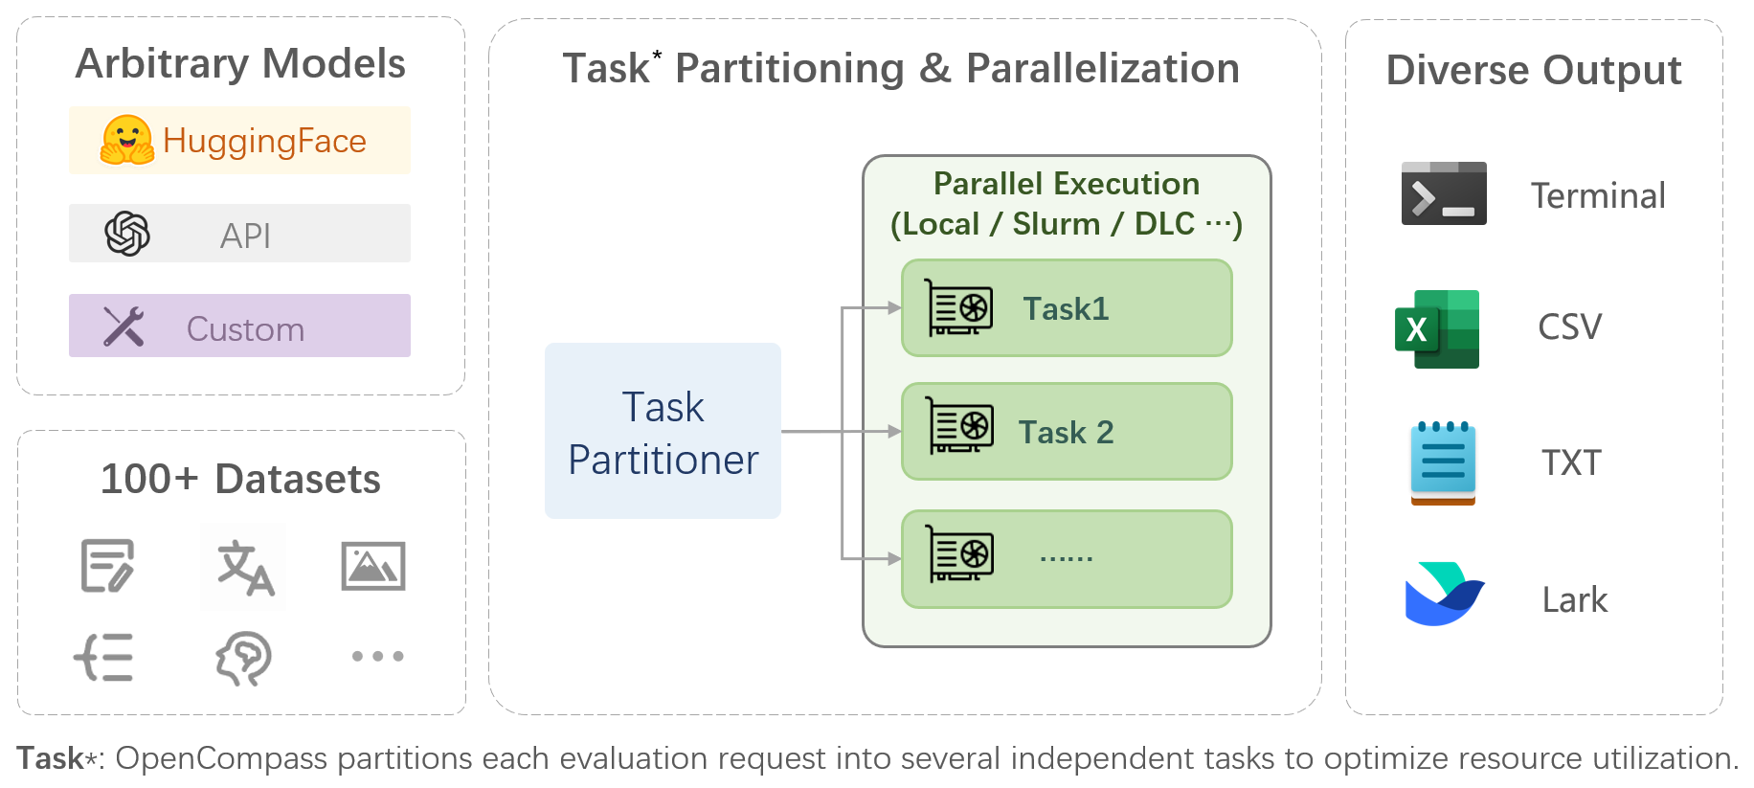

Xiwu-2.0 Evaluation
  Based on the OpenCompass Sinan 2.0 large model evaluation system, we conducted fair and comprehensive assessments of the Xiwu-2.0 model and various open-source models using three datasets: MMLU, BoolQ, and HumanEval.
    MMLU: Massive Multitask Language Understanding
    BoolQ: A dataset for answering yes/no questions, sourced from unprompted and unconstrained environments
    HumanEval: A code generation evaluation dataset created and released by OpenAI
Notes:
使用opencompass评测xiwu2的通用能力，
MMLU：涵盖广泛的学科和领域，用于评估模型在多任务语言理解中的表现。
BoolQ：二元问题回答数据集，其中每个问题都要求模型基于给定的段落回答“是”或“否”
HumanEval：评估代码生成模型的性能

Slide 22
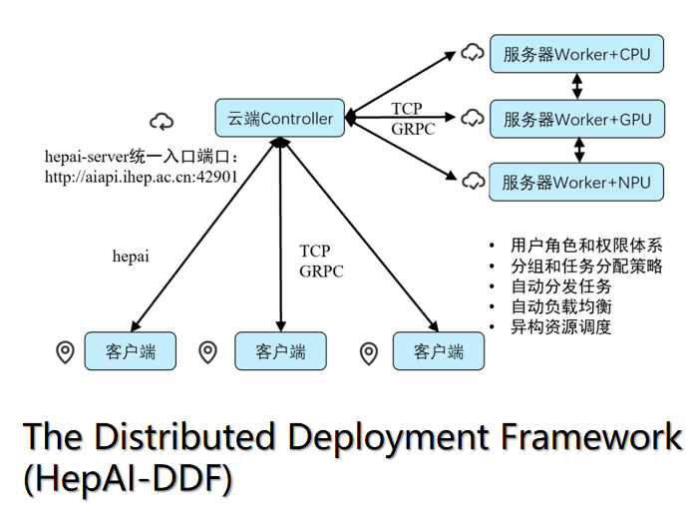
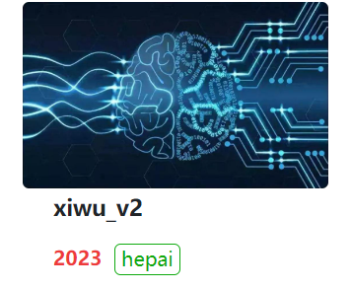
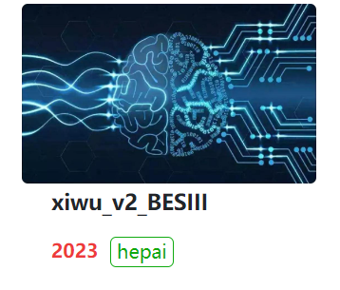
Xiwu-2.0 Deploy

Slide 23
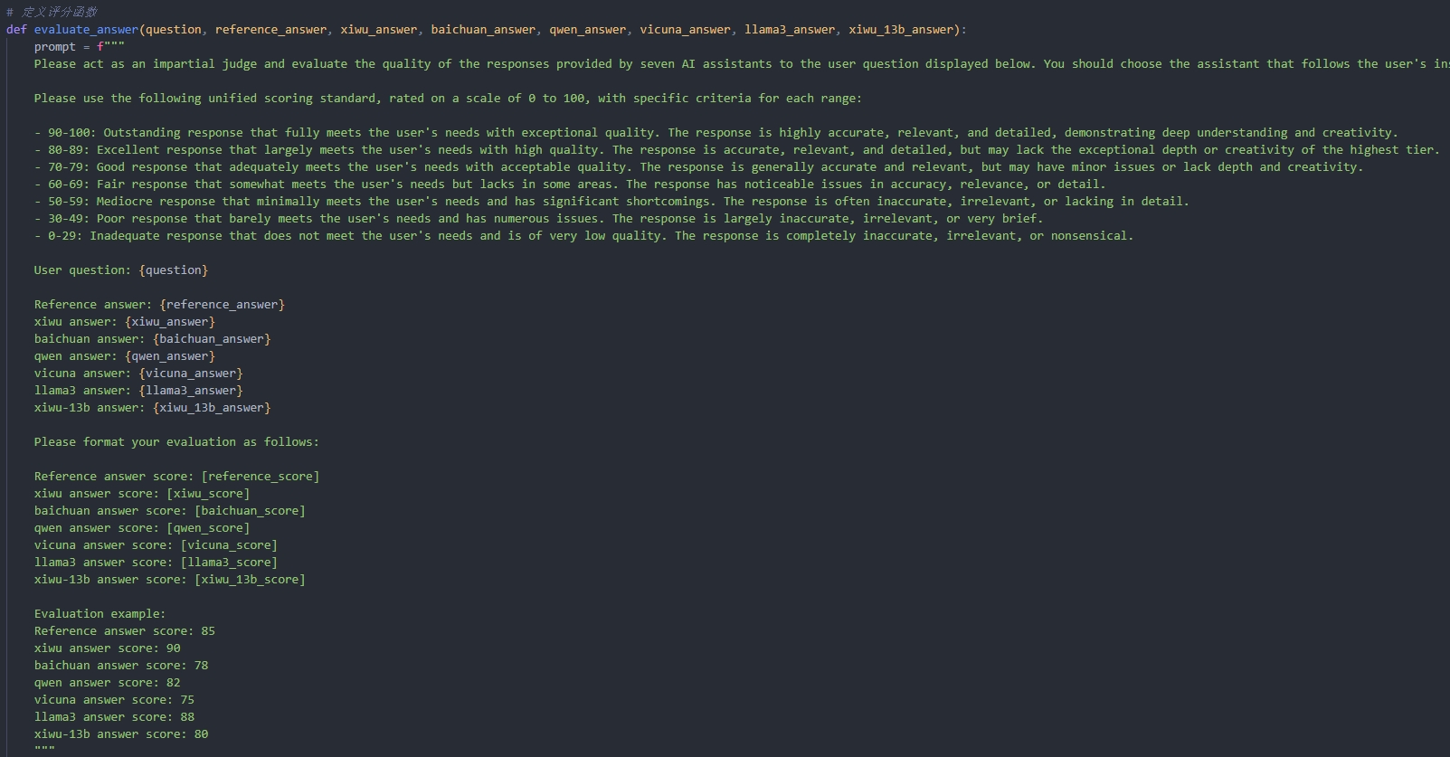
Xiwu-2.0 Evaluation
  HEPeval_QA:
    We constructe a question-answering test dataset based on the corpus of HEP. Each model was evaluated by posing questions and obtaining corresponding answers.
    The responses from all models were then aggregated, and a prompt-based scoring standard was designed. Utilizing GPT-4, a unified scoring process was implemented to derive subjective evaluation scores for the large models.
Notes:
目前还没有权威的用于评估大模型在高能物理领域能力的评测数据集
我们基于高能物理（HEP）语料库构建了一个问答测试数据集。这个数据集包含了我们从HEP领域提取的各种问题和对应的答案。
我们通过向每个模型提出问题并获取相应的答案来评估它们的表现。所有模型的回答被汇总后，我们设计了一个基于提示的评分标准。
我们利用GPT-4实现了对不同模型的统一的评分过程。利用gpt4当裁判，得出各个大模型的主观评价分数。

Slide 24
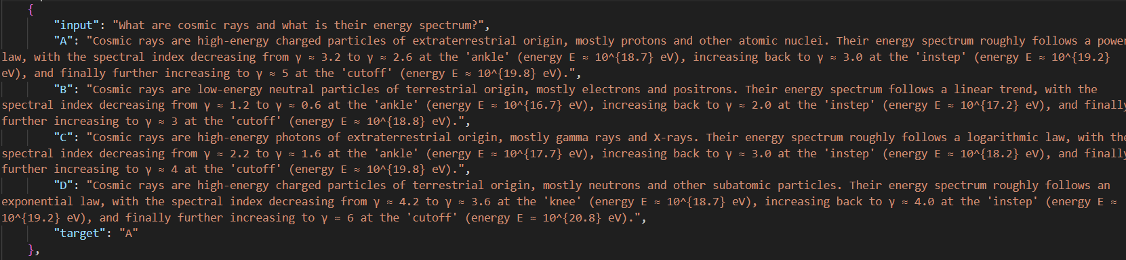
Xiwu-2.0 Evaluation
  HEPeval_MCQ:
    Approximately 1,200 question-answer pairs were selected from previously unseen question-answer pairs as a baseline. These were rewritten into high-energy physics-related prompts using GPT-4.
Notes:
使用提示学习的方式利用gpt4，
将精选的来自不同领域的1200条未被训练的问答对改写成内容和结构相似但是具有事实性错误或者内容答非所问的单项选择题，
用于测试模型在高能物理领域问题回答的能力

Slide 25
Xiwu-2.0 Evaluation
Model | MMLU_average | BoolQ | Humaneval | HEPeval_QA | HEPeval_MCQ
Baichuan2-7B-Chat | 48.9 | 5.44 | 2.44 | 74.56 | 59.33
ChatGLM3-6B | 51.82 | 72.6 | 61.59 | 71.52 | 65.24
LLaMA3-8B | 58.34 | 83.61 | 21.34 | 76.94 | 70.03
Vicuna-7B-v1.5-16k | 33.03 | 45.81 | 17.07 | 62.67 | 41.51
Xiwu2.0-8B | 58.23 | 83.55 | 19.51 | 78.06 | 73.13

Slide 26
Xiwu 2.0: Experience
1
The primary goal of the fine-tuning phase is to activate the knowledge and capabilities learned during pre-training, rather than to inject new knowledge.
2
If the aim is to introduce entirely new knowledge to the model, it is more effective to use retrieval-augmented generation (RAG) techniques.
3
The quality and diversity of fine-tuning data are crucial.
4
Fine-tuning data can be supplemented and constructed using LLMs, but it is essential to conduct further quality checks and modifications.
Notes:
l 微调阶段主要目的是激发预训练阶段学到的知识和能力，而不是注入新知识。
l 使用微调为模型注入全新的知识，不如直接使用检索增强技术（RAG）。
l 微调数据的质量和多样性这两个点十分重要
l 微调数据可以使用LLM来辅助生成和构造，但是最好要进行进一步的质检和修改。

Slide 27
Xiwu 2.0: Experience
5
Avoid using duplicate or conflicting data during fine-tuning, as this can harm the model.
6
When GPU resources are limited, parameter-efficient fine-tuning can still achieve good results.
7
With sufficient GPU resources, full-parameter fine-tuning is preferable for better learning outcomes, although it may lead to more forgetting.
8
Long data is not necessarily better, and very short data is usually not ideal. It's important to ensure data length while maintaining content quality.
Notes:
l 微调尽量不要使用重复的数据和有冲突的数据，这样反而会损害模型。
l GPU不够的情况下可以选择参数高效微调，也能达到不错的效果。
l GPU充足的条件下尽量选择全参数微调，学习效果会好很多，不过遗忘的也更多。
l 长数据不一定好，太短的数据通常不太好，需要保证长度的同时保证内容的质量。

Slide 28
Summary & Next to Do
    Summary
      Compared to the XIwu-1.0 model, the Xiwu-2.0 model has achieved advancements in the HEP field, surpassing the LLaMA3 foundation model and other open-source models.
      Xiwu-2.0 also retains its general knowledge question-answering capabilities, enabling developers to further fine-tune Xiwu for various downstream tasks.
      More and more high-energy physics data have been incorporated into Xiwu's training.
    Next to Do
      Incorporate more BESIII data into Xiwu's training, including information from Indico.
      Support a wider range of diverse task applications, beyond just QA.
      Implement precise data filtering and cleaning—Less is More.
      Xiwu-2.1 8B and 70B (based LLaMa3.1) are coming soon!
Notes:
Xiwu-2.0在高能物理领域中表现超过了作为基座的llama3和其他开源模型
通用问答能力没有退化
越来越的高能物理数据被加入到xiwu的训练当中
收集更多的besiii数据加入到xiwu的训练
实现更多样的任务应用，不只是QA
进一步的数据筛选和清洗

Slide 29

感谢观看
Thank you for watching
Siyang Chen（陈思炀）
siyangchen@ihep.ac.cn

