Slide 1


Imaginary Hamiltonian Variational Ansatz($i$HVA)
Xiao-yang Wang（王啸洋）
Peking University
collaborate with
Yahui Chai（柴雅卉）, Xu Feng（冯旭）,
Yibin Guo（郭奕斌）, Karl Jansen, Cenk Tüysüz
[Phys. Rev. A 108, 022612(2023)]
[arXiv:2307.13598]
2024-8-7 QCML 吉林长春

Slide 2
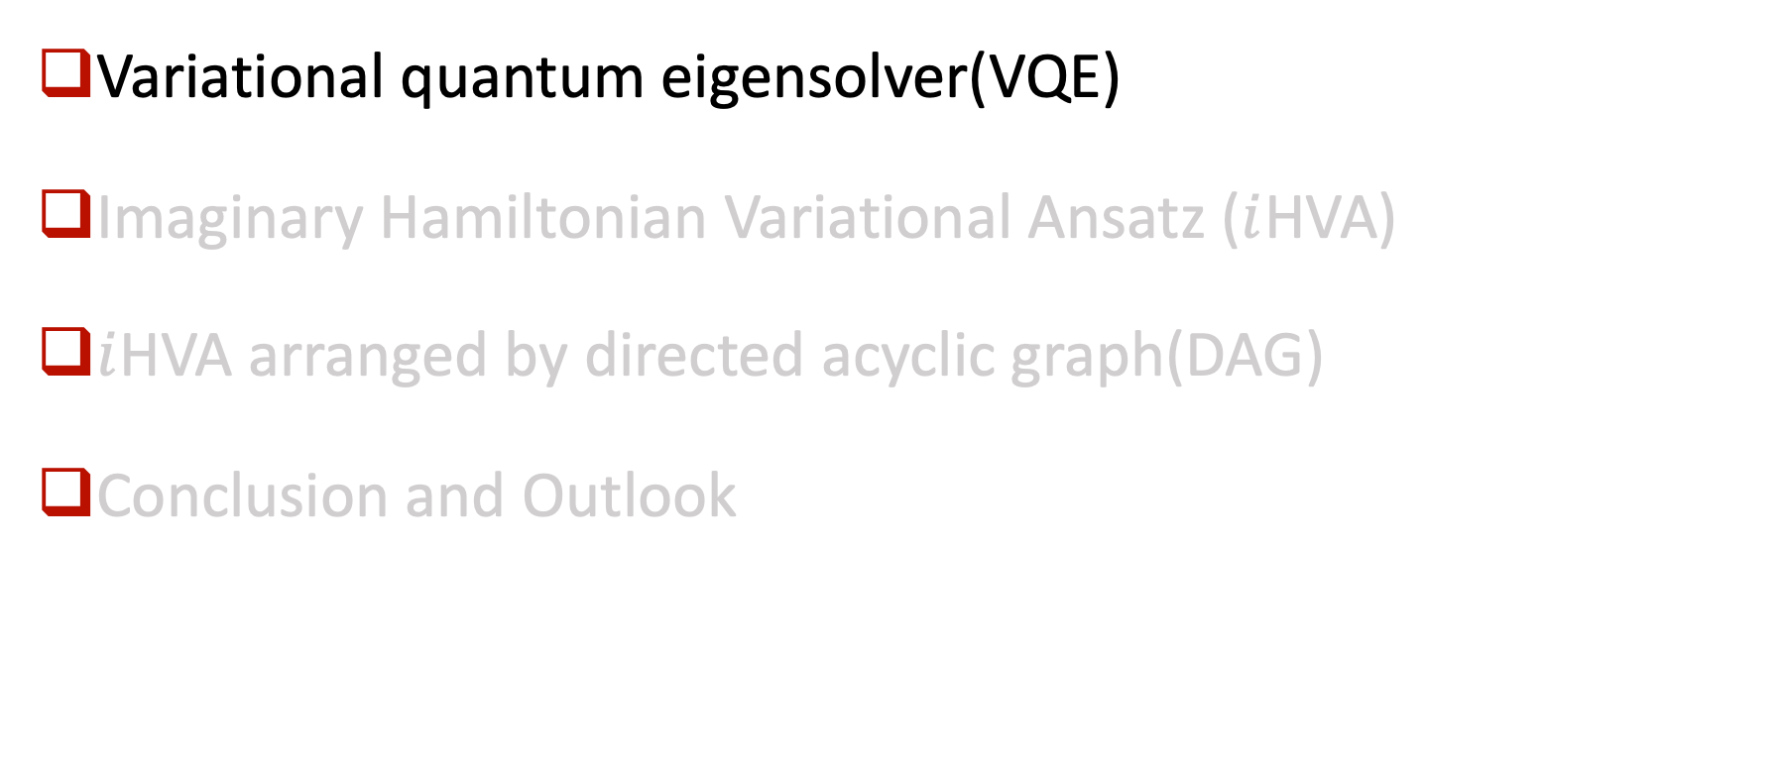
Main Content
Variational quantum eigensolver(VQE)
Imaginary Hamiltonian Variational Ansatz ($i$HVA)
$i$HVA arranged by directed acyclic graph(DAG)
Conclusion and Outlook

Slide 3
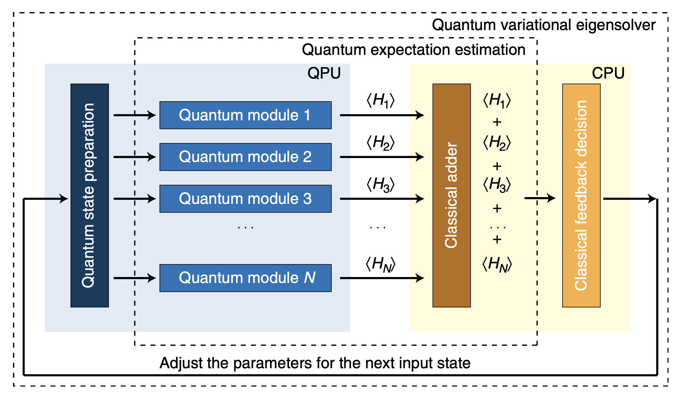
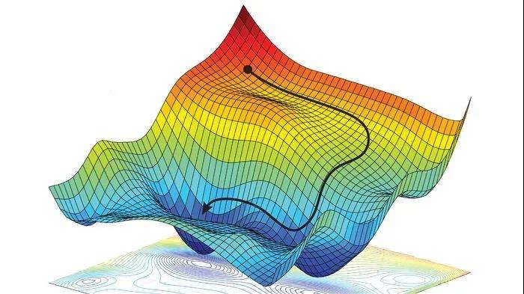
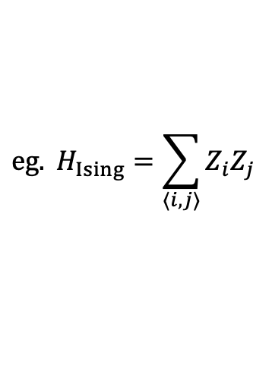

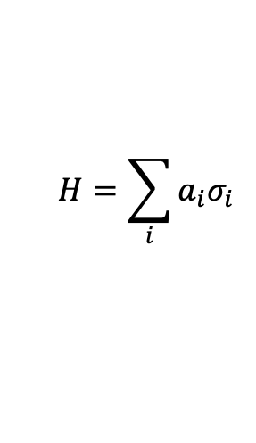
Variational quantum eigensolver(VQE)
VQE optimization loop
[Peruzzo et. al. 2014]
To prepare the ground state of Hamiltonian
$$H=\sum_{i}{a_{i}σ_{i}}$$
$$eg. H_{Ising}=\sum_{⟨i,j⟩}{Z_{i}Z_{j}}$$
The Hamiltonian expectation is minimized variationally.
$$\left\langle φ(θ)|H|φ(θ)\right\rangle ≥E_{0}$$
The global minimum of the energy landscape is an approximation to the Hamiltonian ground state energy.
Hamiltonian expectation on quantum computers
optimization performed on classical computers
3/35
Notes:
第一个变分量子算法是变分量子本征求解器VQE。其目的是制备任意哈密顿量的基态。
任意哈密顿量可以写为泡利串的线性组合,
VQE使用变分法优化哈密顿量期望值，这样一个能曲面的全局最小值就是哈密顿基态本征值的近似。
在VQE中，量子计算机用于计算能量期望值，

Slide 4

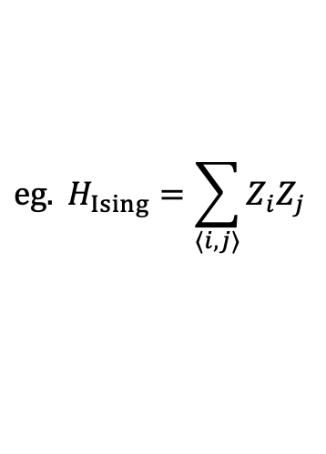
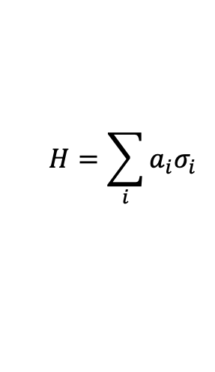
Variational quantum eigensolver(VQE)
Variational ansatz (quantum)
VQE optimization loop
[Peruzzo et. al. 2014]
To prepare the ground state of Hamiltonian
$$H=\sum_{i}{a_{i}σ_{i}}$$
$$eg. H_{Ising}=\sum_{⟨i,j⟩}{Z_{i}Z_{j}}$$
The Hamiltonian expectation is minimized variationally.
$$\left\langle φ(θ)|H|φ(θ)\right\rangle ≥E_{0}$$
The global minimum of the energy landscape is an approximation to the Hamiltonian ground state energy.
Key to the success of VQE:
Variational ansatz：$\left|φ\left(θ\right)\right\rangle =U\left(θ\right)|Ω⟩$
4/35
Notes:
第一个变分量子算法是变分量子本征求解器VQE。其目的是制备任意哈密顿量的基态。
任意哈密顿量可以写为泡利串的线性组合,
VQE使用变分法优化哈密顿量期望值，这样一个能曲面的全局最小值就是哈密顿基态本征值的近似。
在VQE中，量子计算机用于计算能量期望值，

Slide 5
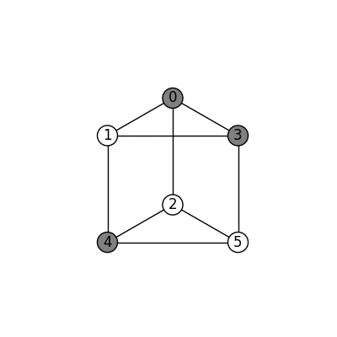
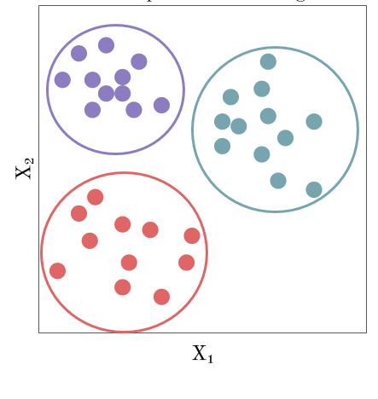
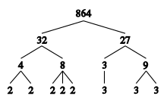

QAOA ansatz for MaxCut
MaxCut: Find a way to cut the maximum number of edges of a graph.
3-regular graph with number of nodes $N=6$
[$D$-regular graph: every node connect with $D$ edges.]
Applications:
unsupervised machine learning
integer factorization
5/35
Notes:
贫瘠高原现象是指从随机初始点开始优化过程制备基态。我们首先要计算梯度。而初始点的梯度会随着系统尺寸增加而指数减小。这导致梯度在量子计算机上无法精确计算

Slide 6
QAOA ansatz for MaxCut
MaxCut: Find a way to cut the maximum number of edges of a graph.
Karp’s 21 NP-complete problems [R. M. Karp, 1972]
Satisfiability
  0-1 integer programming
  Clique
    Set packing
    Vertex cover
      Set cover
      Feedback node set
      Feedback arc set
      Directed Hamiltonian cycle
        Undirected Hamiltonian cycle
3-SAT
  Chromatic number
    Clique cover
    Exact cover
      Hitting set
      Steiner tree
      3-d matching
      Knapsack
        Job sequencing
        Partition
          MaxCut
3-regular graph with number of nodes $N=6$
[$D$-regular graph: every node connect with $D$ edges]
Applications:
unsupervised machine learning
integer factorization
6/35
Notes:
贫瘠高原现象是指从随机初始点开始优化过程制备基态。我们首先要计算梯度。而初始点的梯度会随着系统尺寸增加而指数减小。这导致梯度在量子计算机上无法精确计算

Slide 7

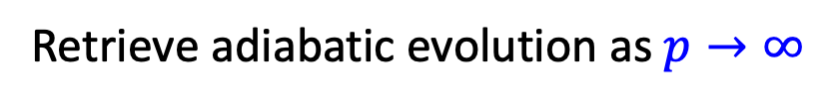






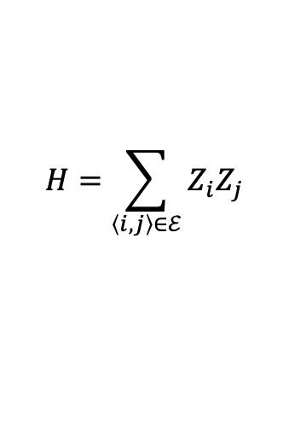

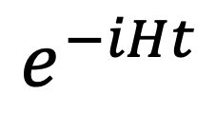
QAOA ansatz for MaxCut
MaxCut: Find a way to cut the maximum number of edges of a graph.
Ground state preparation of
$$H=\sum_{\left\langle i,j\right\rangle ∈ℰ}{Z_{i}Z_{j}}$$
QAOA ansatz(or Hamiltonian Variational Ansatz (HVA)):
$$e^{−iHt}$$
$p$ rounds
$$|+⟩$$
$$|+⟩$$
Retrieve adiabatic evolution as $p→∞$
$$e^{−iγ_{1}H}$$
$$e^{−iβ_{1}∑X}$$
$$e^{−iγ_{p}H}$$
$$e^{−iβ_{p}∑X}$$
$$|+⟩$$
$$|+⟩$$
7/35
Notes:
贫瘠高原现象是指从随机初始点开始优化过程制备基态。我们首先要计算梯度。而初始点的梯度会随着系统尺寸增加而指数减小。这导致梯度在量子计算机上无法精确计算

Slide 8
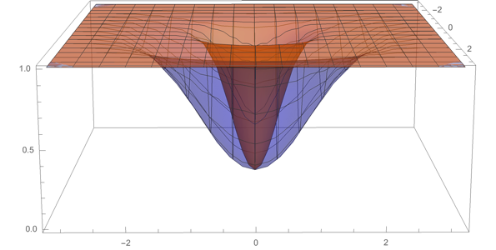








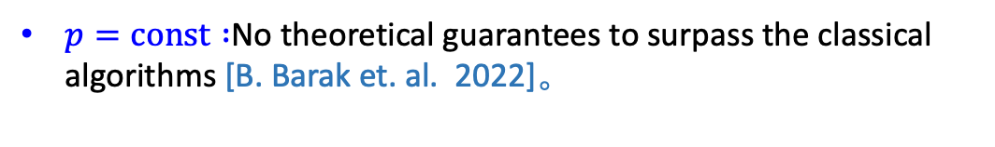
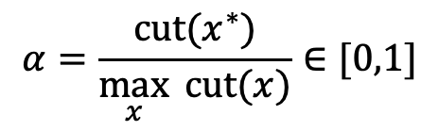
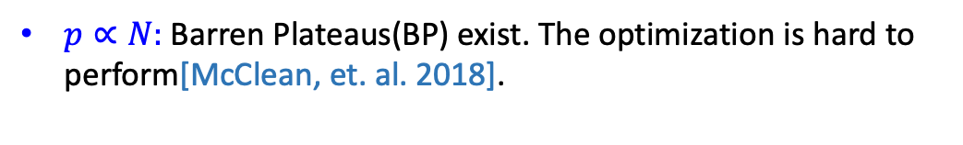

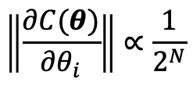











Challenges to QAOA
Evaluate MaxCut performance of an algorithm
$p=const :$No theoretical guarantees to surpass the classical algorithms [B. Barak et. al. 2022]。
$$α=\frac{cut(x^{∗})}{\max_{x}{ cut(x)}}∈[0,1]$$
[For 3-regular graph]
$$0.5$$
$$0.6925$$
$$0.7559$$
$$0.7924$$
$$0.9412$$
$$α$$
$p$ rounds
$$p=0$$
$$p=1$$
$$p=2$$
$$p=3$$
Hardness under $NP≠P$
[E.Farhi, et.al. 2014]
[J. Wurtz, et.al. 2021]
(Quantum Advantage)
$$|+⟩$$
$p∝N:$ Barren Plateaus(BP) exist. The optimization is hard to perform[McClean, et. al. 2018].
$$|+⟩$$
$$e^{−iγ_{1}H}$$
$$e^{−iβ_{1}∑X}$$
$$e^{−iγ_{p}H}$$
$$e^{−iβ_{p}∑X}$$
$$|+⟩$$
vanishing gradient
$$|+⟩$$
$$\left\|\frac{∂C(θ)}{∂θ_{i}}\right\|∝\frac{1}{2^{N}}$$
$$N=24$$
Ground state
$$N=4$$
8/35
Notes:
贫瘠高原现象是指从随机初始点开始优化过程制备基态。我们首先要计算梯度。而初始点的梯度会随着系统尺寸增加而指数减小。这导致梯度在量子计算机上无法精确计算

Slide 9
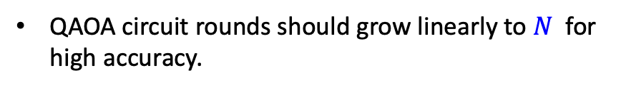


Challenges to QAOA
$p=const :$No theoretical guarantees to surpass the classical algorithms [B. Barak et. al. 2022]。
[For 3-regular graph]
$$0.5$$
$$0.6925$$
$$0.7559$$
$$0.7924$$
$$0.9412$$
$$α$$
$$p=0$$
$$p=1$$
$$p=2$$
$$p=3$$
Hardness under $NP≠P$
QAOA circuit rounds should grow linearly to $N$ for high accuracy.
[E.Farhi, et.al. 2014]
[J. Wurtz, et.al. 2021]
(Quantum Advantage)
$$p\sim T_{Real}∝Δ_{min}^{−1}∝N$$
$p∝N:$ Barren Plateaus(BP) exist. The optimization is hard to perform[McClean, et. al. 2018].
vanishing gradient
$$\left\|\frac{∂C(θ)}{∂θ_{i}}\right\|∝\frac{1}{2^{N}}$$
$$N=24$$
BP comes if the circuit rounds grows linearly to $N$.
[Cerezo, et.al. 2021]
Ground state
$$N=4$$
9/35
Notes:
贫瘠高原现象是指从随机初始点开始优化过程制备基态。我们首先要计算梯度。而初始点的梯度会随着系统尺寸增加而指数减小。这导致梯度在量子计算机上无法精确计算

Slide 10


Challenges to QAOA
In contrast, imaginary time evolution requires constant time.
$p=const :$No theoretical guarantees to surpass the classical algorithms [B. Barak et. al. 2022]。
[For 3-regular graph]
$$e^{−TH}\left|Ω\right\rangle \sim e^{−TΔ_{QITE}}\left|E_{1}\right\rangle +\left|E_{0}\right\rangle$$
$$T_{Imag}∝Δ_{QITE}^{−1}=Const$$
$$0.5$$
$$0.6925$$
$$0.7559$$
$$0.7924$$
$$0.9412$$
$$α$$
$$p=0$$
$$p=1$$
$$p=2$$
$$p=3$$
Hardness under $NP≠P$
QAOA circuit rounds should grow linearly to $N$ for high accuracy.
[E.Farhi, et.al. 2014]
[J. Wurtz, et.al. 2021]
(Quantum Advantage)
$$p\sim T_{Real}∝Δ_{min}^{−1}∝N$$
$p∝N:$ Barren Plateaus(BP) exist. The optimization is hard to perform[McClean, et. al. 2018].
vanishing gradient
$$\left\|\frac{∂C(θ)}{∂θ_{i}}\right\|∝\frac{1}{2^{N}}$$
$$N=24$$
BP comes if the circuit rounds grows linearly to $N$.
[Cerezo, et.al. 2021]
Ground state
$$N=4$$
10/35
Notes:
贫瘠高原现象是指从随机初始点开始优化过程制备基态。我们首先要计算梯度。而初始点的梯度会随着系统尺寸增加而指数减小。这导致梯度在量子计算机上无法精确计算

Slide 11




Challenges to QAOA
In contrast, imaginary time evolution requires constant time.
$p=const :$No theoretical guarantees to surpass the classical algorithms [B. Barak et. al. 2022]。
[For 3-regular graph]
$$e^{−TH}\left|Ω\right\rangle \sim e^{−TΔ_{QITE}}\left|E_{1}\right\rangle +\left|E_{0}\right\rangle$$
$$T_{Imag}∝Δ_{QITE}^{−1}=Const$$
$$0.5$$
$$0.6925$$
$$0.7559$$
$$0.7924$$
$$0.9412$$
$$α$$
$$p=0$$
$$p=1$$
$$p=2$$
$$p=3$$
Hardness under $NP≠P$
$p$ rounds
(Quantum Advantage)
[E.Farhi, et.al. 2014]
[J. Wurtz, et.al. 2021]
$$|+⟩$$
$p∝N:$ Barren Plateaus(BP) exist. The optimization is hard to perform[McClean, et. al. 2018].
$$|+⟩$$
$$e^{−iγ_{1}(−iH)}$$
$$e^{−iγ_{p}(−iH)}$$
vanishing gradient
$$|+⟩$$
$$|+⟩$$
$$\left\|\frac{∂C(θ)}{∂θ_{i}}\right\|∝\frac{1}{2^{N}}$$
$$N=24$$
imaginary Hamiltonian Variation?
Ground state
$$N=4$$
11/35
Notes:
贫瘠高原现象是指从随机初始点开始优化过程制备基态。我们首先要计算梯度。而初始点的梯度会随着系统尺寸增加而指数减小。这导致梯度在量子计算机上无法精确计算

Slide 12
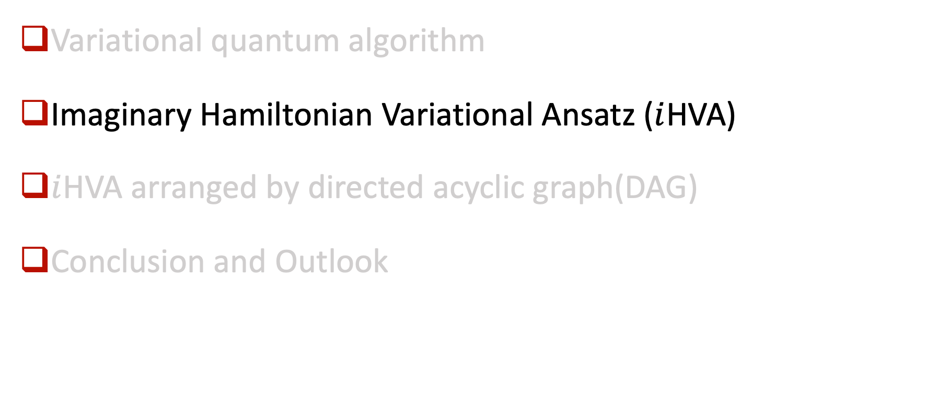
Main Content
Variational quantum algorithm
Imaginary Hamiltonian Variational Ansatz ($i$HVA)
$i$HVA arranged by directed acyclic graph(DAG)
Conclusion and Outlook

Slide 13


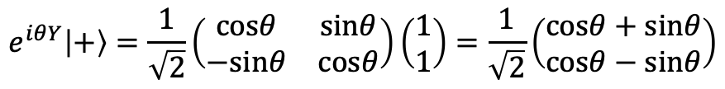
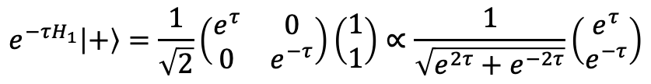
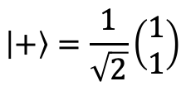
imaginary time evolution by unitary quantum gates
Consider the following Hamiltonian
$$H_{1}≡−Z=\left(\begin{matrix}−1 & 0 \\ 0 & 1\end{matrix}\right)$$
The initial state of the evolution is
$$\left|+\right\rangle =\frac{1}{\sqrt{2}}\left(\begin{matrix}1 \\ 1\end{matrix}\right)$$
The imaginary time evolution of the state is
$$e^{−τH_{1}}\left|+\right\rangle =\frac{1}{\sqrt{2}}\left(\begin{matrix}e^{τ} & 0 \\ 0 & e^{−τ}\end{matrix}\right)\left(\begin{matrix}1 \\ 1\end{matrix}\right)∝\frac{1}{\sqrt{e^{2τ}+e^{−2τ}}}\left(\begin{matrix}e^{τ} \\ e^{−τ}\end{matrix}\right)$$
$$e^{τZ}\left|+\right\rangle ∝e^{iθ\left(τ\right)Y}\left|+\right\rangle$$
The evolution can be realized by a single-qubit rotation
[M. Motta et al. Nat. Phys. (2020)]
$$e^{iθY}\left|+\right\rangle =\frac{1}{\sqrt{2}}\left(\begin{matrix}cosθ & sinθ \\ −sinθ & cosθ\end{matrix}\right)\left(\begin{matrix}1 \\ 1\end{matrix}\right)=\frac{1}{\sqrt{2}}\left(\begin{matrix}cosθ+sinθ \\ cosθ−sinθ\end{matrix}\right)$$
13/35

Slide 14


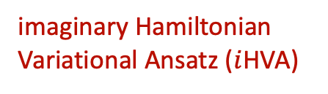
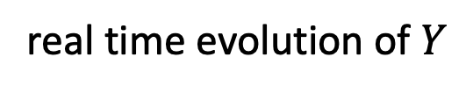
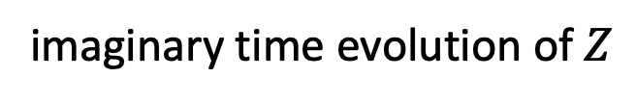


imaginary time evolution by unitary quantum gates
$$∝$$
imaginary Hamiltonian Variational Ansatz ($i$HVA)
$$|+⟩$$
$$e^{−iγ_{1}(−iZ)}$$
$$|+⟩$$
$$e^{−iγ_{1}Y}$$
imaginary time evolution of $Z$
real time evolution of $Y$
The imaginary time evolution of the state is
$$e^{−τH_{1}}\left|+\right\rangle =\frac{1}{\sqrt{2}}\left(\begin{matrix}e^{τ} & 0 \\ 0 & e^{−τ}\end{matrix}\right)\left(\begin{matrix}1 \\ 1\end{matrix}\right)∝\frac{1}{\sqrt{e^{2τ}+e^{−2τ}}}\left(\begin{matrix}e^{τ} \\ e^{−τ}\end{matrix}\right)$$
$$e^{τZ}\left|+\right\rangle ∝e^{iθ\left(τ\right)Y}\left|+\right\rangle$$
The evolution can be realized by a single-qubit rotation
[M. Motta et al. Nat. Phys. (2020)]
$$e^{iθY}\left|+\right\rangle =\frac{1}{\sqrt{2}}\left(\begin{matrix}cosθ & sinθ \\ −sinθ & cosθ\end{matrix}\right)\left(\begin{matrix}1 \\ 1\end{matrix}\right)=\frac{1}{\sqrt{2}}\left(\begin{matrix}cosθ+sinθ \\ cosθ−sinθ\end{matrix}\right)$$
14/35

Slide 15
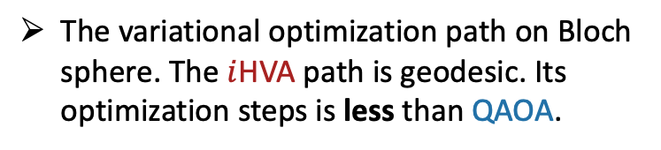





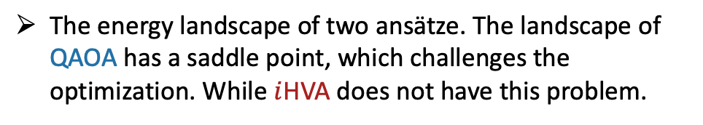
imaginary Hamiltonian Variational Ansatz on toy models
To prepare the ground state of $H_{1}=−Z$.
To prepare the ground state of $H_{2}=ZZ$.
QAOA
QAOA
$i$HVA
$i$HVA
$i$HVA
QAOA
The variational optimization path on Bloch sphere. The $i$HVA path is geodesic. Its optimization steps is less than QAOA.
The energy landscape of two ansätze. The landscape of QAOA has a saddle point, which challenges the optimization. While $i$HVA does not have this problem.
15/35

Slide 16



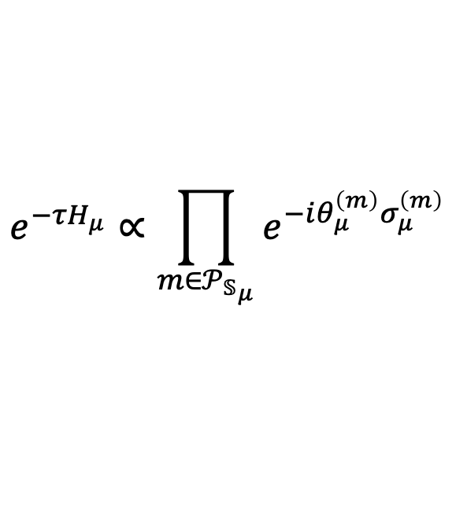
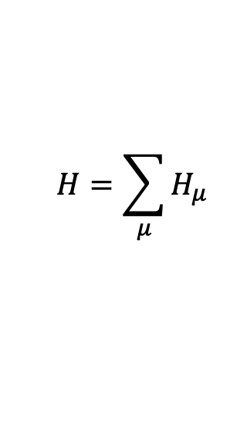

$i$HVA for arbitrary quantum system
Consider a local interacting Hamiltonian
$$H=\sum_{μ}{H_{μ}}$$
The imaginary time evolution is expanded by
$$e^{−τH_{μ}}∝\prod_{m∈𝒫_{𝕊_{μ}}}{e^{−iθ_{μ}^{\left(m\right)}σ_{μ}^{\left(m\right)}}}$$
$$σ_{μ}^{\left(m\right)}∈span\{σ∈𝒫_{𝕊_{i}}\}$$
$σ_{μ}^{\left(m\right)}$ derived by system symmetries
$$\left[U_{g}, σ_{μ}^{\left(m\right)}\right]=0$$
$$\left(\left[U_{g}, H_{μ}\right]=0\right)$$
[X. Wang, Y. Chai, M. Demidik, X. Feng, K. Jansen, C. Tuysuz. arXiv:2307.13598]
16/35
Notes:
16个幺正门对应U(4)群的16个自由度

Slide 17
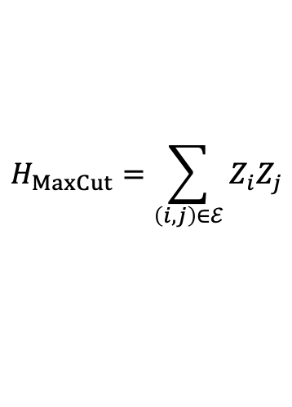
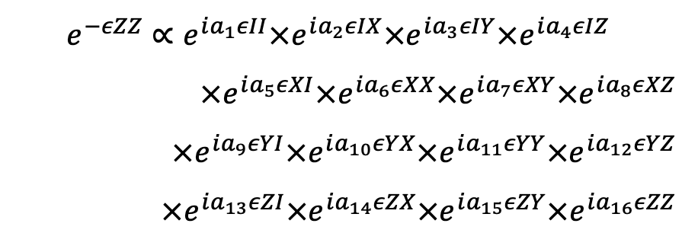
$i$HVA for arbitrary quantum system
Consider a local interacting Hamiltonian
$$H_{MaxCut}=\sum_{\left(i,j\right)∈ℰ}{Z_{i}Z_{j}}$$
$$H=\sum_{μ}{H_{μ}}$$
$$e^{−εZZ}∝e^{ia_{1}εII}×e^{ia_{2}εIX}{×e}^{ia_{3}εIY}{×e}^{ia_{4}εIZ}$$
$×e^{ia_{5}εXI}×e^{ia_{6}εXX}{×e}^{ia_{7}εXY}×e^{ia_{8}εXZ}$
$×e^{ia_{9}εYI}×e^{ia_{10}εYX}{×e}^{ia_{11}εYY}×e^{ia_{12}εYZ}$
$×e^{ia_{13}εZI}×e^{ia_{14}εZX}{×e}^{ia_{15}εZY}×e^{ia_{16}εZZ}$
The imaginary time evolution is expanded by
$$e^{−τH_{μ}}∝\prod_{m∈𝒫_{𝕊_{μ}}}{e^{−iθ_{μ}^{\left(m\right)}σ_{μ}^{\left(m\right)}}}$$
$$σ_{μ}^{\left(m\right)}∈span\{σ∈𝒫_{𝕊_{i}}\}$$
$σ_{μ}^{\left(m\right)}$ derived by system symmetries
$$\left[U_{g}, σ_{μ}^{\left(m\right)}\right]=0$$
$$\left(\left[U_{g}, H_{μ}\right]=0\right)$$
[X. Wang, Y. Chai, M. Demidik, X. Feng, K. Jansen, C. Tuysuz. arXiv:2307.13598]
17/35
Notes:
16个幺正门对应U(4)群的16个自由度

Slide 18




$i$HVA for arbitrary quantum system
Consider a local interacting Hamiltonian
$$H_{MaxCut}=\sum_{\left(i,j\right)∈ℰ}{Z_{i}Z_{j}}$$
$$H=\sum_{μ}{H_{μ}}$$
The imaginary time evolution is expanded by
$$e^{−τH_{μ}}∝\prod_{m∈𝒫_{𝕊_{μ}}}{e^{−iθ_{μ}^{\left(m\right)}σ_{μ}^{\left(m\right)}}}$$
$$σ_{μ}^{\left(m\right)}∈span\{σ∈𝒫_{𝕊_{i}}\}$$
: time-reversal symmetry
$$U_{g}=K$$
$σ_{μ}^{\left(m\right)}$ derived by system symmetries
: spin-flip symmetry
$$U_{g}=XX$$
$$\left[U_{g}, σ_{μ}^{\left(m\right)}\right]=0$$
$$\left(\left[U_{g}, H_{μ}\right]=0\right)$$
$$σ_{(i,j)}^{\left(1\right)}=Z_{i}Y_{j}$$
$$σ_{(i,j)}^{\left(2\right)}=Y_{i}Z_{j}$$
[X. Wang, Y. Chai, M. Demidik, X. Feng, K. Jansen, C. Tuysuz. arXiv:2307.13598]
18/35
Notes:
16个幺正门对应U(4)群的16个自由度

Slide 19
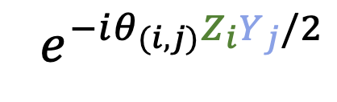
$i$HVA for arbitrary quantum system
Consider a local interacting Hamiltonian
$${ e}^{−iθ_{(i,j)}Z_{i}Y_{j}/2}$$
$$H=\sum_{μ}{H_{μ}}$$
The imaginary time evolution is expanded by
0
$$e^{−τH_{μ}}∝\prod_{m∈𝒫_{𝕊_{μ}}}{e^{−iθ_{μ}^{\left(m\right)}σ_{μ}^{\left(m\right)}}}$$
1
3
2
4
5
$$σ_{μ}^{\left(m\right)}∈span\{σ∈𝒫_{𝕊_{i}}\}$$
$σ_{μ}^{\left(m\right)}$ derived by system symmetries
$$\left[U_{g}, σ_{μ}^{\left(m\right)}\right]=0$$
$$\left(\left[U_{g}, H_{μ}\right]=0\right)$$
$$σ_{(i,j)}^{\left(1\right)}=Z_{i}Y_{j}$$
$$σ_{(i,j)}^{\left(2\right)}=Y_{i}Z_{j}$$
[X. Wang, Y. Chai, M. Demidik, X. Feng, K. Jansen, C. Tuysuz. arXiv:2307.13598]
19/35
Notes:
16个幺正门对应U(4)群的16个自由度

Slide 20



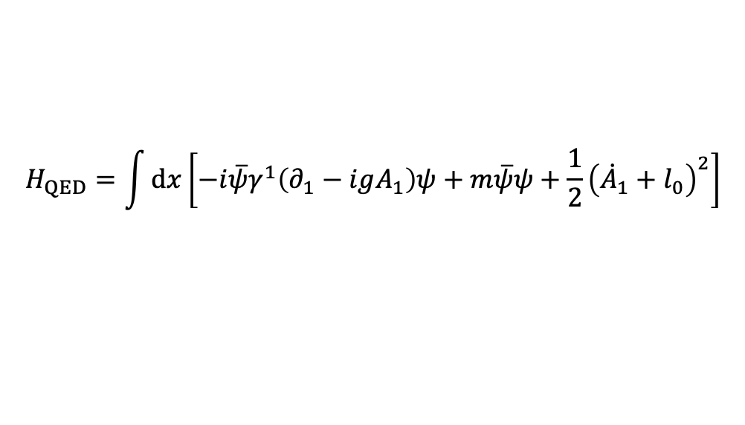
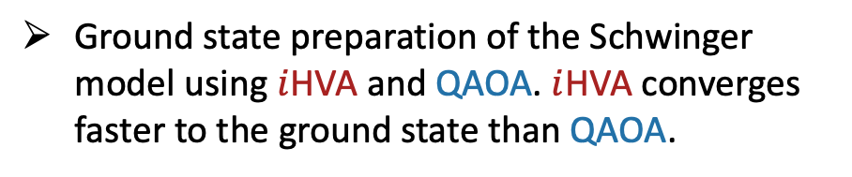

$i$HVA of the Schwinger model
$$H_{QED}=\int{dx\left[−i\overline{ψ}γ^{1}\left(∂_{1}−igA_{1}\right)ψ+m\overline{ψ}ψ+\frac{1}{2}{\left({\dot{A}}_{1}+l_{0}\right)}^{2}\right]}$$
local $U(1)$ gauge invariance
$$\left[H_{QED},{\hat{G}}_{x}\right]=0,$$
$${\hat{G}}_{x}≡{\hat{E}}_{x}−{\hat{E}}_{x−1}−{\hat{q}}_{x}$$
$i$HVA
QAOA
Ground state preparation of the Schwinger model using $i$HVA and QAOA. $i$HVA converges faster to the ground state than QAOA.
20/35
Notes:
16个幺正门对应U(4)群的16个自由度

Slide 21


Different arrangements in $i$HVA
Different arrangements
0
1
3
2
4
5
$$depth=3$$
$$depth=6$$
Numerically, we find arrangement with larger depth gets more accurate results. How to choose an appropriate arrangement?
21/35
Notes:
16个幺正门对应U(4)群的16个自由度

Slide 22
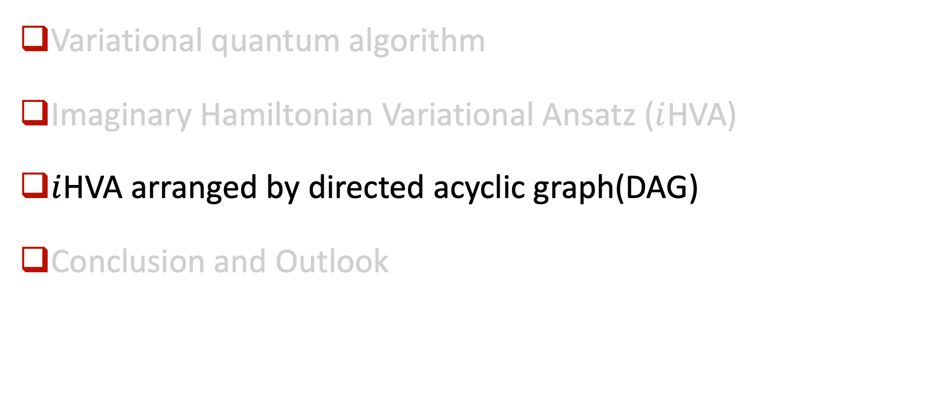
Main Content
Variational quantum algorithm
Imaginary Hamiltonian Variational Ansatz ($i$HVA)
$i$HVA arranged by directed acyclic graph(DAG)
Conclusion and Outlook

Slide 23
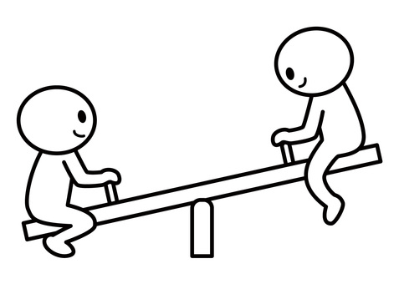
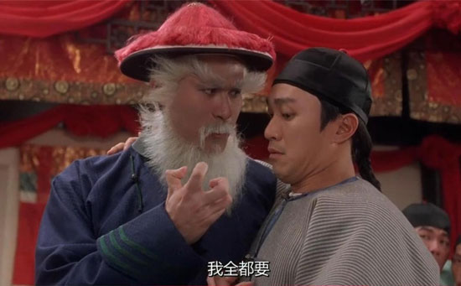









Challenges to QAOA
$p=const :$No theoretical guarantees to surpass the classical algorithms [B. Barak et. al. 2022]。
$p$ rounds
high trainability
$$|+⟩$$
low accuracy
$$|+⟩$$
$$e^{−iγ_{1}H}$$
$$e^{−iβ_{1}∑X}$$
$$e^{−iγ_{p}H}$$
$$e^{−iβ_{p}∑X}$$
$$|+⟩$$
$p∝N:$ Barren Plateaus(BP) exist. The optimization is hard to perform[McClean, et. al. 2018].
$$|+⟩$$
high accuracy
We need them all !
low trainability
23/35
Notes:
贫瘠高原现象是指从随机初始点开始优化过程制备基态。我们首先要计算梯度。而初始点的梯度会随着系统尺寸增加而指数减小。这导致梯度在量子计算机上无法精确计算

Slide 24







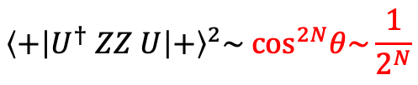


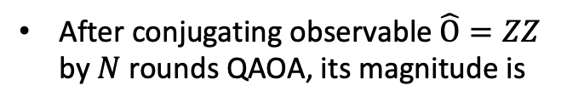
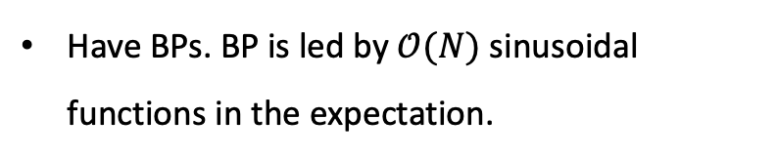








Challenges to QAOA
$p=const$
$$p∝N$$
Classically simulatable, which is almost impossible to surpass classical algorithms.
Have BPs. BP is led by $𝒪(N)$ sinusoidal functions in the expectation.
$$R_{X}$$
$$Z_{i}$$
$$R_{X}$$
$$Z_{i+1}$$
$$|+⟩$$
$$|+⟩$$
$$e^{iθXI/2} ZZ e^{−iθXI/2}=cosθZZ+sinθ YZ$$
$$|+⟩$$
$$|+⟩$$
After conjugating observable $\hat{O}=ZZ$ by $N$ rounds QAOA, its magnitude is
$$|+⟩$$
$$|+⟩$$
$$|+⟩$$
$$Z_{i}$$
$$|+⟩$$
$$Z_{i}$$
$$\left\langle +\right|U^{†} ZZ U{\left|+\right\rangle }^{2}\sim \cos^{2N}θ\sim \frac{1}{2^{N}}$$
$$|+⟩$$
$$Z_{i+1}$$
$$|+⟩$$
$$Z_{i+1}$$
$$|+⟩$$
$$|+⟩$$
Barren Plateau
$$|+⟩$$
$$|+⟩$$
$$|+⟩$$
$$|+⟩$$
24/35
classically simulatable
non-classically simulatable
Notes:
绝热变分拟设由L次重复的层状结构组成，我们成为L层

Slide 25





Gates deletion in variational ansatz
$$|+⟩$$
$$|+⟩$$
$$|+⟩$$
Non-classicality
$$|+⟩$$
$$|+⟩$$
$$|+⟩$$
$$Z_{i}$$
$$|+⟩$$
$$|+⟩$$
$$Z_{i+1}$$
$$|+⟩$$
$$|+⟩$$
$$|+⟩$$
Barren Plateau
$$|+⟩$$
$$|+⟩$$
$$|+⟩$$
$$|+⟩$$
$$|+⟩$$
Non-classical (necessary for high accuracy )
Barren Plateau-free (high trainability) [H. Zhang, et.al. PRL 2024]
25/35
Notes:
绝热变分拟设由L次重复的层状结构组成，我们成为L层

Slide 26
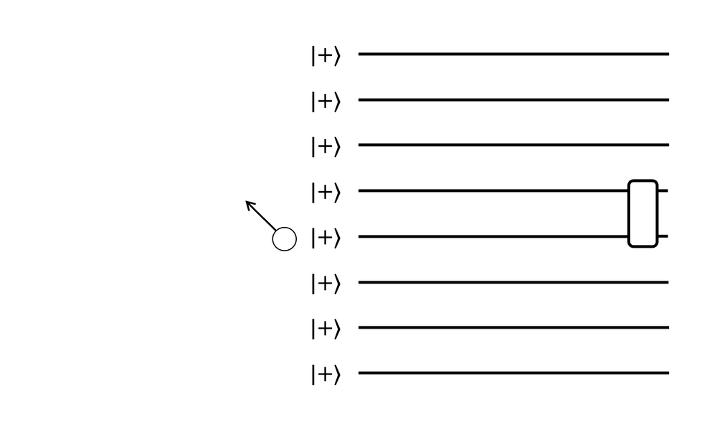
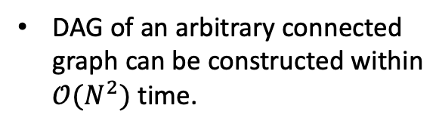
$i$HVA arranged by DAG
For arbitrary graph, ansatz is can be constructed by directed acyclic graph(DAG)
DAG of an arbitrary connected graph can be constructed within $𝒪(N^{2})$ time.
light-cone represented by directed graph
26/35
Notes:
绝热变分拟设由L次重复的层状结构组成，我们成为L层

Slide 27
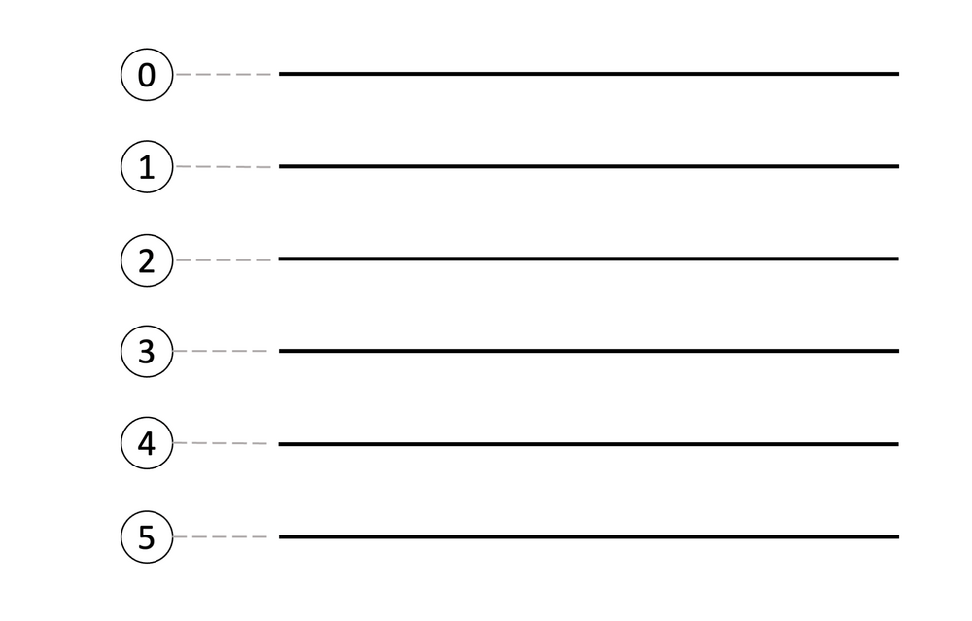
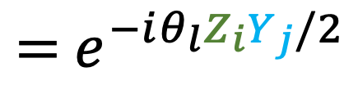


$i$HVA arranged by DAG
For arbitrary graph, ansatz is can be constructed by directed acyclic graph(DAG)
DAG provides a natural time order to edges and nodes in the graph (called topological order).
4
1
5
0
3
2
DAG of an arbitrary connected graph can be constructed within $𝒪(N^{2})$ time.
$$i$$
$$={ e}^{−iθ_{l}Z_{i}Y_{j}/2}$$
$$j$$
27/35
Notes:
绝热变分拟设由L次重复的层状结构组成，我们成为L层

Slide 28
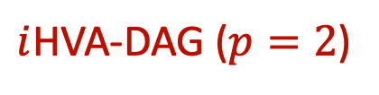
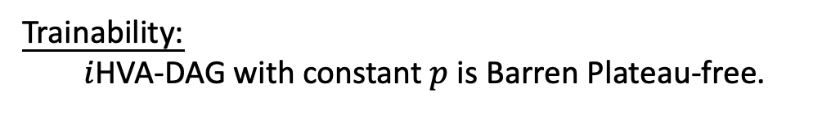
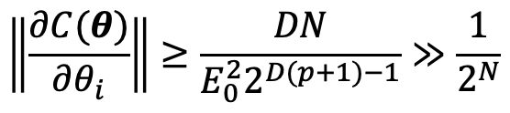
$i$HVA arranged by DAG
For arbitrary graph, ansatz is can be constructed by directed acyclic graph(DAG)
$i$HVA-DAG ($p=2$)
$$|+⟩$$
4
1
$$|+⟩$$
$$|+⟩$$
5
0
$$|+⟩$$
$$|+⟩$$
3
2
$$|+⟩$$
Trainability:
$i$HVA-DAG with constant $p$ is Barren Plateau-free.
DAG of an arbitrary connected graph can be constructed within $𝒪(N^{2})$ time.
$$\left\|\frac{∂C(θ)}{∂θ_{i}}\right\|≥\frac{DN}{E_{0}^{2}2^{D(p+1)−1}}≫\frac{1}{2^{N}}$$
28/35
Notes:
绝热变分拟设由L次重复的层状结构组成，我们成为L层

Slide 29
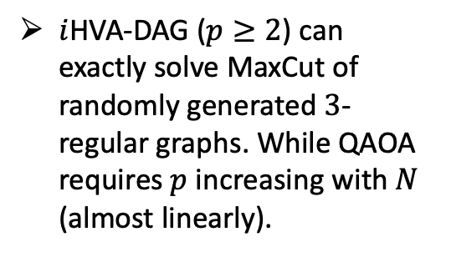
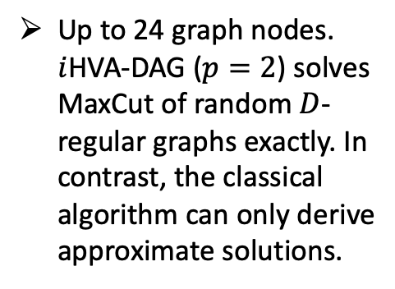
Numerical results on simulator
Compared with QAOA
$i$HVA-DAG ($p≥2$) can exactly solve MaxCut of randomly generated $3$-regular graphs. While QAOA requires $p$ increasing with $N$ (almost linearly).
Compared with classical algorithm (Goemans-Williamson)
Up to 24 graph nodes. $i$HVA-DAG ($p=2$) solves MaxCut of random $D$-regular graphs exactly. In contrast, the classical algorithm can only derive approximate solutions.
29/35

Slide 30





Numerical results on hardware
MaxCut experiment (63 Qubits)
$$H=−\frac{1}{2}\sum_{\left(i,j\right)∈ℰ}{(1−w_{ij}Z_{i}Z_{j})}$$
$$（w_{ij}=±1）$$
$$\left|φ_{I}\left(θ\right)\right\rangle =\prod_{\left(i,j\right)∈ℰ}{e^{−iθw_{ij}Z_{i}Y_{j}/2}}{\left|+\right\rangle }^{⊗N}$$
$$\left|φ_{R}\left(β,γ\right)\right\rangle =\prod_{i∈𝒱}{e^{−iβX_{i}/2}}\prod_{\left(i,j\right)∈ℰ}{e^{−iγw_{ij}Z_{i}Z_{j}/2}}{\left|+\right\rangle }^{⊗N}$$
ibm_kyoto
30/35
Notes:
使用iHVA-dag求解MaxCut近似比最高可达到0.96

Slide 31
Numerical results on hardware
MaxCut experiment (63 Qubits)
$$H=−\frac{1}{2}\sum_{\left(i,j\right)∈ℰ}{(1−w_{ij}Z_{i}Z_{j})}$$
$$（w_{ij}=±1）$$
$$\left|φ_{I}\left(θ\right)\right\rangle =\prod_{\left(i,j\right)∈ℰ}{e^{−iθw_{ij}Z_{i}Y_{j}/2}}{\left|+\right\rangle }^{⊗N}$$
$$\left|φ_{R}\left(β,γ\right)\right\rangle =\prod_{i∈𝒱}{e^{−iβX_{i}/2}}\prod_{\left(i,j\right)∈ℰ}{e^{−iγw_{ij}Z_{i}Z_{j}/2}}{\left|+\right\rangle }^{⊗N}$$
ibm_kyoto
31/35
Notes:
使用iHVA-dag求解MaxCut近似比最高可达到0.96

Slide 32












Theoretical performance guarantees
For 3-regular graphs
QAOA
$$0.5$$
$$0.6925$$
$$0.7559$$
$$0.7924$$
$$0.9412$$
$$α$$
$$p=0$$
$$p=1$$
$$p=2$$
$$p=3$$
Hardness under $NP≠P$
[E.Farhi, et.al. 2014]
[J. Wurtz, et.al. 2021]
$6$ variational parameters
32/35

Slide 33




Theoretical performance guarantees
For 3-regular graphs
QAOA
$i$HVA-DAG
$$0.5$$
$$0.6925$$
$$0.7559$$
$$0.7924$$
$$0.7933 \text{(}\text{preliminary}\text{)}$$
$$0.9412$$
$$α$$
$$p=0$$
$$p=1$$
$$p=2$$
$$p=3$$
$$p=1$$
Hardness under $NP≠P$
[E.Farhi, et.al. 2014]
[J. Wurtz, et.al. 2021]
[This work]
(Quantum Advantage)
$6$ variational parameters
$1$ variational parameter
33/35

Slide 34

Main Content
Variational quantum algorithm
Imaginary Hamiltonian Variational Ansatz ($i$HVA)
$i$HVA arranged by directed acyclic graph(DAG)
Conclusion and Outlook

Slide 35

Conclusion and Outlook
Conclusion
We proposed a systematic method to construct imaginary Hamiltonian Variational Ansatz ($i$HVA)
Compared with QAOA:
$i$HVA converges faster to ground state.
$i$HVA-DAG has both high accuracy and high trainability.
Outlook
Numerically: Solve ground-state problems in larger-scale and more complicated setups
Theoretically: find a theoretical performance bound that could beat the best classical algorithm
35/35

Slide 36














Conclusion and Outlook
QAOA
$i$HVA-DAG
$$0.5$$
$$0.6925$$
$$0.7559$$
$$0.7924$$
$$0.7933 \text{(}\text{preliminary}\text{)}$$
$$0.9412$$
$$α$$
$$p=0$$
$$p=1$$
$$p=2$$
$$p=3$$
$$p=1$$
Hardness under $NP≠P$
[E.Farhi, et.al. 2014]
[J. Wurtz, et.al. 2021]
[This work]
(Quantum Advantage)
long way to go
Numerically: Solve ground-state problems in larger-scale and more complicated setups
Theoretically: find a theoretical performance bound that could beat the best classical algorithm
To show quantum advantage in real-world applications
Thanks for watching!
36/35

Slide 37




Depth of $i$HVA-DAG for regular graphs
Depth of QAOA:
$$d_{r}(p,N)=𝒪(p)$$
Depth of $i$HVA-DAG :
Upper bounded by
$$d_{i}(p,N)=𝒪(pN)$$
Lower bounded by
$$d_{i}(p,N)=𝒪(plogN)$$

