Slide 1
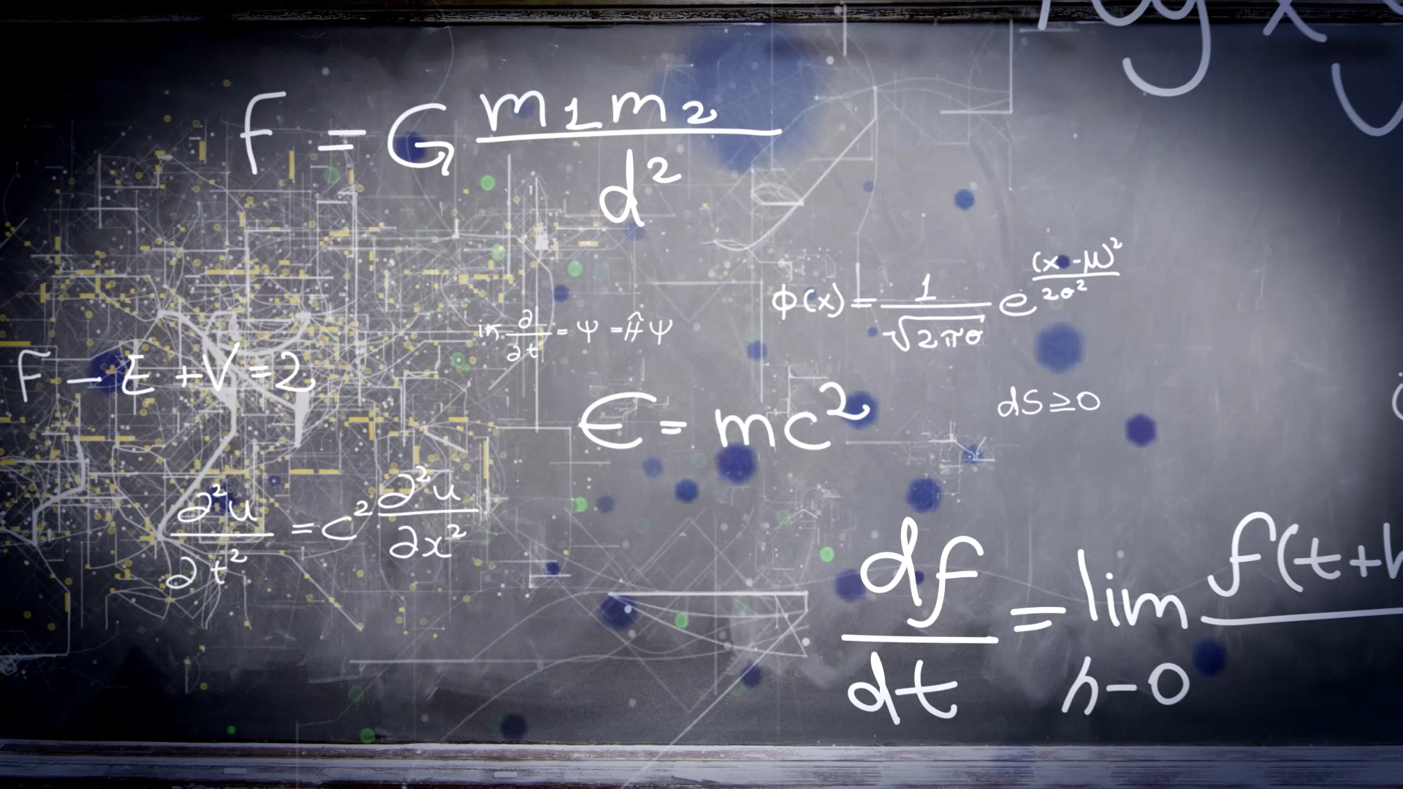
Brief Introduction to Experimental Collider Physics
Yusheng Wu (吴雨生)
wuyusheng@ustc.edu.cn
University of Science and Technology of China
“新视角下的强相互作用”冬季学校，复旦大学，2025年2月

Slide 2
Lecture schedule
3-hour brief introduction to experimental aspects of physics studies at particle colliders
Target for junior graduate students in this field
Cover the following:
  Part I: how are collision events produced and collected
  Part II: how can we analyze collision events for physics studies
  Part III: milestones (example) and prospects
Disclaimer: incomplete introduction with personal biases (towards LHC)

Slide 3
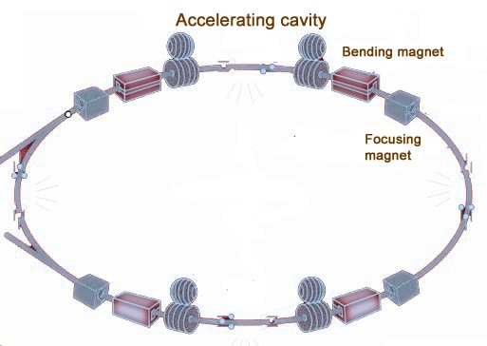
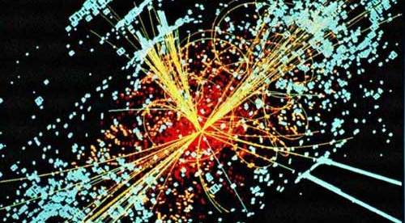
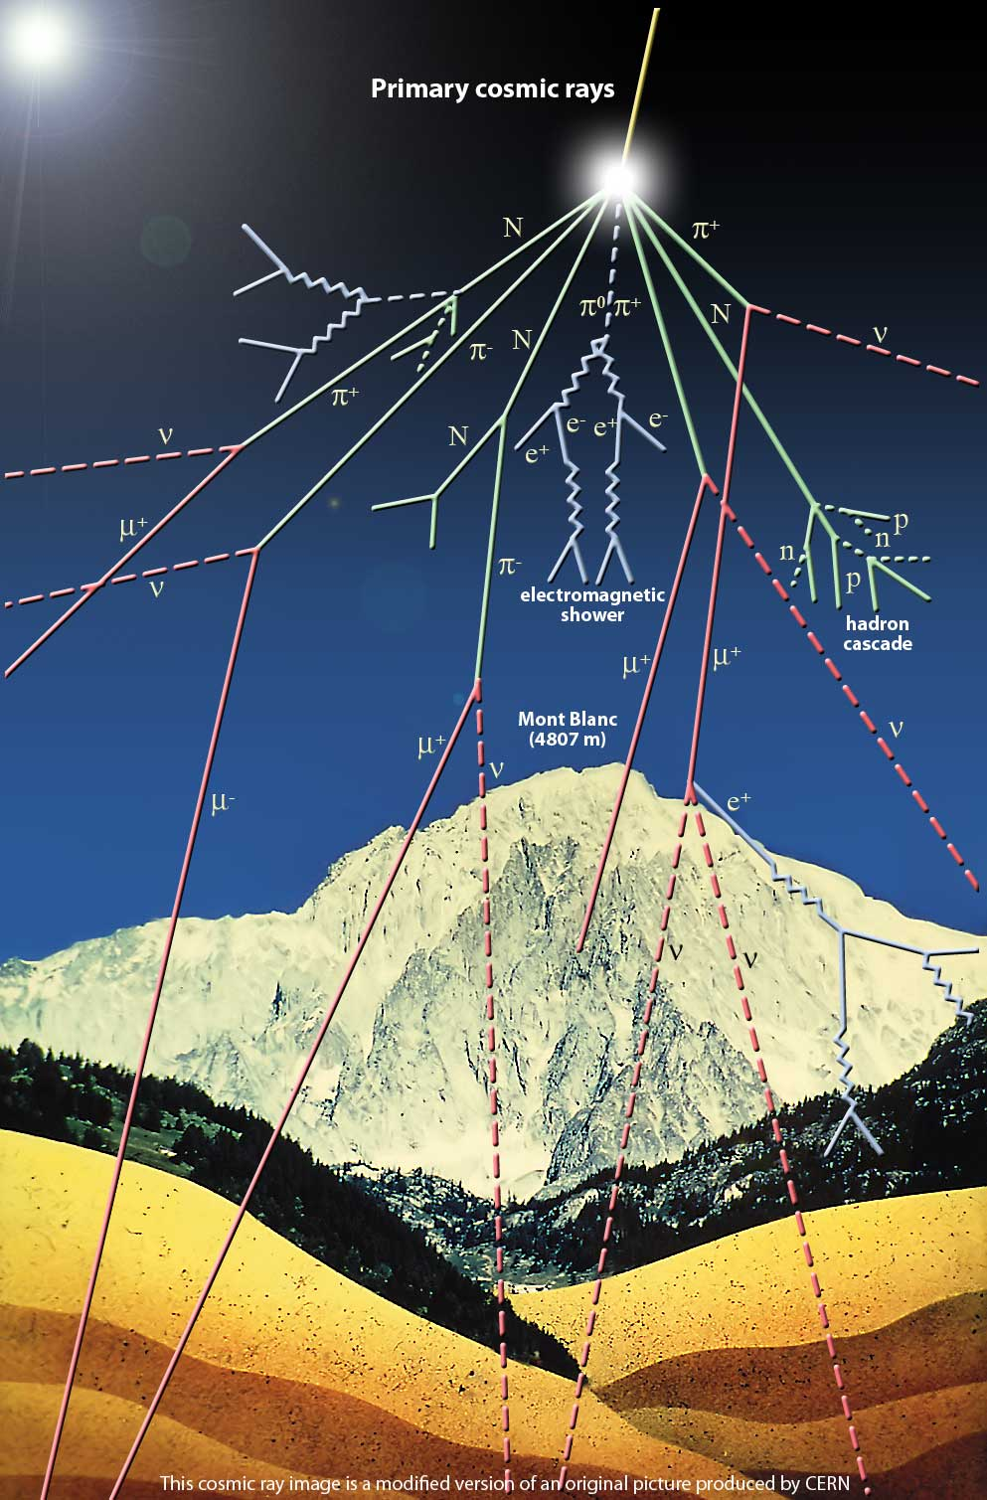
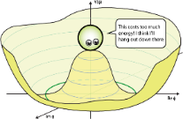
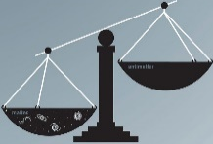
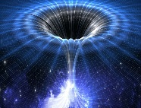
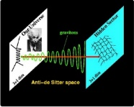

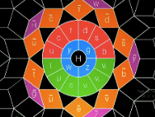
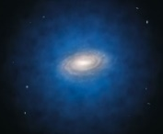
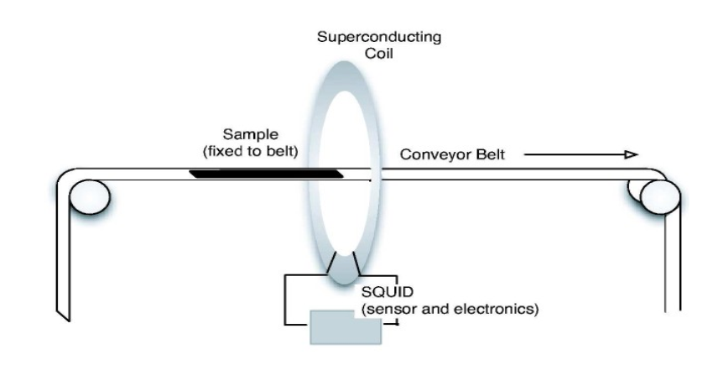
Experimental probes of fundamental world
Collider/Accelerator/Reactor
Matter:
atoms, laser,
plasma, magnets,
bulk matter
Science Questions
Cosmic Ray:
space, sea level,
underground

Slide 4
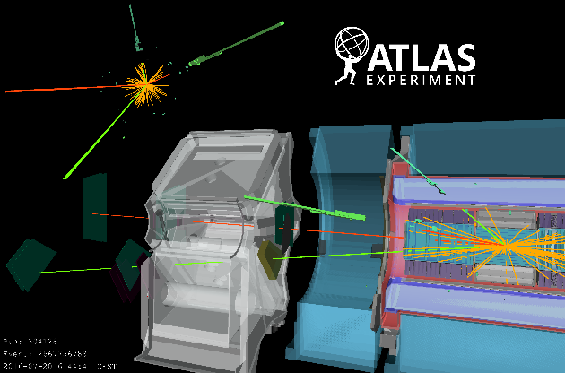

Theory + Experiment = Fundamental Research
BSM?
New Physics
SM
Precision comparisons between observations (exp) and predictions (theory):
>> precisely test the Standard Model (cross-sections, parameters, …)
  >> search for new physics phenomena (resonances, deviations)

Slide 5
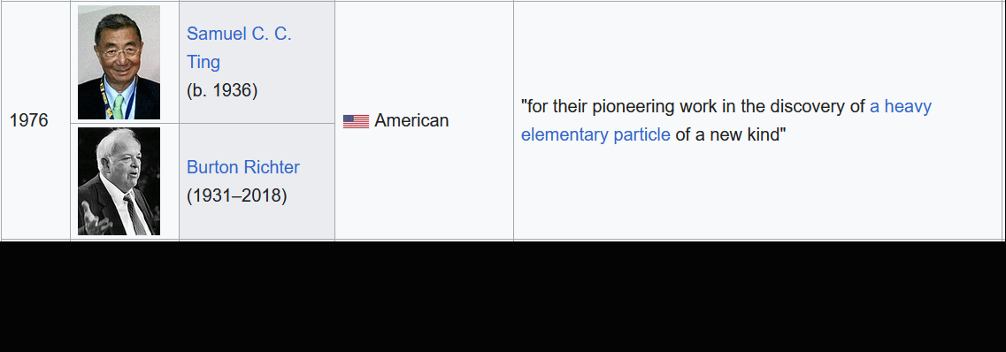
Theory + Experiment → Breakthrough
Tables from WIKI
During last 50 years, ~1/3 Nobel prizes in Physics awarded to particle physics：
Experimental breakthrough guided by theory leading to new chapter of research
Fundamental theoretical predictions confirmed by experimental discoveries
Potential path for future breakthrough
* Deep link between theory and experiment
* Adequate understanding of experimental (theoretical) details for theorists (experimentalists)

Slide 6
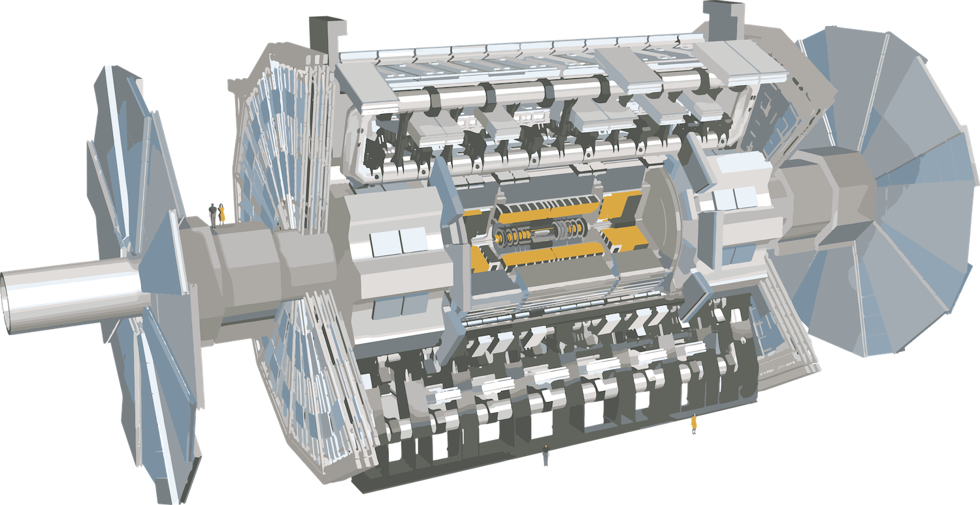
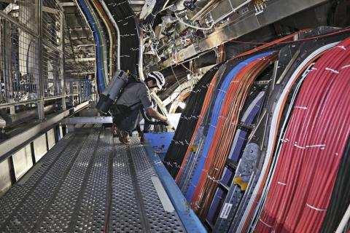
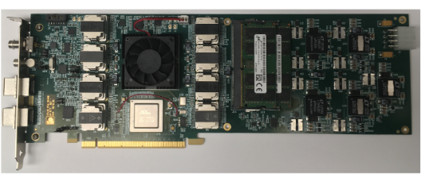
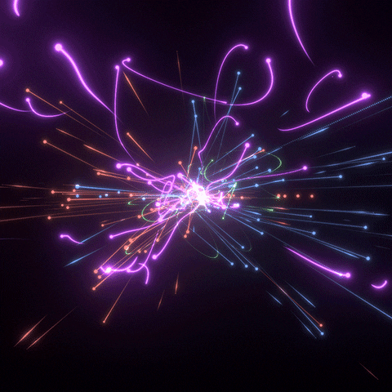
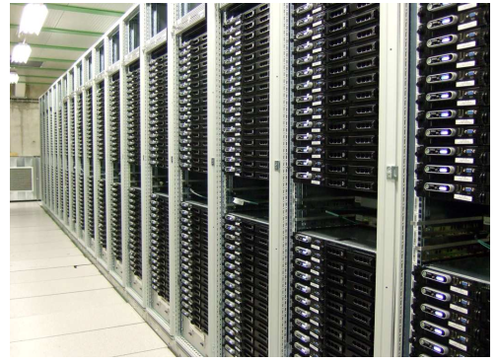
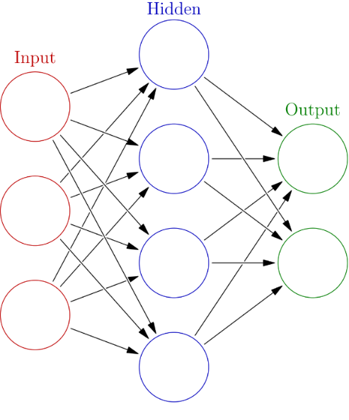
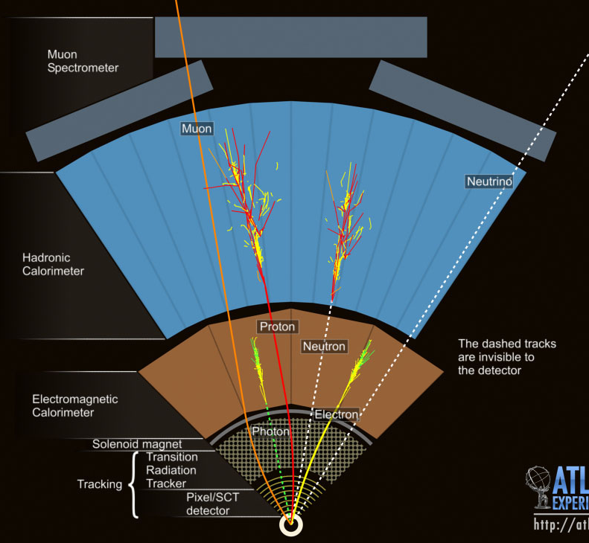
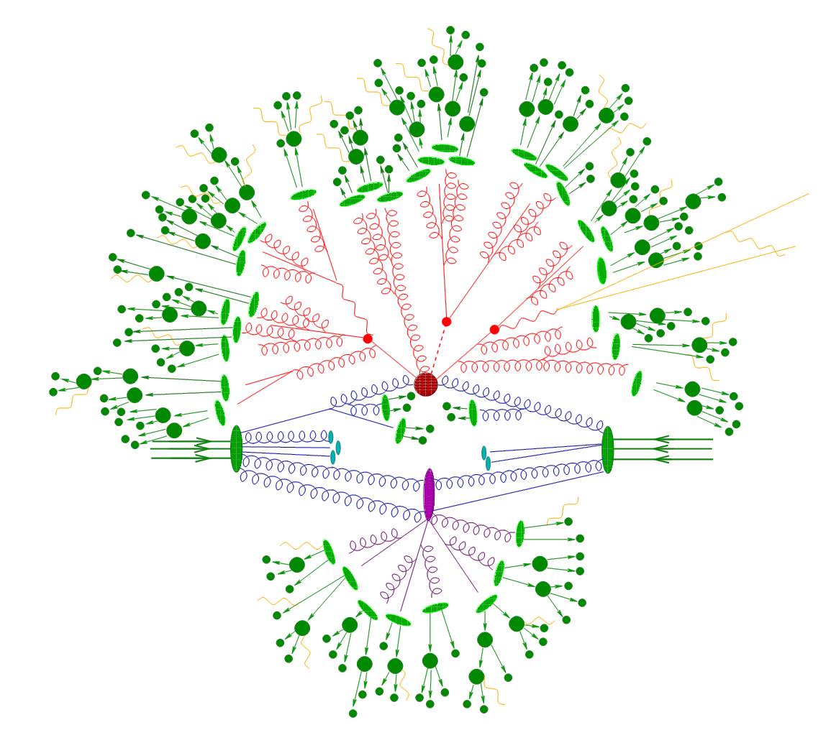

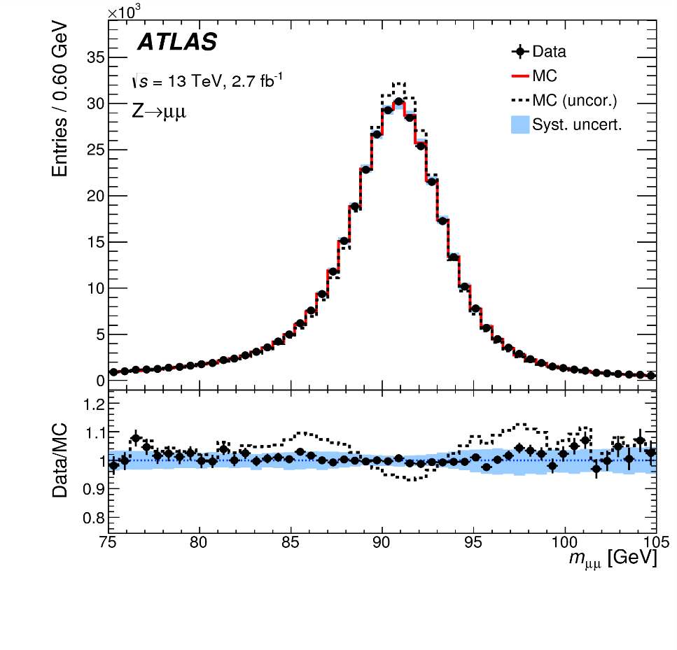
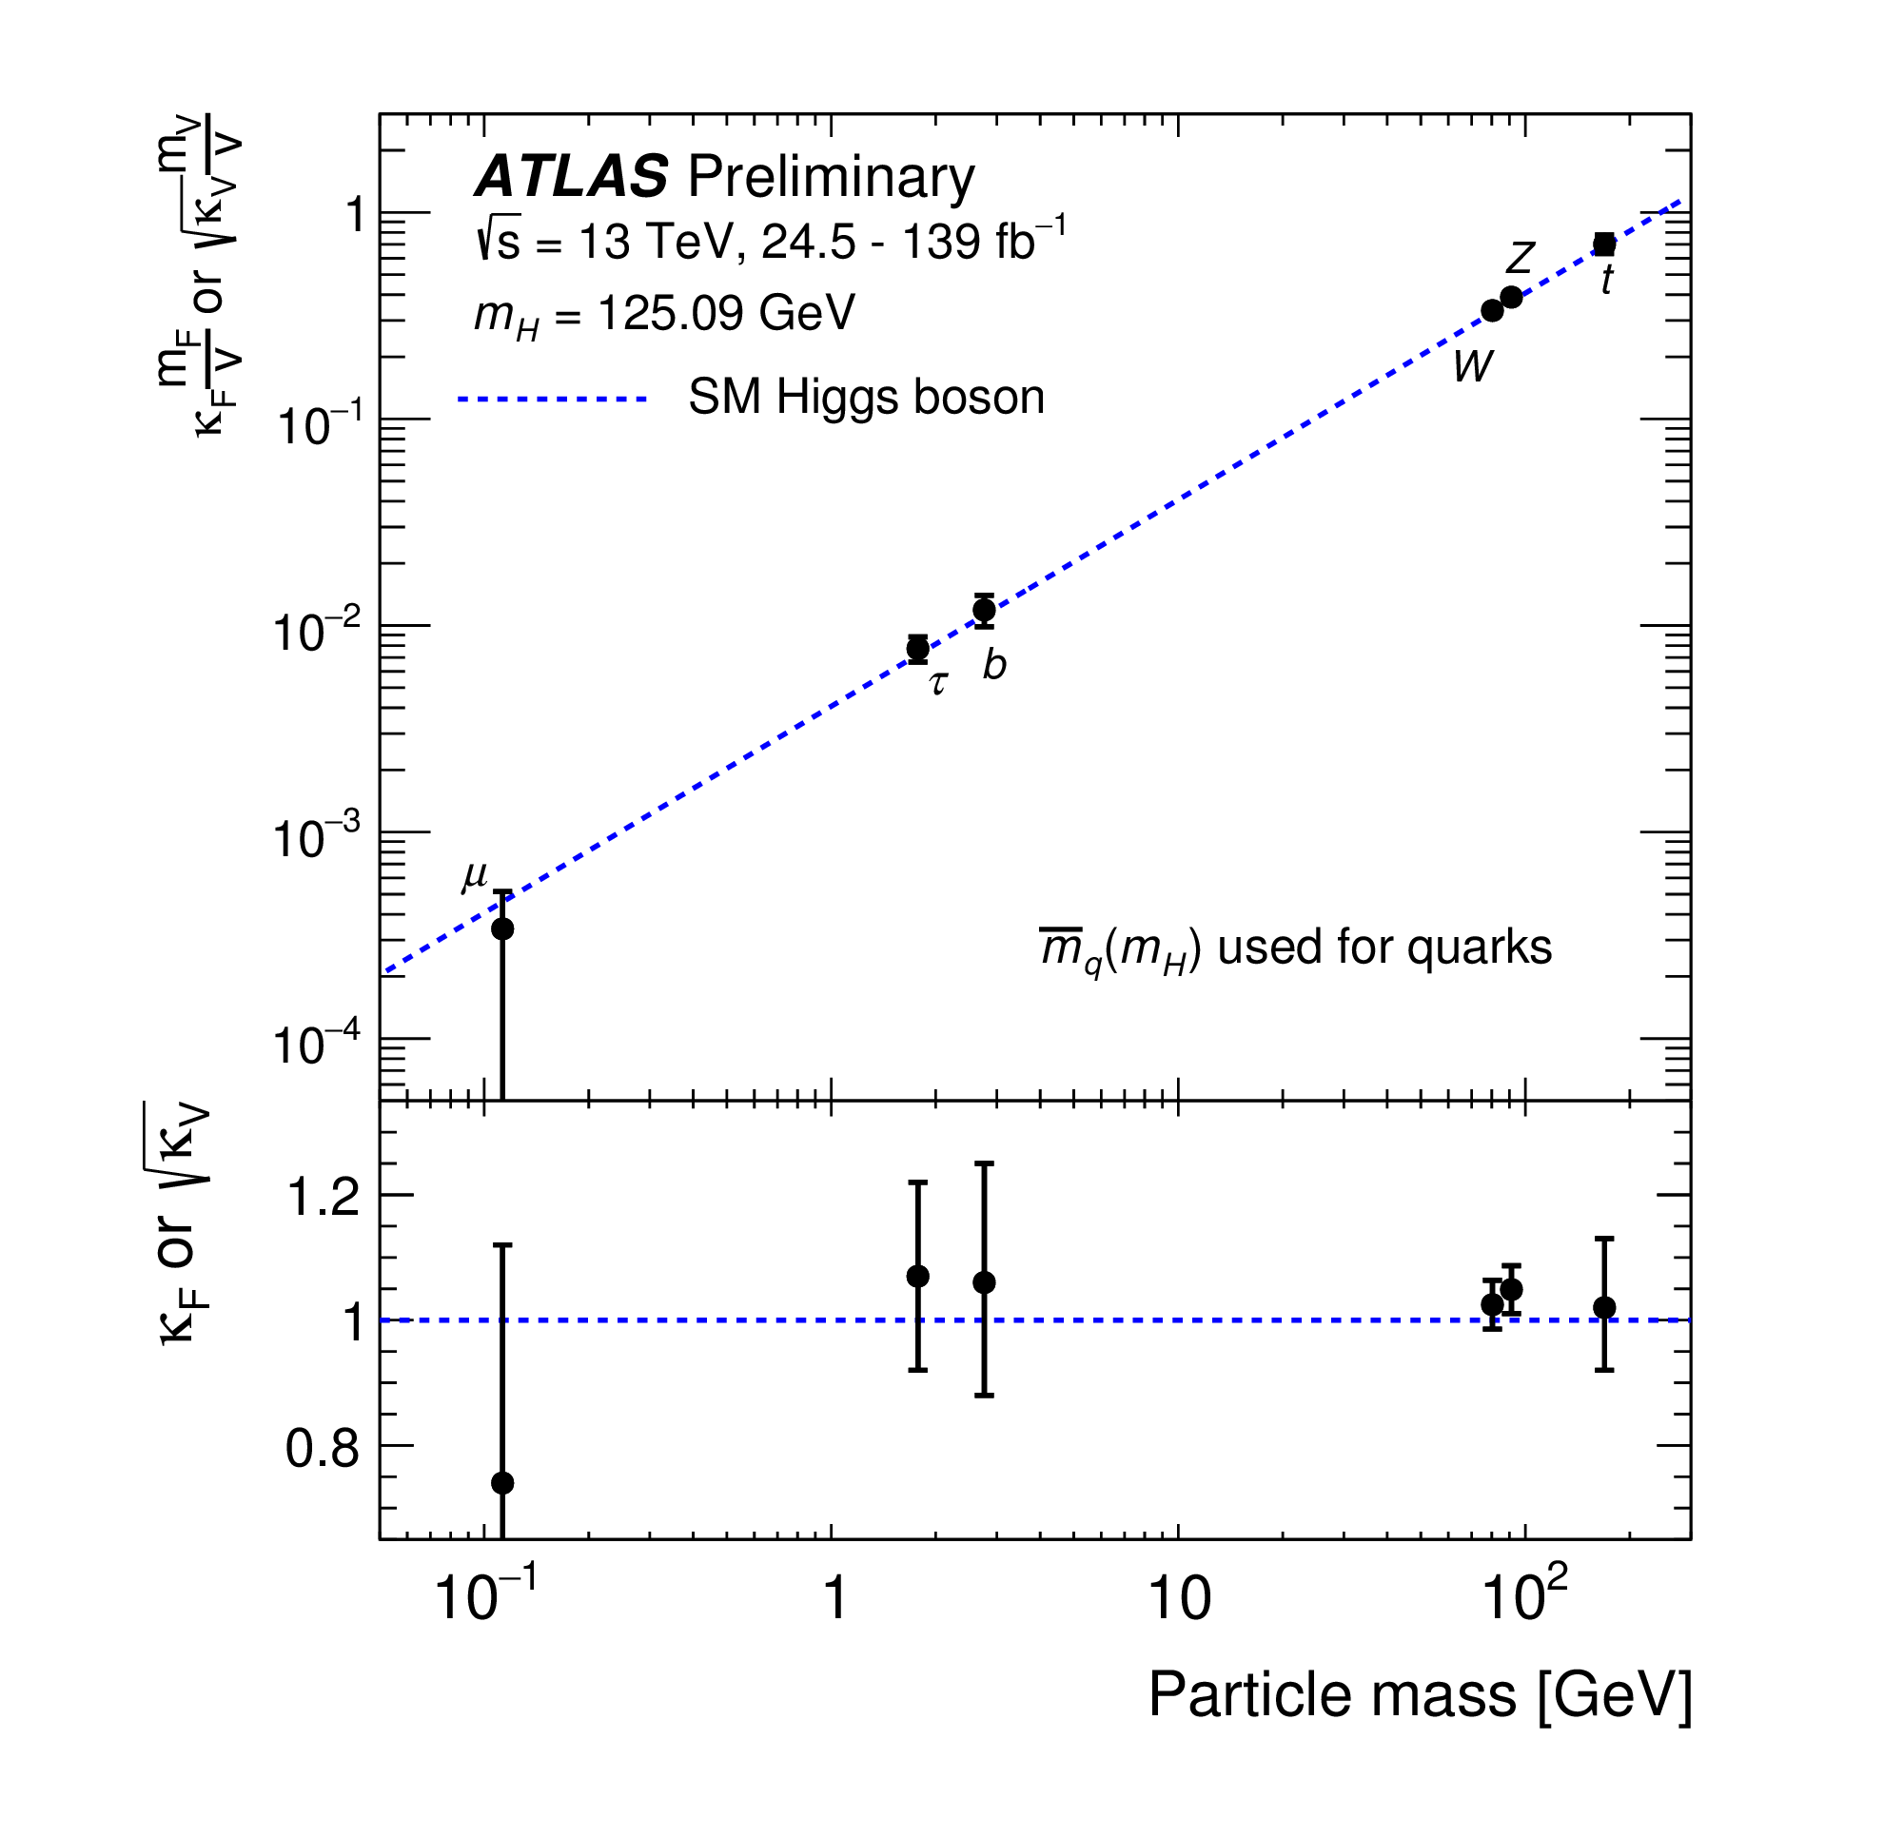
Collider experiments in a nutshell
Particle beam 2
Particle beam 1
Trigger, Data Acquisition, computing
Collider and detector
Object and event reconstruction
against noisy final states
BIG data analysis

Slide 7
Part I: collision events – production and collection

Slide 8
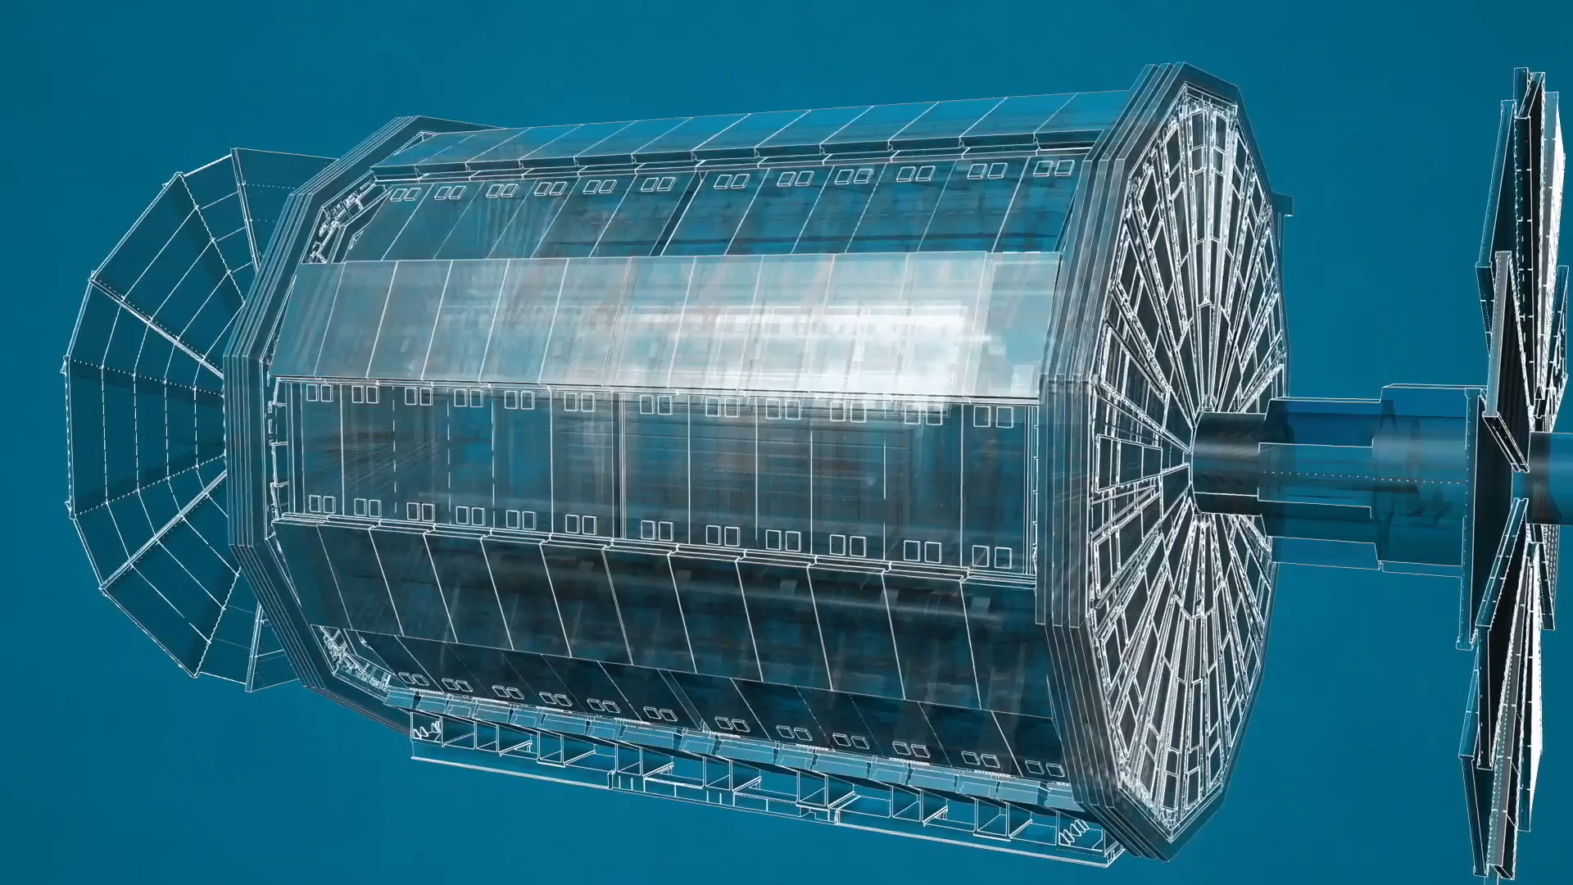
Produce and capture the traces of interior mysteries
Collider →
Source of energetic microscopic events
Detector →
big, precise camera to capture all final states and help trace back to space/time zero

Slide 9
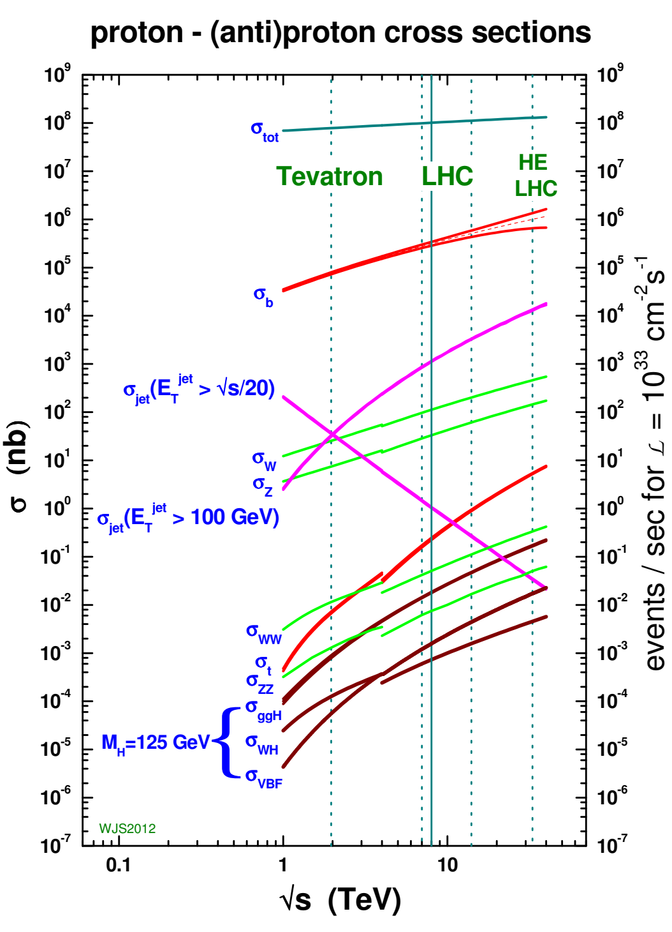
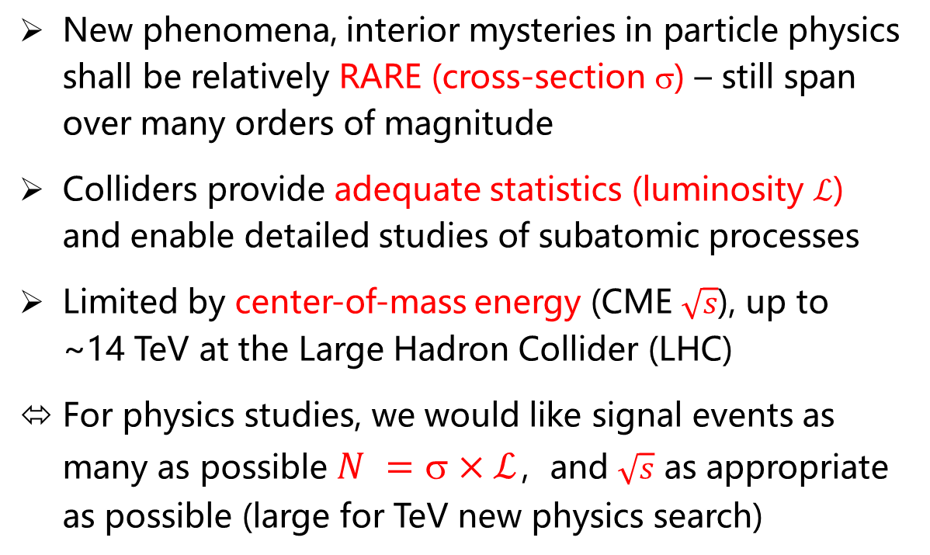

Richness of physics spectrum
New phenomena, interior mysteries in particle physics shall be relatively RARE (cross-section σ) – still span over many orders of magnitude
Colliders provide adequate statistics (luminosity $ℒ$) and enable detailed studies of subatomic processes
Limited by center-of-mass energy (CME $\sqrt{s}$), up to ~14 TeV at the Large Hadron Collider (LHC)
For physics studies, we would like signal events as many as possible $N =\text{s}×ℒ$，and $\sqrt{s}$ as appropriate as possible (large for TeV new physics search)
⬄ Those aspects are drastically different from researches via other means (e.g., cosmic rays)
Example with hadron collider

Slide 10
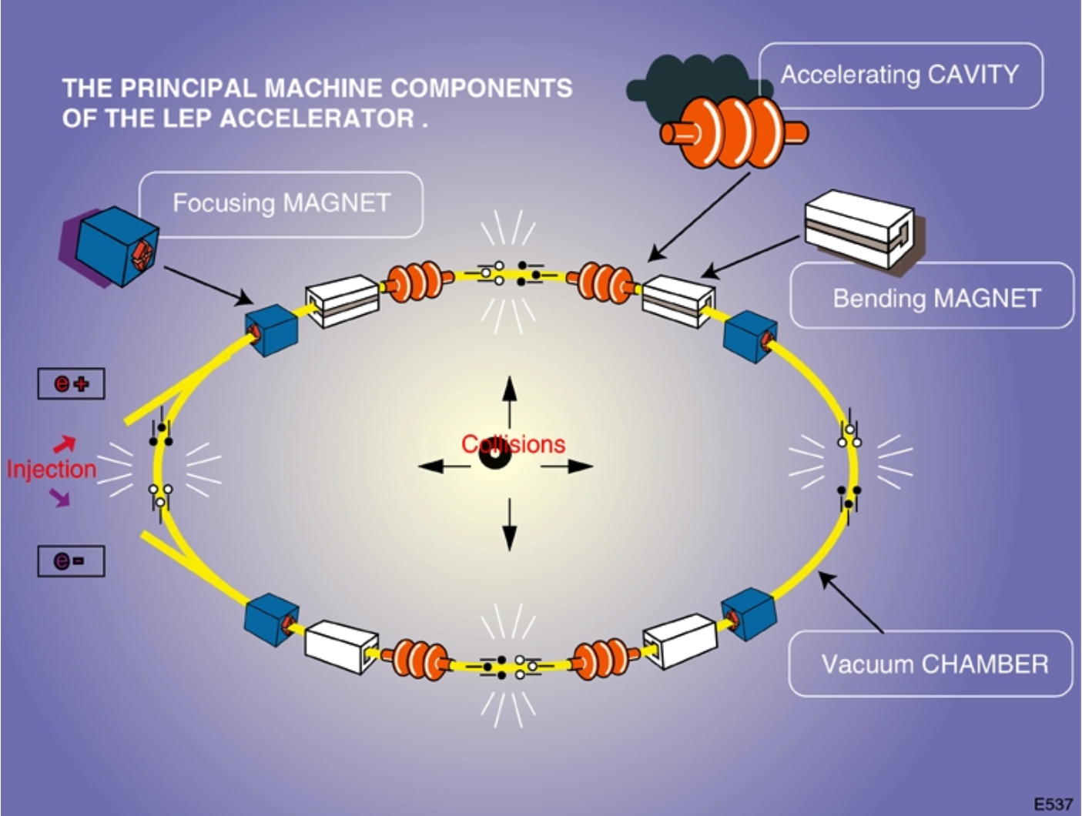
Sketch of a (circular) collider
A few facts:
Accelerator dated back to 1930s as Cyclotron invented by Ernest Lawrence
Developing over ~100 years into powerful machine based on Synchrotron concept
Particle acceleration and storage via electromagnetism
Separate sectors for different functions along the ring, lattice optimization crucial
Illustration figure from CERN

Slide 11
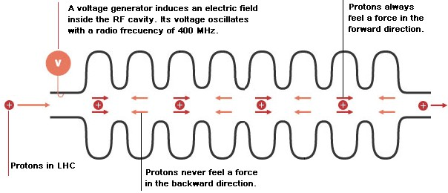
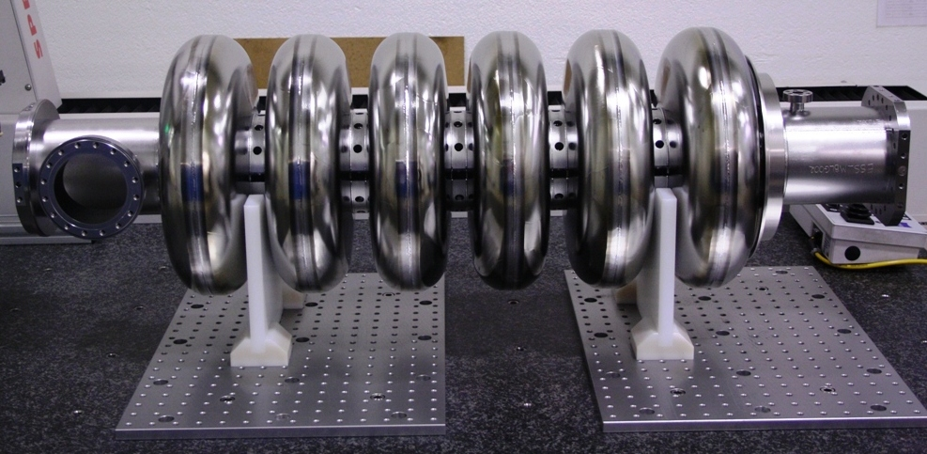
Key components of a (circular) collider
Radio Frequency cavity to accelerate particles bit by bit to highest energy
The key component of a linear collider
Particles should come in bunches
Cavity resonator provides strong E-field in beam line to accelerate particles
E-field frequency synchronize with particle moving in the tunnel ➔ always accelerating
Accelerating gradient up to 5 x 10⁷ volts / m with superconducting cavity
Synchronization frequency up to 10⁹ Hz

Slide 12
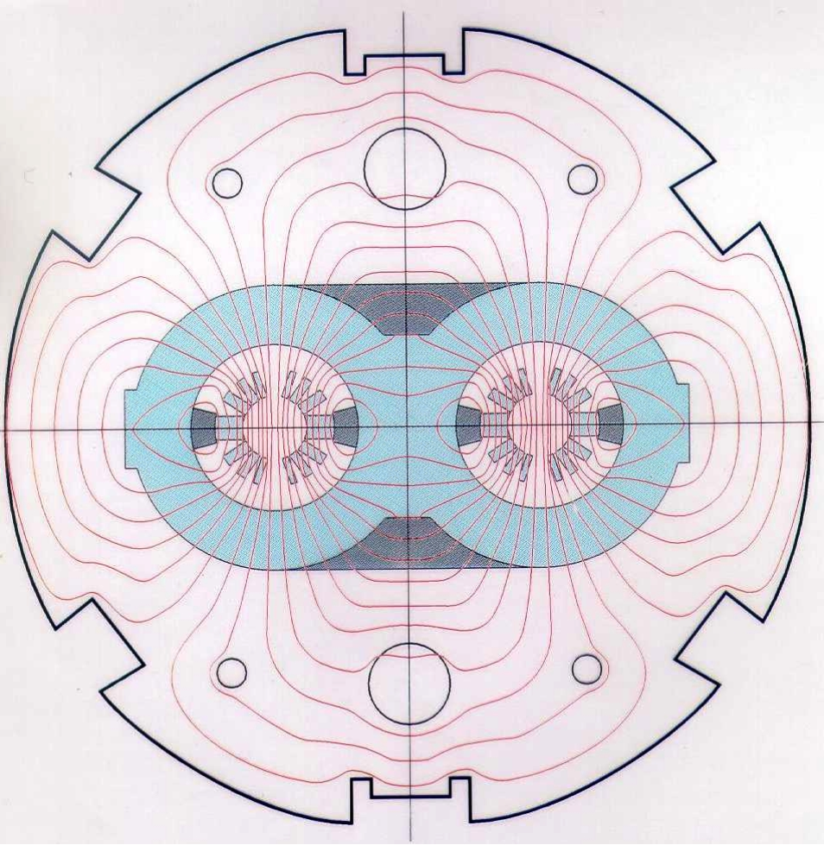
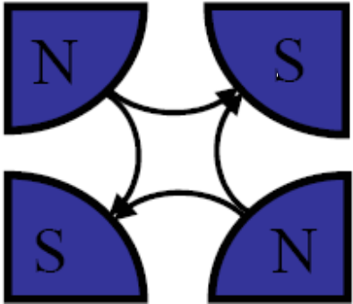
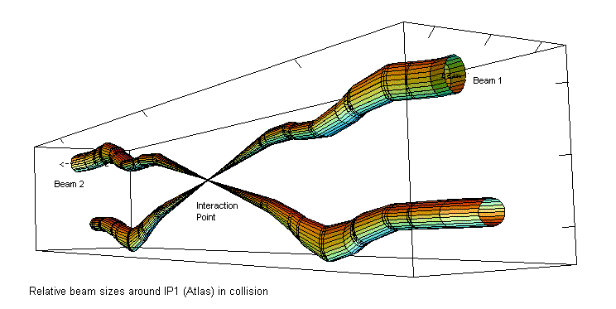
Key components of a (circular) collider
Bending magnets
To form a circular beam
Focusing magnets
To keep the beam narrow
Machine detector interface
To properly collide beams
Quadrupole magnet may focus in one axis (X or Y) but defocus in the other.
➔ Multiple quadrupoles needed to form a lattice
Squeeze, turn beams from storage mode to head-on collision mode
Superconducting dipole magnets Mega-size for TeV colliders

Slide 13
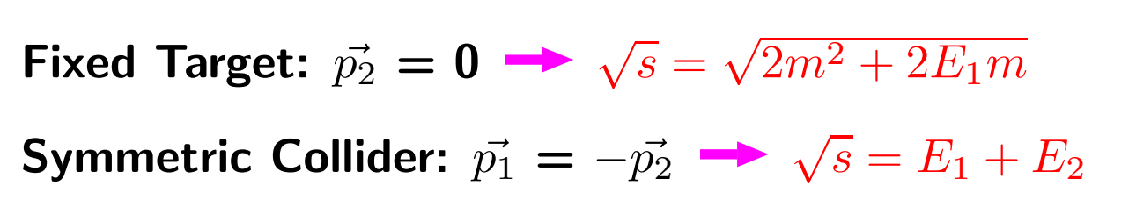


Key concepts for a (circular) collider
Center of mass energy → Threshold of physics probe
Win in terms of turning beam energy into physics
Energy loss (synchrotron radiation)
For a same size of collider and a given energy,
electron loses energy
10¹³ times quicker than proton
10⁹ times quicker than muon
How to realize highest-possible energy collider?

Slide 14

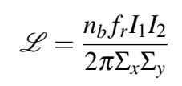
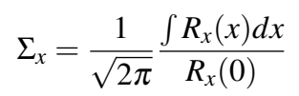
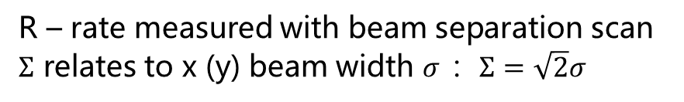
Key concepts for a (circular) collider
Luminosity: with cross-sections of processes, determine how likely they can be observed
Instantaneous luminosity can be formulated as
If no correlation between x and y density, this can be simplified into
(taking the van der Meer formulism)
Number of bunches
LHC ~ 3000
Number of particles per bunch
LHC ~ 10¹¹
Particle density in x-y plane
R – rate measured with beam separation scan
$Σ$ relates to x (y) beam width $σ$ ：$Σ=\sqrt{2}σ$
Machine revolution frequency
LHC ~ 11k Hz
This formulism gives a simple illustration how luminosity can be configured
Designed value for LHC: 10³⁴ cm⁻²s⁻¹

Slide 15
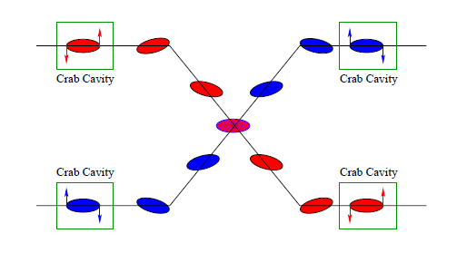
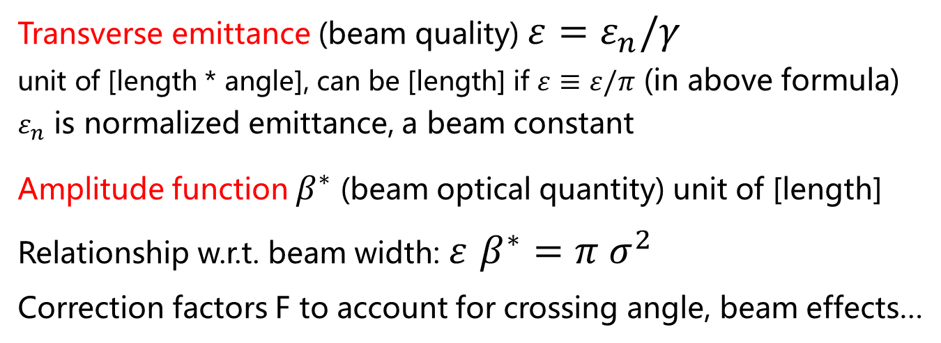
Key concepts for a (circular) collider
Luminosity: alternative formulism
Transverse emittance (beam quality) $ε=ε_{n}/γ$
unit of [length * angle], can be [length] if $ε≡ε/π$ (in above formula)
$ε_{n}$ is normalized emittance, a beam constant
Amplitude function $β^{∗}$ (beam optical quantity) unit of [length]
Relationship w.r.t. beam width: $ε$ $β^{∗}=π σ^{2}$
Correction factors F to account for crossing angle, beam effects…
Complication in understanding and computing luminosity!
A calculation tool from CERN to play with the parameters: https://lpc.web.cern.ch/lumiCalc.html

Slide 16
Example of LHC
Can try to understand this table (often seen in conference talks) with the abovementioned concepts
Parameter (for illustration only) | Nominal | HL-LHC | HL-LHC updated
Bunch population N_{b} [10¹¹] | 1.15 | 2.2 | 2.2
Number of bunches | 2808 | 2748 | 2748
Beam current [A] | 0.58 | 1.12 | 1.12
Stored Beam Energy [MJ] | 362 | 677 | 677
Full crossing angle [mrad] | 285 | 590 | 512
Crossing angle with crab cavities [mrad] | 285 | 0 | 150
Beam separation [σ] | 9.9 | 12.5 | 12.5
Min β* [m] | 0.55 | 0.15 | 0.2
Normalized emittance ε_{n} [mm] | 3.75 | 2.5 | 2.5
r.m.s. bunch length [m] | 0.075 | 0.081 | 0.081
Max. Luminosity [10³⁴ cm⁻²s⁻¹] | 1 | 5.3 | 5.3
Levelled Pile-up/Pile-up density [evt. | evt./mm] | 26/0.2 | 140/1.2 | 140/1.2

Slide 17
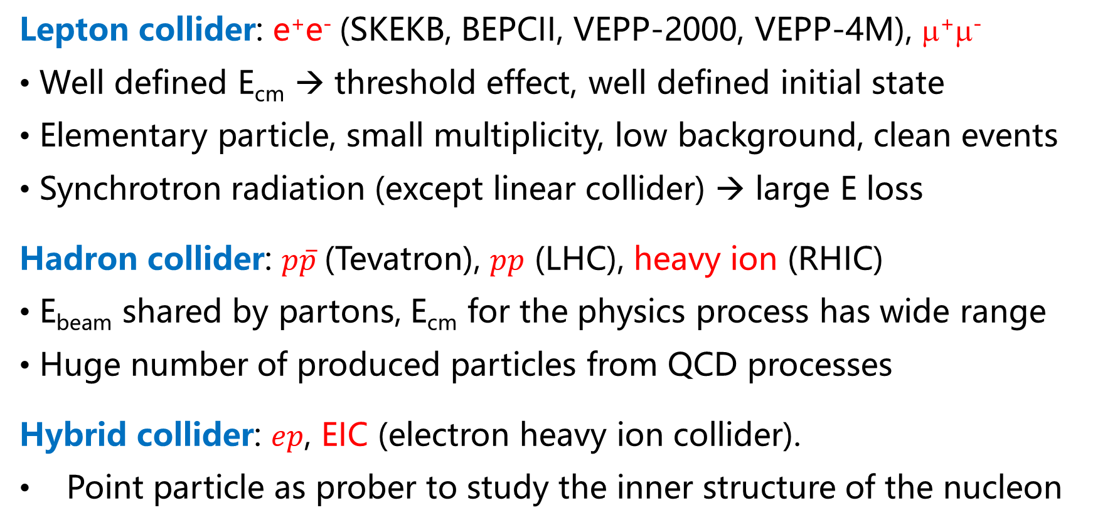
Type of colliders
Lepton collider: e⁺e⁻ (SKEKB, BEPCII, VEPP-2000, VEPP-4M), μ⁺μ⁻
Well defined E_{cm} → threshold effect, well defined initial state
Elementary particle, small multiplicity, low background, clean events
Synchrotron radiation (except linear collider) → large E loss
Hadron collider: $p\overline{p}$(Tevatron), $pp$ (LHC), heavy ion (RHIC)
E_{beam} shared by partons, E_{cm} for the physics process has wide range
Huge number of produced particles from QCD processes
Hybrid collider: $ep$, EIC (electron heavy ion collider).
Point particle as prober to study the inner structure of the nucleon

Slide 18
Frontier of collider experiments
High energy frontier
Discover new particles and new phenomena, e.g., Higgs, SUSY, ….
* Tevatron, LHC, ILC, CLIC, CEPC, FCC
Precision frontier
Precision test of the SM and seek for deviation from SM predictions.
Factories for φ (DAΦNE in Italy)
τ-charm (CESR in USA, BEPC in China, STCF)
B (PEPII at SLAC, KEKB in Japan)
Z (LEP at CERN)

Slide 19
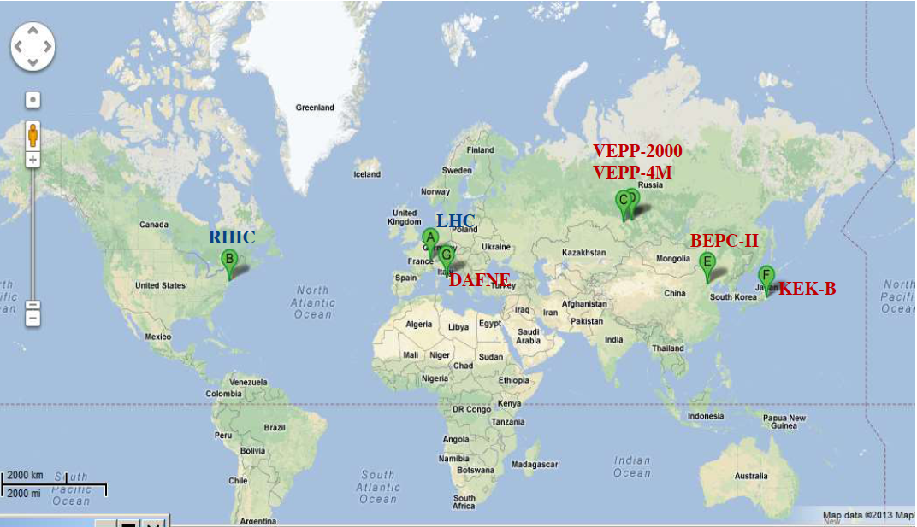
Map of collider experiments
China
CEPC?
STCF?
Europe
HL-LHC
CLIC?
FCC?
Russia
STCF ?
USA
EIC
Japan
SKEK-B
ILC?
Only ~ 40 colliders in the history, from CME of O(100) MeV up to O(10) TeV – LHC
Reflecting the integrated power of economy, education, science and technology.

Slide 20
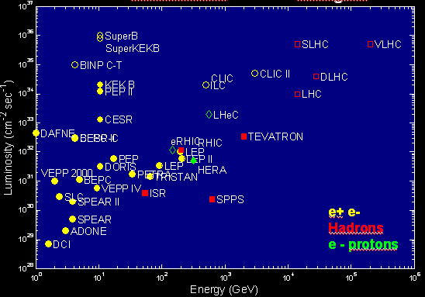
Map of collider experiments
CEPC, FCC
An Olympic game of increasing luminosity and energy over time
Increasing cost (→ B USD) and lifetime of collider experiments (→ 50 years)
Path in near future: new intensive frontier machines, new collider techniques
STCF
Luminosity Frontier
Courtesy of
M. Biscari
EPS-HEP09
Toward
Energy frontier

Slide 21
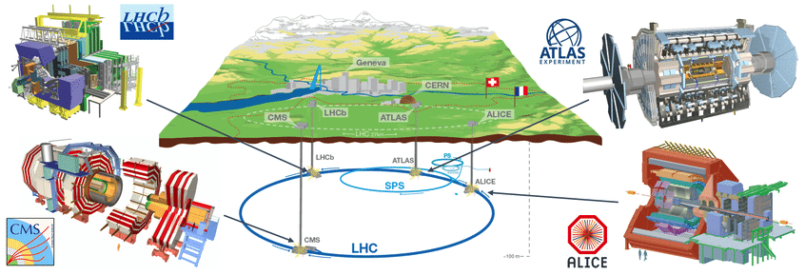
CERN Large Hadron Collider
1160 Physicist
69 Institution
16 Country
75 MCHF
2800 Physicist
182 Institution
40 Country
550 MCHF
LHC: ~5 B CHF (using existing LEP tunnel)
pp CME from 7 TeV up to 14 TeV
The largest detector
in the world
L=46m H=20 m
W=7000 tons
The heaviest
detector in the world 14000 tons
2800 Physicists
184 Institution
40 Country
550 MCHF
Circumstance of 27 km
Underground 100 m
1550 Physicists
151 Institution
37 Country
150 MCHF

Slide 22
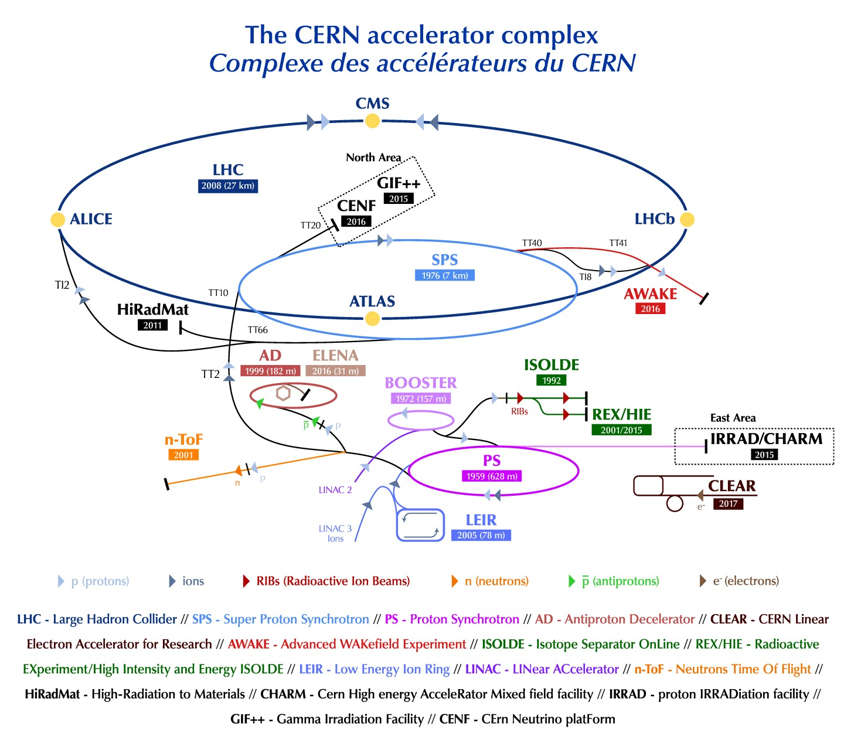
LHC Complex
Cutting edge technologies
High vacuum: 10^{–7} – 10⁻⁹ Pa in the beam pipe (150 m³), insulation pipe 9000 m³
Low temperature: 1.8 K for 27 km cryogenic ring.
Strong magnetic field: 8 T
Modern machine engineering, material science
Fast, radiation-hard, micro-electronics
Computing and network
  Data triggered/stored: 10⁵ CD per second, 5x10¹⁰ phone call per second
  3000 online PCs and 10⁵ PCs for offline analysis
  Grid computing
Diverse experimental programs

Slide 23
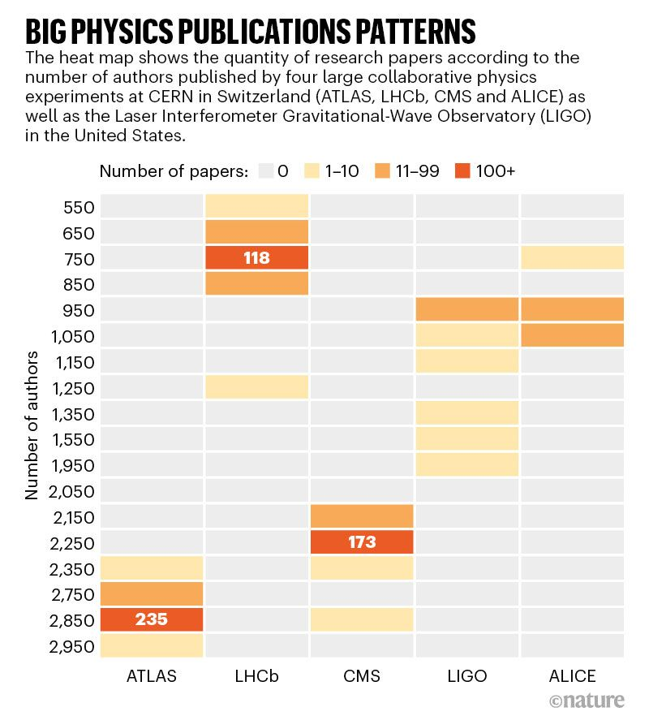
Mega-size Scientific Collaborations
Experiments looking at the extremely fine details of nature (Universe)
Big science ⬄ Great Challenges ⬄ Large scientific collaborations
https://www.nature.com/articles/d41586-019-03544-x
Examples:
* ATLAS, CMS – O(3000)
* LHCb, ALICE – O(1000)
* DUNE – O(1000)
* LIGO – O(1000)
* Many more with hundreds of collaborators
Characteristics
* Key scientific questions and big impact
* Pushing the boundary of technologies
* Challenging both scientifically and socially
* Numerous publications and long author lists

Slide 24
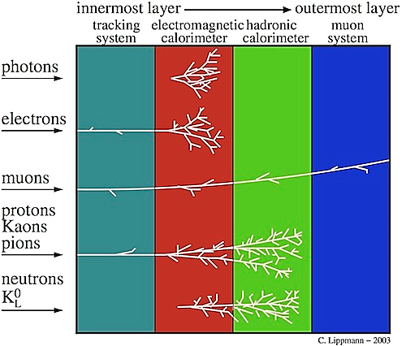
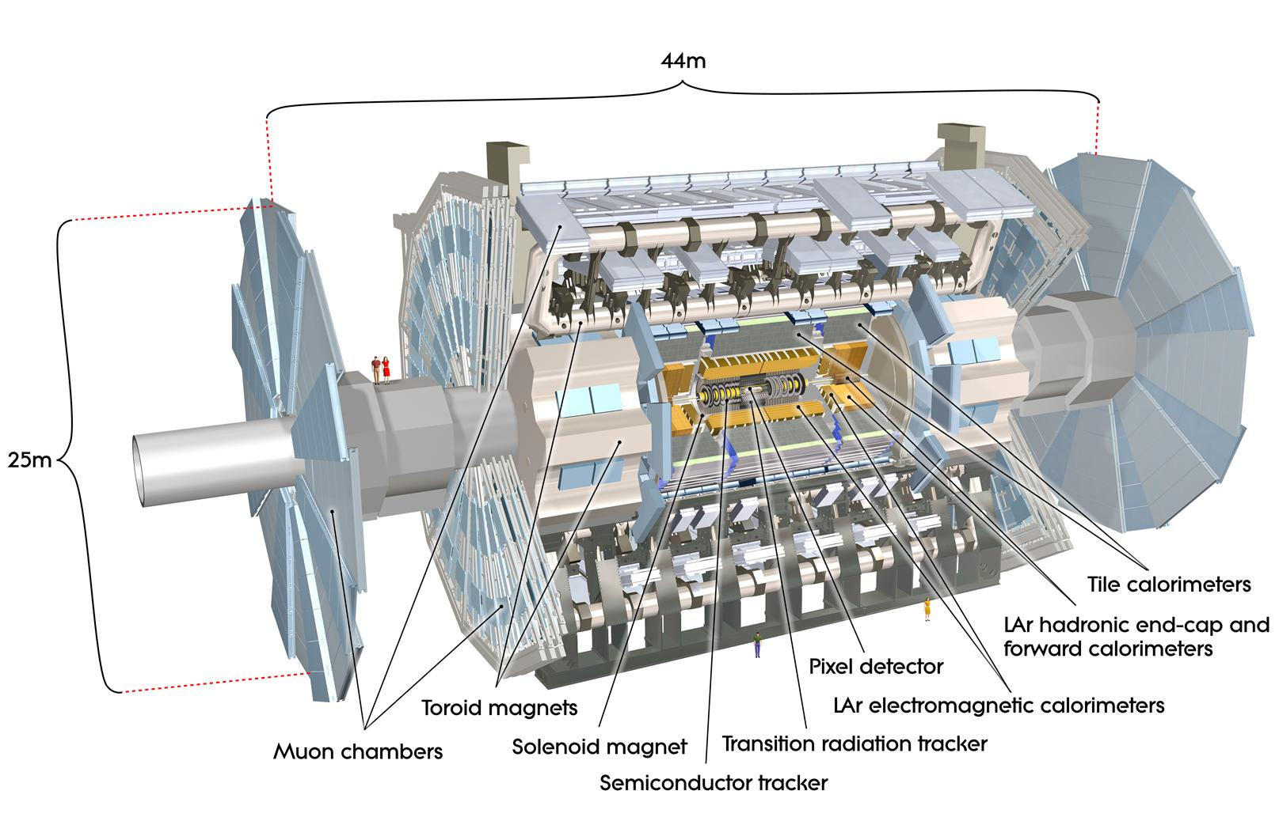
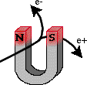
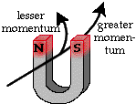
Detector: camera to capture collision events
Complex detector system to measure charge , momentum and other info. of final state particles …
Onion structure: vertexing, tracking, calorimeters, muon system, magnets
The largest collider experiment detector: ATLAS
Size of you!

Slide 25
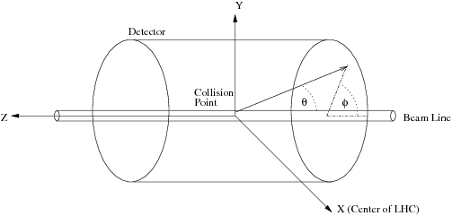

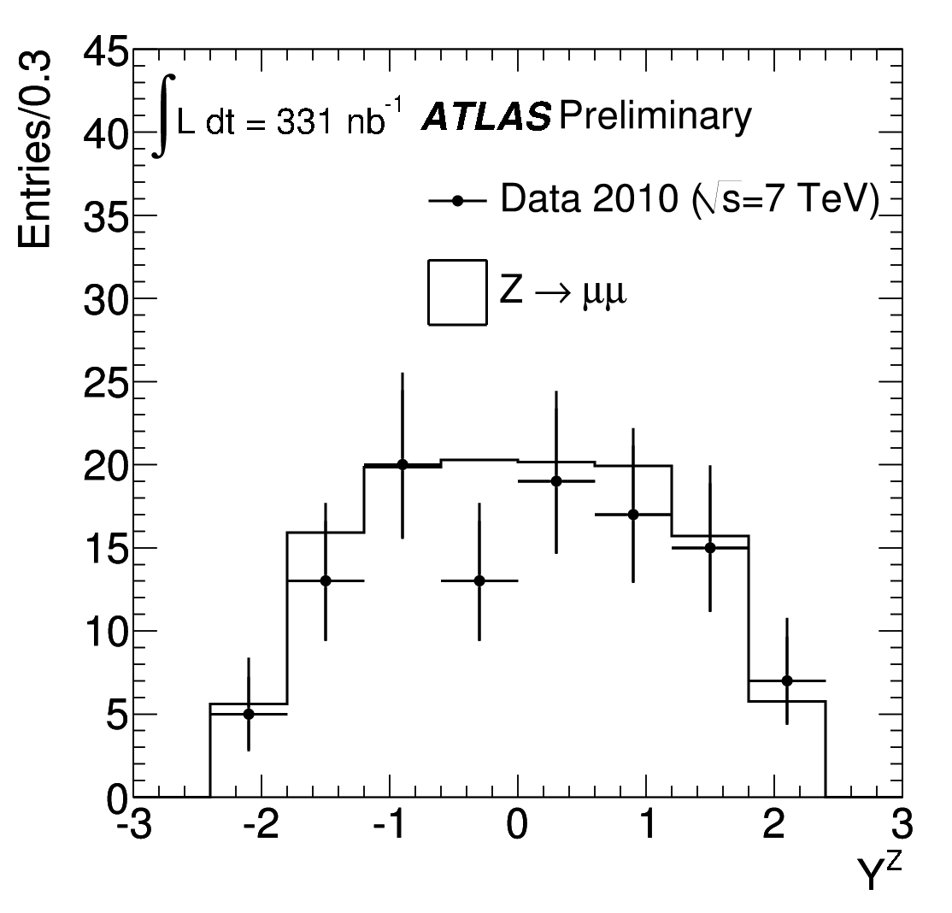

Coordinate System
Pseudo-rapidity
- Identical to rapidity in the case of m<<p,
- Rapidity difference is Longitudinal Lorentz invariant
JHEP 12 (2010) 060
Example: Z boson was measured relatively central at the LHC!
Large rapidity is extremely along the beam!
Concept important for detector design

Slide 26

Extraordinary Facts about Gigantic Detector: ATLAS
ATLAS is the largest detector ever built on a particle collider
L x W | 44m x 25m
Weight | 7000 tons
Temperature | down to ~5K
Readout Channels | ~100 Million
Cable Length | ~3000 KM
Magnets | 2T Solenoid 4T Toroid
Collision Rate | ~10⁹ per second
Triggering | 1 in 500 0000
Recorded Events | ~10⁹ per year ~3 PB per year
CPU Resources | ~50000 PCs
Efforts needed for detector operation | ~50000 hours per year
Among all the design parameters, coverage and measurement resolution are two crucial quantities
Sub-detector | η Range | Resolution
Inner Tracking | |η|<2.5
EM Calorimeter | |η|<3.2
Hadron Calorimeter | |η|<3.2
Forward Calorimeter | 3.1< |η|<4.9
Muon | |η|<2.7
These requirements are driven by the goals of physics studies

Slide 27



Large and precise
To satisfy the desired resolution,
Tracking detectors provide a spatial resolution of the diameter of human hair ~ 50 mm, which is 6 orders of magnitude smaller than the size of the detector
Units in Tesla, Meter, GeV
Fractional resolution depends on
Momentum, magnet field, detector size, and single measurement precision
EM Calorimeter has a very fine granularity, with the smallest cell size in φ x η plane being 0.025 x 0.025
    In total ~ 200000 cells
    ~ 20 X₀ (radiation length)
Part of EM calo. for illustration

Slide 28


Collision events
What kind of physics processes do they represent?

Slide 29



Precise Time Evolution
Time Axis per Collision Event
< 10⁻¹⁰ s
Collision and short-range interactions
10⁻¹⁰ – 10⁻⁷ s
Final-state particles
interact with detector and generate electronic signals
10⁻⁶ s – 10⁰ s
Trigger decision (L1:μs, High-level: ms - s) and Data acquisition
> 1s
Post-progressing of data: calibration & reconstruction (1s – 1 min), distribution over network, and physics studies
Online data reduction of 99.9999%
Efficiency and precision in trigger and DAQ systems crucial
A sketch of collision events
Trigger scheme
Grid computing scheme
Detector signals

Slide 30





Detector Overview (Modularity and Complexity)
Tracking
Calorimetry
Muon system
Magnets

Slide 31




Detector technologies 101: Tracking
Precise Intrinsic resolution and alignment ~ μm
Enormous number of channels: 100M to billion!
Radiation hardness (up to 2 x 10¹⁵⁻¹⁶ cm⁻² 1 MeV neutron equivalent fluence) – most tough working condition in the planet
Often resort to semiconductor detector technology, benefiting from industry-standard fabrication processes
For Illustration
Idea of pixel detector:
Detect a drop from sea? Deplete the sea of irrelevant water
PN-conjunction, reverse bias voltage
New generation of tracking detector R&D ongoing (MAPS, 4D tracking, …)

Slide 32




Detector technologies 101: Calorimetry
Contain the particle and subsequent showers and measure the total energy, etc.
high-Z materials
Large dimension
Ability to detect shower particles
(ionization, excitation, Cherenkov)
Metal
Solid-state (crystals, silicon)
Noble liquid, Gas detectors
Homogeneous
Sampling
Pick up most appropriate solution considering cost and physics desire

Slide 33







Detector technologies 101: Muon System
A variety of technologies: gaseous detector, scintillators, …
Usually outmost layers of detector, large area, stability and alignment important
Often used for triggering muons: fast response and resolution

Slide 34



Concepts on intrinsic resolution
Muon system (similar for tracking)
Calorimeter
Multiple scattering (subject to material budget → tracking system shall have less materials!)
Intrinsic resolution
Alignments
Stochastic
Noise
Leakage etc.

Slide 35

Triggering and DAQ
Look for interesting events and read out them with speed
Utilize detector information for physics-oriented decision

Slide 36

Example of trigger system
Taking the Run-I ATLAS Model as an example
Level 1
  Hardware based: FPGAs, ASICs
  Coarse granularity information from calorimeter and muon
  Identify “Region of Interests” (ROI) for further processing
  Latency of 2.5 μs
< 2.5 μs
High-level
  Software based: computing farms at CERN
  “Seeded” by Lv1 Trigger ROI
  Use full granularity information and combination of detectors: fast reconstruction (LV2) and “offline”-like reconstruction (EF)
  Execution time up to O(1s)

Slide 37



Characteristics of trigger system
Pattern recognition for triggering to find an object with rough momentum meas.
However, key to improve trigger resolution for reliability and diversity of physics program
Trigger threshold
Example of muon rate

Slide 38


Complex DAQ and detector control
Control system
Put detectors in correct operational conditions (HV, LV, thresholds, gas, …)
Monitoring, alarming
Human interface
  Counting Room Shifts 7 x 24

Slide 39


A long way reaching this triumph point,
next is to study physics!

