Slide 1
Brief Introduction to Experimental Collider Physics
Yusheng Wu (吴雨生)
wuyusheng@ustc.edu.cn
University of Science and Technology of China
“新视角下的强相互作用”冬季学校，复旦大学，2025年2月

Slide 2
Lecture schedule
3-hour brief introduction to experimental aspects of physics studies at particle colliders
Target for junior graduate students in this field
Cover the following:
Part I: how are collision events produced and collected
Part II: how can we analyze collision events for physics studies
Part III: milestones (examples) and prospects
Disclaimer: incomplete introduction with personal biases (towards LHC)

Slide 3
Part III: physics results (examples) and prospects

Slide 4
Higgs Physics
Outline
Overview
Historical Review
Observation
Post-observation

Slide 5
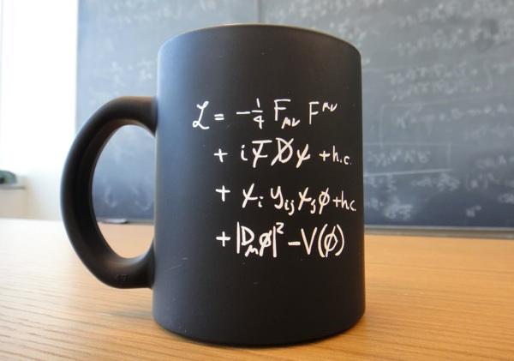
Origin of Particle Mass
Lagrangian for Standard Model electroweak theory:
Gauge group invariance requires no direct mass term
➔
Clever addition of a scalar doublet field “Higgs field”, coupled to bosons and fermions
➔
Scalar field goes through a symmetry breaking and takes its non-zero vacuum expectation value, mass term appears $φVV→mVV, φff→mff$
SU(2)_{L} x U(1)_{Y} terms
Kinetic term only
Yukawa interactions Higgs kinetic and potential

Slide 6
The Standard Model and The Higgs Boson

Slide 7
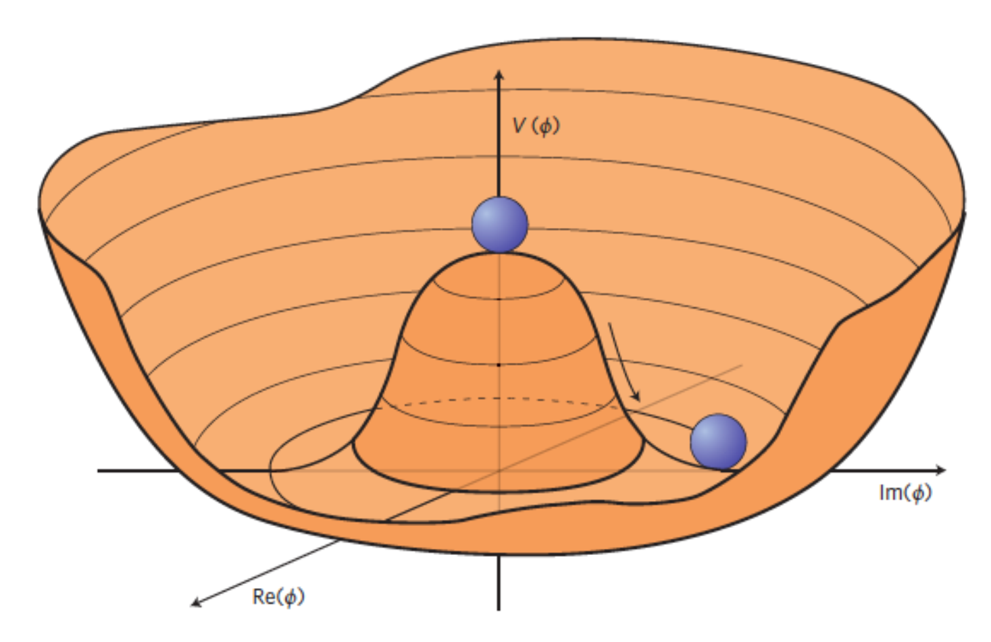
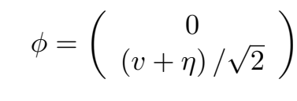
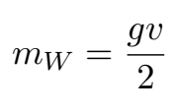
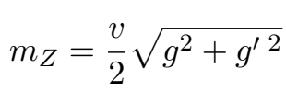
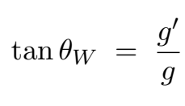
Broken Symmetry
Inspired by studies in the superconducting theories:
Anderson, Bardeen–Cooper–Schrieffer theory, etc.
Importance of interdisciplinary view
If
Why has to be this form???
Parameters are not predicted !?
H
ν = μ² / λ
Seems to be OK now !

Slide 8
Half century of hunting for Higgs boson
1964 – 2012
2012 - ?
Use of Higgs boson as a window seek for further insights of universe

Slide 9
Milestone Year - 1964
The only one
who mentioned a
massive scalar boson

Slide 10
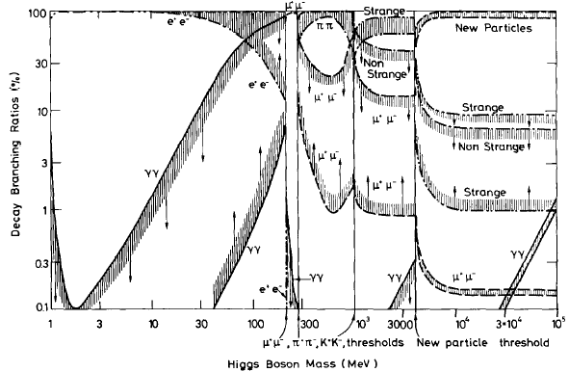
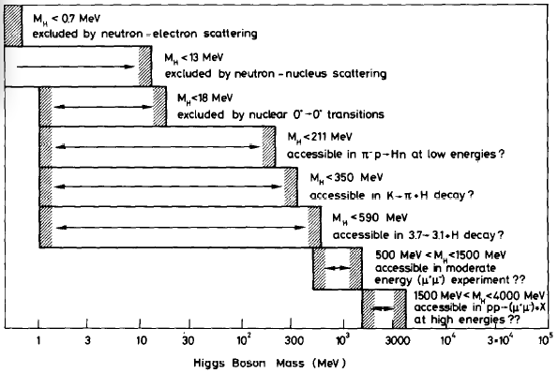
Pheno. and Experimental Work on Higgs
Intensive Higgs research started in the 1970s, shortly after charm, τ was discovered, and attention turned to the electroweak sector experiment searches
The search for the Higgs boson started from a very low mass region

Slide 11
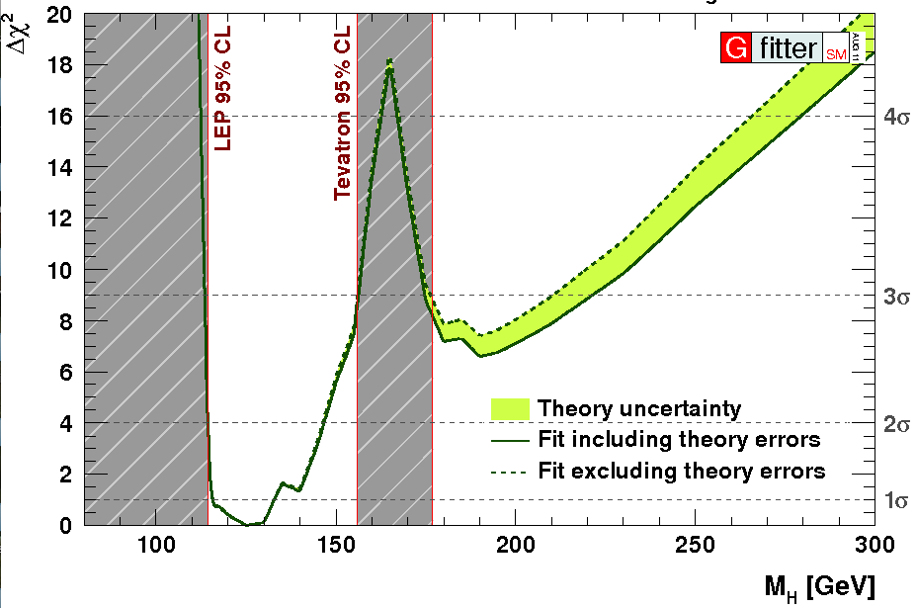
Around 2011: Combining direct and indirect searches
If the SM is a consistent theory, space left for Higgs boson was narrow

Slide 12
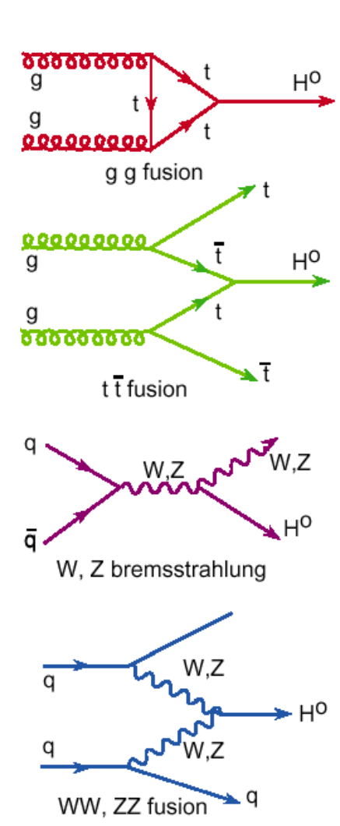
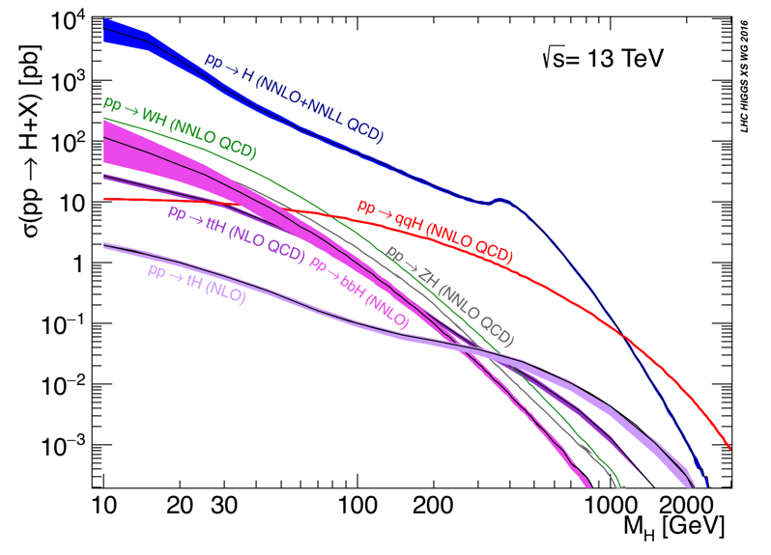
Higgs Boson at the LHC
ggF
ttH
VH
VBF
O(100)pb x 100fb⁻¹ = 10⁷ Higgs bosons produced

Slide 13
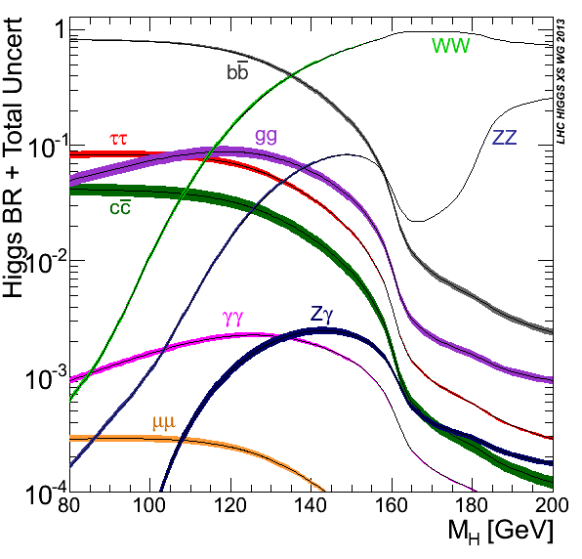
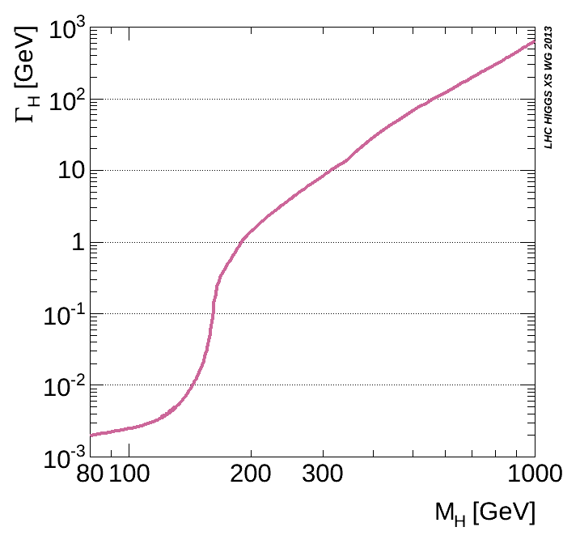
Higgs Boson at the LHC
Decay Branching Ratios
Total width at low mass
<< detector resolution
Actual sensitive channels are ZZ/WW→4 leptons, γγ, bb, ττ,
➔ Good BR as well as reasonable S/B
Very important for verifying the nature of the Higgs boson

Slide 14
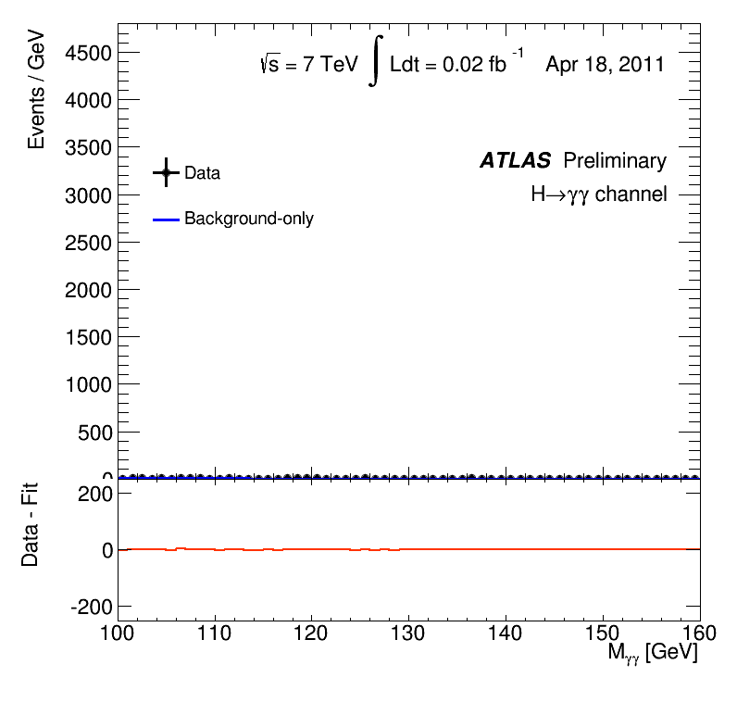
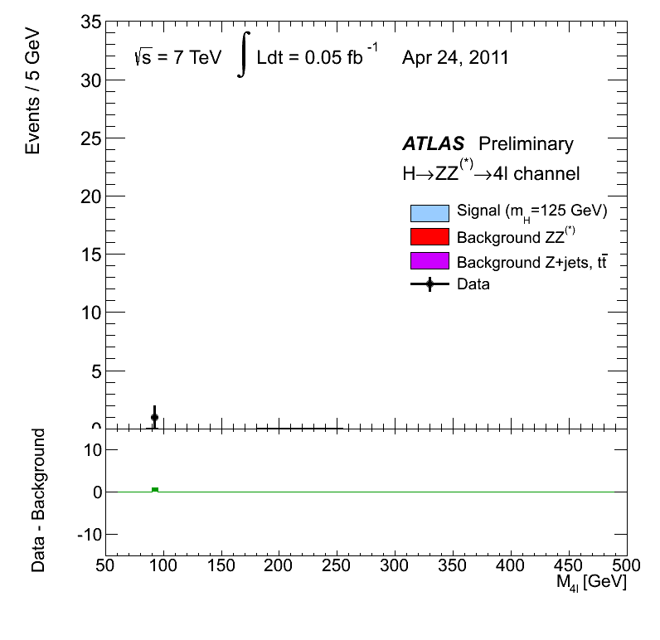
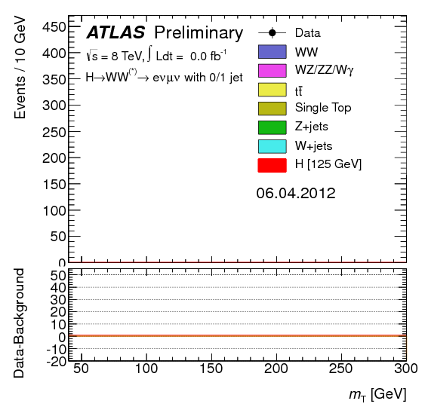
LHC Data taking up to 2012 (7 + 8 TeV)
H → γγ
H → ZZ → four leptons
H → WW
◊ ll+MET

Slide 15
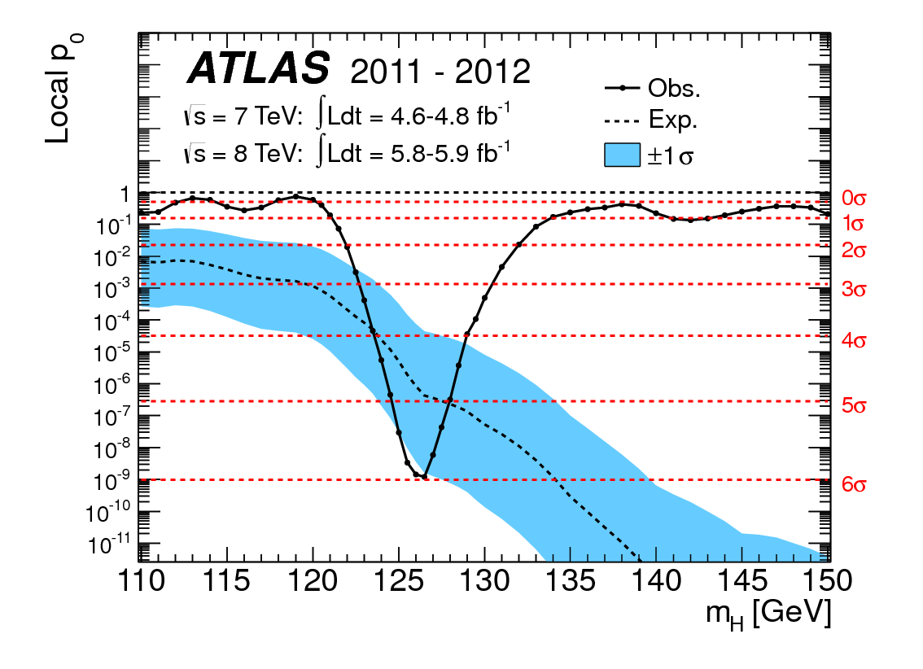
Higgs Discovery
plus CMS, after combining the leading channels, claiming a more-than-5 σ discovery

Slide 16
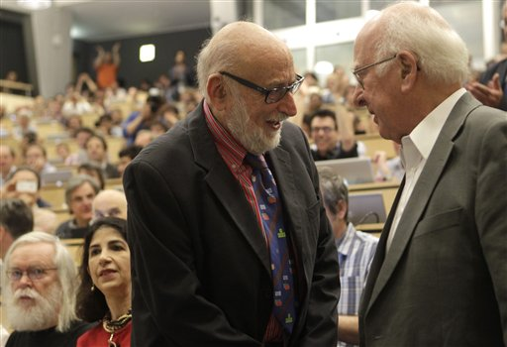
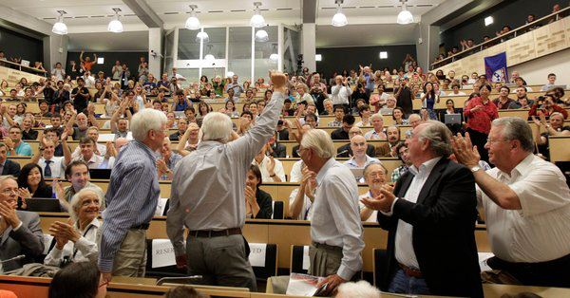
Higgs Independence Day – 2012.7.4 !

Slide 17
Higgs Boson Cartoon
Now, you need to explain what the Higgs boson does, instead of just calling it “god particle”, which was disliked by many physicists
In short, elementary particles interact with Higgs field to acquire mass
Remember NOT to say to others, Higgs boson is responsible for the masses of the Universe (Which is WRONG)
QCD confinement does!

Slide 18
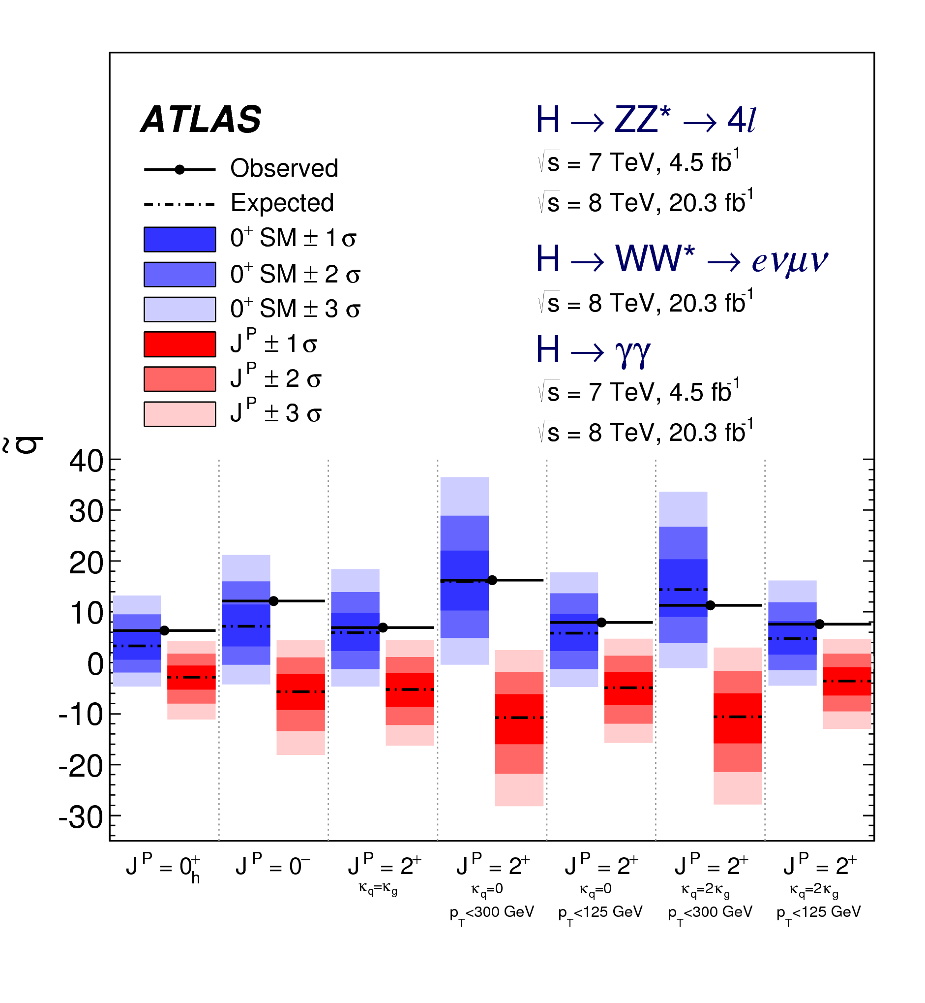
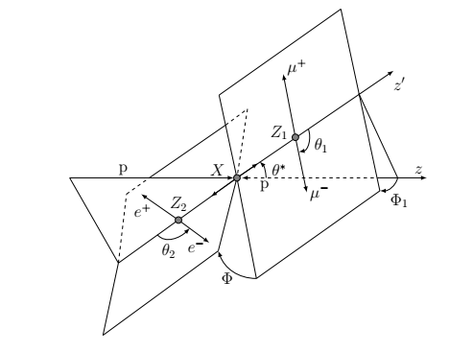
Property Of The “Higgs” Boson
Spin and CP
Studied by looking at the angular distribution of decay products
Example of a H→ZZ→4l decay
SM prediction of J^{P} = 0⁺ is strongly favored -- SCALAR

Slide 19
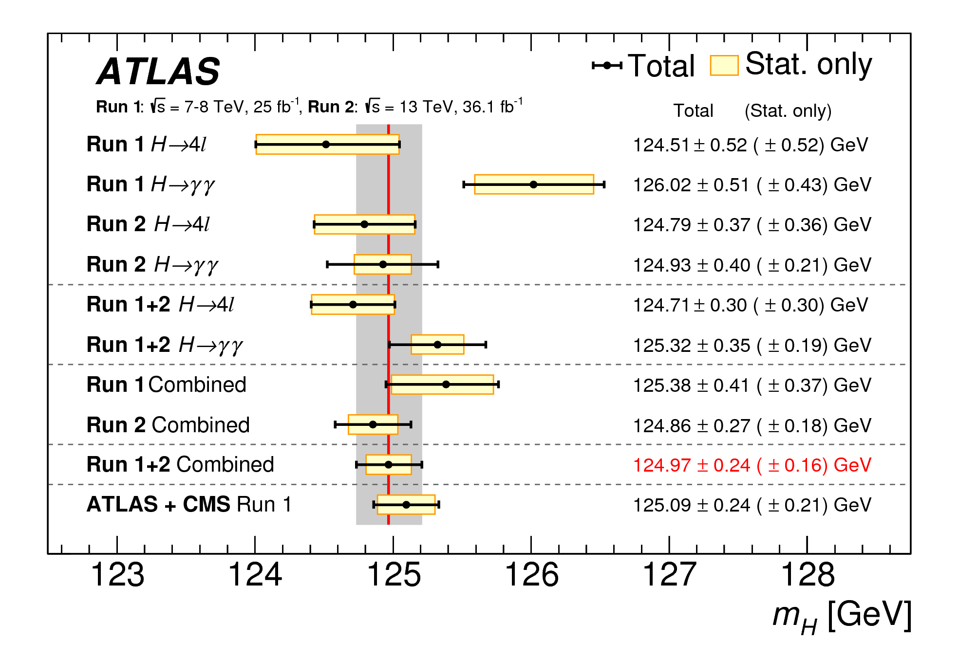
Property Of The “Higgs” Boson
Precision ~ O(100) MeV >> Natural width of 5 MeV

Slide 20
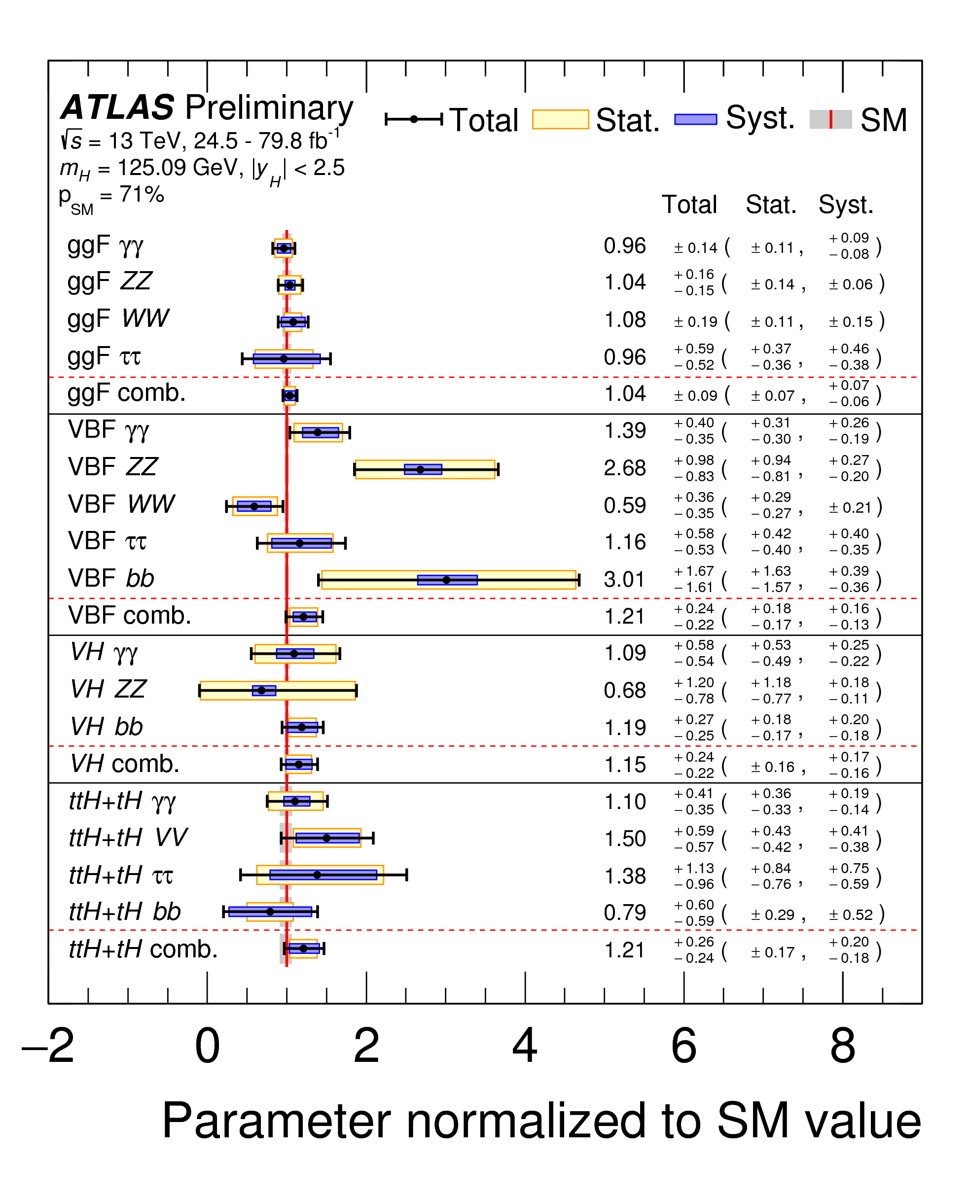
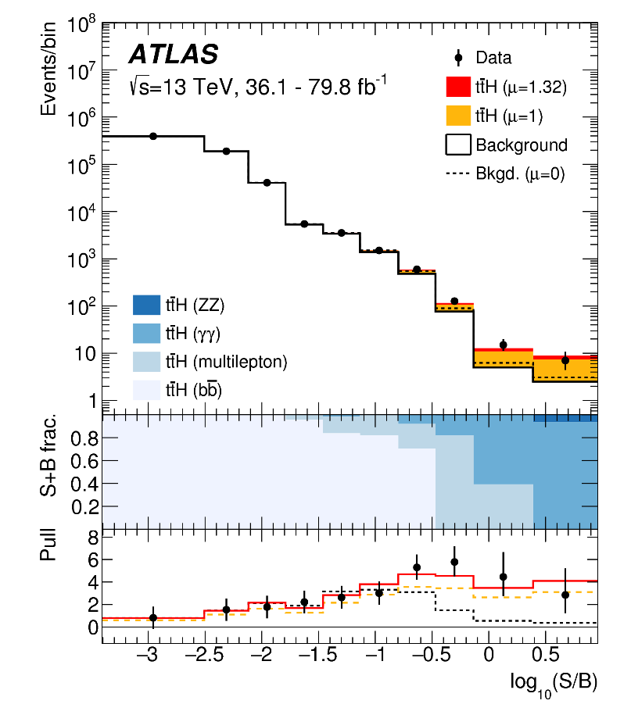
Property Of The “Higgs” Boson
All production modes observed; Decay channels to γγ, ZZ, WW, ττ, bb
Example of ttH observation
For difficult channels, often MVA techniques exploited

Slide 21
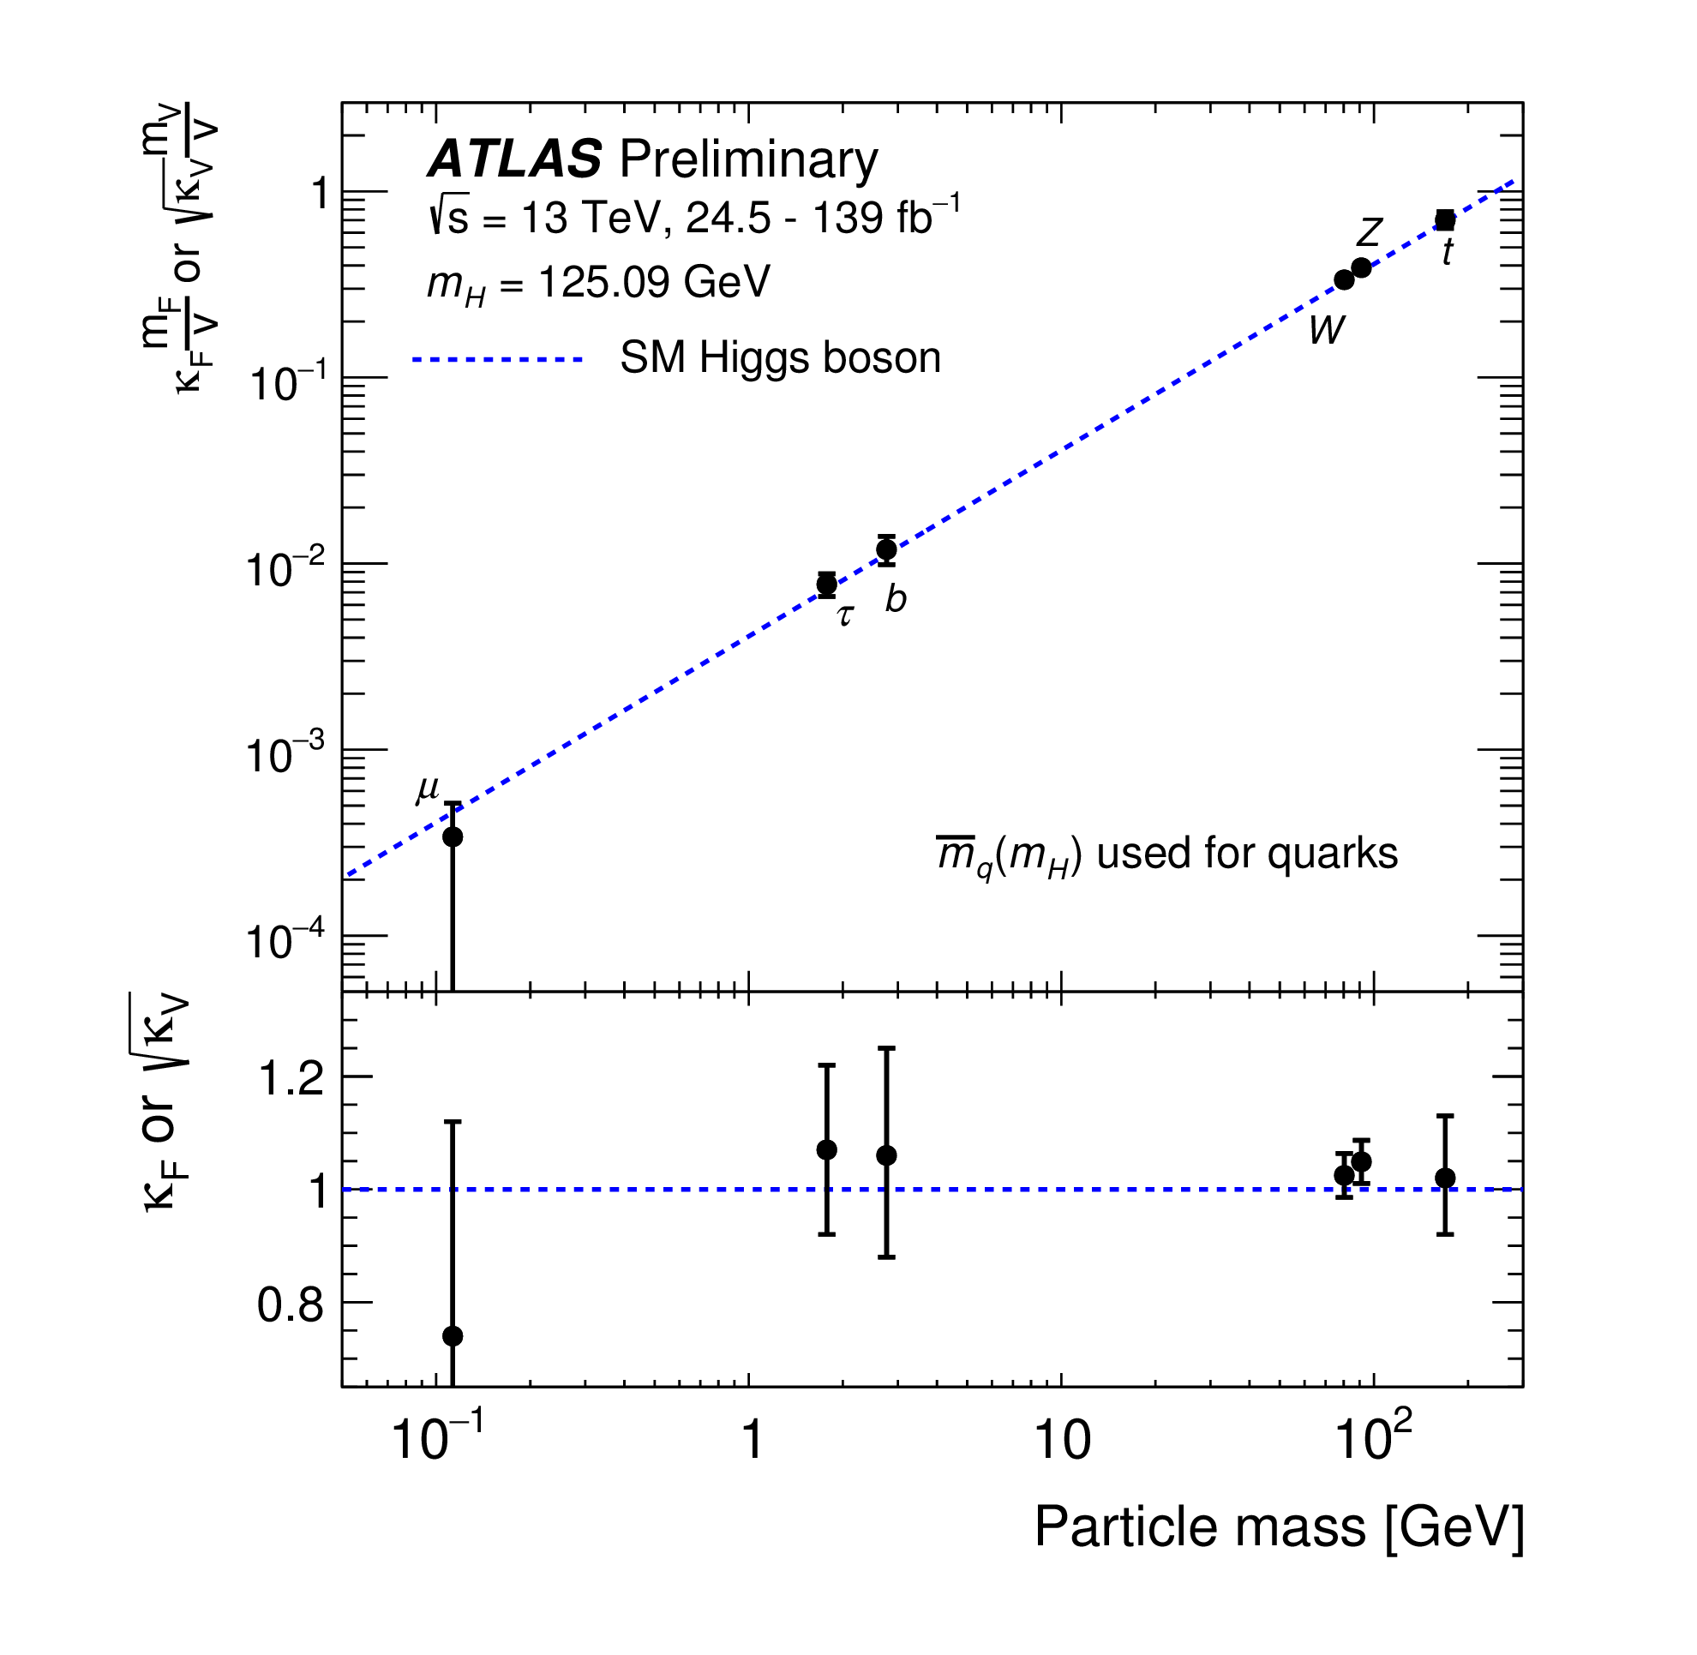
Property Of The “Higgs” Boson
A precise measurement of all Higgs couplings will essential insights into EWSB
Question for you:
Can we observe Hee coupling at the LHC?
How about Hcc?

Slide 22
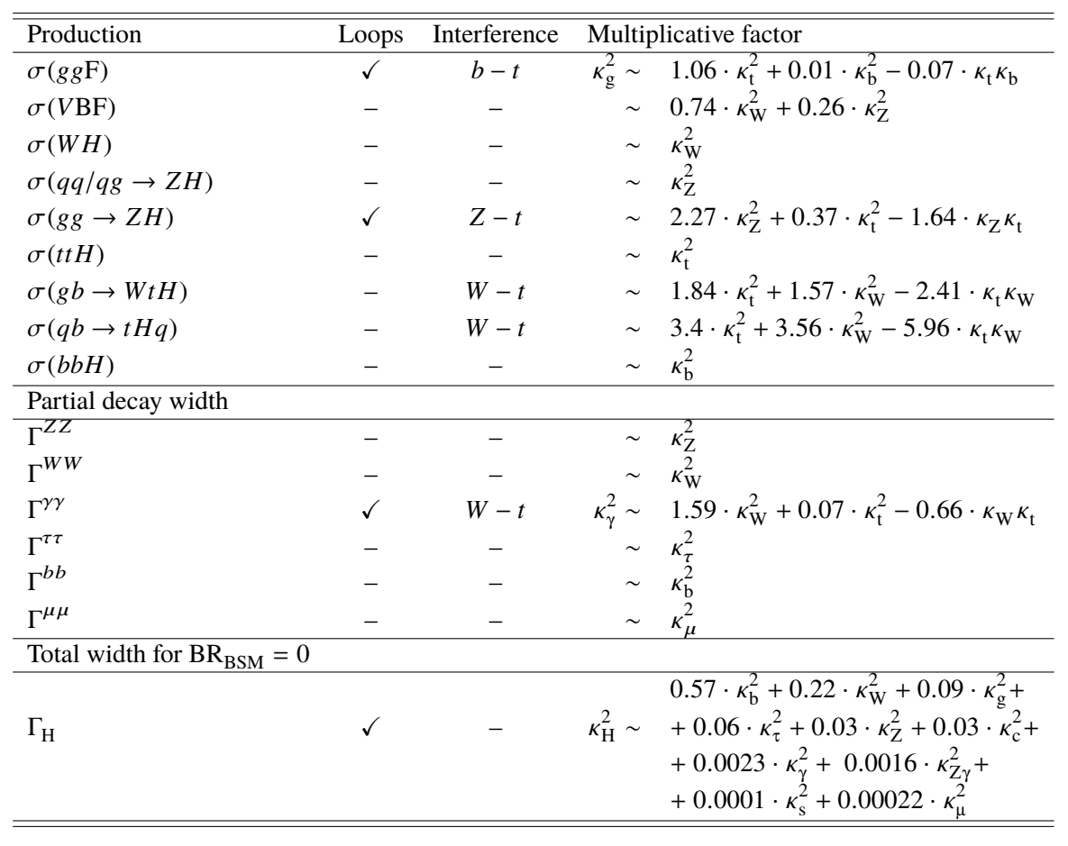
Property Of The “Higgs” Boson
Give you an idea how couplings can be measured out of measurements of production modes and decays
Assumption needed for total Higgs width : - (

Slide 23
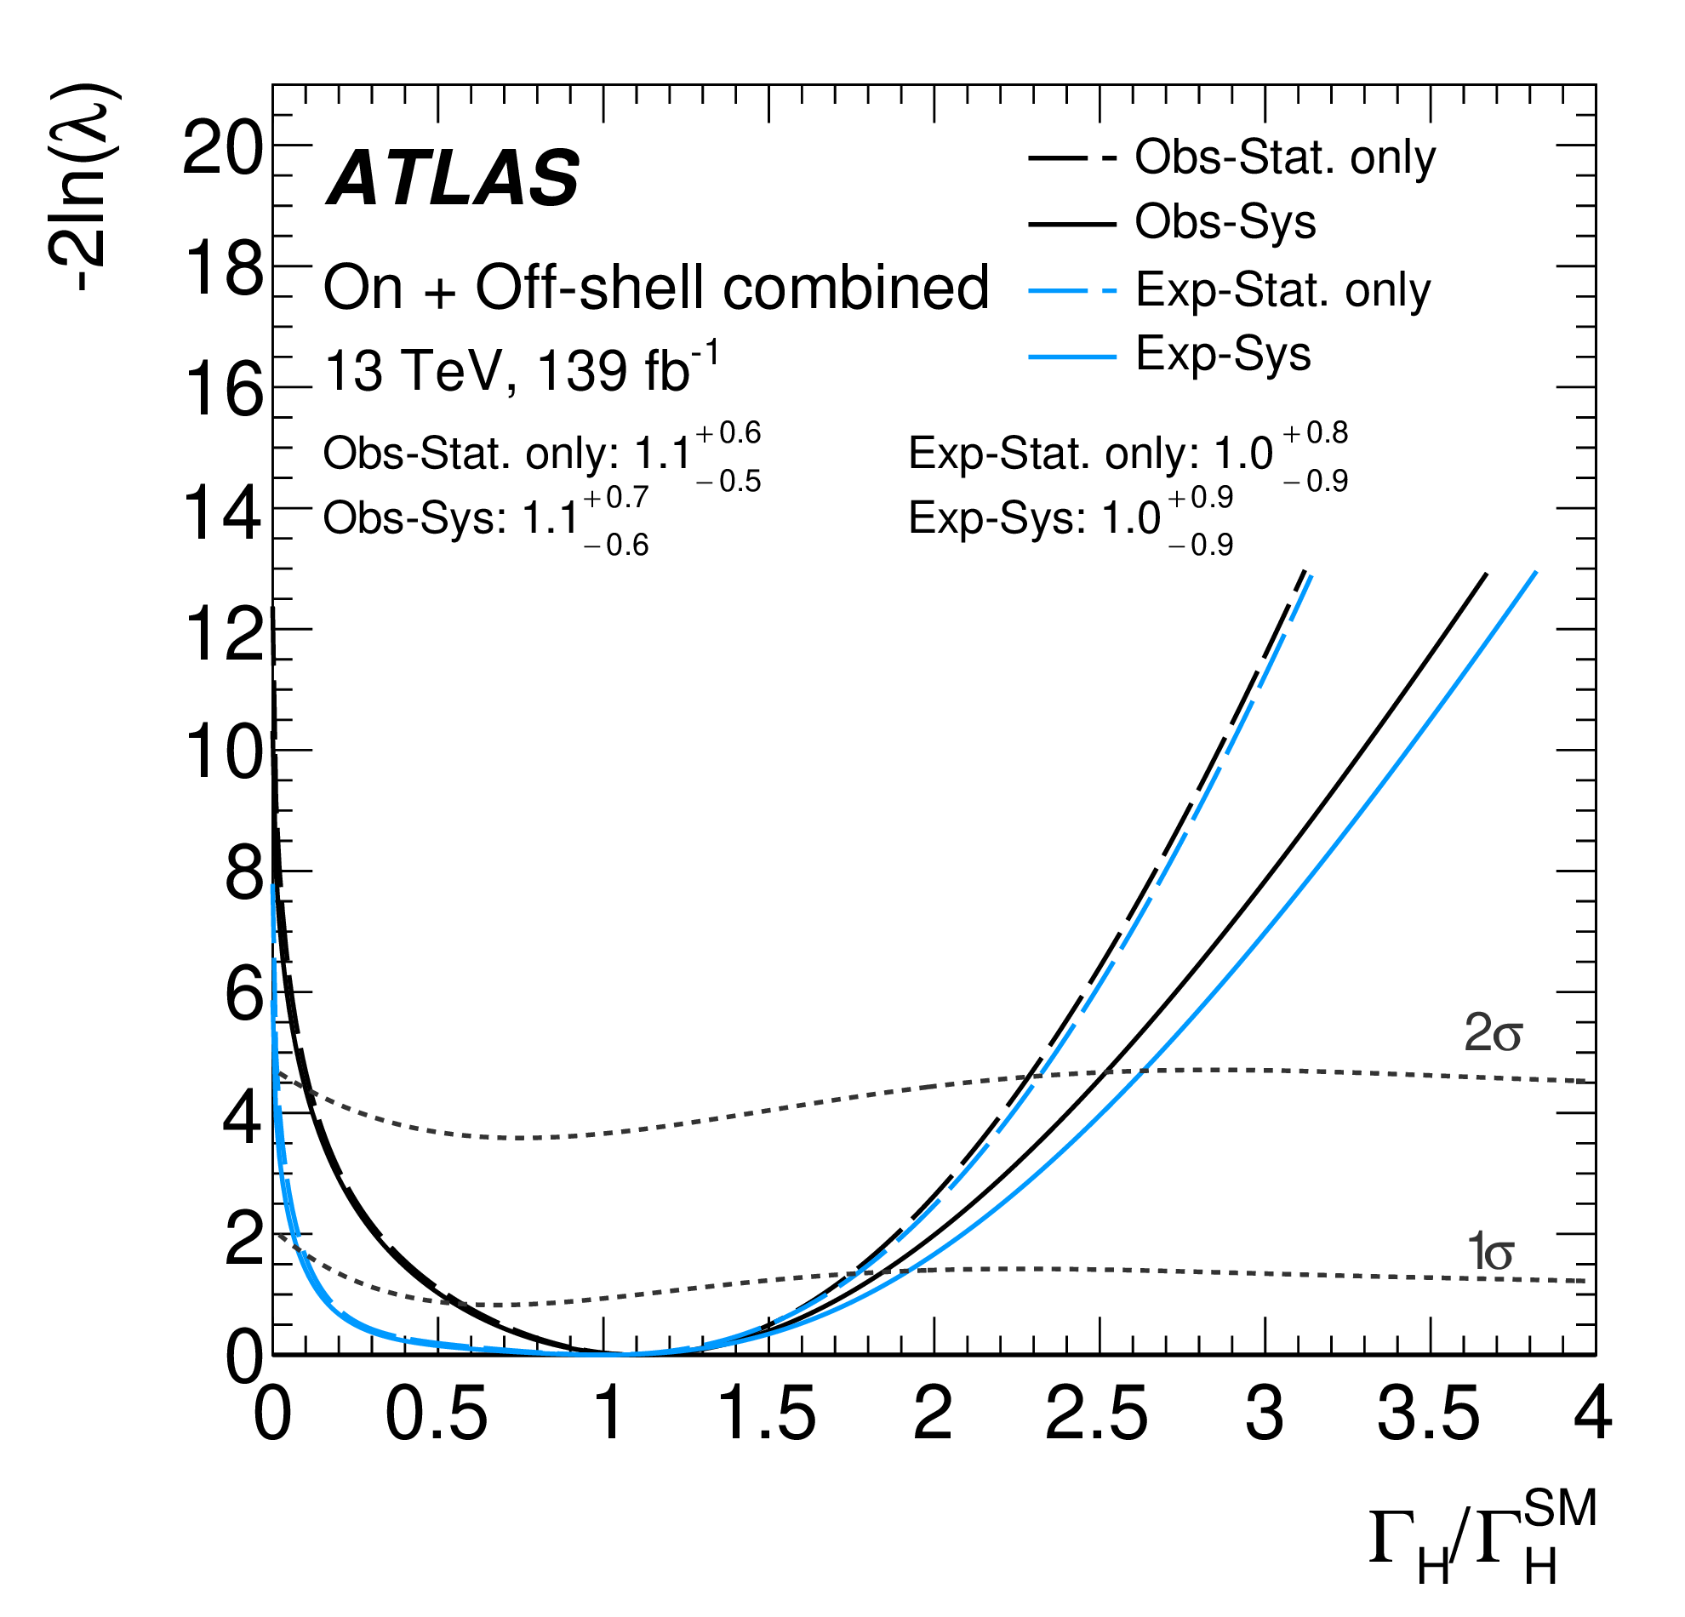
Property Of The “Higgs” Boson
Can we measure the total width?
Yes, but with again some assumptions, on-shell v.s. off-shell tricks
Derived Γ_{H} < 10.5 MeV at 95% CL

Slide 24
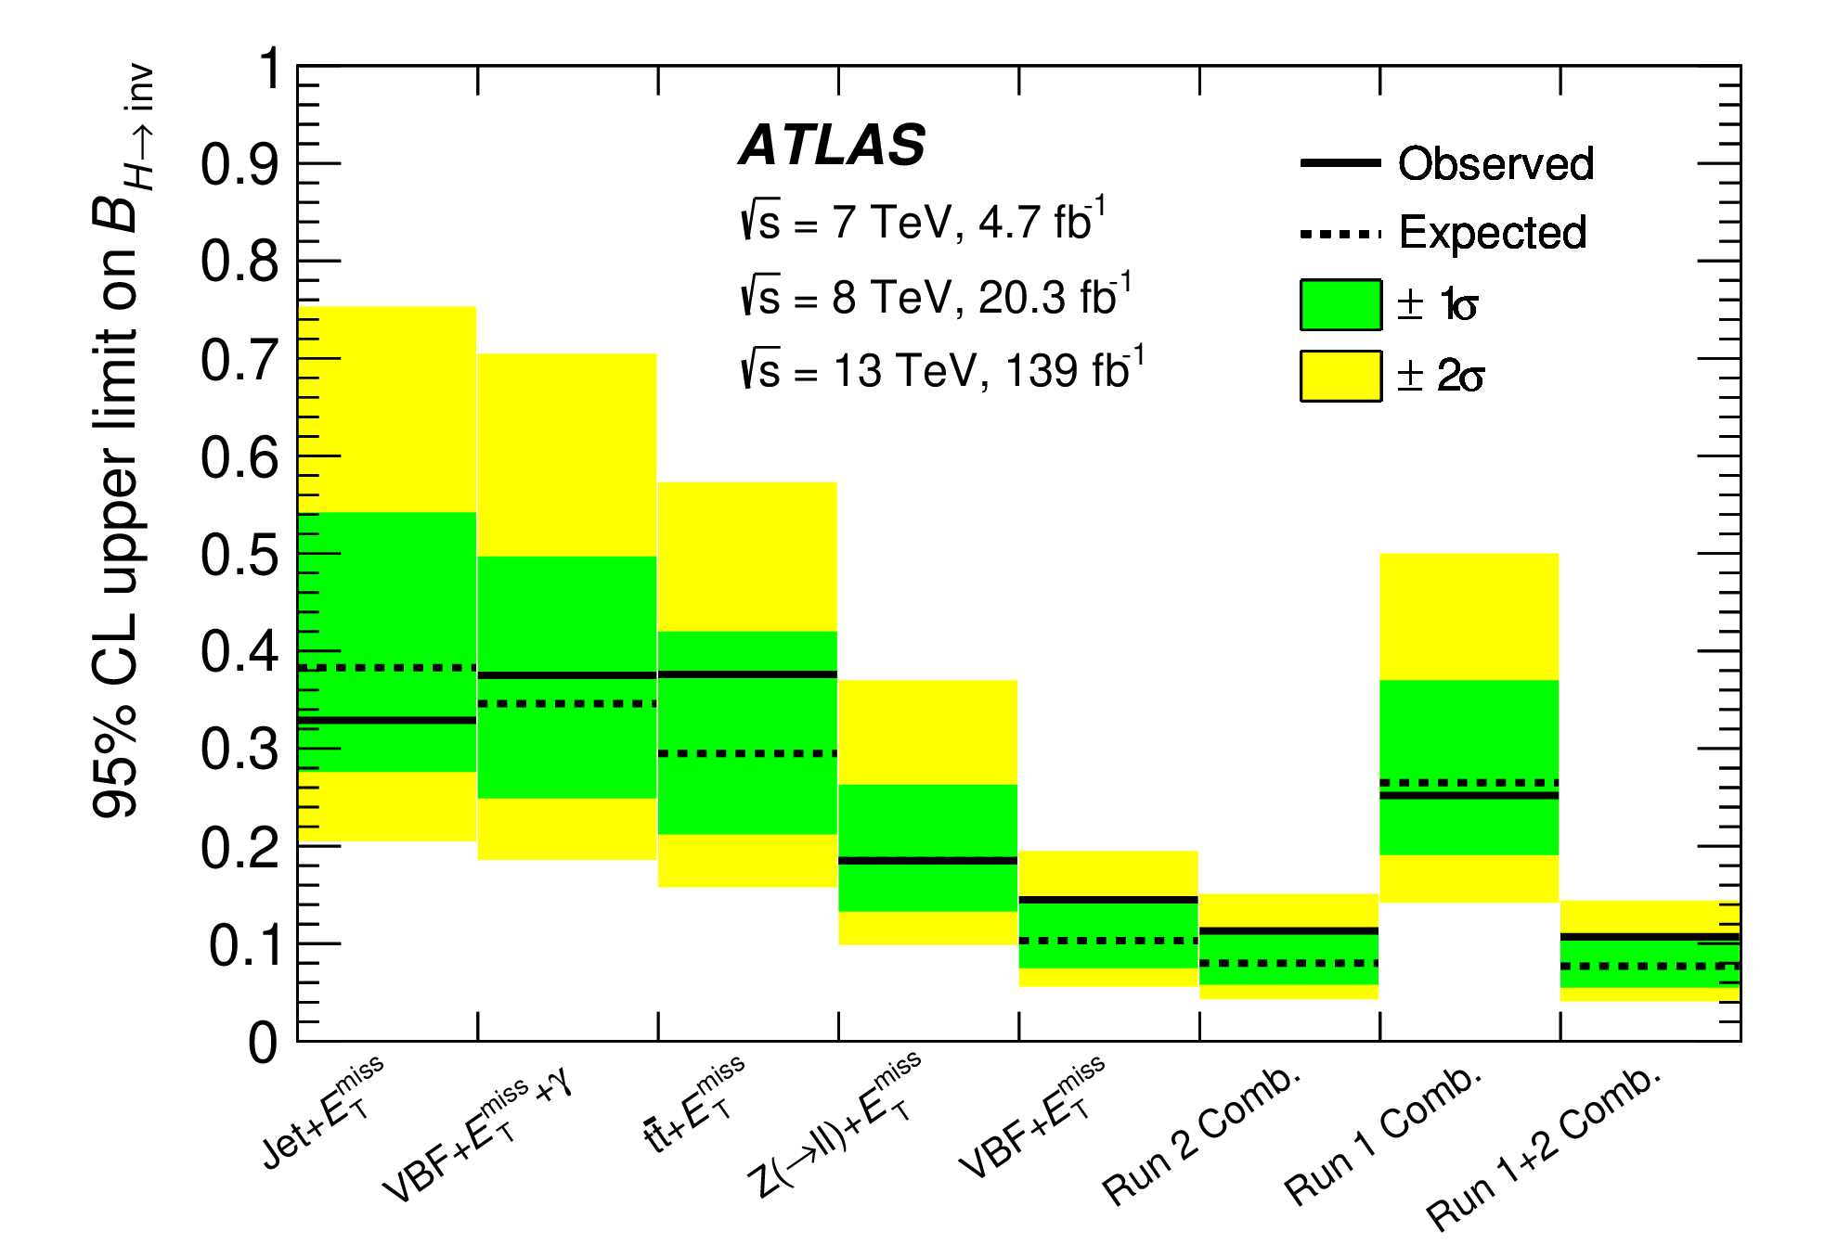
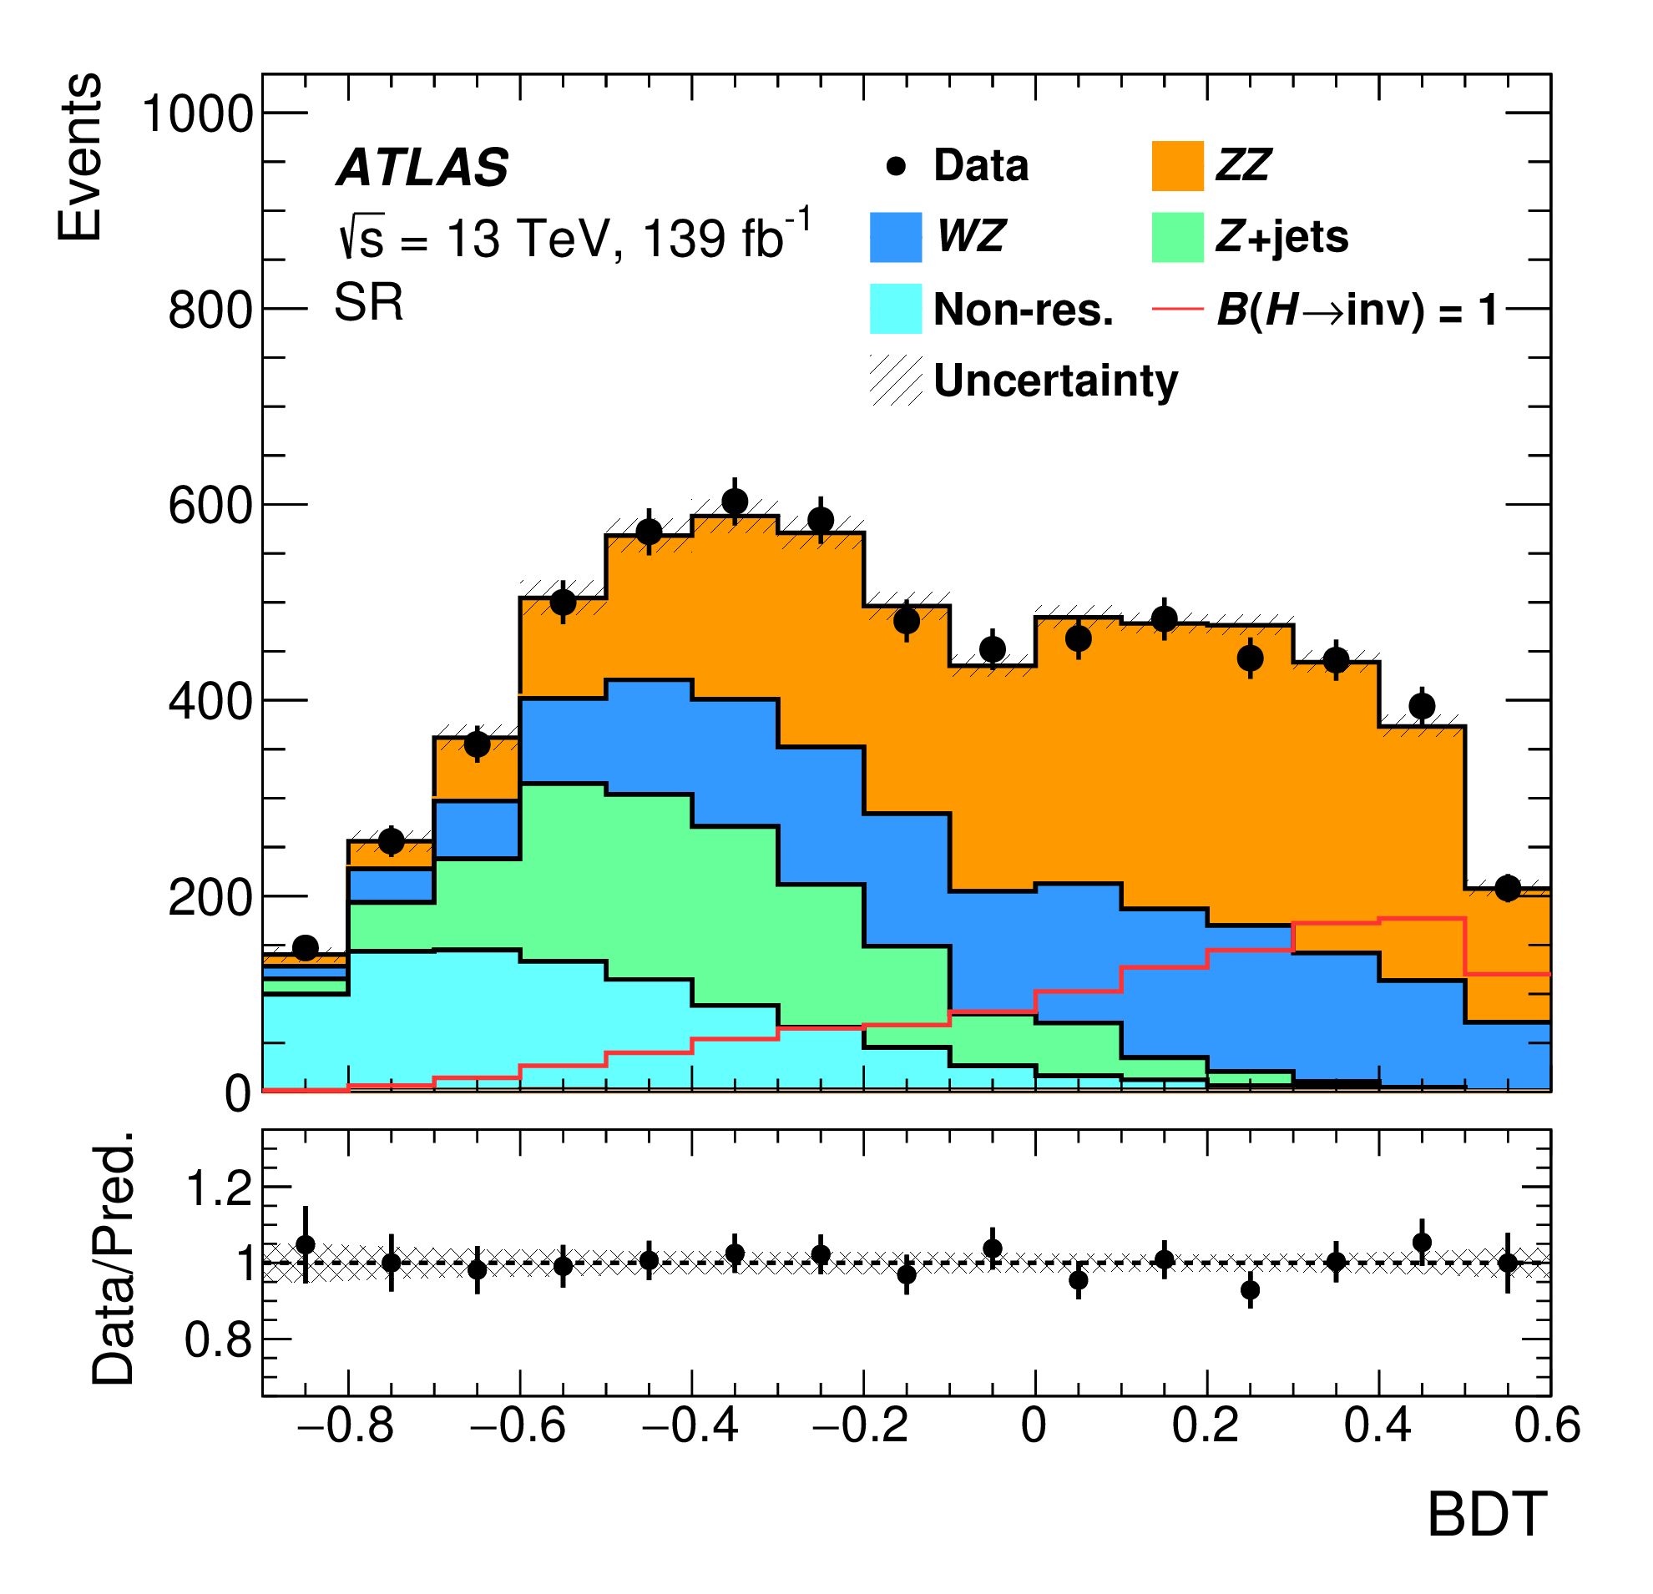
Property Of The “Higgs” Boson
Partial width Γ_{H→invisible} can be constraint directly in a assumption-free way
By studying many channels, such as VH, VBF; and look at MET
Γ_{H→invisible} / Γ_{H} < 11% at 95% CL

Slide 25
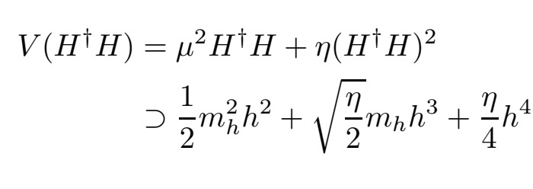
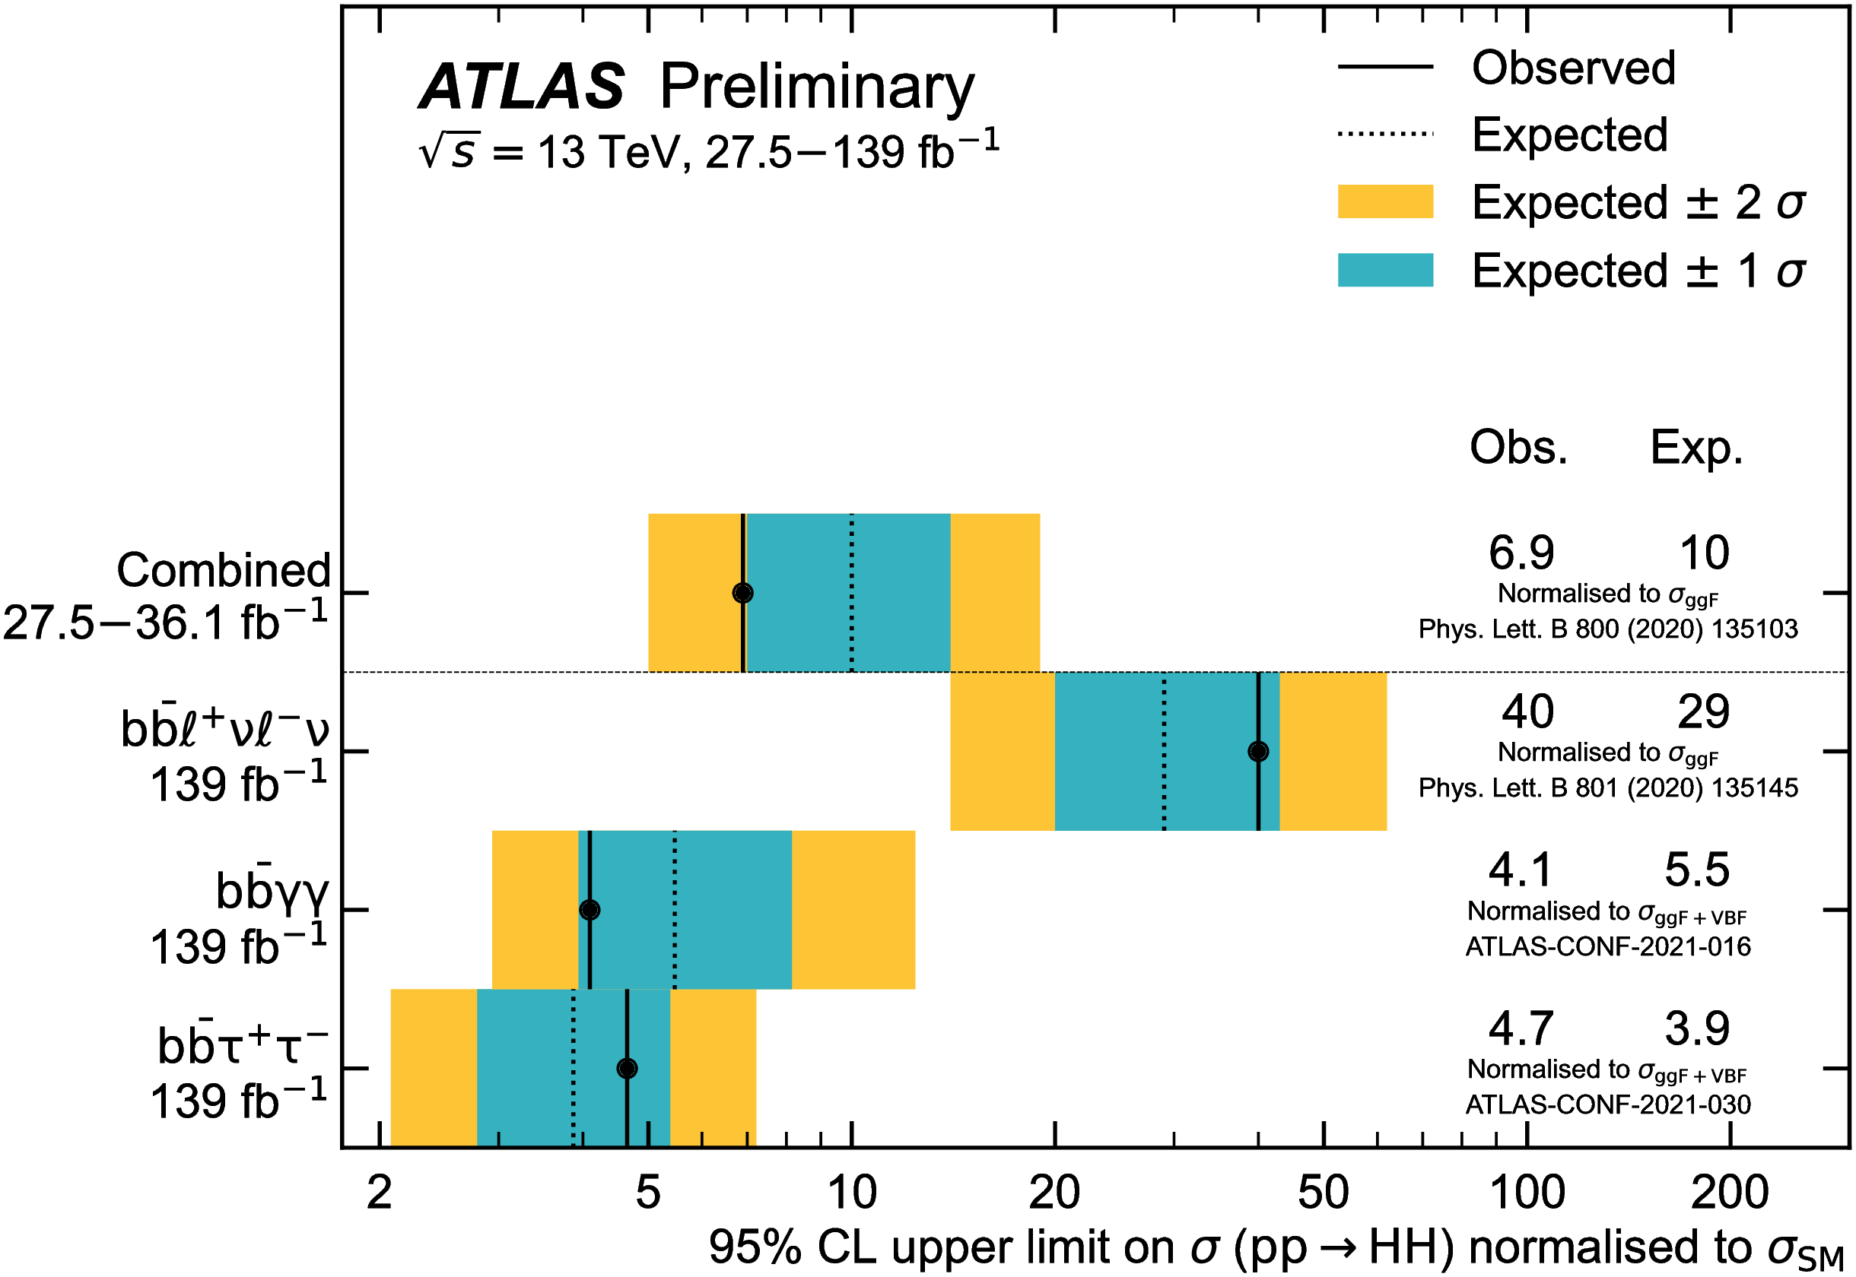
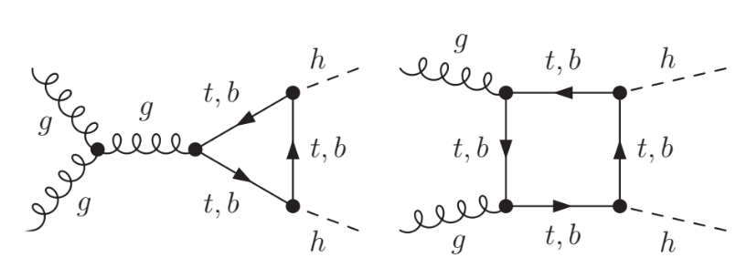
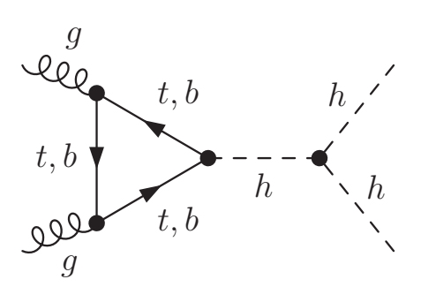
Property Of The “Higgs” Boson
Higgs self coupling
O(1/1000) of σ(H)
Fundamental interactions due to the special form of Higgs potential
Mission “Impossible” ?
=> Endeavour being made

Slide 26
Situation So Far
The Higgs boson seems to be the SM Higgs boson, and EWSB seems to be validated by the experimental data
The “miracle” Mexican-hat form of Higgs potential is crucial to explain and understand, yet very difficult to fully explore, due to its nature related to rare Higgs self-interactions

Slide 27
Problems
Also referred to as naturalness problem

Slide 28
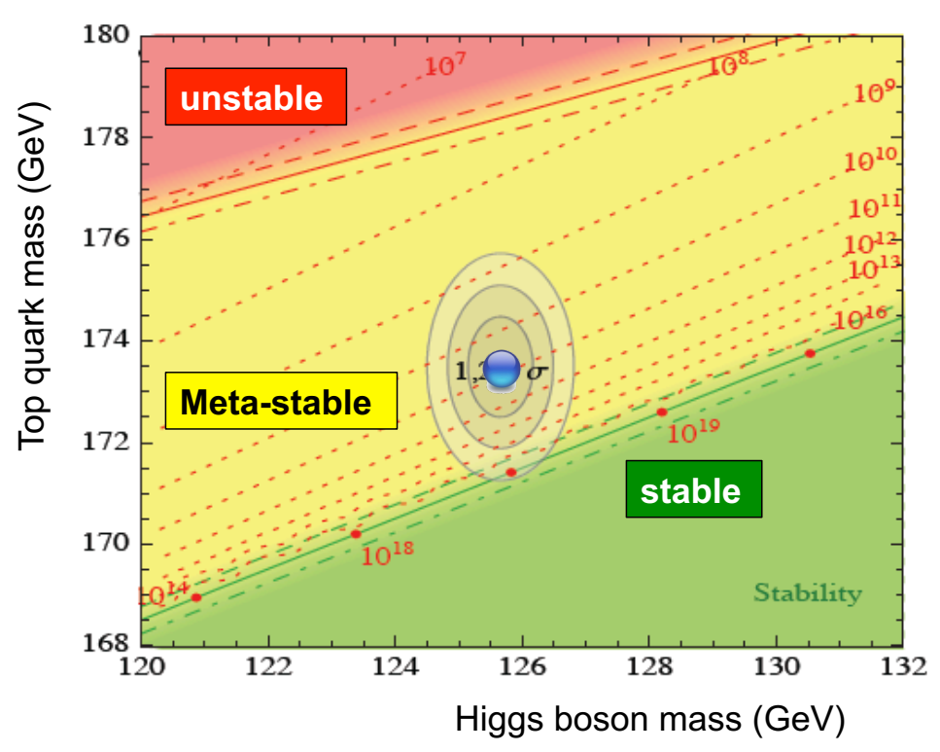
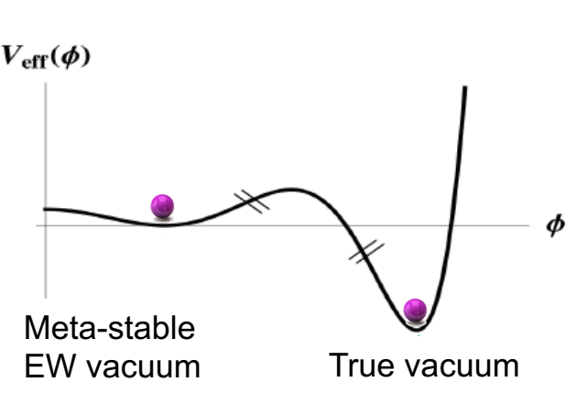
Problem of the Void
Top quark loop largely affect the behavior of the Higgs self-coupling at high energy
Possible to create a lower vacuum
Possibility for decay of vacuum through quantum “tunneling”, however, chance extremely small

Slide 29
Imagine a Room …
… Open
The Door
From John Ellis

Slide 30
What lies Beyond?
From John Ellis

Slide 31
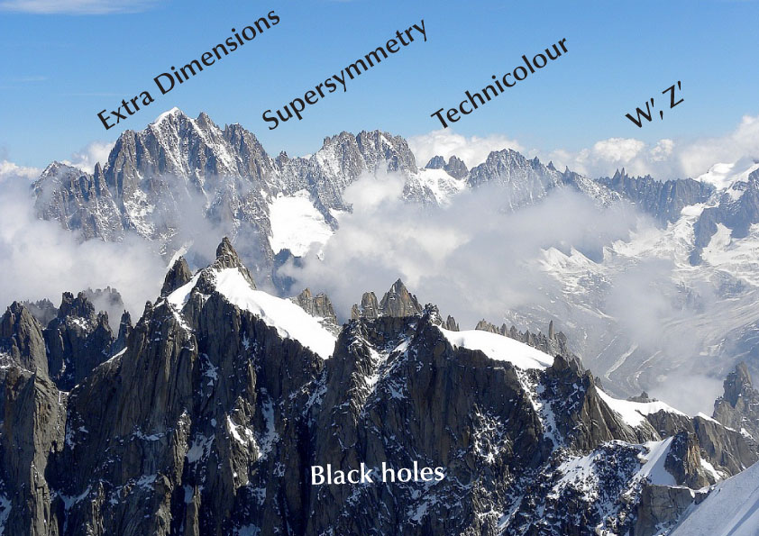
From John Ellis

Slide 32
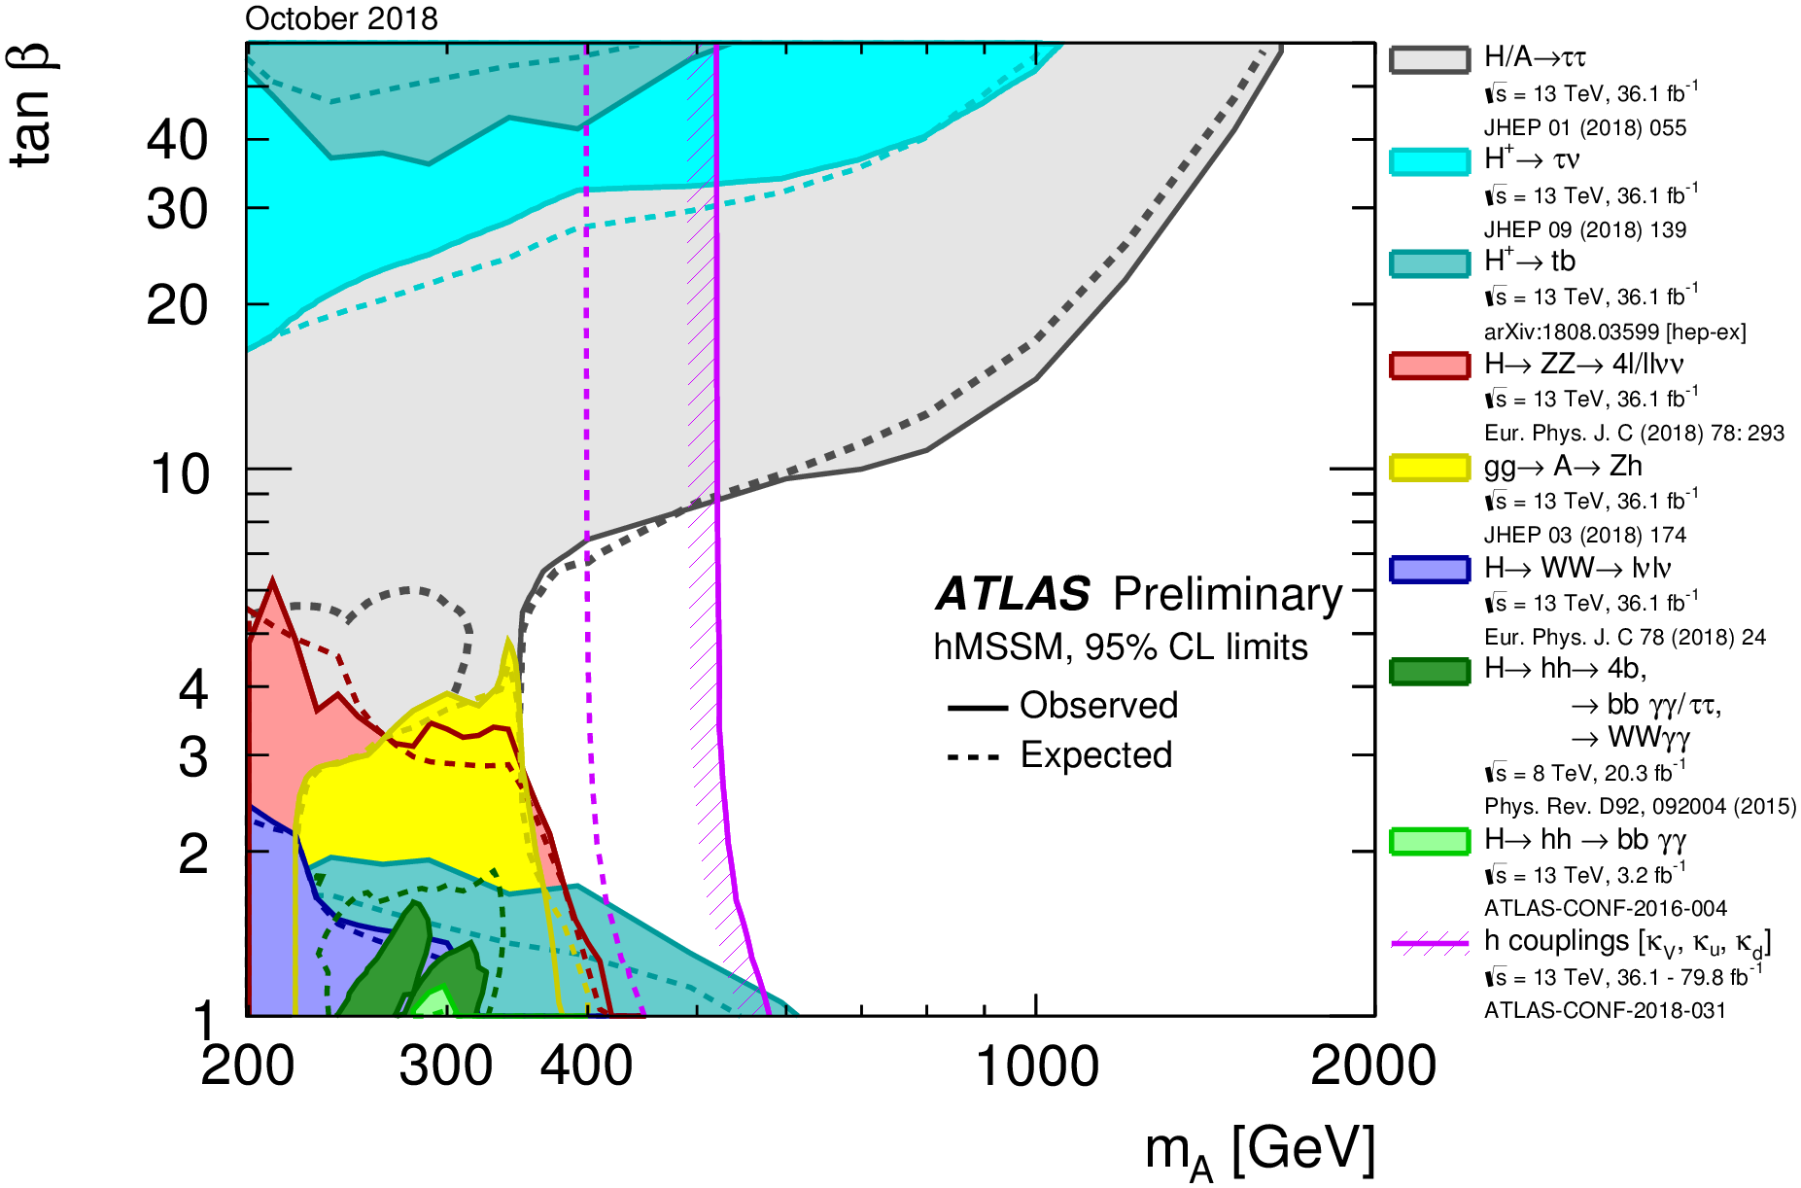
Higgs and Beyond
Search for additional Higgs bosons in hMSSM framework, and exclusion

Slide 33
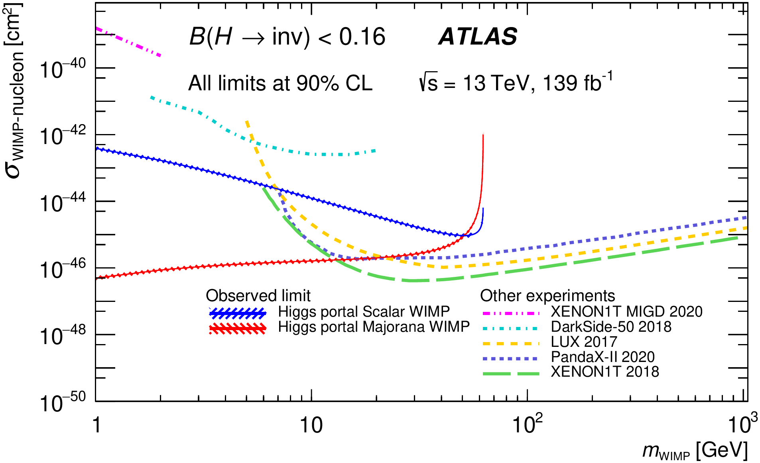
Higgs and Beyond
Higgs portal with dark matter

Slide 34
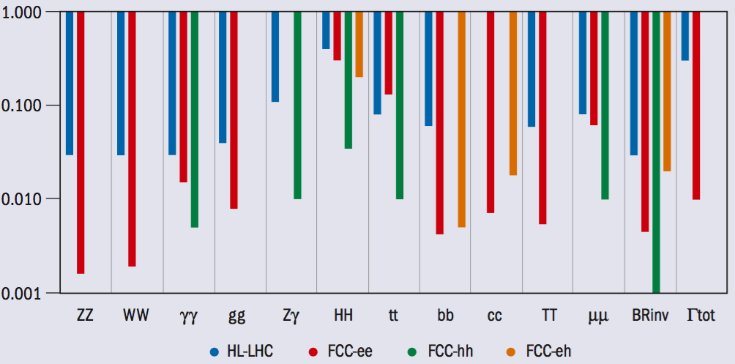
Higgs and Beyond
Next generation colliders essential to make fundamental progress on Higgs physics

Slide 35
SM Measurements and Searches
Outline
Not a complete review, but only highlights or examples concerning the measurements of SM processes and searches for new physics

Slide 36
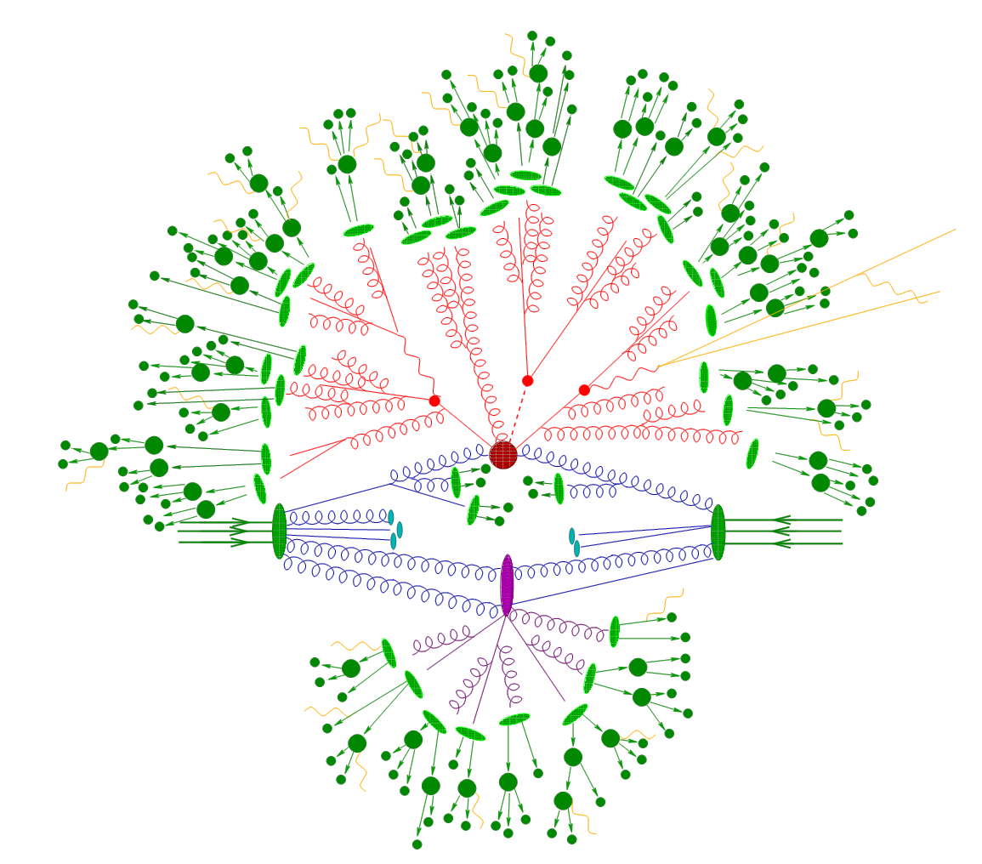
Measurements v.s. Searches
Measurements of all phenomena from particle interactions
Test of the SM
Basis for searches
Searches for rare phenomena manifest as the consequence of new physics, usually for a scale beyond EW scale

Slide 37
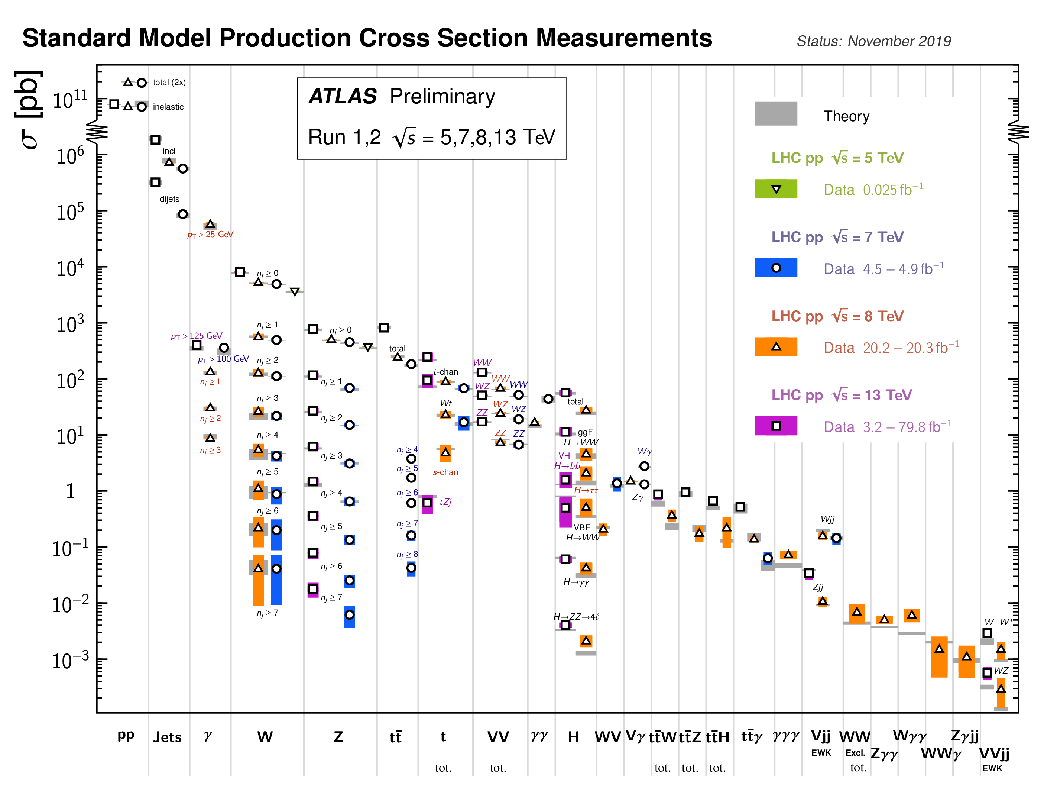
SM Measurements
Explore all known and unknown phase spaces and leave no stones unturned
Total pp collisions, jets
Weak bosons
Top quark
Multiboson, Higgs
Rare processes

Slide 38
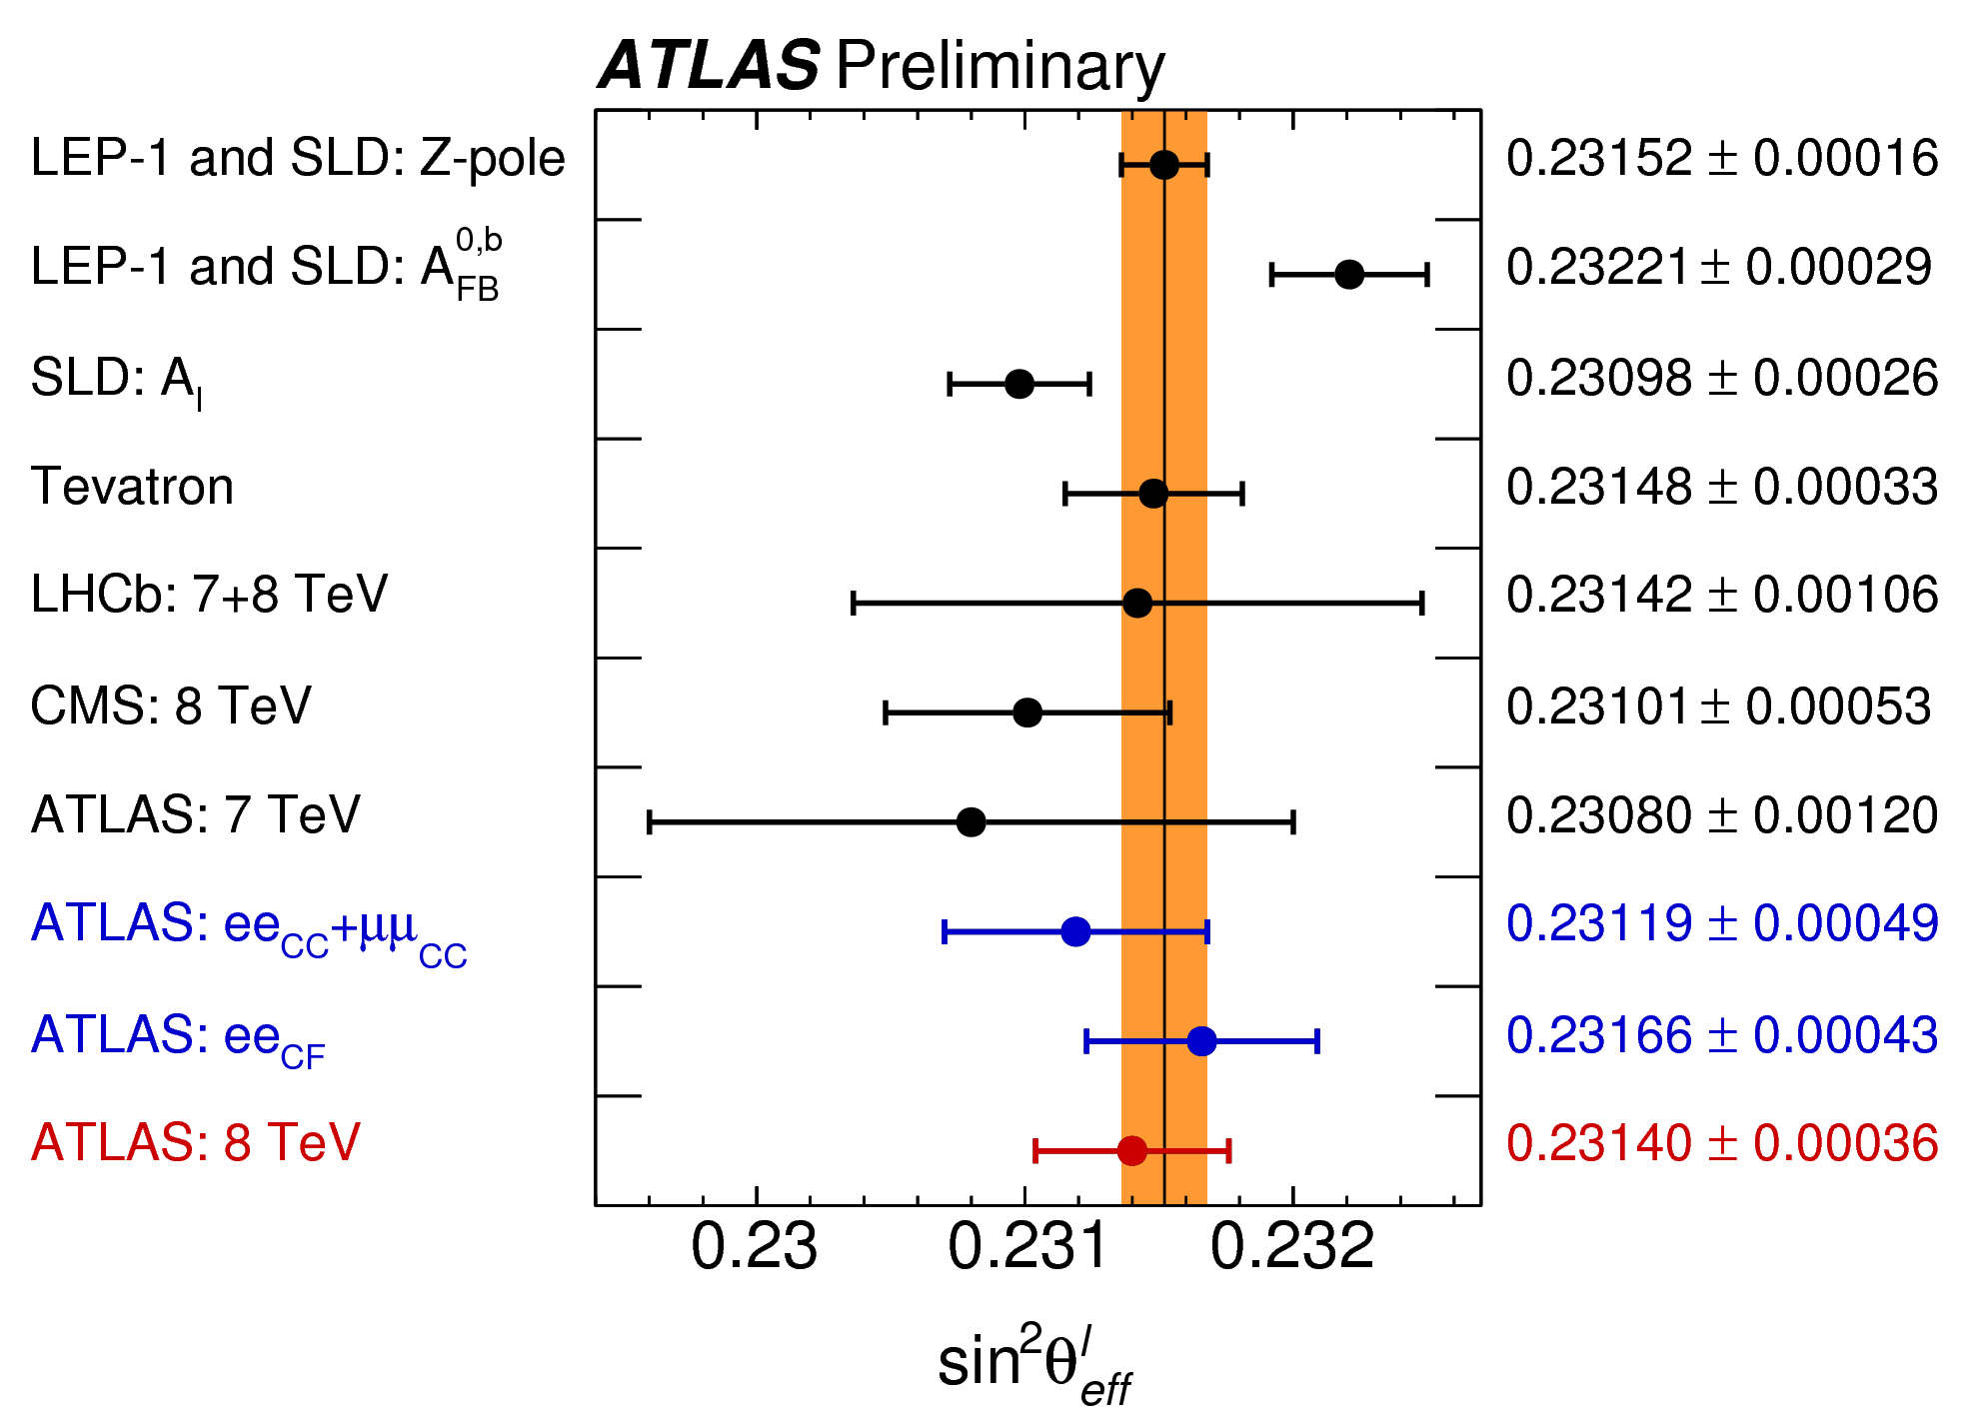
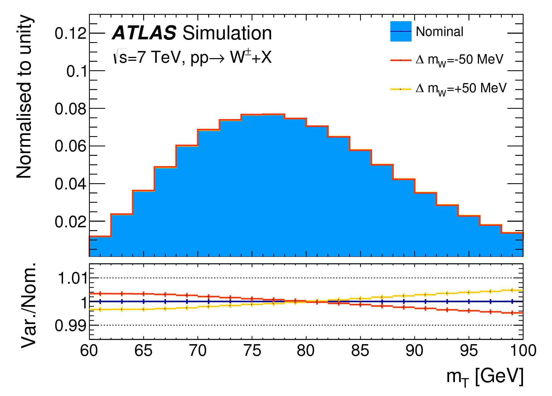
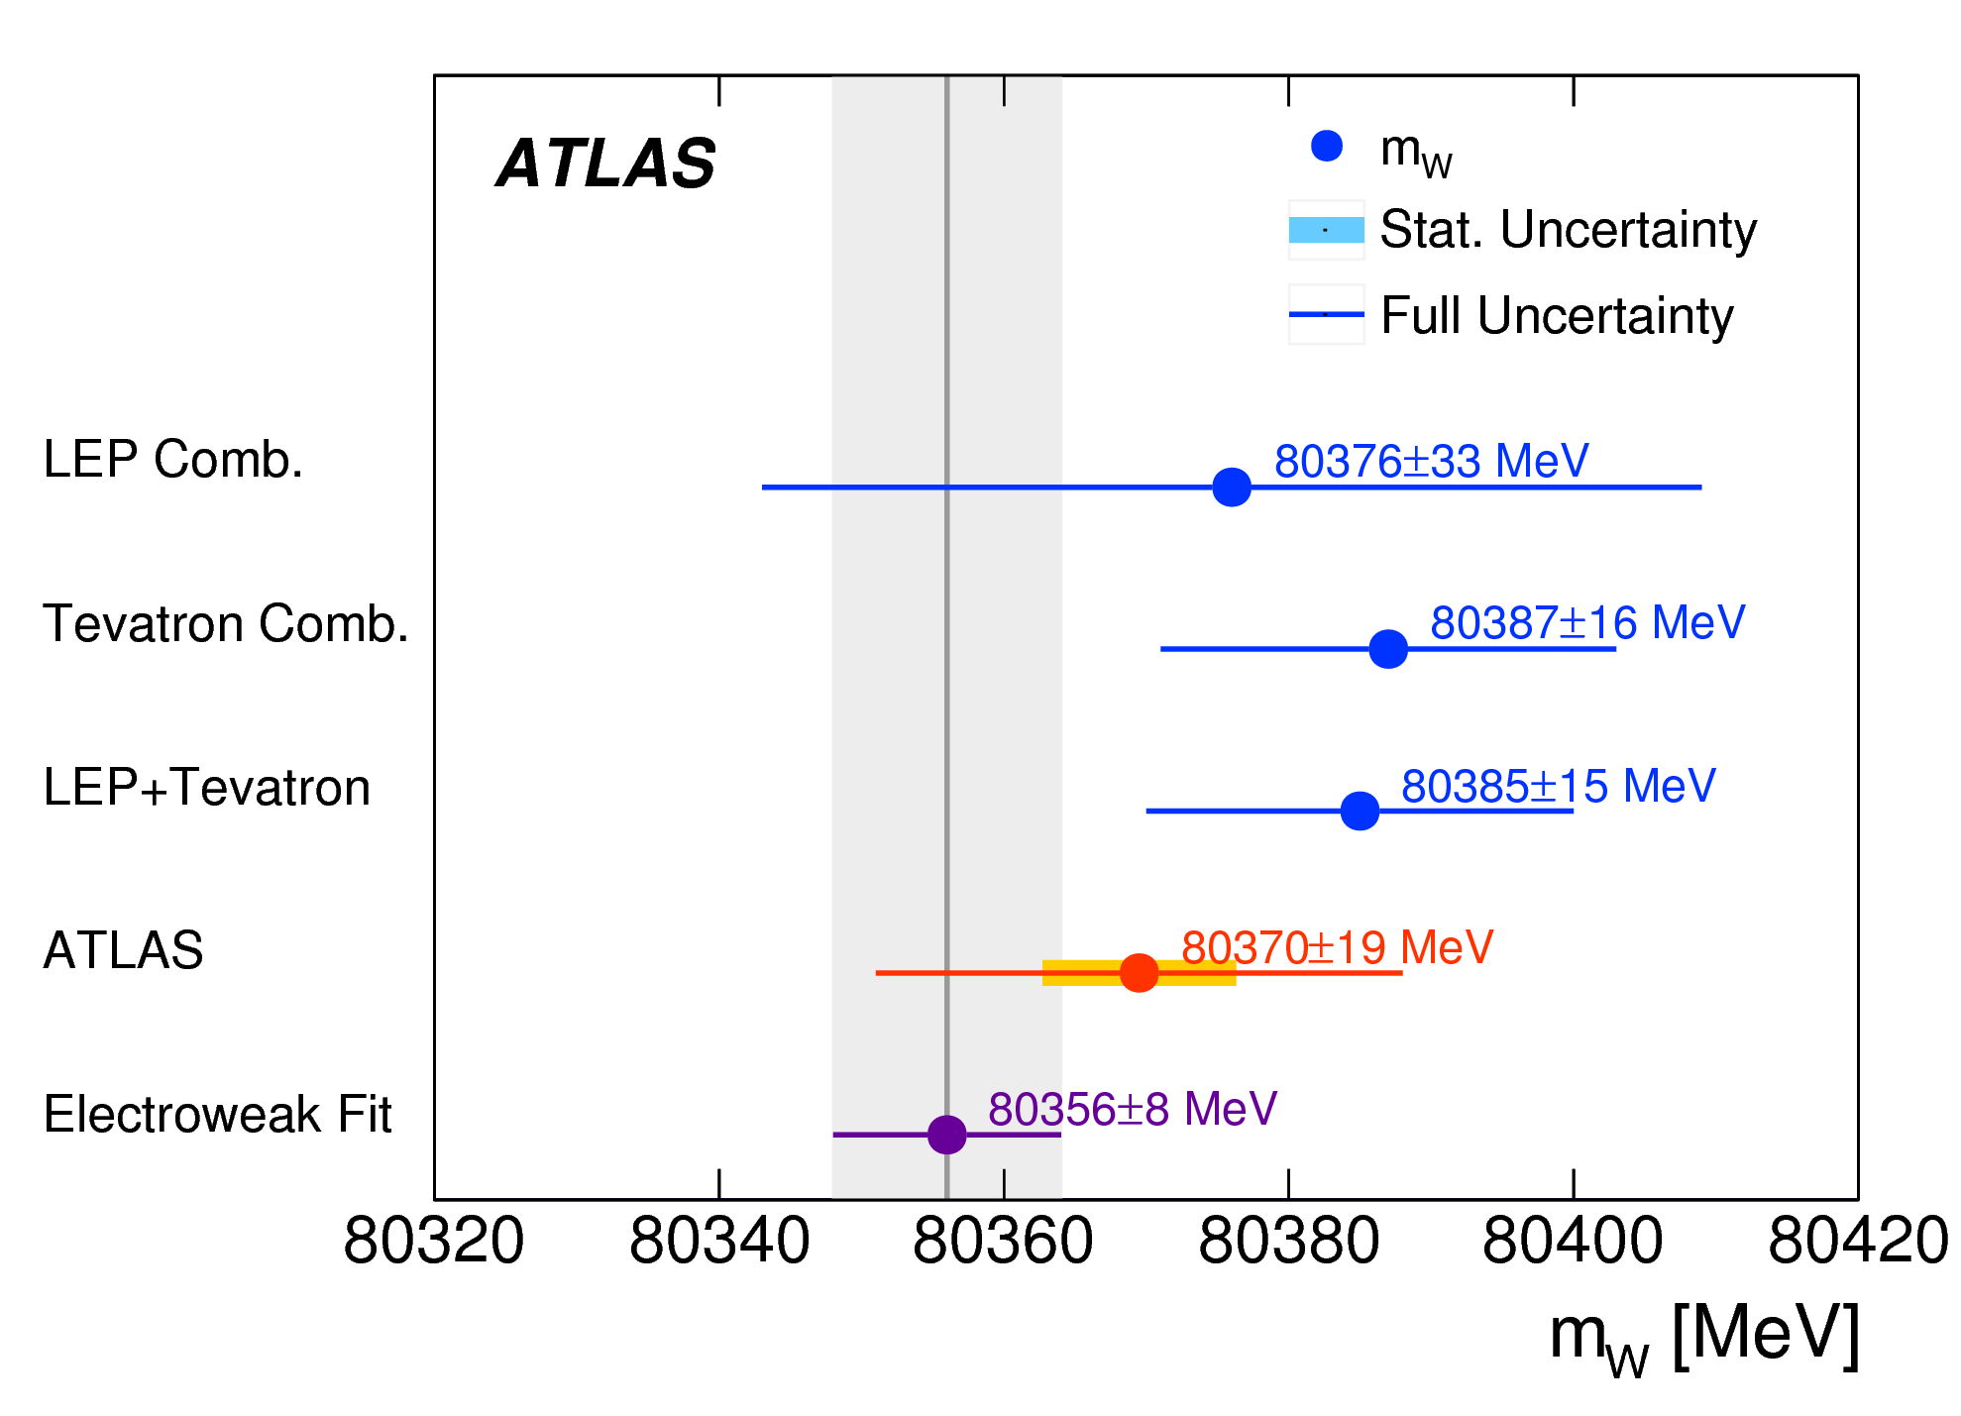
SM Measurements
Dedication for precision W and Z boson physics (weak mixing angle, w mass, etc.)
- Full understanding of detector response and QCD dynamics needed
Illustration of the precision required for experimental measurements

Slide 39
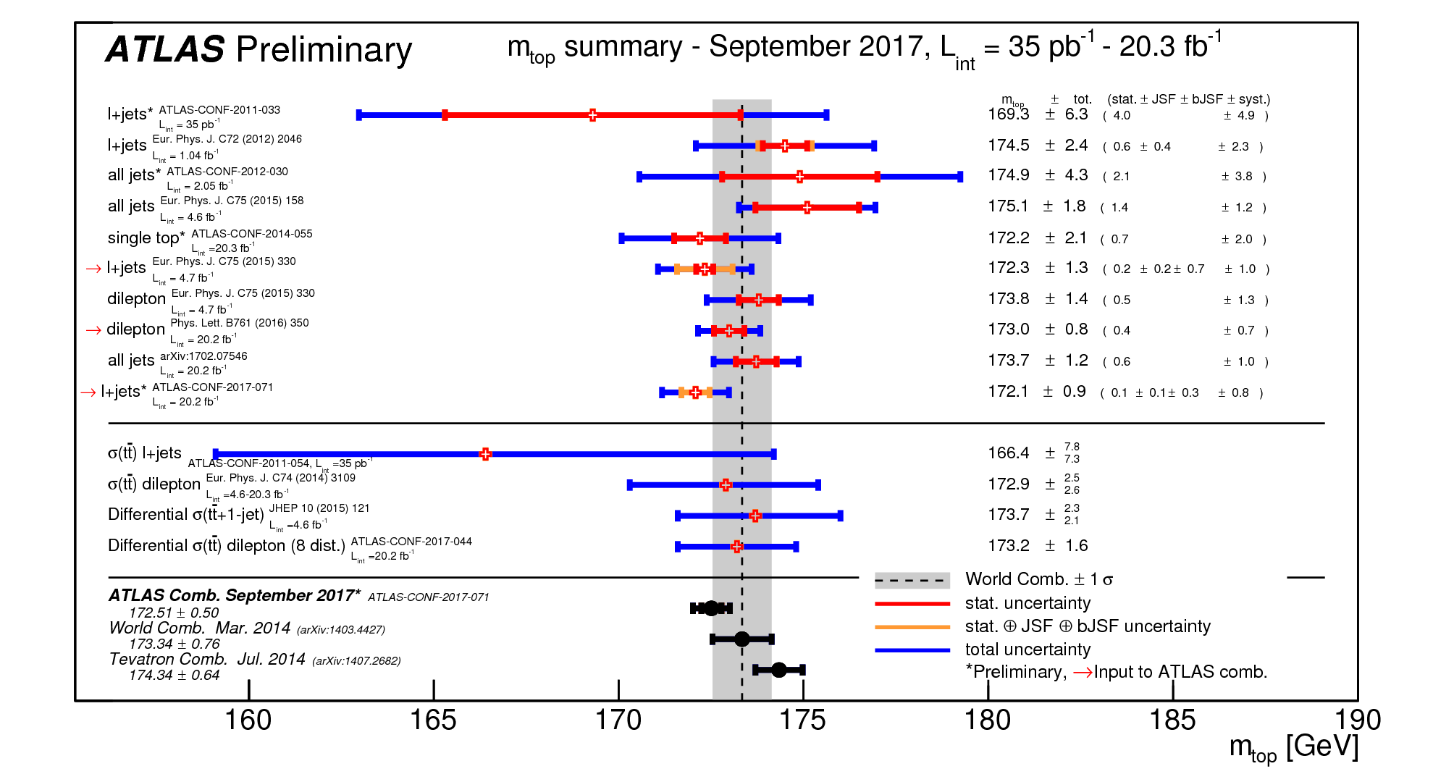
SM Measurements
Top physics is unique for LHC due to its energy reach
An example showing the multiple channels ATLAS is probing and contribution to mass determination already with partial data; other measurements and rare channels have been probed as well

Slide 40
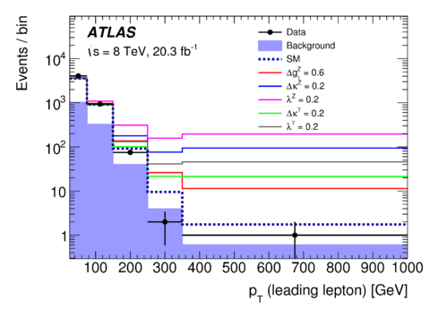
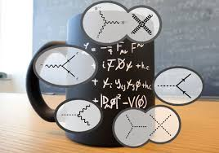
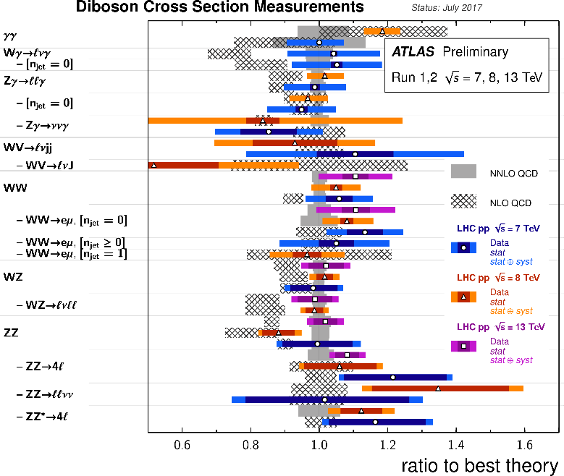
SM Measurements
Non-abelian Gauge theory structure probed by gauge boson self couplings
➔ VV, VVV production
LHC offers a unique opportunity to study those, current measurement enters O(5%) precision

Slide 41
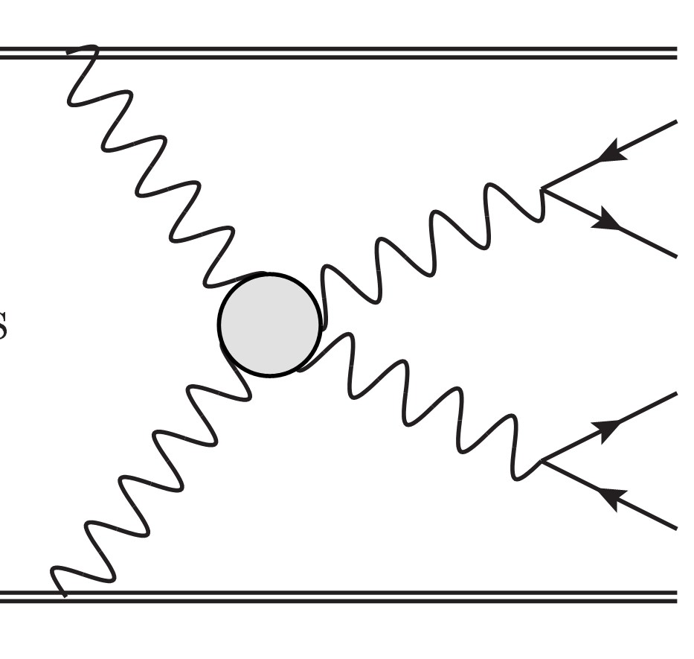
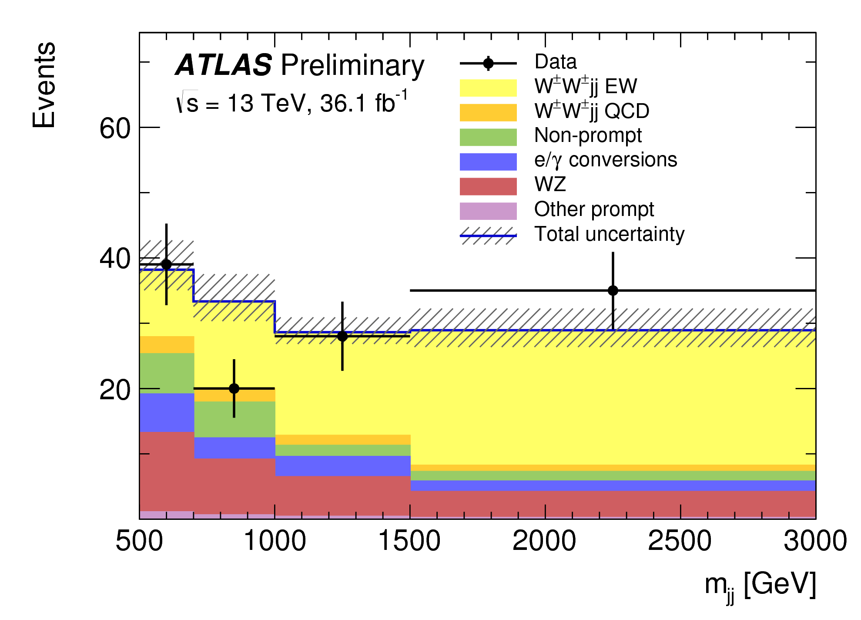
SM Measurements
Vector boson scattering
Probe of EWSB dynamics
Delicate cancellation needed to unitarize at TeV scale
Historically, one of main motivations for a Higgs boson!
WW
scattering

Slide 42
Searches
General searches by looking for excess of events in the straightforward final states
ee
μμ
Mass exclusion of W’ or Z’ from extended Gauge sector or GUT theories already ~ 5 TeV
Question for you: why mass resolution is worse in the dimuon case

Slide 43
Searches
Looking for MISSING: Combination of many channels of dark matter searches
LHC is more relevant in the case of WIMP for lower mass ranges

Slide 44
Searches
Puzzle of the origin of neutrino masses:
Push the mass limits for right-handed heavy neutrino to TeV regime

Slide 45
Searches
Many other searches: for supersymmetric models, long-lived, …
Example: considerations for searching for long-lived particles
Exploitation of the dE/dx or TOF information essential for those searches
Relatively hotter given no signals from other channels

Slide 46
Concluding
Where is it?
New Physics
Physics studies v.s. energy scale
Very successful
Still expecting new physics due to dark matter, …
SM

Slide 47
Prospect
HL-LHC up to 204x will deliver another 90% of the total data set (3 ab⁻¹)
LHC has achieved great success, yet wanting other discoveries
full-scale analysis of large statistical data (+ revolution of analysis techniques, such as new method, machine learning)
Will produce eventually a sensitivity on Higgs self coupling and many more precision measurement
LHC is beyond Higgs: a QCD and search machine (lots of exciting probes to be done!)

Slide 48
Conversation with Mrs Thatcher: 1982
What do you do?
Think of things for the experiments to look for, and hope they find something different
Wouldn’t it be better if they
found what
you predicted?
From John Ellis
Then we would not learn anything!

