Slide 1
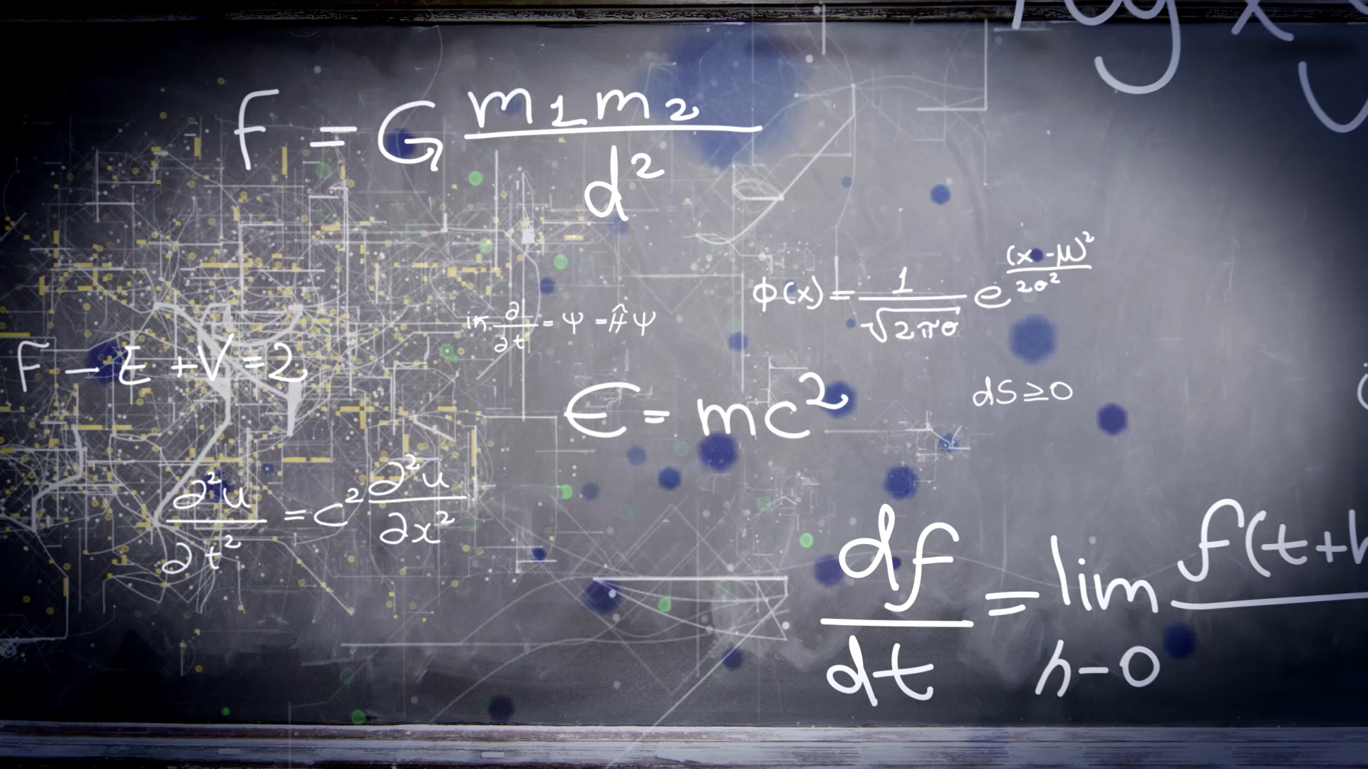
Brief Introduction to Experimental Collider Physics
Yusheng Wu (吴雨生)
wuyusheng@ustc.edu.cn
University of Science and Technology of China
“新视角下的强相互作用”冬季学校，复旦大学，2025年2月

Slide 2
Lecture schedule
3-hour brief introduction to experimental aspects of physics studies at particle colliders
Target for junior graduate students in this field
Cover the following:
  Part I: how are collision events produced and collected
  Part II: how can we analyze collision events for physics studies
  Part III: milestones (examples) and prospects
Disclaimer: incomplete introduction with personal biases (towards LHC)

Slide 3
Part II: physics analysis

Slide 4
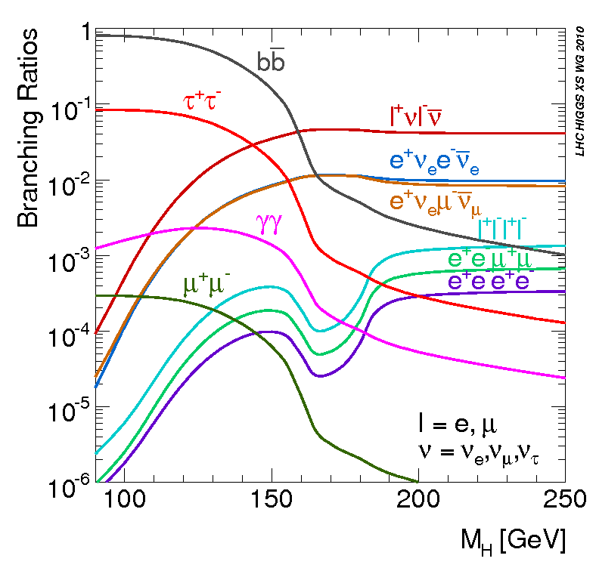
Physics Objects
Final state particles from interesting physics processes interact with detectors
e
γ
μ
jet
τ
E_{T}^{miss}
(ν pT)
Vertices
Inner tracks
Calorimeter energy deposits
muon tracks
Example: Higgs decay channels to final state particles
All info.

Slide 5
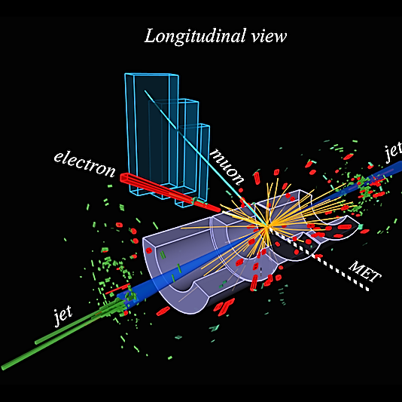
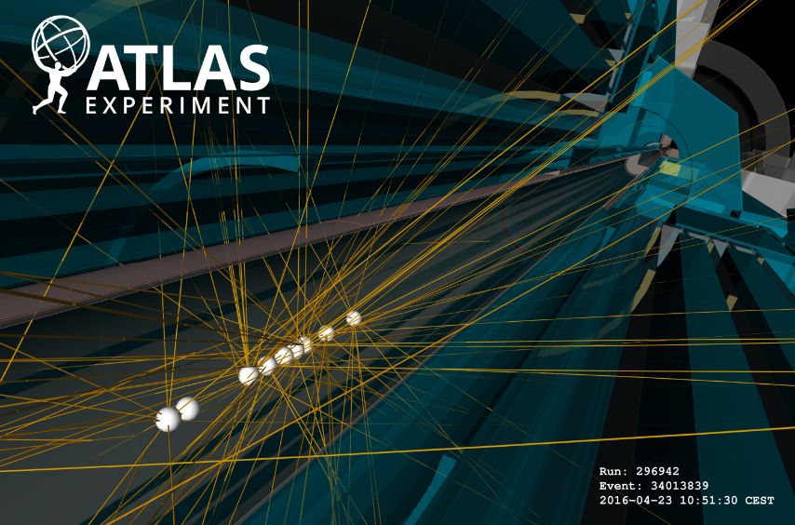
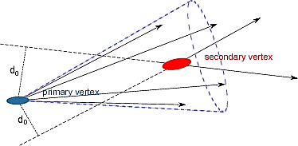
Physics Objects
Vertices and tracks
e, γ, μ, jets, E_{T}^{miss}
b-jet: contain secondary vertex due to meson lifetime in flight

Slide 6
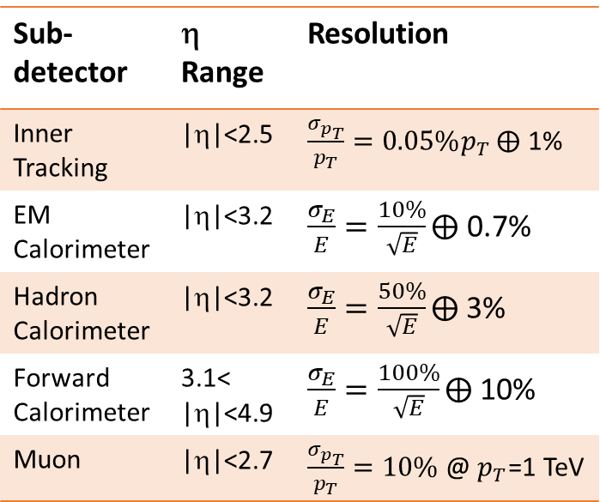
Physics Objects
Resolution
Characteristics
  p_{T} or E resolution featured by the detector capability
  p or E scale is also crucial for physics
  not all the objects can be cleanly “identified” due to background contributions
  Monte-Carlo or Collision data to calibrate the performance
Sub-detector | η Range | Resolution
Inner Tracking | |η|<2.5
EM Calorimeter | |η|<3.2
Hadron Calorimeter | |η|<3.2
Forward Calorimeter | 3.1< |η|<4.9
Muon | |η|<2.7
E_{measured} = scale * E_{true}
Object Identification

Slide 7
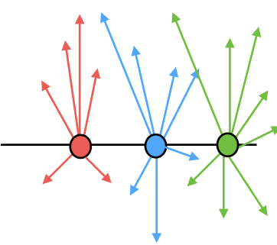
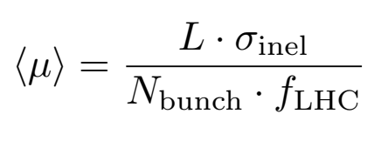
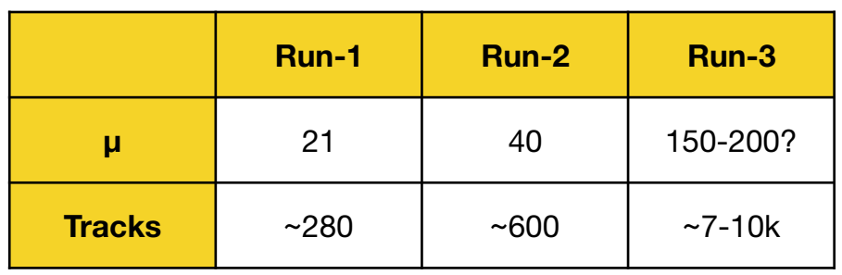
Vertex and Track
Basic concept:
Typically ~15 charged-particles per proton-proton collision at 13 TeV
Each recorded event correspond to a single bunch crossing (25ns)
  However multiple collisions are recorded together (pile-up)
Interested ☺
Piles-ups ☹
Huge number of particles enter one event, challenging for tracking and vertexing!

Slide 8
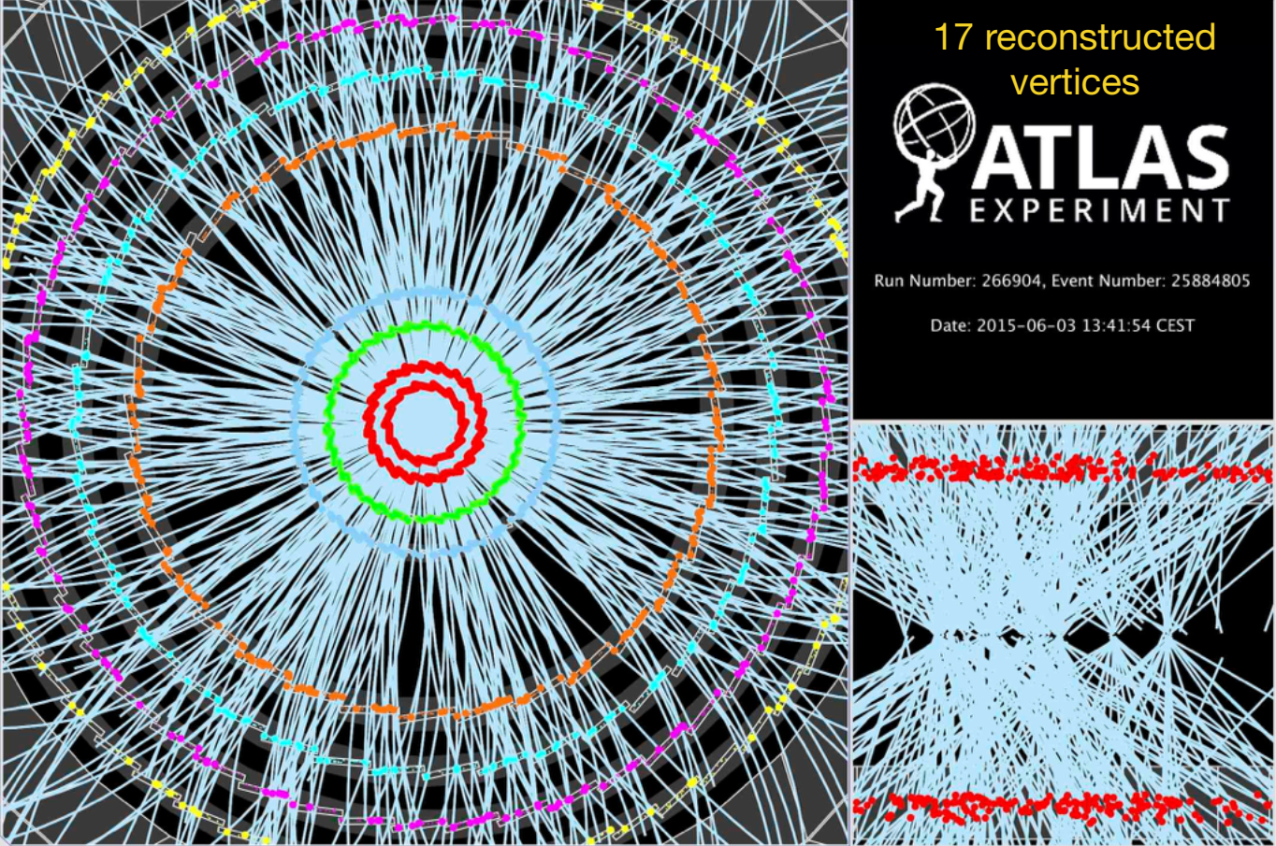
Vertex and Track
For future High-luminosity LHC: ~ 5000 tracks per event, typically >100 vertices

Slide 9
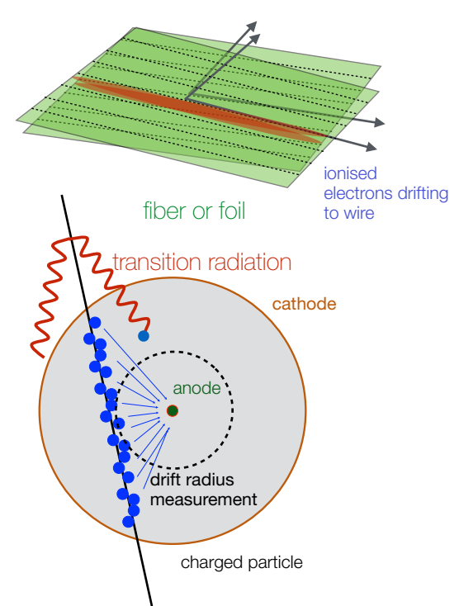
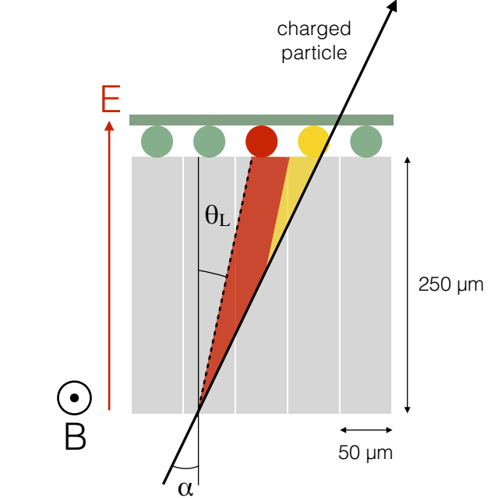
Vertex and Track
Reconstruction starts with space points (hits) recorded by detection layers

Slide 10

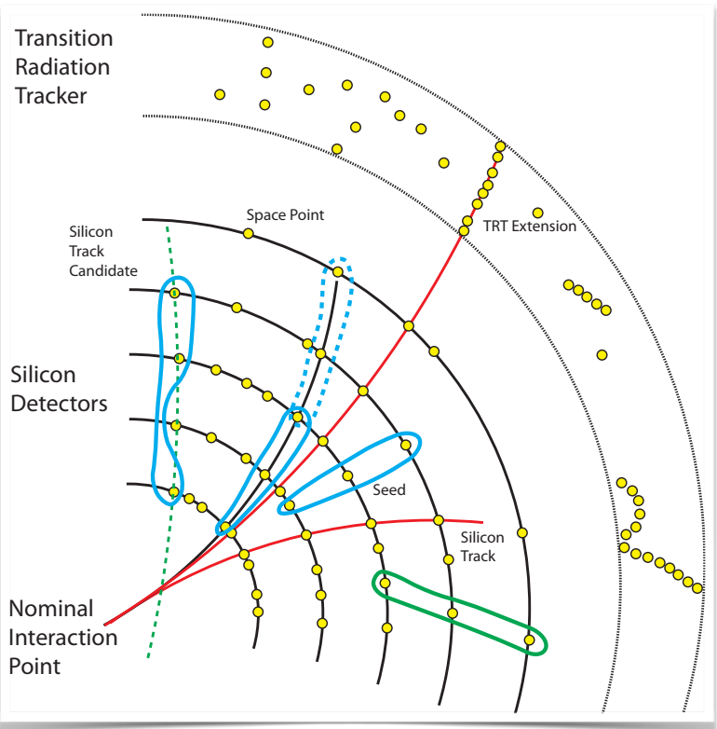
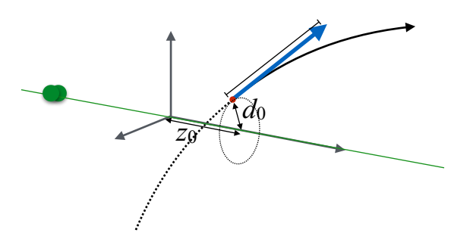
Vertex and Track
To determine the tracking parameters:
Space point formation
Seed finding
Track finding
Ambiguity solving
Extending to TRT (outside layers)

Slide 11
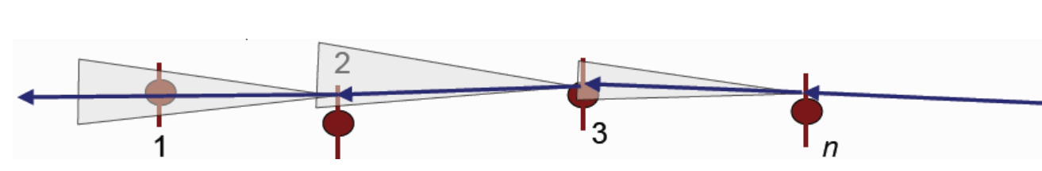
Vertex and Track
Algorithm for track finding:
Kalman filter
Takes into account particle interactions with detectors due to multiple scattering, and Bremsstrahlung (for e)
If not taking account the scattering effect, tracking parameters biased
KF: step-by-step extrapolation, based on current measurement, expected scattering errors, and info. On next layer
Many iterations needed, can be expensive
Resulting a best estimate of parameters and best errors

Slide 12
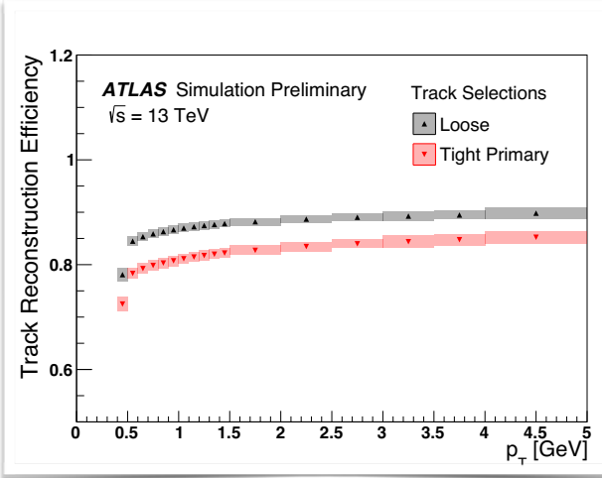
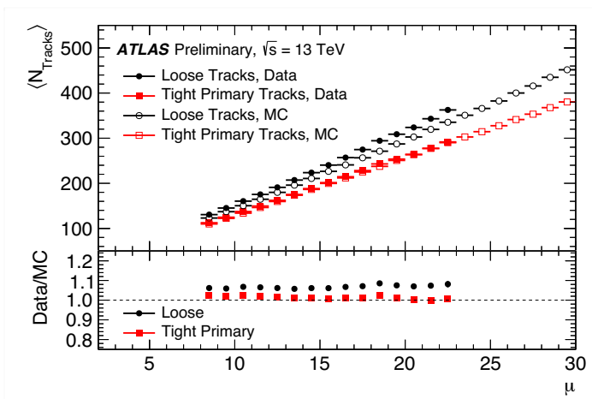
Vertex and Track: Performance
Tracking efficiency ~ 90% at high pT
Number of tracks calibration
For tracks with pT > 10 GeV, σ(d0) < 50 μm, σ(z0) ~ 100 μm
Vertex finding efficiency (fit multiple tracks to a common vertex): ~ 100% if n(tracks) > 4
Vertex resolution: x-y ~ 10-50 μm, z ~ 30-50 μm
Made possible for B-physics and B jet finding

Slide 13
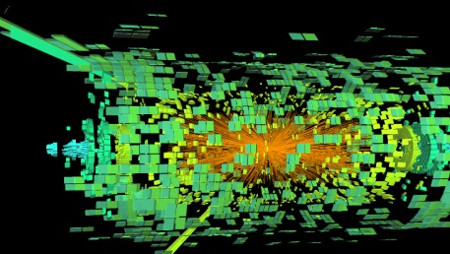
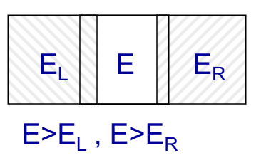
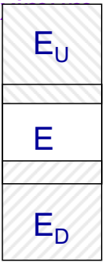
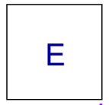
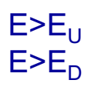
Clustering for e and γ
In a complex collision environment, very often, we are looking at many energy deposits in calorimeter cells
=> To find photons and electrons, find their energy core
Cluster of cells are identified with
the sliding window method (efficiency and robust)
Then, rebuild e or γ candidates with the clusters as a reference
Use cell directly
Candidate size with dη x dφ ~ 0.1 x 0.1
Candidate window, 3 x 5 towers

Slide 14
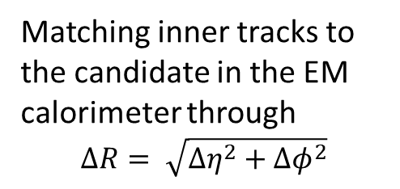
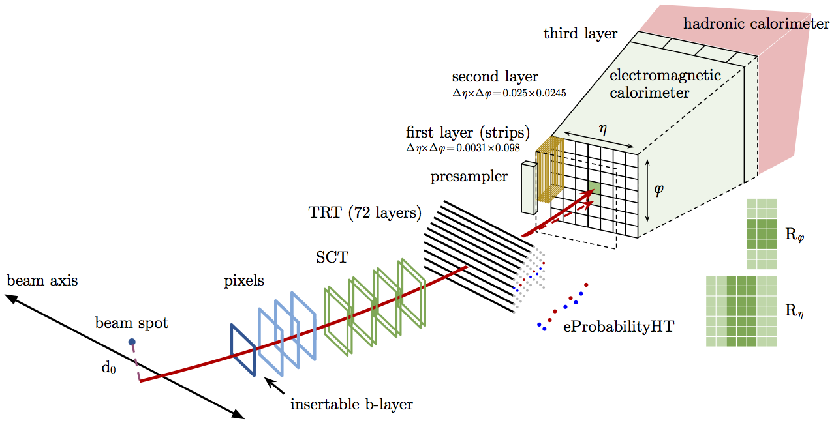
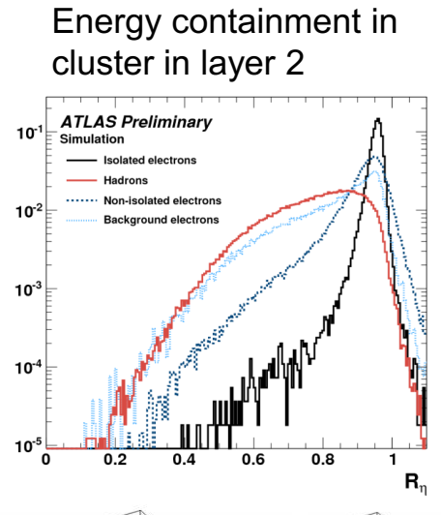
Electron
Example of shower information
Identification based on calorimeter shower shapes, tracking information, track-cluster matching etc. to reject fake electrons
Multivariate technique to combine these information to form an identification of electrons
~ rejection of jet by factor of 500 - 50000

Slide 15
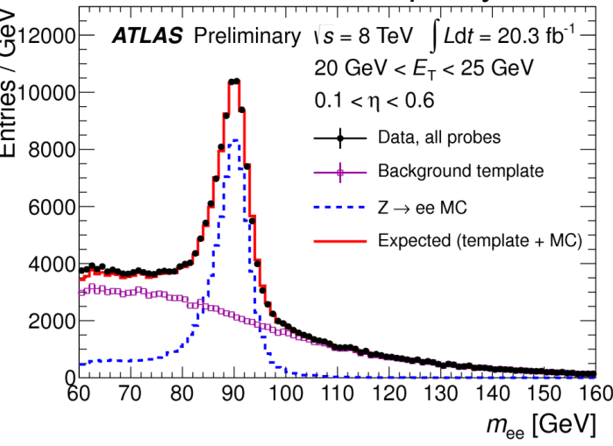
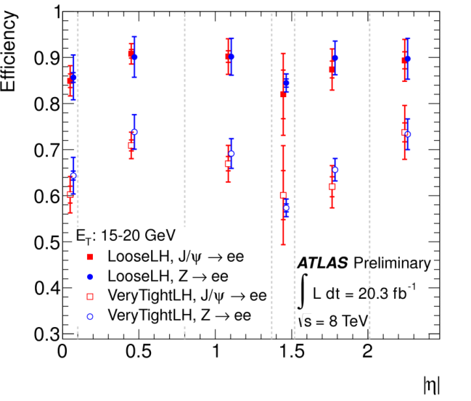
Electron
Example performance plots
Z boson as a “ruler” to calibrate the lepton reconstruction

Slide 16
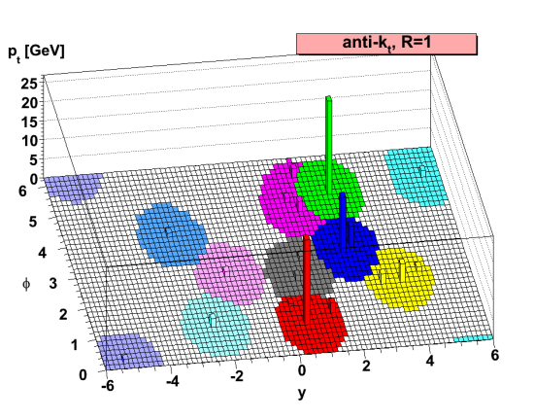
Jets
1
1
1
1
1
1
1
1
1
1
1
1
1
1
1
1
1
1
1
1
1
1
1
4
1
4
4
1
5
1
1
5
1
1
5
1
1
1 5
4
1
4
1
4
1
1
4
4
2
1
1
1
5
1
1
4
1
4
1
5
1
4
4
5
2
5
4
2
2
2
1
1
5
2
5
2
2
2
2
2
2
2
2
3
3
3
2
2
2
2
2
2
2
3
3
3
3
2
2
2
2
2
3
3
3
3
3
3
3
Topo-clusters formed by clustering signal cells (above noise)
Towers of calorimeter clusters combined to jets using jet algorithms (famous are anti-kT, kT, siscone, …)
Or Particle flow (combing tracks and clusters to form jets)
R parameter defines jet size:
larger - more fluctuations
smaller – energy leakage
Response of clustered energy to true energy calibrated with MC and data

Slide 17
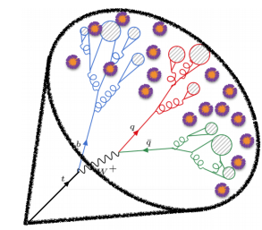
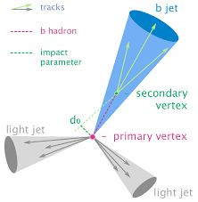
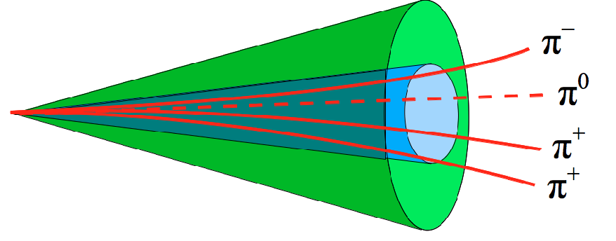
Special Jets
B-jets
Large radius jets: important for searches, boosted boson decays
τ jets: follow the decay chain of τ for identification
leptonic τ identification, not covered here
Use of tracking parameters, secondary vertex, information
<= Multivariate techniques

Slide 18
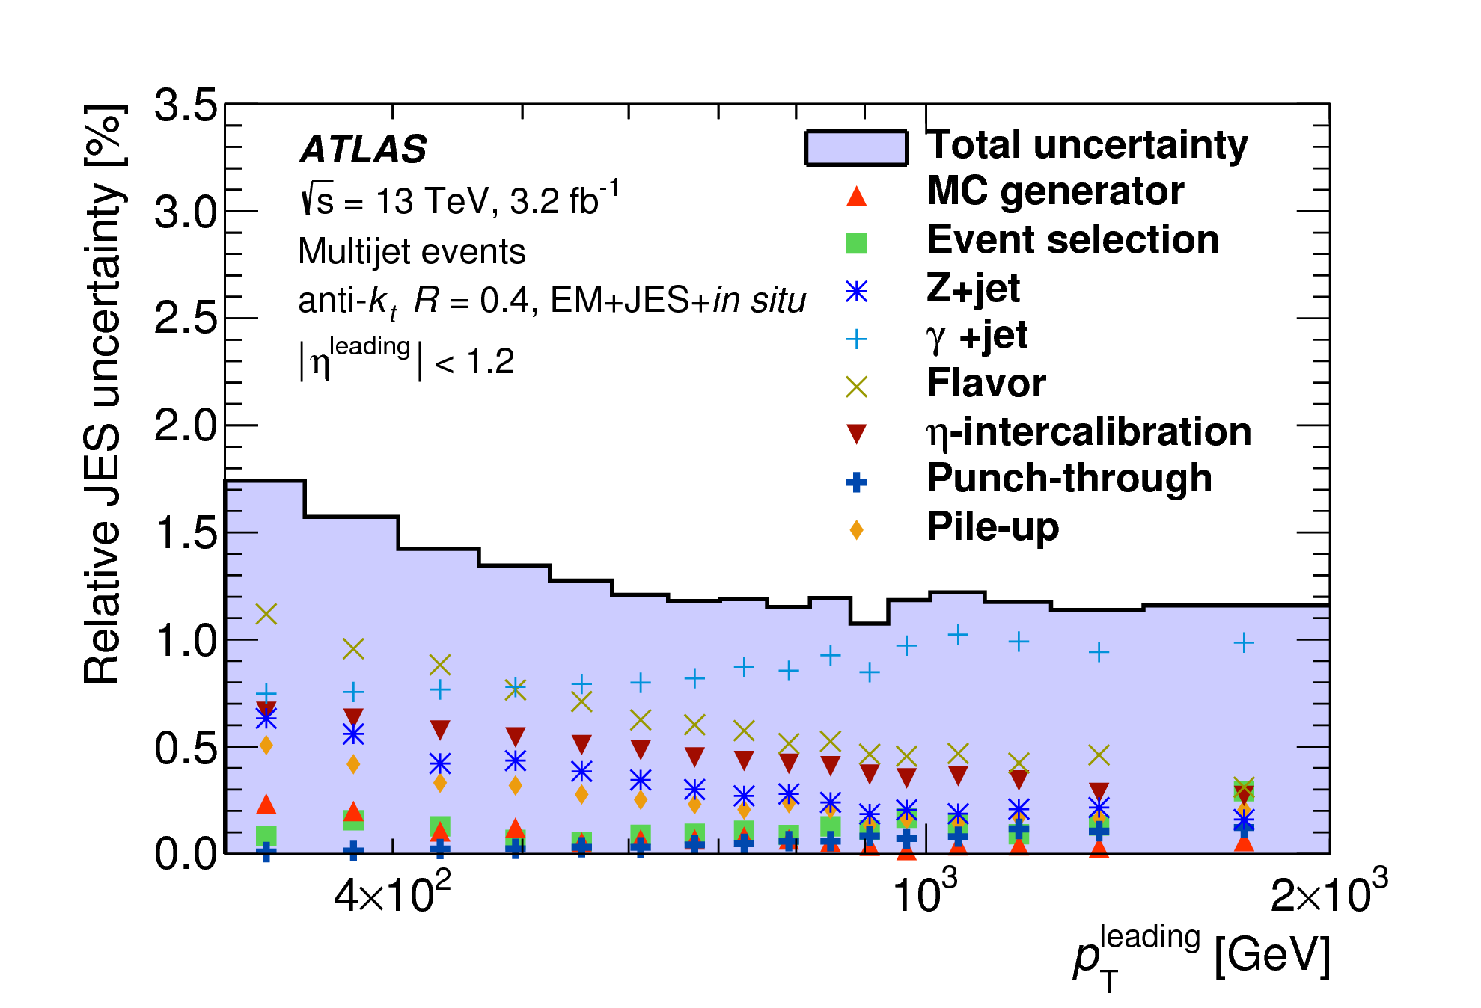
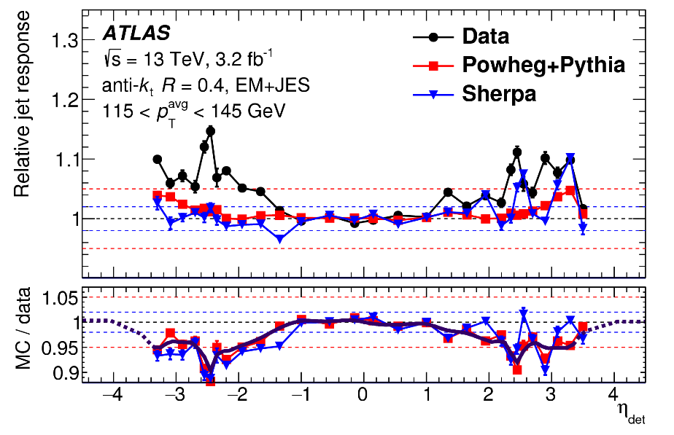
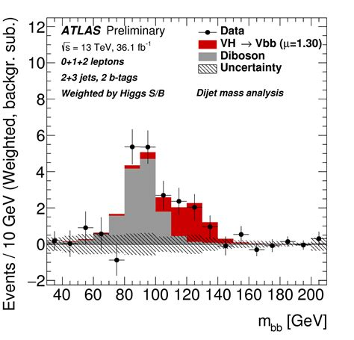
Jets
Example of performance plots
Jet energy scale uncertainty ~ 1% level
Jet response
Successful jet reconstruction: utilize the calorimeter potentials and enable discovery of H→bb decay

Slide 19
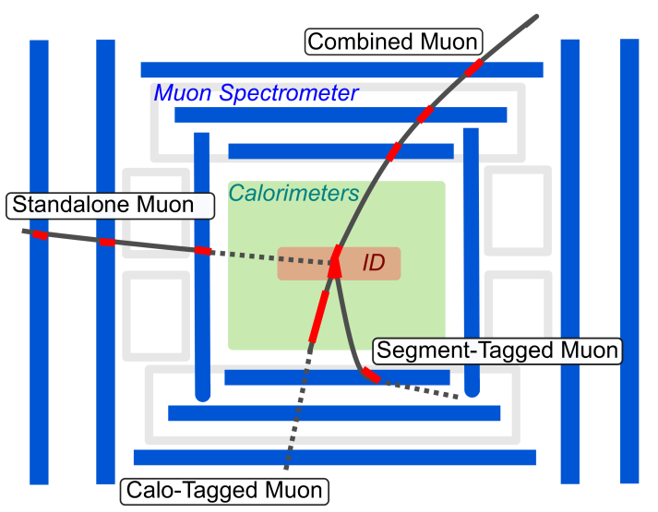
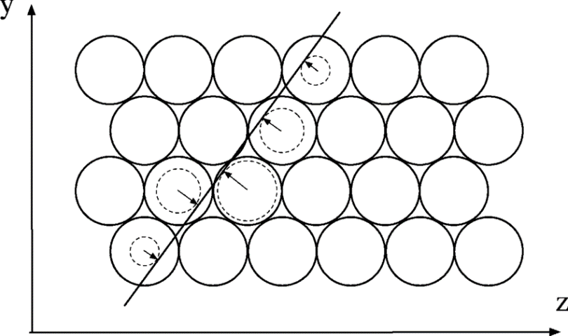
Muon
Majority of analysis-level muons are combined muons: combing inner track and muon tracks
Other types of muons are available to extend the acceptance
Muon identification imposes cuts on track quality, combination chi2, etc.
Note: muons with p < 3 GeV cannot reach muon tracker
Muon trackers reconstructed by precision chamber hits （MDT + CSC)

Slide 20
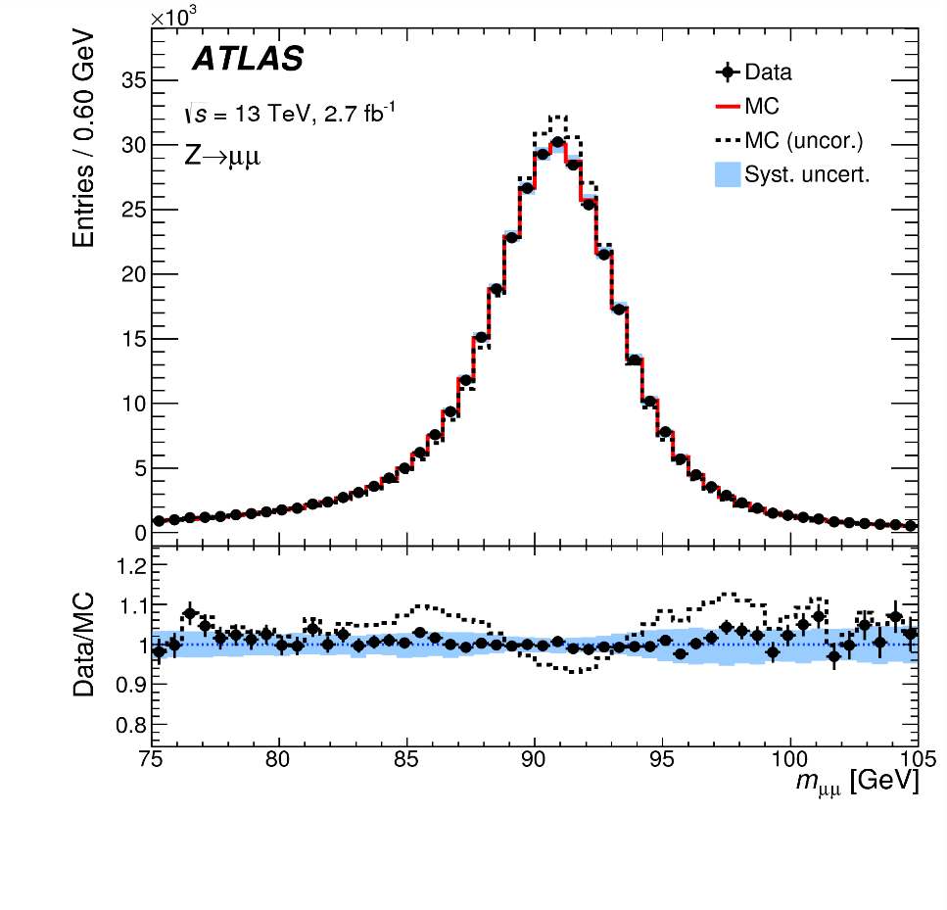
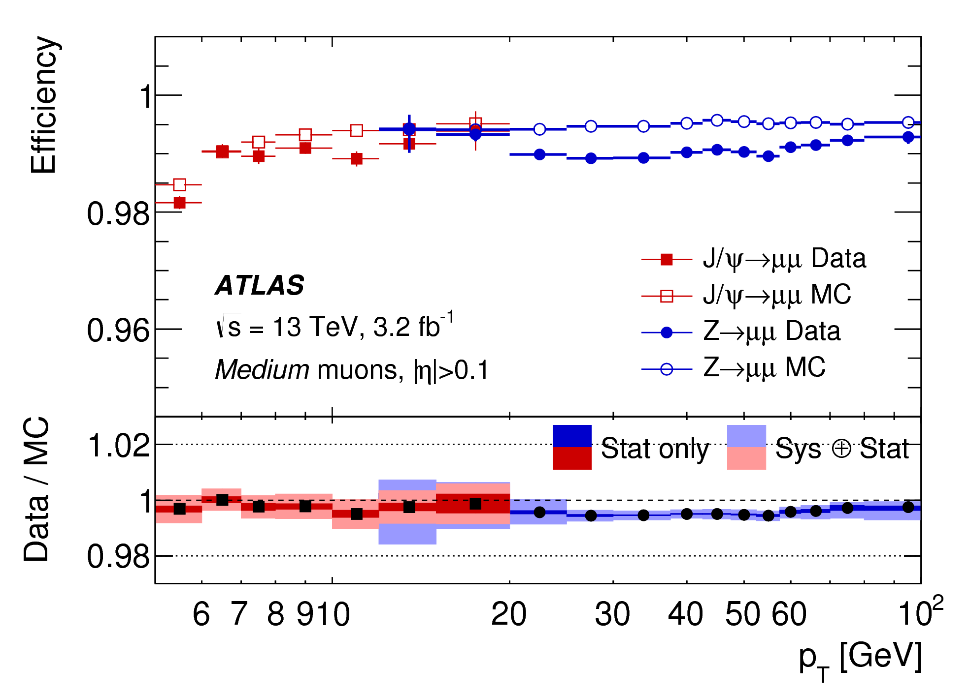
Muon
Standard “Ruler”
Efficiency

Slide 21
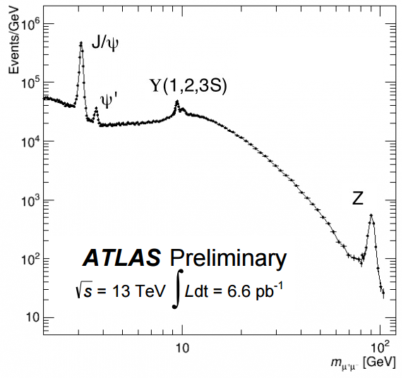
Muon
Data tells the success of reconstruction over many orders of magnitude

Slide 22
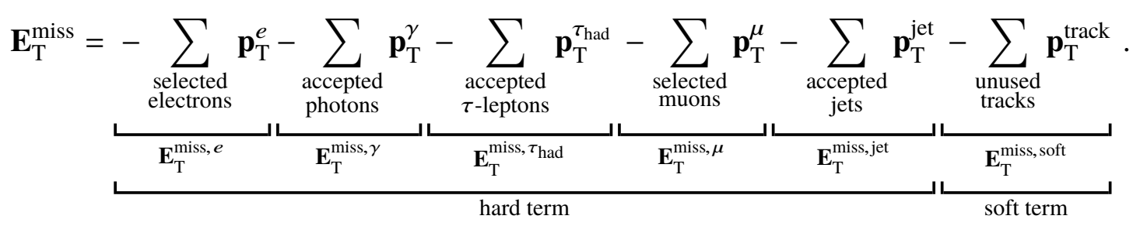
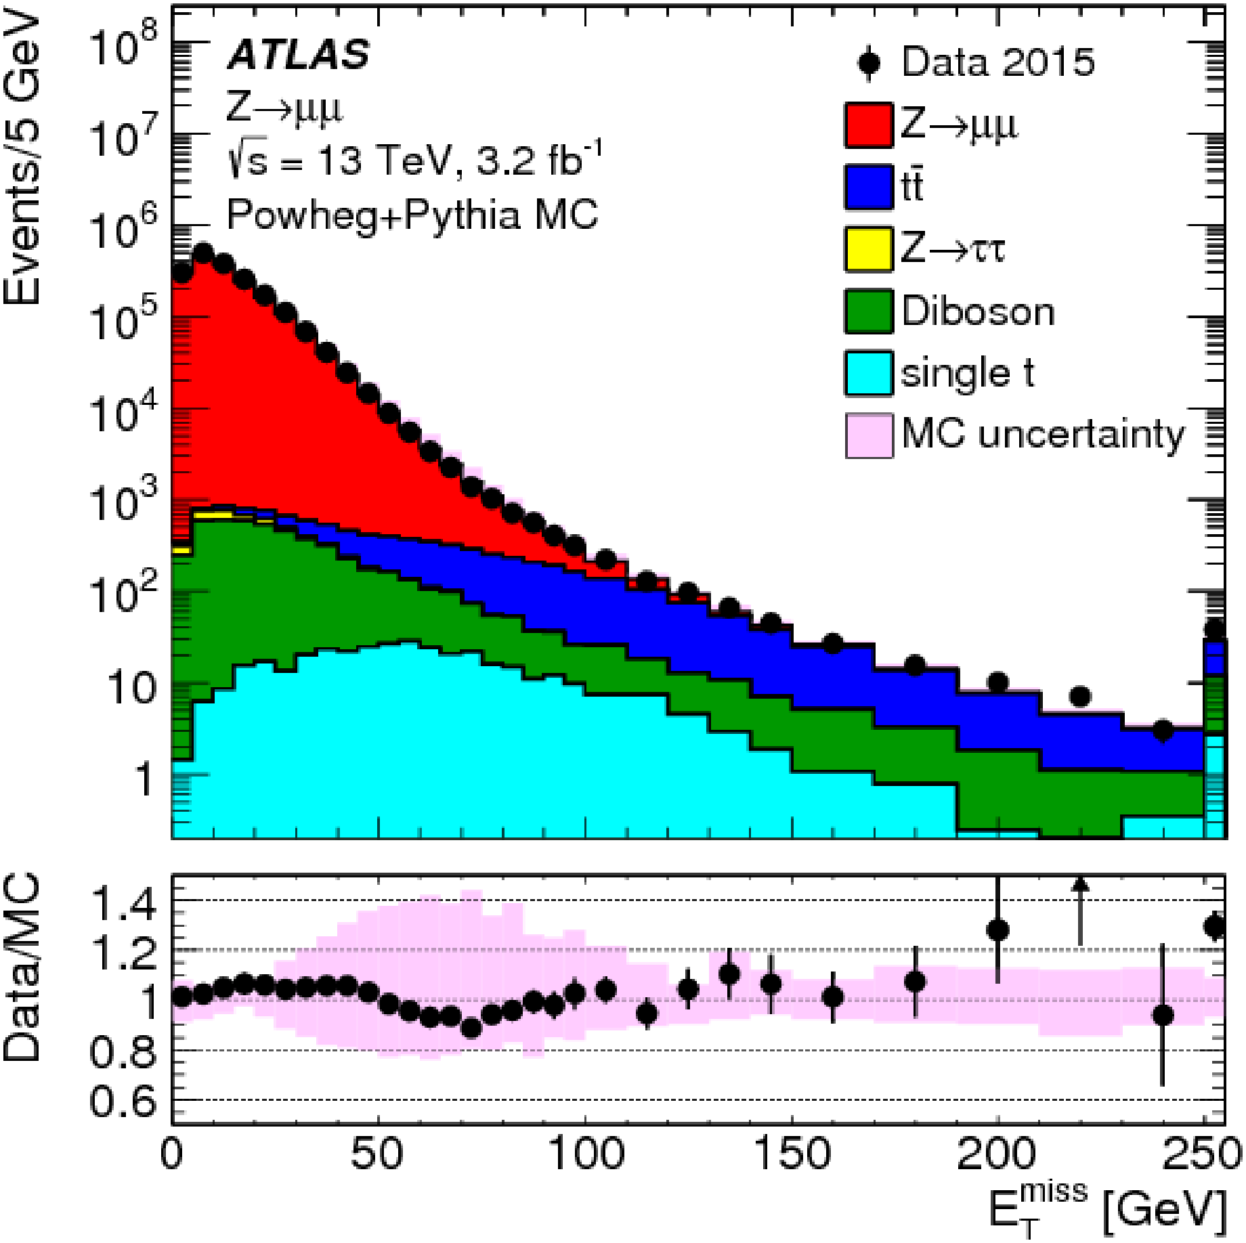
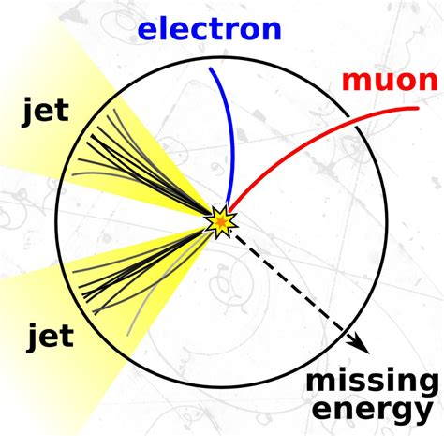
Missing transverse energy
Use of all information in the detector, important for physics with neutrinos
A good calibration using data

Slide 23
Experiments and Physics Studies
Focuses on one or few of fundamental questions in physics
Physics Motivation
Optimization of the detector to be sensitive to the physics topics
Design of experiments
R&D, Construction
Construction and commissioning of the detector to make sure the physics requirement is fulfilled
Taking experimental data
Physics studies
Analysis of data to probe the targeted physics
Throughout the lifetime of the experiments, important to keep in mind the requirement and the direction of physics studies

Slide 24
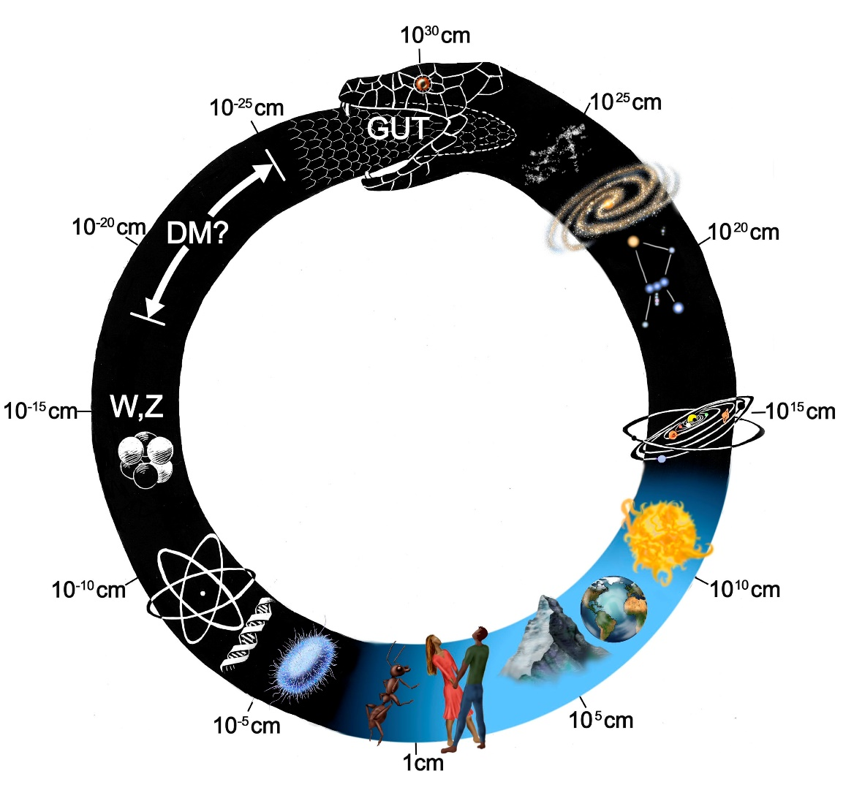
Physics Topics
Many believe eventually all forces will be unified from plank scale to universe scale, and make a consistent description of everything
ATLAS, as a general-purpose experiment at high energy collider frontier, probes:
Electroweak scale physics
O(100 GeV): Higgs, W, Z, top.
New Physics at high scale, with their phenomena manifested at TeV or lower scale.
QCD physics O(GeV→ TeV): complementary to LHCb etc.
The Universe Uroboros

Slide 25
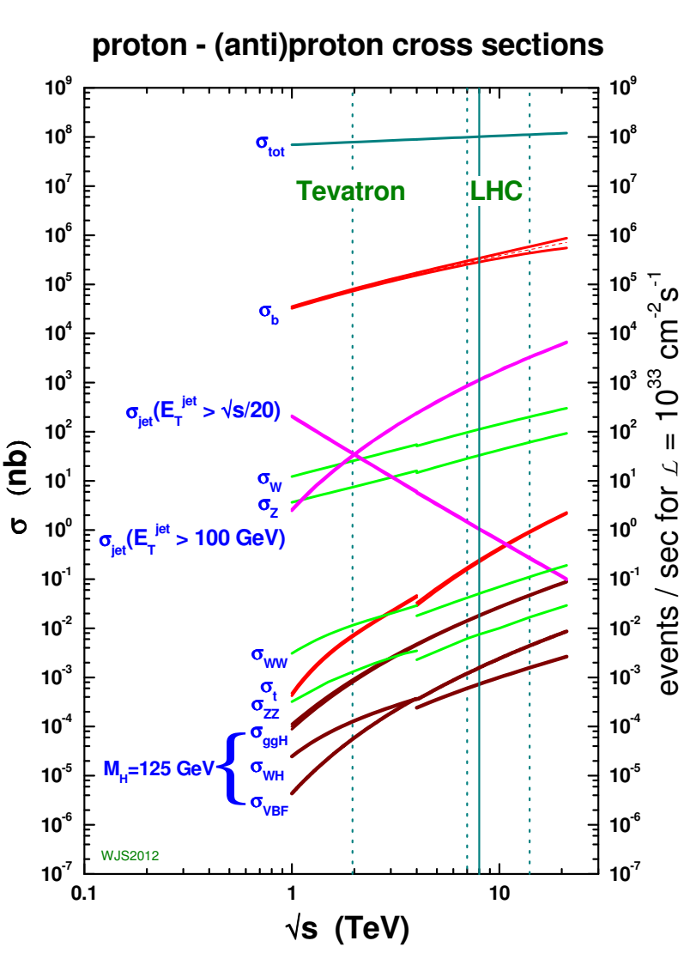
Physics Topics
e.g. Higgs physics
Up to O(0.1) nb
X 100 fb⁻¹ data
~ 1000 0000
Higgs bosons
Orders of magnitudes of physics under scrutiny
Possible new physics: SUSY, Graviton, …?

Slide 26
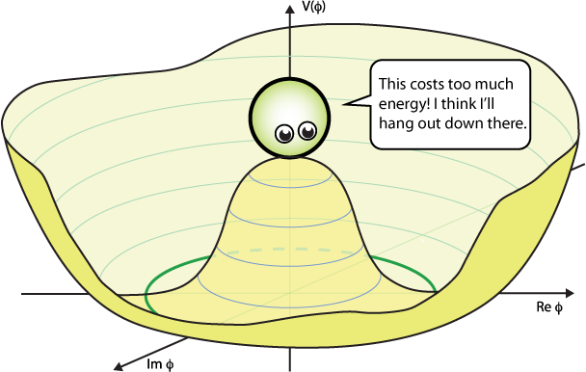
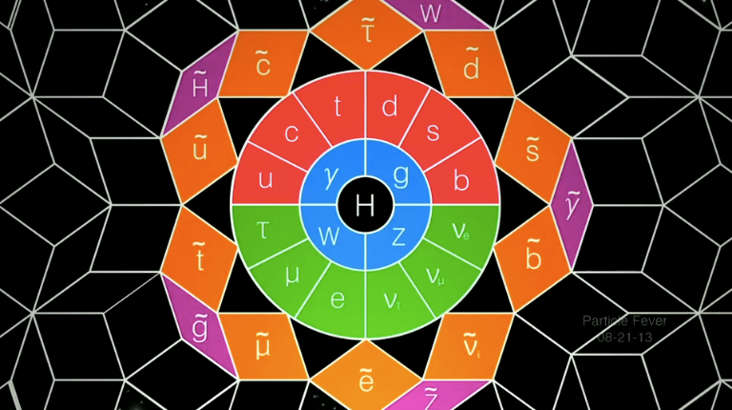
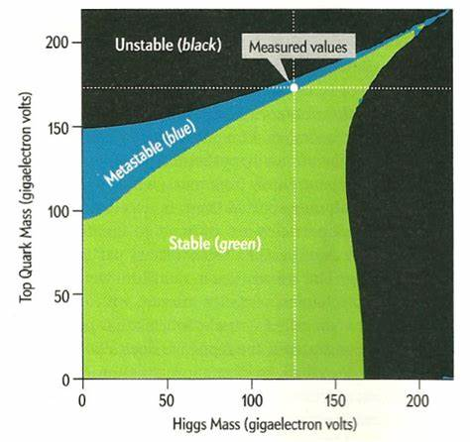

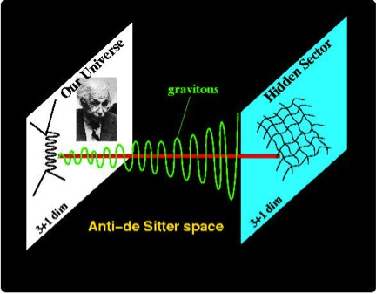
Physics Topics
Higgs
SUSY
Top quark
Dark Matter
Gravitons, Hidden Sector etc.
Vacuum Stability
WIMP, Axion, etc.
Randall-Sundrum Model, etc.

Slide 27
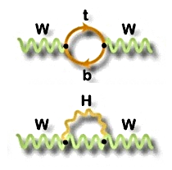
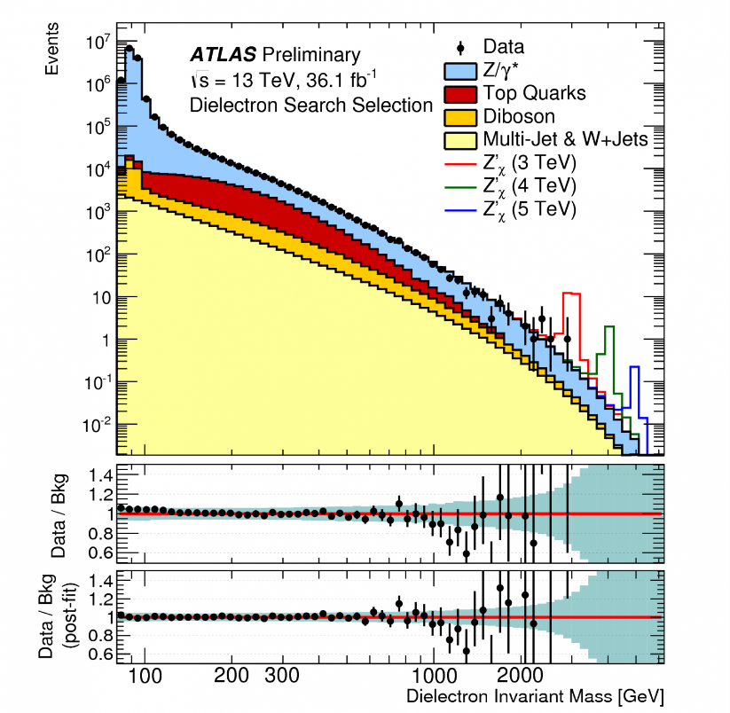

Physics Topics
Looking for resonances and anomalies (=> new physics)
Parameters in the SM are inter-connected (m_{w}, m_{Z}, m_{H}, m_{t}, θ_{w})
=> Precision EW measurements give a stringent test of the SM and therefore sensitive to new physics

Slide 28




Physics Topics
Heavy right-handed neutrinos
possible Origin of neutrino mass
Flavor physics, heavy ions, etc.
Particles with long-lifetime:
Unique signature in the detector
+Many other physics study channels!

Slide 29

Physics Topics

Slide 30

Physics Topics

Slide 31


Physics Study in a Nutshell
BSM?
SM
Measure certain quantities or observables from collision data (with the assistance of Monte-Carlo simulation)
And compare to the theory prediction (by Monte-Carlo simulation)
Reach a conclusion: compatibility between data and theory, observation of new channels, existence of new physics

Slide 32
Physics Study in a Nutshell
Motivated to study a physics process, use MC simulation to understand the features of the signals and backgrounds
Decide on the final states to study, and optimize the selection criteria to reach a good signal-over-background ratio
Use collision data to calibrate the simulation and reconstruction of physics objects
Estimate the background contributions and use data control regions to validate, calculate signal selection efficiencies, and then derive physics results with uncertainties
Measurement of physics quantities or cross-sections of a process
Statistical test against background-only or new physics hypothesis

Slide 33


Basic Concepts
A schematic view of detector effects
True event happened
Reconstruction from the detector signals
Backgrounds
Detector inefficiency and smearing
Physics studies try to remove the detector effects and “see” the core physics process (differential cross-sections, parameters, etc.)

Slide 34




Basic Concepts
Signal phase spaces in physics analyses
Total Phase Space
Fiducial
Reco.
To have a precise measurement of σ or x (physics goal), requirements for all the terms
Large datasets
Optimized selection for S/B ratio
Stable estimation of backgrounds
Good calibration of simulation

Slide 35




Basic Concepts
Practically, interpretation of physics results are usually done with likelihood functions
Profile log-likelihood ratio test statistics ➔ detection significance, upper limits…
μ: parameter of interests
n_{j}: observed number of events in bin-j
Signal: s_{j} = s_{j}(θ)
Background: b_{j} = b_{j}(θ)
θ: nuisance parameters, representing systematic uncertainties
Example of a binned histogram

Slide 36




Basic Concepts
Differential measurement “unfolding”
efficiency
Reconstructed distribution: R(x)
Detector smearing matrix
To deal with instability of matrix inversion: iterative Bayes, singular value decomposition …
Truth distribution at fiducial-region T(x)
Example of the smearing matrix

Slide 37

Simulation
To describe “Hard scattering” with high-Q²
Parton distribution function (PDF)
Perturbative EW and QCD
QCD showering and hadronization
Underlying event
Soft interactions beam remnants
Rely on Monte-Carlo techniques to
Describe particle types and momenta on an event-by-event basis
Provide production cross-sections
i.e. MC Generators

Slide 38


Simulation
parton flavors
helicities & colors

Slide 39


Simulation
Efforts to reduce the dependence of physics results on QCD scales:
➔ By a proper choice of scales or including a higher-order calculation
Many processes (Higgs, top, W/Z …) have been calculated to NNLO or even N³LO
Gluon resummation calculated up to NNLL for places necessary, otherwise done by parton-shower program
Real events generated by parton-level generators with MC method, usually in Les Houches format
Example for Higgs cross-section

Slide 40

Simulation
Parton-level generator:
Precise determination of final state kinematics a given order
Limited order for extra radiations
Shower generator
Efficient simulation of QCD radiations (unlimited order)
Tuning needed to be precise
Generator purpose generator:
Matching and merging the two!
Key is to resolve the overlapped phase space
Up to NNLO+PS for the time being

Slide 41

Simulation
Not cover electroweak calculation in this lecture
Mostly standard and calculable
Importance for high pT physics, where EW corrections become sizable
Many programs on the market, often need to compare several to make sure a good understanding of the process

Slide 42

Simulation
ATLAS detector simulation is based on Geant4,
plus detector signal amplification and collection with analytical functions
Events produced by MC generators
Detector simulation
Complex implementation due to the large-scale experiment
>1 mins per event
Dominated by calorimeter
Faster simulation also deployed by simplifying calo. simulation
Common interactions between particles and materials simulated:
- ionization, pair production, scattering, Bremsstrahlung, hadronic interactions

Slide 43


Simulation
Inclusion of pile-ups is essential to make the simulation realistic for LHC conditions
Hard scattering events
Overlaid and then go through detector simulation
<μ> x Minibias events
(pp inelastic collisions)
Important for physics relying on understanding of soft contributions: MET, jets

Slide 44


Simulation
How do we trust million lines of code?
➔ Codes are the starting point, always tune and validate with nature (data)
Example 1: TRT performance on π, e efficiency achieved during test beam
Example 2: ttbar measurement

Slide 45



Software Tools
ROOT:
N-tuple processing;
plotting
TMVA:
multivariate analysis
RooFit / RooStats for statistical studies
ATHENA
Comprehensive code repository for ATLAS, all functions implemented inside
Codes organized per “package”, each for a dedicated application case
O(10⁴) packages, O(10⁷-10⁸) lines of codes
VERSION CONTROL: “GIT”
Highly recommend to use no matter the size of project …

Slide 46
A few more comments
Collider physics studies often go beyond the precision of theoretical prediction, measuring them is important for theoretical development, or using data to constrain background contributions (“data-driven” method)
Results of collider physics studies often stored in HepData format (for future studies): https://www.hepdata.net/
The selection and fiducial definitions often offered at particle in codes stored in Rivert Routing: https://rivet.hepforge.org/
  New theoretical models can be quickly processed and directly compared with measured results
Ask your experimental colleagues DIRECTLY if anything unclear from their publications

Slide 47

A snapshot of uncertainty estimation
From 7 TeV W mass measurements

