Slide 1
quark AMM from triangle diagram of QCD in the presence of strong magnetic field
Kun Xu @ Group meeting
2024/05/24

Slide 2
2403.10641
Quark AMM
Strong magnetic field
pQCD

Slide 3
Magnetic dipole interaction
$$ge\vec{B}∙\vec{S}$$
where
$$\vec{S}=\frac{1}{2}\vec{σ}$$
g-factor
Magnetic moment of classic fermion:
Classic fermion
The Dirac equation
$$e\vec{B}∙\vec{σ}=2∗e\vec{B}∙\frac{1}{2}\vec{σ}$$
g=2
$$\left(iD+m\right)\left(iD−m\right)ψ=0$$
“regular” magnetic moment
exists in Dirac equation, $γ^{μ}$
AMM: g-2
P315, D.Schwartz
Spin interacts with both
magnetic field and electric field

Slide 4
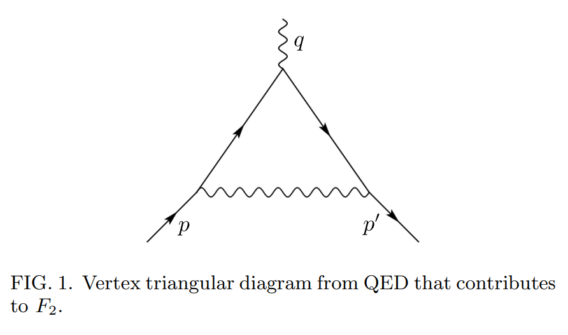
The general form of Interaction with photon:
AMM in one-loop QED
then g-factor:

Slide 5
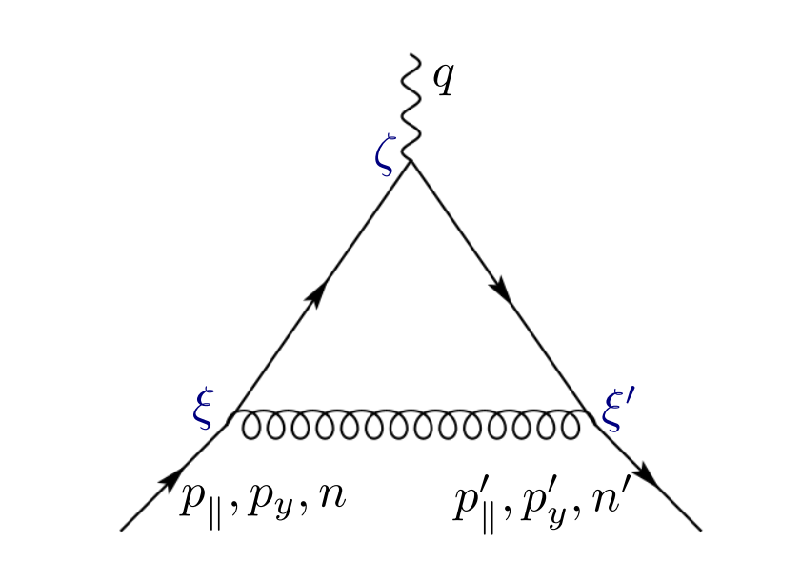
AMM in one-loop QCD
at vacuum, eB=0

Slide 6
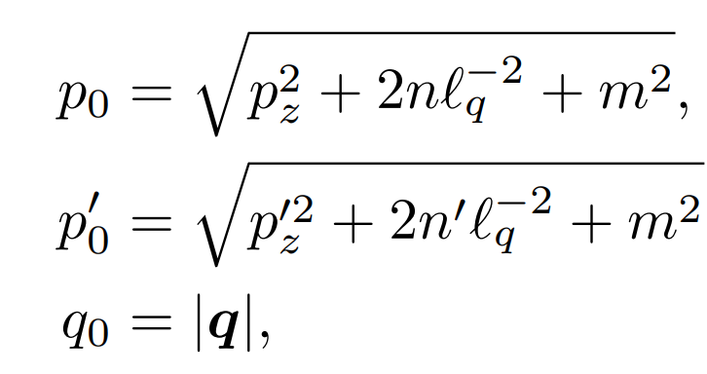
In the presence of a magnetic field
Dispersion relation:
Landau gauge
Quark field:
magnetic length
$$f\sim$$
n: Landau level.
Gluon field:

Slide 7
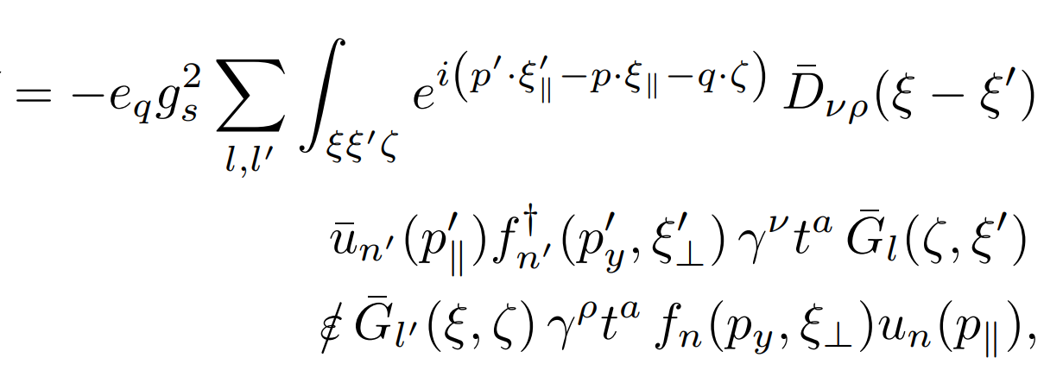
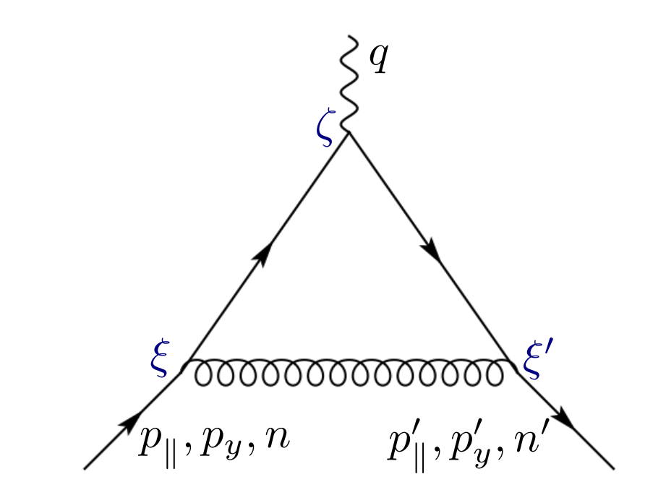
gluon propagator:
quark propagator:

Slide 8
Strong magnetic field limit
lowest-Landau level
Quark field:
projection operators:
Quark propagator:
Scattering matrix in LLL:
$$μ=0,3$$

Slide 9
polarized AMM
Then define:
where:
correction to charge
$$δF_{1}$$
$$F_{2}$$
AMM contribution in parallel components
$$F_{3}$$
Correction to gauge fixing $∂∙A_{||}$
Modification to AMM in the presence of a STRONG magnetic background
Different for two spins

Slide 10
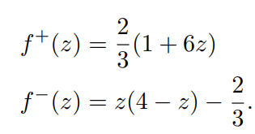
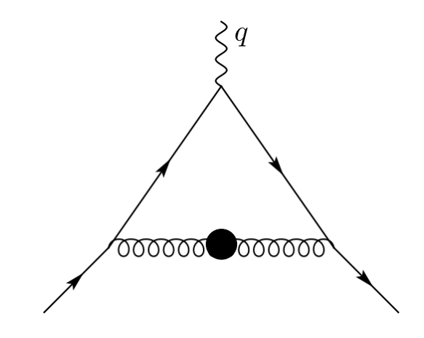
Coupled to electric field, instead of magnetic field
AMM contributes to the electric part
AMM:
Gluon mass
Quark loop

Slide 11
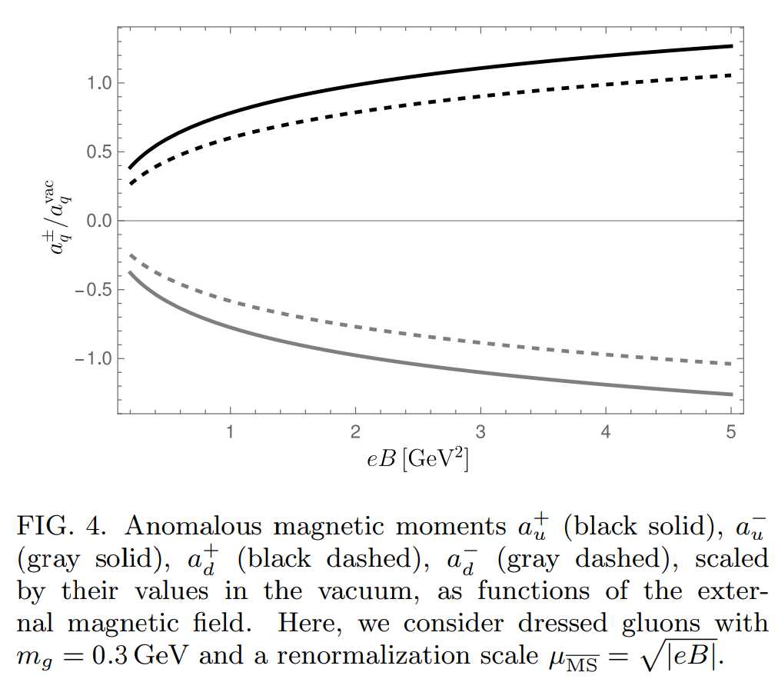
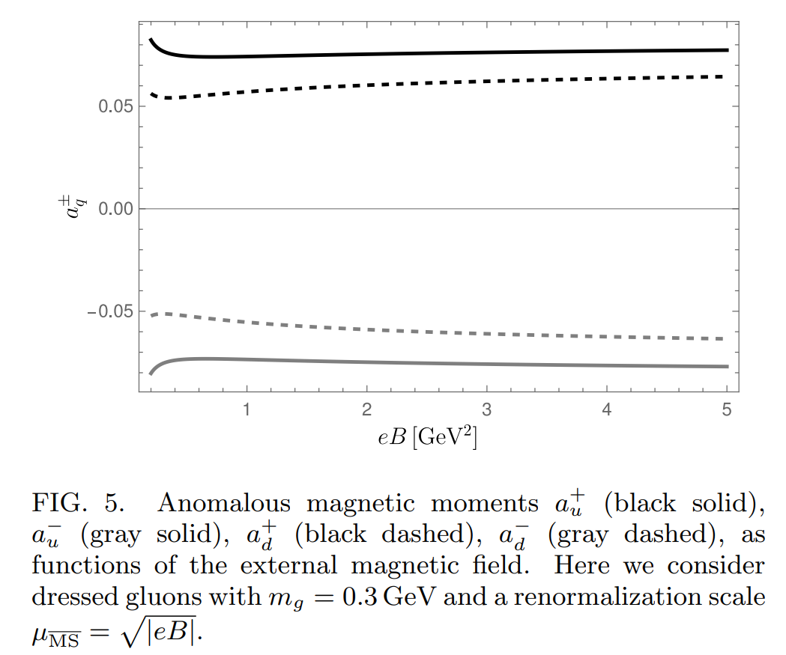
Results
a fixed infrared scale
$$m_{g}\sim 0.3GeV$$
$$a_{u}^{+}$$
$$a_{d}^{+}$$
$$a_{d}^{−}$$
$$a_{u}^{−}$$
Coupling constant dependence
$$a_{u}^{+}≈−a_{u}^{−}$$

Slide 12
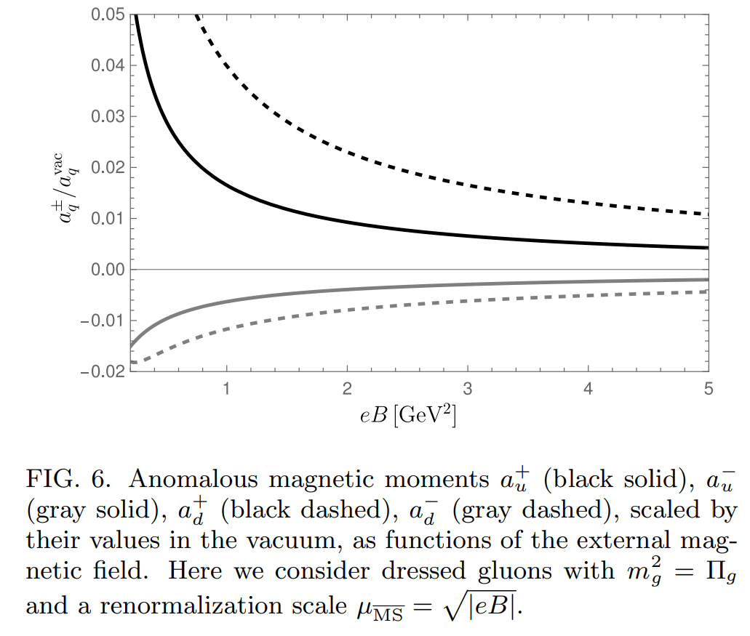
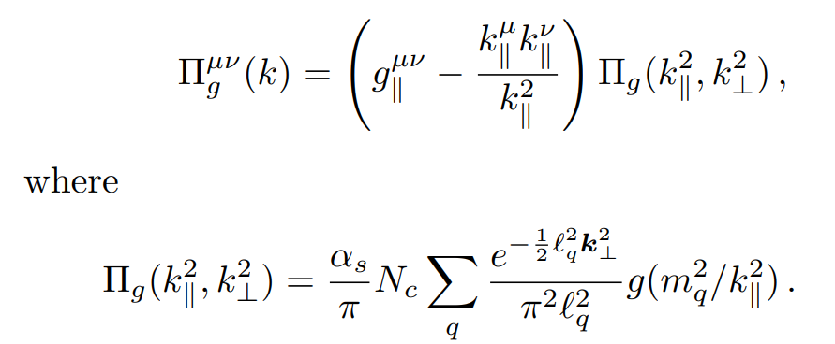
A magnetically-dressed gluon self-energy
$$m_{g}^{2}=$$
Gluon mass increases with magnetic field increses

Slide 13
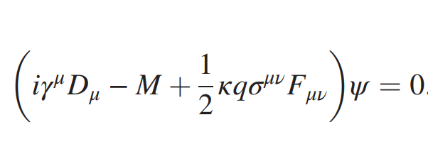
perturbative
Non-perturbative
$$G_{T}{(\overline{ψ}σ^{μν}ψ)}^{2}$$
Mean field approximation
$$κ_{μν}\overline{ψ}σ^{μν}ψ$$
$$κ_{μν}=−2G_{T}\left\langle \overline{ψ}σ_{μν}ψ\right\rangle$$
$$κ_{μν}σ^{μν}$$
How spin-up and spin-down different?

