Slide 1

中国科学院高能物理研究所
Institute of High Energy Physics, CAS
CEPC Detector Magnet V0 weekly
Feipeng NING
2024.05.28

Slide 2

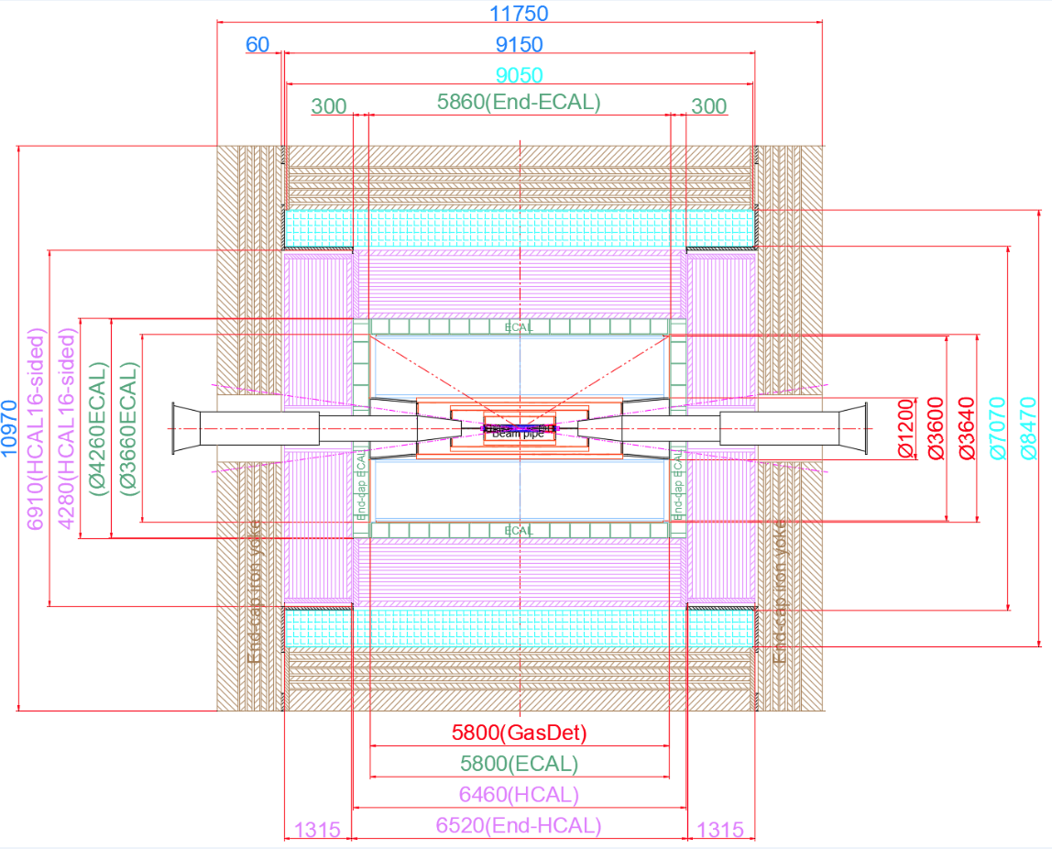
1. The size of magnet
Inner diameter | 7070 mm
Thickness | 700 mm
Outer diameter | 8470 mm
Length | 9050 mm

Slide 3
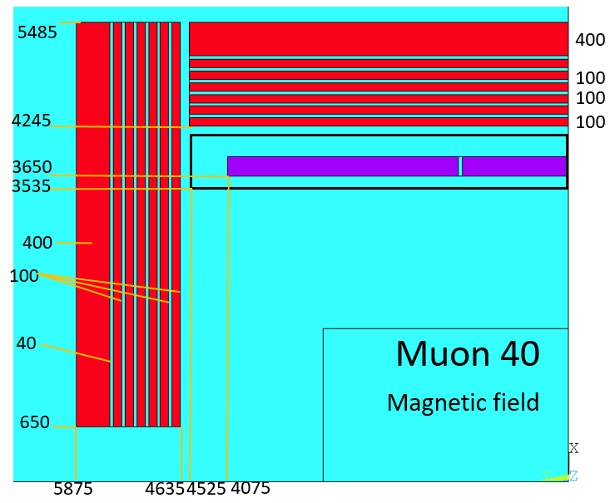
Detector Magnet
Yoke parameters：
Barrel yoke (ton) | 2300
Each End yoke (ton) | 754
Total Yoke (ton) | 3808
Diameter(m) & length (m) | 10.97&11.75
Coil parameters:
Inner diameter | 7300 mm
Operating current | 16702 A
Cable length | 33 km
Inductance | 11 H
Stored Energy | 1.54 GJ
Total mass | 220 tons
The gap between each layer of yoke is 40 mm.
Notes:
Two changes: first, add yoke to reduce the range of stray field; second, the size of HCal increase, so size of the solenoid and the yoke increase accordingly.

Slide 4
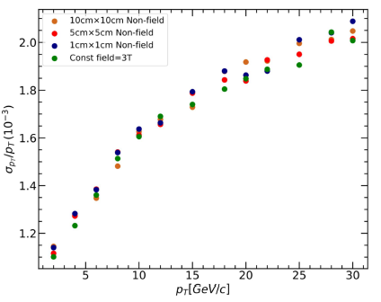
Detector Magnet
Liu Mengyao, Zhang Yao
Conclusion：在采样点10cm间隔内，磁场采样点的密度对动量分辨影响不大。
还在继续进行研究中
对比三种非均匀磁场在不同横动量下的动量分辨率的变化：（single muon- , 5000 events）
Notes:
Two changes: first, add yoke to reduce the range of stray field; second, the size of HCal increase, so size of the solenoid and the yoke increase accordingly.

Slide 5
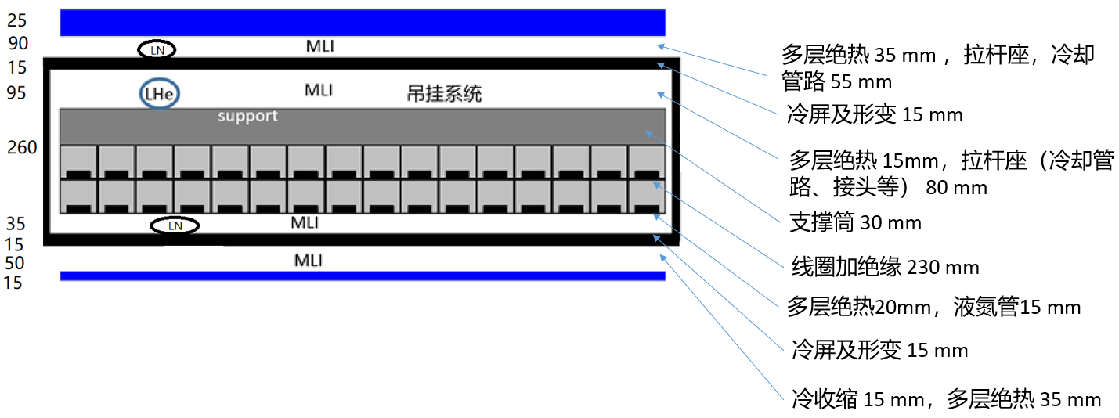
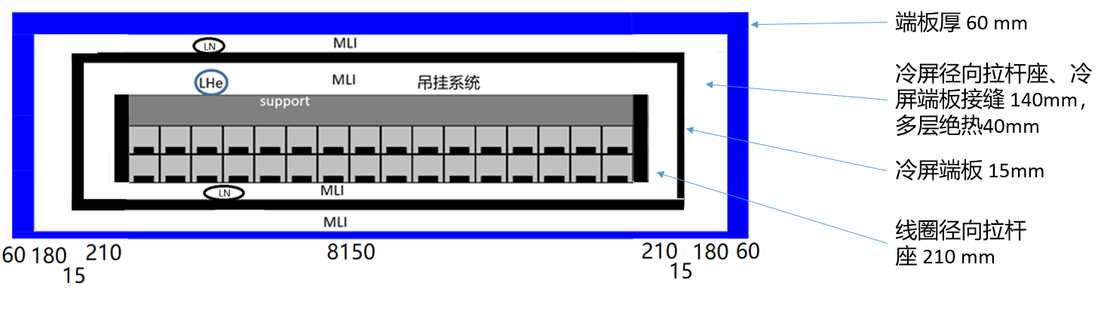
Mechanical design of the magnet
Schematic diagram of magnet barrel layout
Schematic diagram of magnet end layout
Notes:
Two changes: first, add yoke to reduce the range of stray field; second, the size of HCal increase, so size of the solenoid and the yoke increase accordingly.

Slide 6
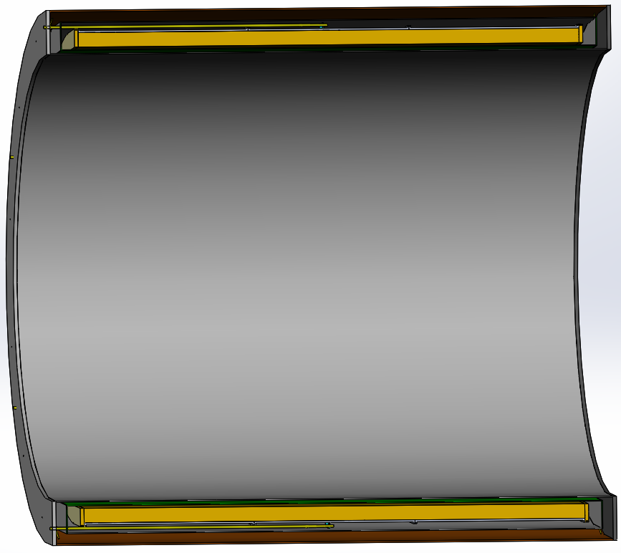
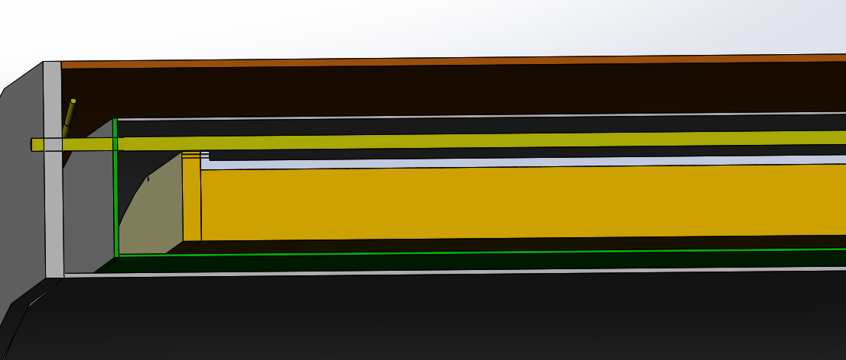
Mechanical design of the magnet
低温恒温器
冷质量吊挂
冷屏
线圈
探测器超导磁体参数
参数 | 数值（mm）
内径 | 7070
外径 | 8470
长度 | 9050

Slide 7
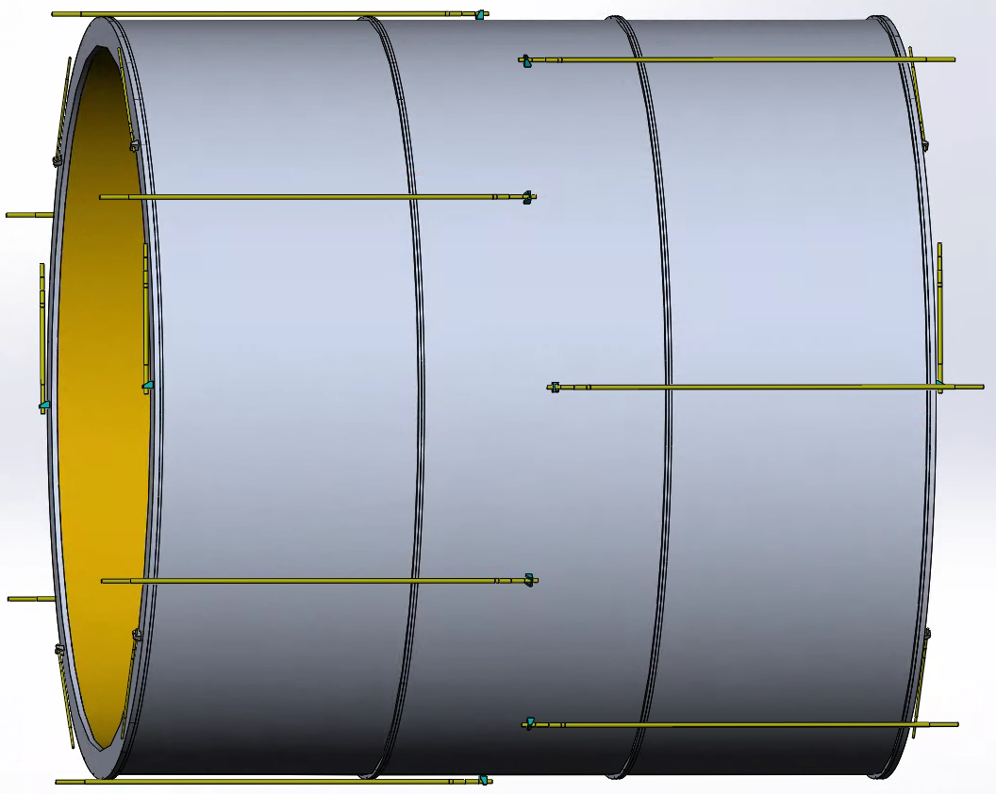
Mechanical design of the magnet
Support structure design
Radial suspend system
总重：约 140 t ，因安装位置误差
磁体励磁后有较大的电磁力
结构：三段组装（焊接、螺栓连接支撑筒）
吊挂：轴向两端各均布6~8 根拉杆
径向两端各2 根向上主拉杆、
各4 根斜向拉杆
拉杆材料：钛合金
Axial suspend system

Slide 8
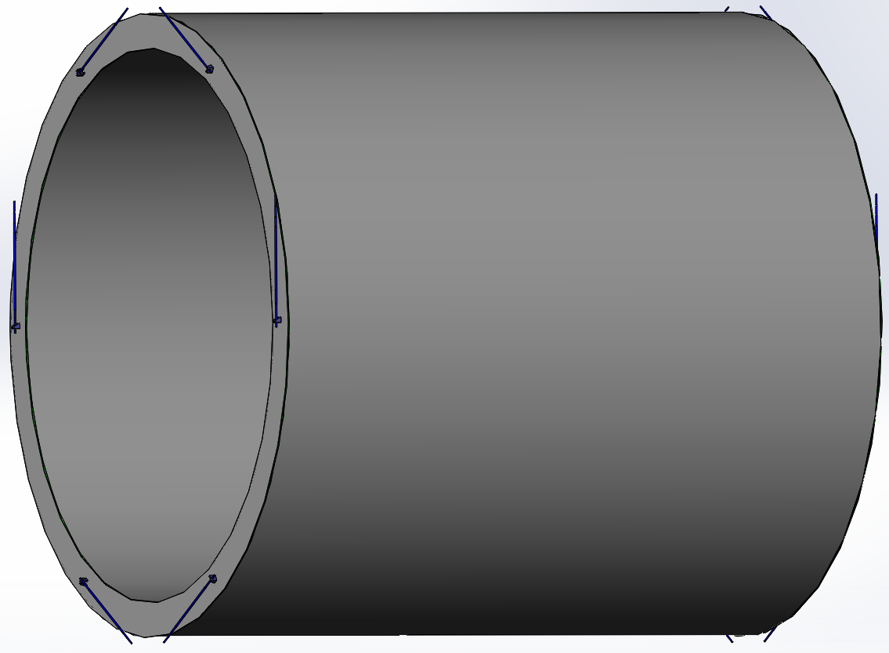
Mechanical design of the magnet
Thermal shield design
吊挂：轴向无拉杆
径向两端各2 根向上主拉杆、
各4 根斜向拉杆 ，室温端在轴向
向中间偏移，提供轴向力和径向力
拉杆材料：设计选取中（钛合金、
碳纤维）

Slide 9
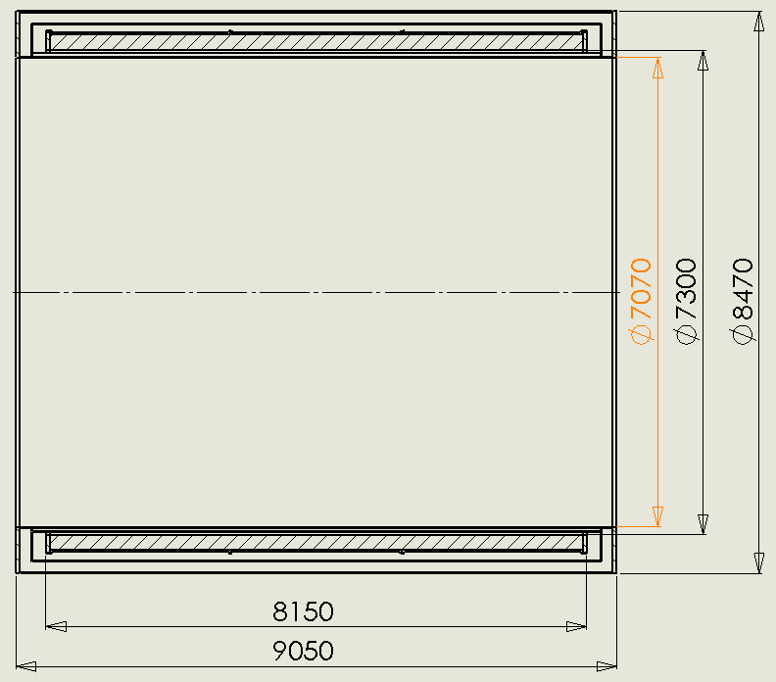
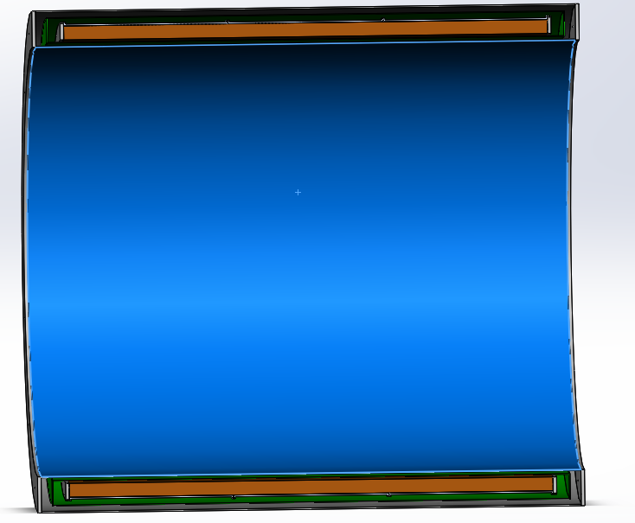
Mechanical design
2D and 3D design of magnet
Notes:
Two changes: first, add yoke to reduce the range of stray field; second, the size of HCal increase, so size of the solenoid and the yoke increase accordingly.

Slide 10
Future work of the mechanical design
后续将核算低温恒温器内外筒壁厚度
后续将确定拉杆材料，设计拉杆长度和截面积
液氦、液氮管路不影响磁体尺寸，后续设计
与低温系统配合调整空间布局

Slide 11
Ongoing work
Mechanical design of the magnet
Cryogenic system
Support structure of the magnet
Mechanical design of the yoke
Notes:
Two changes: first, add yoke to reduce the range of stray field; second, the size of HCal increase, so size of the solenoid and the yoke increase accordingly.

