Slide 1

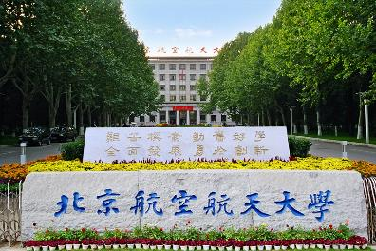

河南师范大学，新乡，2024.05.26
费米镜技术与奇特强子态研究
Li-Sheng Geng（耿立升）@ Beihang U.
Zhi-Wei Liu, Jun-Xu Lu, LSG*, PRD 107(2023)074019
Zhi-Wei Liu, Jun-Xu Lu, Ming-Zhu Liu, LSG*, PRD 108(2023)L031503
Zhi-Wei Liu, Jun-Xu Lu, Ming-Zhu Liu, LSG*, 2404.18607
Ming-Zhu Liu, Ya-Wen Pan, Zhi-Wei Liu, Tian-Wei Wu, Jun-Xu Lu, LSG*, 2404.06399

Slide 2

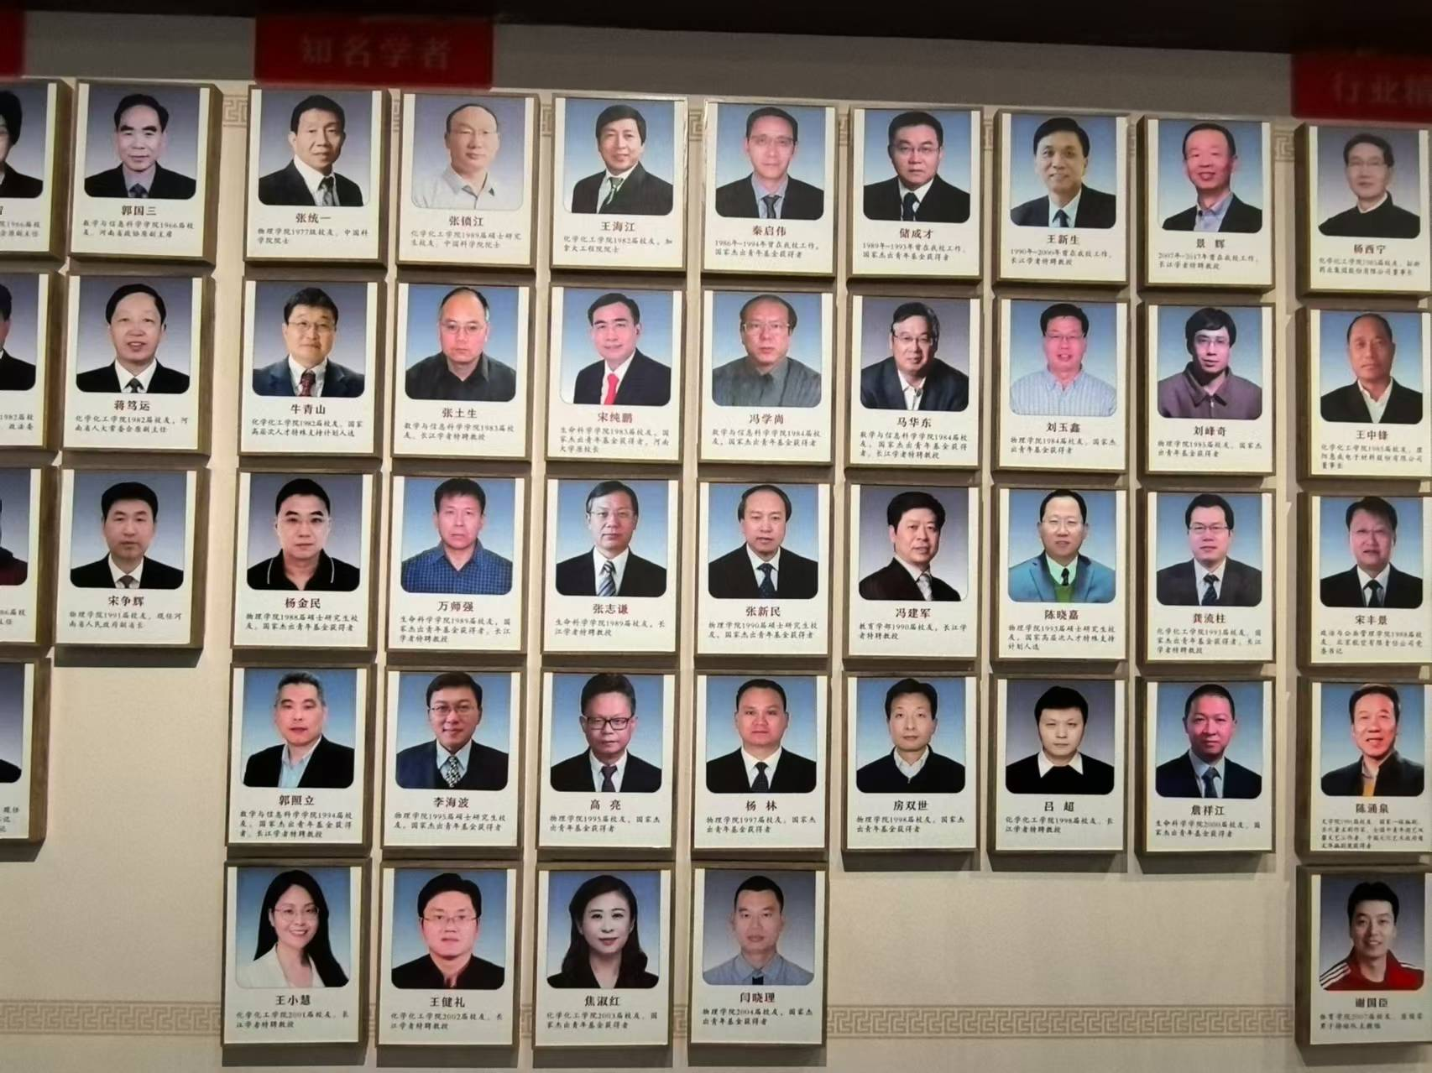

Slide 4
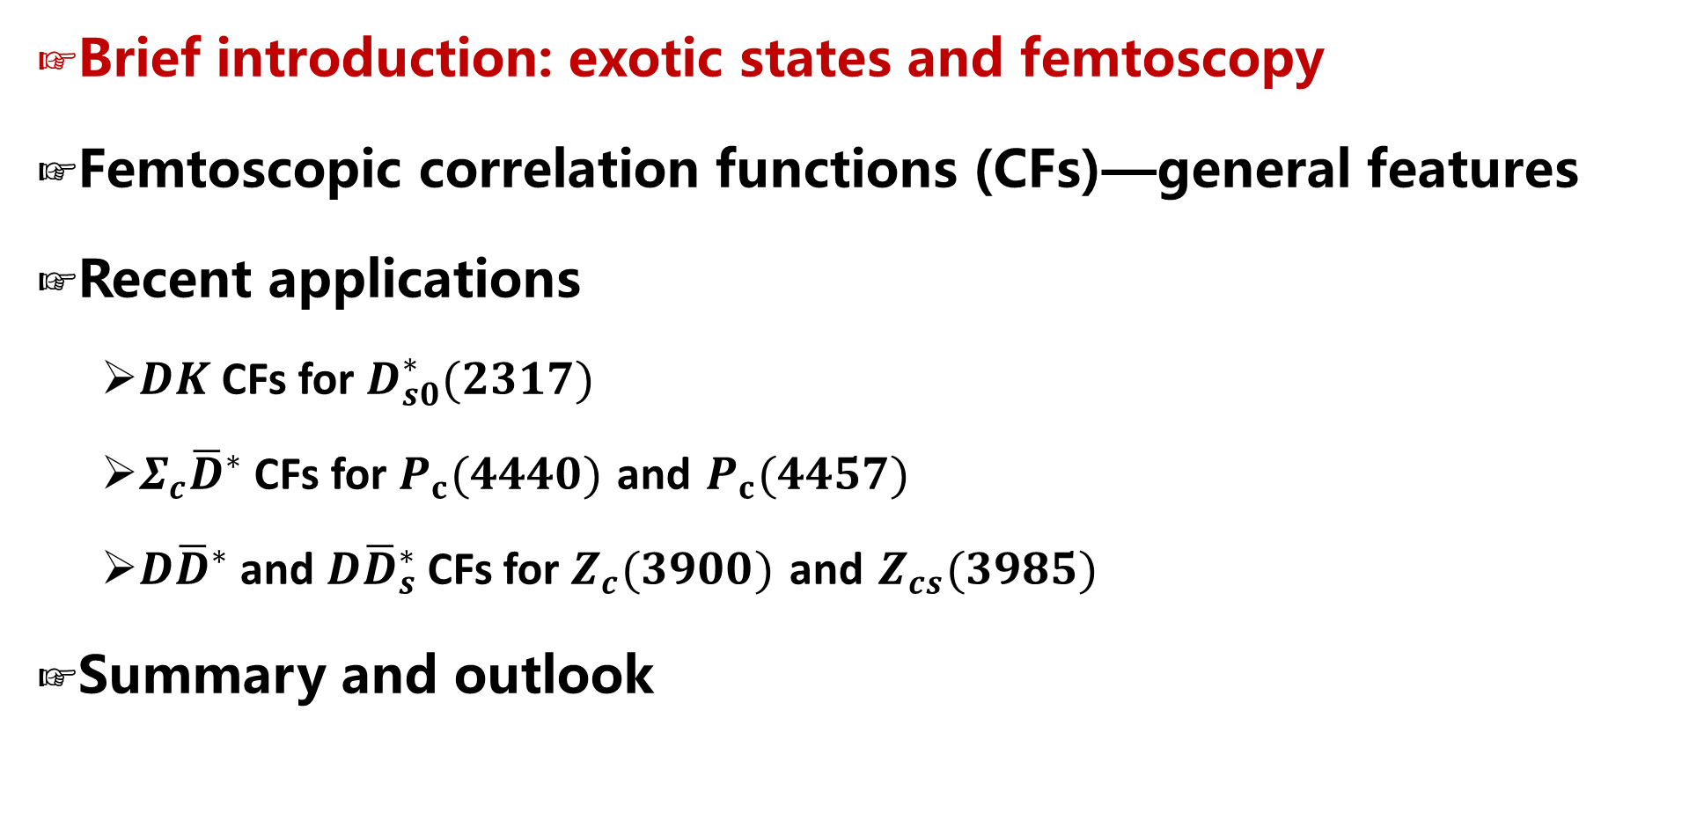
Contents
Brief introduction: exotic states and femtoscopy
Femtoscopic correlation functions (CFs)—general features
Recent applications
  $DK$ CFs for $D_{s0}^{∗}(2317)$
  $Σ_{c}{\overline{D}}^{∗}$ CFs for $P_{c}(4440)$ and $P_{c}(4457)$
  $D{\overline{D}}^{∗}$ and $D{\overline{D}}_{s}^{∗}$ CFs for $Z_{c}(3900)$ and $Z_{cs}(3985)$
Summary and outlook

Slide 5
The world was once very simple
Very preliminary!
Particles discovered before 1932
Notes:
We used to live in a very simple world, before the only known elementary particles were electron, proton and neutron

Slide 6
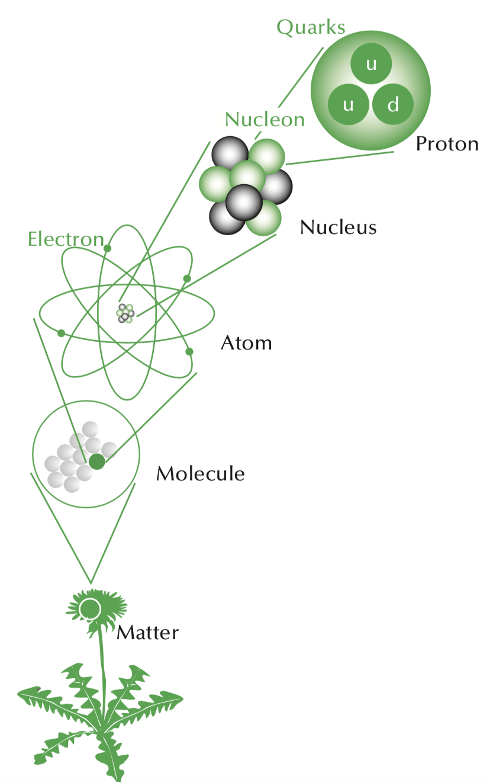
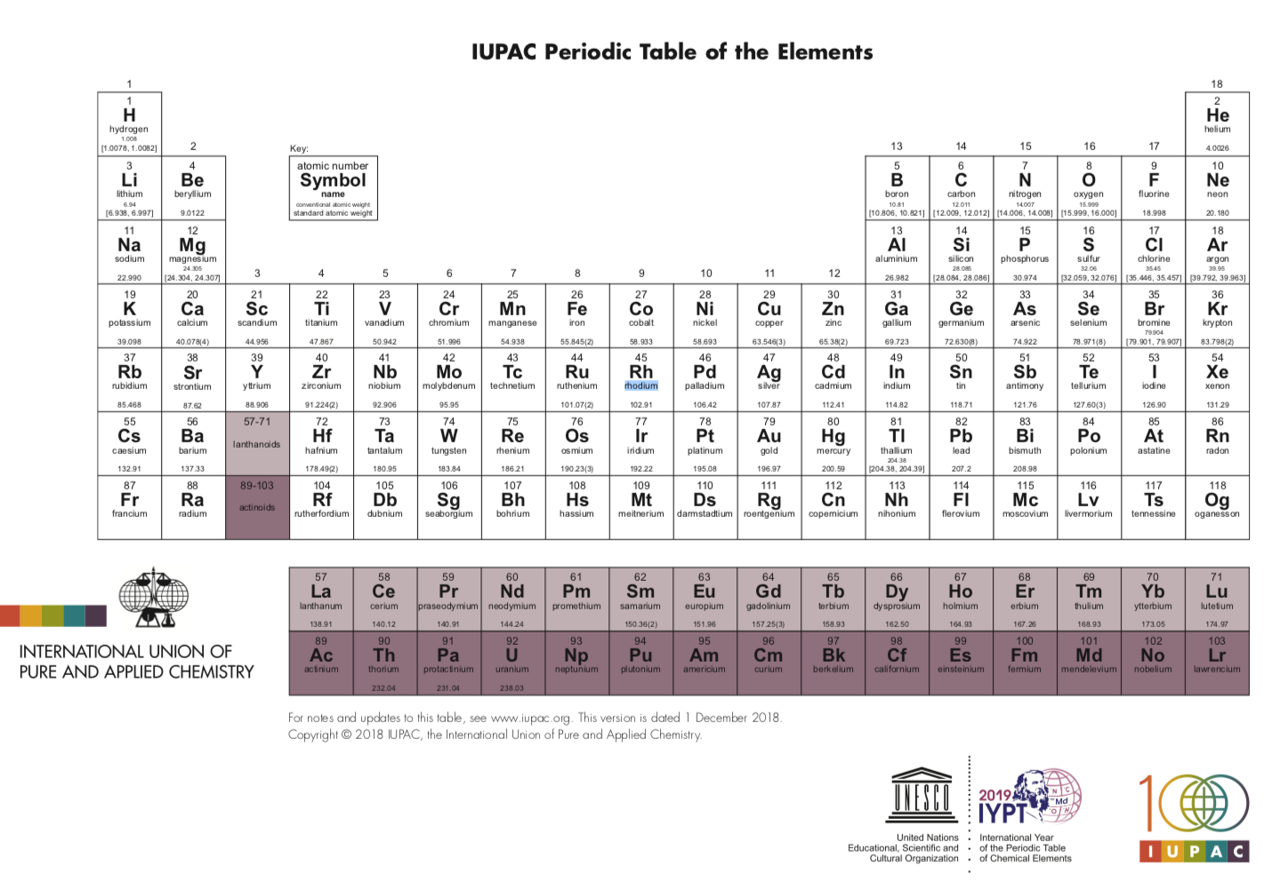
10⁻¹⁵
10⁻¹⁴
10⁻¹⁰
10⁻⁶
Building up the atomic world
10⁻¹
Notes:
Based on which, we can understand more or less the whole visible universe

Slide 7
Many particles observed in the 1960’s
Very preliminary!
Notes:
In the 1960’s, many particles were observed, including the one predicted by Yukawa and many others completely unexpected. Clearly, they cannot all be elementary. This created a big confusion

Slide 8
Hadron spectroscopy—QM—QCD
Put an end to the then chaotic situation
Murray Gell-Mann
Eightfold way-1961
Quark model-1964
QCD/SM
V. E. Barnes et al., Phys. Rev. Lett. 12, 204 (1964)
Yuval Ne'eman.
Notes:
In particle/hadron physics, the eightfold way paved the way for the quark model, which has an important position in the so-called standard model of particle physics. on the basis of their symmetrical properties, the number of members of each group being 1, 8 (most frequently), 10, or 27. The system was proposed in 1961 by the American physicist Murray Gell-Mann and the Israeli physicist Yuval Neʾeman. It is based on the mathematical symmetry group SU(3); however, the name of the system was suggested by analogy with the Eightfold Path of Buddhism because of the centrality of the number eight. One of the early triumphs of the Eightfold Way was the prediction of the existence of a heavy subatomic particle required to complete one of the groups. The particle, called omega-minus, was discovered in 1964. That same year, Gell-Mann set forth the concept of quarks as the physical basis for the classification system, thereby establishing the foundation for the modern quark model of hadrons. See also quark.

Slide 9
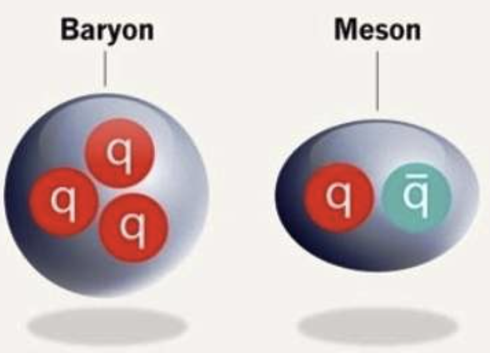
Naive QM: hadron structure

Slide 10
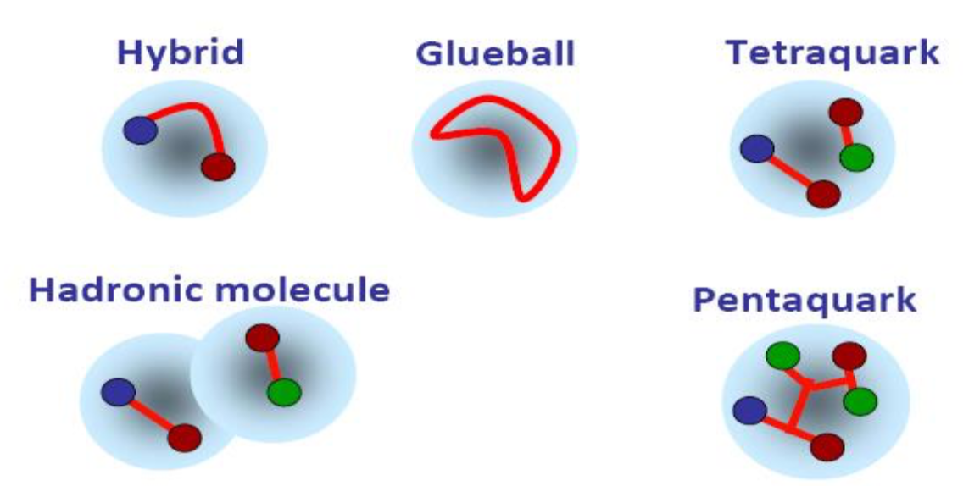
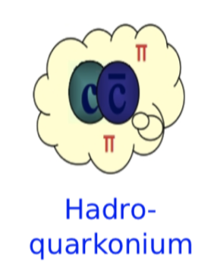
Beyond Naïve QM, more complicated structures allowed
In the naïve quark model
In principle,
QCD allows

Slide 11


Naïve quark models more or less fine until 2003
$Λ（1405），N^{∗}(1535)$,…
$f_{0}\left(500\right),$ $f_{0}\left(980\right),$ $a_{0}\left(980\right),…$

Slide 12




2003—the beginning of a new era
Belle, 0309032
> 1800
BaBar, 0304021
> 900
LEPS, 0301020
> 1100

Slide 13
2003—the beginning of a new era
Belle, 0309032
> 1800
BaBar, 0304021
> 900
LEPS, 0301020
> 1100

Slide 14











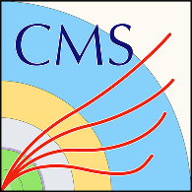








































Many more exotic hadrons discovered (up to 2022)
$$X_{0}(2866)$$
$$X_{1}(2904)$$
$D_{s1}$(2460)
$$\text{X}\text{(4160)}$$
$$\text{Y}\text{(4220)}$$
$Z_{c}$(4100)
$$\text{Y}\text{(4660)}$$
$Z_{c}$(4020)
$$P_{c}(4380)$$
$Ξ$(1620)
$$X(6900)$$
X(6900)
X(7200)
$D_{s0}$(2317)
$$\text{Y}\text{(4260)}$$
$$\text{X}\text{(3915)}$$
$$\text{X}\text{(4274)}$$
$Z_{c}$(3900)
$$P_{c}(4450)$$
$$\text{Y}\text{(4390)}$$
$$P_{cs}(4459)$$
$$\text{Y}\text{(4500)}$$
$$\text{Y}\text{(4360)}$$
$Ω$(2012)
$$P_{c}(4337)$$
2003
2005
2006
2007
2009
2011
2013
2014
2015
2016
2018
2019
2020
2021
2022
2023
$$\text{X}\text{(3960)}$$
$$\text{X}\text{(3872)}$$
$Z_{c}$(4430)
$X$(4140)
$Z_{c}$(4200)
$$P_{c}(4457)$$
$Z_{cs}$(3985)
$$P_{cs}(4338)$$
X(6900)
X(6600)
X(7100)
$$\text{X}\text{(5568)}$$
$$P_{c}(4440)$$
$$T_{cs}(2900)$$
$Y$(3940)
$$P_{c}(4312)$$
$T_{cc}$(3875)
$Z_{b}$(10610)
$Z_{b}$(10650)
$Λ_{c}$(2940)

Slide 15
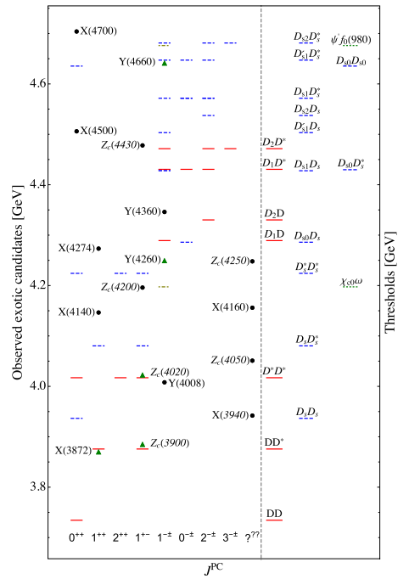
Many (if not all) of them close to thresholds—molecules
Feng-Kun Guo, Christoph Hanhart,
Ulf-G. Meißner, Qian Wang,
Qiang Zhao, Bing-Song Zou.
Rev.Mod.Phys. 90 (2018) 015004
1177 citations
Hua-Xing Chen, Wei Chen, Xiang Liu and Shi-Lin Zhu,The hidden-charm pentaquark and tetraquark states,Phys. Rept.639 (2016) 1
1079 citations

Slide 16

How to check the molecular picture?
Notes:
莎士比亚（Shakespeare）名言：“一千个读者眼中就会有一千个哈姆雷特”
也就是说，每个立场不同的人可以在〈Hamlets〉《哈姆雷特》这本书里看出完全不同的意境。
英语原句是：There are a thousand Hamlets in a thousand people's eyes.
（一千个读者眼里有一千个哈姆雷特）即（一千个人就有一千个哈姆雷特）

Slide 17
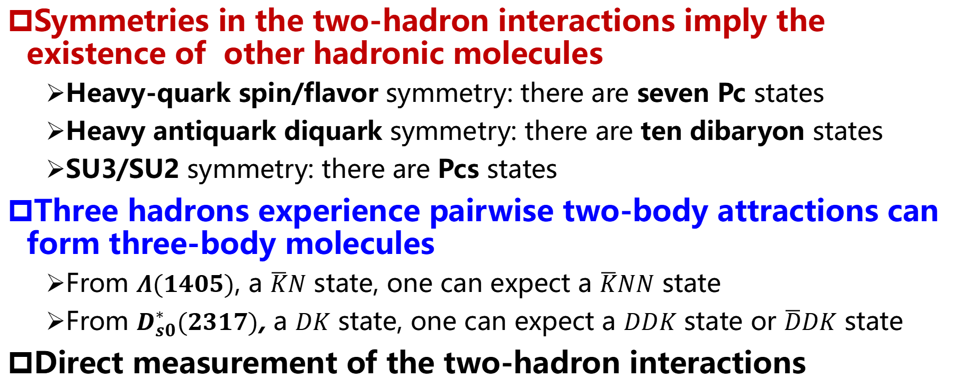
How to verify the molecular picture
Symmetries in the two-hadron interactions imply the existence of other hadronic molecules
  Heavy-quark spin/flavor symmetry: there are seven Pc states
  Heavy antiquark diquark symmetry: there are ten dibaryon states
  SU3/SU2 symmetry: there are Pcs states
Three hadrons experience pairwise two-body attractions can form three-body molecules
  From $Λ(1405)$, a $\overline{K}N$ state, one can expect a $\overline{K}NN$ state
  From $D_{s0}^{∗}(2317)$, a $DK$ state, one can expect a $DDK$ state or $\overline{D}DK$ state
Direct measurement of the two-hadron interactions
2404.06399, Ming-Zhu Liu, Ya-Wen Pan, Zhi-Wei Liu, Tian-Wei Wu, Jun-Xu Lu, LSG*

Slide 18
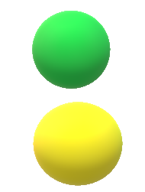
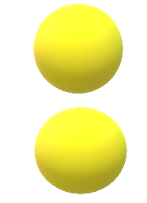

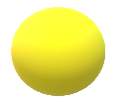
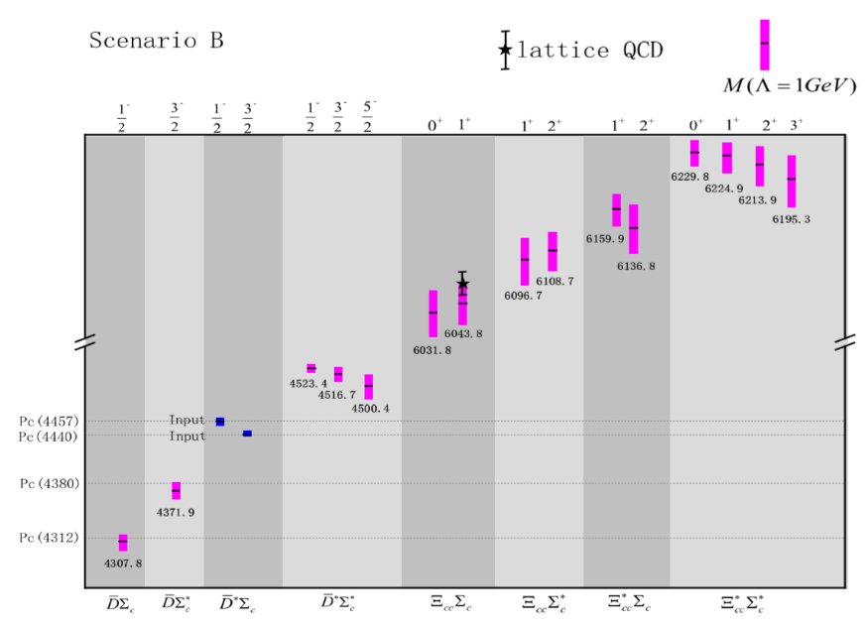





M1: Sym. multiplets—pentaquarks
$$3⊗3=6⨁\overline{3}$$
$$\overline{D}$$
HADS
$$Ξ_{cc}$$
$$\overline{3}$$
$$Σ_{c}$$
$$Σ_{c}$$
Heavy-quark spin symmetry—seven pentaquark states
Heavy-antiquark diquark symmetry—ten dibaryons
Liu, Pan, Peng, Sanchez Sanchez, LSG*, Hosaka* and Pavon Valderrama*, PRL122, 242001 (2019）
Pan, Liu, Peng, sanchez Sanchez, LSG* and Pavon Valderrama, PRD102, 011504 (2020)

Slide 19
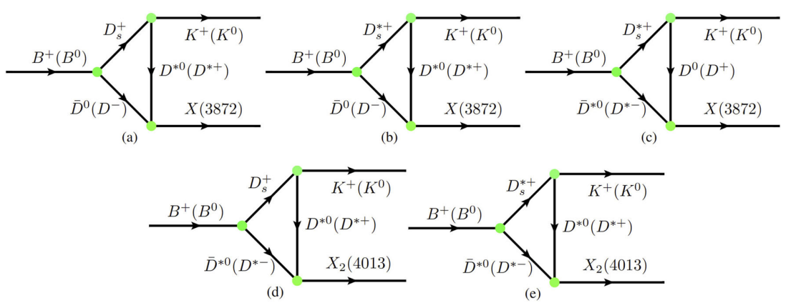
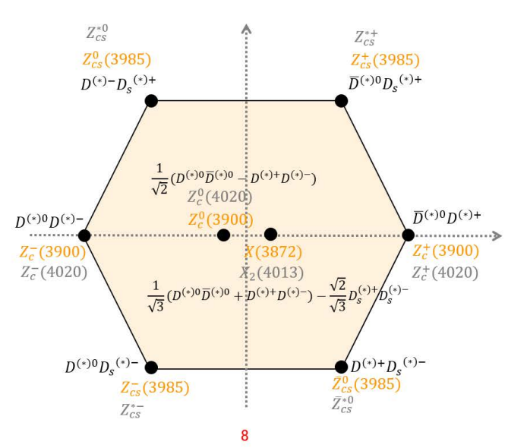
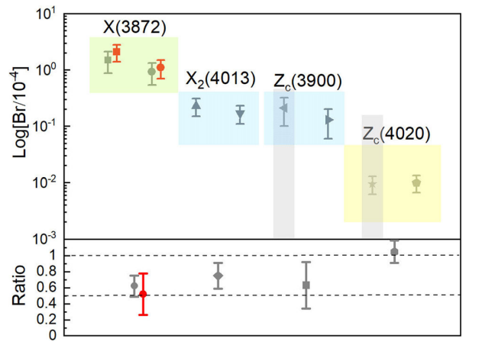
M1: Sym. multiplets—X(3872)
Ming-Zhu Liu, Ya-Wen Pan, Zhi-Wei Liu,
Tian-Wei Wu, Jun-Xu Lu, LSG*, 2404.06399
Qi Wu, Ming-Zhu Liu, LSG*, Eur.Phys.J.C 84 (2024) 147

Slide 20
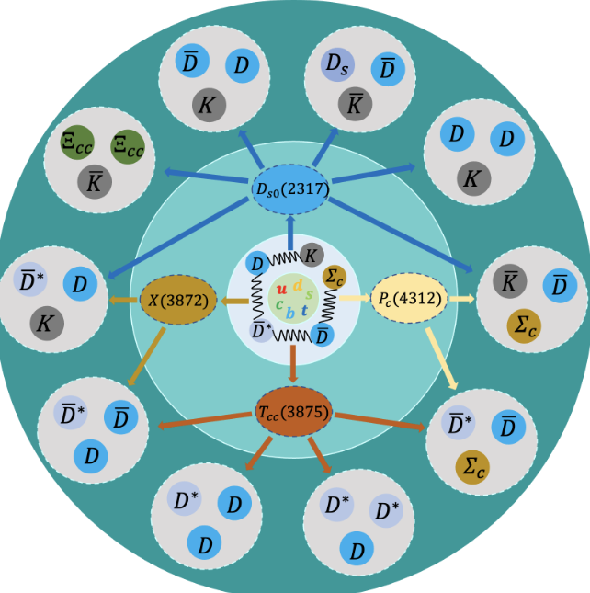
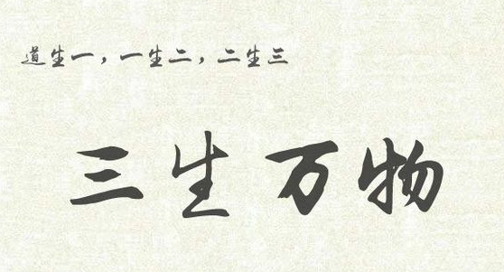
M2: from 2 to 3
Wu, Pan, Liu, LSG*, Sci.Bull. 67 (2022) 1735
Liu, Pan, Liu, Wu, Lu, LSG*, 2404.06399

Slide 21
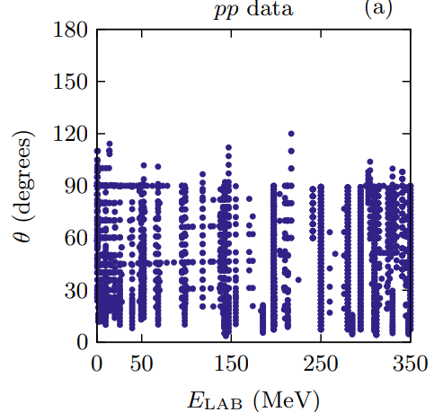
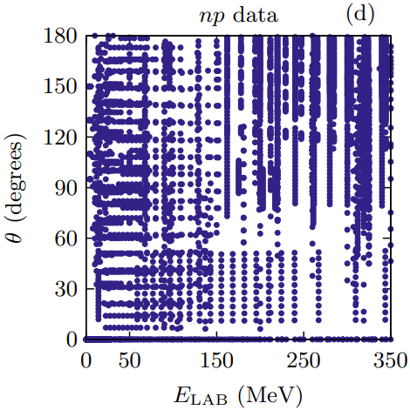
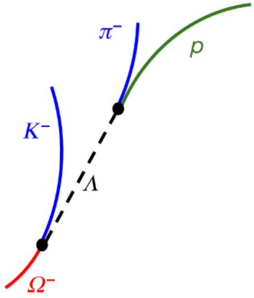
M3: Direct verifications of hadron-hadron interactions
For stable hadrons, scattering experiments are extremely valuable in extracting their interactions
There exist
abundant data for
nucleon-nucleon scattering (8125)
Phys.Rev.C 89 (2014) 064006
For unstable particles, scattering experiments are difficult or impossible!

Slide 22



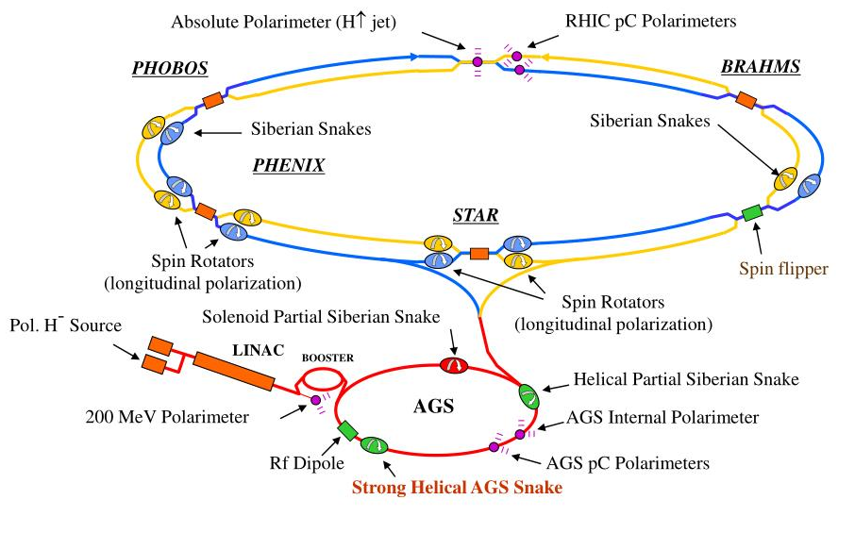
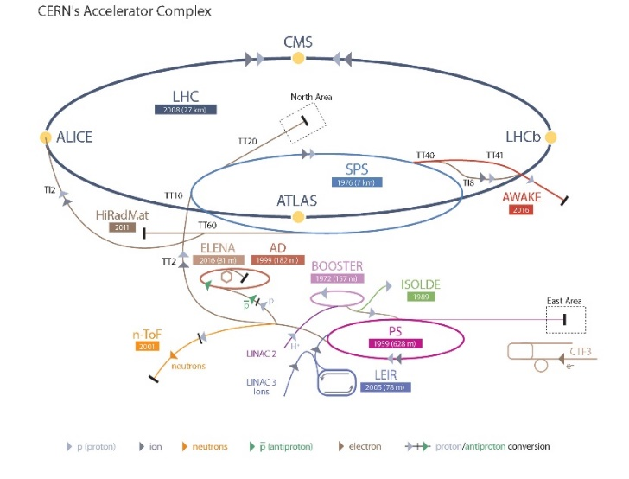
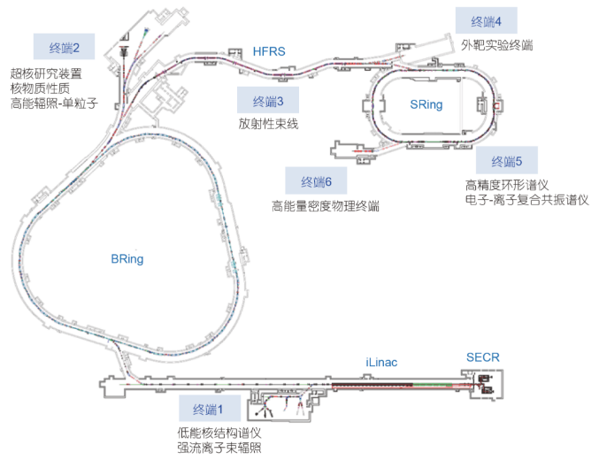
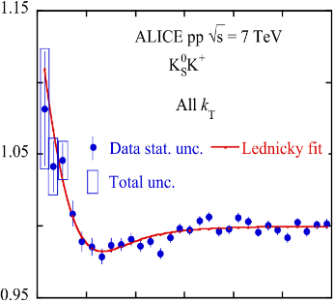
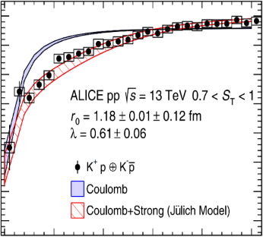
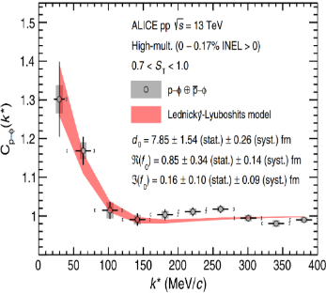
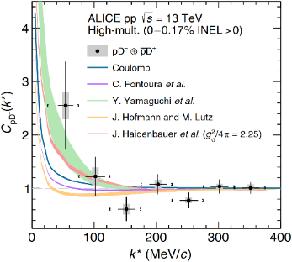
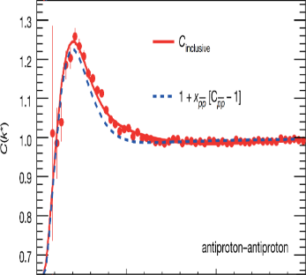
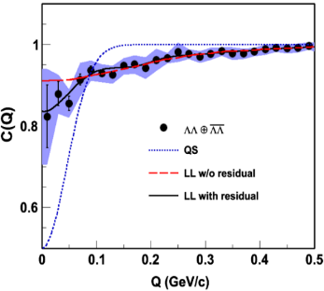
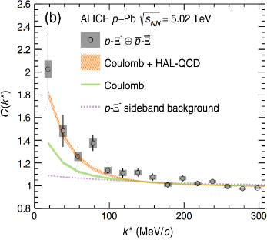
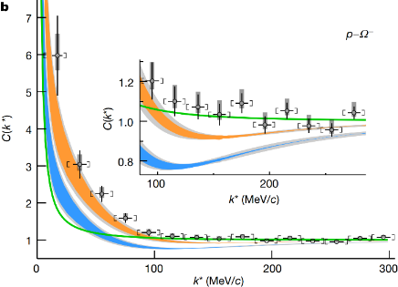









New probe—femtoscopic correlation functions
Large Hadron Collider
$$K_{S}^{0}K^{±}$$
$$p+p, \sqrt{s}=7 TeV$$
$$K^{±}p$$
$$p+p, \sqrt{s}=5,7,13 TeV$$
$$φp$$
$$p+p, \sqrt{s}=13 TeV$$
$$D^{−}p$$
$$p+p, \sqrt{s}=13 TeV$$
$$\overline{p }\overline{p }$$
$$Au+Au, \sqrt{s}=200 MeV$$
$$\text{ΛΛ}$$
$$Au+Au, \sqrt{s}=200 MeV$$
$${\text{X}}^{−}p$$
$$p+Pb, \sqrt{s}=5.02 TeV$$
$$^{−}p$$
$$p+p, \sqrt{s}=13 TeV$$
ALICE Collaboration, Phys. Lett. B 790 (2019) 22
STAR Collaboration, Nature 527 (2015) 345
ALICE Collaboration, Phys. Rev. Lett. 124 (2020) 092301
STAR Collaboration, Phys. Rev. Lett. 114 (2015) 022301
ALICE Collaboration, Phys. Rev. Lett. 127 (2021) 172301
ALICE Collaboration, Phys. Rev. Lett. 123 (2019) 112002
ALICE Collaboration, Phys. Rev. D 106 (2022) 052010
ALICE Collaboration, Nature 588 (2020) 232

Slide 23
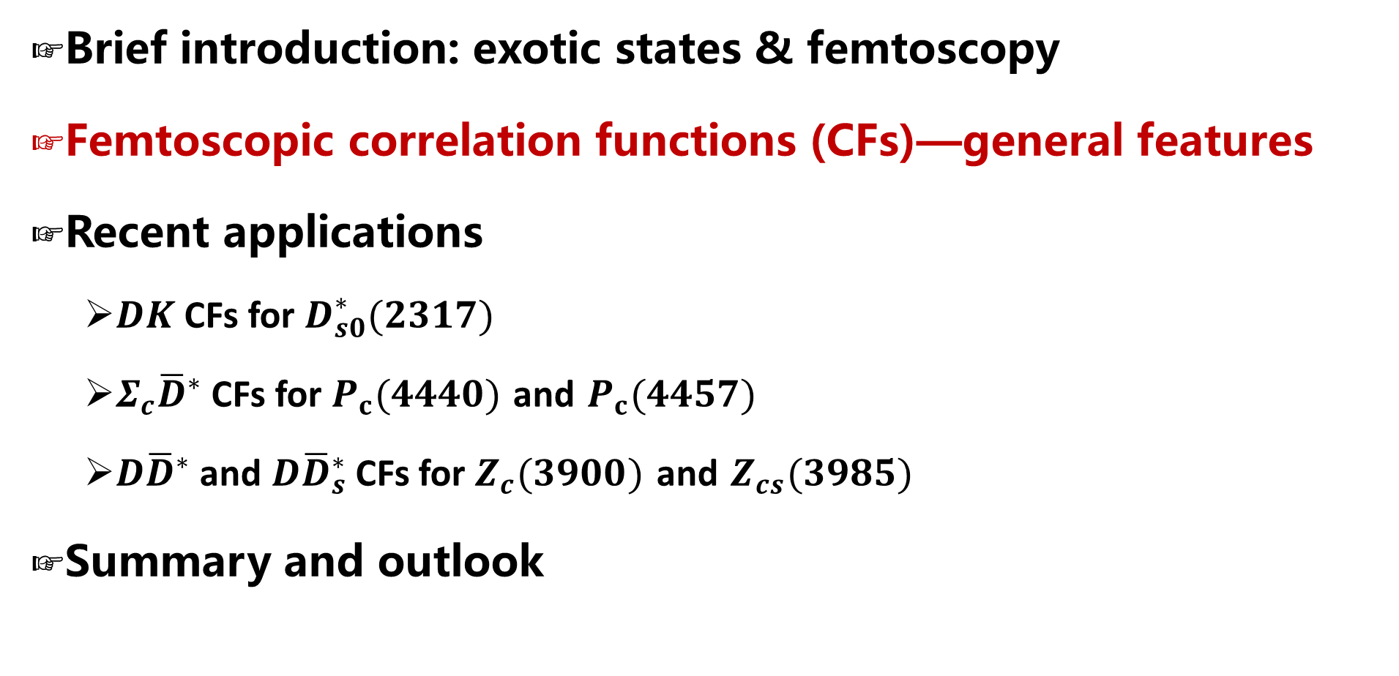
Contents
Brief introduction: exotic states & femtoscopy
Femtoscopic correlation functions (CFs)—general features
Recent applications
  $DK$ CFs for $D_{s0}^{∗}(2317)$
  $Σ_{c}{\overline{D}}^{∗}$ CFs for $P_{c}(4440)$ and $P_{c}(4457)$
  $D{\overline{D}}^{∗}$ and $D{\overline{D}}_{s}^{∗}$ CFs for $Z_{c}(3900)$ and $Z_{cs}(3985)$
Summary and outlook

Slide 24
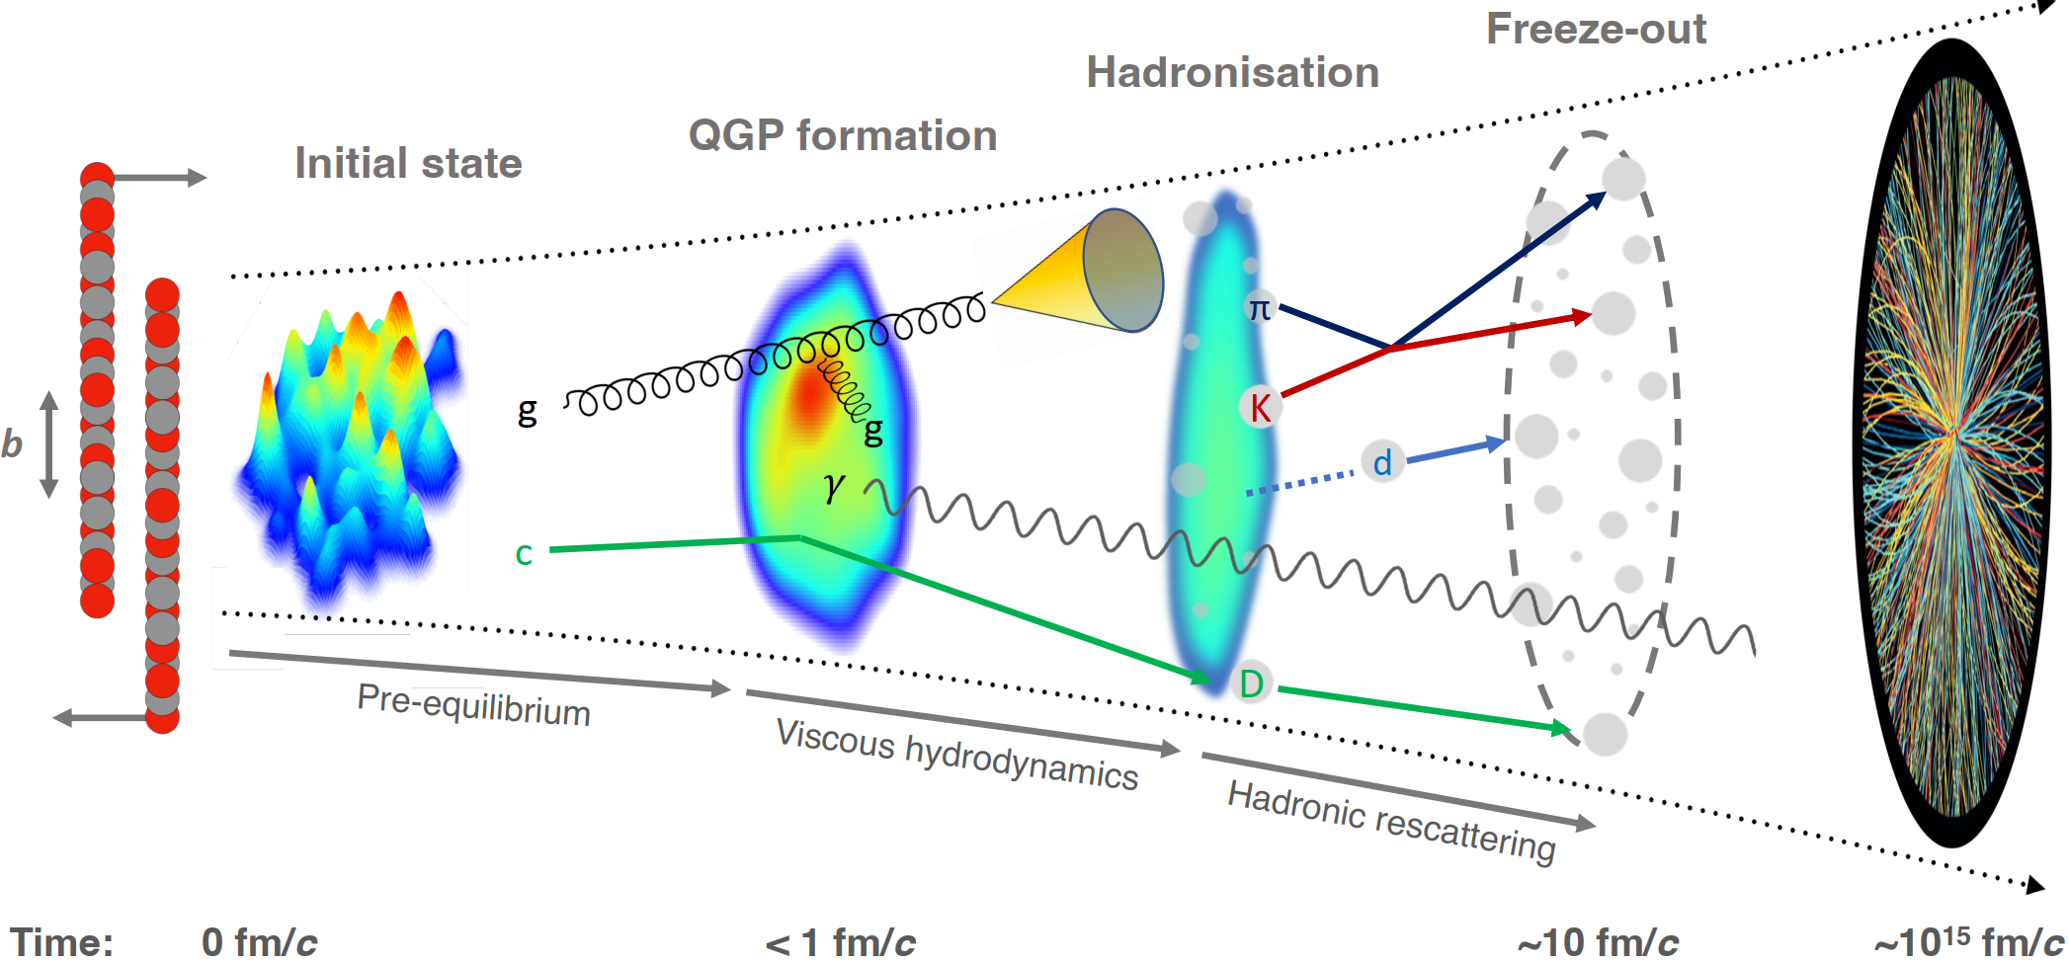
Abundant particles produced in AA, pA, and pp collisions
Final-State Interaction

Slide 25
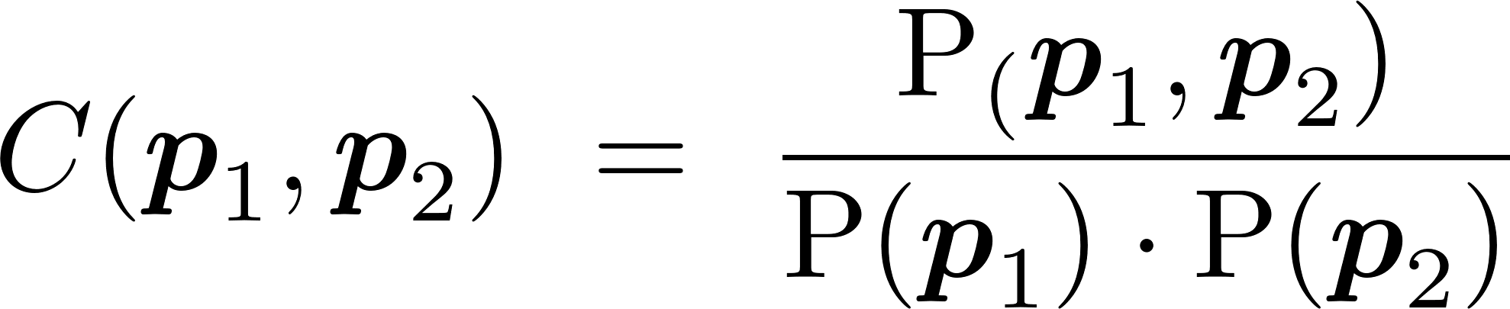
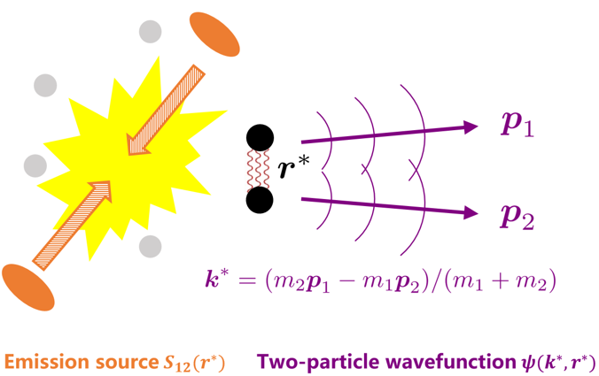
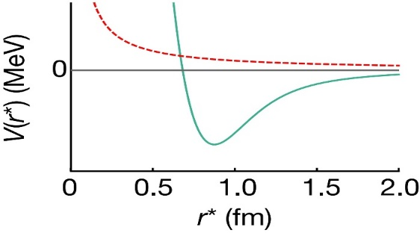
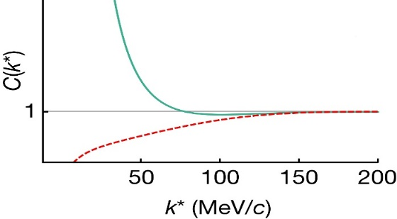
Femtoscopic correlation functions (CFs)
Interacting potential
Correlation function
repulsive
attractive
attractive
repulsive
Schrödinger equation
Two-particle wavefunction$ψ(k^{∗}, r^{∗})$
Theo. description
Koonin–Pratt formula
Exp. measurement
mixed-event technique
>1 if the interaction is attractive
=1 if there is no interaction
<1 if the interaction is repulsive
final-state interactions
quantum statistics effects
coupled-channel effects
the same and mixed event distributions
the corrections for experimental effects
spacial structure

Slide 26
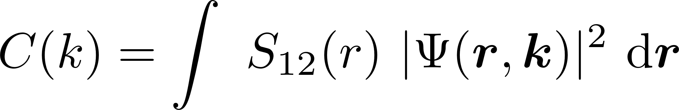
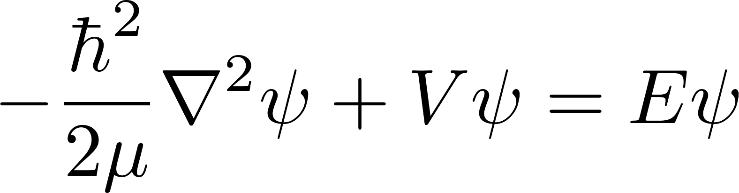
Femtoscopic correlation functions (CFs)
S. E. Koonin, Phys. Lett. B 70 (1) (1977) 43
A. Ohnishi, Nucl. Phys. A 954 (2016) 294
Koonin–Pratt (KP) formula
Common static and spherical Gaussian source
Correlation function (consider only correlations in S-waves)
Scattering wave function
Solving the Schrödinger equation in coordinate space
Solving the Lippmann-Schwinger scattering equation in momentum space

Slide 27

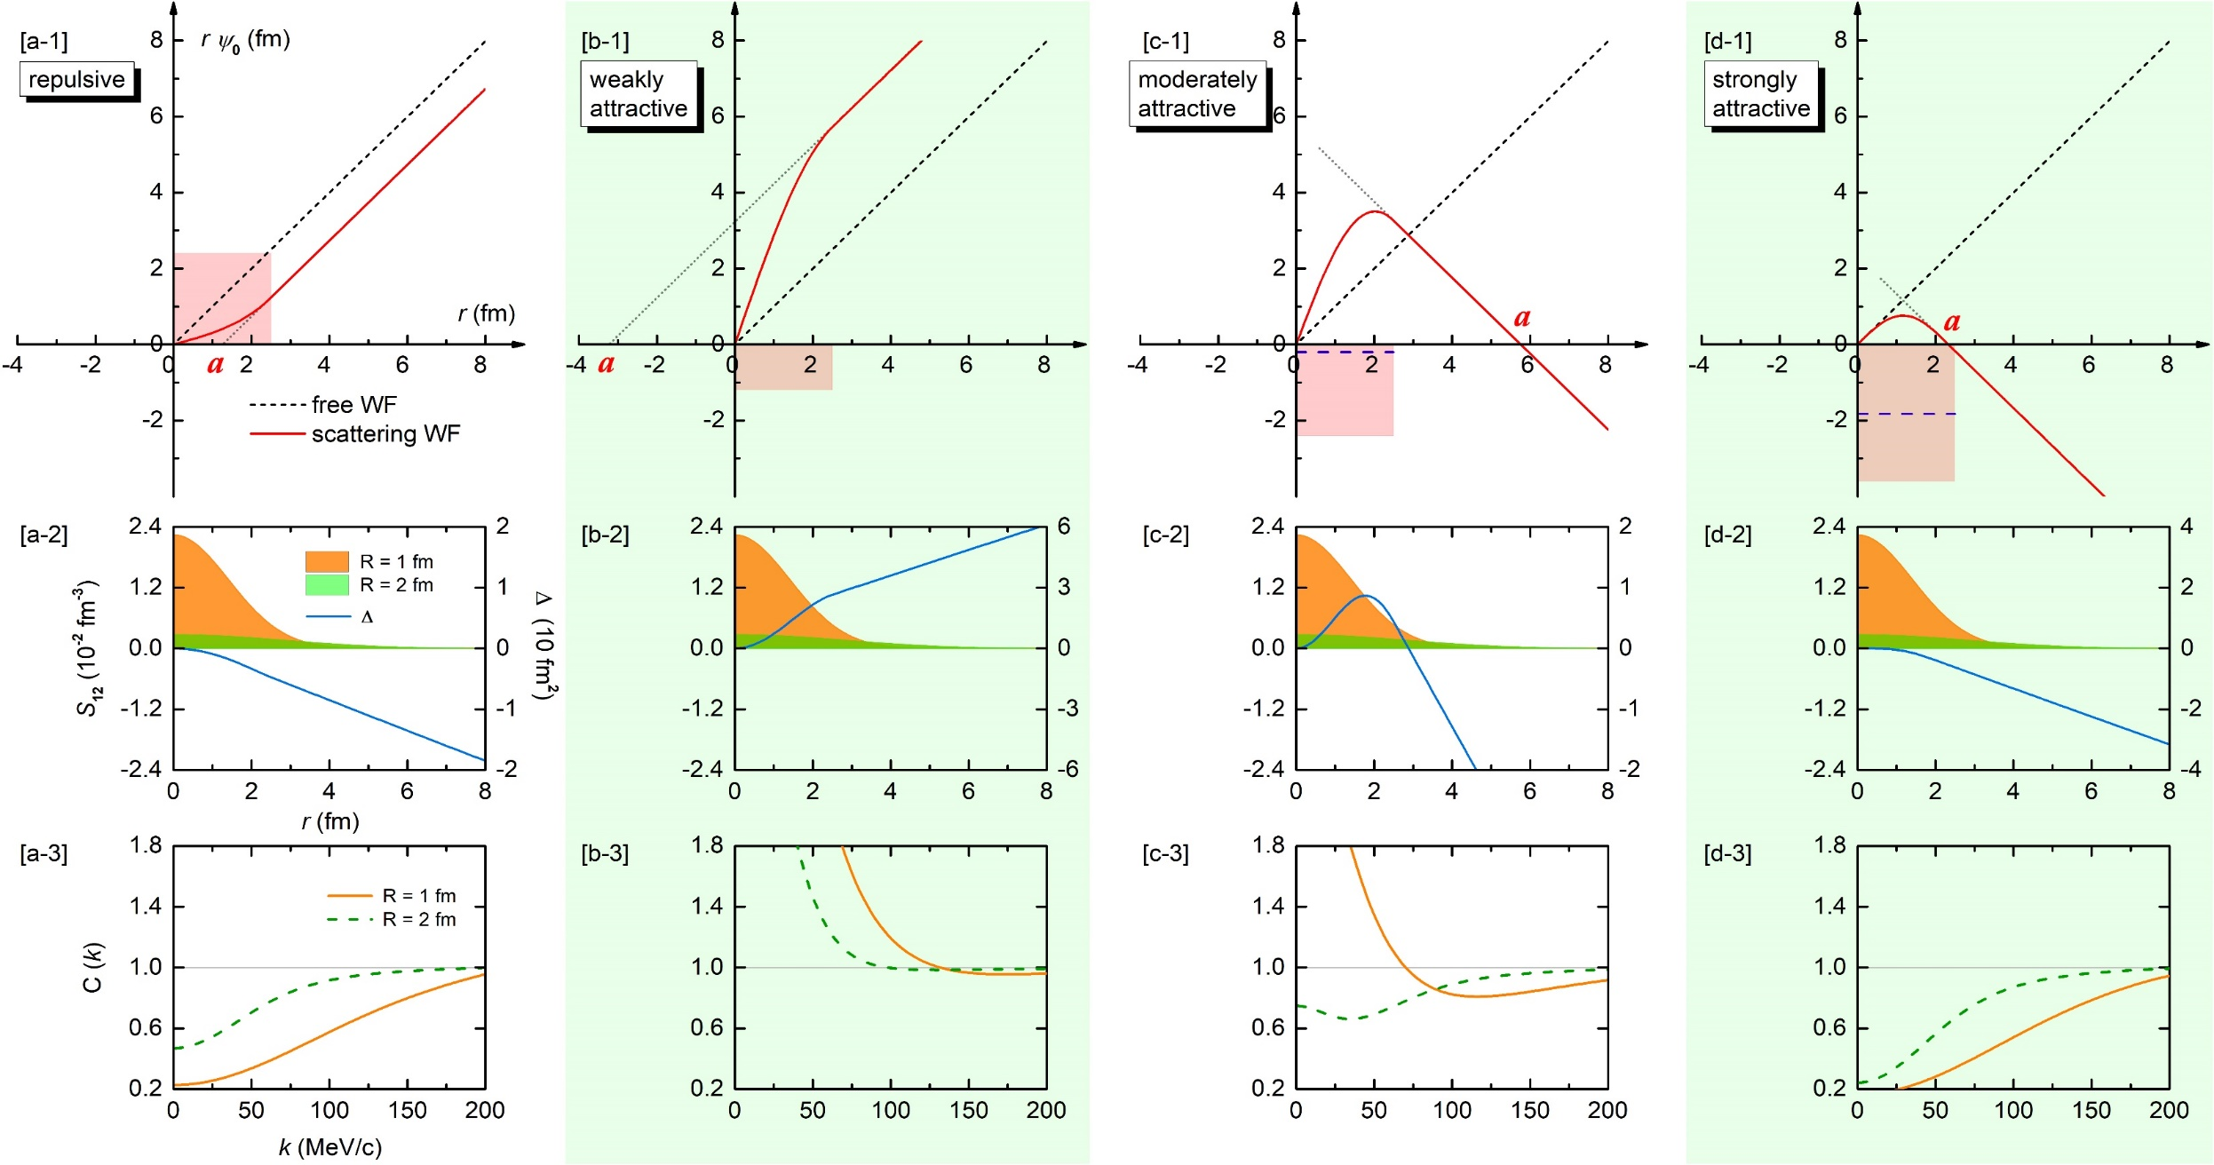
CFs in the presence of bound states
Zhi-Wei Liu, Jun-Xu Lu and LSG*, PRD 107, 074019 (2023)
Notes:
color online) Scattering wave functions, source functions, and correlation functions for the four different square-well potentials, namely, (a) a repulsive potential, (b) a weakly attractive potential, (c) a moderately attractive potential, and (d) a strongly attractive potential.Panels (a1–d1): the product of the relative distance r and the S-channel wave function ψ0 as a function of r in the low-momentum region. The black short-dashed line denotes the free-wave result, while the red solid line denotes the scattering-wave result. The light red region depicts the square-well potential. Panels (a2–d2): Gaussian source function S12 as a function of r. The results are calculated with a source size R = 1 fm (dark orange region) and R = 2 fm (light green region). In the same plot, the difference between the free and scattering wave functions squared ∆ ≡ r 2 (|ψl=0| 2 − |jl=0| 2 ) in Eq. (7) is also shown as the blue solid line. Panels (a3–d3): Correlation function as a function of the relative momentum k. The orange solid line and the green dashed line denote the results obtained with R = 1 fm and R = 2 fm, respectively.

Slide 28
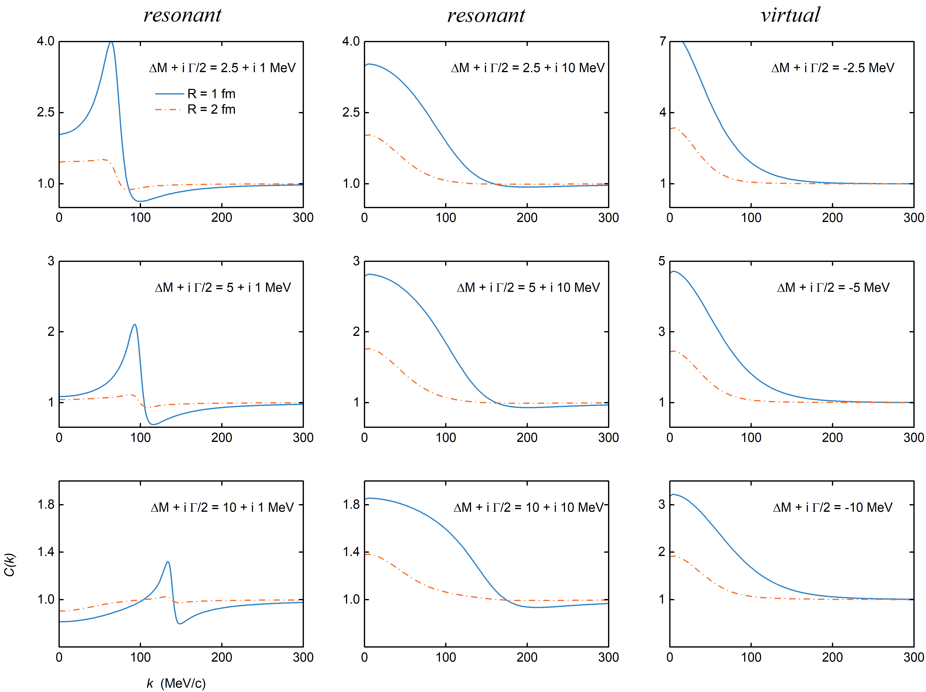
CFs in the presence of resonant and virtual states
2404.18607 , Zhi-Wei Liu, Ming-Zhu Liu, Jun-Xu Lu and LSG*
narrow
broad

Slide 29
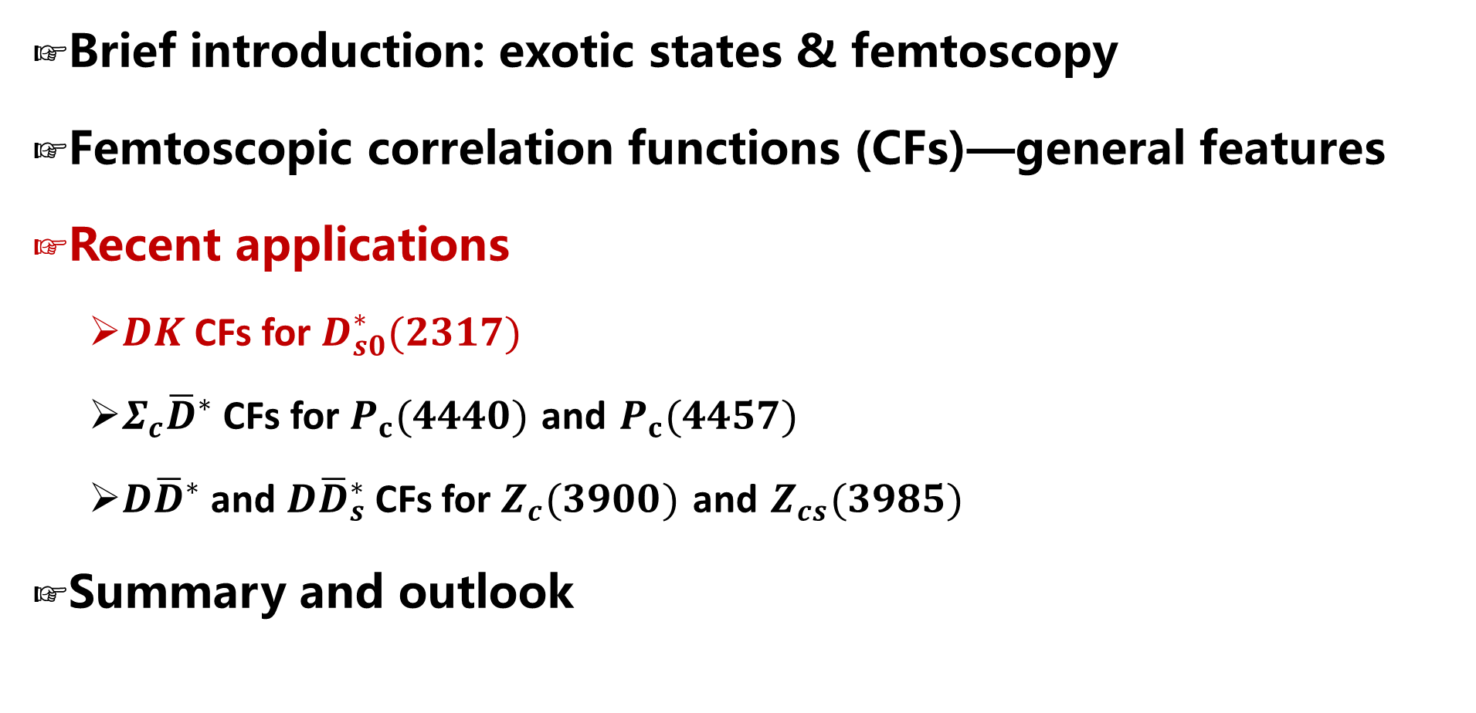
Contents
Brief introduction: exotic states & femtoscopy
Femtoscopic correlation functions (CFs)—general features
Recent applications
  $DK$ CFs for $D_{s0}^{∗}(2317)$
  $Σ_{c}{\overline{D}}^{∗}$ CFs for $P_{c}(4440)$ and $P_{c}(4457)$
  $D{\overline{D}}^{∗}$ and $D{\overline{D}}_{s}^{∗}$ CFs for $Z_{c}(3900)$ and $Z_{cs}(3985)$
Summary and outlook

Slide 30
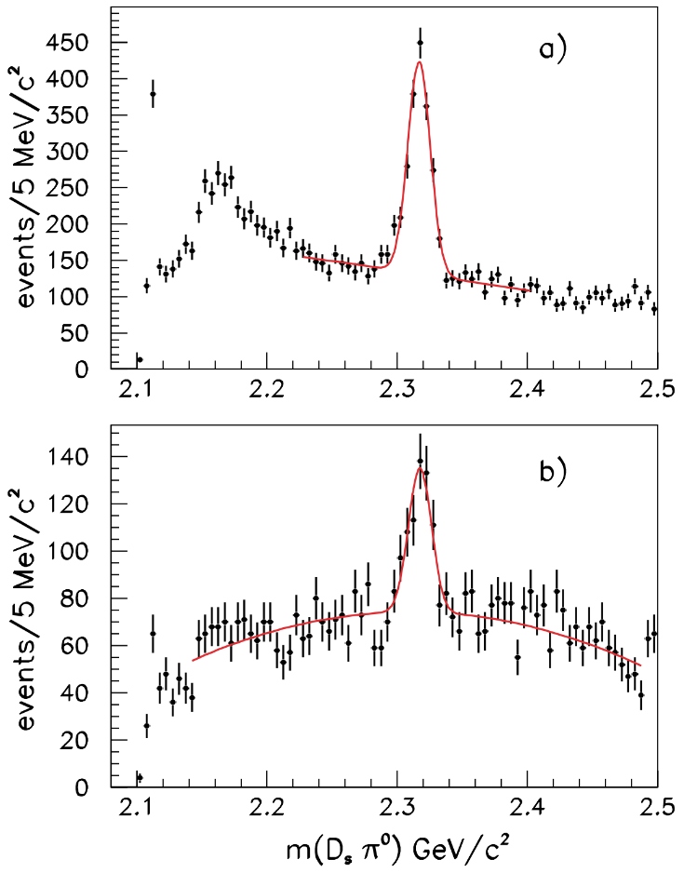
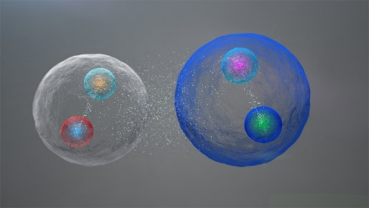
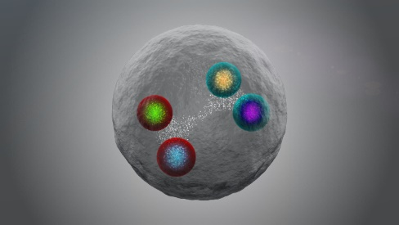

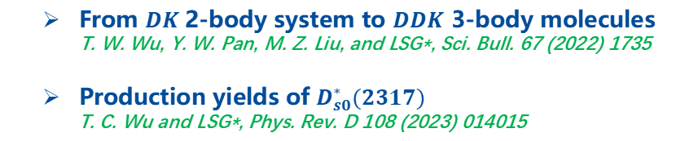


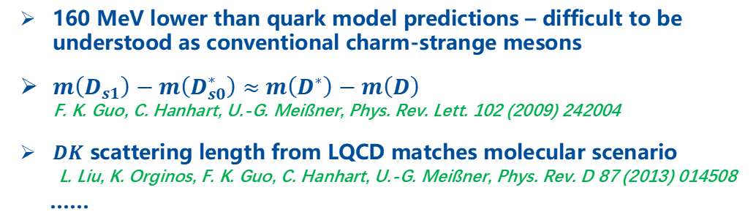
Mysterious exotic hadron $D_{s0}^{∗}(2317)$—998 citations
160 MeV lower than quark model predictions – difficult to be understood as conventional charm-strange mesons
$m\left(D_{s1}\right)−m\left(D_{s0}^{∗}\right)≈$ $m\left(D^{∗}\right)−m\left(D\right)$
F. K. Guo, C. Hanhart, U.-G. Meißner, Phys. Rev. Lett. 102 (2009) 242004
$DK$ scattering length from LQCD matches molecular scenario
L. Liu, K. Orginos, F. K. Guo, C. Hanhart, U.-G. Meißner, Phys. Rev. D 87 (2013) 014508
……
$$D_{s}^{+}→K^{+}K^{−}π^{+}$$
$$D_{s}^{+}→K^{+}K^{−}π^{+}π^{0}$$
VS
How to verify the $DK$molecular picture ?
From $DK$2-body system to $DDK$ 3-body molecules
T. W. Wu, Y. W. Pan, M. Z. Liu, and LSG*, Sci. Bull. 67 (2022) 1735
Production yields of $D_{s0}^{∗}(2317)$
T. C. Wu and LSG*, Phys. Rev. D 108 (2023) 014015
BABAR, Phys. Rev. Lett. 90 (2003) 242001

Slide 31





Weinberg-Tomozawa Interaction (leading order)
LO interaction between a NGB and a heavy pseudoscalar boson
Weinberg-Tomozawa (WT) potential – parameter free

Slide 32




Scattering wave function
Coupled-channel scat. eq.
Dynamically generated state — singularities of unitarized amplitude $T$
S-wave scattering wave function (including off-shell effect)

Slide 33



$DK$CFs and its source size dependence
$$D^{+}K^{0} → D^{0}K^{+}$$
Typical feature of deeply bound states
Zhi-Wei Liu, Jun-Xu Lu and LSG*, PRD 107, 074019 (2023)

Slide 34




Confirmed by two subsequent studies

Slide 35

Contents
Brief introduction
Symmetry and multiplets & three-hadron molecules
Femtoscopic correlation functions (CFs)—general features
Recent applications
  $DK$ CFs for $D_{s0}^{∗}(2317)$
  $Σ_{c}{\overline{D}}^{∗}$ CFs for $P_{c}(4440)$ and $P_{c}(4457)$
  $D{\overline{D}}^{∗}$ and $D{\overline{D}}_{s}^{∗}$ CFs for $Z_{c}(3900)$ and $Z_{cs}(3985)$
Summary and outlook

Slide 36



Pentaquark states $P_{c}(4440)$ & $P_{c}(4457)$—1734 citation
LHCb, Phys. Rev. Lett. 115 (2015) 072001
LHCb, Phys. Rev. Lett. 122 (2019) 222001
Pentaquark states · 2015 APS Highlights
How to distinguish the spins of $P_{c}(4440)$ and $P_{c}(4457)$ ?
Masses, invariant mass distributions, decays, magnetic momenta, production rates
M. Z. Liu, Y. W. Pan, F. Z. Peng, M. Sánchez S, LSG*, A. Hosaka, M. P. Valderrama, Phys. Rev. Lett. 122 (2019) 242001
M. L. Du, V. Baru, F. K. Guo, C. Hanhart, U. G. Meißner, J. A. Oller, Q. Wang, Phys. Rev. Lett. 124 (2020) 072001
Y. H. Lin, B. S. Zou, Phys. Rev. D 100 (2019) 056005
M. W. Li, Z. W. Liu, Z. F. Sun and R. Chen, Phys. Rev. D 104 (2021) 054016
Q. Wu, D. Y. Chen, Phys. Rev. D 100 (2019) 114002
Heavy antiquark diquark symmetry
Y. W. Pan, M. Z. Liu, F. Z. Peng, M. S. Sánchez, LSG*, M. P. Valderrama, Phys. Rev. D 102 (2020) 011504
Neural network-based approach
Z. Zhang, J. Liu, J. Hu, Q. Wang, U.-G. Meißner, Sci. Bull. 68 (2023) 981

Slide 37




Light vector meson exchange interaction
Interaction in hidden local symmetry approach – parameter free
Isospin basis
Charge basis

Slide 38










Two different spin assignments
Interaction strengths
deep bound state of $Σ_{c}{\overline{D}}^{∗}$
shallow bound state of $Σ_{c}{\overline{D}}^{∗}$
CF for the shallow bound state is significantly larger than that for the deep bound
Experimental CFs – spin-averaged
Scenarios A
Scenarios B

Slide 39



Spin-averaged $Σ_{c}{\overline{D}}^{∗}$CFs
$\text{Scenario} \text{A}$: higher mass, larger spin
model independent
CF for shallow bound state
$$Σ_{c}^{++}D^{∗−}→Σ_{c}^{+}{\overline{D}}^{∗0}$$
CF for deep bound state
Scenario B: higher mass, smaller spin
Zhi-Wei Liu, Ming-Zhu Liu, Jun-Xu Lu and LSG*, PRD 108, L031503 (2023)

Slide 40

Contents
Brief introduction: exotic states & femtoscopy
Femtoscopic correlation functions (CFs)—general features
Recent applications
  $DK$ CFs for $D_{s0}^{∗}(2317)$
  $Σ_{c}{\overline{D}}^{∗}$ CFs for $P_{c}(4440)$ and $P_{c}(4457)$
  $D{\overline{D}}^{∗}$ and $D{\overline{D}}_{s}^{∗}$ CFs for $Z_{c}(3900)$ and $Z_{cs}(3985)$
Summary and outlook

Slide 41







Tetraquark states $Z_{c}(3900)$ & $Z_{cs}(3985)$—1092 citations
$$Z_{c}(3900)$$
$$Z_{cs}(3985)$$
BESIII, Phys. Rev. Lett. 110 (2013) 252001
BESIII, Phys. Rev. Lett. 126 (2021) 102001
Tetraquark states · 2013 APS Highlights
$Z_{c}(3900)$ & $Z_{cs}(3985)$: Resonant state VS Virtual states
Particle Data Group, PTEP 2022 (2022) 083C01
M.-L. Du, M. Albaladejo, F.-K. Guo and J. Nieves, Phys. Rev. D 105 (2022) 074018
T. Ji, X.-K. Dong, M. Albaladejo, M.-L. Du, F.-K. Guo and J. Nieves, Phys. Rev. D 106 (2022) 094002
L.-W. Yan, Z.-H. Guo, F.-K. Guo, D.-L. Yao and Z.-Y. Zhou, Phys. Rev. D 109 (2024) 014026
How to tell whether $Z_{c}(3900)$ and $Z_{cs}(3985)$ are resonant or virtual states ?

Slide 42



General potential from EFTs
Interaction between heavy pseudoscalar bosons
constant contact-range potential $−→$ bound or virtual state
energy-dependent potential $−→$ resonance state
Scattering equation – unitarity
Loop function G with cutoff regularization

Slide 43


Invariant mass distributions fail to distinguish vir. or res.
Virtual state scenario
Resonant state scenario
M.-L. Du, M. Albaladejo, F.-K. Guo, and J. Nieves, Phys. Rev. D 105, 074018 (2022)
Data are compatible with $Z_{c}(3900)/Z_{cs}(3985)$ as either a resonant or virtual state.

Slide 44

Interaction strengths determined by fitting to data
7777
【95】 Particle Data Group, PTEP 2022, 083C01 (2022)
【27】M.-L. Du, M. Albaladejo, F.-K. Guo, and J. Nieves, Phys. Rev. D 105, 074018 (2022)
Correlation functions with on-shell approximation

Slide 45

$D^{0}D^{∗−}$CFs for $Z_{c}(3900)$
Resonant state scenario
Virtual state scenario
Typical feature of broad resonant state
In preparation, Zhi-Wei Liu, Ming-Zhu Liu, Jun-Xu Lu and LSG*

Slide 46

$D^{0}D_{s}^{∗−}$CFs $Z_{cs}(3985)$
Resonant state scenario
Virtual state scenario
Typical feature of narrow resonant state

Slide 47

Contents
Brief introduction: exotic states & femtoscopy
Femtoscopic correlation functions (CFs)—general features
Recent applications
  $DK$ CFs for $D_{s0}^{∗}(2317)$
  $Σ_{c}{\overline{D}}^{∗}$ CFs for $P_{c}(4440)$ and $P_{c}(4457)$
  $D{\overline{D}}^{∗}$ and $D{\overline{D}}_{s}^{∗}$ CFs for $Z_{c}(3900)$ and $Z_{cs}(3985)$
Summary and outlook

Slide 48

Contents
Brief introduction: exotic states & femtoscopy
Femtoscopic correlation functions (CFs)—general features
Recent applications
  $DK$ CFs for $D_{s0}^{∗}(2317)$
  $Σ_{c}{\overline{D}}^{∗}$ CFs for $P_{c}(4440)$ and $P_{c}(4457)$
  $D{\overline{D}}^{∗}$ and $D{\overline{D}}_{s}^{∗}$ CFs for $Z_{c}(3900)$ and $Z_{cs}(3985)$
Summary and outlook

Slide 49

Summary and outlook
  Femtoscopy offers high-precision tests of the strong interaction between pairs of (un)stable particles.
    $DK$ correlation functions can be used to verify or refute the molecular picture of $D_{s0}^{∗}(2317)$
    $Σ_{c}{\overline{D}}^{(∗)}$ correlation functions can be used to discriminate the spins of $P_{c}(4440)$ and $P_{c}(4457)$
    $D{\overline{D}}^{∗}/D{\overline{D}}_{s}^{∗}$ correlation functions can tell whether $Z_{c}(3900)/Z_{cs}(3985)$ is a resonant or a virtual state

Slide 50












Summary and outlook
$$Σ_{c}{\overline{D}}^{∗}$$
  More two-hadron correlations involving s, c, b quarks
$$BD$$
DK, Z.W. Liu, J.X. Lu, LSG*, PRD 107 (2023) 074019
$Σ_{c}{\overline{D}}^{∗}$, Z.W. Liu, J.X. Lu, M.Z. Liu, LSG*, PRD 108 (2023) L031503
$DD^{∗}$, I. Vidana, A. Feijoo, M. Albaladejo, J. Nieves, and E. Oset, PLB 846 (2023) 138201
$DD^{∗}$, Y. Kamiya, T. Hyodo, and A. Ohnishi, EPJA 58 (2022) 131
$D{\overline{D}}^{∗}$, Z.W. Liu, J.X. Lu, M.Z. Liu, LSG*, In preparation
${BB}^{∗}$, A. Feijoo, L. R. Dai, L. M. Abreu, and E. Oset, PRD 109 (2024) 016014
$\text{B}D,$ H.P. Li, J.Y. Yi, C.W. Xiao, D.L. Yao, W.H. Liang, and E. Oset, CPC (2024)
……
$$ΞN$$
$$N\overline{D}$$
$$ΛN$$
$$ΛΛ$$
$$D{\overline{D}}^{∗}$$
$$NN$$
$$DK$$
  Three-particle correlations — genuine three-body effects
ppp, pp$Λ$, ALICE Collaboration, Eur. Phys. J. A 59 (2023) 145
pp$K^{±}$, ALICE Collaboration, Eur. Phys. J. A 59 (2023) 298
ppp, A. Kievsky and et al., Phys. Rev. C 109 (2024) 034006

Slide 51

Thanks a lot for your attention!

Slide 52


Comparison with the ALICE CF data: YN/YY interactions
Zhi-Wei Liu, Kai-Wen Li, LSG*, CPC 47 (2023) 024108
no free parameter
no free parameter
no free parameter
no free parameter

Slide 53


Test of SU(3)-flavor symmetry breaking with CFs
Zhi-Wei Liu, Kai-Wen Li, LSG*, CPC 47 (2023) 2, 024108
${pp,Σ^{+}p,Σ}^{+}Σ^{+},Ξ^{−}Σ^{−},Ξ^{−} Ξ^{−}$: no coupled-channel & repulsive coulomb
Spin singlet（identical fermions）
Spin-average（nonidentical fermions）

Slide 54





ΛΛ theoretical correlation functions
$ΛΛ$ 动量关联函数
Quantum statistics responsible for the low momentum CF
$\text{LL}$ interaction is attractive
Two cusp structures around 170MeV/c corresponding to $ΞN→ΛΛ$ coupled-channel effects
Identical neutral fermion pair

Slide 55

ΛΛ theoretical correlation functions: theo. vs. exp.
stat. factor
hadronization temp.
exp. backgr.
purity of the particle pair
no free parameter
no free parameter
Covariant $ΛΛ$ interaction is reliable. More accurate data needed

Slide 56



$Ξ^{−}p$ theoretical correlation functions
Sommerfeld para.
confluent hypergeometric function
Coulomb interaction responsible for the low-momentum behavior；
$Ξ^{−}p$ interaction is attractive
Cusp structure at 230MeV/c—coupled-channel effect
cusp structure
Non-identical charge fermion pair: Coulomb, Vincent-Phatak

Slide 57






$Ξ^{−}p$ theoretical correlation functions
CF as the sum of spin 0 and 1 contributions
Momentum dependence of spin singlet is stronger than that of spin triplet
Cusp structure originates form ${}^{3}S_{1} Σ^{0}Λ→Ξ^{−}p$ inelastic process

Slide 58
$Ξ^{−}p$ theoretical correlation functions: theo. vs. exp.
$Ξ^{−}p$ 动量关联函数
stat. factor
hadronization temp.
exp. backgr.
purity of the partice pair
no free parameter
no free parameter
Covairant chiral $ΞN$ reliable
The coupling between $ΞN−ΣΛ$ needs to be verified

Slide 59



Predicted $Σ^{+}Σ^{+}、Σ^{+}Σ^{−}、$ $Σ^{+}Λ$ correlation functions
No bound state close to threshold

Slide 60


Predicted $Σ^{+}Σ^{+}$ theoretical correlation functions
$Σ^{+}Σ^{+}$ strong interaction increase the low-momentum CF
Weak source size dependence； smaller size, stronger effect of the strong interaction
Below 50MeV/c, CF not sensitive to the source size

Slide 61


Predicted $Σ^{+}Σ^{−}$ theoretical correlation functions
$Σ^{+}Σ^{−}$ Intermediate strong between $Σ^{+}Σ^{−}$
Inelastic effects from ${}^{1}S_{0} Σ^{0}Σ^{0}−Σ^{+}Σ^{−} and {}^{3}S_{1} Λ−Σ^{+}Σ^{−}$ coupling；
Smaller source size，smaller strong interaction effect
No bound state close to threshold

Slide 62


Predicted $Σ^{+}Λ$ theoretical correlation functions
Weak attraction between $Σ^{+}Λ$；
Inelastic effects from ${}^{3}S_{1} Ξ^{0}p−Σ^{+}Λ$；
Smaller source size，larger strong interaction effect
No bound state close to threshold

