Slide 1
Hunting for WIMPs and Variants
高能理论论坛第76期
武 雷
南京师范大学
thanks to all my collaborators in this talk

Slide 2
Outline
WIMPs and Variants from Theory and Data
Sub-GeV DM and Low Energy Ionization
Conclusions

Slide 3
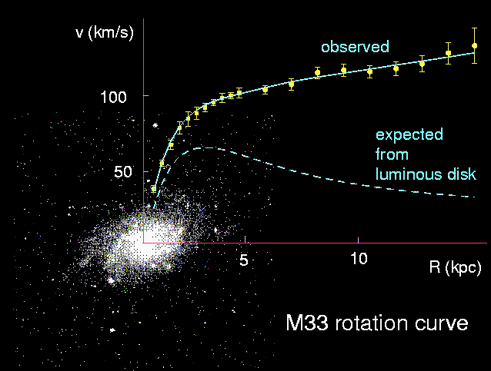
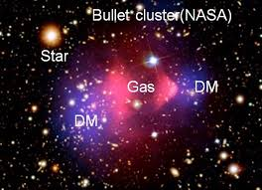
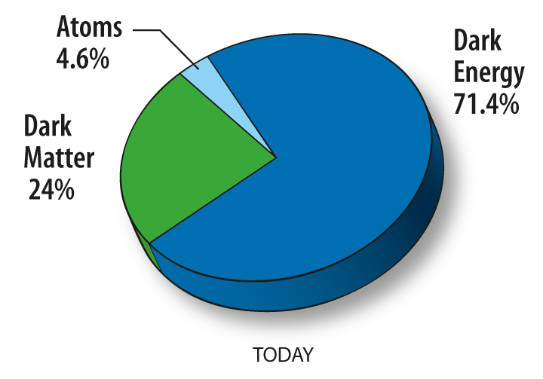
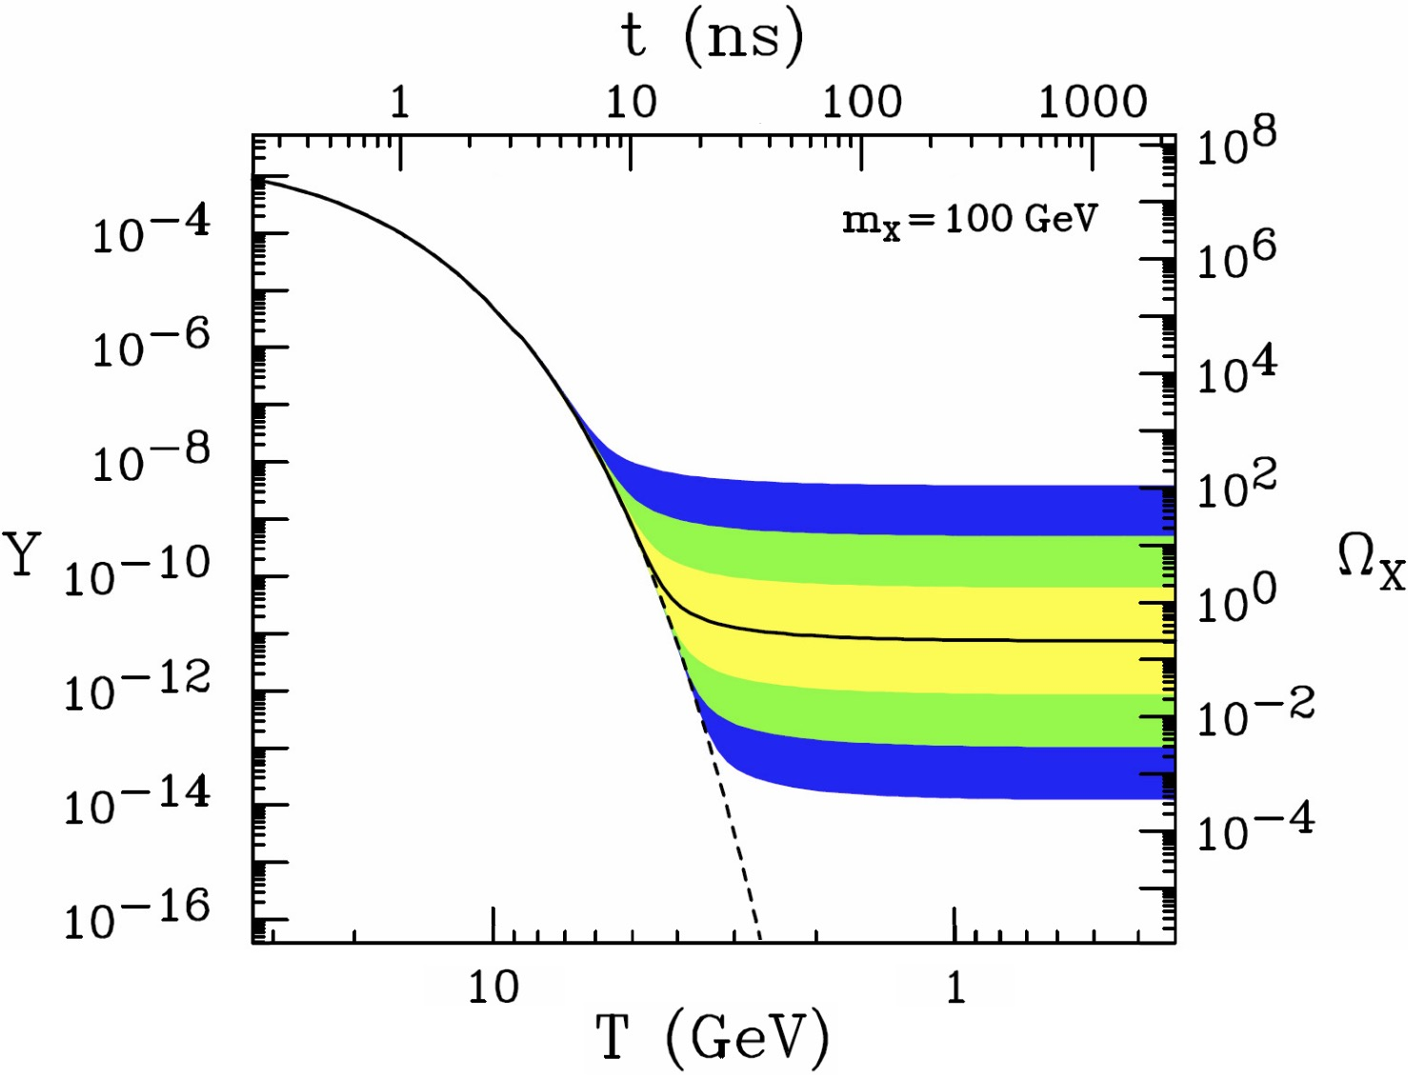
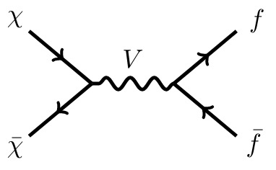
1. WIMPs and Variants from Data and Theory
WIMP
Miracle
Notes:
暗物质的存在得到了大量天文和宇宙学实验的支持。暗物质是宇宙中物质的重要组成部分。目前我们对暗物质的了解主要是来自于它的引力效应，但正像对普通物质的研究，对暗物质的微观性质的研究一直是科学界关注的前沿。在众多暗物质模型中，WIMP是被研究最多的一类，主要是它完美结合了宇宙学大爆炸的图像和粒子物理模型。如果暗物质粒子质量在电弱能标，和已知粒子的相互作用强度在弱相互作用量级，我们便可以自然的得到正确的残留密度。而这样的新粒子广泛存在于新物理模型中。

Slide 4
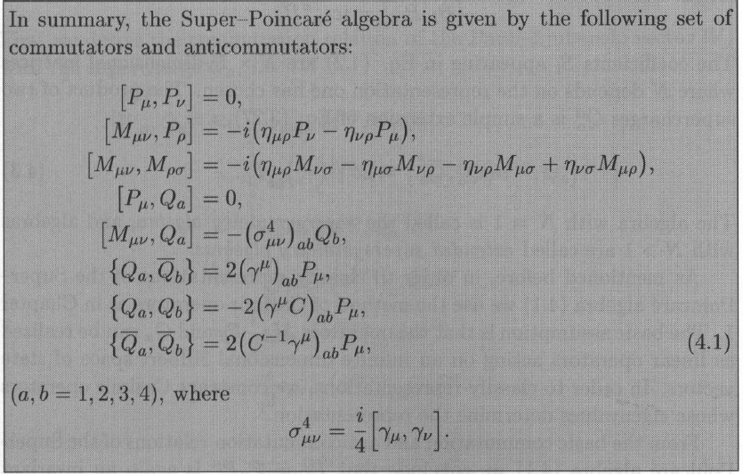
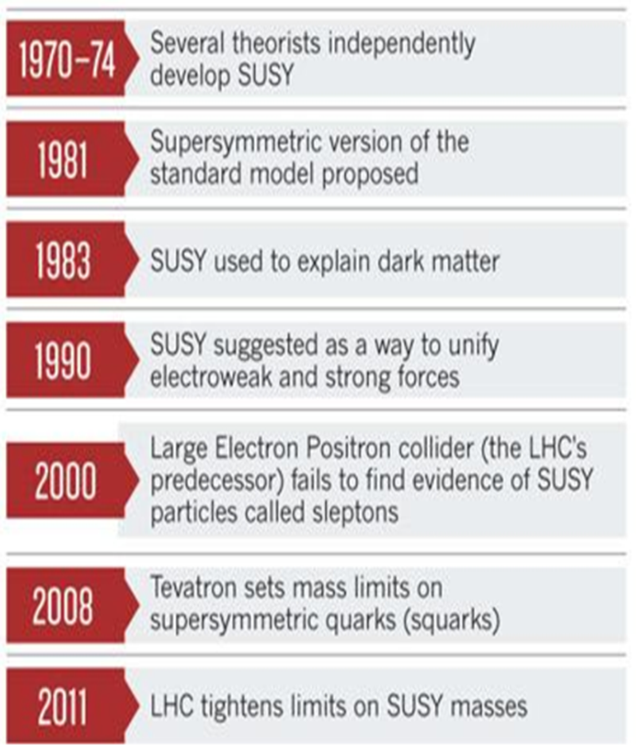
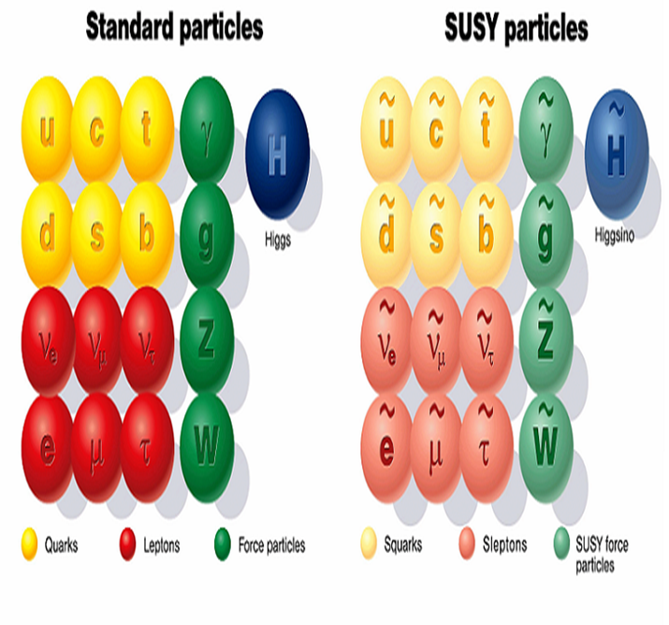
1. WIMPs and Variants from Data and Theory
SUperSYmmetry
时空对称性最大扩充！
费米和玻色子对称性！
Notes:
其中一个最具代表性的新物理模型就是超对称。超对称建立之初是为了解决时空对称性和内部对称性的统一问题。再后来它的唯象学研究中，人们发现它既可以解决higgs质量的自然性问题，也可以提供暗物质候选者，还能够实现大统一，因而得到了大量研究。

Slide 5
1. WIMPs and Variants from Data and Theory
Bino-like
Wino-like
Higgsino-like
Mixed
Notes:
在R宇称守恒的最小超对称模型中，最轻的neutralino可以作为暗物质粒子，根据其成分可以有bino-like，wino-like，higgsino-like，以及混合型粒子。

Slide 6
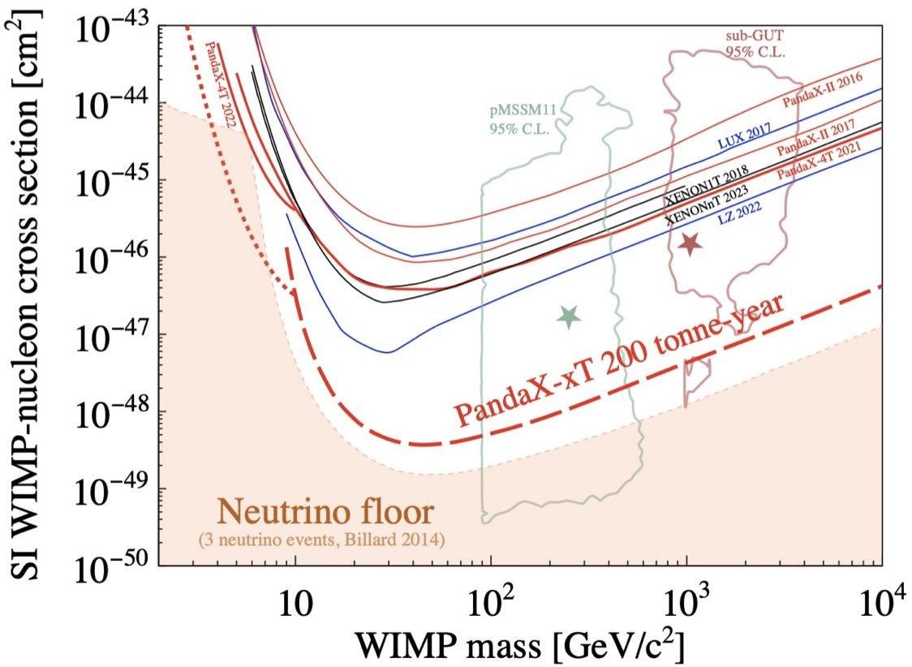
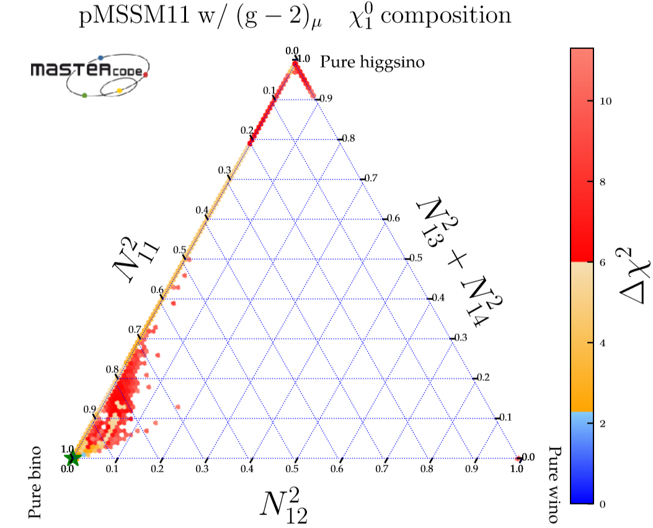
1. WIMPs and Variants from Data and Theory
PandaX collaboration, 2402.03596
Bagnaschi, etc., 1710.11091
Notes:
从目前直接探测实验看，相当一部分参数空间被排除，但仍有一部分存活。

Slide 7
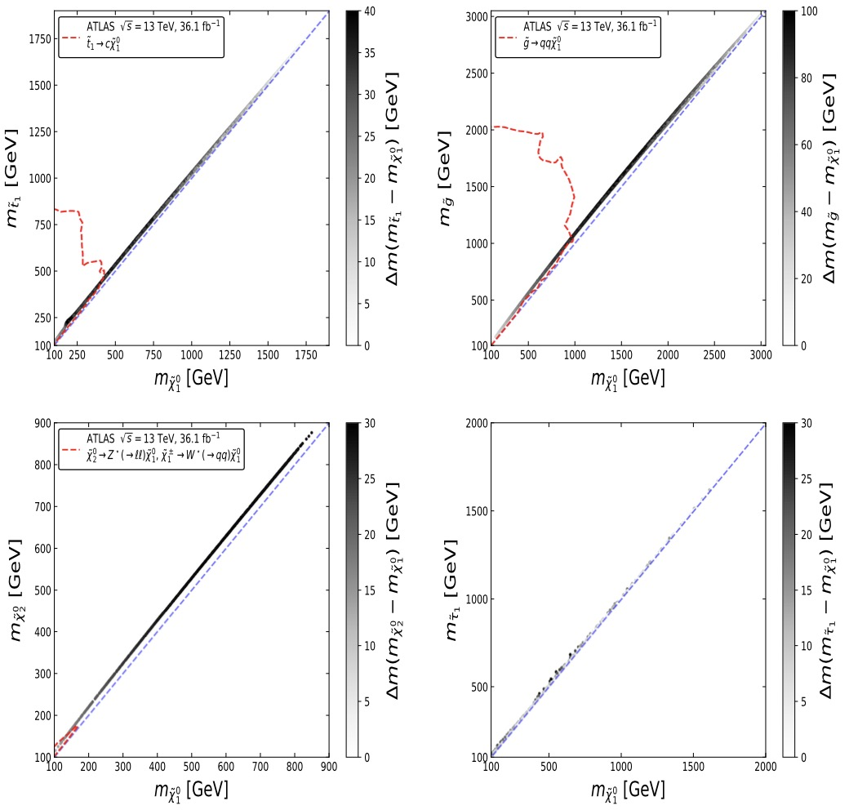
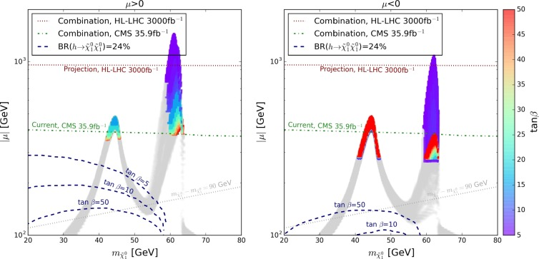
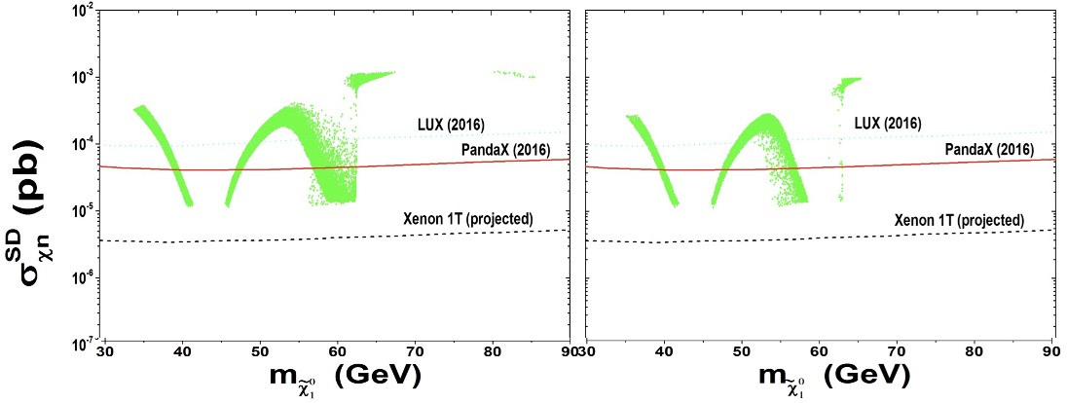
1. WIMPs and Variants from Data and Theory
I. Coannihilation
Abdughani, Wu 1908.11350
II. Resonant Annihilation
Pozzo, Zhang 1807.01476
III. Mixture with Higgsino (SI blind spot)
Abdughani, Wu, Yang 1705.09164
Notes:
即是对这三种情况，目前对撞机和自旋相关的实验数据也给出了一定的限制。

Slide 8
1. WIMPs and Variants from Data and Theory
Other Conventional WIMPs:
Model | DM particle | Spin
Next-to-MSSM | Singlino | 1/2
SUSY+seesaw | Sneutrino | 0
Inert 2HDM | Inert Higgs boson | 0
Littlest Higgs Model with T Parity | Heavy photon | 1
……. | …… | ……
Fan, Tang, Tsai, WU, 2204.03693
WU, Yang, Zhang, 1607.06355

Slide 9
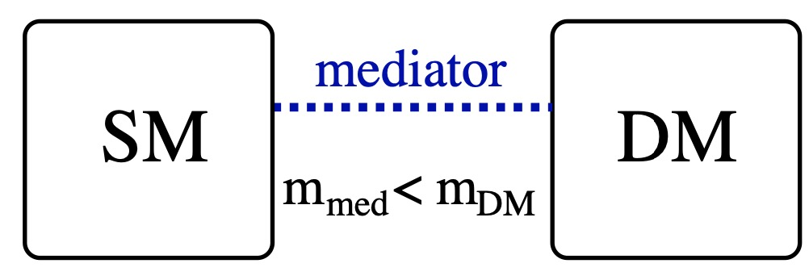
1. WIMPs and Variants from Data and Theory
Relic production
Detections
1
Lessons from classical WIMPs:
Mediators
SM particles
2
Secluded WIMPs/WIMPless
Pospelov, Ritz, Voloshin, 0711.4866
Feng, Kumar, 0803.4196
Light Mediator
indirect detection, e.g. gamma rays
Notes:
In order to avoid the existing constraints, we can learn at least two lessons from

Slide 10
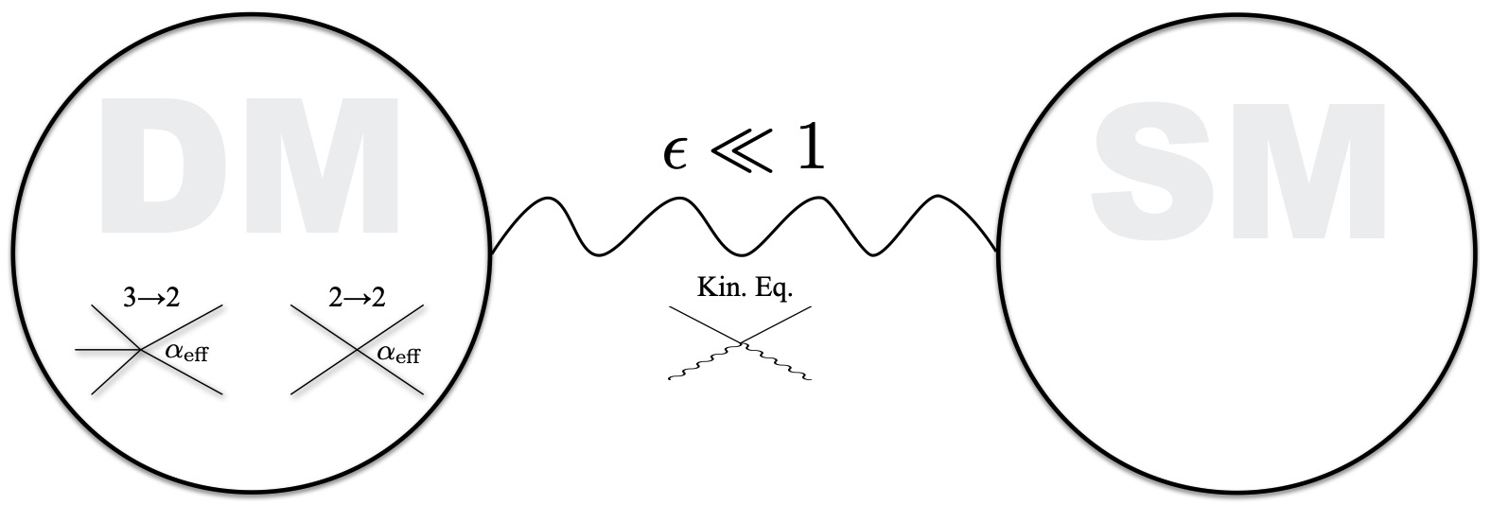
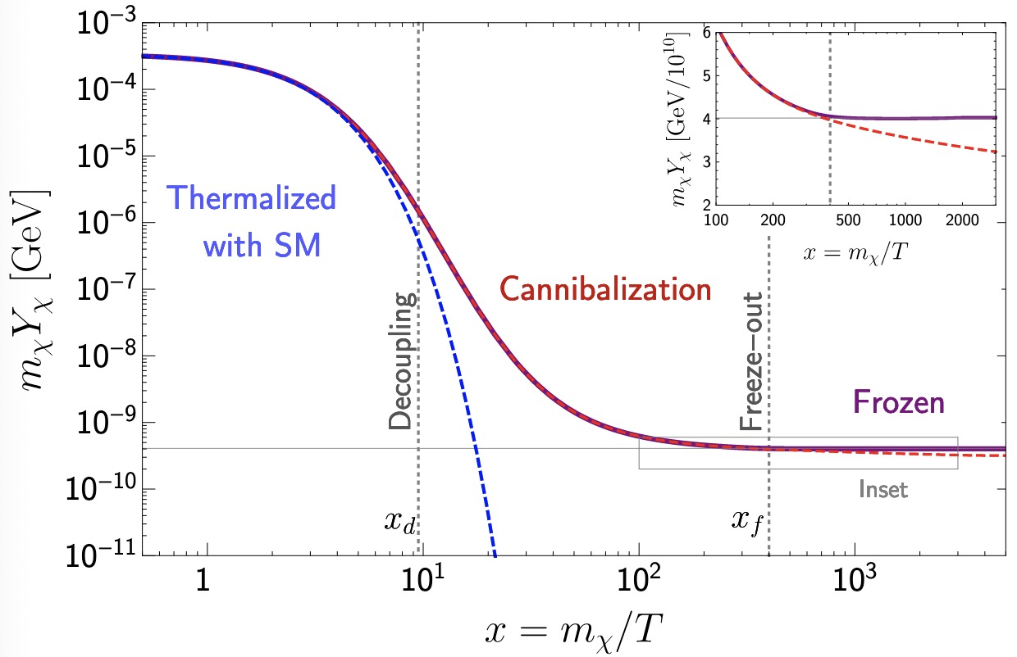
1. WIMPs and Variants from Data and Theory
From EW scale to sub-GeV Thermal DM
Relic is set by processes that change 𝝌 number
Relic is set by elastic scattering
Strongly Interacting MPs
ELastically DEcoupling Relic
Notes:
随着实验的推进，大家对sub-gev热产生暗物质研究越来越多，在产生机制方面出现了一些“新”的想法，例如：forbidden dm，simp，elder等。对于forbidden dm，并不是新的，早在90年代的时候，Griest等人就用在wimp暗物质上，它的主要想法是利用了热效应，在宇宙早期的时候，暗物质满足boltzman分布，尾巴上的高速暗物质可以湮灭到比它重的粒子；而在随着宇宙膨胀，温度降低，特别是现在T=0，该过程禁戒。研究发现这种情况，这种情况只能发生在末态粒子比初态重5-10%的情况。对于simp暗物质，它的主要想法是：2-2的湮灭过程被压低，主导暗物质残留密度的是3-2的过程，并通过与标准模型粒子发生弹性散射转移热量，达到平衡。这样的机制自然预言了sub-gev的暗物质粒子。对于elder暗物质，本质上也是simp，但和前面的几种不同的是，前面几种是通过改变暗物质粒子数的过程确定残留密度，而elder是弹性散射先退偶，然后通过3-2的蚕食过程，暗物质freeze-out。

Slide 11
Outline
WIMPs and Variants from Data and Theory
Sub-GeV DM and Low Energy Ionization
Conclusions

Slide 12
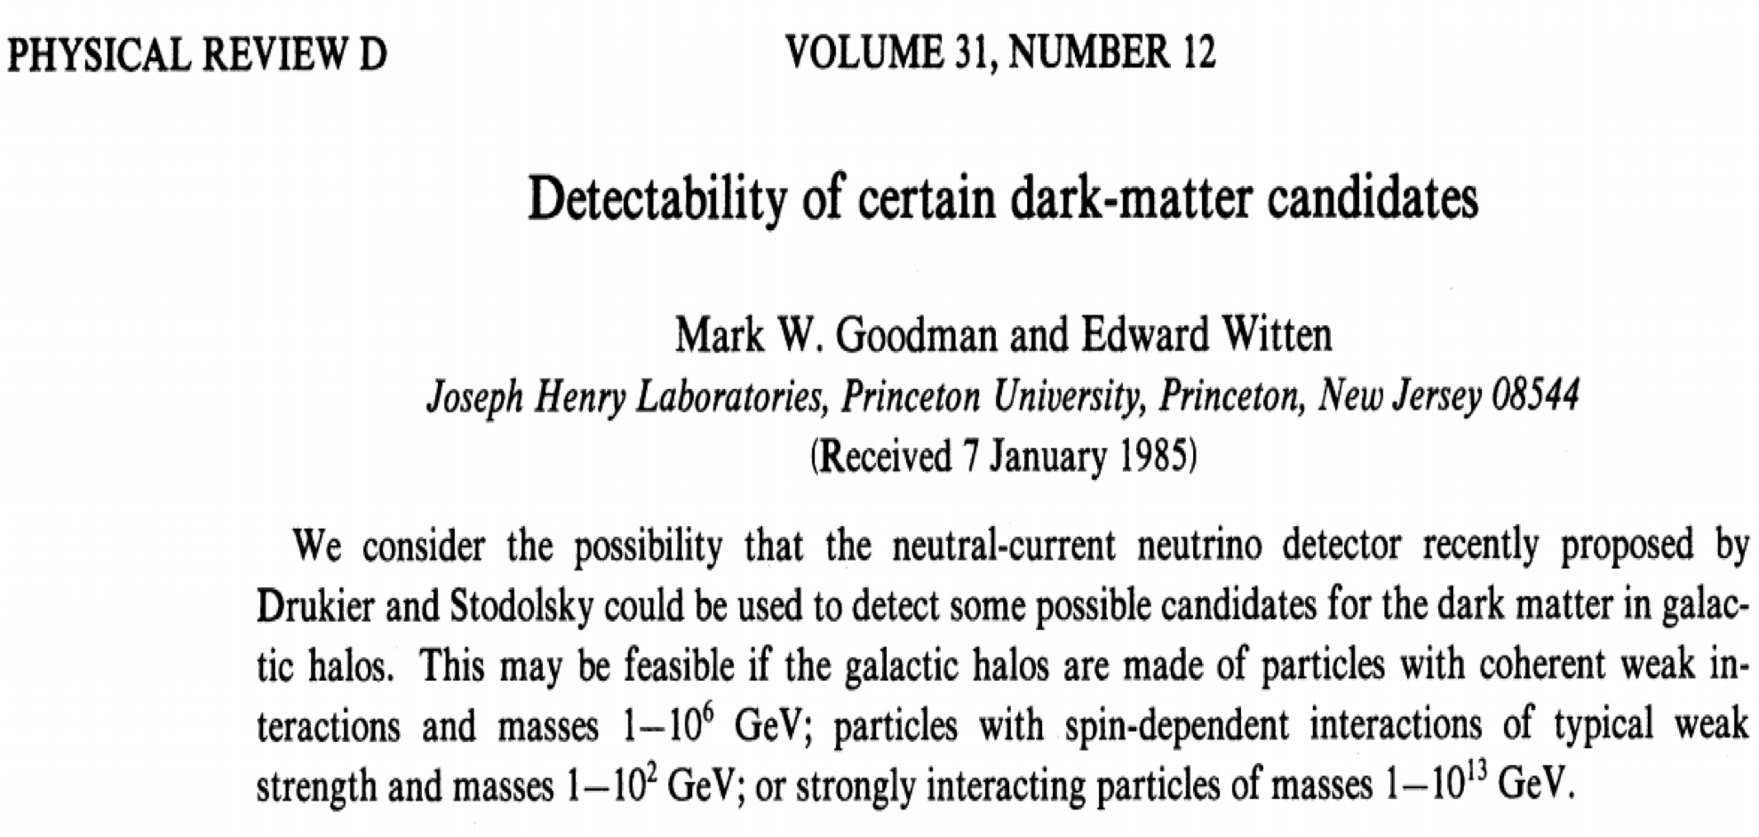
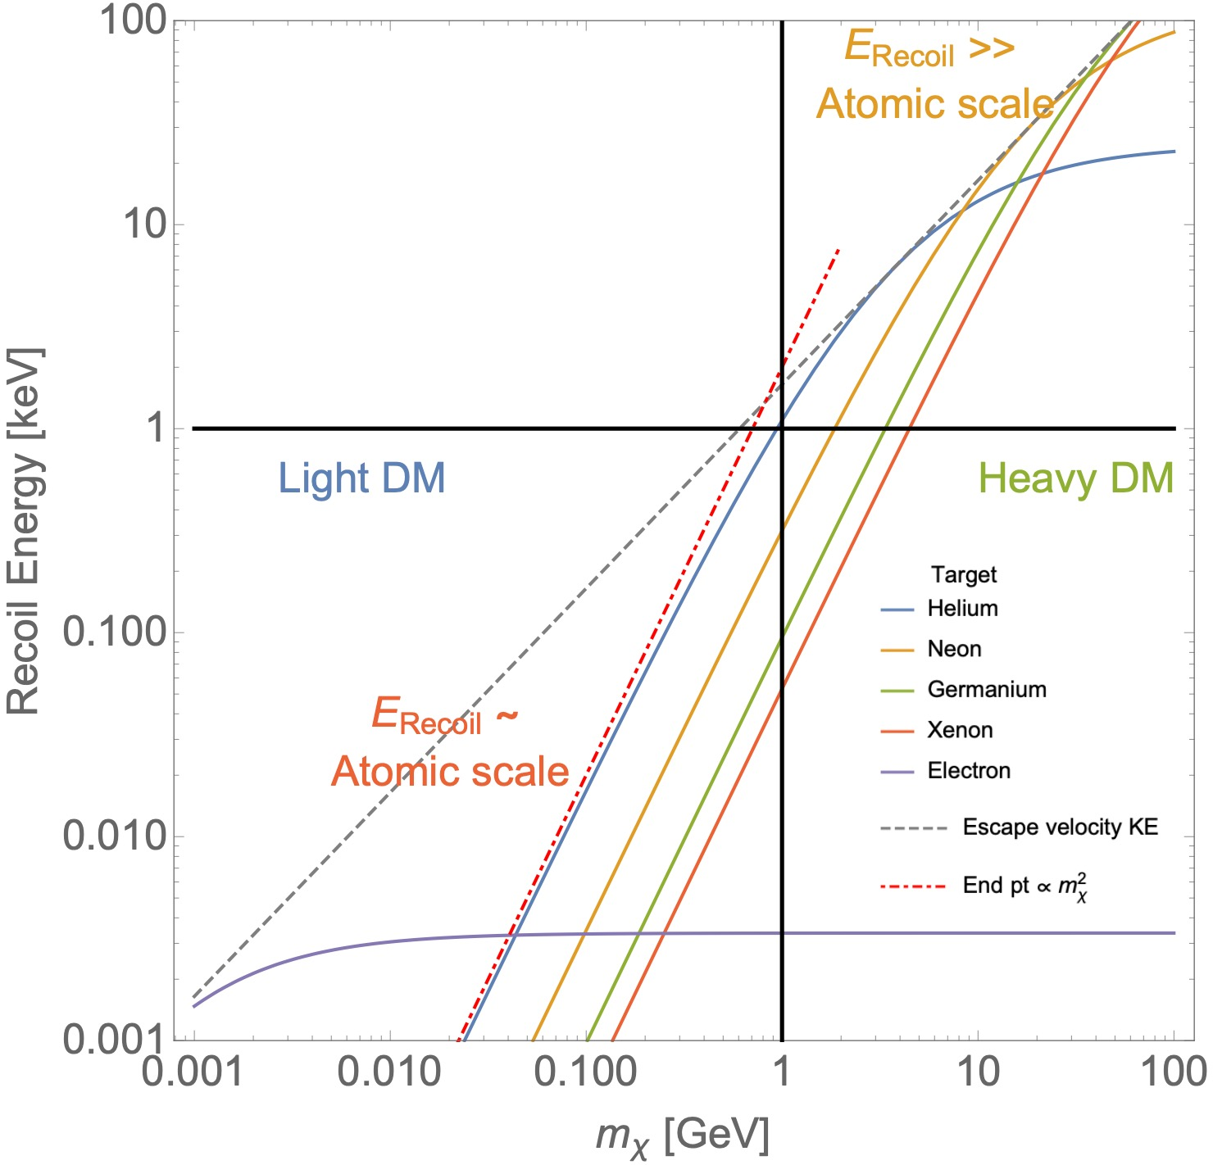
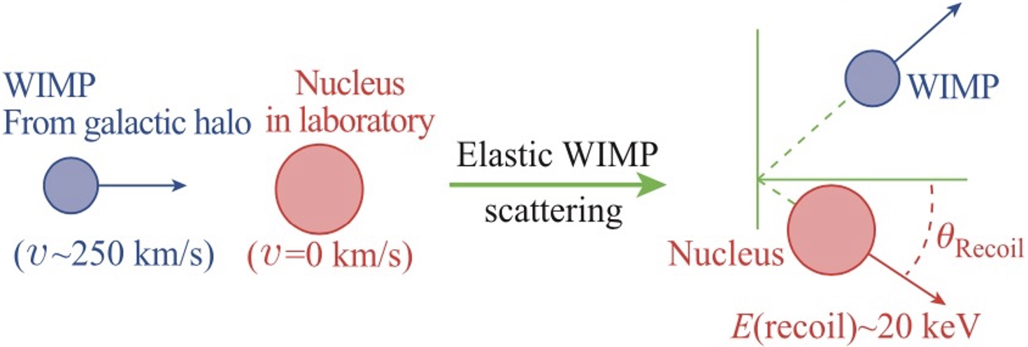
2. Sub-GeV DM and Low Energy Ionization
Nucleus recoil of sub-GeV DM is usually below the threshold of Detector
e.g. threshold of nucleus recoil for Xenon experiment : ~ keV

Slide 13
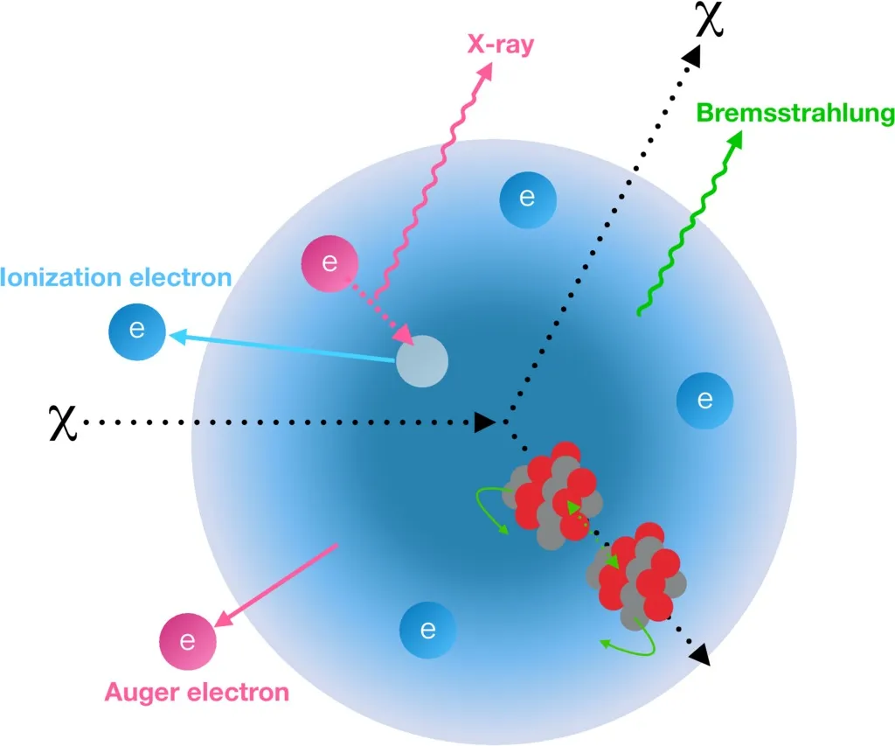
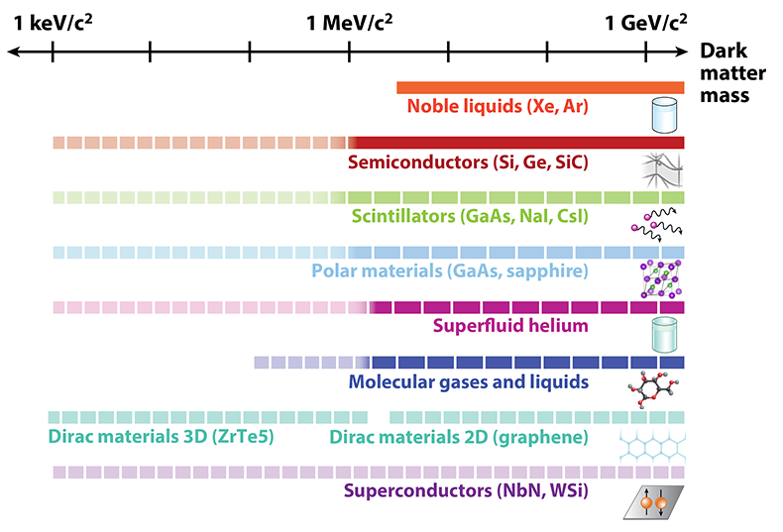
2. Sub-GeV DM and Low Energy Ionization
1. Boosted Dark Matter
2. Low Energy Ionization
V ~ 10⁻³ c
V ~ c
3. Low Threshold Detectors
Notes:
Other possibilities:

Slide 14
2. Sub-GeV DM and Low Energy Ionization
1. Boosted Dark Matter
2. Low Energy Ionization
V ~ 10⁻³ c
V ~ c
3. Low Threshold Detectors
Notes:
Other possibilities:

Slide 15
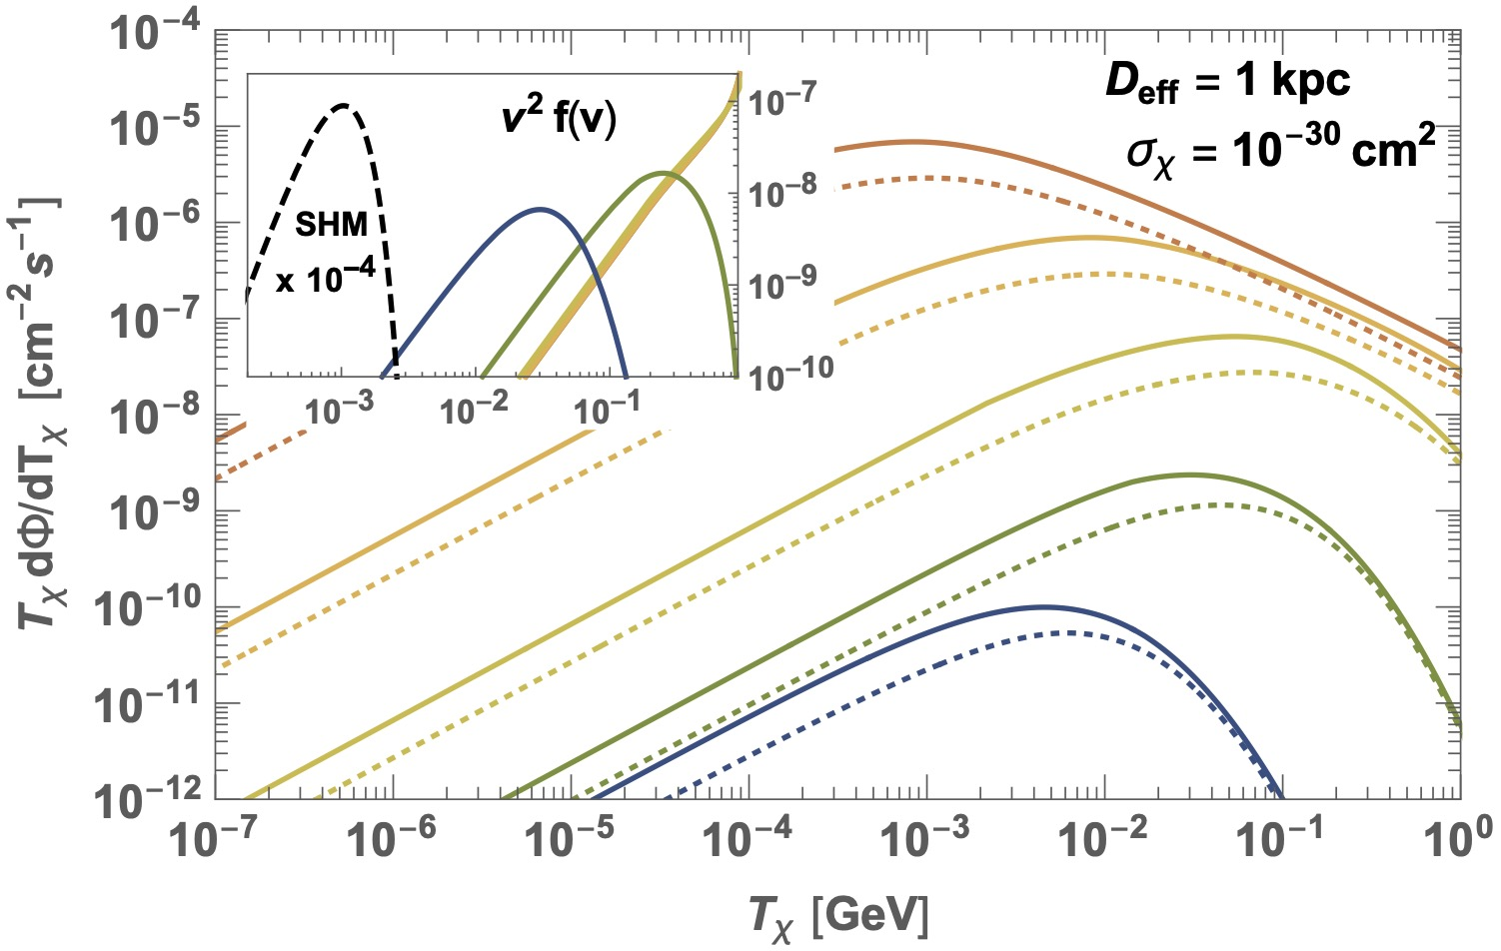
2. Sub-GeV DM and Low Energy Ionization
1. Boosted DM
Cosmic ray DM
Bringmann, Pospelov, 1810.10543
Notes:
Other possibilities:

Slide 16
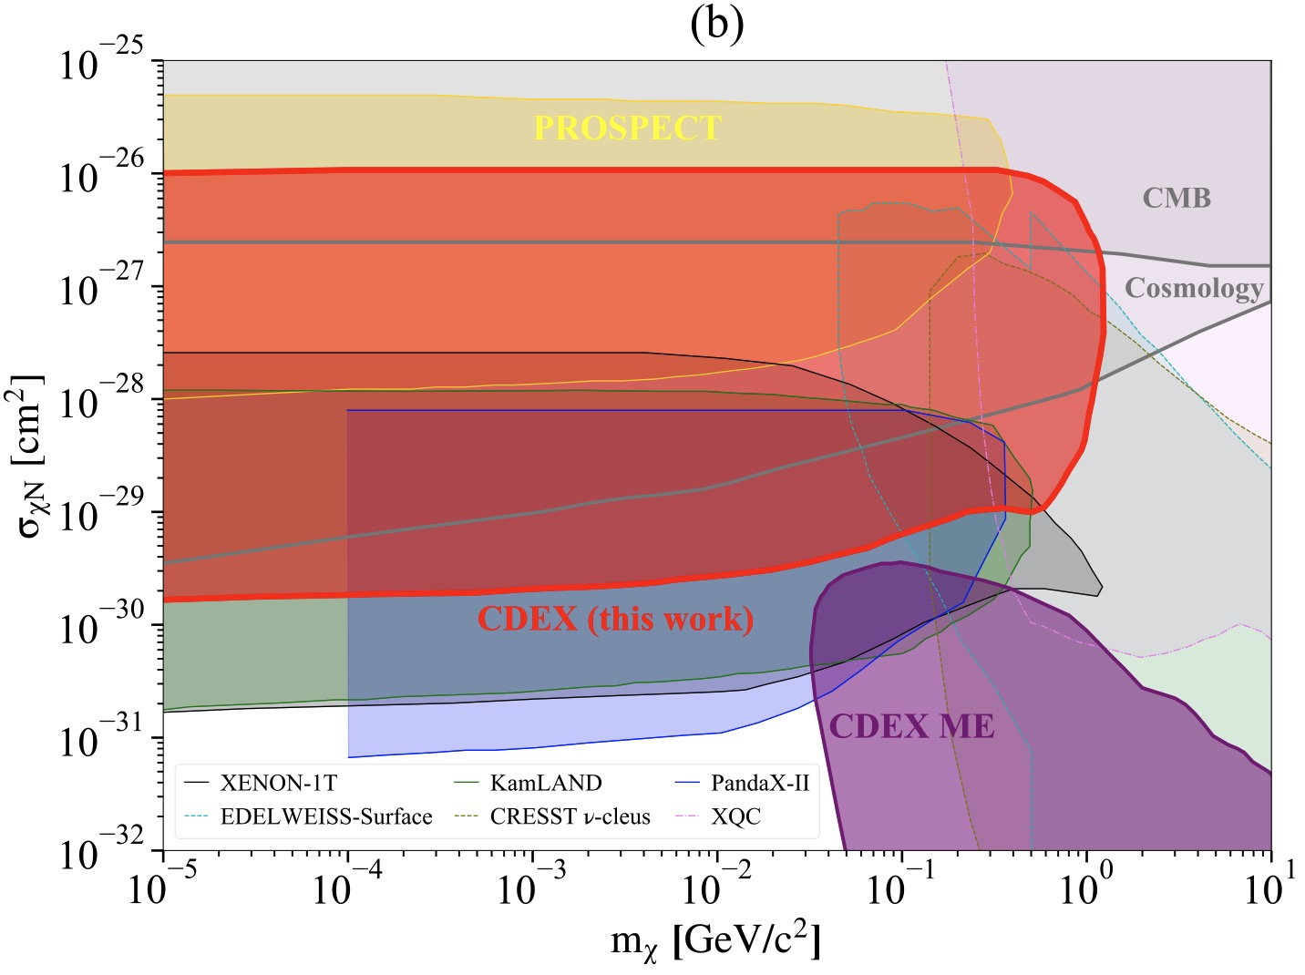
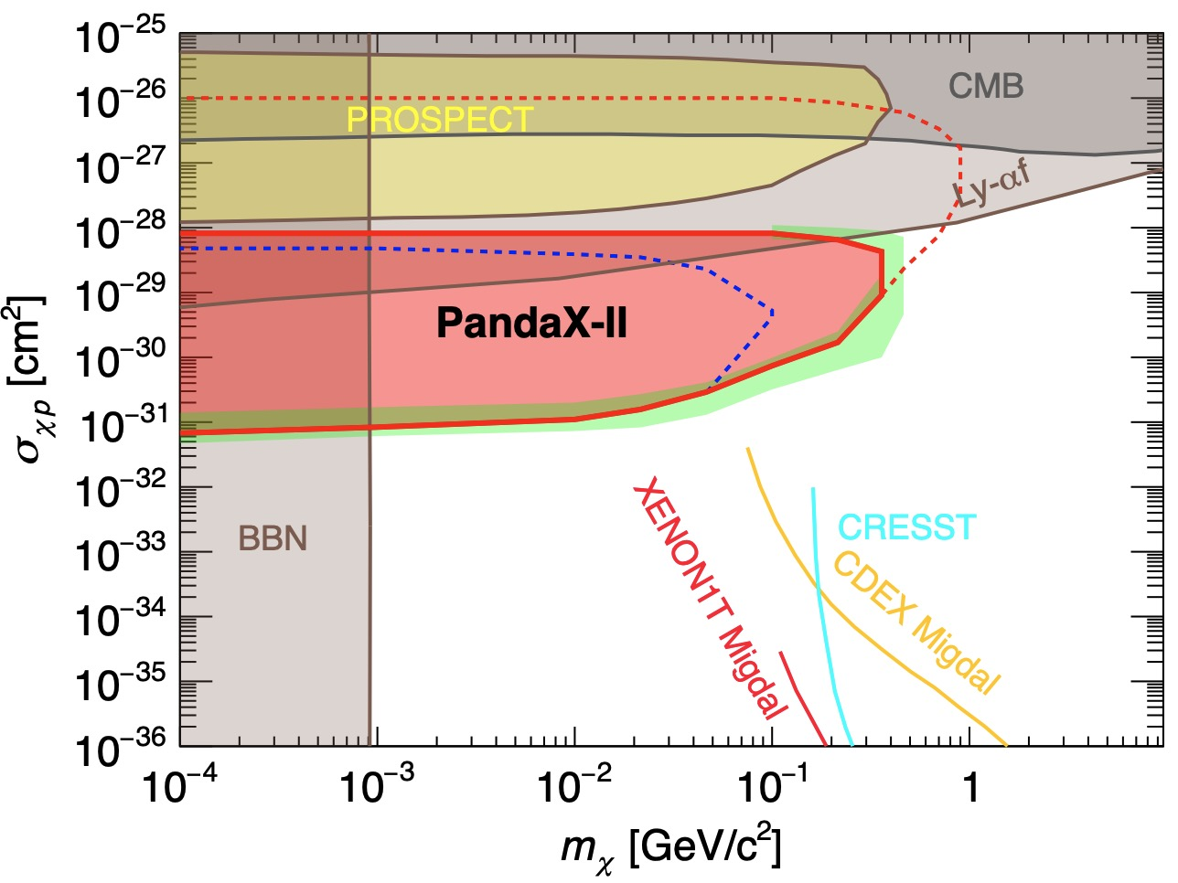
2. Sub-GeV DM and Low Energy Ionization
1. Boosted DM
CDEX, 2201.01704
PandaX, 2112.08957
1810.07705, 1810.10543, 1912.09904, 2005.09480, 2006.12767, 2009.00353, …
Notes:
Other possibilities:

Slide 17
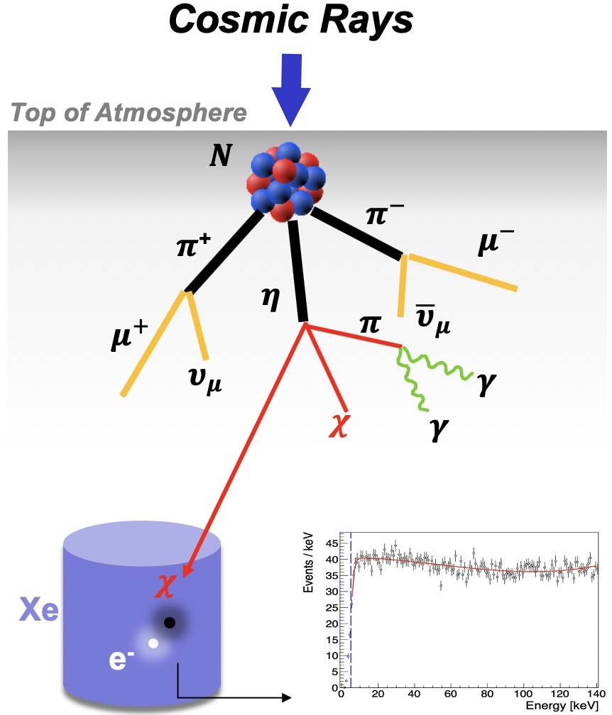
2. Sub-GeV DM and Low Energy Ionization
1. Boosted DM
Atmospheric DM
p+N$→$Mesons$→$DM
p+N $→$ P+N +DM
p+N $→$ DM
1905.05776, 2006.11837, 2012.09751, 2211.11469, 2212.02286, 2301.03010, …
Notes:
Other possibilities:

Slide 18
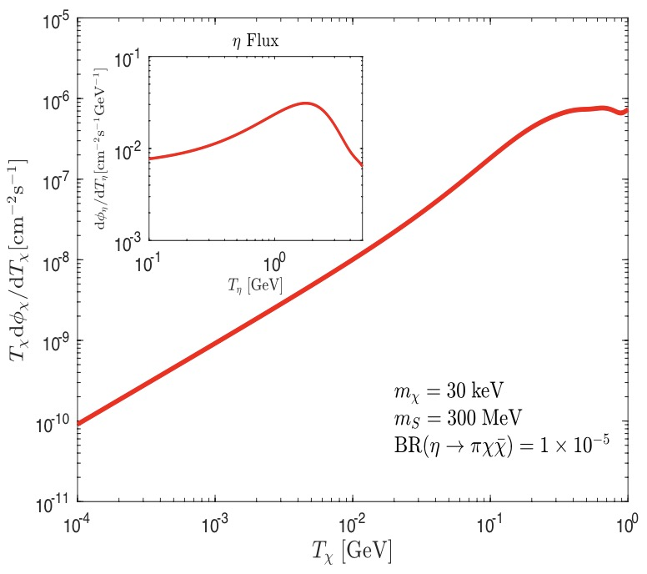
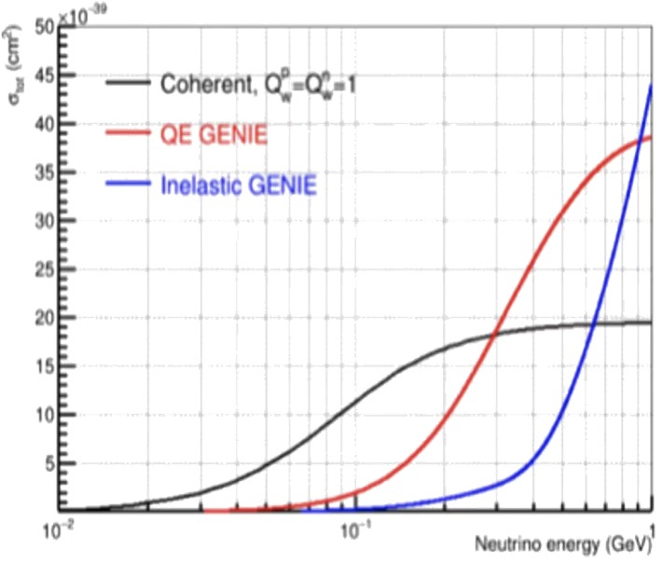
2. Sub-GeV DM and Low Energy Ionization
1. Boosted DM
$$pN→η→πS(→χ\overline{χ})$$
Wang, Su, Wu, Yang, Zhu, 2006.11837
Notes:
Other possibilities:

Slide 19
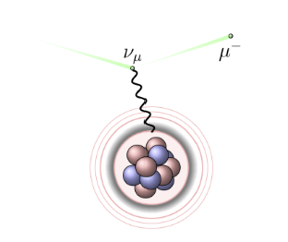
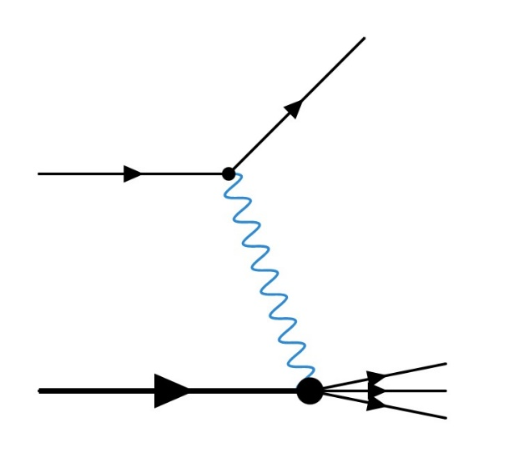
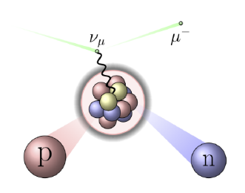
2. Sub-GeV DM and Low Energy Ionization
1. Boosted DM
Su, Wu, Zhou, Zhu, 2212.02286
DM-nucleus ES
DM-nucleus QES
DM-nucleus DIS
residual nucleus
Notes:
Other possibilities:

Slide 20
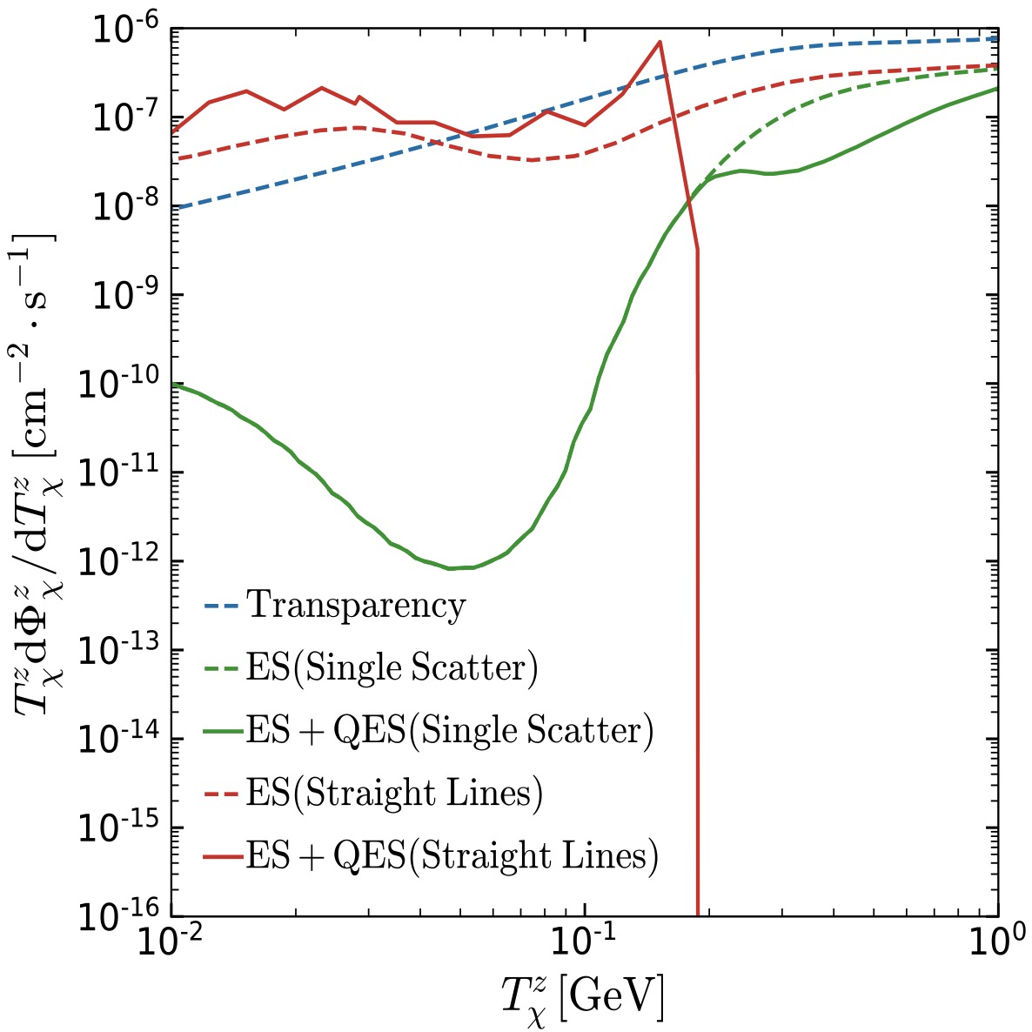
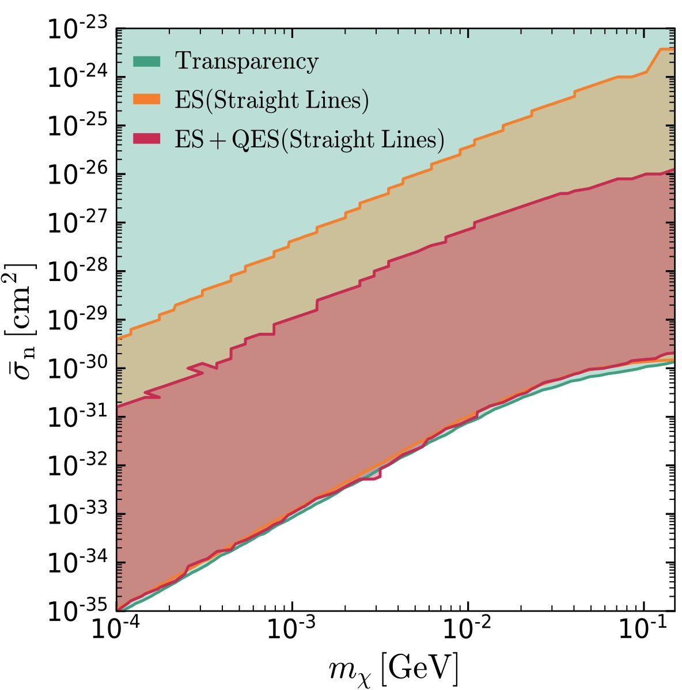
2. Sub-GeV DM and Low Energy Ionization
1. Boosted DM
Attenuation Enhanced by QES
Su, Wu, Zhou, Zhu, 2212.02286
Too large
Too small
Notes:
Other possibilities:

Slide 21
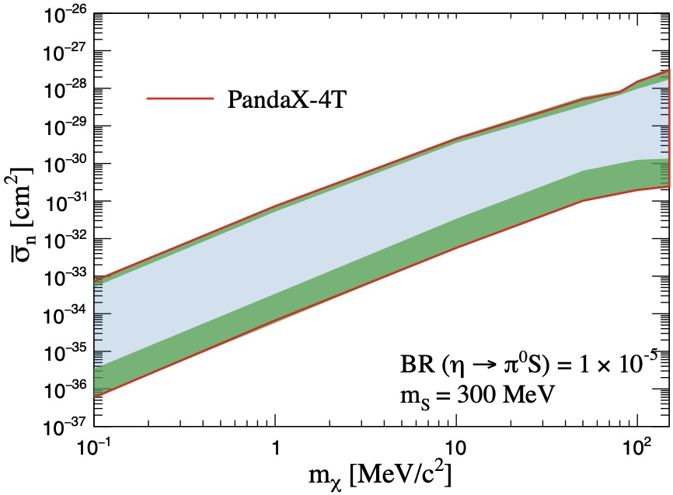
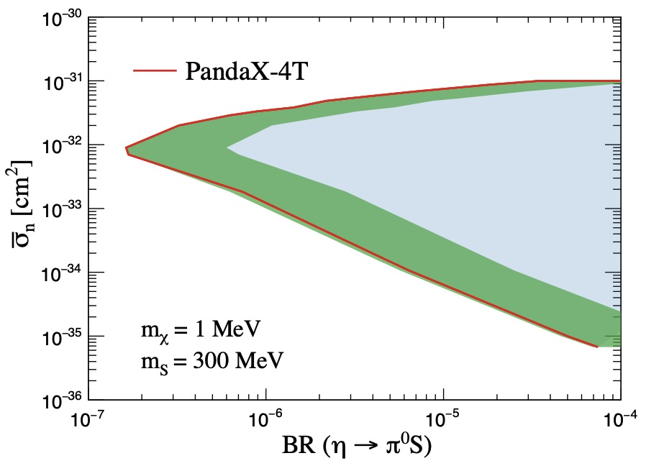
2. Sub-GeV DM and Low Energy Ionization
1. Boosted DM
PandaX-4T, 2301.03010
BES-III analysis is on-going as well
Notes:
Other possibilities:

Slide 22
2. Sub-GeV DM and Low Energy Ionization
1. Boosted Dark Matter
2. Low Energy Ionization
V ~ 10⁻³ c
V ~ c
3. Low Threshold Detectors
Notes:
Other possibilities:

Slide 23
2. Sub-GeV DM and Low Energy Ionization
2. Low Energy Ionization
Ionization signal provides a promising way to detect sub-GeV DM
e.g. threshold of electron recoil for Xenon experiment : ~ 100 eV

Slide 24
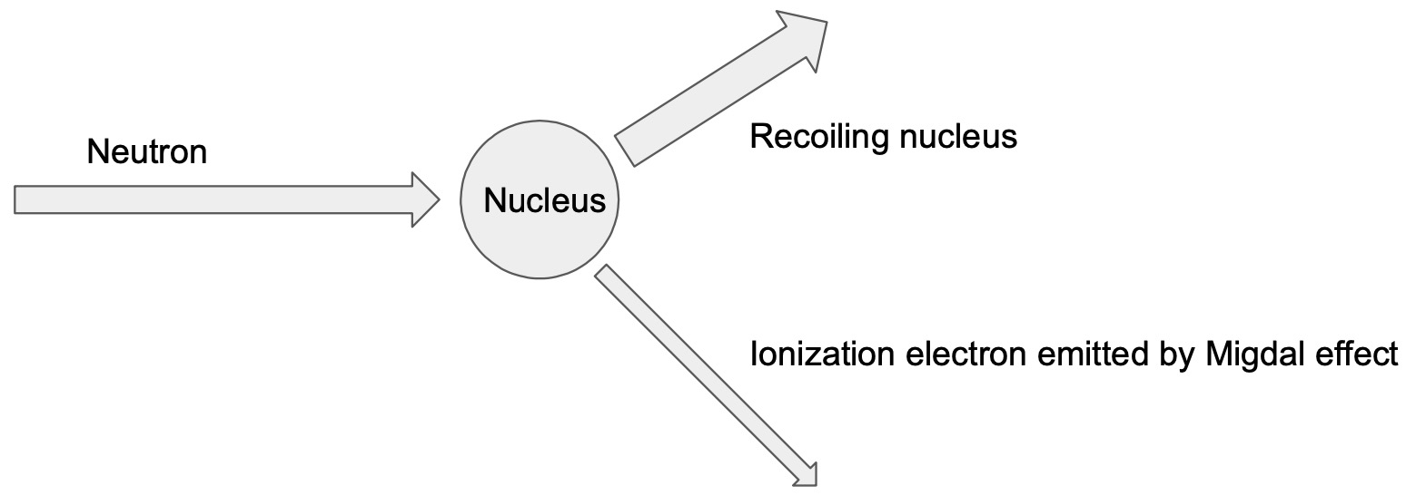
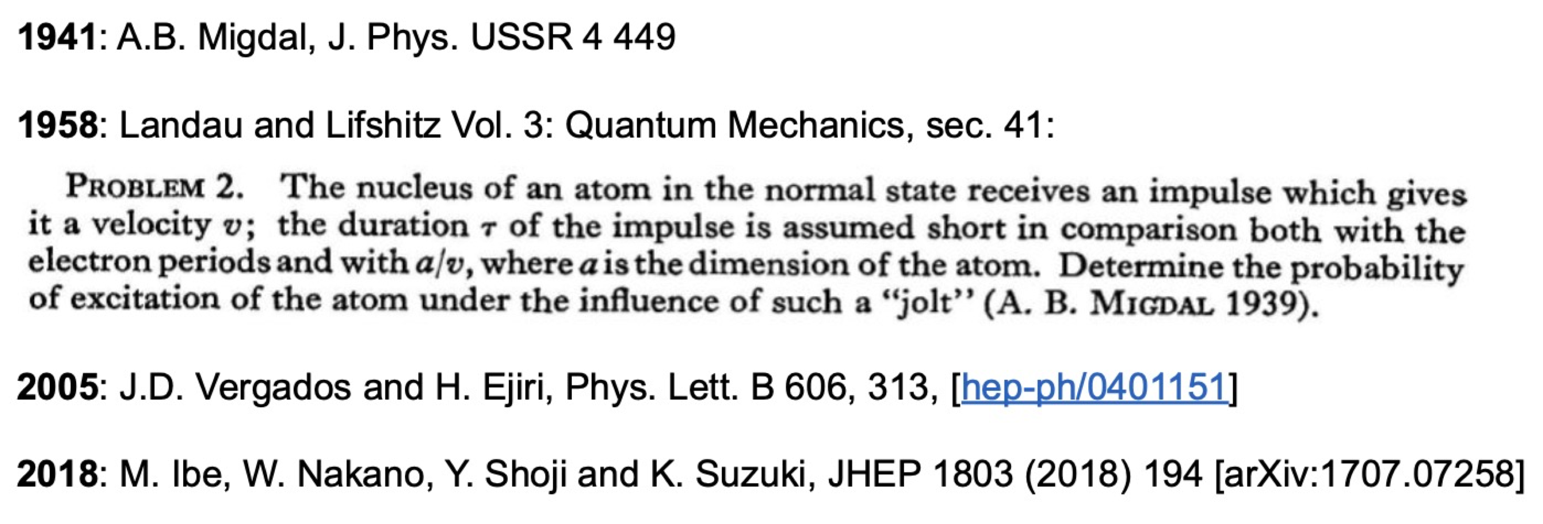
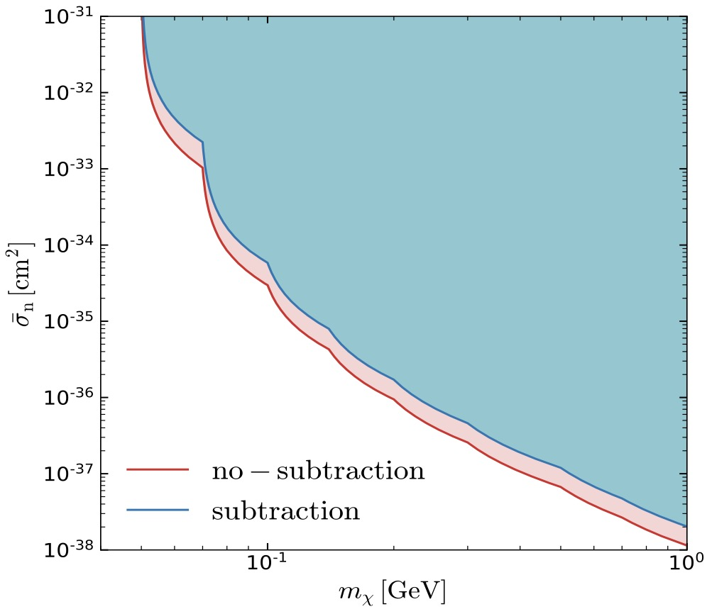
2. Sub-GeV DM and Low Energy Ionization
2. Low Energy Ionization
Signal: Two tracks from the same vertex
DM
short
No quenching!
long
Flambaum, Su, Wu, Zhu2012.09751

Slide 25
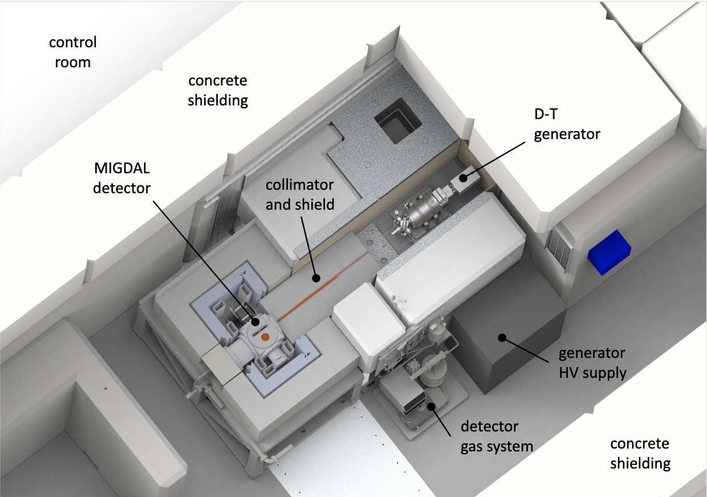
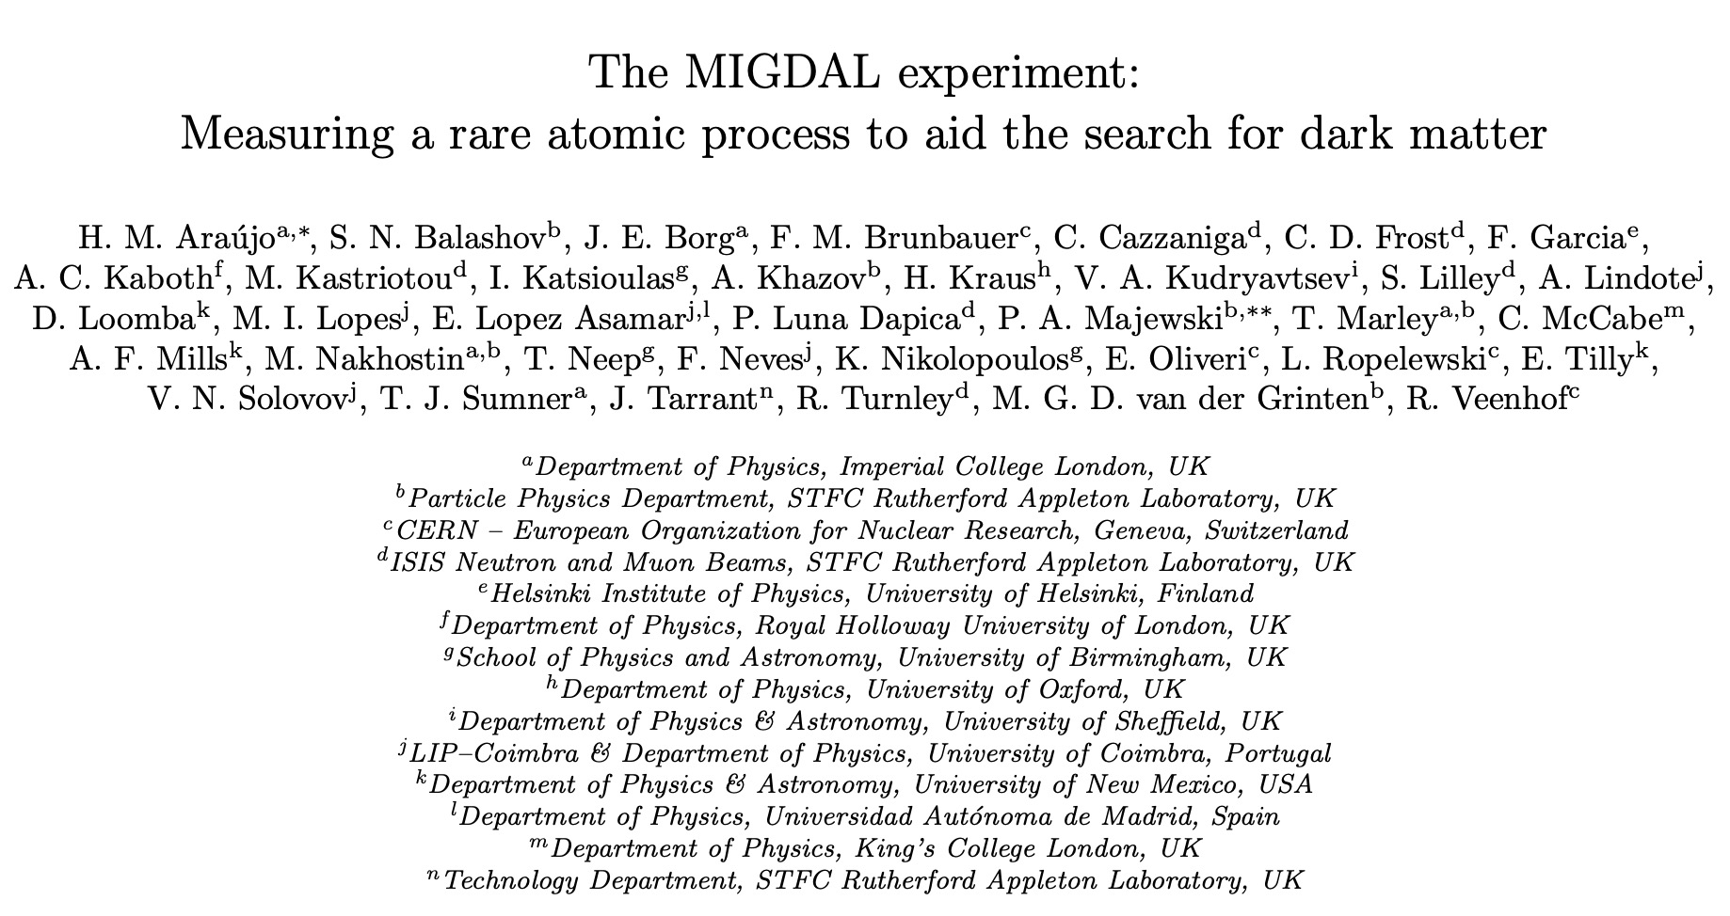
2. Sub-GeV DM and Low Energy Ionization
2. Low Energy Ionization
MIGAL collaboration, 2207.08284
Experiments are on-going!

Slide 26
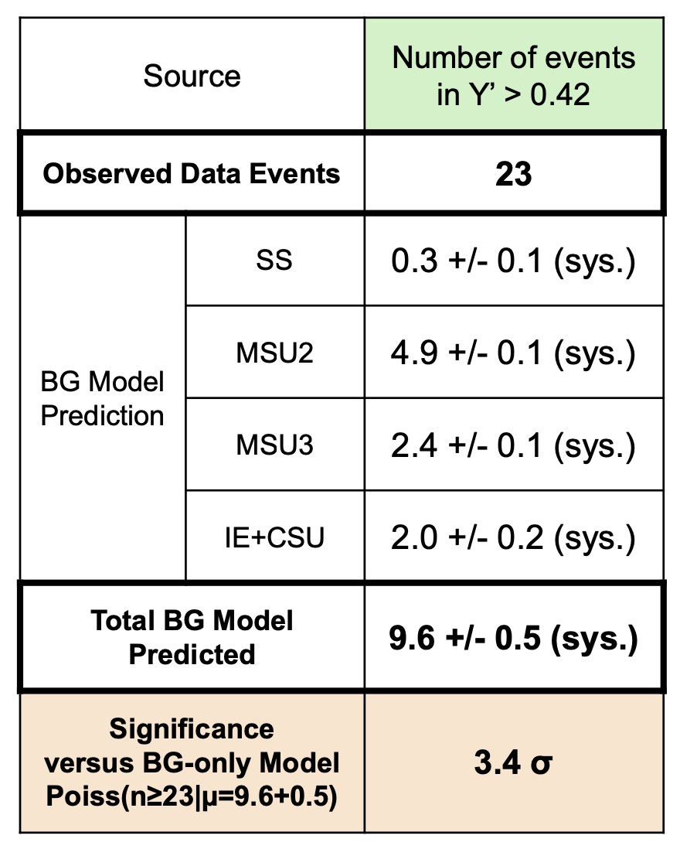
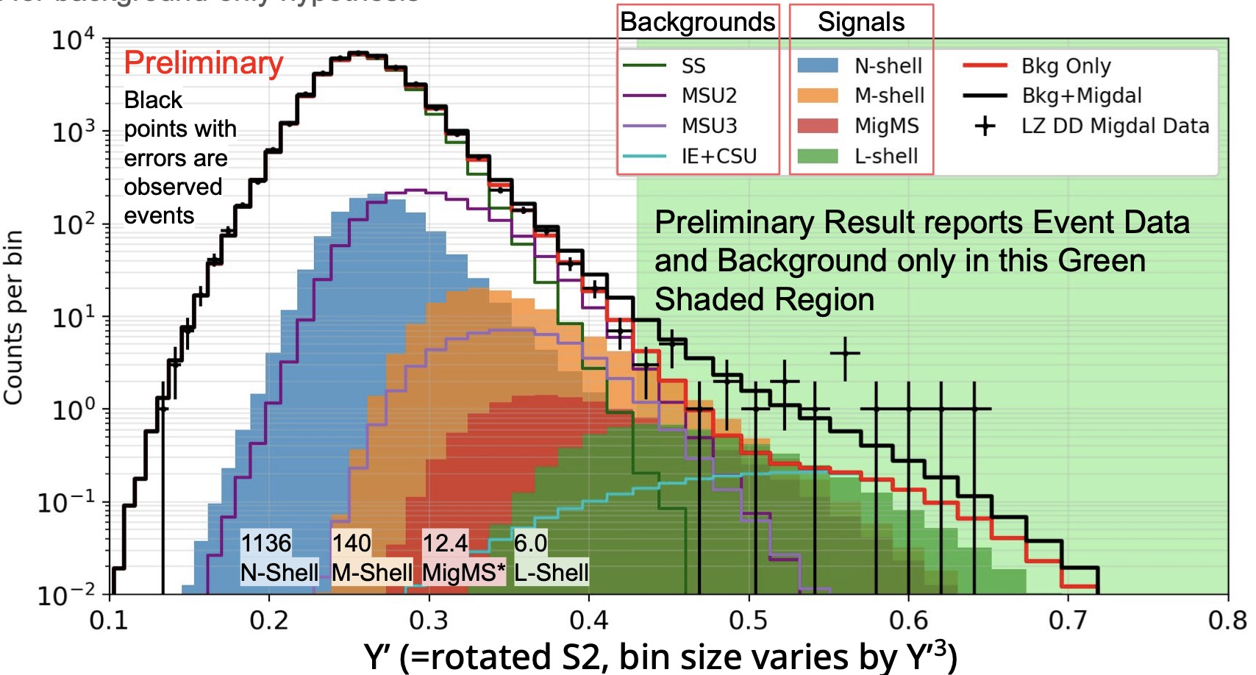
2. Sub-GeV DM and Low Energy Ionization
2. Low Energy Ionization
LZ IDM-2023 conference
Experiments are on-going!

Slide 27
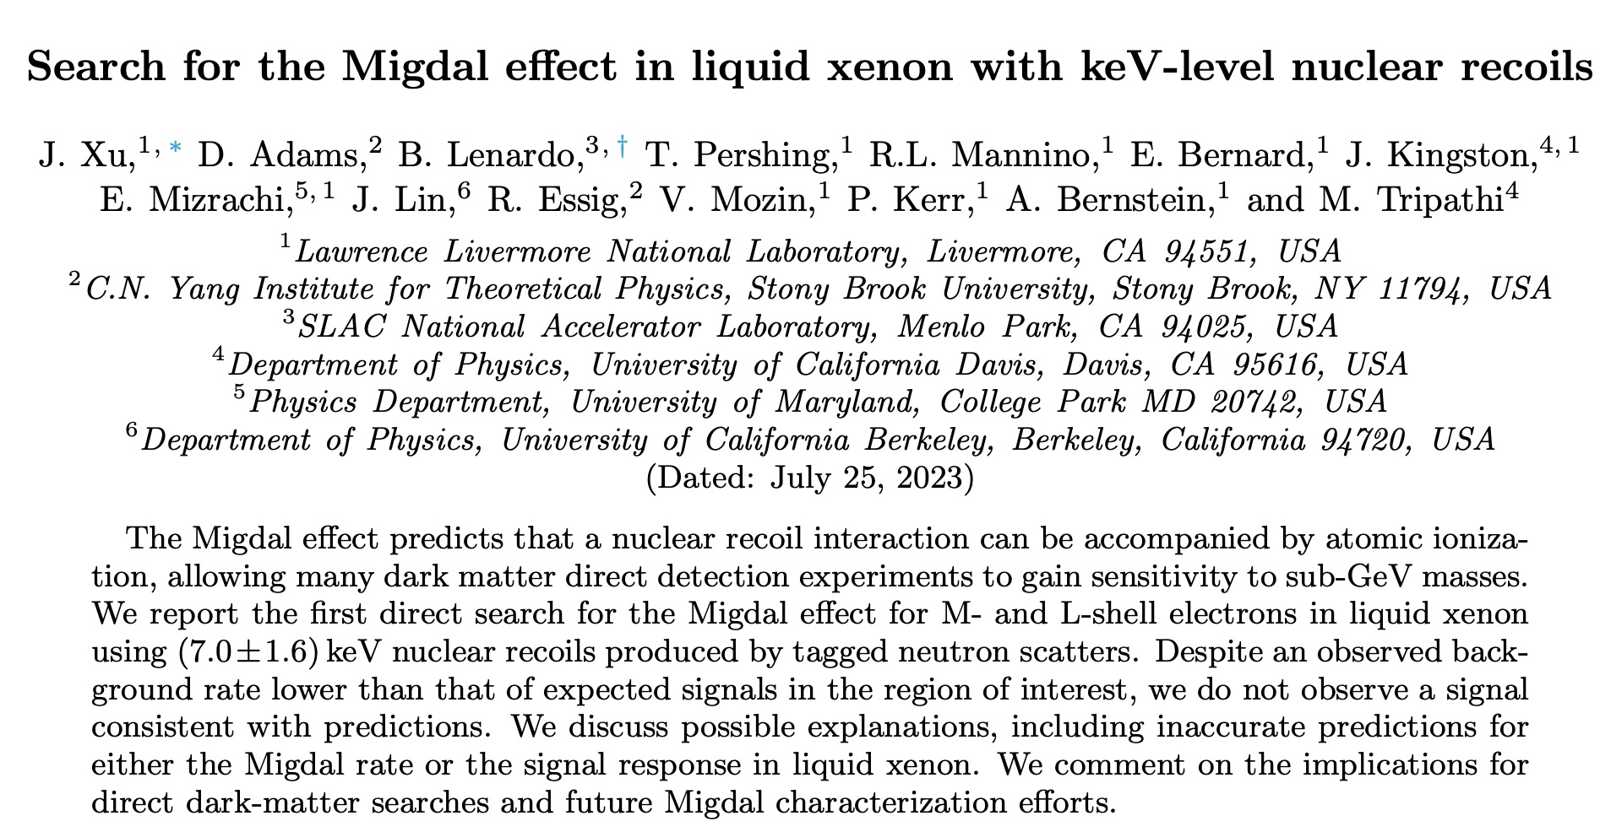
2. Sub-GeV DM and Low Energy Ionization
2. Low Energy Ionization
2307.12952
Experiments are on-going!

Slide 28
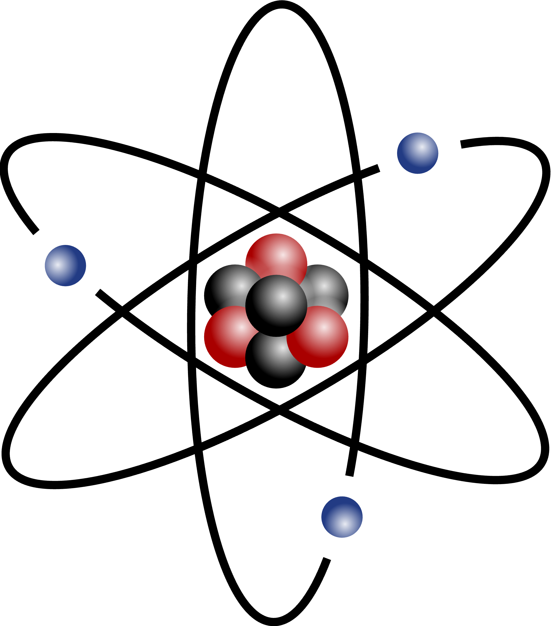
2. Sub-GeV DM and Low Energy Ionization
2. Low Energy Ionization
Ionized electron
Conduction bands
e
DM
detector
DM
Bandgap: ~ eV
DM
DM
Valence bands
Kinematics limits:
We can detect lighter DM in semi-conductor than the noble liquid experiment

Slide 29
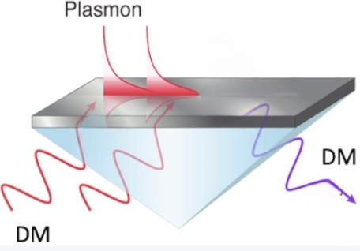
2. Sub-GeV DM and Low Energy Ionization
2. Low Energy Ionization
Plasmon Effect: a collective excitation of valence electrons in a semi-conductor
Dielectric Function:
Electronic Structure
(polarization)
Dissipation Processes
(absorption and scattering)

Slide 30
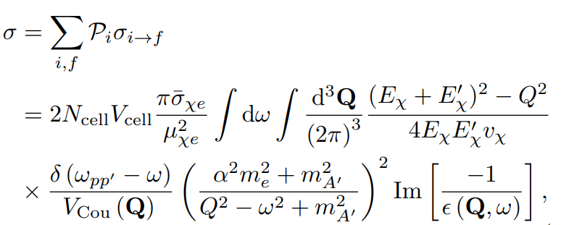
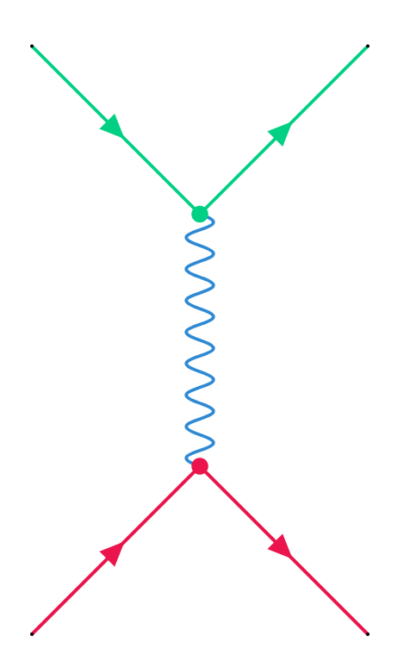
2. Sub-GeV DM and Low Energy Ionization
thermal distribution of initial target state
Density Functional Theory
Energy Loss Function (ELF)

Slide 31
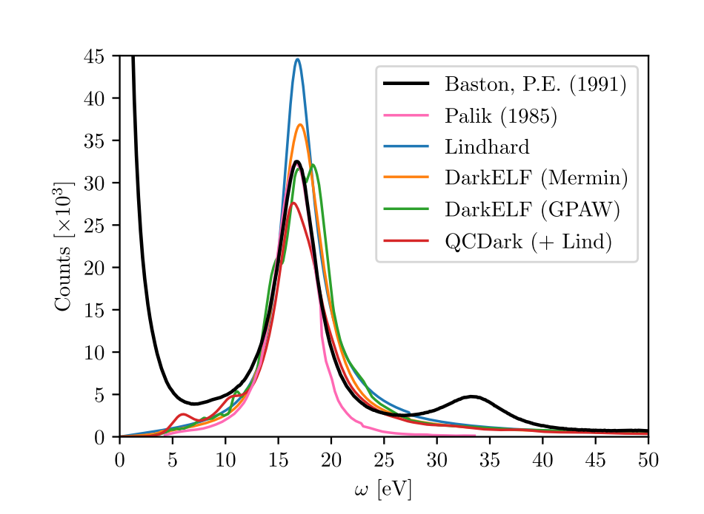
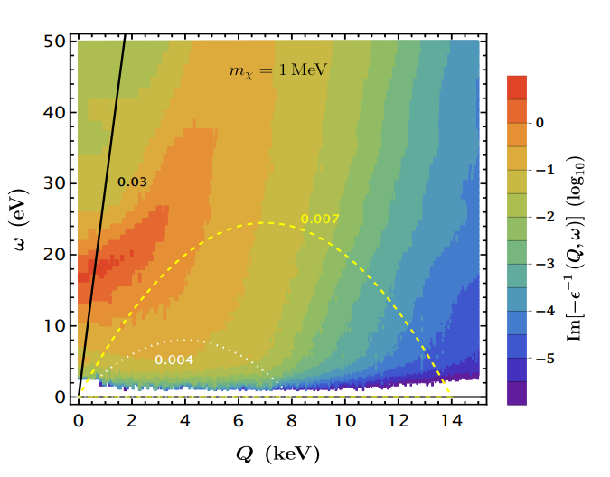
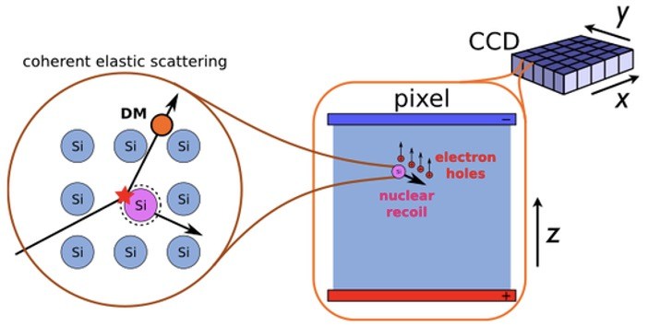
2. Sub-GeV DM and Low Energy Ionization
Essig, Plestid, Singal, 2403.00123
Liang, Su, WU, Zhu, 2401.11971
The data of EELS
DM velocity
Scattering with electron gas
Plasmon excitation provides a new avenue to detect the DM with high velocity

Slide 32
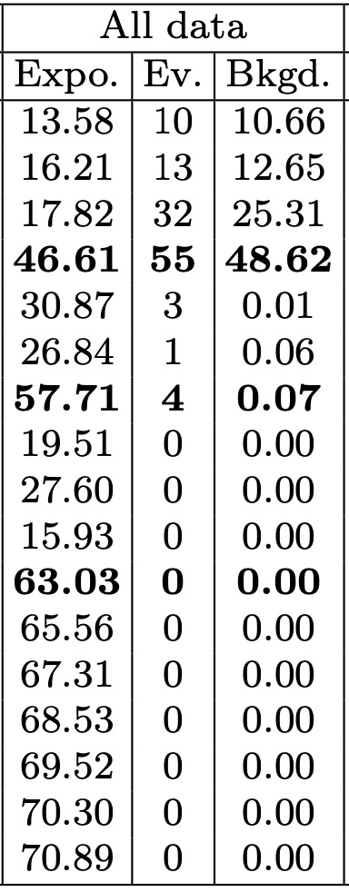
2. Sub-GeV DM and Low Energy Ionization
CRs
CRs
SENSEI @ SNOLAB
2312.13342
DM
e.g. Cosmic Ray DM
DM
Liang, Su, WU, Zhu, 2401.11971
Ionization charge:
1509.01598
Silicon: E_{gap} = 1.2eV and ε = 3.8eV.

Slide 33
2. Sub-GeV DM and Low Energy Ionization
Plasmon + DM with high velocity + massless mediator
Liang, Su, WU, Zhu, 2401.11971
Light Dark Matter | Noble Liquid Detector (large volume, high threshold) | Solid detector (small volume, low threshold)
Non-Relativistic | Migdal Effect (Inelastic Scattering) | ✔️
Relativistic | ✔️ | Plasmon Effect (Collective Excitations)

Slide 34
2. Sub-GeV DM and Low Energy Ionization
excess may corresponds to a WIMP with mass ∼2.5 GeV/c² and a WIMP-nucleon scattering cross section ∼3 × 10⁻⁴⁰ cm².

Slide 35
Outline
WIMPs and Variants from Data and Theory
Sub-GeV DM and Low Energy Ionization
Conclusions

Slide 36
Conclusions
Asymmetric
2-to-2
WIMPs
Thermal
2-to-2
WIMPless
Secluded DM
LDM
Symmetric
3-to-2
SIMPs
……
Dark Matter
decay
superwimp
thermal parent
oscillation
sterile neutrino
misalignment
axion
Non-thermal
PHB evaporation
topological deficit
cosmic rings
……
Notes:
除了刚才我们谈到的热产生暗物质外，还可以有非热产生，由于时间关系，就不再介绍了。

Slide 37
Conclusions
Wave-like
Particle-like
Macroscopic
Feng 2212.02479

Slide 38
Conclusions
Astrophysical Probes: Neutron star, Dwarf, Sun, Black Holes, ......
Cosmological Probes: Gravitational Waves, CMB, BBN, ......
Collider Probes: LHC, e⁺e⁻, gamma factory, Beam-dump, ......
Underground Probes: CDEX, PandaX, JUNO, DUNE, HyperK, ......
Quantum Probes: Cavity, Atomic clock, Interferometers, ......
Space Probes: DAMPE, AMS-02, Fermi-LAT, CSST, ......
Terrestrial Probes: LASSHO, SKA, FAST, 21CMA, PTA, ......

Slide 39
Conclusions
Multi-disciplines + Multi-messengers
A New Era in the Quest for Dark Matter
Thank you very much !

Slide 40
Back Up
Notes:
我们知道100gev在粒子物理中是一个很特殊的能标，也就是常说的电弱能标，和电弱对称破缺机制以及质量起源密切相关。在标准模型中，有higgs粒子缺乏对称性保护，会带来自然性问题。

Slide 41
Back Up

Slide 42
Back Up

Slide 43
Back Up
Dark photon portal
Higgs portal
Axion portal
QCD/QED-like theory,
Remnant from SUSY breaking,
Sector arising from an Randall-Sundrum
...
Neutrino portal

Slide 44
Back Up
Low Energy Ionization
New Particles | Noble Liquid Detector (large volume, high threshold) | Solid detector (small volume, low threshold)
Non-Relativistic, light | Migdal Effect (Inelastic Scattering)
Relativistic, light |  | Plasmon Effect (Collective Excitations)
Rouven Essig, et.al, arxiv: 2203.08297

Slide 45
Back Up
The calculation of dielectric function:
DarkELF: Including the real and imaginary parts of the dielectric function calculated using the DFT software GPAW.
Simon Knapen, Jonathan Kozaczuk, and Tongyan Lin, Phys. Rev. D 105, 015014(2021).
The Lindhard method:
The Mermin method:
The GPAW method:
Assuming homogenous material and neglecting all dissipation effects.
A generalization of the Lindhard which includes dissipation.
It relies on a first principles calculation with package GPAW.

Slide 46
2. Sub-GeV DM and Low Energy Ionization
e.g. Cosmic Ray DM
CRs
CRs
DM
DM
differential electronic excitation rate:

Slide 47
Back Up
DM-Electron scattering in semiconductor
Comparison with EELS data:
The results an incident electron beam kinetic energy of
The data of EELS
Overestimating the response
The position and height of peak is consistent, but GPAW predicts a slightly broader peak.
Underestimates
The elastic scattering between incident electrons and lattice, not electron-hole pair excitations.
Rouven Essig, et.al, arxiv: 2403.00123

Slide 48
介电函数（dielectric function）是描述材料对电磁场响应的一个复数函数，它在固体物理和材料科学中非常重要。对于硅这样的材料，介电函数的表达式可以描述电子气对电磁波的集体响应，特别是等离子体激元（plasmons）的特性。
在论文中提到的介电函数的表达式通常具有实部和虚部，可以写成如下形式：
\[ \varepsilon(\omega, k) = \varepsilon_1(\omega, k) + i\varepsilon_2(\omega, k) \]
其中，\( \varepsilon_1(\omega, k) \) 是介电函数的实部，与材料的电子结构和电磁波的频率 \( \omega \) 及波矢 \( k \) 有关；\( \varepsilon_2(\omega, k) \) 是介电函数的虚部，与材料中电子的耗散过程有关。

Slide 49
在论文中，作者们使用了几种不同的方法来计算或近似介电函数，包括：
1. **Lindhard模型**：这是一个半经典的模型，用于描述低动量转移下的电子气响应。它提供了一个合理的描述，特别是在低动量转移和小能量损失的区域。
2. **密度泛函理论（DFT）和随机相近似（RPA）**：这些方法可以更精确地计算介电函数，包括电子波函数的量子力学计算。DFT结合RPA可以提供对介电函数实部和虚部的全面描述。
3. **QCDark计算**：这是一个基于第一性原理的计算工具，用于计算暗物质与电子散射的介电函数虚部。
4. **DarkELF工具**：这是一个开源软件包，它提供了使用DFT软件GPAW计算介电函数的实部和虚部的功能，并且可以选择使用Lindhard模型来拟合介电函数。
论文中还提到了如何将这些不同的计算方法结合起来，以获得更准确的介电函数表达式，特别是通过使用Lindhard模型来校正QCDark计算的介电函数虚部，从而得到一个在低能量区域表现良好的介电函数模型。这种组合模型在描述等离子体激元峰值方面特别有效，这是因为Lindhard模型在这一区域内提供了可靠的描述，并且与QCDark计算的介电函数虚部的更复杂的计算相匹配。

