Slide 1
LGAD based time of flight and outer tracker
Yunyun Fan，
Friday, May 29, 2024

Slide 2
Estimate of the Electronics Thickness ？
Region 1
Region 4
Region 2
Region 3
The thickness of the region 1：4.6mm
PCB：1.6 mm
ASIC：3 mm
The thickness of the region 2:
一级汇总供电：3 mm
PCB：1.6 mm
The thickness of the region 3：14.6mm
电源模块：6 mm
光电复合电缆：5mm
弯折走线空间：2mm
PCB：1.6 mm
The thickness of the region 4：6 mm
柔性板厚度：1 mm
二级汇总电缆：5 mm （高低压供电，光纤）
Region 1
Y
Z

Slide 3
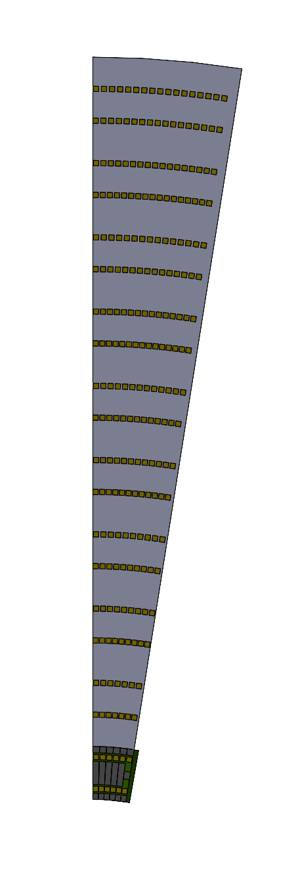
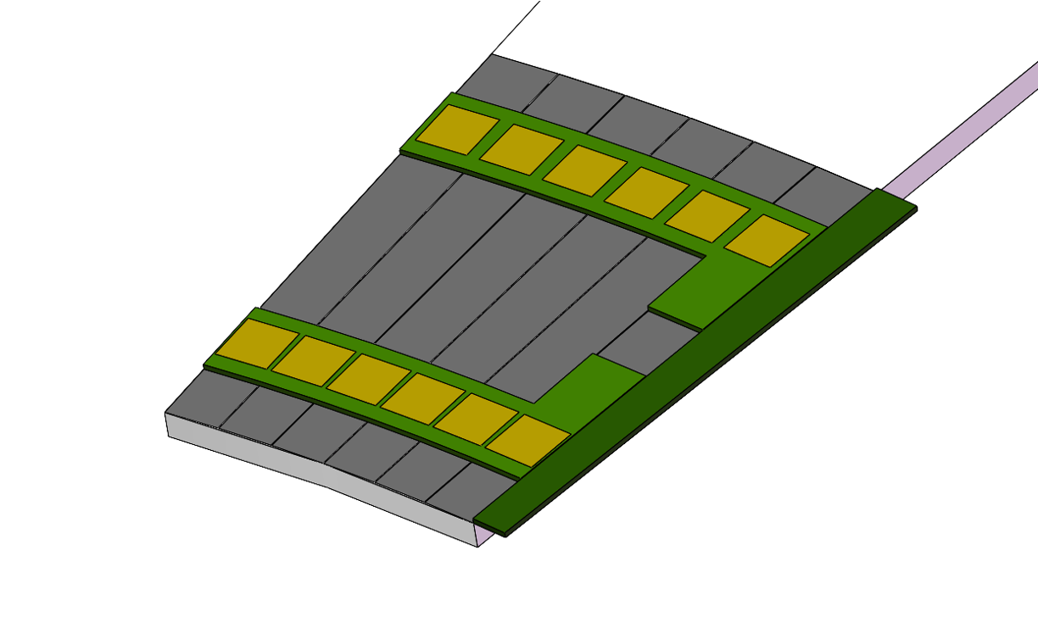
Endcap design 1
282.6 mm
Double layer to reduce the dead area
20 petals/layer
10 row/petal，
9º per row，
R10
23 ASIC
140 mm / row at R direction， same pitch （100 um）
The differences between the ASIC number of R10 and R1 ：23 ASIC /5 ASIC = ~ 4.5
R1
5 ASIC
62.8mm

Slide 4
Backup

Slide 5
Need reasonable hit rate at endcap
Need reasonable hit rate at endcap
The present rate 10⁵ hit/cm2（from haoyu ） is too high to realize at ASIC side

Slide 6
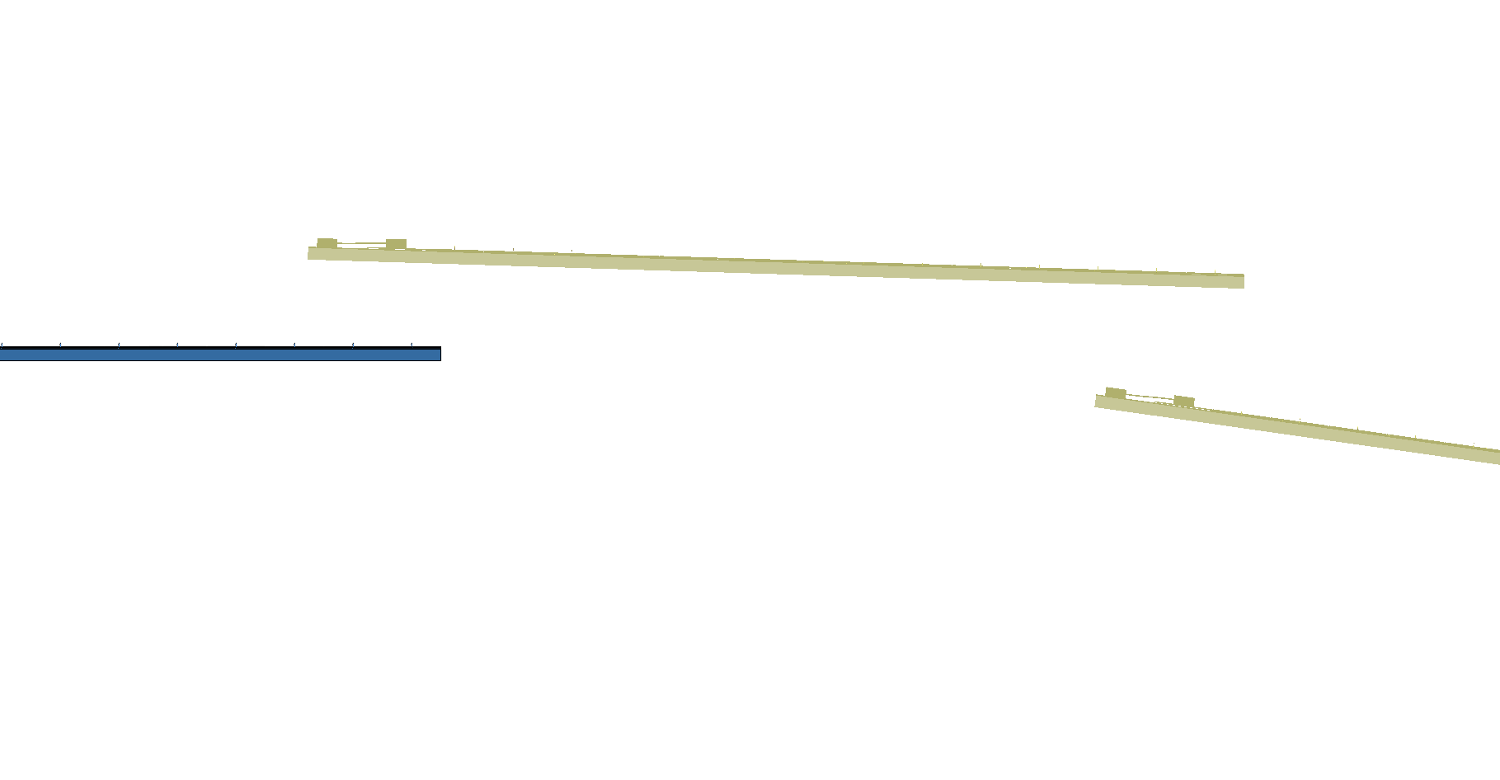
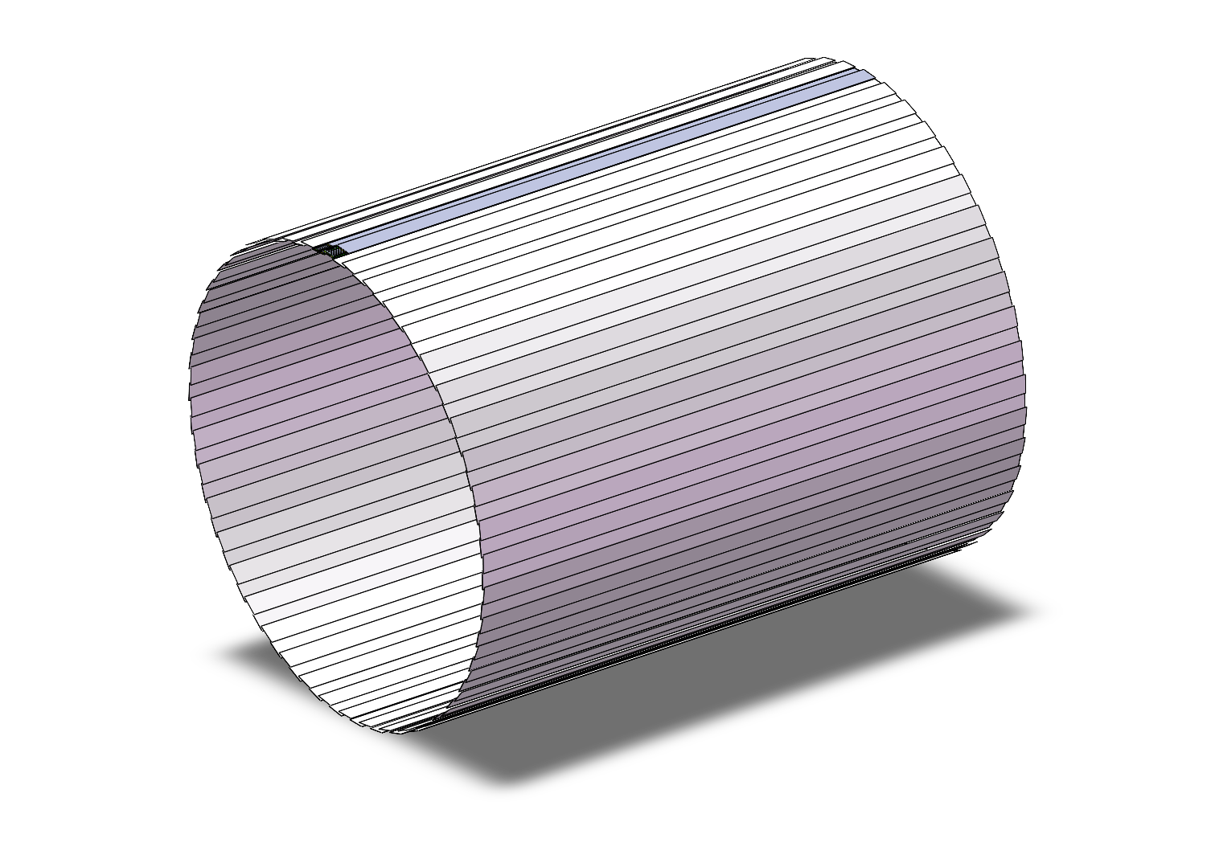
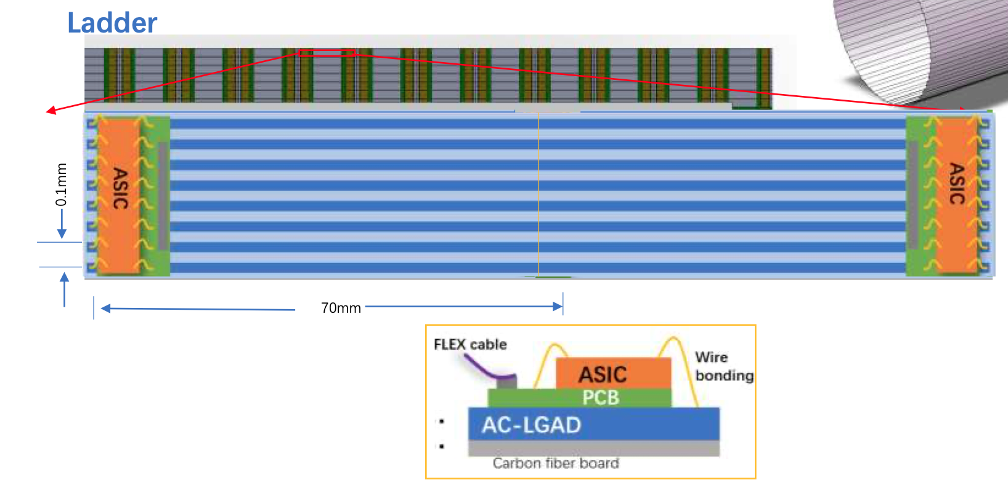
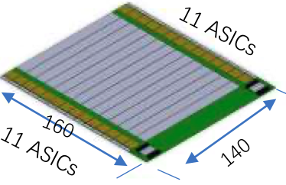
Arrangement of the ToF with strip LGAD：Barrel
One layer ToF
R= 1800 mm
H～5800mm
One layer: 3780 modules
90 ladders，45 ladders each side,
42 modules/ladder，
22 ASIC/module，128 Channel/ASIC
Module
140mm x 160mm

Slide 7
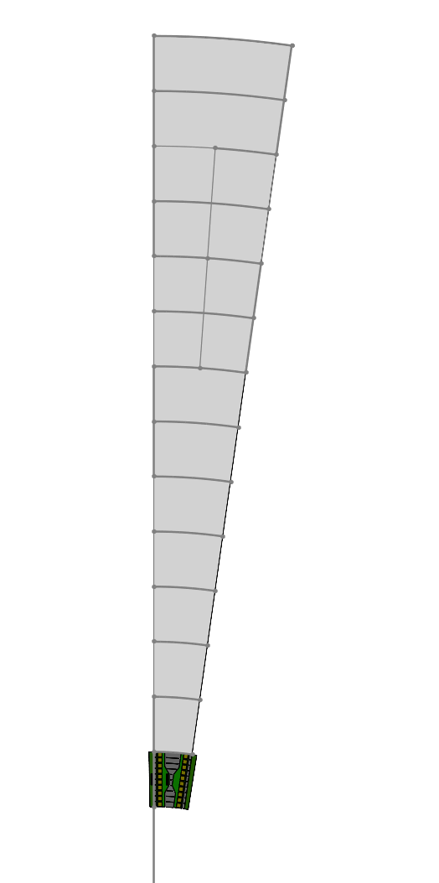
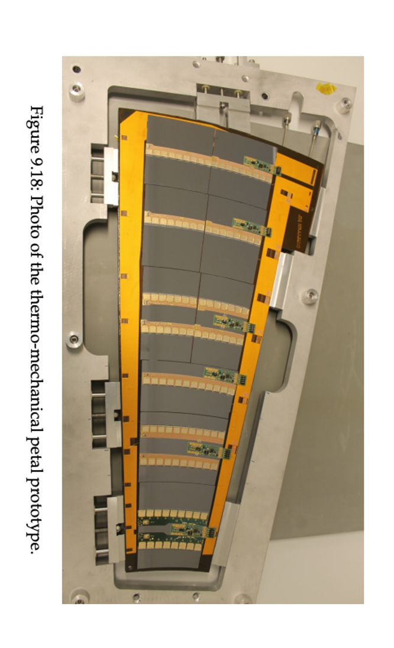
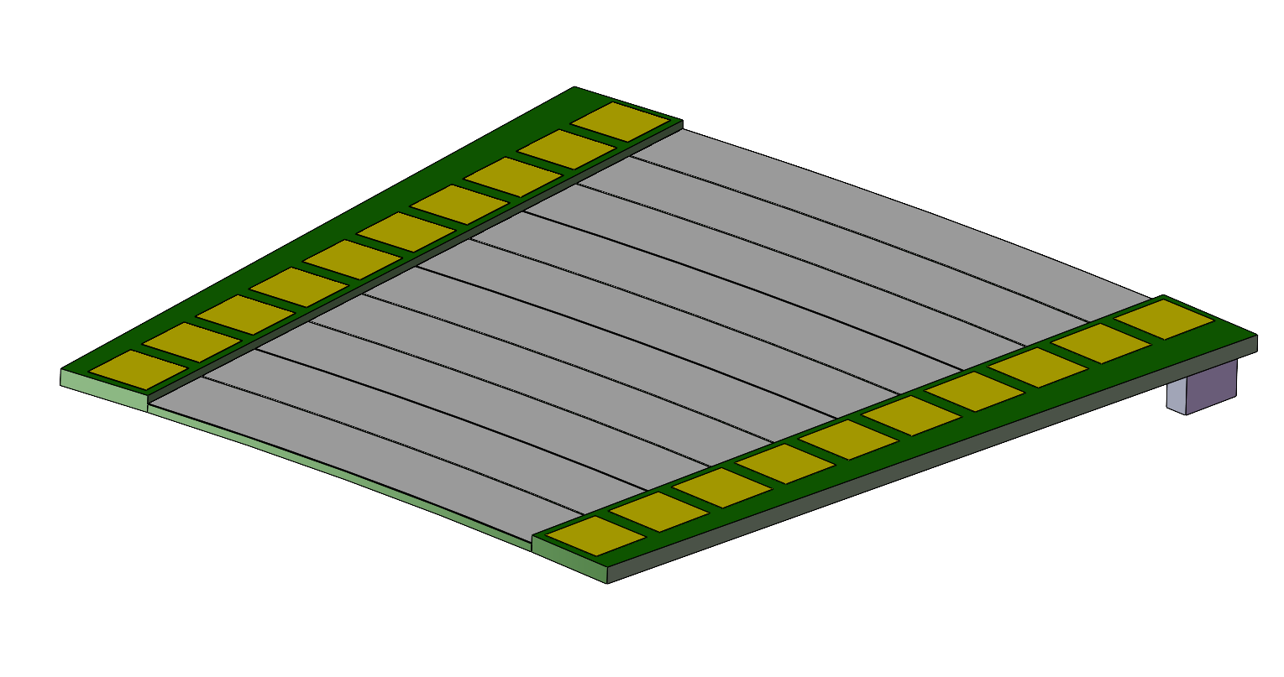
Arrangement of the ToF with strip LGAD ：Endcap
Petals： one petal each 8°× 45 = 360°
Total modules：~ 450 (14cm × )
R：400 mm - 1800 mm
8°
Module
Longest side：140mm

Slide 8
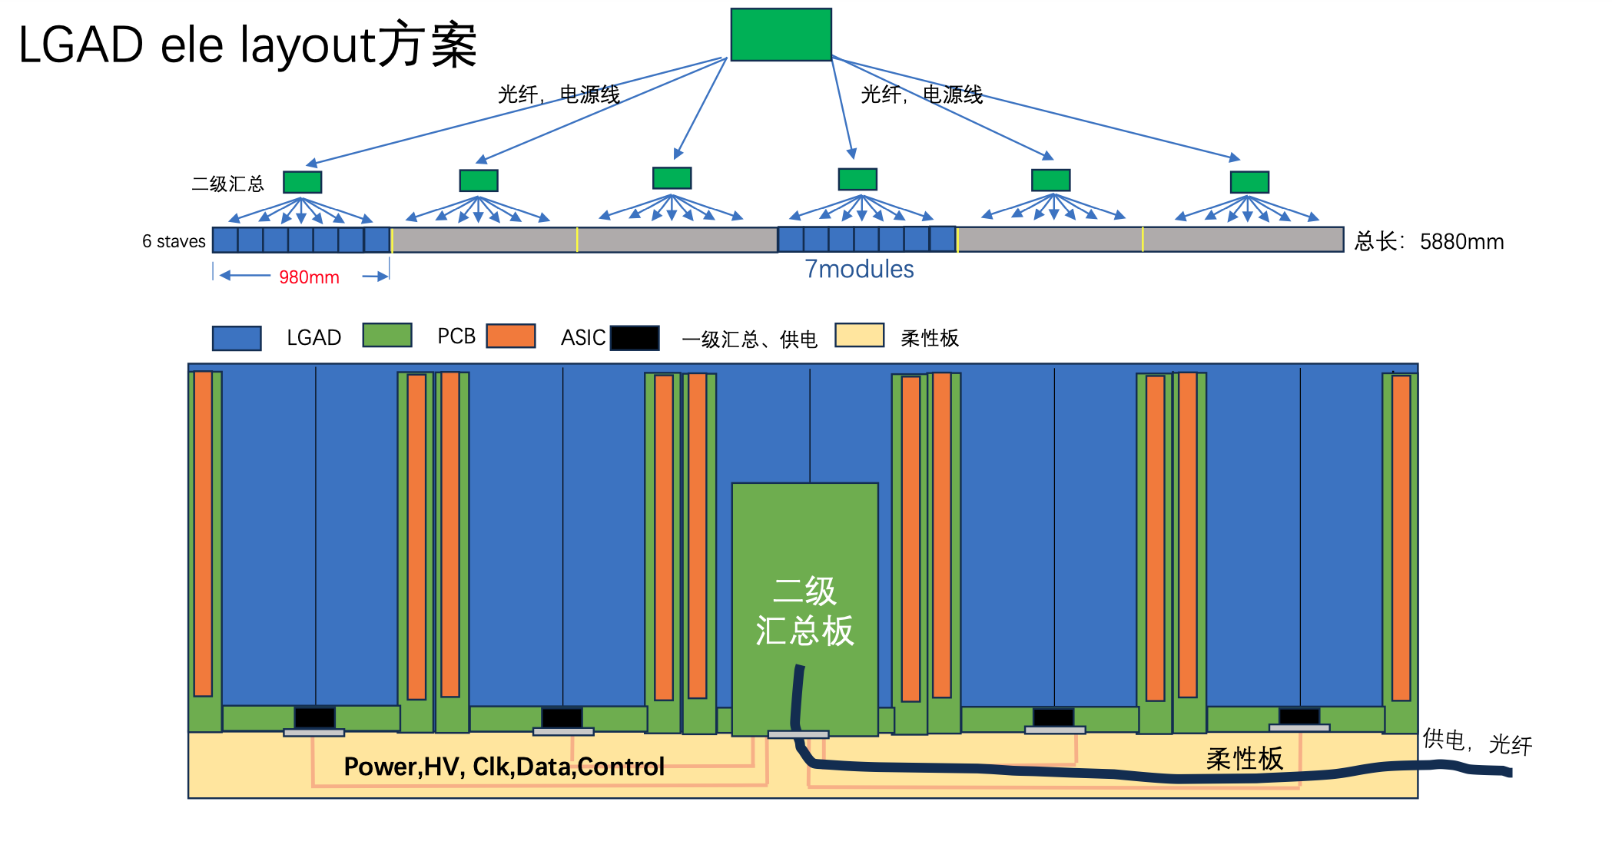
Layout of the Electronic System for LGAD ToF & oTracker

Slide 9
Detector Impact – Vertex -- Higgs
Preliminary results. Without any safety factor. Take the highest bin value as result.
Pair Could be used as reference of design, Beam Loss could not. Further optimization/mitigation will be performed.
Result File link:
Pairs: /cefs/higgs/shihy/work/cepc_bkg/Results/Ref-TDR/20240312/Higgs/Pairs.root
BeamLoss: /cefs/higgs/shihy/work/cepc_bkg/Results/Ref-TDR/20240312/Higgs/BeamLoss.root(available when exists)
 | Higgs
BXRate(Hz) | 1.34e6
Layer | Hit Density($kHz∙cm^{−2}$) |  | TID(k$rad⋅yr^{−1}$) |  | 1 MeV equivalent neutron fluence ($n_{eq}×{10}^{12}⋅cm^{−2}⋅yr^{−1}$)
 | Pair | Beam Loss | Pair | Beam Loss | Pair | Beam Loss
1 | 760 | 110.0634 | 185 | 75.28 | 1.8 | 0.20506
2 | 490 | 90.1943 | 112 | 62.51 | 1.75 | 0.16436
3 | 70 | 45.72336 | 6.4 | 12.63 | 0.01 | 0.030855
4 | 66 | 43.73305 | 5.4 | 12.08 | 0.01 | 0.030824
5 | 42 | 27.91237 | 1.1 | 3.15 | 0.004 | 0.007239
6 | 40 | 27.60218 | 1.0 | 3.34 | 0.004 | 0.010251

Slide 10
Detector Impact – Vertex – Z-pole
Preliminary results. Without any safety factor. Take the highest bin value as result.
Pair Could be used as reference of design, Beam Loss could not. Further optimization/mitigation will be performed.
Result File link:
Pairs: /cefs/higgs/shihy/work/cepc_bkg/Results/Ref-TDR/20240312/Z/Pairs.root
BeamLoss: /cefs/higgs/shihy/work/cepc_bkg/Results/Ref-TDR/20240312/Z/BeamLoss.root
 | Z
BXRate(Hz) | 3.93e7
Layer | Hit Density(k$Hz∙cm^{−2}$) |  | TID(k$rad⋅yr^{−1}$) |  | 1 MeV equivalent neutron fluence ($n_{eq}×{10}^{12}⋅cm^{−2}⋅yr^{−1}$)
 | Pair | Beam Loss | Pair | Beam Loss | Pair | Beam Loss
1 | 16200 | 316763 | 8613 | 12198874 | 35.61 | 1081.16
2 | 11400 | 253791 | 5353 | 7569336 | 34.60 | 1252.93
3 | 1490 | 133919 | 252 | 6819307 | 0.5 | 555.51
4 | 1410 | 161755 | 232 | 7585843 | 0.45 | 609.69
5 | 825 | 100452 | 67.0 | 3660636 | 0.16 | 318.95
6 | 786 | 102476 | 59.6 | 3408929 | 0.14 | 592.95

Slide 11
R10
9度
10列，每列140mm 长, Asic 数量差：
最长弧度/最短弧度（282.6mm （3 strip sensors）/62.8mm（1 strip sensors））=4.5
9度
10列，每列140mm 长,
R10和R1 的Asic 数量差：
23 ASIC /5 ASIC 约 4.5倍差
R1

