Slide 1
Impact of globally spin-aligned vector mesons on the search for the chiral magnetic effect in heavy-ion collisions
Diyu Shen, Jinhui Chen, Aihong Tang, Gang Wan
Phys.Lett.B 839 (2023) 137777

Slide 2
CME observable
The CME-sensitive observable
Resonances decay background
For example, the $ρ$ mesons decay to charged pions:
Where Cov(a,b) denotes the covariance of variables a and b.

Slide 3
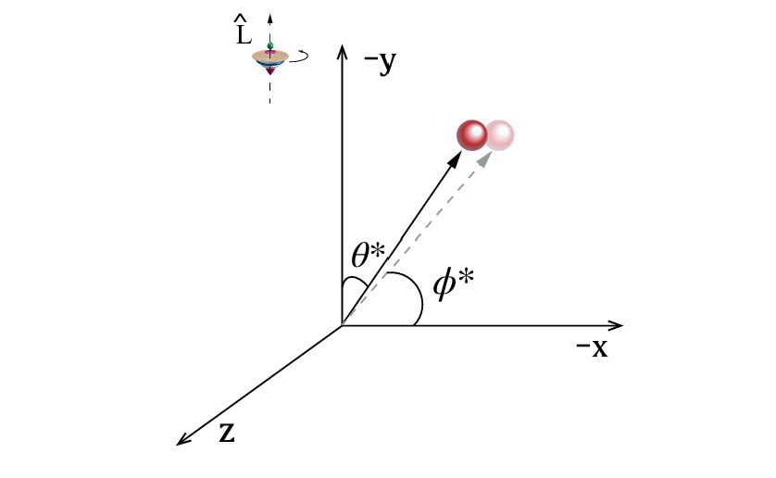
Global spin alignment
$ρ_{00}$ is the 00-component of the spin density matrix
In the decay of $ρ→π^{+}+π^{−}$, the emission angle of $π$, in the $ρ$ rest frame
Projected to the transverse (x-y) plane, it becomes
In my calculation, it should be
$$cos⁡(φ^{∗})$$

Slide 4
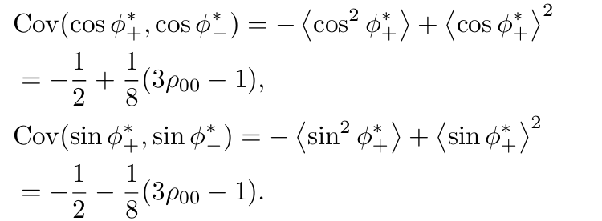
Relation between CME and global spin alignment
Using
And
The covariance term in $γ$
(7)
(8)
The contribution of$ρ$ decay, in the $ρ$ rest frame
a finite background when $ρ_{00}$ deviates from 1/3.

Slide 5
Relation between CME and global spin alignment
The particle distribution
Noticing
$$\frac{dN}{dφ^{∗}}=\frac{1}{2π}[1+2v_{2}cos2φ^{∗}]$$

Slide 6
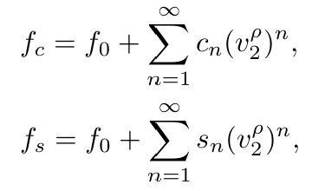
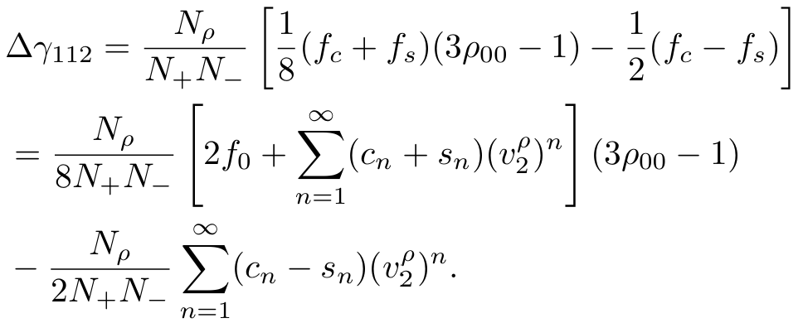
Relation between CME and global spin alignment
In the laboratory frame, Eqs. (7) and (8) should be scaled by factors of $f_{c}$ and $f_{s}$, respectively, due to the Lorentz boost of the meson.
In the $ρ$ rest frame
In the laboratory frame

Slide 7
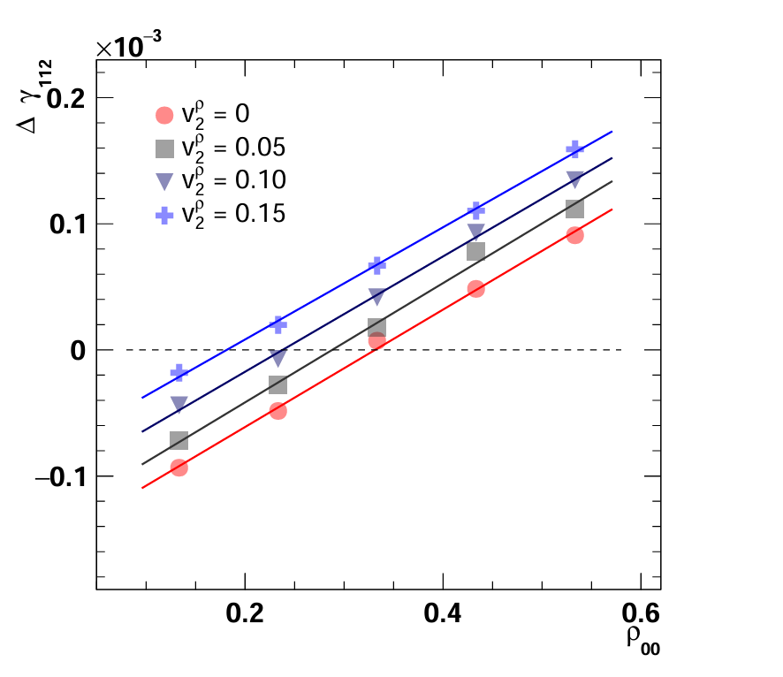
Toy Monte Carlo simulation
Each event contains 195 $π^{+}$and 195 $π^{−}$,with 33 pairs of them from$ρ$ decays
$$ρ→π^{+}+π^{−}$$
Pseudorapidity is uniformly distributed in the range of [-1,1]
$Δγ$ correlation as a function of $ρ$ meson $ρ_{00}$ with various inputs of $v_{2}^{ρ}$.

Slide 8
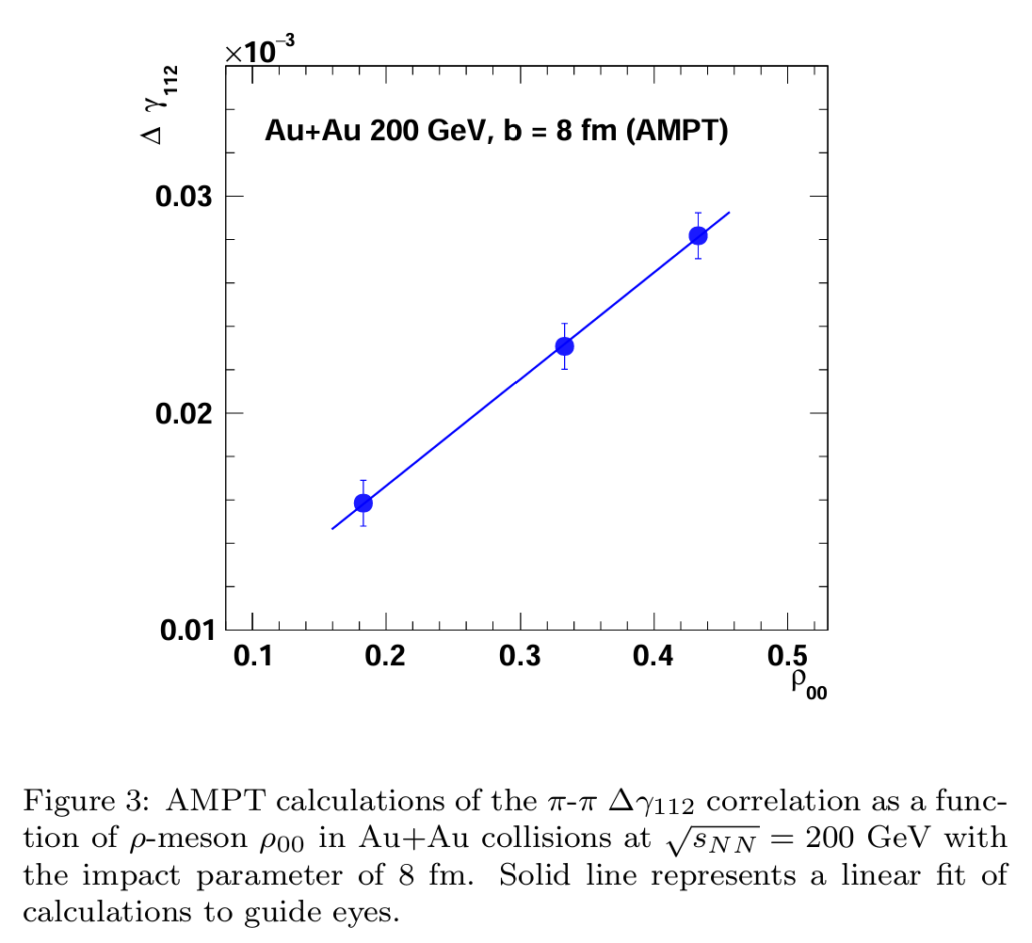
AMPT simulation
The selected decay channel is
The $ρ_{00}$values are set to be 0.18, 1/3 and 0.43
Without any kinematic cut

Slide 9
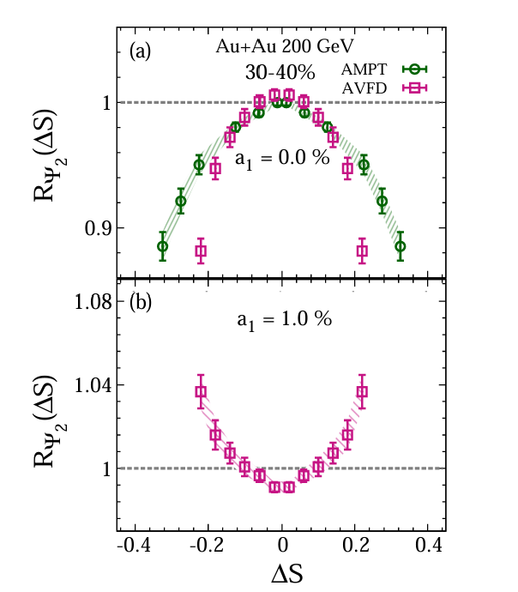
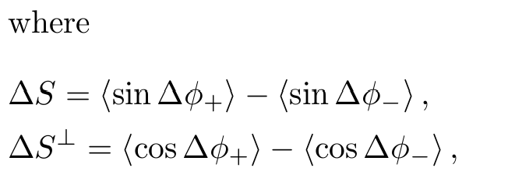
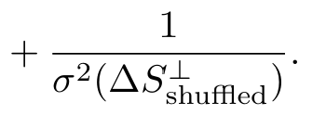
The $Rψ_{2}(ΔS)$ correlator
‘real’ and ‘shuffled’ represent real events and charge shuffled events
$Rψ_{2}(ΔS)$ quantified by the width of a Gaussian fit,$σ_{R}$
Concavity of $Rψ_{2}(ΔS)$
Comparison of the $Rψ_{2}(ΔS)$ correlators for (a) background-driven and (b) CME-driven charge separation

Slide 10
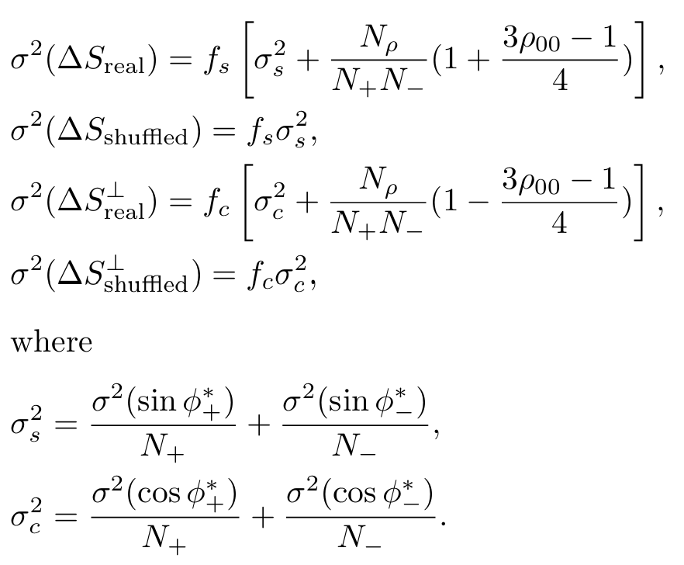
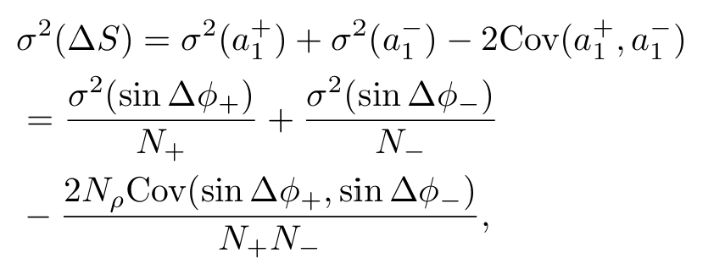
The $Rψ_{2}(ΔS)$ correlator

Slide 11
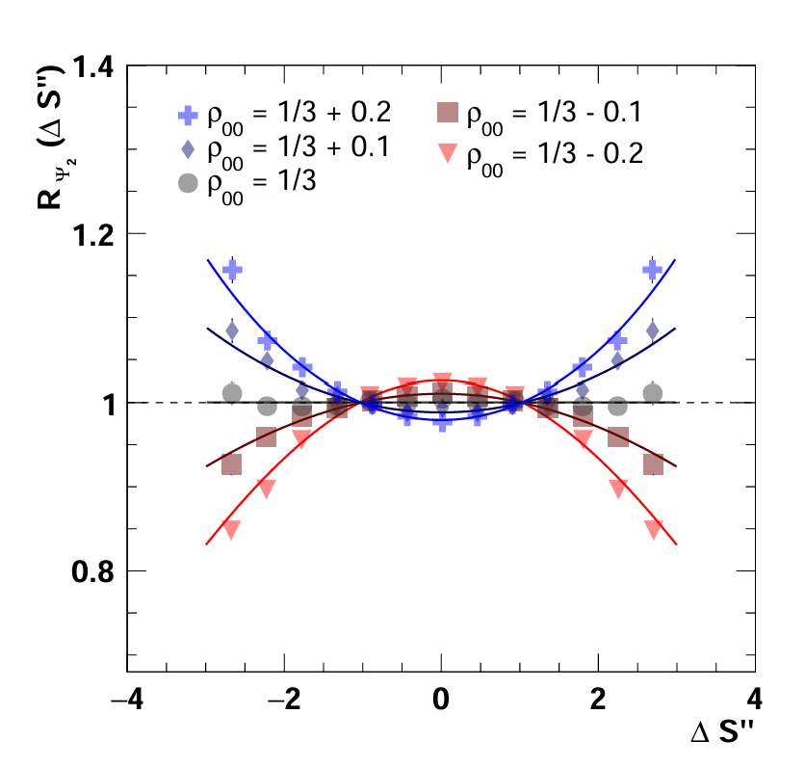
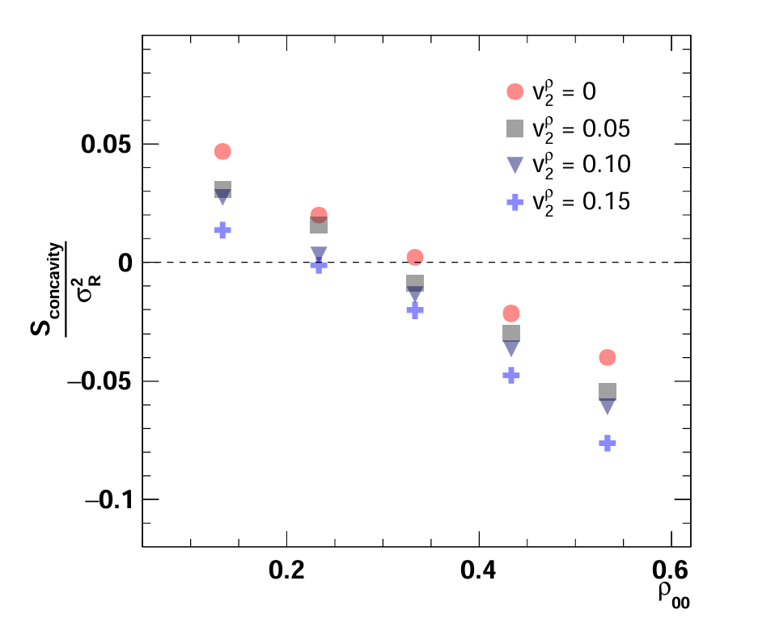
The $Rψ_{2}(ΔS)$ correlator

Slide 12
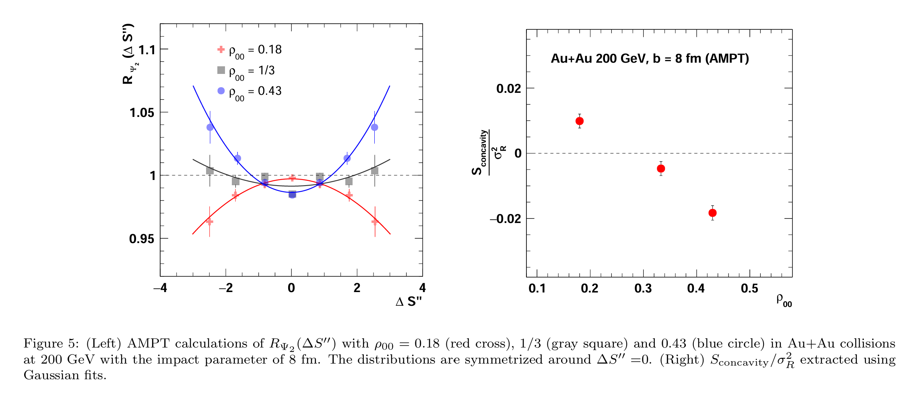
The $Rψ_{2}(ΔS)$ correlator

Slide 13
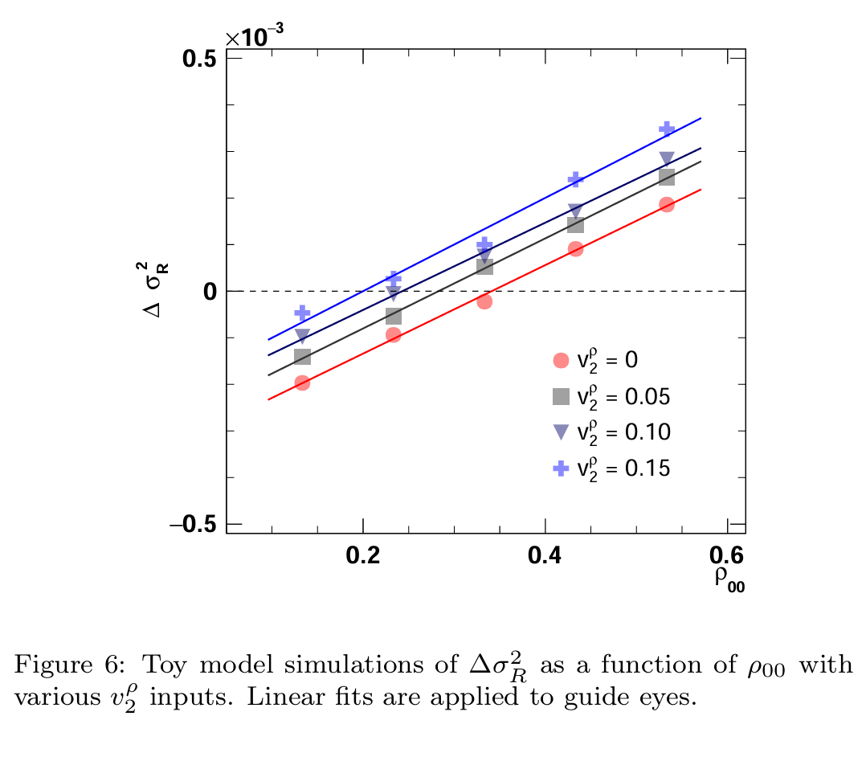
The $Rψ_{2}(ΔS)$ correlator

Slide 14
The calculation
$$p cosθ^{∗}=p_{y}=p sinψ sinφ^{∗}$$
$$\frac{dφ}{dcosθ^{∗}}={\left(\frac{dcosθ^{∗}}{dφ}\right)}^{−1}={\left(sinψ cosφ^{∗}\right)}^{−1}$$
$$\frac{dN}{dφ}=\frac{dN}{dcosθ^{∗}}\frac{dcosθ^{∗}}{dφ}$$
$$=\frac{3}{4}\frac{1}{sinψcosφ^{∗}}\left[\left(1−ρ_{00}\right)+\left(3ρ_{00}−1\right)\cos^{2}{θ^{∗}}\right]$$
$$=\frac{3}{4}\frac{\int_{0}^{π}{\frac{dN}{dψ}dψ 1/sinψcosφ^{∗}\left[\left(1−ρ_{00}\right)+\left(3ρ_{00}−1\right){\left(sinψ sinφ^{∗}\right)}^{2}\right]}}{\int_{0}^{π}{\frac{dN}{dψ}dψ}}$$
$$=\frac{1}{2π}cosφ^{∗}\left[1−\frac{1}{2}\left(3ρ_{00}−1\right)cos2φ^{∗}\right]$$
$$ψ$$

Slide 15
$$\frac{dN}{dφ}=\frac{1}{2π}cosϕ^{∗}\left[1−\frac{1}{2}\left(3ρ_{00}−1\right)cos2ϕ^{∗}\right]$$
$$=\frac{1}{2π}[cosϕ^{∗}\text{−}\frac{1}{2}\left(3ρ_{00}−1\right)cos2ϕ^{∗}cosϕ^{∗}]$$
$$=\frac{1}{2π}[cosϕ^{∗}\text{−}\frac{1}{2}\left(3ρ_{00}−1\right)\left(2\cos^{2}{ϕ^{∗}}−1\right)cosϕ^{∗}]$$
$$=\frac{1}{2π}\text{\{}\text{[1}\text{+}\frac{1}{2}\left(3ρ_{00}−1\right)]cosϕ^{∗}\text{ −}\left(3ρ_{00}−1\right)\cos^{3}ϕ^{∗}\}$$
$$=\frac{1}{2π}\text{\{}\text{[1}\text{+}\frac{1}{2}\left(3ρ_{00}−1\right)]cosϕ^{∗}\text{ −}\left(3ρ_{00}−1\right)(\frac{3}{4}cosφ^{∗}+\frac{1}{4}cos3φ^{∗})\}$$
$$=\frac{1}{2π}[\frac{1}{4} \left(3−ρ_{00}\right)cosϕ^{∗}\text{ −}\frac{1}{4}\left(3ρ_{00}−1\right)cos3φ^{∗}]$$
So,$v_{1}=\frac{3−ρ_{00}}{8},v_{3}=−\frac{3ρ_{00}−1}{8}$

Slide 16
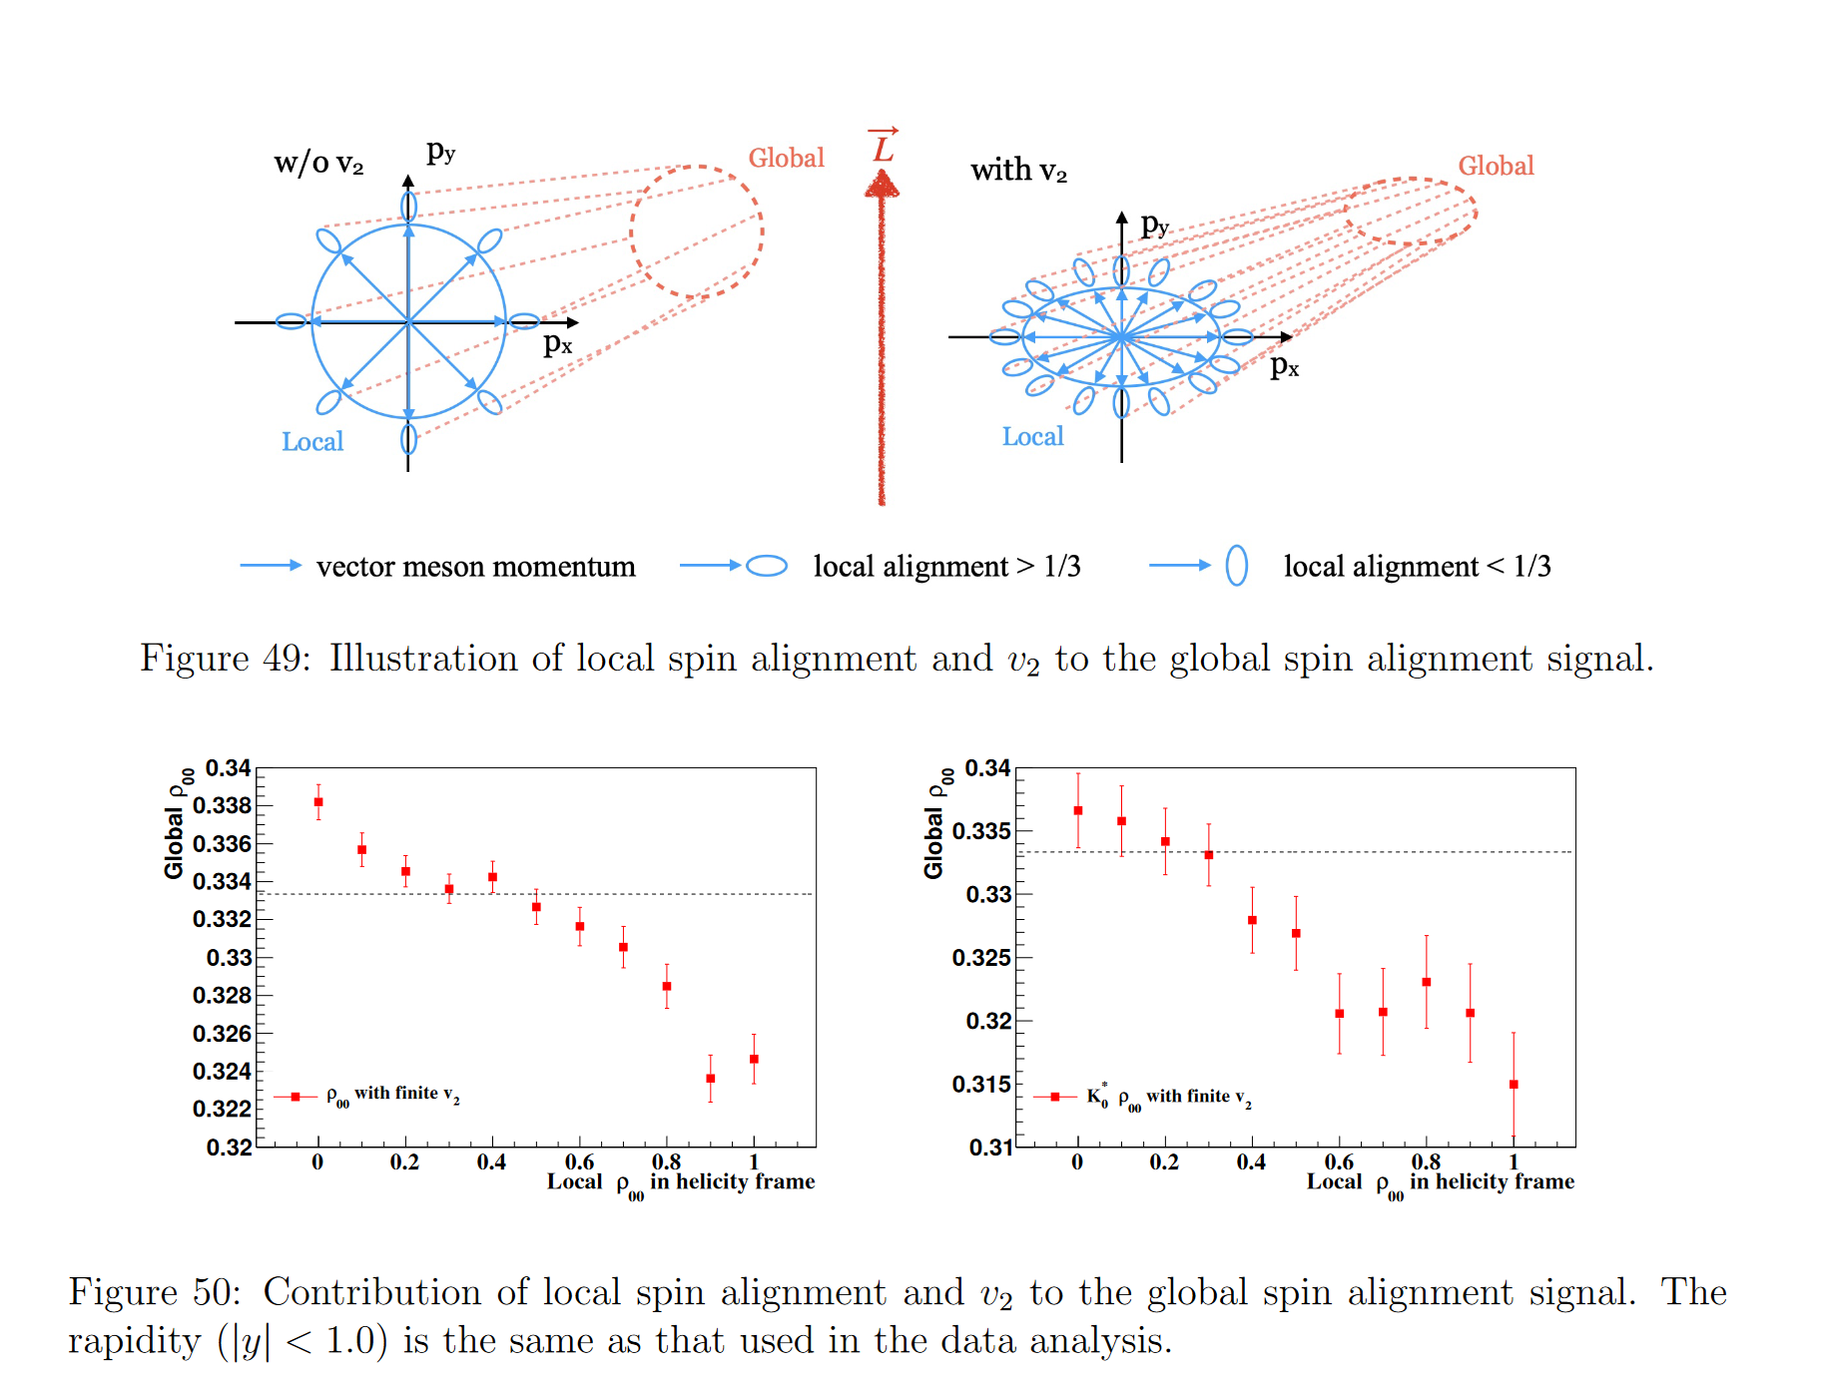

Slide 17
