Slide 1
Efficiency test on 1m×1m RPC
Lining Mao
2024.5.30

Slide 2
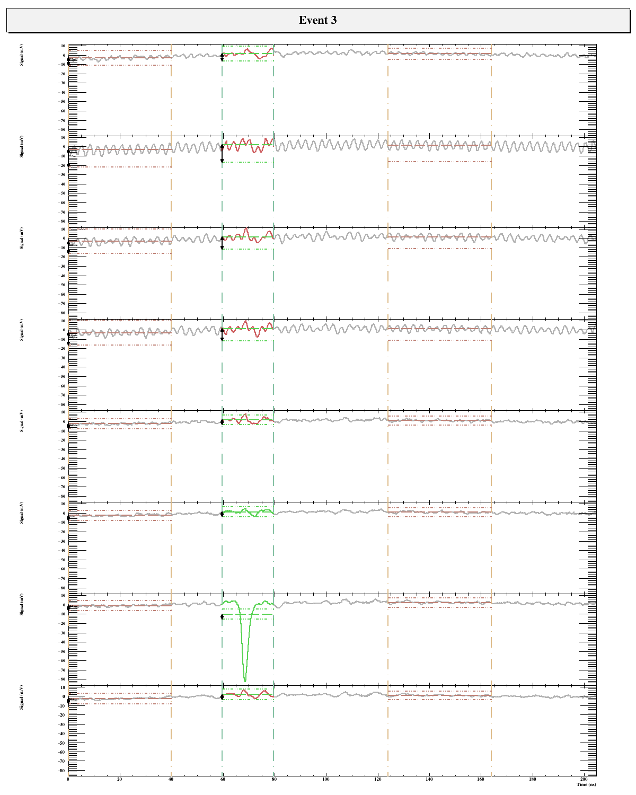
Analysis strategy
2 noise regions to define the baseline
(event will be skipped if difference between two regions >5σ)
Signal window
STD of the first noise region will be used to extract signal (max>5σ)

Slide 3
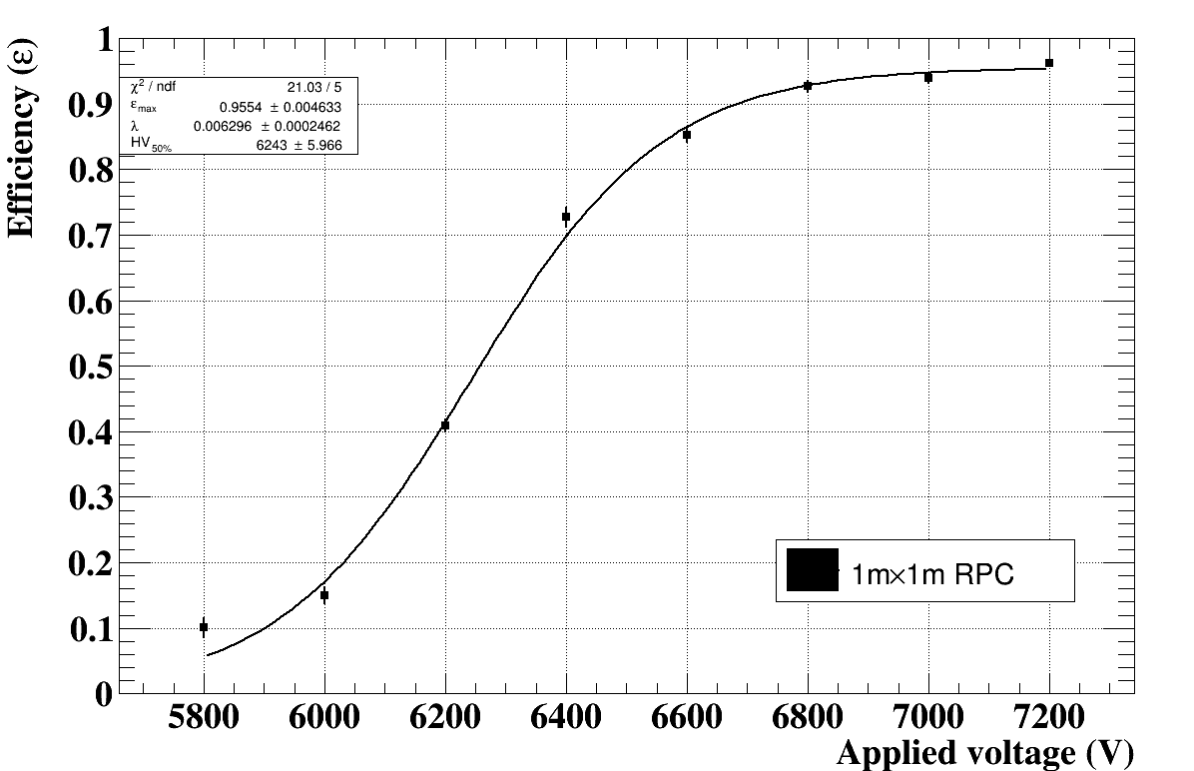
Efficiency curve of large RPC
Fit to $ε=\frac{ε_{max}}{1+e^{λ×(HV_{50\%}−U)}}$，$error=\sqrt{\frac{ε(1−ε)}{N_{total}}}$

