Slide 1

中国科学院高能物理研究所
Institute of High Energy Physics, CAS
CEPC Detector Magnet V0 weekly
Feipeng NING
2024.06.04
On behalf of detector magnet team

Slide 2

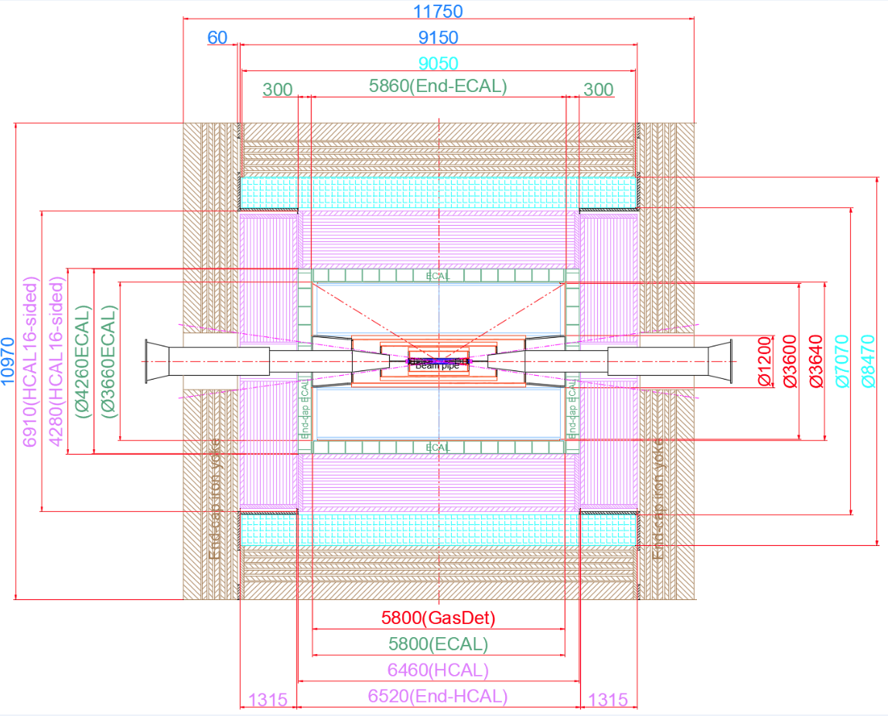
1. The size of magnet
Inner diameter | 7070 mm
Thickness | 700 mm
Outer diameter | 8470 mm
Length | 9050 mm

Slide 3
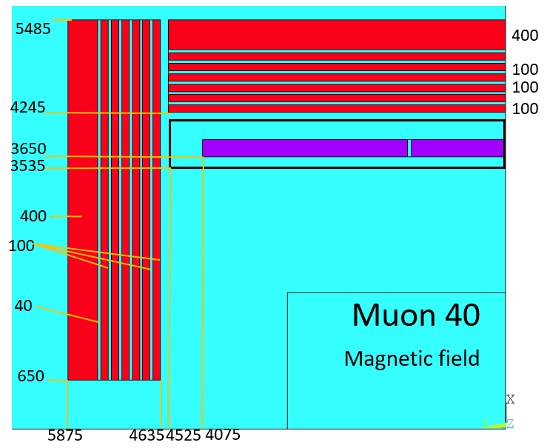
Detector Magnet
Yoke parameters：
Barrel yoke (ton) | 2300
Each End yoke (ton) | 754
Total Yoke (ton) | 3808
Diameter(m) & length (m) | 10.97&11.75
Coil parameters:
Inner diameter | 7300 mm
Operating current | 16702 A
Cable length | 33 km
Inductance | 11 H
Stored Energy | 1.54 GJ
Total mass | 265 tons
The gap between each layer of yoke is 40 mm.
Notes:
Two changes: first, add yoke to reduce the range of stray field; second, the size of HCal increase, so size of the solenoid and the yoke increase accordingly.

Slide 4
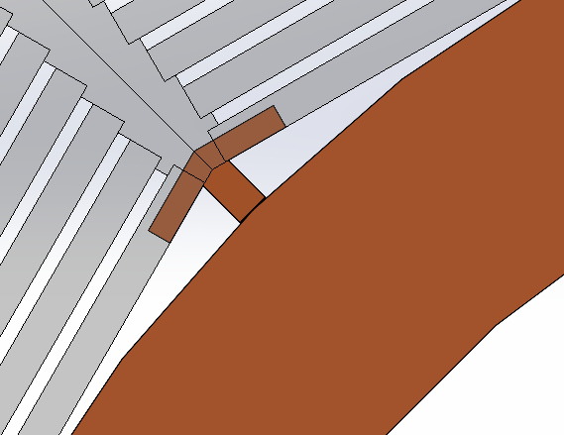
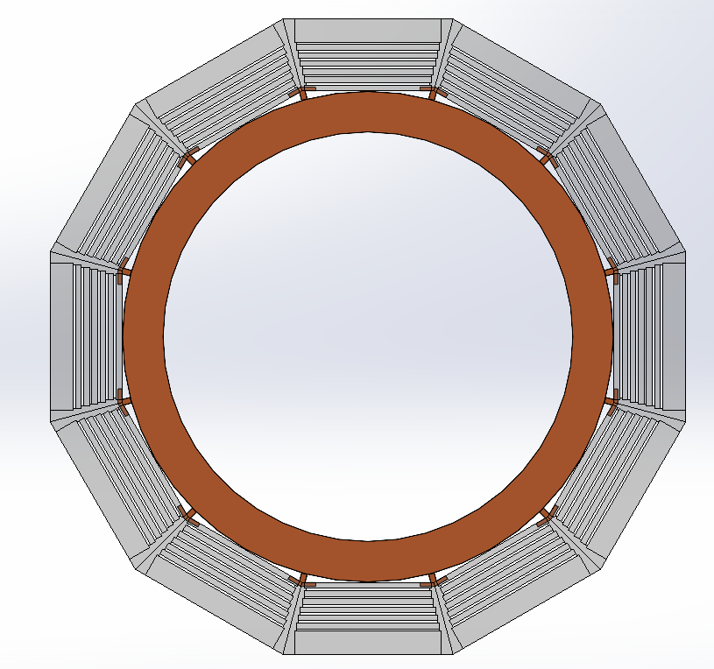
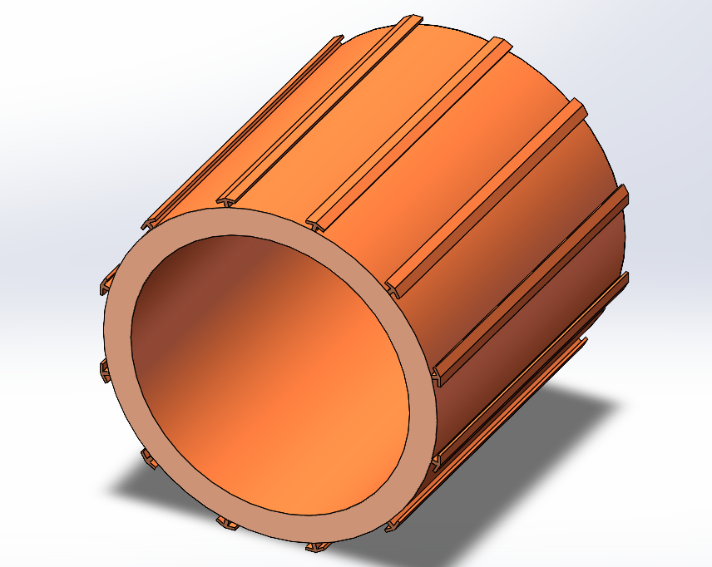
Support structure of the magnet
抗剪销
嵌入式T型块
杜瓦
轭铁
嵌入式T型块支撑结构

Slide 5
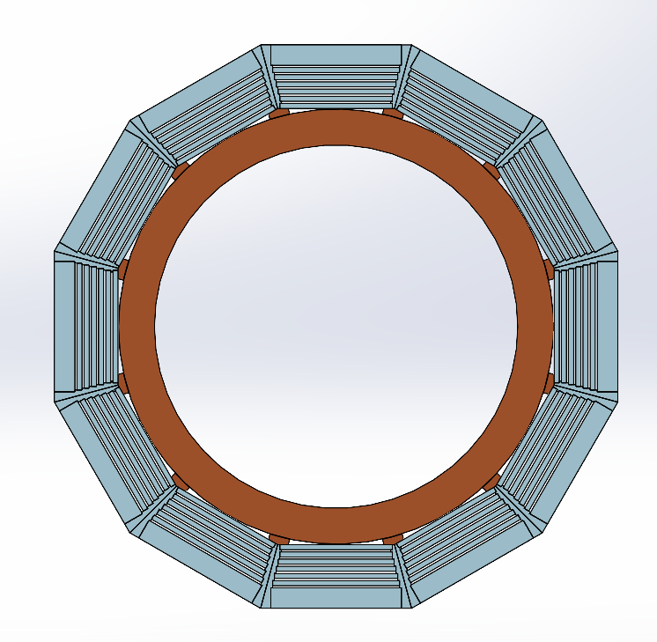
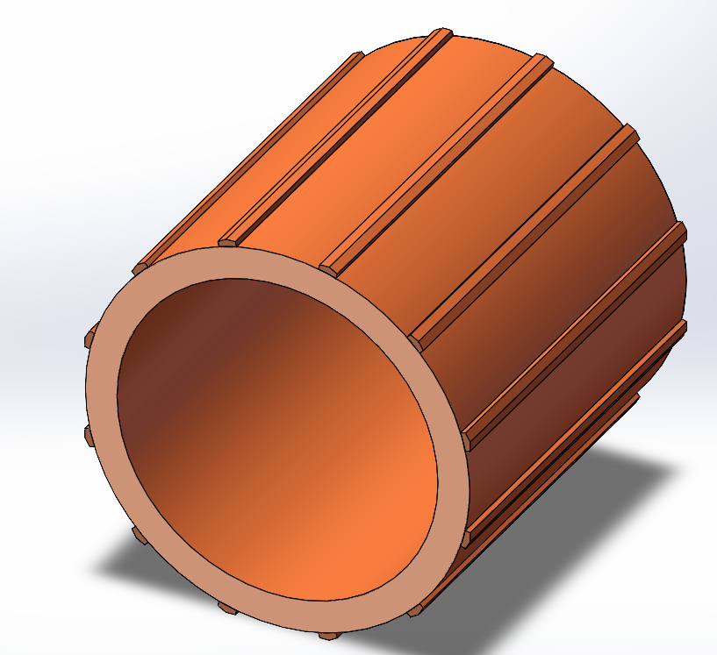
Support structure of the magnet
杜瓦
塞块
轭铁
插入式塞块支撑结构

Slide 6
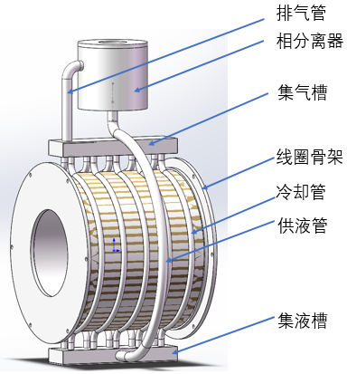
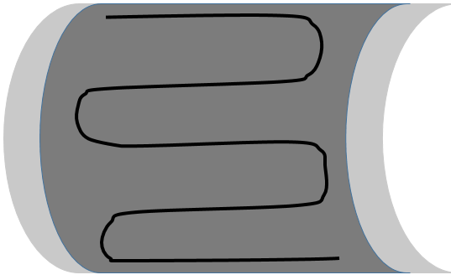
Cryogenic system of the magnet
低温部分开始进行方案设计，预计两周内完成增压迫流，过冷迫流，热虹吸三种方案的初步设计与预算评估，形成评审报告。
Thermosiphon
Forced flow
桶轭部分已经开始了详细的模块设计，目前已经进行了自重初步计算，电磁力模拟正在进行中。

Slide 7
Ongoing work
LTS cable and HTS cable development
Mechanical design of the magnet
Cryogenic system
Support structure of the magnet
Mechanical design of the yoke
Notes:
Two changes: first, add yoke to reduce the range of stray field; second, the size of HCal increase, so size of the solenoid and the yoke increase accordingly.

