Slide 1
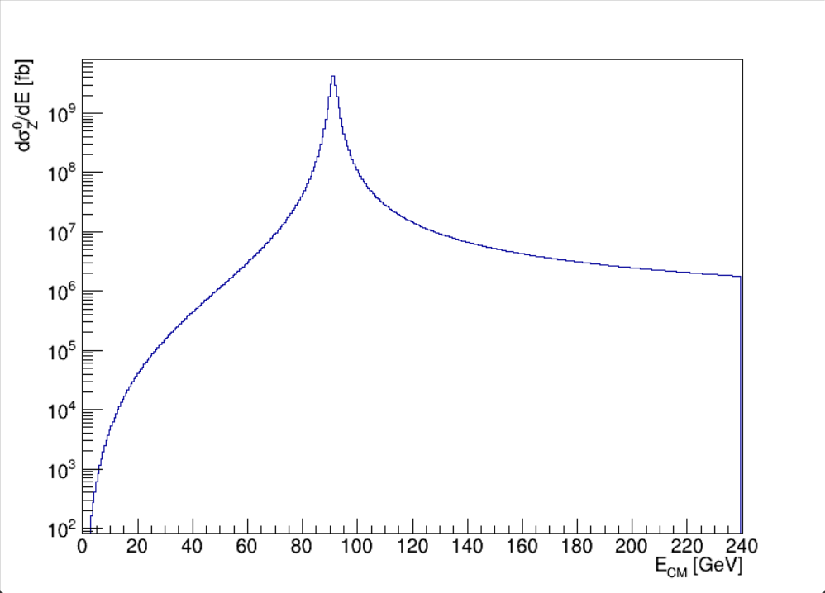
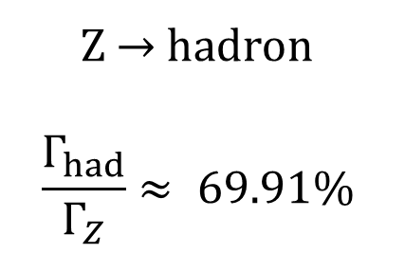
Z$→$hadron
$$\frac{Γ_{had}}{Γ_{Z}}≈ 69.91\%$$

Slide 2
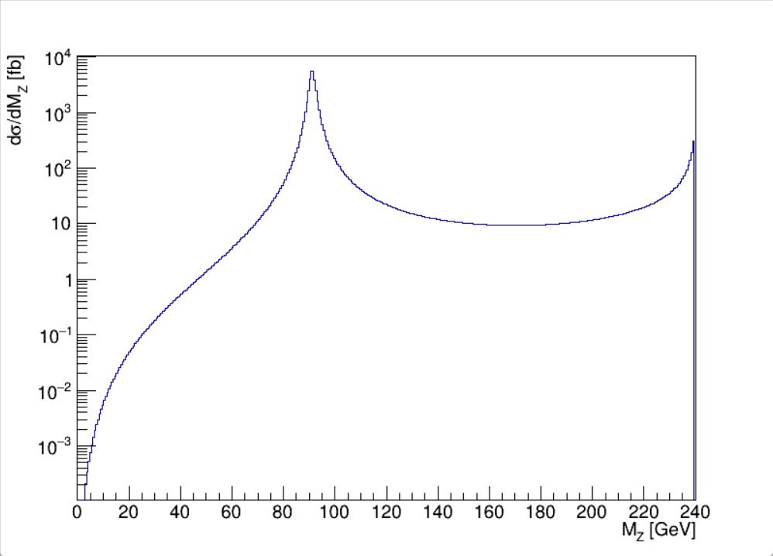
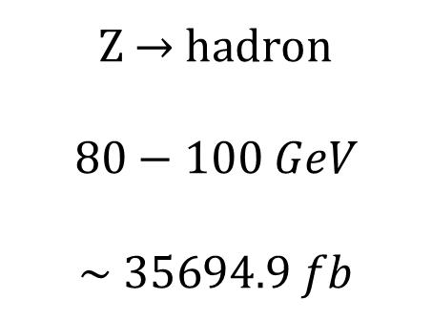
Z$→$hadron
$$80−100 GeV$$
$$\sim 35694.9 fb$$
ISR

