Slide 1
CEPC vertex detector towards TDR
Zhijun Liang,
On behalf of CEPC vertex working group

Slide 2
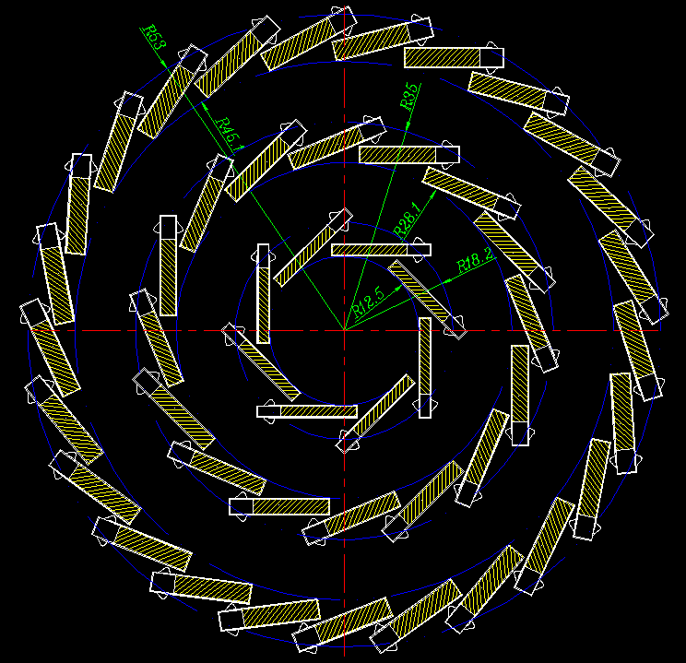
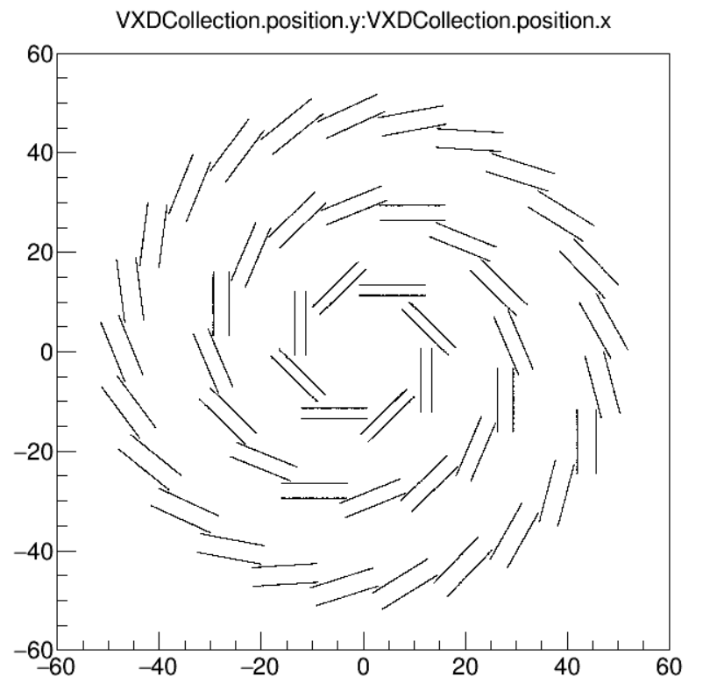
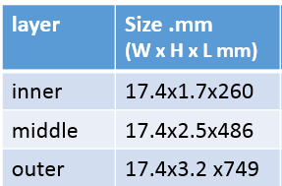
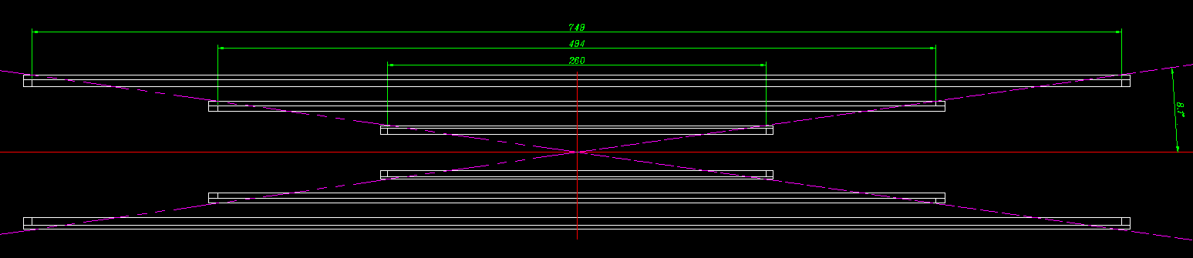
Vertex detector Layout - long barrel
Implementing the long barrel layout into CEPCSW release, under review
Inner layer smallest radius about 12.5mm→ close to beam pipe (r=10.7mm)
Middle and outer layer is long to cover the acceptance up to cosθ <= 0.99
The VTX - section view
The VTX – in CEPCSW full simulation
Ladder support size
The VTX - side view

Slide 3
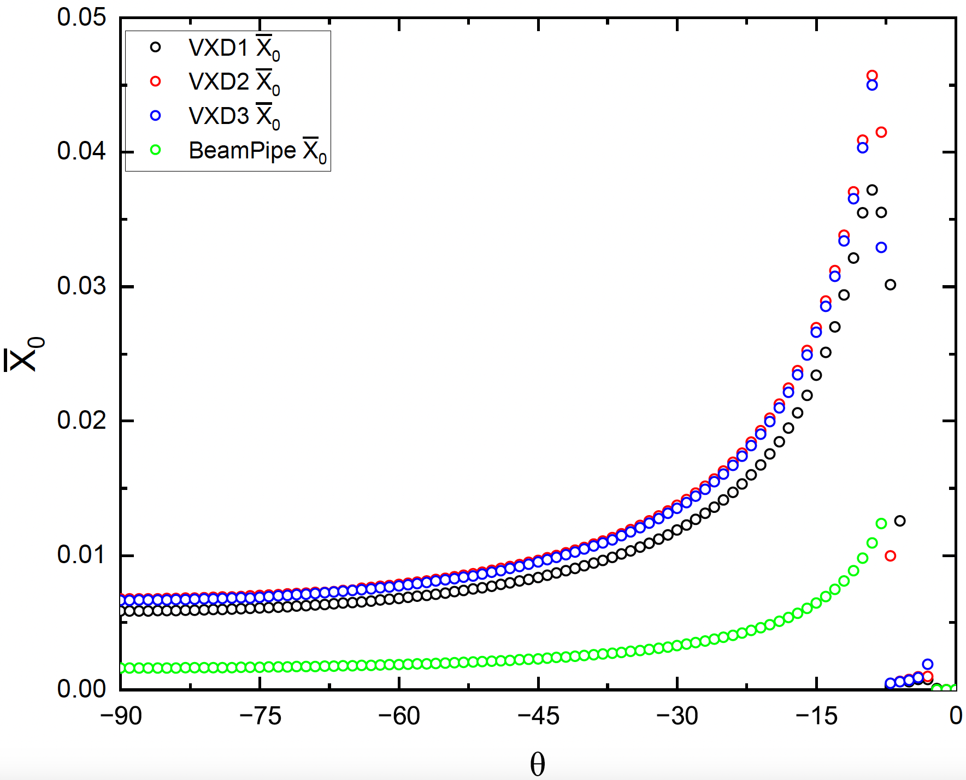
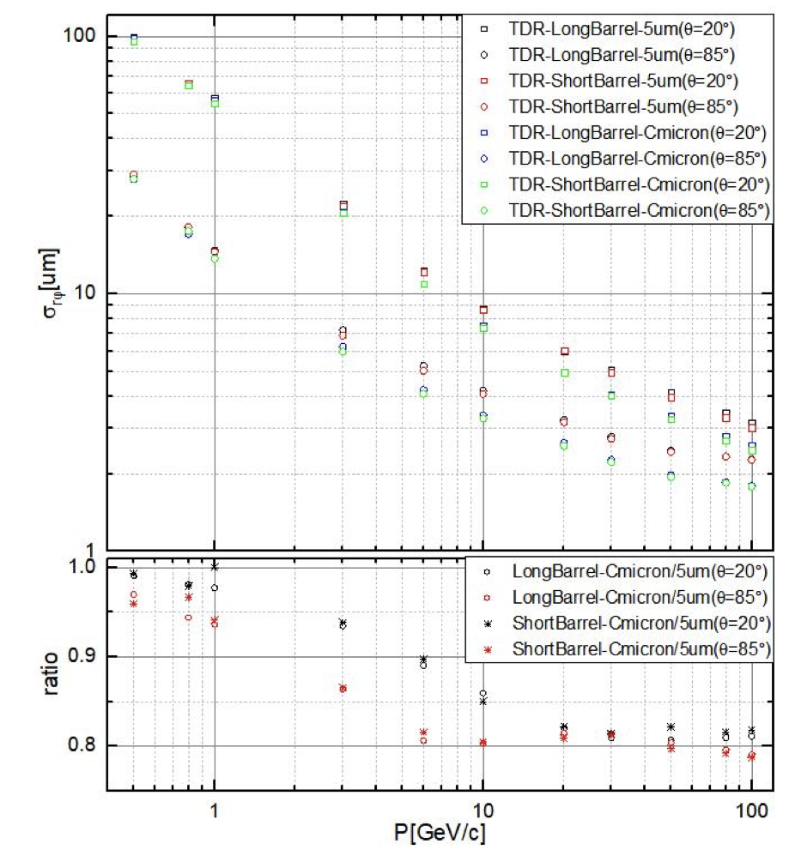
Material budget and impact parameter performance
Implementing the long barrel layout into CEPCSW release
Geometry implemented in CEPCSW full simulation
  Material budget and performance can be studied with full simulation
Material budget is 0.3% X0 per layer
  With realistic support material and realistic material for flexible PCB
Material budget for long barrel layout
Impact parameter resolution in CEPCSW
θ=20° , 85°

Slide 4
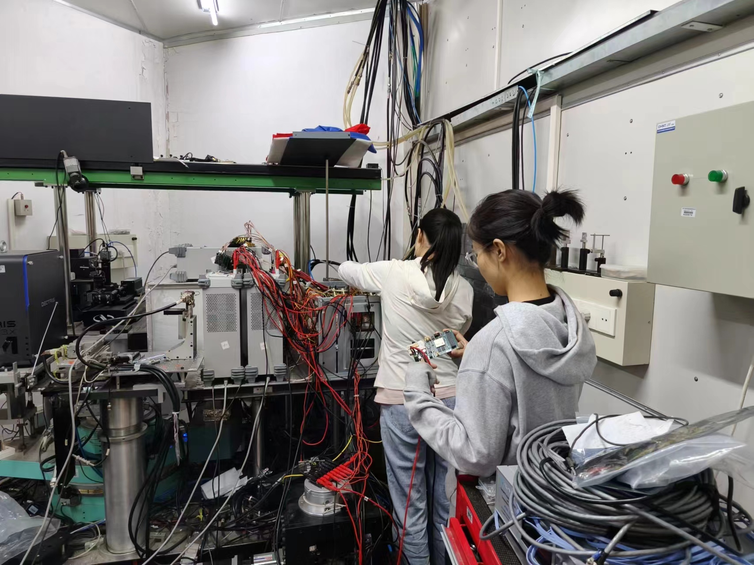
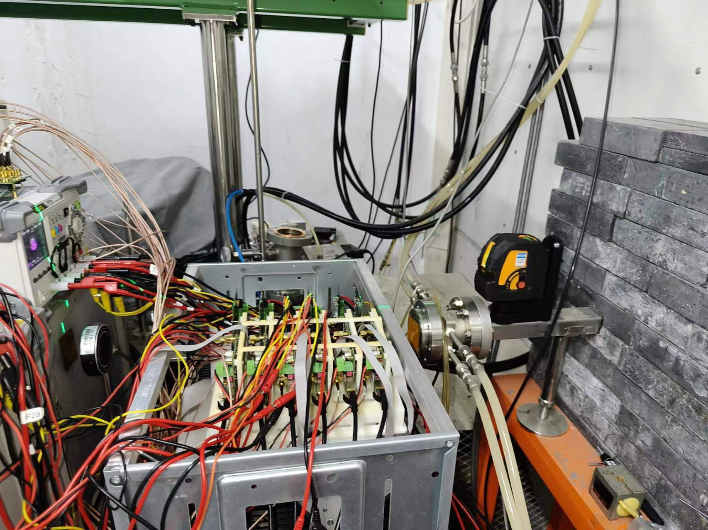
Testbeam in BSRF for vertex sensor digitization model
Testbeam in BSRF from June 1st to July 1st
Try to test different incident angle from 8° - 90°
  In last test beam at DESY, incident angle is about 70-90°
  Cluster size, efficiency vs incident angle

Slide 5
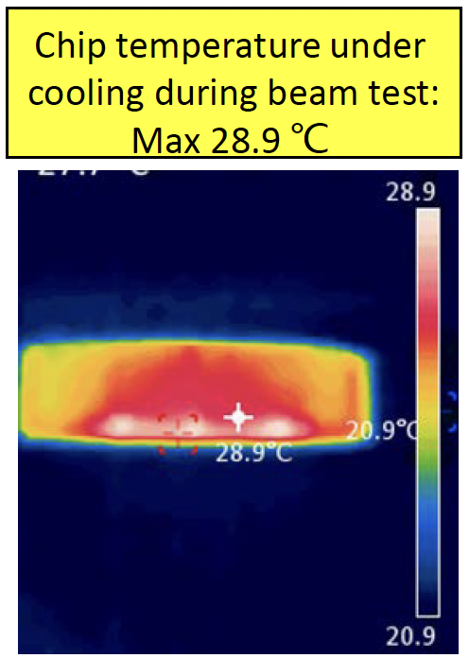
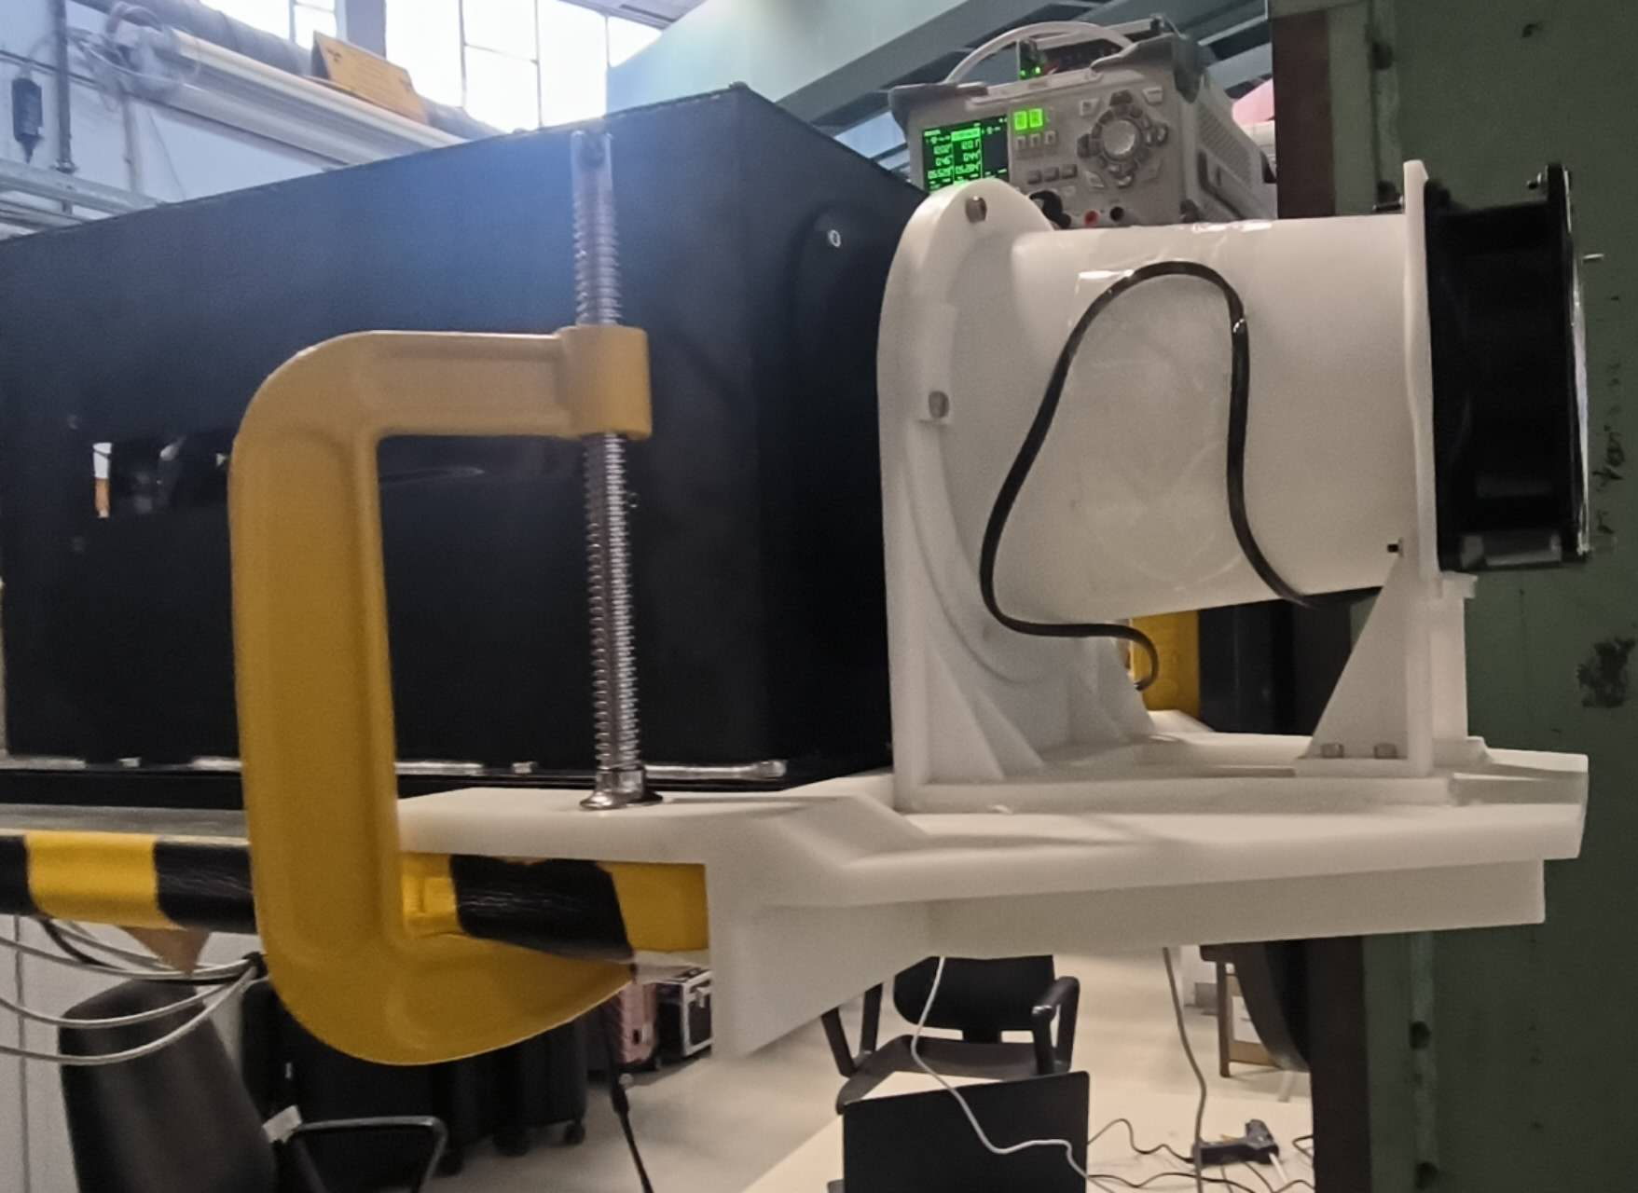
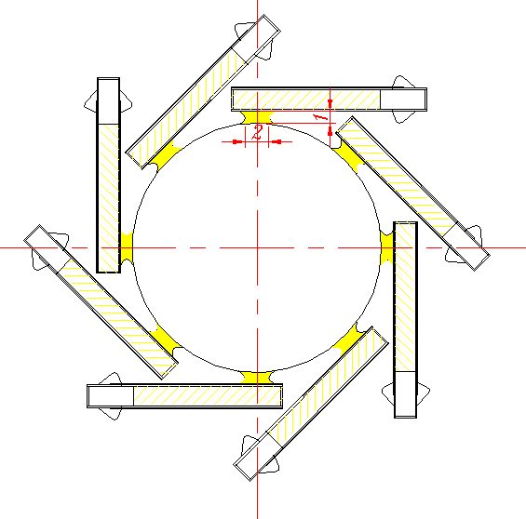
Update on Cooling design (preliminary )
Power consumption of the vertex detector chip is about 40mW/cm²
  Aim to operate vertex detector at around 20°C
Baseline is to use air cooling
  Simulation: Air speed ~2.3 m/s , middle and outer layer can cooled down to 25 °C -28 °C
  Vertex prototype testbeam @ DESY with air cooling: 25°C -28.9°C
The thermal conduct to beam pipe is important for inner layer
  Beam pipe with active cooling
  With thermal glue conducted to beam pipe, inner layer can cooled down to below 25 °C
Cooling design schematic
for inner layer
The VTX prototype air cooling

Slide 6
Reference TDR outline
Sub-system: Vertex detector
  Performance requirement
  Tech. Survey and review
    CMOS pixel
    SOI
    Stitching
    Our Exploration & Choice on Tech
    Brief Description of Vertex detector Prototype R & D with CMOS pixel tech
  Sub Detector Design – Detector layout, Electronics, Mechanics, Cooling
    Layout optimization
      Long barrel layout Vs “short barrel +endcap” layout
      Our Exploration of the choice of layout
    Mechanics
    Electronics
      CMOS pixel sensor
      Ladder electronics (very brief description of basic function and dimension, more details referred to electronics section)
    Cooling and service
  Conclusion: Vertex subdetector Level Performance
    Expected Impact parameter performance

Slide 7
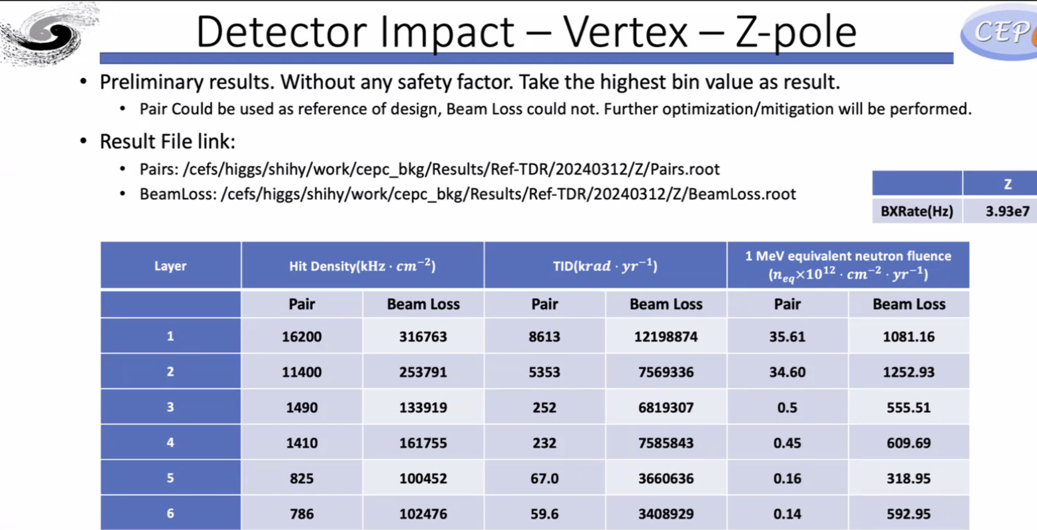
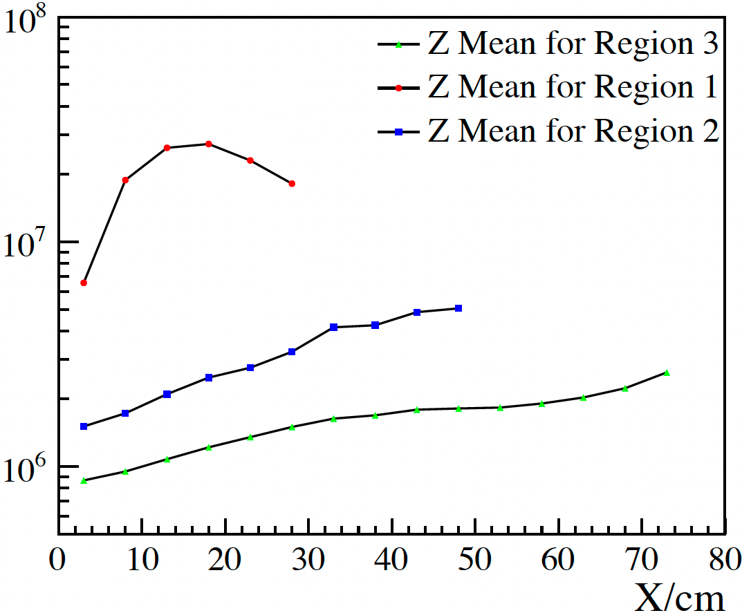
Vertex detector background data rate
2D pair production background from old version CEPCsoft (from haoyu)
  Pairs: /cefs/higgs/shihy/work/cepc_bkg/Results/Ref-TDR/20240312/Higgs/Pairs.root
Need to check new software CEPCSW
Rate( Hz/cm2)
Z pole (high lumi)

Slide 8
Summary
Implementing long barrel layout into CEPCSW release
New round of Test beam in BSRF
  Provide feedback to CEPSW Digitation model

Slide 9
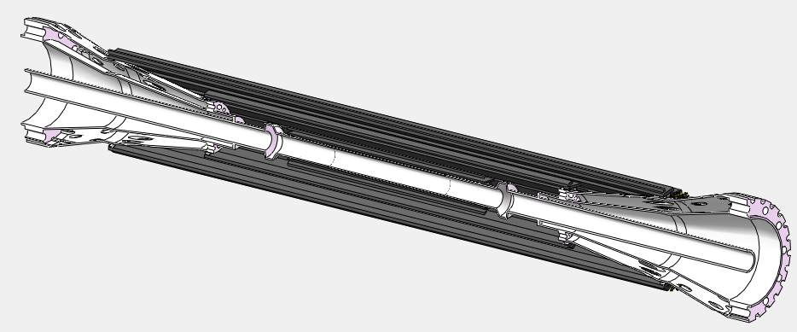
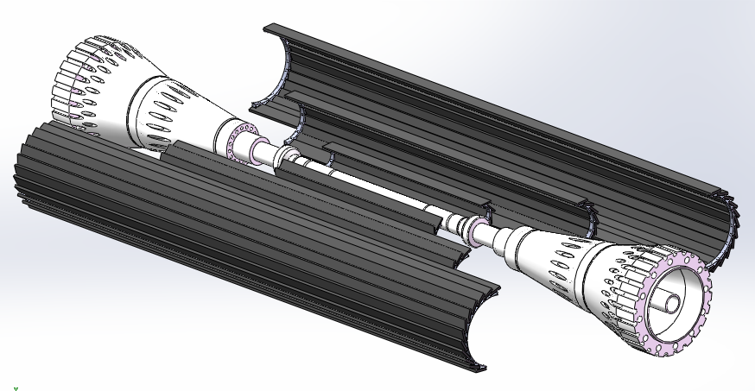
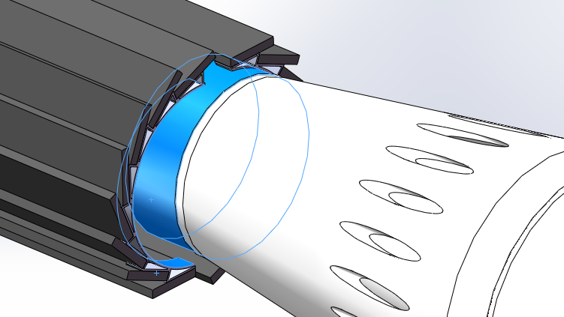
Reminder of long barrel design
The support ring can be either glued/bolted to or pre machined on the beam pipe related parts. (for the inner most layer bolting and machining are too difficult)
The VTX on the tentatively modified beam pipe components
The drawings show the option that pre-assembled halves barrels mounted onto the beam pipe(dedicated tooling required)
More consideration - different constraint on two ends?

Slide 10
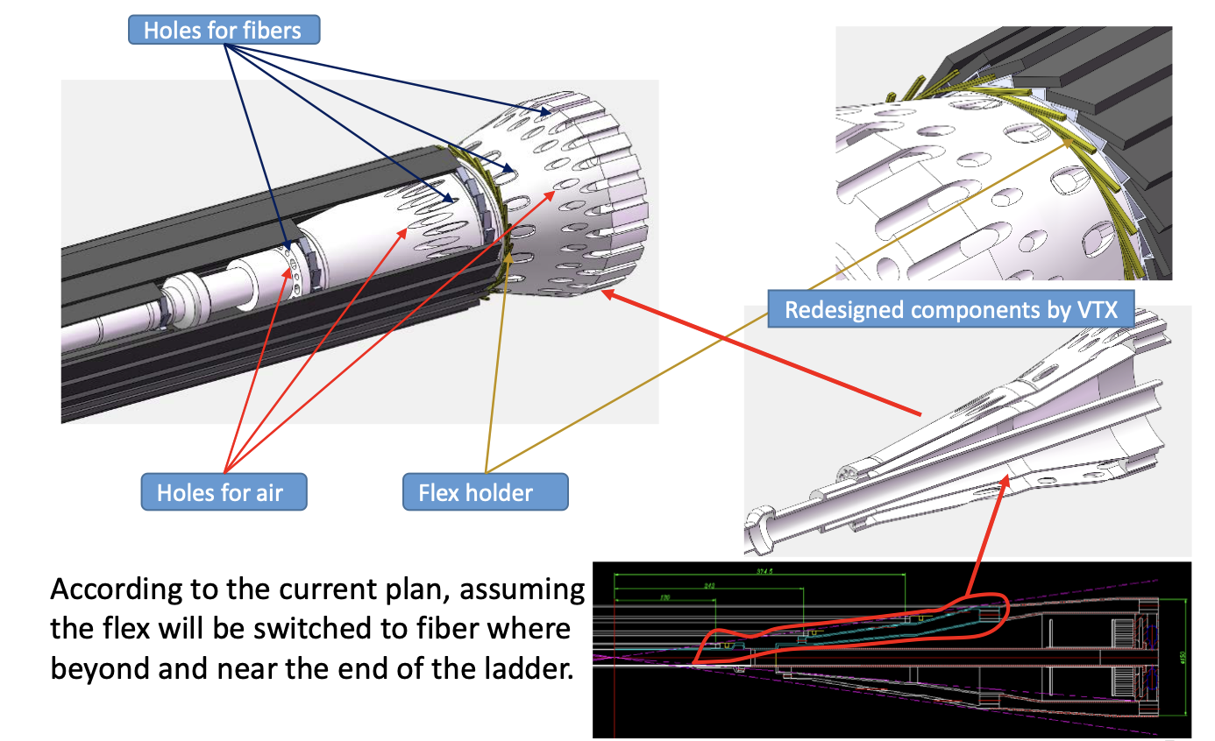
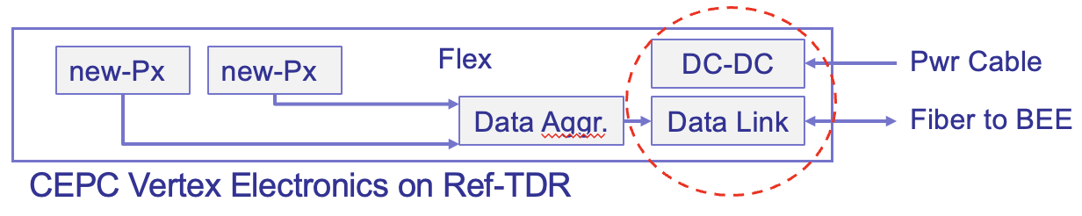
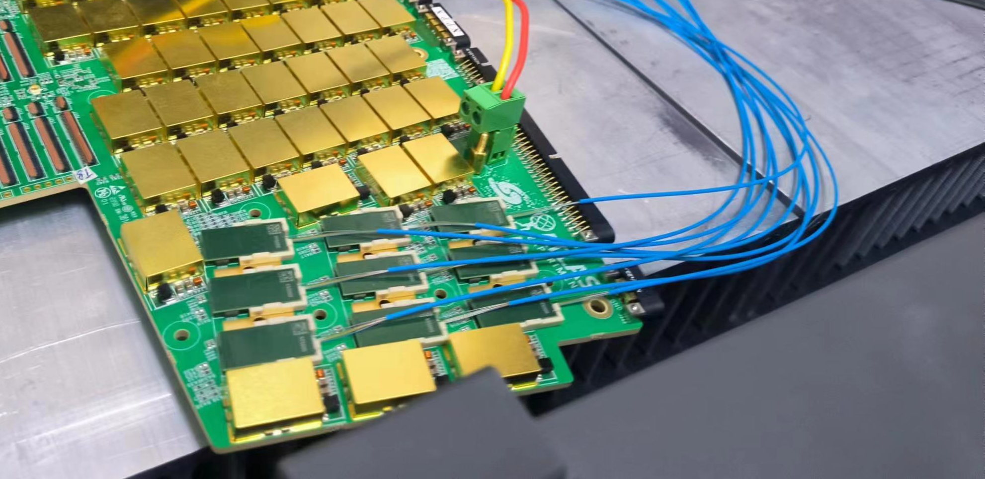
Cable and service
Optical data link is expected to use for fast signal transmission
Service and cable space has been identified
Example from ATLAS HGTD upgrade

Slide 11
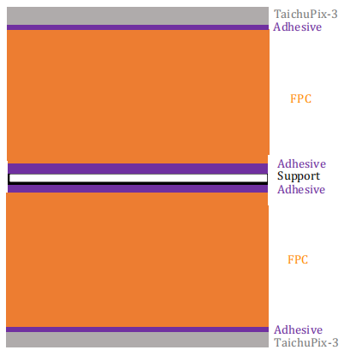
backup: CEPCSW full simulation of PCB material
50um Si
12.5um Acrylicglue
12.5um Kapton
12.5um Acrylicglue
8um G4_Al
13um Kapton
12.5um Acrylicglue
8um G4_Al
13um Kapton
12.5um Acrylicglue
12um G4_Al
25um Kapton
12um G4_Al
12.5um Acrylicglue
13um Kapton
8um G4_Al
12.5um Acrylicglue
13um Kapton
8um G4_Al
12.5um Acrylicglue
12.5um Kapton
12.5um Acrylicglue
250um CFPR
12.5um Acrylicglue
12.5um Kapton
12.5um Acrylicglue
8um G4_Al
13um Kapton
12.5um Acrylicglue
8um G4_Al
13um Kapton
12.5um Acrylicglue
12um G4_Al
25um Kapton
12um G4_Al
12.5um Acrylicglue
13um Kapton
8um G4_Al
12.5um Acrylicglue
13um Kapton
8um G4_Al
12.5um Acrylicglue
12.5um Kapton
12.5um Acrylicglue
50um Si
50um Si
12.5um Acrylicglue
12.5um Kapton
12.5um Acrylicglue
8um G4_Al
13um Kapton
12.5um Acrylicglue
12um G4_Al
25um Kapton
12um G4_Al
12.5um Acrylicglue
13um Kapton
8um G4_Al
12.5um Acrylicglue
12.5um Kapton
12.5um Acrylicglue
250um CFPR
12.5um Acrylicglue
12.5um Kapton
12.5um Acrylicglue
8um G4_Al
13um Kapton
12.5um Acrylicglue
12um G4_Al
25um Kapton
12um G4_Al
12.5um Acrylicglue
13um Kapton
8um G4_Al
12.5um Acrylicglue
12.5um Kapton
12.5um Acrylicglue
50um Si
layer1
layer2、3 (for each ladder with more than 10 sensors)

Slide 12
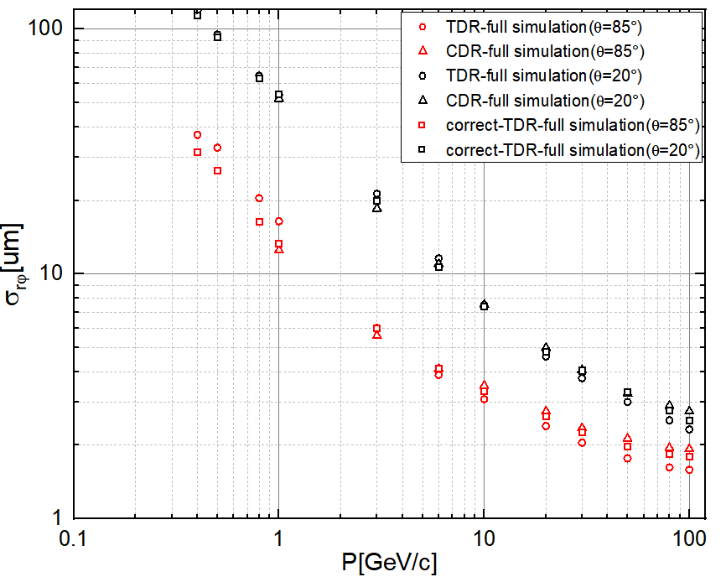

Full Simulation of different structures (CDR vs reference TDR long barrel design)
$δd_{0}$随出射粒子动量的变化
The correct-TDR-full simulation and CDR, following from the single-point resolutions as CDR
the impact parameter $d_{0}$ exhibits similar performance as the momentum changes.

Slide 13
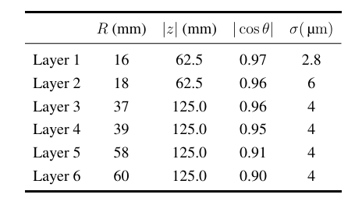
Full Simulation of different structures (CDR vs reference TDR long barrel design)
$δd_{0}$随出射粒子动量的变化
By CEPCSW
The correct-TDR-full simulation and CDR, following from the single-point resolutions as CDR
the impact parameter $d_{0}$ exhibits similar performance as the momentum changes.

Slide 14
VTX像素芯片功耗分布估算
(from Weiwi,Ying)
估算说明：
太初3芯片：180 nm工艺，电源1.8 V;
65 nm芯片：电源1.2 V;
Data rate@Triggless-CDR: 4.48 Gbps /chip
bunch spacing (min.): 25 ns需要快前沿前端
Data rate@Triggless-TDR (Low Lumi):
1 Gbps/chip
Low Lumi@TDR: bunch spacing ~几百ns，像素前端不需要快前沿，Matrix功耗可降低到60 mW
 | Matrix | Periphery | DataTrans. | DACs | Total Power
太初3芯片 @ triggerless (CDR) | 304 mW | 135 mW | 206 mW | 10 mW | 655 mW
65nm 芯片 @ 1 Gbps/chip (TDR LowLumi) | 60 mW | 80 mW | 36 mW | 10 mW | 186 mW

Slide 15
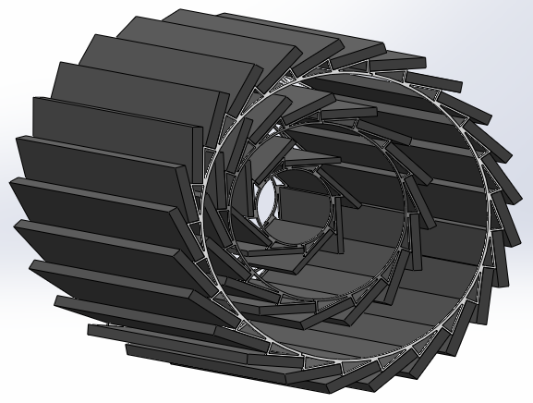
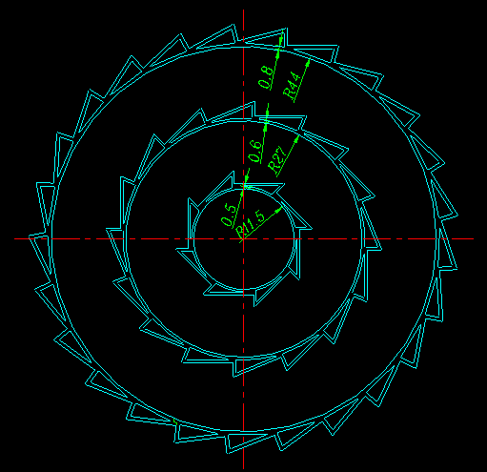
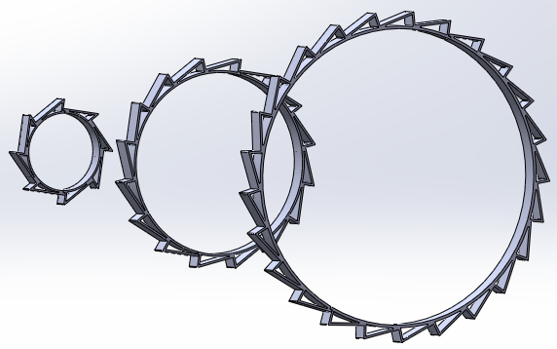
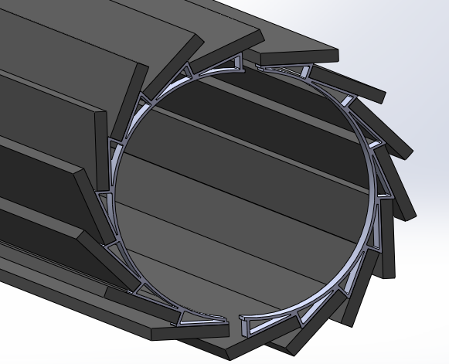
VTX assembly
Support rings / Al alloy
Ladder can be glued / bolted to the support ring. Gluing will save space to make the ratchet teeth hollow, which helps ventilation, currently we prefer this method.
Two methods to assemble the VTX:
Assemble the barrel in advance (consisting of two halves), and then install the barrel on the beam tube.
Install (or machined) the support rings on beam pipe in advance, then directly install the ladders (preferred).
Notes:
Ratchet shaped support ring The ratchet teeth is hollow, this is not only for reducing the materials due to the support ring is outside the acceptance. It is mainly used for air ventilation, the end of ladder is kind of blocked .

Slide 16
Air Cooling of vertex detector
Beam pipe temperature is very important for vertex inner layer cooling
  With thermal conduct from beam pipe, it brings down temperature
  We now assume 16 Celsius as beam pipe temperature
Final goal: ~20°C
  Middle and outer layer are likely to reach the goal by further optimization
  Inner layer still need significant improvement
Barrel layer | # of ladder | Max temperature (Celsius)
 |  | 40mW/cm2
Inner layer w/wo beam pipe Temperature | 8 | ~25°C(w thermal glue) / 49 (wo thermal glue)
Middle | 16 | 28°C
Outer | 25 | 30°C
From Jinyu Fu
Total heat generation of the VTX is 337W, assuming 40mW/cm²

