Slide 1
CEPC Time of flight and outer tracker with LGAD
Yunyun Fan
Tuesday, June 11, 2024

Slide 2
Outline
Optimize the geometric design of the barrel
The preliminary design of AC-LGAD endcap
Summary

Slide 3
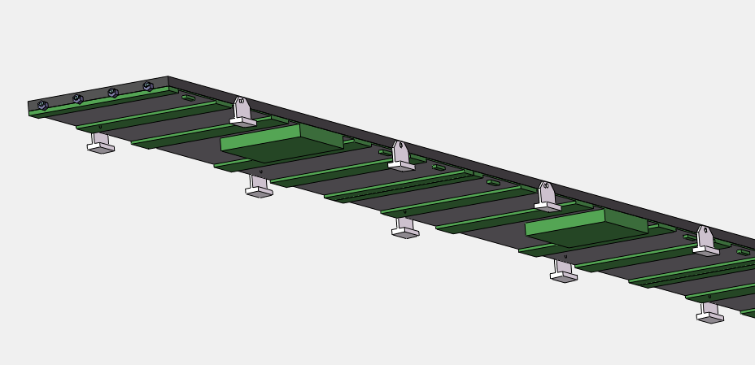
Re-estimate the Electronics Thickness
Region 1
Ladder 2D module
Y
R
X
Y
Detail thicknesses of different regions
The thickness of the region 1：4.6mm
PCB：1.6 mm
ASIC：3 mm
The thickness of the region 2:
一级汇总供电：3 mm
PCB：1.6 mm
The thickness of the region 3：14.6 mm
电源模块：6 mm
光电复合电缆：5mm
弯折走线空间：2mm
PCB：1.6 mm
The thickness of the region 4：6 mm
柔性板厚度：1 mm
二级汇总电缆：5 mm （高低压供电，光纤）
Region 2
Region 3
Region 4
Thickness of electronics + sensor:
25 mm -> 15.1 mm
Total thickness of ToF:
85 mm -> 58 mm
Ladder 3D module

Slide 4
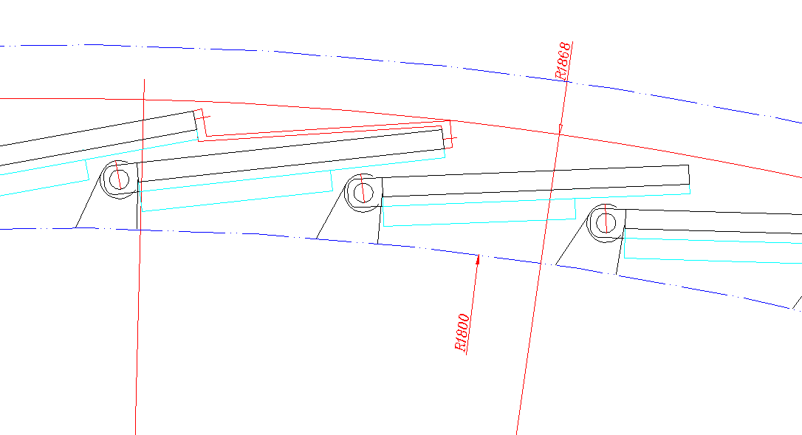
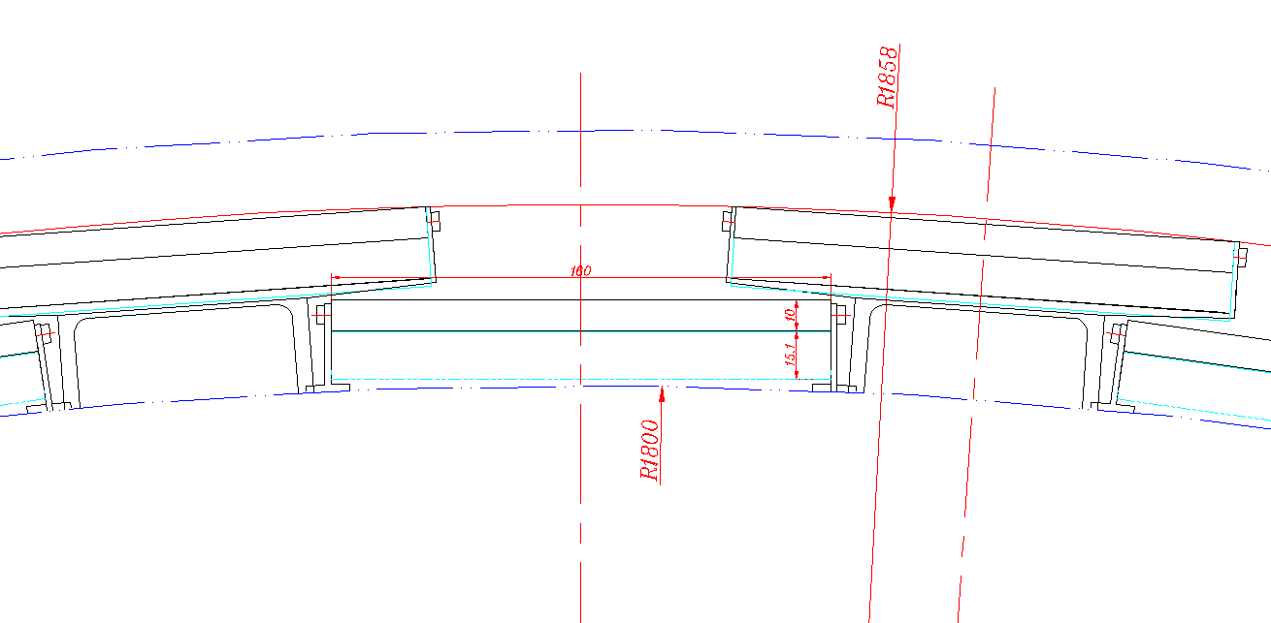
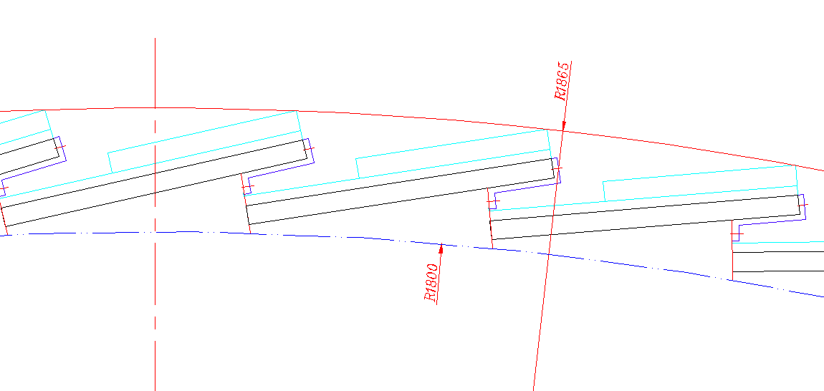
Optimization of the Barrel Design
From：付金煜
Three arrangement of the ladder
G2:$∆$R = 68 mm
G1:
$∆$R = 58 mm （The Best arrangement）
Sensor towards the IP
G3: $∆$R = 65 mm

Slide 5
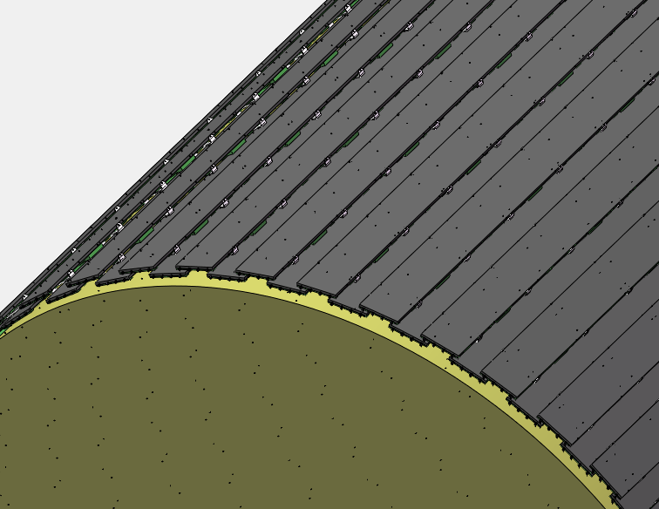
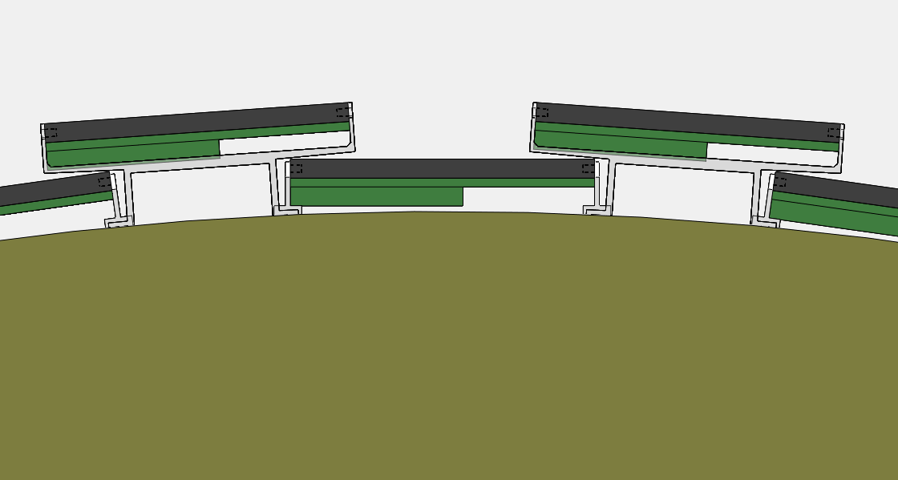
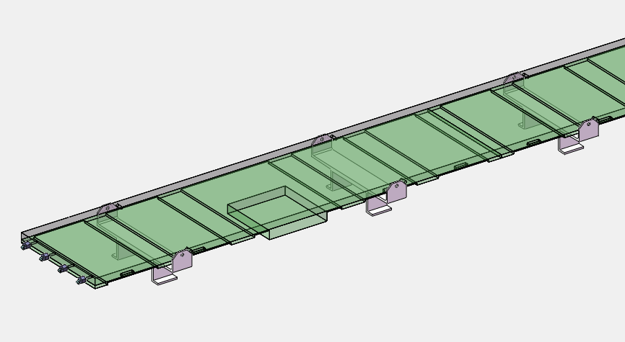
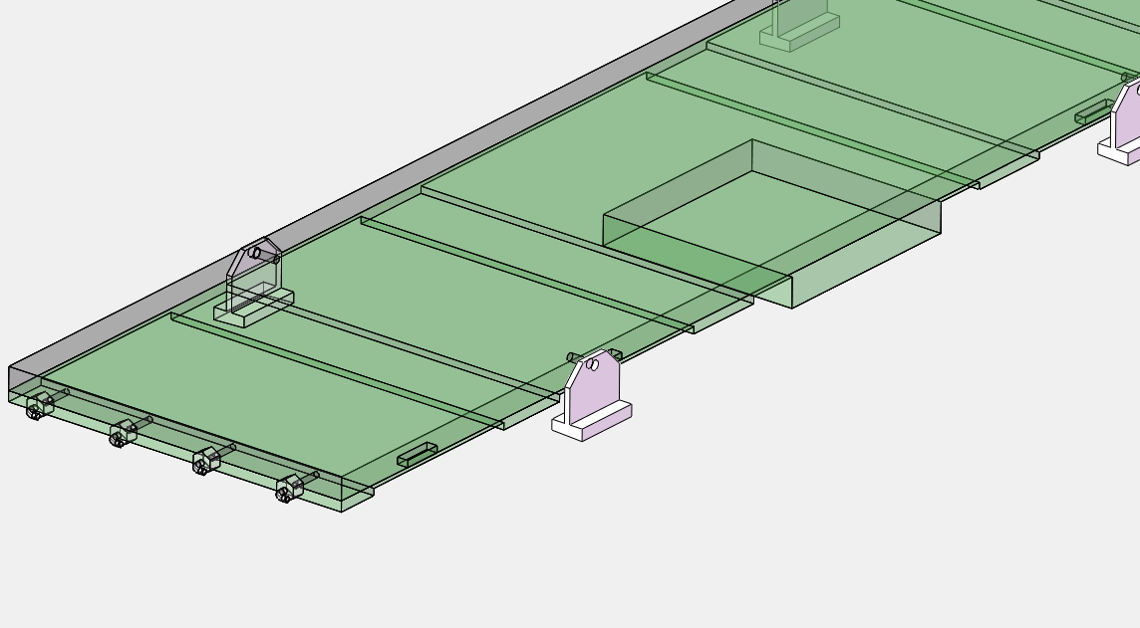
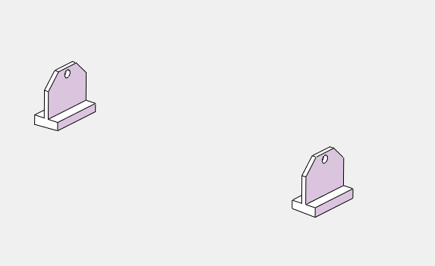
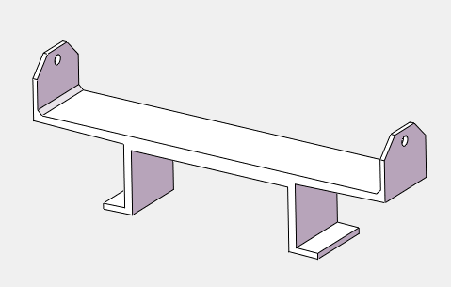
3D module of the Barrel
From：付金煜
d
Higher Ladder
Lower Ladder

Slide 6
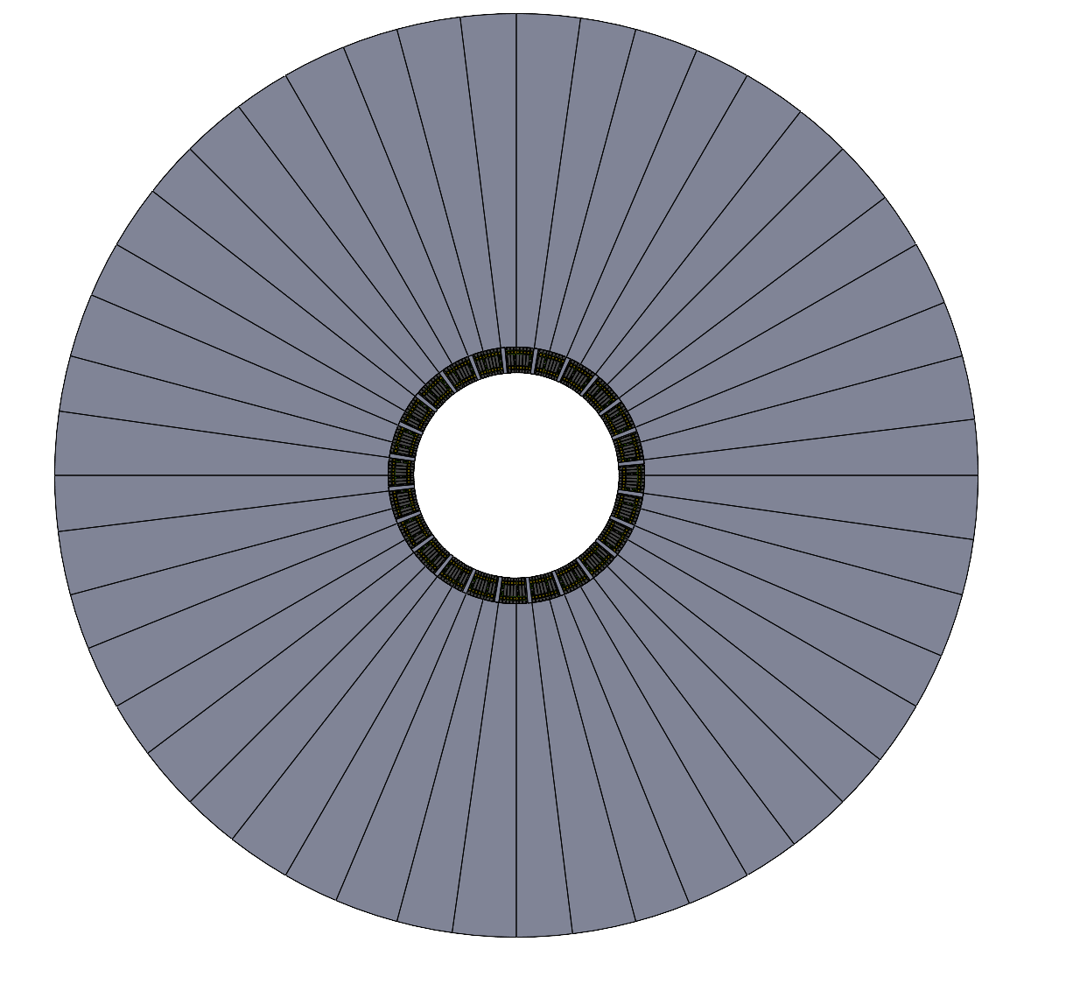
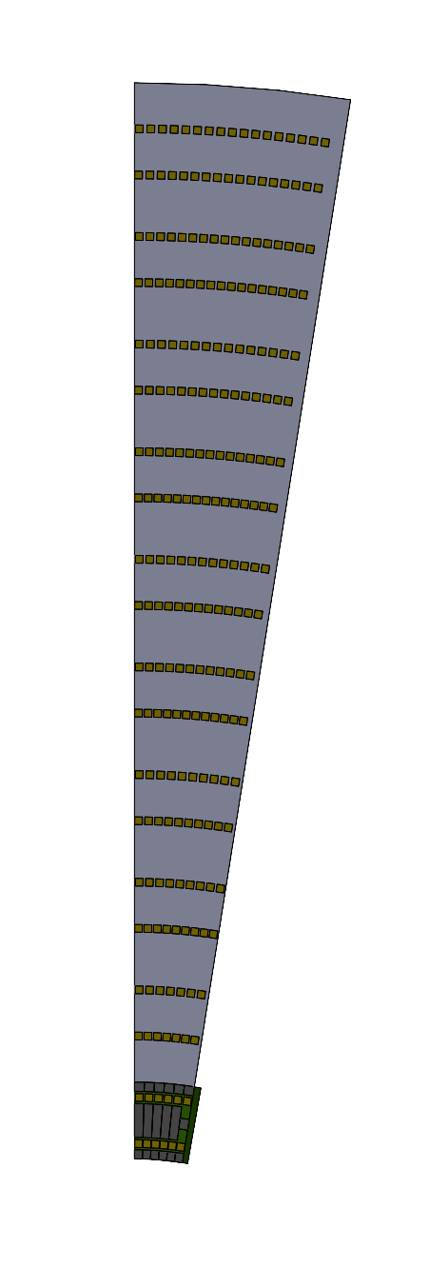
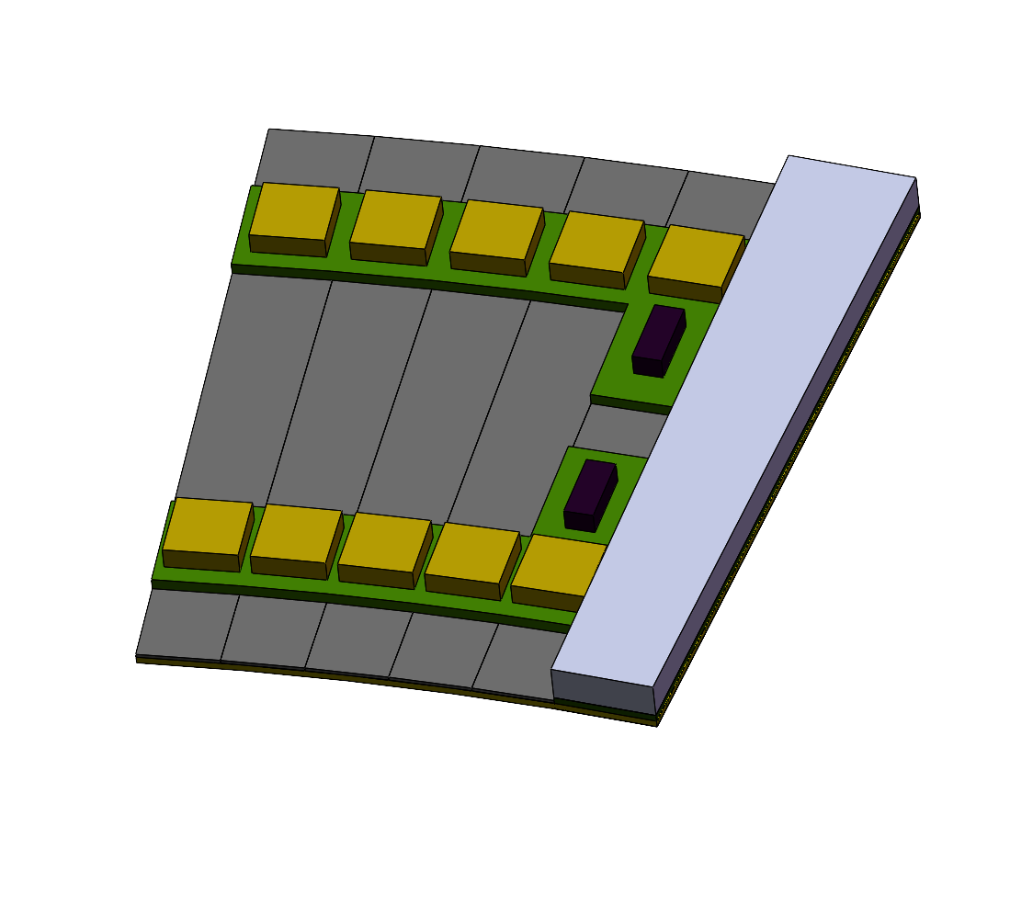
Endcap design 1
Petal
Disk
235.5 mm
Double layers to reduce the dead area
24 petals/layer
10 rows/petal，
7.5º per row，
Overlap 0.5º/petal
R10
20 ASIC
Double layers arrangement
140 mm / row at R direction， same pitch （100 um）
The differences between the ASIC number of R10 and R1 ：20 ASIC /4 ASIC = 5
Sector Module per row
70 mm
R0: 52.36mm-70.69mm
R1
4 ASIC
～52.4mm

Slide 7
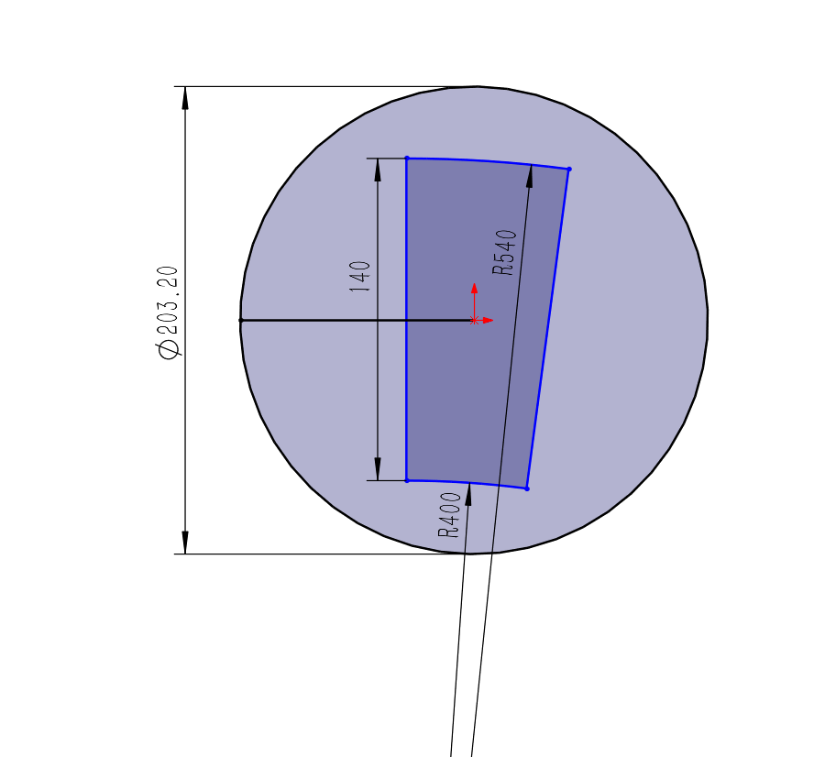
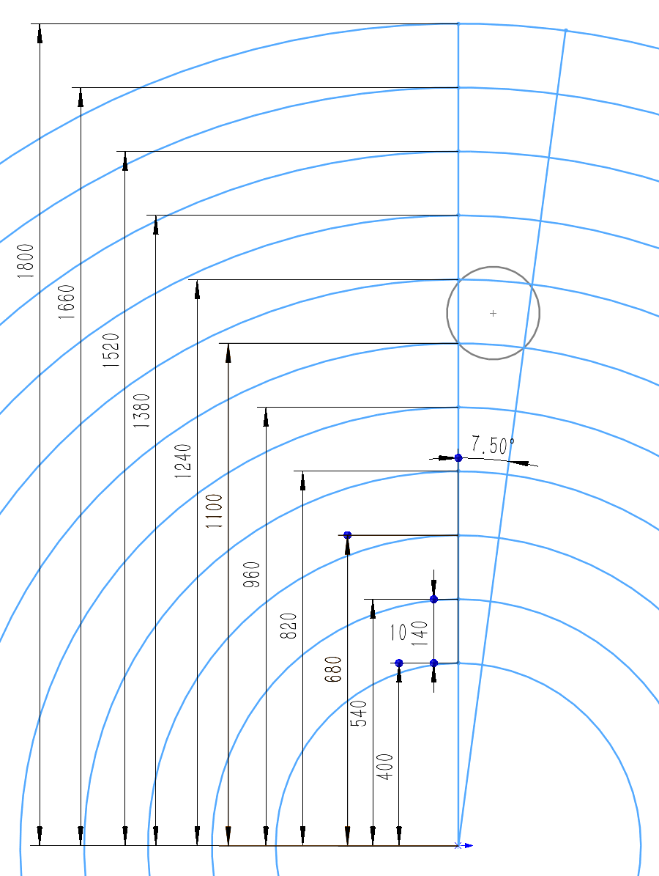
Sensor Arrangement and the readout channel
Sensor in the 8 inch wafer
Old number
 |  | Maxmum Arc（mm） | Readout channel number | Sensor number | Hit Rate Hz/cm²
R0（400-540） | 52.36 | 70.686 | 707 | 1 | 10⁵
R1：540-680 | 70.69 | 89.012 | 891 | 1 | 10³
R2：680-820 | 89.012 | 107.338 | 1074 | 1 | 10²
R3: |  | 125.664 | 1257 | 1 | 20
R4 | 125.664 | 143.990 | 1440 | 1 | 20
R5 |  | 162.316 | 1624 | 2 | 20
R6 |  | 180.642 | 1807 | 2 | 20
R7 |  | 198.968 | 1990 | 2 | 20
R8 |  | 217.294 | 2173 | 2 | 20
R9：1660-1800 |  | 235.620 | 2357 | 2 | 20
位置分辨：10 um （最大pitch 100 um）

Slide 8
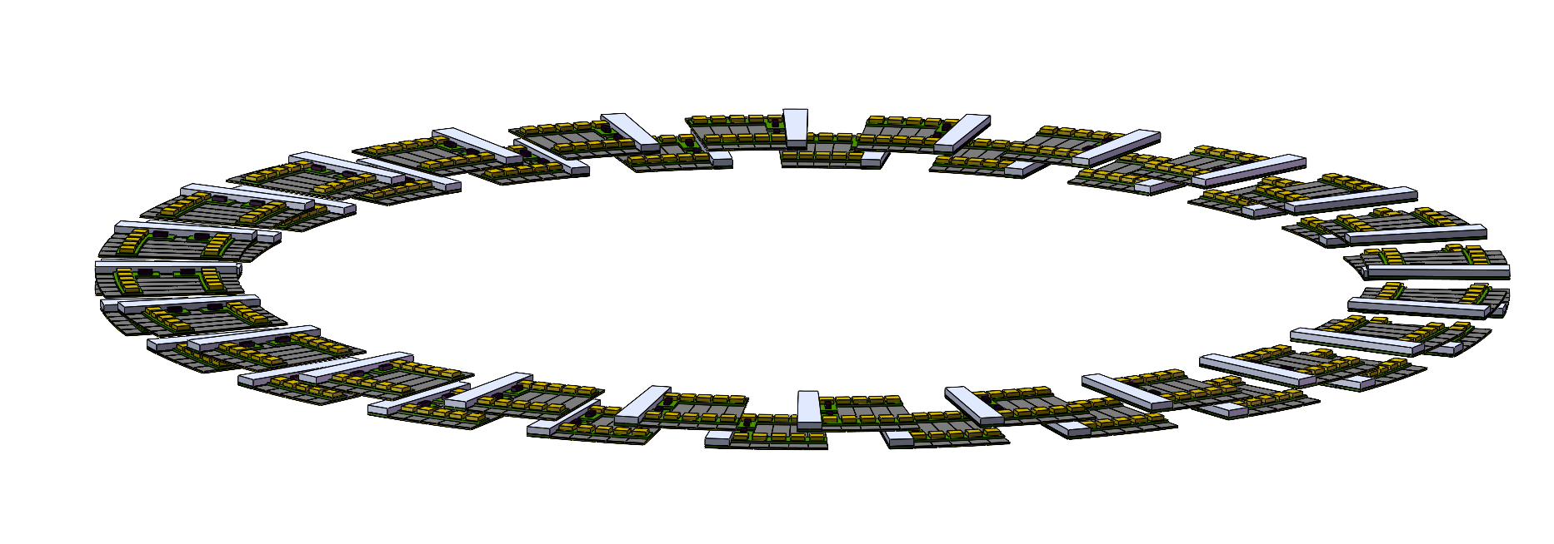
Endcap design
Need to consider the details of the mechanics
Need detailed electronics design （How different from the barrel？）
Arc PCB
Hit rate of each channel and ASIC
Cluster size？
TOA TOT
Impedance matching
Arc LGAD sensor
leakage current
Different pitch
3D arrangement of endcap

Slide 9
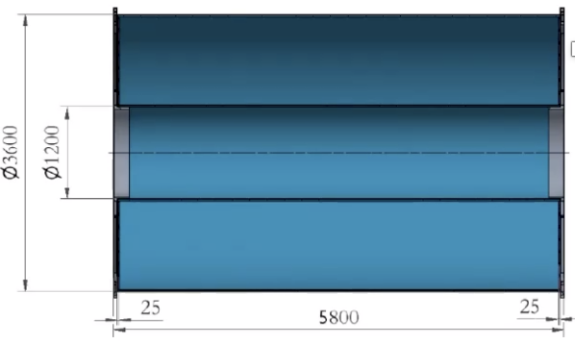
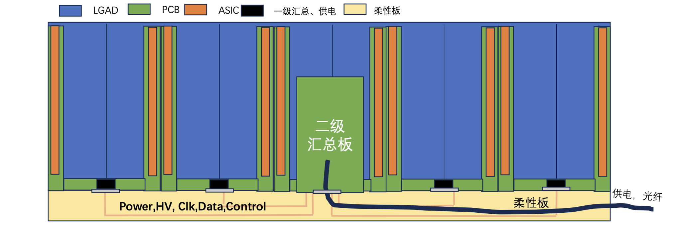
Summary and questions
Decrease the thickness of barrel from 85 mm to 58 mm
Get the preliminary design of the endcap.
Need to discuss about the longer TPC at the endcap(> 1800mm problem)
Need to know the spatial resolution in the z direction(beam direction) ?(important to the power density of electronics )
TPC

Slide 10
Backup

Slide 11
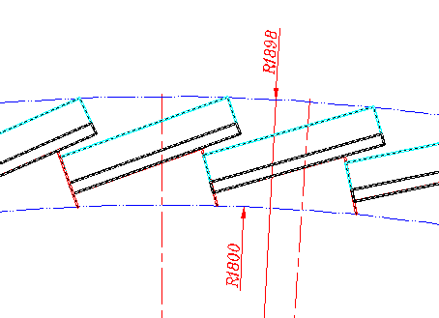
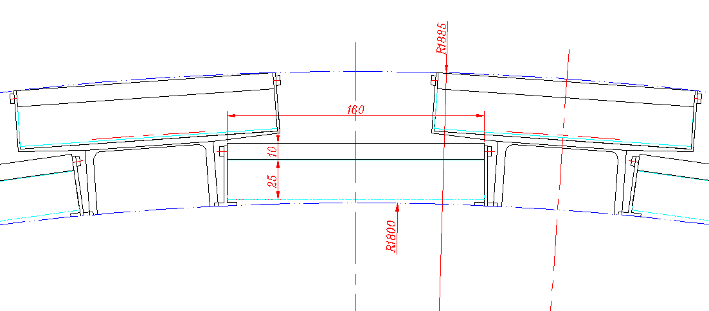
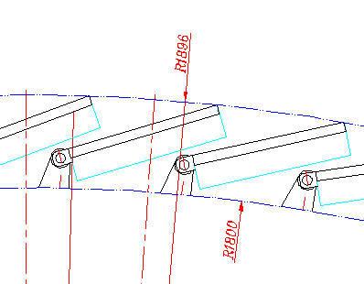
Geometric layout: Barrel-OTk
TPC is limited within R = 1.8 m
LGAD: minimum radial requirement is 85(58) mm (R1800-1858 mm) after comparing different deployments
two layers of ladders
ladder thickness 35 （25.1 mm） mm: 25 （15.1）mm of sensors and electronics, 10 mm of support embedded with cooling tubes
best option

Slide 12
Need reasonable hit rate at endcap
Need reasonable hit rate at endcap
The present rate 10⁵ hit/cm2（from haoyu ） is too high to realize at ASIC side

Slide 13
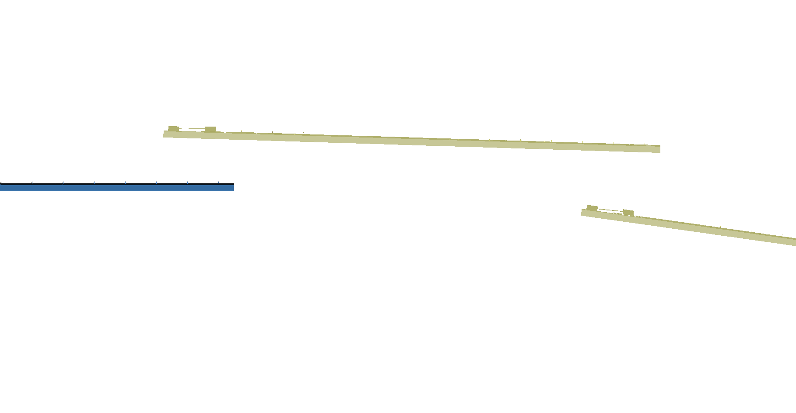
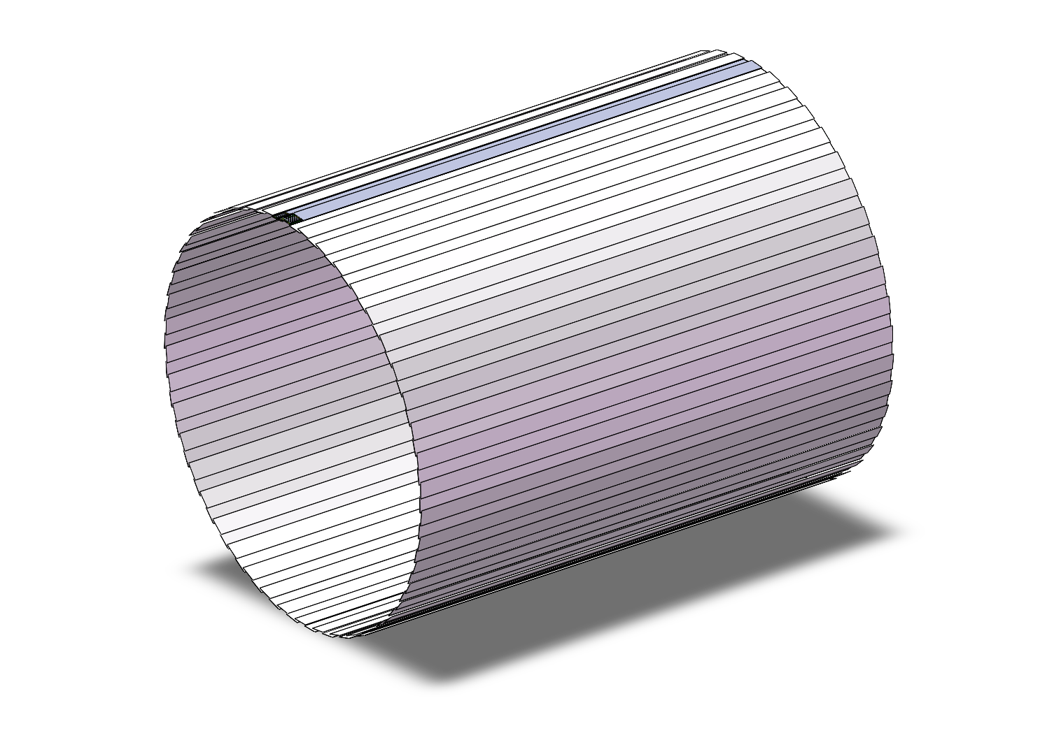
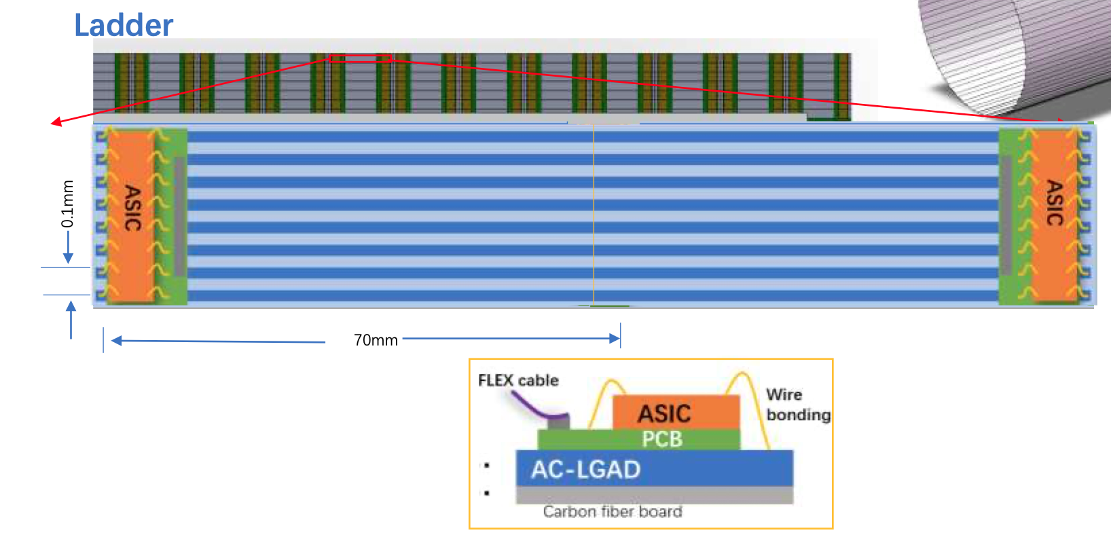
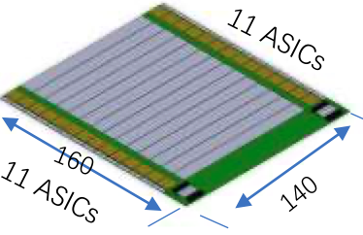
Arrangement of the ToF with strip LGAD：Barrel
One layer ToF
R= 1800 mm
H～5800mm
One layer: 3780 modules
90 ladders，45 ladders each side,
42 modules/ladder，
22 ASIC/module，128 Channel/ASIC
Module
140mm x 160mm

Slide 14
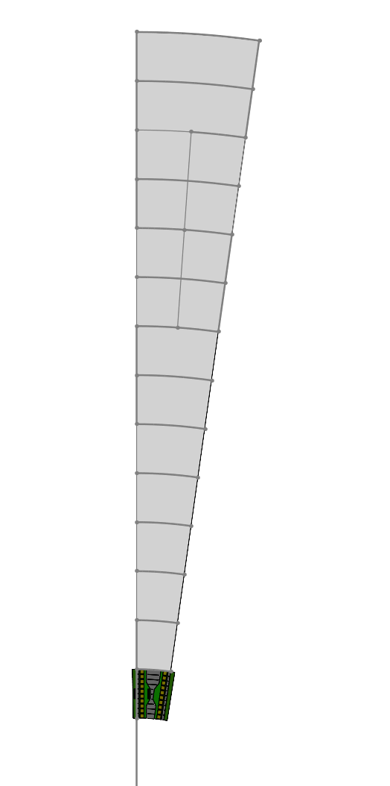
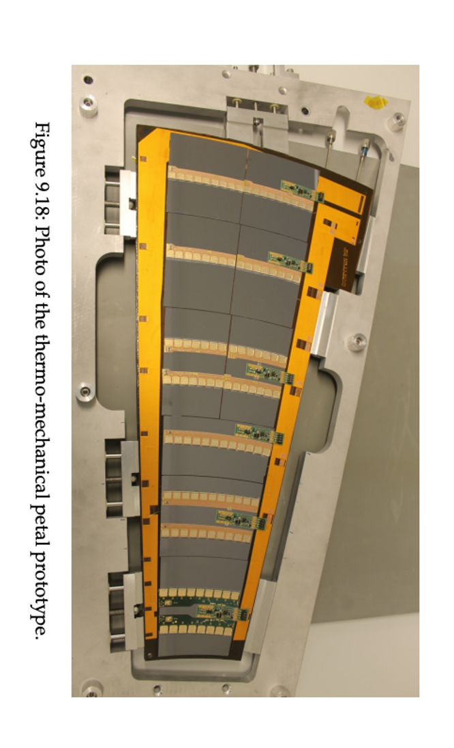
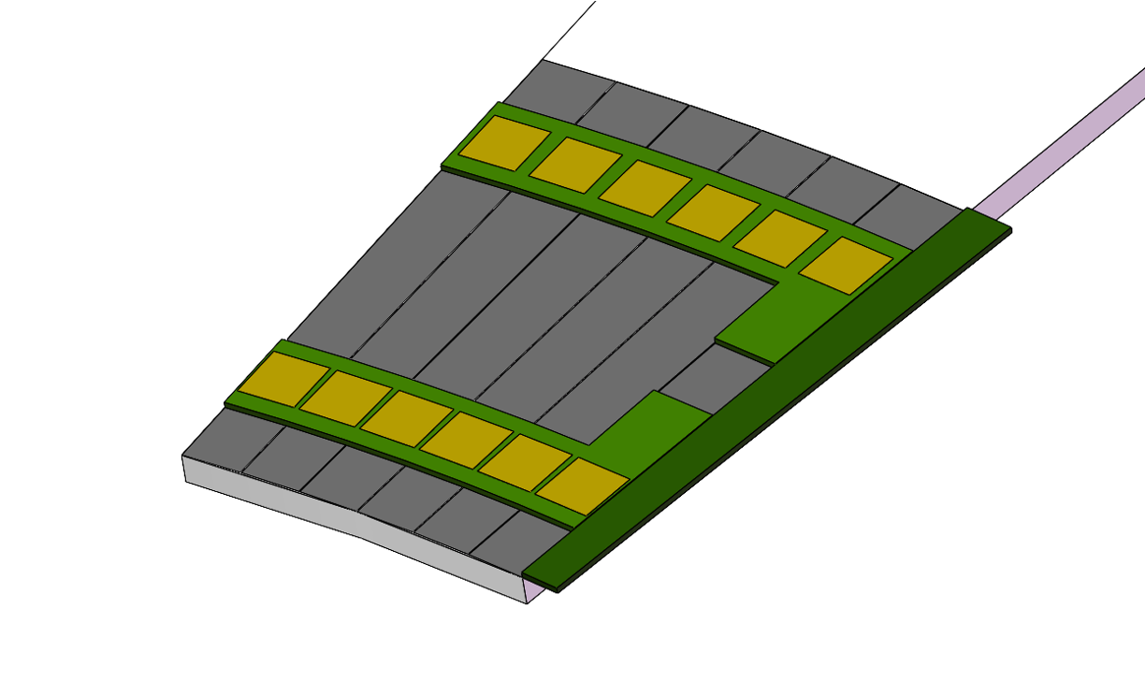
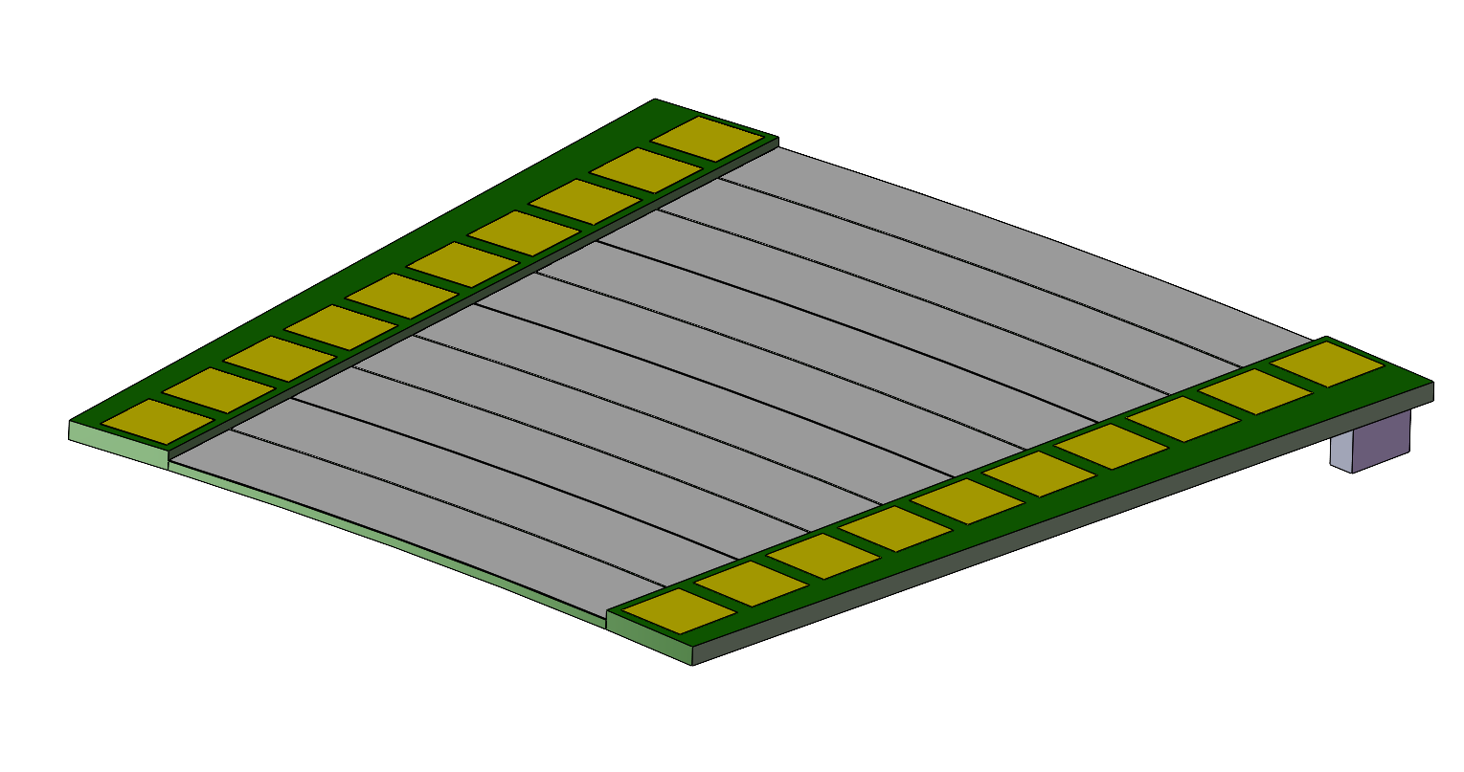
Arrangement of the ToF with strip LGAD ：Endcap
Petals： one petal each 8°× 45 = 360°
Total modules：~ 450 (14cm × )
R：400 mm - 1800 mm
8°
Module
Longest side：140mm

Slide 15
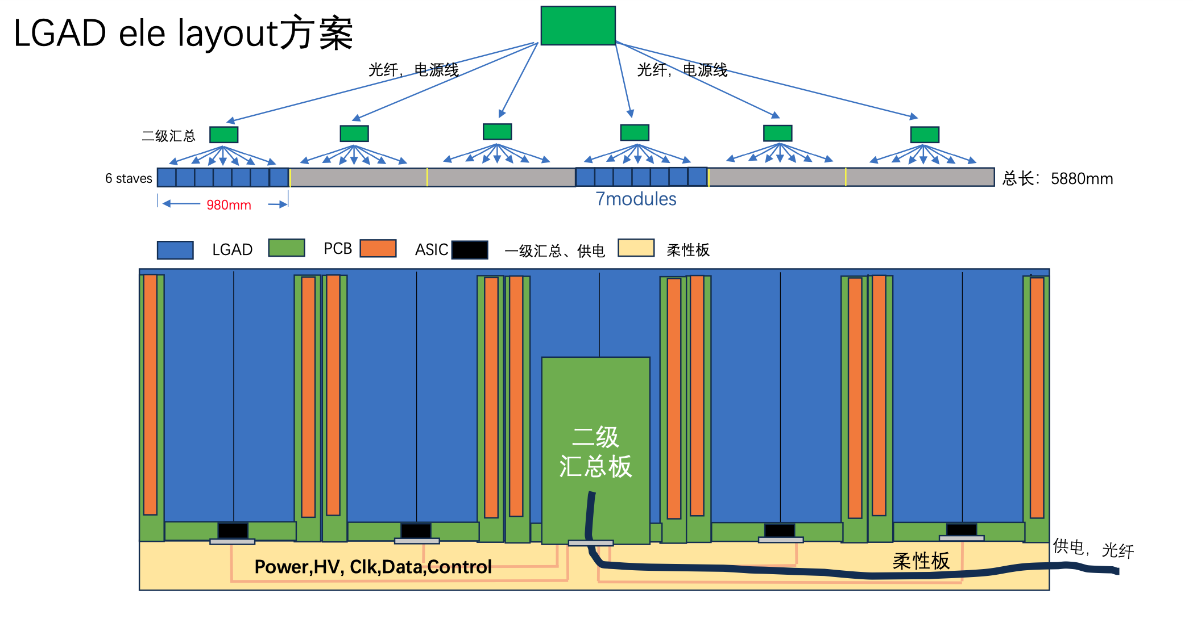
Layout of the Electronic System for LGAD ToF & oTracker

Slide 16
Re-estimate the Electronics Thickness
Region 1
Thickness of electronics + sensor:
25 mm -> 15.1 mm
Total thickness of ToF:
85 mm -> 58 mm
Detail thicknesses of different region
The thickness of the region 1：4.6mm
PCB：1.6 mm
ASIC：3 mm
The thickness of the region 2:
一级汇总供电：3 mm
PCB：1.6 mm
The thickness of the region 3：14.6 mm
电源模块：6 mm
光电复合电缆：5mm
弯折走线空间：2mm
PCB：1.6 mm
The thickness of the region 4：6 mm
柔性板厚度：1 mm
二级汇总电缆：5 mm （高低压供电，光纤）
Region 3
Region 4
Region 2
Region 1
Y
Z

Slide 17
Detector Impact – Vertex -- Higgs
Preliminary results. Without any safety factor. Take the highest bin value as result.
Pair Could be used as reference of design, Beam Loss could not. Further optimization/mitigation will be performed.
Result File link:
Pairs: /cefs/higgs/shihy/work/cepc_bkg/Results/Ref-TDR/20240312/Higgs/Pairs.root
BeamLoss: /cefs/higgs/shihy/work/cepc_bkg/Results/Ref-TDR/20240312/Higgs/BeamLoss.root(available when exists)
 | Higgs
BXRate(Hz) | 1.34e6
Layer | Hit Density($kHz∙cm^{−2}$) |  | TID(k$rad⋅yr^{−1}$) |  | 1 MeV equivalent neutron fluence ($n_{eq}×{10}^{12}⋅cm^{−2}⋅yr^{−1}$)
 | Pair | Beam Loss | Pair | Beam Loss | Pair | Beam Loss
1 | 760 | 110.0634 | 185 | 75.28 | 1.8 | 0.20506
2 | 490 | 90.1943 | 112 | 62.51 | 1.75 | 0.16436
3 | 70 | 45.72336 | 6.4 | 12.63 | 0.01 | 0.030855
4 | 66 | 43.73305 | 5.4 | 12.08 | 0.01 | 0.030824
5 | 42 | 27.91237 | 1.1 | 3.15 | 0.004 | 0.007239
6 | 40 | 27.60218 | 1.0 | 3.34 | 0.004 | 0.010251

Slide 18
Detector Impact – Vertex – Z-pole
Preliminary results. Without any safety factor. Take the highest bin value as result.
Pair Could be used as reference of design, Beam Loss could not. Further optimization/mitigation will be performed.
Result File link:
Pairs: /cefs/higgs/shihy/work/cepc_bkg/Results/Ref-TDR/20240312/Z/Pairs.root
BeamLoss: /cefs/higgs/shihy/work/cepc_bkg/Results/Ref-TDR/20240312/Z/BeamLoss.root
 | Z
BXRate(Hz) | 3.93e7
Layer | Hit Density(k$Hz∙cm^{−2}$) |  | TID(k$rad⋅yr^{−1}$) |  | 1 MeV equivalent neutron fluence ($n_{eq}×{10}^{12}⋅cm^{−2}⋅yr^{−1}$)
 | Pair | Beam Loss | Pair | Beam Loss | Pair | Beam Loss
1 | 16200 | 316763 | 8613 | 12198874 | 35.61 | 1081.16
2 | 11400 | 253791 | 5353 | 7569336 | 34.60 | 1252.93
3 | 1490 | 133919 | 252 | 6819307 | 0.5 | 555.51
4 | 1410 | 161755 | 232 | 7585843 | 0.45 | 609.69
5 | 825 | 100452 | 67.0 | 3660636 | 0.16 | 318.95
6 | 786 | 102476 | 59.6 | 3408929 | 0.14 | 592.95

Slide 19
R10
7.5度
10列，每列140mm 长, Asic 数量差：
最长弧度/最短弧度（282.6mm （3 strip sensors）/62.8mm（1 strip sensors））=4.5
9度
10列，每列140mm 长,
R10和R1 的Asic 数量差：
23 ASIC /5 ASIC 约 4.5倍差
R1

Slide 20
Endcap design 1
282.6 mm
Double layer to reduce the dead area
20 petals/layer
10 row/petal，
9º per row，
R10
23 ASIC
140 mm / row at R direction， same pitch （100 um）
The differences between the ASIC number of R10 and R1 ：23 ASIC /5 ASIC = ~ 4.5
4 module，maximum arc < 140 mm
10 module, maximum arc > 140 mm
R1
5 ASIC
62.8mm

Slide 21
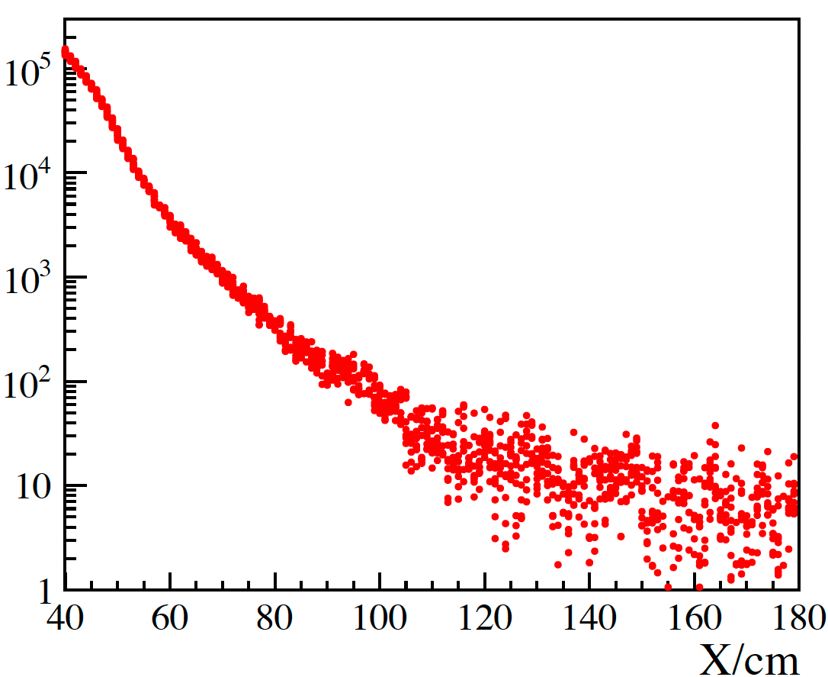
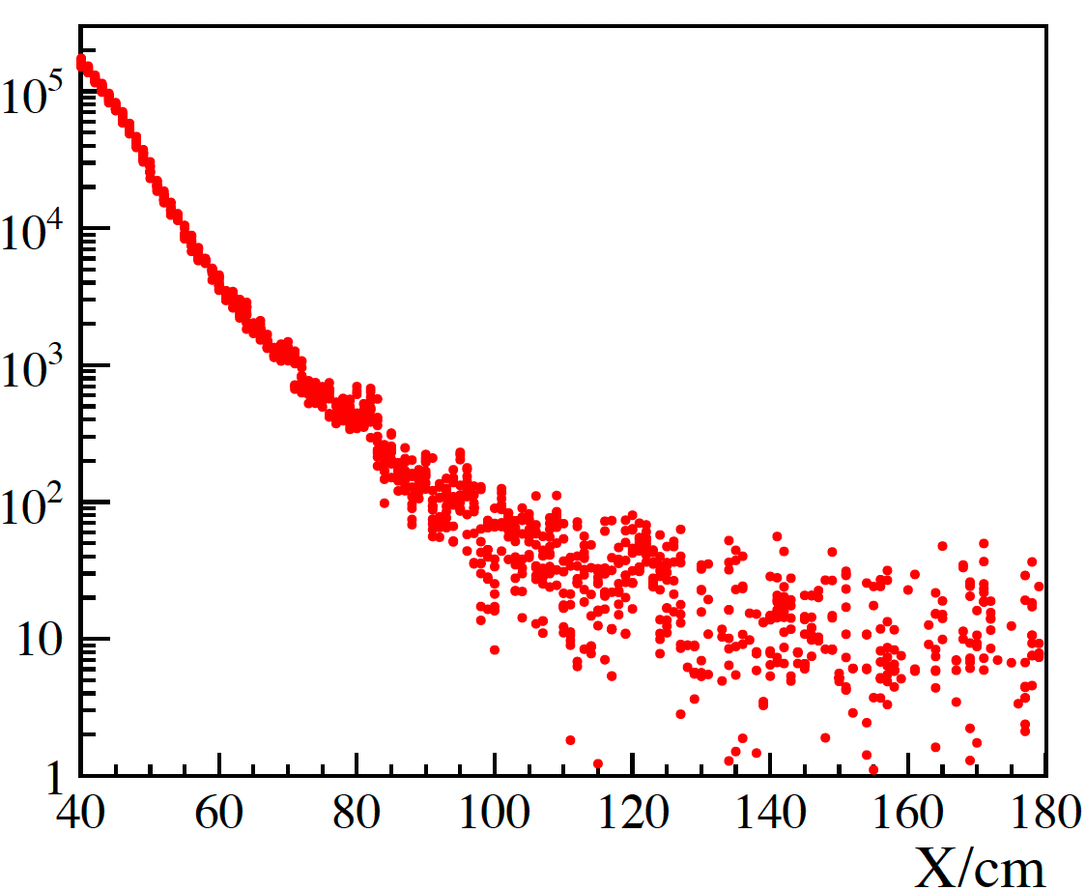
CEPC TOF
One layer ToF
R= 1800 mm
H～5800mm
Pair production background from Haoyu
Need to updated with new version of CEPCSW
Rate( Hz/cm2)
Rate( Hz/cm2)
ZH runs
Z pole (high lumi)

Slide 22
7.5º
Radius | Arc (mm)
400 | 52.36
470 | 61.52
540 | 70.69
610 | 79.85
680 | 89.01
750 | 98.17
820 | 107.34
890 | 116.5
960 | 125.66
1030 | 134.83
1100 | 143.99
1170 | 153.15
1240 | 162.32
1310 | 171.48
1380 | 180.64
1450 | 189.8
1520 | 198.97
1590 | 208.13
1660 | 217.29
1730 | 226.46
1800 | 235.62

Slide 23
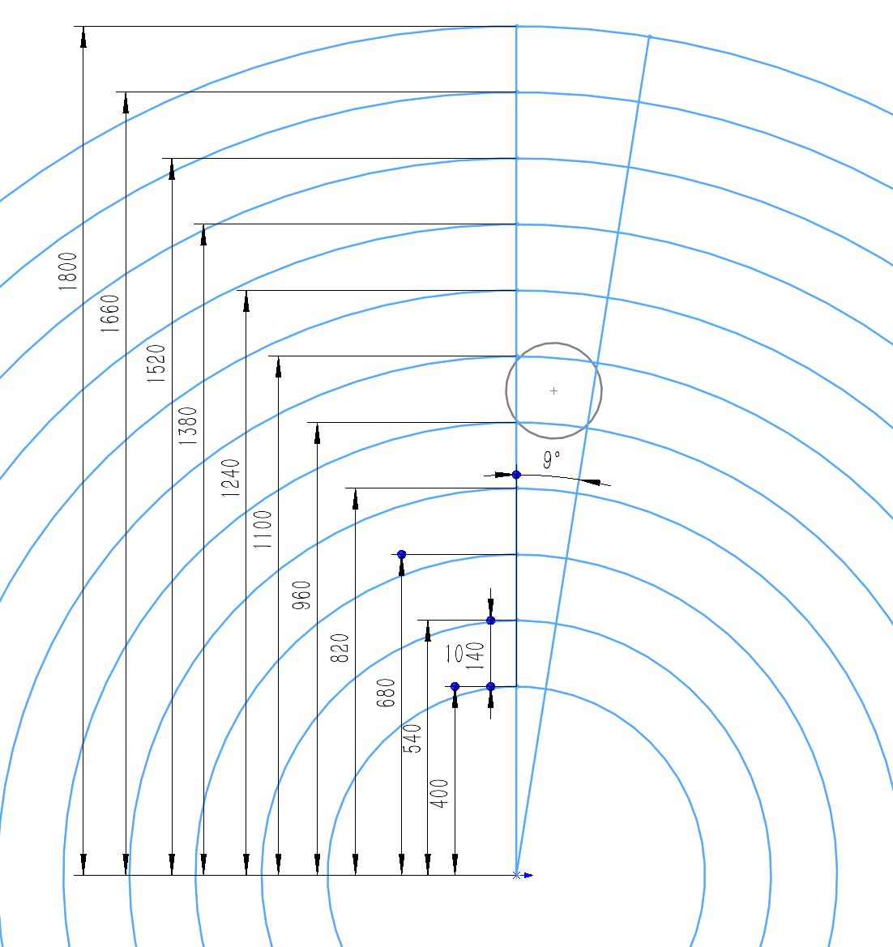
Petal with 9º
^{5 single}
^{5 double sensor}

