Slide 1
2306.17830
Dian-Wei Wang
2024.06.07

Slide 2

ALP domain wall
Axion potential – via dark $SU(N_{d})$ gauge coupling
where
Effective potential
kink solution
surface tension

Slide 3
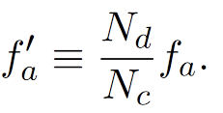
ALP domain wall
Bias – via QCD
Effective potential
bias
at finite temperature

Slide 4
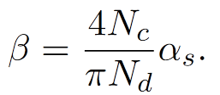
ALP domain wall
friction – before QCDPT
friction from gluon
where for ($+$/$−$) helicity
$$+$$
$$−$$
$$−$$

Slide 5
ALP domain wall
friction – after QCDPT
friction from pion
reflection probability
friction pressure

Slide 6
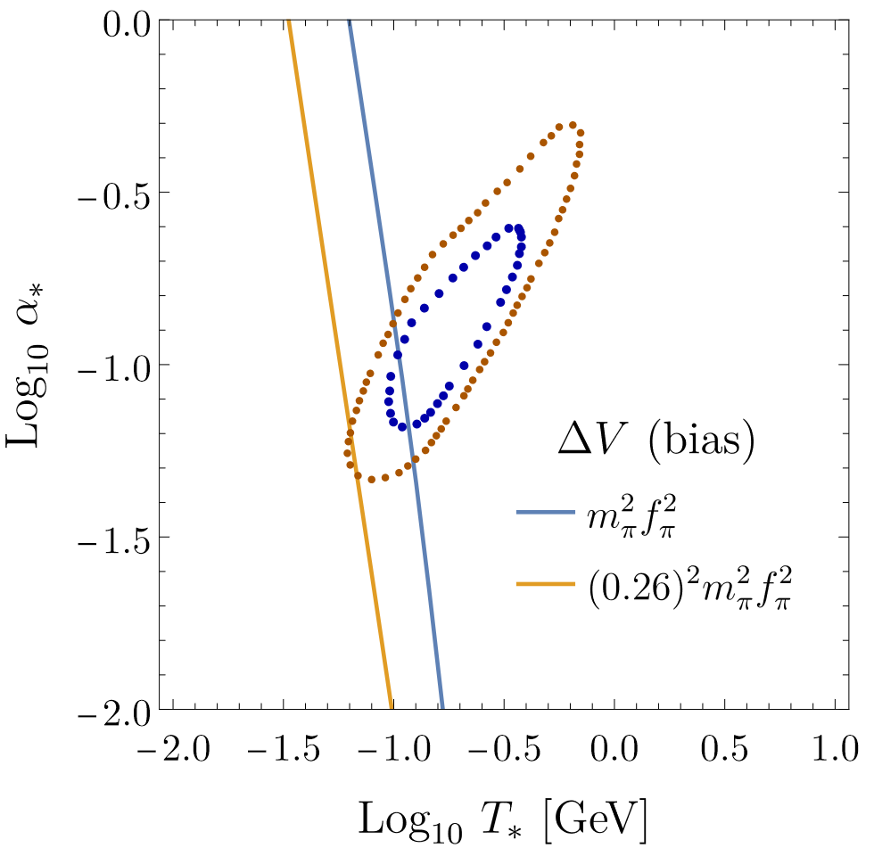
About GW
NANOGrav prediction
Hubble dominate: scaling, $ρ_{DW}∝σ_{DW}H$
bias dominate: domain wall annihilate

Slide 7
ALP domain wall
bias, friction, and Hubble parameter
Hubble dominate: scaling, $ρ_{DW}∝σ_{DW}H$
bias dominate: domain wall annihilate
friction dominate: ……?

Slide 8
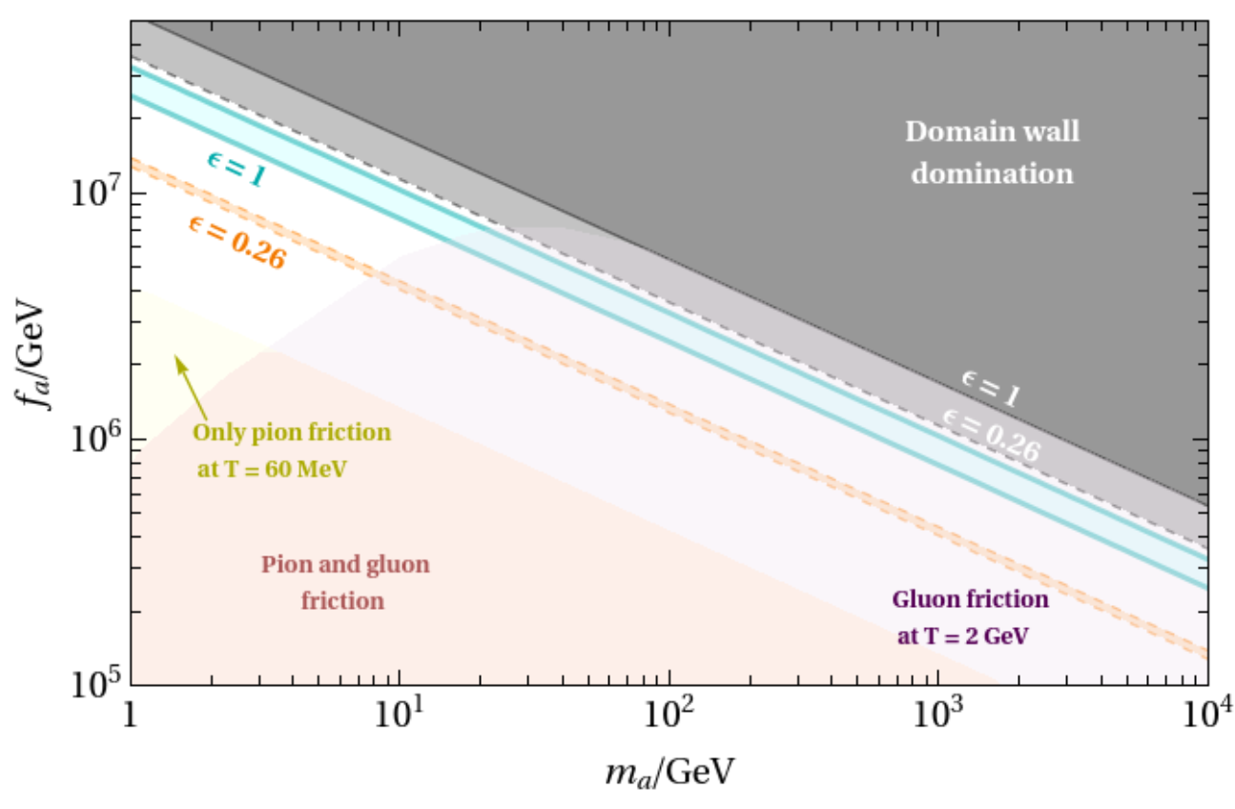
About GW
$m_{a}$ and $f_{a}$ predicted by NANOGrav

Slide 9
Thanks for your listening!
Dian-Wei Wang
2024.06.07

