Slide 1
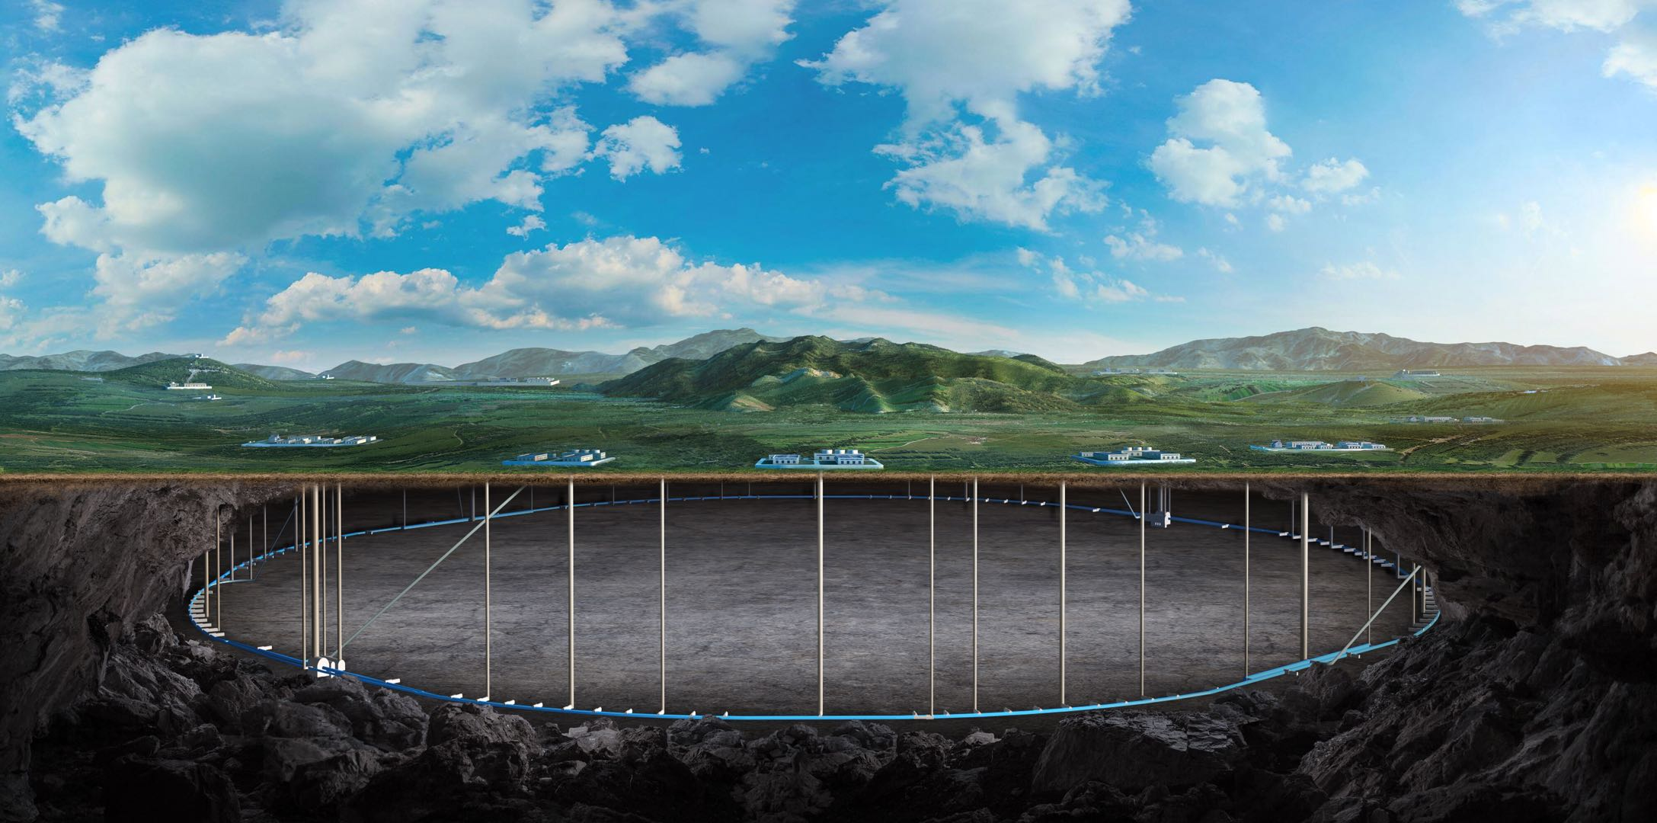
Progress of CEPC EDR superconducting anti-solenoid
Yingshun Zhu
On behalf of CEPC MDI SC magnet system
June.20 2023

Slide 2
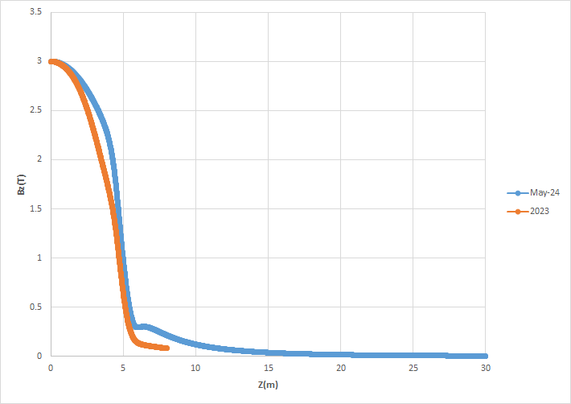
Requirement of superconducting anti-solenoid
The design requirements of the anti-solenoids in the CEPC Interaction Region are summarized below:
1) The total integral solenoid field generated by the detector solenoid and anti-
solenoid coils is zero.
The solenoid field inside Q1a, Q1b and Q2 should be smaller than a few
hundred Gauss at each longitudinal position.
The distribution of the solenoid field along longitudinal direction should meet
the requirement of the beam optics for emittance.
The field of the Detector solenoid is not constant; it decreases slowly.
Field of detector solenoid

Slide 3
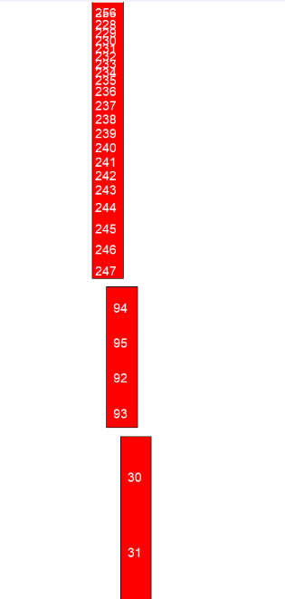
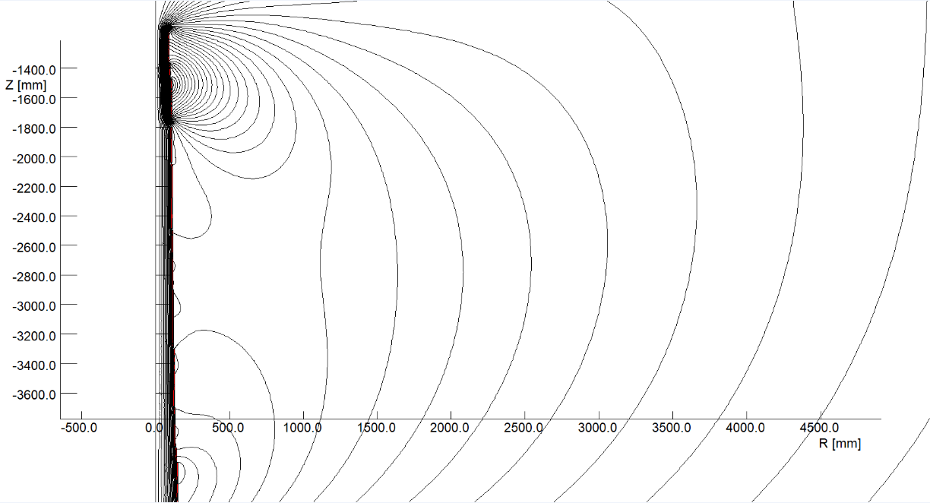
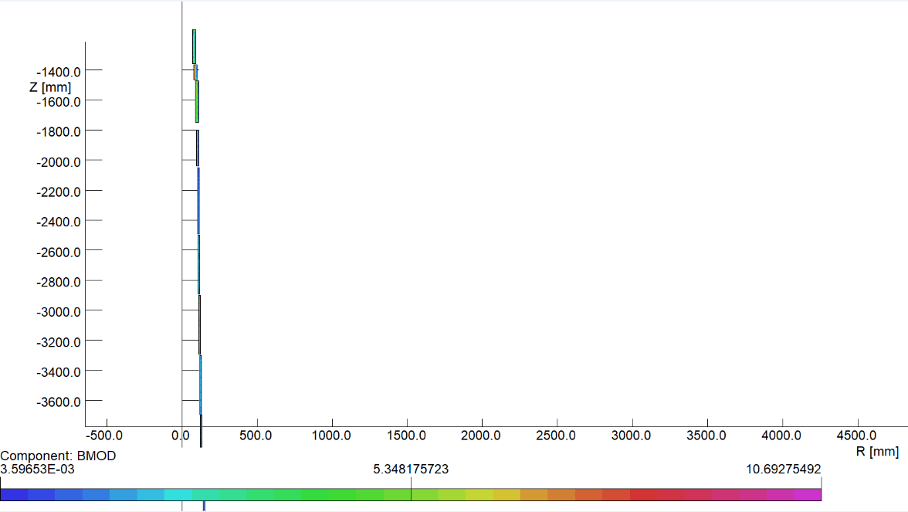
Design progress of superconducting anti-solenoid
In order to reduce the magnet size, energy and cost, the anti-solenoid is divided into more than 100 sections with different inner coil diameters.
The coil radius of anti-solenoid in quadrupole region is smaller than that in TDR. ( radius reduction about 10 to 15mm)
Magnetic field calculation and optimization is performed using axi-symmetric model in OPERA-2D.
The central field of the first section of the anti-solenoid is the strongest, with a peak field of 8.7T @ r=0, and 10.7T in coil.
2D flux lines
Magnetic flux density distribution

Slide 4
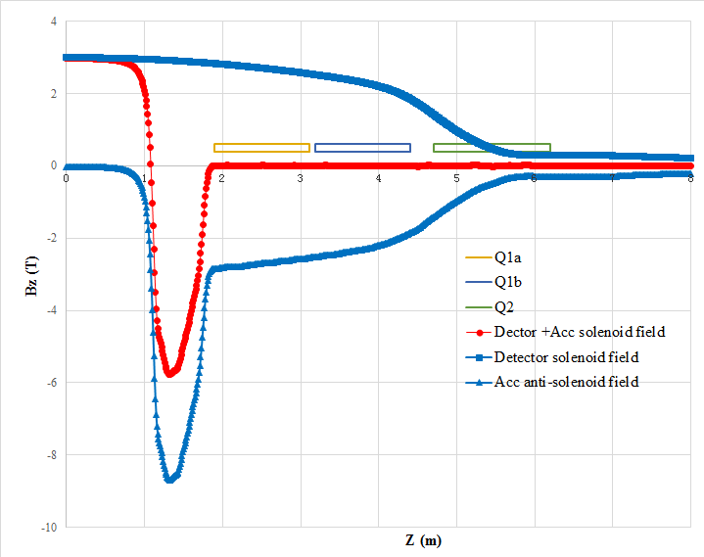
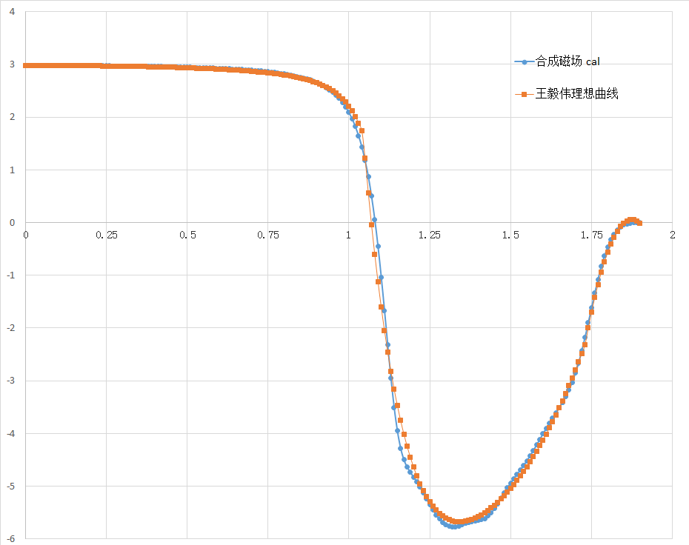
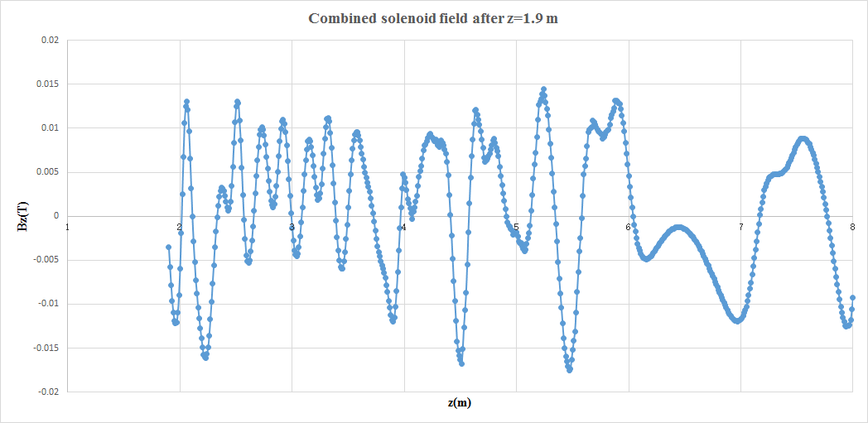
Design progress of superconducting anti-solenoid
Combined field of Anti-solenoid and Detector solenoid is fine tuned.
The total integral solenoid field is almost zero.
The net solenoid field inside quadrupole magnet at each longitudinal position is smaller than 170 Gs.
Combined field
Combined field @z <1.9m
Combined field @z >1.9m

Slide 5
Thanks for your attention!

