Slide 1
Belle和Belle II中国组历史，发展
Chengping Shen
Fudan University
shencp@fudan.edu.cn
Belle II实验冬季学校，南开大学， Nov 24 – 30, 2024

Slide 2
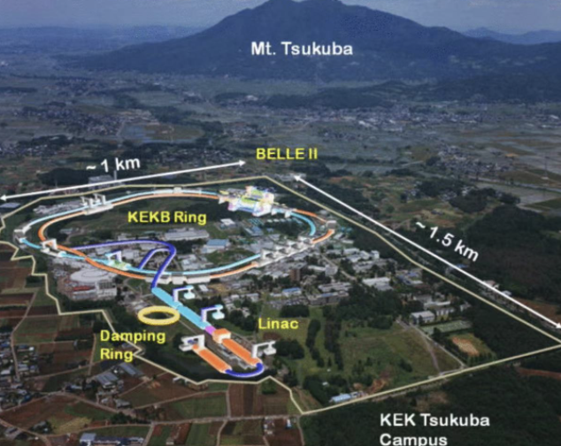
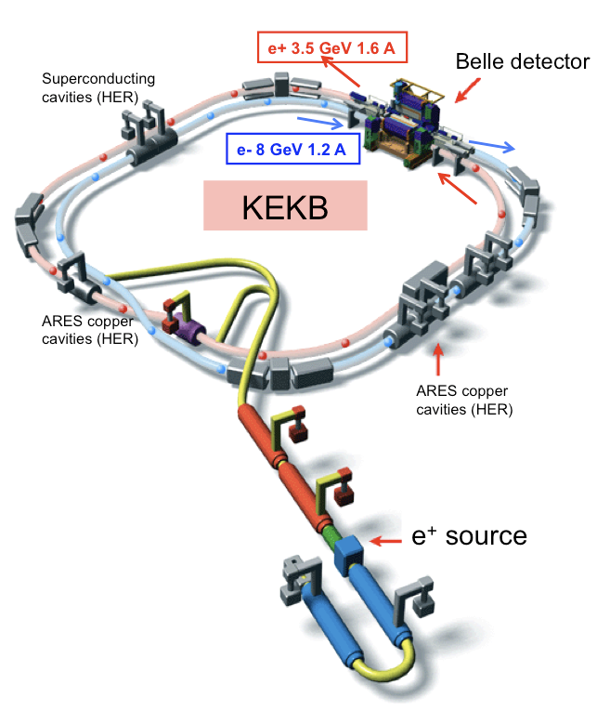
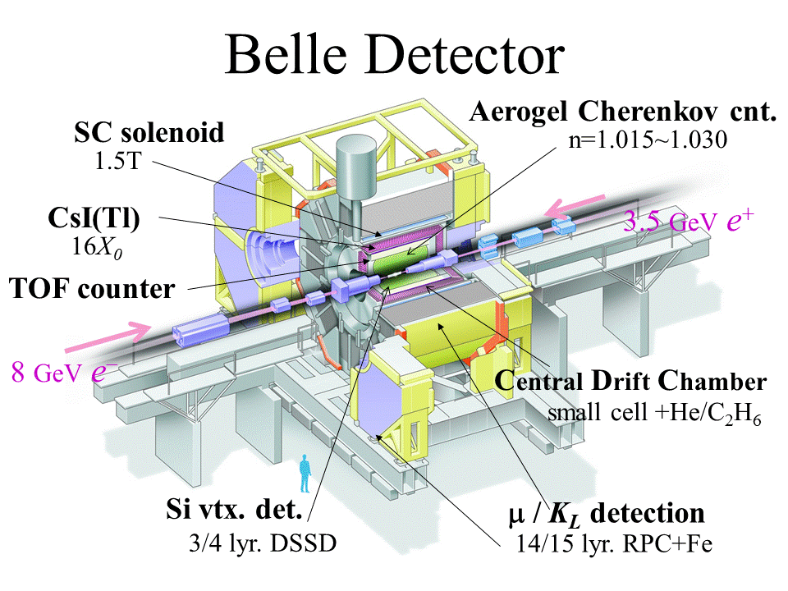
KEKB and Belle
Peak luminosity: $2.11×{10}^{34}cm^{−1}s^{−1}$
Integrated luminosity (~980 fb⁻¹ in total):
$Υ(5S)$: 121 fb⁻¹, $Υ(4S)$: 711 fb⁻¹, $Υ(3S)$: 3 fb⁻¹,
$Υ(2S)$: 25 fb⁻¹, $Υ(1S)$: 6 fb⁻¹, continuum: 90 fb⁻¹
$\sqrt{s} \sim 10.6$ GeV
2

Slide 3
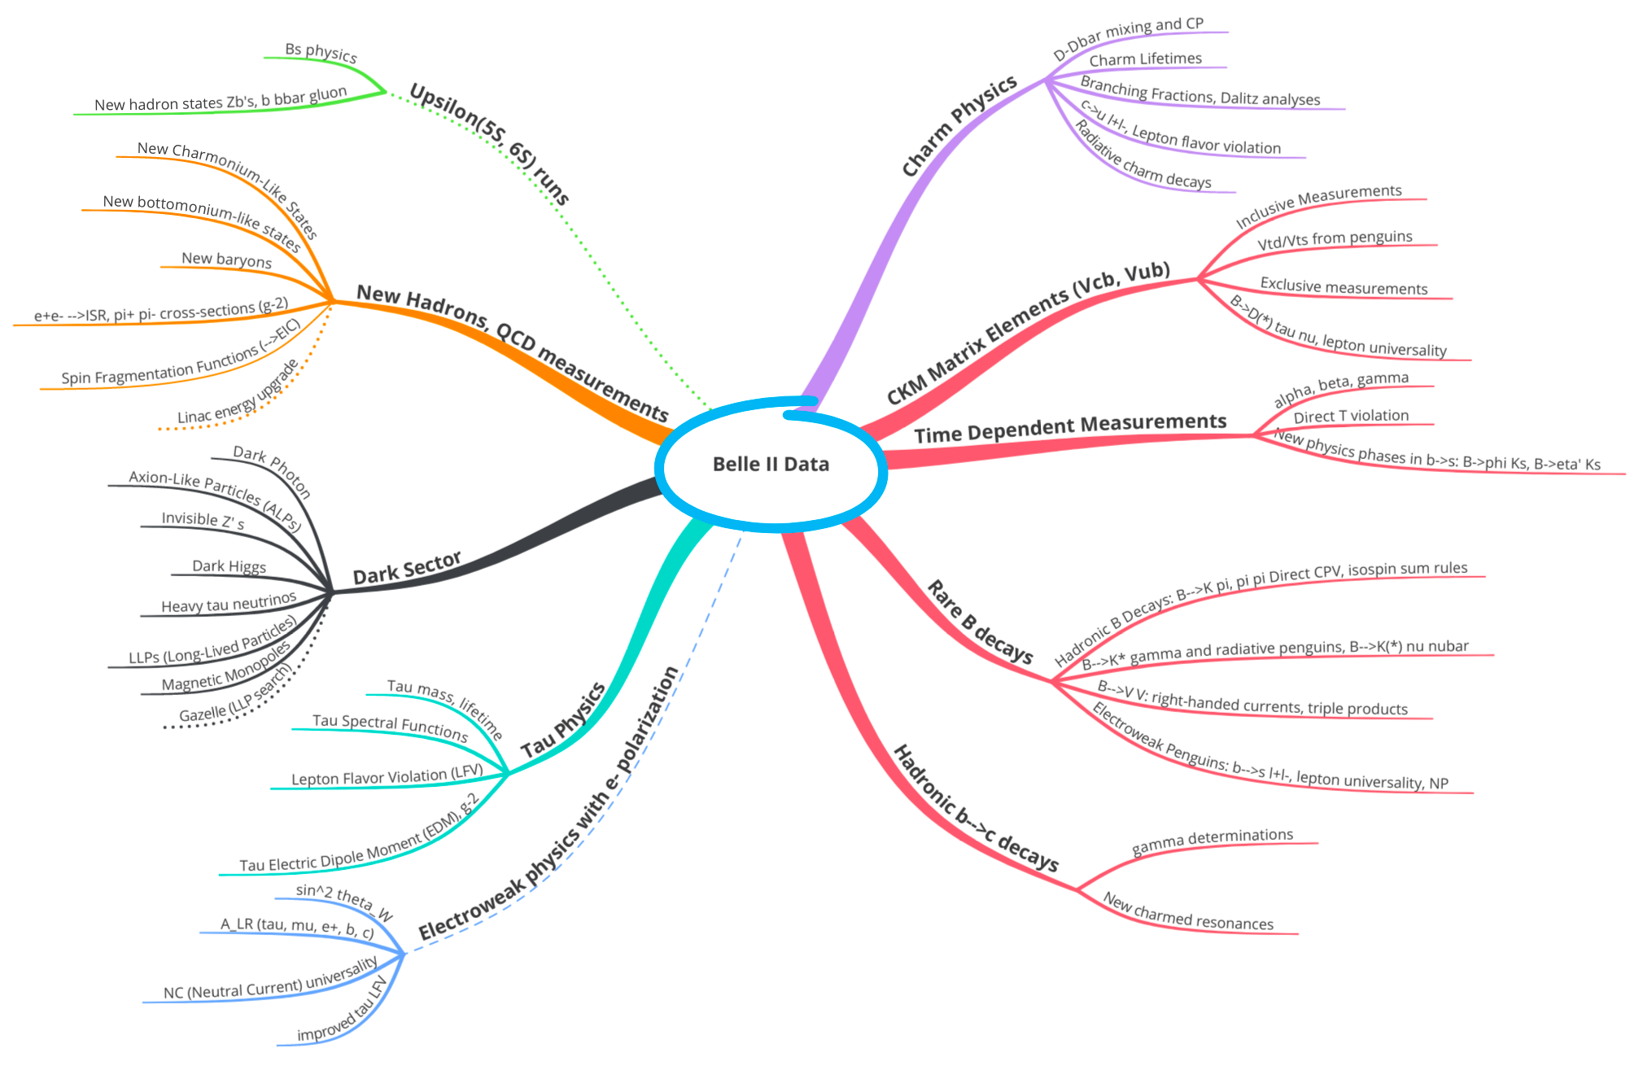

Productions in Belle/Belle II
Belle/Belle II Physics
$$B\overline{B}$$
Wealth of new physics possibilities in different domains of HEP (weak, strong, electroweak interactions). Many opportunities for initiatives by young scientists.
3

Slide 4
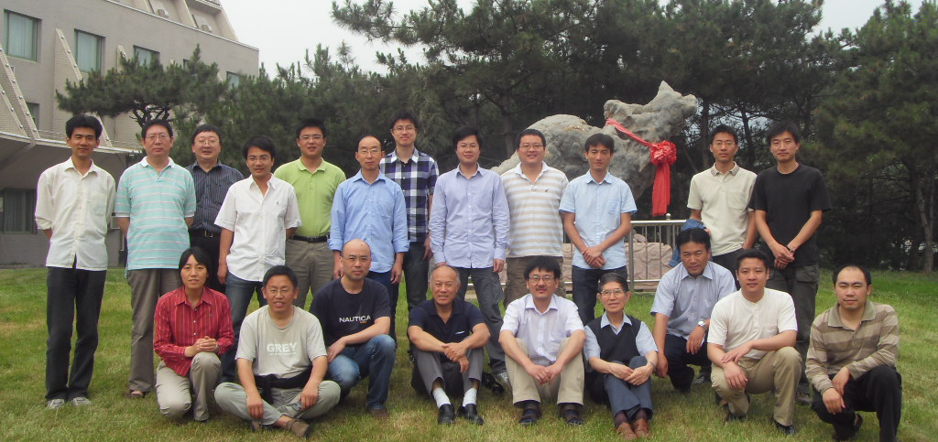
第一届Belle合作中国组会议
2010年6月11-12日，怀柔
2010年（Belle）
高能所（7+8）
北京大学（1+2）
中国科技大学（2+3）
共23人
4
4

Slide 5
Belle发表论文情况(中国大陆组主要贡献)
B 物理： Phys. Rev. D 6篇
粲偶素： Phys. Rev. D 3篇
粲介子+粲重子： Sci. Bull. 1篇，JHEP 3篇，Phys. Rev. D 12篇，Phys. Rev. Lett. 6篇， EPJC 2篇
底偶素能谱及底偶素衰变：Phys. Rev. D 9 篇， Phys. Rev. Lett. 1篇
奇特态： JHEP 3篇，Phys. Rev. D 21篇, Phys. Rev. Lett. 5篇
新物理：Phys. Rev. Lett. 1篇
重子： Phys. Rev. D 2篇
合计：75篇，包括PRL13篇。缺τ衰变的研究，这次会议的目的！
5
5

Slide 6
引用百次以上的论文
D&Dbar mixing【PRL96, 151801(2006)】 151次
Y(2175)【PRD80, 031101(R) (2009)】 145次
Y(4360、4660)【PRD91, 112007 (2015)】 180次
Y(4660)【PRL99, 142002(2007)】 533次
Y(4008)【PRL99, 182004(2007)】 535次
X(4350)【PRL104, 112004(2010)】 203次
Zc(3900)【PRL110, 252002(2013)】 917次
关于D介子混合的工作也是一个近年前沿和热门的研究领域，B工厂升级的重要物理目标之一即高精度进行D介子混合研究。
关于Zc(3900)、Y(4008)和Y(4660)的工作几乎在高能物理所有的国际、国内会议上被报告和引用，“XYZ”粒子研究，依然是一个前沿和热门研究领域。
6

Slide 7
B 物理
B介子稀有衰变
含重子对末态的B衰变； B到粲重子对过程
引用28次
No evidence for a signal is found.
We report an upper limit on the branching fraction B(B⁰→ K^{*0}τ⁺ τ⁻ ) < 3.1 × 10⁻³ at 90% confidence level.
This is the first direct limit on B(B⁰→ K^{*0}τ⁺ τ⁻ )

Slide 8
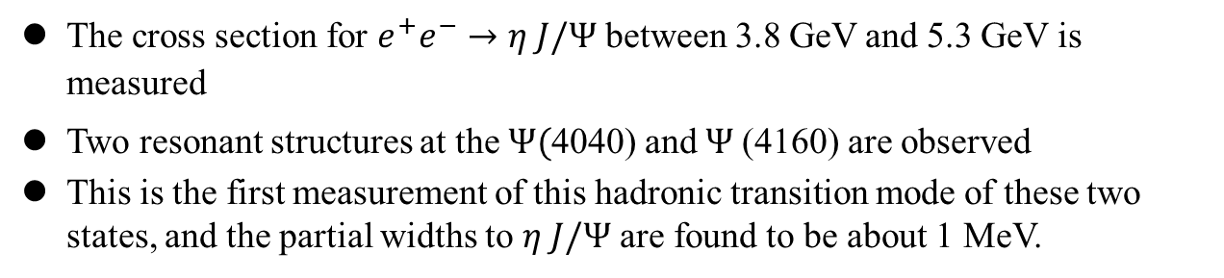
粲偶素
初态辐射过程
Continuum 过程寻找丢失的粲偶素
引用84次
The cross section for $e^{+}e^{−}→η J/Ψ$ between 3.8 GeV and 5.3 GeV is measured
Two resonant structures at the $Ψ($4040) and $Ψ$(4160) are observed
This is the first measurement of this hadronic transition mode of these two states, and the partial widths to $η J/Ψ$ are found to be about 1 MeV.

Slide 9
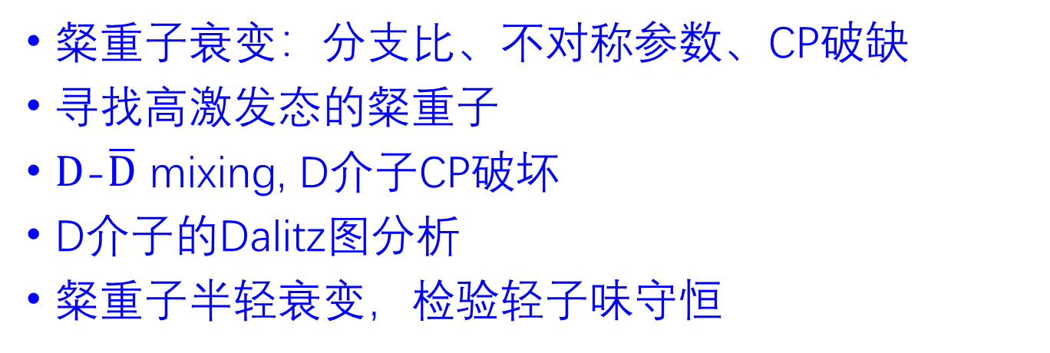
粲强子
粲重子衰变：分支比、不对称参数、CP破缺
寻找高激发态的粲重子
$D$-$\overline{D}$ mixing, D介子CP破坏
D介子的Dalitz图分析
粲重子半轻衰变，检验轻子味守恒
引用30次

Slide 10
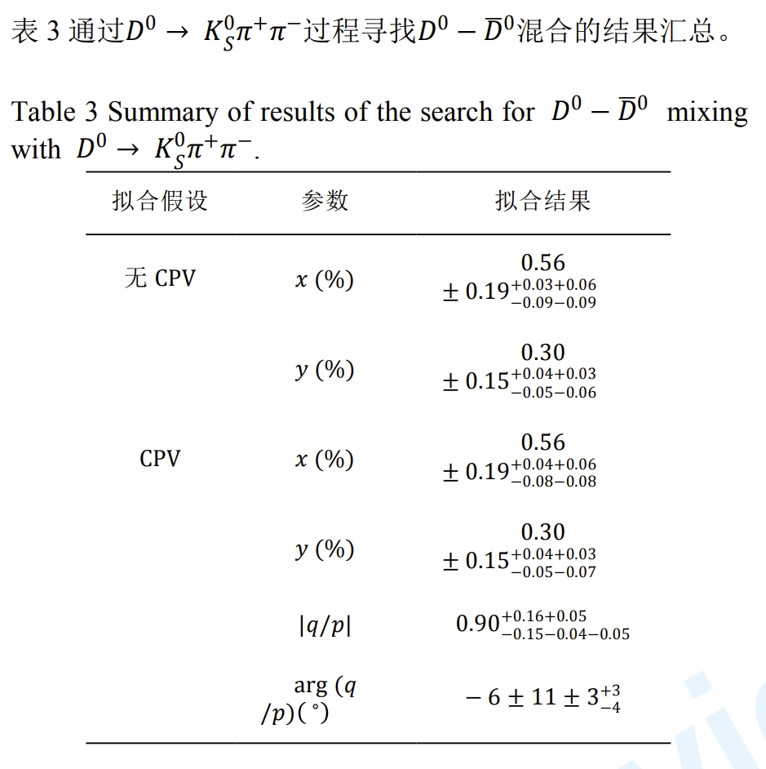
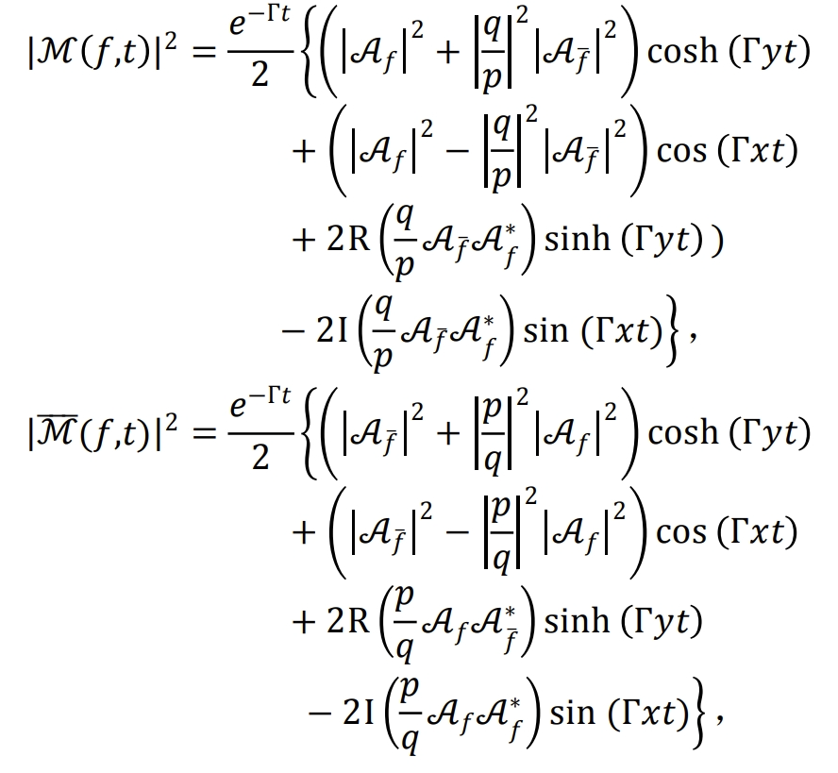
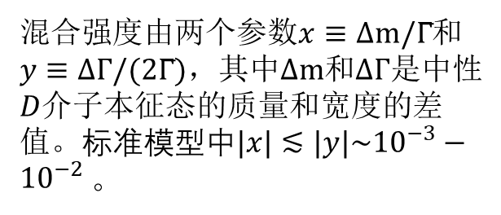
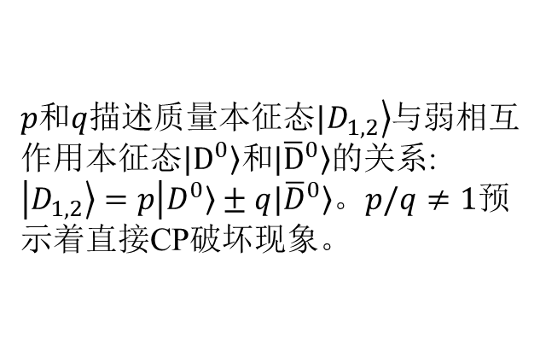
引用82次
引用151次
Through a time-dependent amplitude analysis of D⁰ → Ks⁰π⁺π⁻ decays, measure D⁰-${\overline{D}}^{0}$ mixing parameters and indirect CP violation
混合强度由两个参数$x≡Δm/Γ̅$和$y≡ΔΓ/(2Γ̅)$，其中$Δm$和$ΔΓ$是中性$D$介子本征态的质量和宽度的差值。标准模型中$|x|≲|y|\sim {10}^{−3}−{10}^{−2}$。
$p和q$描述质量本征态$|\left.D_{1,2}\right\rangle$与弱相互作用本征态$\left.|D^{0}\right\rangle 和\left.{|\overline{D}}^{0}\right\rangle$的关系: $\left|\left.D_{1,2}\right\rangle =p\right|\left.D^{0}\right\rangle ±q\left.{|\overline{D}}^{0}\right\rangle$。$p/q≠1$预示着直接CP破坏现象。

Slide 11
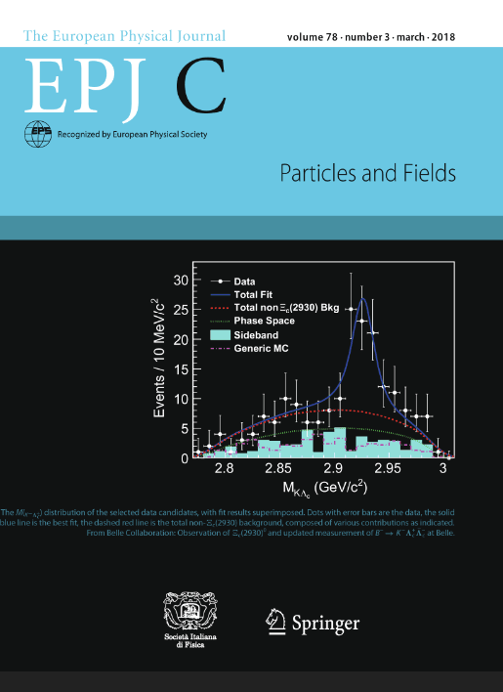
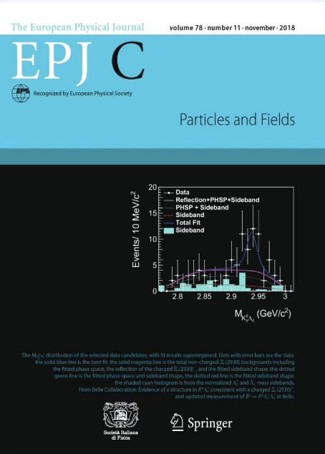

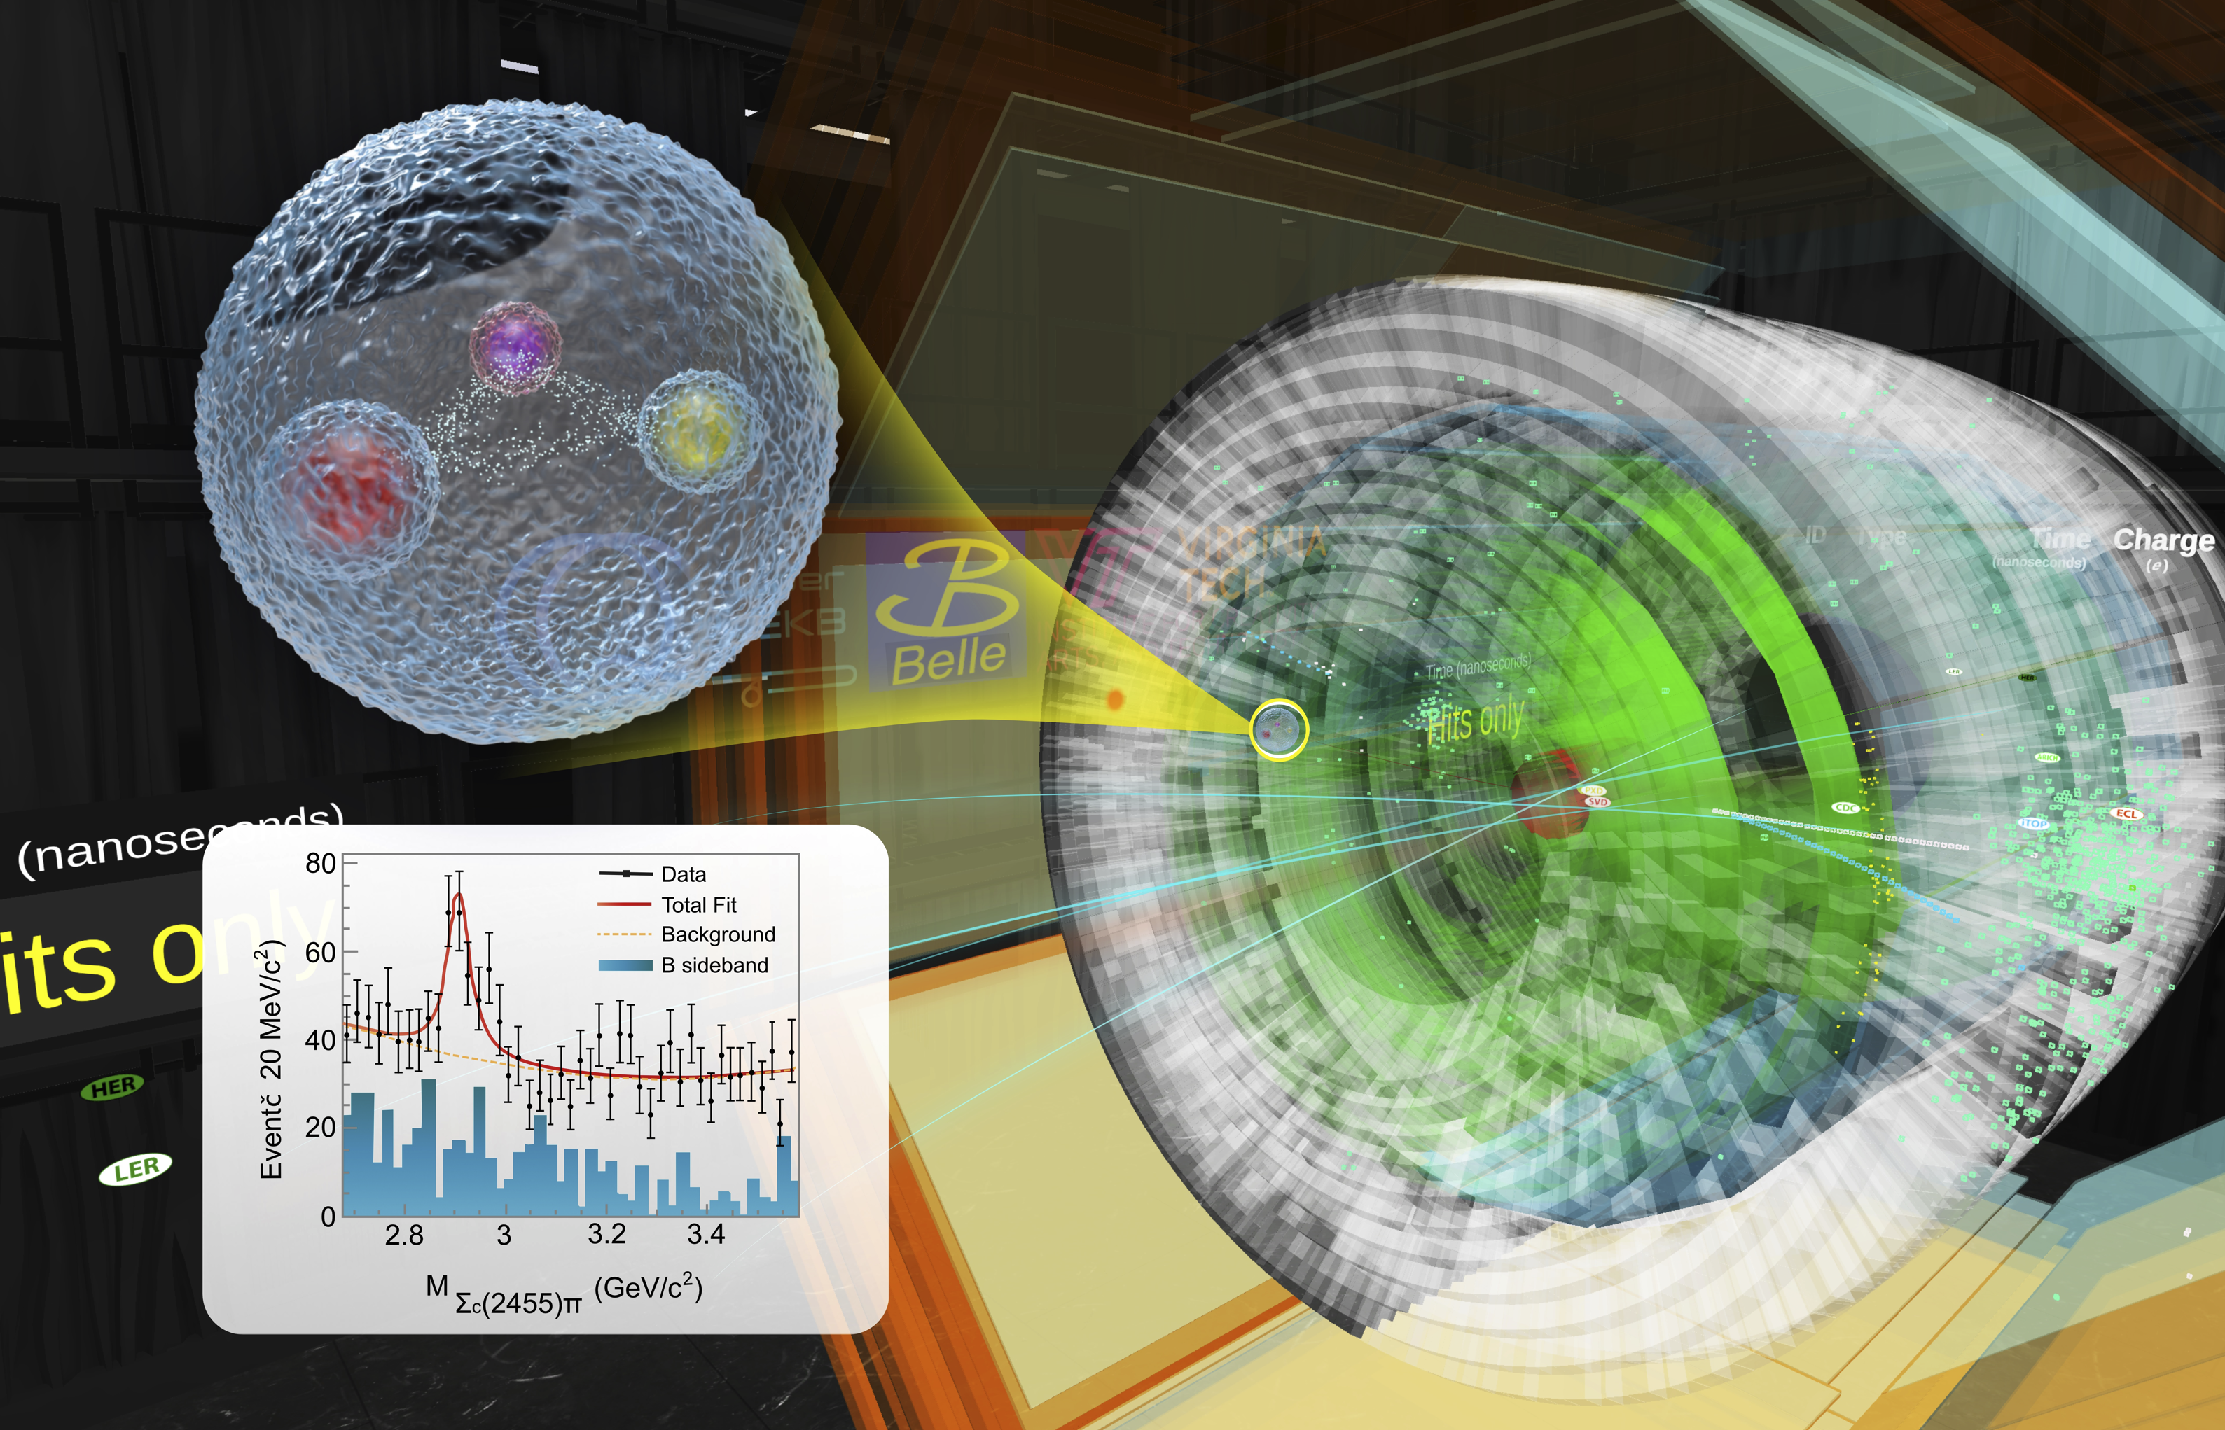

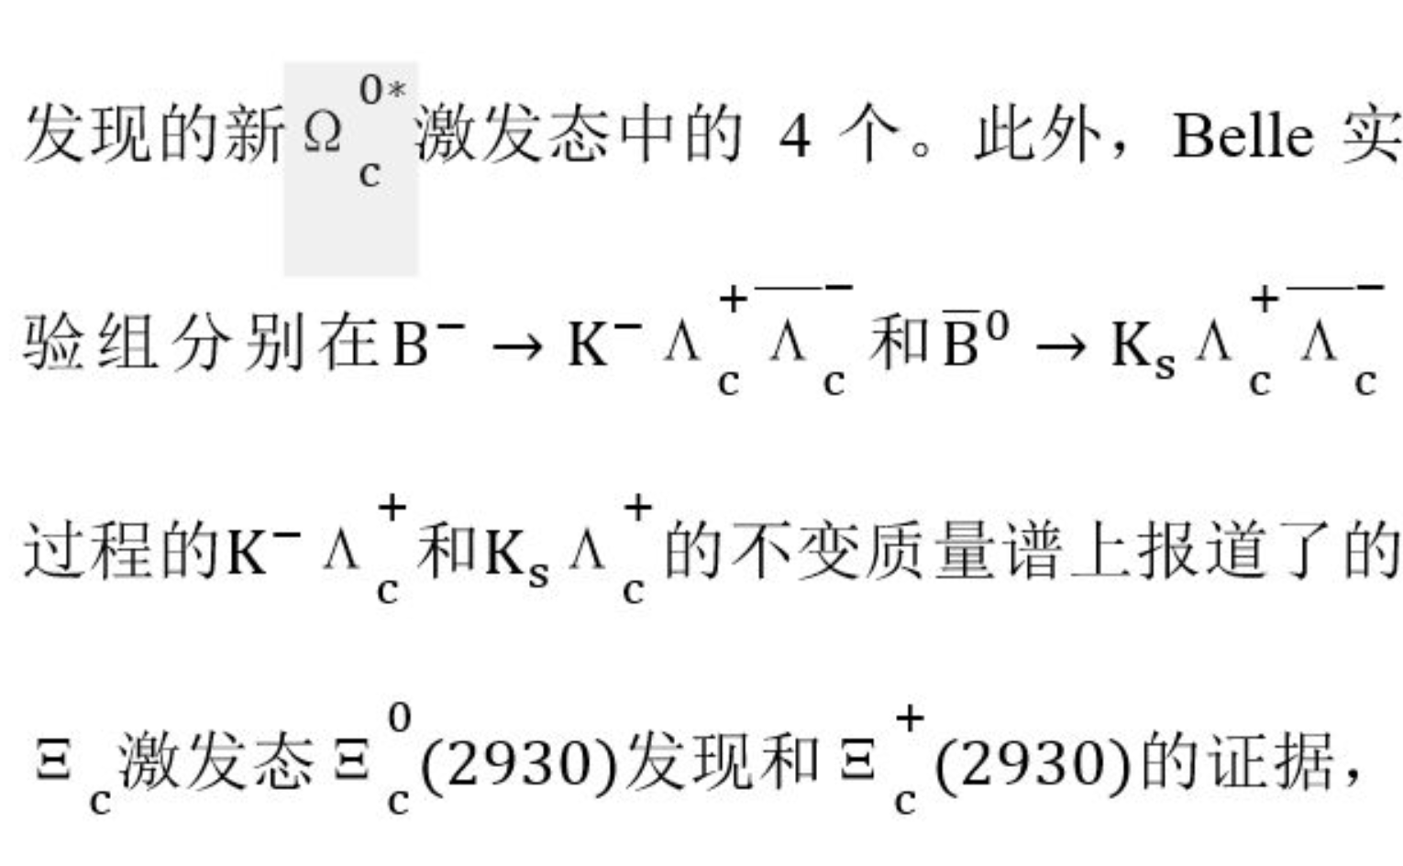


发现新粲重子激发态$Ξ_{c}(2930)$
发现新粲重子激发态$Λ_{c}(2910)$
相继发现中性和带电的$Ξ_{c}(2930)$: 唯一在B介子衰变中发现，被选为EPJC的封面文章(2篇)。《科技导报》的《2018粒子物理学热点回眸》报道本成果
在$Σ_{c}^{ }\left(2455\right)π$质量谱上，观测到一个新粒子
不符合任何现有理论的预言
获复旦大学首届十大科技进展之一(2022)。
Y. B. Li, *C.P.Shen, et al (Belle) EPJC 78, 928 (2018);
EPJC 78, 252 (2018)
Y. B. Li, *C.P.Shen, et al (Belle Collaboration)
Phys. Rev. Lett. 130, 031901 (2023)
引用88次
引用16次
21

Slide 12
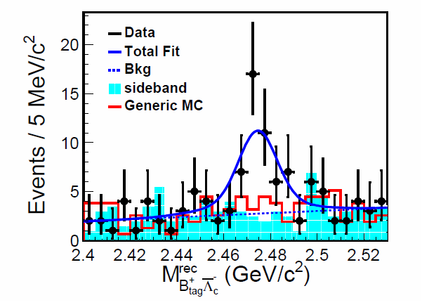
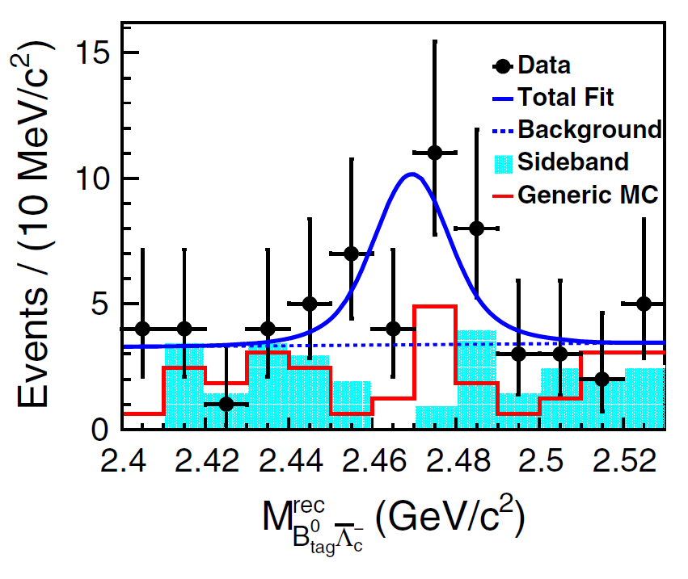




基态$Ξ_{c}^{+,0}$绝对衰变率的首次测量
在发现基态$Ξ_{c}^{+,0}$的30多年里，人们一直没有办法测量其绝对衰变率，导致和$Ξ_{c}^{+,0}$相关的物理量如粲重子散射截面等一直无法测量。我们通过测量B介子单举和遍举衰变到$Ξ_{c}^{+,0}$的过程，首次测量 $Ξ_{c}^{0,+}$ 的绝对衰变率。解决粲重子领域30多年难题。
极大促进了底夸克重子、双粲重子、重味重子谱学等的研究。
$$Ξ_{c}^{0}信号$$
$$Ξ_{c}^{+}信号$$
Y. B. Li, *C.P.Shen, et al (Belle Collaboration) PRL 122, 082001 (2019); PRD-RC 100, 031101 (2019)
引用106次

Slide 13
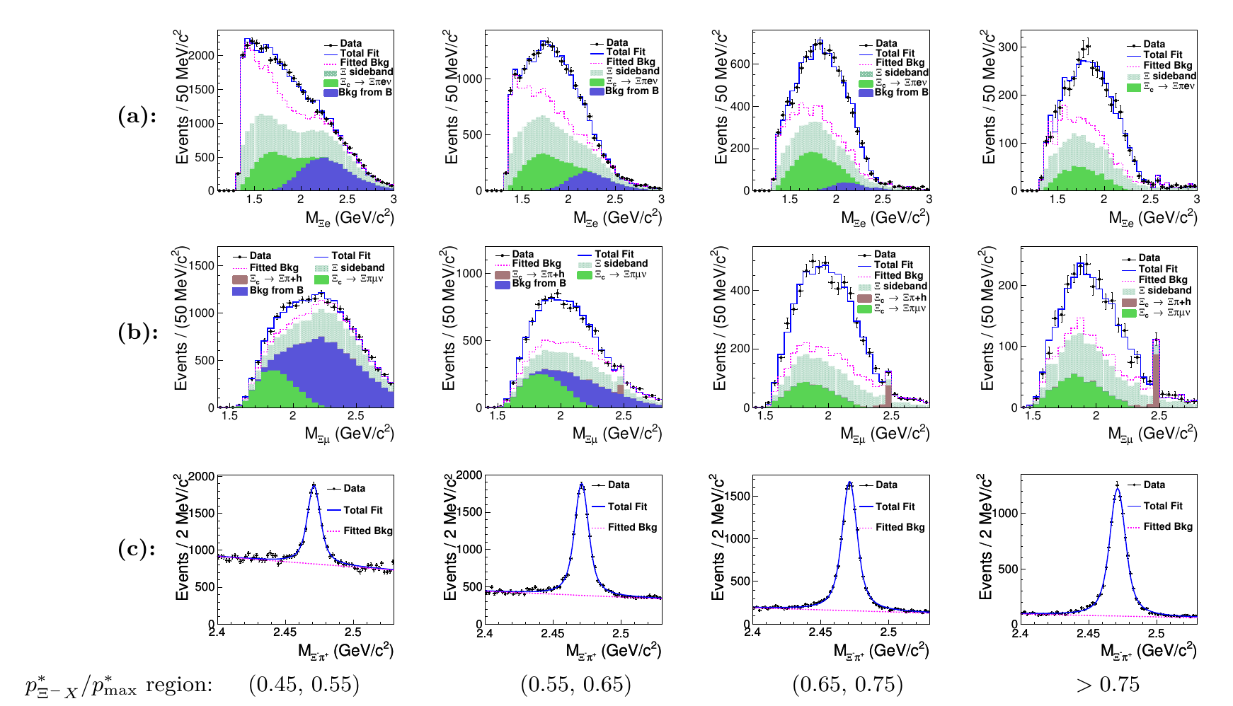
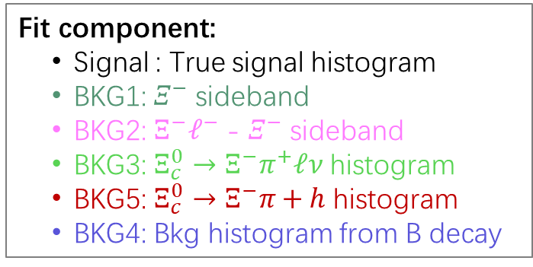



Measurement of $ℬ\left(Ξ_{c}^{0}→Ξ^{−}l^{ }ν_{ }\right)$
Y. B. Li. *C.P.Shen et al., PRL 127, 121803 (2021)
引用51次
Fit component:
Signal : True signal histogram
BKG1: $Ξ^{−}$ sideband
BKG2: $Ξ^{−}ℓ^{−}$ - $Ξ^{−}$ sideband
BKG3: ${Ξ_{c}^{0}→Ξ}^{−}π^{+}ℓν$ histogram
BKG5: ${Ξ_{c}^{0}→Ξ}^{−}π+h$ histogram
BKG4: Bkg histogram from B decay
data-driven method for bkg extraction
$$𝓑\left(Ξ_{c}^{0}→Ξ^{−}{ e}^{+}ν_{e}\right)=\left(1.31±0.39\right)\%$$
Previous: $\left(2.34±1.59\right)\%$
$$𝓑\left(Ξ_{c}^{0}→Ξ^{−}{ μ}^{+}ν_{μ}\right)=\left(1.27±0.39\right)\%$$
Consistent with LFU
13

Slide 14
重子
重子衰变：分支比，到不同末态的耦合常数

Slide 15

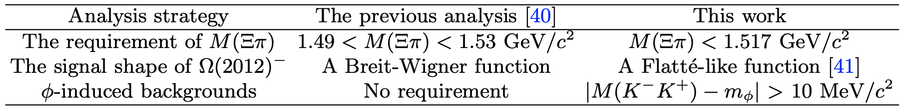
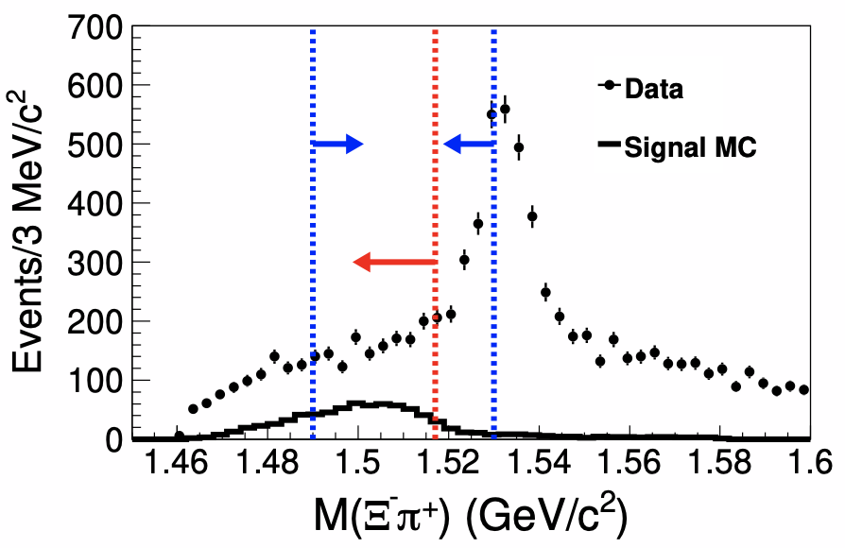
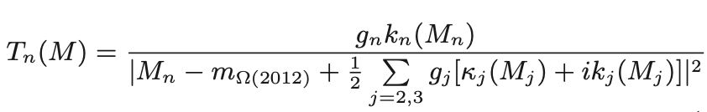
Revisit ${Ω(2012)}^{−}→Ξ(1530)\overline{K}→Ξπ\overline{K}$
arXiv: 2207.03090
引用16次
The comparisons between the previous analysis [PRD 100, 032006 (2019)] and this work.
The Flatt$\acute{e}$-like function [PRD 81, 094028 (2010)]
$g_{n}$ is the effective coupling of to the n–body final state.
$k_{n}$ and $κ_{n}$ parameterize the real and imaginary parts of the ${Ω(2012)}^{−}$self-energy.
Above 2.02 GeV, the phase space k₃ increases sharply to cover more signal candidates.
The red arrow for this updated work; The blue arrow for the previous analysis.
15

Slide 16
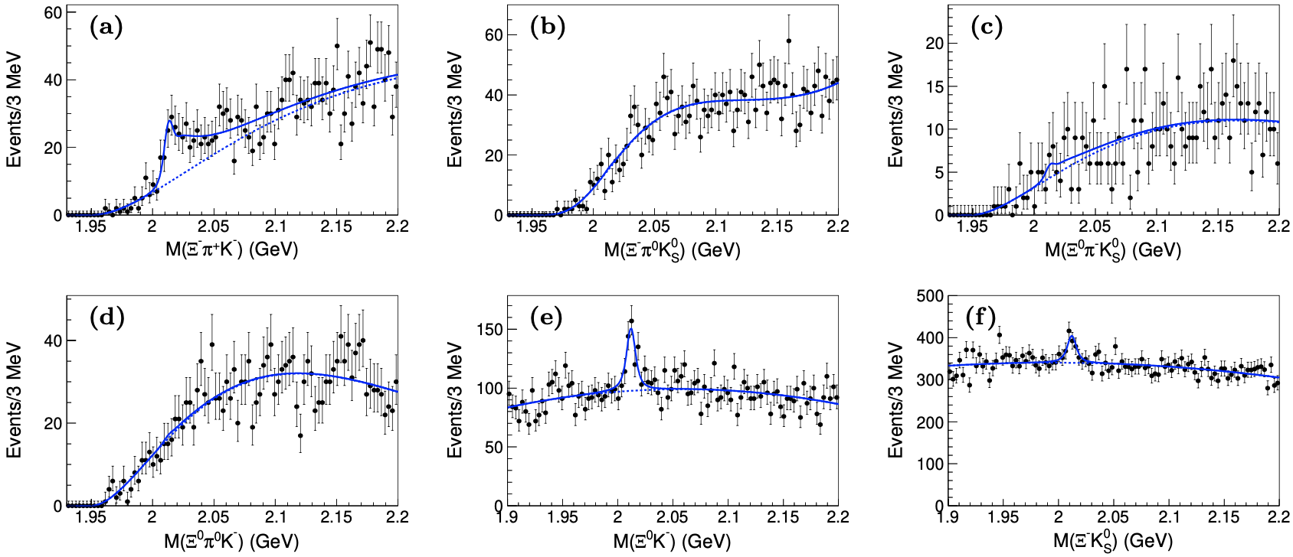

Revisit ${Ω(2012)}^{−}→Ξ(1530)\overline{K}→Ξπ\overline{K}$
arXiv: 2207.03090
We fit simultaneously to the binned $Ξ^{−}π^{+}K^{−}$, $Ξ^{−}π^{0}K_{S}^{0},Ξ^{0}π^{−}K_{S}^{0},Ξ^{0}π^{0}K^{−},Ξ^{0}K^{−}$ and $Ξ^{−}K_{S}^{0}$ mass distributions from $Υ$(1S,2S,3S) data samples.
The mass and effective couplings :
${Ω(2012)}^{−}$ mass | (${2012.5}_{−0.7}^{+0.8}$±0.5) MeV
The coupling to $Ξ\overline{K}$ | (${1.7}_{−0.3}^{+0.3}$±0.3)×10⁻²
The coupling to $Ξ(1530)\overline{K}$ | (${38.9}_{−38.9}^{+31.1}$±6.0)×10⁻²
0.99±0.26(stat.)±0.06(syst.)
Our result is consistent with the molecular model of ${Ω(2012)}^{−}$, which predicts comparable rates for ${Ω(2012)}^{−}$decay to $Ξ(1530)\overline{K}$ and $Ξ\overline{K}$ .
16

Slide 17
新物理
在ϒ(1S)的辐射衰变中寻找轻Higgs

Slide 18
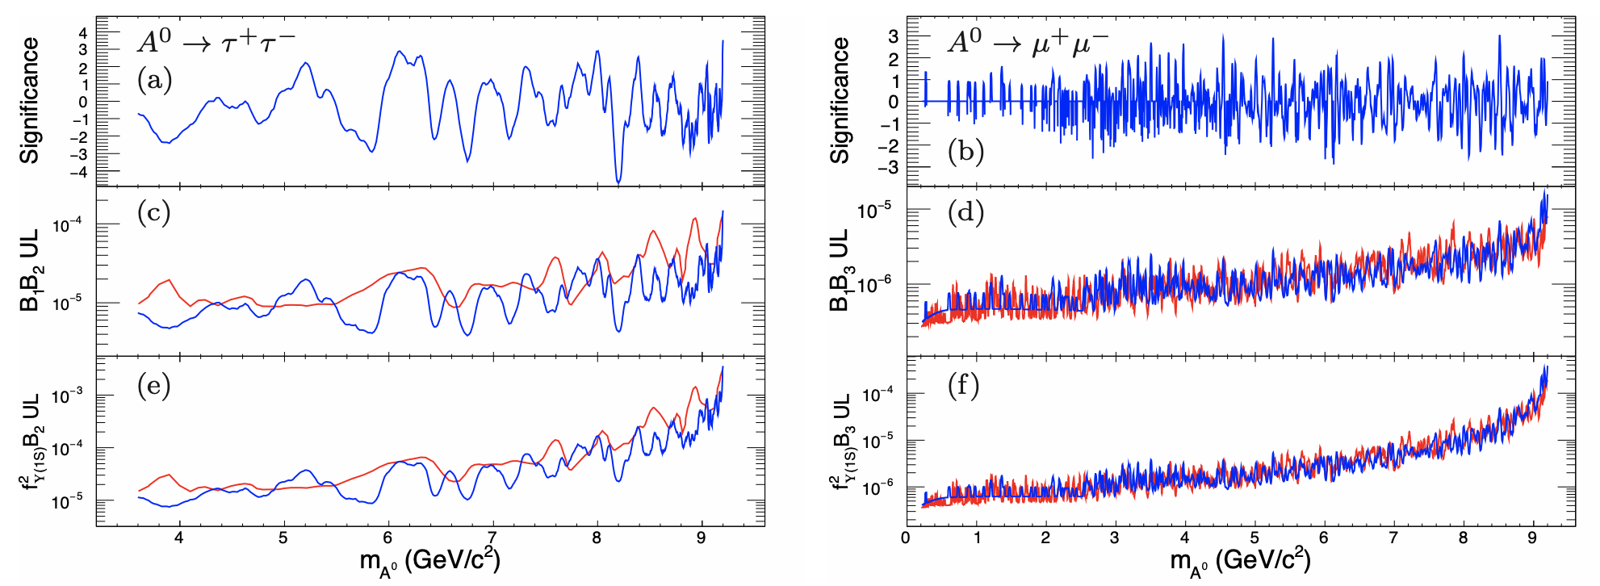


在$Υ$(1S)辐射衰变过程中对CP-odd希格斯玻色子A⁰的寻找
PRL 128, 081804 (2022)
Belle 实验上 1.58亿的Υ(2S)的数据样本。
利用Y(2S)$→π^{+}π^{−}$Y(1S)标记的方法对Y(1S) $→γA^{0}$进行测量，可以极大的压制连续区的本底和初态辐射产生的本底。
除了寻找A⁰的信号，给出相应的分支比，给出A⁰与b夸克之间汤川耦合的结果，与 LHC 实验测得的𝐻𝑡𝑡，H𝜏𝜏等汤川耦合作比较，为理论学家对希格斯玻色子的动力学研究提供帮助。
显著性、分支比、汤川耦合的结果：
蓝色的线是我们的结果。
红色的线是目前世界上最好的来自BaBar实验的结果。
没有观测到明显的新物理A⁰的信号，给出目前世界上最为严格的$A^{0}→τ^{+}τ^{−}$的产生率的限制。
-18-

Slide 19
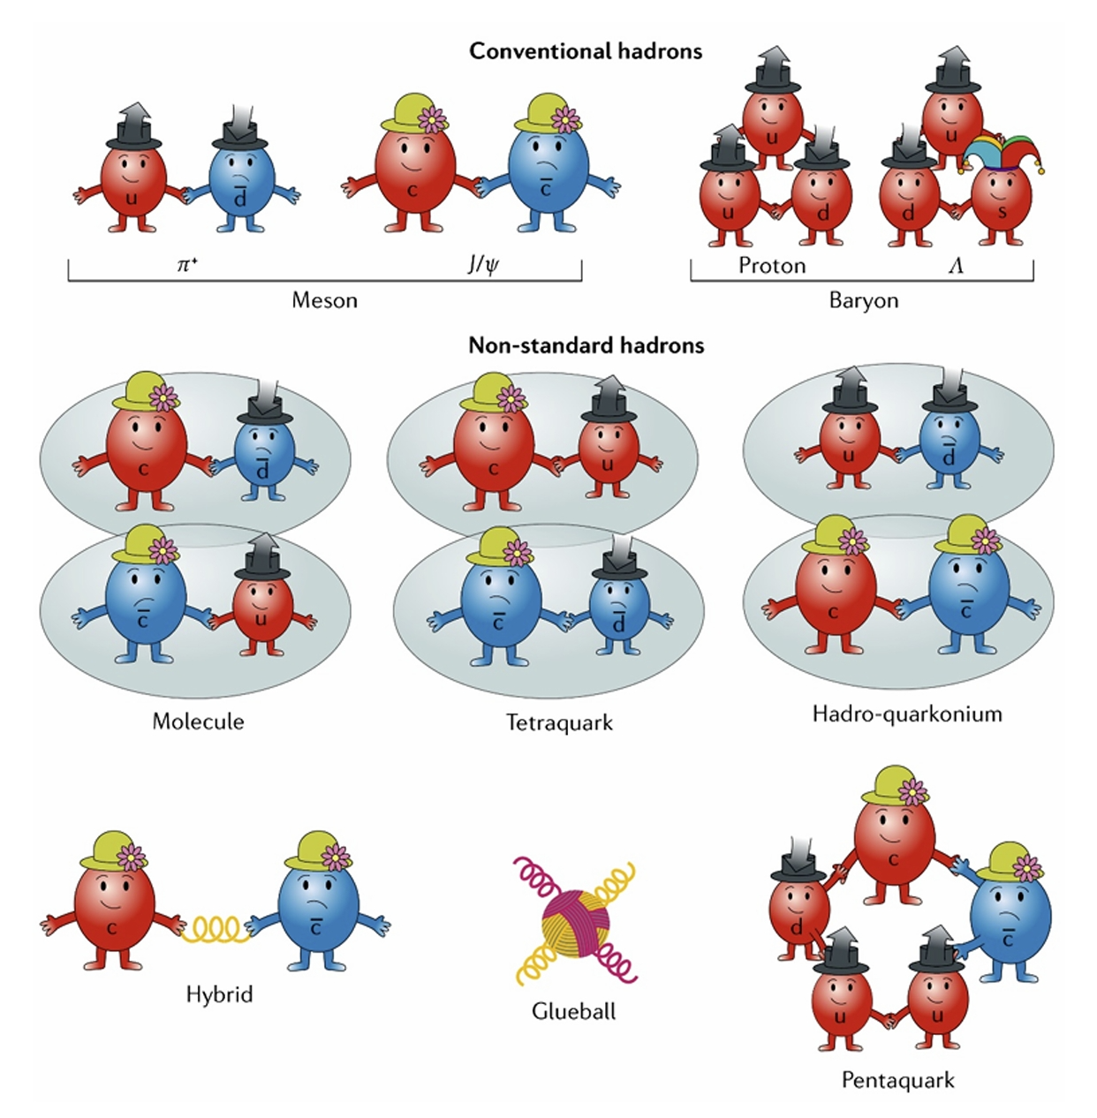
奇特态
初态辐射过程
双光子过程
底偶素辐射衰变、强衰变
双粲偶素末态
B介子衰变
Continuum过程
Nature Reviews Physics 1, 480 (2019)

Slide 20
Y(2175)
Updated Y(4360、4660)
Y(4360、4660)
引用180次
引用533次
引用145次
Y(4008、4260)
X(4350)
Zc(3900)
引用203次
引用917次
引用535次

Slide 21
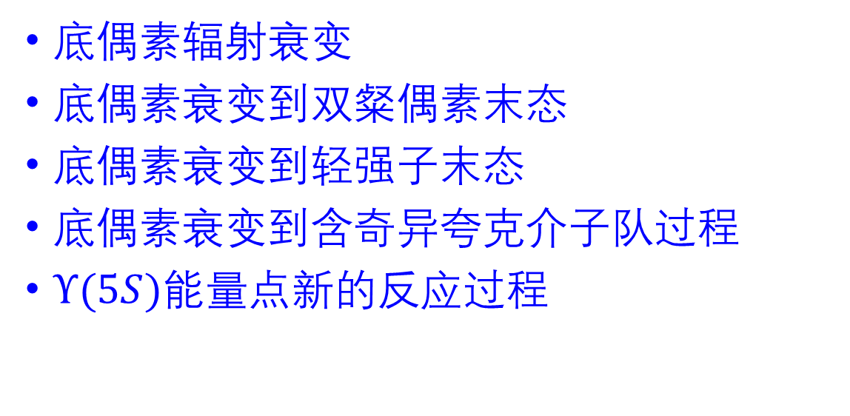
底偶素
底偶素辐射衰变
底偶素衰变到双粲偶素末态
底偶素衰变到轻强子末态
底偶素衰变到含奇异夸克介子队过程
$Υ(5S)$能量点新的反应过程

Slide 22
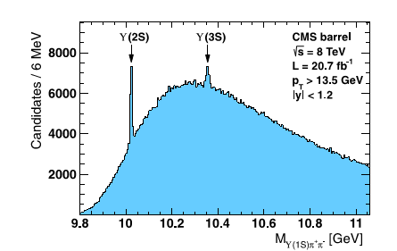

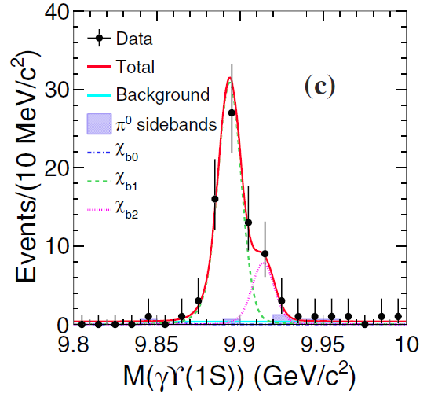
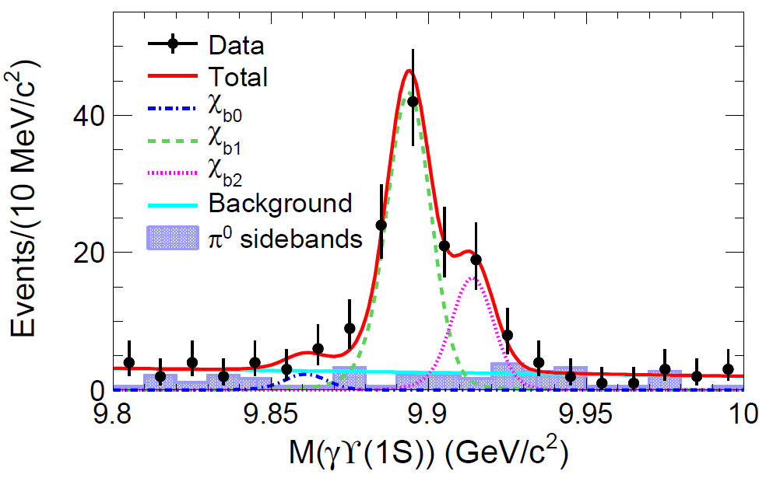
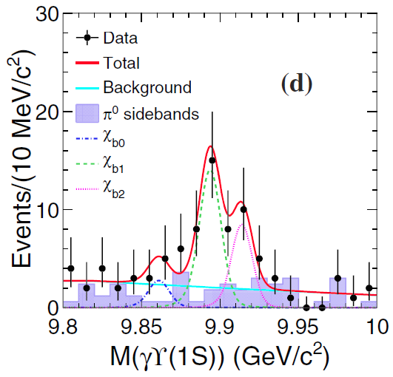
Search for X_{b} in e⁺e⁻ → ɣπ⁺π⁻π⁰Y(1S) at 10.867 GeV
The X(3872) counterpart in the bottomonium sector X_{b}, NOT observed decay channel π⁺π⁻ϒ(1S).
As X_{b} is above ωY(1S) threshold, this Isospin-conserving process should be a more promising decay mode. [PRD88, 054007].
PLB 727, 57 (2013)
12σ
118 fb⁻¹
5.9σ
Large Brs of Y(5S) to π⁺π⁻π⁰χ_{b1/b2}, ωχ_{b1/b2}are observed for the first time and their ratios are measured: hadronic loop effect ?
arXiv:1406.6763
4.9σ
PRL 113, 142001 (2014)， 引用64次
3.1σ
Assuming X_{b} is narrow, the upper limit on the product branching fraction was given.
22

Slide 23
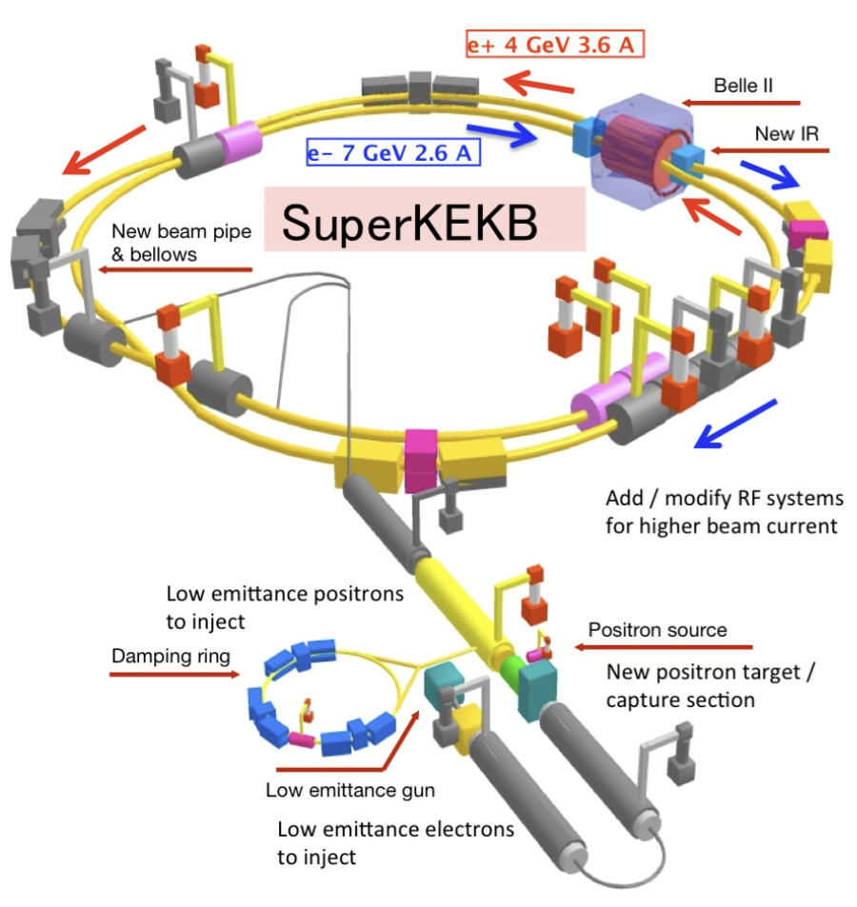
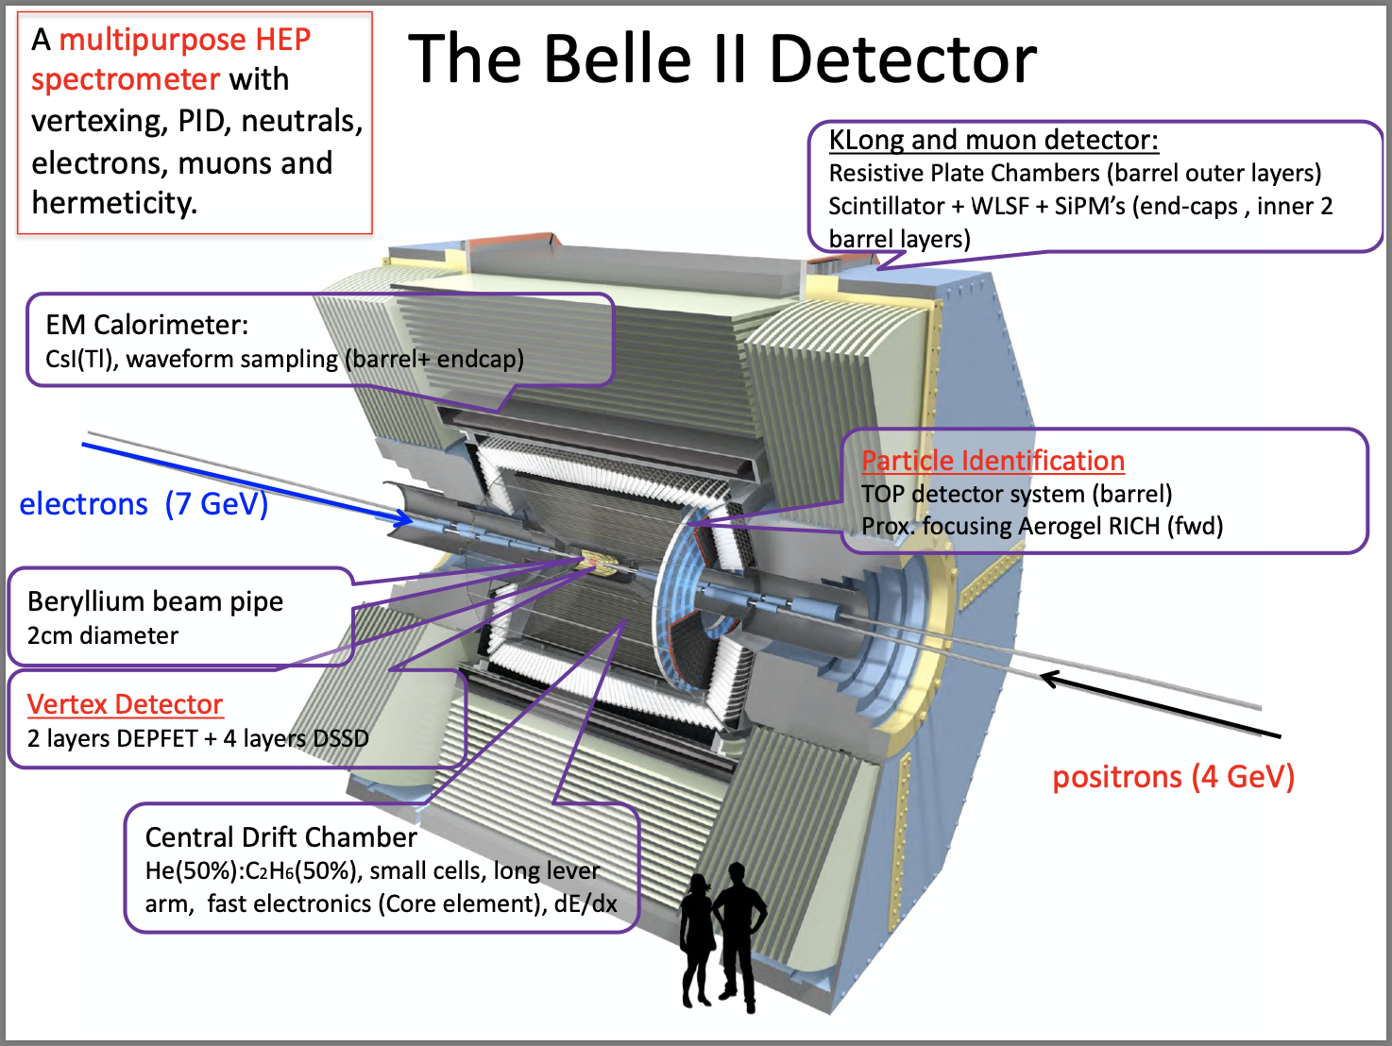
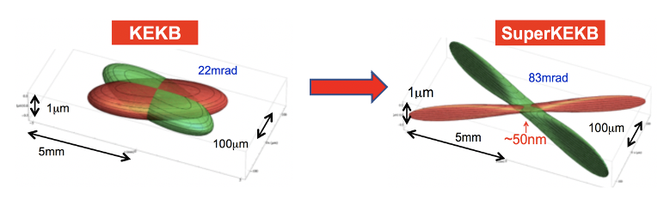
SuperKEKB and Belle II
Achieved peak luminosity: 4.7×10³⁴ cm⁻²s⁻¹
Integrated luminosity: 427/fb [arXiv:2407.00965]
Currently ~ 530/fb recorded
$\sqrt{s}$ ~ 10.58 GeV
Nano-beam design:
Beam squeezing: $×$20 smaller
Target luminosity: KEKB$×$40
23

Slide 24
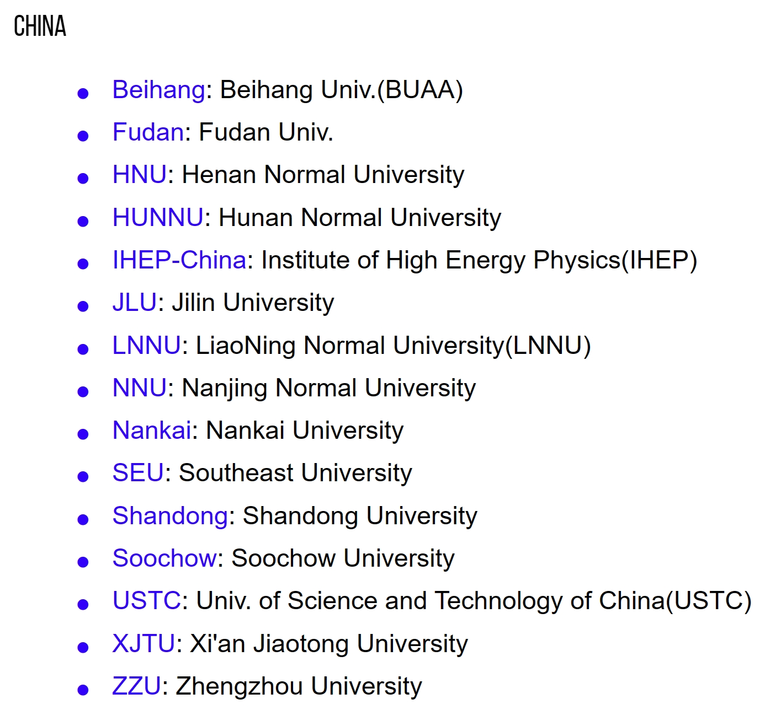
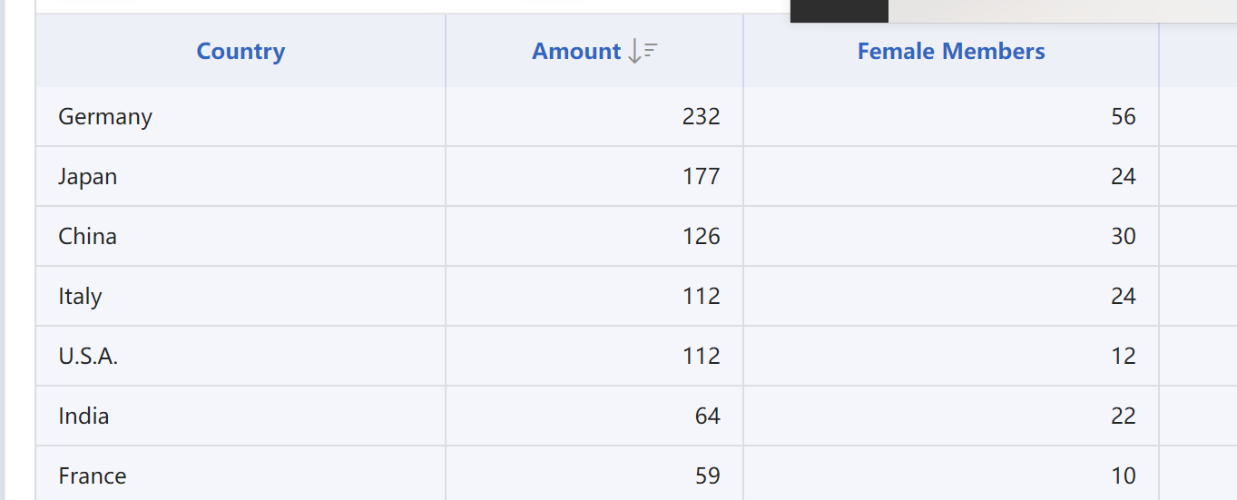
International Belle II collaboration
Belle II now has grown to ~1100 researchers (~600 authors) from 28 countries/regions
24

Slide 25
Belle II发表论文情况(中国大陆组主要贡献)
积分亮度： Chin. Phys. C 2篇
B物理：JHEP 2篇，Phys. Rev. D 1篇
底偶素： Phy. Rev. Lett. 1篇， JHEP 1篇
粲重子： JHEP 1篇
CKM矩阵元： JHEP 1篇
Belle II已经提交的论文情况(中国大陆组主要贡献)
τ衰变：Phy. Rev. D 1篇
粲强子： JHEP 1篇

Slide 26
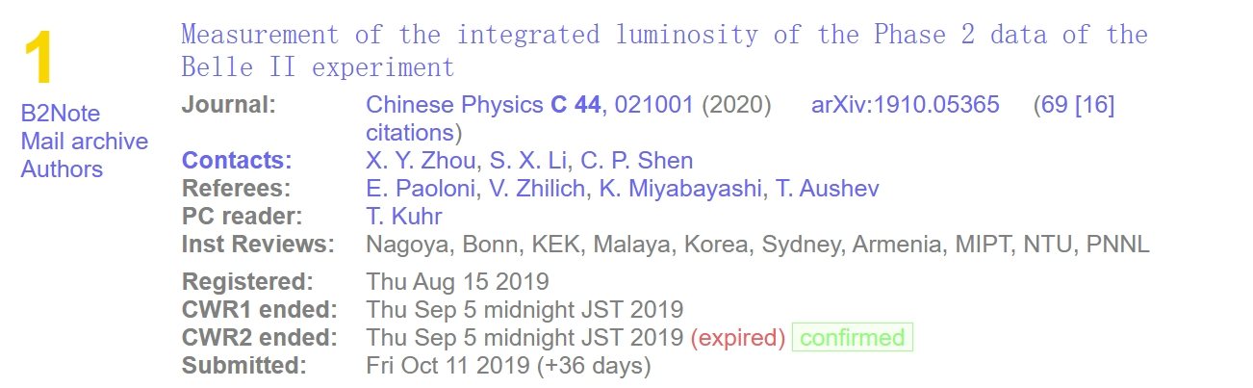

Slide 27
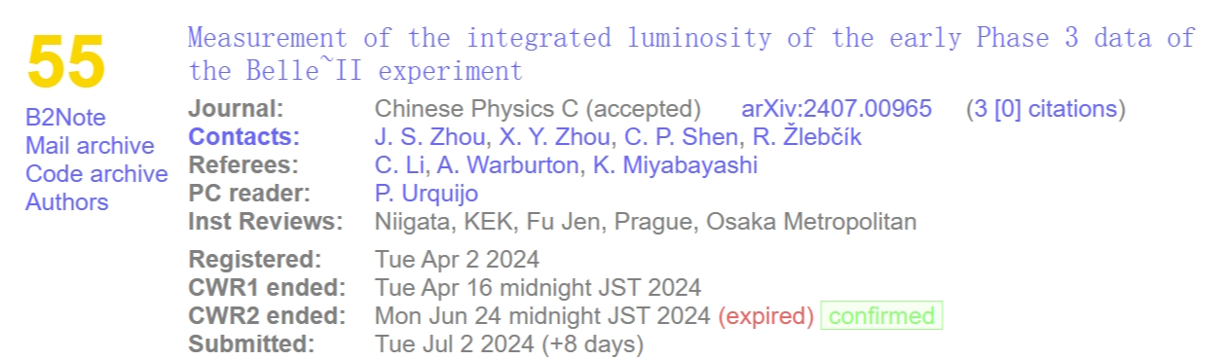
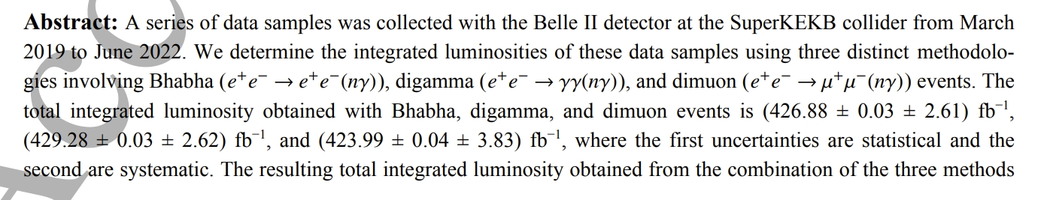


Slide 28
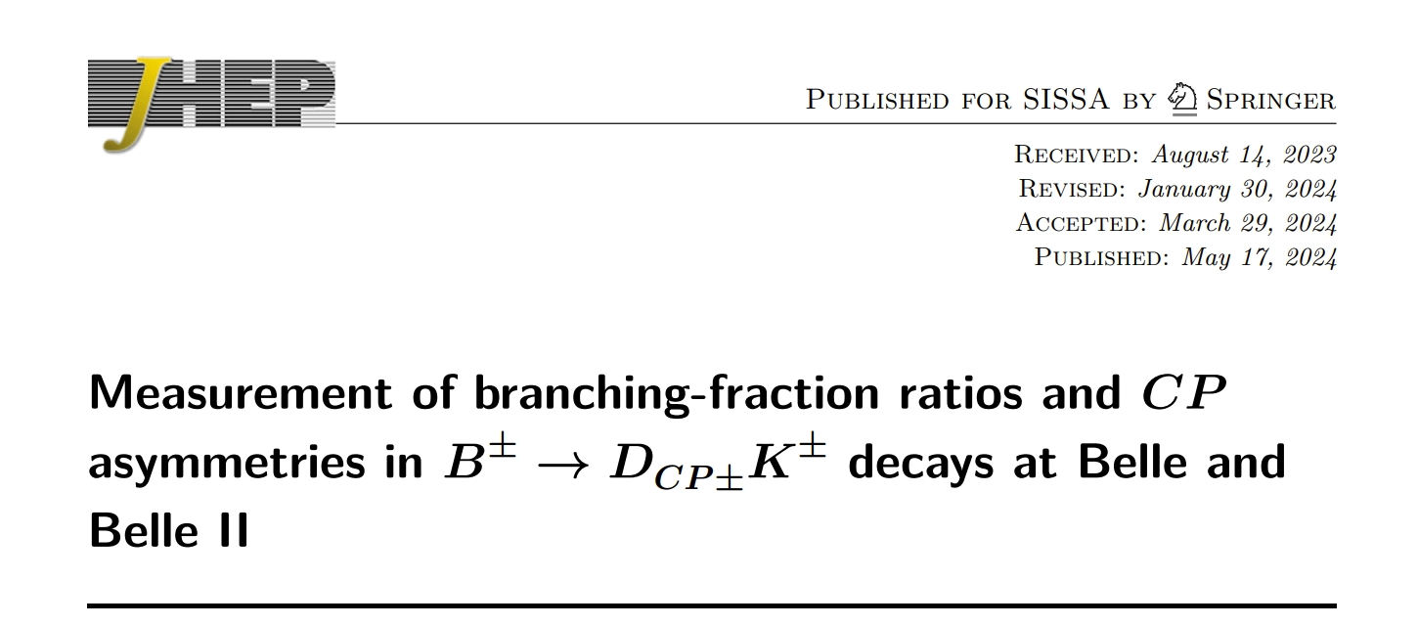
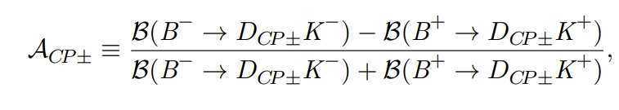
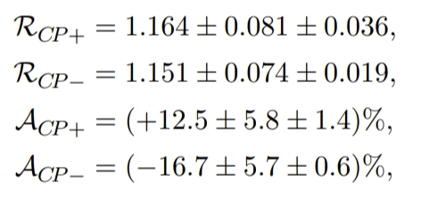
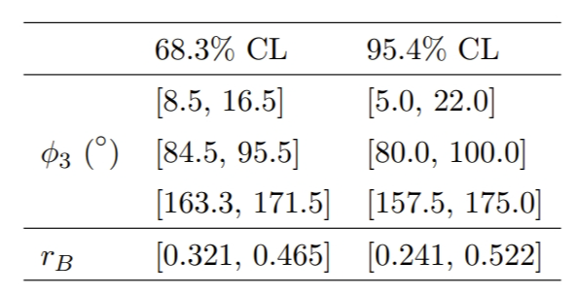
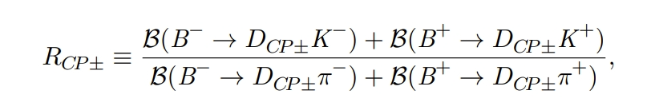
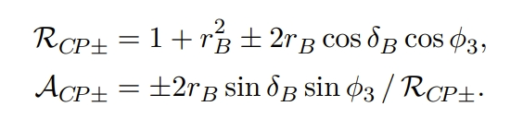
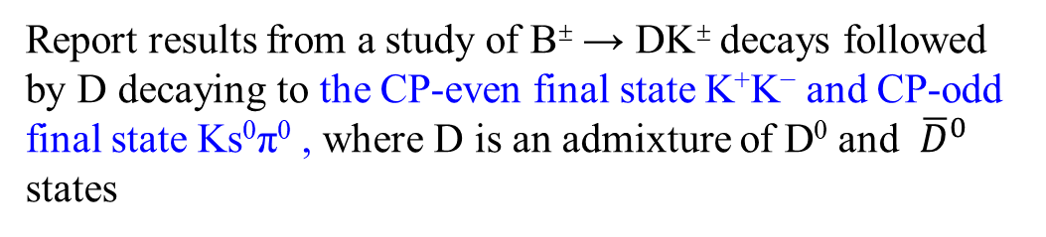
Report results from a study of B± → DK± decays followed by D decaying to the CP-even final state K⁺K⁻ and CP-odd final state Ks⁰π⁰ , where D is an admixture of D⁰ and ${\overline{D}}^{0}$ states
JHEP 05 (2024) 212
The results are consistent with those of the BABAR and LHCb experiments
the ratio r_{B} of the magnitudes of the suppressed to favored B± → DK± amplitudes
the relative CP-conserving phase δ_{B} between them

Slide 29
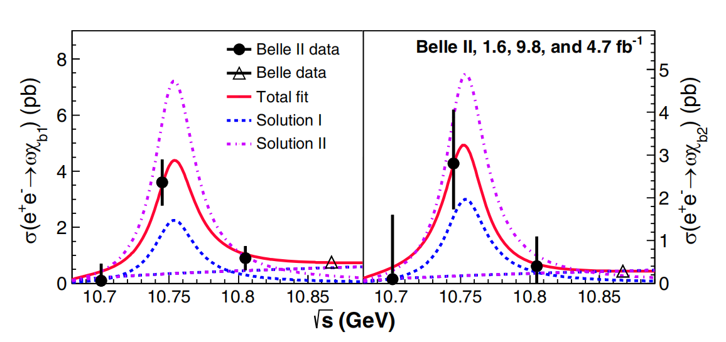

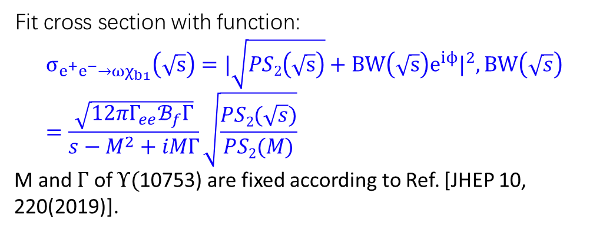
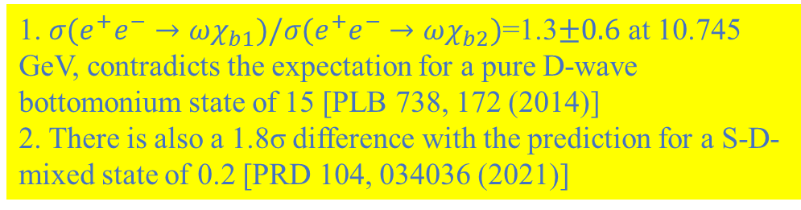
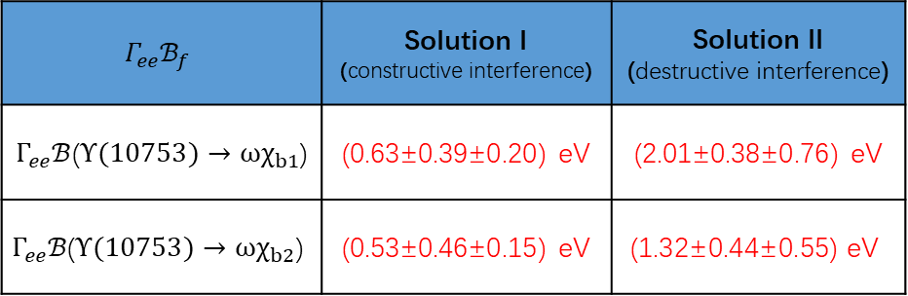
Observation of $Υ$(10753) $→ωχ_{bJ}$
PRL 130, 091902 (2023)
The $e^{+}e^{−}→ωχ_{bJ}$ (J = 1, 2) cross sections peak at $Υ$(10753).
Fit cross section with function:
$$σ_{e^{+}e^{−}→ωχ_{b1}}\left(\sqrt{s}\right)=|\sqrt{PS2\left(\sqrt{s}\right)}+BW\left(\sqrt{s}\right)e^{iϕ}|^{2}, BW\left(\sqrt{s}\right)=\frac{\sqrt{12πΓ_{ee}ℬ_{f}Γ}}{s−M^{2}+iMΓ}\sqrt{\frac{PS2(\sqrt{s})}{PS2(M)}}$$
M and $Γ$ of $Υ($10753) are fixed according to Ref. [JHEP 10, 220(2019)].
$$Γ_{ee}ℬ_{f}$$ | Solution I (constructive interference) | Solution II (destructive interference)
$Γ_{ee}ℬ$($Υ(10753)→ωχ_{b1}$) | (0.63±0.39±0.20) eV | (2.01±0.38±0.76) eV
$$Γ_{ee}ℬ\text{(}Υ(10753)→ωχ_{b2}\text{)}$$ | (0.53±0.46±0.15) eV | $$\text{(1.32}\text{±}\text{0.44}\text{±}\text{0.55) }\text{eV}$$
1. $σ(e^{+}e^{−}→ωχ_{b1})/σ(e^{+}e^{−}→ωχ_{b2})$=1.3$±0.6$ at 10.745 GeV, contradicts the expectation for a pure D-wave bottomonium state of 15 [PLB 738, 172 (2014)]
2. There is also a 1.8σ difference with the prediction for a S-D-mixed state of 0.2 [PRD 104, 034036 (2021)]
29

Slide 30
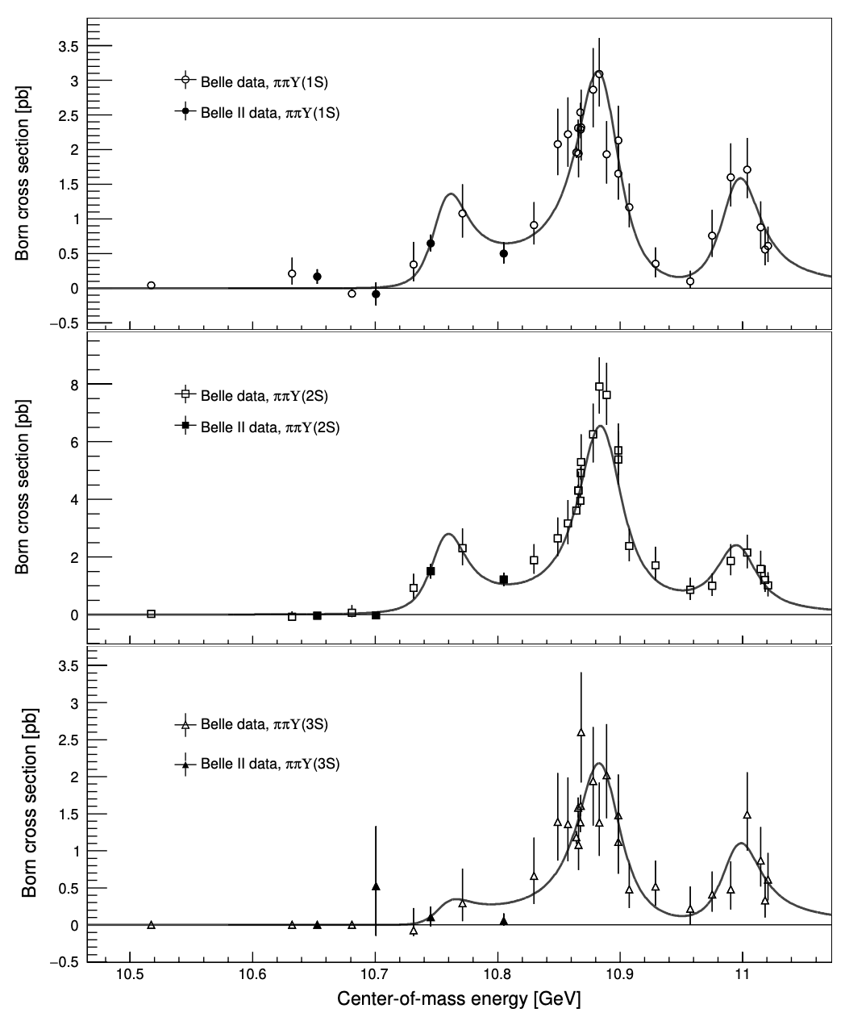



Updated measurement of the energy dependence of the $e^{+}e^{−} \text{→}π^{+}π^{−}Υ(nS)$ cross sections
Fit with three coherent BW, convoluting a Gaussian modeling energy spread:
JHEP 07 (2024) 116
$$σ∝|\overset{3}{\underset{i}{∑}}\frac{\sqrt{12πΓ_{i}ℬ_{i}}}{s−M_{i}+iM_{i}Γ_{i}}⋅\sqrt{\frac{f(\sqrt{s})}{f(M_{i})}}e^{iφ_{i}}|^{2}⊗G(0,δE)$$
Parameters of $Υ(10753)$:
$$M=10756.3±{2.7}_{(stat.)}±{0.6}_{(syst.)}MeV/c^{2}$$
$$Γ=29.7±{8.5}_{(stat.)}±{1.1}_{(syst.)}MeV$$
Agree with previous Belle measurement.
Improve uncertainties ~2 times smaller
30
30

Slide 31









First Study of $Ξ_{c}^{0}→Ξ^{0}π^{0}/η/η^{′}$
Belle + Belle II ~1.4/ab:
Invariant mass spectra for $Ξ_{c}^{0}$ candidates
First measurements of the branching fractions using combined data:
$$ℬ\left(Ξ_{c}^{0}→Ξ^{0}π^{0}\right) =\left(6.9±0.3\left(stat.\right)±0.5(syst.)±1.5\left(norm.\right)\right)×{10}^{−3}$$
$$ℬ\left(Ξ_{c}^{0}→Ξ^{0}η\right) =\left(1.6±0.2\left(stat.\right)±0.2(syst.)±0.4\left(norm.\right)\right)×{10}^{−3}$$
$$ℬ\left(Ξ_{c}^{0}→Ξ^{0}η′\right) =\left(1.2±0.3\left(stat.\right)±0.1(syst.)±0.3\left(norm.\right)\right)×{10}^{−3}$$
taking $Ξ_{c}^{0}→Ξ^{−}π^{+}$ as reference mode (BR error dominate the uncertainties), favoriting predictions in SU(3) flavor symmetry [JHEP 02, 235 (2023)]
First asymmetry parameter $α(Ξ_{c}^{0}→Ξ^{0}π^{0})$ measurement depending on
$$\frac{dN}{dcosθ_{Ξ^{0}}} ∝1+α\left(Ξ_{c}^{0}→Ξ^{0}h^{0}\right)α\left(Ξ^{0}→Λπ^{0}\right)cosθ_{Ξ^{0}}$$
through a simultaneous fit to Belle and Belle II data samples
$$α\left(Ξ_{c}^{0}→Ξ^{0}π^{0}\right)=−0.90±0.15\left(stat.\right)±0.23\left(syst.\right)$$
taking $α$($Ξ^{0}→Λπ^{0}$) = $−$0.349$±$0.009(PDG)
PRELIMINARY
PRELIMINARY
$$Ξ_{c}^{0}→Ξ^{0}π^{0}$$
$$Ξ_{c}^{0}→Ξ^{0}η$$
PRELIMINARY
PRELIMINARY
PRELIMINARY
PRELIMINARY
PRELIMINARY
PRELIMINARY
JHEP 10 (2024) 045
$$Ξ_{c}^{0}→Ξ^{0}η′$$
31

Slide 32






Search for BNV decay $τ→Λ\left(\overline{Λ}\right)π$ at Belle II
arXiv:2407.05117
Signal efficiencies are 9.5% and 9.9% for $τ→Λπ$ and $τ→\overline{Λ}π$;
Poisson counting experiment technique in signal region in the $M\left(Λπ\right)=\sqrt{E_{Λπ}^{2}−P_{Λπ}^{2}}$and $ΔE=E_{Λπ}^{CM}−\sqrt{s}/2$ plane;
Expected events are 1 and 0.5 for $τ→Λπ$ and $τ→\overline{Λ}π$;
No observed events;
World's best upper limits at 90% C.L. of $4.7×{10}^{−8}$ for $ℬ\left(τ→Λπ\right)$ and $4.3×{10}^{−8}$ for $ℬ\left(τ→\overline{Λ}π\right)$;

Slide 33
TopoAna: A generic tool for the event type analysis of inclusive Monte-Carlo samples
To help analysts obtain the physics process information from the truth information of the samples, we develop a physics process analysis program, TopoAna, with C++, ROOT, and LaTeX.
TopoAna is now a very mature system: ~14, 000 lines of code, ~50 setting items, a 41-page-long user guide, and many examples in the package.
Independent of specific software frameworks, the program is applicable to many experiments: BESIII, Belle, Belle II, and so on.
The paper has been published: Comput. Phys. Commun.258 (2021) 107540, 引用110次

Slide 34
Now & future at Belle II
We have made great contributions to Belle II
  Belle2link
  PXD DAQ
  Belle II software
We are willing to contribute more
  Simulation
  Computing
  Detector upgrade
  …..
More physics studies
  XYZ states，light hadron spectrum
  Charm meson/baryon, D Dbar mixing
  B decays, new physics
  Tau decays [this workshop]
  …….
仍然缺乏 crazy ideas
  是否有新的探测新物理的途径？是否有对新物理敏感的道没有人发现？如何解决奇特态内部结构问题？如果用新的技术进一步提高效率？
Do not forget your service work
to obtain the author’s signature !

Slide 35
科研经费
基金委
  重点项目
  国际交流合作项目
  面上项目
  青年项目
  人才项目
科技部
  国家重点研发计划子课题
省部级
  上海市人才项目
  上海市面上
  。。。。。
不像LHC上的大科学装置实验，Belle II没有稳定的长期的经费支持。

Slide 36
经费的问题
多途径争取更多经费支持，重点解决M&O经费来源和今后探测器升级贡献相关经费来源
在各种场合宣传我们在Belle II的贡献和Belle II的重要性
进一步推动Belle II项目在科技部重点研发计划中立项
积极申请基金委仪器设备相关项目
联合申请基金委重点项目
积极申请国际交流、面上、青年、人才项目
  ➔ 好的物理想法是申请的关键，多交流、多探讨

Slide 37
Problems! Solutions?
Some important topics have been occupied by foreign institutes, like B semi-leptonic decays, B pure-leptonic decays, CKM matrix, …
Less productive in a few universities
  Very slow progress for some important analyses
  Tried too many topics without finishing any one of them
An estimation:
  1 paper/1.5 years/student should be reasonable
Question to students
  how much time do you work on an analysis per day? <8h (except playing games)?

Slide 38
感谢南开大学和殷俊昊组织这次冬季学校！
38

