Slide 1
$$B^{0}→K_{S}^{0}ψ\left(2S\right) with ψ\left(2S\right)→π^{+}π^{−}J/ψ$$
Wanyi Zhuangª, Shuangshuang Zhang^{b}, Yahui Zhao^{c}, Xueqiang Yan^{d}
ªFDU
^{b}SDU
^{c}HNNU
^{d}IHEP
Belle II China Winter School 2024
Nov. 29 2024

Slide 2
Outline
Motivation
..
Data sets
..
General event selection
..
Background study
..
$$\text{Signal} \text{yields}$$
..
Summary
..
1

Slide 3
Motivation
optimizing reconstruction strategy:
higher detection efficiency
Good signal resolution
Low mis-combination background
……
..
Background study: according to GenericMC
..
Fit method: according to GenericMC and signal MC
..
2

Slide 4
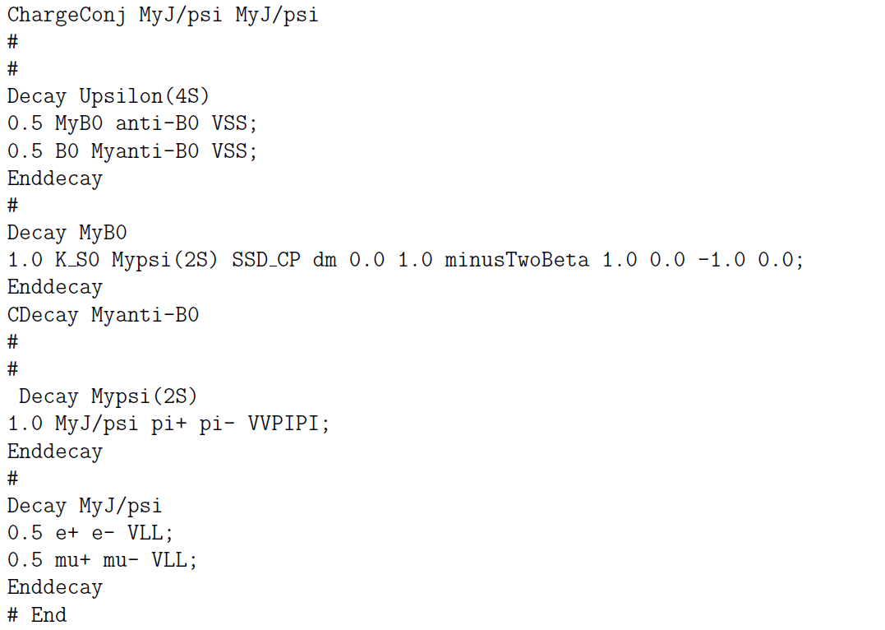
Data Sets
..
Basf2 version:
release-08-01-08
Decay card:
Generic MC sample:
Type: Run-independent MC
Energy: on resonance
Integrated luminosity:40/fb
..
..
Signal MC sample
Event number: 10⁶
Decay mode:
$B^{0}→K_{S}^{0}ψ\left(2S\right),ψ\left(2S\right)→π^{+}π^{−}$ $J/ψ$, $J/ψ$ $→e^{+}e^{−}/μ^{+}μ^{−}$
3

Slide 5
General event selection
Decay mode: $Υ\left(4S\right)→B^{0}{\overline{B}}^{0};B^{0}→K_{S}^{0}ψ\left(2S\right), ψ\left(2S\right)→π^{+}π^{−}J/ψ;J/ψ→e^{+}e^{−}/μ^{+}μ^{−}$
..
Charged track:
Pion identification likelihood ratio:
..
..
$|dr|<0.5 cm \&\left|dz\right|<2.0 cm$
clusterNHits>1.5
thetaInCDCAcceptance
$pionID_{binary}=ℒ_{π}/(ℒ_{π}+ℒ_{K})≥0.5$
dr: transverse distance with respect to IP for a vertex.
dz: vertex or the point of closest approach(POCA) in case of tracks z with respect to IP.
4

Slide 6
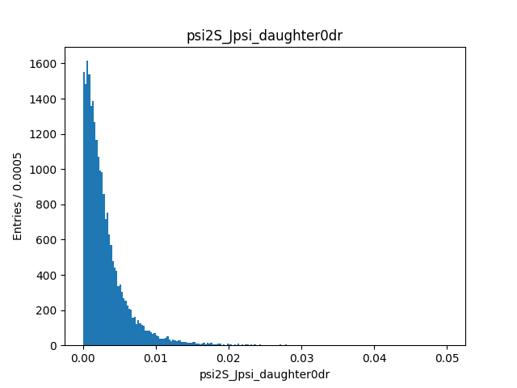
dr distribution
4

Slide 7
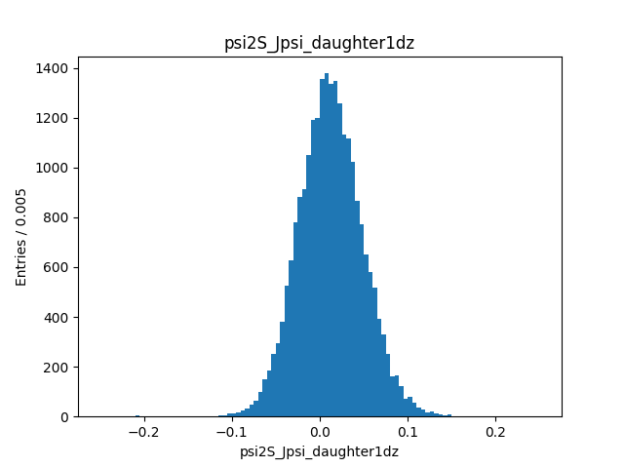
dz distribution
4

Slide 8
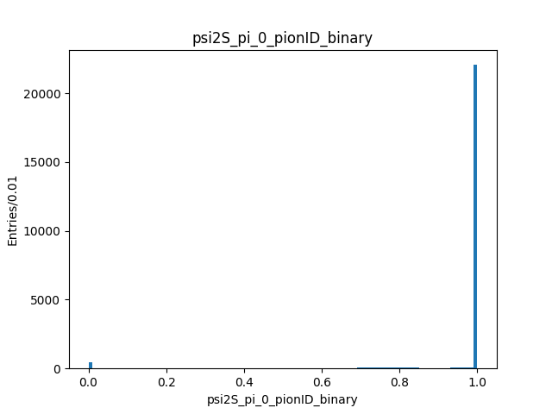
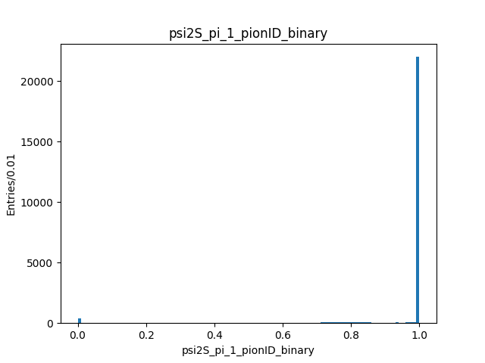
kaonID_binary distribution
4

Slide 9
General event selection(2)
$K_{S}^{0}$ meson selection:
..
stdKshorts(using standard list to reconstruct)
GoodBelleKshort>0
Invariant mass window: $490 MeV/c^{2}<M_{K_{S}^{0}}<506 MeV/c^{2}$
$J/ψ$ meson selection :
..
A pair of oppositely-charged lepton tracks ($e^{+}e^{−}/μ^{+}μ^{−}$)
$muonID_{noSVD}>0.5,electronID_{noSVDnoTOP}>0.5$
$P_{cms}\left(J/ψ\right)<2.0Gev/c$
$3.03 GeV/c^{2}<M_{l^{+}l^{−}} <3.13GeV/c^{2}$
Continuum suppression:
..
$R2<0.5$
5

Slide 10
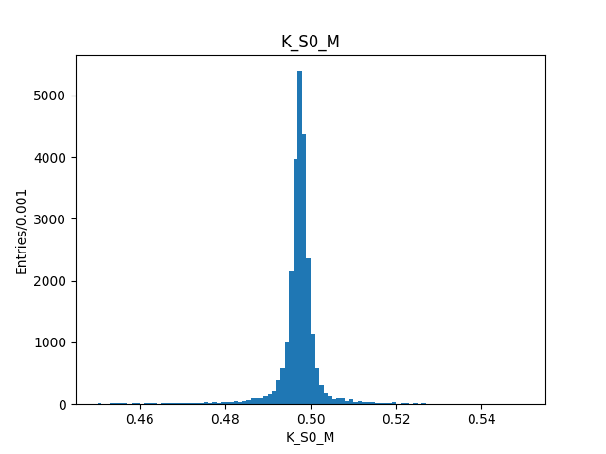
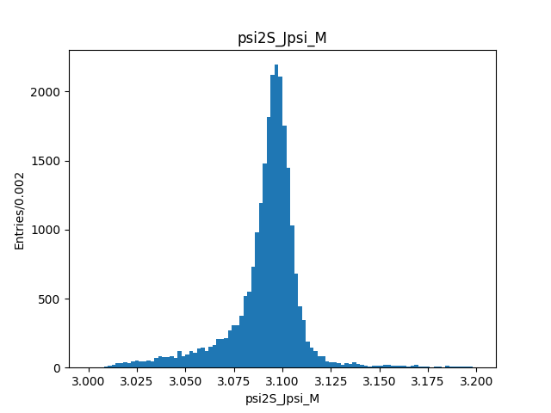
$K_{S}^{0}$and $J/ψ$ mass distribution
$$490 MeV/c^{2}<M_{K_{S}^{0}}<506 MeV/c^{2}$$
$3.03 GeV/c^{2}<M_{l^{+}l^{−}} <3.13GeV/c^{2}$
4

Slide 11
General event selection(3)
$ψ(2S)$ meson selection:
..
Invariant mass window: ${|M}_{π^{+}π^{−}J/ψ}−m_{J/ψ}|<0.009 MeV/c^{2}$
$M_{π^{+}π^{−}J/ψ} is defined as M_{ψ(2S)}−M_{l^{+}l^{−}}+m_{J/ψ},m_{J/ψ}=3.686 GeV/c^{2}$
$B^{0}$ meson selection :
..
$M_{bc}>5.20GeV/c^{2}$
$\left|∆E\right|<0.3 GeV$
Tree fit: chiProb_rank < 10
Mbc: beam constrained mass.
deltaE: difference between E and half the center of mass energy.
5

Slide 12
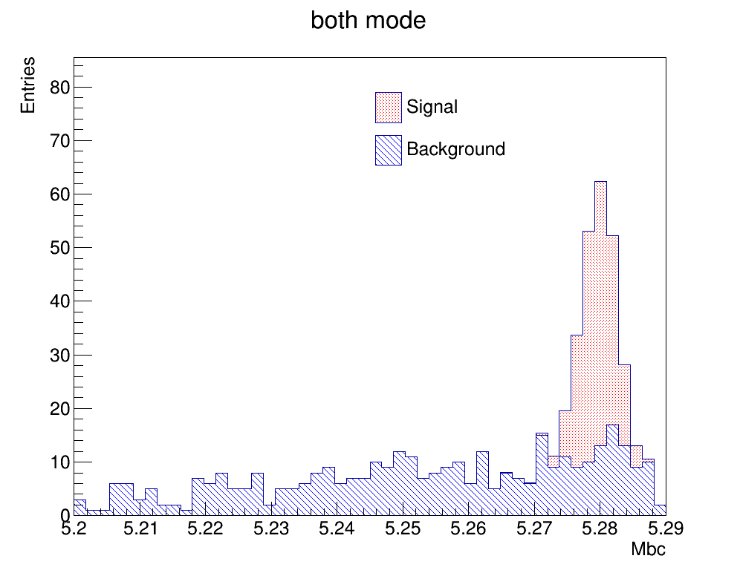
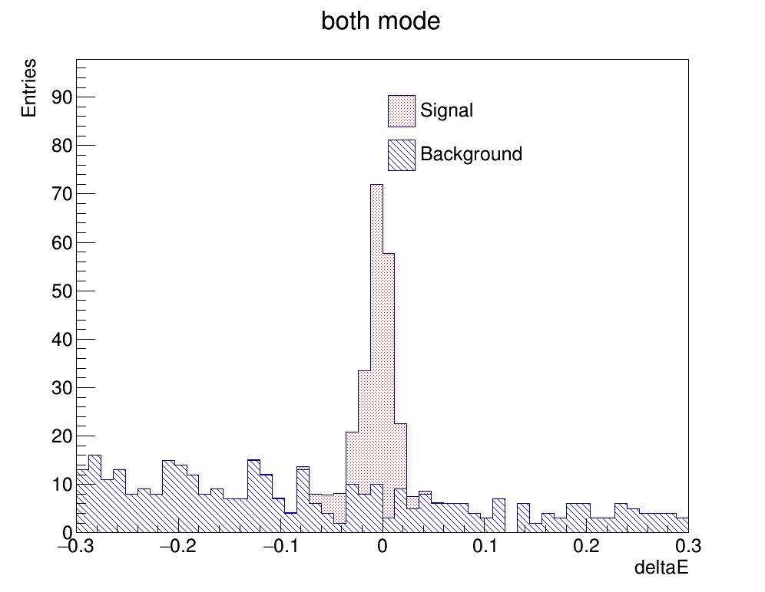
Mbc and deltaE distribution
4

Slide 13
Cut flow
$$Selection$$ | efficiency
$$Lepton ID$$ | 22.79%
$$goodBelleKshort$$ | 22.79%
$$psi2S_Jpsi_CMS_pt$$ | 22.79%
$$pionID_binary$$ | 22.49%
$$Jpsi_M$$ | 22.21%
$$psi2S_M$$ | 21.47%
$$K_S0_M$$ | 19.03%
$$chiProb_rank$$ | 18.34%
$$R2$$ | 18.34%
$$Mbc$$ | 18.34%
$$deltaE$$ | 18.34%
$$Reconstruction efficiency$$ | 18.34%
Signal mis-reconstruction efficiency=5.23%

Slide 14
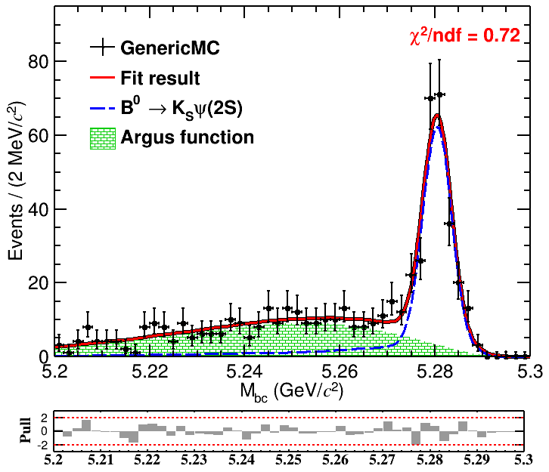
Signal yield
Signal shape: Exclusive MC shape $⨂$ Gaussian function
Non-peak background: Argus function
$$N^{sig}=281±23$$
$$N_{non−peak}^{bkg}=265±22$$
Mean value of Gaussian function: $\left(1.25±0.25\right)×{10}^{−3}GeV/c^{2}$
Sigma value of Gaussian function: $\left(1.29±0.51\right)×{10}^{−3}GeV/c^{2}$
9

Slide 15
Summary
Get reconstruction strategy and event selection criteria
..
Get signal detection efficiency
..
Get fit method (based on GenericMC)
..
Group member contribution:
Wanyi Zhuang: 主导MC产生，编写重建算法，PPT具体内容编写，画图
Shuangshuang Zhang: 参与MC产生，参与重建算法优化，PPT完善，画图
Yahui zhao: 参与MC产生，参与重建算法优化，PPT完善，画图
Xueqiang Yan: 参与MC产生，参与重建算法优化，负责PPT框架，画图
10

