Slide 1
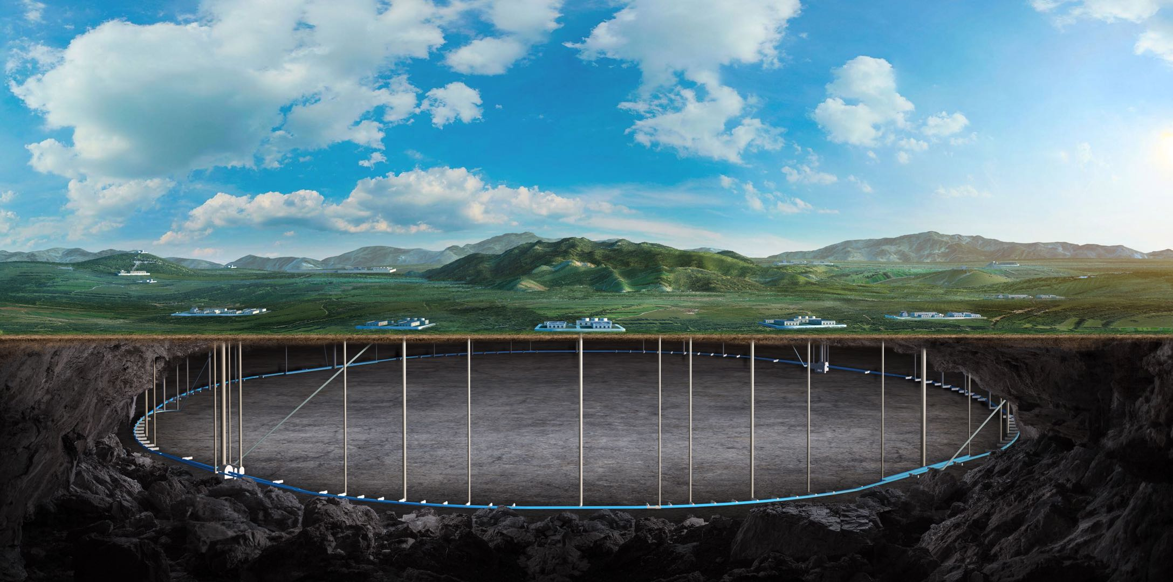
CEPC Accelerator physics design
Yiwei Wang
for the CEPC Accelerator Physics Group
2024年CEPC机械设计研讨会，河南洛阳中信重工

Slide 2
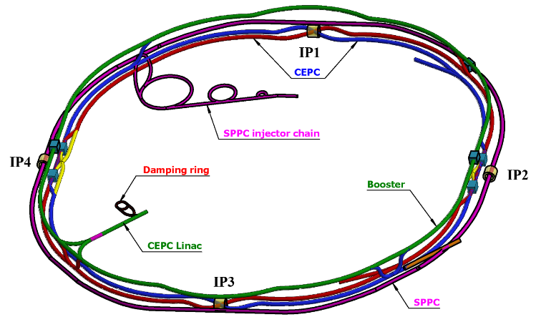
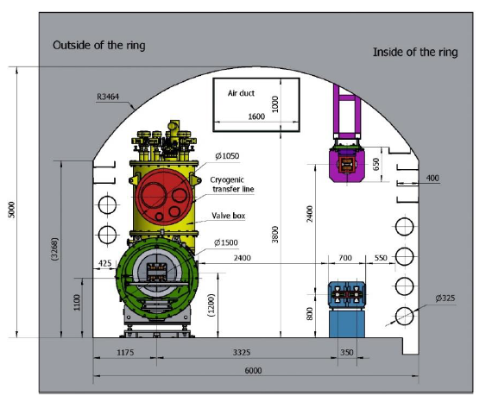
Overall design requirement of the CEPC accelerators
SR power per beam 30 MW (50 MW upgradable), 100 km, 2 interaction points
Higgs mode hold the 1st priority and compatible with the ttbar/W/Z modes.
Compatible with SPPC: 100km, section length, two machines share the most tunnels
CEPC+SPPC complex
Tunnel in the arc regions
CEPC detectors

Slide 3
CEPC accelerator system parameters

Slide 4
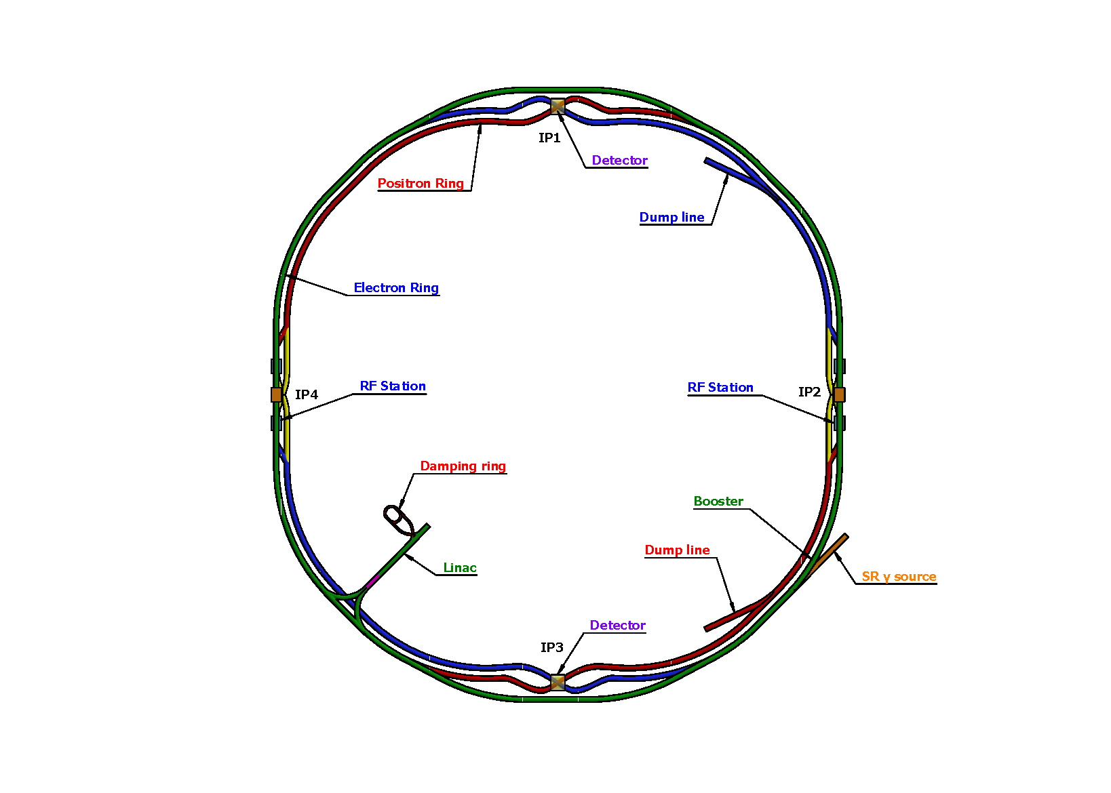
Lattice design requirement of the CEPC collider ring
Basically 2 folded symmetry
2 interaction regions @ IP1 and IP3
crab waist collision
local chromaticity correction for the interaction region
2 RF acceleration regions @ IP2 and IP4
shared cavities for two beam @ ttbar, Higgs
flexible switching between compatible modes
8 arc sections
dual aperture dipole and quadrupole magnets
4 short straight section
on/off axis injection regions for different modes
beam dumping, gamma source
Providing polarized beam
SS4
SS1
SS: short straight section
SS3
SS2

Slide 5
Collider ring parameters
 | Higgs | Z | W | $$t\overline{t}$$
Number of IPs | 2
Circumference (km) | 100.0
SR power per beam (MW) | 30
Half crossing angle at IP (mrad) | 16.5
Bending radius (km) | 10.7
Energy (GeV) | 120 | 45.5 | 80 | 180
Energy loss per turn (GeV) | 1.8 | 0.037 | 0.357 | 9.1
Damping time τ_{x}/τ_{y}/τ_{z} (ms) | 44.6/44.6/22.3 | 816/816/408 | 150/150/75 | 13.2/13.2/6.6
Piwinski angle | 4.88 | 24.23 | 5.98 | 1.23
Bunch number | 268 | 11934 | 1297 | 35
Bunch spacing (ns) | 591 (53% gap) | 23 (18% gap) | 257 | 4524 (53% gap)
Bunch population (10¹¹) | 1.3 | 1.4 | 1.35 | 2.0
Beam current (mA) | 16.7 | 803.5 | 84.1 | 3.3
Phase advance of arc FODO (°) | 90 | 60 | 60 | 90
Momentum compaction (10⁻⁵) | 0.71 | 1.43 | 1.43 | 0.71
Beta functions at IP β _{x}*/β _{y}* (m/mm) | 0.3/1 | 0.13/0.9 | 0.21/1 | 1.04/2.7
Emittance ε_{x}/ε_{y} (nm/pm) | 0.64/1.3 | 0.27/1.4 | 0.87/1.7 | 1.4/4.7
Betatron tune ν_{x}/ν_{y} | 445/445 | 317/317 | 317/317 | 445/445
Beam size at IP σ_{x} /σ_{y} (um/nm) | 14/36 | 6/35 | 13/42 | 39/113
Bunch length (natural/total) (mm) | 2.3/4.1 | 2.5/8.7 | 2.5/4.9 | 2.2/2.9
Energy spread (natural/total) (%) | 0.10/0.17 | 0.04/0.13 | 0.07/0.14 | 0.15/0.20
Energy acceptance (DA/RF) (%) | 1.6/2.2 | 1.0/1.7 | 1.05/2.5 | 2.0/2.6
Beam-beam parameters ξ_{x} /ξ_{y} | 0.015/0.11 | 0.004/0.127 | 0.012/0.113 | 0.071/0.1
RF voltage (GV) | 2.2 | 0.12 | 0.7 | 10
RF frequency (MHz) | 650
Longitudinal tune ν_{s} | 0.049 | 0.035 | 0.062 | 0.078
Beam lifetime (min) | 18 | 77 | 22 | 18
Hourglass Factor | 0.9 | 0.97 | 0.9 | 0.89
Luminosity per IP (10³⁴ cm^{–2} s^{–1}) | 5.0 | 115 | 16 | 0.5
𝛽y∗ and emittance chosen for luminosity
adequate bunch population Ne for the luminosity and the achievable energy acceptance for lattice design
Number of bunches Nb is adjusted to keep the beam current
Gaps in Higgs bunch train (1 train): 1-268*591ns/333us=53%
Gaps in Z bunch trains (153 trains): 1-23ns*153*78/333us=18%
The minimum bunch separation for Z mode, taking into account electron cloud effects and timing structure, is 23 ns, leaving 18% beam gap for ion cleaning and kicker rise.
Ref: CEPC TDR, arXiv 2312.14363

Slide 6
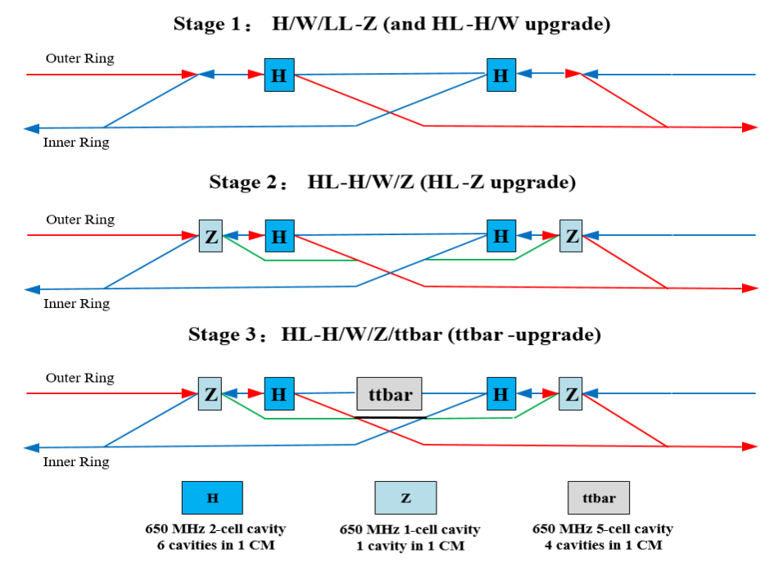
Collider Ring RF Staging
Ref: CEPC TDR, arXiv 2312.14363; Jiyuan Zhai, CEPC workshop-EU 2024
Higgs priority
- timeline and performance priority
Upgradable
- power (luminosity) and energy upgrade
Low cost (especially first stage)
- staged cost and in-kind contribution
Max luminosity for each mode
- up to 50 MW SR power per beam
Seamless mode switch
- switch among H/W/Z/(ttbar)
stage 1: 2-cell H cavities are shared by two rings for the Higgs and W running; Half the number of H cavities are bypassed for W and Z running.
Low luminosity Z: bunch numbers limit by the High order modes, 267 bunches, 38*10^34/cm^2/s, SR 10MW
stage 2: 1-cell Z cavities will be installed, and the low current H cavities are bypassed with the transfer line (shown in green) when running in Z mode; For Higgs and W running, the beams go through both the 2-cell and 1-cell cavities.
stage 3: 5-cell t𝑡𝑡̅ cavities will be installed in the center for t𝑡𝑡̅ running; For W/Z running, the beams go through the same beamline as in stage 2 and is possible to switch to Higgs running by bypassing the t𝑡̅ cavities with a transfer line (in black colour).

Slide 7
Collider Ring RF Parameters
30/50 MW SR power per beam for each mode. Higgs/ttbar shared cavities for the two rings. W/Z separate cavities. HL-Z cavities bypass. | ttbar 30/50 MW |  | Higgs 30/50 MW | W 30/50 MW | Z 10 MW | Z 30/50 MW
 | New cavities | Higgs cavities
Luminosity / IP [10³⁴ cm⁻²s⁻¹] | 0.5 / 0.8 |  | 5 / 8.3 | 16 / 26.7 | 38 | 115 / 192
RF voltage [GV] | 10 (6.1 + 3.9) |  | 2.2 | 0.7 | 0.12 | 0.12 / 0.1
Beam current / beam [mA] | 3.4 / 5.6 |  | 16.7 / 27.8 | 84 / 140 | 267 | 801 / 1345
Bunch charge [nC] | 32 |  | 21 | 21.6 | 22.4 | 22.4 / 34.2
Bunch length [mm] | 2.9 |  | 4.1 | 4.9 | 8.7 | 8.7 / 10.6
650 MHz cavity number | 192 | 336 | 192/336 | 96 / 168 / ring | 48 / ring | 30 / 50 / ring
Cell number / cavity | 5 | 2 | 2 | 2 | 2 | 1
Gradient [MV/m] | 27.6 | 25.2 | 24.9 / 14.2 | 15.9 / 9.1 | 5.4 | 17.4 / 8.7
Q₀ @ 2 K at operating gradient | 3E10 | 3E10 | 3E10 | 3E10 | 3E10 | 2E10
HOM power / cavity [kW] | 0.4 / 0.66 | 0.16 / 0.26 | 0.4 / 0.67 | 0.93 / 1.54 | 1.9 | 2.9 / 6.2
Input power / cavity [kW] | 188 / 315 | 71 / 118 | 313 / 298 | 313 / 298 | 206 | 1000
Optimal Q_{L} | 1E7 / 6E6 | 9E6 / 5.4E6 | 1.6E6 / 9.5E5 | 8E5 / 2.7E5 | 1.4E5 | 1.5E5 / 3.8E4
Optimal detuning [kHz] | 0.01 / 0.02 | 0.02 / 0.03 | 0.1 / 0.2 | 0.7 / 2 | 7 | 6.7 / 21.7
Cavity number / klystron | 4 / 2 | 2 | 2 | 2 | 2 | 1
Klystron power [kW] | 800 | 800 | 800 | 800 | 800 | 1200
Klystron number | 48 / 96 | 168 | 96 / 168 | 96 / 168 | 48 | 60 / 100
Cavity number / cryomodule | 4 | 6 | 6 | 6 | 6 | 1
Cryomodule number | 48 | 56 | 32 / 56 | 32 / 56 | 16 | 60 / 100
Total cavity wall loss @ 2 K [kW] | 12.1 | 7.1 | 3.9 / 2.3 | 1.6 / 0.9 | 0.1 | 0.45 / 0.2
Ref: Jiyuan Zhai, CEPC workshop-EU 2024

Slide 8
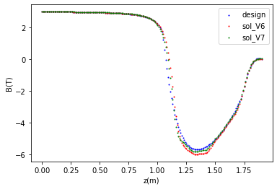
Vertical emittance generated by solenoid field
Detector solenoid field @ W/Higgs/ttbar
(Scaled to 2T at IP @ Z)
The detector solenoid are compensated locally with anti-solenoids as the skew quadrupole will introduce additional chromaticity.
From IP to the entrance of Q1A(0 to 1.9m):
∫Bzdz cancled between the IP and the entrance of final quadrupole with strong anti-solenoid field in 1.1m to 1.9m.
Field configuration optimized to get emittance minimum and iterate with anti-solenoid technical constraints
Data from Feipeng Ning
tentative, to be optimized with the evolution of the detector design
Z(m)
Compensated solenoid field from IP to the entrance of Q1A
Emittance contribution from the from IP to the entrance of Q1A
Version | ttbar | Higgs | W | Z
$ε_{y0}$ (pm) | 4.7 | 1.3 | 1.7 | 1.4
op. design $ε_{y}$ (pm) | 0.03 | 0.26 | 0.85 | 0.67
tech. design v6 $ε_{y}$ (pm) | 0.04 | 0.41 | 1.35 | 1.07
tech. design V7 $ε_{y}$ (pm) | 0.04 | 0.36 | 1.20 | 0.95
by Ande MA, Yiwei Wang, Yingshun Zhu

Slide 9
Vertical emittance generated by solenoid field
Detector solenoid field @ W/Higgs/ttbar
(Scaled to 2T at IP @ Z)
From the entrance of Q1A to Q3(1.9m to 7.55m)
Bz keep fully cancellation along this region
Torlerance of the cancellation: amplitude ≤±200 Gs in a region L≥2 cm to limit the emittance growth less than 1% nominal value
From the Q3 and the last bend (farer than 7.55m)
∫Bzdz from detector only < 0.5 T*m.
Along beam line (not z), fully cancelation in Q3 and pre-cancelation in some extension region for the long tail of the detector solenoid field
The fringe field configuration need to be optimized due the significant radial deviation from the Z axis to the beam line.
Data from Feipeng Ning
tentative, to be optimized with the evolution of the detector design
Z(m)

Slide 10
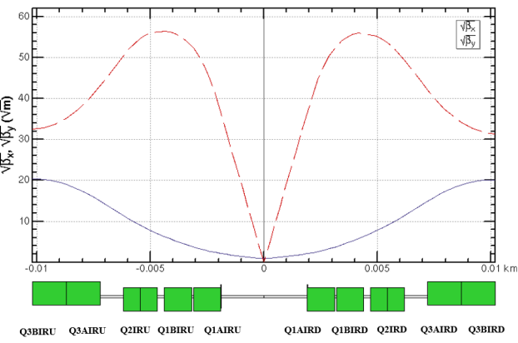
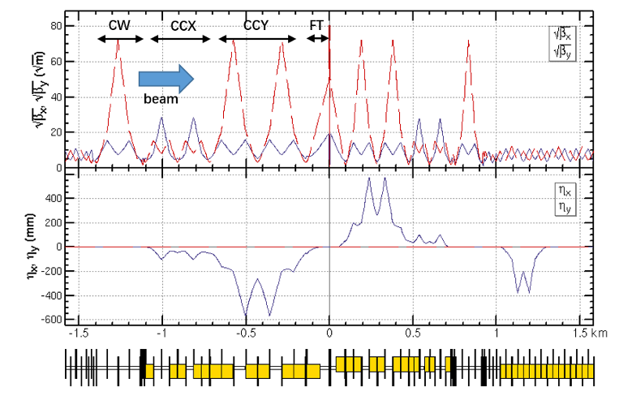
Super conducting final quadrupoles for all modes
The final quadrupole parameters near the IP are chosen based on a trade-off between the beam dynamics and the machine detector interface.
Constraint by the SCQ technology, the gradients of the two aperture of the SCQs should be same to get better filed quality.
The asymmetric beta functions in the upstream and downstream of the IP will be generated by additional normal-conducting quadrupoles in the final telescope (FT).
Layout of the dual aperture SCQ final quadrupoles
Parameters of the twin-aperture SCQs between the IP
Quadrupole | L [m] | Distance from IP [m] | Strength [T/m]
 |  |  | $$t\overline{t}$$ | Higgs | W | Z
Q1AIRU | 1.21 | 1.9 | -142 | -142 | -95 | -110
Q1BIRU | 1.21 | 3.19 | -59 | -85 | -57 | +65
Q2IRU | 1.5 | 4.7 | -51 | +97 | +65 | 0
Q3IRU | 3 | 7.2 (7.55) | +40 | 0 | 0 | +2
Q1AIRD | 1.21 | -1.9 | -142 | -142 | -95 | -110
Q1BIRD | 1.21 | -3.19 | -59 | -85 | -57 | +65
Q2IRD | 1.5 | -4.7 | -51 | +97 | +65 | 0
Q3IRD | 3 | -7.2 (7.55) | +40 | 0 | 0 | +2

Slide 11
Super conducting final quadrupoles for all modes
Dipole field aberration due to cross talk of the two aperture
Three types of SCQ design are undergoing.
Beam dynamics: integrated dipole field should be corrected
Radiation and particle loss: maximum 450/300/200/100 gs in the good field region along the SCQs for ttbar/Higgs/W/Z modes (the requirement will be updated with simulation of an integrated model of the quadrupoles, dipole error and solenoid)
The normal conducting quadrupole of Q3 for ttar running was moved outward (outer end from 7.2m to 7.55m) due to conflict between the cryomodule and the Q3
Layout of the dual aperture SCQ final quadrupoles
Parameters of the twin-aperture SCQs between the IP
Quadrupole | L [m] | Distance from IP [m] | Strength [T/m]
 |  |  | $$t\overline{t}$$ | Higgs | W | Z
Q1AIRU | 1.21 | 1.9 | -142 | -142 | -95 | -110
Q1BIRU | 1.21 | 3.19 | -59 | -85 | -57 | +65
Q2IRU | 1.5 | 4.7 | -51 | +97 | +65 | 0
Q3IRU | 3 | 7.2 (7.55) | +40 | 0 | 0 | +2
Q1AIRD | 1.21 | -1.9 | -142 | -142 | -95 | -110
Q1BIRD | 1.21 | -3.19 | -59 | -85 | -57 | +65
Q2IRD | 1.5 | -4.7 | -51 | +97 | +65 | 0
Q3IRD | 3 | -7.2 (7.55) | +40 | 0 | 0 | +2

Slide 12
Lattice design of the ARC region
FODO cell to provide a large filling factor of dipole.
90/90 degrees’ phase advances for the Higgs and ttbar modes due to the emittance and nonlinearity cancelation.
60/60 degrees’ phase advances for the W and Z modes to fulfil the collective instability requirement.
The distance 0.35m and opposite polarity between two beams fulfill the requirement technical design of the twin-aperture of dipoles and quadrupoles.
The distribution of sextupoles for Higgs & ttbar mode allowed to select –I sextupole pairs for W &Z modes.
0.35m
Dual aperture quadrupole and bend with opposite polarity in two ring
Distribution of sextupoles

Slide 13
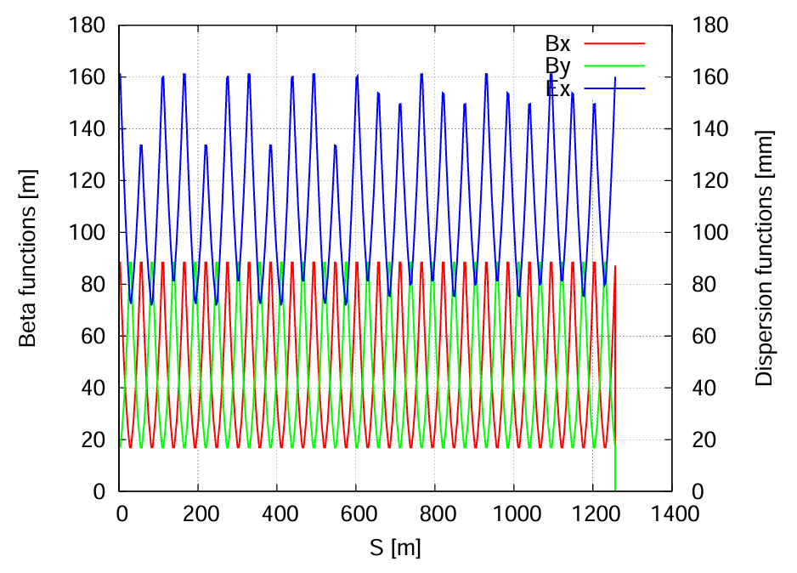
Update of the ARC lattice
FODO cells in the arc to provide a large filling factor of dipole
Dual-aperture dipoles and quadrupoles in the arc to save magnet power
Single-aperture sextupoles for independent nonlinearity optimization of e+ e- rings
Two kind of dipole length to use the space where no sextupoles
Single aperture magnets in the RF, injection and interaction regions
Correction of the energy sawtooth effects require adjusting range of magnets strength ±2.5% with the trim coils
Running at energy up to 180 GeV
The layout of the lattice in the arc area were updated based on the space required for vacuum, BPM, magnets, and mechanical equipment.
Work undergoing
Exploring less alignment sensitivity arc lattice

Slide 14
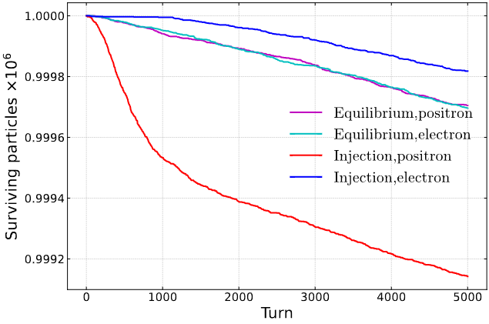
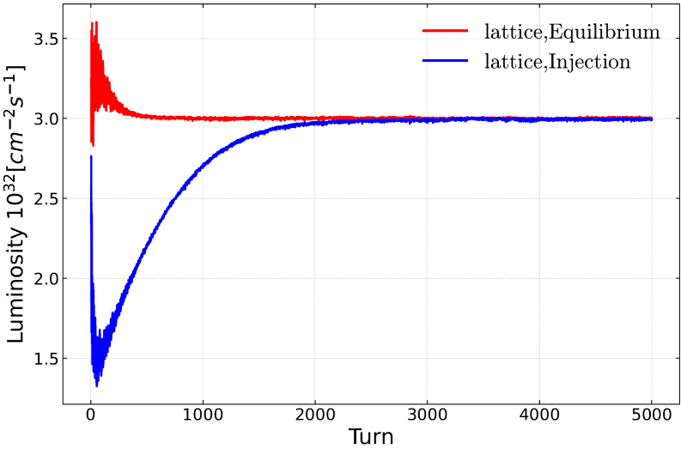
Beam lifetime of lattice + beam beam(s-s) + beamstrahlung
Using an integrated simulation code in APES-T (IHEP homemade, in progress) which can implement element-by-element tracking with strong-strong beam-beam interaction and lattice*
 | Equilibrium bunch (e-) | Injected bunch (e+)
$ε_{x0}$(nm) | 0.66 | 1.26
$ε_{y0}$(pm) | 1.35 | 13
Bunch length (mm) | 4.1 | 1.85
Energy spread (%) | 0.17 | 0.099
The injection pattern reaches a stable state equivalent to the equilibrium collision after 2000 turns, with a lifetime of approximately 40-60 minutes (33 min required). The particle loss before stability is about 0.06%.
Ref: Z. Li, Y. Zhang, K. Ohmi, D. Zhou, Y. Wang, G. Xu, DOI:10.1016/j.nima.2024.169386

Slide 15
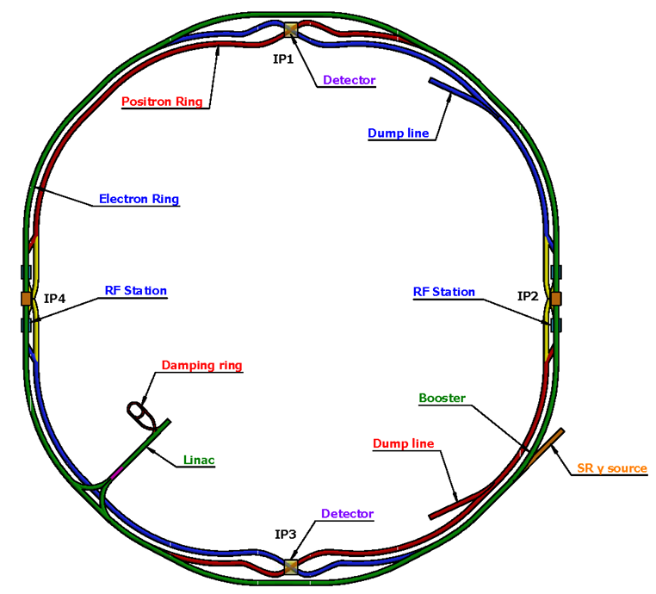
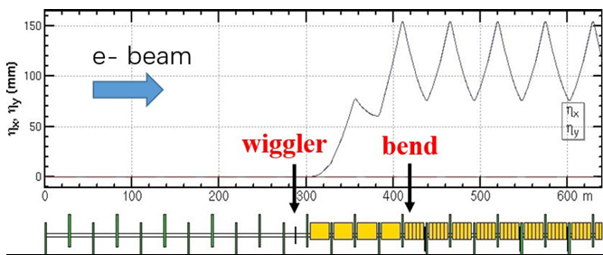
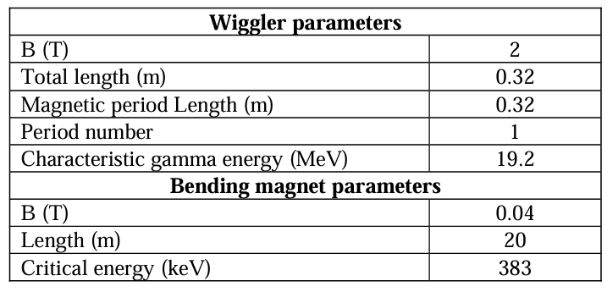
Wiggler and bends for gamma source
The strength of wiggler is required by the experiment and its length is limited by the beam performance for collision.
The introduction of an additional wiggler for the SR γ-ray source leads to a slight increase in energy loss per turn ∆U0/U0 increment of 0.6%.
Synchrotron radiation effects of wiggler on beam dynamics can be mitigated by adjusting the magnet strength to accommodate the beam (COD 2um)
The reduction in luminosity due to the SR from the wiggler is ~3% as the total bunch length increasing is ~3%.
further investigation to restore luminosity will be done
Comparison of the dynamic aperture with (left) and without (right) wiggler at Higgs energy.

Slide 16
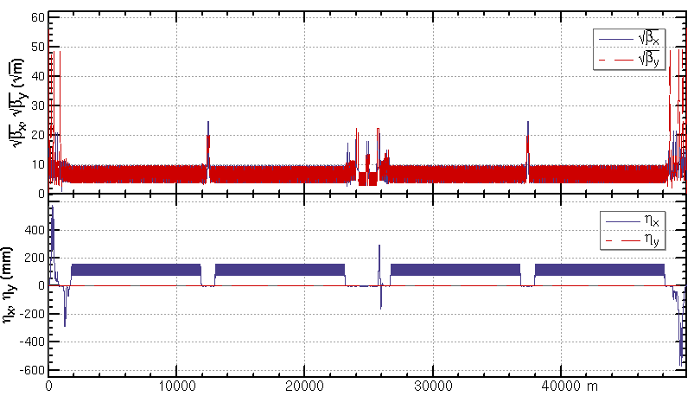
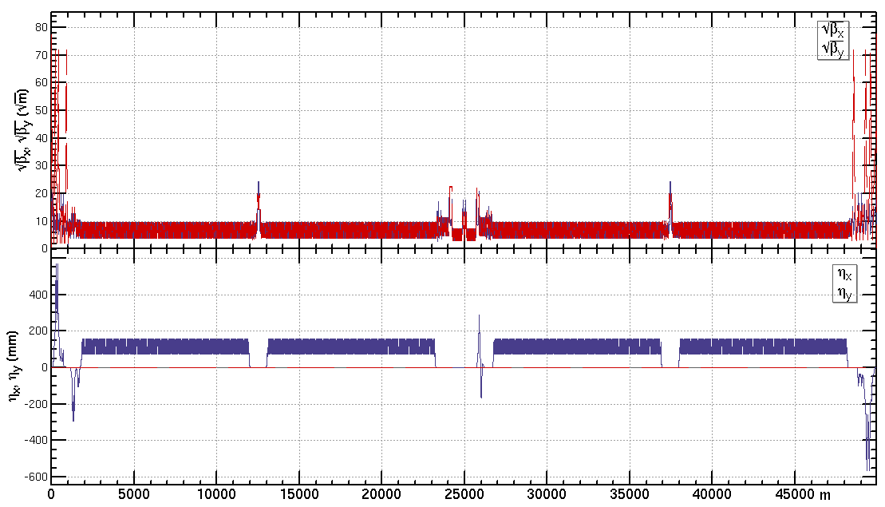
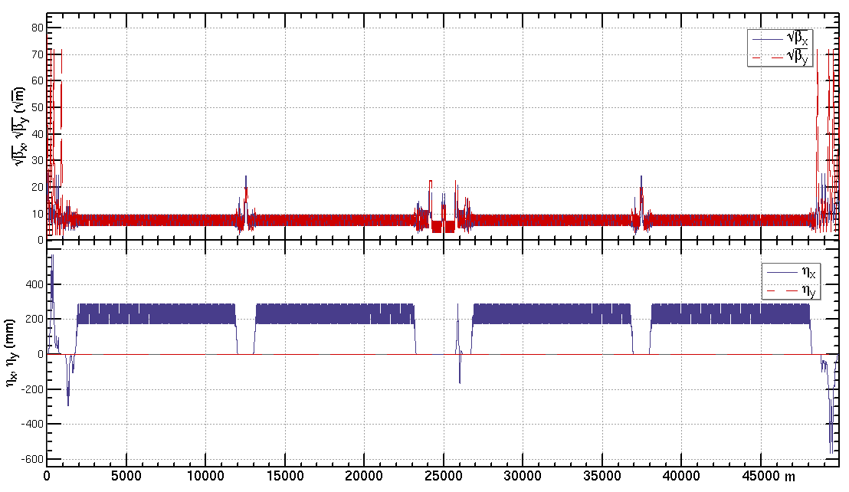
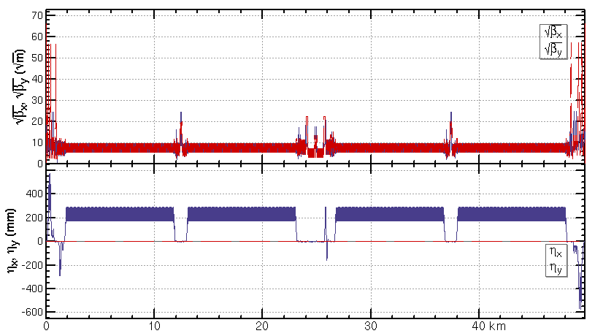
Lattice of the CEPC collider ring
ttbar: β=1.04m/2.7mm, εx=1.4nm, μ=90/90 deg
Higgs: β=0.30m/1mm, εx=0.64nm,
μ=90/90 deg
W: β=0.21m/1mm, εx=0.87nm, μ=60/60 deg
Z: β=0.13m/0.9mm, εx=0.27nm, μ=60/60 deg

Slide 17
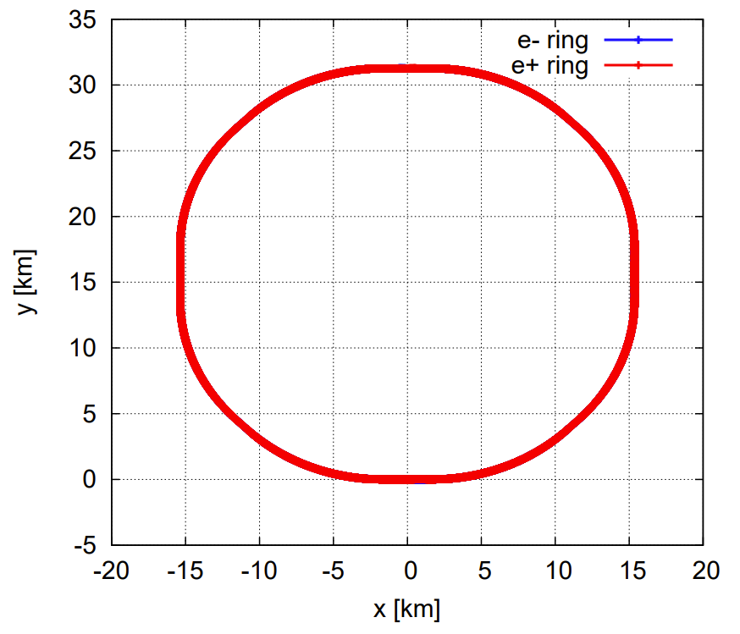
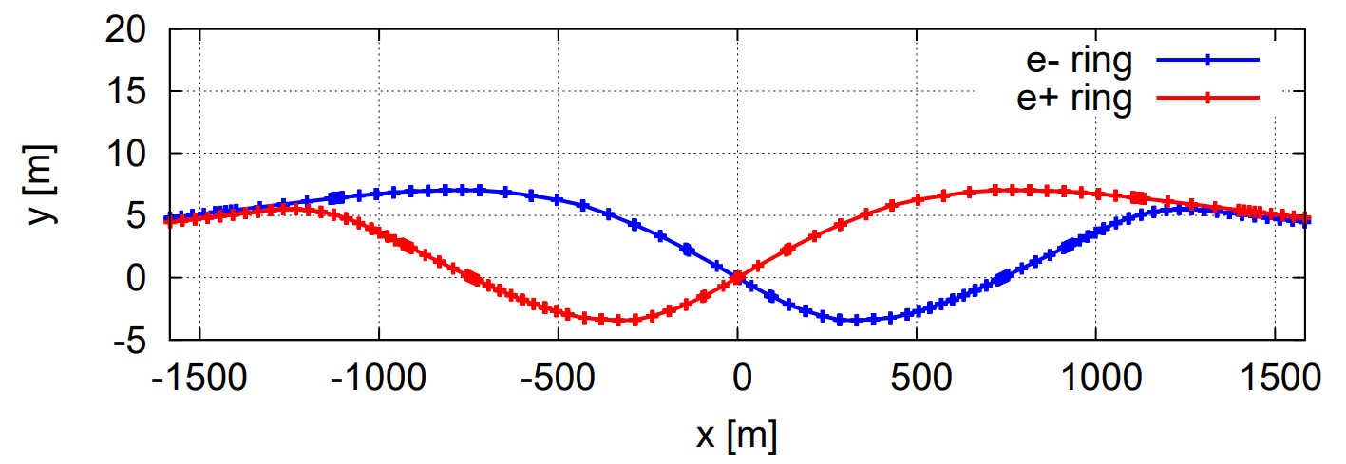
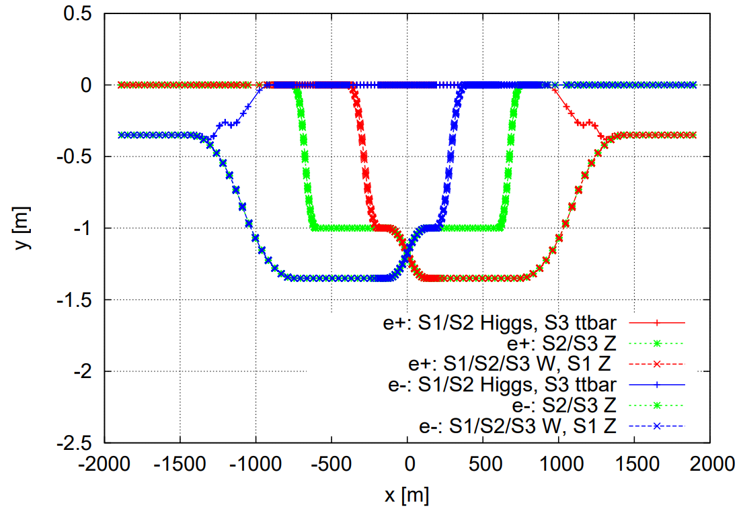
Geometry of the collider ring
4 curved arc sections, each with a length of 10270.44 m
4 curved arc sections, each with a length of 10185.70 m
2 interaction regions (IRs), IP1/IP3, each with a length of 3337.13 m
2 linear sections for RF, IP2/IP4, each with a length of 3776.90 m
4 linear sections, each with a length of 986.84 m
SS4
SS1
SS3
SS2

Slide 18
Magnet power supplies of the collider ring
Arc regions
In principle, the dual-aperture dipoles and quadrupoles can be connected in series as same FODO cells in the arc. Actually powered by many power supplies due to the large scale of CEPC.
Correctors, trim coils for the tapering, each pair of sextupoles for nonlinearity optimization should be powered independently (single-aperture)
RF, injection and interaction regions
most magnets should be powered independently (single-aperture)
Further calculation show that (Ref: Yiwei Wang, Note on the stability of power supply, 20230814, v2.1)
the accuracy of the collision energy measurement from the HEP experiment would require better dipole stability esp. at Z pole (1ppm for seconds)
The working point and beta* stability would require better quadrupole stability (1ppm)
The stability requirement of magnet PS in TDR
Magnet Power Supplies | Quantity | Stability /8hours
Dipole-D-aperture | 32 | 10ppm
Dipole-S-aperture | 38 | 10ppm
Quadrupole-D-aperture | 328 | 10ppm
Quadrupole-S-aperture | 600 | 10ppm
Sextupole | 1096 | 20ppm
Corrector-H & V | 7088 | 100ppm
Trim | 11904 | 100ppm
Superconducting magnets | 88 | 10ppm
Total | 21174

Slide 19
Alignment requirement of collider ring
Requirement of the relative alignment accuracy of the adjacent equipment is basically 100um based on the current error correction simulation.
Accuracy of the collider circumference due to alignment doesn’t pose an issue as the RF frequency and timing can be change slightly.
The relative difference of the two-ring circumferences
Contribution form the ARC would be limited due to the application of dual aperture dipole and quadrupole ( with order(2Pi*tens um) )
Further adjustment can be done by the closed orbit correction (TBD)
Simulation with the long range alignment data (work under going)

Slide 20
Mechanical systems of collider ring
Independent support for dual aperture dipole as long length (~5m)
Independent support for dual aperture quadrupole as long length (3m)
One support per 3 adjacent sextupoles
The resolution of the support should be better than 10 um due to the sensitivity of the closed orbit to the magnets
 | Number
Mechanical Systems
Dipole support | 13314
Quadrupole support | 4128
Sextupole support | 1128
Corrector support | 3544
Vacuum device support | 98979
BI Support | 4254
Collimators | 120
MDI mechanical devices | 8
RF support | 100
Adjustment range and resolution of supports
Direction | Range of adjustment | Direction | Resolution
X | ≥±20 mm | X | ≤10μm
Y | ≥±30 mm | Y | ≤10μm
Z | ≥±20 mm | Z | ≤10μm

Slide 21
Summary
Accelerator design for the TDR and progress toward EDR are presented.
Update of the lattice design toward the EDR were done with the iteration between beam physics simulation and hardware engineering design.
Work toward the EDR are undergoing.
Thanks to beneficial discussion with colleague of CEPC Accelerator Physics Group!

Slide 22
backup

Slide 23
CEPC Power and Energy Upgrade Plan
Slide from Jiyuan Zhai, CEPC workshop-EU 2024
 | Baseline |  |  | Power Upgrade |  |  | Energy Upgrade
 | Higgs | W | Z | Higgs | W | Z | tt̄
Collider SR power / beam [MW] | 30 |  |  | 50 |  |  | 30 |  | 50
Beam energy [GeV] | 120 | 80 | 45.5 | 120 | 80 | 45.5 | 180
Luminosity / IP [10³⁴ cm⁻²s⁻¹] | 5 | 16 | 115 | 8.3 | 26.7 | 192 | 0.5 |  | 0.8
Collider 650 MHz cavities | 2-cell |  | 1-cell | 2-cell |  | 1-cell | Add 5-cell | Existing 2-cell | Add 5-cell | Existing 2-cell
RF voltage [GV] | 2.2 | 0.7 | 0.12 | 2.2 | 0.7 | 0.1 | 10 (6.1 + 3.9) |  | 10 (6.1 + 3.9)
Beam current / ring [mA] | 16.7 | 84 | 801 | 27.8 | 140 | 1345 | 3.4 |  | 5.6
Cavity number | 192 | 96×2 | 30×2 | 336 | 168×2 | 50×2 | 192 | 336 | 192 | 336
Cryomodule number | 32 | 32 | 60 | 56 | 56 | 100 | 48 | 56 | 48 | 56
Klystron number | 96 | 96 | 60 | 168 | 168 | 100 | 48 | 168 | 96 | 168
Klystron power [kW] | 800 | 800 | 1200 | 800 | 800 | 1200 | 800 | 800 | 800 | 800
Collider 4.5 K equiv. heat load [kW] | 44.4 | 28.1 | 15.2 | 41.9 | 20 | 20.1 | 128.3 |  | 128.3
Booster 1.3 GHz cavities | 9-cell |  |  | 9-cell |  |  | Add 9-cell | Existing 9-cell | Add 9-cell | Existing 9-cell
Extraction RF voltage [GV] | 2.17 | 0.87 | 0.46 | 2.17 | 0.87 | 0.46 | 9.7 (7.53 + 2.17) |  | 9.7 (7.53 + 2.17)
Beam current [mA] | 1 | 3.1 | 16 | 1.4 | 5.3 | 30 | 0.12 |  | 0.19
Cavity number | 96 | 96 | 32 | 96 | 96 | 32 | 256 | 96 | 256 | 96
Cryomodule number | 12 | 12 | 4 | 12 | 12 | 4 | 32 | 12 | 32 | 12
SSA number | 96 | 96 | 32 | 96 | 96 | 32 | 256 | 96 | 256 | 96
SSA power [kW] | 25 | 25 | 25 | 30 | 30 | 40 | 10 | 10 | 10 | 10
Booster 4.5 K equiv. heat load [kW] | 7.8 | 3.1 | 3.5 | 8.1 | 3.2 | 3.7 | 11.4 |  | 11.4
Total RF length [m] | 704 | 704 | 384 | 1088 | 1088 | 608 | 2368 |  | 2368
Total 4.5 K equiv. heat load [kW] | 52.2 | 31.2 | 18.7 | 50.0 | 23.2 | 23.8 | 139.7 |  | 139.7

Slide 24
EDR plans for the collider ring lattice
Further tradeoff between the collider lattice, MDI, booster to get a more adequate machine design and further improve the dynamic aperture for the bare machine.
Establish the more realistic lattice with polarization systems, energy measurement systems, the complex interaction region components, realistic finite length fringe field and so on.
Face to the engineering design, trade off the accelerator physics requirements and the technology to establish parameters for future engineering.
Improve the global corrections and emittance tuning with errors.
Investigate more static errors including effect of BPM errors and multi-field errors, the long range alignment errors and the beam-based alignment for the main magnets et al.
Investigate on the dynamic error effects and possible feedback, including the injection jitter, the power source jitter, the ground motion with realistic data from the candidate sites.
Perform tracking simulations with a realistic lattice and strong-strong beam-beam interaction, to study the effects of machine errors on the beam-beam performance and the interplay with the luminosity-tuning knobs.
Establish the detailed procedures for the first turn injection, tuning, operation, different modes switching et al. Establish the tools and soft wares for tuning and operation.

