Slide 1



CEPC加速器机械设计
王海静 2024.8.22
2024 CEPC 机械设计研讨会 河南洛阳

Slide 2
Content
概况
CEPC设备布局
CEPC设备支撑
MDI机械
准直器
EDR计划
总结

Slide 3
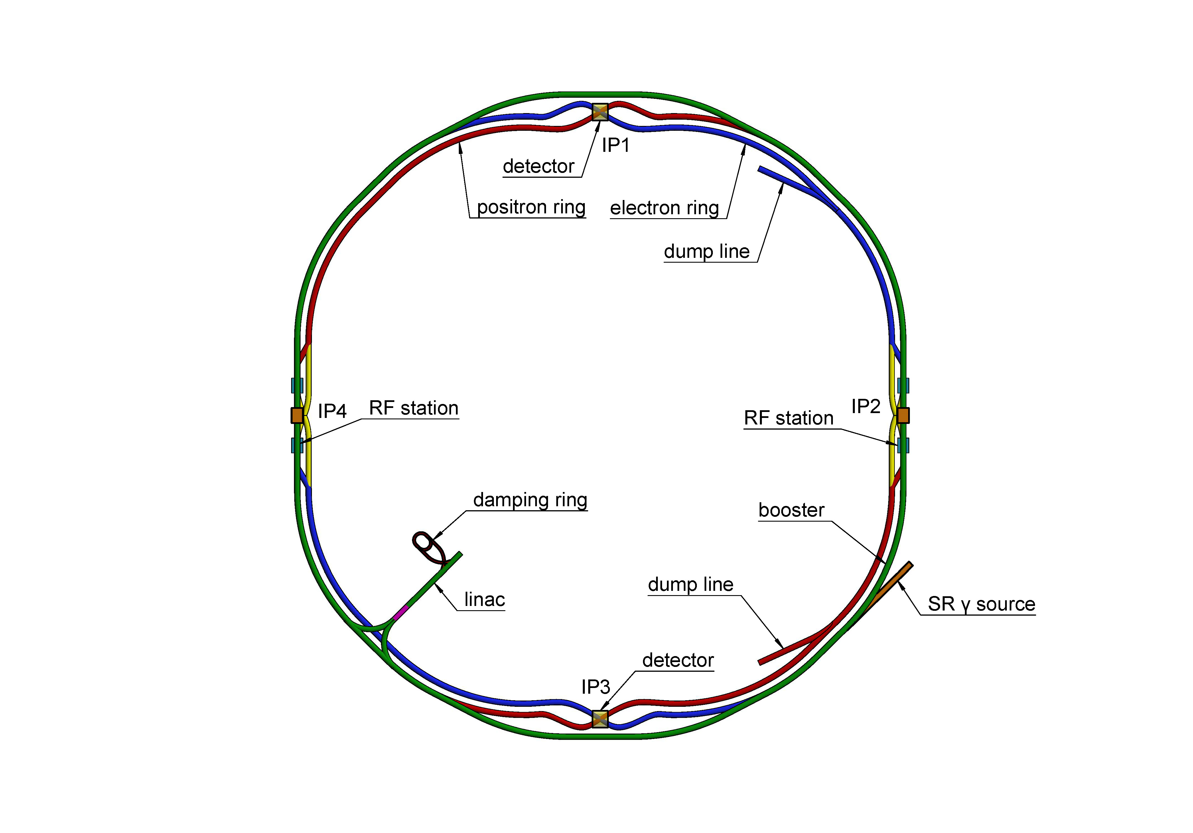
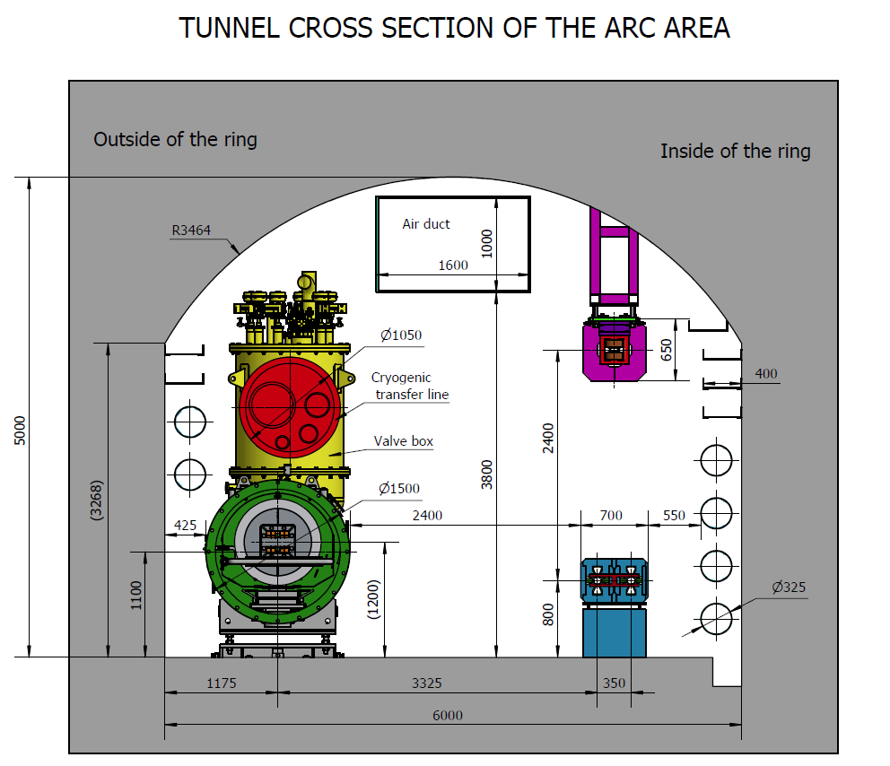
概况
CEPC（环形正负电子对撞机）为设计中的隧道周长为100km的大型对撞机，由对撞环、增强器、直线、输运线、阻尼环等构成。
CEPC与SPPC位于同一隧道，隧道宽6米，高5米。
加速器机械系统包括
  支撑：磁铁、真空设备、束测设备、高频模组等设备的支撑调节
  MDI机械：MDI设备布局、恒温器支撑调节、远程真空连接
  准直器
Booster
Collider

Slide 4
CEPC设备布局
工作基本路线
  以Linac-IP3部分为初始设计位置
  逐渐扩展到MDI、RF区等
  错序开展Booster、Linac、输运线等布局
关键布局约束
  四极铁位置物理给定
  泵口间距限制
  真空连接长度优化
  二极铁尽可能长
  隧道准直调整量≥20mm（因多数设备不共架，需留有相对调节空间）
布局设计初始位置

Slide 5
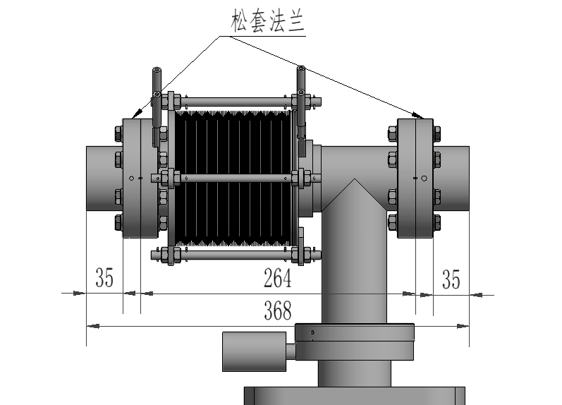
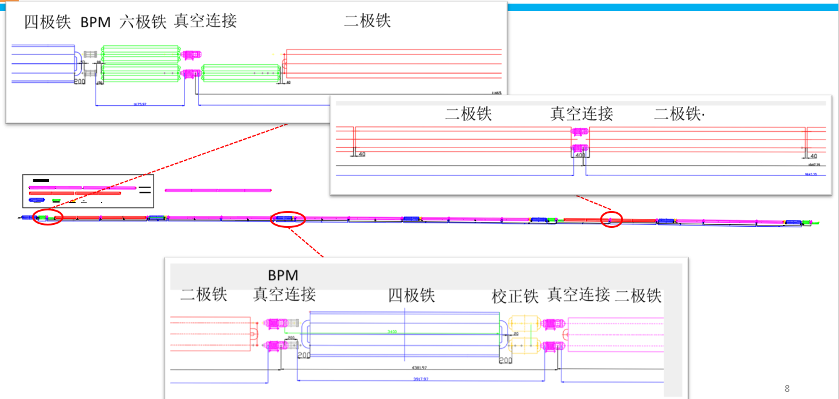
CEPC设备布局
Collider弧区真空布局
  泵口间距＜12.5米，满足Higgs、W、Z、tt各种工作模式真空度要求
  四极铁位置按TDR设计不动，二极铁长度尽可能长
  充分考虑安装空间，优化后真空连接长度取400mm。波纹管与泵口一体，压缩量50mm，伸长量5mm，可满足烘烤要求。

Slide 6
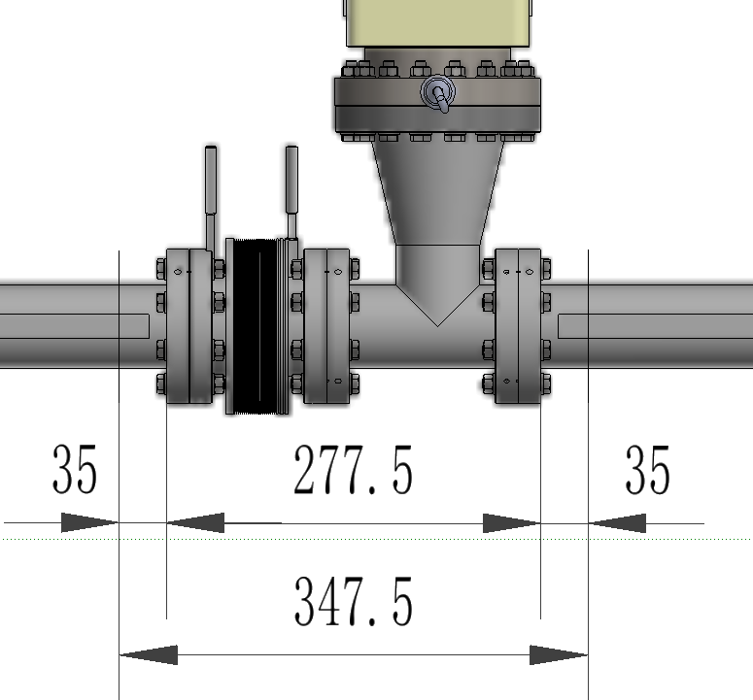
CEPC设备布局
Booster弧区布局
  泵口间距＜12.5米
  四极铁位置按TDR设计不动，二极铁长度尽可能长
  充分考虑安装空间，优化后真空连接长度取350mm。波纹管与泵口分体，不烘烤。
  所有磁铁单独支撑，不预准直。

Slide 7
CEPC设备支撑
CEPC设备众多，其中90%以上被磁铁覆盖。磁铁支撑是机械支撑的主要工作。
要求
  稳定性：长时间工作无变形、蠕变等。磁铁支撑系统固有频率高，动态稳定性（振动）好。
  简单高效：结构简单易于标准件化批量生产。调节性能好，调节效率高。
  低成本。
Elements in Collider | Unit | Number
Dipole support | set | 13314
Quadrupole support | set | 4128
Sextupole support | set | 1128
Corrector support | set | 3544
Vacuum device support | set | 98979
Beam Instrument Support | set | 4254
RF Support | set | 100
Adjustment range and resolution of supports in
Collider, Booster, Linac, Damping ring and transport lines
Elements in Booster | Unit | Number
Dipole support | set | 14866
Quadrupole support | set | 3458
Sextupole support | set | 100
Corrector support | set | 1200
Vacuum device support | set | 69164
Beam Instrument support | set | 2412
RF support | set | 12
Direction | Range of adjustment | Direction | Resolution
X | ≥±20 mm | X | ≤10μm
Y | ≥±30 mm | Y | ≤10μm
Z | ≥±20 mm | Z | ≤10μm

Slide 8
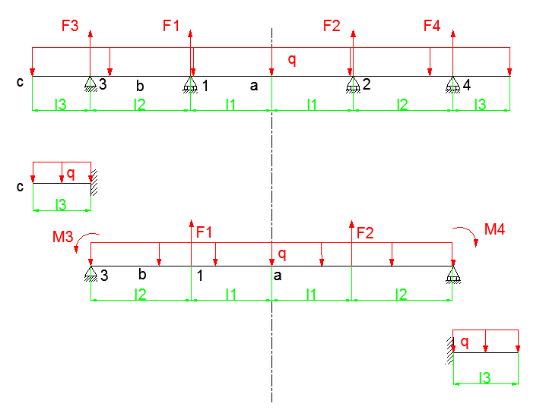
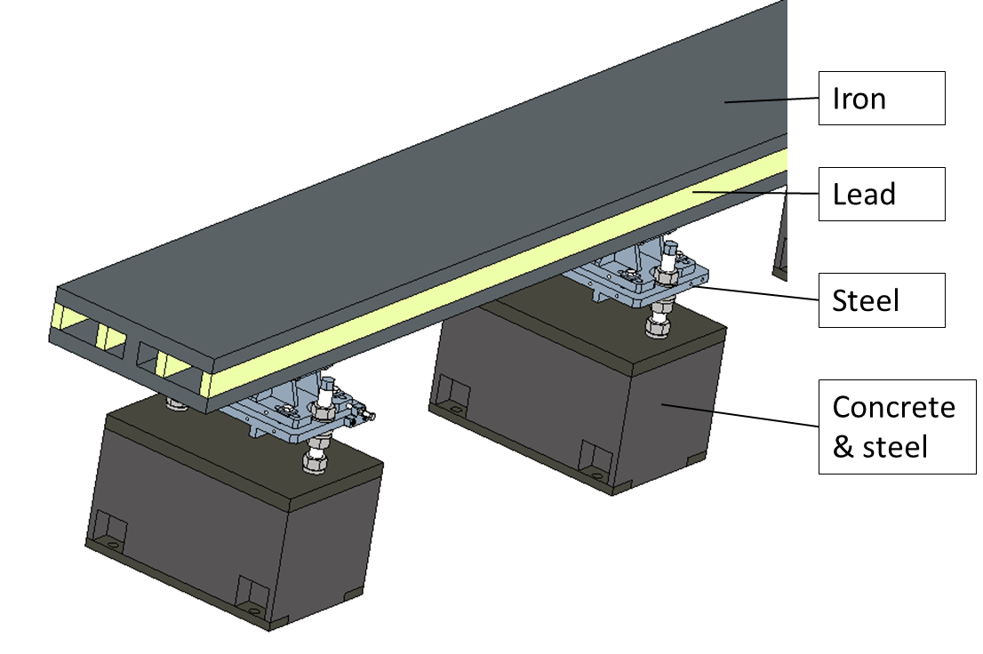
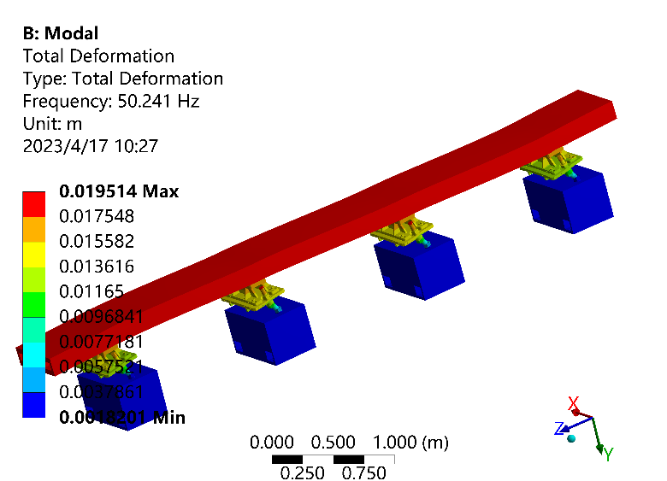
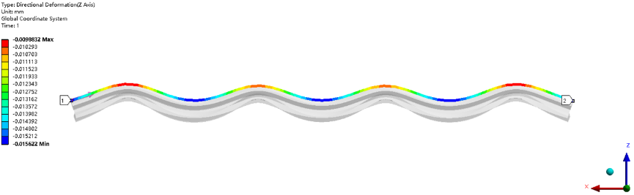
CEPC设备支撑
Collider二极铁支撑设计优化
  方法：理论推导& Workbench Response surface
  5.6米长二极铁在重力及4支撑作用下最大变形 7μm. 一阶固有频率约50Hz。
No. of dipole supports | Maximum deformation (um) | 1st natural frequency (Hz)
2 | 50.5 | 33.2
3 | 13.0 | 45.7
4 | 6.5 | 50.2
Model for analyzing
No. of order | Frequency (Hz) | Mode
1 | 50.2 | Z translation
2 | 51.3 | X translation
3 | 59.7 | Yaw rotation
4 | 89.0 | Bend in XZ plane
5 | 117.2 | 1st order bend YZ plane
6 | 123.8 | 2nd order bend YZ plane

Slide 9
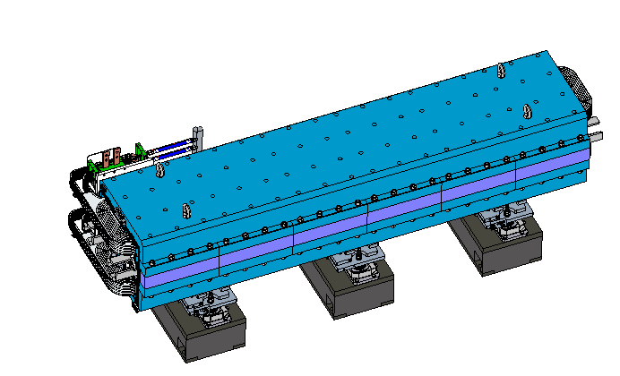
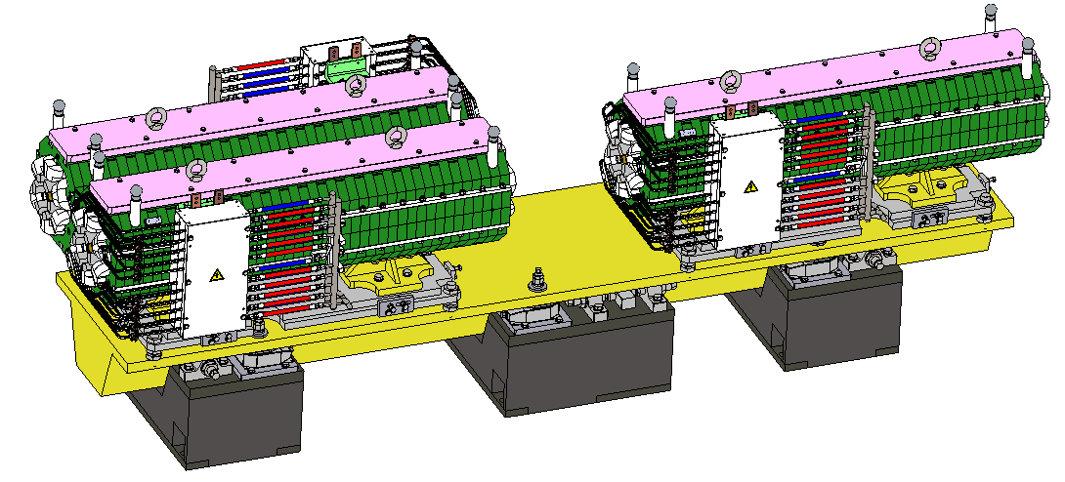
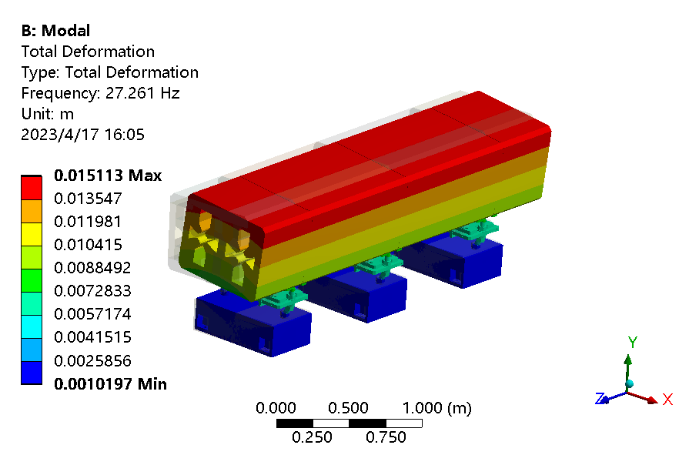
CEPC设备支撑
Collider四极铁及支撑
Collider六极铁及支撑
四极铁
六极铁
上层支架
调节机构
共架支架
基座
基座
调节机构
No. of order | Frequency (Hz) | Mode
1 | 27.3 | X translation
2 | 31.5 | Z translation
3 | 33.2 | Yaw rotation

Slide 10
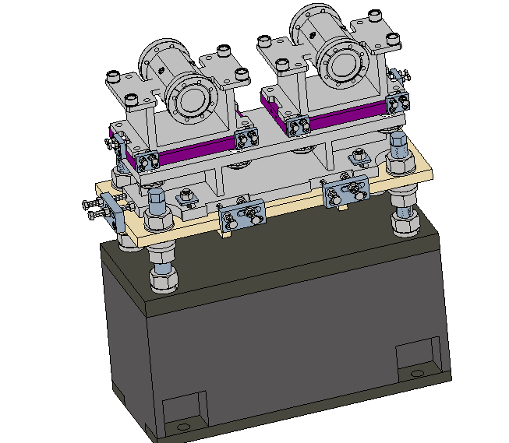
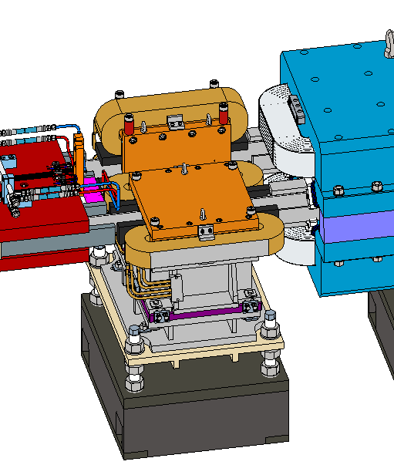
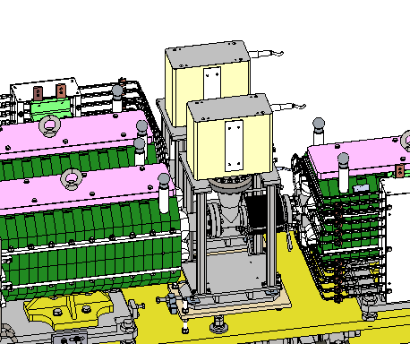
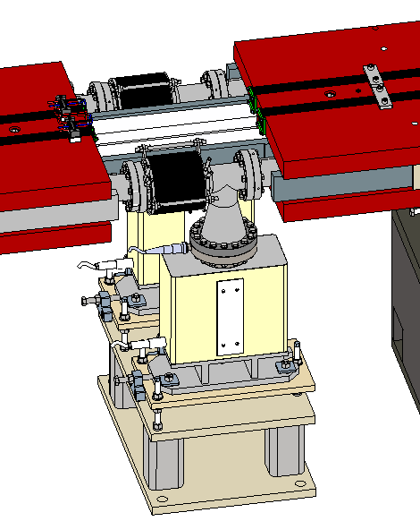
CEPC设备支撑
Collider校正铁支撑
Collider BPM及支撑
BPM
CV铁
相邻四极铁
相邻二极铁
真空盒
上层支架
下层支架及调节机构
基座
铅屏蔽
Collider 真空连接段及支撑
共架支架及调节机构
CH铁
真空连接段
上层支架
SP-50泵
基座
泵调节机构
泵下层支架

Slide 11
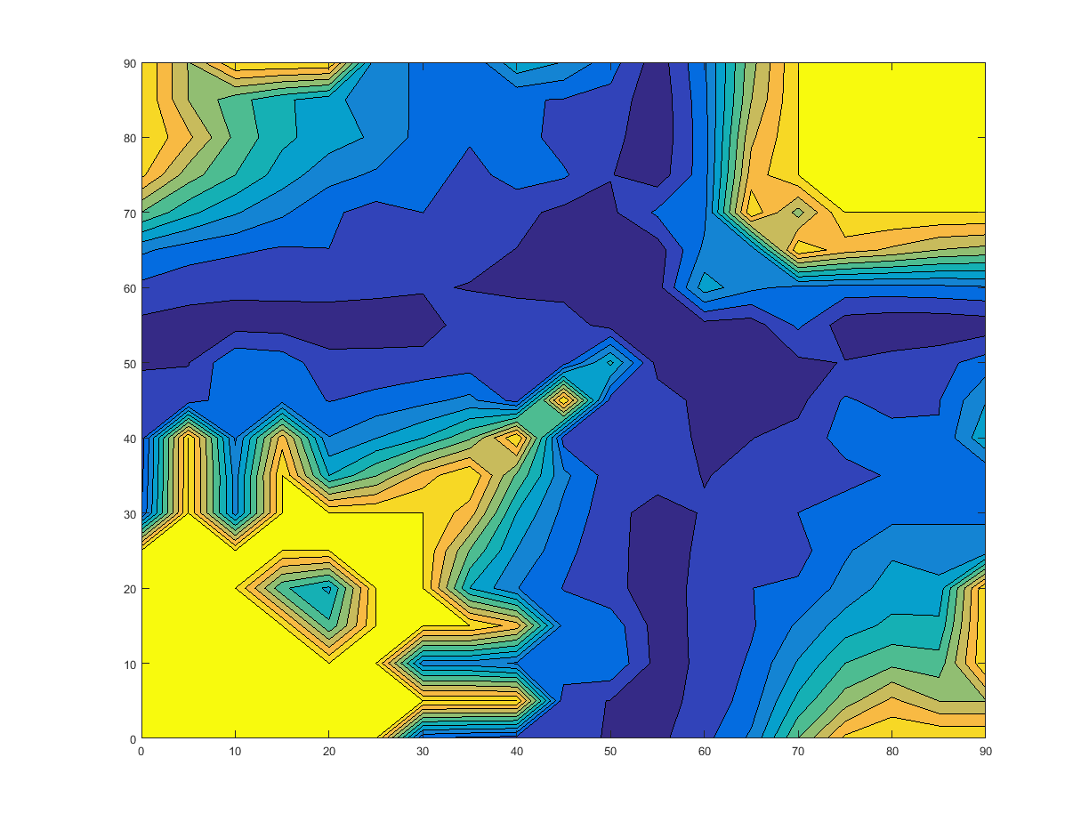
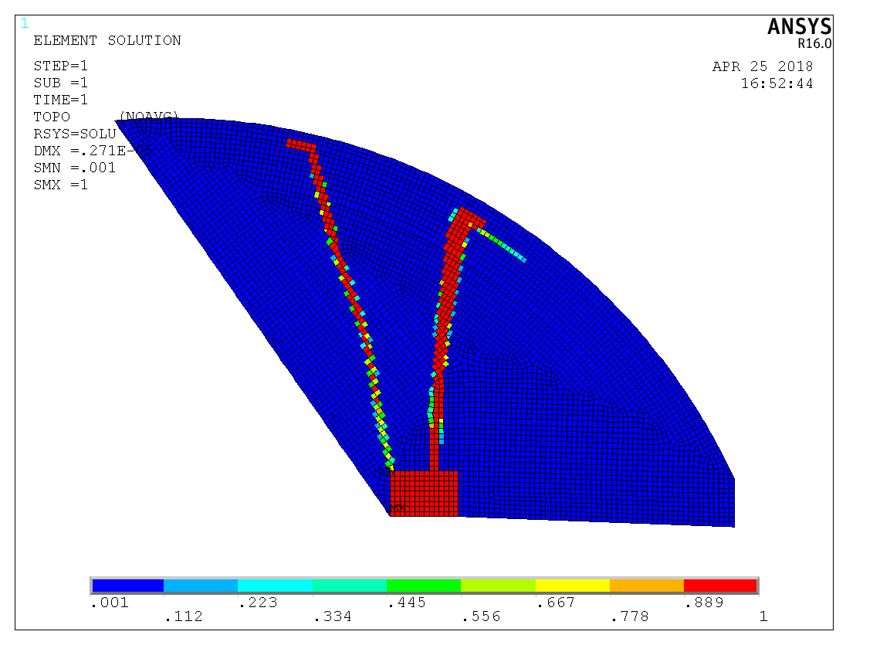
CEPC设备支撑
支架拓扑优化：设计Booster磁铁支架在XY截面分布。
  Constraint: volume; Objective function: structure compliance.
  Applicable to all types of magnet supports hanged to the ceiling.
  Vertical steel frames with horizontal ribs are adopted to achieve a simple structure and a better appearance.
Tunnel ceiling
Selected elements for support
Angular coordinate of 2nd support point
Magnet
Angular coordinate of 1st support point

Slide 12
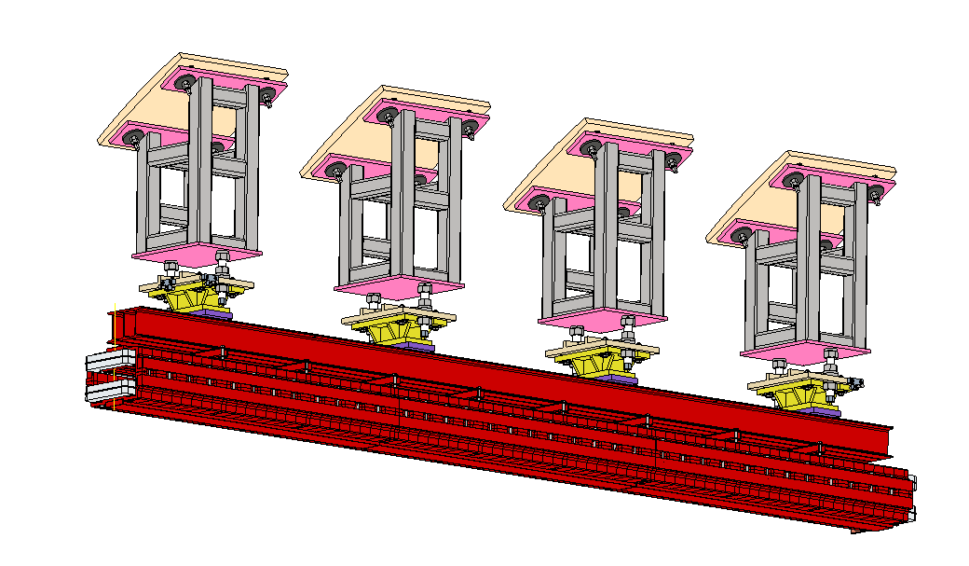
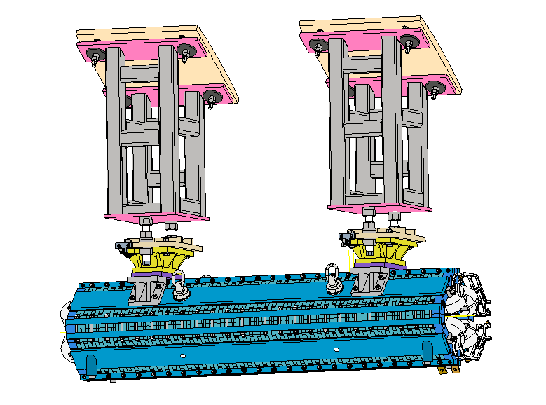
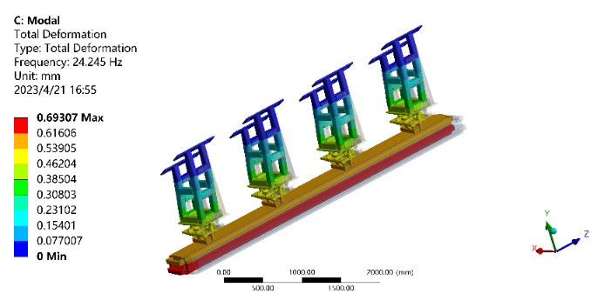
CEPC设备支撑
Booster二极铁及支撑
Booster四极铁及支撑
上层钢架
调节机构
线圈
铁芯
No. of order | Frequency (Hz) | Mode
1 | 24.2 | X translation
2 | 26.6 | Yaw rotation
3 | 28.9 | Z translation

Slide 13
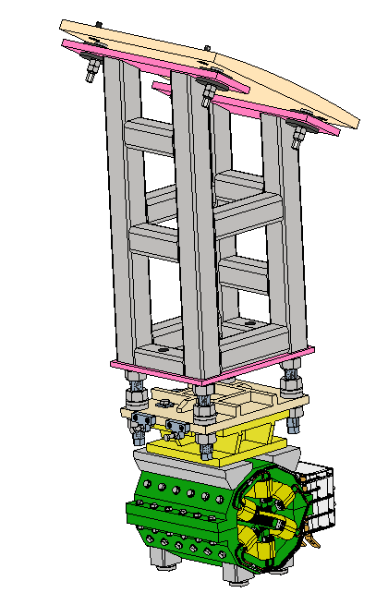
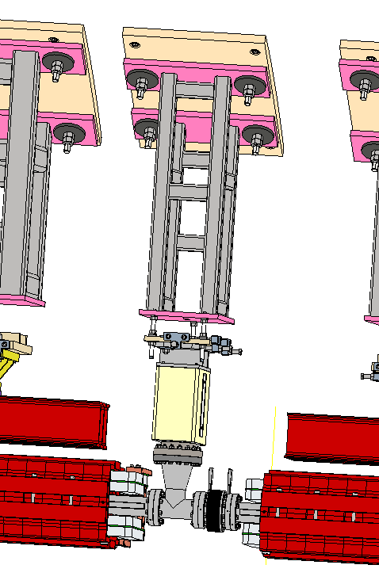
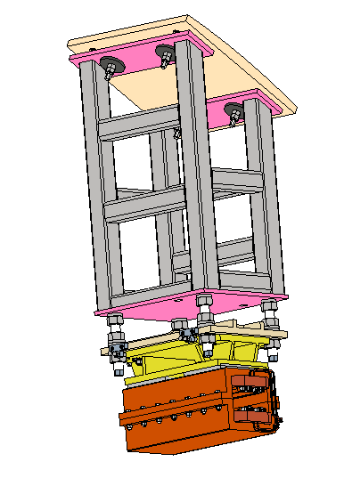
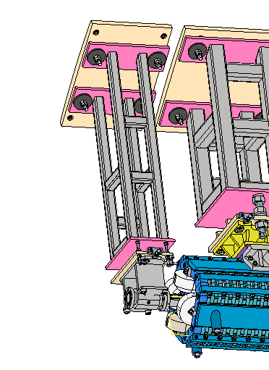
CEPC设备支撑
Booster 六极铁及支撑
Booster BPM及支撑
Booster 真空连接段及支撑
Booster 校正铁及支撑

Slide 14
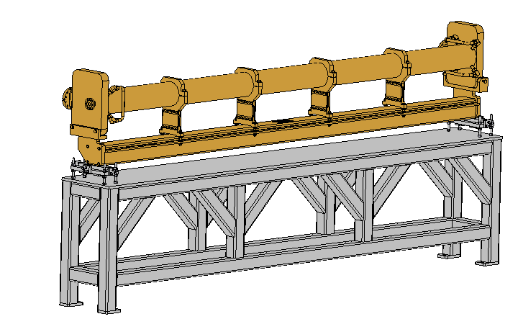
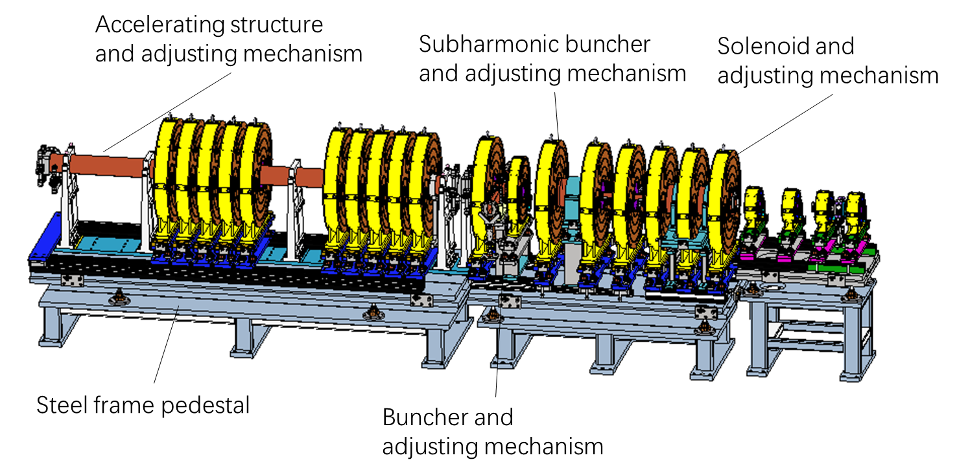
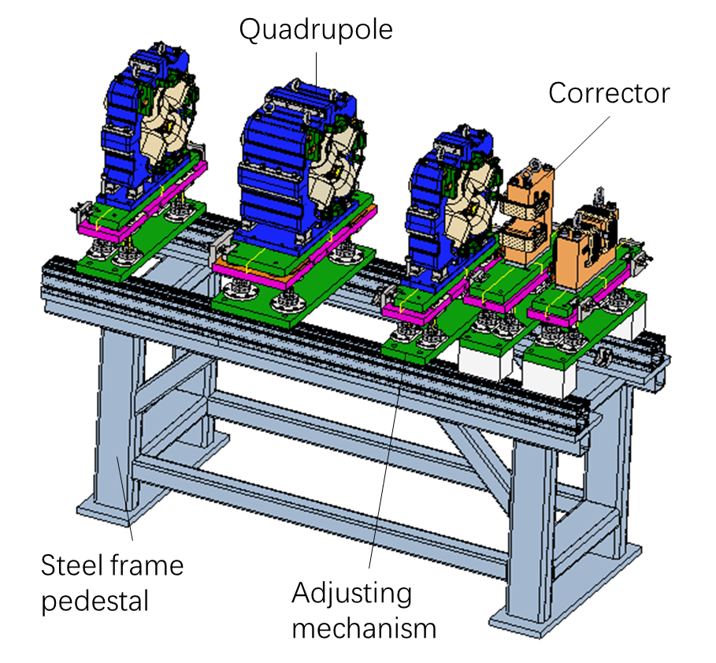
CEPC设备支撑
Linac：Similar to the Linac support of HEPS
Accelerating structure support
Bunching system support
Elements in Linac | Unit | Number
Bunching system support | set | 1
Magnet support | set | 144
EBTL support | set | 6
Accelerating structure support | set | 604
Vacuum device support | set | 5589
Beam Instrument support | set | 213
Triplet unit support

Slide 15
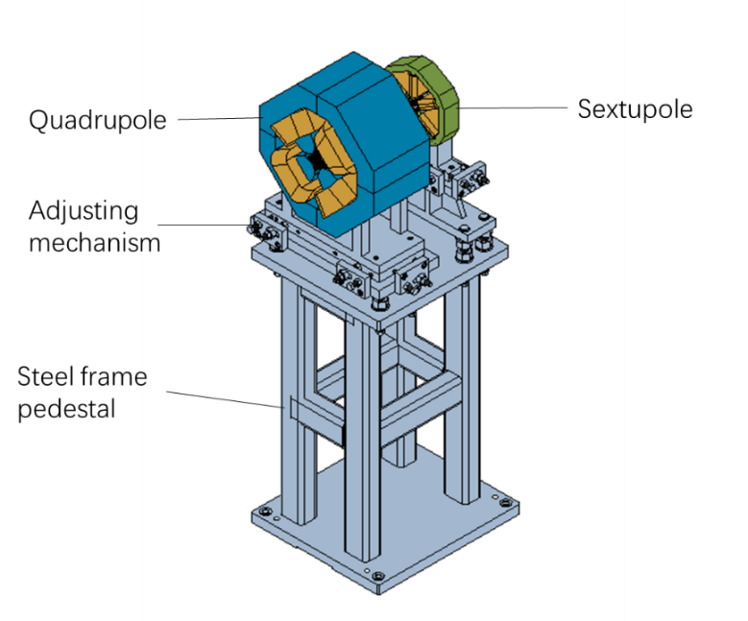
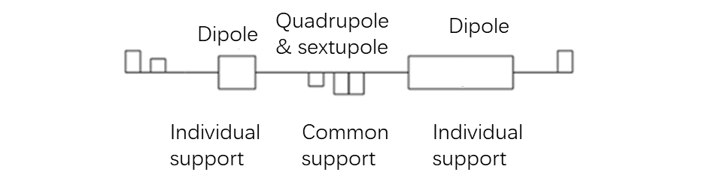
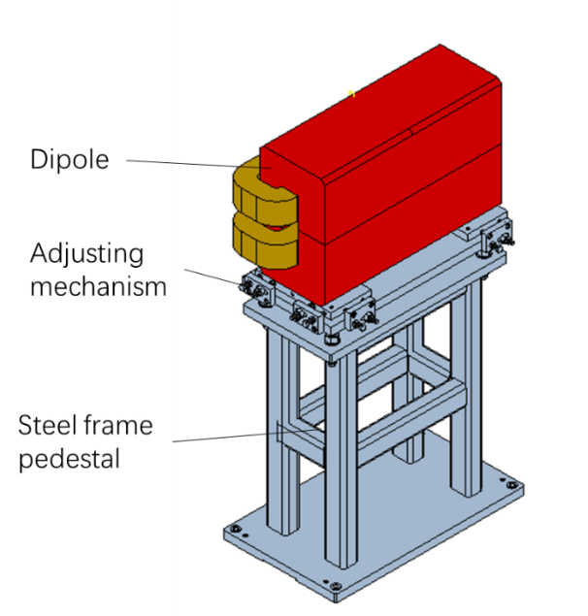
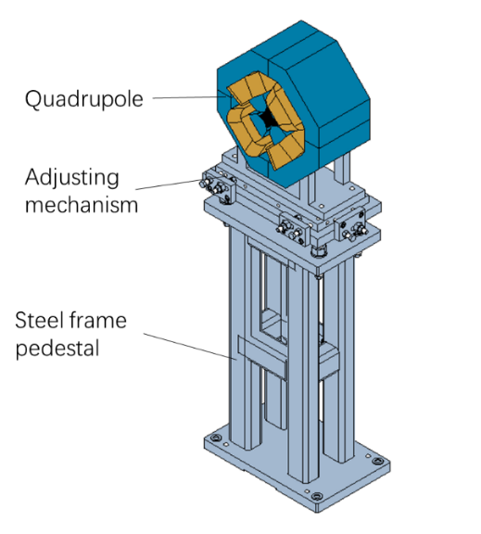
CEPC设备支撑
Damping Ring: Similar to the transport line supports of HEPS
Mechanical supports in the Damping Ring
Supports | Quantity (set) | Remarks
Quadrupole & sextuple support | 72 | Common girder for one quadrupole and one sextuple
Quadrupole support | 32 | Supports of 2 kinds of quadrupoles
Dipole support | 80 | Supports of 2 kinds of dipoles
Lambertson support | 2
Kicker support | 2
Support of adjcent quadrupole and sextupole
Individual support of dipole magnet
Individual support of quadrupole magnet

Slide 16
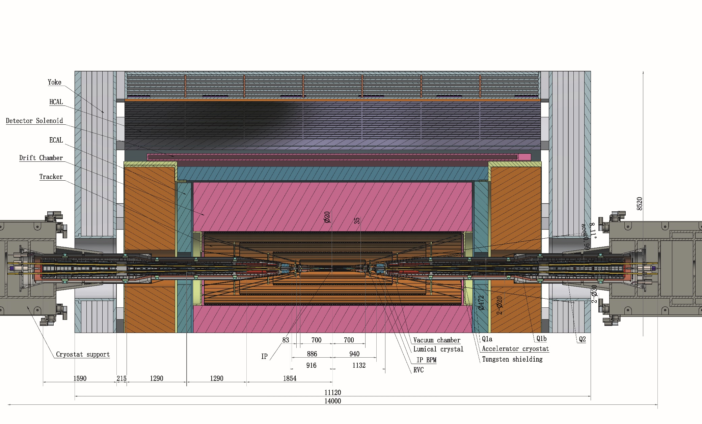
MDI 机械
MDI机械布局（TDR）
  Detective angle: acos0.99
  Detector York length: 11120mm
  IP chamber:-700mm~700mm

Slide 17
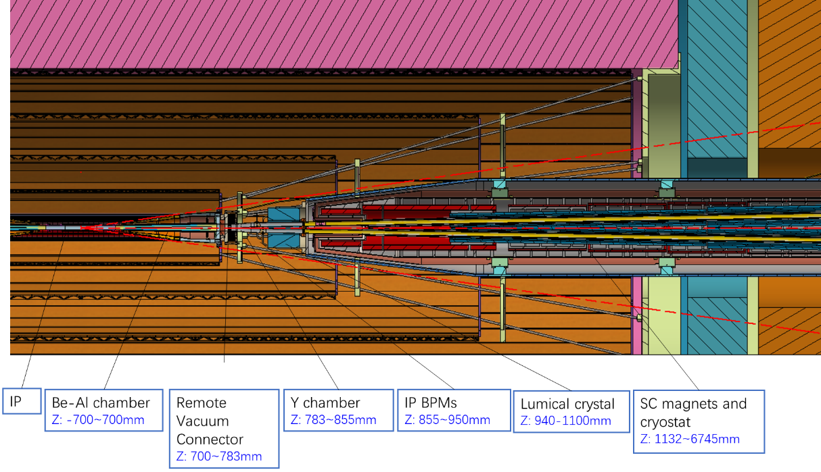
MDI 机械
Distance to detective angle
  IP chamber flange: 5.3mm RVC: 14.9mm (pressure tube) Shielding outside cryostat: 16.5mm

Slide 18
MDI 机械
Assuming the detectors are assembled, and the IP chamber is installed and aligned, the assembly sequence for the accelerator devices in the MDI region proceeds as follows:
  Secure the SC magnets with the supports inside the helium vessel.
  Assemble the helium vessel to the vacuum vessel of the cryostat and perform pre-alignment in the lab.
  Assemble the vacuum chambers inside the cryostat and align them with the cryostat in the lab.
  Assemble the Lumical crystal, Y chamber with IP BPM, and perform alignment in the lab.
  Assemble the cryostat to the cryostat support system on-site, adjusting the cryostat using the adjusting mechanism with alignment, and then attach the RVC.
  Move the cryostat into the detector using the moving mechanism of the cryostat support system to its designated location, connecting the Y chamber with the IP chamber using the RVC.
  Perform the final alignment.

Slide 19
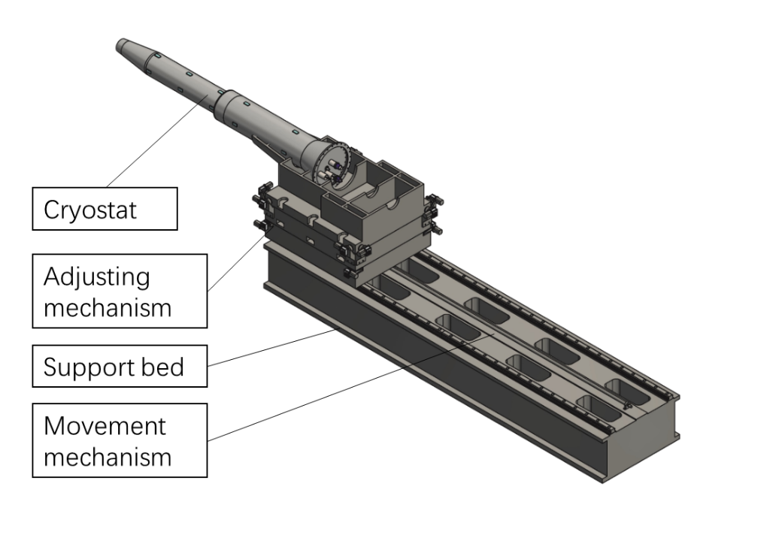
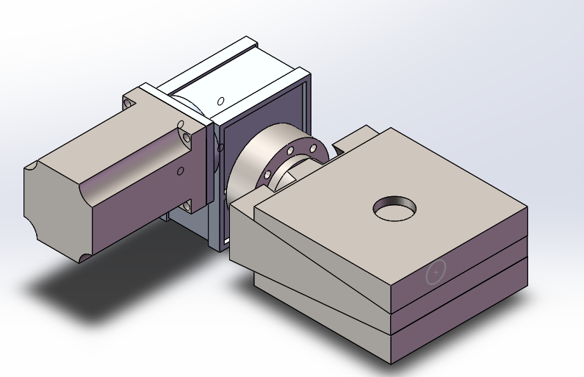
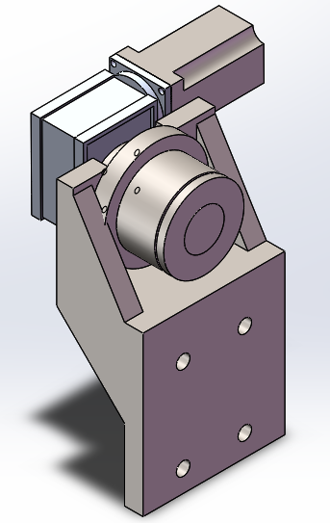
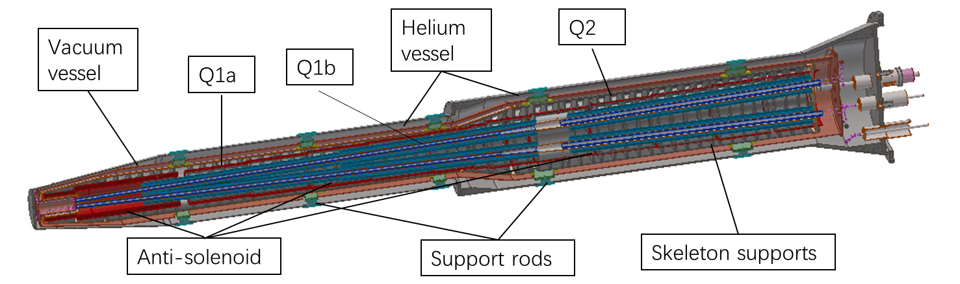
MDI机械
恒温器支撑（TDR）
Key points
  Stability (static and dynamic)
  Accuracy
  Easy-operating
  Dimensions
Alignment requirements: ≤100 μm.
  High resolution: ≤ 5 μm
  Small uneven deformation
Cryostat length: ~5.6 m

Slide 20
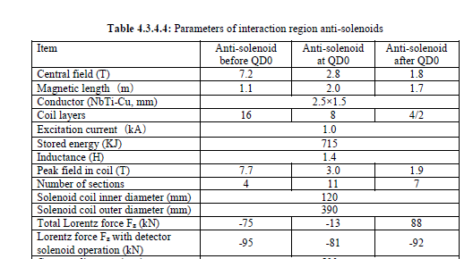
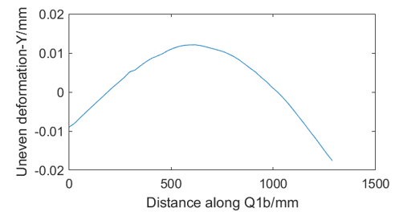
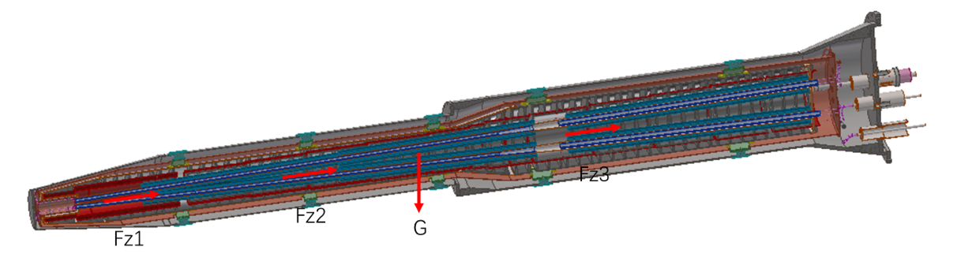
MDI机械
Integral FEA
  Loads：gravity, Lorentz force Fz with detector solenoid operation
  Alignment cannot based on the displacement.
  To pre-align the magnet to compensate the absolute displacement.
Temperature | uneven deformation in Y direction (um) |  |  | Displacement in Z direction (mm)
 | Q1a | Q1b | Q2 | Q1a | Q1b | Q2
295K | 5 | 31 | 14 | 0.3 | 0.26 | 0.24
4.2K* | 7 | 30 | 12 | Contract with temperature
  *Thermal expansions are assumed constants for this estimation.

Slide 21
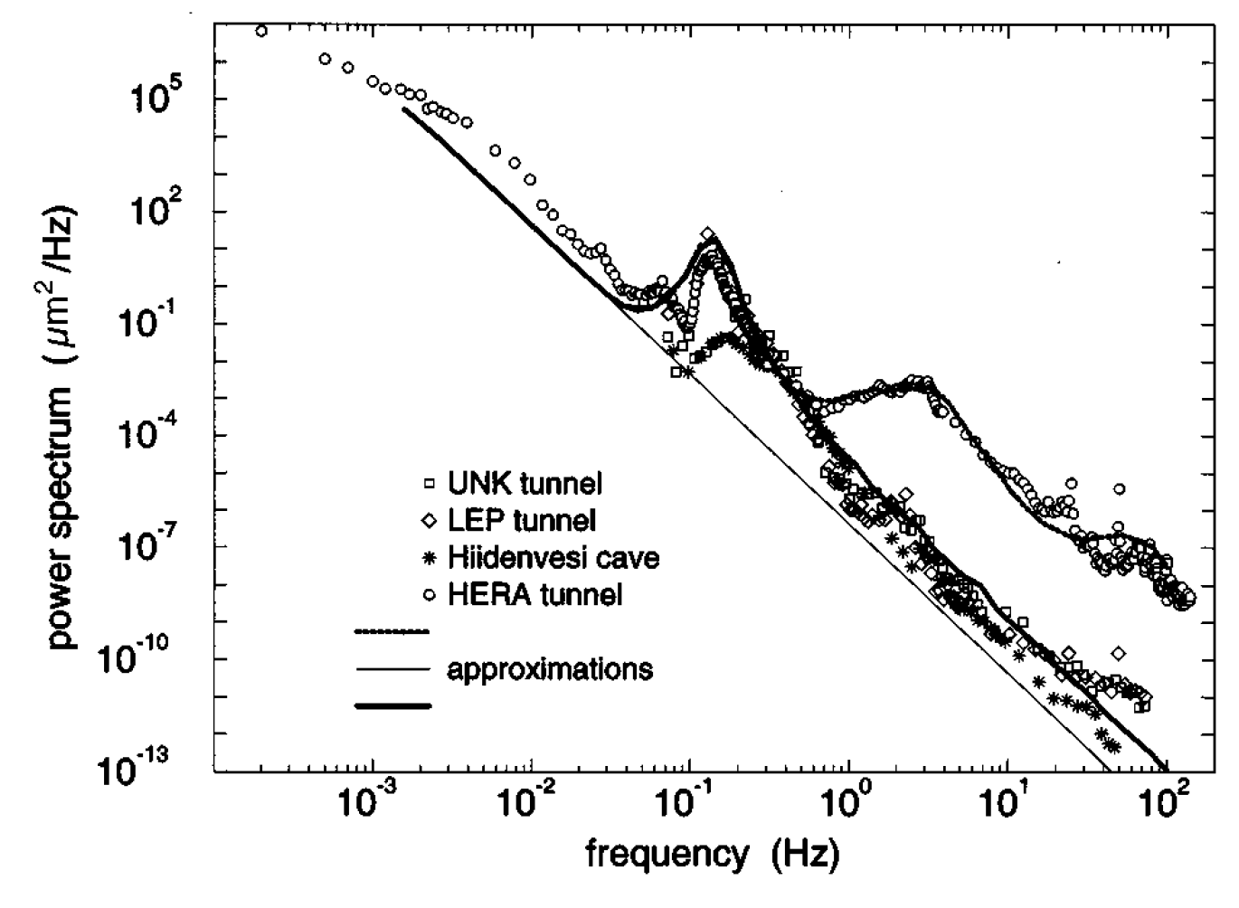
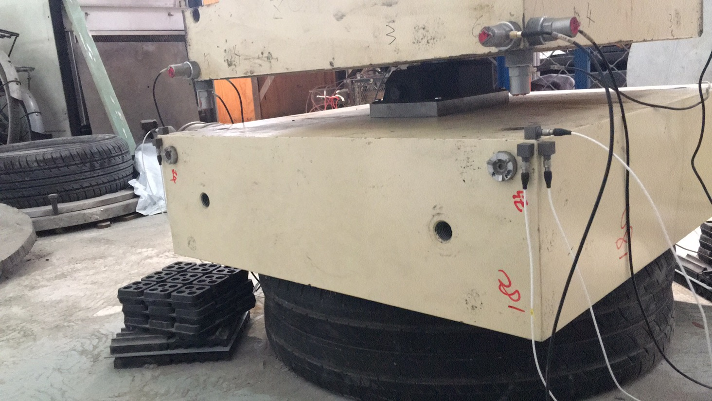
MDI机械
提高磁铁支架系统固有频率对于降低振动、提高束流稳定性有重要作用。
[M2,k2,Q2]
Joint
HEPS site
[M1,k1,Q1]
大地振动随固有频率提高而降低 :
  大地振动
  磁铁-支撑系统结构
  阻尼
  地基及基座
已有基础
  HEPS工程中积累了一定的基座制作及浇注经验
  HEPS工程中提出了有限元指导的锤击测试方法，测试条件简单，精度高，效率高。
  以上工作基础可直接应用。

Slide 22
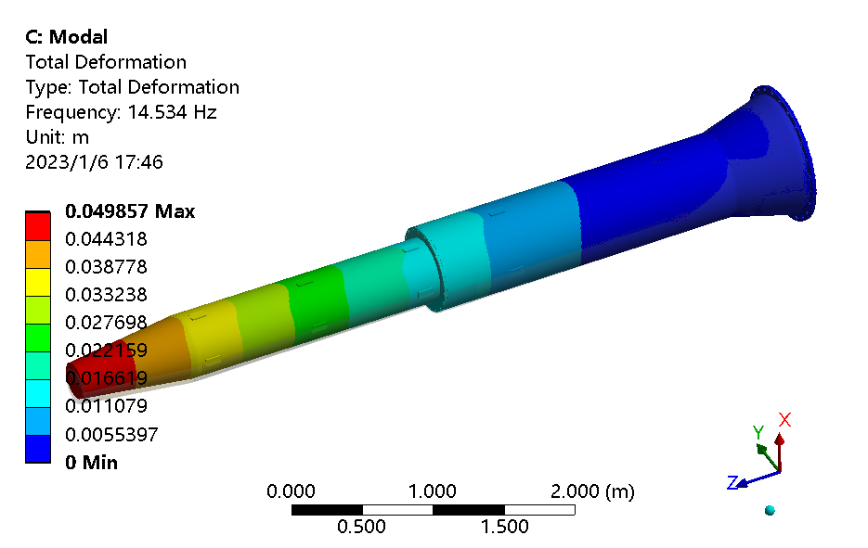
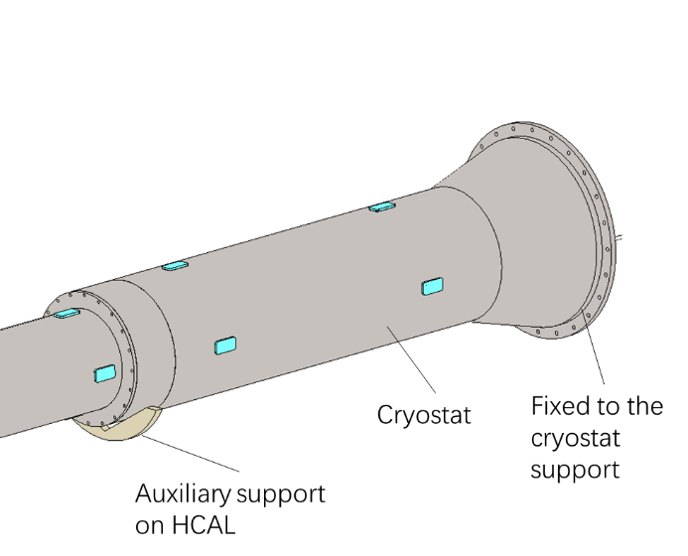
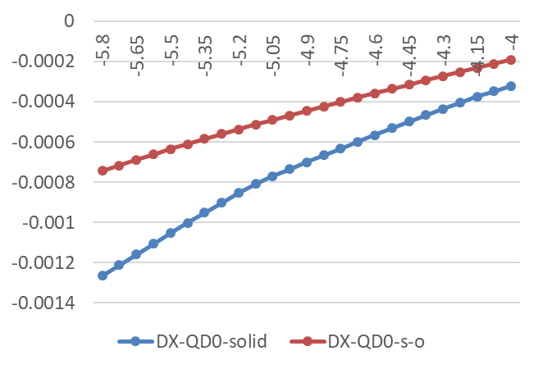
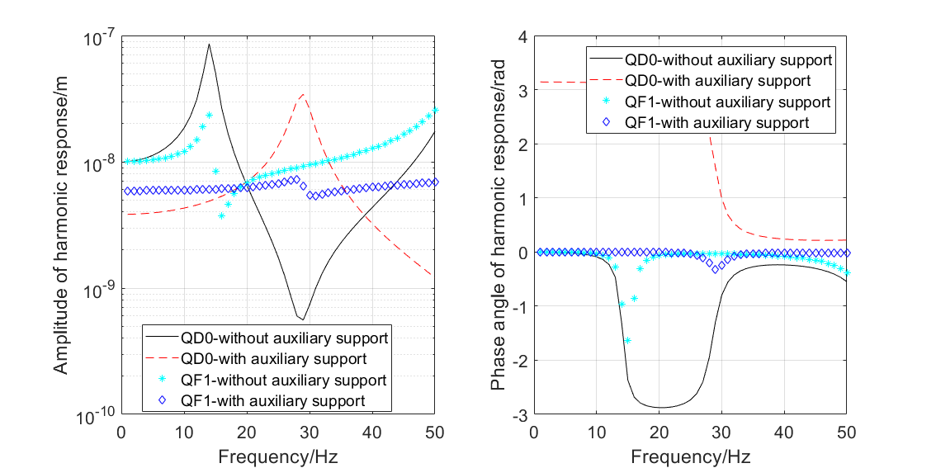
MDI机械
动态稳定性分析
  恒温器端部固定，一阶固有频率14.5HZ
  辅助支撑：固有频率14Hz→29HZ。1-50HZ谐波响应振幅大幅减小。磁铁位移大幅减少。
No. of order | Frequency (Hz) | Mode
1 | 14.5 | Integral vertical sway
2 | 14.9 | Integral horizontal sway
3 | 51.7 | Integral vertical wave

Slide 23
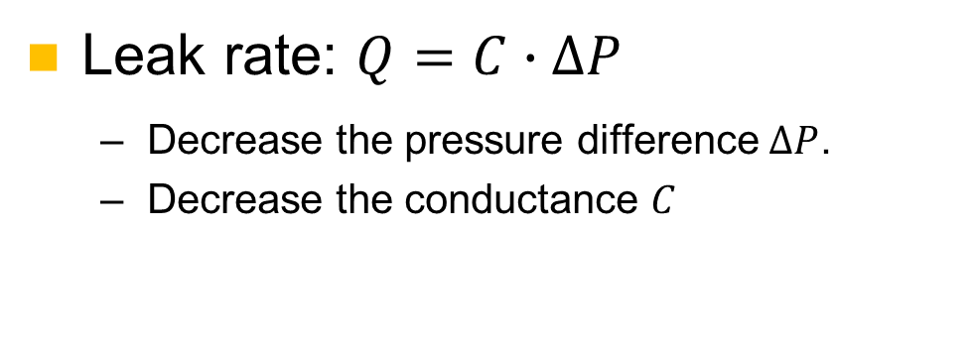
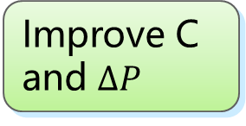
MDI机械
RVC：Used to connect the IP chamber and the vacuum tubes of accelerator.
Leak rate requirement: 2.7 ×10^{–11} Pa·m³/s
Limited operation space
Anti-radiation
High leak rate requirement
Special location
Difficulties
Solutions
Remote connection
All-metal sealing
Improve C and $∆P$
High safety and reliability
Leak rate: $Q=C∙∆P$
  Decrease the pressure difference $∆P$.
  Decrease the conductance $C$

Slide 24
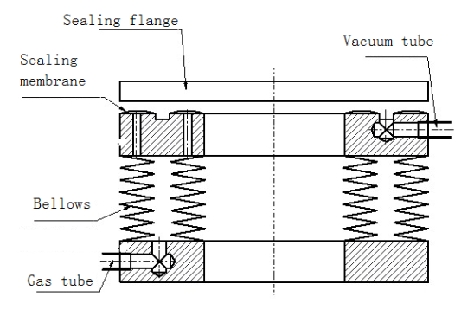




MDI机械
    Decrease $∆P$ (experience from CSNS)
  Single-layer → double layer, leak rate can be improved from 1e-6 Pa.m3/s to 8.5e-10 Pa.m3/s.
    Decrease conductance C
Inflatable seal
$$\left.C=34A^{2}（L/w）exp{[}−3F/(LwR)\right]$$
  For sealings with the same F/L
  Decrease roughness A, demonstrated by J-PARC
  Decease the perimeter L →almost determined by layout
  Decrease the hardness of gasket materials$R$→using copper
  Decrease the seal width $w$→knife-edge seal
Roughness and conductance, J-PARC

Slide 25



MDI机械
    Leak rate estimation
  Leak rate obtained in CSNS: 3.9e-10 Pa.m3/s (inner diameter 320mm)
  It is possible to obtain the requirement of 2.7e-11Pa.m3/s (inner dimensions 35-20mm, racetrack)
    Can endure a heat flux of 1 W/cm², the HOM power is acceptable.
temperature
Heat flux

Slide 26
准直器
CEPC has two kinds of collimators. One is for background decreasing. The other is for machine protection (will begin in EDR).
9 collimators per IP per ring for background decreasing.
name | Position | Distance to IP/m | Beta function/m | Horizontal Dispersion/m | Phase | BSC/2/m | Range of half width allowed/mm
APTX1 | D1I.785 | 44611 | 20.7 | 0.12 | 164.00 | 0.006 | 1~6
APTX2 | D1I.788 | 44680 | 20.7 | 0.12 | 164.25 | 0.006 | 1~6
APTY1 | D1I.791 | 44745 | 105.37 | 0.12 | 165.18 | 0.0036 | 0.156~3.6
APTY2 | D1I.794 | 44817 | 113.83 | 0.12 | 165.43 | 0.0036 | 0.156~3.6
APTX3 | D1O.5 | 1729.66 | 20.7 | 0.06 | 6.85 | 0.00182 | 1~6
APTX4 | D1O.8 | 1798.24 | 20.7 | 0.12 | 7.10 | 0.00182 | 1~6
APTY3 | D1O.10 | 1832.52 | 20.7 | 0.25 | 7.22 | 0.00182 | 0.069~3.3
APTY4 | D1O.14 | 1901.1 | 20.7 | 0.25 | 7.47 | 0.00182 | 0.069~3.3
APTX5 | DMBV01IRU0 | 56.3 | 196.59 | 0 | 362.86 | 0.01178 | 2.9~11.78

Slide 27



准直器
Horizontal movable collimator for background decreasing
  Inner profile is gradually altered from a circular to a rectangle to minimize impedance.
  Material of vacuum vessel and the jaws is GlidCopAl-15， and SS for flanges.
  Half aperture 4mm for normal operation.
  Open-loop accuracy 10 µm (can be obtained for HEPS).

Slide 28





准直器
Structure Optimization
  Impedance varies with the offset of the tip.
  About 70% of the synchrotron radiation energy (7.5 kW @ 30MW Higgs) is deposited in the block.

Slide 29




准直器
Thermal mechanical analyses @30MW Higgs
  Jaw: highest temperature 147 ℃，Maximum von Mises stress89.7 MPa
  Vacuum chamber: highest temperature 124 ℃，Maximum von Mises stress 110.4 MPa

Slide 30

准直器
For the collimators used for MPS, drawing from the experiences such as SuperKEKB or HEPS, low-Z, high-melting-point carbon-based materials need to be taken into consideration.
We have accumulated relevant experience from the HEPS.
Jointing prototype of copper, graphite and graphene film
2D adjusting mechanism:
X for collimation and Y for fresh surface in case of failure
Jaw of HEPS collimator with copper body and graphite tip

Slide 31


准直器
We have accumulated relevant experience from the HEPS.
  Shear strength: 38.7 Mpa between graphite and copper
  Copper coating to improve conductivity about one level.
  Endure more than 100 thermal shocks higher than 2000 ℃.
Before/after thermal shock
Microscopic observation of copper-graphite brazing
Copper coating on graphite

Slide 32
EDR计划
机械系统将在EDR期间继续对CEPC机械设备进行设计，同时对一些关键工艺/设备进行实验研究。
设计工作
  更多设备支撑设计及细化
  持续MDI布局设计及恒温器支撑设计
  准直器设计及优化
实验研究
  CEPC mockup展示模型
  高精度自动准直调节系统
  稳定性测试（跟随勘探可研进行）
  RVC样机研制

Slide 33
EDR计划
Mockup展示模型
  弧区：Collider及Booster各一个标准cell（含二极铁、四极铁、六极铁、校正铁、BPM）
  RF区：Collider及Booster模组各一台
  针对上述设备的工艺安装、准直、稳定性等技术验证
  设备采用ABS+钢，支撑调节设备按真实设计材料
目的及意义
开工前需验证相关关键技术及工艺流程
  磁铁&支撑的稳定性与调节灵活性。
  准直方法及准直效率优化。
  工艺安装及设备/操作空间验证。
  其他需要在隧道进行的操作验证。
CEPC有效的宣传展示
  典型区段的1:1步入式隧道内景展示。
  科普宣传。

Slide 34


EDR计划

Slide 35


EDR 计划
Mockup展示模型
二极铁装配体1
二极铁装配体2
二极铁装配体3
二极铁装配体4
真空连接装配体a
真空连接装配体a
六极铁装配体
校正铁装配体
四极铁装配体
BPM装配体
真空连接装配体b

Slide 36


EDR 计划
Mockup展示模型
真空连接装配体
真空连接装配体
二极铁装配体
二极铁装配体
二极铁装配体
二极铁装配体
二极铁装配体
六极铁装配体
BPM装配体
四极铁装配体
校正铁装配体

Slide 37




Mockup展示模型
Mockup展示模型
Booster模组
拼接线
Collider模组
拼接线
局部透明
一串腔剖视

Slide 38
EDR计划
高精度自动准直调节系统
  因此在保证精度的同时提高准直效率是CEPC工程设计的重要内容之一。
目前普遍准直方法为激光跟踪仪，人工放球，逐点测量，效率低。
目前常见调节方法
  自动调整，如TPS、EBS、HEPS-TF等，效率高，价格高，且不适合CEPC的强辐射环境。
  手动调整，如HEPS、APSU等，效率低，价格低。
项目 | 目标
调节范围 | Y≥±30mm，X/Z≥20mm
调节分辨率 | ≤10μm
支撑磁铁最大重量 | ≥7ton
标定场范围 | 1m~20m
采集频率 | ≥15 Hz
空间单点测量误差 | ≤ 10μm+10μm/m
本课题将研究一种新的准直调节方法
  高精度测量场：多目摄影测量，多点同步监测，效率高
  自动调整结构：可移动驱动，统一快速插拔接口

Slide 39


高精度自动准直调节系统
高精度测量场
  需要准直的磁铁及单元：二极铁、四极铁、六极铁单元
  相机配置：4相机，满足上述磁铁及单元的测量范围需求，基准点测量精度优于45μm。
  选取高精度CMOS器件，提高像点求取精度。
  相机间主光轴交会角控制在最佳摄影测量需求范围（60°~120°）之内。
  满足测量精度的条件下选取短焦距镜头提高测量范围，减小测量场体积。
三维视觉测量精度与相机CMOS参数、相机焦距、相机间距离、相机间主光轴交会角度有关。相机间距离和CCD参数一定的条件下，焦距越大，测量精度越高，测量范围越小，需要综合考虑。

Slide 40


高精度自动准直调节系统
测量方案
  输入控制点和设备基准点理论坐标
  以控制点为基准定位测量系统
  在基准点上安放摄影测量半球靶标实现基准点测量
  用编码点实现点名自动识别
  安放标准尺提供长度基准
  实时显示和输出各基准点实测坐标与理论坐标的偏差

Slide 41


高精度自动准直调节系统
自动调整结构
  涉及磁铁及单元：Collider 二极铁、四极铁及六极铁单元
  二极铁：基于螺杆的调节，结构简单，调节范围大，预算低，承重低
  四极铁/六极铁单元：基于楔块调节，需配合增减垫片加大调节范围，预算高，承重高
  考虑三种形式，目前基于可移驱动车为基本方案
方案1：可移驱动及调节机构
方案2：可移调整车
方案3：可移驱动车

Slide 42



高精度自动准直调节系统
垂直调整：
  二极铁：螺旋升降机或同心大螺纹+涡轮螺杆，输出轴错开在人行道侧引出
  四极铁/六极铁：楔块，垫片增加调节范围
水平调整：
  螺纹调节+万向节转向，在人行道侧引出
万向节转向
螺旋升降机
二极铁同心大螺纹方案
四极铁楔块方案
二极铁螺旋升降机方案

Slide 43

EDR计划
RVC样机研制
  漏率指标：≤2.7e-11Pa.m3/s
恒温器外壳模拟件
IP真空盒模拟件，模拟IP真空盒已固定
加速器端支撑组件（三方向可调节固定），模拟恒温器末端的变形
远程连接装置（充气型波纹管为例）

Slide 44
总结
CEPC加速器机械系统主要工作包括CEPC设备布局、设备支撑、MDI机械、准直器等内容。目前正在全面进行EDR设计。
机械系统将在EDR期间进行关键工艺/设备进行实验研究，这些研究将为CEPC工程开展提供必要基础。

Slide 45
谢谢各位老师！

