Slide 1


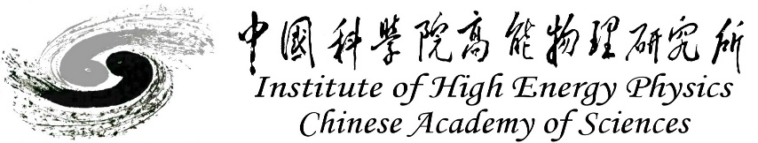
CEPC Detector Magnet
Feipeng Ning
On behalf of SC magnet Team
Aug. 22, 2024, CEPC Mechanical workshop

Slide 2
Content
Introduction of Detector magnet
Detailed design of the CEPC solenoid magnet
Cryogenic system
Mechanical design
Main Technical challenges
Research team
Summary

Slide 3
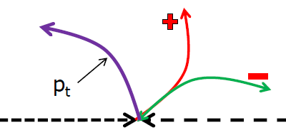
Introduction of Detector magnet
How to analyze the shower of particles ? We need:
- Track reconstruction
- Energy measurement, in calorimeters
- Charge identification in magnetic field
Momentum measurement in magnetic field.
A detector magnet is in fact a “magnetic separator”.
BESIII 2009
Information yield:
- left turn > positively charged particle
- right turn > negative particle
- curvature > momentum

Slide 4
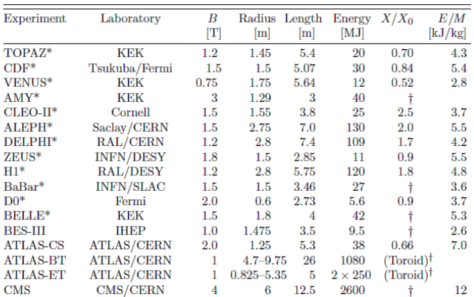
Introduction of Detector magnet
History of High Energy Physics Detector Magnets
•1969 CERN –BEBC, Big European Bubble Chamber (solenoid)
•1972 CERN –Omegamagnet (large aperture dipole)
•1977 CERN/ISR –Solenoid
•1978 DESY –CELLO (solenoid)
•1983 SLAC/PEP4 –TPC solenoid
•1985 KEK/TRISTAN –TOPAZ, VENUS (solenoids)
•1988 CERN/LEP –ALEPH, DELPHI (solenoids)
•1990 DESY/HERA –ZEUS (solenoid)
•1997 SLAC –BABAR (solenoid)
•2004 KEK –BESS-Polar (ultra-thin solenoid)
•2007 CERN/LHC –CMS (solenoid), ATLAS (Toroids, solenoid)
∙2009 IHEP/BES III (solenoid)
T. M. Taylor, CERN Summer Student Lecture, 2006

Slide 5
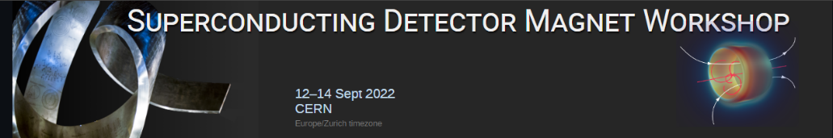
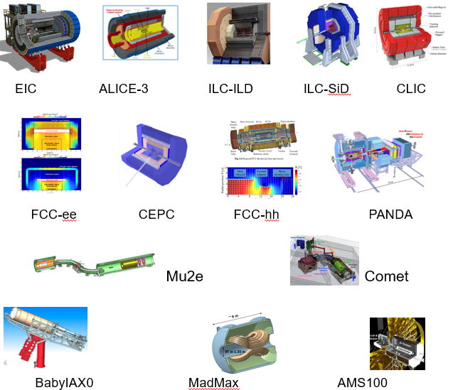
Introduction of Detector magnet
Detector Magnet needed in the future
 | Experiments | Site | B [T} | Size, ID x L [m] | Note | Fabrication Expected
Collider | EIC-Detector | BNL | 1.5~3 | 2.5~3.2 x 8.5 | Solenoid | 2025 ~
 | ILC-ILD | Japan | 4 | 6.88 X 7.35 | Solenoid | 2030 ~
 | ILC-SiD | Japan | 5 | 5 X 5 | Solenoid | 2030 ~
 | CLIC-ILD | CERN | 4 | 6.8 X 8.3 | Solenoid | 2035 ~
 | CLIC-SiD | CERN | 5 | 5.4 X 6.5 | Solenoid | 2035 ~
 | CLIC | CERN | 4 | 7 X 8.3 | Solenoid | 2035 ~
 | FCC-ee IDEA | CERN | 2 | 4.2 X 6.0 | Solenoid | 2035 ~
 | FCC-ee CLD | CERN | 2 | 7.4 X 7.4 | Solenoid | 2035 ~
 | FCC-hh | CERN | 4 | 10 X 20 | Solenoid | 2060 ~
 | ALICE-3 | CERN | 2 | 3 x 7.5 | Solenoid | 2027 ~
 | CEPC | IHEP | 3 | 7.07*9.05 | Solenoid
Others | Mu2e | Fermilab | 5 ~ 2.5 | 1.5 X 4 | Production | Under construction
 | Muon-g-2 | Fermilab | 1.473 | 0.09 X 14.22▪2π | Storage solenoid | Reuse after BNL
 | COMET | J-PARC | 5 ~ 3 | 1.3 X 1.6 | Capture Sol. | Under const.
 | Muon-g-2 | J-PARC | 3 | 0.66 X 0.33 | Solenoid | 2025 ~
 | BabyIAXO | DESY | 2 | 0.7 X 10 | D. Racetrack | TBD
 | IAXO | DESY | 5 - 6 | 5 X 25 | Toroid | TBD
 | Panda | GSI | 2 | 1.8 x 3.1 | Solenoid | TBD
 | Madmax | DESY | 9 | 1.35 x 1.2 | Dipole | TBD

Slide 6
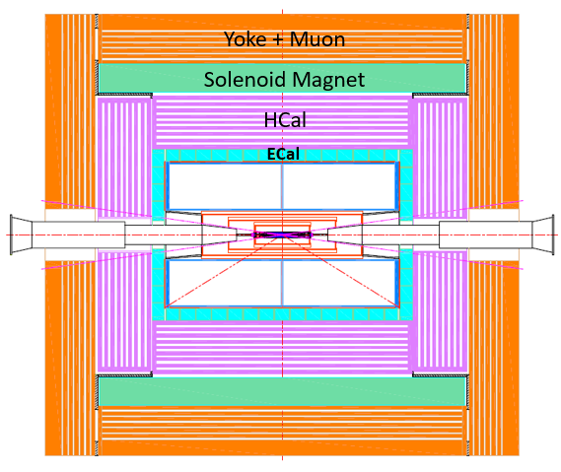
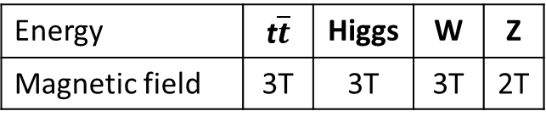
Detailed design of the solenoid magnet
Position and size
Magnetic field
Inner diameter | 7070 mm
Thickness | 700 mm
Outer diameter | 8470 mm
Length | 9050 mm
Energy | t$\overline{t}$ | Higgs | W | Z
Magnetic field | 3T | 3T | 3T | 2T

Slide 7
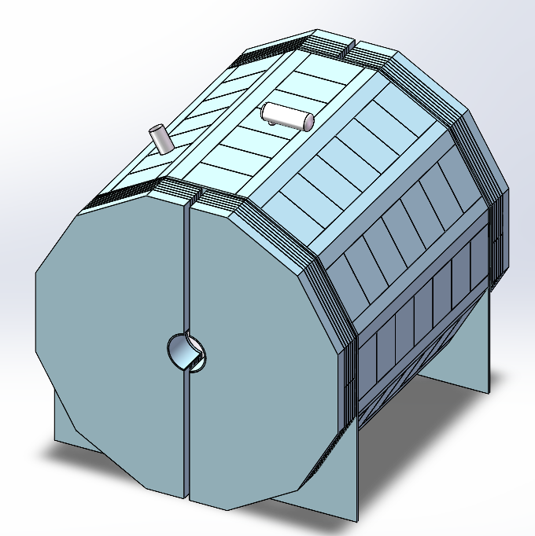
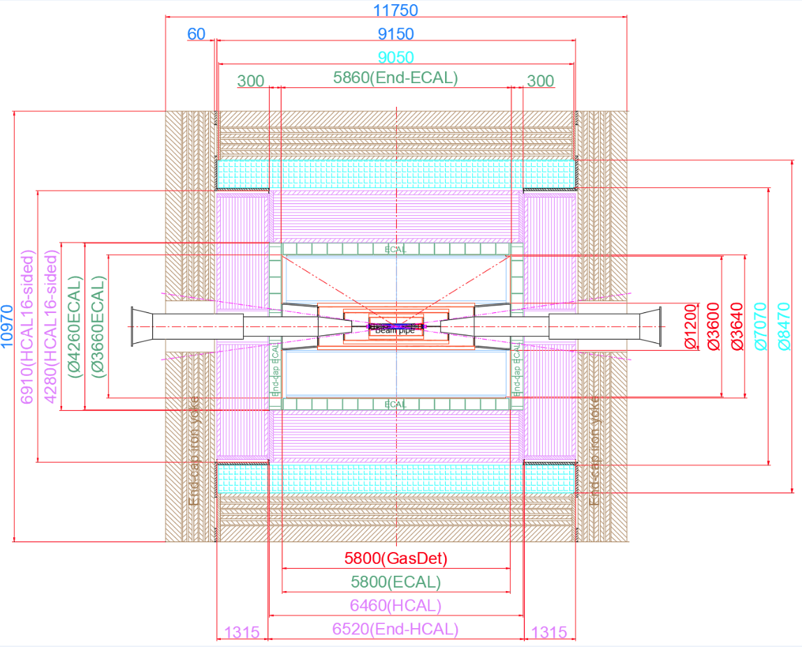
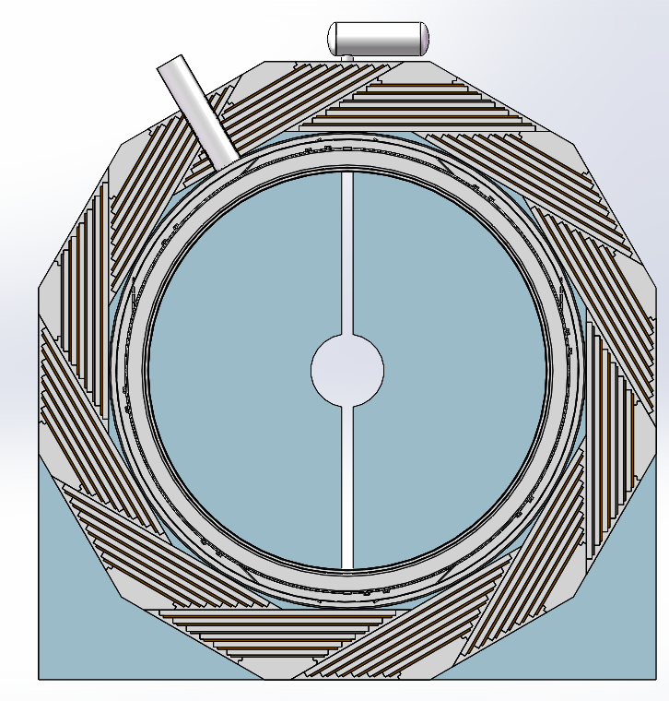
Detailed design of the solenoid magnet
Design of the magnet
Magnet parameters:
Central magnetic field | 3 T
Inner diameter | 7070 mm
Outer diameter | 8470 mm
Thickness | 700 mm
Length | 9050 mm
Cold mass | 140 tons
Yoke mass | 3752 tons
Magnet mass | 265 tons
magnet
7

Slide 8
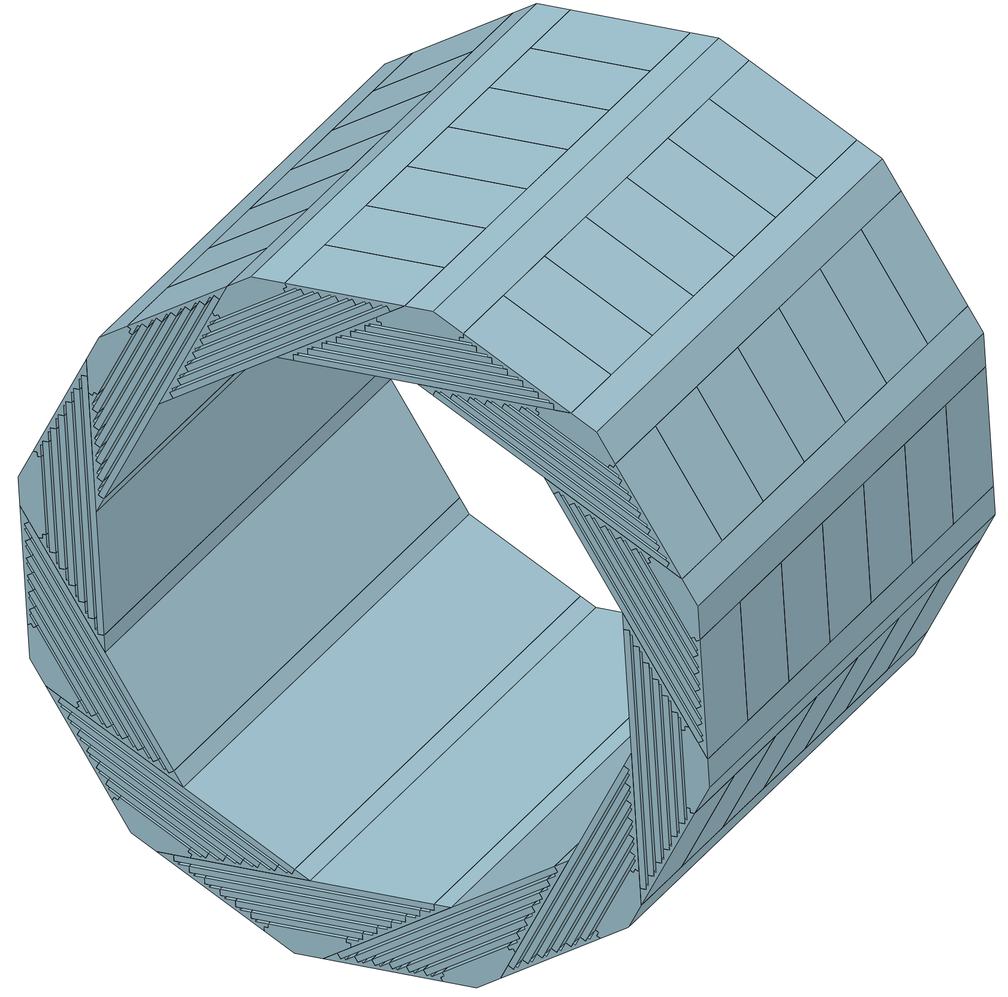
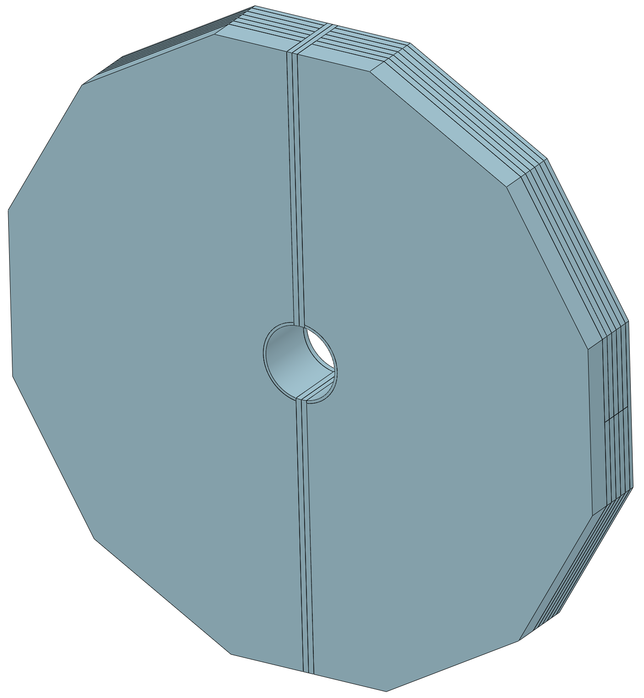
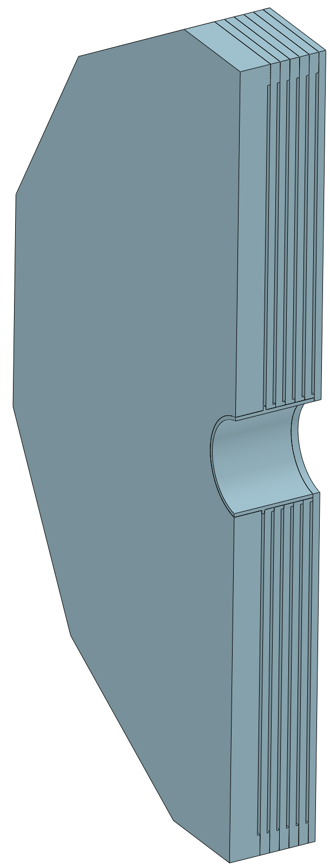
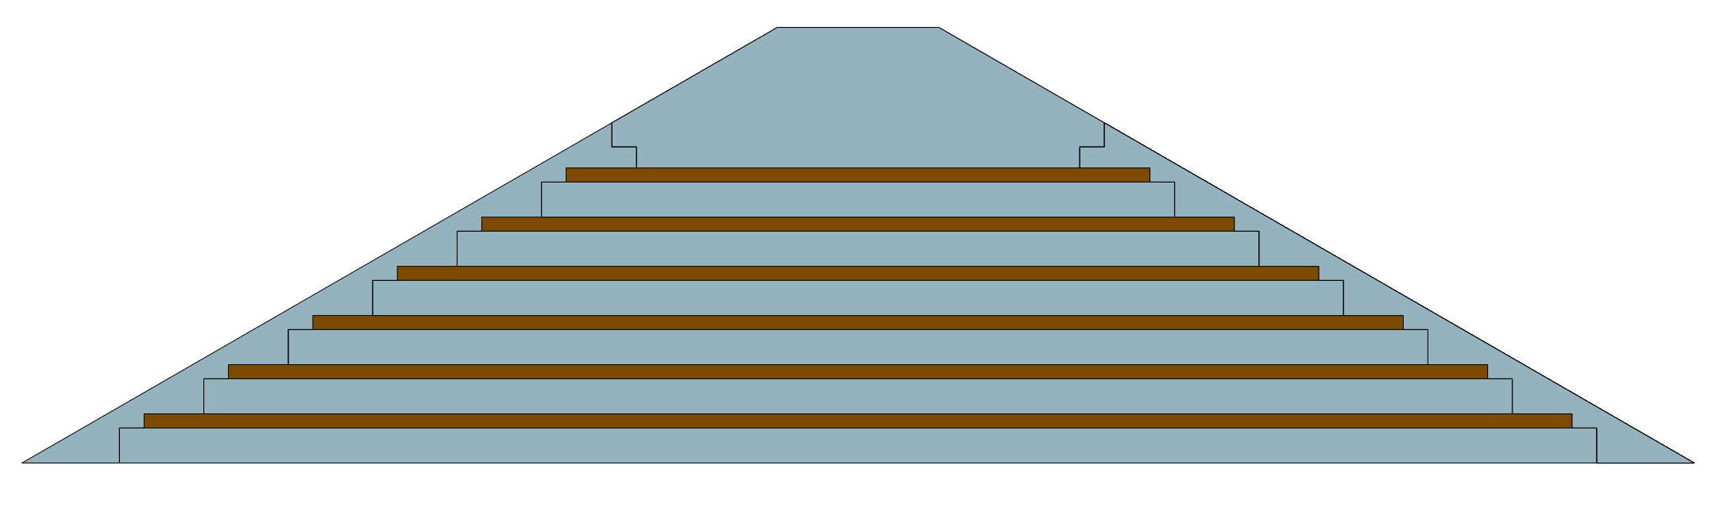
Detailed design of the solenoid magnet
Yoke
Yoke parameters：
In order to reduce the detection dead zone of the muon detector, the barrel yoke is designed as a spiral structure.
Barrel yoke (ton) | 2184
Each End yoke (ton) | 784
Total Yoke (ton) | 3752
Diameter(m) & length (m) | 10.97&11.75
Single module of the barrel yoke
182 tons
Barrel yoke
2184 tons
End yoke
784 tons
8

Slide 9
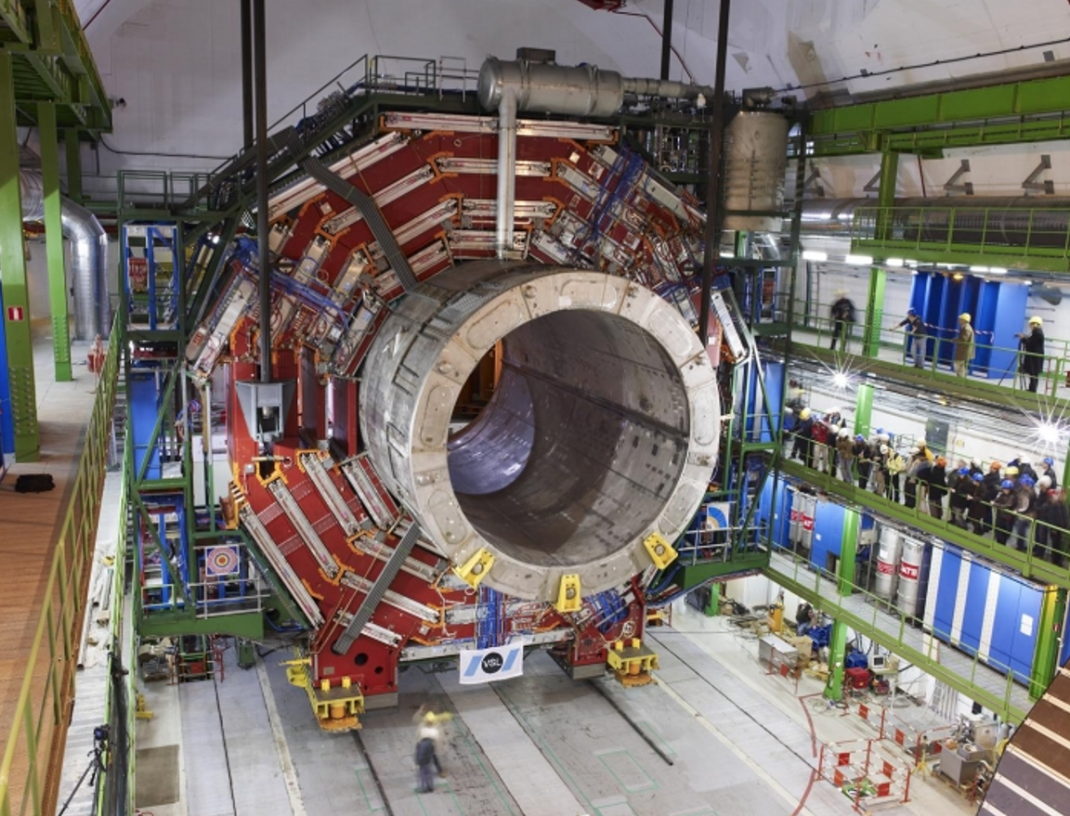
Detailed design of the solenoid magnet
Magnet parameters:
 | CEPC | CMS
Central magnetic field (T) | 3 | 4
Inner diameter (m) | 7.07 | 5.94
Outer diameter (m) | 8.47 | 7.6
Thickness (m) | 0.7 | 0.83
Length (m) | 9.05 | 14.4
Cold mass (ton) | 140 | 225
Yoke mass (ton) | 3752 | 10000
Yoke Diameter & Length(m*m) | 10.97*11.75 | 14.0*21.6
9

Slide 10
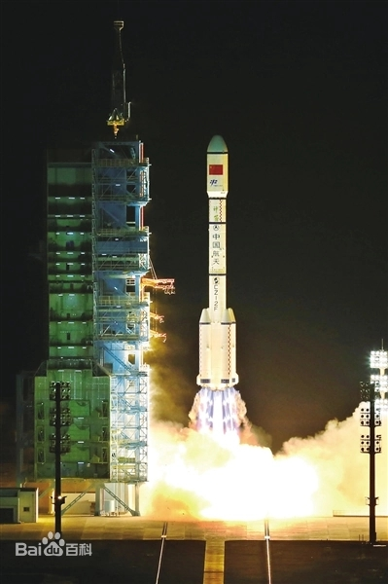
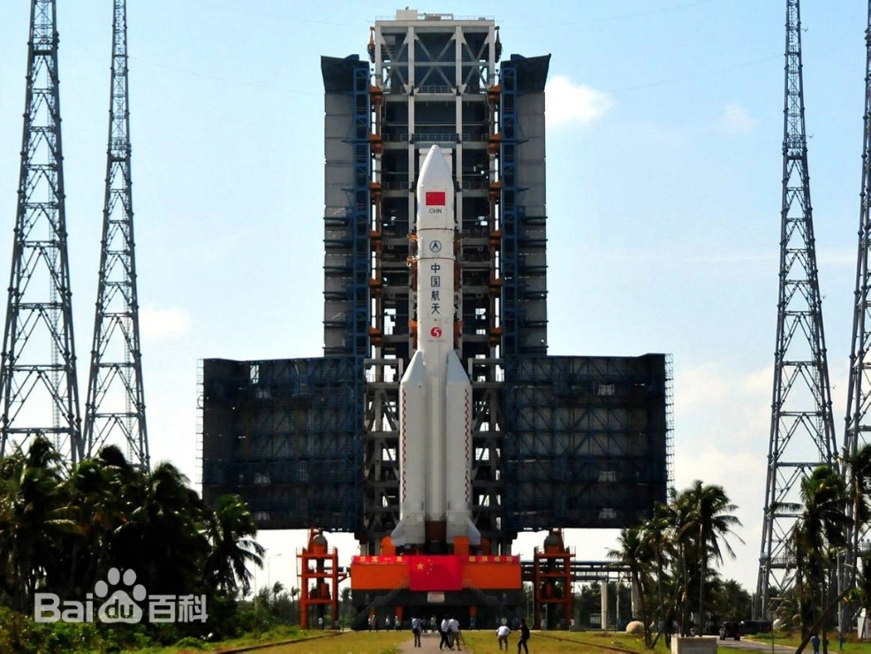
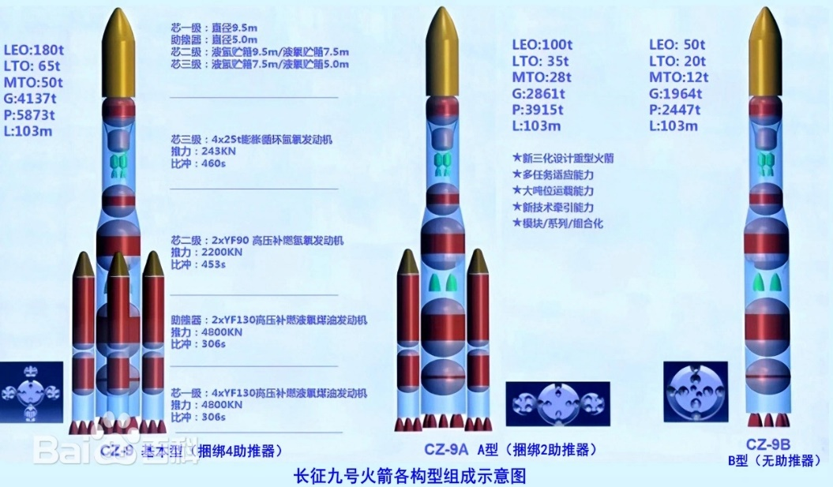
Detailed design of the solenoid magnet
长征二号、三号、四号
长征五号重型运载火箭
长征九号重型运载火箭
直径 | 3.35米
芯一级 | 5米
任务规划于2030年前后实现首飞
一级直径/米 | 11 | 10.6 | 9.5 | 9.5 | 9.5
10

Slide 11
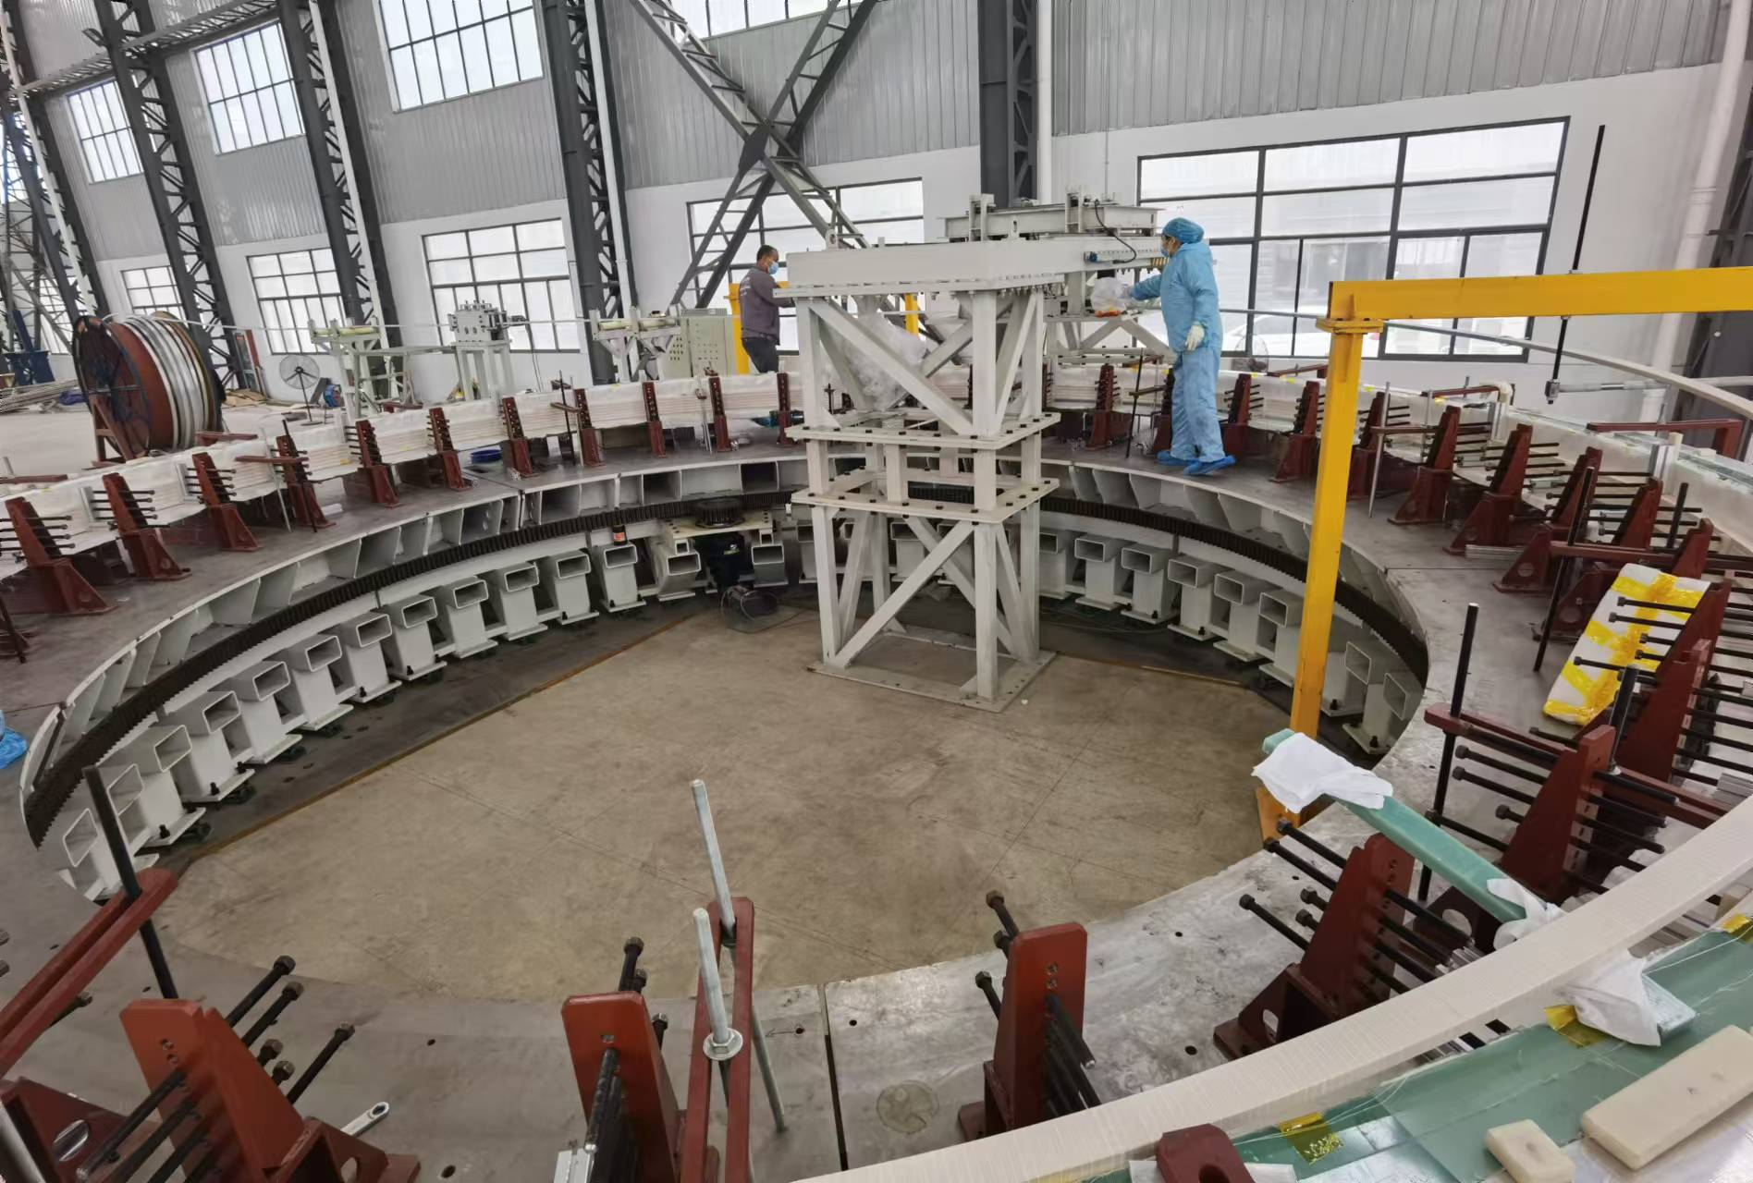
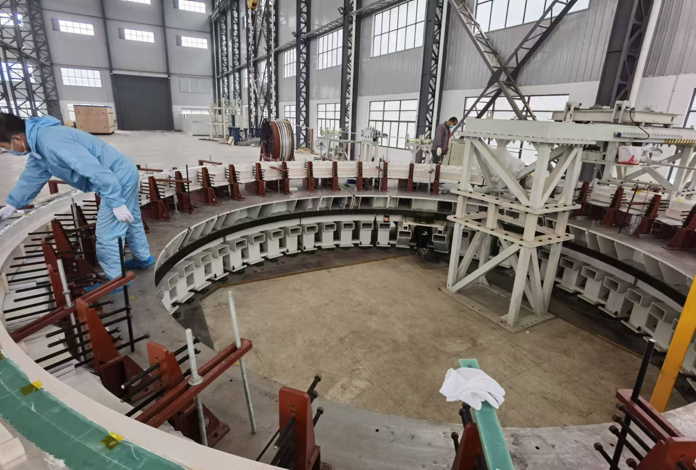
Detailed design of the solenoid magnet
CEPC detector magnet dummy coil:
11

Slide 12
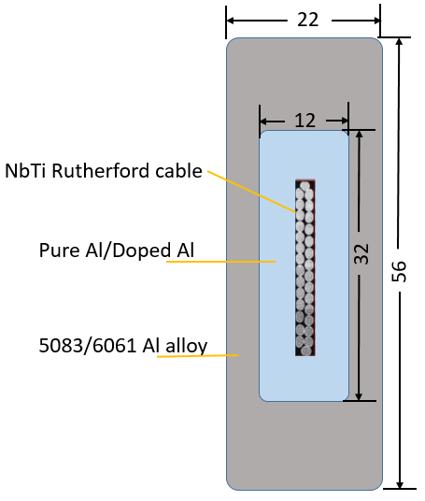
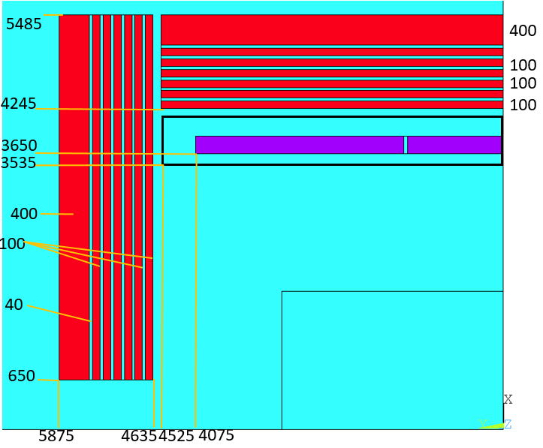
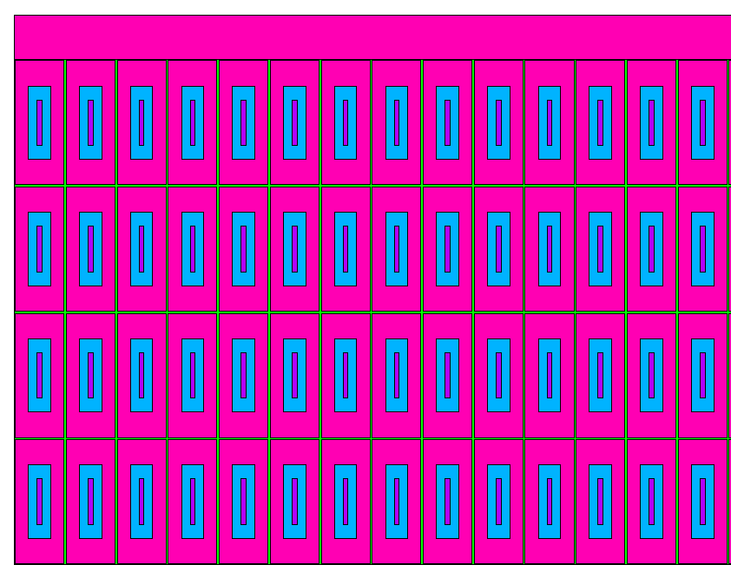
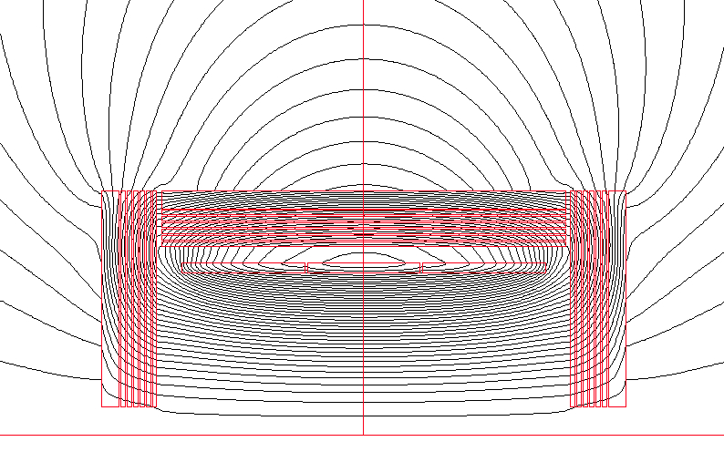
Detailed design of the solenoid magnet
Physical design of the magnet
Coil parameters:
Material | Von Mises stress (MPa)
Coil at 4.2 K
Pure Aluminum | 12.8-96.5
SC cable | 188-246
Al alloy | 30.2-57.1
Coil at 4.2 K, energized
Pure Aluminum | 52.5-102
SC cable | 80-223
Al alloy | 46.7-125
Central magnetic field | 3 T
Inner diameter | 7300 mm
Operating current | 16702 A
Cable length | 33 km
Inductance | 11 H
Stored Energy | 1.54 GJ
12

Slide 13
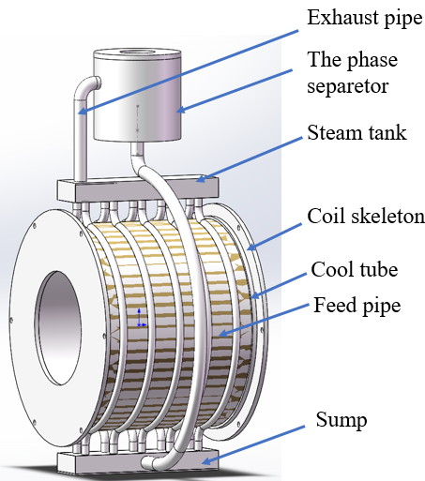
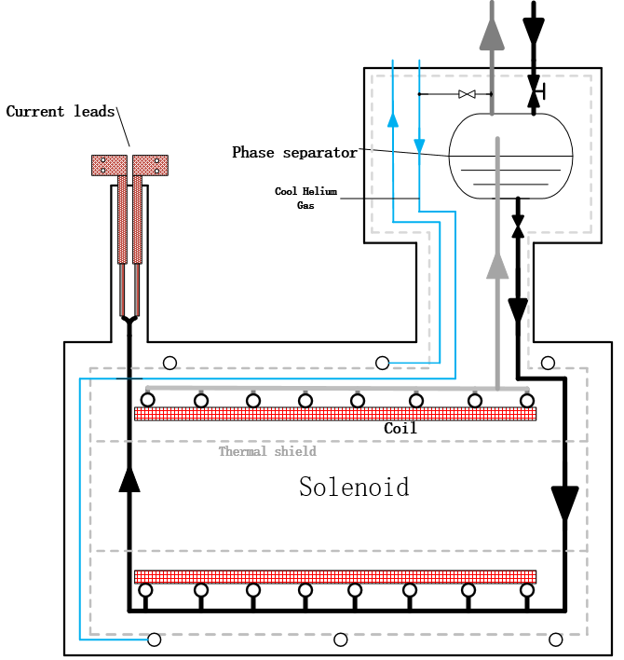
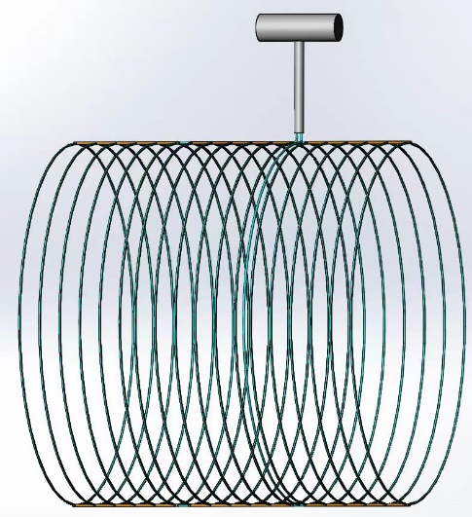
Cryogenic system
Cooling methods: Thermal siphon
Uniform temperature distribution;
High heat transfer efficiency, not limited by source pressure and pressure drop;
Low cost. No need for liquid helium circulation pump
Detailed calculations and process designs are currently underway.
Cooling process diagram
Verification experiment schematic diagram
13

Slide 14
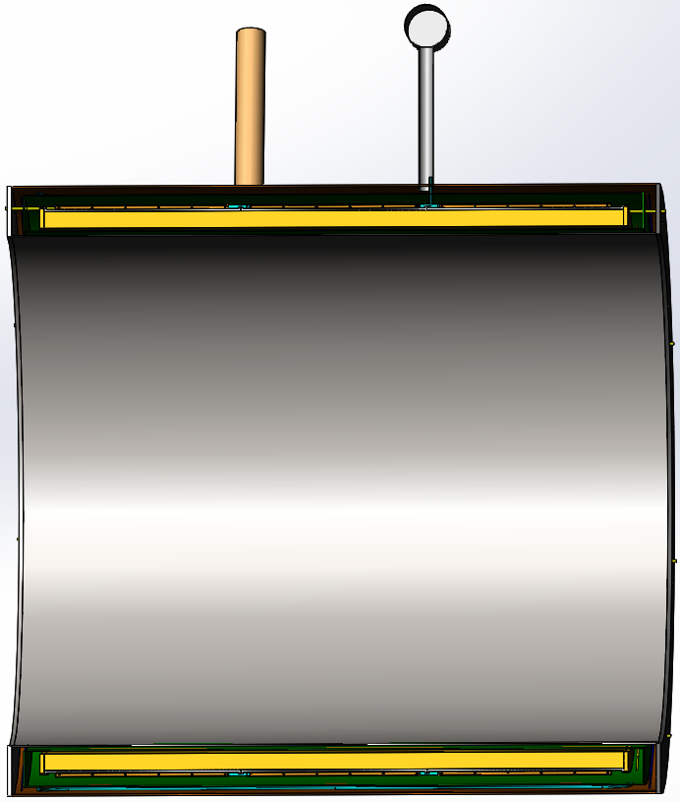
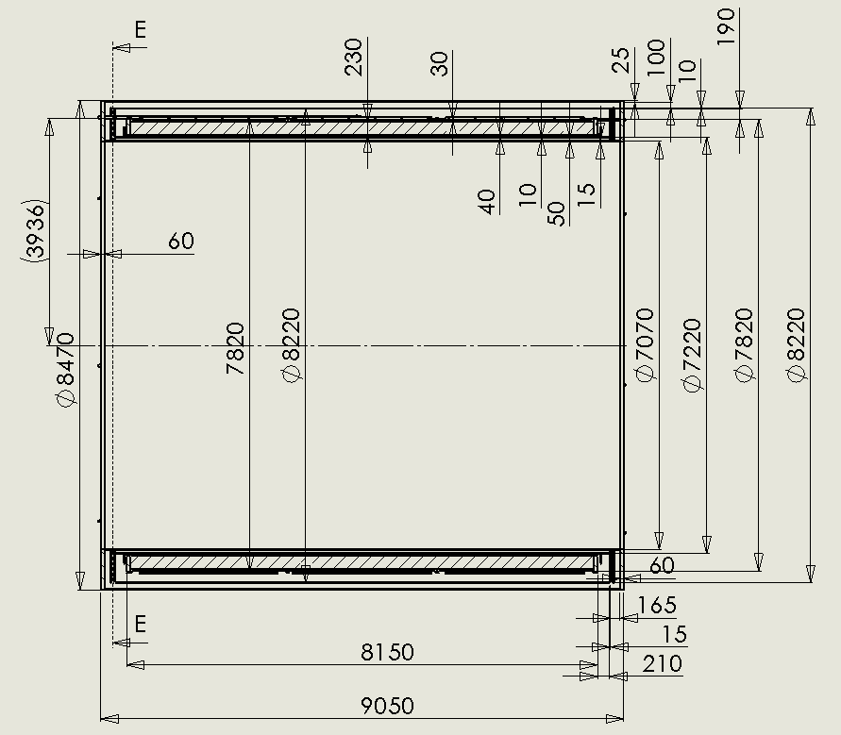
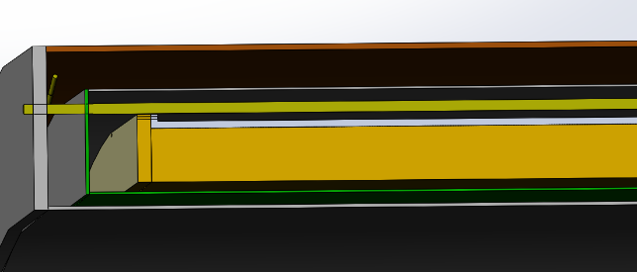
Mechanical design
2D
Completed the design of the 2D chain and the space occupied by each component.
3D
Completed the design of the 3D structure, added suspension system, cooling pipes, and connection structure.
suspension rod
coil
Thermal shield

Slide 15
Main Technical Challenges
Aluminum stabilized superconducting cable;
Suspension system of the huge coil (140 tons);
High precision machining and assembly of large cylindrical dewar；
There are lots of welds in low-temperature pipes, including pipes and coil supports, pipes and liquid/gas helium tanks.

Slide 16
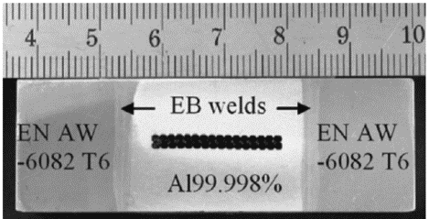
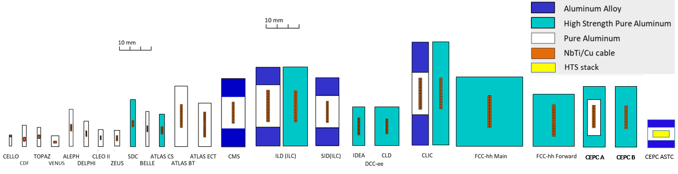
Main Technical challenges
Aluminium-stabilized Nb-Ti/Cu conductor types
CMS
Pioneer
Now
Future

Slide 17
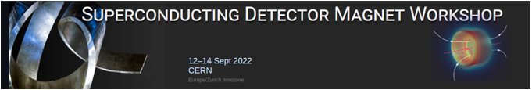
Main Technical challenges
Aluminium-stabilized Nb-Ti/Cu conductor
The Superconducting Detector Magnet Workshop is organized by CERN and KEK, and is hosted at CERN in hybrid format
For the purpose of:
  Addressing the issue of commercial availability of aluminum-stabilized conductor technology for future superconducting detector magnets
  Informing the community of on-going and future projects
  To exchange ideas, concepts, best practices, and to advance superconducting detector magnet technology
  Fostering collaboration
With 88 participants (55 on-site and 33 online) from 36 institutes and companies
Welcome!
The aluminum-stabilized Nb-Ti/Cu conductor is the traditional workhorse that is used in nearly all superconducting detector magnets
For a given amount of mass, aluminum-based superconducting conductors give strong performance needed for superconducting detector magnets:
Significant heat capacity for a given amount of weight
Excellent electrical and thermal conductivity at 4 K (pure or nickel-doped aluminum)
Very good mechanical properties (nickel-doped aluminum or aluminum-alloy)
Affordable, in combination with superconducting Nb-Ti/Cu Rutherford cables
However, in recent years, commercial availability has been an issue
Can we obtain it? Do viable alternatives exist?

Slide 18
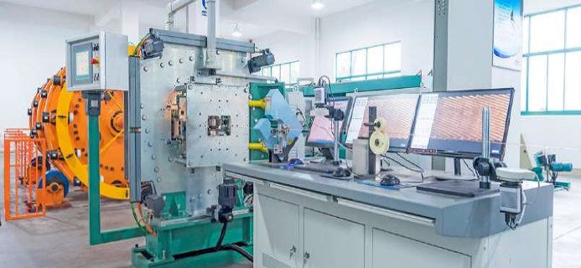
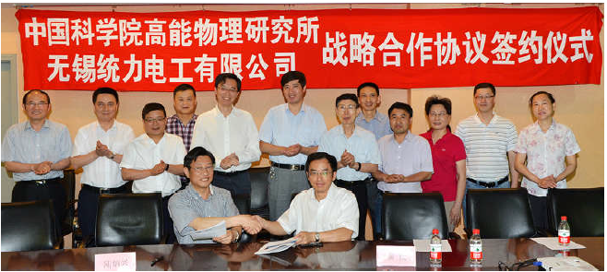
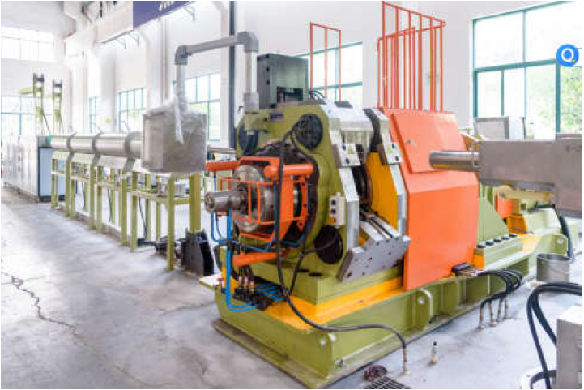
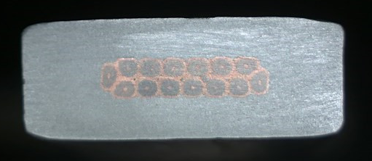
Main Technical Challenges
Conductors
  Conductor is the foundation of the magnet development. Most of the detector magnets used or will use the Aluminum-stabilized Nb-Ti/Cu conductors.
Rutherford Cable
Aluminum stabilized NbTi/Cu conductor
The IHEP and Toly company have jointly established an aluminum coated conductor production line in 2015.
Extrusion machine
18

Slide 19
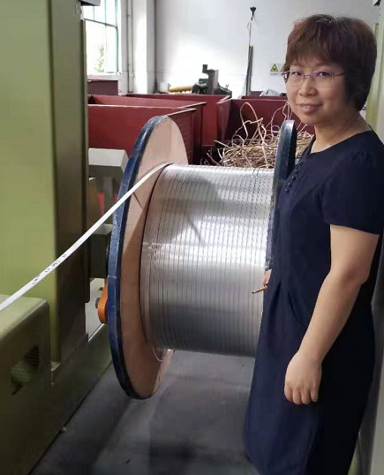
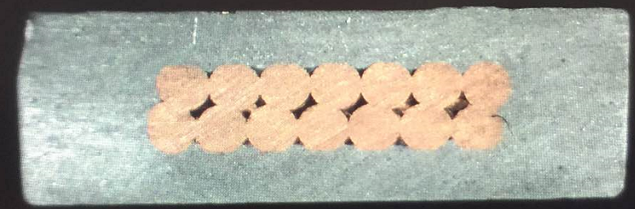
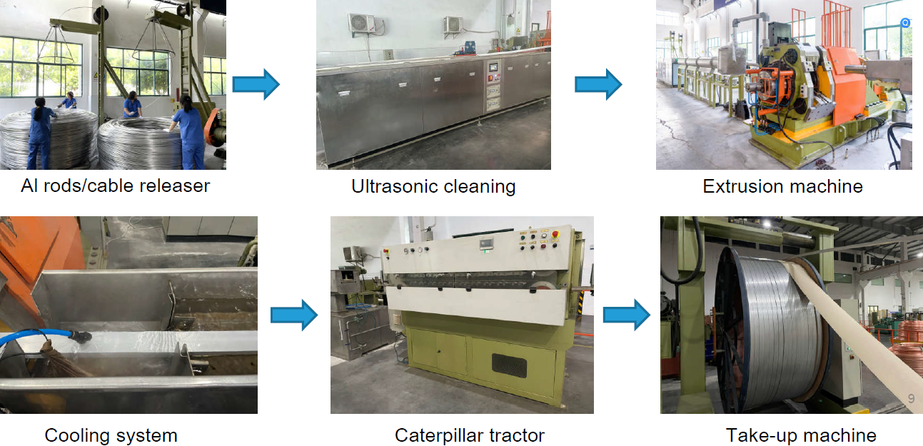
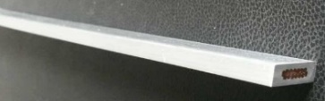
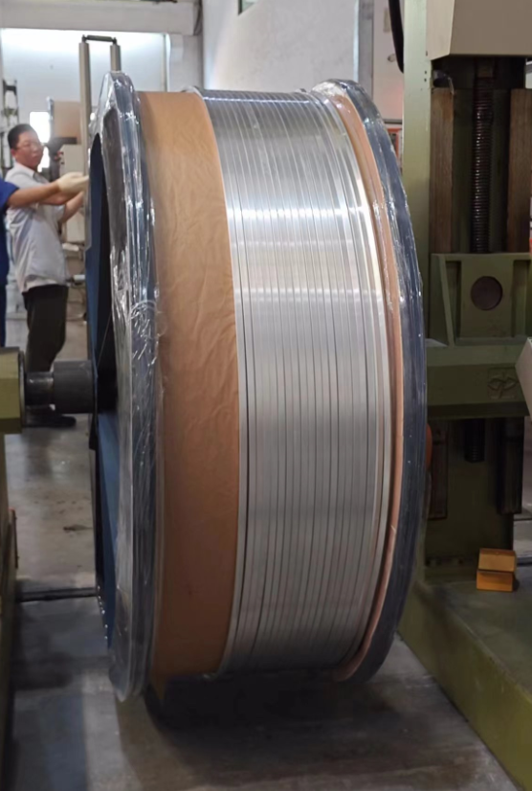
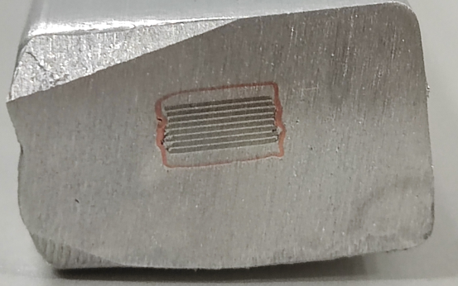
Production line
LTS: Aluminum stabilized NbTi Rutherford cable
Al-stabilized Conductors
1.5 km
HTS: Aluminum stabilized Stacked REBCO Tape Cable
Aluminum coated conductor production line
100 m
19

Slide 20
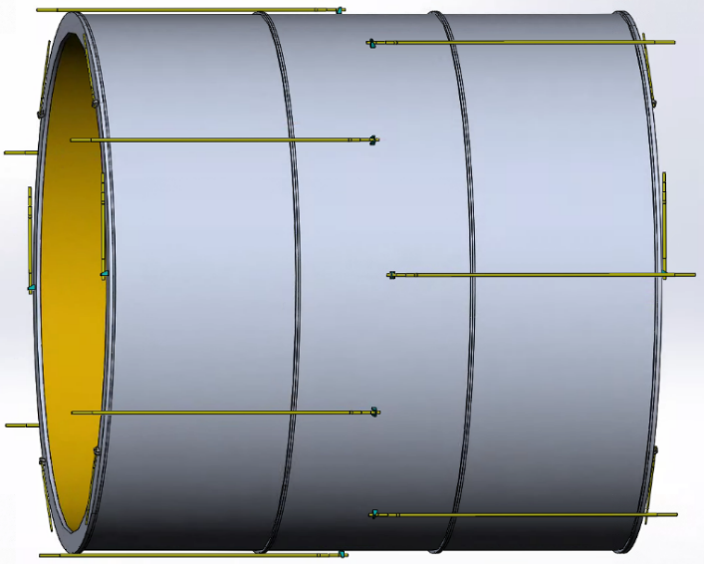
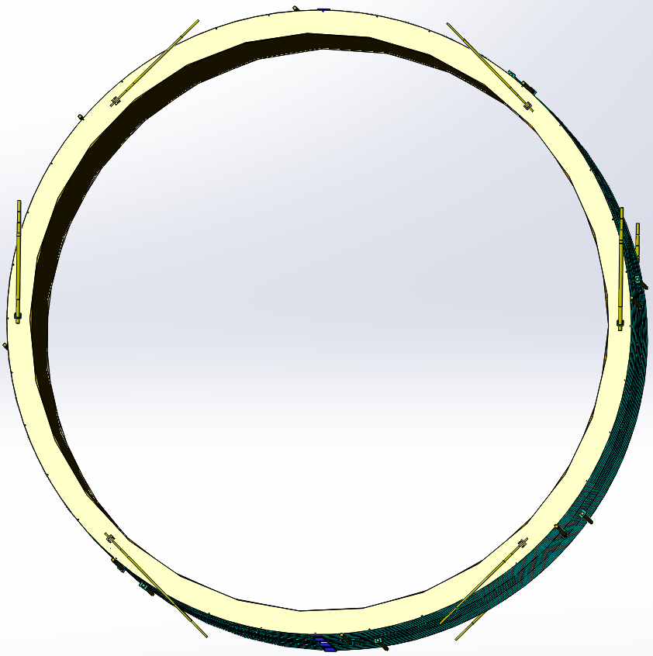
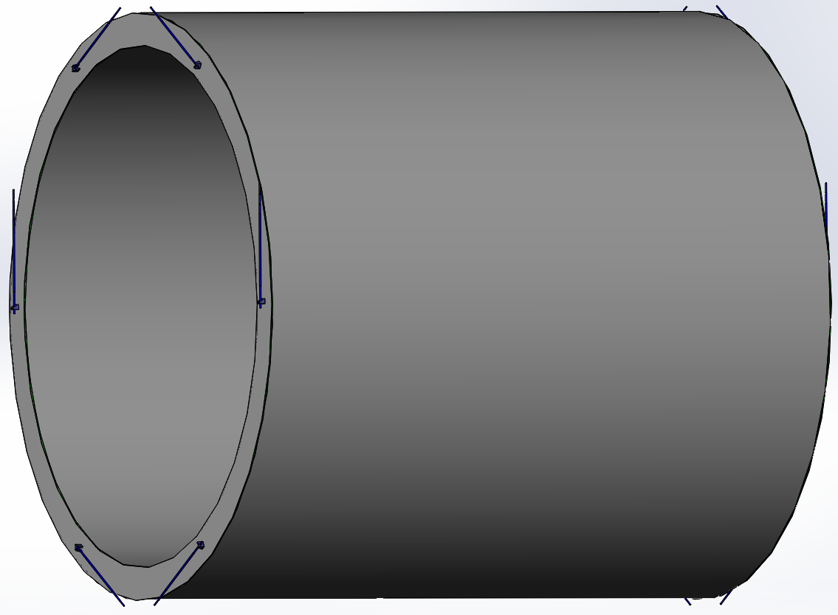
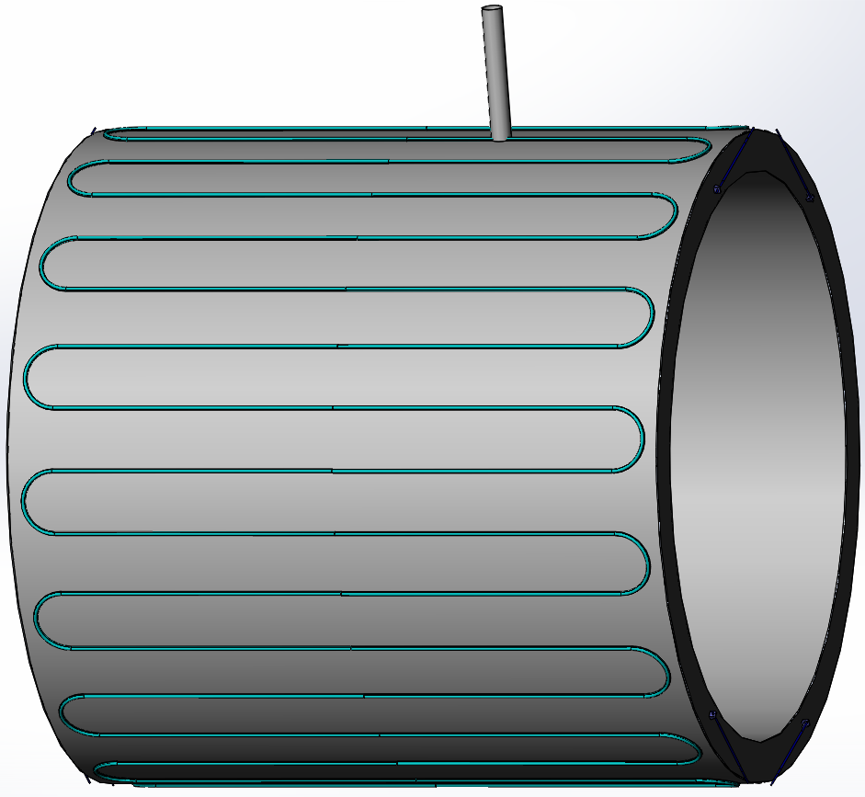
Main Technical Challenges
Suspension system
Coil suspension system (140 tons):
8 axial rods each end
6 radial rods each end
Material: titanium alloy
 | Diameter | Length | amount
Axial rods | 30 mm | 3530 mm | 16
Radial rods | 40 mm | 1700 mm | 8
Main pull rods | 48 mm | 1650 mm | 4
Forces and torques resulting from axial and radial offset, and from angular tilt of the coil.
Thermal shield suspension system:
6 radial rods each end
Material: titanium alloy
Axial displacement (cm) | 1 | 3 | 10
Axial force (kN) | 484 | 1498 | 5034
Radial displacement (cm) | 1 | 3 | 10
Radial force (kN) | 34.3 | 236 | 656
Angular tilt (angle) | 1/407.5 =0.14° | 3/407.5 =0.42° | 10/407.5 =1.41°
Torque (kN.m) | 1965 | 6170 | 19935

Slide 21
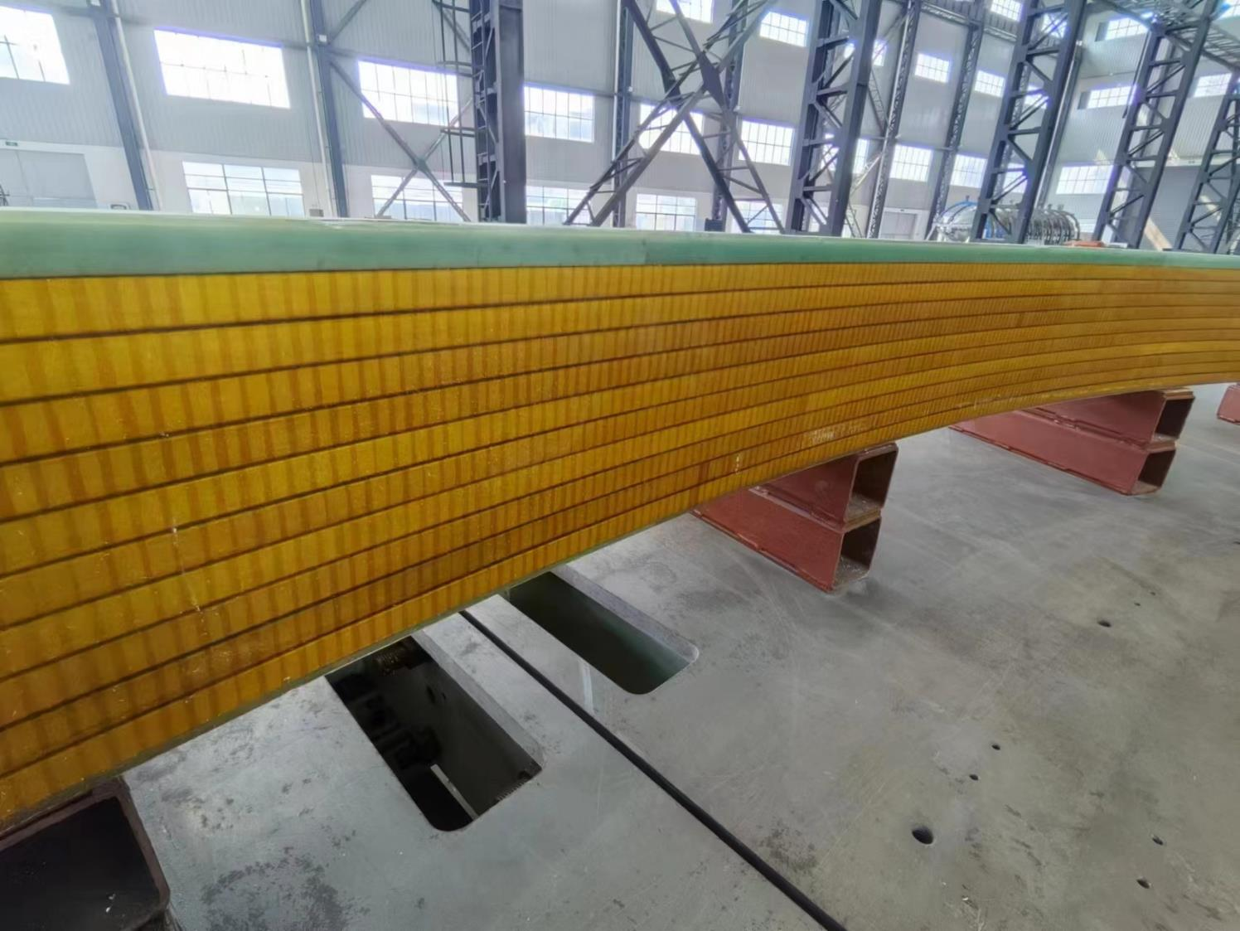
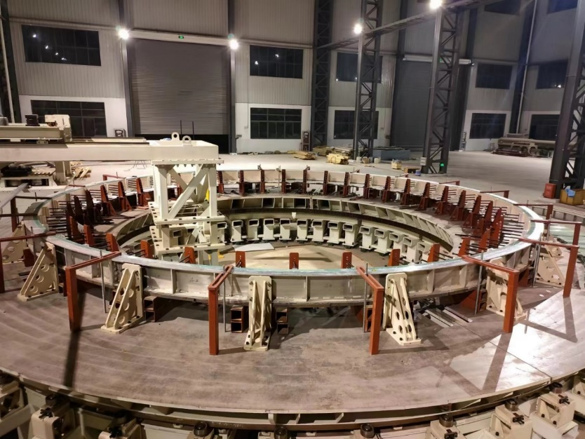
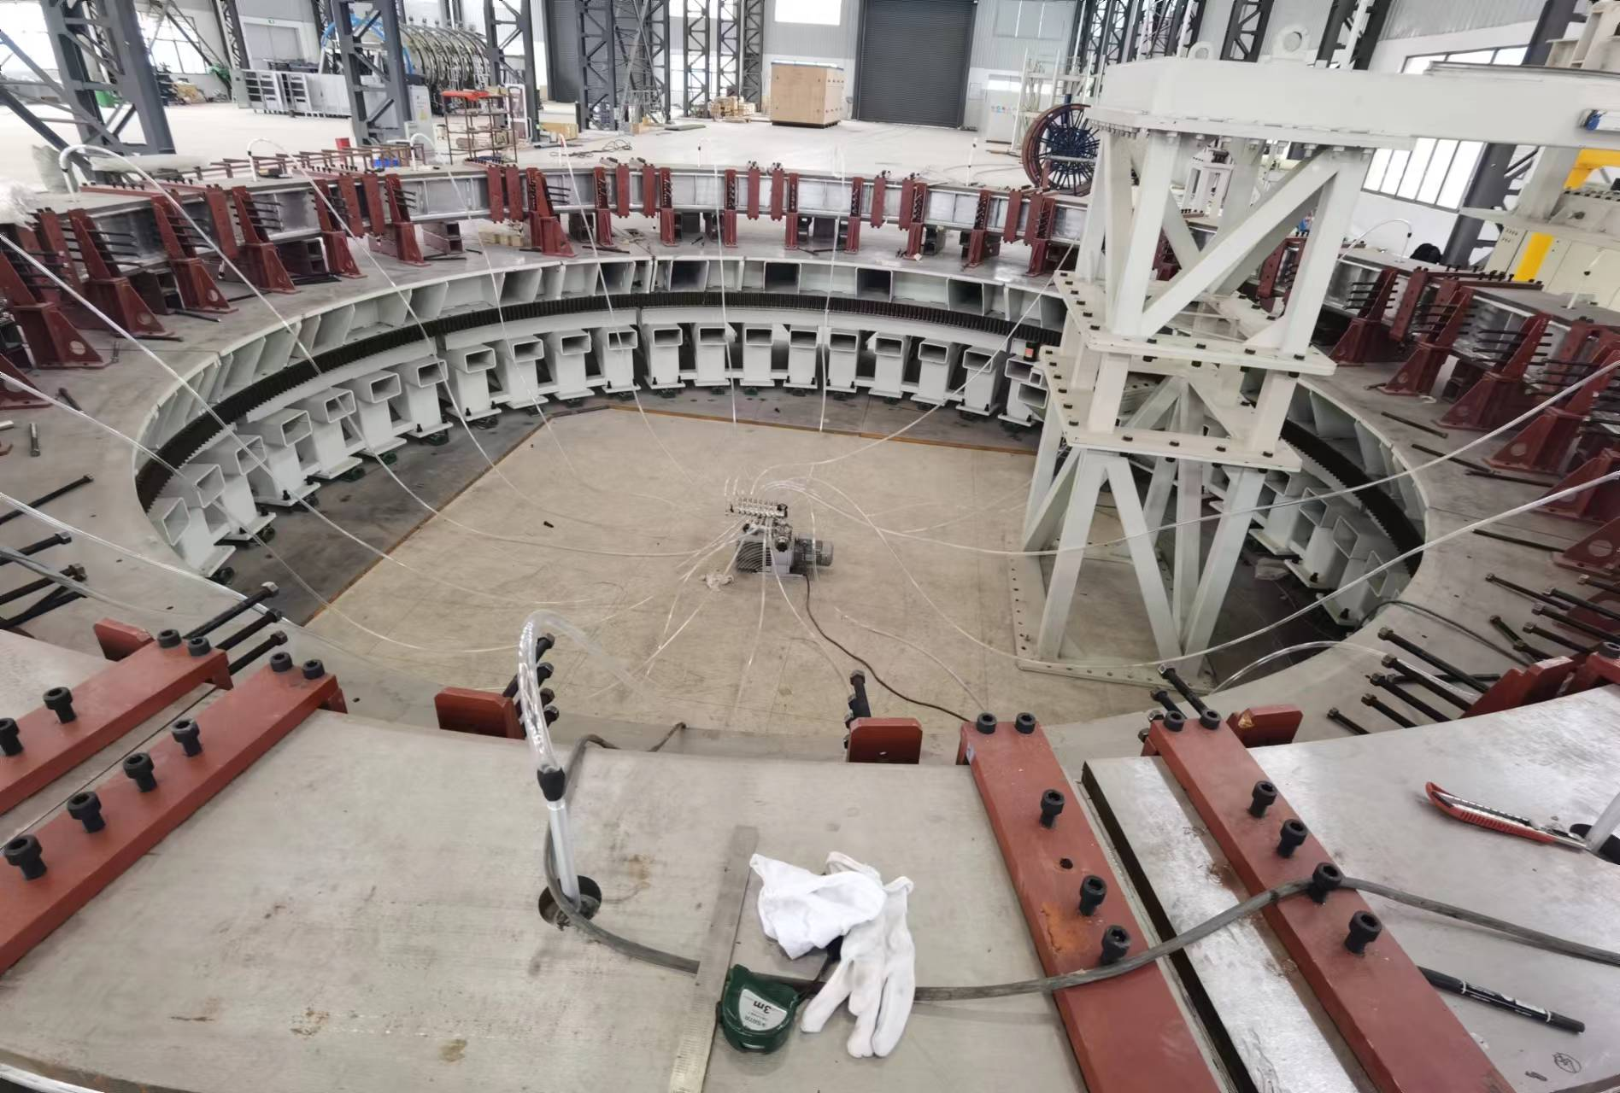


Main Technical Challenges
High precision machining and assembly of large coil and dewar
Coil winding, vacuum leak detection, epoxy impregnation curing.
4 layers*10 turns
φ7.2m dummy coil
Large scale superconducting coil winding platform
vacuum leak detection
The machining accuracy is controlled within ± 1mm
Dummy coil
21

Slide 22


Main Technical Challenges
Processing and assembly of large thin-walled cylinders.
22

Slide 23



Main Technical Challenges
There are lots of welds in low-temperature pipes, including pipes and coil supports, pipes and liquid/gas helium tanks.
Good contact
Leak proof

Slide 24

Research Team
IHEP: staff 13; engineer 5; post doctor 1; students 3
Cooperative institutes and Universities: SJTU, SWJTU, NCEPU, TSINGHUA, IEE, IPC, IPP and so on.
Cooperative companies: Wuxi Toly (aluminum stabilized conductors), Hefei Keye ( coil winding platform and dummy coil development), Xinjiang Zhonghe ( Aluminum stabilizer), WST ( LTS wires), SSCT ( HTS tapes), and so on.
Welcome international cooperation.

Slide 25



Research Team
Experience: BES III detector magnet
Design, processing, manufacturing, and assembly experience of BES III detector magnet;
Safe, stable, and accident free operation for nearly 20 years.

Slide 26
Summary
1. There are many challenges faced in the mechanical aspect.
2. We have achieved a leading position in aluminum-stabilized superconducting cable development.
3. We need the cooperation of large precision machining companies.

Slide 27
Thank you for your attention!
Aug. 7th, 2024, CEPC Detector Ref-TDR Review

