Slide 1


CEPC MDI
Sha Bai
On behalf of CEPC MDI group
The 2024 CEPC Mechanical Workshop
Aug 22-24, 2024

Slide 2
Outline
Introduction
Key aspects of MDI design
The central IR beam pipe design
Background estimation
Mitigation design efforts
  Masks
  Collimators
  Shielding
Thermal Analysis
  HOM, SR, Beam loss backgrounds, Beam pipe thermal analysis
Remote Vacuum Connector
SC magnet supporting system
IR BPMs
Integration and assembly
Fast luminosity tuning system
Summary

Slide 3
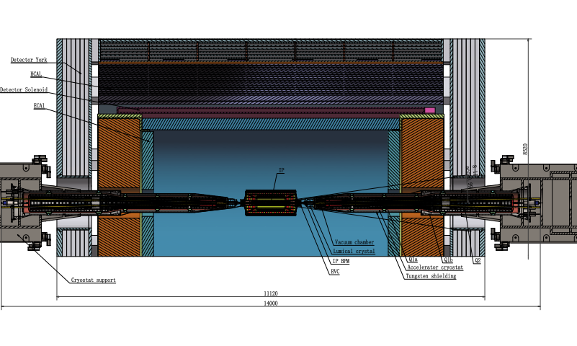
MDI layout and IR design
The Machine Detector Interface (MDI) of CEPC double ring scheme is about ±7m long from the IP.
The CEPC detector superconducting solenoid with 3T magnetic field (2T in Z).
The accelerator components inside the detector are within a conical space with an opening angle ~detective angle: acos0.99
The e+e- beams collide at the IP with a horizontal angle of 33mrad and the final focusing length is to 1.9m.

Slide 4
Key aspects of the MDI design
Beam induced backgrouds
  The MDI region is now improved as more realistic, and software model developed. Narrow the difference with future experiments.
  Backgrounds, collimators, IR beam losses, SR, IR radiation level & fluences
  Beamstrahlung dumps with radiation levels.
Heat loads in IR region
  HOM heating, SR, Beam loss backgrounds, Beam pipe thermal analysis
IR magnet system & Cryostats
  FF Quads & Correctors
  Solenoid compensation & anti-solenoid design update
  Cryomodule design update, thermal and mechanical analysis of the structure, optimization of heat and mass transfer of the helium, design of current leads. PI&D scheme determination, assembly process design and alignment considerations.
IR Mechanical model, including vertex and lumical integration, and assembly concept
  Cooling for vertex and vacuum chambers
  Remote Vacuum connection, IR BPMs
  Integrate in the design an alignment system
  Overall integration and installation for all components in the MDI. Specific installation procedure.

Slide 5
MDI parameters
 | range | Peak field in coil | Central field gradient | Bending angle | length | Beam stay clear region | Minimal distance between two aperture | Inner diameter of beam pipe | Outer diameter of beam pipe | Critical energy (Horizontal) | Critical energy (Vertical) | SR power (Horizontal) | SR power (Vertical)
L* | 0~1.9m |  |  |  | 1.9m
Crossing angle | 33mrad
MDI length | ±7m
Detector requirement of accelerator components in opening angle | 8.11˚
Q1a/Q1b |  | 3.5/2.8T | 142/85T/m |  | 1.21m | 14.9/18.2mm | 62.71/105.28mm | 20/23mm | 26/29mm | 724.7/663.1keV | 396.3/263keV | 212.2/239.23W | 99.9/42.8W
Q2 |  | 3.3T | 96.7T/m |  | 1.5m | 24.48mm | 155.11mm | 32mm | 38mm | 675.2keV | 499.4keV | 472.9W | 135.1W
Lumical | 0.95~1.11m |  |  |  | 0.16m
Anti-solenoid before Q1 |  | 8.6T |  |  | 1.1m
Anti-solenoid Q1 |  | 3T |  |  | 2.5m
Anti-solenoid Q2 |  | 3T |  |  | 1.5m
Beryllium pipe |  |  |  |  | ±85mm |  |  | 20mm
Last B upstream | 64.97~153.5m |  |  | 0.77mrad | 88.5m |  |  |  |  | 33.3keV
First B downstream | 44.4~102m |  |  | 1.17mrad | 57.6m |  |  |  |  | 77.9keV
Beampipe within Q1a/Q1b |  |  |  |  | 1.21m |  |  |  |  |  |  | 1.19/1.31W
Beampipe within Q2 |  |  |  |  | 1.5m |  |  |  |  |  |  | 2.39W
Beampipe between Q1/Q2 |  |  |  |  | 0.3m |  |  |  |  |  |  | 26.5W

Slide 6
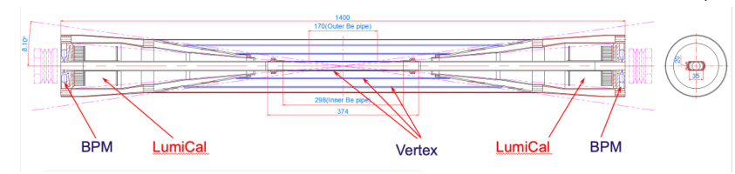
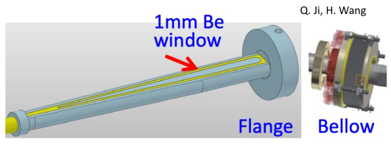
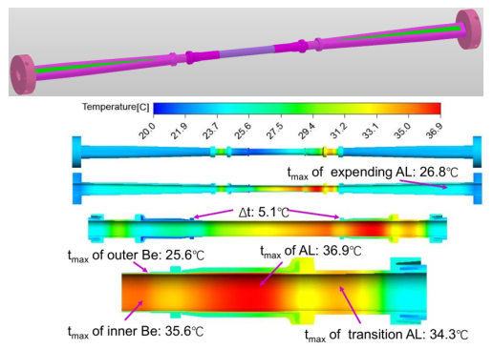
The central beampipe design
Outer Be layer: 0.15mm Gap: 0.35mm, coolant
Inner Be layer: 0.2mm
Thickness: ~0.2%X0
Water was chosen to be the coolant
Preliminary analysis shows that the dynamic temperature/pressure could meet the requirements.

Slide 7
Background estimation
Background sources
  Photon backgrounds: SR, Pair production
  Beam loss backgrounds
    Radiative Bhabha scattering
    Beam Gas scattering
    Beam Thermal photon scattering
  Injection background
Real beam
  Errors
  Beam-beam effect
  Beam tail
  Solenoid
Multi-turn tracking
  Using built-in LOSSMAP with one step ahead output
  SR emitting on
  RF on
  Radtapper on
A. Natochii
Beam loss BG
A. Natochii
Photon BG
Injection BG

Slide 8
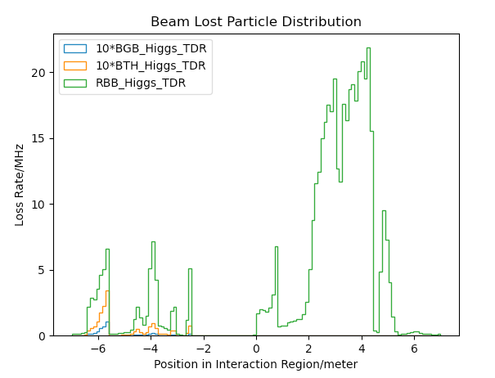
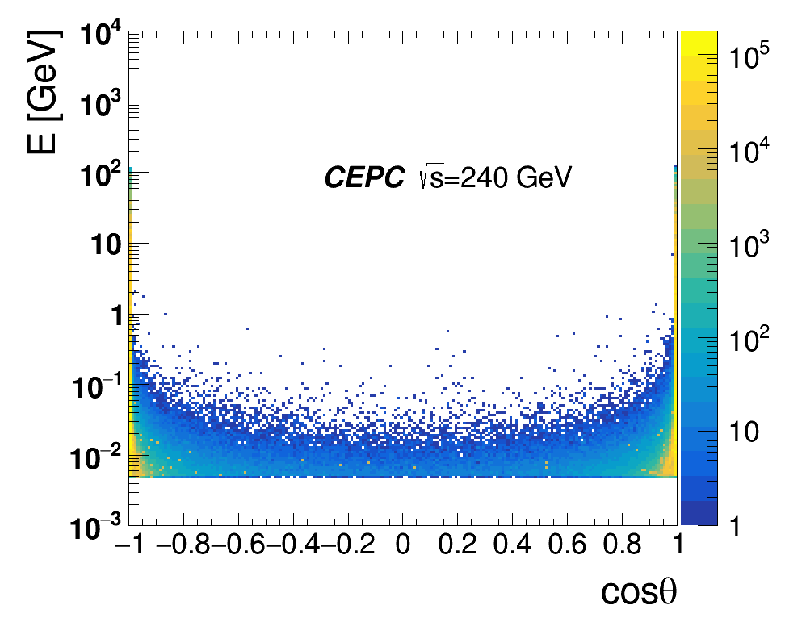
Radiation background
Including Radiative Bhabha scattering, Beam-Gas scattering, Beam Thermal Photon scattering.
Beam loss background from Beamstrahlung almost no in upstream IP, but mainly from pair-production distribution.
Beam loss particle distribution with collimator design.
Collimator design meet requirements of beam-stay-clear region, impedance, phase etc on.
4 sets of collimators were implemented per IP per Ring(16 in total)
  2 sets are horizontal(4mm radius), 2 sets are vertical(3mm radius).
One more upstream horizontal collimator sets were implemented to mitigate the Beam-Gas background

Slide 9
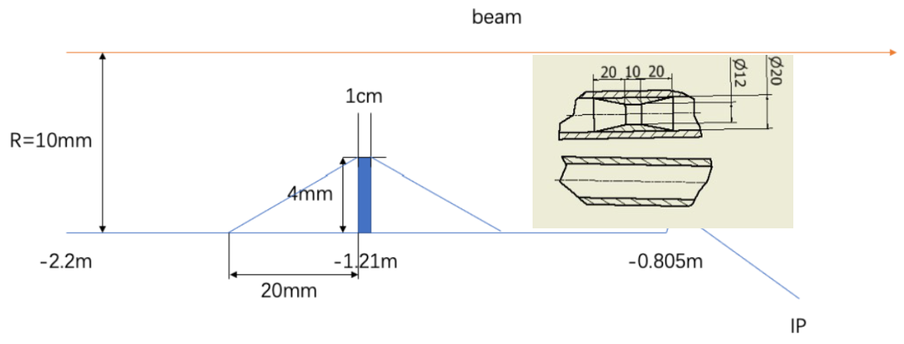
SR mitigation – mask and gold plating
Methods | Photon hitting number on Be/BX | Deposition power on Be(W)
No mask | 39400.0 | 30.57*e-5
1.21-mask-Cu | 1736.0 | 1.45*e-5
1.21-mask-W | 1698.0 | 1.36*e-5
2.2-mask-Cu | 1147.0 | 0.94*e-5
1.21-mask-Cu-5㎛Au | 216.0 | 0.273*e-5
Masks design(two masks/IP/ring) :
  Tungsten
  One locates at -1.21m with 4mm height and 10mm long
  The other at -4.2m with 0.6mm height
Lots of photons are secondaries, generated within Q1
Photons hitting number on Be/BX reduced by two orders of magnitude
~216 photons/BX could hit Be
  ~2.73x10⁻⁶ W deposition power on Be beampipe

Slide 10
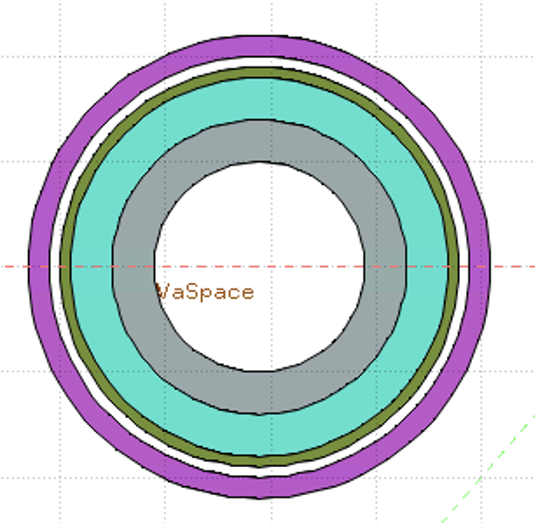
Shielding
Shielding in MDI including 4 parts:
Tungsten alloy IR beam pipe
Combined iron and tungsten yoke of SC magnet
Gold plating on beryllium pipe (~5µm)
Tungsten shielding outside of cryostat
Accelerator
Detector
White: Vacuum
Gray: Tungsten Pipe
Light Green: Helium
Heavy Green: Stainless Steel Vassel
Pink: Coil
Key Issues on Calculation and Simplification of Beam pipe model
Pure tungsten IR beam pipe with 4mm thickness without cooling taken into account, simulate the Absorbed Dose on Coil (Region)
The very tight space of thickness ~Tungsten IR beam pipe
Seek for better new shielding material
It is unlikely to use pure tungsten, which is too brittle.
WNiFe and WNiCu are two kinds of alloys that can be made. WNiCu is non-magnetic, but it is difficult to make this alloy too long. It must be welded in sections, with each section no more than 1m.
For the 6m long IR beam pipe, there will be many welds.
Tungsten alloy is made by powder pressing. It has certain machining performance and welding performance (brazing). The vacuum performance is unknown.

Slide 11
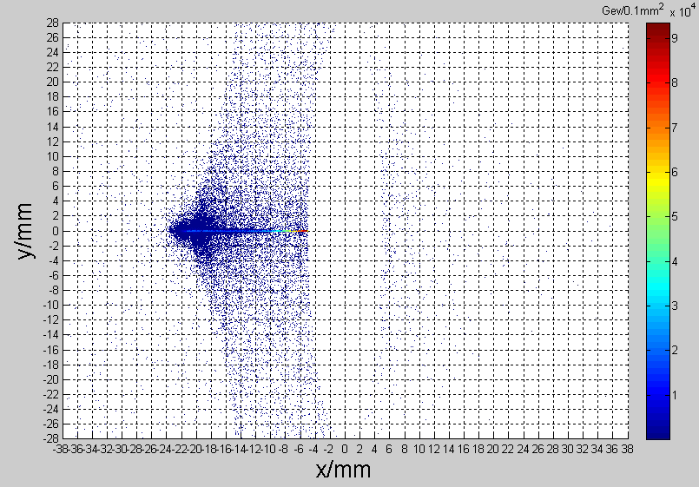
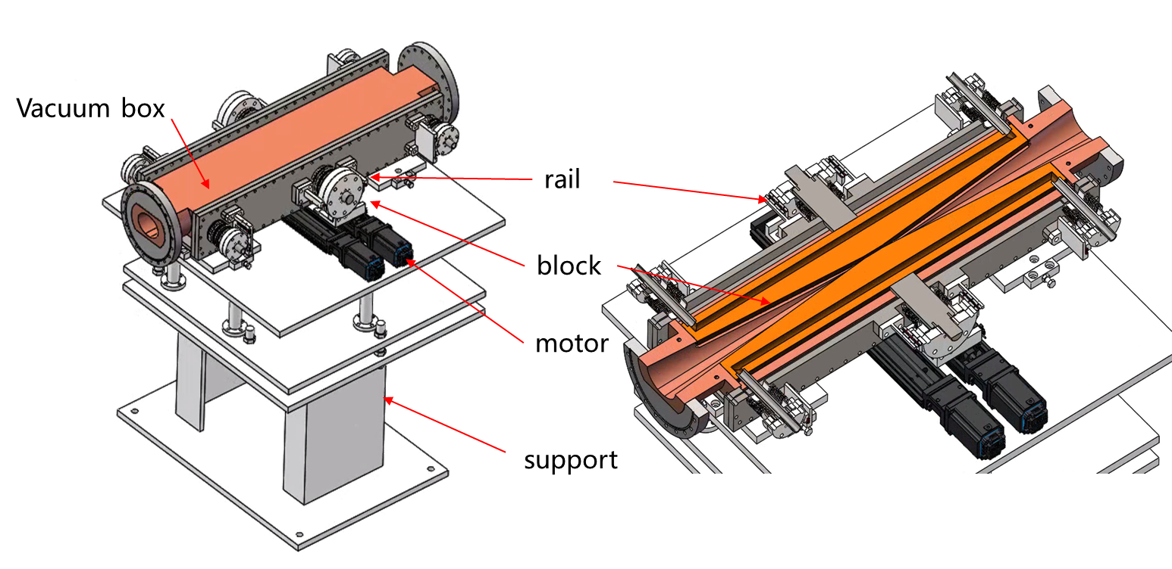
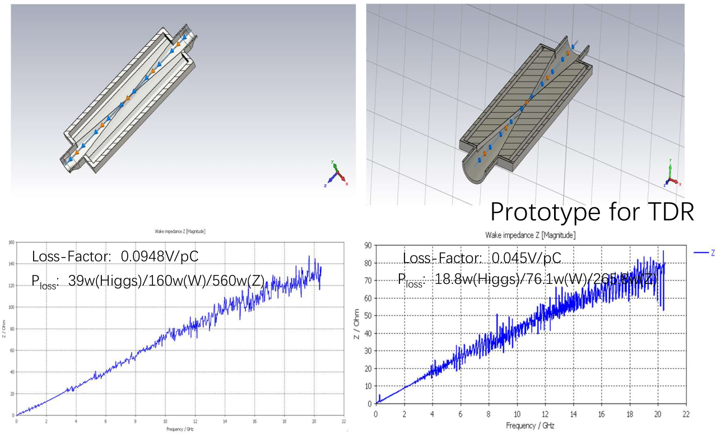
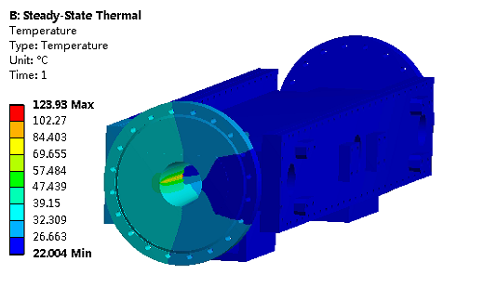
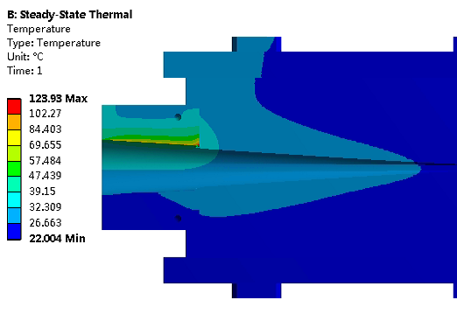
Movable collimators
Located in straight section between two dipoles, the length is 800 mm.
SR power: 7.5kW @Higgs, 30MW
  Particle deposition:
  Jaw material: Cu
  Total heat generation: 91.6 W
  Maximum temperature raise by particle-material reaction: 2℃
Highest temperature: 124 ℃

Slide 12
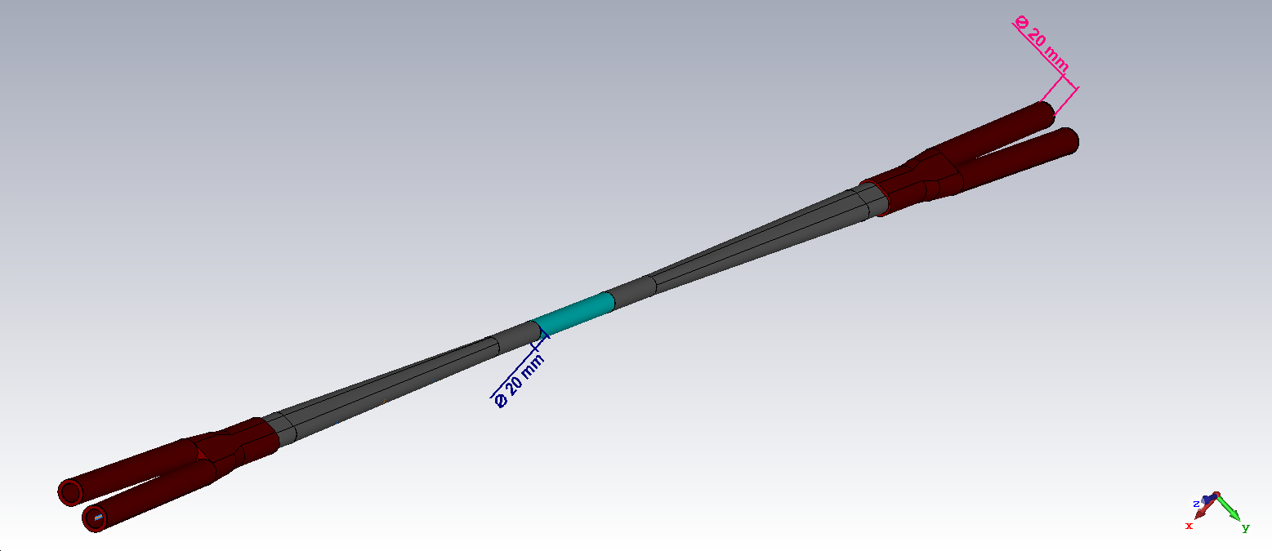
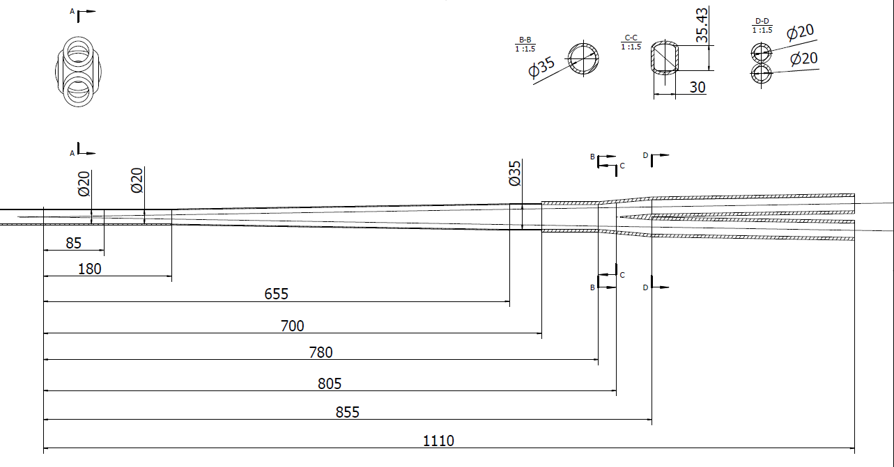
HOM power distribution
results for MDI 20mm-20mm
Transition region: Racetrack (including materials)
σ_{z}=5mm: Two beam in the IR
Loss factor Trap in IR @k_trap: 0.032v/pc
P_{trap}: H/W/Z/tt: 24.0w/117.1w/1160.8w/6.67w
Position | Position Start-end（mm） | material | Length (mm) | Higgs(w) & (w/cm²) | W (w) & (w/cm²) | Z(w) & (w/cm²) | ttbar（w） & (w/cm²)
Be pipe (w) | 0-85 | Be | 85 | 1.13 & 0.021 | 5.587 & 0.105 | 55.295 & 1.35 | 0.31 & 0.005
Be pipe transition(w) | 85-180 | Al | 95 | 0.61 & 0.01 | 2.950 & 0.049 | 29.280 & 0.491 | 0.172 & 0.007
Transition pipe (w) | 180-655 | Al | 475 | 6.99 & 0.017 | 34.48 & 0.085 | 341.562 & 0.83 | 1.958 & 0.005
Transition （w） | 655-700 | Al | 45 | 0.62 & 0.015 | 2.95 & 0.071 | 29.28 & 0.701 | 0.172 & 0.004
RVC bellow（w） | 700-780 | Cu | 80 | 0.52 & 0.007 | 2.532 & 0.034 | 25.002 & 0.337 | 0.14 & 0.002
Transition on Y-crotch | 780-805 | Cu | 25 | 0.16 & 0.007 | 0.785 & 0.032 | 7.822 & 0.316 | 0.05 & 0.002
Y- crotch (w) | 805-855 | Cu | 50 | 0.33 & 0.005 | 1.572 & 0.024 | 15.626 & 0.241 | 0.091 & 0.002
Quadrupole pipe(w) | 855-1100 | Cu | 245 | 1.58 & 0.005 | 7.735 & 0.024 | 75.594& 0.24 | 0.434 & 0.002
Total | 0-1100 | - | 1100 | 12.0 &0.011 | 58.594 &0.056 | 580.46 & 0.56 | 3.331 & 0.003

Slide 13
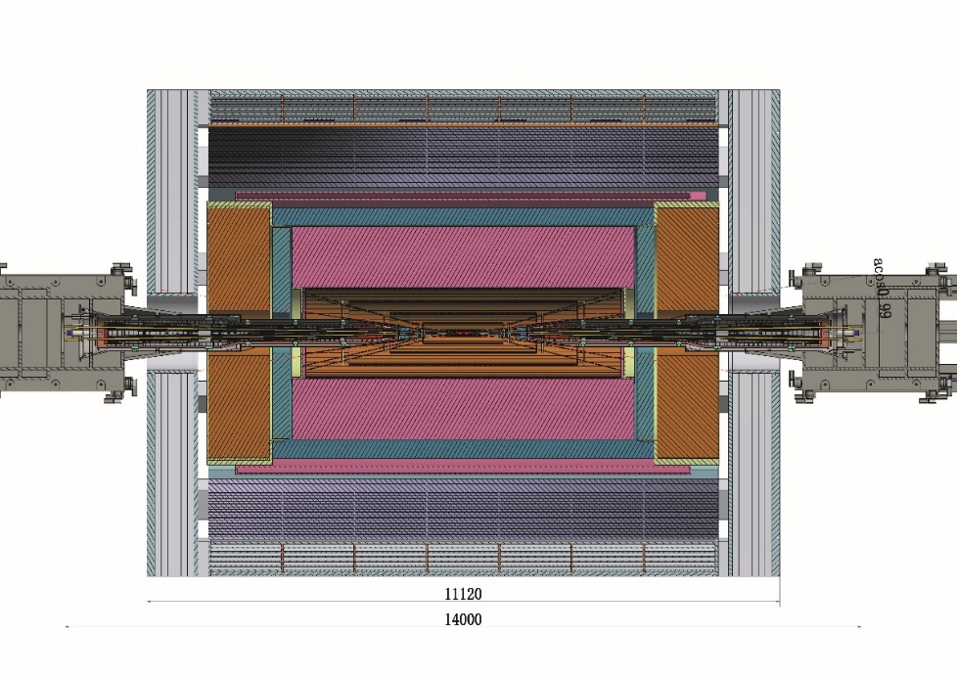
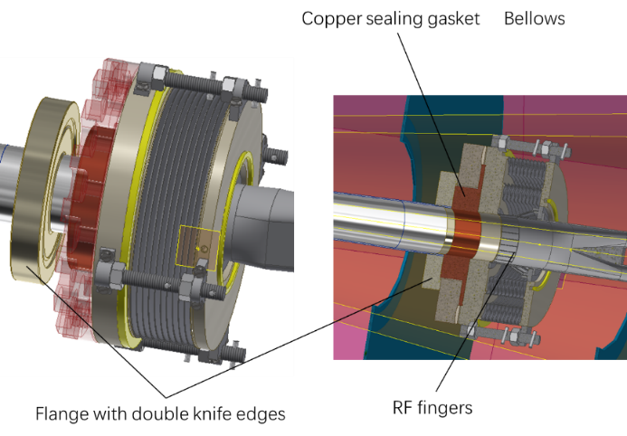
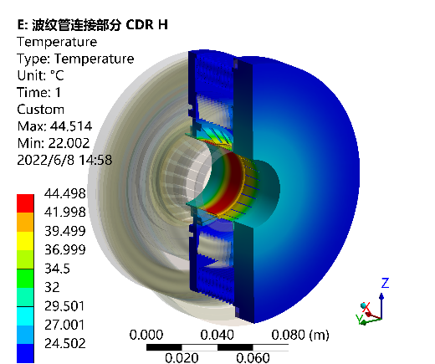
Remote Vacuum Connector plan in EDR
  Further assessment and mechanical design of the RVC, and a prototype if possible in EDR.
  Aim: RVC leak rate~ 2.7 ×10^{–11} Pa·m³/s
  Can endure a heat flux of 1 W/cm², the HOM power is acceptable.

Slide 14
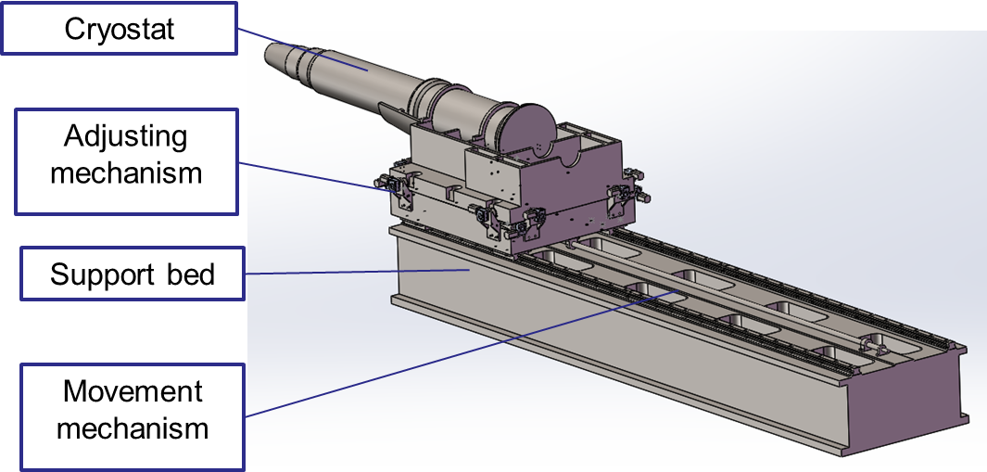
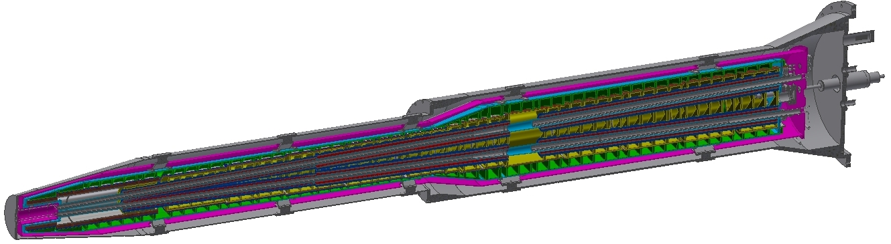
SC magnet support system
After the optimization of the supports in the cryostat, the total weight of the cryostat and the devices inside is 2790 Kg.
The cryostat is about 5.6m long. The cantilever length is 5283mm.
The resolution requirement of the adjusting mechanism < 5 μm.
Thermal shield
Helium vessel
Q2
Vacuum vessel
Q1b
Q1a
Anti-solenoid
Support rods

Slide 15
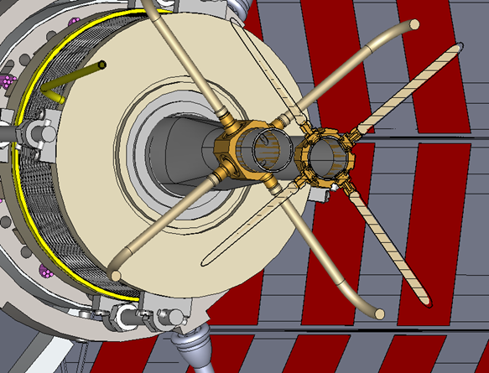
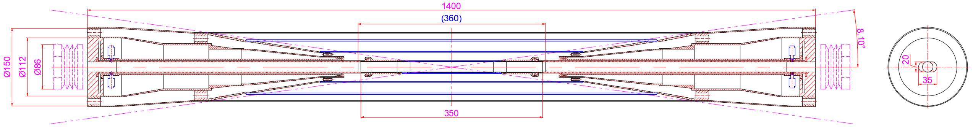
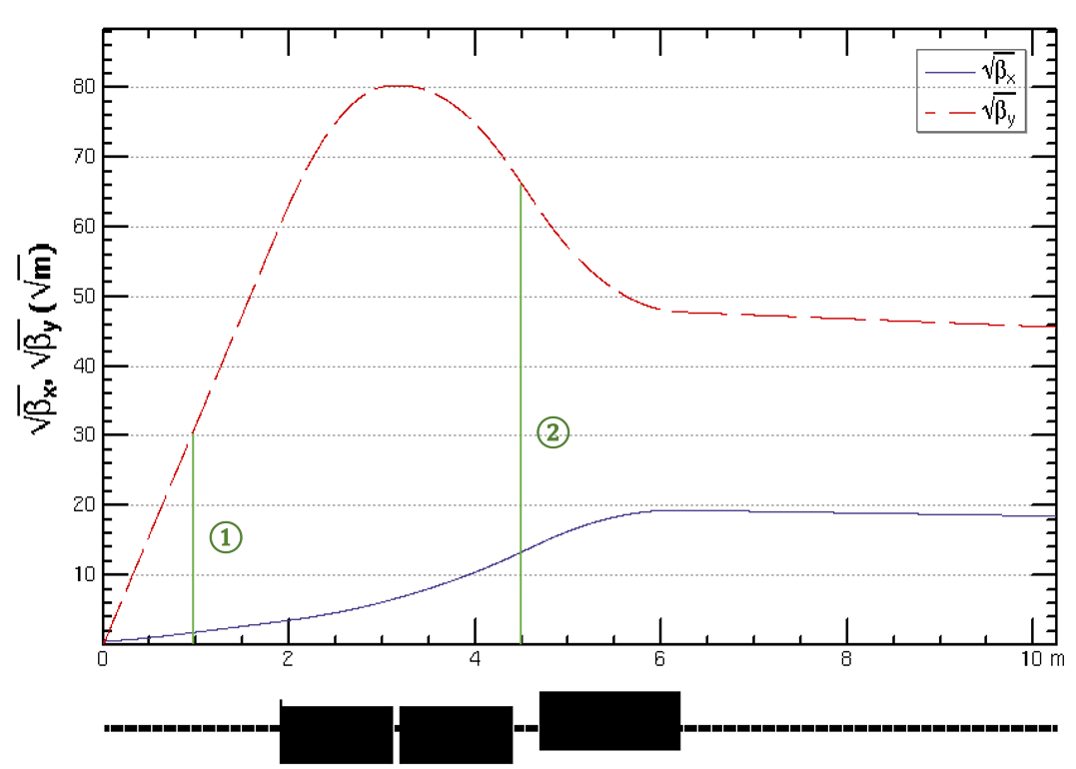
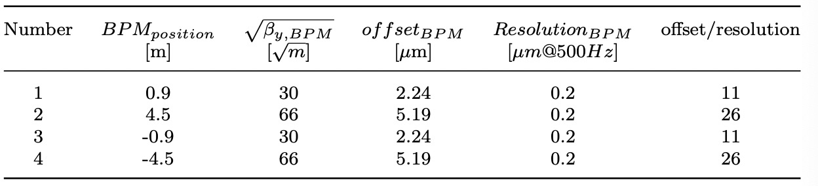
IP BPM
Considering response time and calibration difficulty, two 4 button electrodes BPM in double pipe and one 2 button electrodes BPM in single pipe at each side of CEPC IR are adopted.
2 button electrodes BPM for measuring the arrival time.
Utilize two pairs of BPMs for vertical beam orbit feedback, placed at symmetric positions on each side of the IP, located at distances of 0.9m and 4.5m

Slide 16
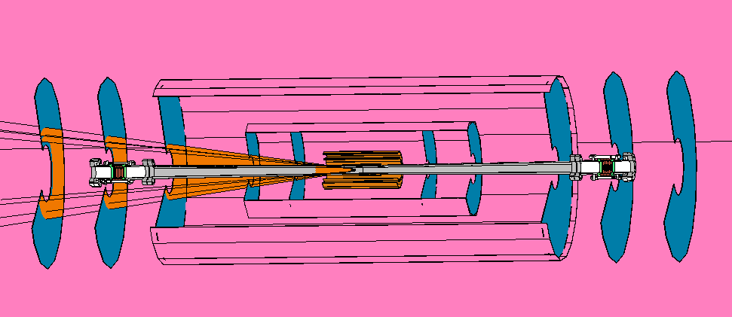
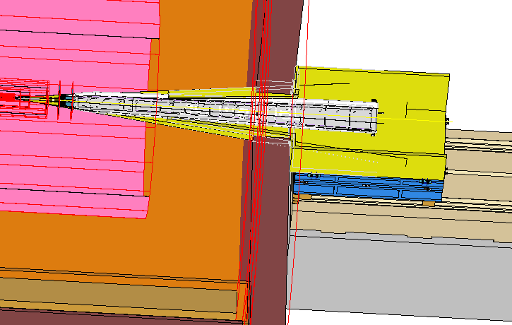
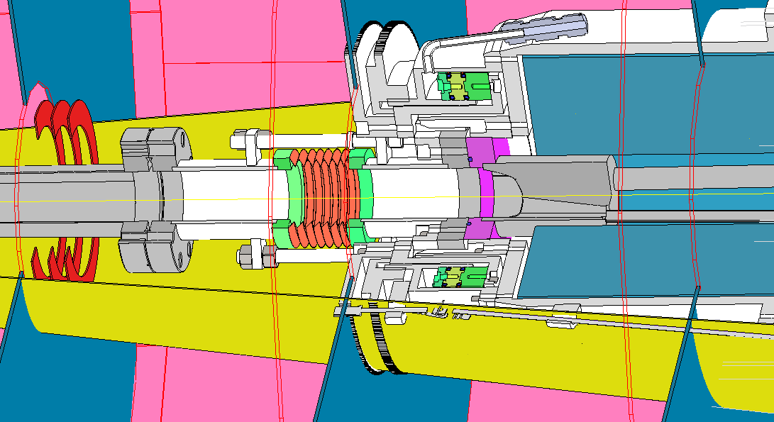
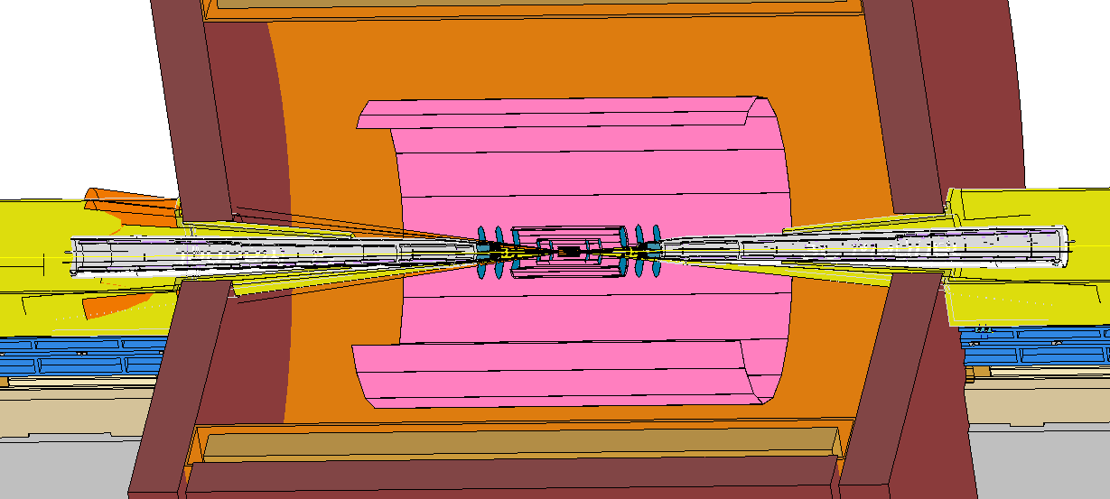
Integration and Assembly
Overall integration and installation for all components in the MDI.
Specific installation procedure.
Cryostat including Final doublet installation alignment.
Lumical and Berryllium pipe installation alignment.

Slide 17
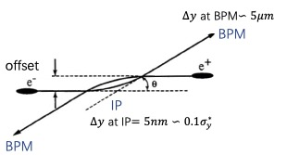
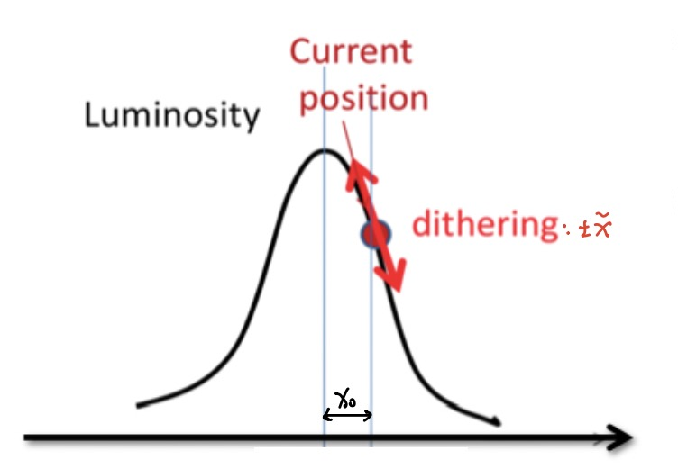
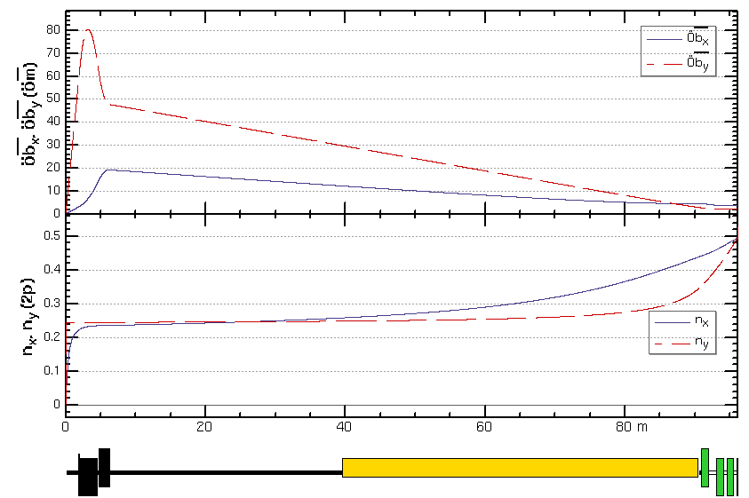
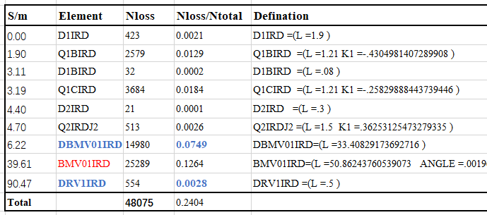
Fast luminosity tuning system
Motivation
With very small beam sizes at IP and the presence of strong FFS quadrupoles in the CEPC, the luminosity is very sensitive to the mechanical vibrations, It is essential to the fast luminosity measurements and IP orbit feedback.
In principle, there are two possible methods used for the IP orbit feedback system.
  Beam-Beam deflection driven method for vertical
  Fast luminosity monitor for horizontal
IP
1
2
3
  The proposed approach involves utilizing the beam-beam deflection driven method based on BPMs for vertical orbit feedback and a luminosity-driven method for horizontal feedback.
  Candidate positions for BPMs and luminosity detector have been identified.
  The detailed design of the detectors is getting started.
  M. Li, P. Bambade, D. Wang et al., “Preliminary design consideration for CEPC fast luminosity feedback system” accepted by RDTM.
Three potential locations of fast lumi monitor were considered: before, inside, and after the first bending magnet

Slide 18
Summary
The MDI layout is compatible and no interference for the design.
Φ20mm~ Φ20mm IR beam pipe is well designed.
The estimation of the radiative background from photon background, beam loss background and injection background has been estimated with real beam.
The mitigation efforts of every kinds of background dedicated to the mask, collimator and shielding has been designed.
The thermal analysis including HOM heating, synchrotron radiation, beam loss background and beam pipe thermal analysis meet the requirement.
Considering response time and calibration difficulty, two 4 button electrodes BPM in double pipe and one 2 button electrodes BPM in single pipe at each side of CEPC IR are adopted.
The SC magnet supports inside the cryostat are designed and optimized.
Fast Luminosity Tuning System, including fast BPMs and fast luminosity monitor, would be necessary for CEPC.

Slide 19
Thanks for your attention

