Slide 1


CEPC MDI EDR cryomodule design progress
Xiangzhen Zhang, Xiaochen Yang
On behalf of cryogenics group，Institute of High Energy Physics(IHEP)
2024.08.23
The 2024 CEPC Mechanical Workshop, Luoyang, Henan

Slide 2
Content
Introduction
Cryogenic scheme of the cryostat
Structural design of the cryostat
Calculation and simulation
Current leads design
Summary and plan

Slide 3
  Introduction
In CEPC, there are two combined-function Superconducting magnets in MDI
Each combined-function magnet includes double aperture high gradient quadrupole (Q1a, Q1b, Q2) and anti-solenoid, around each side of the IP point.
The cryostat is used to provide the cryogenic environment for SC magnets, which is below 5.0 K.
ITEM | Q1a | Q1b | Q2 | Anti-solenoid
Central field gradient (T/m) | 142.3 | 85.4 | 96.7
Cooling type | LHe | LHe | LHe | LHe
Operating current (A) | 780 | 650 | 770 | 1300
Magnetic storage energy (KJ) | 11.5 | 11 | 33.2 | 630
Cross section parameter (mm) | Φ40~61 | Φ52~78 | Φ62~88 | 100 sections
Magnet length (m) | 1.21 | 1.21 | 1.53 | 5.1
Net weight (Kg) | 25 | 32 | 43 | 302
Total weight of magnets (Kg) |  |  |  | 402
From Yingshun Zhu

Slide 4
  Introduction
Works for the cryostat
Design and optimization of the structure.
Heat and mass transfer of the cryostat.
PI＆D of the cryogenic system.
Scheme of the current leads.
Some other problems.
From Yingshun Zhu

Slide 5
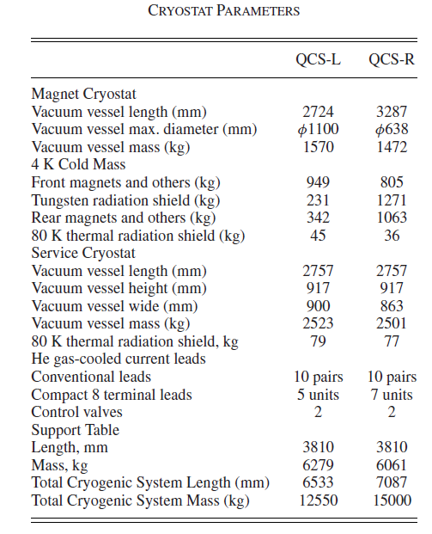
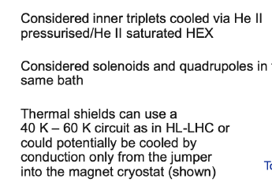
  Introduction
KEK and FCC
The length is approximately 3.3 m, and diameter is 1.1 m.
The weight of the magnet cryostat is 1570kg.
It is cooled by subcooled liquid helium at the pressure of 0.16MPa.
The length is approximately 3.36 m initially, and 6.24 m for second option.
It is cooled by superfluid helium He∥. (2.0 K)

Slide 6
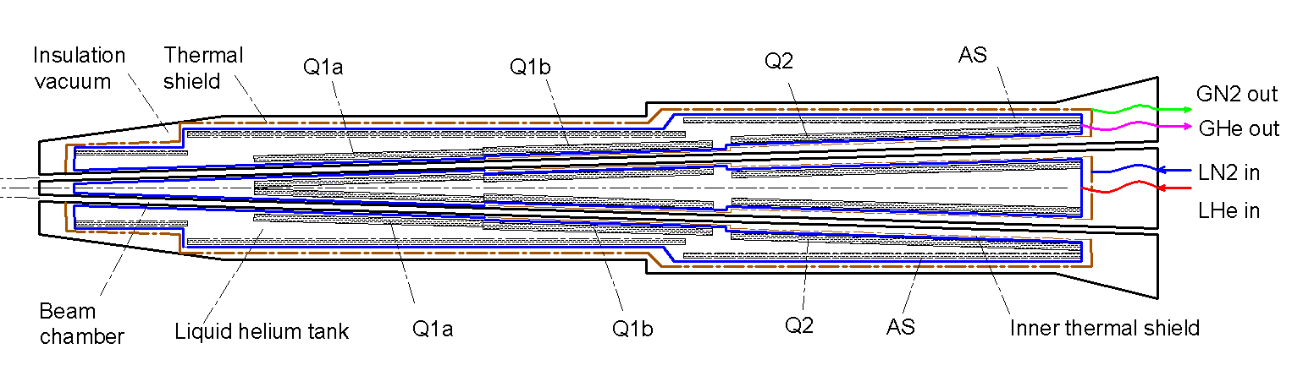
Cryogenic scheme of the cryostat
Cryostat scheme
Superconducting magnets are immersed in the helium tank for the low temperature.
One thermal shield is set for the heat interruption from the ambient temperature.
The shield is extended between the helium tank and the beam chamber.
The 4K cold mass is cooled by supercritical or subcooled helium, and the shield is by liquid nitrogen.

Slide 7
Cryogenic scheme of the cryostat
Cooling system
Conventional helium cooling scheme: Liquid helium is directly provided by helium refrigerator. The flow rate is limited by the refrigerator. Liquid helium can be subcooled or supercritical type.
Helium circulation cooling scheme: A closed helium circulation is established depending on a pump. The flow rate can be increased largely. The system will be complex.
Superfluid helium(HeⅡ): Perfect cooling uniformity; Stable pressure; Higher magnet current; Higher cost.

Slide 8
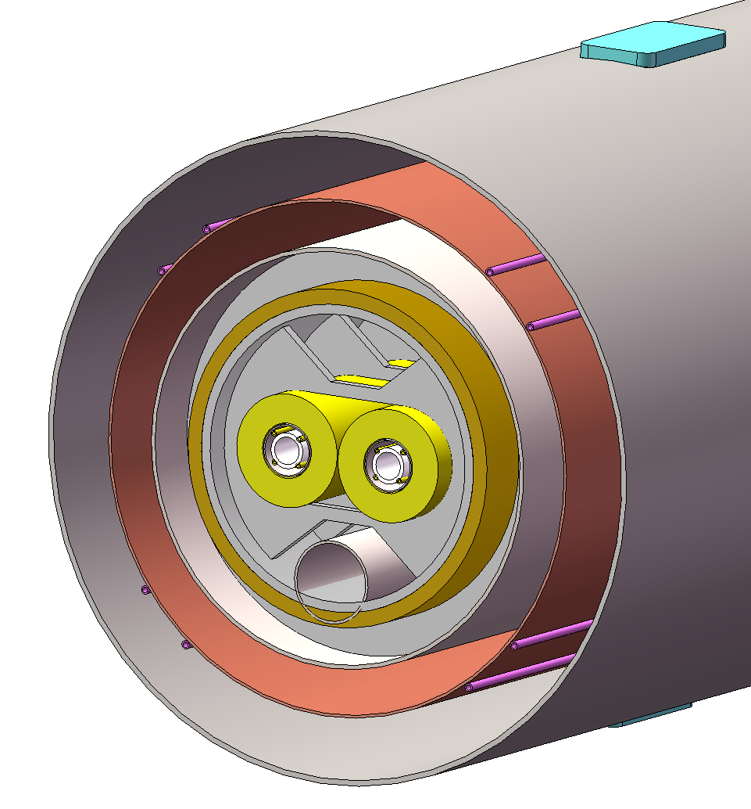
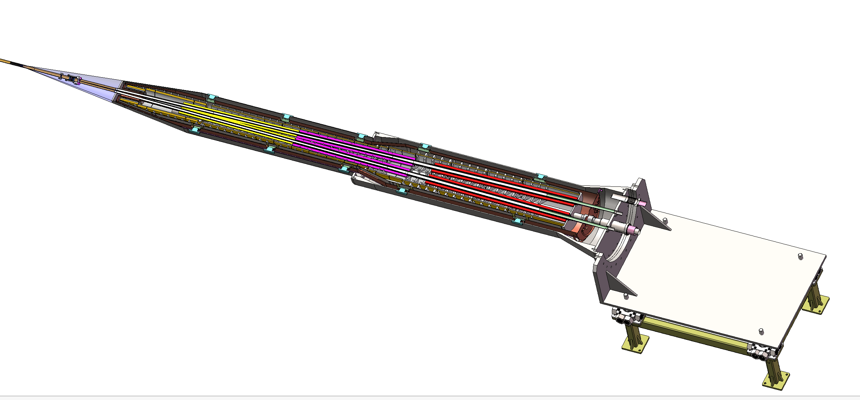
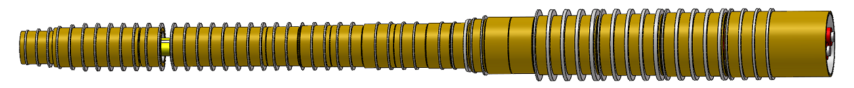
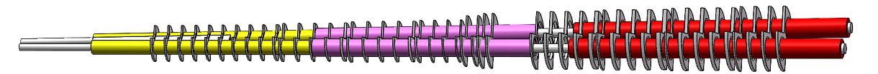
Structural design of the cryostat
Support of SC magnet
The superconducting magnets Q1a,Q1b and Q2 are supported on the inner wall of the solenoid.
The anti-solenoid is supported by a ring on the inner wall of the helium tank.
Vacuum
Thermal shield
1985mm
LHe tank
1915mm
Support
Anti-solenoid
2885mm
Anti-solenoid
Q1a
Beam chamber
Q1a
Q1b
Q2
Notes:
标注尺寸

Slide 9
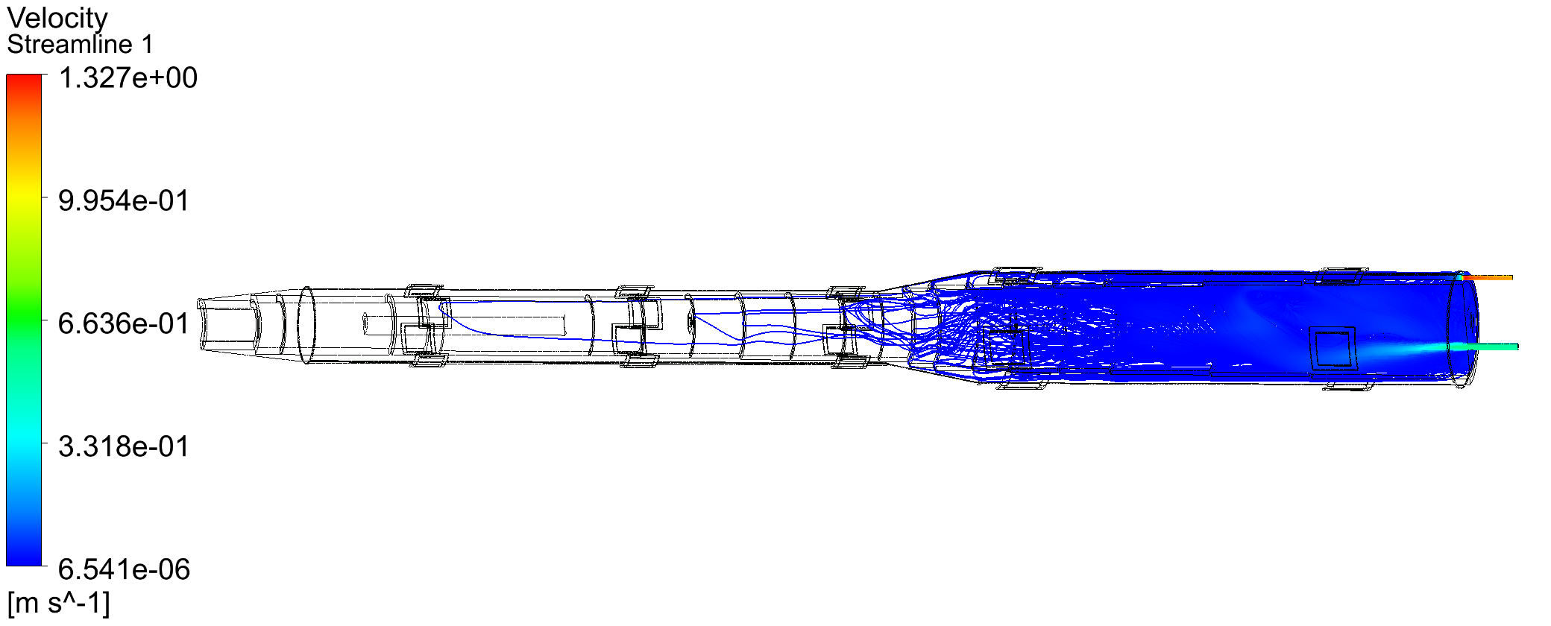
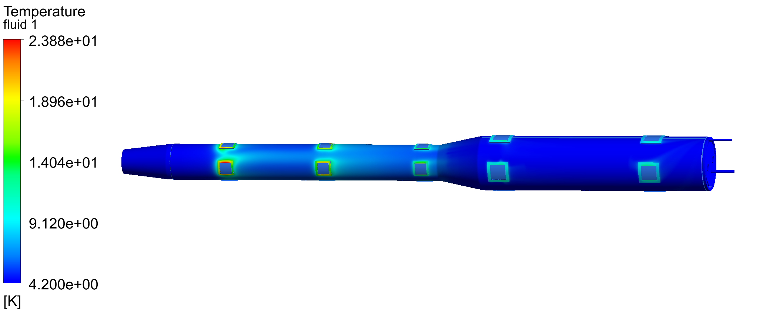
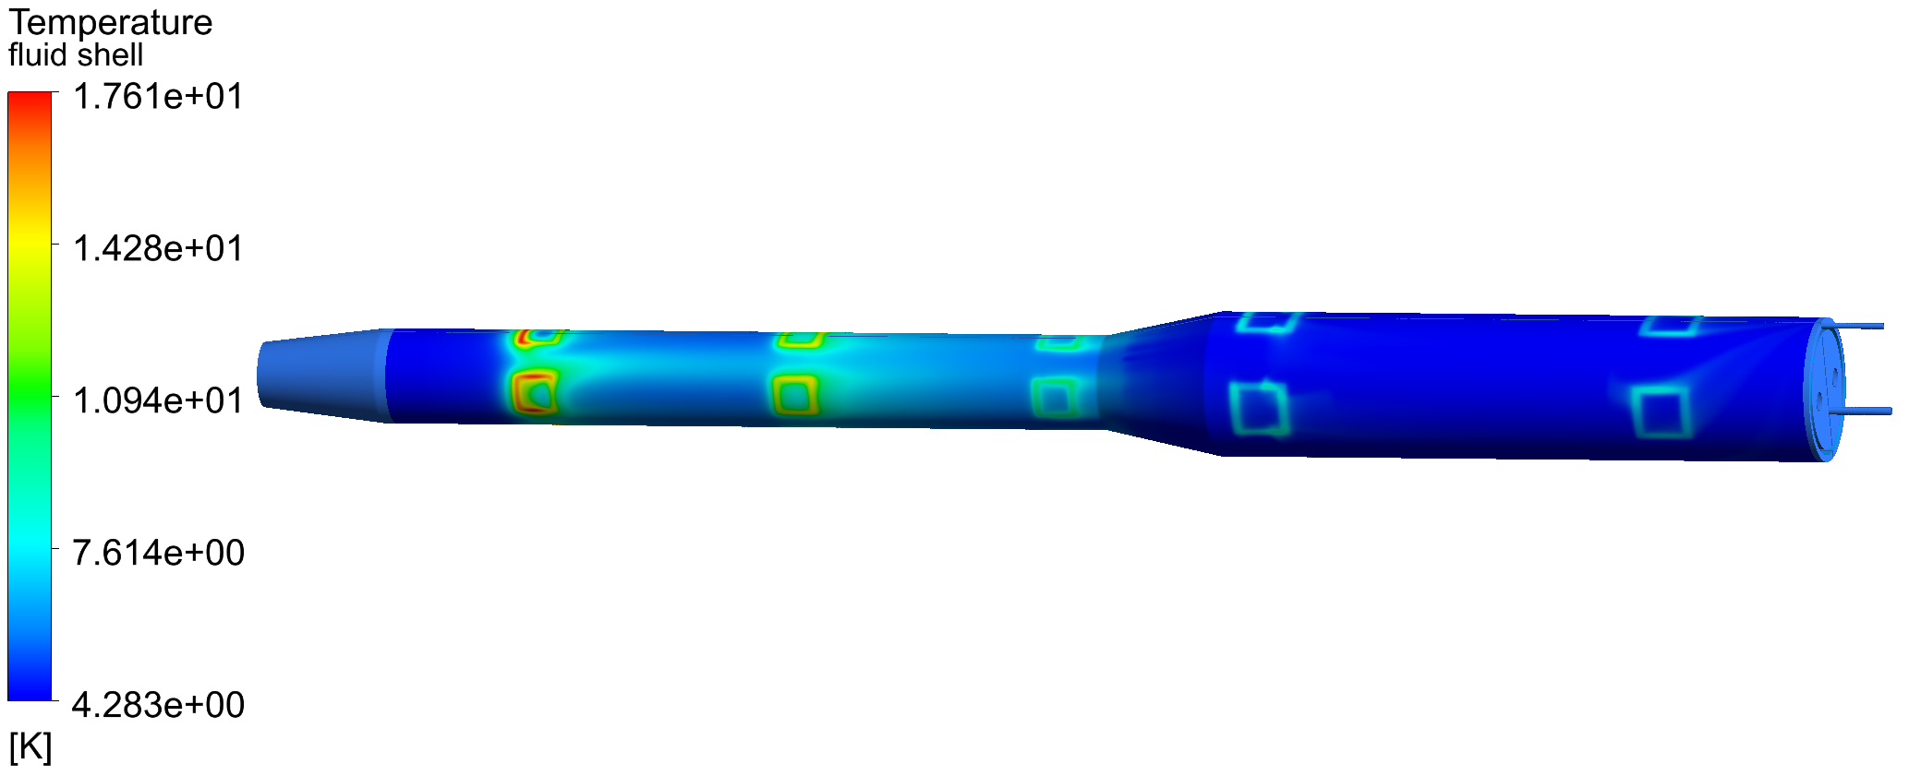
Calculation and simulation
Cooling of anti solenoid
Cooling flow: One-way in and out
Without considering the magnetic support structure:
Heat conduction of support is 13.68 W; Heat flux of thermal radiation is 0.1 W/m²;
Helium inlet flow is 3.0 bar@4.2 K.
outlet
inlet
Outer cylinder of helium tank
Not feasible！
Fluid domain

Slide 10
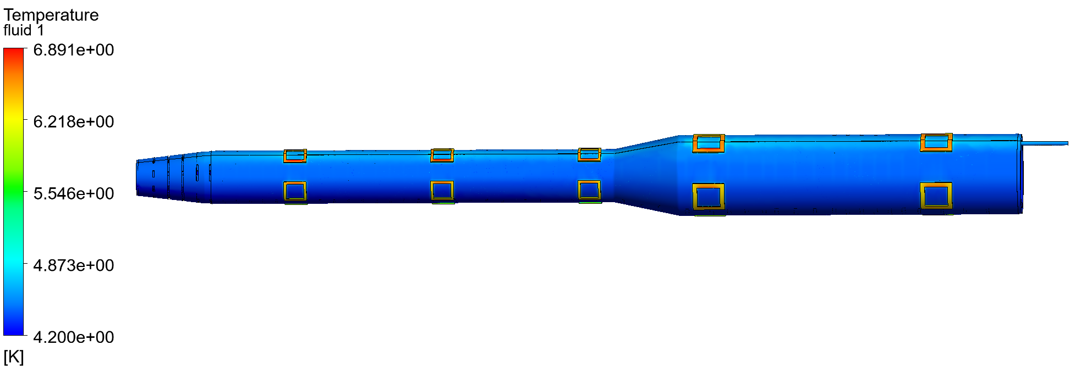
Calculation and simulation
Cooling of anti solenoid
Cooling flow: Outer single-layer flow channel ：
inlet
outlet
Temperature distribution of the outer cylinder of the helium tank: 3bar@4.2K 10g/s

Slide 11
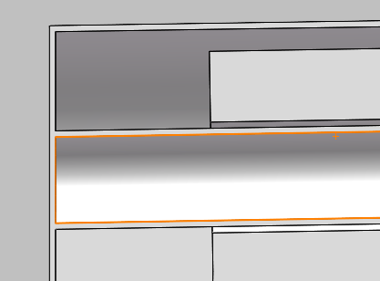
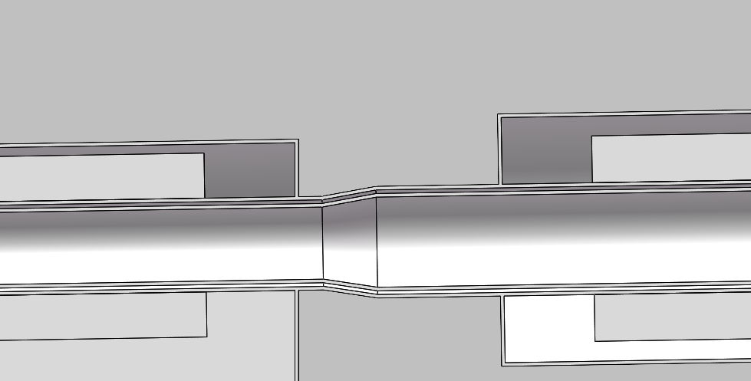
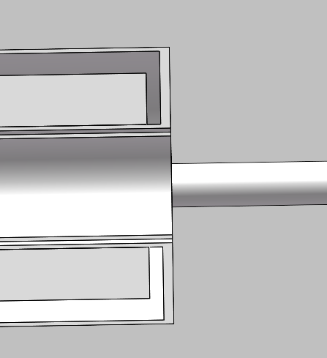
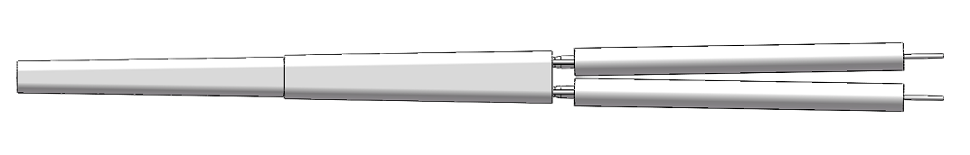
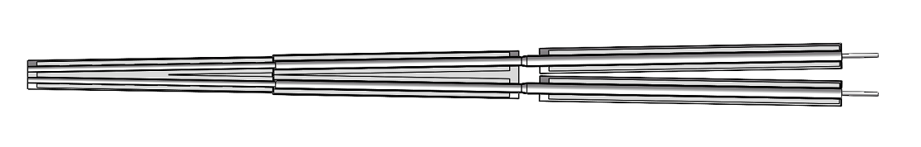

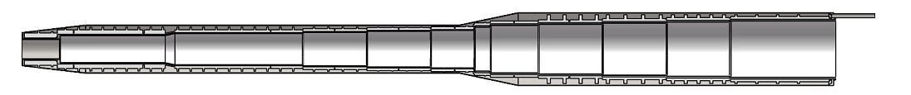
Calculation and simulation
Optimized helium channel
Inner and outer double flow channel design：
Quadrupole flow channel:
Minimum gap is 2mm
outlet
inlet
Anti-solenoid flow channel :
outlet
inlet
Minimum gap is 4mm

Slide 12
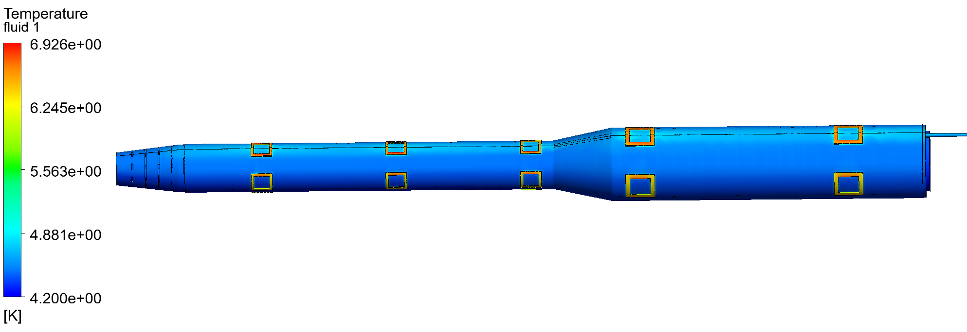
Calculation and simulation
Cooling of anti solenoid
Comparison of single-layer and double-layers cooling channels ：
outlet
inlet
A double-layers flow channel is more effective for cooling superconducting magnets compared to a single-layer flow channel, especially when the helium flow rate is low ；
Some other advantages, including the heat management, quench recovery or magnet cooling time.

Slide 13
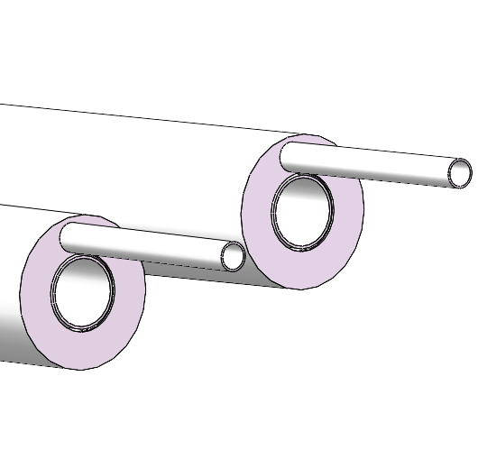
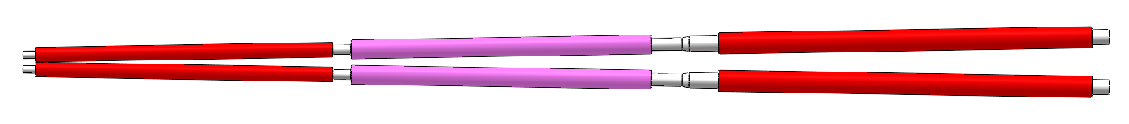
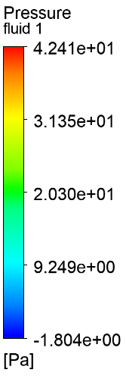
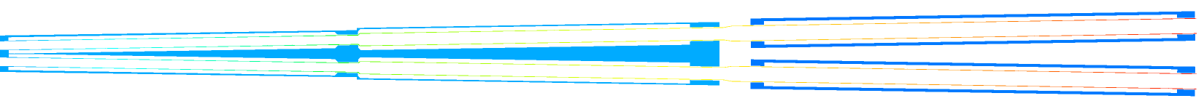
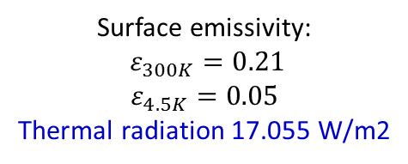
Calculation and simulation
Cooling of quadrupole coils
Q1-A
Q1-B
Q2
Surface emissivity:
$ε_{300K}=0.21$
$$ε_{4.5K}=0.05$$
Thermal radiation 17.055 W/m2
Thermal radiation 0.2 W/m2
Thermal radiation 0.2 W/m2
Helium flows into the inner channel and out from the outer channel.
Inlet helium state:
3.0bar@4.5K
(Supercritical helium)
Fluid pressure difference diagram (Inlet flow rate 10g/s)

Slide 14
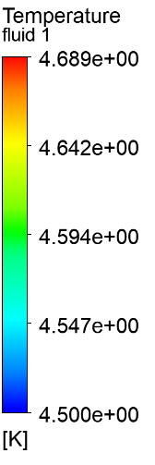

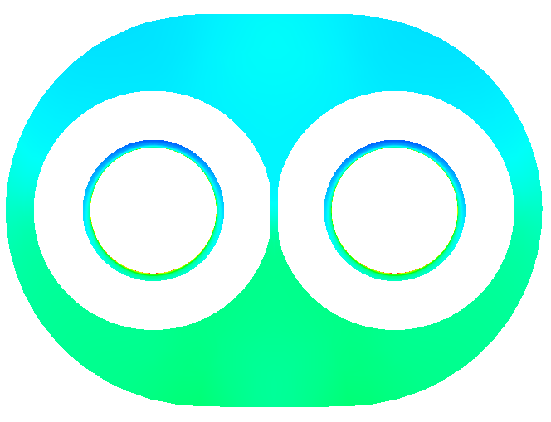



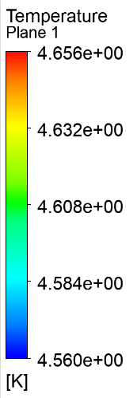

Calculation and simulation
Cooling of quadrupole coils
Inlet flow rate 10g/s, 3.0bar@4.5K
Helium fluid is heated in the inner channel.
The temperature of the fluid in the inner channel varies greatly near Q1-A
X
x=2.500 m
x=0.060 m
x=1.250 m
x=1.400 m
Temperature distribution of helium fluid
x=3.500 m

Slide 15
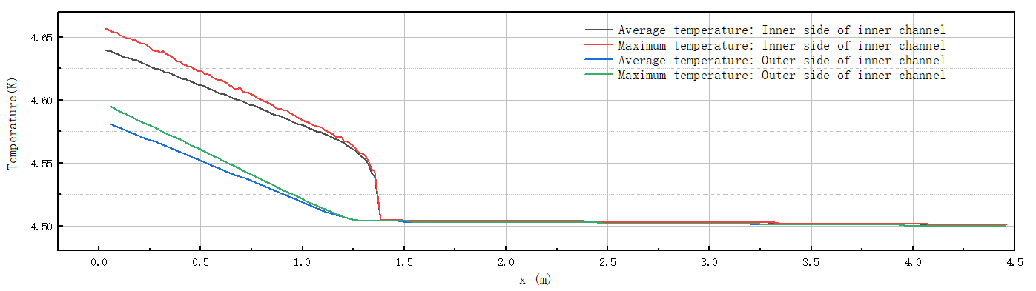
Calculation and simulation
Cooling of quadrupole coils
Inlet flow rate 10g/s, 3.0bar@4.5K
Temperature distribution inside the inner channel
Temperature distribution on the outer side of the inner channel
X
The temperature of 10g/s subcooled helium increases by about 0.04K, after passing through Q2 and Q1-B.
When subcooled helium flows through Q1-A, its temperature risesrapidly, with a gradually increasing temperature difference at the same X position.

Slide 16
Calculation and simulation
Cooling of quadrupole coils
The static thermal radiation of a quadrupole focusing magnet is constant.
The higher the flow rate, the lower the temperature of the Q1-A magnet.
The flow rate of subcooled helium is determined based on the temperature of the magnet.

Slide 17
Calculation and simulation
Possible Improvement
Application cases of large flow forced flow cooling ---- supercritical helium cycle pump:
The electron-proton collider HERA at the electron synchrotron laboratory (DESY) in Hamburg, Germany, uses a 45g/s helium circulating pump. （DESY）
The Atlas-LHC at CERN in Geneva, Switzerland, uses two 600g/s helium circulation pumps and two 1.2Kg/s helium circulation pumps.
The Superconducting magnet Test Facility at the Atomic Energy Research Institute of Japan.
TOSKA at the Institute of Technical Physics at the Karlsruhe Research Center in Germany.
Refrigerator
Refrigerator
helium circulating pump
LHe
LHe
SC Magnet
SC Magnet
Conventional helium cooling mode
Helium circulation cooling mode

Slide 18
Calculation and simulation
Subcooled LHe Circulation
A tank is used to control the pressure.
The flow rate can be improved largely.
Temperature distribution can be more uniform.
The system is complicated.

Slide 19
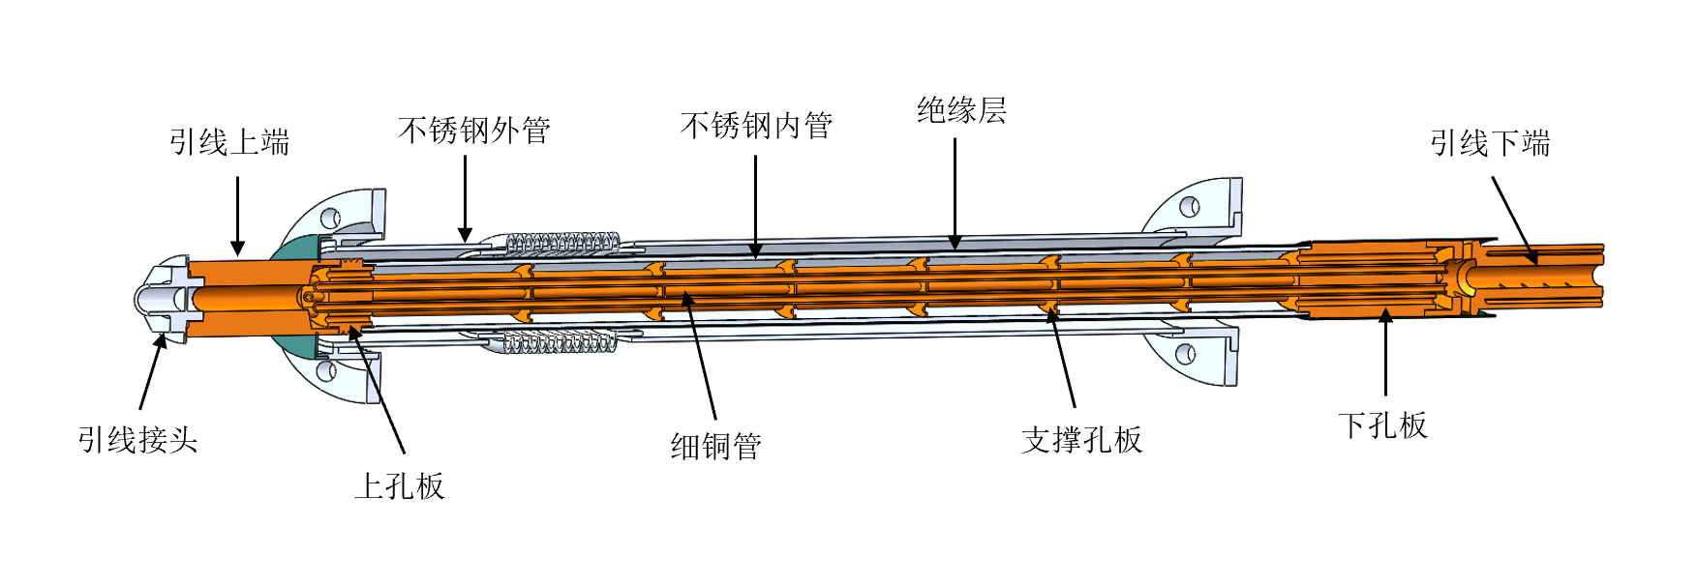
Current leads design
CEPC superconducting inserted quadrupole magnets need to develop 2 kA level current leads;
The traditional pure copper leads are not easy to meet the requirements, and the current feasible solution is to use binary current leads based on high-temperature superconductivity;
The superconducting wire welding resistance optimization, safe protection and low-temperature insulation and other issues are considered;
Current lead in BEPC2
Current lead in KIT

Slide 20
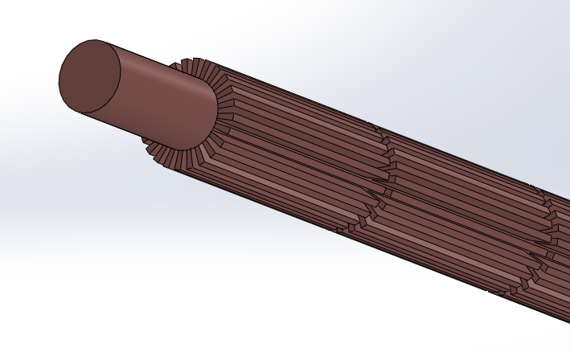
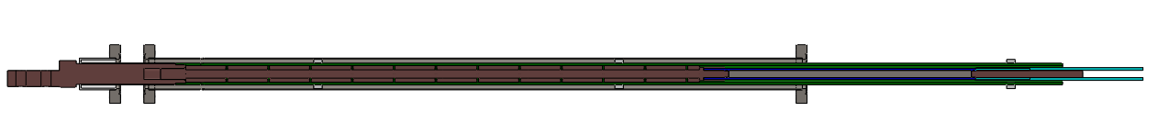
Current leads design
Supercooled LHe Circulation
HTS current lead
高纯无氧铜
高温超导+分流器
低温超导
2KA HTS current lead cooled by helium gas
New heat exchanging method
Current leads cooled by liquid nitrogen or helium are designed based on Bi-2223 high-temperature superconductor and high-purity copper;
With the help of numerical simulation, for the cooling of the copper section is designed; An enhanced heat transfer scheme is proposed；
To study the condensation and frosting problems prevalent in current current leads, and explore the inherent frost-free properties of the leads in future;
Research on the design of various cooling sources, such as conduction cooling, low-temperature helium cooling, liquid nitrogen cooling and other methods.

Slide 21
Summary
Design status of cryomodule:
The cryostat has been updated as the optimization of the SC magnets.
Supercritical/ Subcooled liquid helium is used as the cold source.
Double cooling channels of SC magnets can be used, if the mechanical space is allowed.
A subcooled LHe circulation is designed, which can increase the flow rate largely.
Current lead and cryogenic system is designed initially;
Works to be done:
Optimization of the cryostat;
Thermal and mechanical analysis; (quench protection, energy storage , supports )
Current lead design；
Measurement requirements; (temperature/pressure/BPM)
Initial consideration of processing and manufacturing technology;

Slide 22
EDR plan
EDR plan for MDI SC cryostat:
2024:
Update the design of the cryomodule
Thermal and mechanical analysis of the structure
Optimization of heat and mass transfer of the helium
Design of current leads
2025:
PI＆D scheme determination
Assembly process design and alignment considerations
2026:
Machine-finishing technological design
Cryogenic performance test of critical component

Slide 23
Thanks for your attention!

