Slide 1
ECAL Update
2023/07/12
Speaker : Jiaxuan Wang

Slide 2
Motivation
MIP most probable value in cosmic ray test is greater than that of test beam data
10 um
15 um

Slide 3
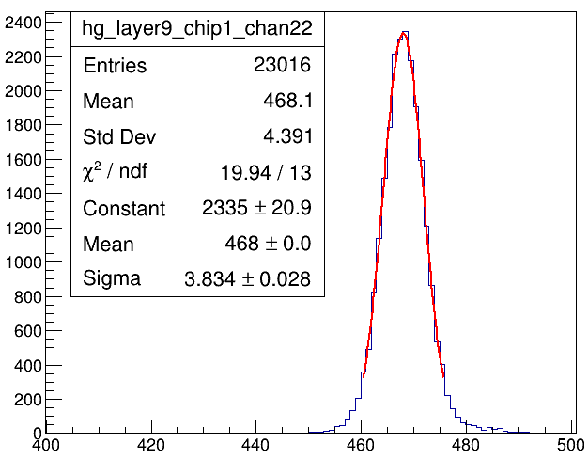
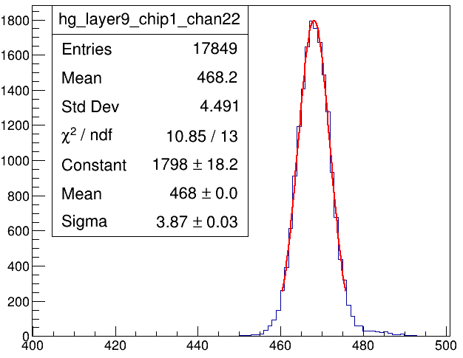
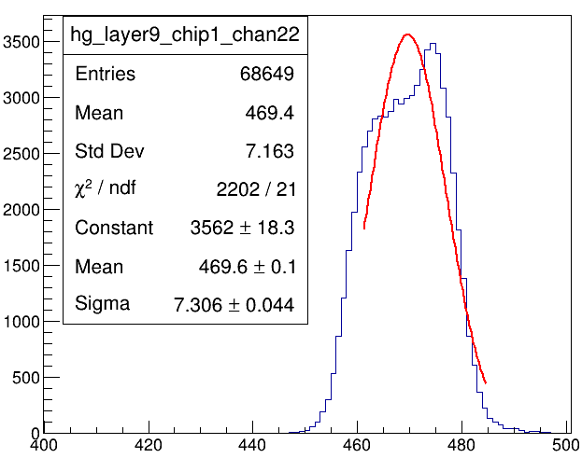
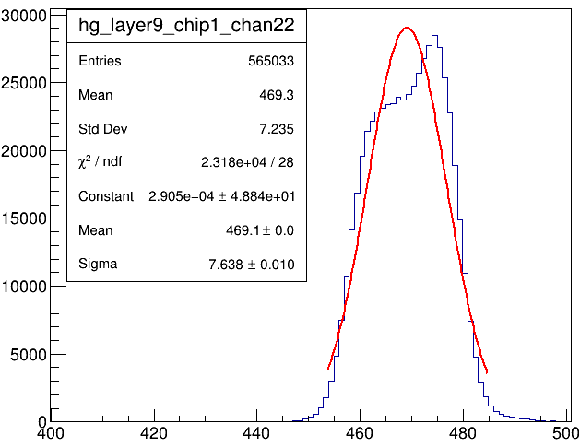
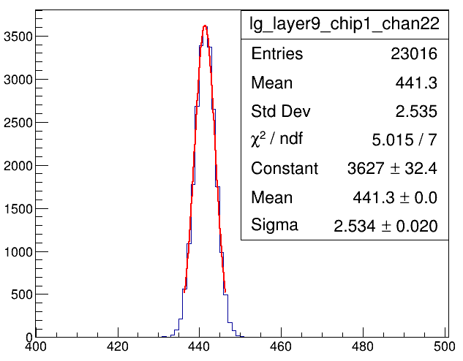
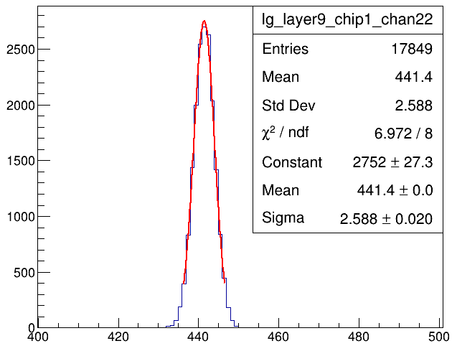
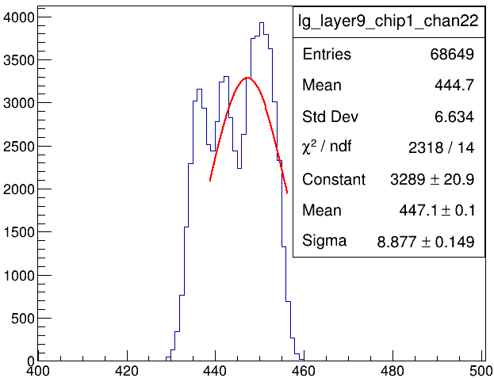
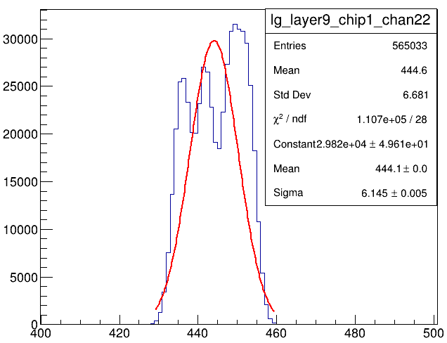
Pedestal
Pedestal from Force-mode file, muon file, electron file
Force mode 0428
Force mode 0503
100GeV mu-
40GeV e-
Force mode 0428
Force mode 0503
100GeV mu-
40GeV e-

Slide 4
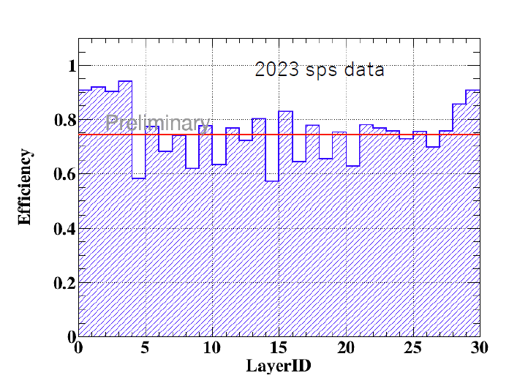
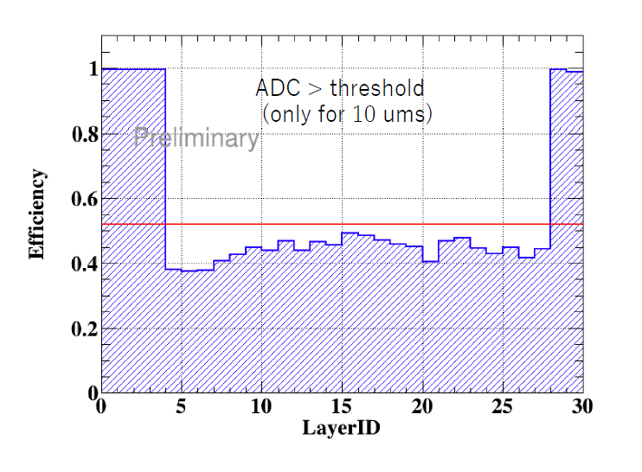
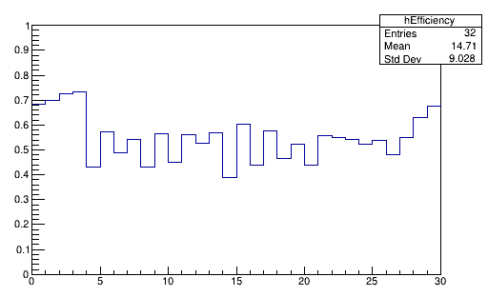
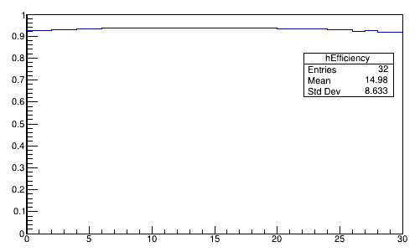
Efficiency
ADC > 0.8MIP

Slide 5
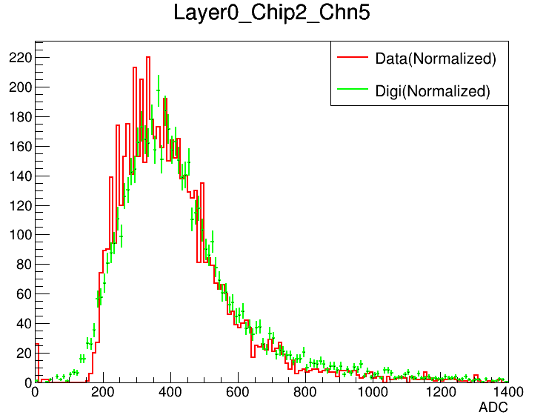
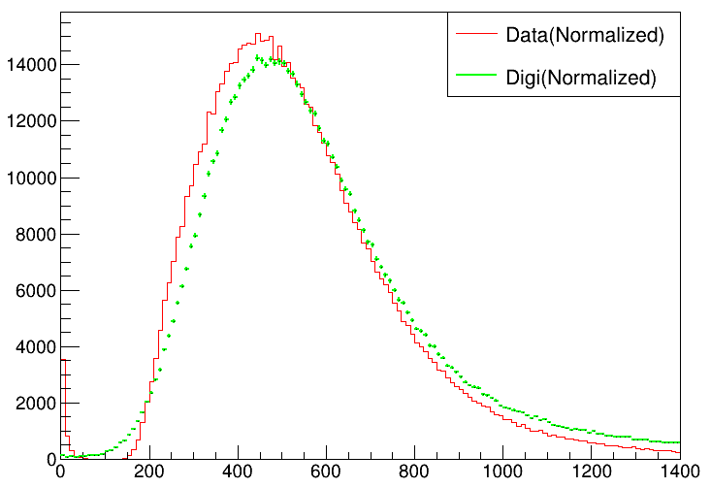
Comparison
Digi and Data muon file comparison
Layer 0 all channels
15 um
15 um

