Slide 1
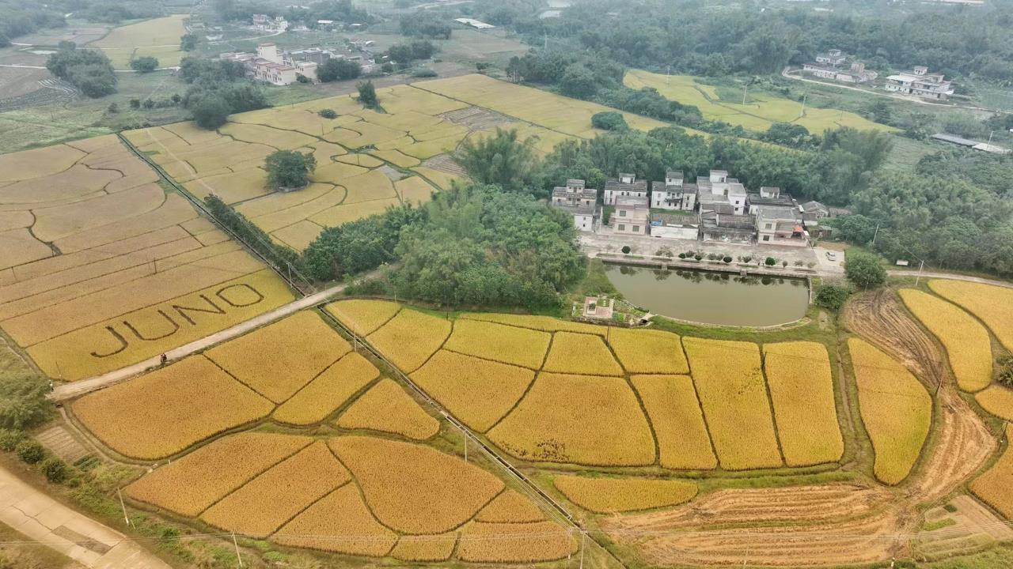
从大亚湾到江门
于泽源
高能物理研究所
2024-07-07

Slide 2
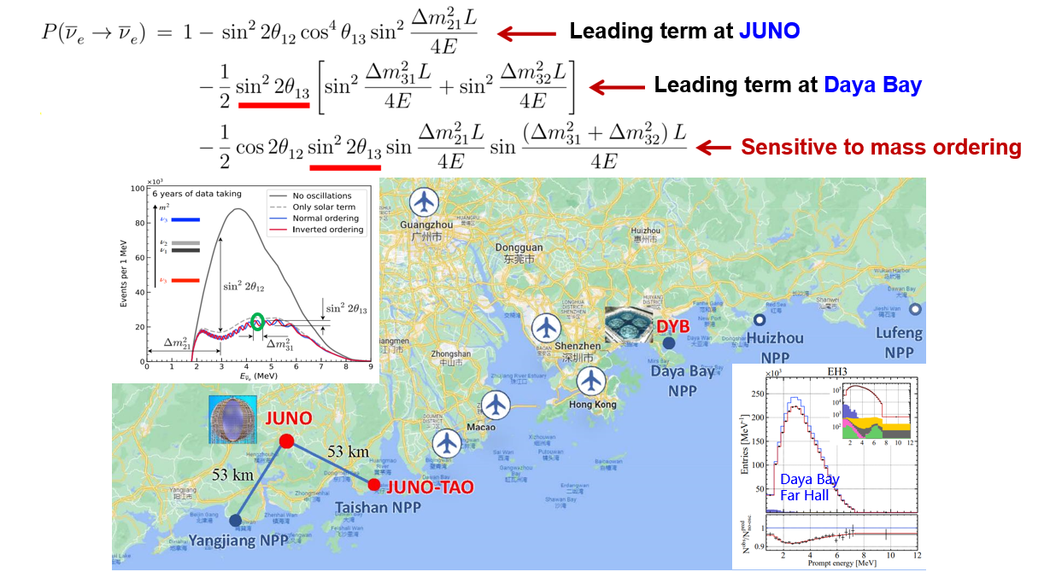
反应堆中微子振荡

Slide 3
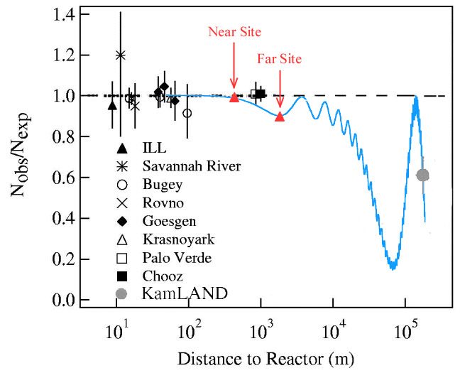
反应堆中微子振荡
JUNO

Slide 4
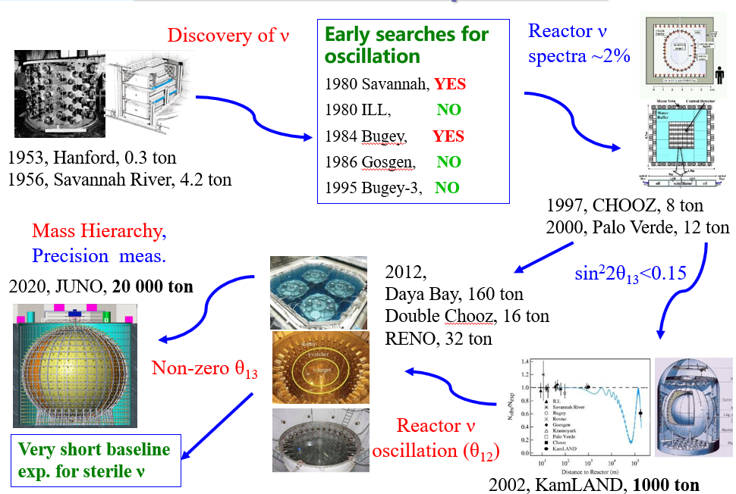
反应堆中微子实验

Slide 5
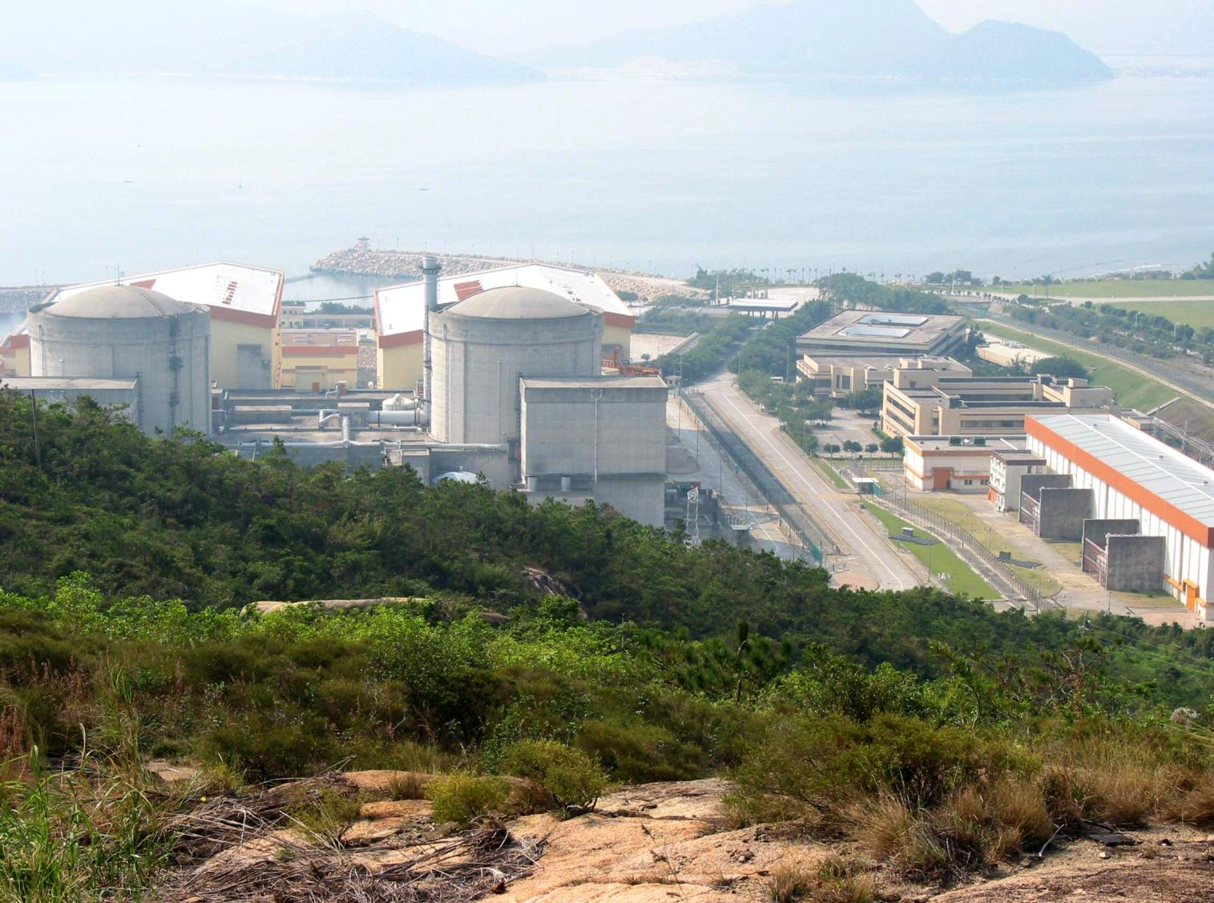
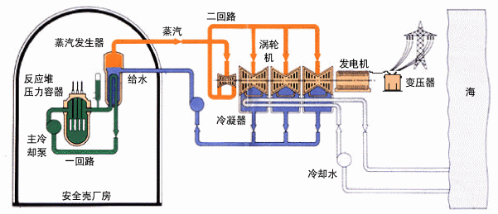
反应堆中微子哪里来的
绝大部分商用反应堆为压水堆或沸水堆，两者原理相同
电功率约为热功率的1/3。大亚湾：2.9 GW_{th}，900 MW_{e}→1080 MW_{e}

Slide 6
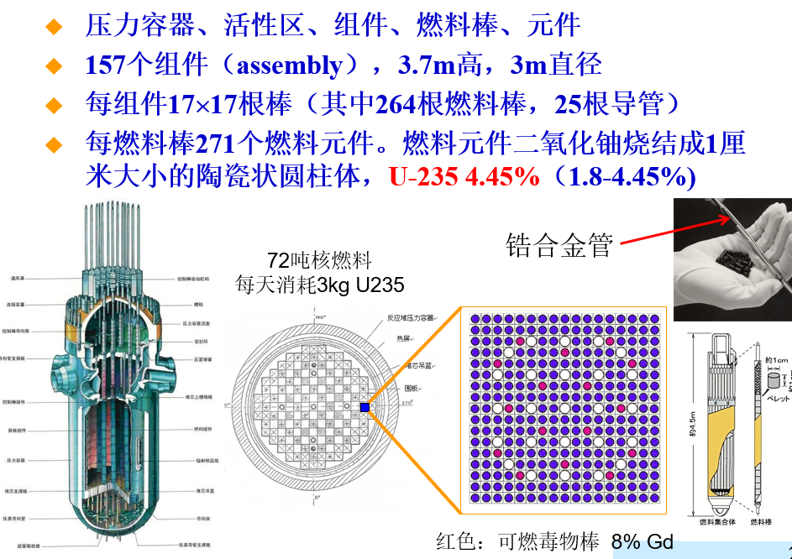
反应堆中微子哪里来的

Slide 7
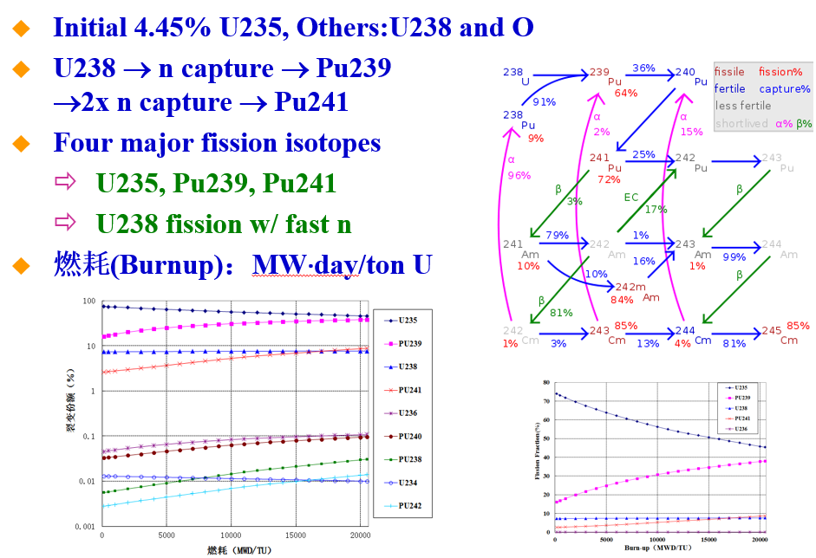
反应堆中微子哪里来的

Slide 8
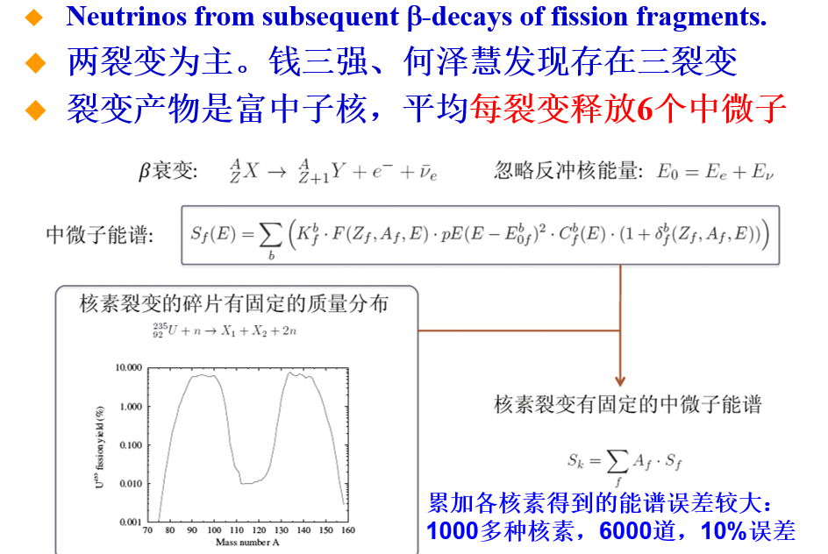
反应堆中微子哪里来的

Slide 9
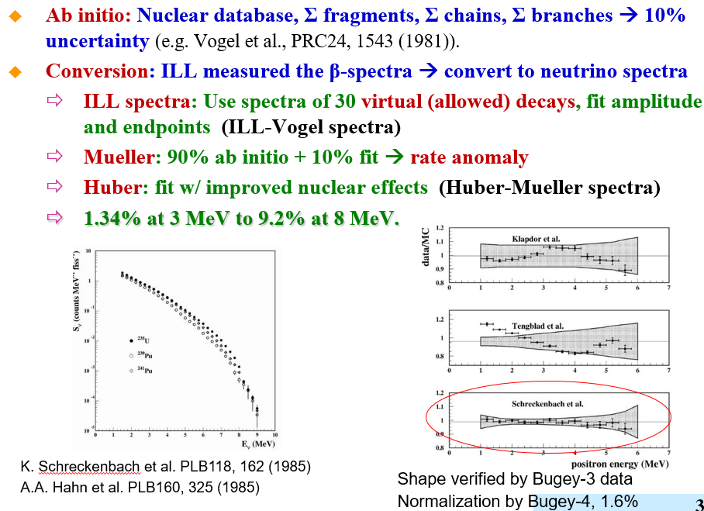
反应堆中微子哪里来的

Slide 10
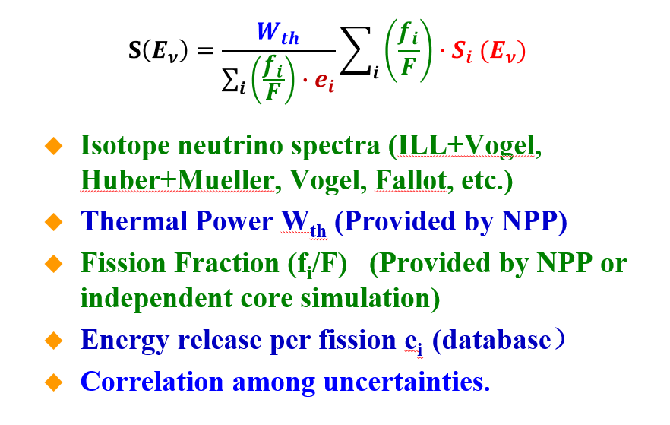
反应堆中微子能谱预期

Slide 11
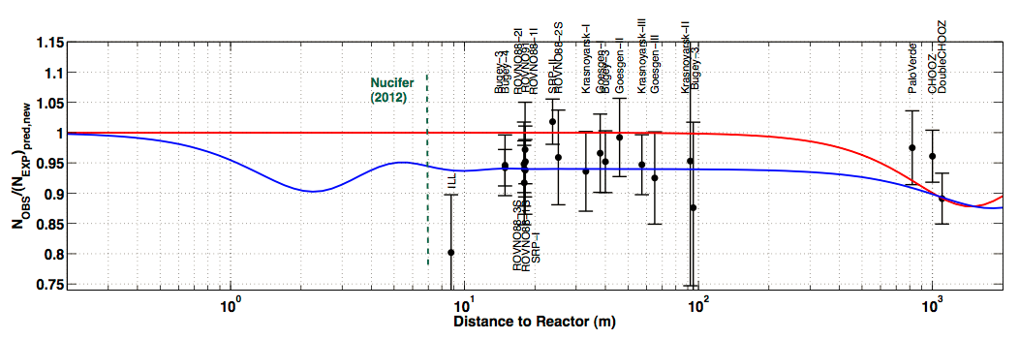
反应堆中微子能谱预期
2011年，Huber等人利用ILL实验测量的电子谱，重新计算了中微子流强和能谱，发现与实验测量有5%的不一致。Reactor rate anamoly
_{算错了？}
_{惰性中微子？}

Slide 12
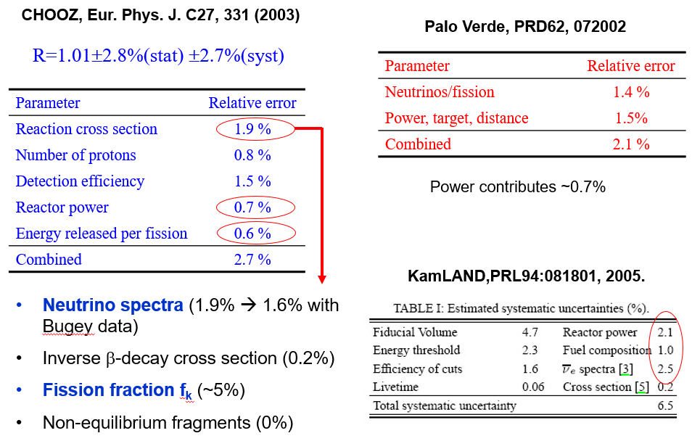
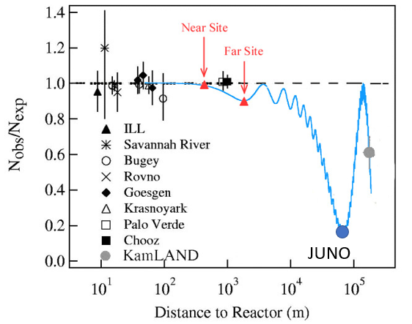
反应堆中微子能谱预期误差
中微子流强预期误差3%
_{如何精确测量反应堆中微子振荡？}

Slide 13
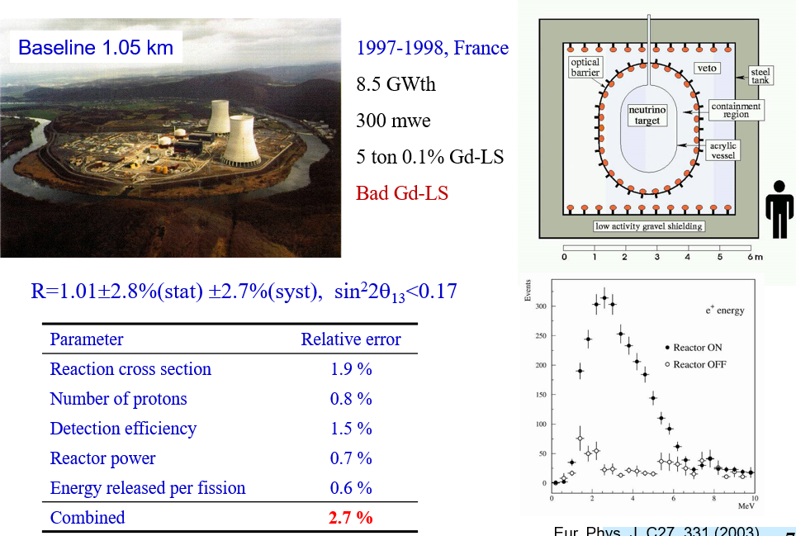
早期实验 Chooz

Slide 14
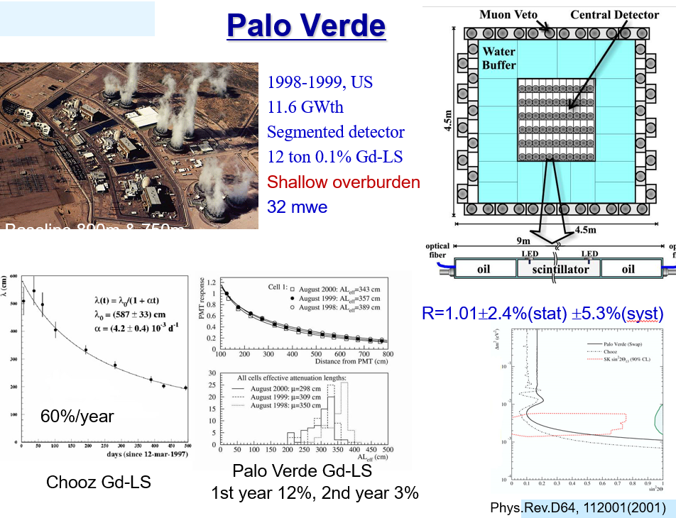
早期实验 Palo Verde

Slide 15
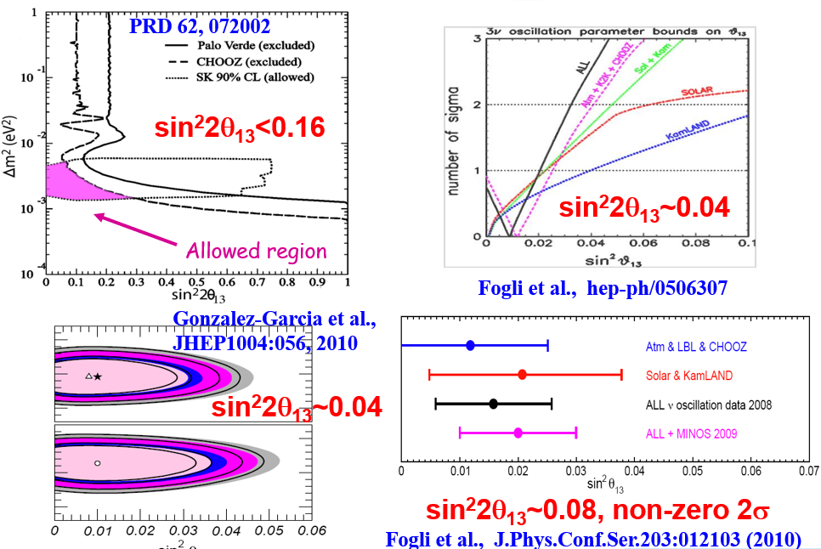
Θ₁₃到底多大？
中微子味混合矩阵长啥样？
轻子混合CP破坏多大，怎么测？

Slide 16
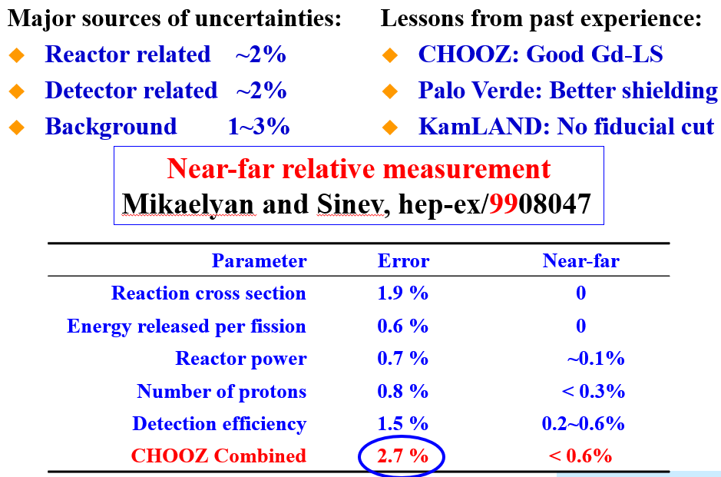
远近相对测量

Slide 17
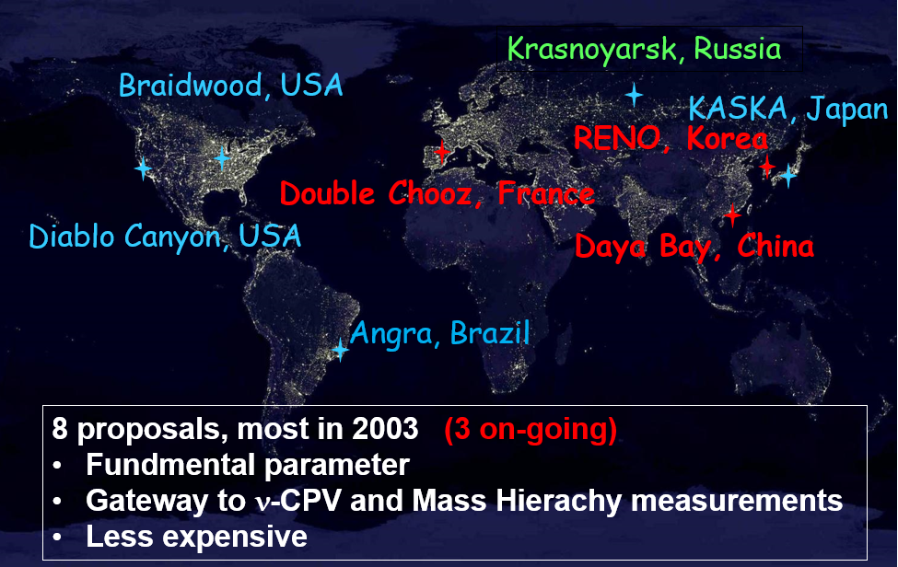
2003年开始
2005-2012年的故事很多人讲过了。
想听干活的小兵的参与故事可以举手

Slide 18
2003年开始
2005-2012年的故事很多人讲过了。
想听干活的小兵的参与故事可以举手
我们来讲精确测量

Slide 19
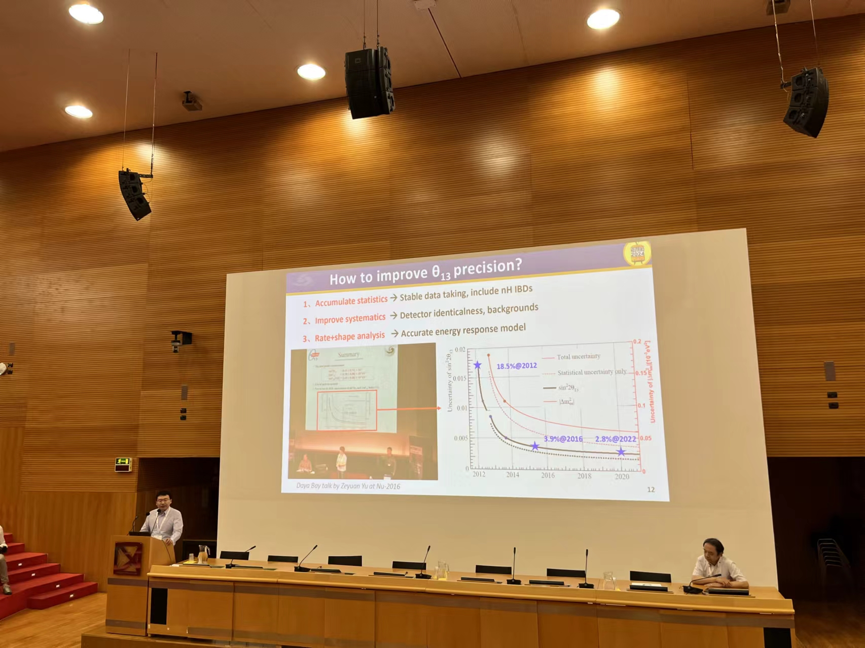
振荡参数精确测量
Neutrino 2024

Slide 20
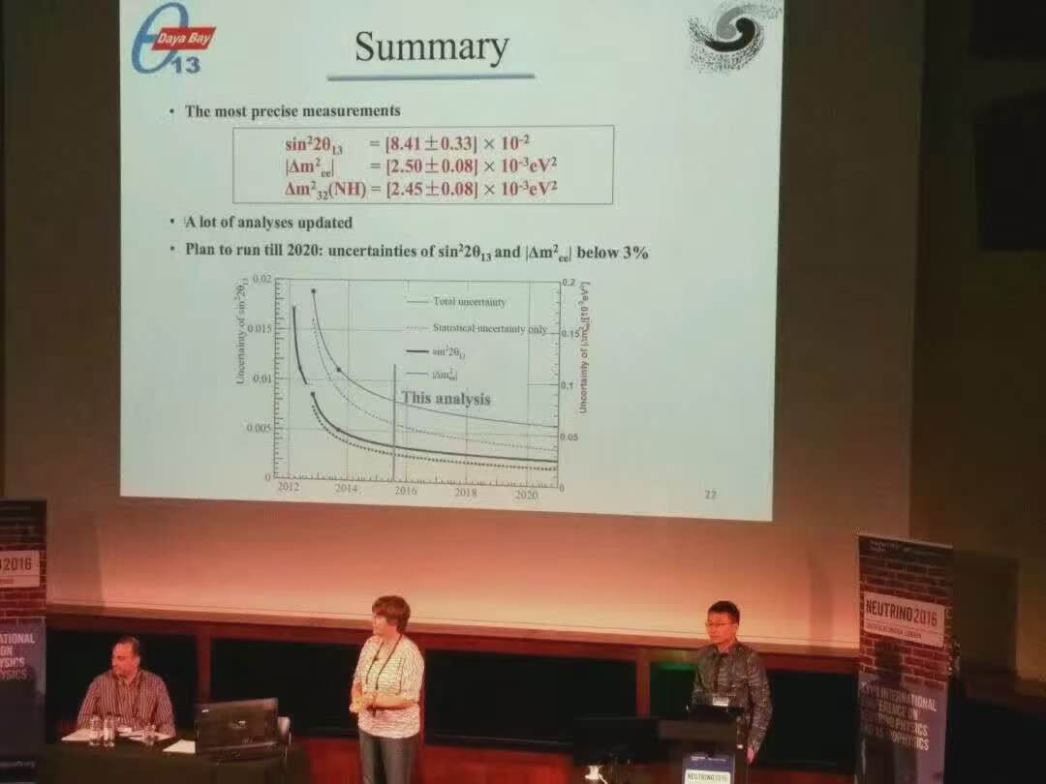
振荡参数精确测量
Neutrino 2016
Neutrino 2024

Slide 21
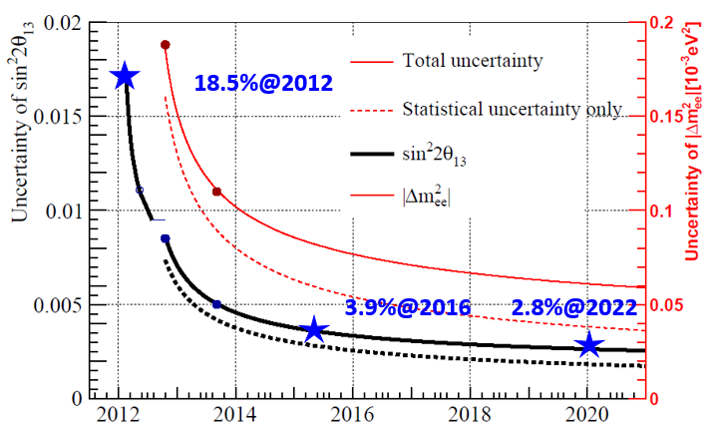
振荡参数精确测量
Neutrino 2016
Neutrino 2024

Slide 22
振荡参数精确测量
1、Accumulate statistics → Stable data taking, include nH IBDs
2、Improve systematics → Detector identicalness, backgrounds
3、Rate+shape analysis → Accurate energy response model
Three experiments have stopped data taking
Backgrounds and systematics well studied
Daya Bay Dec. 2011 to Dec. 2020, 3158 days
Double Chooz Apr. 2011 to Dec. 2017, ~1350 days
RENO Aug. 2011 to Mar. 2023, ~3800 days

Slide 23
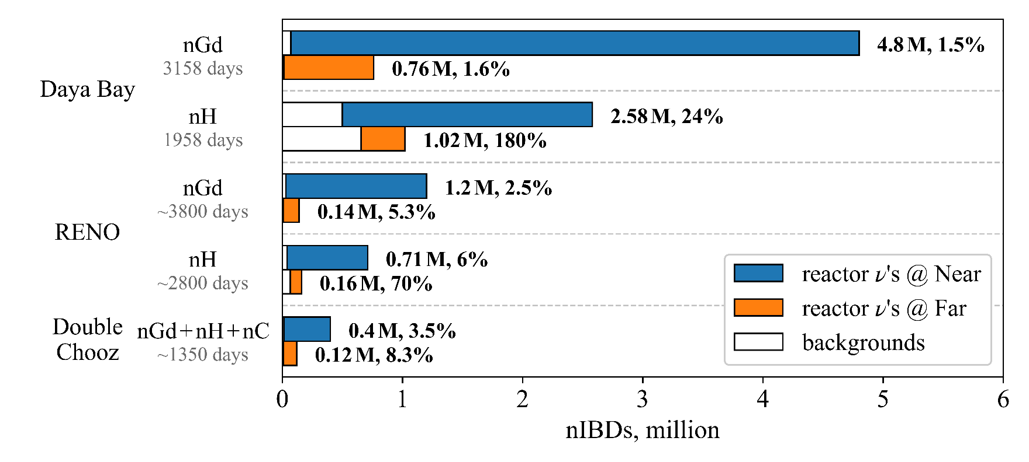
振荡参数精确测量
1、Accumulate statistics → Stable data taking, include nH IBDs
2、Improve systematics → Detector identicalness, backgrounds
3、Rate+shape analysis → Accurate energy response model
Three experiments have stopped data taking
Backgrounds and systematics well studied
Daya Bay Dec. 2011 to Dec. 2020, 3158 days
Double Chooz Apr. 2011 to Dec. 2017, ~1350 days
RENO Aug. 2011 to Mar. 2023, ~3800 days

Slide 24
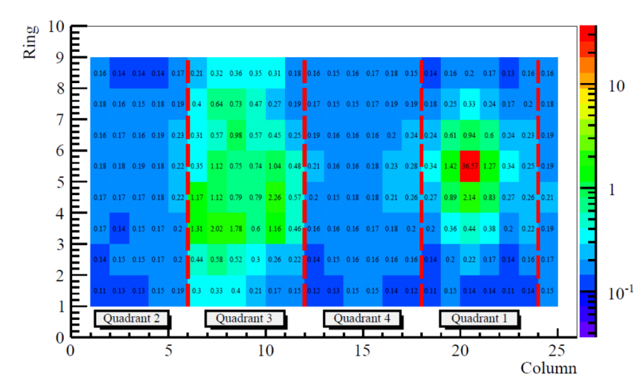
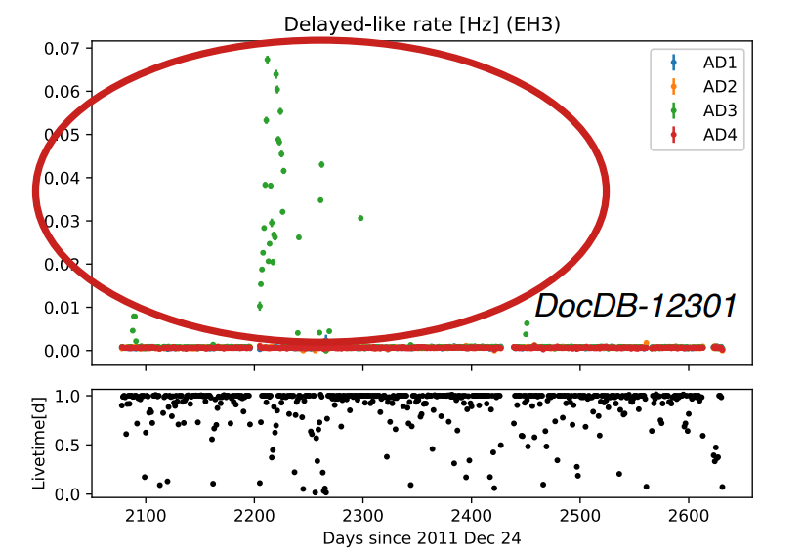
稳定高质量取数不易
2011年发现的PMT打火事例
运行到16年后，新出现打火事例
怎么办？

Slide 25
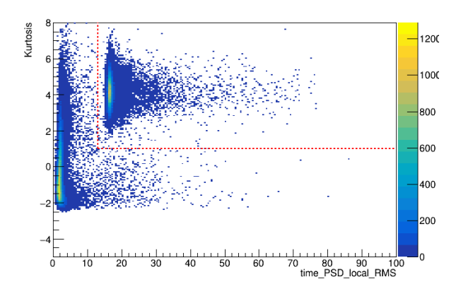
稳定高质量取数不易
美国人：把400多天的数据扔了
对应1000万的运行费
陈志源：去找一个新的鉴别量，把这个问题解决了

Slide 26
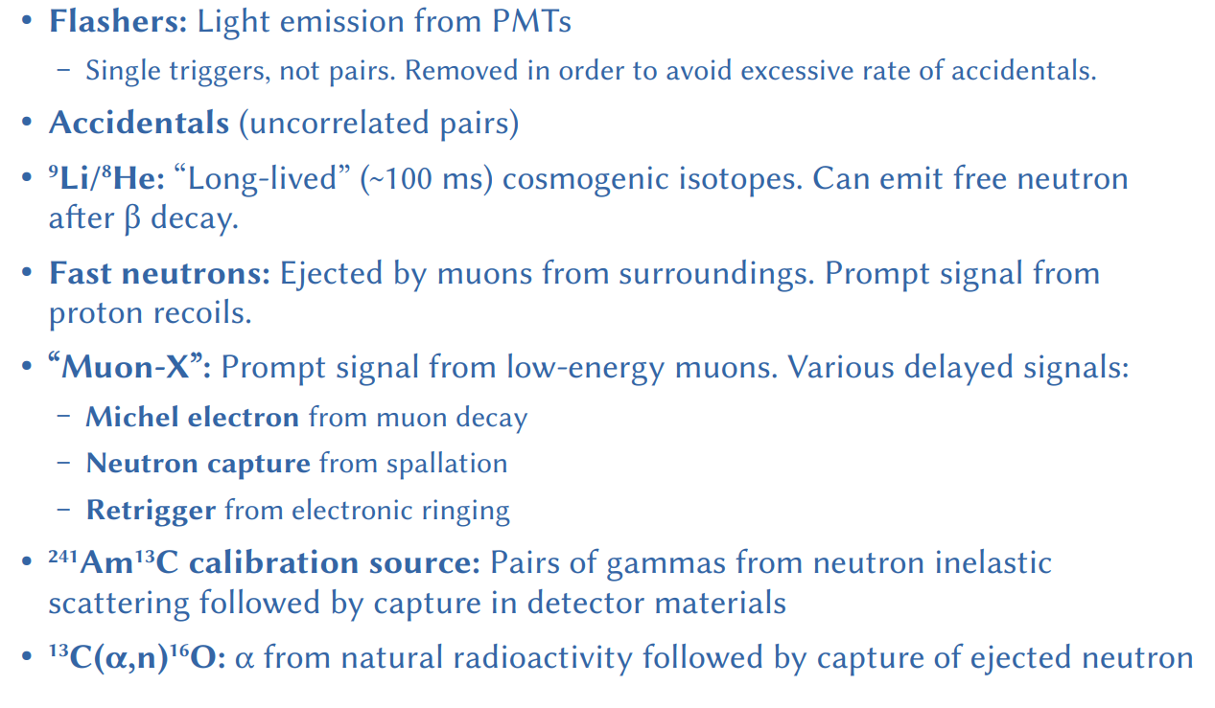
仔细研究本底

Slide 27
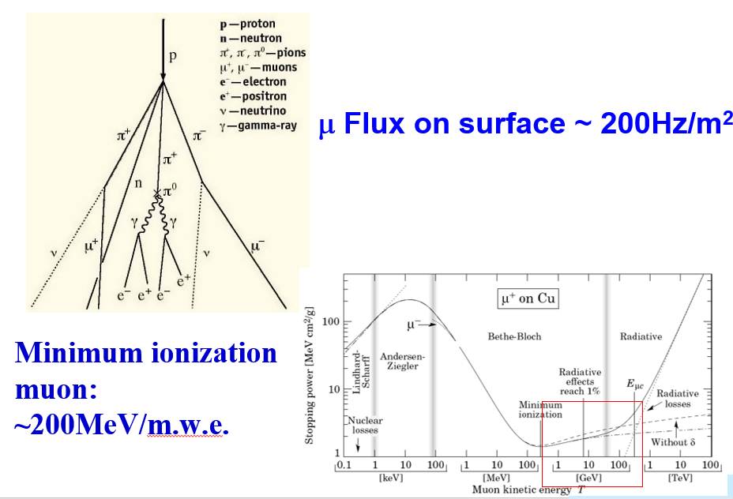
宇宙线缪子

Slide 28
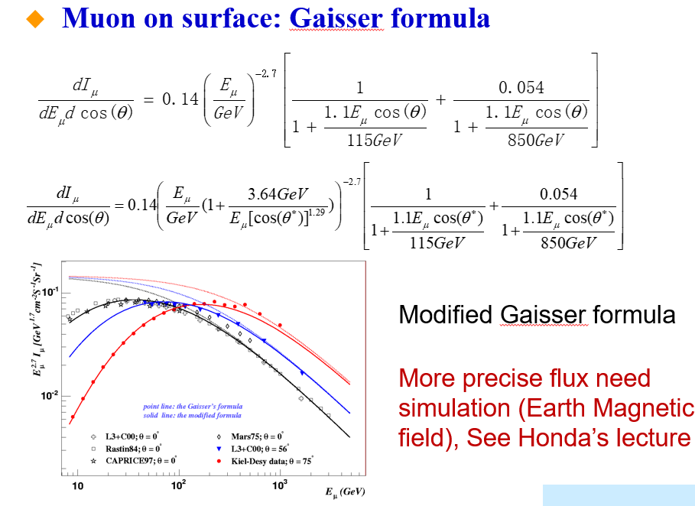
宇宙线缪子

Slide 29
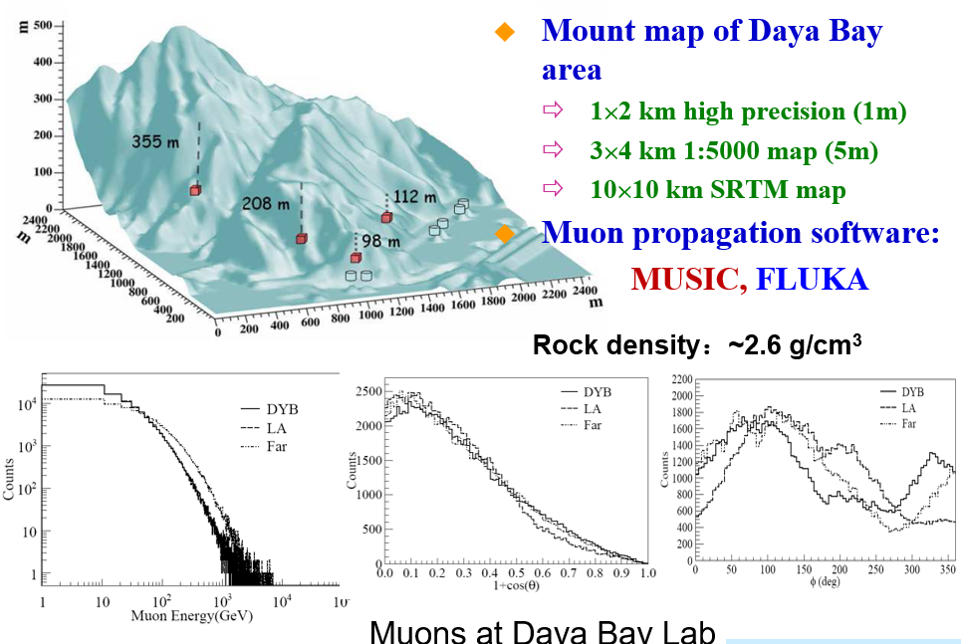
宇宙线缪子

Slide 30
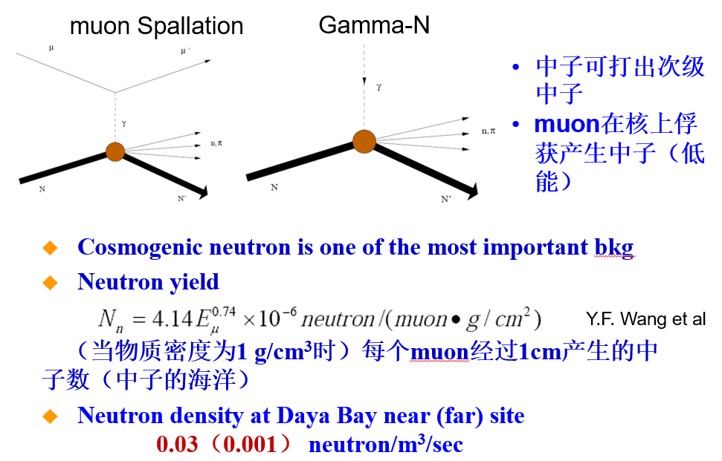
宇宙线缪子 穿过物质

Slide 31
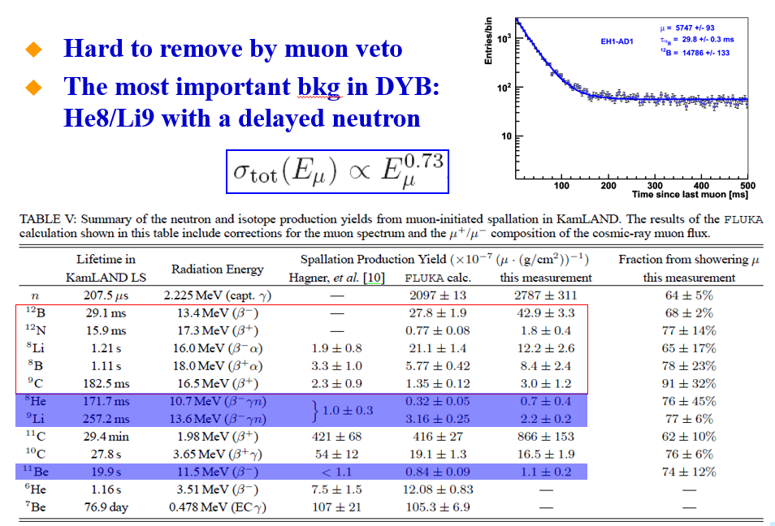
宇宙线缪子 穿过物质

Slide 32
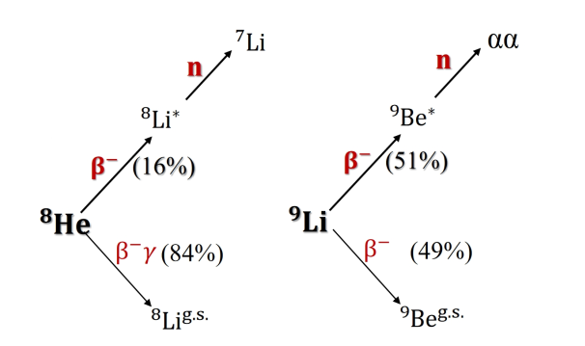
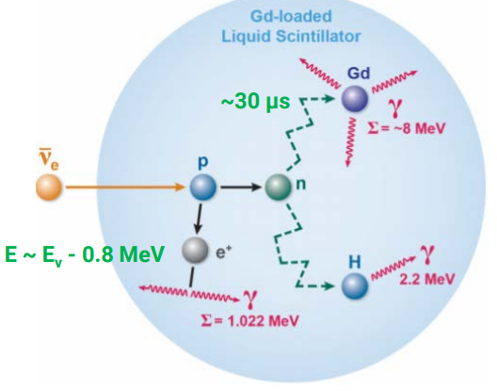
锂9 氦8
两个核素可以发生β+n衰变，完美的伪装成反中微子IBD
半衰期170ms和200ms，想完全排除掉的话，需要舍弃大量IBD

Slide 33
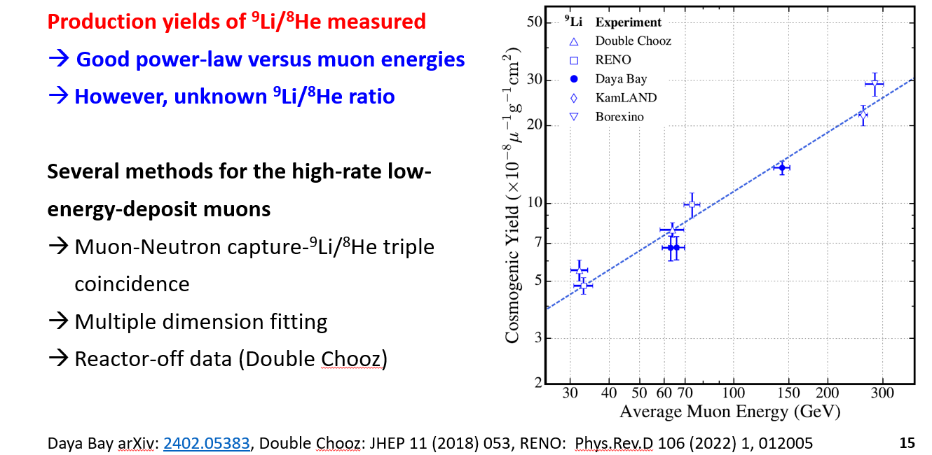
锂9 氦8 产额测量

Slide 34
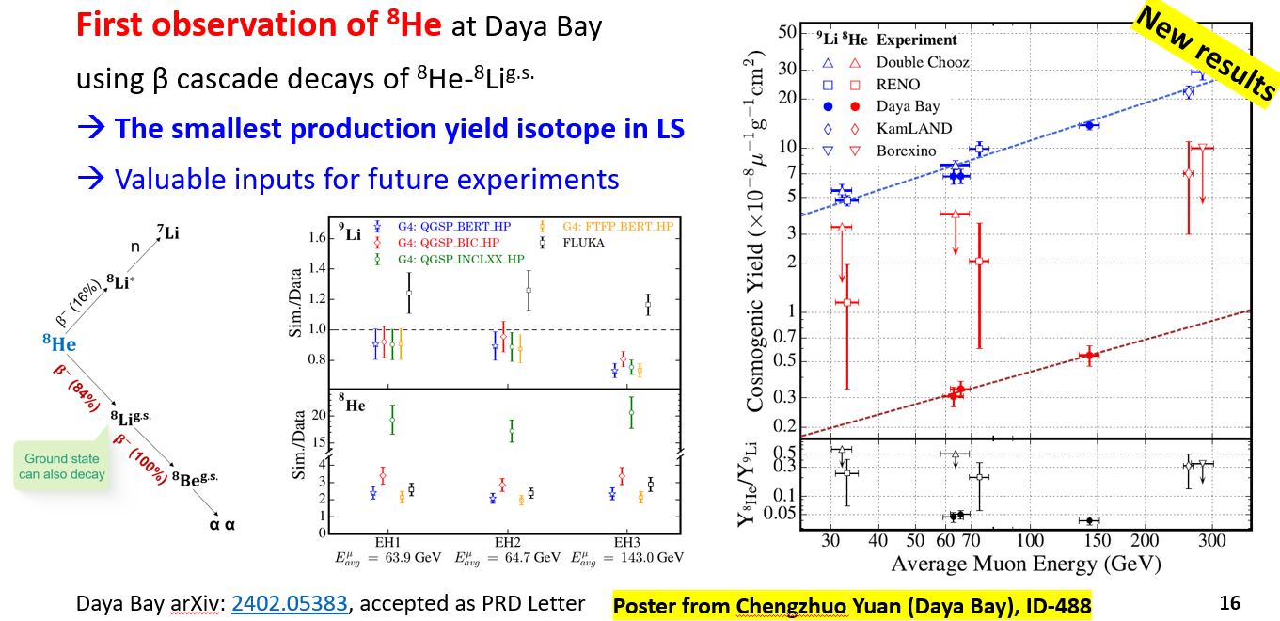
锂9 氦8 产额测量

Slide 35
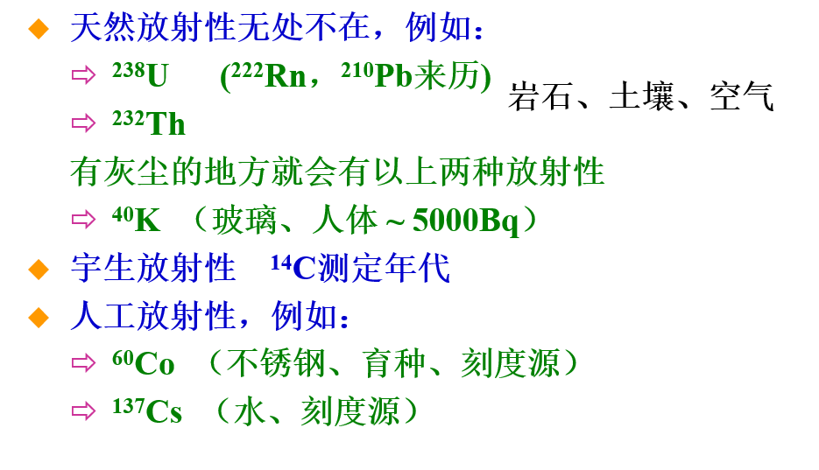
天然放射性

Slide 36
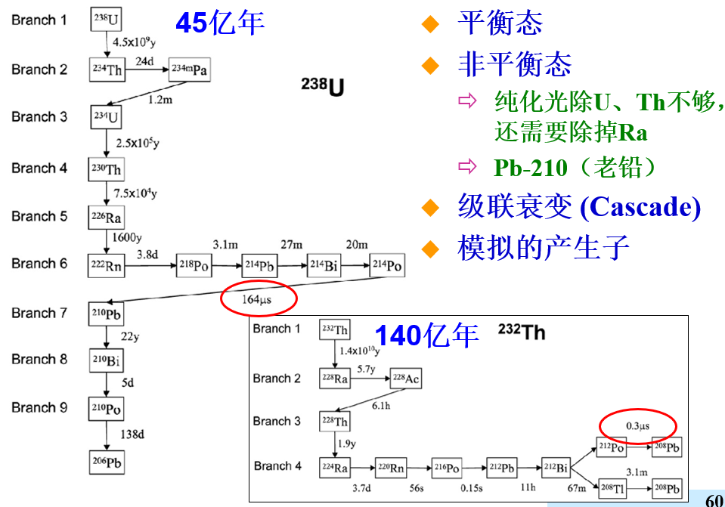
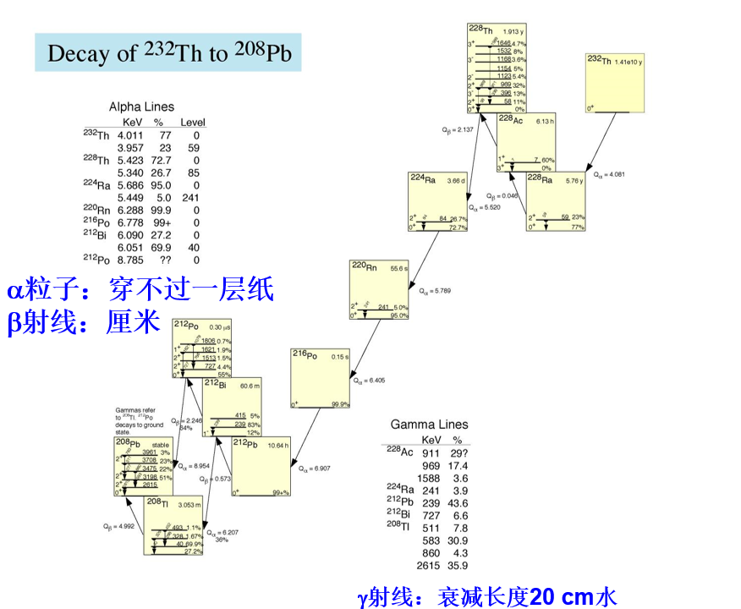
天然放射性

Slide 37
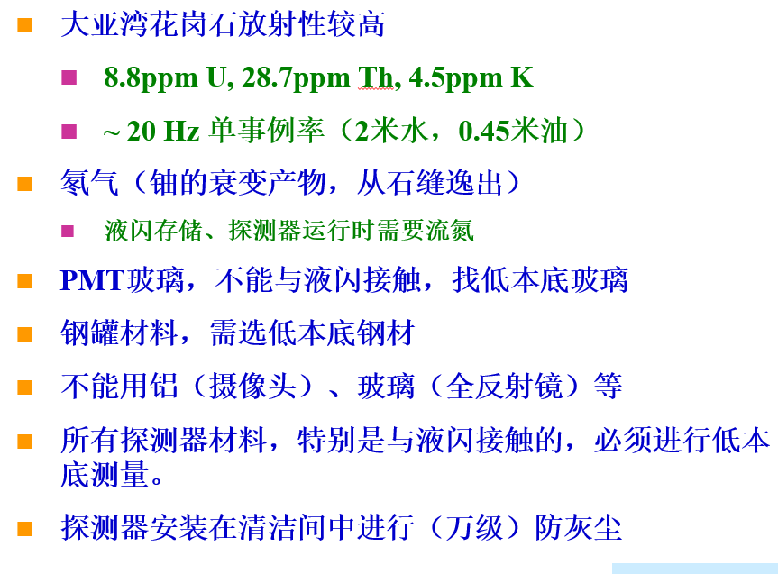
天然放射性
很多低本底实验，如果太阳中微子和暗物质实验，已经积累了大量经验。
有没有没注意到的？

Slide 38
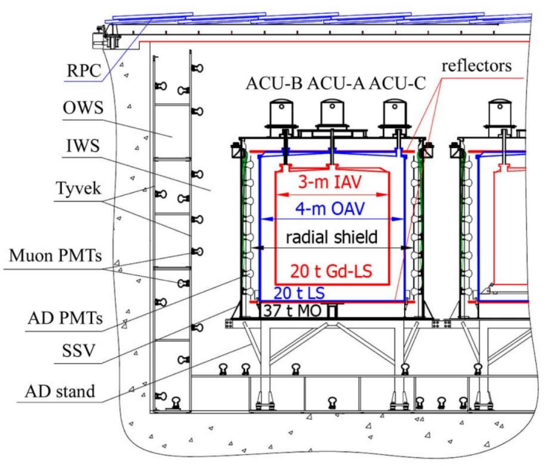
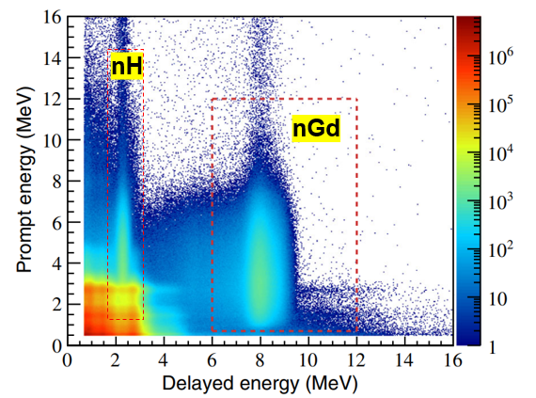
天然放射性
根据模拟，大亚湾实验探测器设计为3层
可以做nGd和nH振荡分析，但是

Slide 39
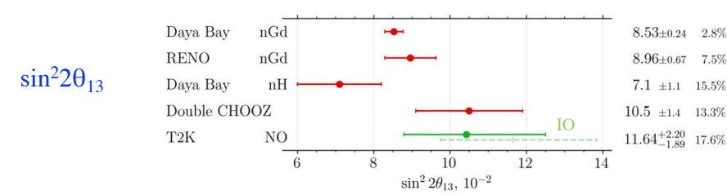
天然放射性
根据模拟，大亚湾实验探测器设计为3层
可以做nGd和nH振荡分析，但是
nH是一个unblind 分析，上一篇文章是2016年发表的
愁死了！！！

Slide 40
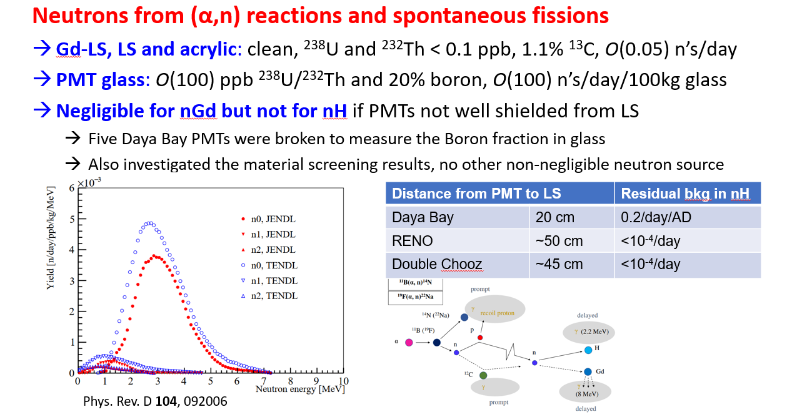
天然放射性

Slide 41
创新 1
多读文献，融会贯通
小目标是做到：让人听了一拍大腿，我怎么没想到？

Slide 42
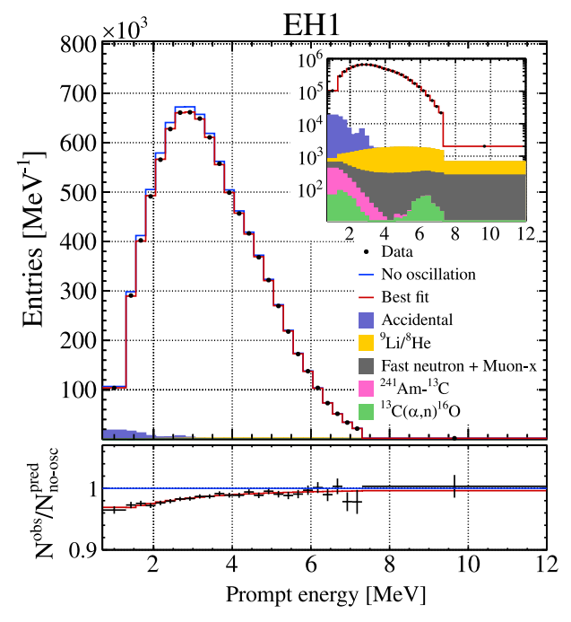
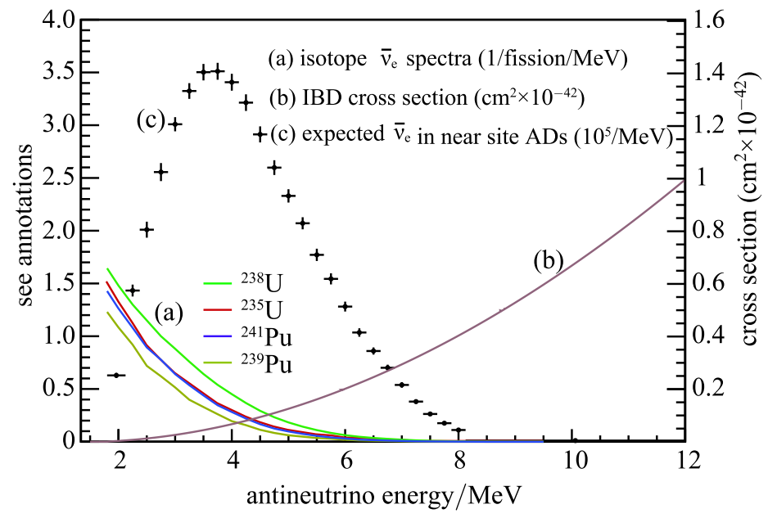
探测器响应
探测器给出的电信号，如何转为中微子能量？

Slide 43
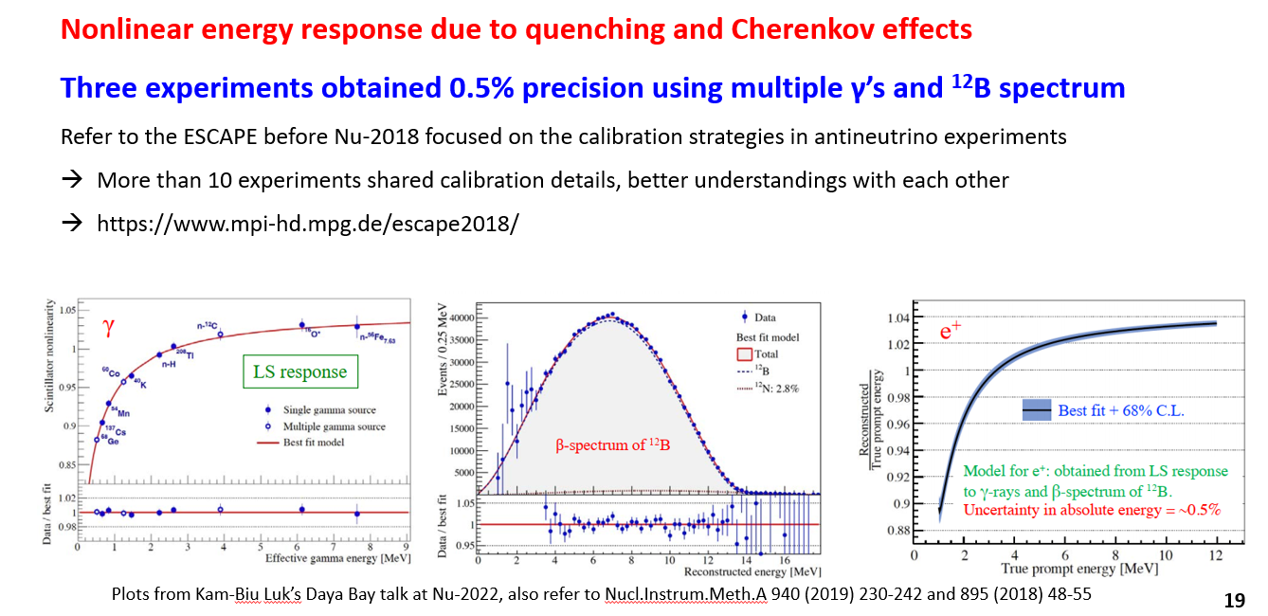
探测器响应

Slide 44
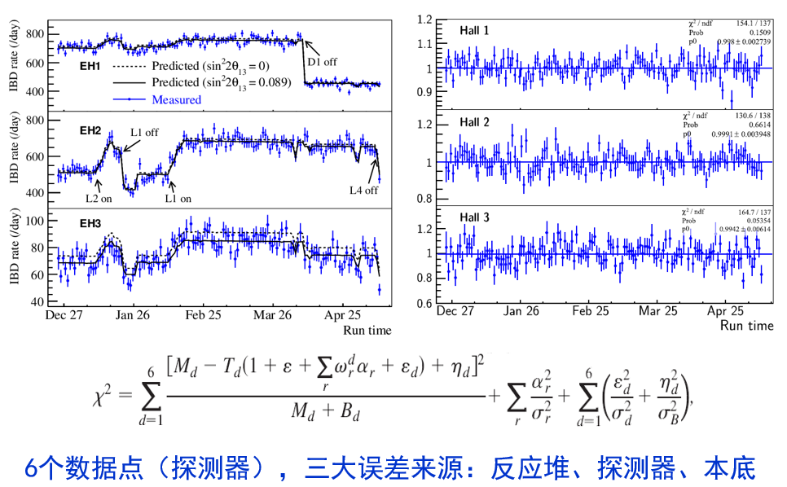
振荡分析

Slide 45
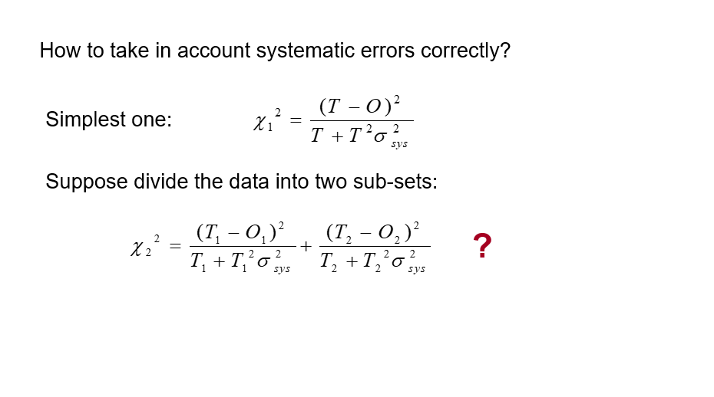
振荡分析

Slide 46
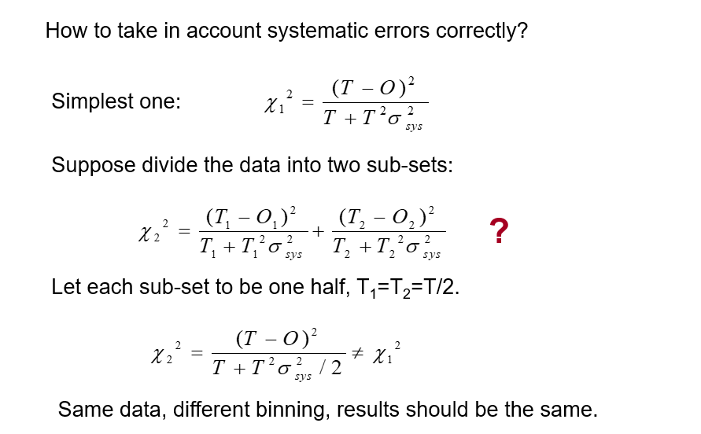
振荡分析

Slide 47

振荡分析

Slide 48

振荡分析

Slide 49

振荡分析

Slide 50

振荡分析

Slide 51

振荡分析

Slide 52

振荡分析

Slide 53

Rate+shape 振荡分析

Slide 54

Rate+shape 振荡分析

Slide 55

Rate+shape 振荡分析

Slide 56


意料之外的核燃料演化
创新：排除惰性中微子

Slide 57

Farewell Daya Bay

Slide 58

Farewell Daya Bay

Slide 59

Farewell Daya Bay

Slide 60





Jiangmen Underground Neutrino Observatory
Vertical tunnel: 563 m
Overburden
~650 m (1800 m.w.e.)
Slope tunnel：1265 m @ slope of 42%
© 刘悦湘
11
Civil construction finished in Dec, 2021

Slide 61






A multi-purpose observatory
Physics goals: neutrino mass ordering (~4σ), precision measurement of neutrino mixing parameters (<<1%), supernova ν, geo-ν, solar ν, nucleon decay, etc
Future upgrade (2030s) : searching for 0νββ
Detector construction completed in 2023
Reactor
Atmosphere
Solar
Supernova
Earth
New physics
+
~60 IBDs per day
Several per day
Hundreds per day
~5000 IBDs for CCSN @10 kpc
Several IBDs per day
IBD: inverse beta decay
CCSN: core-collapse supernova
Neutrino oscillation & properties
Neutrinos as a probe

Slide 62



Requirement for rich physics program
Example: Precision Neutrino Oscillation Measurements
Detector properties
Statistics
Energy resolution
Shape uncertainty
Background
Large target mass (20 kton LS)
Very high PMT coverage (78%)
Satellite detector (TAO)
Good overburden (~650 m)
Highly-efficient veto system (>99.5%)
Highly transparent LS
Powerful nuclear reactors (26.6 GW_{th})
Highly efficient PMTs (PDE~30%)
Material screening
Clean installation
For solar neutrinos: tighter requirements on Liquid Scintillator (LS) radiopurity by 1~2 orders of magnitude.

Slide 63





Reactor Antineutrino Oscillation & Detection
JUNO, arXiv: 2204.13249
Event type | Rate [/day] | Relative rate uncertainty | Shape uncertainty
Reactor IBD signal | 60 ➔ 47 | - | -
Geo-$ν′$s | 1.1 ➔ 1.2 | 30% | 5%
Accidental signals | 0.9 ➔ 0.8 | 1% | negligible
Fast-n | 0.1 | 100% | 20%
$^{9}$Li/$^{8}$He | 1.6 ➔ 0.8 | 20% | 10%
$^{13}C$($α ,n$)$^{16}$O | 0.05 | 50% | 50%
Global reactors | 0 ➔ 1.0 | 2% | 5%
Atmospheric $ν^{′}s$ | 0 ➔ 0.16 | 50% | 50%
JUNO physics book (J. Phys. G43:030401(2016)) → updated ana.
Updates for the spectra and rates since JUNO (2016)
2 fewer reactor cores in Taishan
Better muon veto strategy
Improved energy resolution:
3.0% $@$1MeV ➔ 2.9% $@$1MeV
Signal and backgrounds now assessed with full JUNO simulation
Slight less overburden
Lower radioactivity background based on latest measurements on material radiopurities

Slide 64




Energy Resolution
Change | Light yield in detector center [PEs/MeV] | Energy resolution | Reference
Previous estimation | 1345 | 3.0% $@$1MeV | JHEP03(2021)004
Photon Detection Efficiency (27%→30%) | +11%$↑$ | 2.9% @ 1MeV | arXiv: 2205.08629
New Central Detector Geometries | +3%$↑$
New PMT Optical Model | +8%$↑$ |  | EPJC 82 329 (2022)
Positron energy resolution is understood:
$$\frac{σ}{E_{vis}}=\sqrt{{\left(\frac{a}{\sqrt{E_{vis}}}\right)}^{2}+b^{2}+{\left(\frac{c}{E_{vis}}\right)}^{2}}$$
Photon statistics
Annihilation-induced $γ$s
Dark noise
Scintillation quenching effect
  LS Birks constant from table-top measurements
Cherenkov radiation
  Cherenkov yield factor (refractive index & re-emission probability) is re-constrained with Daya Bay LS non-linearity
Detector uniformity and reconstruction

Slide 65


Neutrino Mass Ordering
 | Design * | Now (2022)
Thermal Power | 36 GW_{th} | 26.6 GW_{th} (26%$↓$)
Overburden | ~700 m | ~ 650 m
Muon flux in LS | 3 Hz | 4 Hz (33%$↑$)
Muon veto efficiency | 83% | 91.6% (11%$↑$)
Signal rate | 60 /day | 47.1 /day (22%$↓$)
Backgrounds | 3.75 /day | 4.11 /day (10%$↑$)
Energy resolution | 3% @ 1 MeV | 2.9% @ 1 MeV (3%$↑$)
Shape uncertainty | 1% | JUNO+TAO
3𝜎 NMO sens. exposure | < 6 yrs $×$ 35.8 GW_{th} | ~ 6 yrs $×$ 26.6 GW_{th}
JUNO+TAO
* J. Phys. G 43:030401 (2016)
JUNO NMO median sensitivity: 3σ (reactors only) @ ~6 yrs * 26.6 GW_{th} exposure
Combined reactor + atmospheric neutrino analysis is in progress: further improve the NMO sensitivity

Slide 66



Neutrino oscillation parameters w/ reactors
arXiv:2204.13249, Chin. Phys. C 46 (2022) 123001
Precision of sin²$2θ_{12}$, $∆m_{21}^{2}$, |$∆m_{32}^{2}$| < 0.5% in 6 yrs
Best measurement for the foreseeable future
The improvement in precision over existing constraints will be about one order of magnitude

Slide 67
谢谢大家

