Slide 1
CEPC AHCAL Barrel Geometry
Hongbin Diao

Slide 2
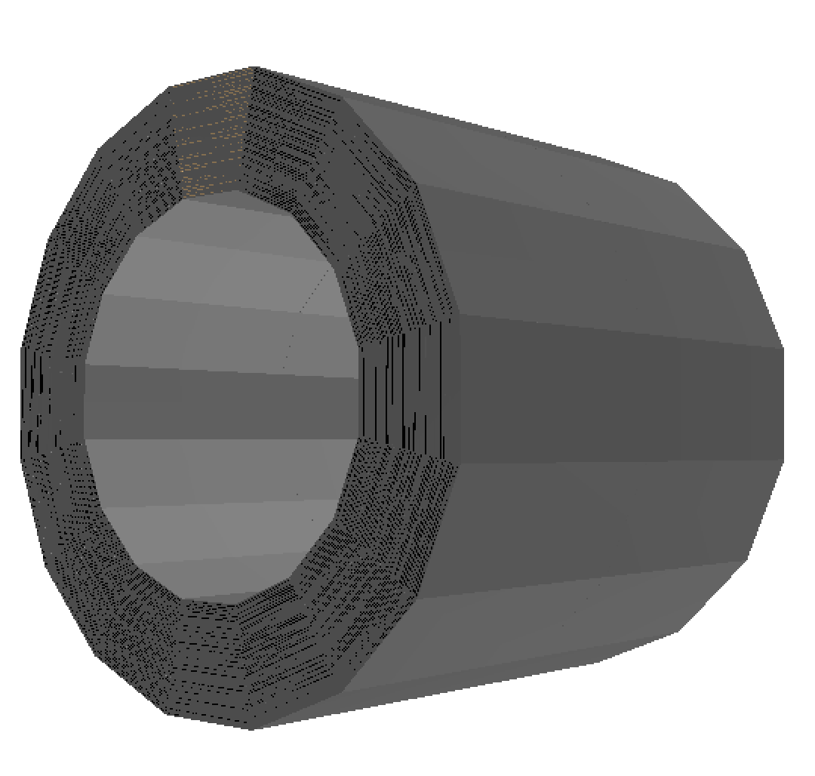
CEPCSW AHCAL Barrel Geometry
not to scale
one sector
one chamber
Steel235
Absorber: 18.8mm Steel235
PCB: 3.2mm PCB
Scintillator: 40*40*3mm G4_POLYETHYLENE 0.065mm G4_ESR
total distance in xy plane: 40.3mm
total thickness: 3.2mm
Absorber: 2mm Steel235

Slide 3
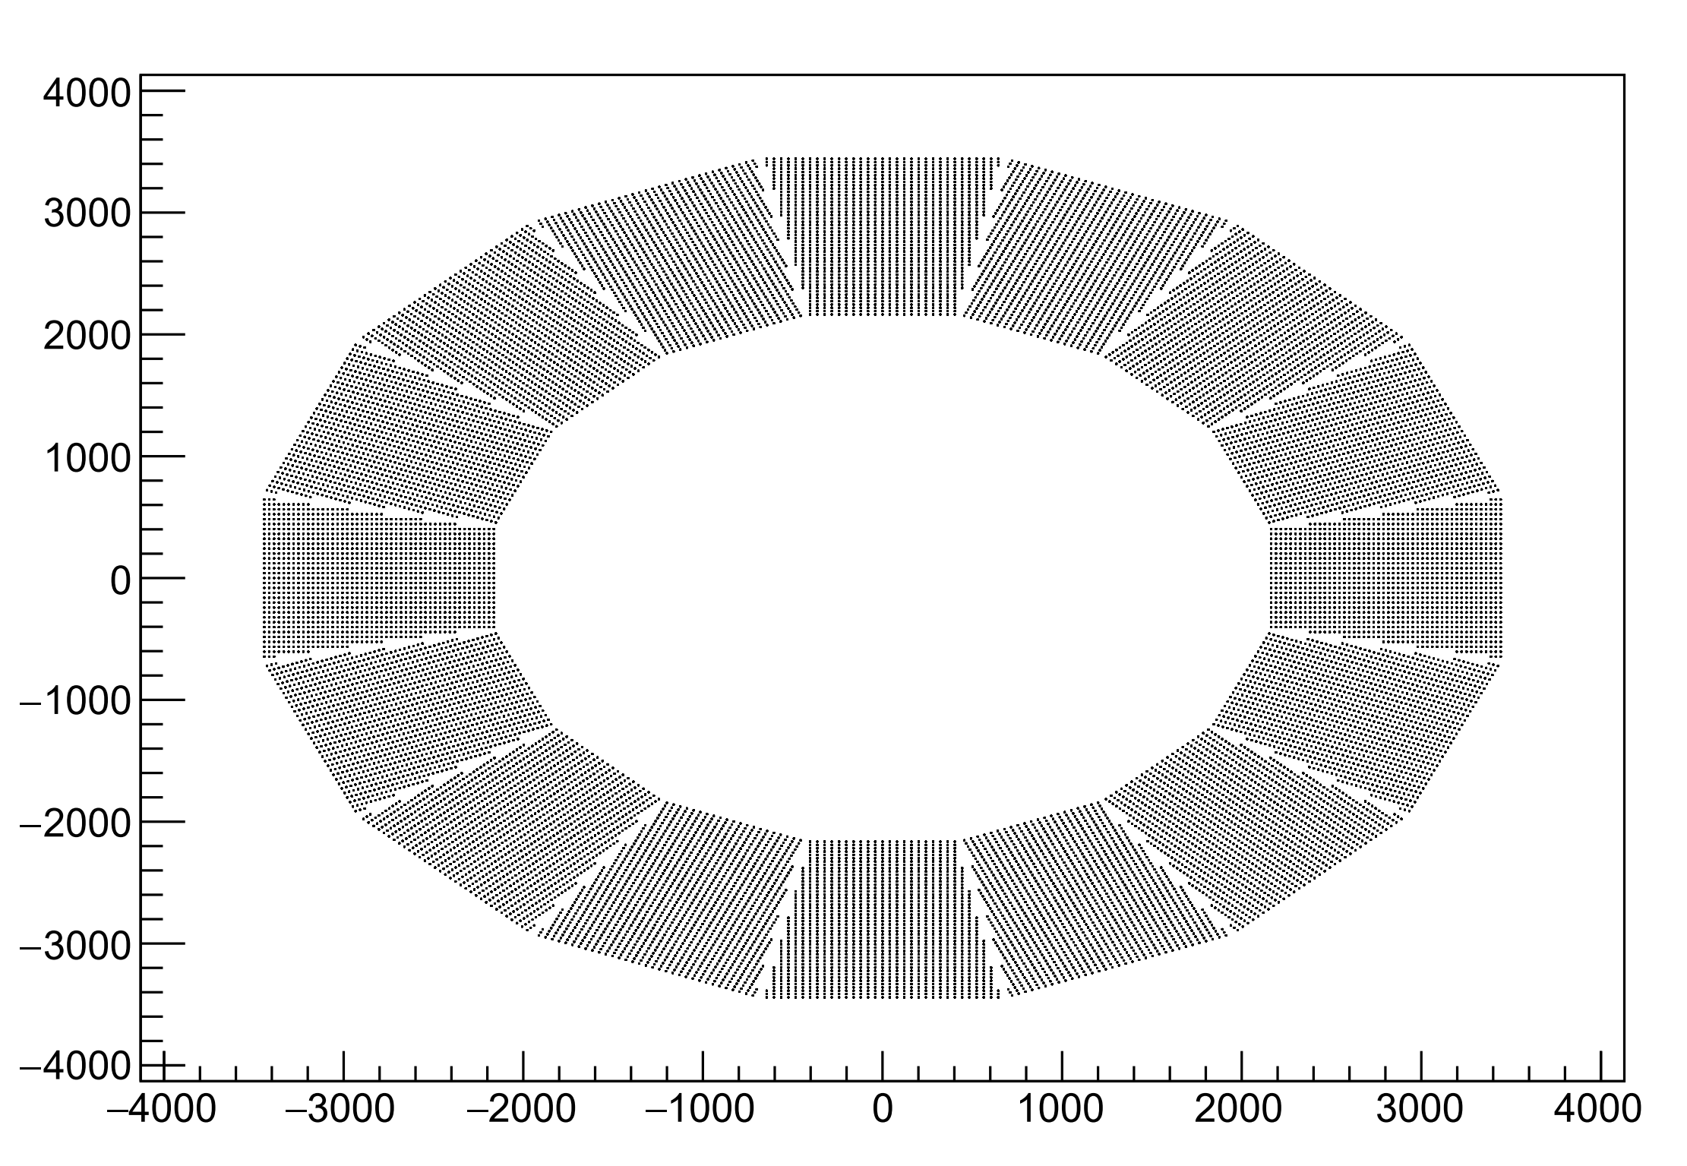
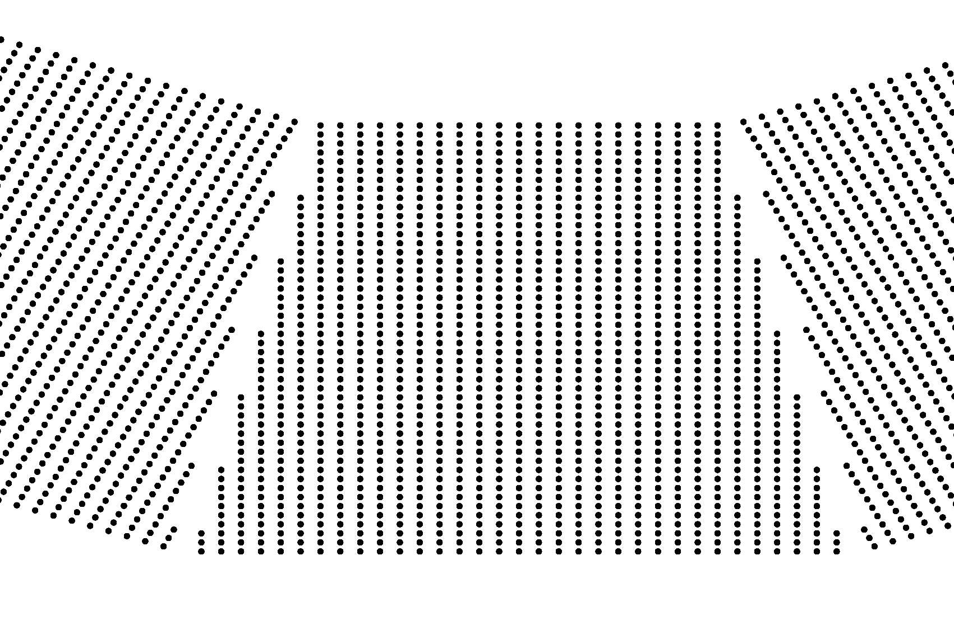
CEPCSW AHCAL Barrel Geometry
layer | length(cm) | cell nunber | dead area(cm) |  | 25 | 110.77 | 27 | 1.96
1 | 84.80 | 21 | 0.17 |  | 26 | 111.86 | 27 | 3.04
2 | 85.89 | 21 | 1.26 |  | 27 | 112.94 | 27 | 4.13
3 | 86.97 | 21 | 2.34 |  | 28 | 114.02 | 27 | 5.21
4 | 88.05 | 21 | 3.42 |  | 29 | 115.10 | 27 | 6.29
5 | 89.13 | 21 | 4.50 |  | 30 | 116.18 | 27 | 7.37
6 | 90.21 | 21 | 5.58 |  | 31 | 117.27 | 29 | 0.40
7 | 91.30 | 21 | 6.67 |  | 32 | 118.35 | 29 | 1.48
8 | 92.38 | 21 | 7.75 |  | 33 | 119.43 | 29 | 2.56
9 | 93.46 | 23 | 0.77 |  | 34 | 120.51 | 29 | 3.64
10 | 94.54 | 23 | 1.85 |  | 35 | 121.59 | 29 | 4.72
11 | 95.62 | 23 | 2.93 |  | 36 | 122.68 | 29 | 5.81
12 | 96.71 | 23 | 4.02 |  | 37 | 123.76 | 29 | 6.89
13 | 97.79 | 23 | 5.10 |  | 38 | 124.84 | 29 | 7.97
14 | 98.87 | 23 | 6.18 |  | 39 | 125.92 | 31 | 0.99
15 | 99.95 | 23 | 7.26 |  | 40 | 127.00 | 31 | 2.07
16 | 101.03 | 25 | 0.28 |  | 41 | 128.09 | 31 | 3.16
17 | 102.12 | 25 | 1.37 |  | 42 | 129.17 | 31 | 4.24
18 | 103.20 | 25 | 2.45 |  | 43 | 130.25 | 31 | 5.32
19 | 104.28 | 25 | 3.53 |  | 44 | 131.33 | 31 | 6.40
20 | 105.36 | 25 | 4.61 |  | 45 | 132.41 | 31 | 7.48
21 | 106.44 | 25 | 5.69 |  | 46 | 133.50 | 33 | 0.51
22 | 107.53 | 25 | 6.78 |  | 47 | 134.58 | 33 | 1.59
23 | 108.61 | 25 | 7.86 |  | 48 | 135.66 | 33 | 2.67
24 | 109.69 | 27 | 0.88 |  |  | total length |  | 189.15
hitmap in xy plane
27.2*tan (180/16)=1.08
total volume: (84.80+135.66+1.08)/2 * (27.2 * 48) = 1.45e5
dead volume caused by placement: (189.5+48*1.08/2)*27.2=5.86e3
5.86e3/1.45e5 = 4.04%
if don’t need alignment, value is halved around

