Slide 1
Free spectator nucleons in ultracentral relativistic heavy-ion collisions as a probe of neutron skin
Lu-Meng Liu, Chun-Jian Zhang, Jun Xu, Jiangyong Jia, Guang-Xiong Peng
arxiv number: 2209.03106
Shen Yifan

Slide 2
Backgroud
The nuclear symmetry energy can characterize the isospin dependence of EoS
, where
futher it can be expanded by density around saturation density ρ₀
is called slope parameter which can be constrained by neutron-skin thickness ∆r_{np}
Then authors think the yield ratio N_{n}/N_{p} of free spectator neutrons to protons at RHIC and LHC can be a more sensitive probe of ∆r_{np}

Slide 3
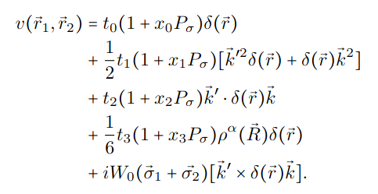
Framework
1. Skyrme-Hartree-Fock (SHF) model
to obtain the nucleon distributions of colliding nuclei
Effective interaction expression:
Here t₀, t₁.... x₀, x₁... are all parameters in Skyrme interaction
is the nucleon density
is relative momentum operator
is the spin exchange operator

Slide 4
Framework
2. Glauber model
fit the charged particle multiplicity and to determine the spectator nucleons
In Glauber model, the colliding nuclei are placed with a random impact parameter, and their orientations with respect to the beam direction are uniformly randomized.
Based on SHF, the number of sources that produce charged particles :
The particle production n from each source is assumed to follow a negative binomial distribution:

Slide 5
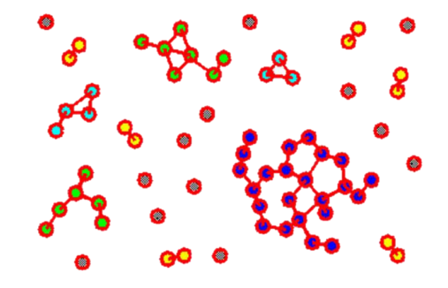
Framework
3. Clusterization
using minimum spanning tree (MST) algorithm to determine heavy fragments and the direct production of free nucleons
If the relative position r<R₀ and relative momentum p<P₀, they can be clusterization.
Schematic diagram of MST algorithm identifying fragments

Slide 6
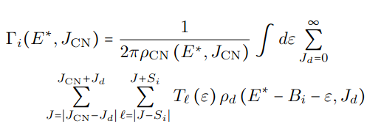
Framework
4. GEMINI model
deexcite heavy fragments
GEMINI model is a Monte Carlo model to calculate the deexcitation of nuclear fragments, which allows all possible binary decay modes including light-particle evaporation and symmetric/asymmetric fission
The Decay Width can be experissed as:

Slide 7
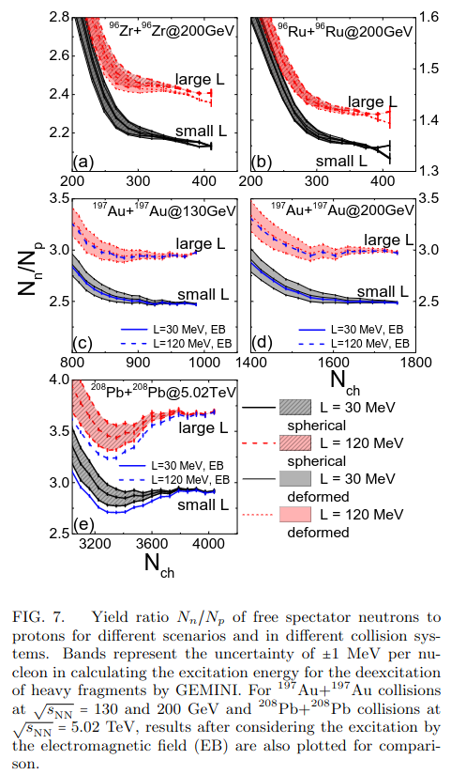
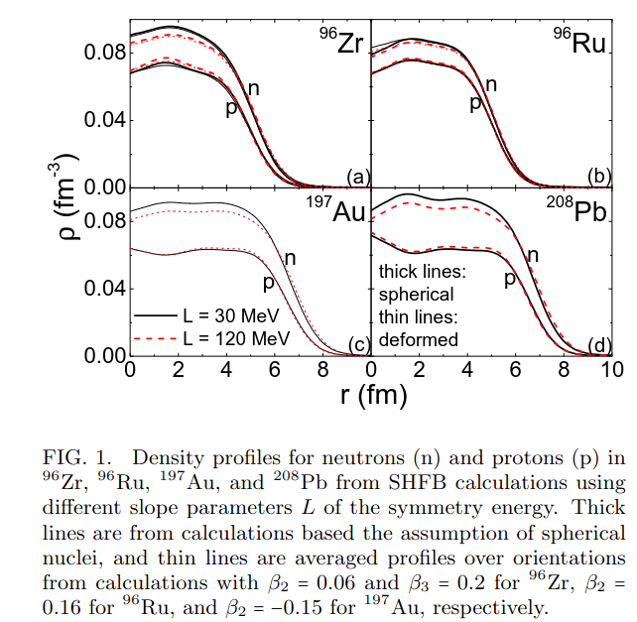
Results

Slide 8
Thank You !

