Slide 1

中国科学院高能物理研究所
Institute of High Energy Physics, CAS
CEPC Detector Magnet V0 weekly
Feipeng NING
2024.06.25
On behalf of detector magnet team

Slide 2

Outline
Size of the magnet;
Joint design of detector solenoid and Anti-solenoid;
Ref-TDR;
Ongoing work

Slide 3
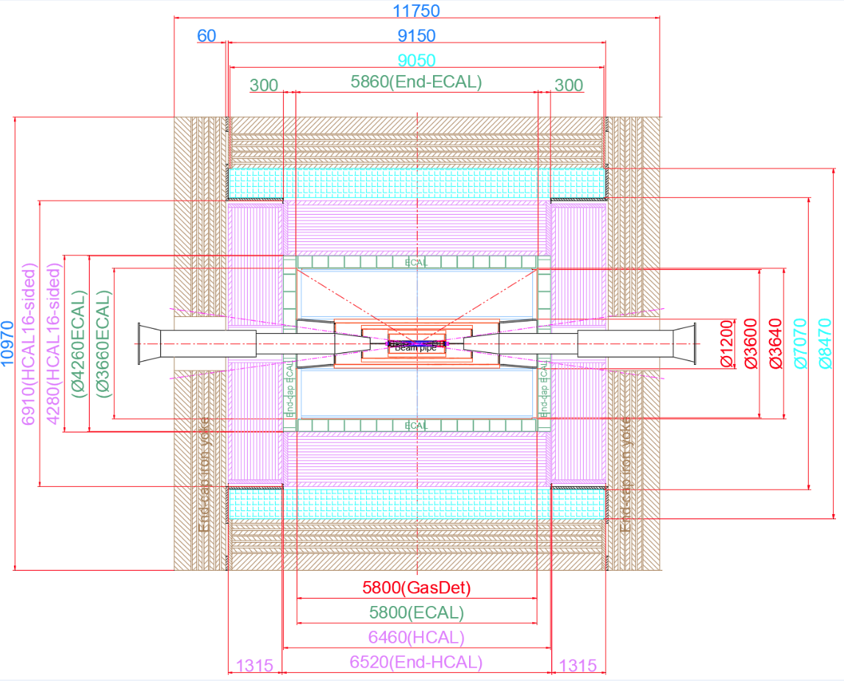
1. The size of magnet
Inner diameter | 7070 mm
Thickness | 700 mm
Outer diameter | 8470 mm
Length | 9050 mm

Slide 4
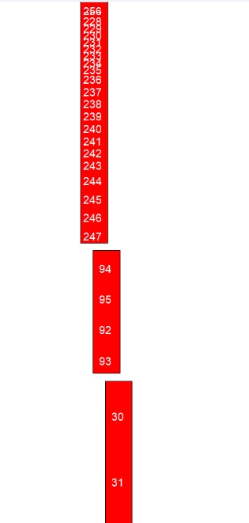
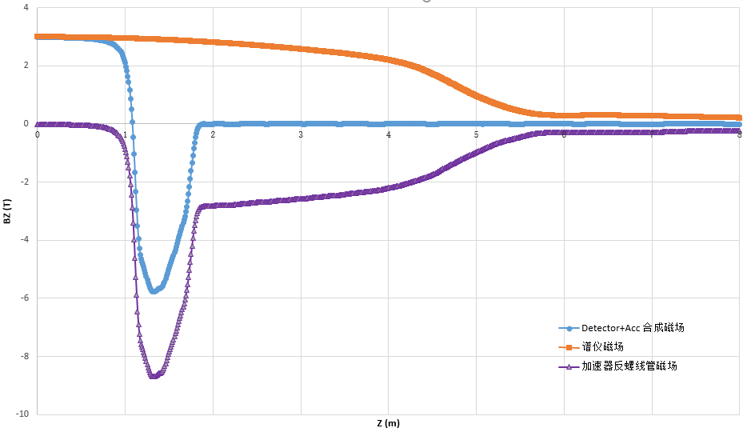
2. Anti-solenoid design
Combined field of Anti-solenoid and Detector solenoid is fine tuned.
 | 对角线点1 |  | 对角线点2 |  | J
Coil编号 | r1(mm) | z1(mm) | r2(mm) | z2(mm) | 线圈电流密度(A/mm2)
1 | 70 | -1130 | 92 | -1160 | 700
2 | 70 | -1160 | 92 | -1167.5 | 280
3 | 70 | -1167.5 | 92 | -1171.25 | 350
4 | 70 | -1171.25 | 92 | -1175 | 400
5 | 70 | -1175 | 92 | -1186.25 | 155
6 | 70 | -1186.25 | 92 | -1197.5 | 140
7 | 70 | -1197.5 | 92 | -1230 | 290
8 | 70 | -1230 | 92 | -1260 | 320.5279867
9 | 70 | -1260 | 92 | -1300 | 330
10 | 70 | -1300 | 92 | -1330 | 325
11 | 70 | -1330 | 92 | -1360 | 320
12 | 80 | -1366 | 102 | -1416 | 360
13 | 80 | -1416 | 102 | -1441 | 350
14 | 80 | -1441 | 102 | -1466 | 360
15 | 90 | -1472 | 112 | -1579 | 315
16 | 90 | -1579 | 112 | -1686 | 235
17 | 90 | -1686 | 112 | -1750 | 300
18 | 98 | -1800 | 112 | -1881.25 | 122
19 | 98 | -1881.25 | 112 | -1904.6875 | 177
20 | 98 | -1904.69 | 112 | -1941.25 | 160
21 | 98 | -1941.25 | 112 | -1975 | 144
22 | 98 | -1975 | 112 | -1991.25 | 165
23 | 98 | -1991.25 | 112 | -2040 | 170
24 | 103 | -2050 | 114 | -2091.625 | 224
25 | 103 | -2091.63 | 114 | -2133.25 | 205
26 | 103 | -2133.25 | 114 | -2216.5 | 200
27 | 103 | -2216.5 | 114 | -2272 | 205
28 | 103 | -2272 | 114 | -2383 | 196
29 | 103 | -2383 | 114 | -2438.5 | 190
30 | 103 | -2438.5 | 114 | -2494 | 205
31 | 108 | -2500 | 119 | -2598 | 205
32 | 108 | -2598 | 119 | -2696 | 195
33 | 108 | -2696 | 119 | -2748.5 | 185
34 | 108 | -2748.5 | 119 | -2845.5 | 190
35 | 108 | -2845.5 | 119 | -2881.875 | 185
36 | 108 | -2881.88 | 119 | -2895 | 205
37 | 113 | -2900 | 124 | -2912.25 | 220
38 | 113 | -2912.25 | 124 | -2949 | 196
39 | 113 | -2949 | 124 | -3100 | 190
40 | 113 | -3100 | 124 | -3197 | 178
41 | 113 | -3197 | 124 | -3281.875 | 182
42 | 113 | -3281.88 | 124 | -3294 | 195
43 | 119 | -3300 | 130 | -3312.25 | 200
44 | 119 | -3312.25 | 130 | -3349 | 193
45 | 119 | -3349 | 130 | -3500 | 182
46 | 119 | -3500 | 130 | -3681.875 | 170
47 | 119 | -3681.88 | 130 | -3694 | 185
48 | 123 | -3700 | 134 | -3736.5 | 195
49 | 123 | -3736.5 | 134 | -3820 | 170
50 | 123 | -3820 | 134 | -3907 | 160
51 | 123 | -3907 | 134 | -3964 | 170
52 | 133 | -3970 | 143 | -4040.5 | 175
53 | 133 | -4040.5 | 143 | -4052.25 | 218
54 | 133 | -4052.25 | 143 | -4064 | 214
55 | 142 | -4069 | 152 | -4088.25 | 210
56 | 142 | -4088.25 | 152 | -4143 | 185
57 | 142 | -4143 | 152 | -4220 | 170
58 | 142 | -4220 | 152 | -4364 | 160
59 | 149 | -4370 | 159 | -4465 | 160
60 | 149 | -4465 | 159 | -4512.5 | 146
61 | 149 | -4512.5 | 159 | -4567 | 160
62 | 149 | -4567 | 159 | -4665.5 | 110
63 | 149 | -4665.5 | 159 | -4751.6875 | 120
64 | 149 | -4751.69 | 159 | -4764 | 124
65 | 156 | -4770 | 166 | -4868.5 | 100
66 | 156 | -4868.5 | 166 | -4967 | 90
67 | 156 | -4967 | 166 | -5164 | 70
68 | 163 | -5170 | 173 | -5267.5 | 50
69 | 163 | -5267.5 | 173 | -5365 | 44
70 | 163 | -5365 | 173 | -5462.5 | 40
71 | 163 | -5462.5 | 173 | -5560 | 39
72 | 167 | -5570 | 177 | -5655 | 21
73 | 167 | -5655 | 177 | -5910 | 22.5
74 | 167 | -5940 | 173 | -7155 | 40
75 | 167 | -7155 | 173 | -7217.5 | 30
76 | 167 | -7217.5 | 173 | -7467.5 | 34
77 | 167 | -7467.5 | 173 | -7892.5 | 30
78 | 167 | -7892.5 | 173 | -8050 | 35
79 | 167 | -8050 | 173 | -8162.5 | 30

Slide 5
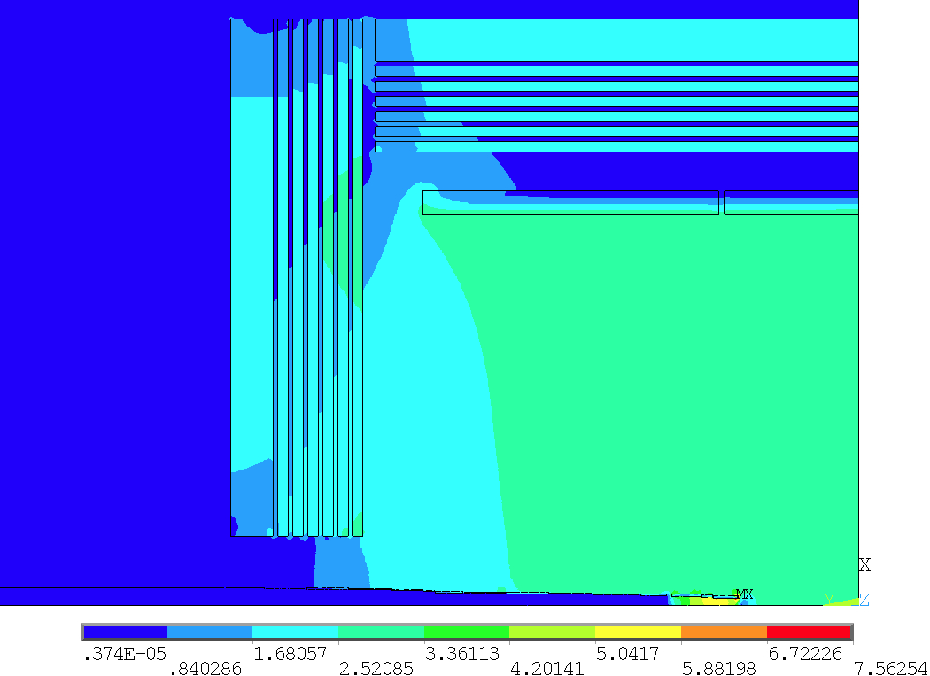
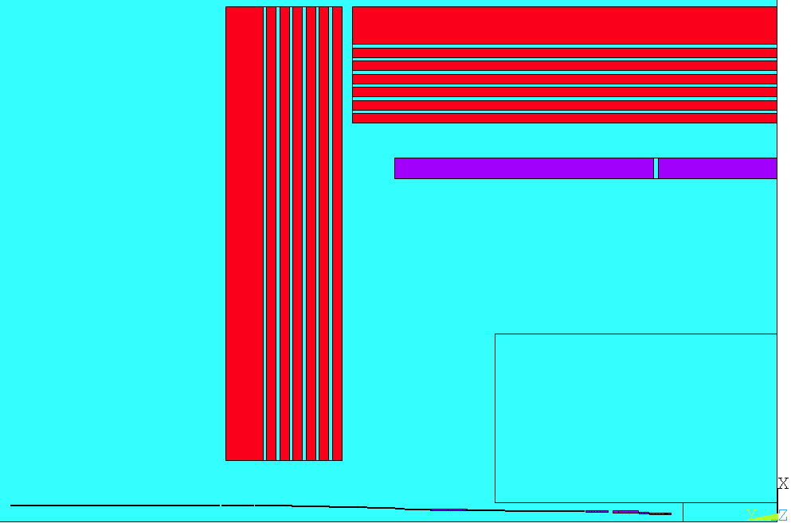
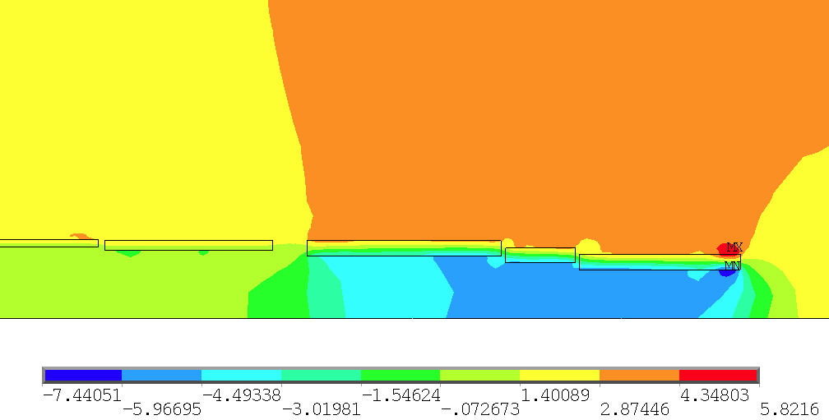
2. Anti-solenoid design
Combined field of Anti-solenoid and Detector solenoid.
R (mm) | 70 | 167
Z (mm) | 1130 | 8162.5
Anti-solenoid:

Slide 6
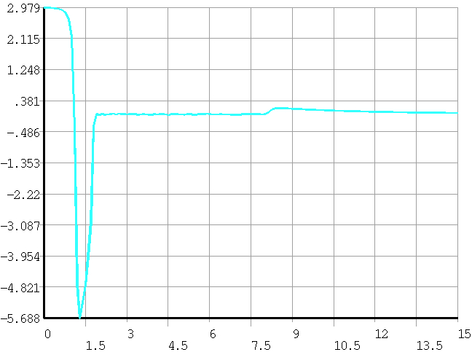
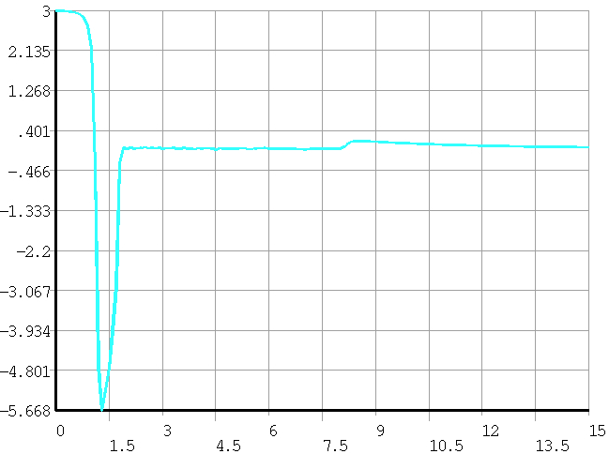
2. Anti-solenoid design
Combined field of Anti-solenoid and Detector solenoid.
Joint modeling, mutual influence of magnetic fields
Central field changes：3 T—2.979 T
Increase current: 16702 A—16829 A
Central field：2.979 T—3 T
0.76%
0.687%

Slide 7
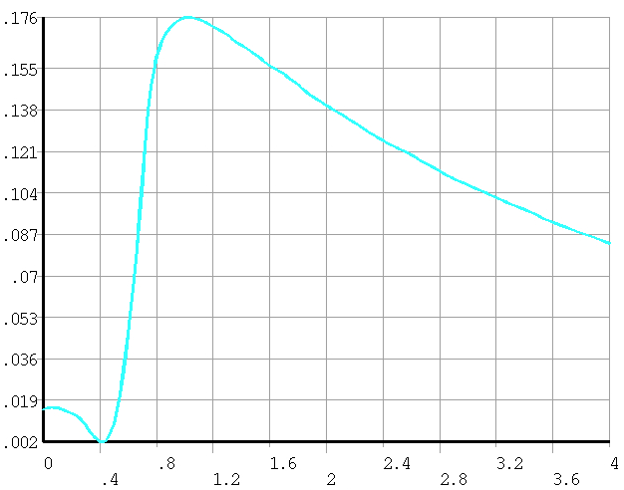
2. Anti-solenoid design
Combined field of Anti-solenoid and Detector solenoid.
The anti solenoid has been designed from the axial 1.1 m to 8.1 m, and further optimization is needed in the future.

Slide 8
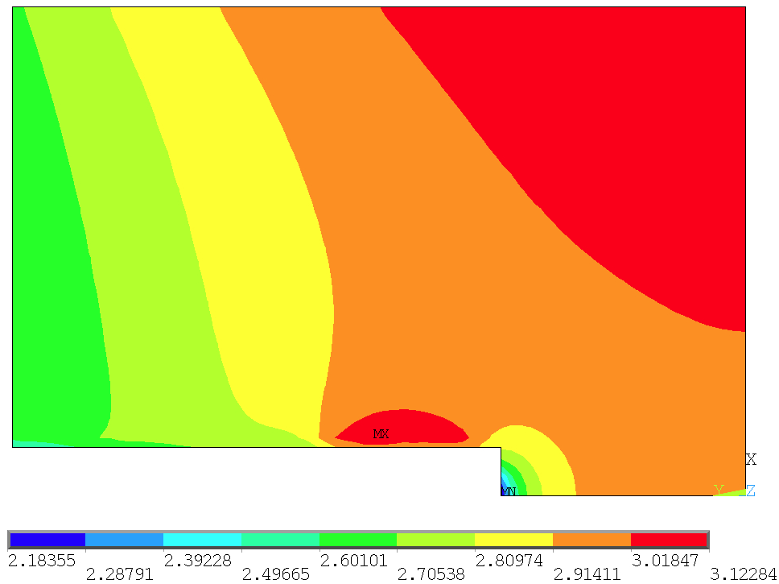
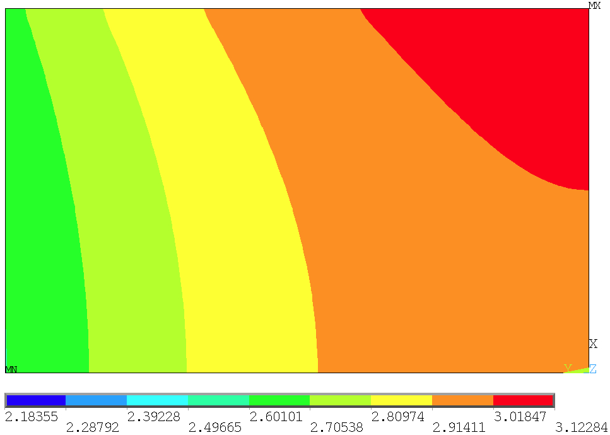
2. Anti-solenoid design
Combined field of Anti-solenoid and Detector solenoid.
Field Mapping area: R 0~2m, Z 0~3m
Anti-solenoid:
R (mm) | 70 | 167
Z (mm) | 1130 | 8162.5
Remove Anti-solenoid area: R 0~0.2m, Z 1~3m
1m
0.2m

Slide 9
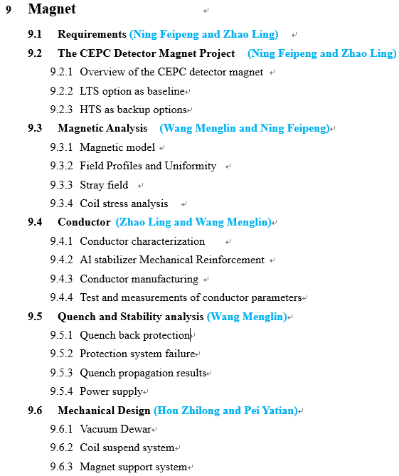
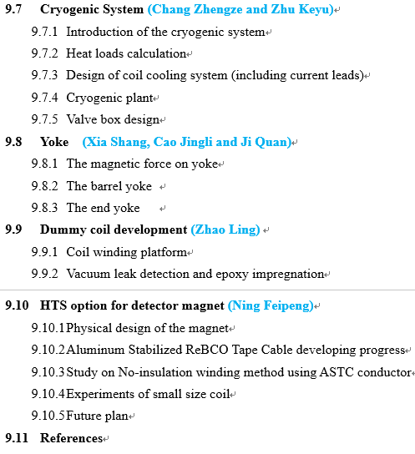
3. Ref-TDR

Slide 10
4. Ongoing work
The chimney of the magnet is being designed;
The magnetic force of the yoke has been provided to mechanical colleagues and is being jointly designed;
Detailed mechanical design of the magnet;
Optimization of the cryogenic system;
Optimization of Support structure.
Notes:
Two changes: first, add yoke to reduce the range of stray field; second, the size of HCal increase, so size of the solenoid and the yoke increase accordingly.

