Slide 1
CEPC vertex detector towards TDR
Zhijun Liang,
On behalf of CEPC vertex working group

Slide 2
Preliminary outline for Vertex section @ referenece TDR
3. Vertex detector (Zhijun & Meng Wang)
a. Requirements (position and vertex) Zhijun , Manqi
b. Technology survey and our choices (both baseline & backup options), Zhijun & Meng
c. R&D efforts and results
→CMOS Stitching: Meng Wang
→ CMOS normal chip: Zhijun, Wei Wei, Yupeng
→ SOI: YunPeng
d. Detailed design including electronics, cooling and mechanics
→ Layout: Zhijun & Meng Wang
→ CMOS sensor design: Wei Wei，Ying Zhang, Yunpeng
→Cooling and mechanics: Jinyu Fu
e. Readout electronics & BEC
→Background estimation : Haoyu Shi
→ Data rate and readout scheme: Jun Hu, Wei Wei
f. Performance from simulation (impact parameters). Chengdong Fu

Slide 3
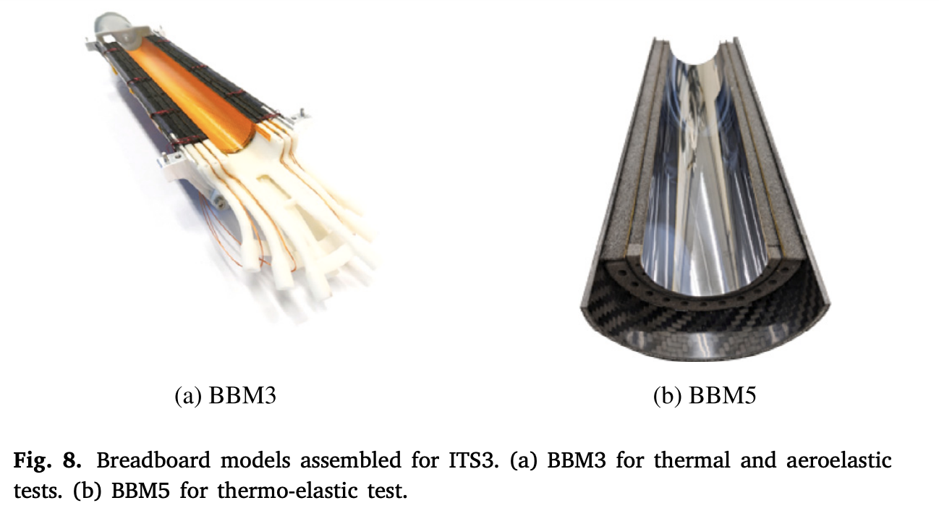
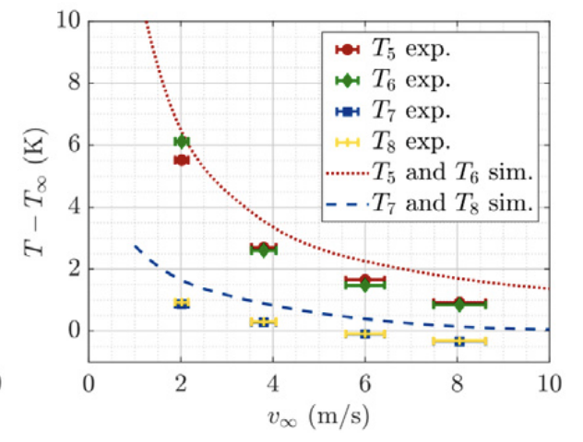
Switching to Stitching baseline:
Quick from Christine Guo
Mechanics is very challenging, more prototyping study is needed
CEPC vertex inner Radius 11mm → 30 um thick sensor ?
ALICE ITS vertex inner Radius : 18mm → 40-50um thick sensors
Power consumption and cooling is key issue
If Temperature difference is too large >5C, sensor is likely to crack
Temperature difference in ITS3

Slide 4
Electronics: data rate
Background and Data rate
Meng Wang, Haoyu, Weiwei and I have some follow up discussion
Haoyu will update with CEPCSW, need to compare with Fcc-ee
Hit pattern per event, total number of hits per event
Hit density per cm² per event

Slide 5
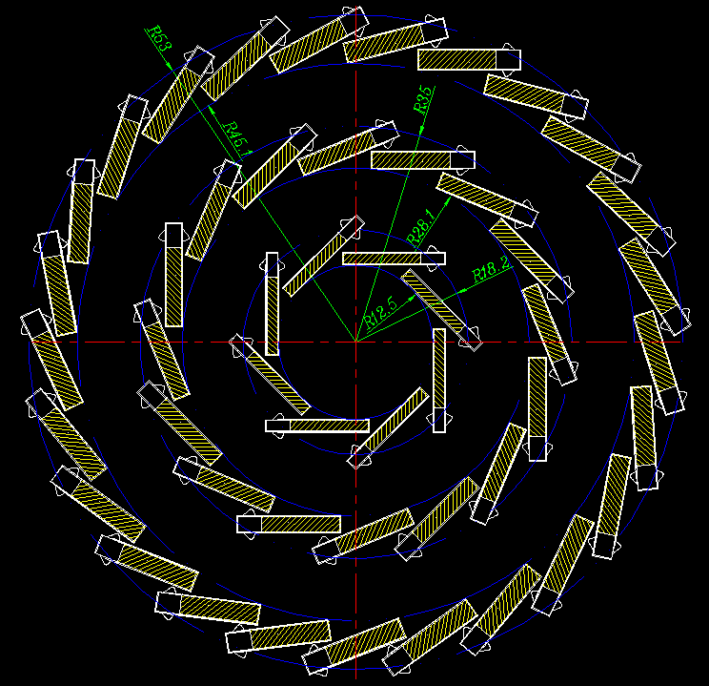
Electronics : stitching issue
100% sensitive area is too ideal & impossible
Stitching area is inevitable!
& can not be covered by the module at the same layer
= dead area have to exist (but normal chip can avoid)

Slide 6
Software
Software needs some development
Dead area should be considered

Slide 7
Backup

Slide 8
Preliminary thoughts
On chip & dimension
NX+2Y scheme:
Challenging but DO-able
Inner layer VTX, a half layer: total data rate 10Gbps at one end on one “chip”
Actually no fundamental change of chip, but save the mechanical
NX+MY (M>2) scheme:
Too ideal ☹ ☹ ☹
Data transmission, power distribution, timing… all with big issues
But maybe possible for outer-most layer – data rate greatly decreased
On mechanical
Overall mechanical is easier than the normal scheme
But dead area seems inevitable on the same layer and not small
Rough estimation
Innermost layer: NX+2Y of (1024row*512col) can be bent to be a semi-circle

Slide 9
What is stitching? (from Meng Wang)
df

Slide 10
Top focus on stitching
Inner layer : background , data rate, power consumption
Middle layer and outter layer:
refine stitching proposal and estimate yield, power consumption

Slide 13
Data rate estimation of CEPC VTX
 |  | Hit density (Hits/cm²/BX) | Bunch spacing (ns) | Hit rate (M Hits/cm²) | Hit Pix rate (M Px/cm²) | Hit rate/chip (MHz) | Data rate@triggerless (Gbps) | Pixel/bunch | FIFO Depth @3us rg latency | Data rate@trigger (Mbps)
CDR | Higgs | 2.4 | 680 | 3.53 | 10.59 | 34.62 | 1.1 | 23.5 | 103.9 | 105.28
 | W | 2.3 | 210 | 10.95 | 32.86 | 107.44 | 3.4 | 22.6 | 322.3 | 101.248
 | Z | 0.25 | 25 | 10 | 30 | 98.1 | 3.1 | 2.4 | 294.3 | 53.76
TDR | Higgs | 0.81 | 591 | 1.37 | 4.11 | 13.44 | 0.43 | 7.96 | 40.4 | 213.9？
 | W | 0.81 | 257 | 3.16 | 9.45 | 30.90 | 0.98 | 7.96 | 92.8 | 213.9？
 | Z | 0.45 | 23 | 19.6 | 58.7 | 191.9 | 5.9 | 4.4 | 575 | 118
TDR raw hit density: Higgs 0.54，Z 0.3; Safety factor: TDR 1.5, CDR 10;
Cluster size: 3pixels/hit (@Twjz 180nm, EPI 18~25um)
Area: 1.28cm*2.56cm=3.27cm² (@pixel size 25um*25um)
Word length: 32bit/event (@Taichu’s scale, 512*1024 array)
Trigger rate：20kHz@CDR，120kHz@TDR estimated
Trigger latency: 3us(very likely not enough), Error window: 7 bins
FIFO depth: @3us * hit rate/chip
Data rate=pixel/bunch*trigger rate*32bit*error window
Assume data rate @1Gbps per chip for low lumi Z (20% of high lumi Z)
for triggerless

Slide 14
Issue of stitching for large pixel matrix
Pixel Matrix
Periphery
1Gbps on PCB
1Gbps on PCB
1Gbps on PCB
1Gbps on PCB
Ladder for Normal chip
Normal chip
Transmission:
Each chip has a dedicated data transmission path for 1Gbps
The transmission path is on PCB (ideal transmission line, high signal quality)
Buffering:
On Periphery (on chip), for high hit rate

Slide 15
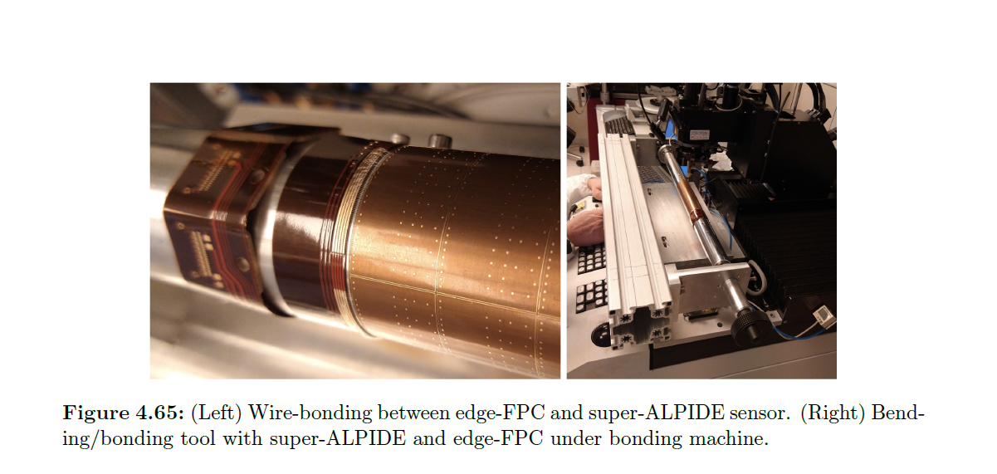
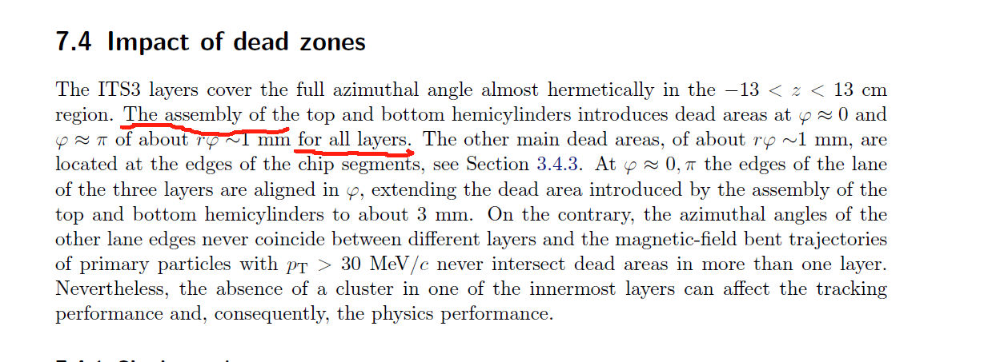
Issues of the dead area

Slide 16
Preliminary outline for Vertex section @ referenece TDR
3. Vertex detector (Zhijun & Meng Wang)
a. Requirements (position and vertex) Zhijun , Manqi
b. Technology survey and our choices (both baseline & backup options), Zhijun & Meng
c. R&D efforts and results
→CMOS Stitching: Meng Wang
→ CMOS normal chip: Zhijun, Wei Wei, Yupeng
→ SOI: YunPeng
d. Detailed design including electronics, cooling and mechanics
→ Layout: Zhijun & Meng Wang
→ CMOS sensor design: Wei Wei，Ying Zhang, Yunpeng
→Cooling and mechanics: Jinyu Fu
e. Readout electronics & BEC
→Background estimation : Haoyu Shi
→ Data rate and readout scheme: Jun Hu, Wei Wei
f. Performance from simulation (impact parameters). Chengdong Fu

Slide 17
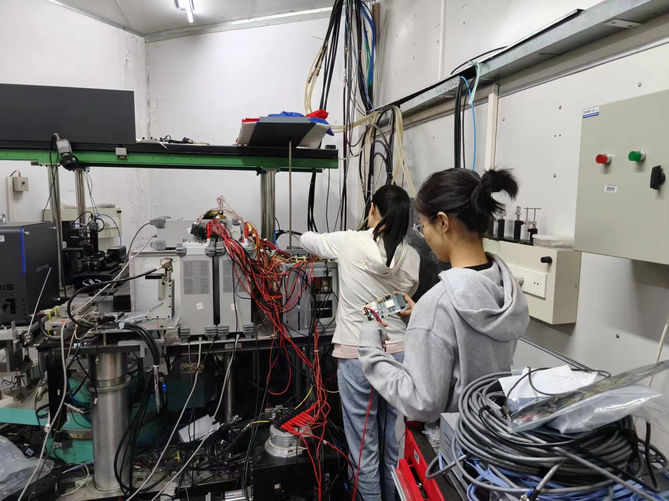
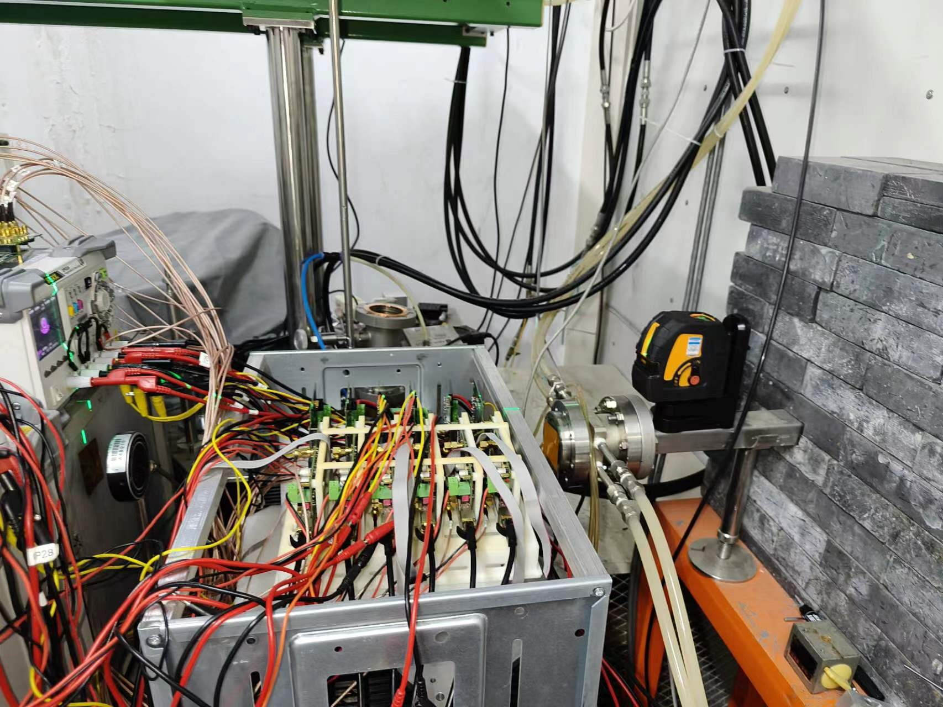
Testbeam in BSRF for vertex sensor digitization model
Testbeam in BSRF from June 1st to July 1st
Try to test different incident angle from 8° - 90°
In last test beam at DESY, incident angle is about 70-90°
Cluster size, efficiency vs incident angle

Slide 18
News about TJ65nm CMOS design
Got design Kit for TJ 65nm technology. (Ying Zhang, Wei wei)
Pixel cell dimension study
Power consumption
Problem
Design kit was N type low resistivity wafer
→ should be p type high resistivity Epi wafer

Slide 19
Issue of stitching for large pixel matrix
Periphery
Periphery
Pixel Matrix
Pixel Matrix
Pixel Matrix
???
Pixel Matrix
Periphery
Pixel Matrix
Periphery
NX+2Y: still have Periphery region, for buffering & data transmission, almost the same as the normal chip scheme
NX+MY: the inner Pixel Matrix with no support of buffering & data link, can only go through others. Data rate accumulation effect reveals

Slide 20
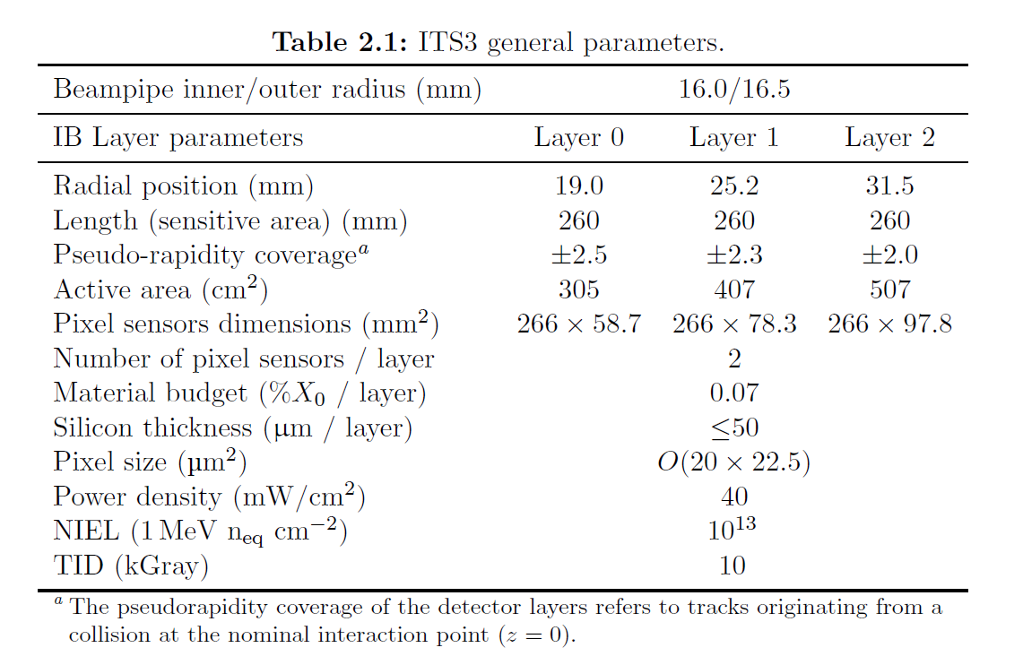
ALPIDE parameters
From CERN-LHCC-2024-003/ALICE-TDR-021：Technical Design Report for the ALICE Inner Tracking System 3 - ITS3 A bent wafer-scale monolithic pixel detector

