Slide 1
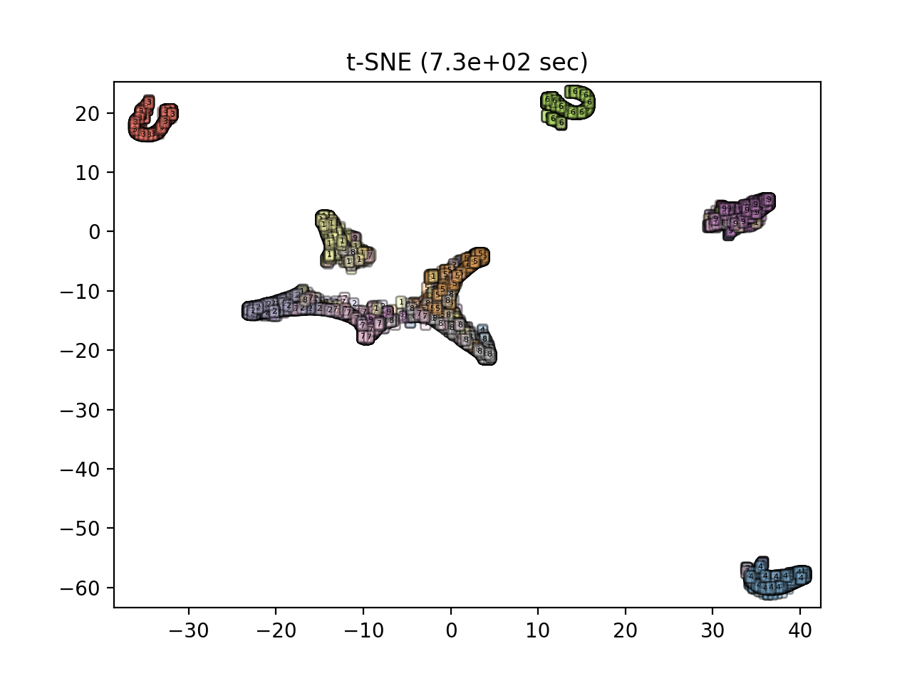

Machine Learning in HEP data processing
李 刚
中国科学院高能物理研究所
IHEP School of Computing 2024, 2024.08.21-23
北京延庆

Slide 2
Disclaimers
This is a very personal review, highly biased
And mainly focusing on classification problems in offline data processing

Slide 3
Outline
Classification as examples
ML in HEP
More ML
Introduction
Summary

Slide 4
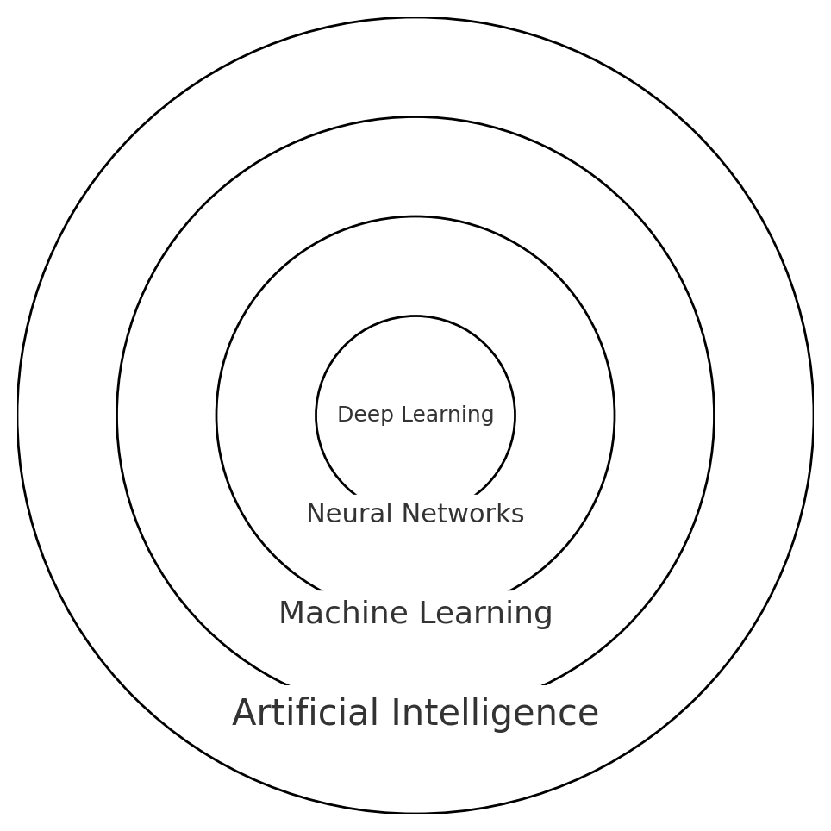
What is Machine Learning ?
Field of study that gives computers the ability to learn without being explicitly programmed
A set of rules that allows systems to learn directly from examples, data and experience
A computer program is said to learn from experience E with respect to some class of tasks T and performance measure P, if its performance at tasks in T, as measured by P, improves with experience E
Machine learning is a set of methods that can automatically detect patterns in data, and then use the uncovered patterns to predict future data or other outcomes of interest
… …

Slide 5
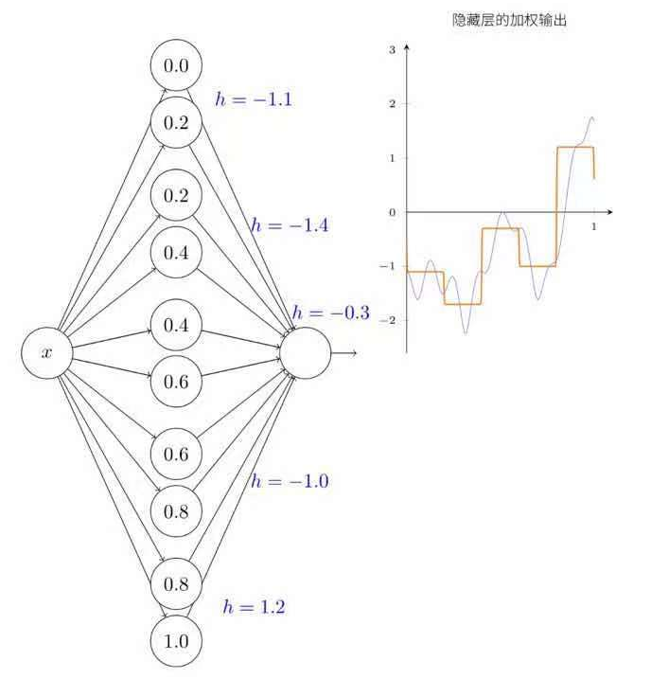
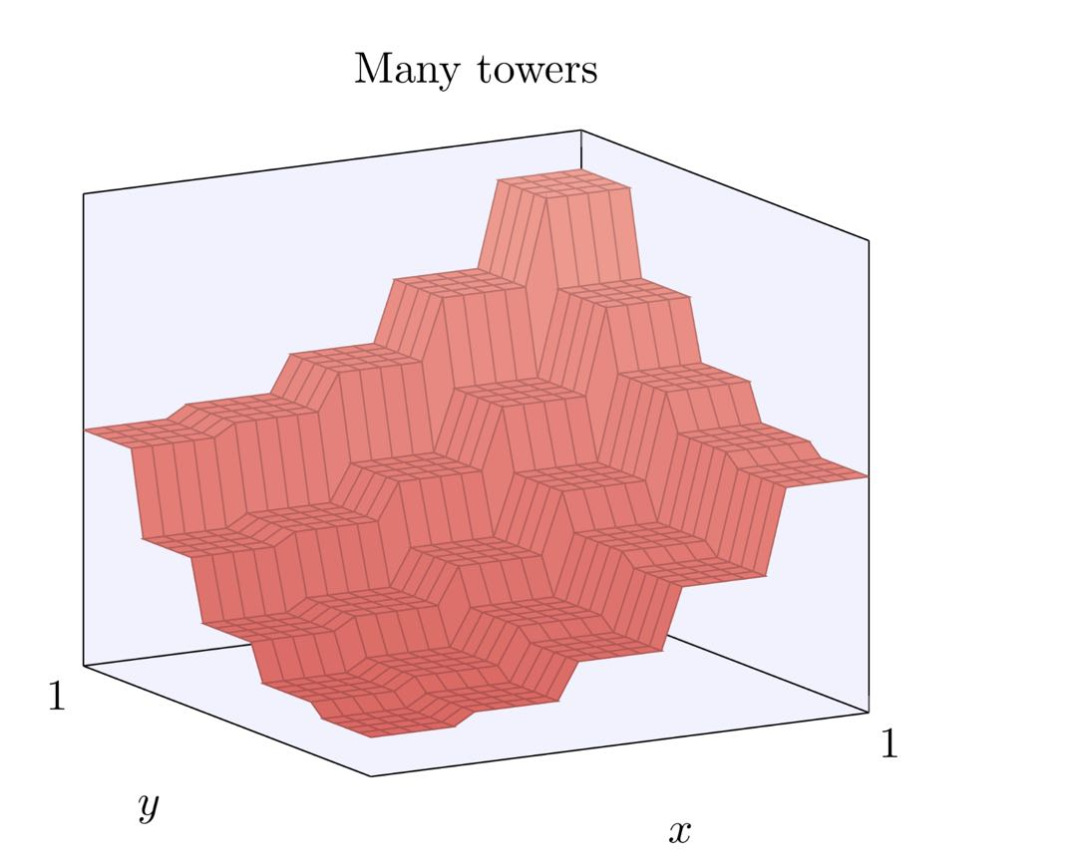
事实 1: Neural network as universal function approximator
1D
2D
A notable fact about neural networks is that they can approximate a continuous function to any desired level of precision, provided that there are enough neurons in the hidden layers.

Slide 6
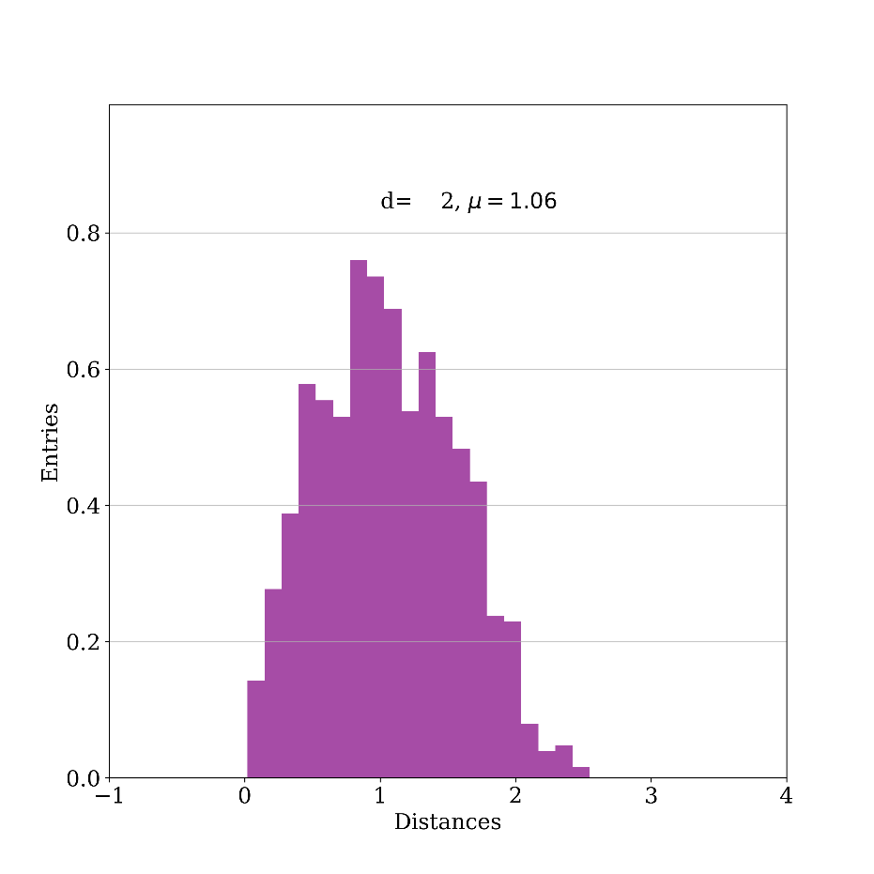
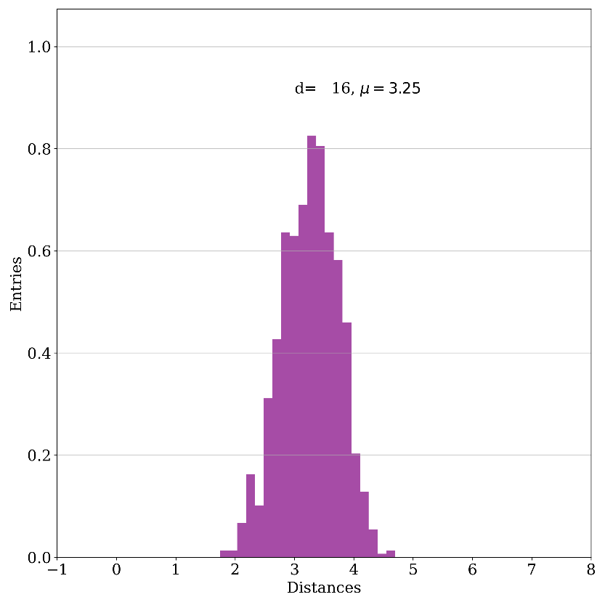
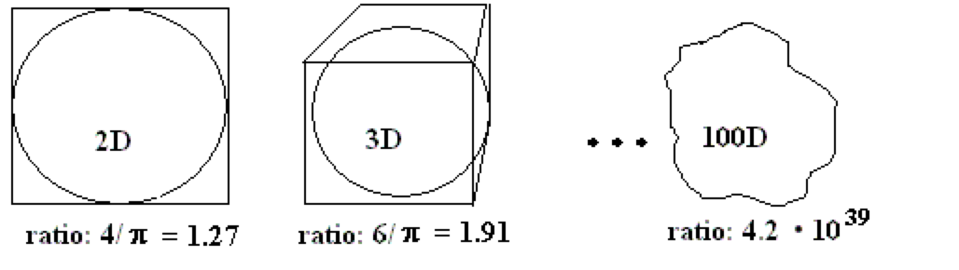
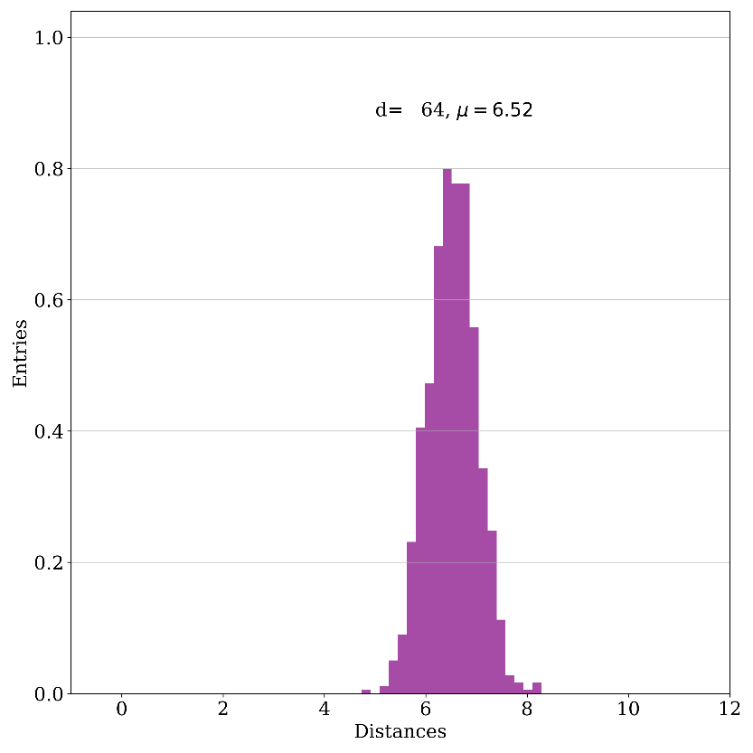
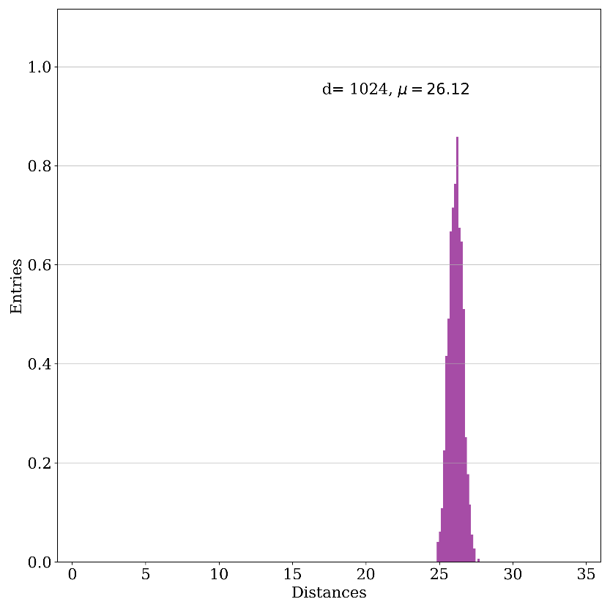
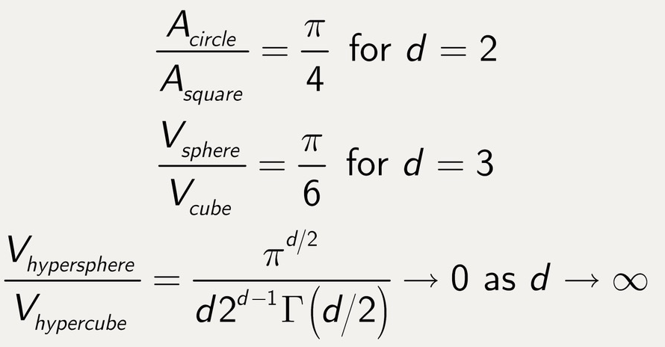
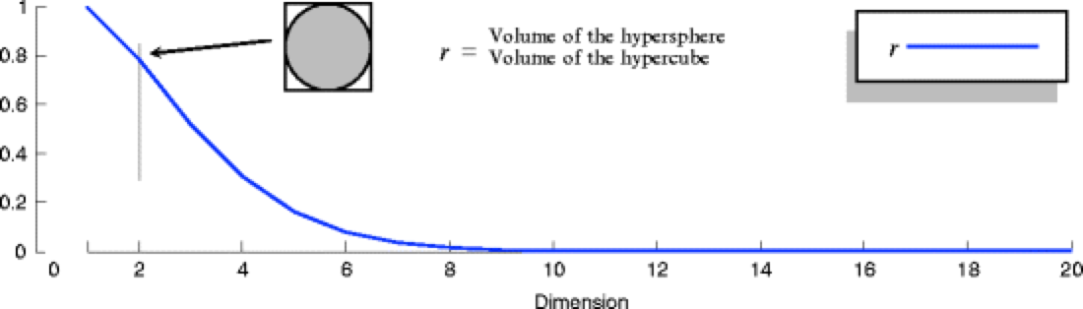
事实 2 : Curse of dimensionality
D=2, d=1.06
D=16 d=3.25
D=16, d=3.25
D=64, d=6.5
D=1024, d=26.12
When D=1: 100 evenly distributed points can sample a unit interval with a distance no greater than 0.01;
When D=10: it requires 10²⁰ sampling points to achieve the same sampling rate.
Almost all points in high-D are isolated
On one hand: fortunately most specific problems can be reduced in dimensionality!

Slide 7
Neural networks have demonstrated their ability to effectively address the dimension problem!

Slide 8
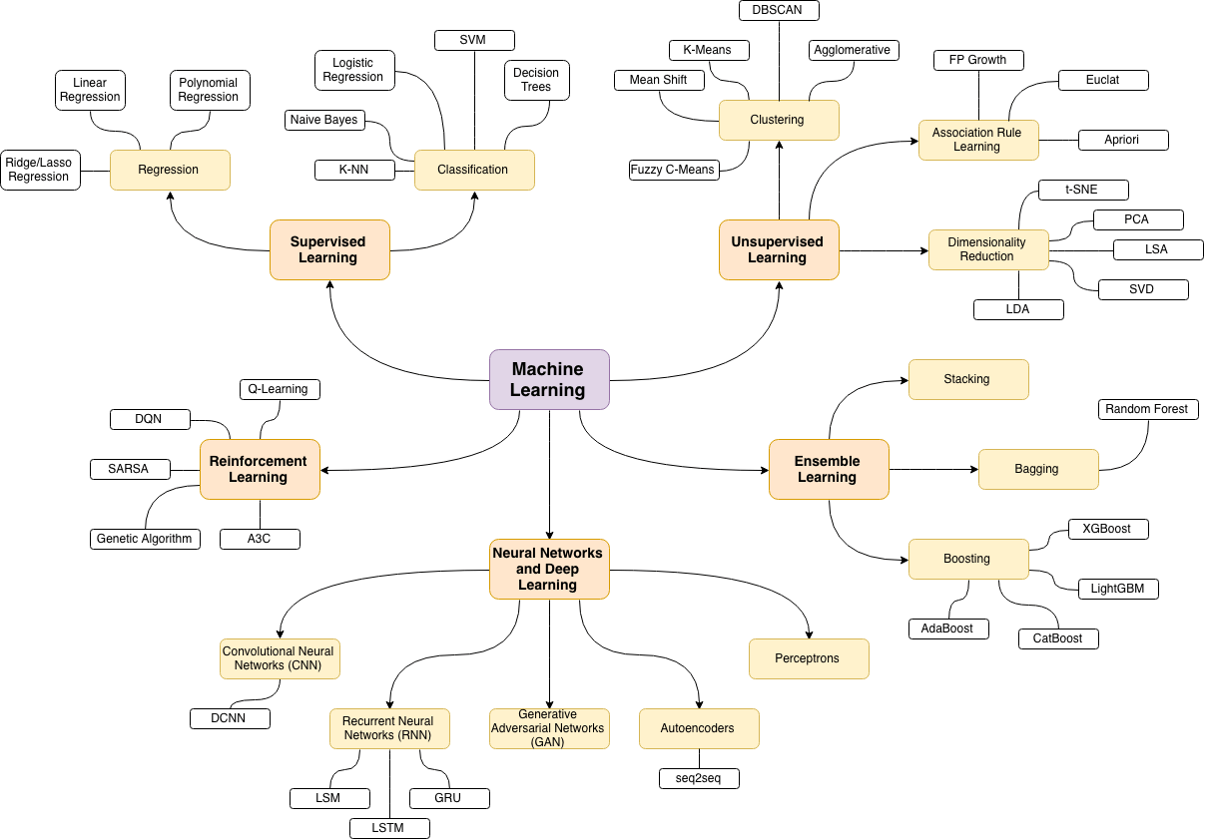
事实 3: No free lunch theorem ( http://www.no-free-lunch.org )
There is no single algorithm that is universally the best for all problems
Performance of a learning algorithm is problem-specific

Slide 9
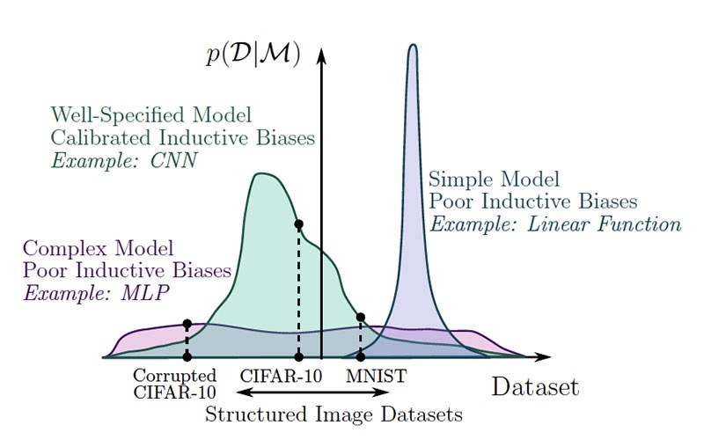
Why do some models perform well on certain datasets? Inductive bias
DeepMind, et al, arXiv:1806.01261

Slide 10
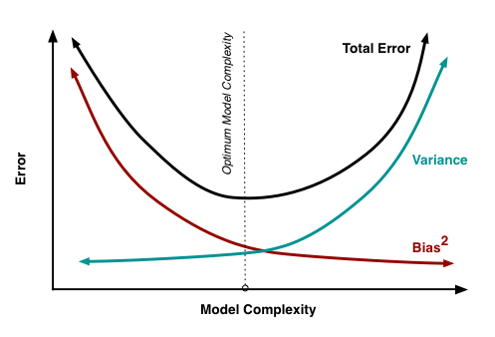
事实 4: bias-variance tradeoff
机器学习模型的目标是最小化预测误差。
预测误差可以分解为偏差、方差和不可减少的误差。
Bias: 模型预测值与真实值之间的差异。高偏差导致模型在训练集上的表现不佳。
Variance :模型在不同数据集上的预测结果的波动。高方差导致模型在新数据上的泛化能力差
Total Error² = Bias² + Variance + Irreducible Error²
理解偏差和方差的关系对于构建有效模型至关重要。
持续调整模型以找到最佳平衡点。

Slide 11
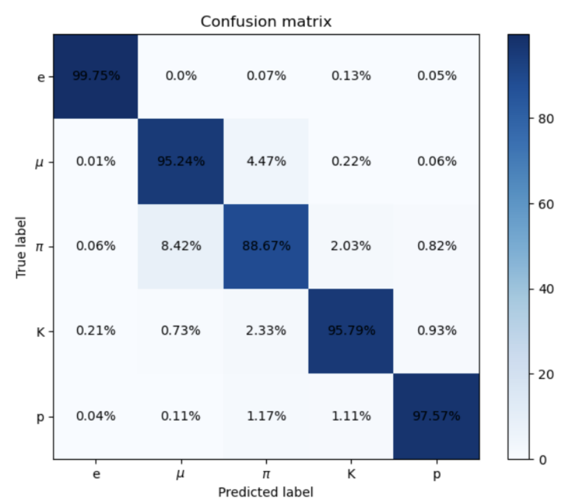
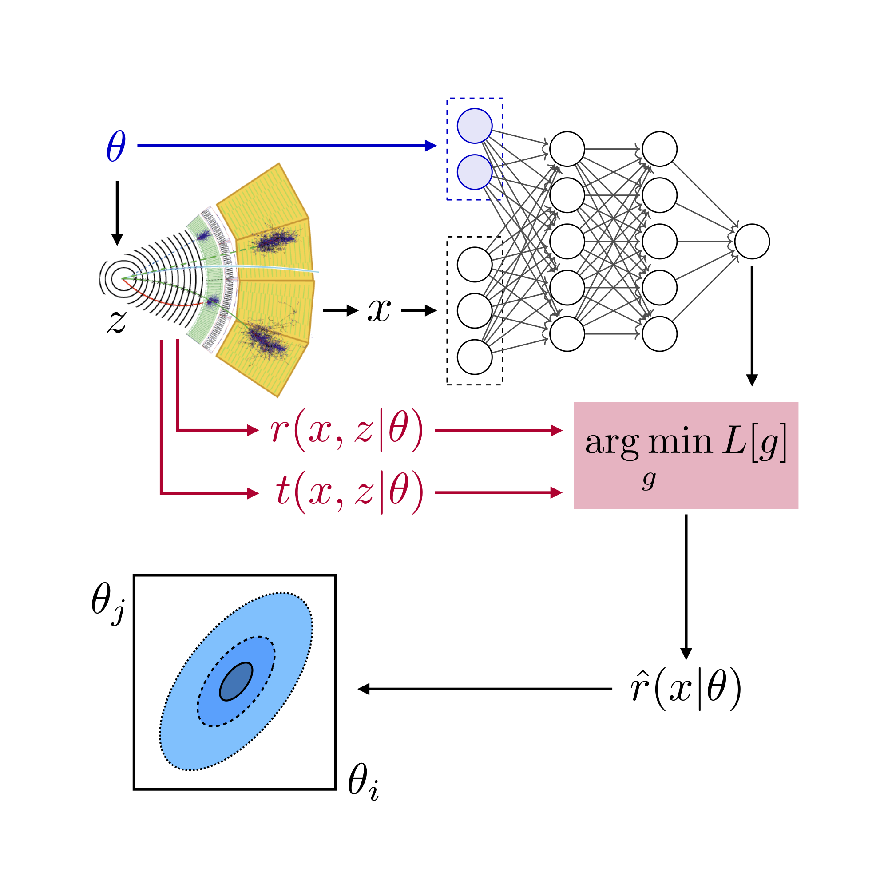
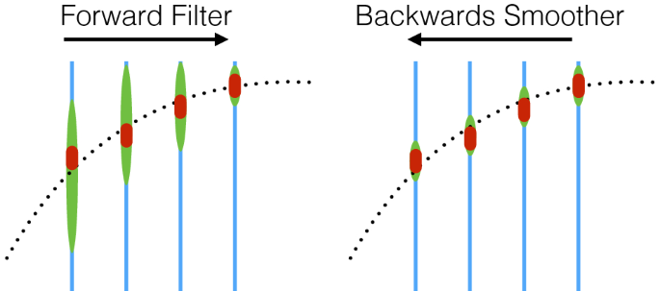
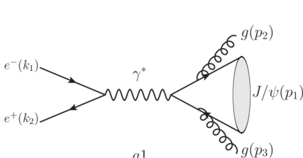
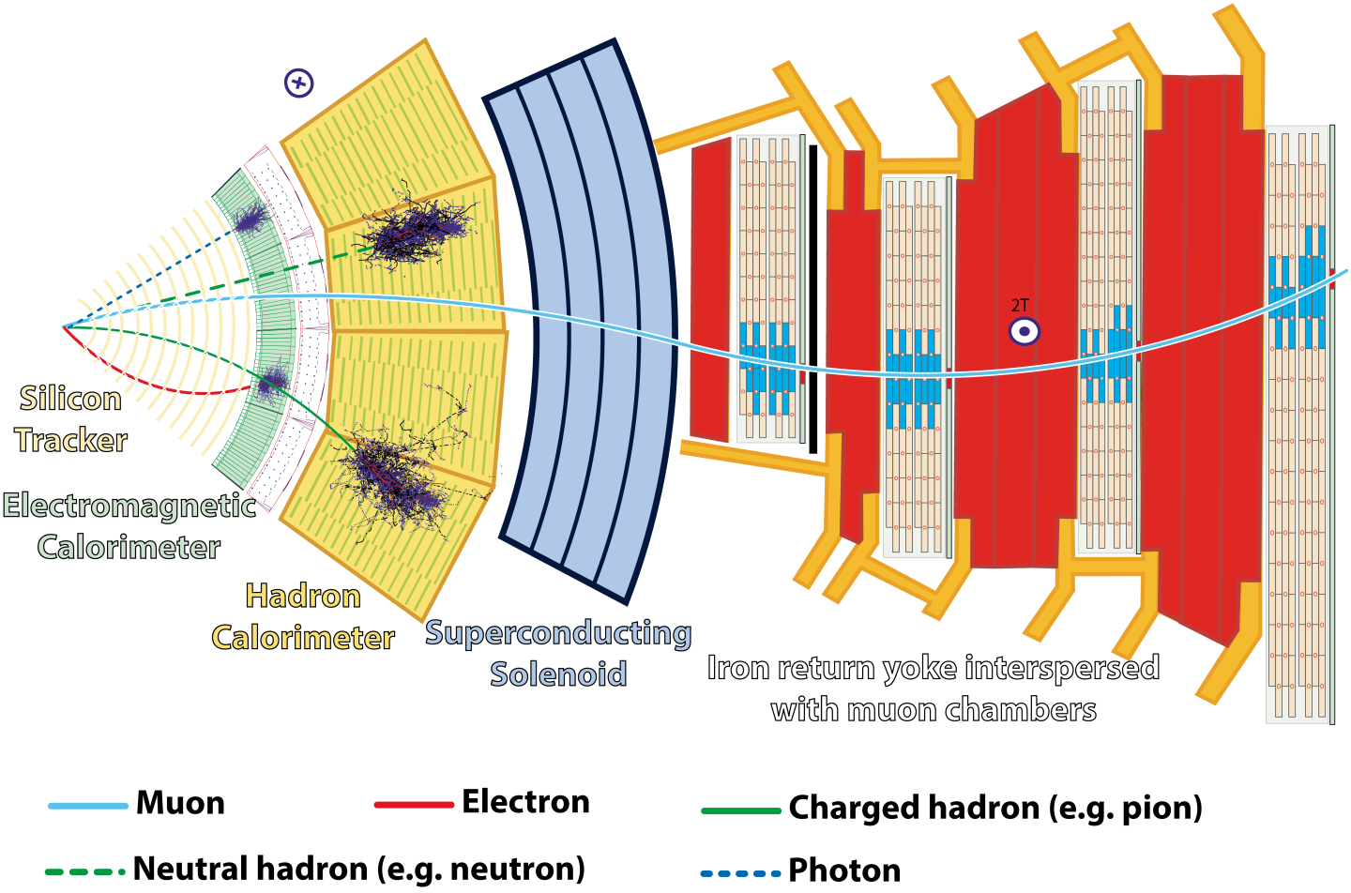
ML in HEP experiments
Noise suppression (FPGA/ASIC)
From Y.C. Zhai
Nature
Detector
Reconstruction
Event selection
Statistical inference
Generators
Simulation
Hits →final state particle :
                Pattern recognition/clustering
                Regression
(Multi-)Classification
Likelihood free inference
Complex processes
Detector response:
e.g. Diffusion model for showering

Slide 12
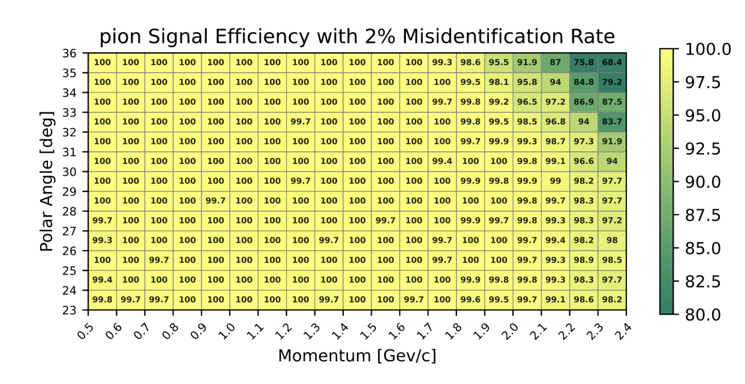
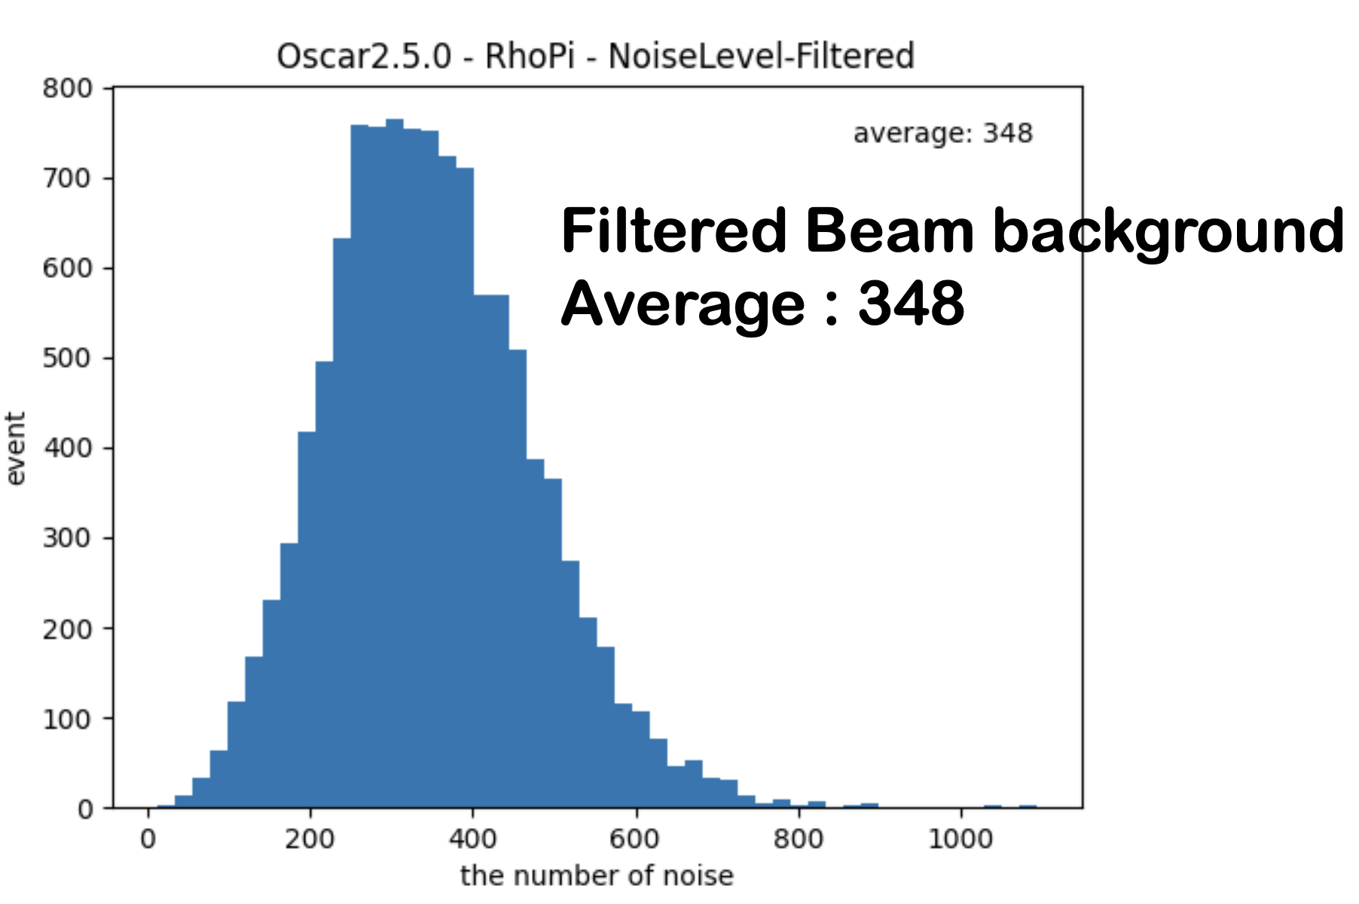
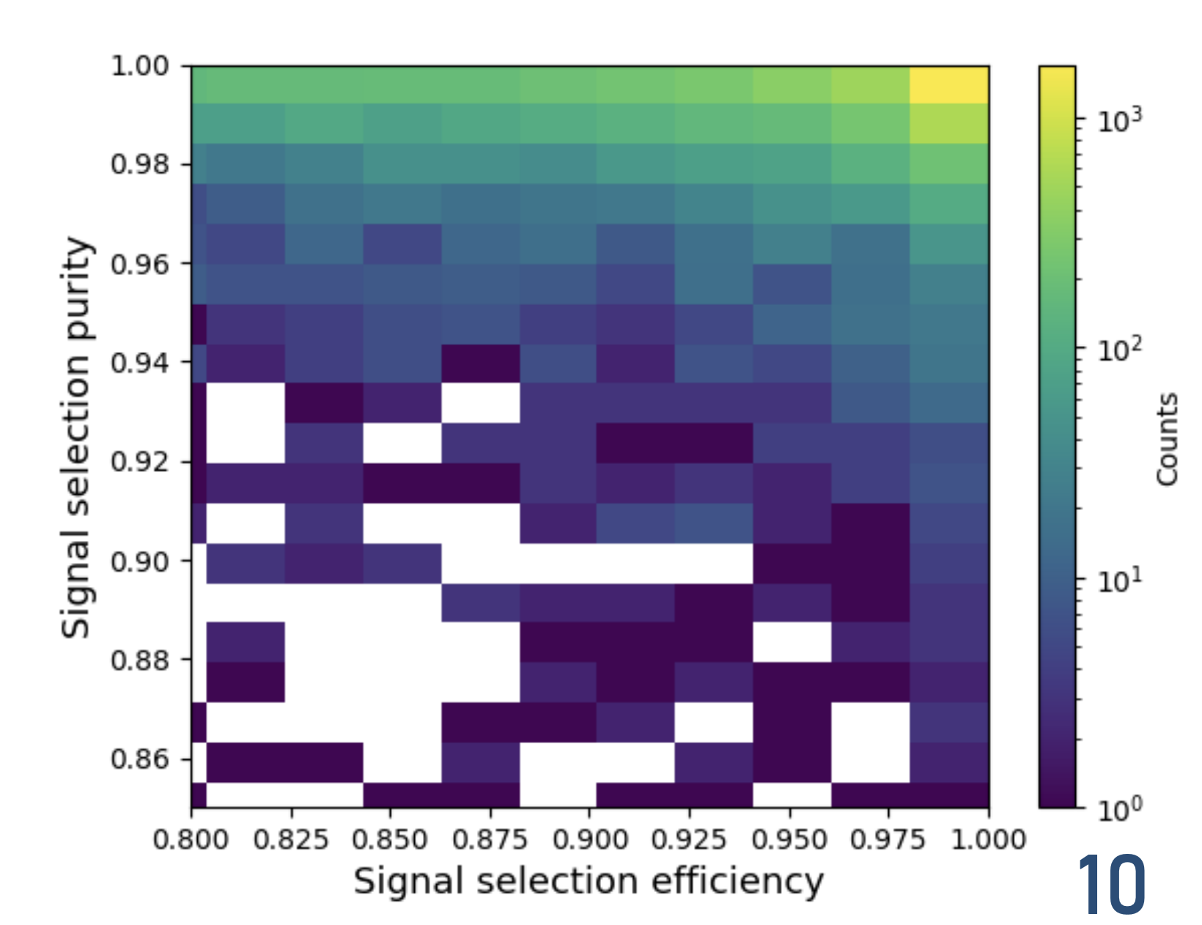
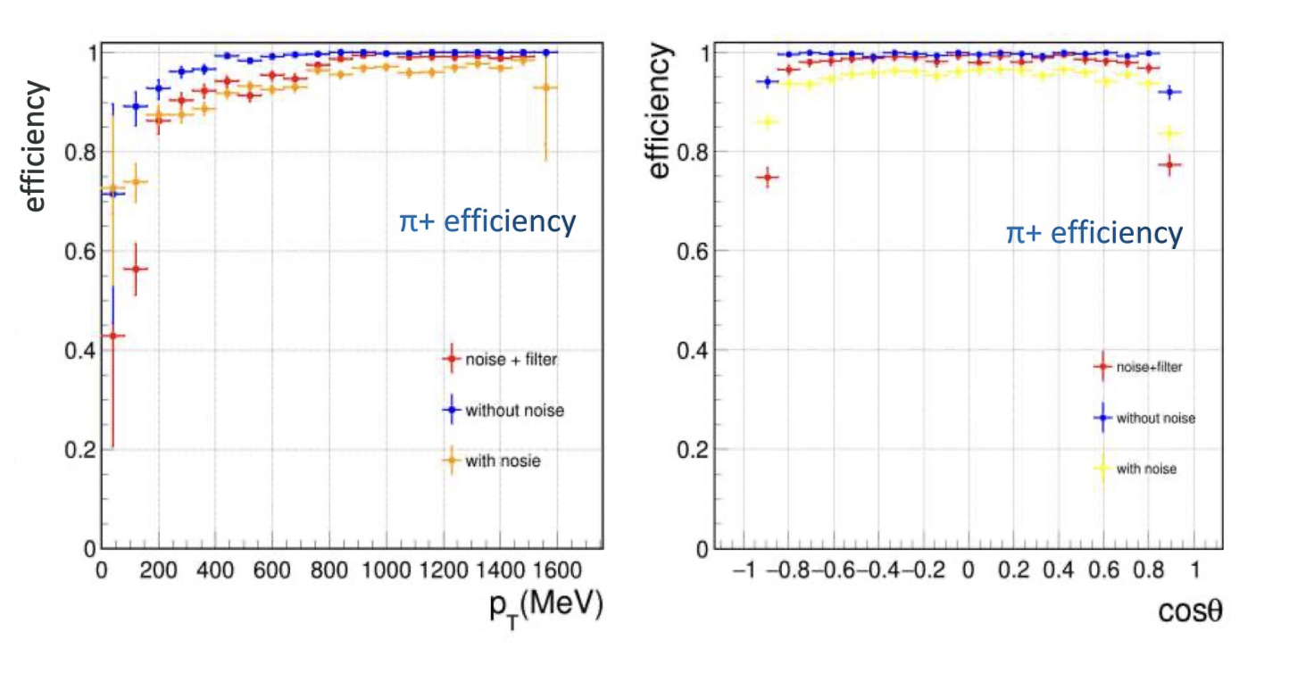
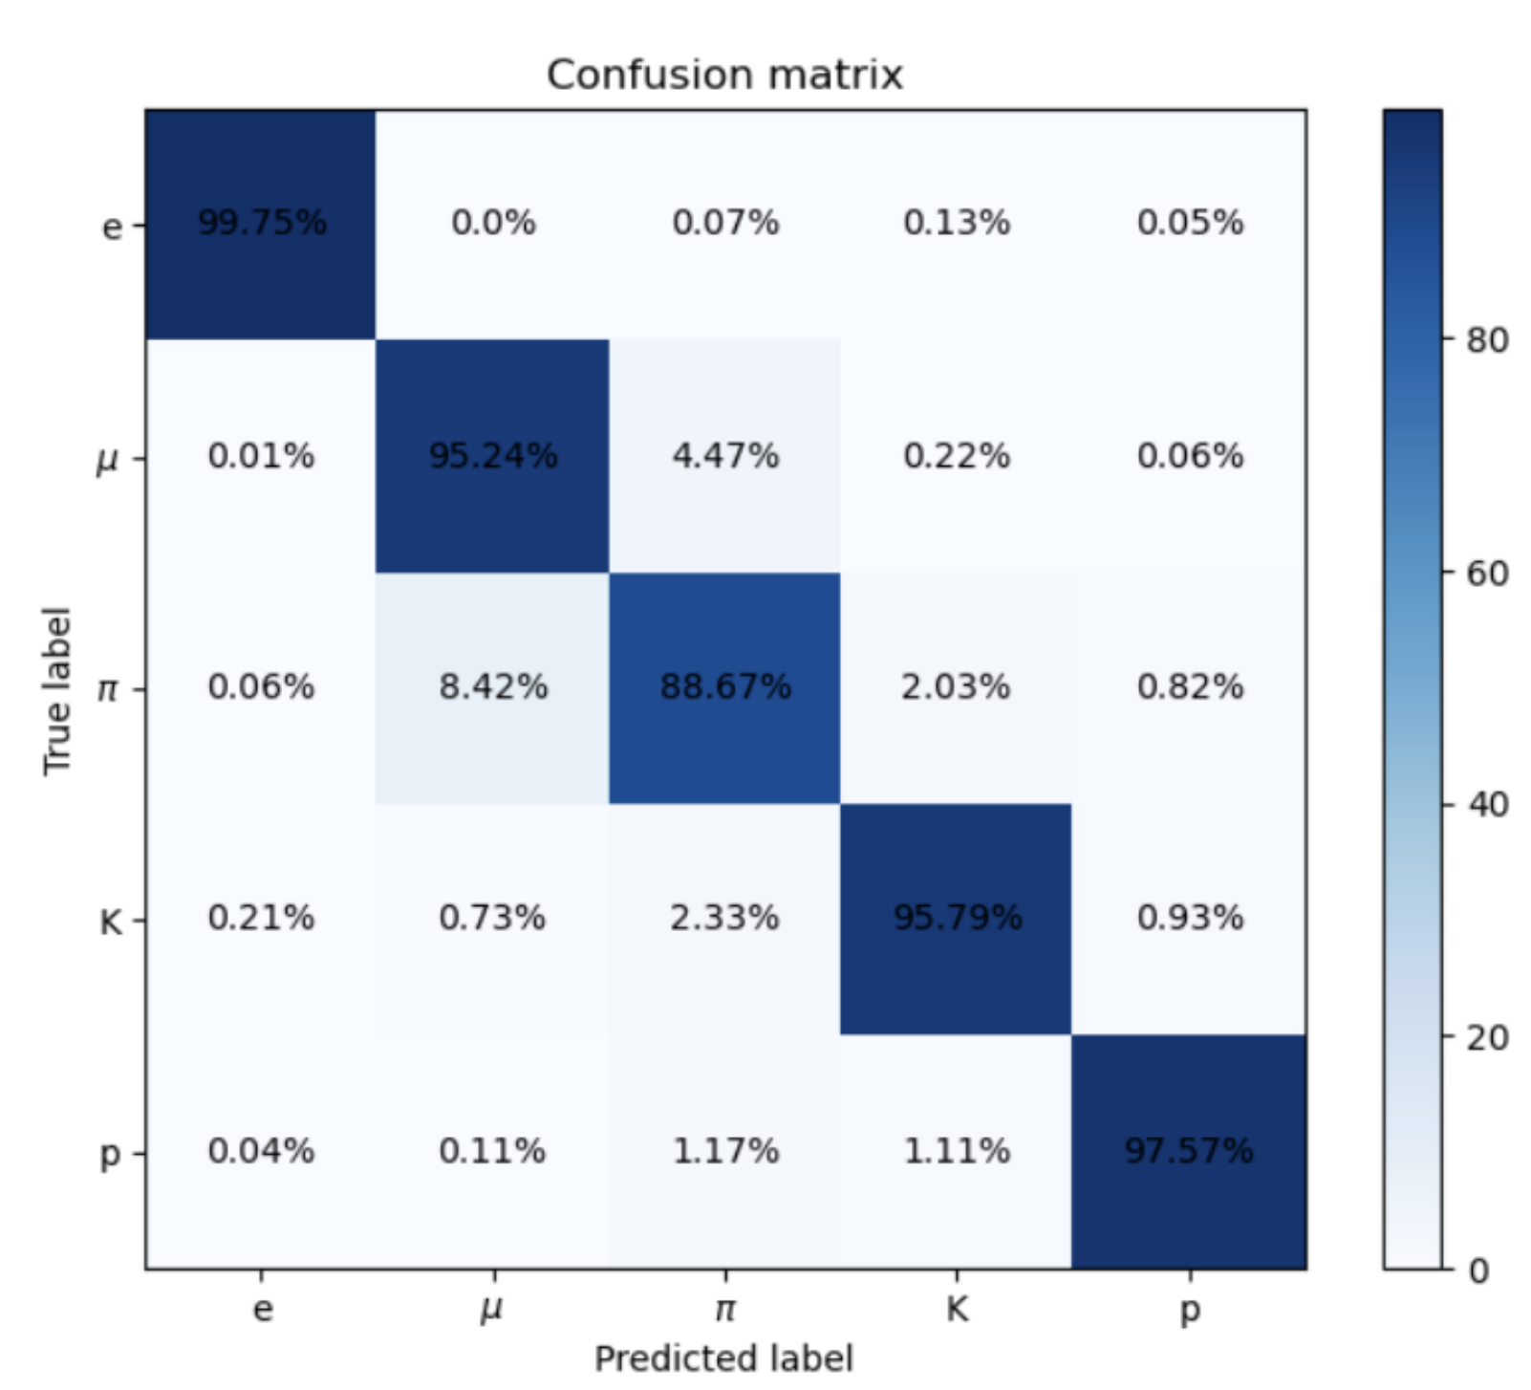
X. Jia: CNN for tracking
Z. Yao: CNN for PID
Y. Zhai: BDT for (global)PID

Slide 13
(Multi-)Classification problem
Jet tagging/W tagger
Event classification

Slide 14
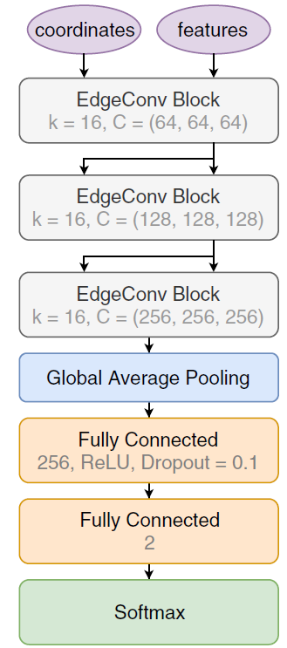
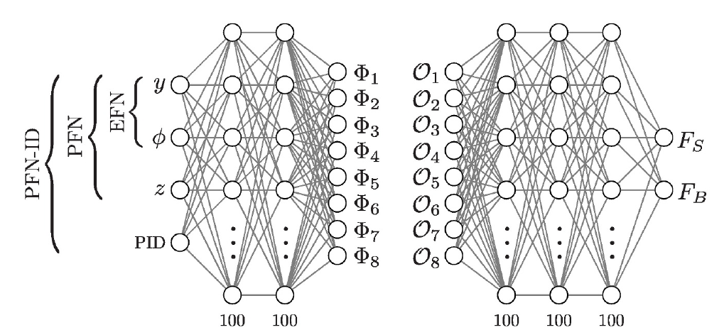
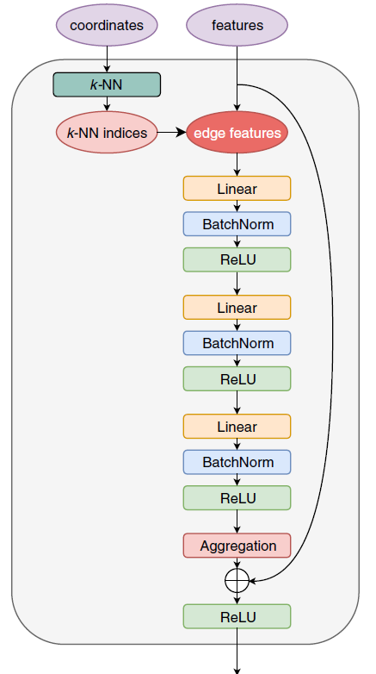
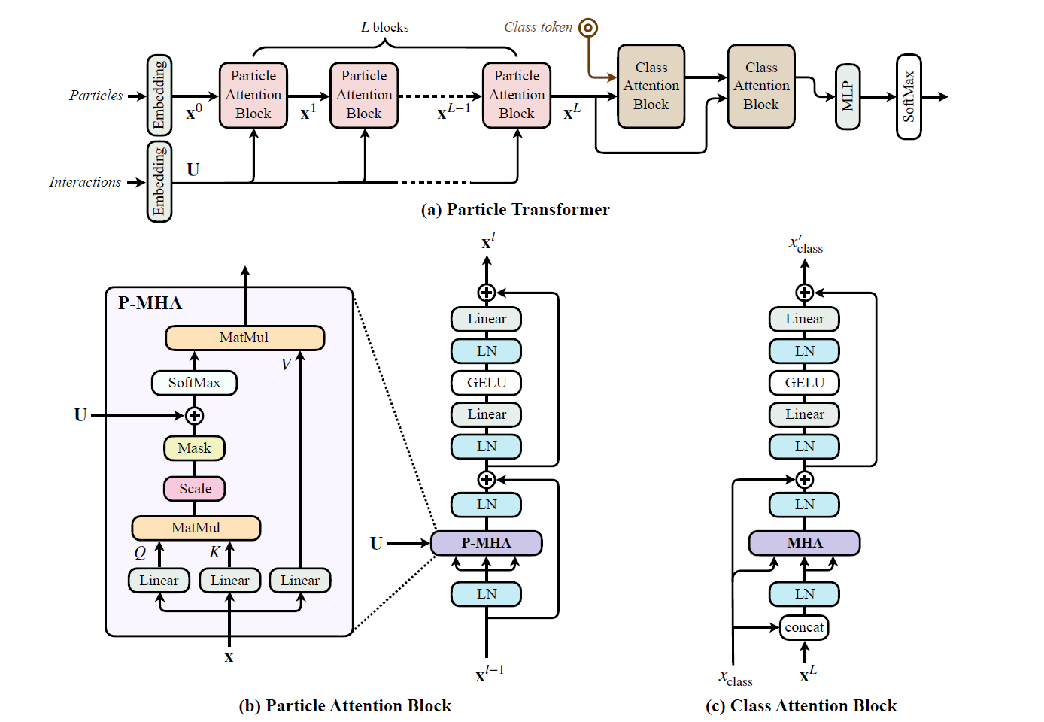
Algorithms used
Energy Flow Network(EFN) / Particle Flow Network(PFN)
ParticleNet
ParticleTransformers
(ParT)
P. T. Komiske, E. M. Metodiev and J. Thaler [JHEP01(2019)121]
H. Qu and L. Gouskos [Phys.Rev.D 101 (2020) 5, 056019]
Φ
H. Qu , C. Li, S. Qian [2202.03772]
F

Slide 15
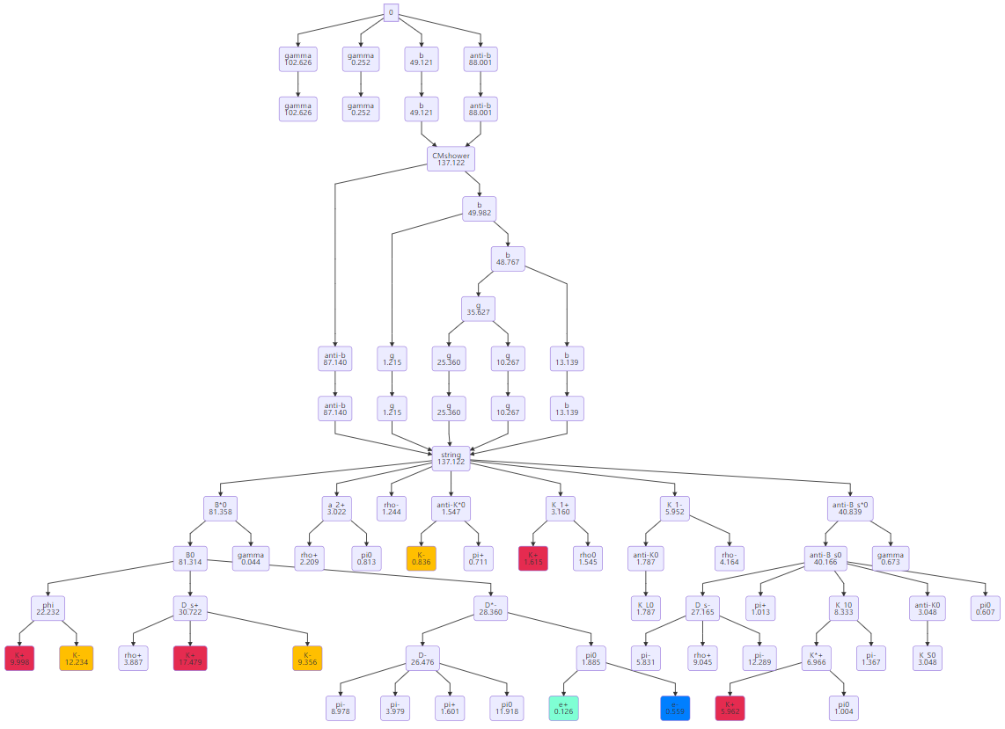
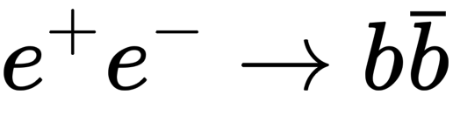
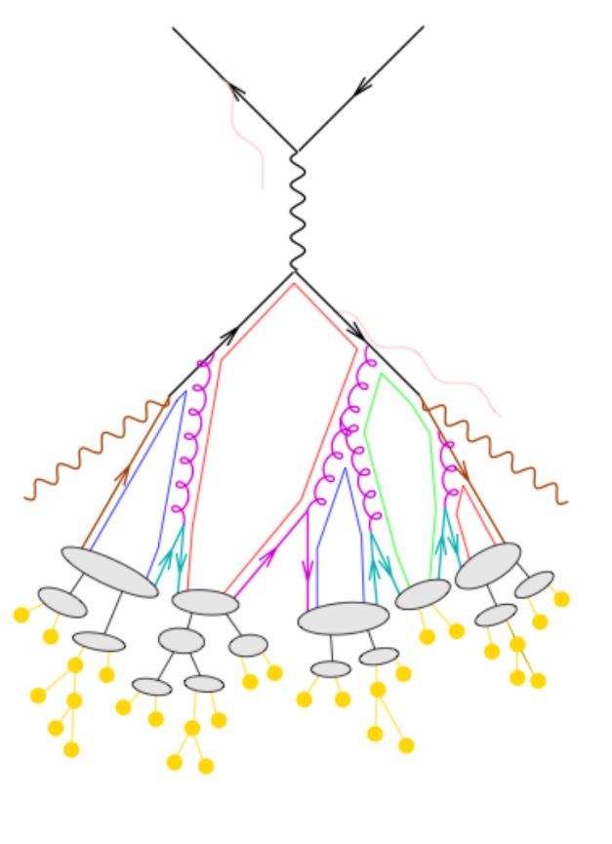
Hard process
Fragmentation

Slide 16

Jet (flavor) tagging(单个喷注)
91 GeV
Z → bb, cc, ll (uu,dd,ss)
450k events（900k jets）for each class
Take particle level information a input
  4-momenta
  d0/z0
  PID
  … …

Slide 17
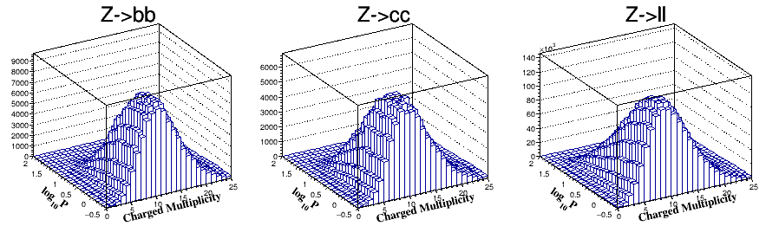
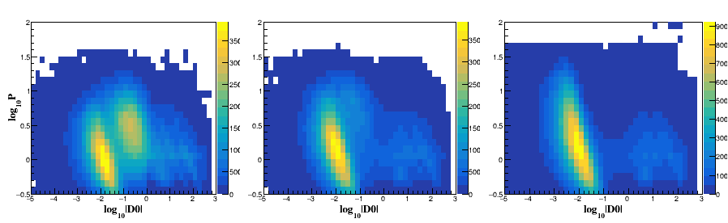
Multiplicity, impact parameters

Slide 18
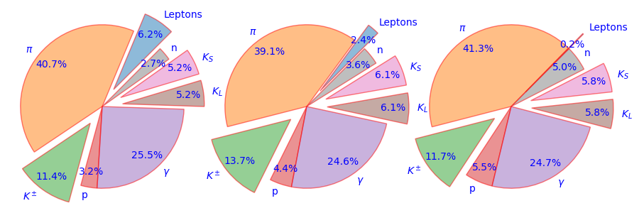
PID information
b
c
light
Weighted by momenta

Slide 19
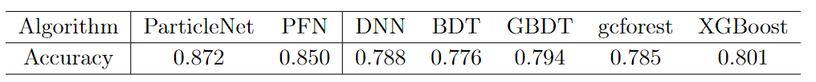
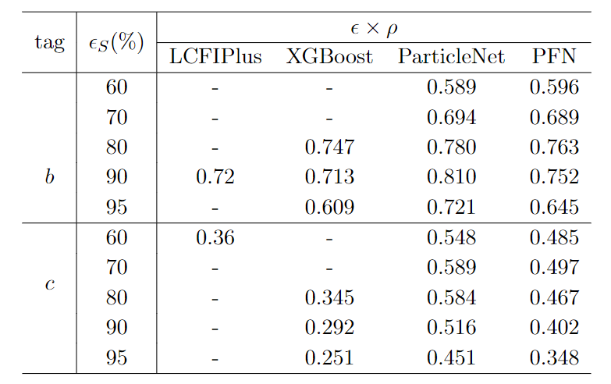

Accuracy
Purity ✕ efficiency
Take c-tagging as example
sqrt(0.584/0.345)=1.3
Statistical uncertainty: 30%

Slide 20
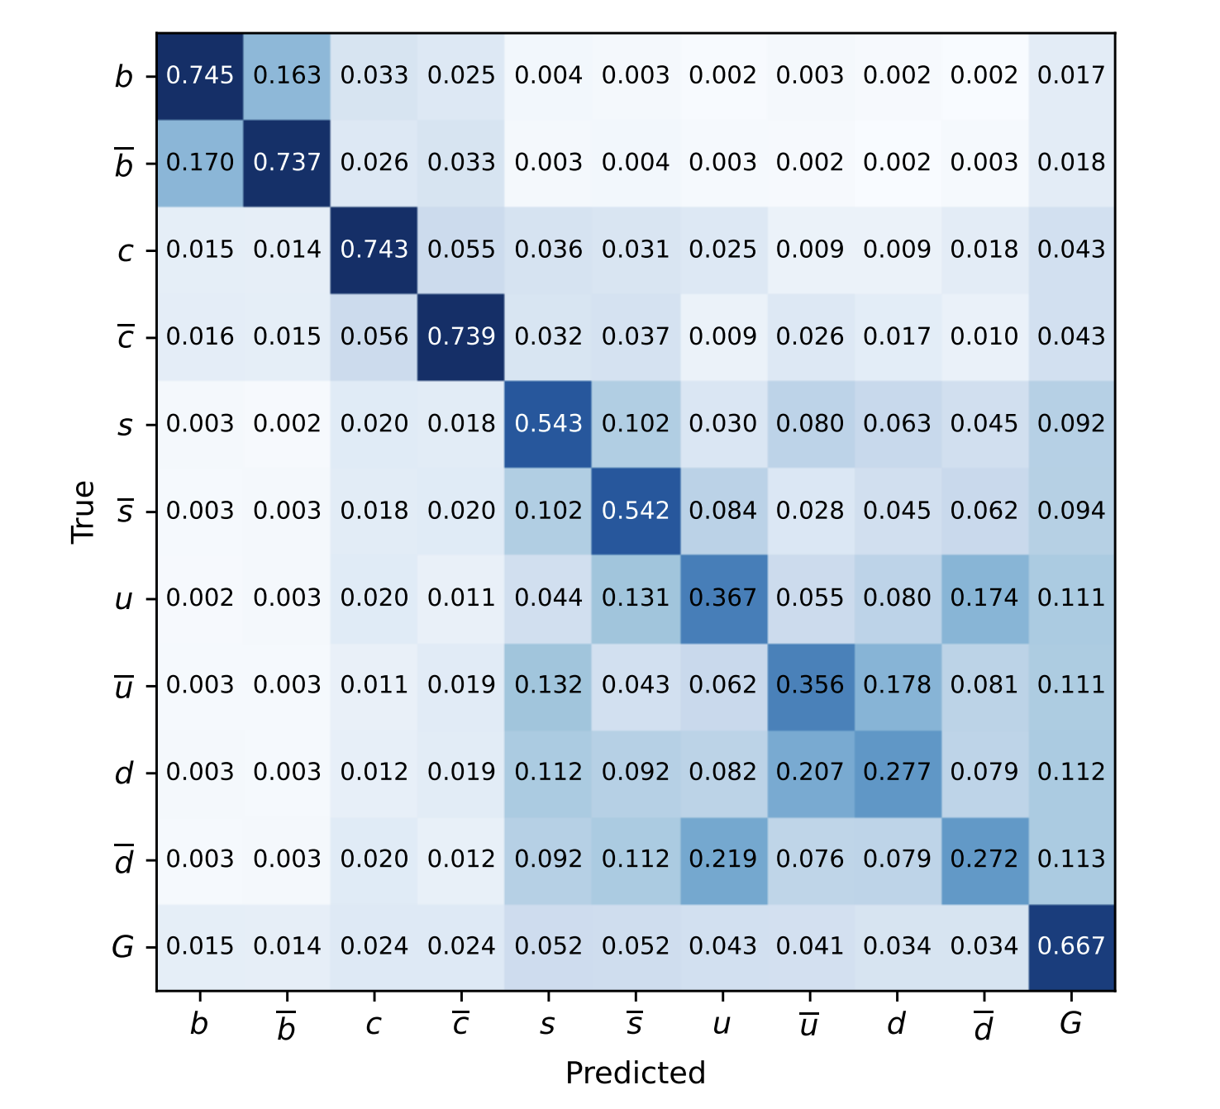
11 classes
Ambitious test by M. Ruan
Phys. Rev. Lett. 132, 221802 (2024)

Slide 21
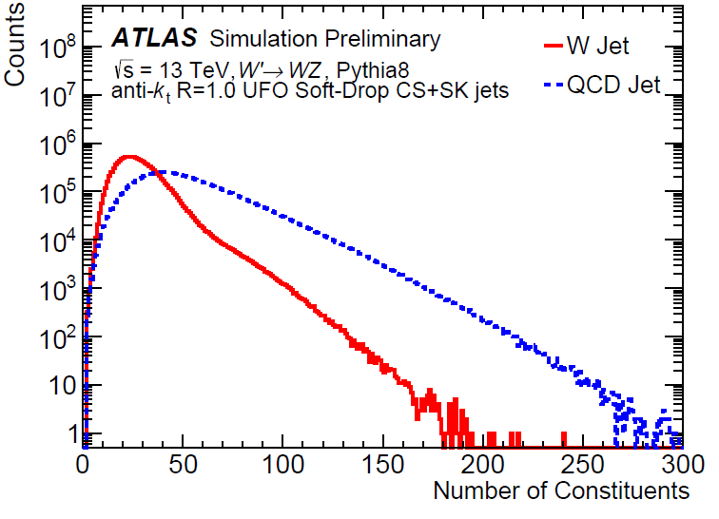
𝑊 Jet Taggers (ATLAS, by Shudong Wang)
(一对喷注)
In this study, a maximum of 200 constituents are considered by all constituent-based taggers. Only a small portion of jets in the dataset have more than 200 constituents (less than 0.04%). As jet constituents are sorted by decreasing 𝑝_{T}, truncation eliminates the softest constituents of the jet.

Slide 22
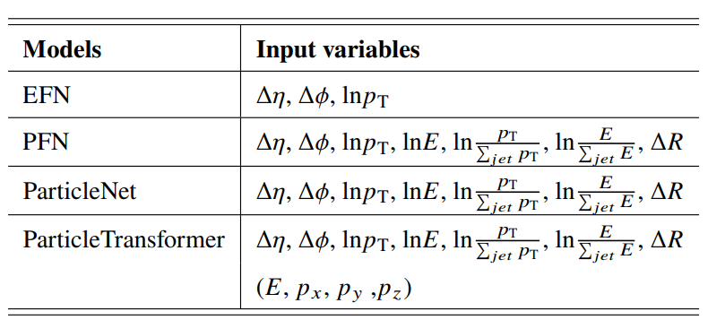
𝑊 Jet Taggers
Particle Flow Network(PFN)/Energy Flow Network(EFN)
  Based on Deep Sets Theorem
  JHEP01(2019)121
ParticleNet
  Customized graph neural network architecture for jet tagging with the point cloud approach
  Phys.Rev.D 101 (2020) 5, 056019
ParticleTransformer
  Transformer designed for particle physics
  arxiv: 2202.03772
Input features used in each tagger.

Slide 23
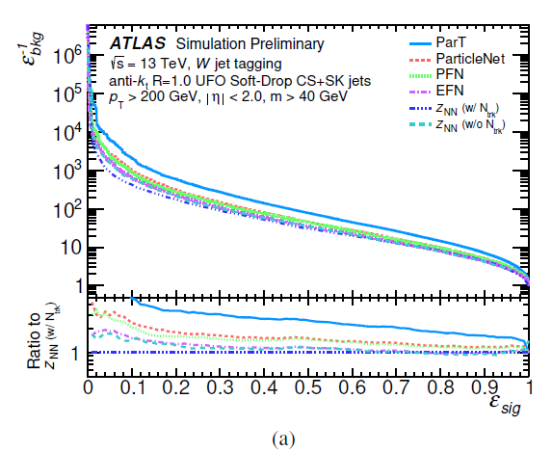
Tagger Performance
Comparison of different taggers
Calculated using samples with steeply falling pT spectra, i.e. both sig & bkg are weighted to have falling pT spectra.
For a signal efficiency of 0.5 (0.8) case,
the background rejection of ParticleTransformer is about 1.8-2.8 (1.6-2.7) times better than the baseline tagger.

Slide 24
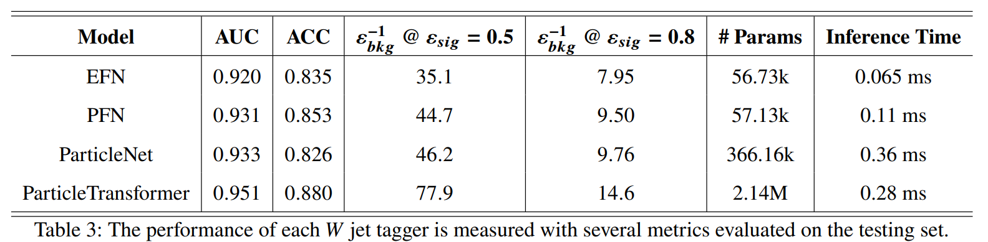
Tagger Performance
Comparison of different taggers
Transformers the best
But the # of parameters is almost one order of magnitude larger

Slide 25
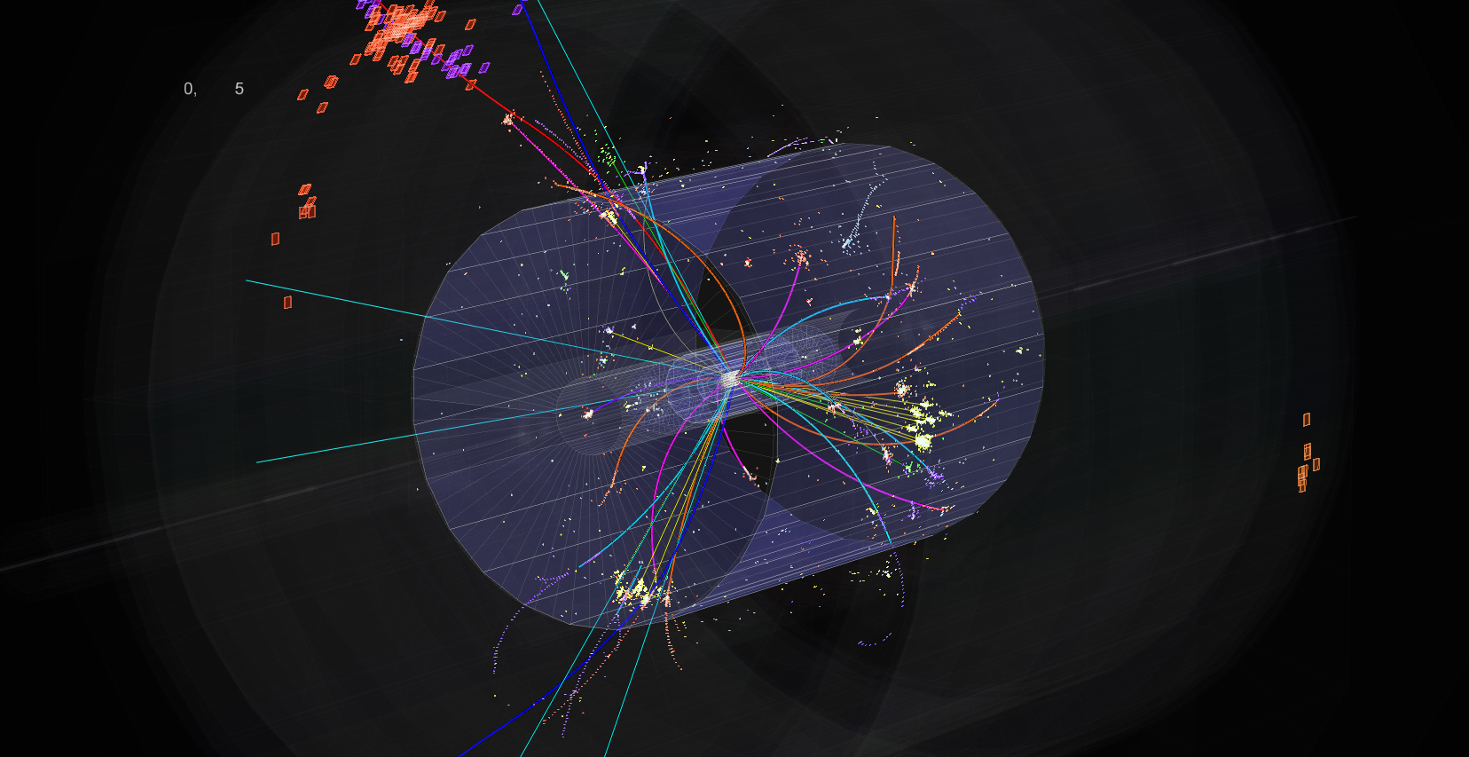
e⁺e⁻ → ZH → 4 jets
(一个事例喷注)

Slide 26
Many processes are selected simultaneously
Prod/decay | cc | bb | mm | ττ | gg | gg | WW | ZZ | aZ | ee, uu,dd,ss
eeH | 3 | 1 | 5 | 2 | 4 | 1 | 2 | 3 | 5 | Not covered yet
mmH | 3 | 1 | 5 | 2 | 4 | 1 | 2 | 3 | 5
ττH | 3 | 1 | 5 | 2 | 4 | 1 | 2 | 3 | 5
qqH | 4 | 1 | 2 | 1 | 2 | 5 | 5 | 5 | 3
nnH | 5 | 1 | 3 | 2 | 3 | 5 | 4 | 2 | 4
Consider: psi(2S) → pi+ pi- J/psi, J/psi → various processes

Slide 27
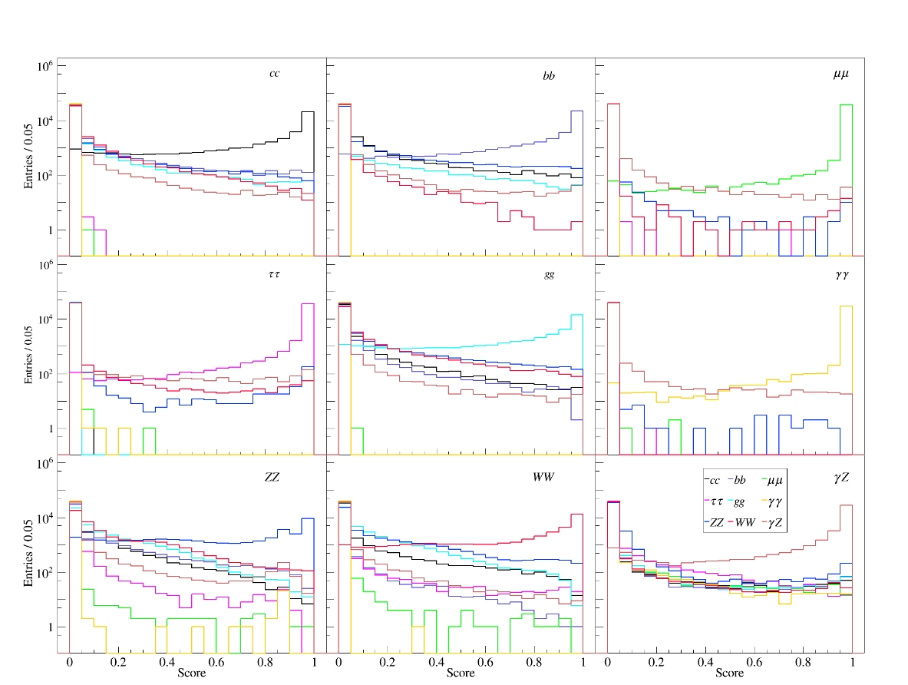
Try eeH first
Probability distributions of each class

Slide 28
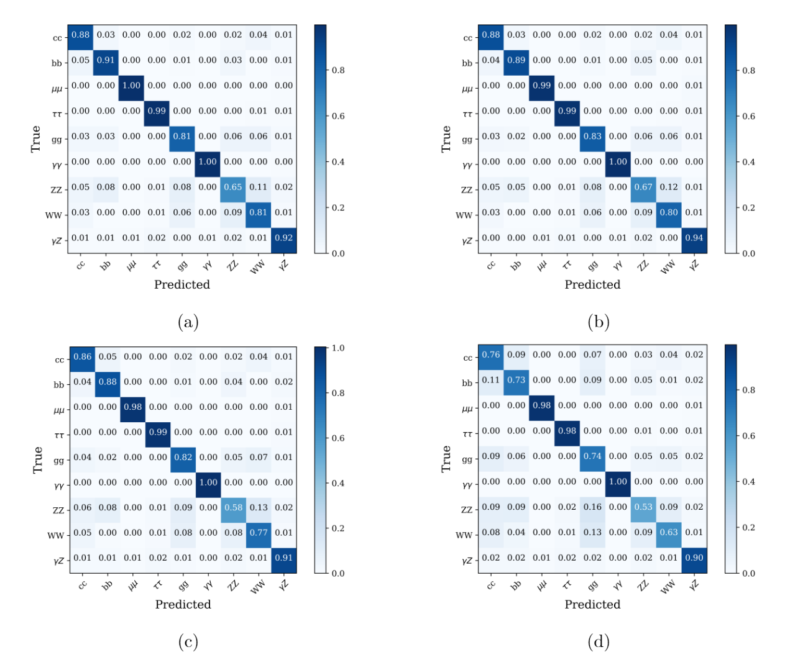
Try eeH first
Sufficiently good performance
Average Accuracy ~ 87%
(11% for random guess)
Taking the one has largest probability (ArgMax)

Slide 29
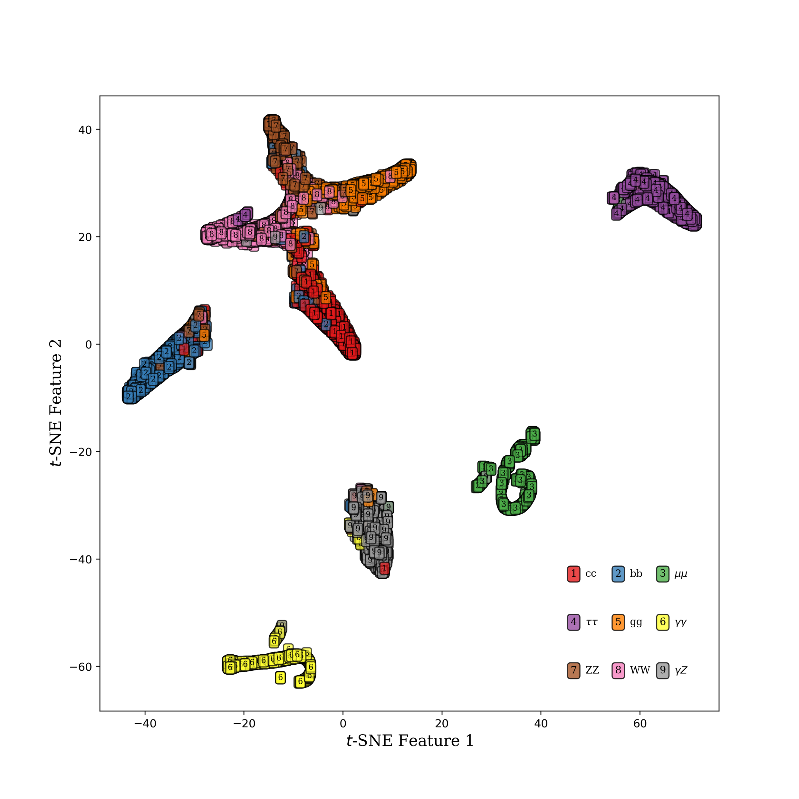
Dimension reduction tells us more
μμ, γγ, ττ well classified as expected
bb and γZ also good
cc, gg, WW, and ZZ fake each other, but under control
Dimensional reduction ( t-SNE )

Slide 30


All 4 production modes
eeH
$μμ$H
$ττ$H
qqH

Slide 31
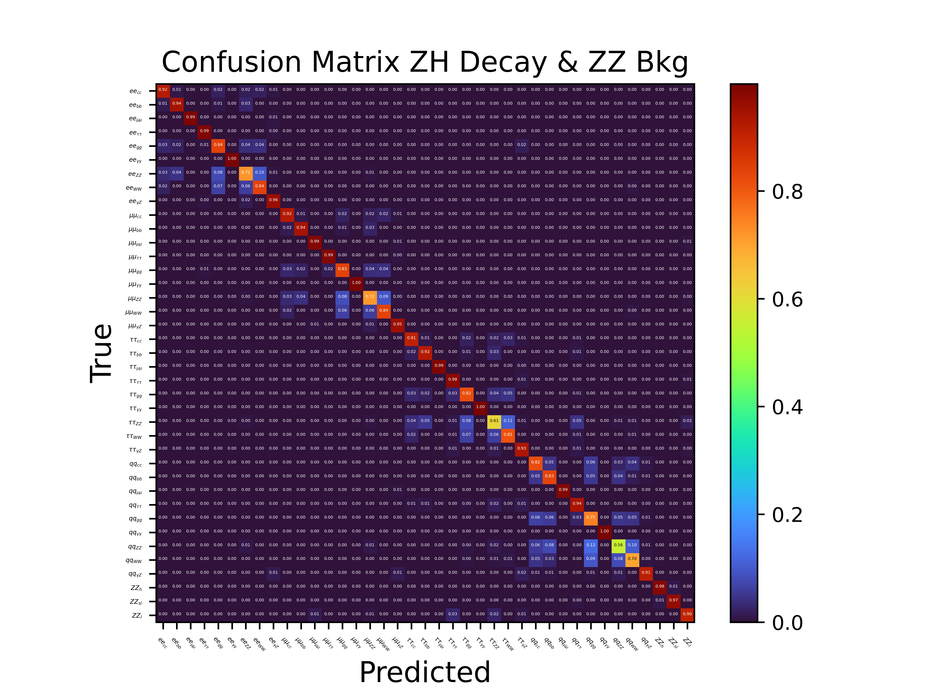

Slide 32
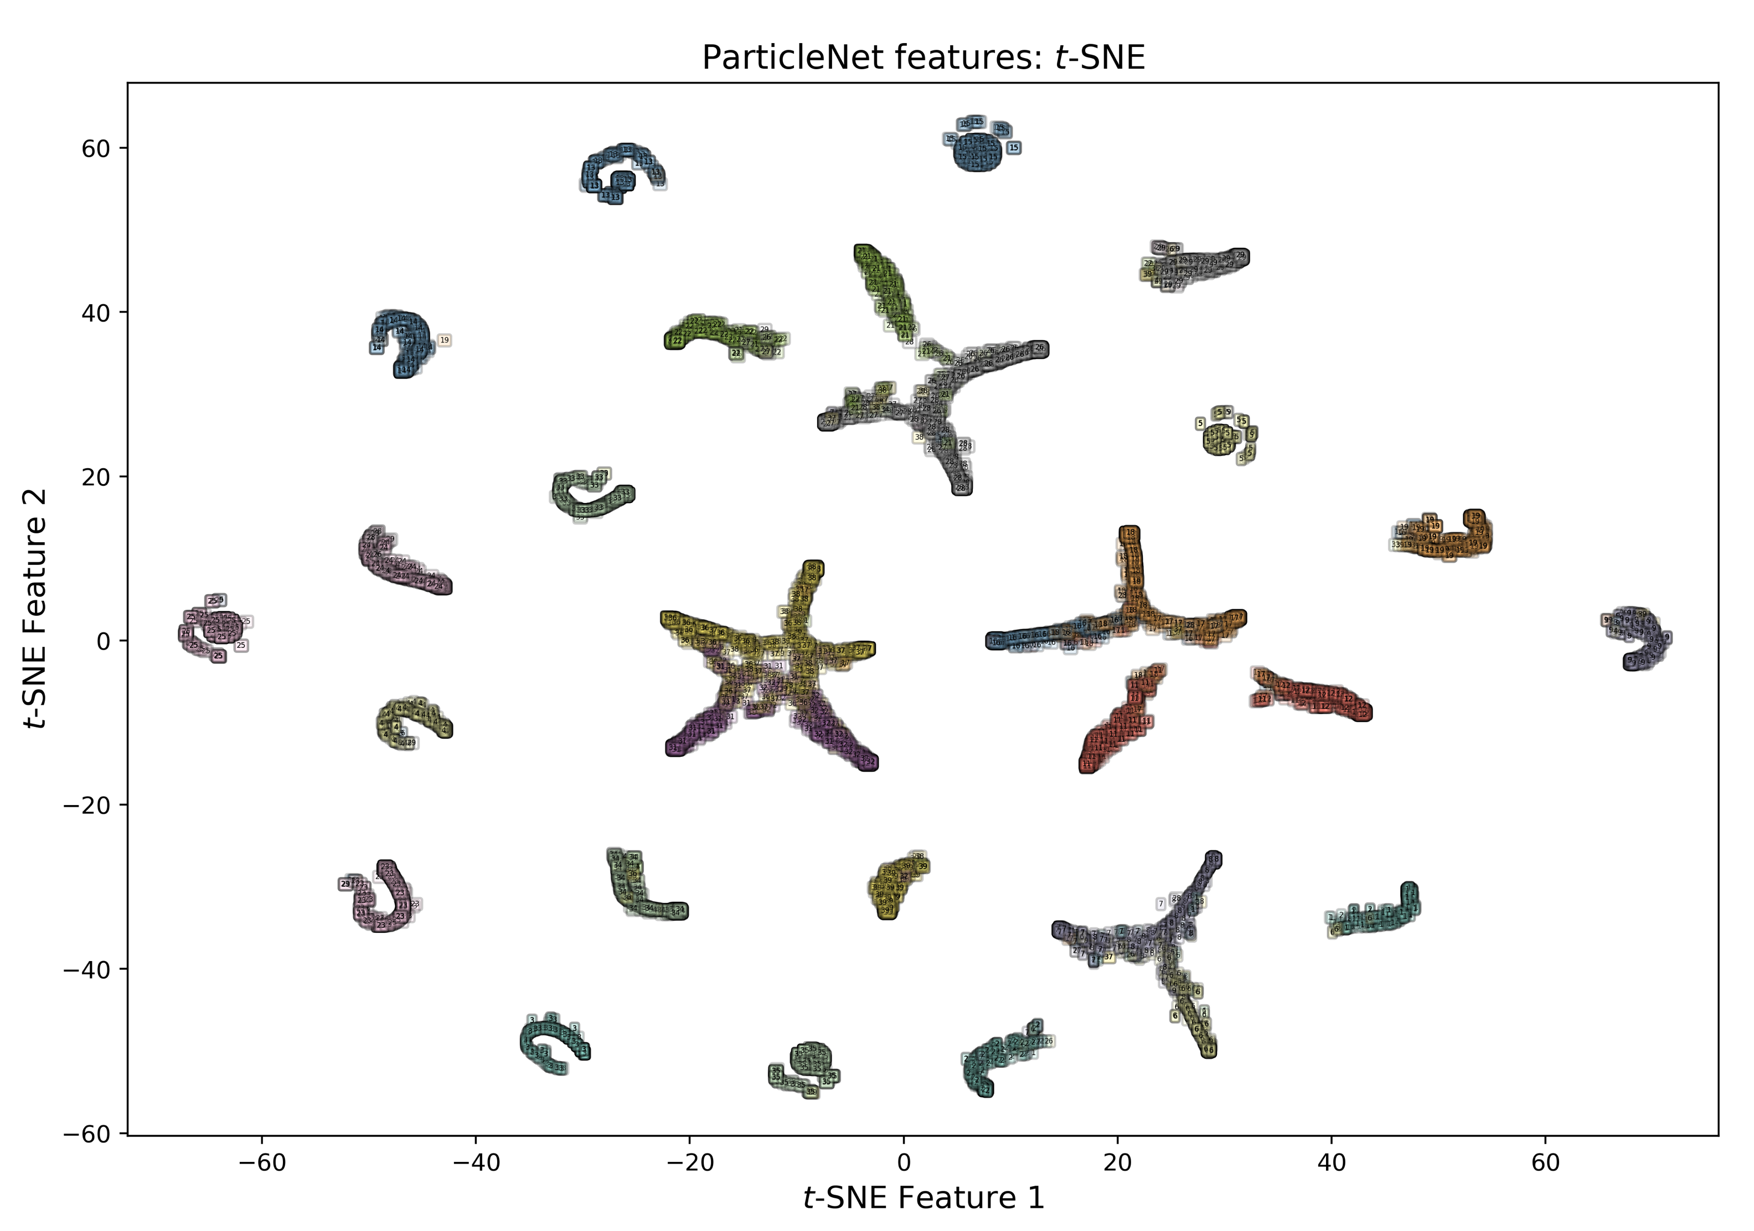
Only signals

Slide 33
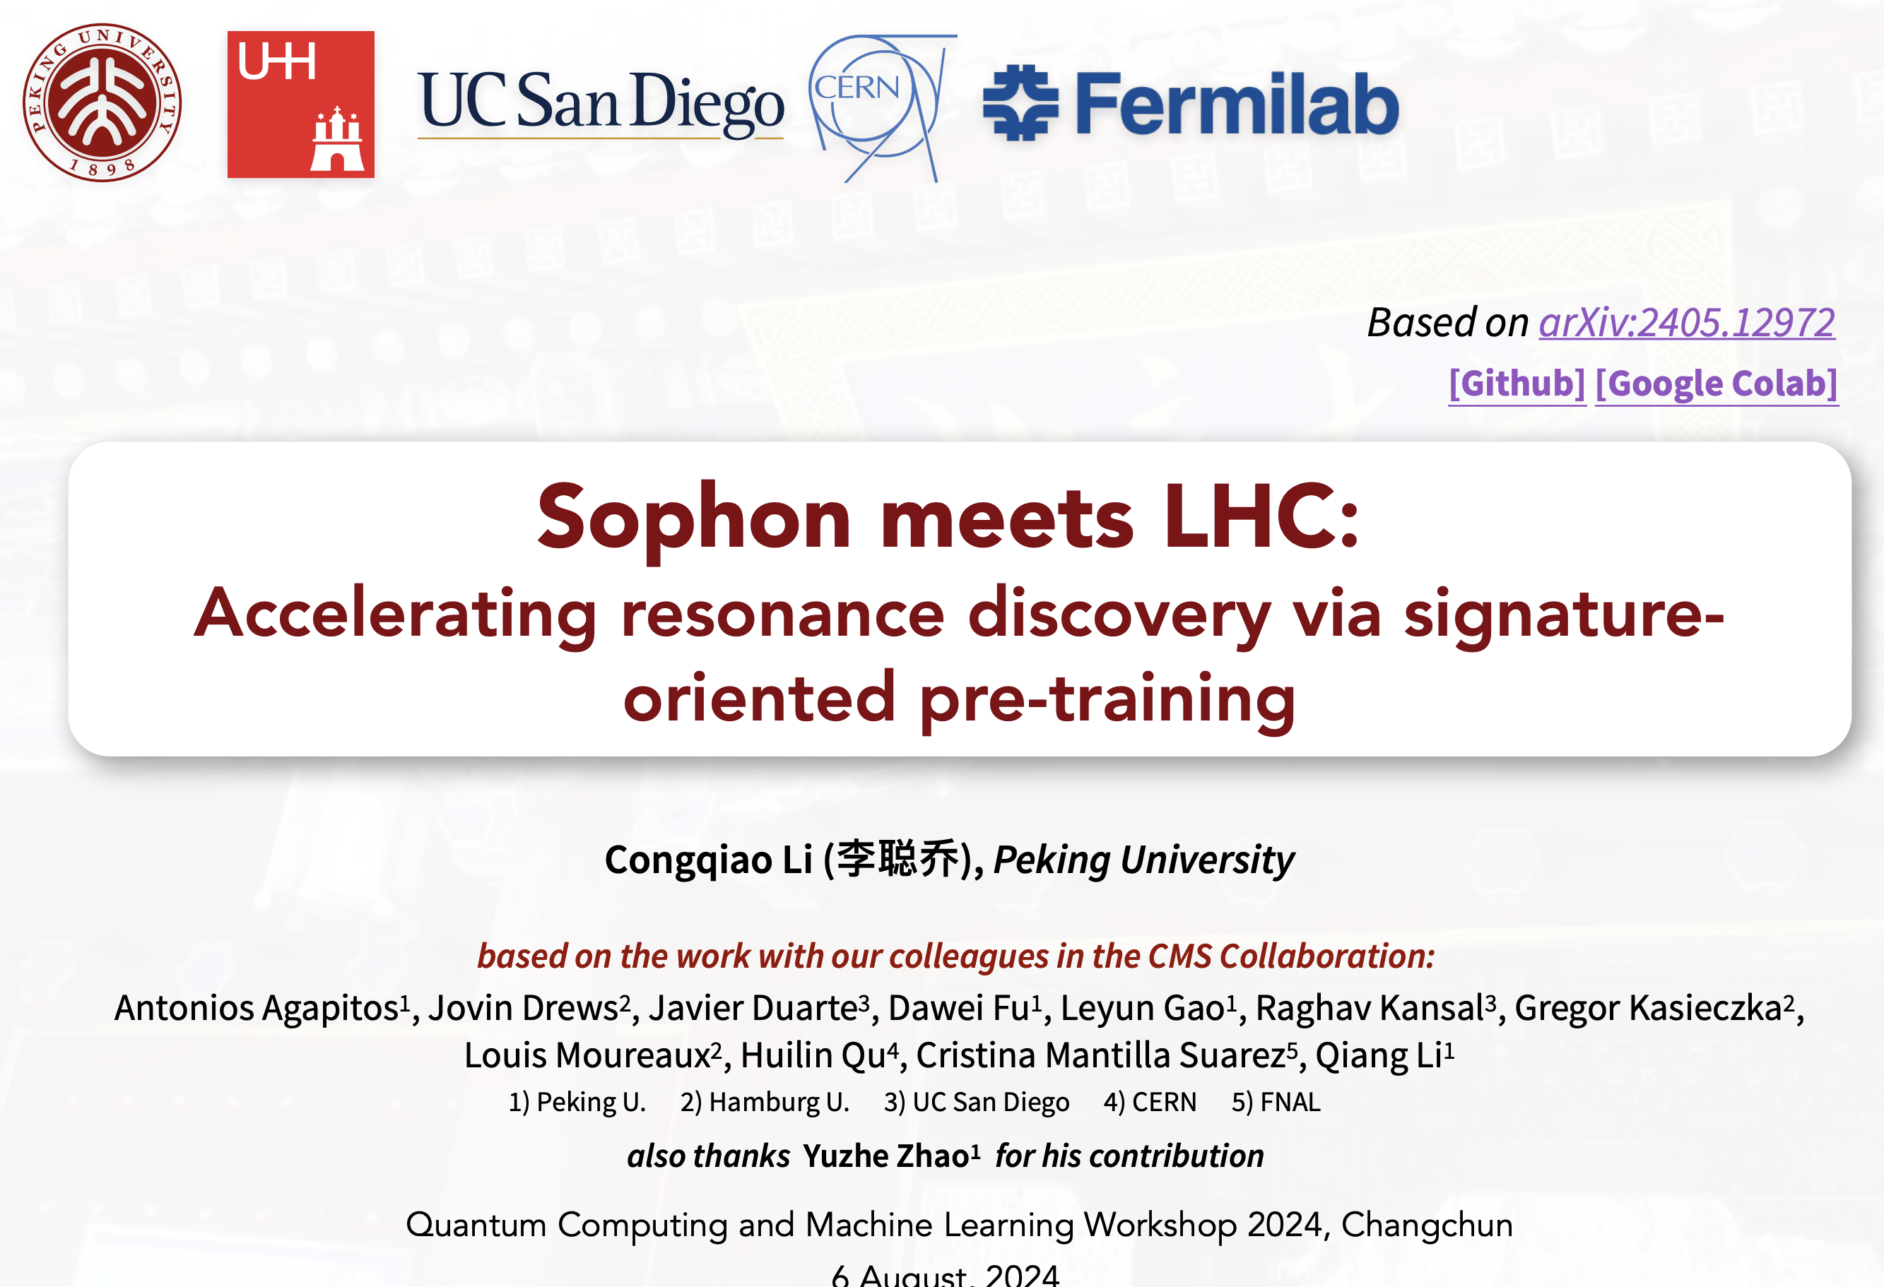
(LHC 上的“事例”)

Slide 34
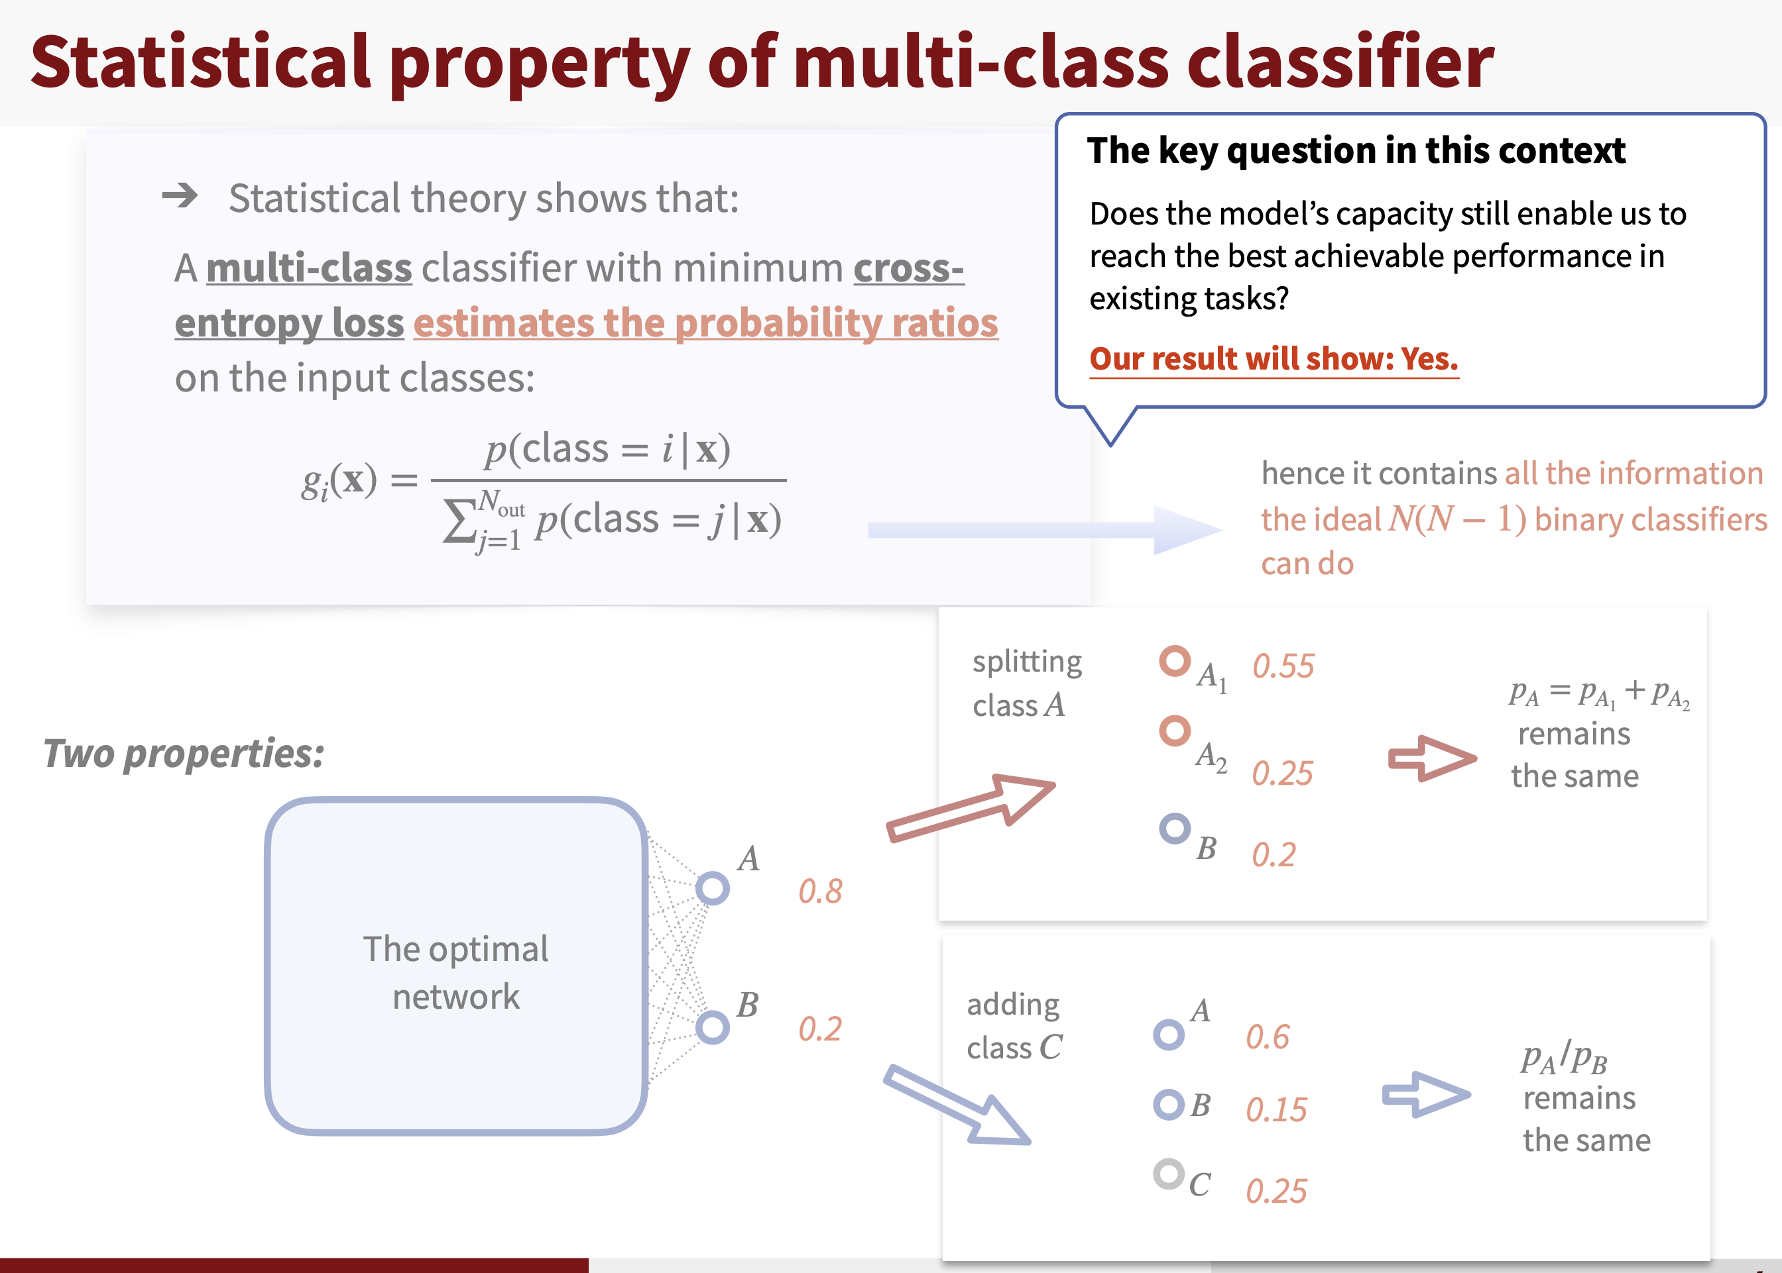
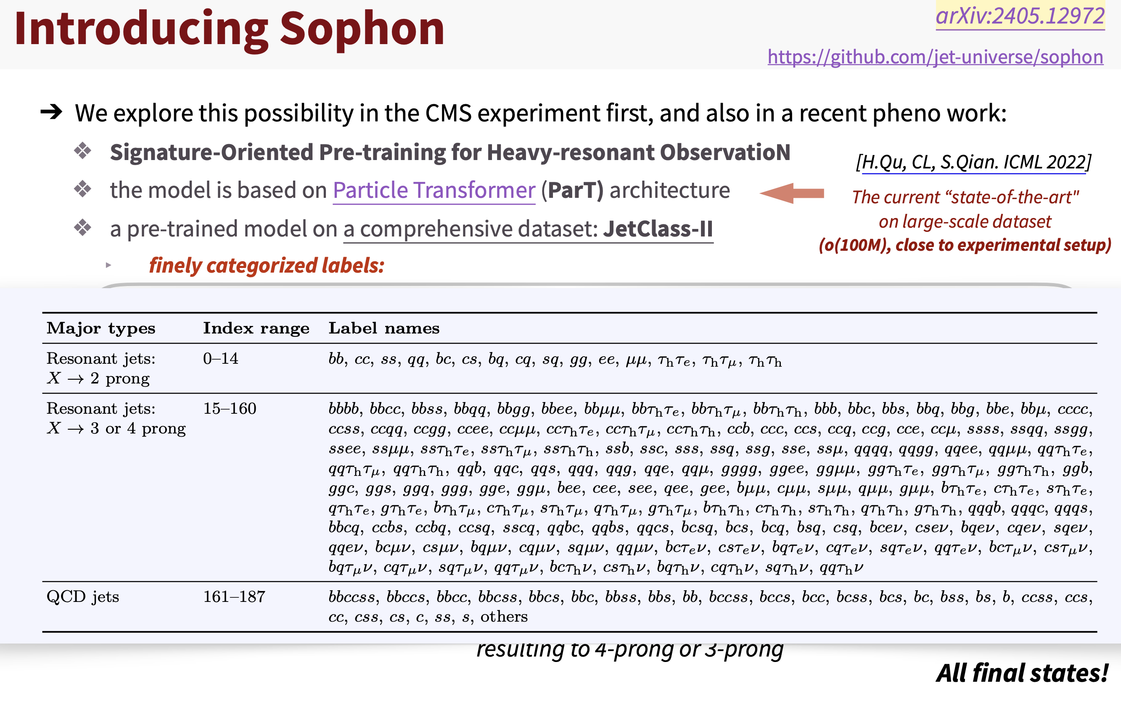



Slide 35
More?
Diffusion models
Large Language Models
… …
Used as copilot-like assistant: Dr. Sai
Used to HEP data directly: tokenization is a key

Slide 36

How to represent a HEP events? Tokenization
Feature engineering
Some mathematical methods? Such as fox-wolfram moments
Autoencoder?

Slide 37
作业：实战内容（借用李聪乔的劳动）
Particle Transformer 用作分类
https://gitee.com/colizz/qcml-2024-tutorial
lxslcaaa.ihep.ac.cn → lxloginaaa.ihep.ac.cn （需要修改的地方）
  chap1 是视频教学：看看就行
  chap2 是 general 的展示：需要科学上网，了解下就行
  chap3 我实测可以跑（CPU ）：复现结果

Slide 38
Summary
Machine learning is statistical learning (NFL)
Machine learning is useful (CoD): high dimensional HEP data
Machine learning method with proper bias is helpful and easy to explain
Machine learning methods can be applied to almost all aspects of HEP experiments.
LLM demonstrated astonishing capabilities, which are worth exploring from two aspects:
                Use LLMs as language-based assistants
                Employing LLMs to directly to process data: how to represent HEP events is the key

