Slide 1
CEPC vertex detector towards TDR
Zhijun Liang,
On behalf of CEPC vertex working group

Slide 2
Introduction
CEPC L0 management decided to develop CMOS stitching baseline design
It is exciting development and cutting edge technology for vertex detector
  Layout & Physics design , then implementation in CEPCSW
  Background & Data rate
  Mechanics & cooling
  Service and cabling

Slide 3
VTX像素芯片功耗分布估算
(from Weiwi,Ying)
Power consumption estimation is based on 25*25um pixel size
估算说明：
太初3芯片：180 nm工艺，电源1.8 V;
65 nm芯片：电源1.2 V;
Data rate@Triggless-CDR: 4.48 Gbps /chip
bunch spacing (min.): 25 ns需要快前沿前端
Data rate@Triggless-TDR (Low Lumi):
1 Gbps/chip
Low Lumi@TDR: bunch spacing ~几百ns，像素前端不需要快前沿，Matrix功耗可降低到60 mW
 | Matrix | Periphery | DataTrans. | DACs | Total Power
太初3芯片 @ triggerless (CDR) | 304 mW | 135 mW | 206 mW | 10 mW | 655 mW
65nm 芯片 @ 1 Gbps/chip (TDR LowLumi) | 60 mW | 80 mW | 36 mW | 10 mW | 186 mW

Slide 4
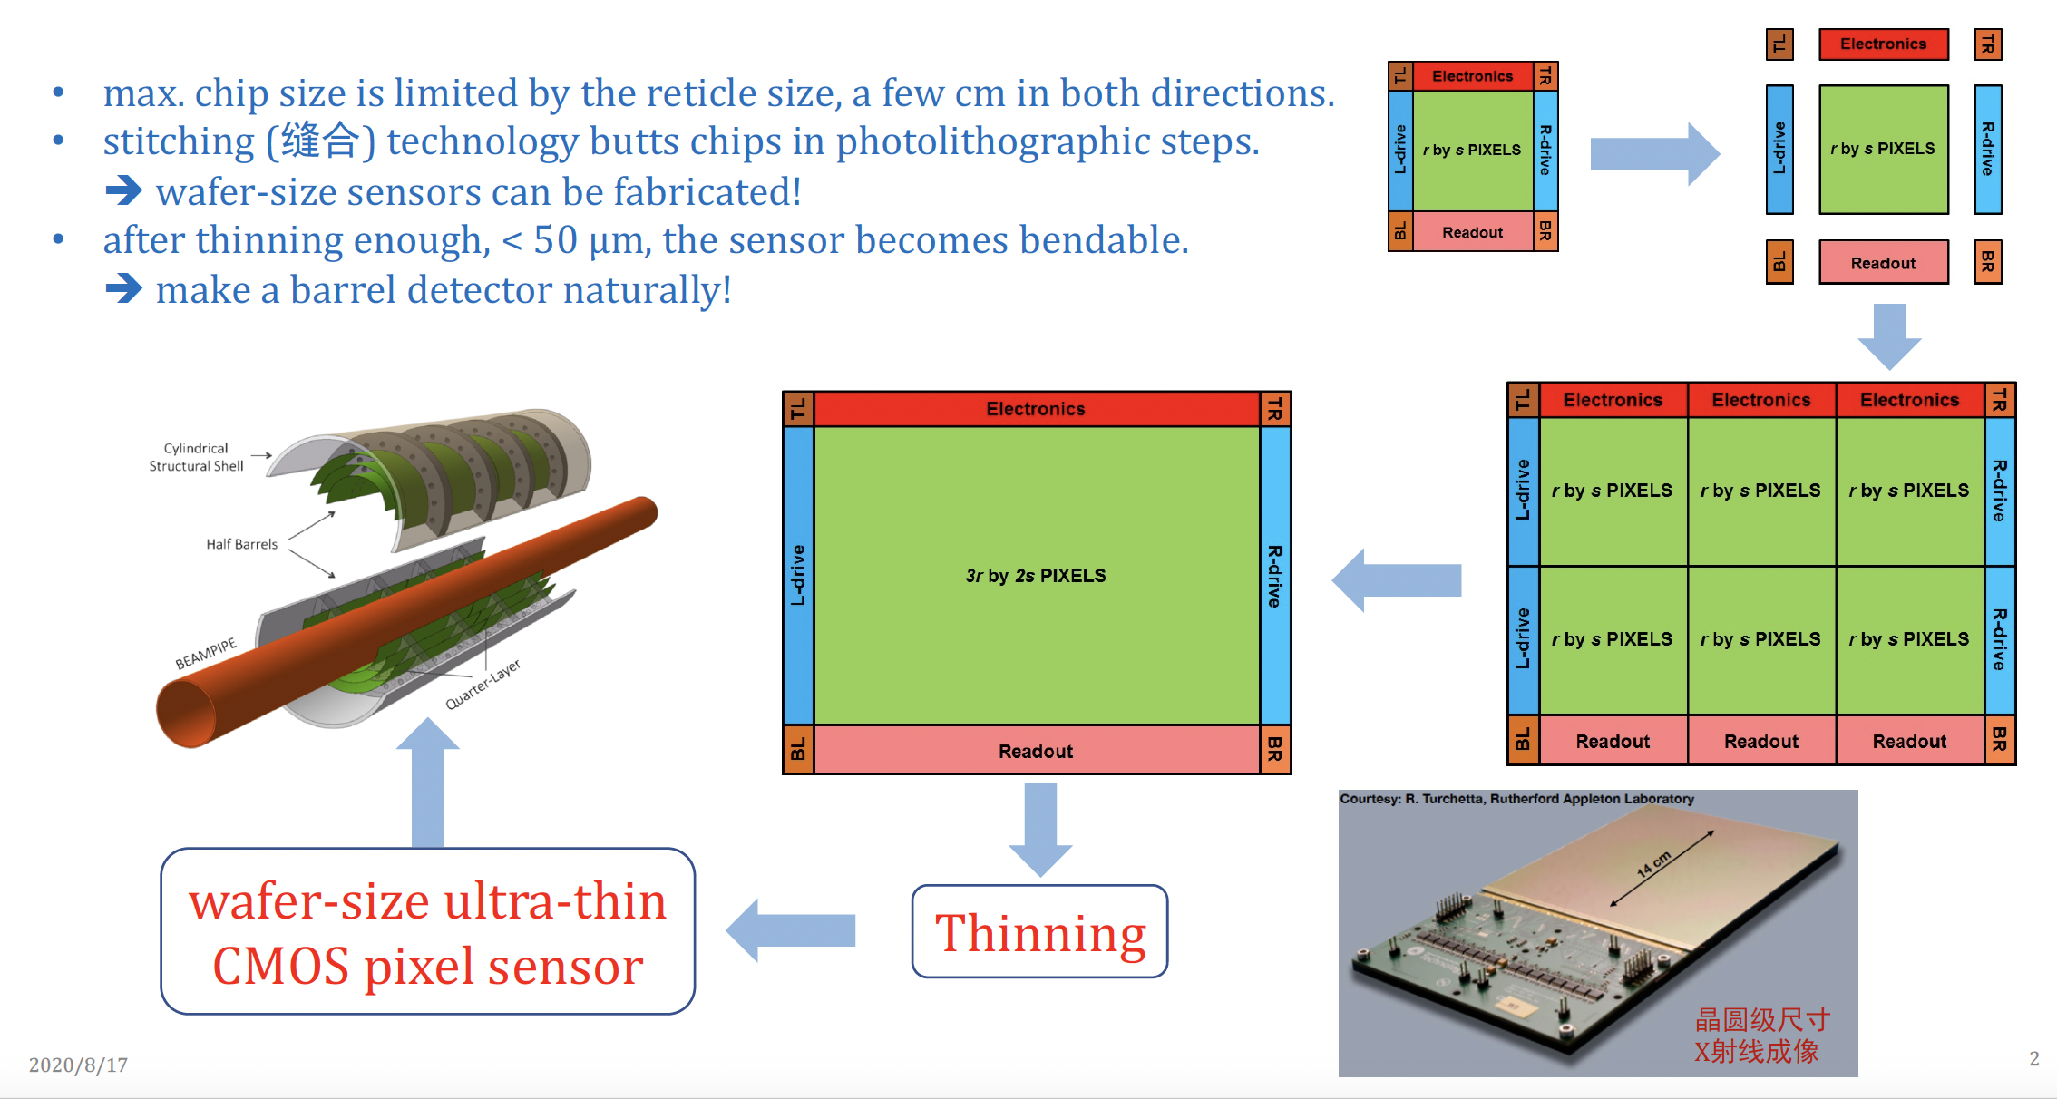
What is stitching? (from Meng Wang)
df

Slide 5
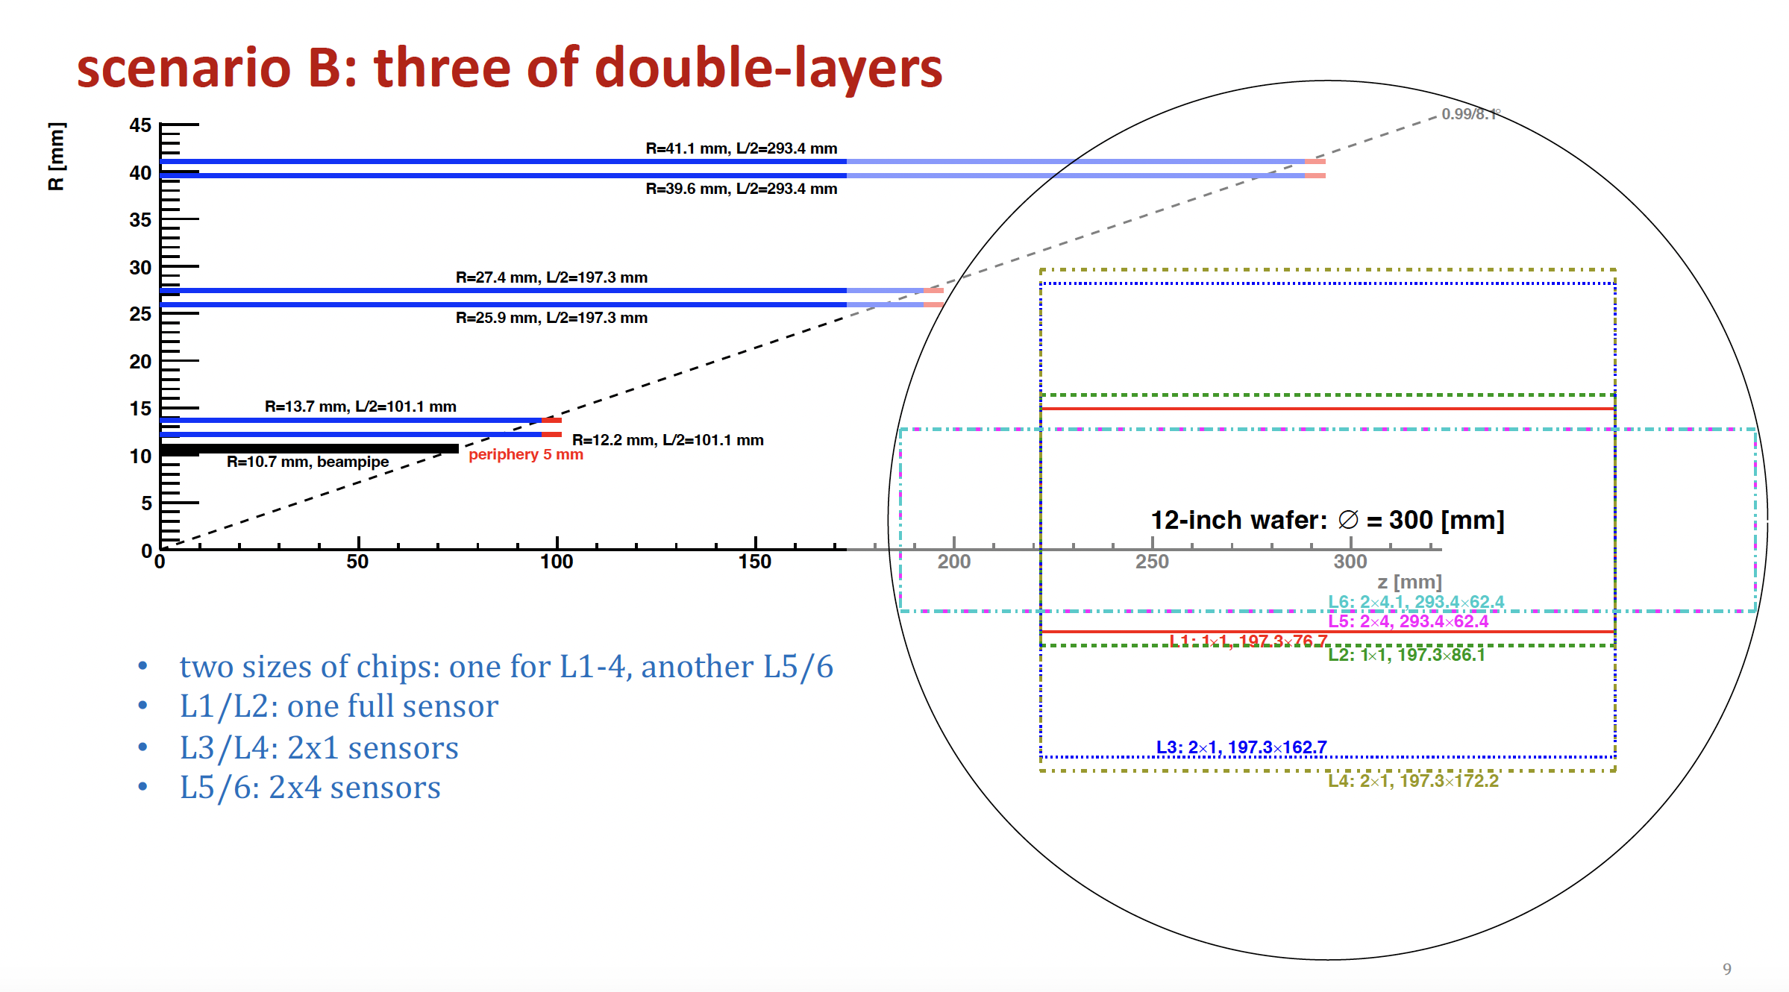
Top focus on stitching
Inner layer : background , data rate, power consumption
Middle layer and outter layer:
  refine stitching proposal and estimate yield, power consumption

Slide 6
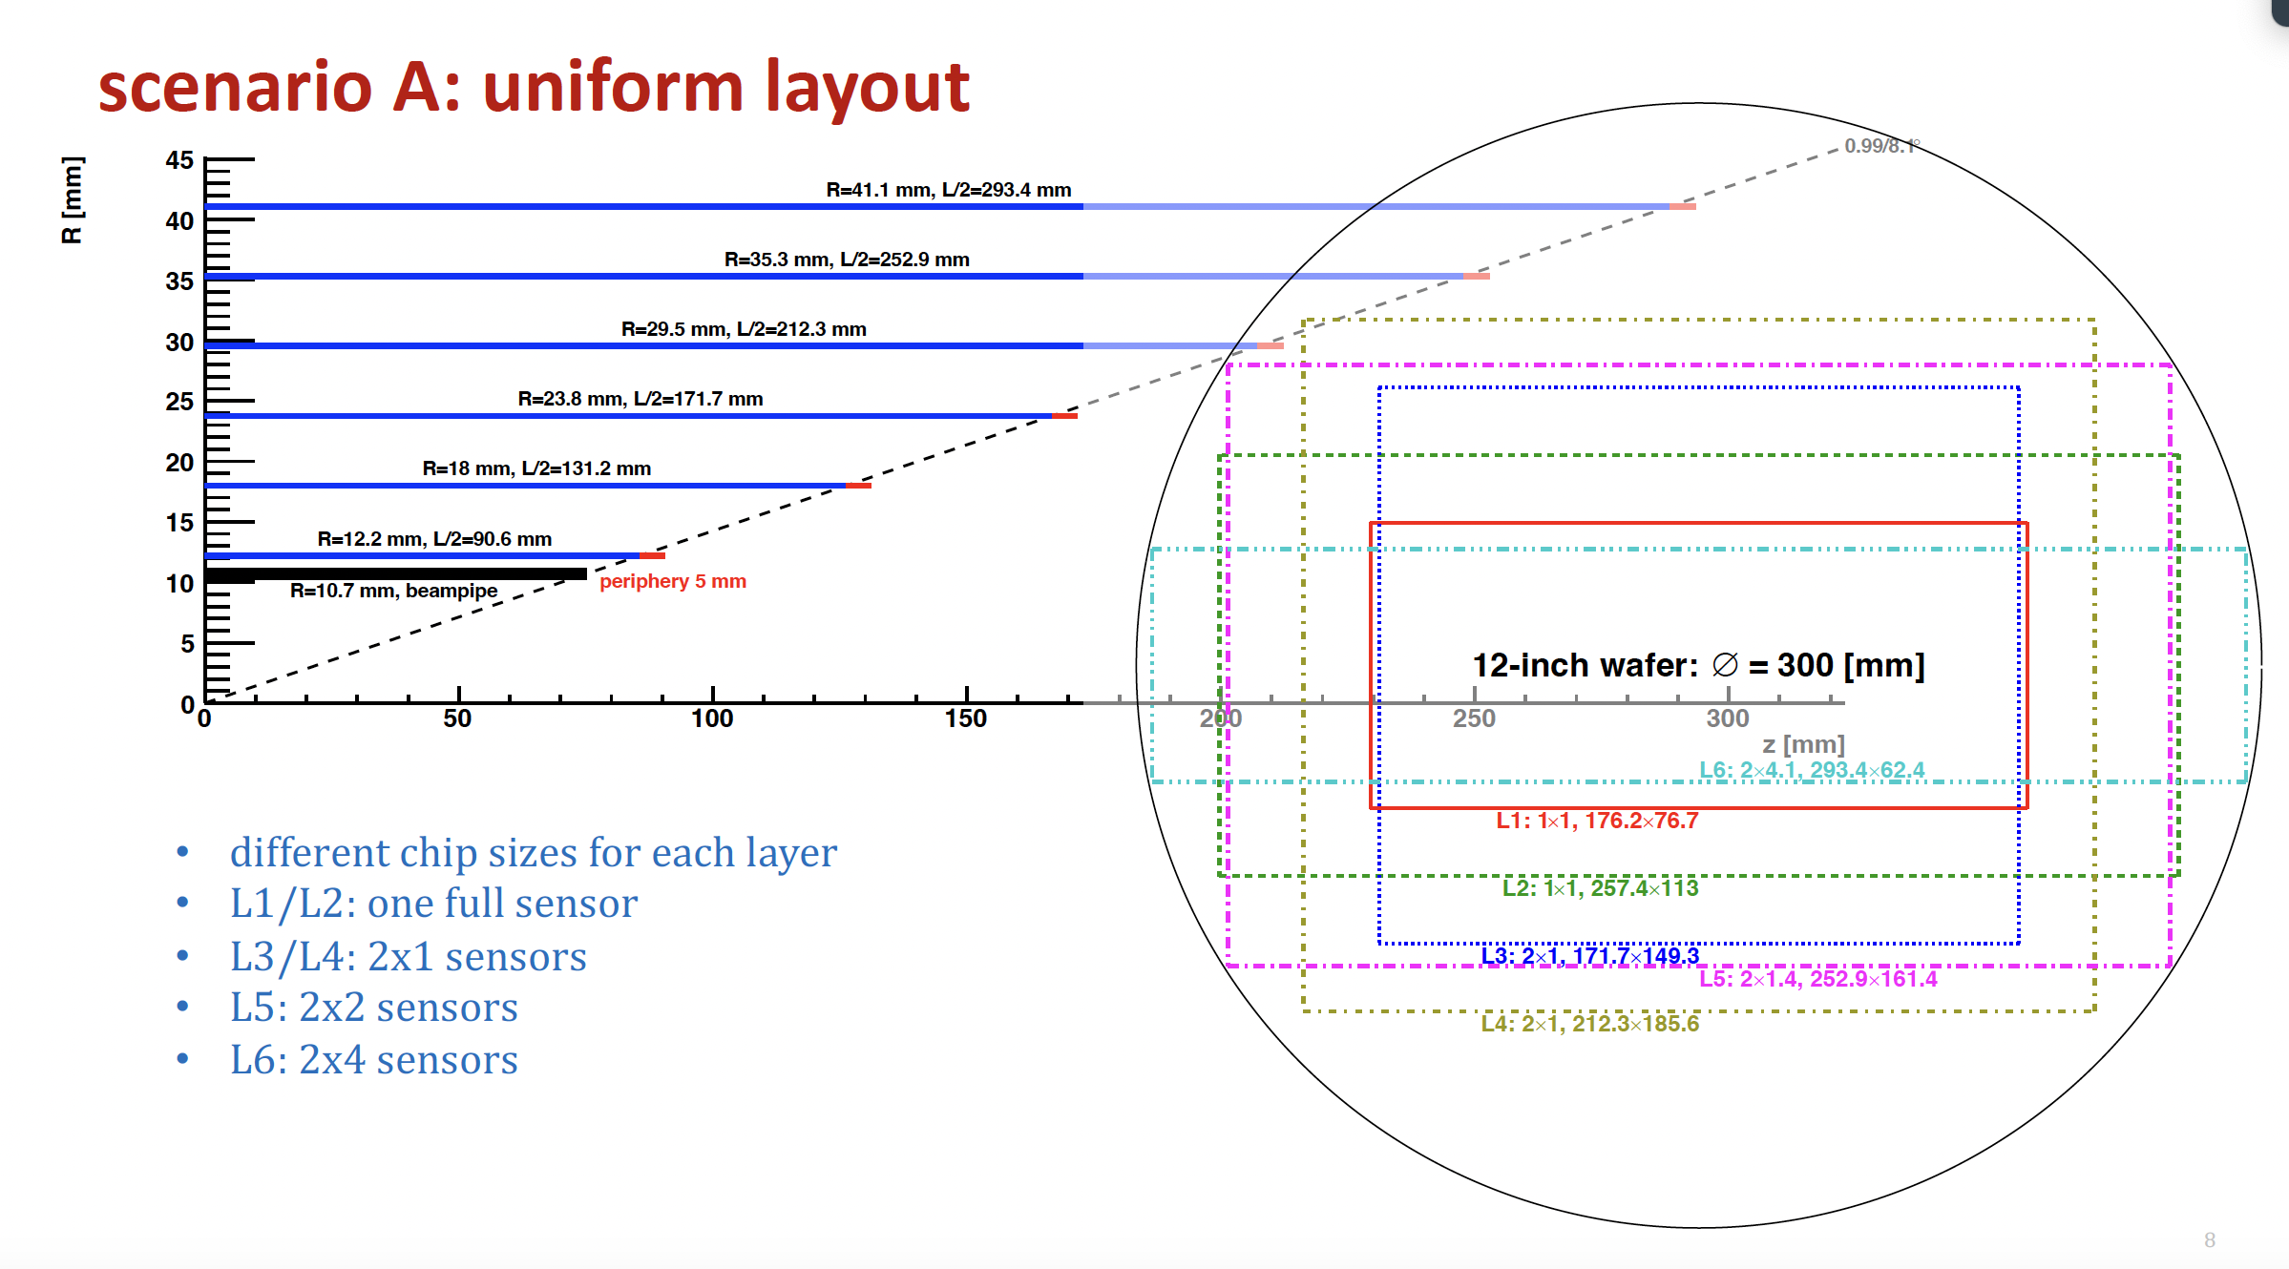

Slide 7
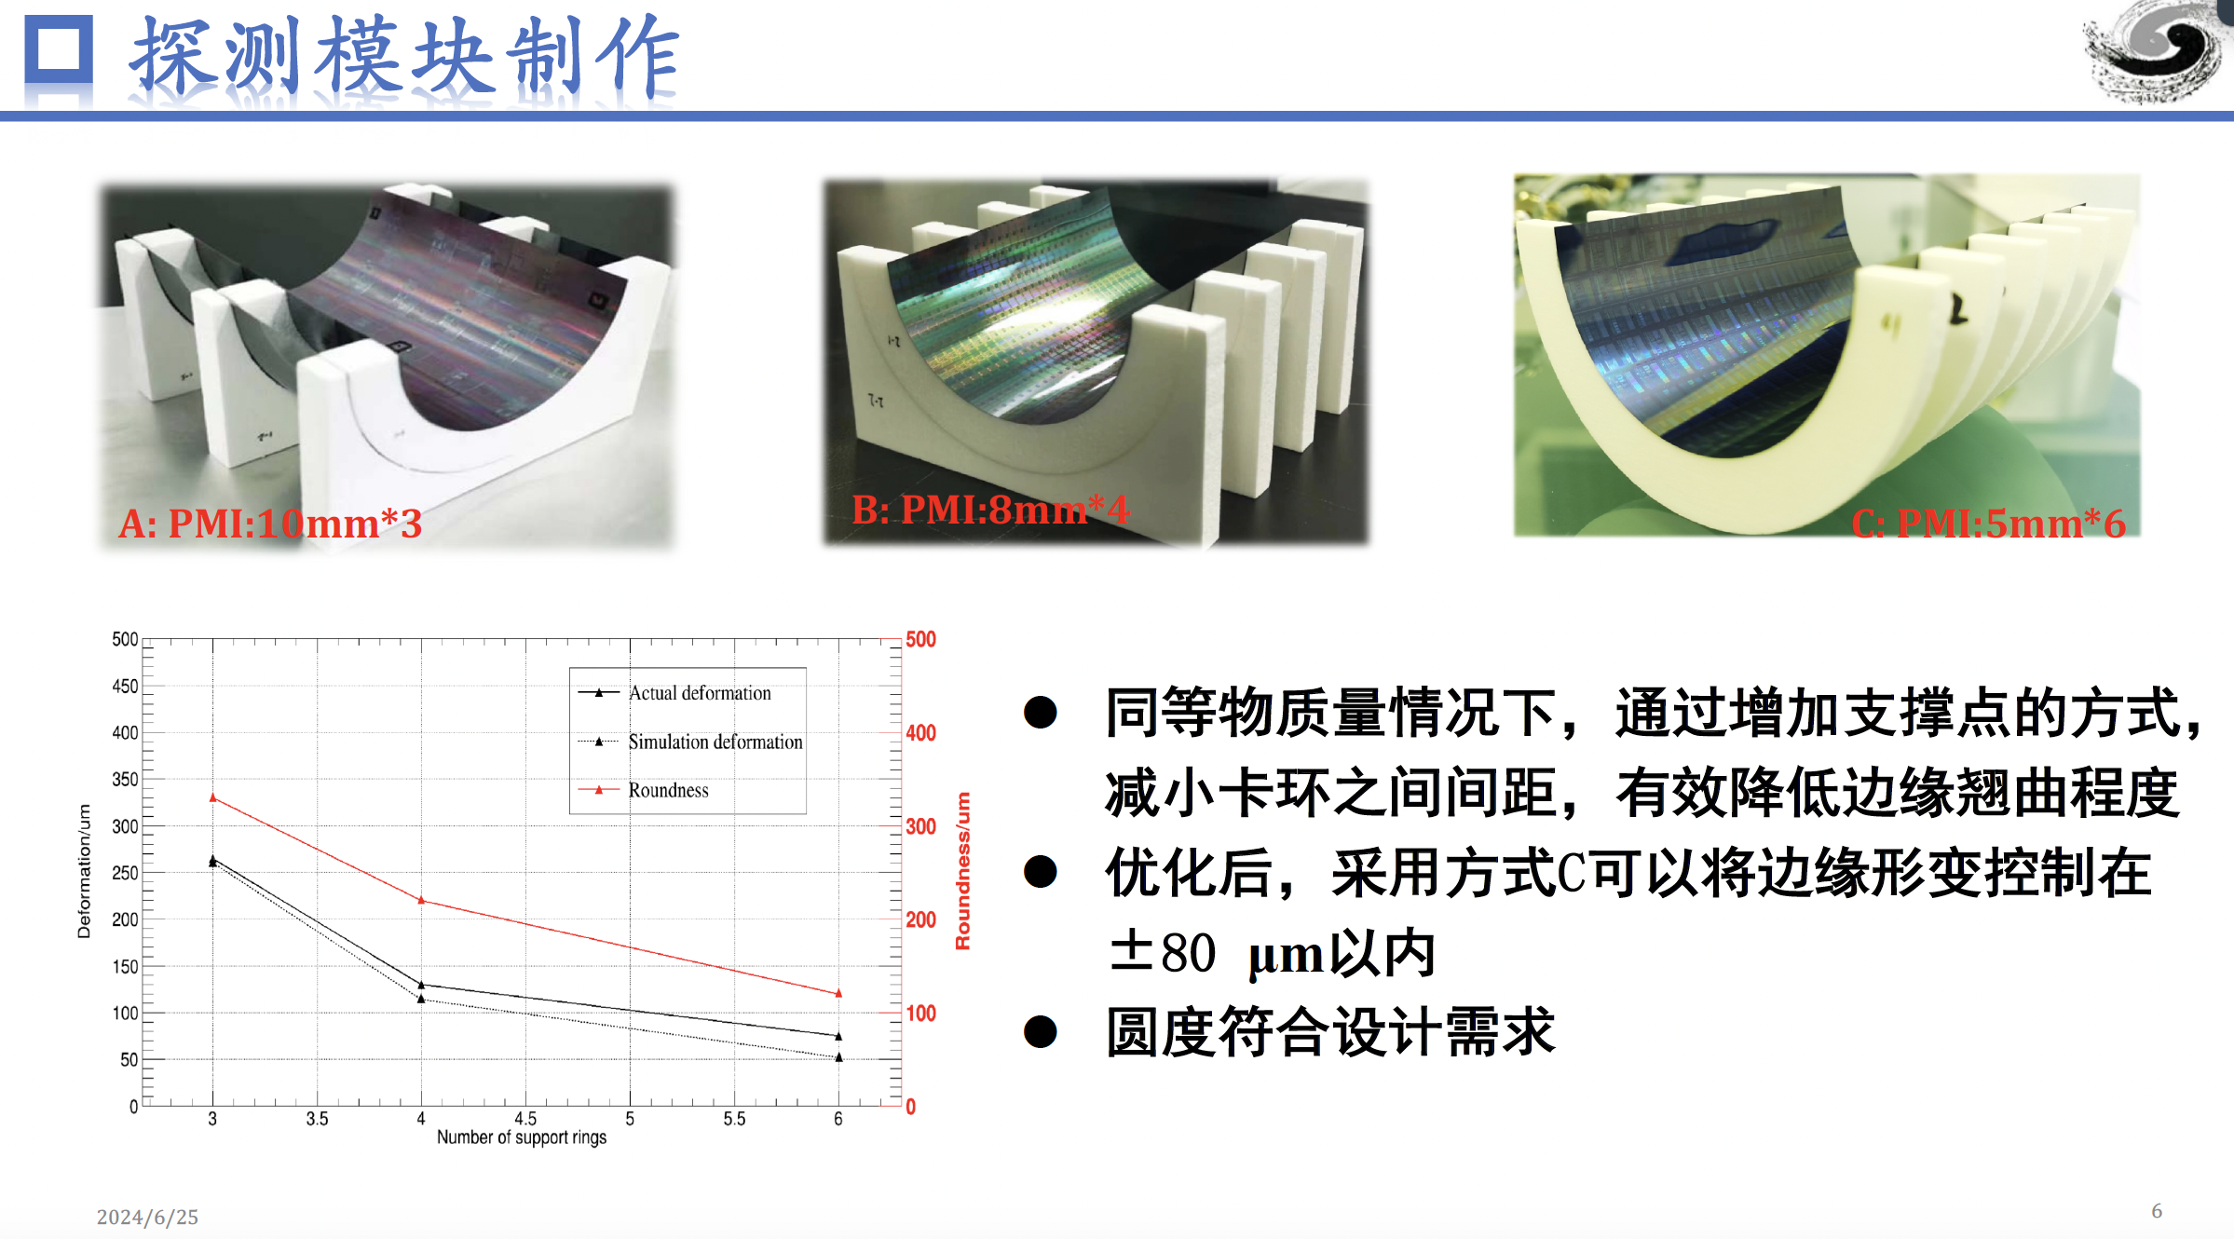

Slide 8
Data rate estimation of CEPC VTX
 |  | Hit density (Hits/cm²/BX) | Bunch spacing (ns) | Hit rate (M Hits/cm²) | Hit Pix rate (M Px/cm²) | Hit rate/chip (MHz) | Data rate@triggerless (Gbps) | Pixel/bunch | FIFO Depth @3us rg latency | Data rate@trigger (Mbps)
CDR | Higgs | 2.4 | 680 | 3.53 | 10.59 | 34.62 | 1.1 | 23.5 | 103.9 | 105.28
 | W | 2.3 | 210 | 10.95 | 32.86 | 107.44 | 3.4 | 22.6 | 322.3 | 101.248
 | Z | 0.25 | 25 | 10 | 30 | 98.1 | 3.1 | 2.4 | 294.3 | 53.76
TDR | Higgs | 0.81 | 591 | 1.37 | 4.11 | 13.44 | 0.43 | 7.96 | 40.4 | 213.9？
 | W | 0.81 | 257 | 3.16 | 9.45 | 30.90 | 0.98 | 7.96 | 92.8 | 213.9？
 | Z | 0.45 | 23 | 19.6 | 58.7 | 191.9 | 5.9 | 4.4 | 575 | 118
TDR raw hit density: Higgs 0.54，Z 0.3; Safety factor: TDR 1.5, CDR 10;
Cluster size: 3pixels/hit (@Twjz 180nm, EPI 18~25um)
Area: 1.28cm*2.56cm=3.27cm² (@pixel size 25um*25um)
Word length: 32bit/event (@Taichu’s scale, 512*1024 array)
Trigger rate：20kHz@CDR，120kHz@TDR estimated
  Trigger latency: 3us(very likely not enough), Error window: 7 bins
  FIFO depth: @3us * hit rate/chip
  Data rate=pixel/bunch*trigger rate*32bit*error window
Assume data rate @1Gbps per chip for low lumi Z (20% of high lumi Z)
for triggerless

Slide 9
Issue of stitching for large pixel matrix
Pixel Matrix
Periphery
1Gbps on PCB
1Gbps on PCB
1Gbps on PCB
1Gbps on PCB
Ladder for Normal chip
Normal chip
Transmission:
  Each chip has a dedicated data transmission path for 1Gbps
  The transmission path is on PCB (ideal transmission line, high signal quality)
Buffering:
  On Periphery (on chip), for high hit rate

Slide 10
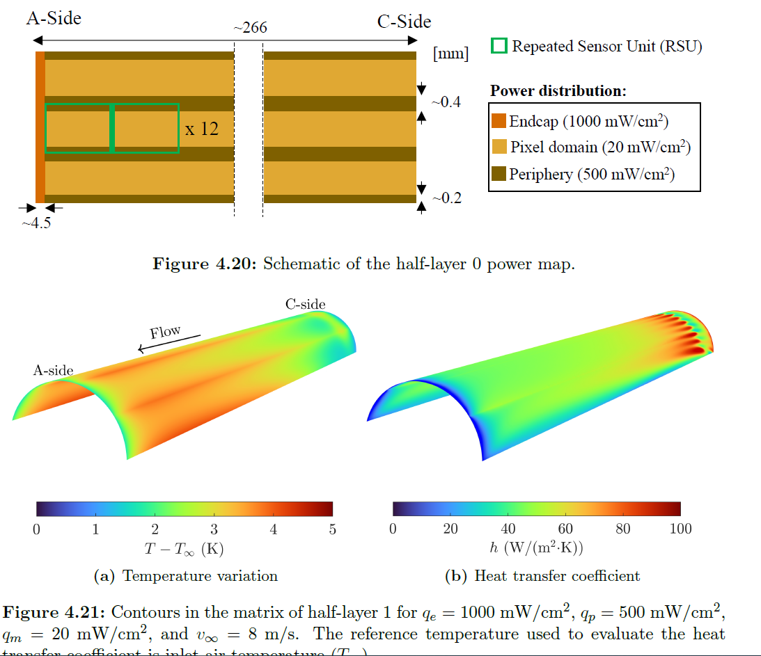
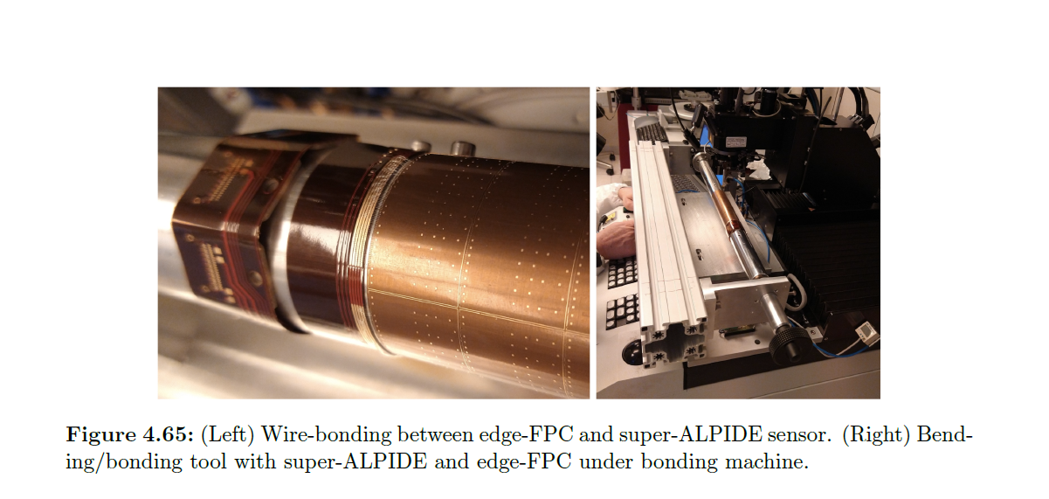
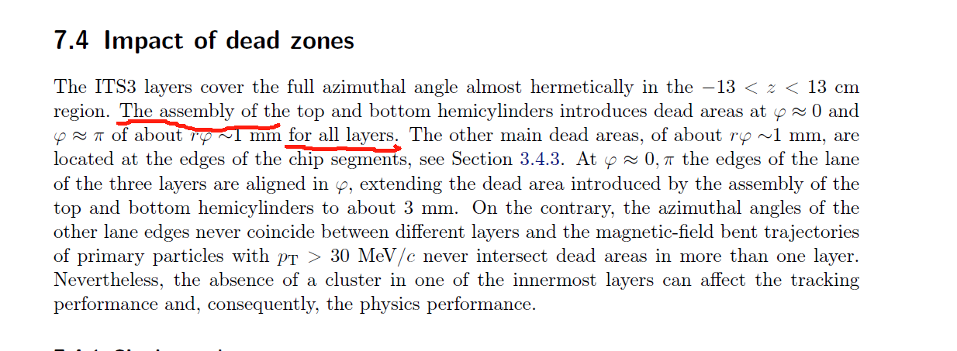
Issues of the dead area

Slide 11
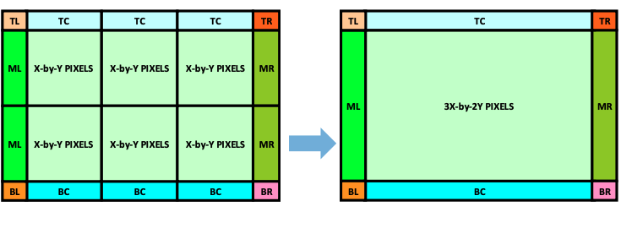
Preliminary thoughts
On chip & dimension
  NX+2Y scheme:
    Challenging but DO-able
    Inner layer VTX, a half layer: total data rate 10Gbps at one end on one “chip”
    Actually no fundamental change of chip, but save the mechanical
  NX+MY (M>2) scheme:
    Too ideal ☹ ☹ ☹
    Data transmission, power distribution, timing… all with big issues
    But maybe possible for outer-most layer – data rate greatly decreased
On mechanical
  Overall mechanical is easier than the normal scheme
  But dead area seems inevitable on the same layer and not small
Rough estimation
  Innermost layer: NX+2Y of (1024row*512col) can be bent to be a semi-circle

Slide 12
Preliminary outline for Vertex section @ referenece TDR
3. Vertex detector (Zhijun & Meng Wang)
a. Requirements (position and vertex) Zhijun , Manqi
b. Technology survey and our choices (both baseline & backup options), Zhijun & Meng
c. R&D efforts and results
→CMOS Stitching: Meng Wang
→ CMOS normal chip: Zhijun, Wei Wei, Yupeng
→ SOI: YunPeng
d. Detailed design including electronics, cooling and mechanics
→ Layout: Zhijun & Meng Wang
→ CMOS sensor design: Wei Wei，Ying Zhang, Yunpeng
→Cooling and mechanics: Jinyu Fu
e. Readout electronics & BEC
→Background estimation : Haoyu Shi
→ Data rate and readout scheme: Jun Hu, Wei Wei
f. Performance from simulation (impact parameters). Chengdong Fu

Slide 13
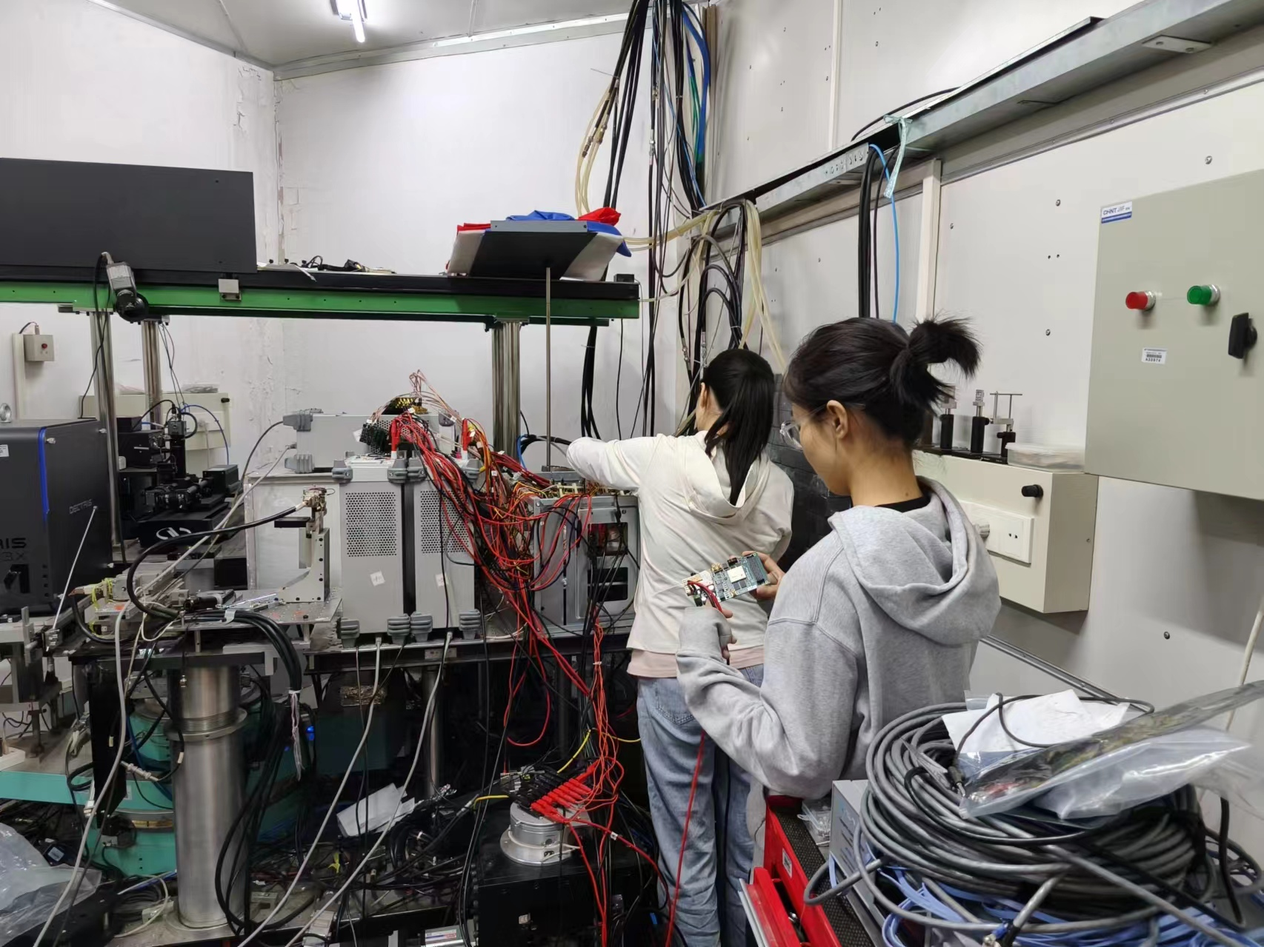
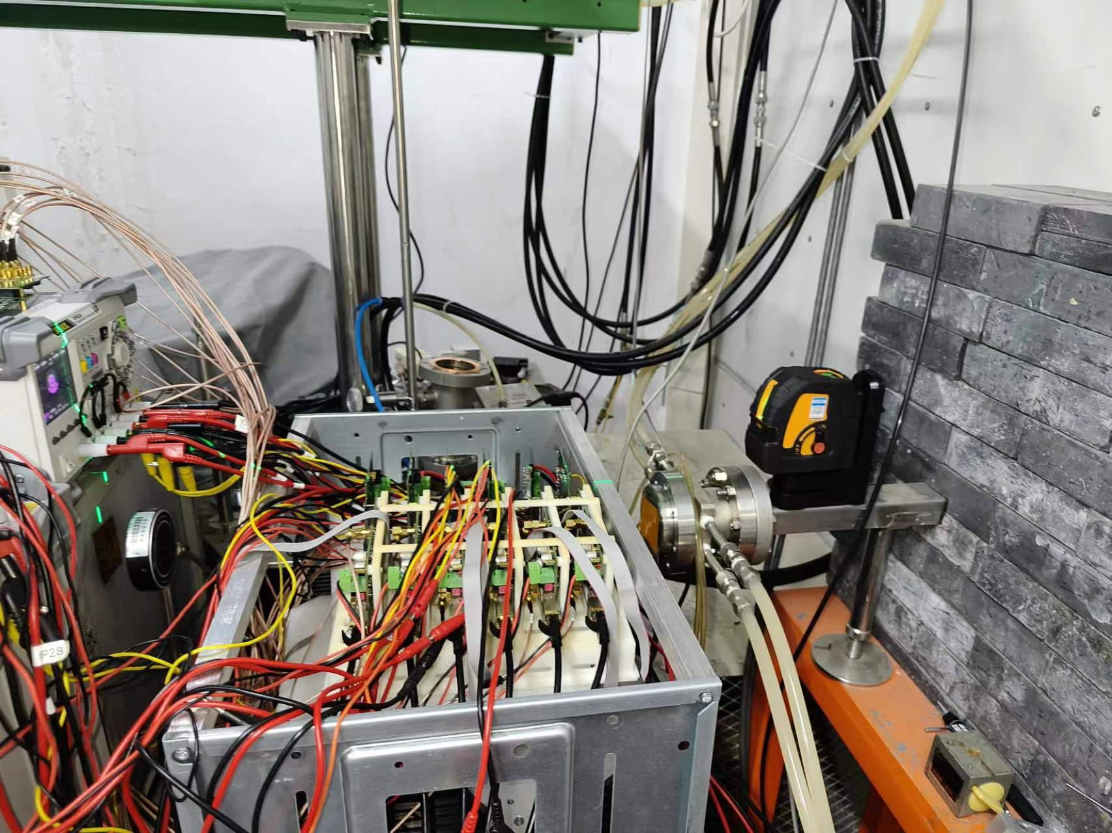
Testbeam in BSRF for vertex sensor digitization model
Testbeam in BSRF from June 1st to July 1st
Try to test different incident angle from 8° - 90°
  In last test beam at DESY, incident angle is about 70-90°
  Cluster size, efficiency vs incident angle

Slide 14
News about TJ65nm CMOS design
Got design Kit for TJ 65nm technology. (Ying Zhang, Wei wei)
  Pixel cell dimension study
  Power consumption
Problem
  Design kit was N type low resistivity wafer
  → should be p type high resistivity Epi wafer

Slide 15
Issue of stitching for large pixel matrix
Periphery
Periphery
Pixel Matrix
Pixel Matrix
Pixel Matrix
???
Pixel Matrix
Periphery
Pixel Matrix
Periphery
NX+2Y: still have Periphery region, for buffering & data transmission, almost the same as the normal chip scheme
NX+MY: the inner Pixel Matrix with no support of buffering & data link, can only go through others. Data rate accumulation effect reveals

Slide 16
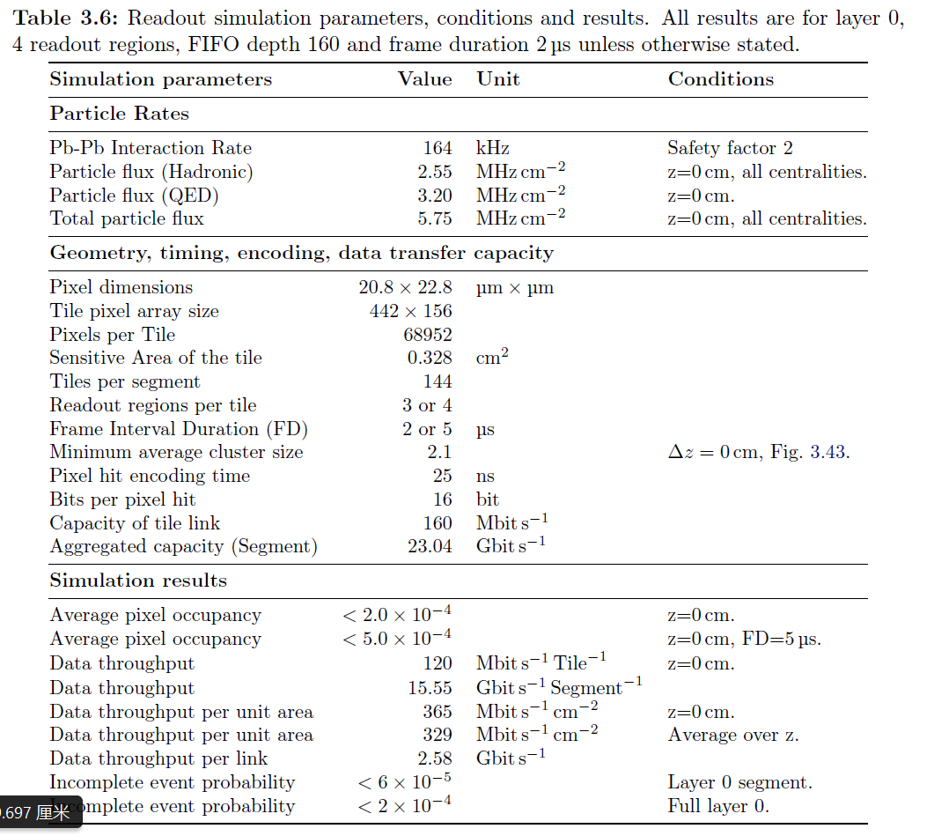
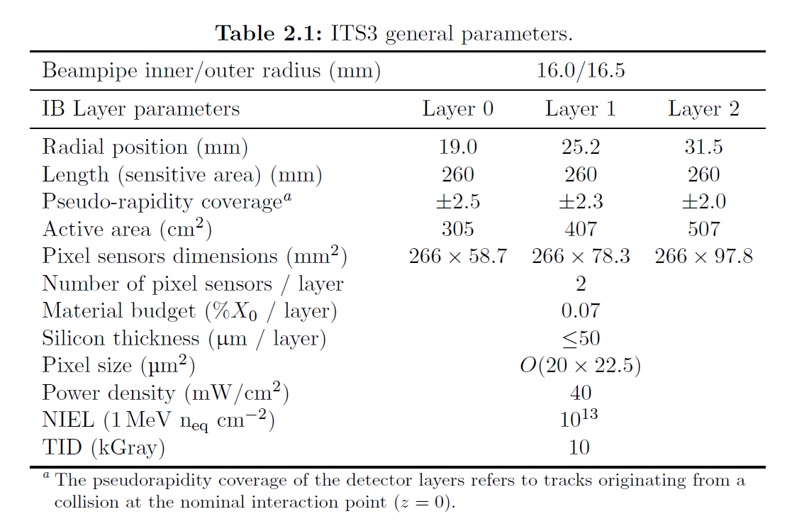
ALPIDE parameters
From CERN-LHCC-2024-003/ALICE-TDR-021：Technical Design Report for the ALICE Inner Tracking System 3 - ITS3 A bent wafer-scale monolithic pixel detector

