Slide 1
Preliminary Design of Laser Alignment Targets
Duan Zhe , Dechong Zhu

Slide 2
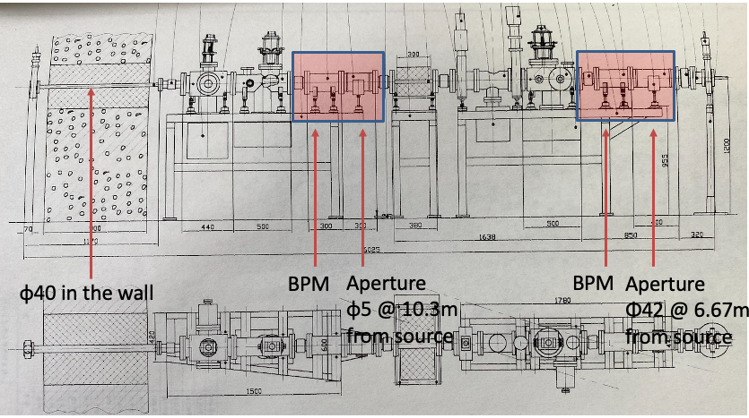
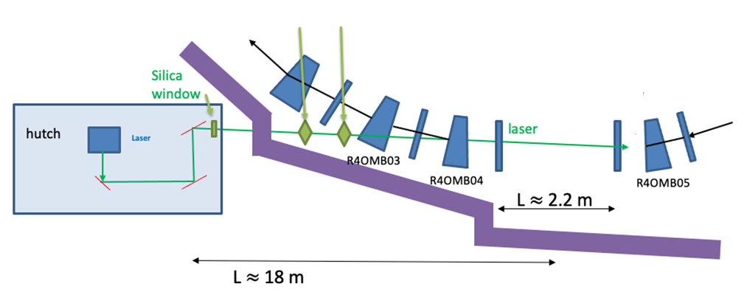
Installation location of Laser Alignment Targets
Two laser target with distance 2-3 m;
Laser target 1
Laser target 2
Laser target 1
Laser target 2

Slide 3
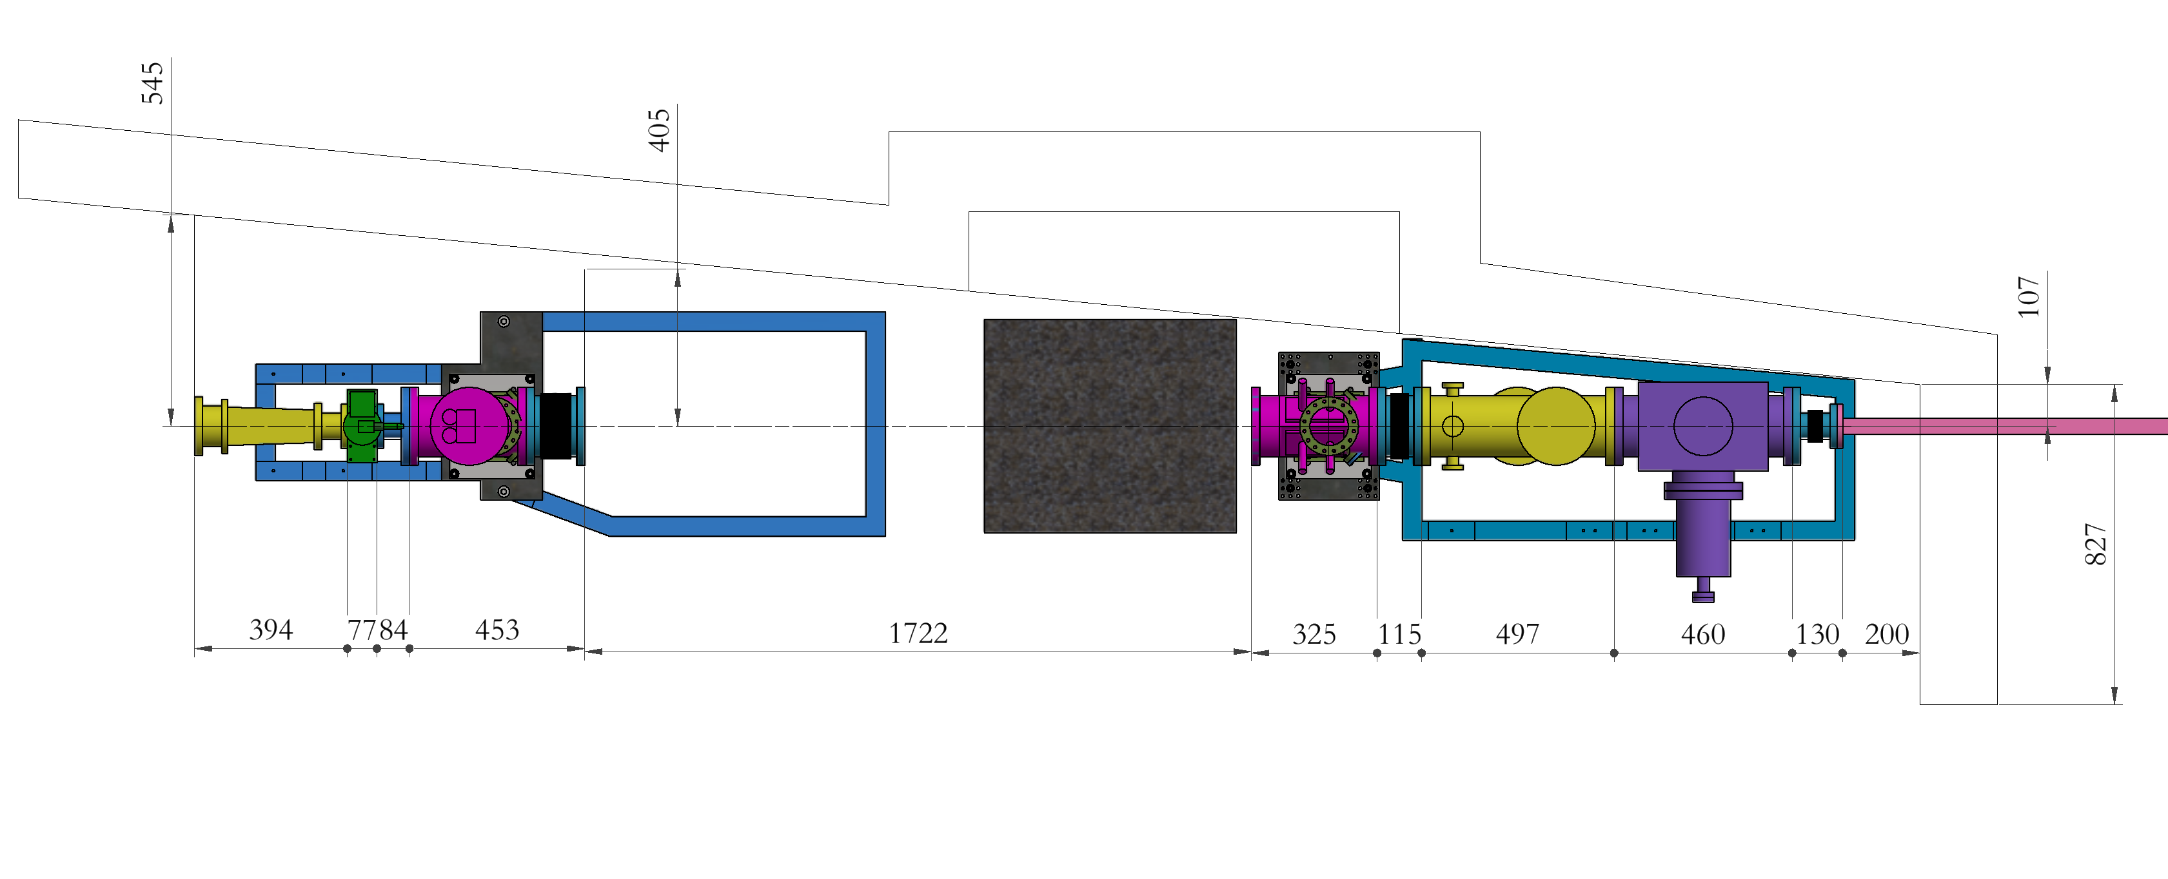
Some measured dimensions of the front end
laser

Slide 4
Vacuum chamber
The target surface is placed at a 45° angle to the incident light.
The center of the front surface will be placed at the geometric center of the pipe.
The observation window faces the target surface.
A camera with a lens will be used to observe the laser spot at the target.
motor
Laser
Top view
Camera with lens
Movable target
Laser
Target
Quartz window

Slide 5
空天院最新3D出图
材料：304？316？
磁导率：1.1？
真空室法兰标准：BEPCII标准
法兰接口：固定？松套？
靶标座：图纸，位置。
准直：没有精确图纸以及坐标。只准直横向，忽略纵向？
末端窗口标准：BEPCII标准？

Slide 6
Target
1、Material
Vacuum compatible;
High diffuse reflectivity ;
Thermal stability;
Some choices： (1) white ceramic? Al₂O₃ or ZrO₂ .
(2) Polytetrafluoroethylene (PTFE) ?不耐辐射。
2、Size
50*50*0.1mm³?
3、Scale mark
Holes? Paiting ? 镀钼。
4、Target movement repeatability
< 50um
5、Target angle deviation
Rotation Angle <±0.2° ；

Slide 7
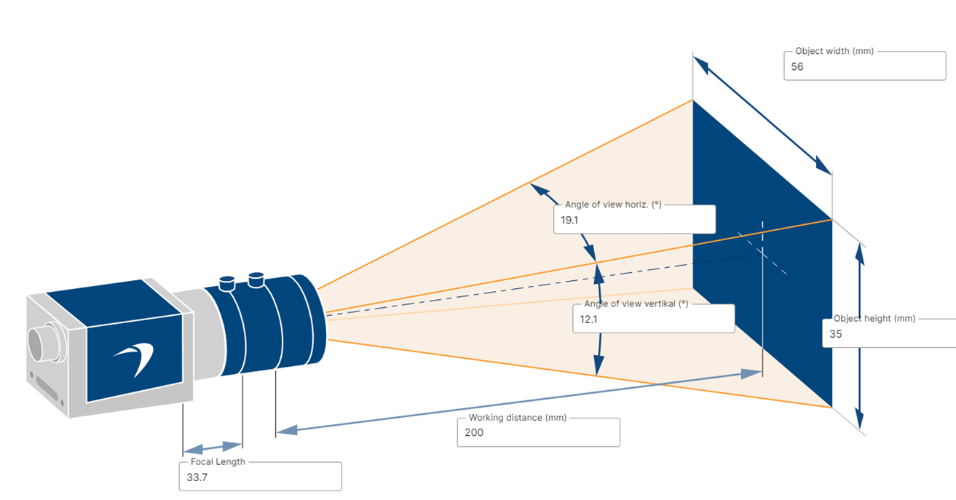
Imaging system
Camera:
Basler acA1920-40gm (GIGE)
Sensor Size： 11.33 mm × 7.13 mm
Pixel Size (H x V) ： 5.86 μm x 5.86 μm
Resolution (H x V)：1920 px x 1200 px
Sensor Type：CMOS
Lens：
Focal length : ~ 35mm
Working distance: 200mm
Demagnification: ~ 1/5

Slide 8
Thanks !

