Slide 1

LHCb Upgrades
Xuhao Yuan (袁煦昊)
IHEP, CAS (中国科学院高能物理研究所)
On behalf of LHCb collaboration
2024-11-17

Slide 2
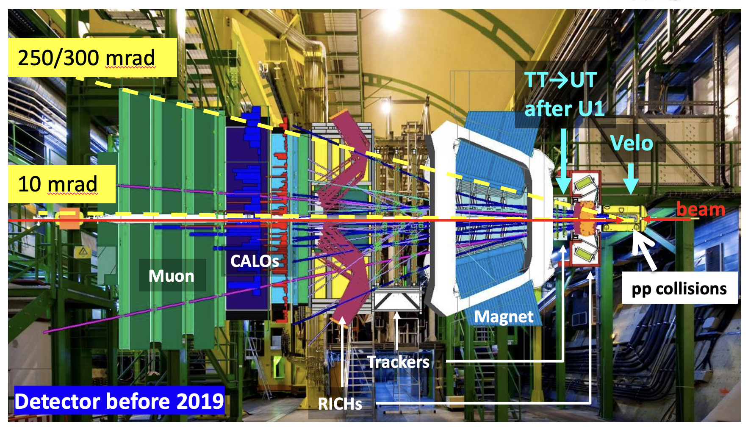
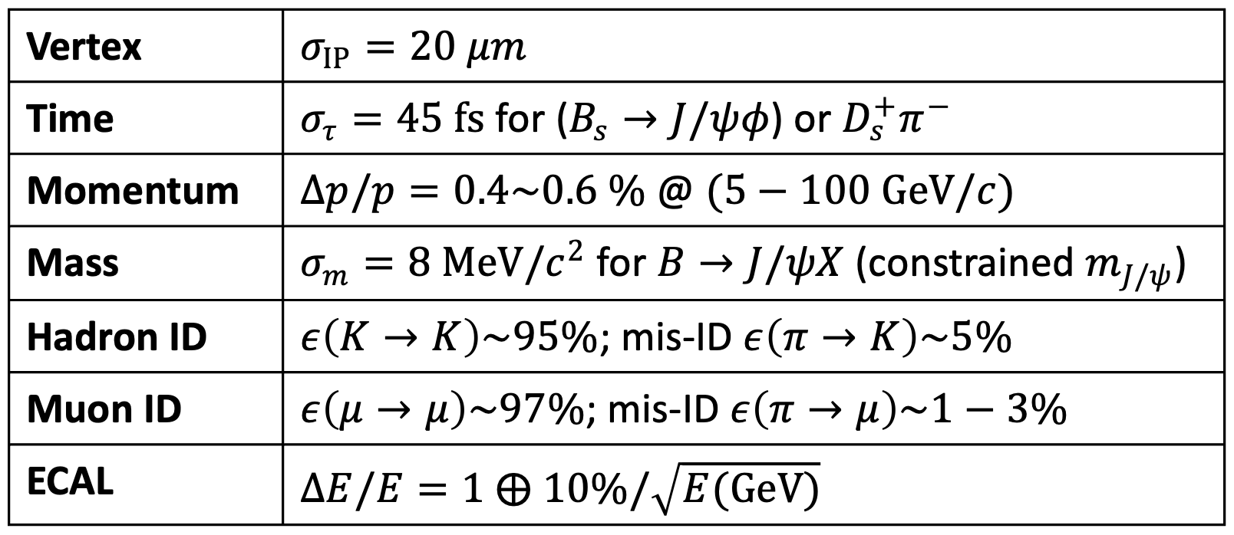
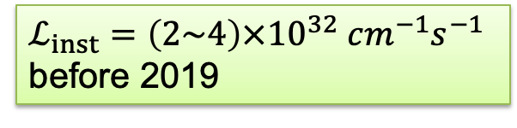
LHCb: a forward spectrometer @ LHC
$ℒ_{inst}=\left(2\sim 4\right)×{10}^{32} cm^{−1}s^{−1}$ before 2019
JINST 3 (2008) S08005
Int. J. Mod. Phys. A 30 (2015) 1530022

Slide 3
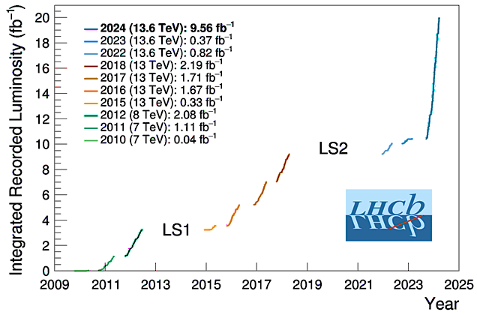
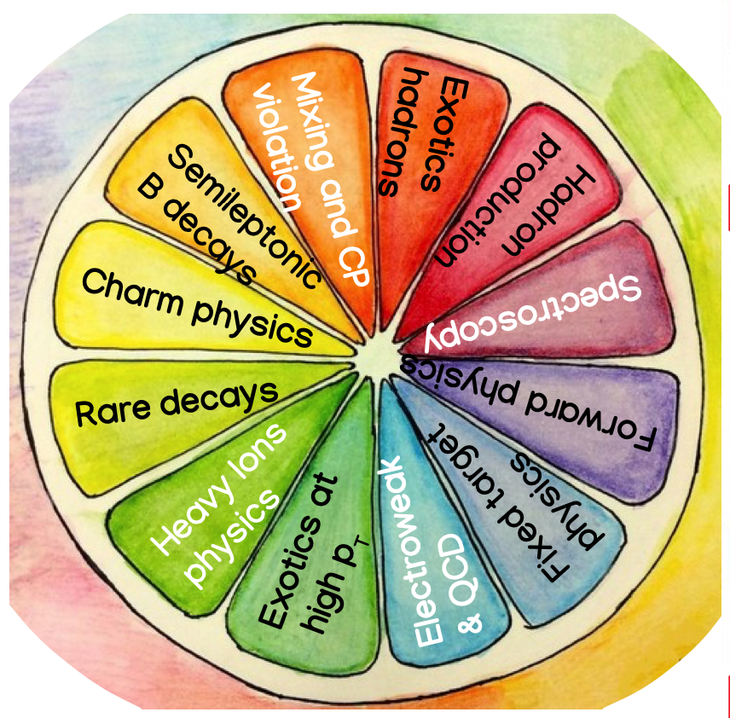
LHCb physics performance in the past
A decade of important discoveries and precision measurements
(9 fb⁻¹ pp data by end of 2018)
10 fb⁻¹ @ 13.6 TeV
3 fb⁻¹ @ 7/8 TeV
More physics results reported by my LHCb colleagues
Hang Yin,
Jiesheng Yu,
Peilian Li
Liming Zhang,
…
6 fb⁻¹ @ 13 TeV

Slide 4
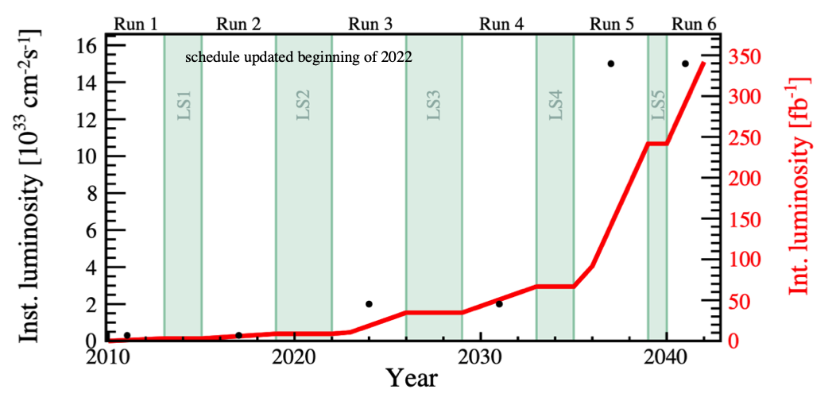
LHCb Upgrades
Upgrade I (U1), started in LS2
ℒ_{max}~2x10³³ cm⁻²s⁻¹
ℒ_{int}~50 fb⁻¹
Upgrade I
Upgrade II
Upgrade II (U2), starts in LS4
ℒ_{max}~1.5x10³⁴ cm⁻²s⁻¹
ℒ_{int}~300 fb⁻¹
Some smaller detector consolidation and enhancements in LS3 (2026) ⇦ U1b
x7.5ℒ_{Run3&4}
x5ℒ_{Run1&2}
Major upgrade of ATLAS/CMS
LHCb also plan enhancements (U1b)

Slide 5
LHCb Upgrade I (2019 ~ 2023)
LHCb Upgrade II (2033 ~ )

Slide 6
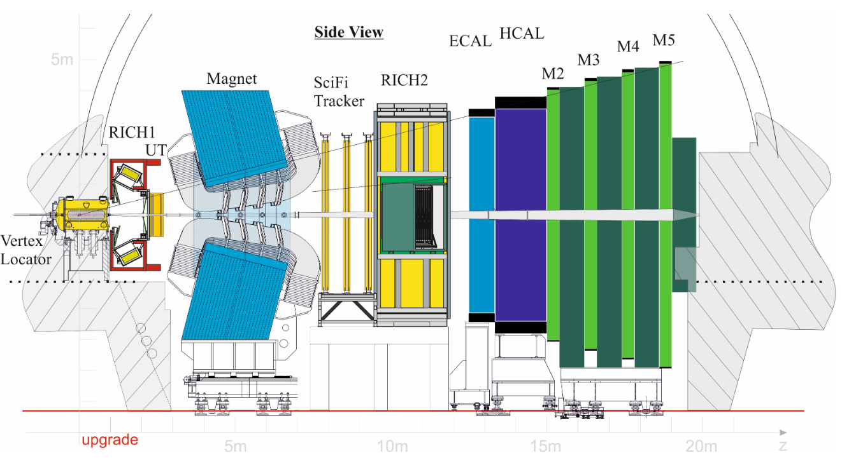
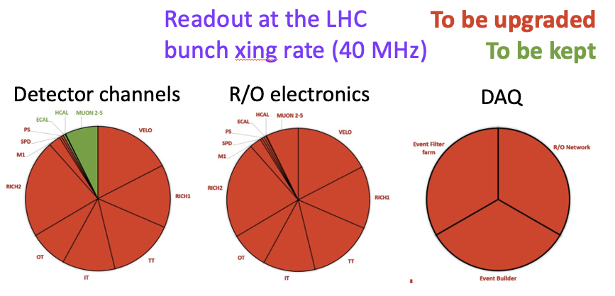
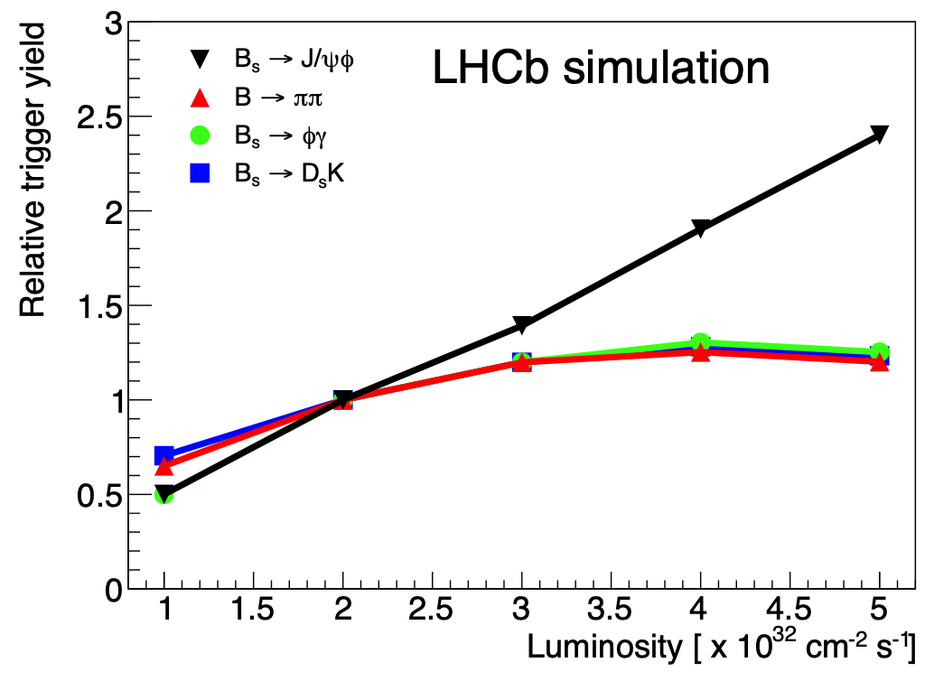
Upgrade I: a brand new detector
Higher luminosity (5xℒ_{Run1&2}) results in
Higher rate, pile up, occupancy, fluence
New tracking system
VErtexLOcator (VELO), Upstream Tracker (UT)
and Scintillating Fiber Tracker (SciFi)
RICHs: New optics + photon detectors
Calos: Reduce PMT gain + new electronics
MUON: new electronics
Leptonic
No hardware trigger
1st GPU trigger in a HEP experiment
Hadronic
Already saturated @ Run 1&2

Slide 7
VErtex LOcator (VELO)
Silicon strip sensor
Silicon pixel sensor

Slide 8
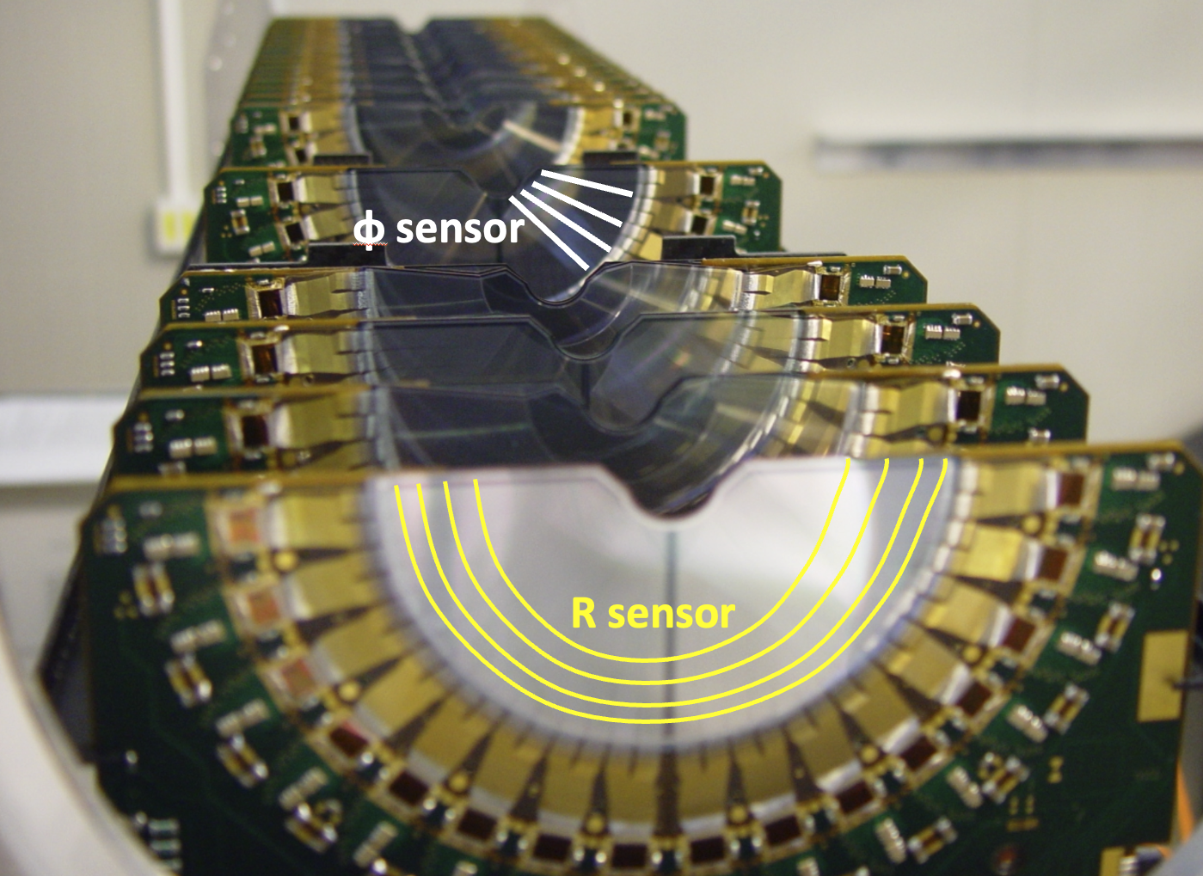
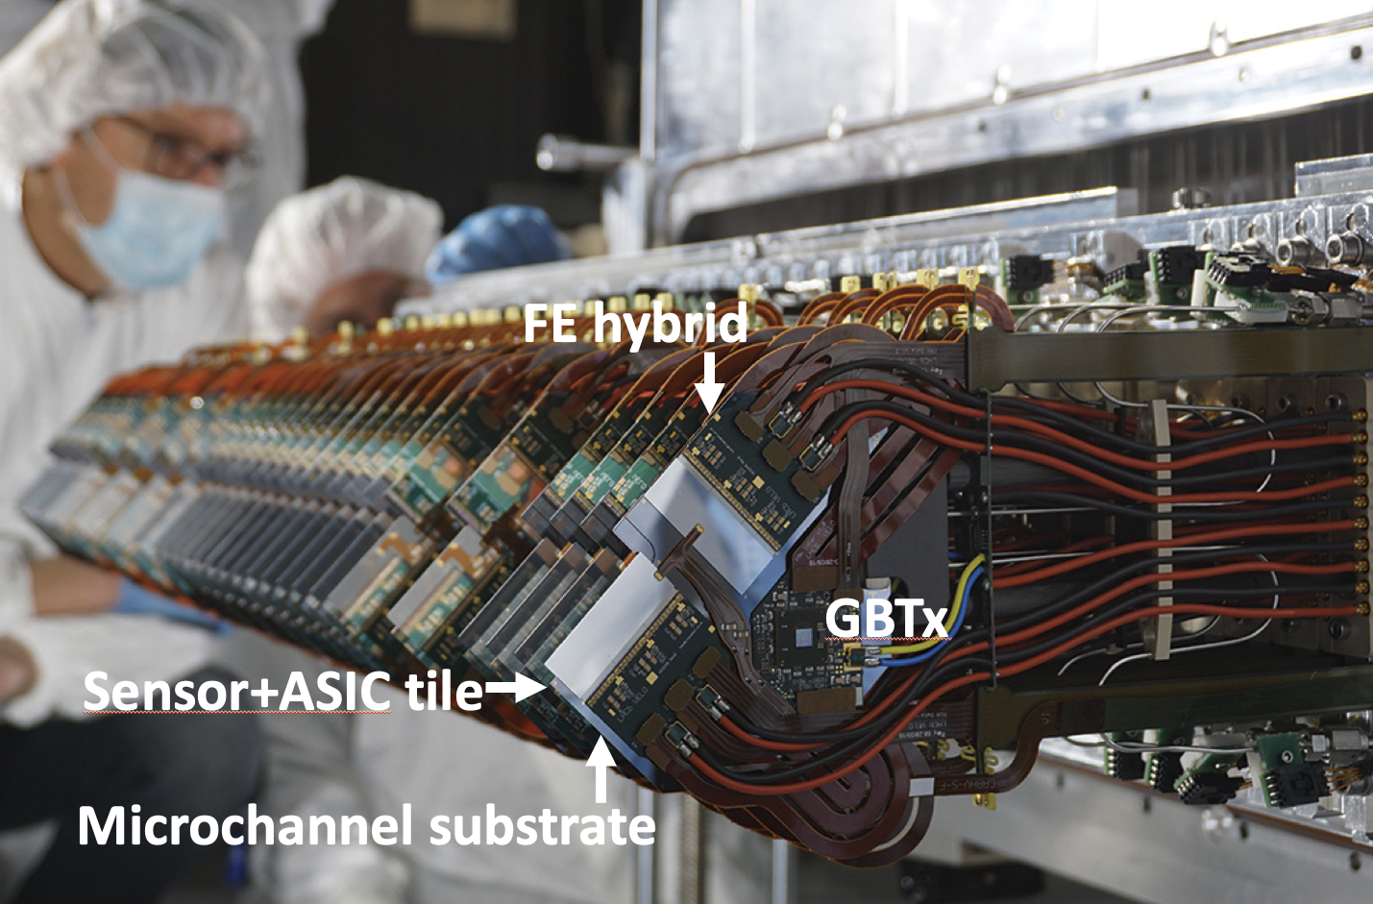
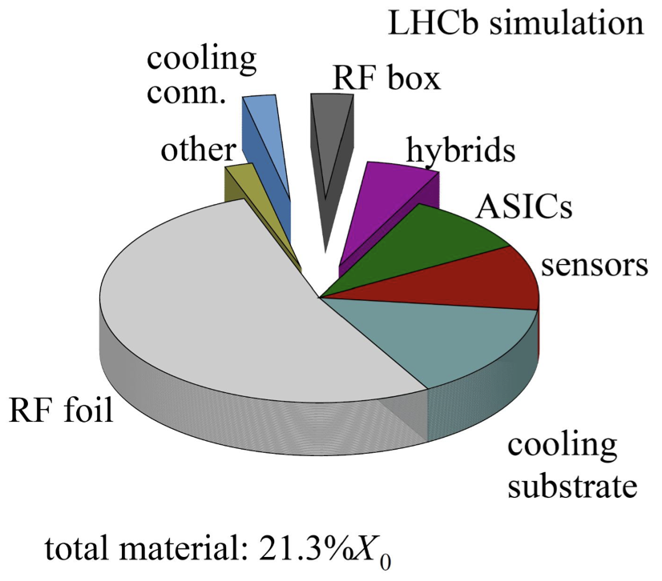
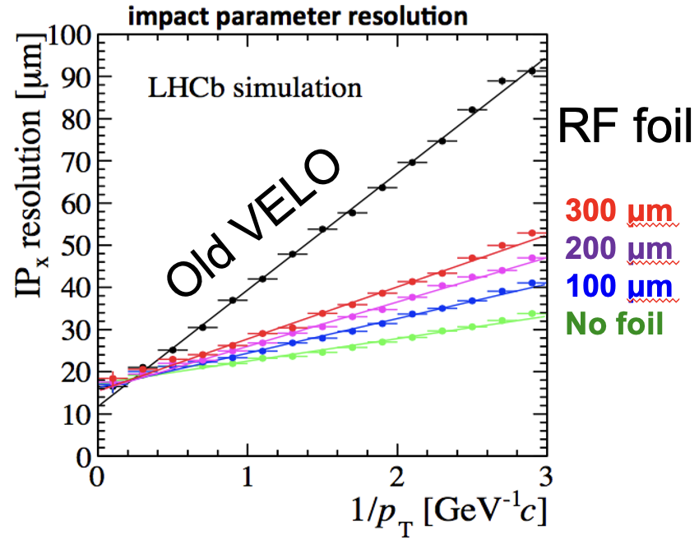
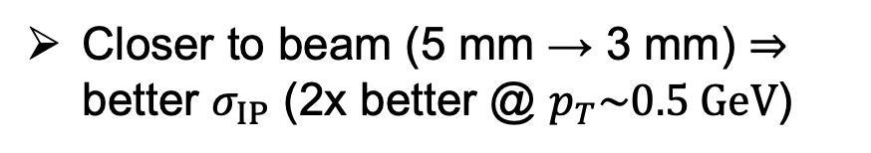
VELO
CERN-LHCC-2013-021
New hybrid pixel detector
52 Modules for 41M pixels & Area~ 1.2 m²
Silicon pixels (55x55 μm²)
Single hit resolution 12-15 μm
Closer to beam (5 mm → 3 mm) ⇒ better $σ_{IP}$ (2x better @ $p_{T}\sim 0.5 GeV$)
Velo before 2019
Velo in U I
Two movable halves
Separate VELO from primary vacuum with RF foil (150 μm thickness in thin region)
Silicon substrate with micro channels carrying CO₂ for evaporative cooling
a load of up to 40W from each module
LHCB-TDR-013
New ASIC VeloPix
~ 20 Gbit/s in hottest ASIC
~ 2 Tbit/s in total
Reduced material interaction (x3 better)

Slide 9
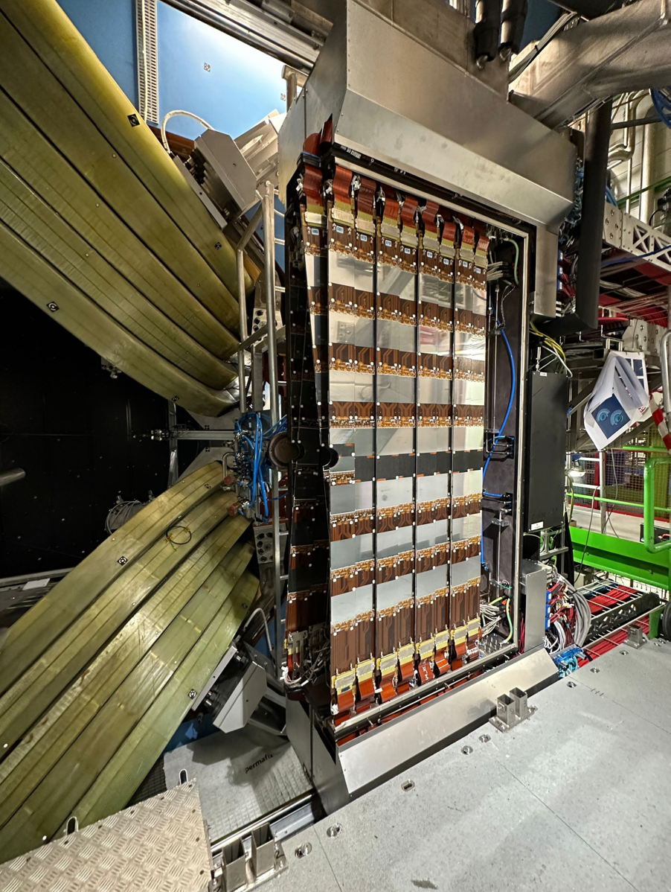
Upstream Tracker (UT)
Silicon strip sensor
Silicon strip sensor, with fine segmentation

Slide 10
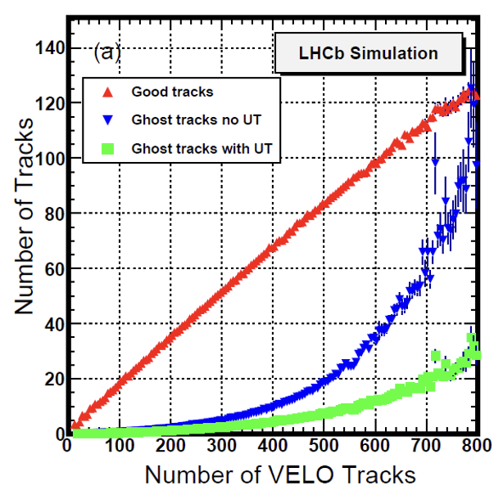
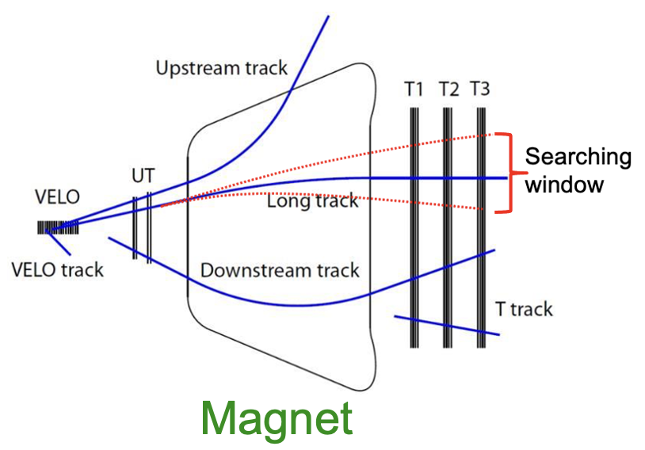

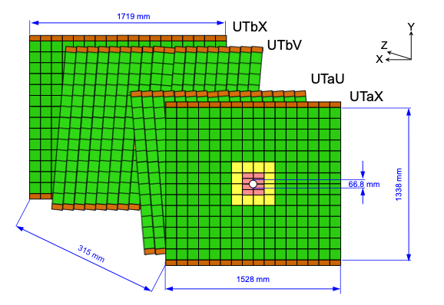
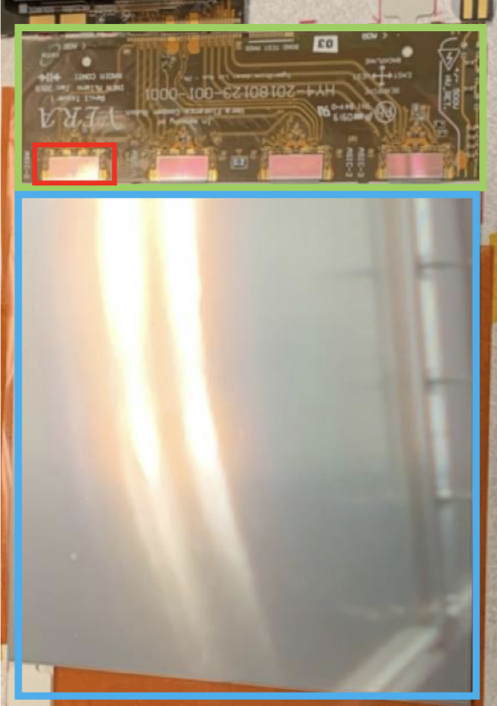
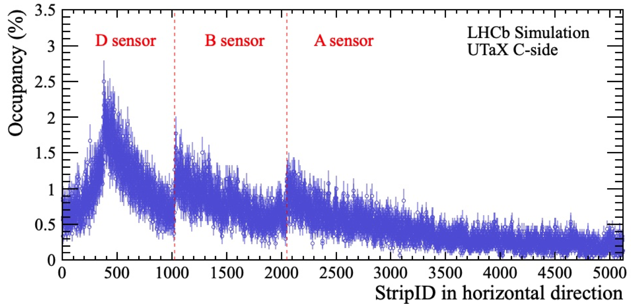
Upstream Tracker (UT)
CERN-LHCC-2014-001
LHCb tracking system
UT: Si Strip detector
Speed up tracks reconstruction & reduce P_{GhostTrk}
High coverage, segmentation, resolution
Different sensors for different regions
A type: p-in-n; 98x98 mm; strip pitch 190 μm
B type: n-in-p; 98x98 mm; strip pitch 95 μm
C/D type: n-in-p; 98x49 mm; strip pitch 95 μm
Maximum occupancy ~ 1%
D sensor
B sensor
A sensor
10x5 cm
10x10 cm
10x10 cm
JINST 19 (2024) P05065
Strips direction

Slide 11
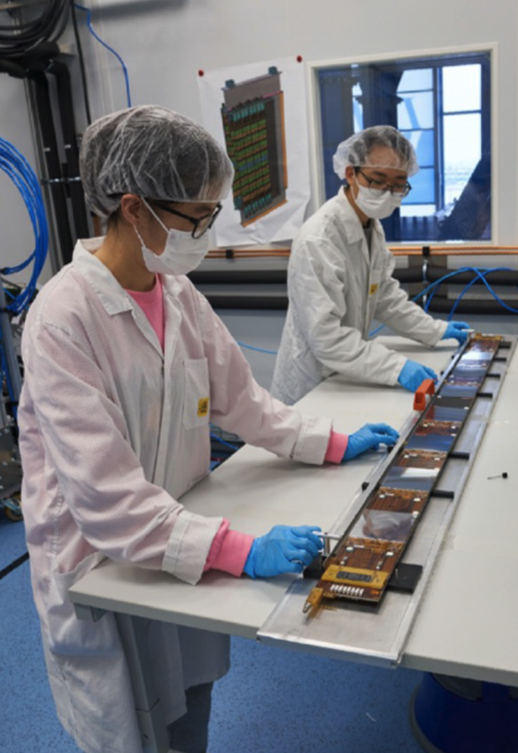
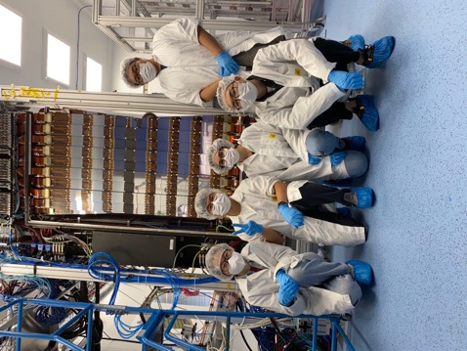
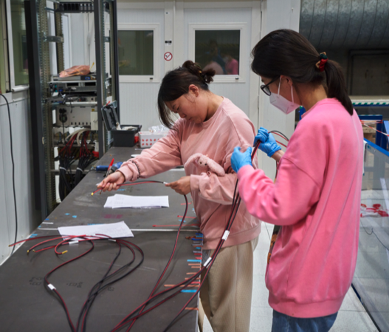
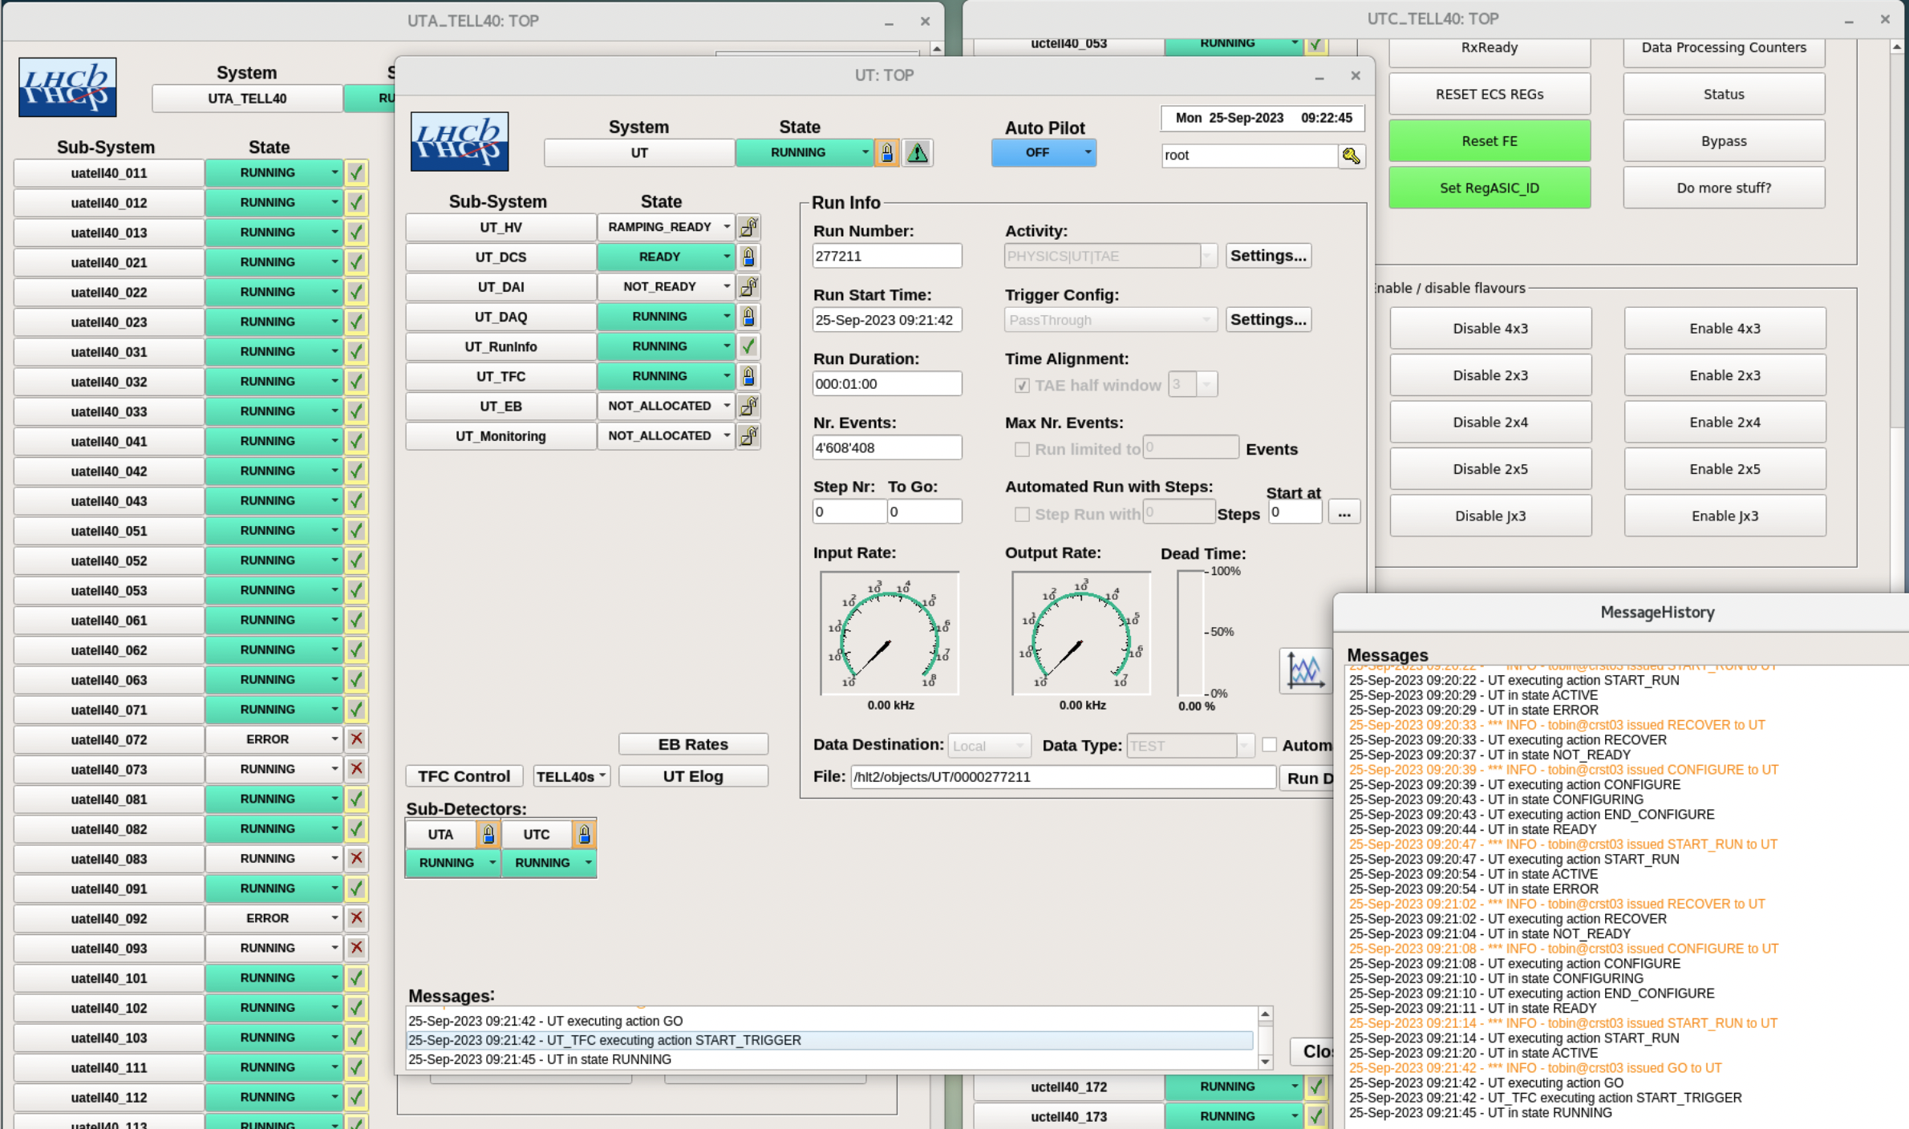
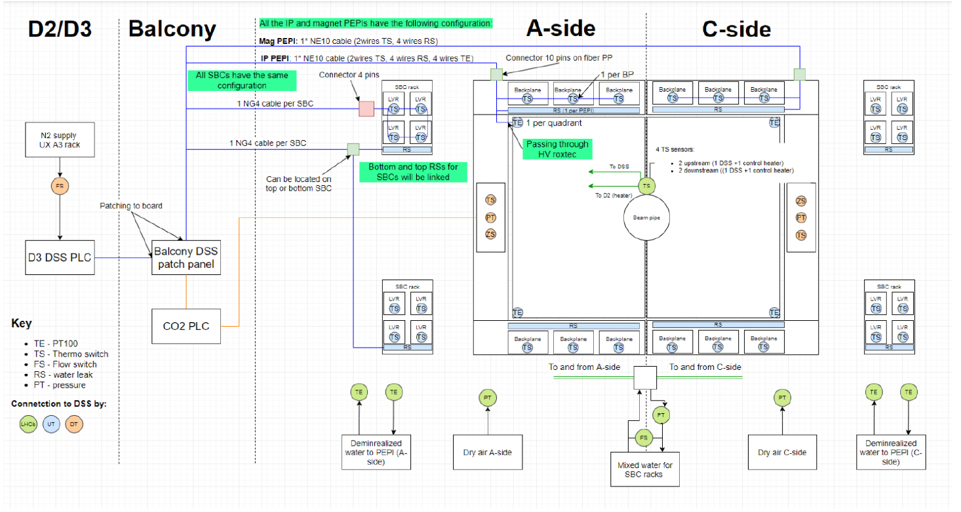
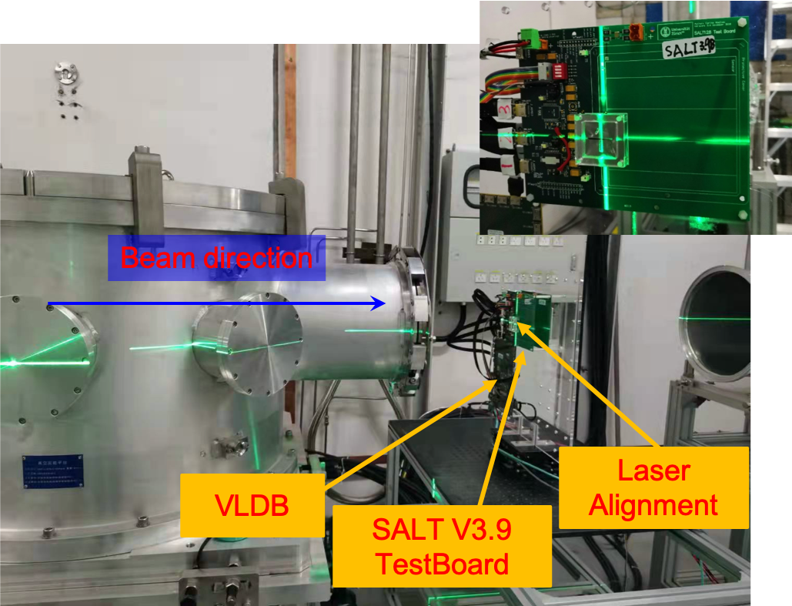
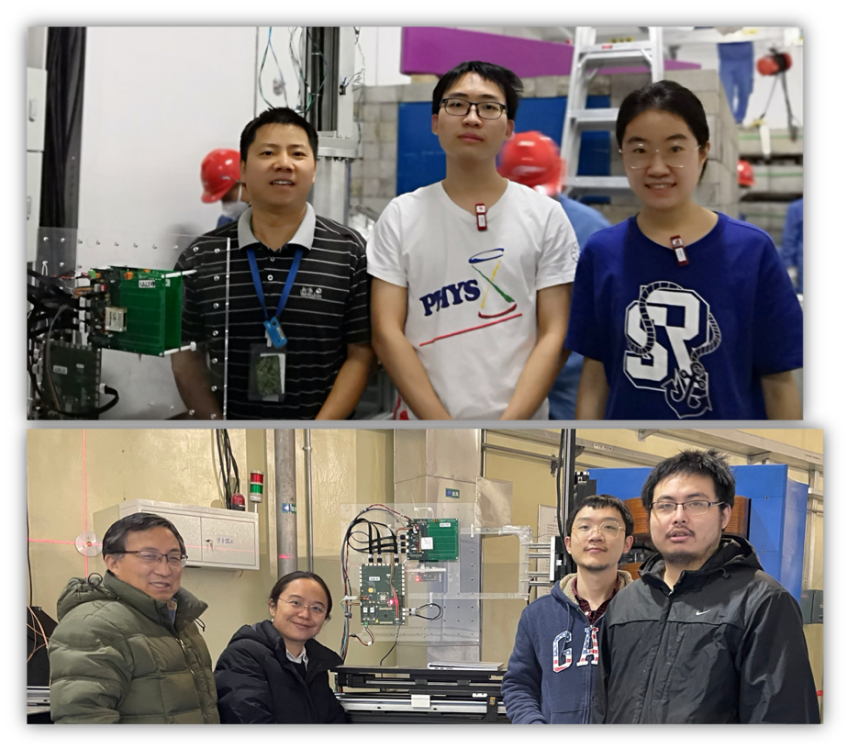
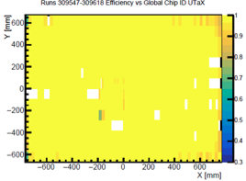
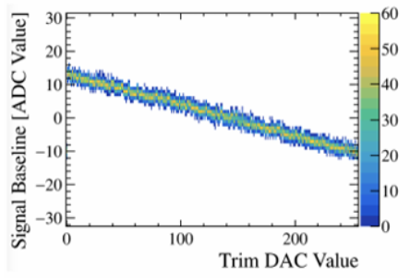
UT @ China
Chinese groups contributed to UT installation, ensuring LHCb Upgrade I completion in time (IHEP/HNU/CCNU/THU/SCNU/LZU)
Lead development in control and safety monitoring software (IHEP)
Exp. Control Software
Detector Safety Software
Performed key radiation tests for SALT chip using Chinese facilities
Contributions in software & commissions (IHEP/LZU/UCAS/THU)
Test at CSNS (Dongguan)
Test at CIAE (Beijing)
More details see the talk by
Mingjie Feng (冯铭婕)

Slide 12
Scintillating Fibers tracker (SciFi)
STD chambers & Silicon strip
Scintillating fibers tracker

Slide 13
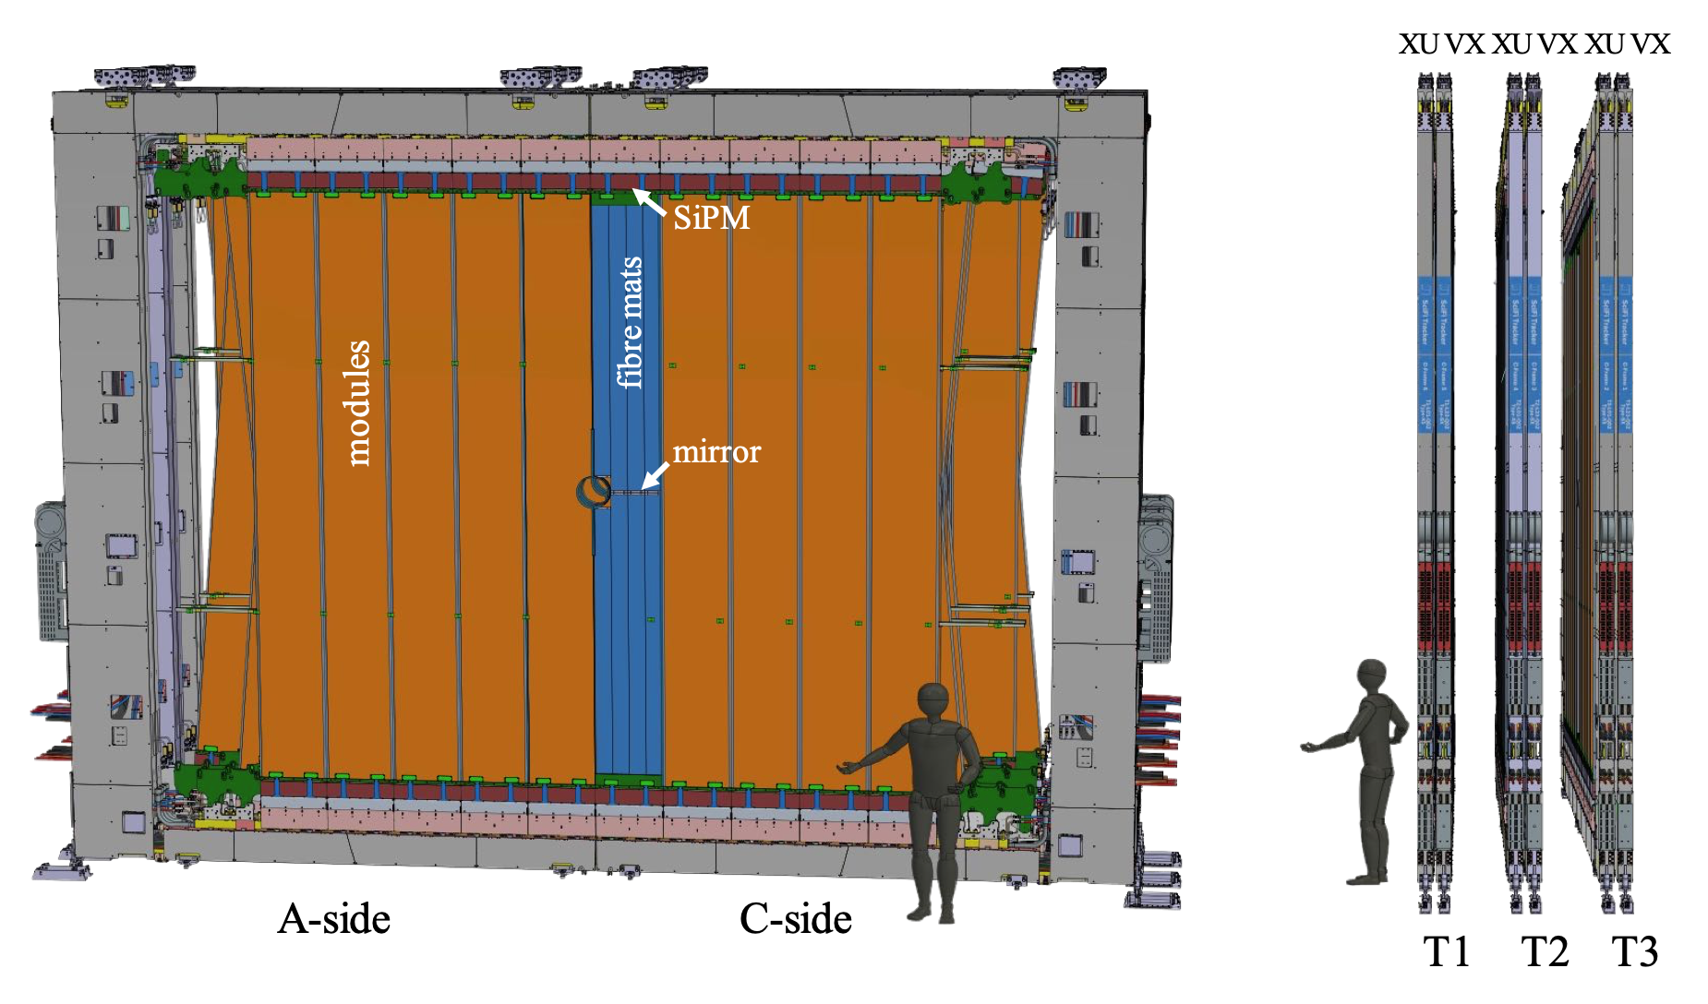
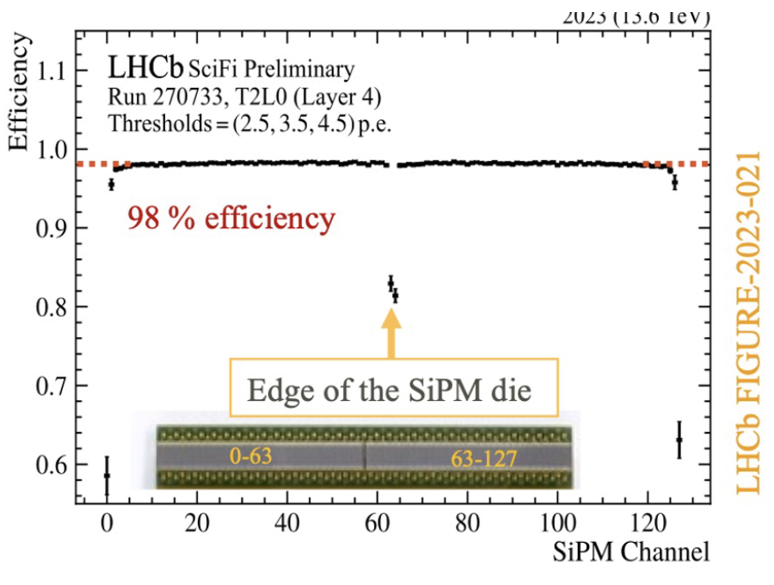
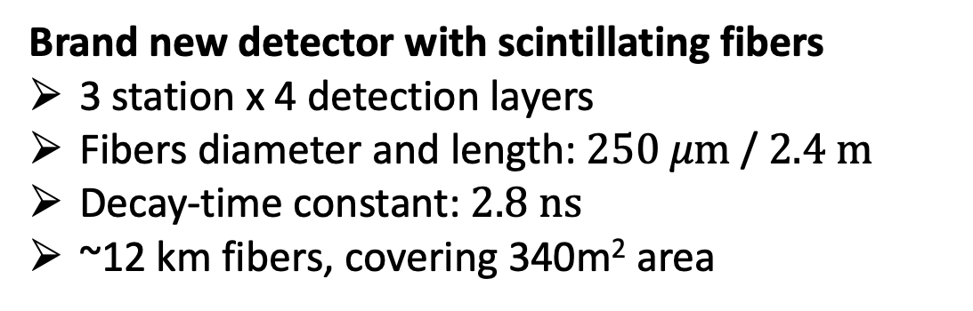
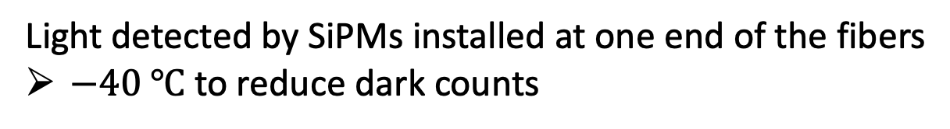
Scintillating Fibers tracker (SciFi)
Brand new detector with scintillating fibers
3 station x 4 detection layers
Fibers diameter and length: $250 μm$ / $2.4 m$
Decay-time constant: $2.8 ns$
~12 km fibers, covering 340m² area
Light detected by SiPMs installed at one end of the fibers
$−40 ℃$ to reduce dark counts
New ASIC (PACIFIC), 64 channels 130 nm CMOS
Clusterization of hits implemented in FPGA after signal digitization
Good performance in 2023 + 2024

Slide 14
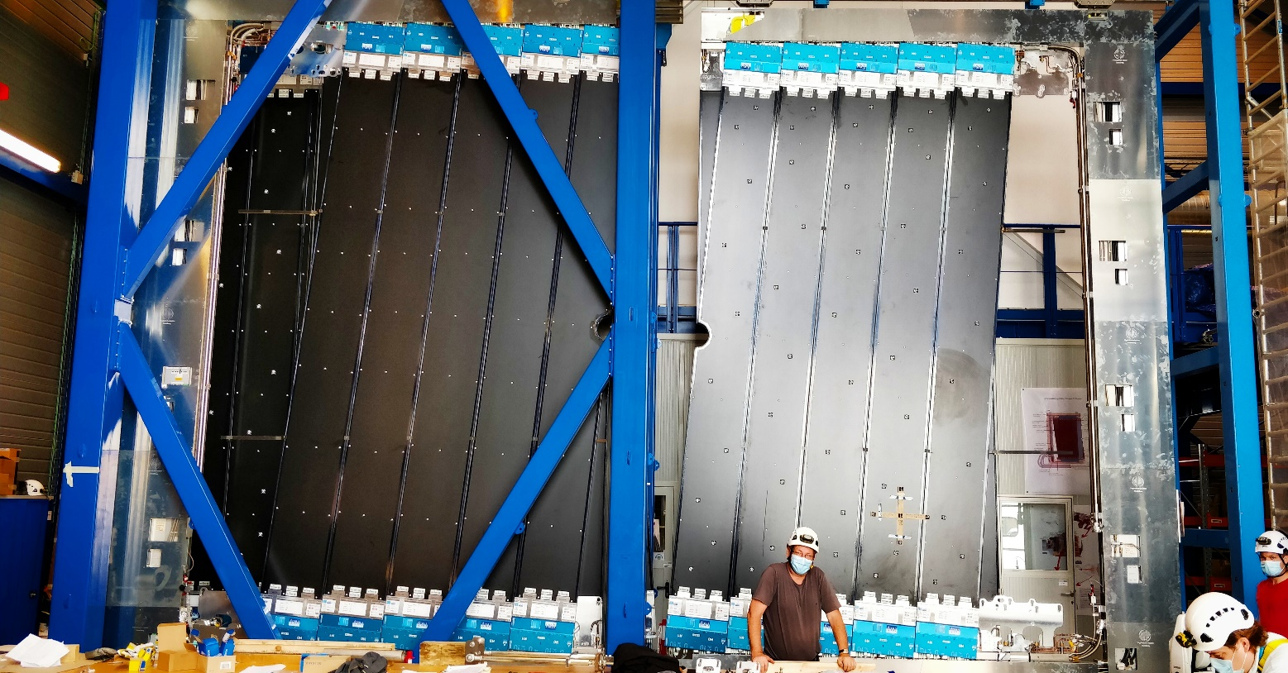
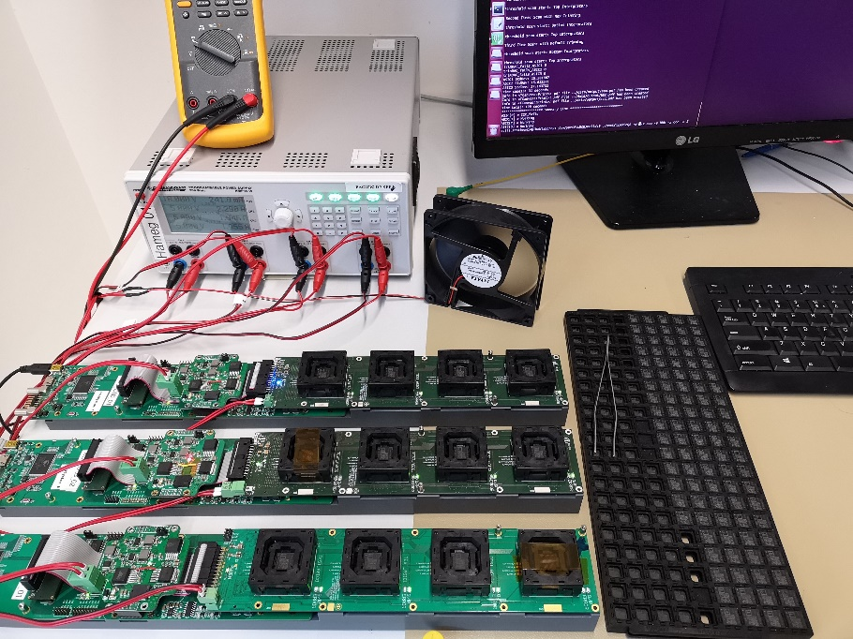
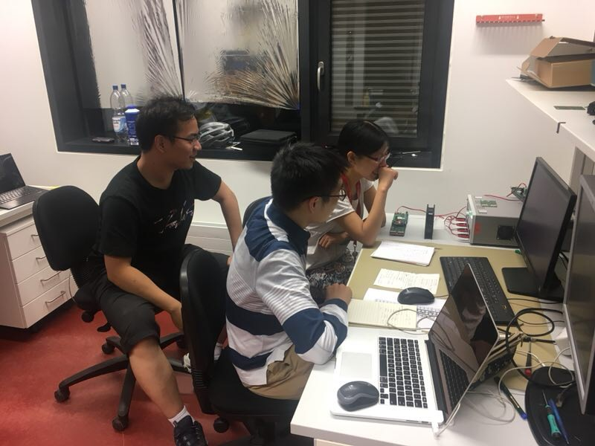
SciFi @ China
LHCb SciFi China group (Tsinghua Univ.)
Co-design the ASIC Frontend Board (with Heidelberg)
Manufacture all 2,528 ASIC boards (64, 168 channels in total)
Test half of ASIC Boards and all the chips

Slide 15
LHCb Upgrade I (2019 ~ 2023)
LHCb Upgrade II (2033 ~ )

Slide 16
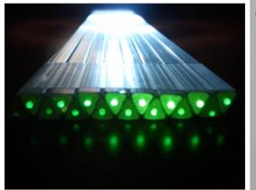
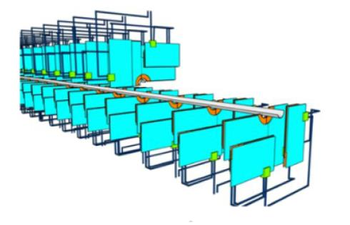
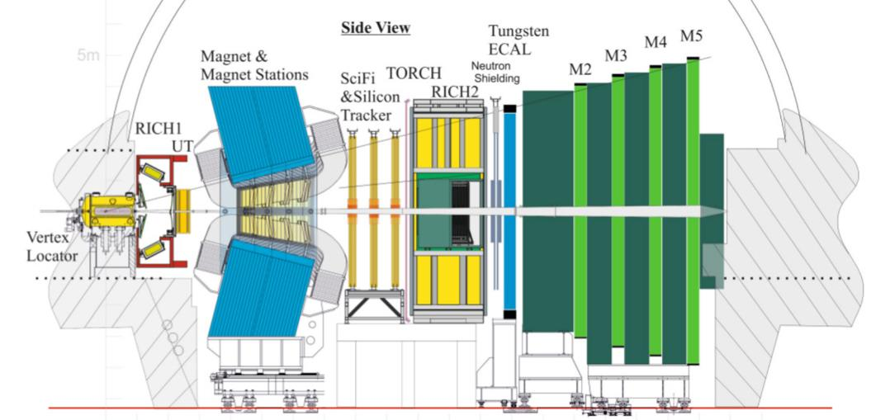
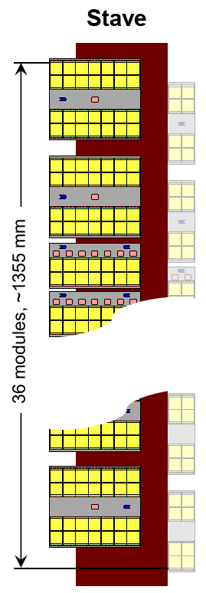
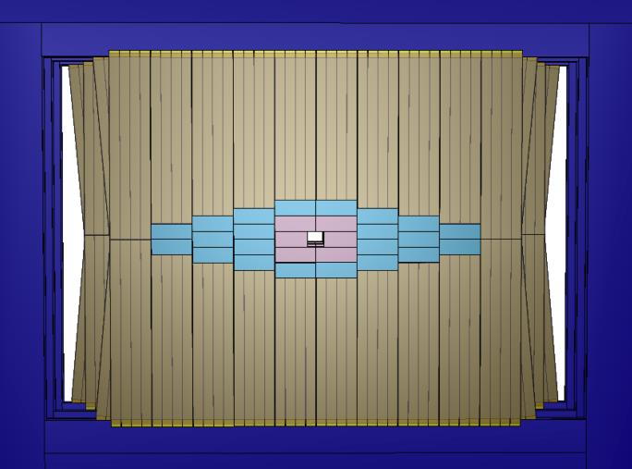
The Tracking System in Upgrade II
Vertex Locator (VELO)
Pixel with timing
New RD-foil
3D, LGAD, 28 nm
Magnet Stations (MS)
Scintillating bar
Low P particles
Might Tracker (MT)
MAPS CMOS pixel (inner)
Keep SciFi (outer)
Upstream Pixel Tracker (UP)
MAPS CMOS pixel
Radiation tolerant

Slide 17
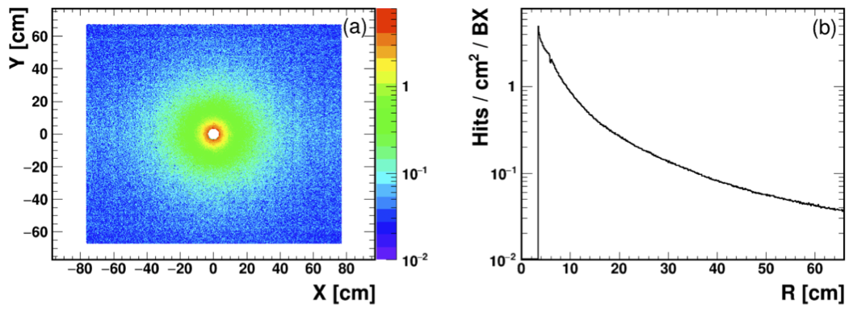
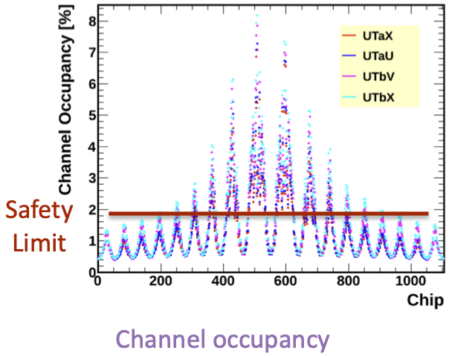
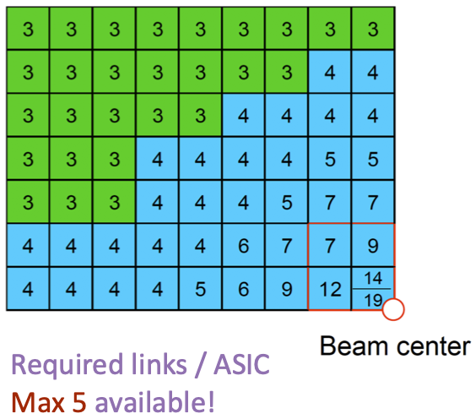
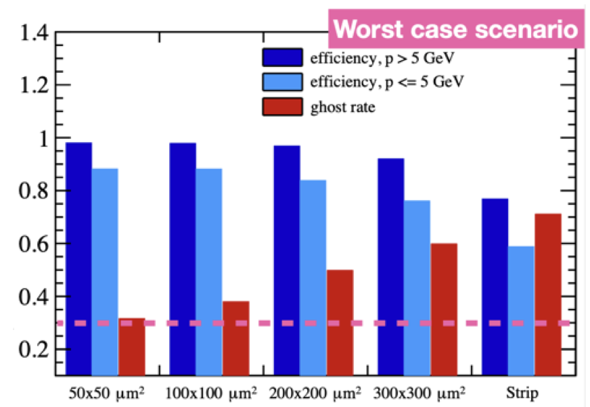
A new UT in Upgrade II
Upgrade II luminosity 1.5x10³⁴ cm⁻²s⁻¹ (x7.5 ℒ_{Run 3&4})
Max hit density ~6 hits/cm²/BX for pp collisions
For Pb-Pb: ~3 hits/cm²/BX, but multiplicity higher
Current UT not optimized in HL-LHC
The occupancy (max ~10%) will compromise the performance
Data rate too high
Radiation does (3x10¹⁵n_{eq}/cm²) too high for current sensor
A new Upstream Pixel (UP) detector will replace the current one
CMOS MAPS technique applied
Studies based on current UT in Upgrade II condition

Slide 18
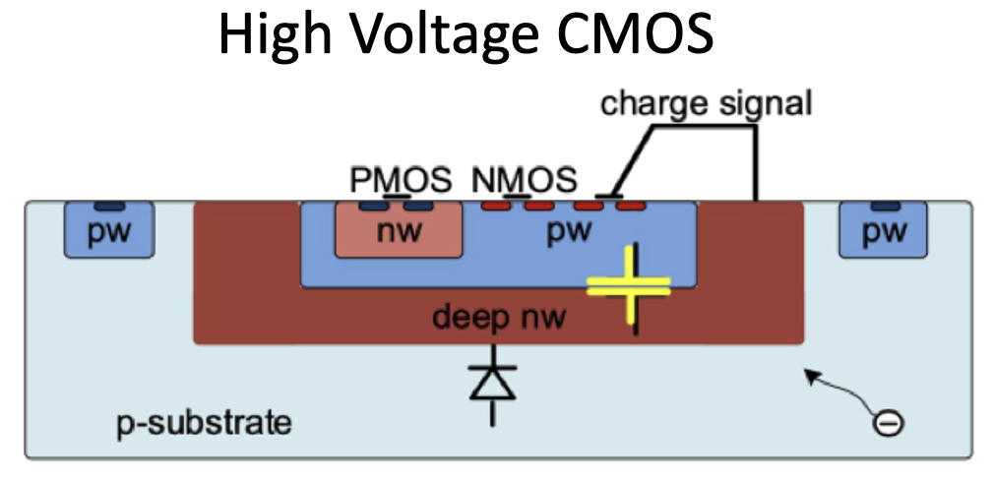
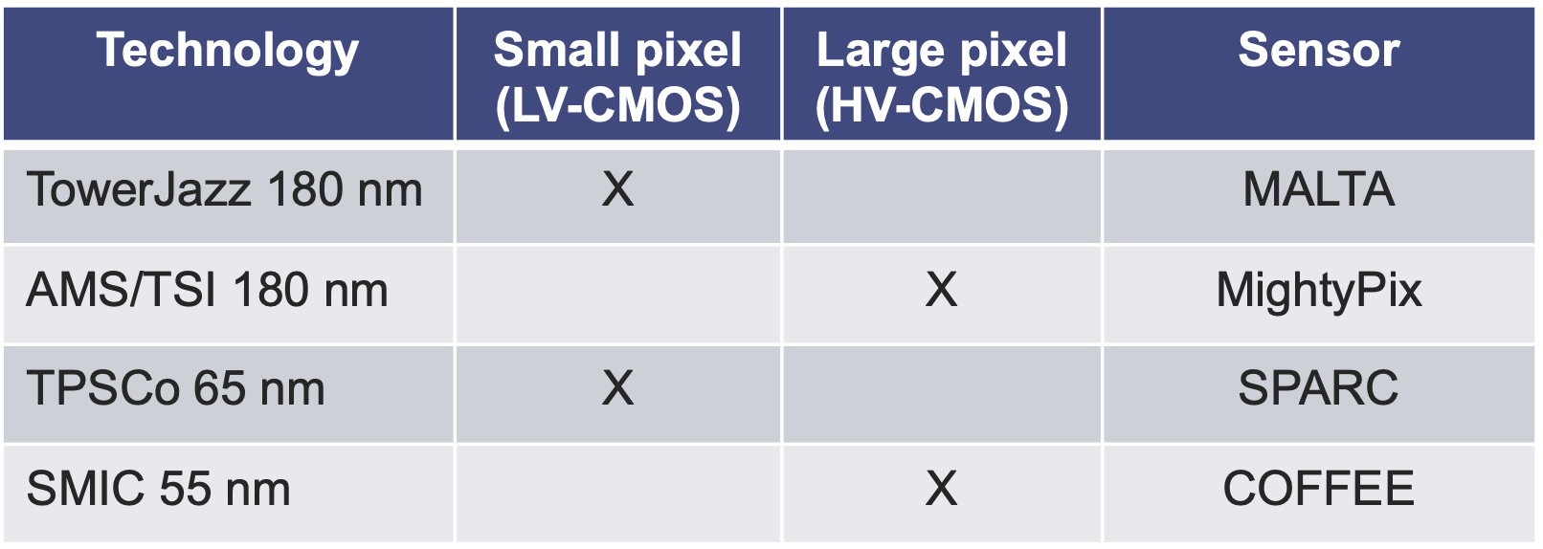
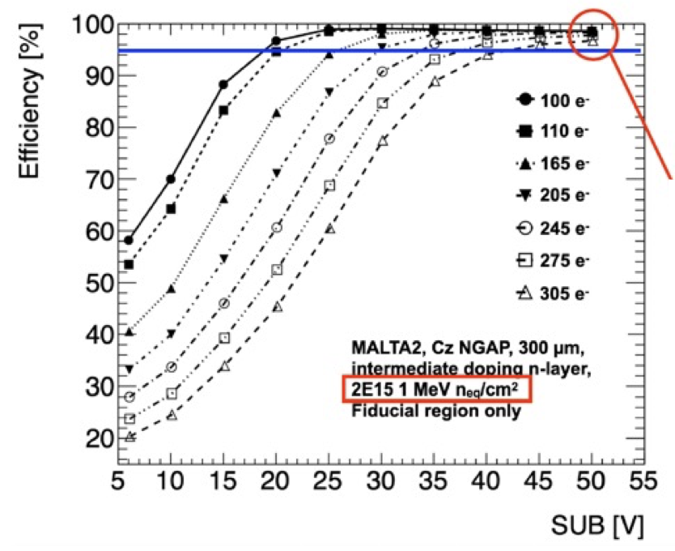
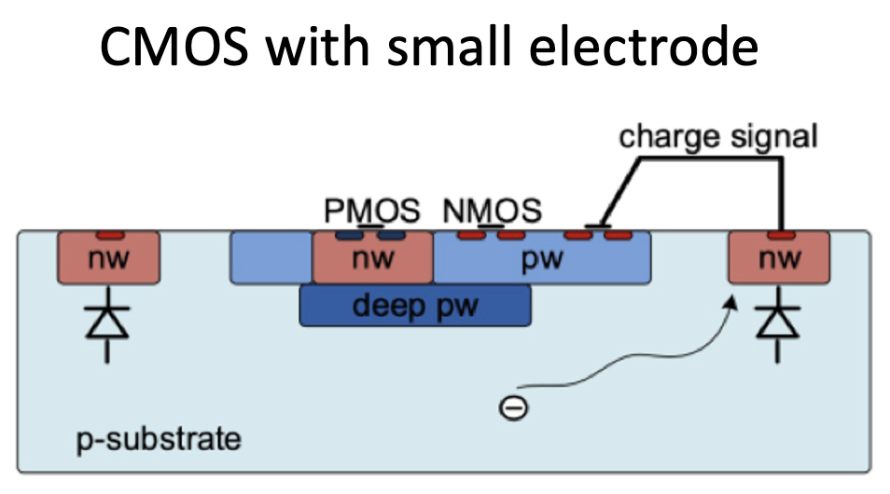

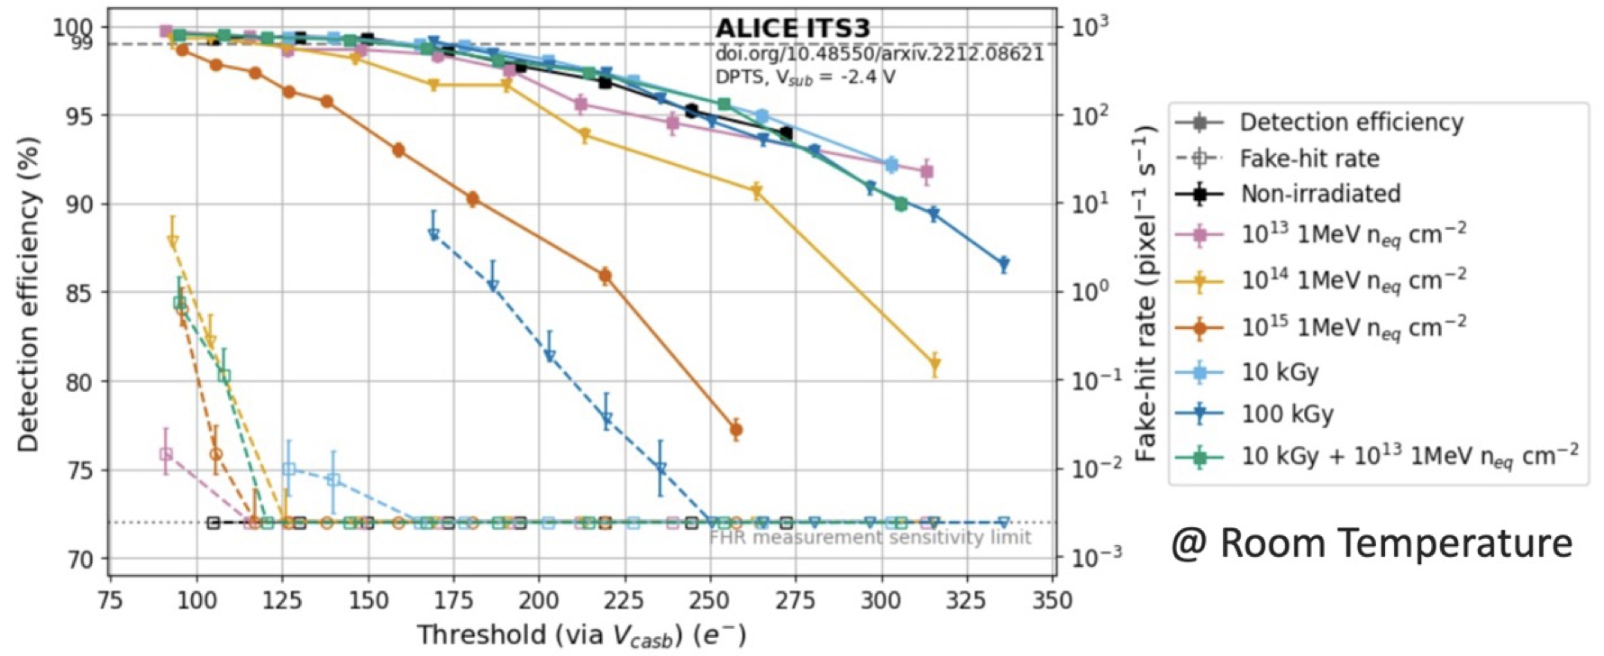



CMOS chips for UP
Two scenarios: HV CMOS or CMOS with small electrode.
Each choice has pros & cons
More details in the talk by Zhiyu Xiang (项治宇)

Slide 19






Layout
Design in Framework TDR, taking HV-CMOS as an example
4 detector layers, at Z position the same as the current UT
32 modules
VTRx+
lpGBT

Slide 20






Detector optimization
Also can see the talk by Yanru Li (李艳茹)
Track efficiency vs X coverage
Preliminary studies on
Track efficiency for $B^{−}→D^{0}K^{−}$, $D^{0}→K_{s}π^{+}π^{−}$, $K_{s}→π^{+}π^{−}$
Optimizing UP coverage
Material budget reoptimized to 1.20% X₀ per layer

Slide 21



Performance studies
Downstream track
Occupancy on busiest chip for each module
Long track
LHCb upgrade II software under developed, aiming TDR @ 2026
Preliminary results based on fast simulation
We can reconstruct UP standalone track, thanks for pixel chips taking with the both well resolution in x/y

Slide 22


UP project management structure

Slide 23




Particle Identification (PID) Detectors
RICH1, RICH2
Reduced pixel size
Add timing information
SiPM, MCP
Muon
μRWELL for inner regions
MWPC for outer regions
TORCH
To enhance PID capibilities for soft particles
Measure light angle, path lenth and TOF
ECAL
Space & time, longitudinal segmentation

Slide 24








5D calorimeter with precision timing
Time resolution (SpaCal)
Shashlik
LHCb upgrade II
LHCb upgrade II
LHCb upgrade II
Simulation
Key features: energy resolution ($10\%/\sqrt{E}⊕1\%$) , radiation hardness (up to 1 MGy), 𝒪(10) ps timing capability
and granularity.
Multiple techs. for different regions from inner to outer
Replacing the inner-most modules at Upgrade 1b.

Slide 25



ECAL @ China
GAGG scintillator fiber
Radiation hard; high density; high light output, fast decay time
Commercial GAGG ~50 ns, desirable <20 ns
Collaborated with SIPAT(中国电科芯片技术研究院)， decay time reduce to 15-20 ns
Absorber
Tungsten: small radiation length & small Moliere radius
Collaboration with LaserAdd (雷佳) to produce W absorber
  High density, 18.9 g/cm³, in comparison to 19.3 of pure W
  Good roughness Ra~4 μm achieved, save for fiber inserted smoothly
  Good sample obtained for prototype detector
Light guide & simulation
More details in the talks by Jiale Fei, Weisong Duan

Slide 26





ECAL/PicoCal management structure

Slide 27

Expected physics results @ LHCb Upgrade II
Key observables in flavor physics
Upgrade II will fully realize the flavor physics potential of the HL-LHC
Further pursue a broad physics programme
Spectroscopy
High precision EW and Higgs
Dark sector
Exotic search
Heavy ions and fixed target
Success of the physics programme relies on
HL-LHC providing LHCb ~ 50 fb⁻¹/year during Run 5&6
A detector with similar or better performance as the present one for Upgrade I
LHCC-2021-012

Slide 28



Summary
LHCb
Upgrade I: Completed
Upgrade II: starts in LS4, R&D now
LHCb Upgrade II to fully exploit HL-LHC for flavor physics and beyond
FTDR approved and now in R&D phase
Next: TDR @2026, construction, installation and eventually operation for physics
More physics results can be expected from LHCb
Expression of Interest, LHCC-2017-003
Physics case, LHCC-2018-027
Accelerator study, CERN-ACC-2018-038
Framework TDR, CERN-LHCC-2021-012
Scoping document, CERN-LHCC-2024-010
Thank you for your attention

Slide 29
Backup

Slide 30




COFFEE chips
More details in the talk by Zhiyu Xiang (项治宇)
CMOS sensOr in Fifty-FivE nm procEss (COFFEE)
Latest version with real validation of the sensor structures with electronics included
Variation of passive diode arrays
Integral analog amplifier and switch circuit to select certain pixel
Discriminator and DAC unit added
CSA output calibrated with charge injection
Clear response to ⁵⁵Fe source
Clear response to laser with low noise

Slide 31


5D calorimeter with precision timing
LHCb upgrade II
Simulation
To fight against large bkg due to pile-up, add time measurement in ECAL with a precision of 15 ps
Select cells with $\left|t_{ECAL}−t_{PV}\right|<3σ_{t}$
$t_{PV}$: collision time measured by other detectors
$t_{ECAL}$: time measured by ECAL cell, ToF corrected
$σ_{t}$: ECAL time resolution

Slide 32


PicoCal: granularity
Improve the performance efficiently at high luminosity
Re-organize ECAL zones to follow the radiation and occupancy map
Five zones with cells of different sizes: (1 module = 1bloc of 12x12 m2
  1.5x1.5 cm²: 32 modules (SpaCal+W) 2048 cells
  3x3 cm²: 144 modules (SpaCal+Pb) 2304 cells
  4x4 cm²: 448 modules (Shashlik) 4032 cells
  6x6 cm²: 1344 modules (Shashlik) 5376 cells
  12x12 cm²: 1344 modules (Shashlik) 1344 cells

Slide 33





Testbeam of SpaCal-W-GAGG prototype
Based on simulation results,
Time resolution above 20 GeV for W-GAGG prototype: better than 10 ps

Slide 34
RICHs
New optics, new PMTs, new readout

Slide 35




Ring imaging Cherenkov detector (RICHs)
Performance in Run 1&2
RICH1 with C₄F₁₀ and RICH2 with CF₄
PID for $p∈\left(2.6,100\right) GeV/c$
Replace Hybrid Photon Detector (HPD) with Multianode PMTs in RICH 1&2
26.2 or 52 mm² area with 64 pixels
Change curvature of RICH1 spherical mirrors to reduce occupancy on PMTs
Factor 2 less
New radiation hard and fast readout ASIC implemented (CLARO)
Performance already better than Run2

Slide 36

Calorimeters
New readout, Preshower (PS) and Scintillating Pad Detector (SPD) removed

Slide 37


ECAL & HCAL
Present detector unchanged
ECAL: Shashlik modules (lead+scintillator) ~ 25X₀
HCAL: TileCal modules (iron+scintillator)
PS/SPD detectors removed
No need for fast inputs to L0 hardware trigger
PMT gain reduced by a factor 5 to increase lifetime of detector
Compensated by an equal increase in the electronic amplifier gain
Front-end electronics redeveloped
Trigger-less readout
Cope with increased instantaneous luminosity
Some ECAL inner modules will be replaced already in LS3 for Upgrade II prototypes tests

Slide 38
MUON
New readout, No M1

Slide 39




MUON
Remove 1st layer (M1) with GEMs of current MUON detector
NO use for L0 trigger which is removed
The 4 layers (M2-M5) of Multi-Wire Proportional Chambers (MWPCs)
Additional shield around beampipe
Reduce particle flux in M2 inner region
Redesign electronics to cope with 40 MHz trigger-less readout
R&D to replace inner parts of M2 and M3 with more granular detectors (triple GEMs/MWPCs)

