Slide 1
The design, production and QC test of
GEM electronics board for CMS ME0 project
Zhe Li (on behalf of PKU Group)

Slide 2
Outline
Outline:
Introduction of CMS ME0 GEB
Requirements of CMS ME0 GEB
Design of CMS ME0 GEB
Production and QC test of ME0 GEB
Summary

Slide 3
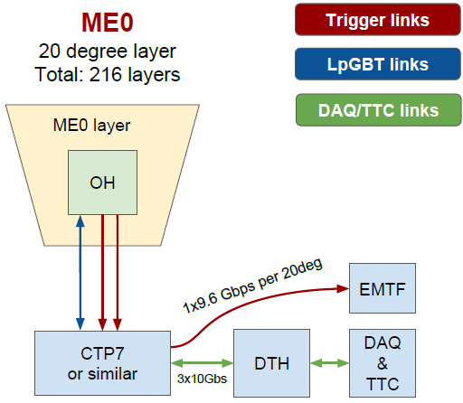
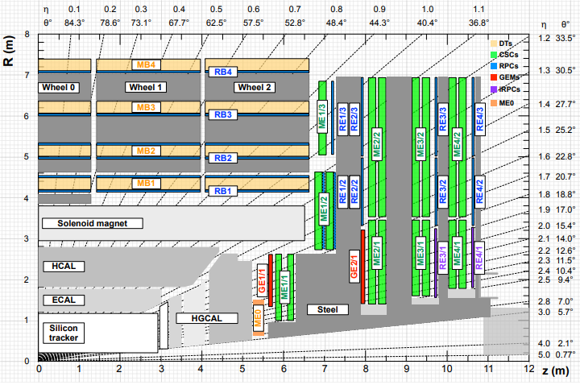
Introduction of CMS ME0 GEB
GEB: front-end electronics board of GEM detector for upgraded CMS muon system (GE1/1, GE2/1, ME0)
Function of GEB:
Carrier of front-end and back-end electronics system
Front-end signal transmission carrier
Provide direct shielding for GEM detectors
GEM
DAQ system of CMS-GEM
Works of CMS China HEP group:
Production and test of GE1/1 GEB
Design、production and test of ME0 and GE2/1 GEB
Development of automatic tester
GE2/1
GE1/1
ME0
CMS detector cross section

Slide 4
Requirements of ME0 GEB
Signal transmission:
Ensure that the characteristic impedance is 100 Ohm for differential line, and small fluctuations in characteristic impedance to reduce signal reflections
Ensuring that time delay of the signal lines are the same to meet isochronism requirement
Low BER (Bit Error Rate) and noise
Power Supply:
Meet the different power requirements of VFAT and OH board
Effective power distribution systems
Power monitor, current, voltage and temperature monitor
Prevent large voltage drop during transmission
Validate the voltage to set value
Mechanical performance:
Total board thickness is less than 1.1mm, limited by installation space.
Surface flatness lower than the IPC standard curvature 0.75%.
standoffs (holding VFAT and OH boards) aligned and firmed mounted

Slide 5
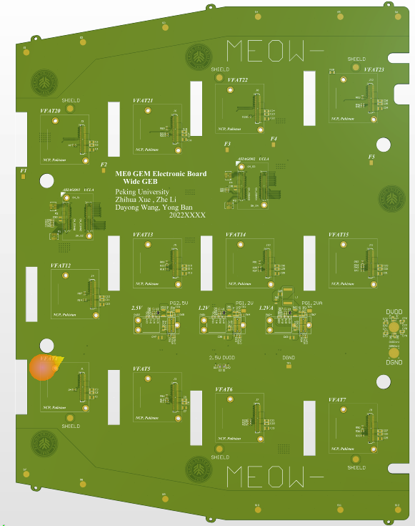
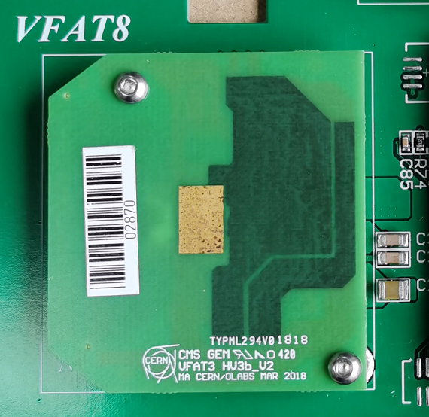
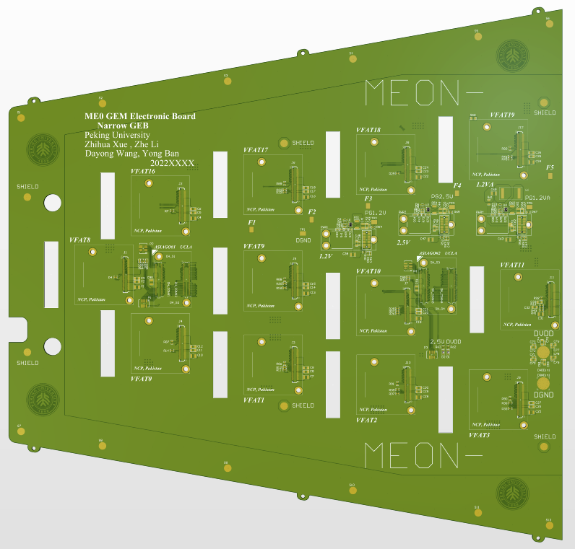
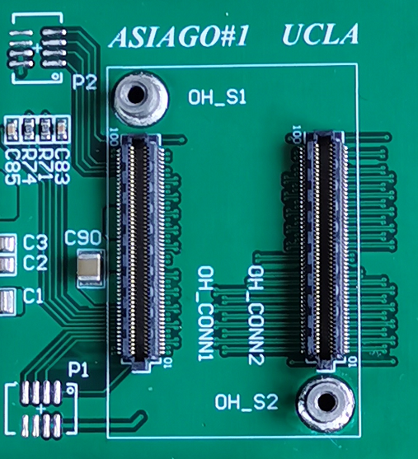
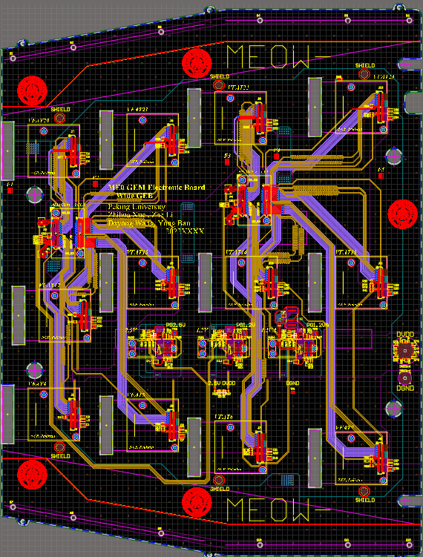
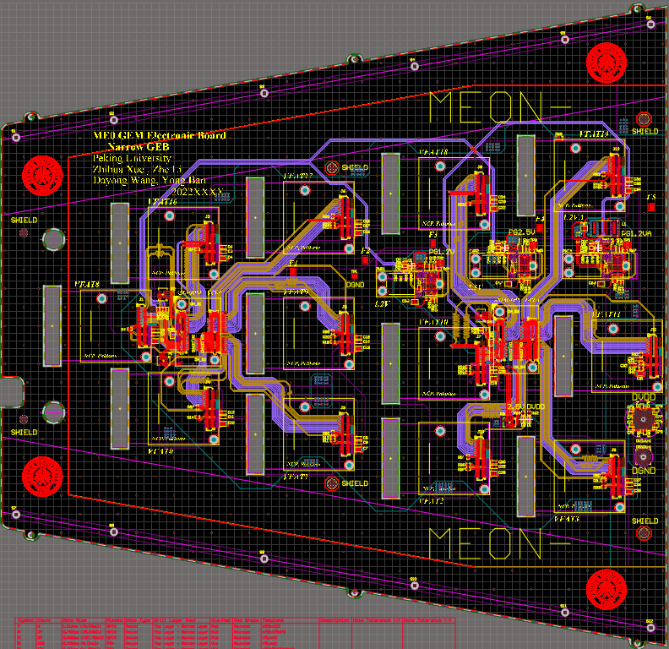
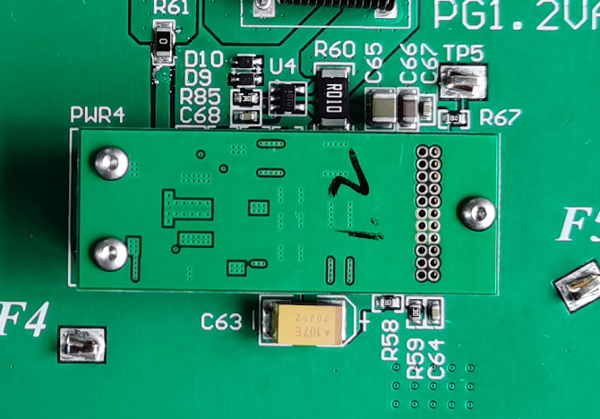
Design of CMS ME0 GEB
GEB with its function modules
The VFAT chip converts the signal on the readout strips into digital signal
A set of GEB connects to:
24 VFATs
4 ASIAGO boards (2 OH-CONN on each)
6 FEAST (1.2VA, 1.2VD and 2.5V)
VFAT Connector and standoff
Electrical components on OH board convert the signal from GEB into an optical signal on the optical fiber
Narrow board
Wide board
OH Connector and standoff
FEASTs provide voltage to chips on VFAT and OH board
FEAST Connector and standoff

Slide 6
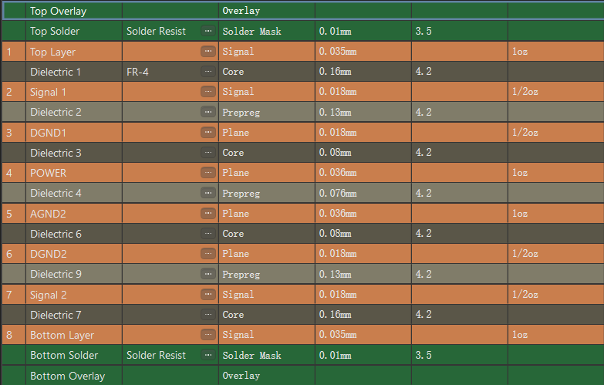
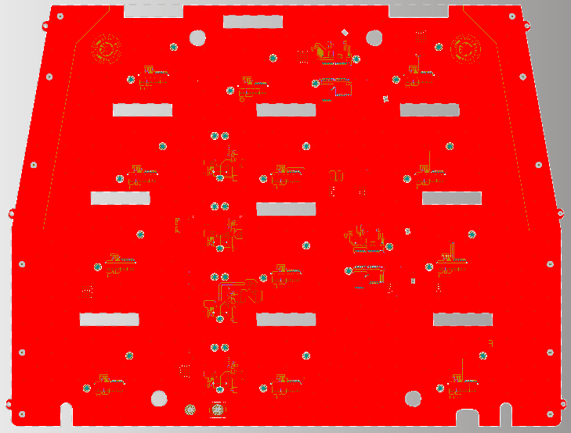
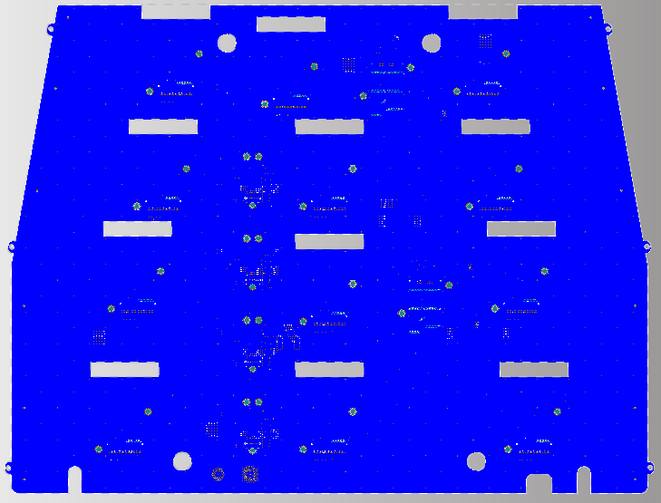
Stacks of GEB board
Stacks structure
To meet characteristic impedance requirement:
Choose proper dielectric constant: surface solder 3.5 medium 4.2
Copper thickness for signal stack: 0.5Oz
Mini number of vias for each differential line: 2 vias (Reduce the fluctuation of characteristic impedance)
To meet mechanical performance requirement:
Board thickness: 1.05mm (within the requirement 1.1mm)
Symmetrical arrangement and the same copper laying method (Reduce the curvature)
Use halogen-free boards
For example, top layer and bottom layer are laid with the same copper arrangement, in order to reduce the board curvature
Top layer
Bottom layer

Slide 7
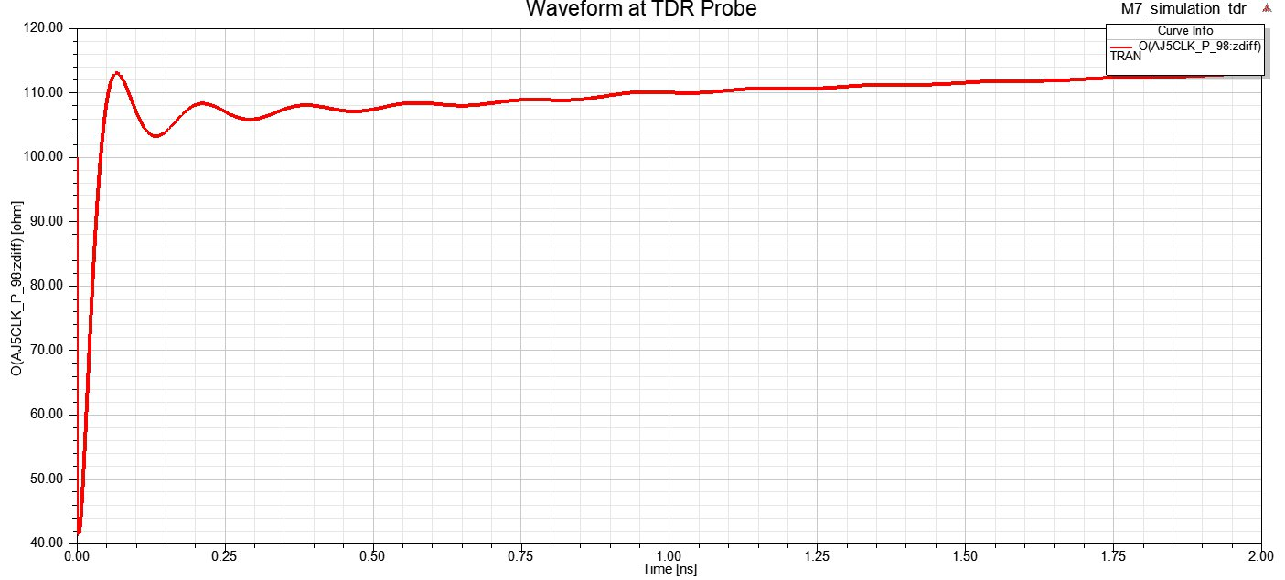
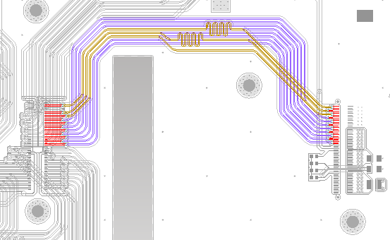
Characteristic impedance and routing
Characteristic Impedance
Set to 100Ohm for differential lines:
Factors that affects characteristic impedance:
W1,W2:Line width
S1:Differential line separation
D1:Ground strip separation
H1,H2:Stack thickness
Er1, Er2: Dielectric constant of the medium
Characteristic Impedance fluctuation: <10%
Characteristic impedance fluctuation of most differential line is within 10%
Routing:
(1) Differential signal lines: linewidth / gap / linewidth: 0.1/0.25/0.1 mm (Considering coupling effect)
(2) Other parameters: Minimum distance to another pairs / DGND: 0.55mm / 0.6mm.
(3) Simpler routing design: Reduce routing corner

Slide 8
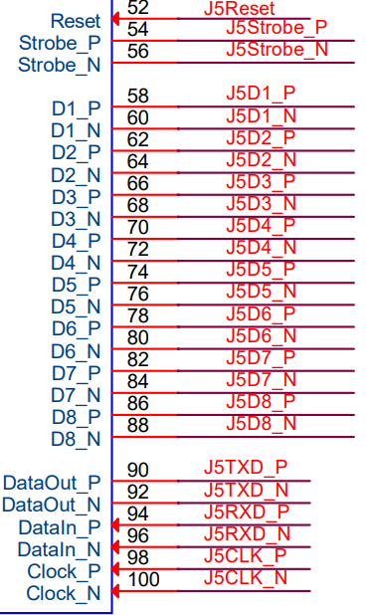
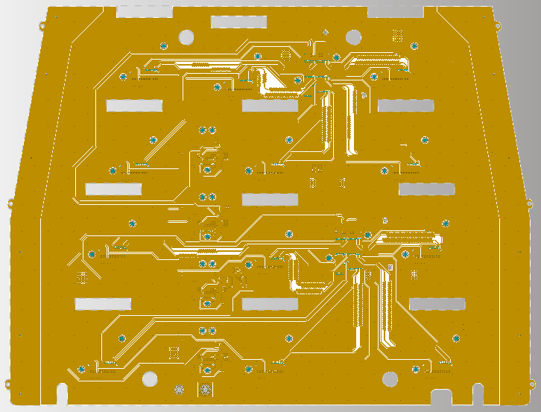
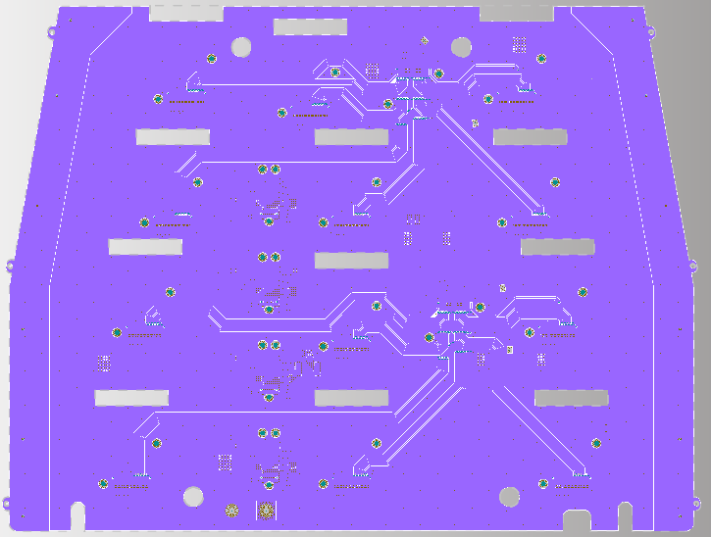
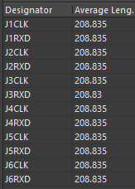
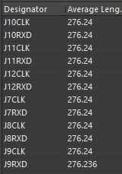
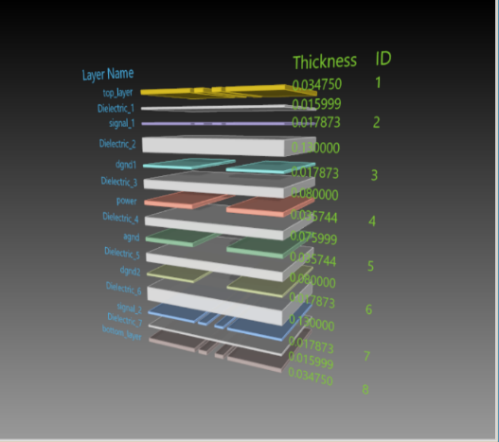
Signal
Signals introduction:
VFAT trigger unit outputs 9 differential signals: VFAT communication E-port has 3 pairs of differential signals
VFAT reset signal LVCMOS level signal: RESET
Signals are arranged on two layers:
Signal1 and signal2
Prevent crossover of signal lines as in GE1/1 case
To meet time resolution requirement of signals:
Equal length(CLK and RXD):
J1-J6,J7-J12 To ensure signal isochronism
Signal1 Layer
Signal2 Layer
Both signal layers have upper (Top layer or bottom layer) and lower shielding layers (DGND1 and DGND2) to reduce signal interference

Slide 9
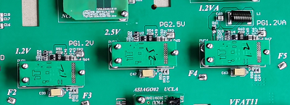
Power distribution system
Chip of VFAT and OH requires a different FEAST power supply
3 FEASTs provides 3 voltages to the corresponding chips of VFAT and OH board
FEAST
GEB distribute the voltage from FEAST to VFAT and OH board through vias and power plane.
In addition, grounding operation is achieved through the DGND and AGND planes.
Prevent voltage loss:
(1) The thickness of the power supply layer is 1oz
(2) For high current power supply, we provide large area power plane
Different colors show different power supply areas and link to different FEAST

Slide 10
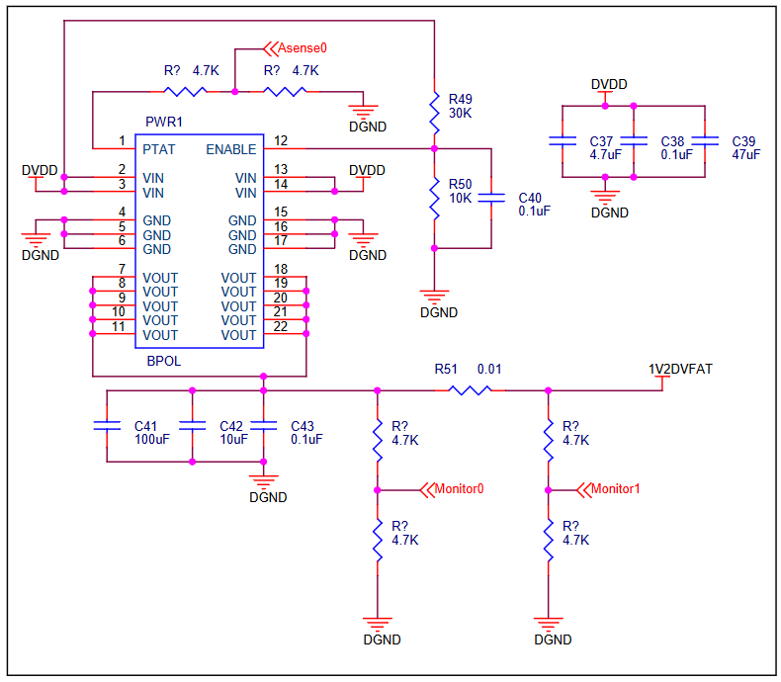
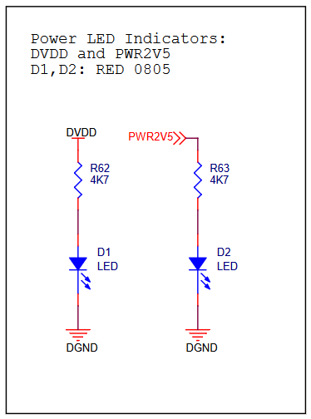
Power monitor
Power monitor:
introduced to ensure that the voltage value of the supply is normal
OH power supply；
PWR1: 1V2DVFAT ---1.3A for one ASIAGO, total is 2.6A.
PWR2: PWR2V5 --- 0.2A for one ASIAGO, total is 0.4A.
VFAT power supply:
PWR1: 1V2DVFAT ---70mA for one ASIAGO, total is 840mA.
PWR2: PWR2V5 --- <1mA for every VFAT
PWR4: 1V2AVFAT ---140mA for one VFAT, total is 1.68A
The output monitoring voltage show whether the FEAST is working properly.
To monitor the current output of each power supply, we use Monitor to detect the voltage drop through the current sensing resistor with a resistance of 0.01 Ohm.
The GEB power supply is designed with 2 sets of LED lights, corresponding to the main power input terminal and 2.5V power output seperately , which can display the power supply status of both in time.
Voltage measurement：
Monitor1 and Monitor0 are 0.6V (1.2V × 0.5)
Current measurement:
If Ir51 = 3.44A, voltage of Monitor0 –Monitor1 = 17.2mV
(3.44A × 0.01Ω × 0.5)
Power monitor of 1V2DVFAT
LED

Slide 11
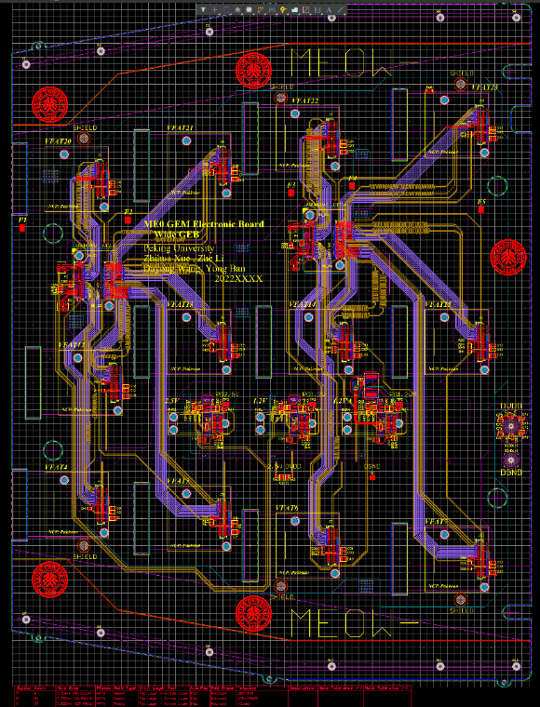
Grounding system and shielding system
Grounding system:
2 DGND layer(digital ground) and 1 AGND(analog ground) layer.
Shielding system:
The signal layer is between top/bottom layer and grounding layers to avoid electromagnetic interference.
Shielding pads which connected to the external frame are added to reduce noise.
chimney
Shielding Pads
12 in total
chimney
Split plane of AGND layer

Slide 12
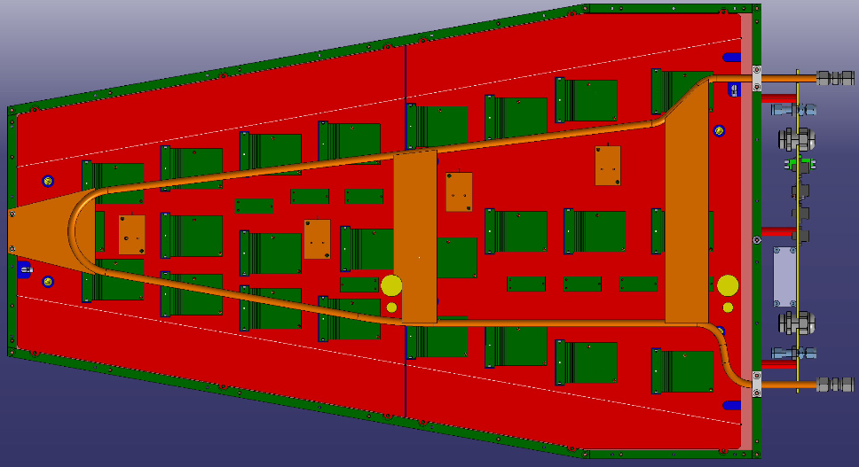
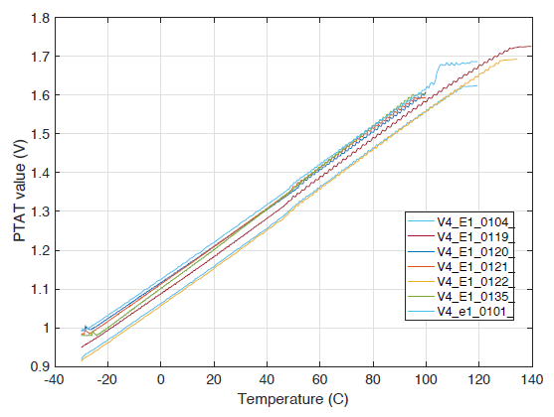
Cooling system and temperature measurement
Cooling system to cool down the DAQ system:
The cooling system is modified as the number of FEAST is from 4 to 3.
Temperature measurement:
Temperature is measured by the pin of PTAT on the BPOL with divided resistors.
The output of the divider of PTAT is 0.45V --- 0.85V(2.425mV/℃).
PTAT output change with temperature shown as below picture.
Cooling system
• Remove the 1.2VD FEAST which is located in the positions marked by the purple X
Temperature curve
Previous temperature measurement system

Slide 13
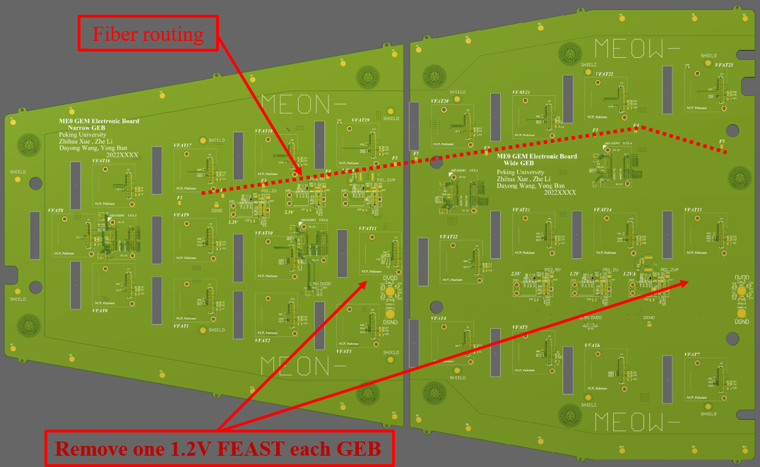
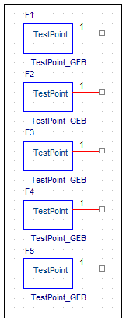
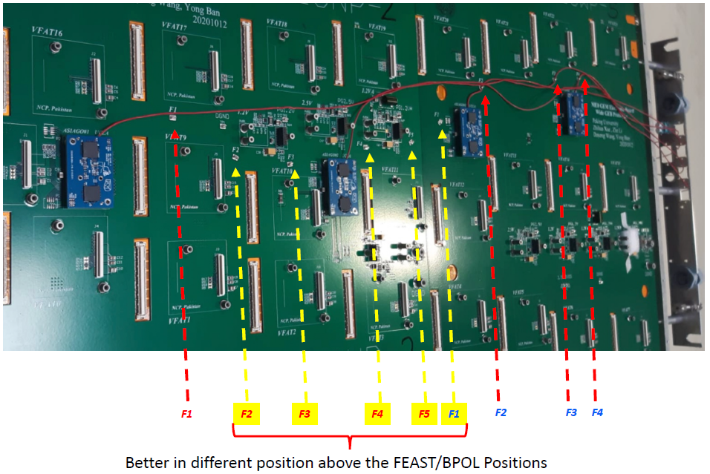
Fiber routing
• Fiber fixing
5 KEYSTONE 5016 for narrow GEB
5 KEYSTONE 5016 for wide GEB
attach optical fiber to zipline
• In order to ensure it is firm, many through holes are placed on the keystone.
• In order to avoid signal interference ,
- 1. The keystone is not grounded
- 2. No signal routes through the occupied position

Slide 14
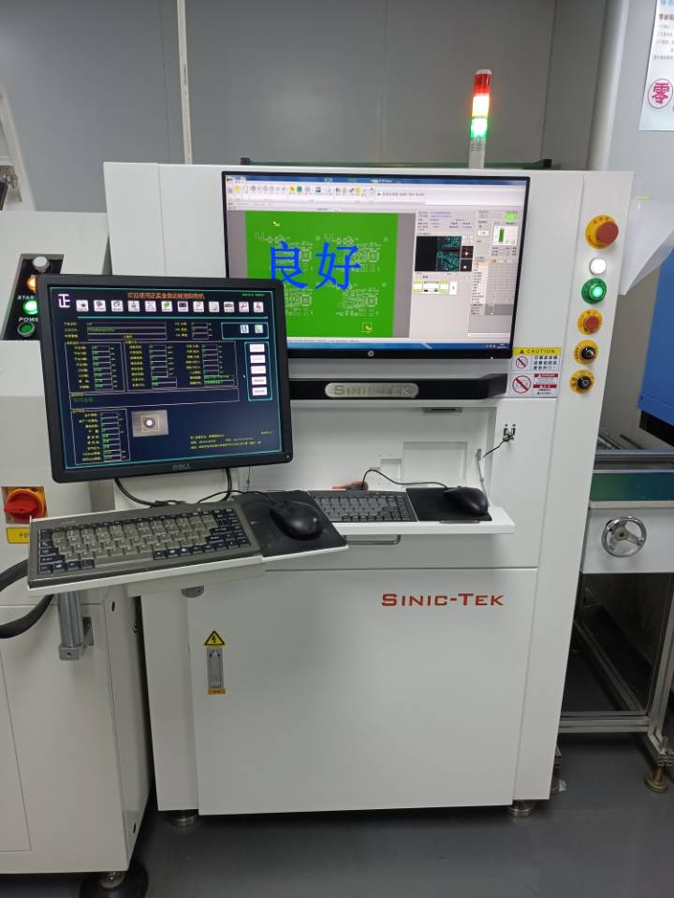
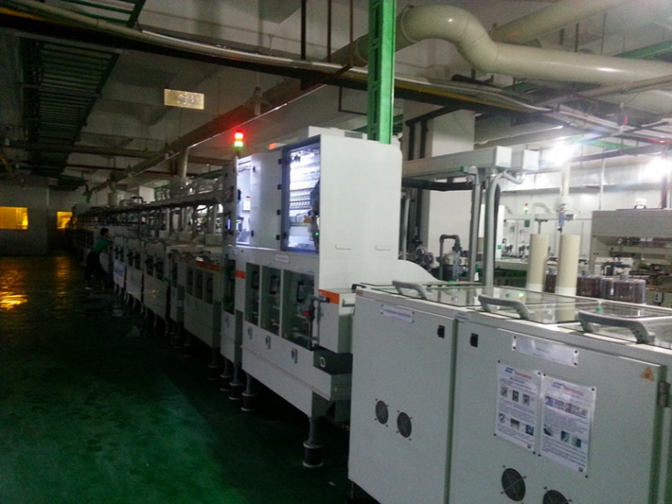
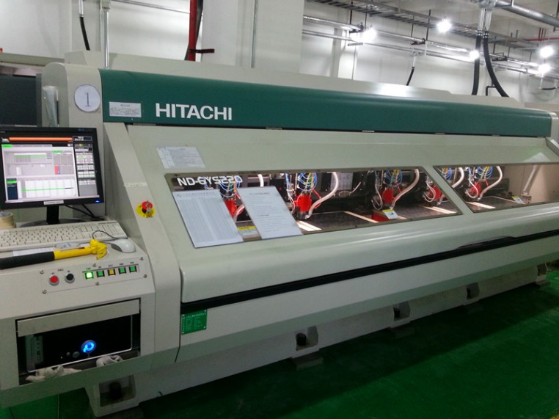
Production site of ME0 GEB
Sinofast in Shenzhen, China has long term collaboration with CMS-GEM team, has produced all GE1/1 & GE2/1 GEBs and ME0 GEB, including their prototypes
Etching Machine CNC drilling machine
Laminating Machine

Slide 15
Production and QC test of ME0 GEB
Milestone of ME0 GEBs production:
Designed finalized in June 2022, 1st batch of 15 sets of ME0 GEBs produced on Jan. 2023, completed test at CERN in Apr. 2024
240 sets of the remaining GEBs production completed in Feb. 2024, 2nd batch of 95 sets of GEBs tested in China and shipped to CERN in April 2024
3rd batch of 145 sets of GEBs tested at China completed in Nov. 2024, shipped to CERN ~15 Nov.
Test at GEB production site in Shenzhen Sinofast Ltd., China:
Flying Probe test and characteristic impedance test (by the factory)
Power module test
Signal connectivity test and BER test (new tool)
Bending degree test and mechanical compatibility test
Acceptance test at CERN:
Similar as GE2/1 acceptance test at CERN, to make sure no damage caused by shipment.

Slide 16
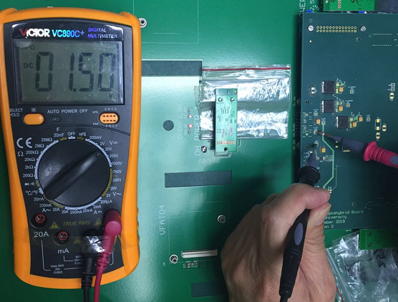
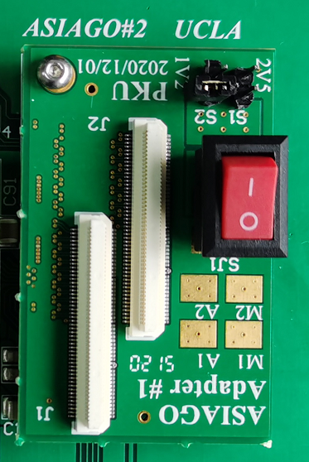
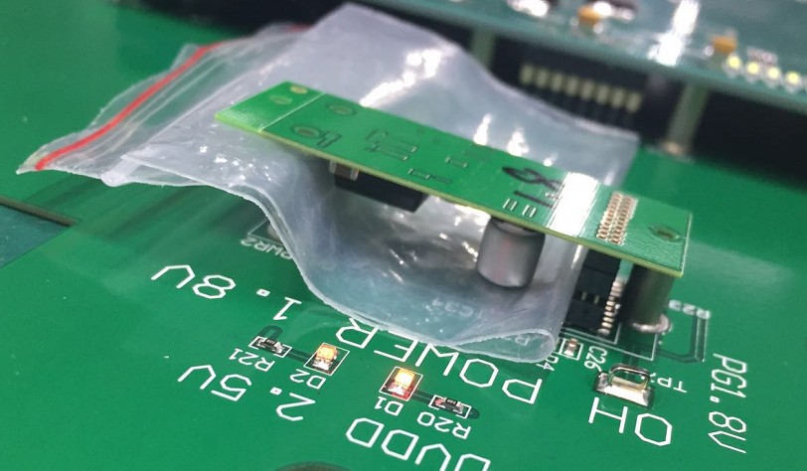
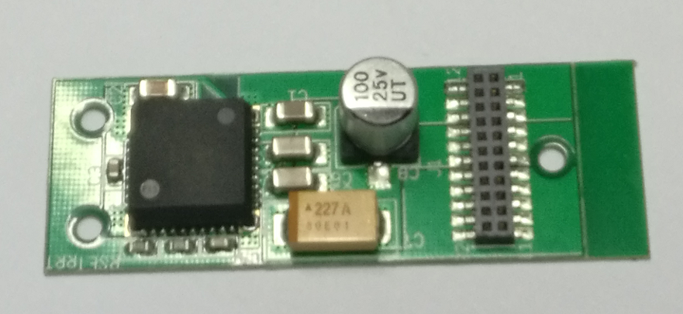
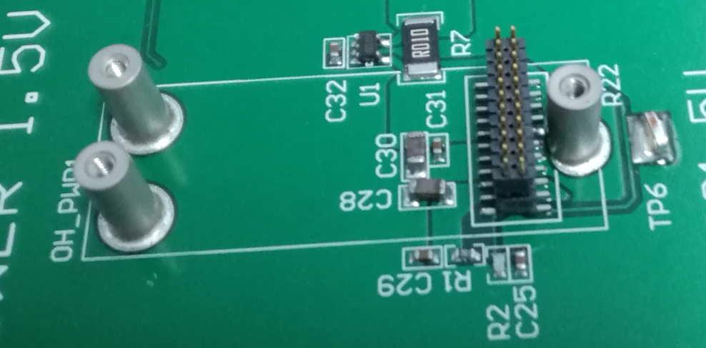
Power module test
Load board
Voltage and current test of 3 power modules:
2.5V on OH board
1.2V digital power、1.2V analog power supply on VFAT
→ The power test has been done with the ME0 GEB(wide & narrow) prototypes, the results meet the GEB design requirements, and the fluctuations are within a reasonable range

Slide 17
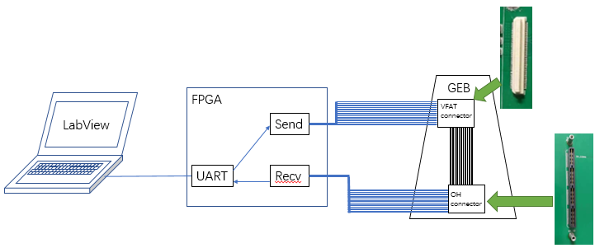
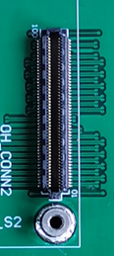
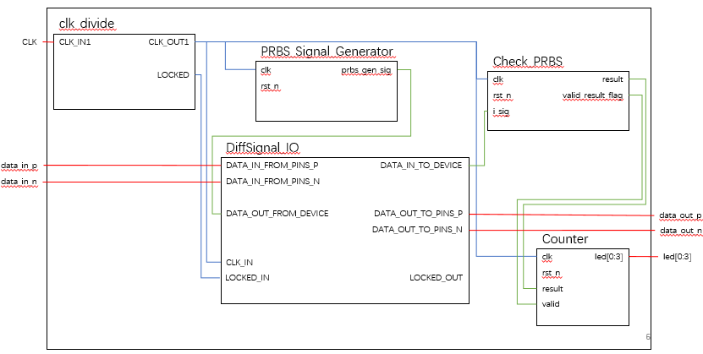
Signal Connectivity Test: FPGA-computer based device
Device:
using Xilinx Spartan-6 FPGA and LabVIEW
Used in acceptance test of GE2/1 GEB
The device was verified and successfully used in GE2/1 mass production
Flow chart of the test device
Connectivity test:
all VFAT signal channels and power supply pins
BER test:
schematic diagram
Test Criteria:
No short and open circuit (connectivity)
No error occurs in one minute (BER)

Slide 18
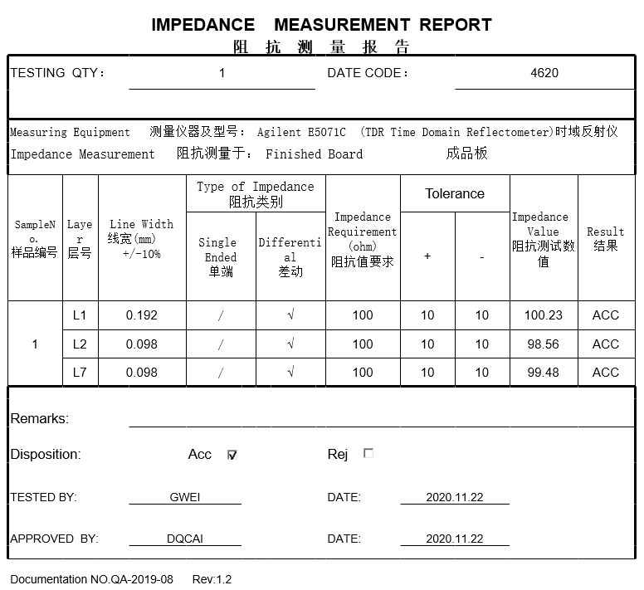
Characteristic Impedance test
Characteristic Impedance test results
(provided by Sinofast company)

Slide 19
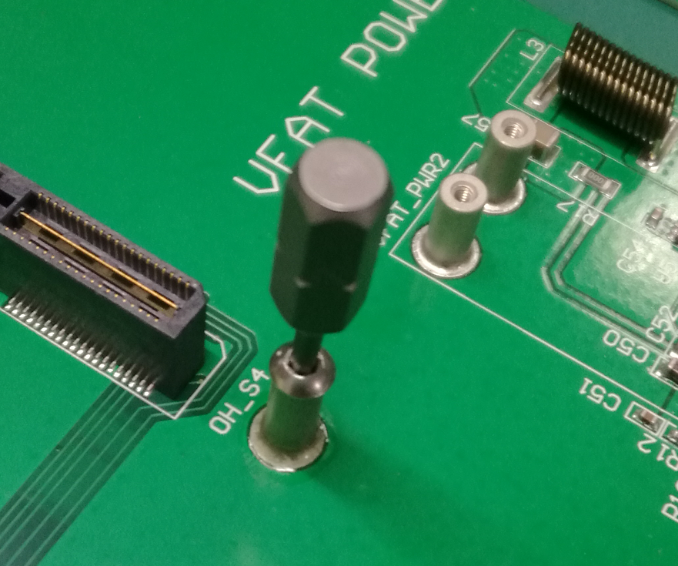
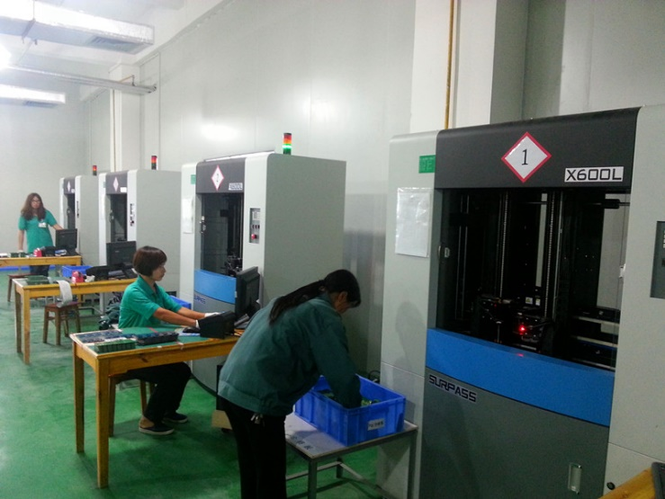
Mechanical Compatibility & Flying Probe Test
Mechanical compatibility test
Mount VFAT (Plugin Card), OH board, and FEAST to check the collimation of Standoff.
Test results of ME0 GEB prototypes: Standoff has good collimation
Flying probe test:
The factory performs automated flying probe test during GEB production.
Automated flying probe test machine

Slide 20
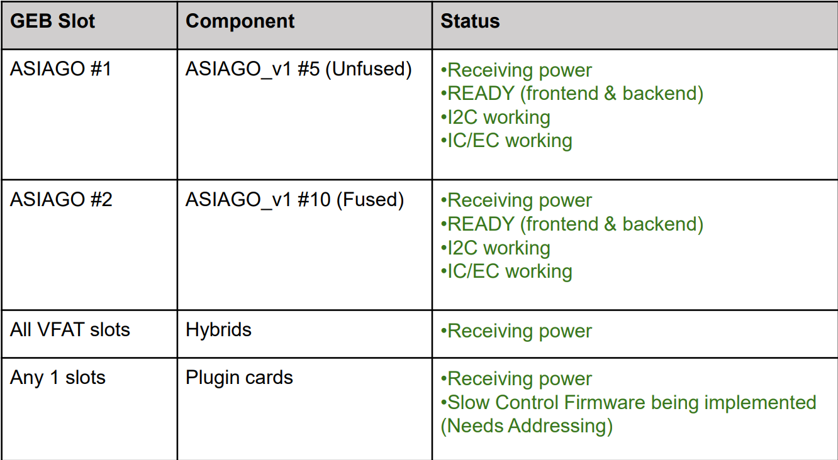
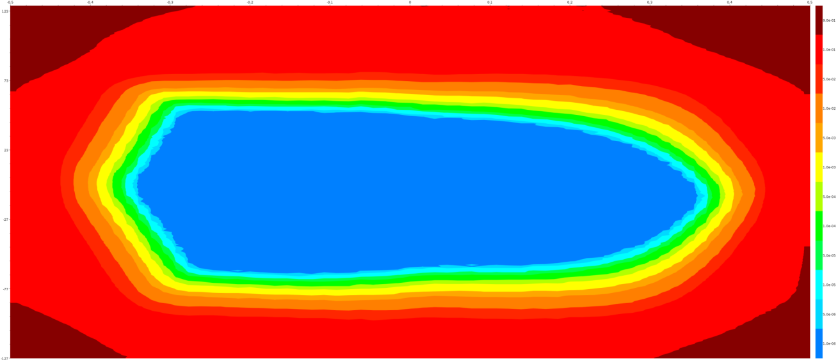
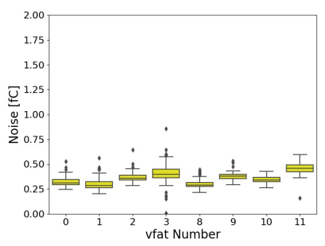
Test At UCLA and FIT
Integration test with OH and VFATs
1. The goal:
6 ME0 GEBs (2N + 4W) arrived and underwent full-loaded test at UCLA
2. Test process:
• Check voltages with only FEASTs loaded onto GEB
• Load one ASIAGO (ME0 Optohybrid) and one VFAT
• Check ASIAGO is ready and can communicate with VFAT
• Fully load GEB and check communication with all VFATs (tests full communication chain and DAQ elinks)
• Take current measurements using current sensing chips + thermistors on ME0 GEB and reading out through ADC of ASIAGO
• Check uplink and downlink error rates and eye diagrams
Test result of full-loaded test
eye diagram
Noise test

Slide 21
Summary
The design, production and test of all CMS-GEM GEB are completed (except the acceptance test of the last batch of ME0 GEBs at CERN)
We developed the GEB test criteria, procedure and automatic device, all GE1/1, GE2/1 and ME0 GEBs produced in China passed the test and shipped to CERN
The CMS-GEM upgrade project is on schedule, Chinese group completed its shared tasks on GEBs (GEM electronics boards).

